Slide 1




NAPMIX Project Overview
[Nuclear, Astroparticle, and Particle Physics Metadata Integration for eXperiments]
Andrew Mistry
ESCAPE DIOS WG
19.02.25
CC-BY 4.0

Slide 2
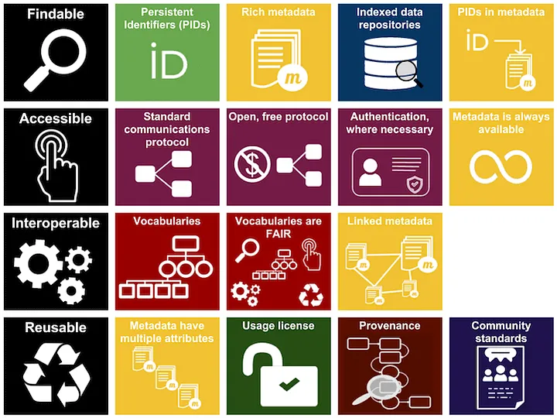
F.A.I.R. data principles and metadata
Metadata is essential in Research Data Management and Open Science to enable FAIR data (and code)
Allows datasets to be searched for and found
Enables interoperability between datasets
Facilitates data reprocessing
Promotes efficient use of resources
Icons made by Freepik are licensed by CC BY 3.0
FAIR resources graphic is licensed under a CC 4.0 International License

Slide 3
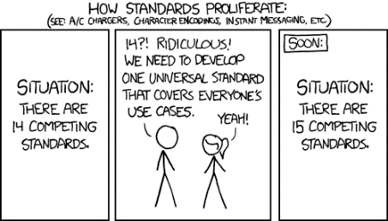
Metadata for nuclear physics experiments: Why?
  Metadata essential in Research Data Management and Open Science to enable FAIR data (and code)
  More info: Guide to HMC Better Metadata Booklet
  2022: We needed a metadata scheme ‘for GSI’:
  Ambitious, at the same time not ambitious enough?
  GSI data is broad and complex: areas of plasma physics, material science, bio physics, hadron physics, atomic physics, nuclear physics, theory etc etc.
  Where to address?: Community consultation
  Starting point: No common schema (yet) between nuclear physics experiments
  Overlaps with other ‘particle accelerator’ fields
  Many labs in Europe to obtain input from
  Is a field that needs to tackle RDM/Open Science, behind the curve
  Caution: Don’t reinvent the wheel!
  Look for synergies with NeXUS, HELPMI, OpenAIRE et al.
By Randall Munroe: https://xkcd.com/927

Slide 4
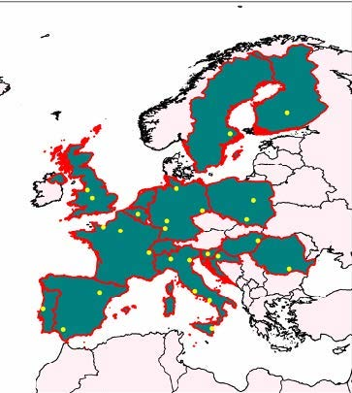
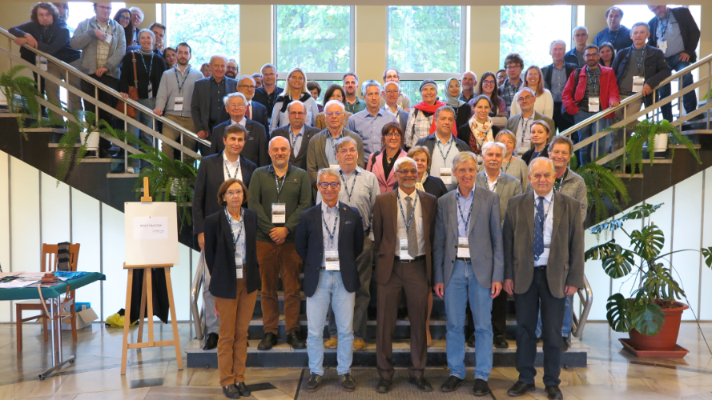

Synergies: EURO-LABS
Goals:
  Providing efficient access to the available resources to a large fraction of EUROpean Laboratories for Accelerator Based Sciences (EURO-LABS)
  Bringing together the three communities engaged in Nuclear Physics, Accelerator and Detector technology for High Energy Physics
  Allowing a synergic implementation of best practices for data management and activities relating to targeted service improvements at these RIs
  Creating synergies and collaborations between the RIs of the Nuclear and High Energy communities
  Enhancing Europe's potential
https://web.infn.it/EURO-LABS/
This project has received funding from the European Union’s Horizon Europe Research and Innovation programme under Grant Agreement No 101057511.

Slide 5

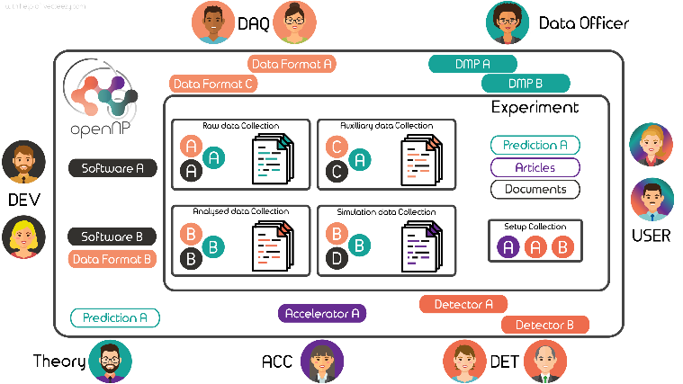
Synergies: EURO-LABS WP 5.2
Data management and Open Science
EURO-LABS : Providing efficient access to the available resources to a large fraction of EURO-LABS
Participants: CSIC, GANIL (Leading partners), INFN, CNRS, IJCLab, GSI
Goals
  Developing services to enhance F.A.I.R data principles
  Integration of Nuclear Physics community to existing infrastructures/services of EOSC environment - using present experience from ESCAPE/HEP physics community
Developments
  Open Science School @ GSI: November 2024: Training and lectures for PhD Students/Postdocs delivered by experts
  openNP catalogue of experimental datasets, auxiliary data, DAQ software, Analysis software…
  Metadata for Nuclear Physics Experiments
  Authentification and Authorization Infrastructure
  Http connection to lustre -> Open Data (large volume)
CC-BY-SA A. Matta, created with help of Vecteezy.com
This project has received funding from the European Union’s Horizon Europe Research and Innovation programme under Grant Agreement No 101057511.

Slide 6

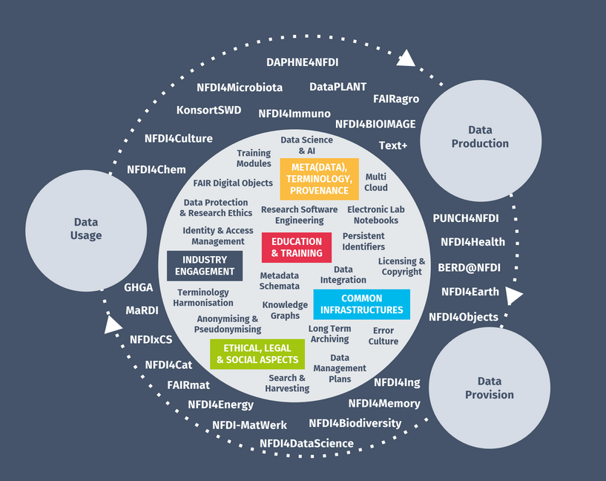
Synergies: PUNCH4NFDI (Germany)
Task Area 2 “Data management” – IT department
Automatization and optimization of big data management workflows
Task Area 4 “Data portal” – Research Division
Mapping and collating metadata
Build and operate the science data portal
Task Area 6 “Synergies and services” – IT department
Authorization and authentication infrastructure
The prime goal of PUNCH4NFDI is the setup of a federated and "FAIR" science data platform, offering the infrastructures and interfaces necessary for the access to and use of data and computing resources of the involved communities and beyond. This will help to master the challenges of big data, open data, and FAIR workflows.

Slide 7
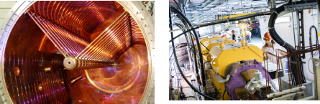
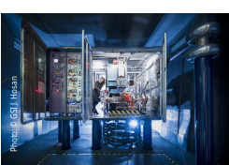
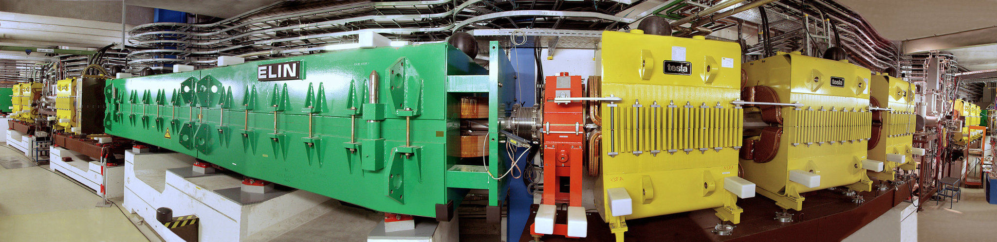
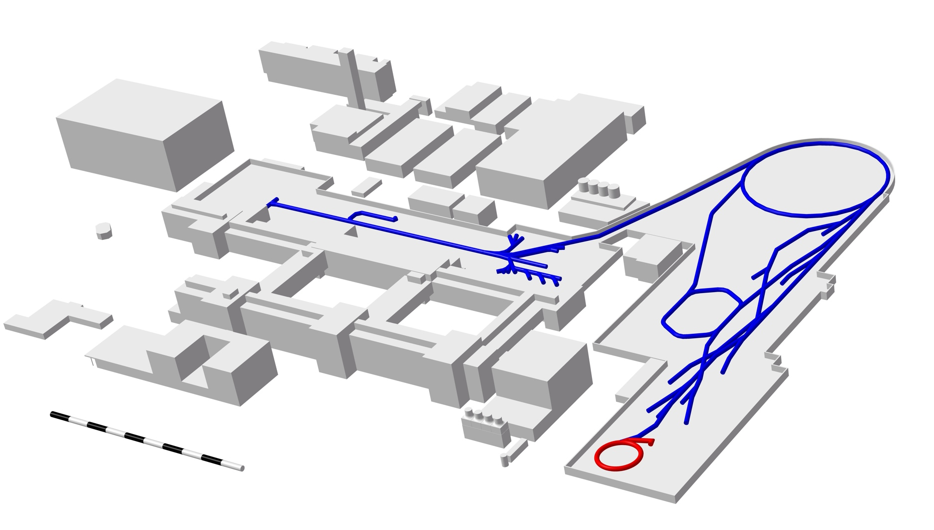
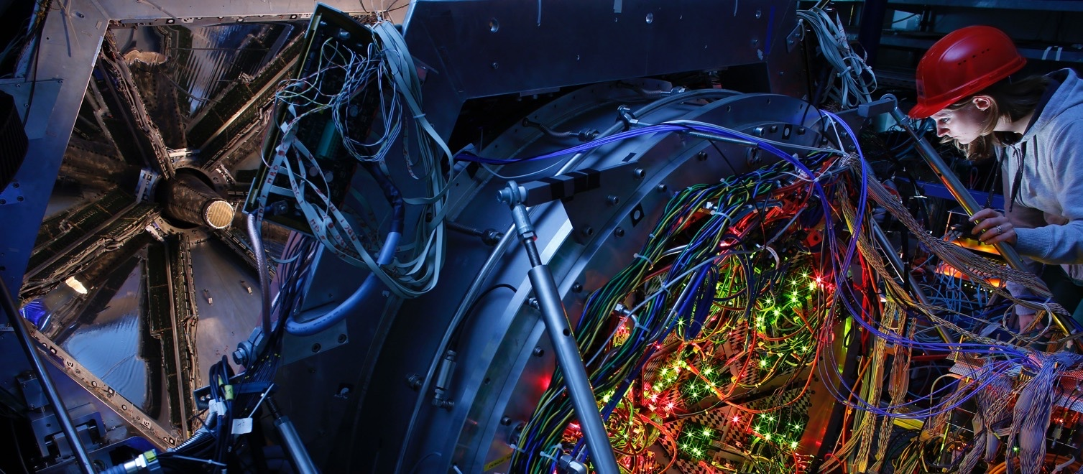
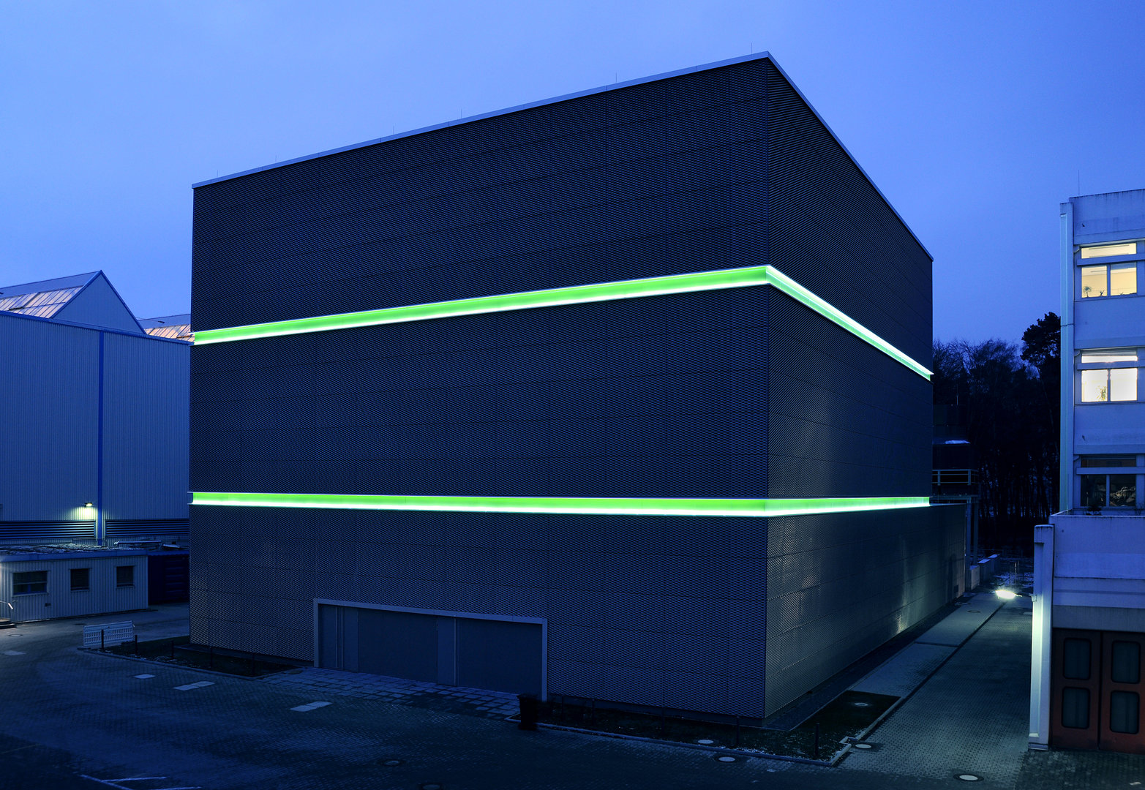
Pilot: GSI accelerator facility
Ion sources
Type,
Projectile Ion…
Photo: © GSI: G. Otto
Accelerators
Beam Energy
Beam Intensity
Photo: © GSI J. Hosan
Separators
Type, Reaction…
Photo: © GSI: G. Otto
SIS18
Unilac
FRS
Experimental areas
Produced Isotope
Experimental setup…
ESR
HPC
Green Cube
Dataset location, size, code repository…
Photo: T. Ernsting/HA Hessen Agentur
Photo: © GSI: G. Otto

Slide 8
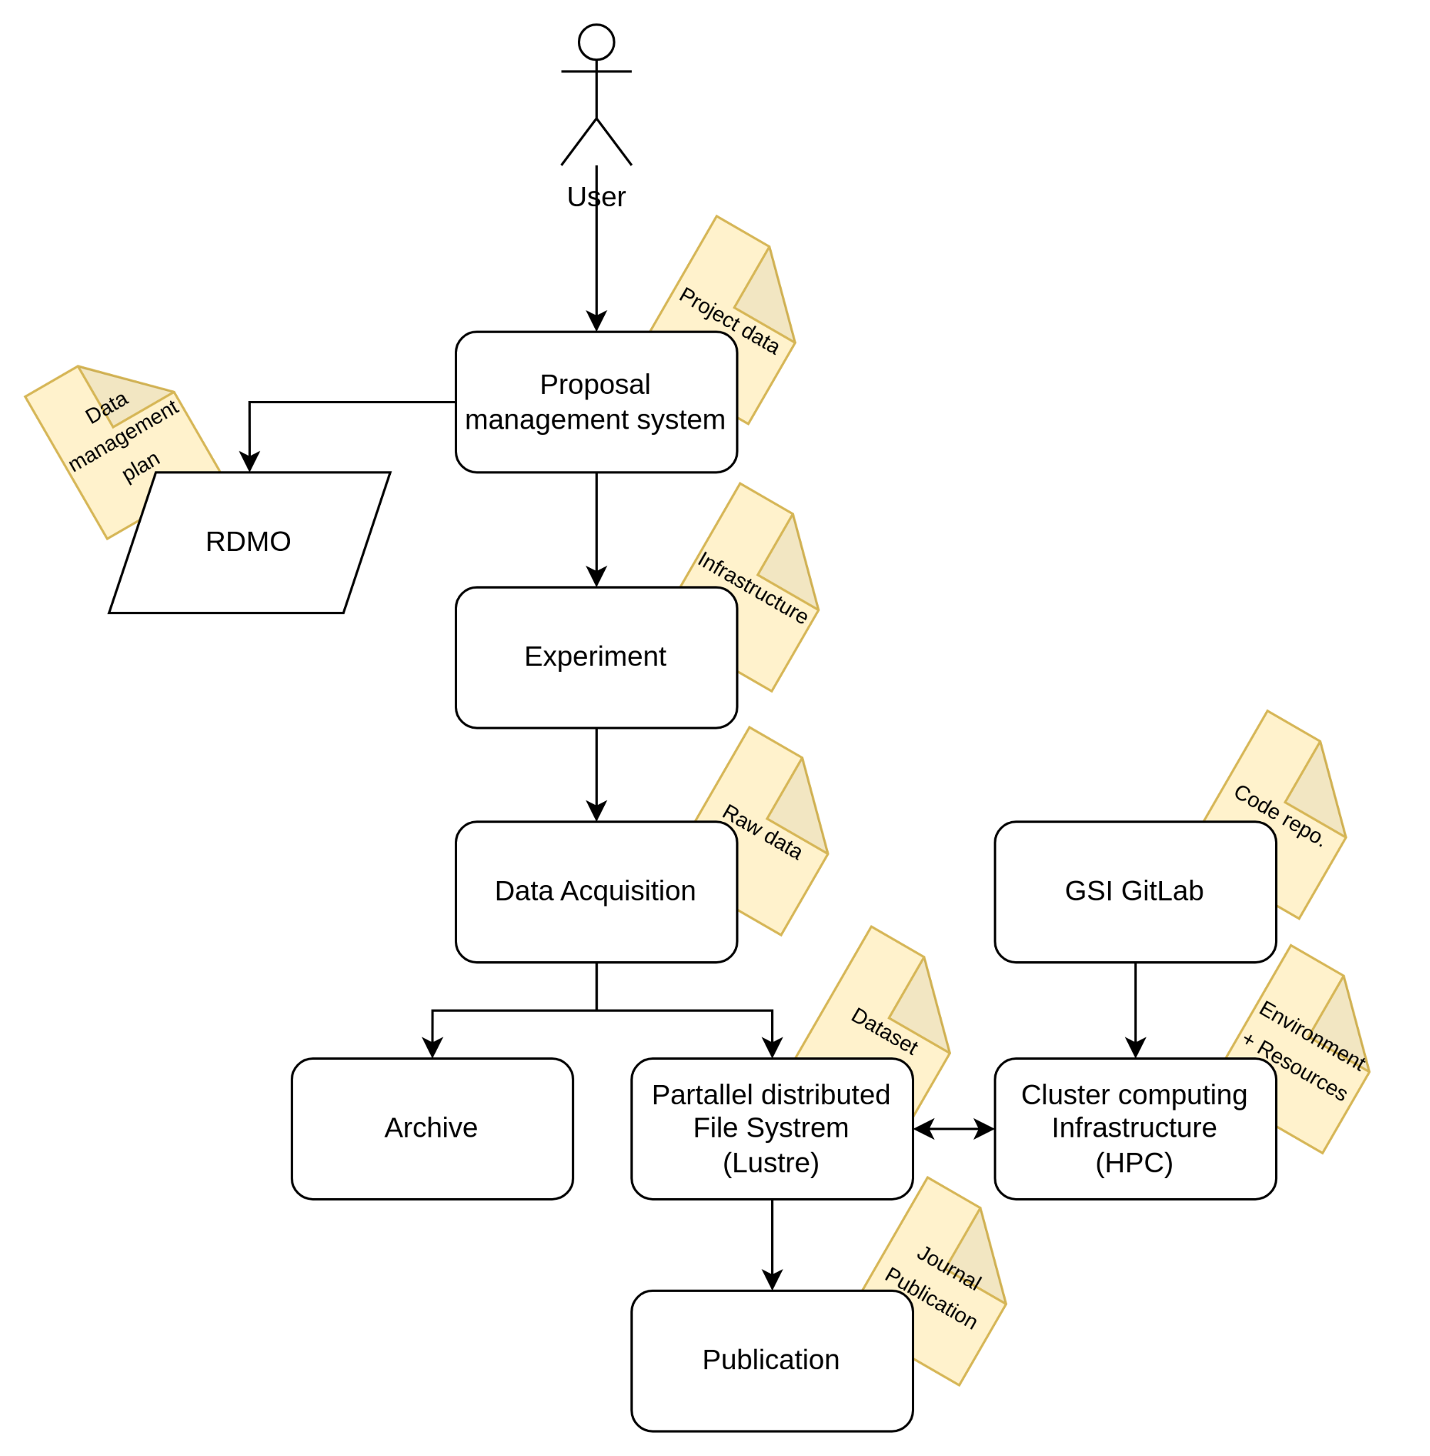
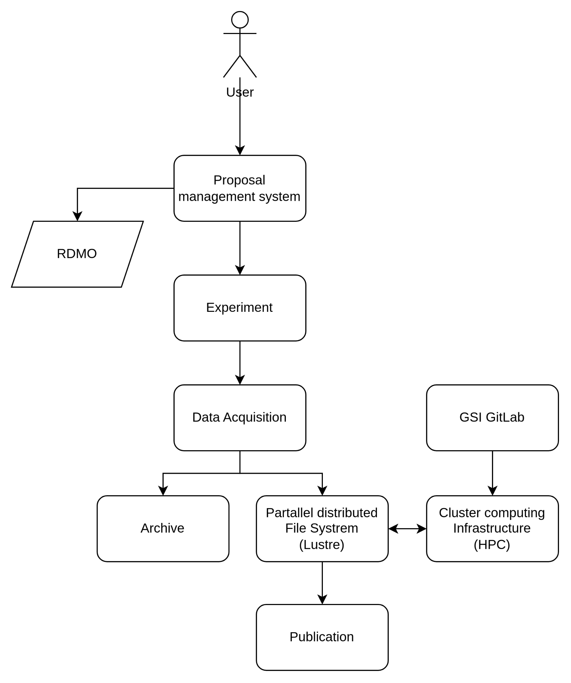
Pilot: Standard Workflow in Experimental Nuclear Physics
Workflow is representative of experimental procedures at GSI and similar facilities.
Each stage generates specific metadata crucial for data management.
Our metadata stratification and categorization is grounded in this workflow.

Slide 9
Pilot: Stratifying metadata structure
Project specific metadata
Project name, publication date, collaborations, researchers, institutions, journal references
1
Discipline specific metadata
Projectile data, target data, infrastructure, detector type, datasets, software repositories
2
Experiment specific metadata
Reaction data, gamma-ray energies, time of flight parameters, instrument records
3
Dataset specific metadata
Data headers, structure….
4

Slide 10
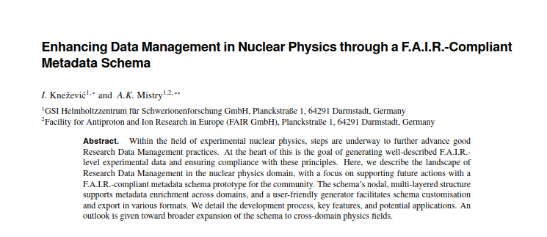
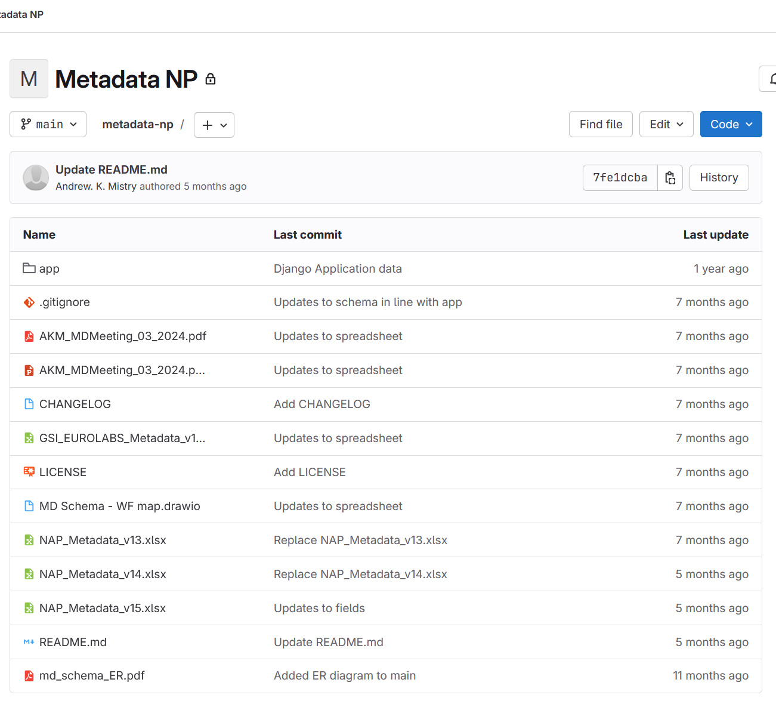
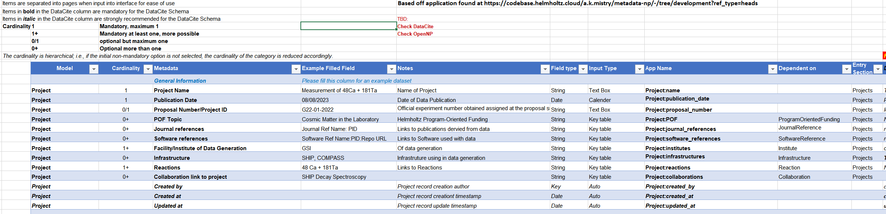
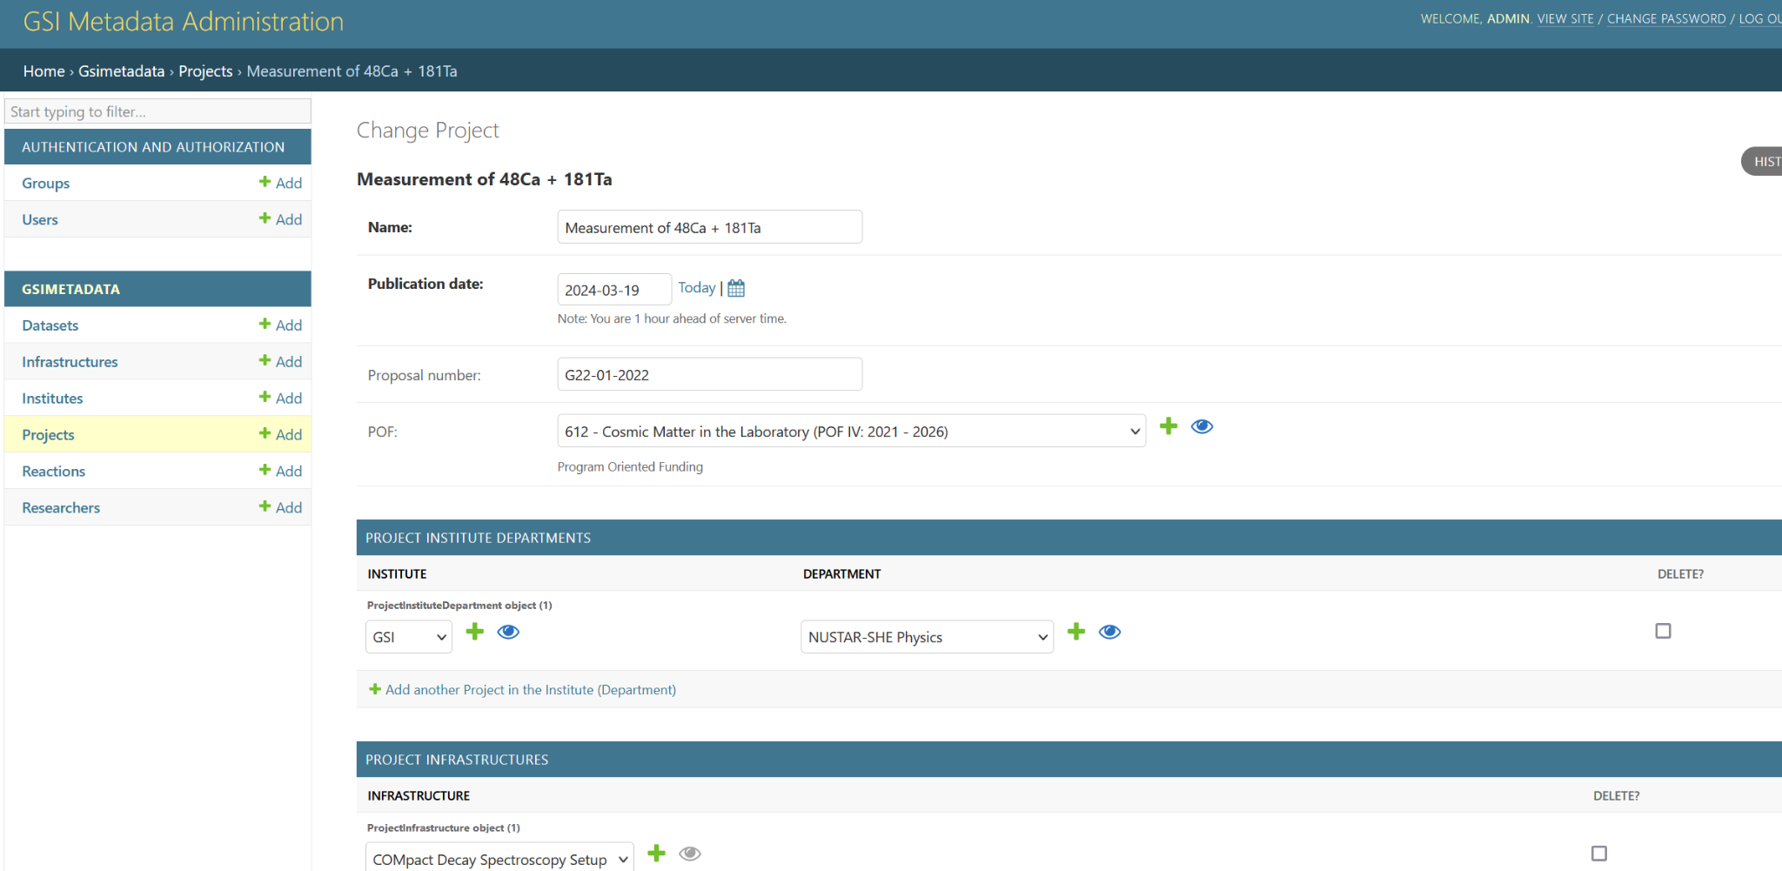
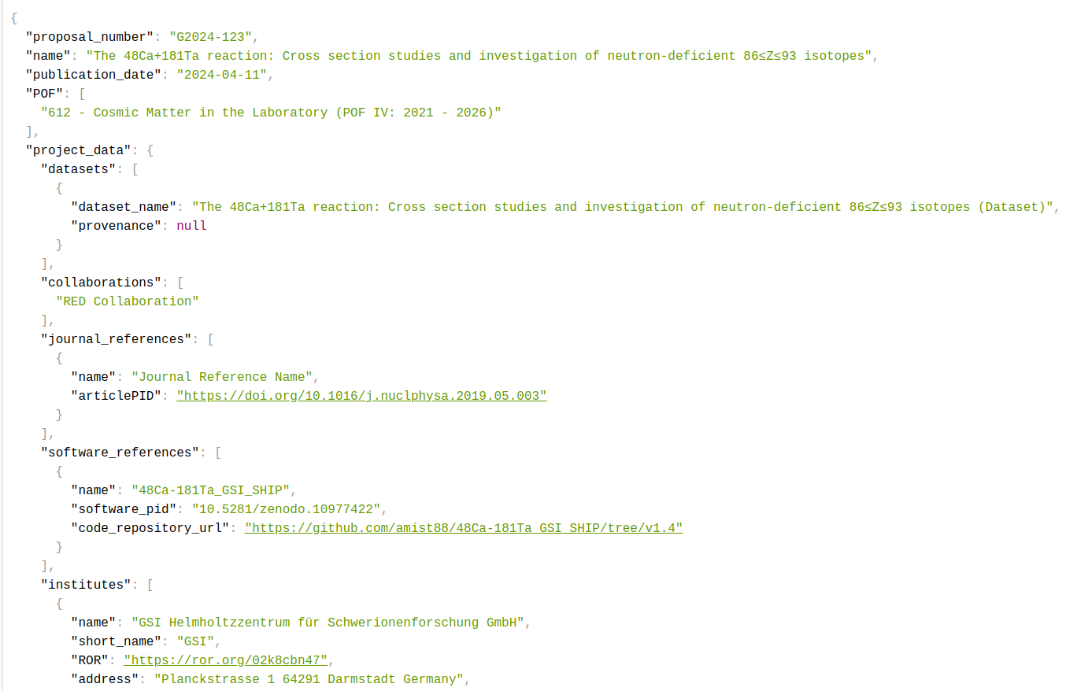
Pilot: Design and Implementation
  Contact with EuroLabs Partners 2023 -> responses from CNA, HZDR, HUN-REN ATOMKI, LATR-IST
  Developments within PUNCH4NFDI TA4
  Support on base development from Helmholtz Metadata Collaboration (Matter) HZB
CHEP Conference Proceedings (In Publication)
  Git Project
  Basic Spreadsheet
  Django Backend
  JSON/XML Schema
Software: https://doi.org/10.5281/zenodo.14770678

Slide 11



















Nuclear, Astroparticle, and Particle Physics Metadata Integration for eXperiments (2024 - 2026)
https://www.oscars-project.eu/projects/napmix-nuclear-astro-and-particle-metadata-integration-experiments
The NAPMIX project emerged to address a significant gap in nuclear, astroparticle and particle physics: the lack of a unified metadata schema necessary for achieving FAIR datasets. This challenge extends to the fields of particle and astro-particle physics, highlighting the need for a collaborative European effort to create a common metadata schema with user-friendly infrastructure. By integrating expertise across these domains, NAPMIX aims to enhance data management practices.
The authors acknowledge the OSCARS project, which has
received funding from the European Commission’s Horizon
Europe Research and Innovation programme under grant
agreement No. 101129751
Funded by:

Slide 12
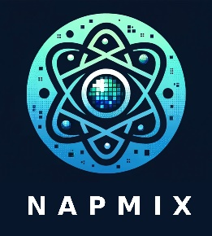
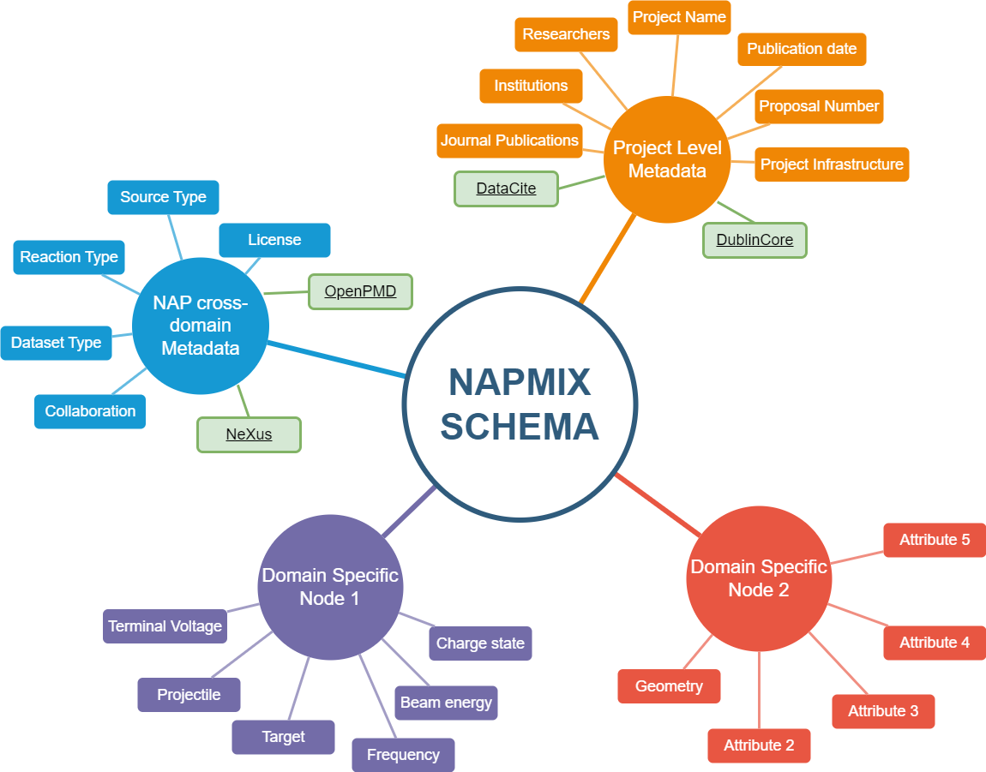
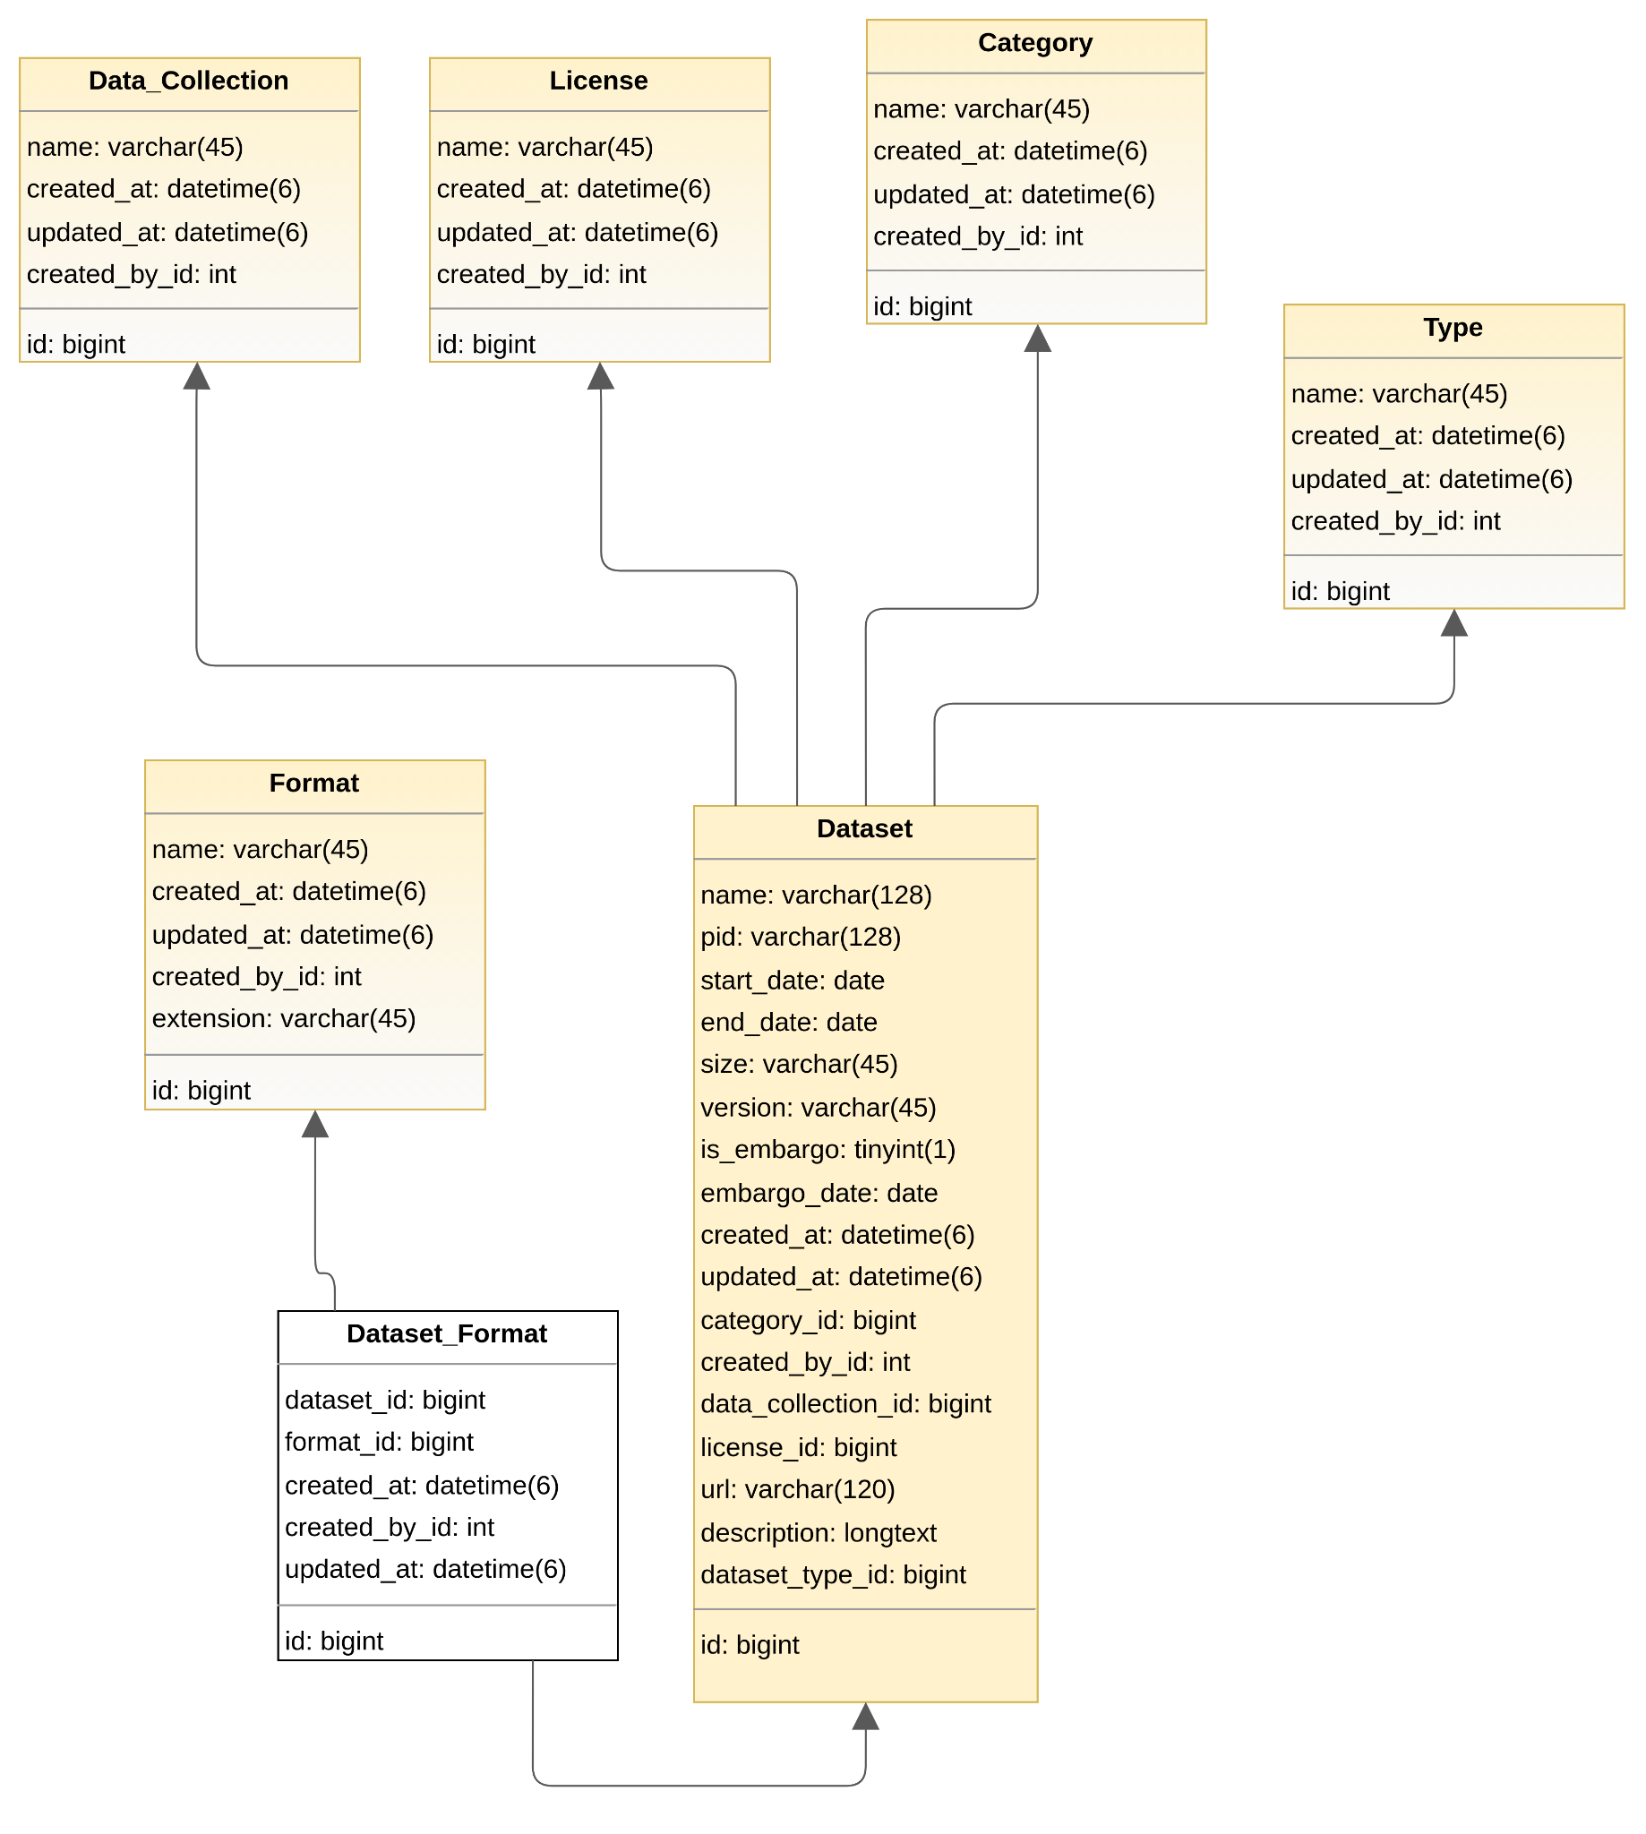
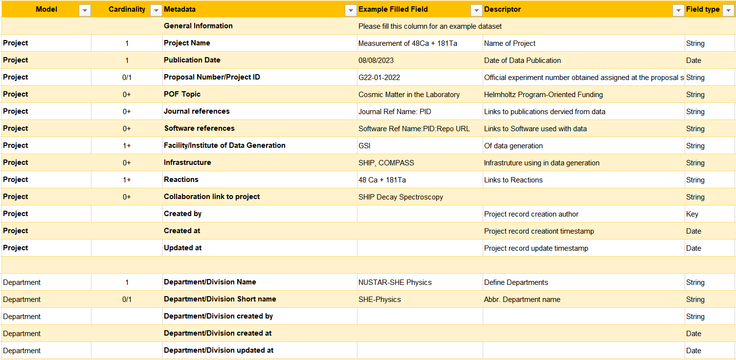

NAPMIX Project Outline
A front-end generator for user input, producing outputs in both machine and human-readable formats.
A multi-layered ‘nodal’ structure to incorporate use cases based on real experimental datasets.
Connections to existing ontologies such as DataCite, OpenPMD and NeXus.
Interfaces to current infrastructures as a pathway to an Open Science Ecosystem.
Testing and deployment of the schema with multiple use cases to enhance data FAIRness.
Training for researchers on the importance and application of metadata.
  24 Months (01/12/24 - 30/11/26)
Concept
Design
Implementation
Schema

Slide 13

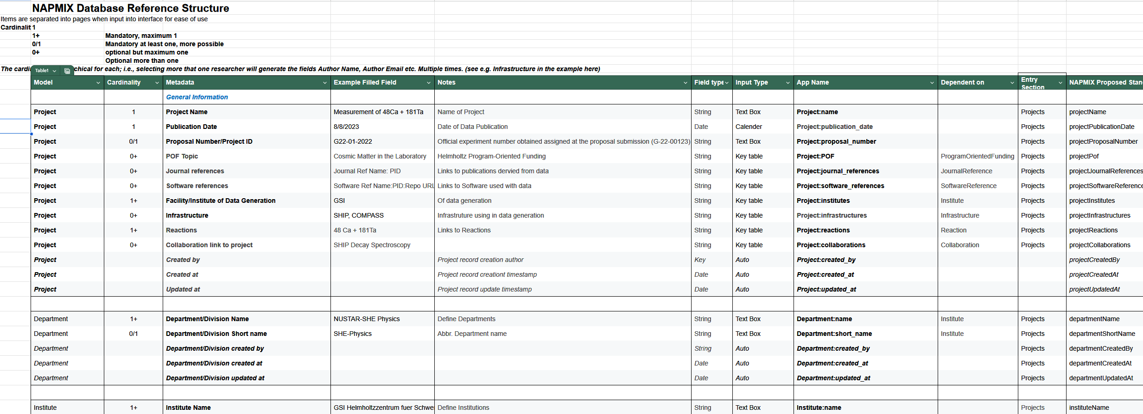
NAPMIX Project Goals
Development of a community in experimental nuclear, astro-particle, and particle physics to generate a common metadata schema and user interface -> Consortium input, options to onboard new partners

Slide 14
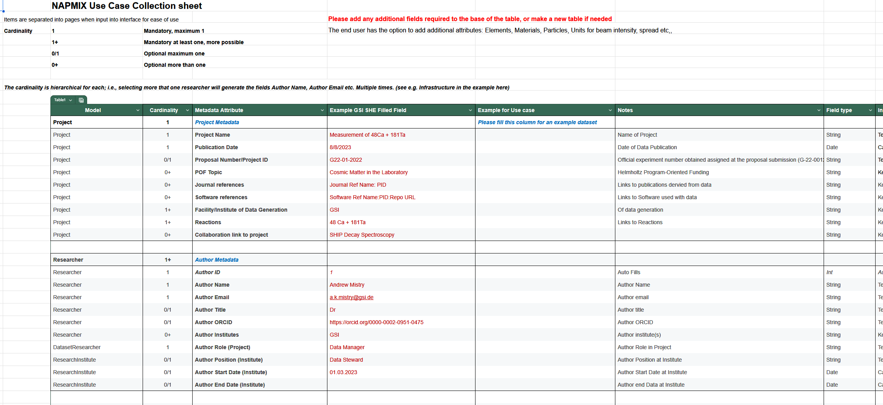
NAPMIX Project Goals
Ensure the scheme is enriched with multiple use case ‘nodes’ based on real experimental datasets -> Use case collation and enhance database for cross domain capabilities

Slide 15
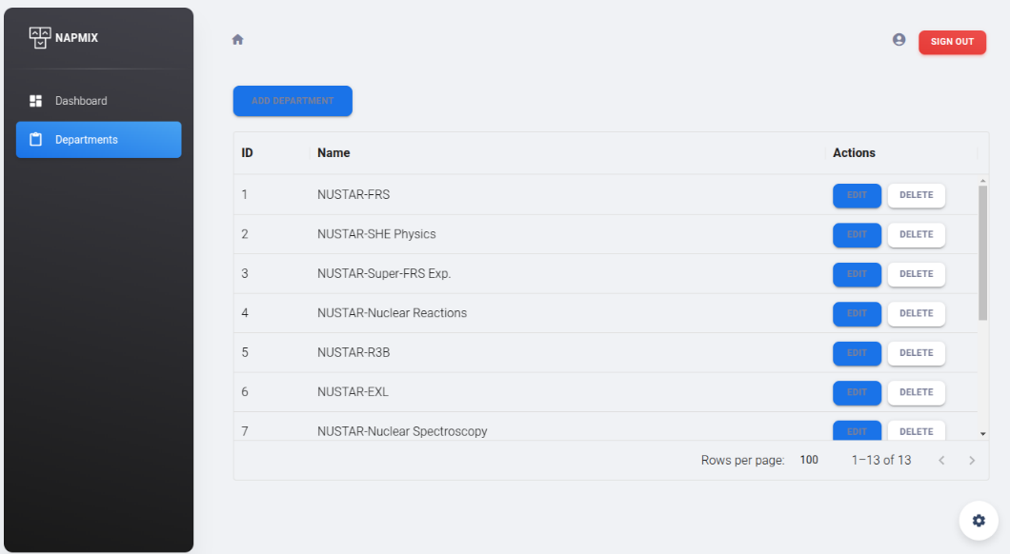
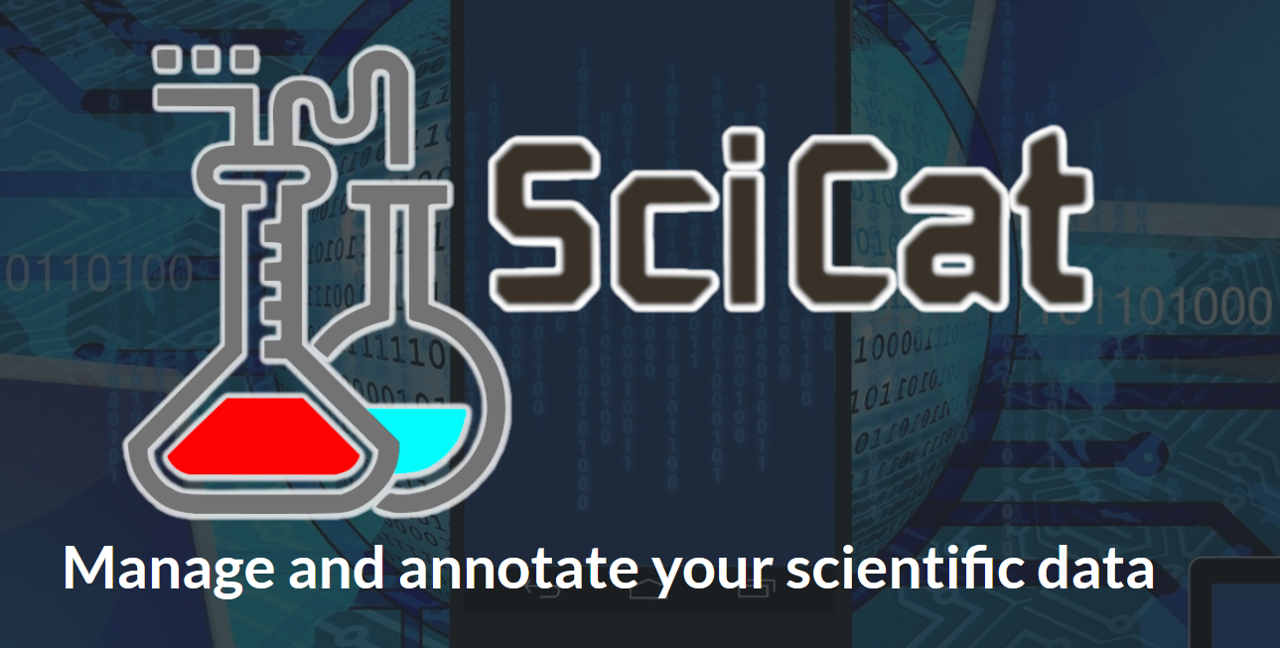
NAPMIX Project Goals
Develop a frontend interface for end-user input with outputs in machine and human readable formats -> SciCat/REACT/InvenioRDM… Outputs to JSON, XML + XSD Validator
Investigate available options
REACT
Open Source Solutions: e.g. SciCat

Slide 16
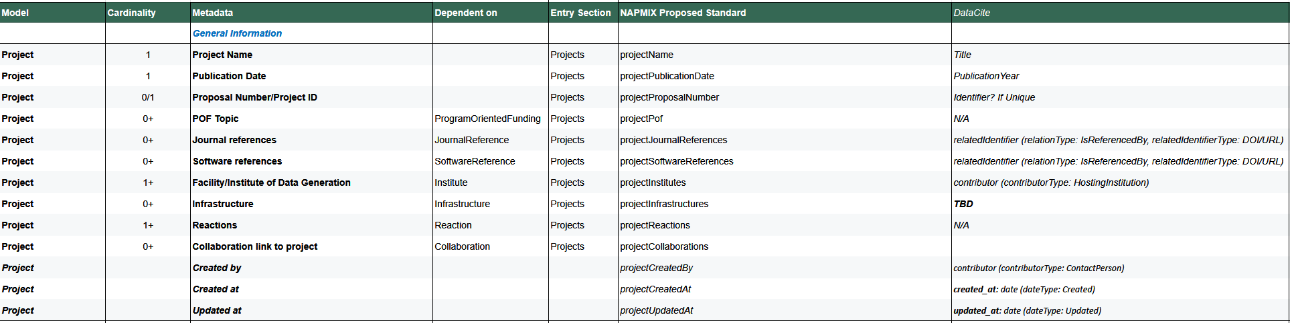
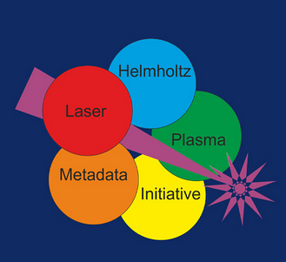


NAPMIX Project Goals
Establish connections and mappings to existing/ongoing ontologies -> DataCite, NeXuS, OpenPMD, HELPMI…

Slide 17
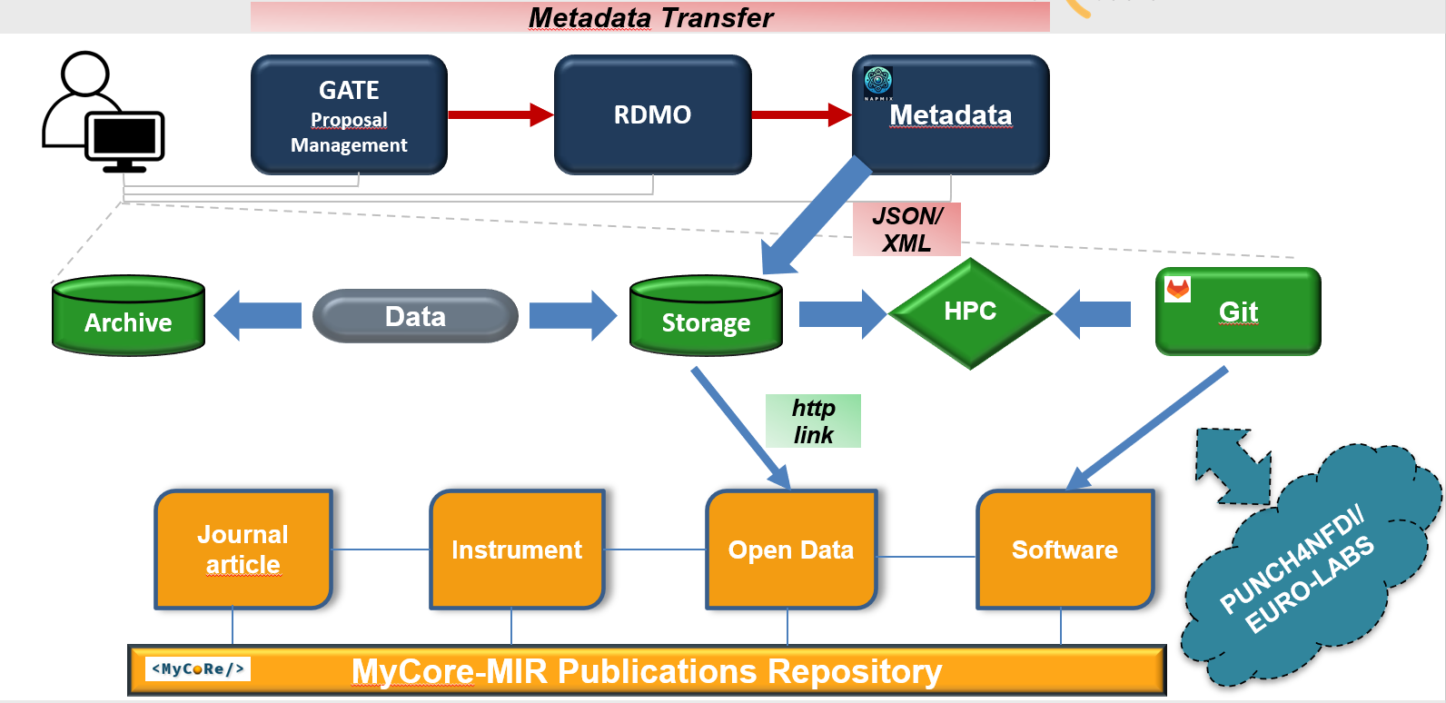
NAPMIX Project Goals
Implement interfaces to existing infrastructure as a stepping stone towards an Open Science Ecosystem -> API/GraphQL capabilities, Repository Ingestion

Slide 18
NAPMIX Project Goals
Test the deployment of the schema and interface with a number of use cases, publishing use-cases with data to enhance the F.A.I.R-ness of the data -> Institutional/Discipline specific repositories + Platforms (e.g., PUNCH RPR) Schema Ingestion, Metrics on uptake
For example:
Deployment of app in partner institutions
Apply to given use cases (including data publication!)

Slide 19
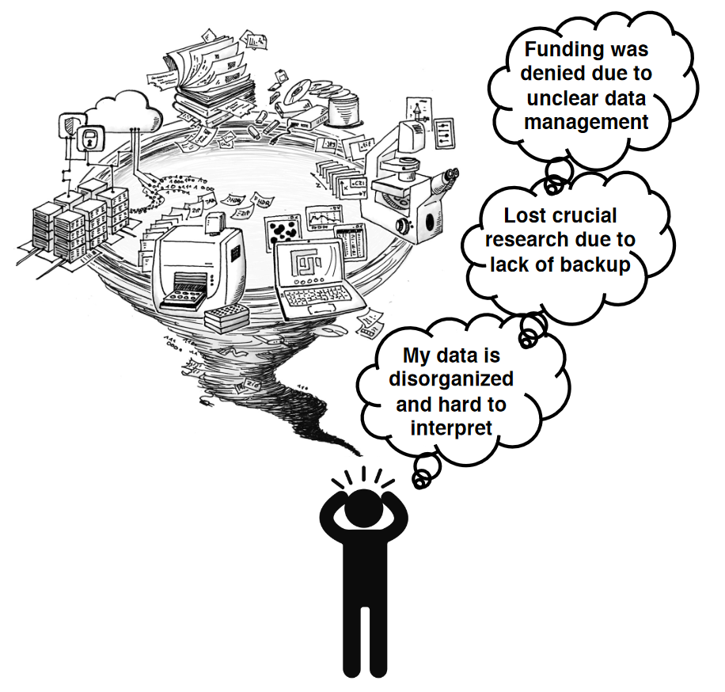
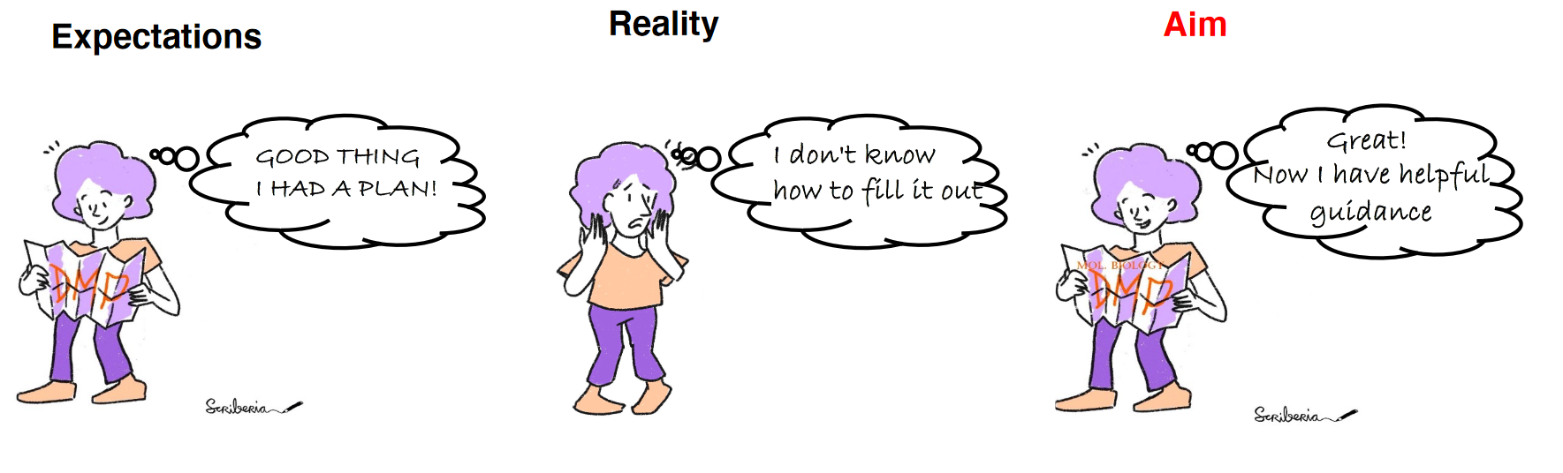
NAPMIX Project Goals
Teaching and training on the purpose, scope, and use of metadata to researchers -> Drive Uptake among researchers
Hands-On Metadata/RDM workshop for researchers (2026)
Basic training on the purpose of metadata
Apply metadata to their projects including application

Slide 20

NAPMIX Project Goals
Publish the schema and broadening connections within the ESCAPE community and EOSC -> Links and synergies, ensure longevity of outcomes
RI’s and universities
Broaden engagement to other RI’s and universities
Additional use cases can always be added, the project forked in Git etc

Slide 21
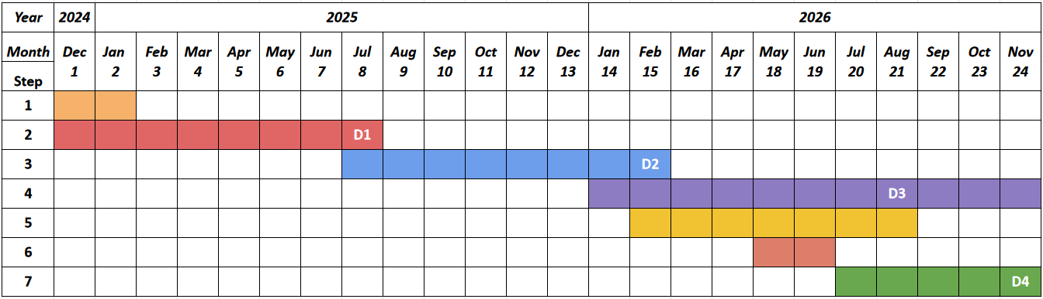
Project Schedule (Basic)
Tasks:
Kick-off Workshop
Database Model Evaluation and Improvement
Data Enrichment Strategy Implementation
API Integration for Metadata Transfer
Metadata Schema Testing and Publication
Comprehensive Training Workshop
EOSC integration and project dissemination
Deliverable D1: Written report on the pilot model and publishing the prototype database structure to the Open GitLab project -> CHEP Proceedings
Deliverable D2: Written report/Presentation on the choice of front end and implementation of the structure
Deliverable D3: Published article or white paper on the NAPMIX schema including use case examples and proof of F.A.I.R. data publication
Deliverable D4: EOSC presentation event

Slide 22
NAPMIX in the Context of ESCAPE
Links to DIOS: exchange and interoperability of the scheme into the interface?
RESTAPIs (or GraphQL) endpoints -> API specifications
Community building and schema enhancements, further use cases?
AAI mechanisms
Data cataloguing (including OpenNP project from EURO-LABS)

Slide 23

Summary
Next steps:
Use Case Development
Development of Database
Investigations into Suitable Front-End
The authors acknowledge the OSCARS project, which has
received funding from the European Commission’s Horizon
Europe Research and Innovation programme under grant
agreement No. 101129751
Notes:
Check here

Slide 24
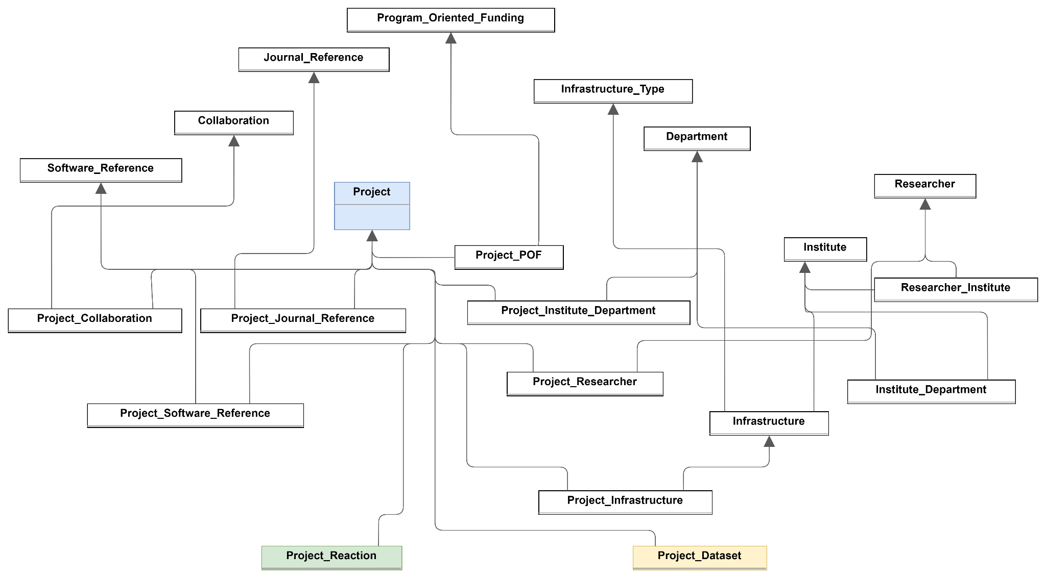
The Database Schema Design
Project cluster

Slide 25
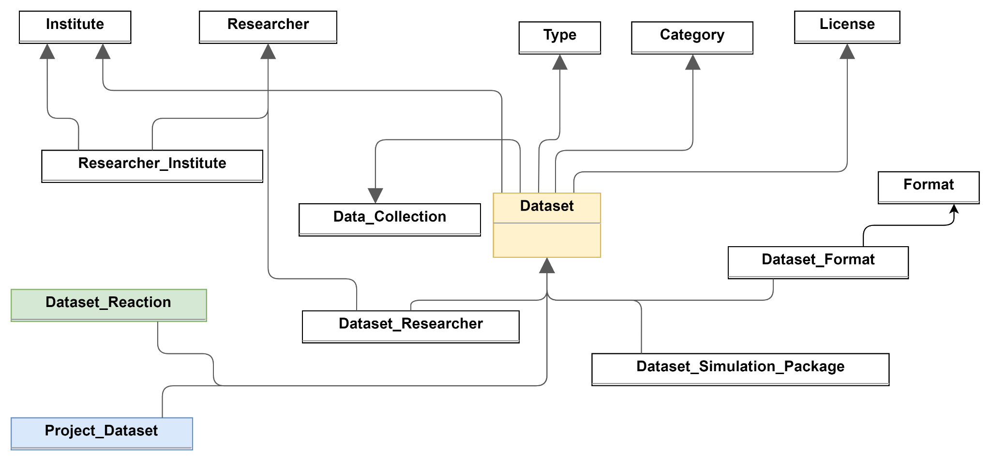
The Database Schema Design
Dataset cluster

Slide 26
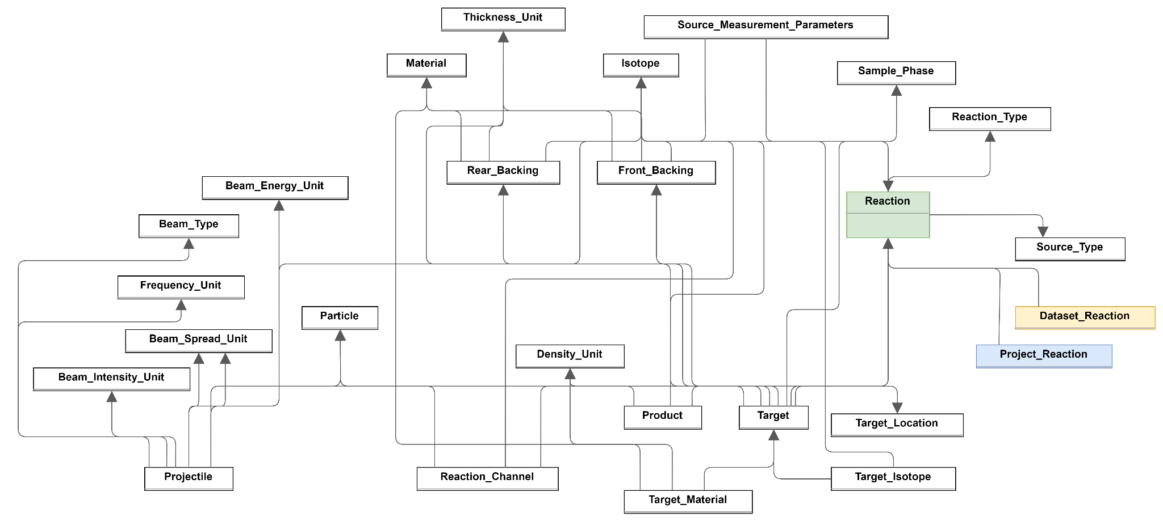
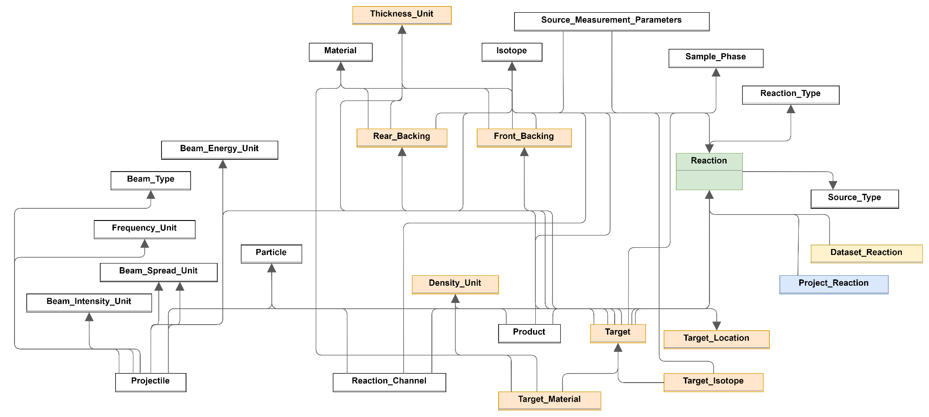
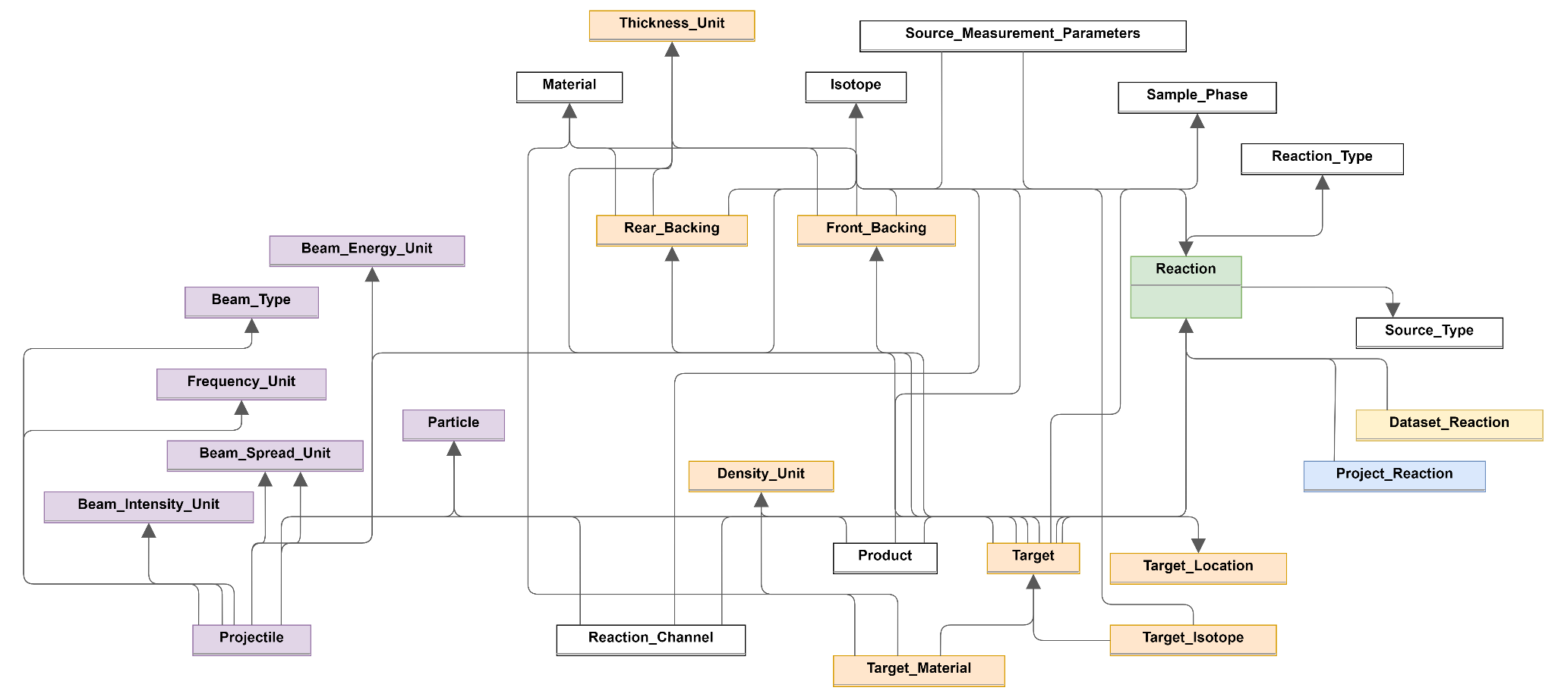
The Database Schema Design
Experiment cluster

Slide 27
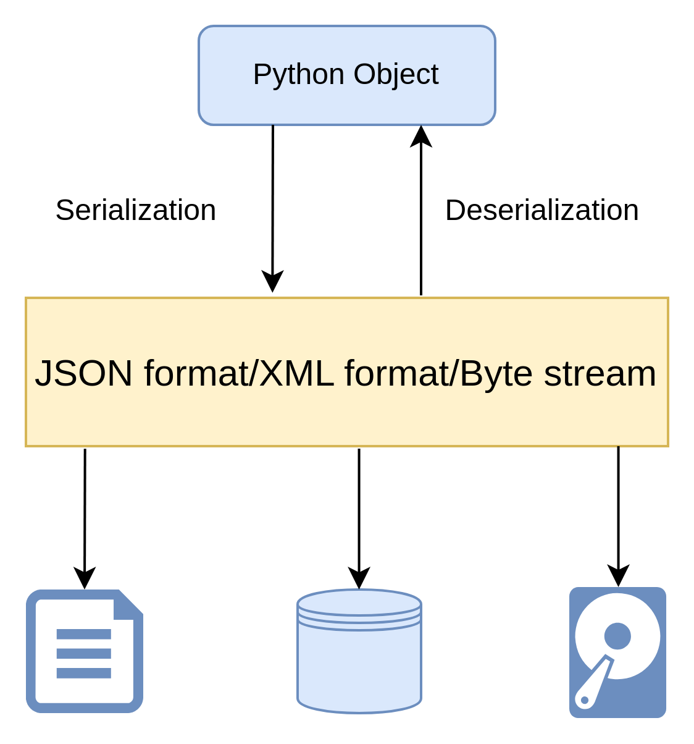
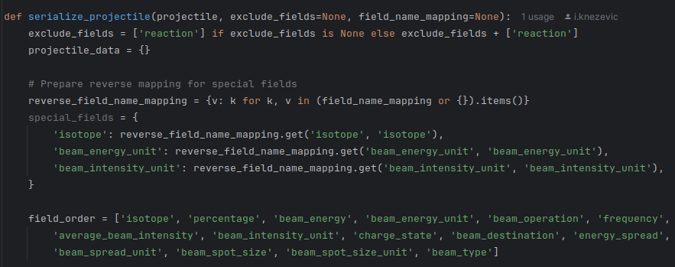
Metadata Schema Generator - data serialization
Serializing each smaller cluster separately,
Increased schema flexibility,
Relationships maintained

Slide 28
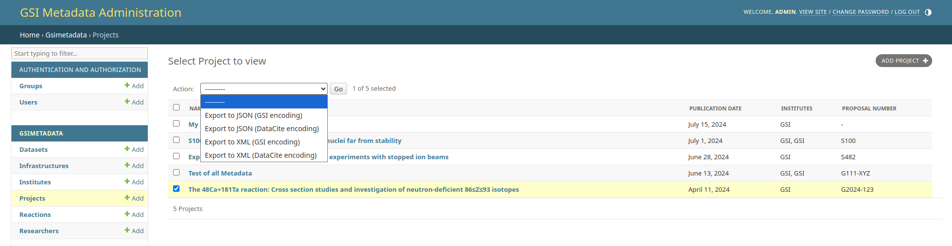
Metadata Schema Generator
A tool that allows users to export comprehensive metadata for a selected project.
Supports multiple formats and encoding standards.

Slide 29
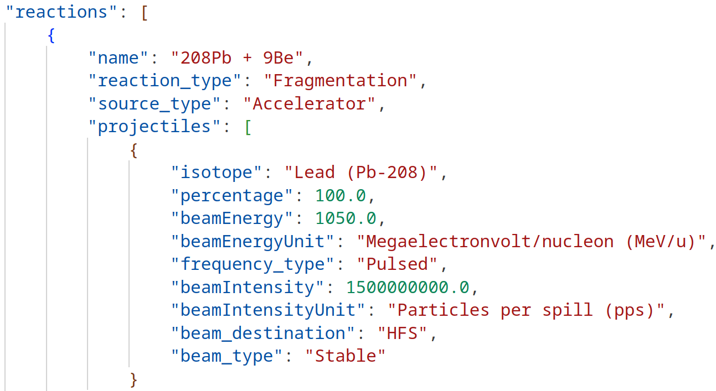
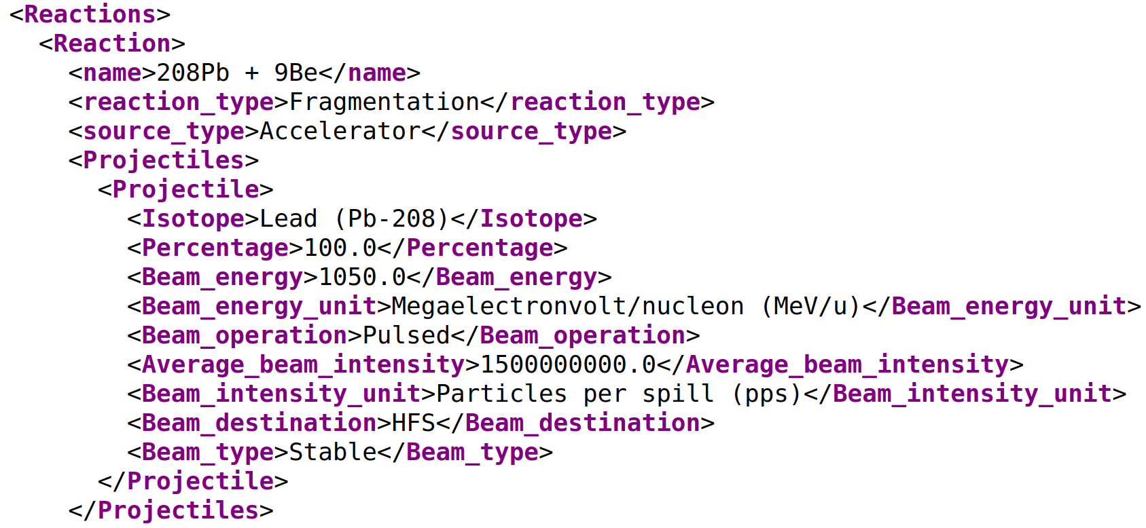
Metadata Schema Generator
XML schema
JSON schema

Slide 30
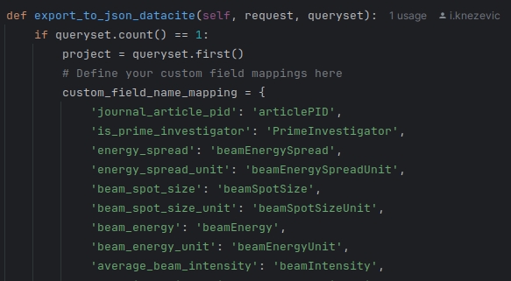
Metadata Schema Generator - Custom attribute names
Original attribute name
Desired attribute name
Attribute names can be customized via code (array mapping),
Supports interoperability across platforms and institutions,
Provides flexibility to meet specific metadata standards,
Plans for making attribute customization more accessible through the UI.
Notes:
We also recognize that users may need to customize attribute names to align with specific standards or institutional guidelines. Currently, this is possible through code by providing key-value pairs of old and new attribute names. While this method requires some technical know-how, it offers a high degree of customization.

