Slide 1
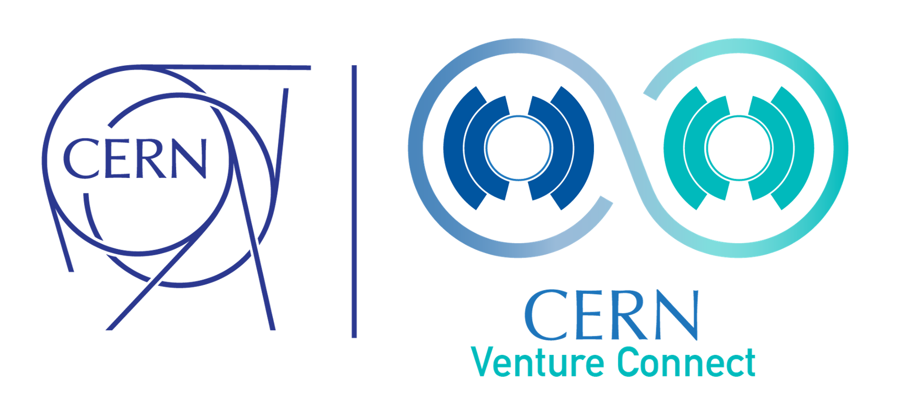

Deep Tech Startup Programme
Linn Kretzschmar (IPT-KT)

Slide 2
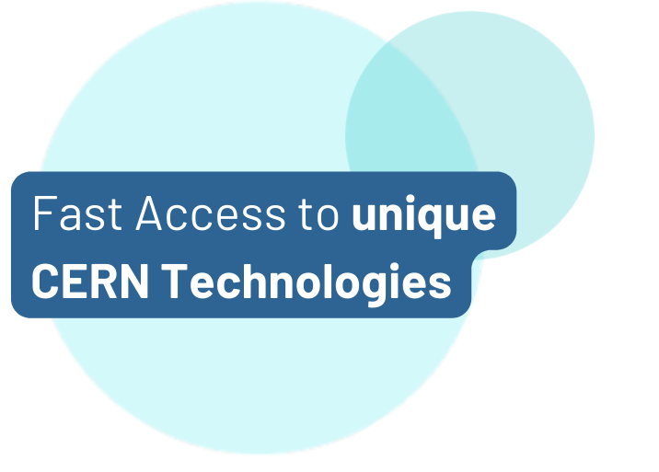
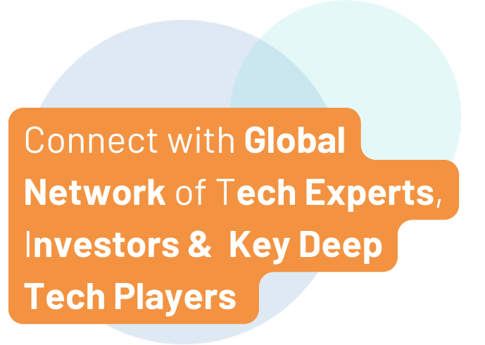
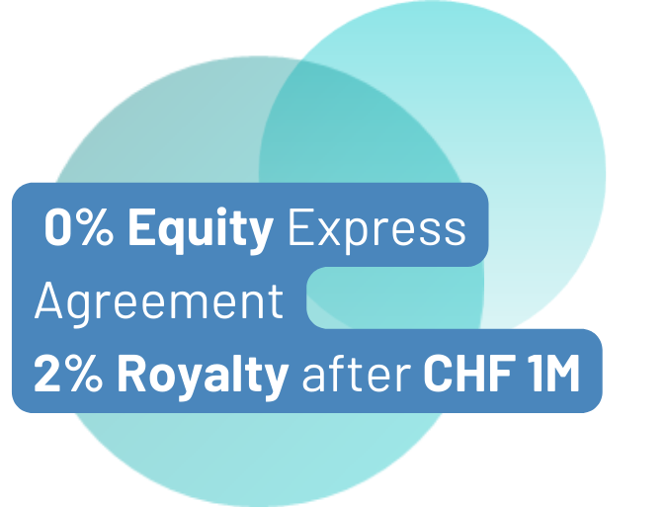
What We Do.
Fundamental research fuelling societal impact
Launched in 2023, CERN Venture Connect (CVC) bridges the gap between cutting-edge scientific research and commercial deep tech ventures.
Our community across 34 countries connects entrepreneurs, researchers and key deep tech partners to create innovative, high-impact startups.

Slide 3
Who We Support.
CERN Venture Connect supports Deep Tech Startups
CERNTREPRENEUR or EXTERNAL VISIONARY
Whether already part of the CERN community or an external entrepreneur, CVC provides valuable resources and connections to visionary founders.
From a seed-stage idea to a thriving scale-up that aims to solve a technological challenge, we support every step of the startup journey.
from ENTREPRENEUR to SCALE-UP
CERN Venture Connect

Slide 4
Technology Excellence meets Ecosystem Support.
Built on two pillars, CVC enables time-optimized engagements with startups
I. Pillar
Preselected, high-TRL tech and expert support
Fast & founder-friendly execution
II. Pillar
Network of established deep tech ecosystem players in MS & ASM
CERN Venture Connect

Slide 5


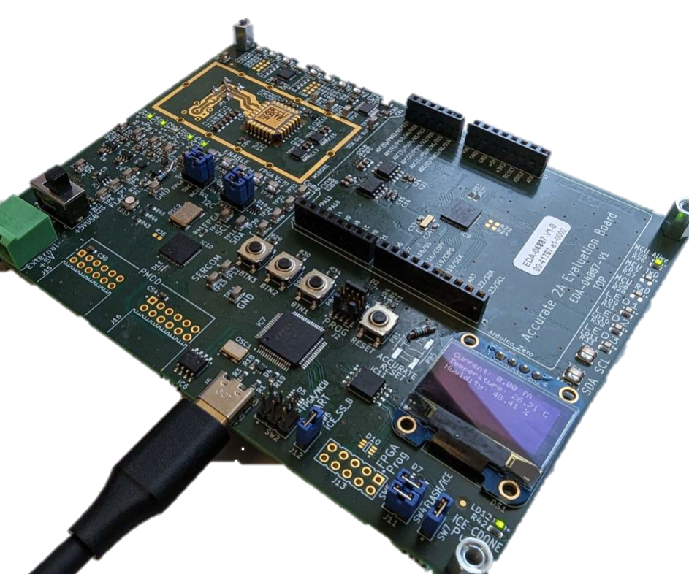



CVC Technology Portfolio.
Seven pioneering technologies ready to use
ACCURATE 2A
Structured Laser
Beam
Single Frequency
Laser
AstroMesh
High-Precision ASIC measuring current at femtoampere levels
Satellite mesh networking with radiation monitoring
Collimation system for focused laser beams
Ultra-narrow, multi-wavelength laser system
White Rabbit
Rucio
Ultralight Carbon
Coldplate
Sub-nano second time synchronization
Management of large, distributed datasets
Lightweight thermal management
35 CVC Prototypes
available for testing
CERN Venture Connect

Slide 6




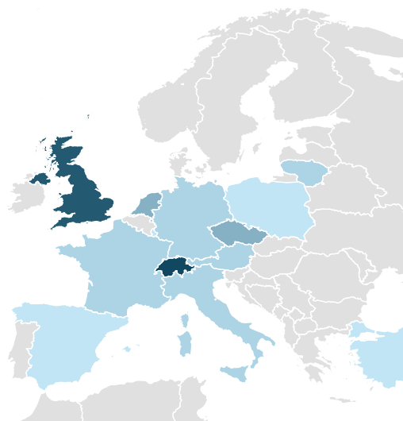






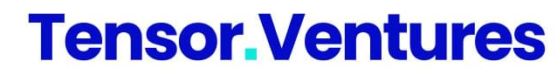

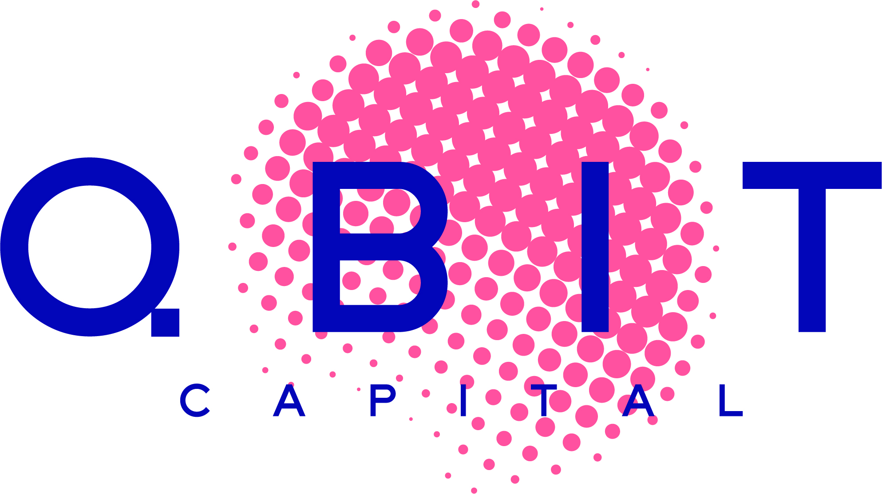





































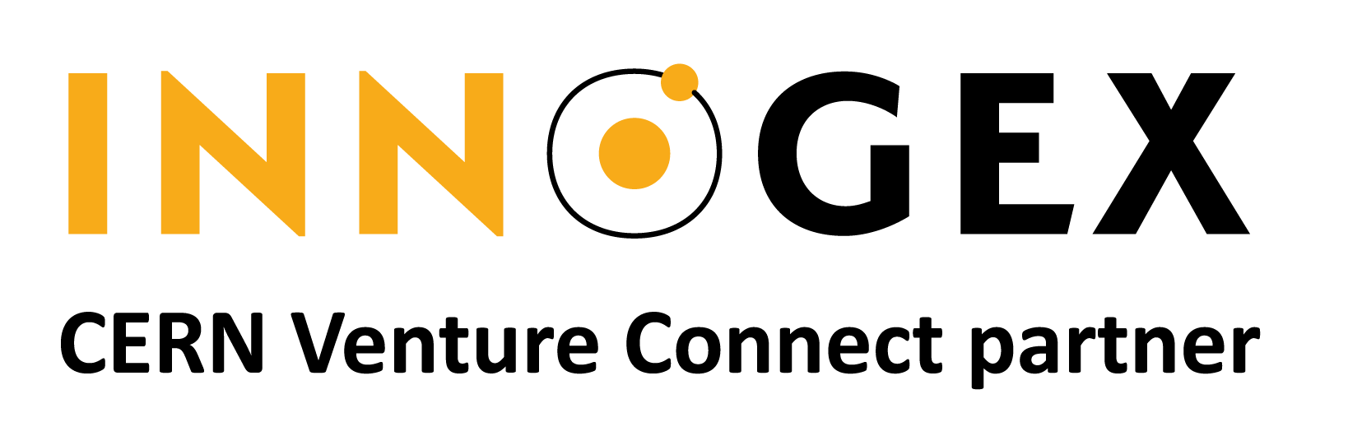

CVC Partner Network.
54 partners from 16 countries pledge their support
6%
4%
25%
48%
7%
6%
4%
CERN Venture Connect

Slide 7


CVC Membership Benefits.
CVC addresses the most critical deep tech startup needs
NEED
Ecosystem
Support.
CERN Tech.
NEED
First clients & networking
Technological Advantage
Workshops.
NEED
Funding Opportunities.
Skills development
NEED
Talent.
Financing
NEED
Strong team
CERN Venture Connect

Slide 8
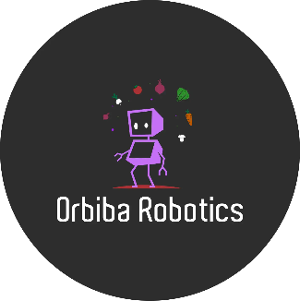








CVC Startups.
Mix of external startups (4) and startups founded by alumni (4)
Revolutionizing product marking with structured laser beams.
Automating risk analysis of complex engineering systems with Gen AI.
Regenerative farming using weed control robots.
Superconducting magnet technology simulation tools.
Imaging technology for heritage objects using cosmic particles.
Open-source event management from CERN to the World.
Long-range fiber optic thermo-hygrometer sensors.
Converting captured greenhouse gases into valuable resources.
CERN Venture Connect

Slide 9
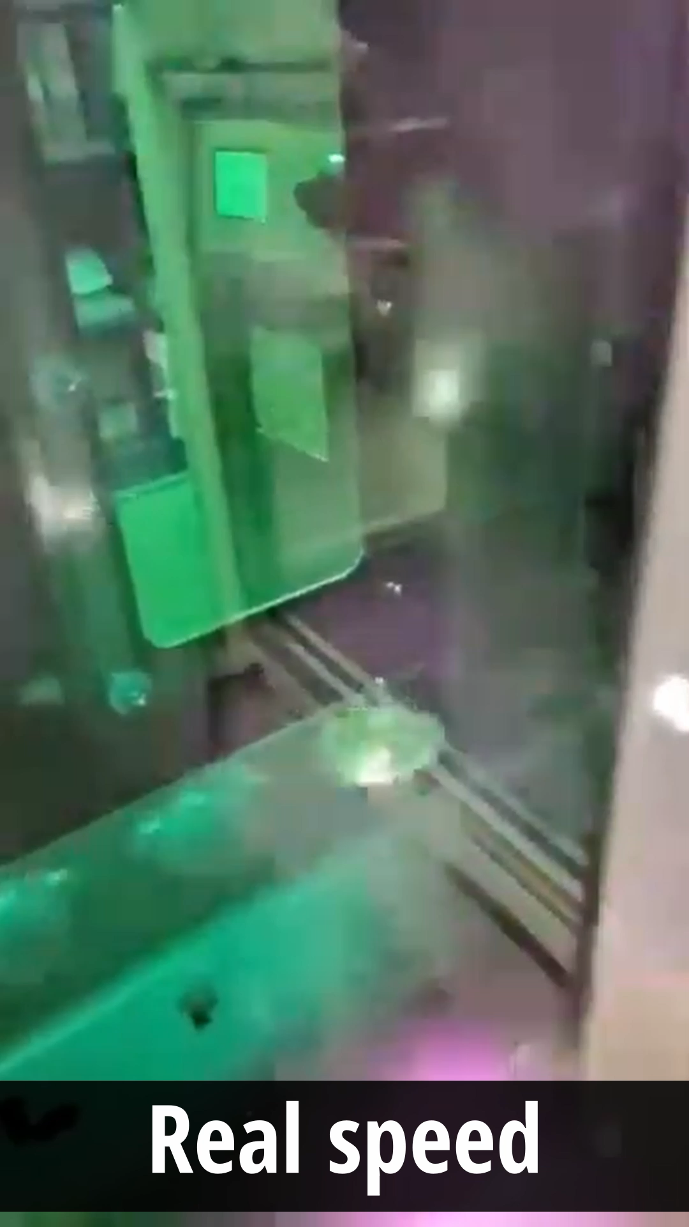
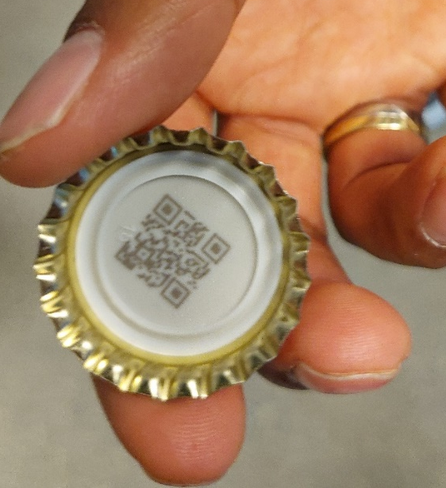

Product marking with structured laser beam
InPhocal aims to replace inkjet and laser printers in the food and beverages industry.
High speed Marking of products, even on curved surfaces
CERN Venture Connect

Slide 10



Wind LIDAR system for flight safety
Lighteye uses CERN’s single frequency laser to detect clean air turbulences
~
~ ~ ~
~ ~ ~
Invisibility of Clean Air Turbulences
CERN Venture Connect

Slide 11
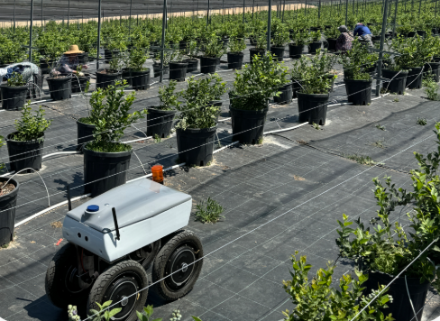

Weed Control Robots for sustainable agriculture
Orbiba Robotics aims to use the structured laser beam for data collection and removal of weeds
Support organic agricultural practices by reducing use of pesticides
CERN Venture Connect

Slide 12
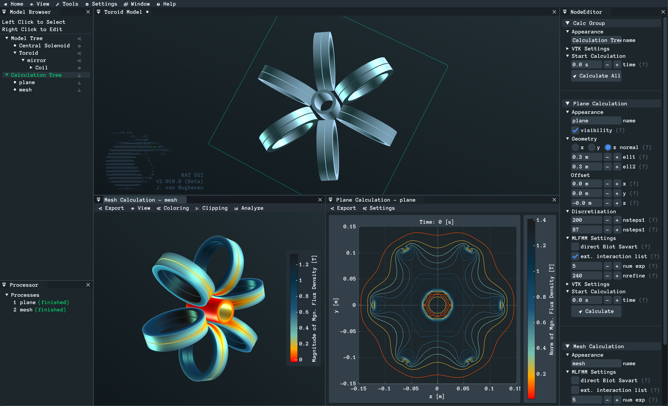
CERN Venture Connect

Slide 13
Our Terms And Conditions.
No-fuss express agreement with founder-friendly terms
2%
PROGRAMME FEE p.a.
Royalty fee on revenue generated with CERN Tech
applicable after exceeding CHF 1 million in annual sales.
Equity-free, non-exclusive worldwide license to commercialize the tech for 10 years
Exclusive access to technical support, resources, and activities to network and gain visibility
Official endorsement from CERN (use of CVC Logo)
Possibility for material transfer (where applicable)
CERN Venture Connect

Slide 14






How To Join.
Straight-forward selection process
Apply via ventureconnect.cern
Introductory Meeting
CERN Technology Matching
CERN Tech
Expert Consultation
Feasibility Assessment with CVC Prototype
Contract Signing
Deep tech startups, scaleups or entrepreneurs that are
based in one of CERN’s member states or associated member states*
driven by a passionate team with an ambitious vision
looking to leverage CERN technology to gain a competitive edge
operating in non-military and non-defense-related industries
Eligibility Criteria
No Deadlines
Applications considered
on a rolling basis
* List of CERN Member States
CERN Venture Connect

Slide 15
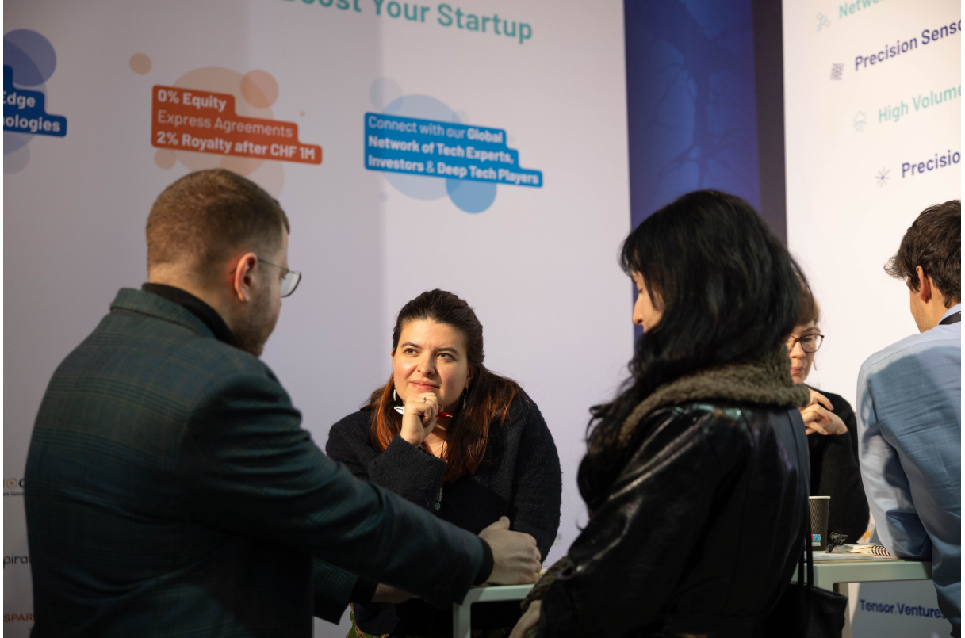
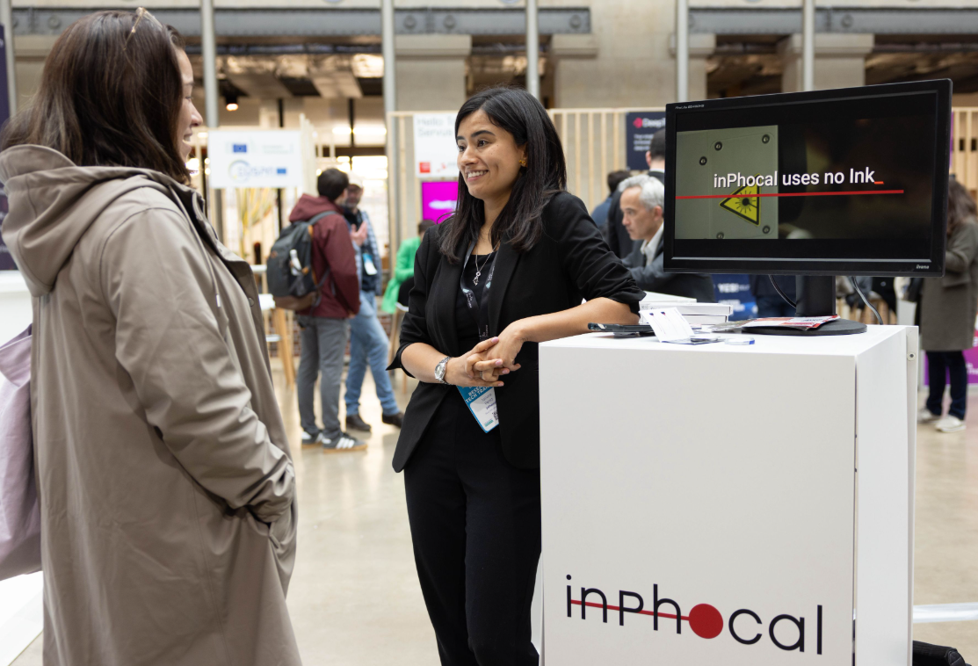
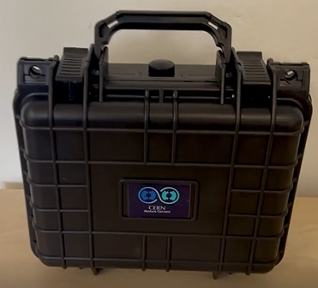
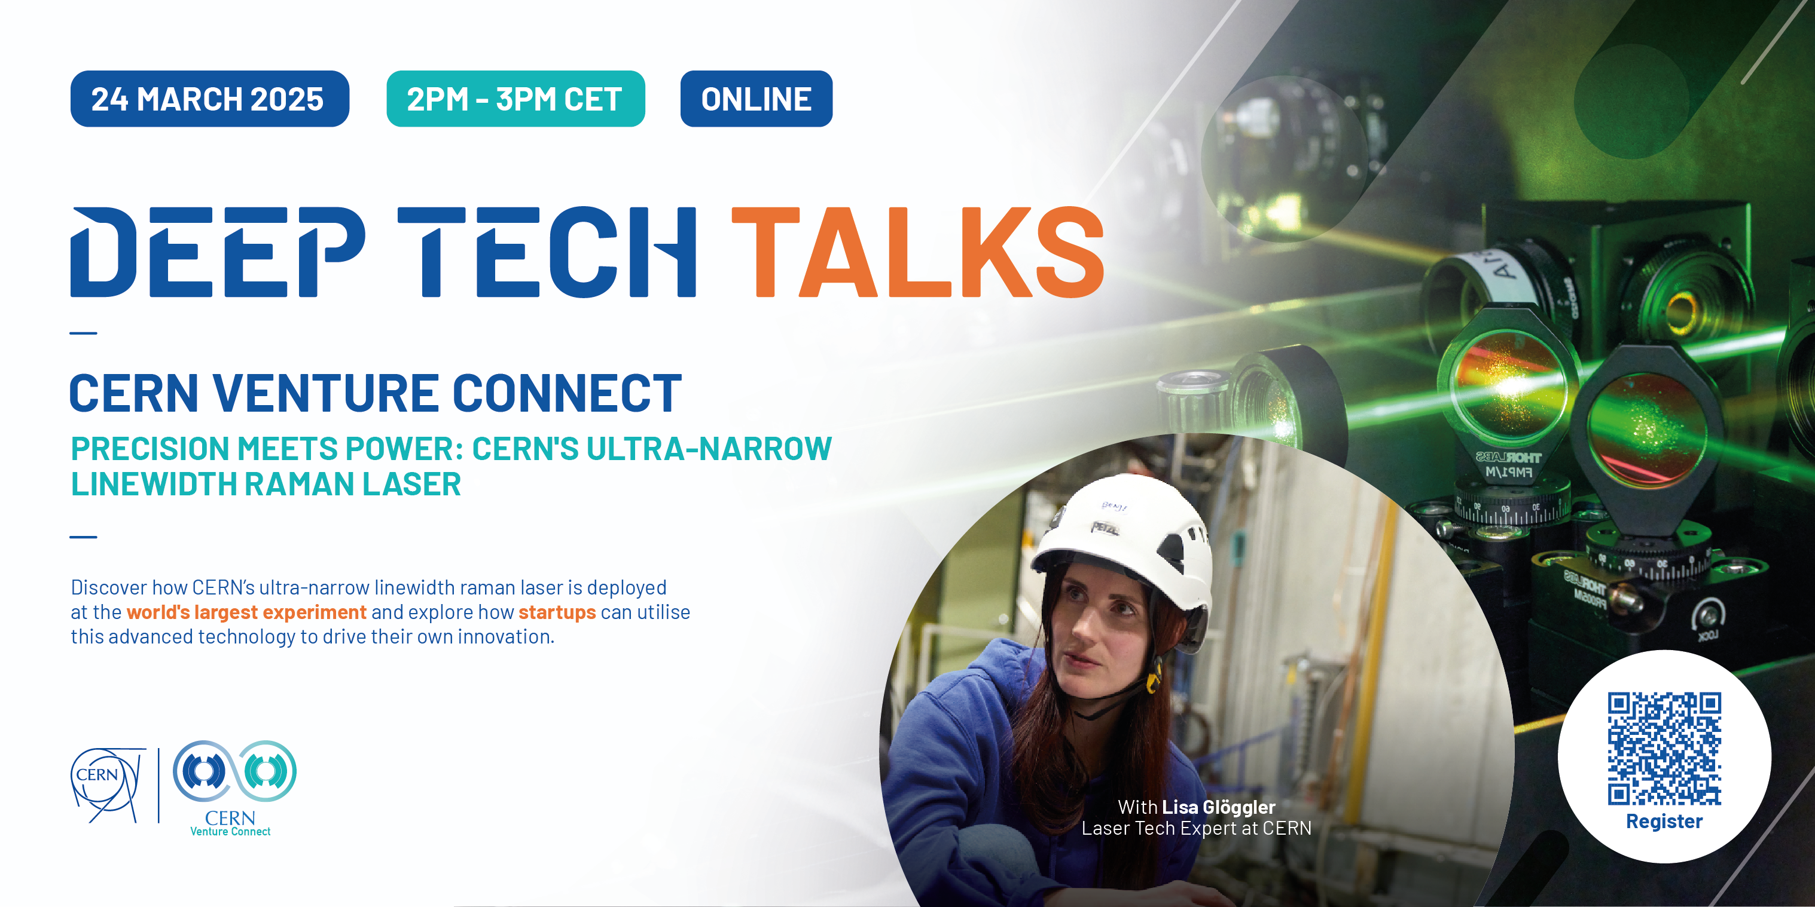
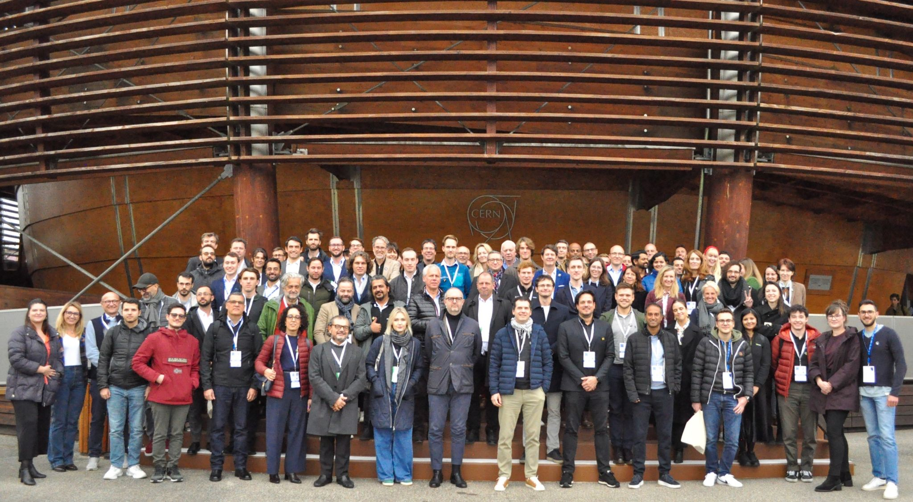
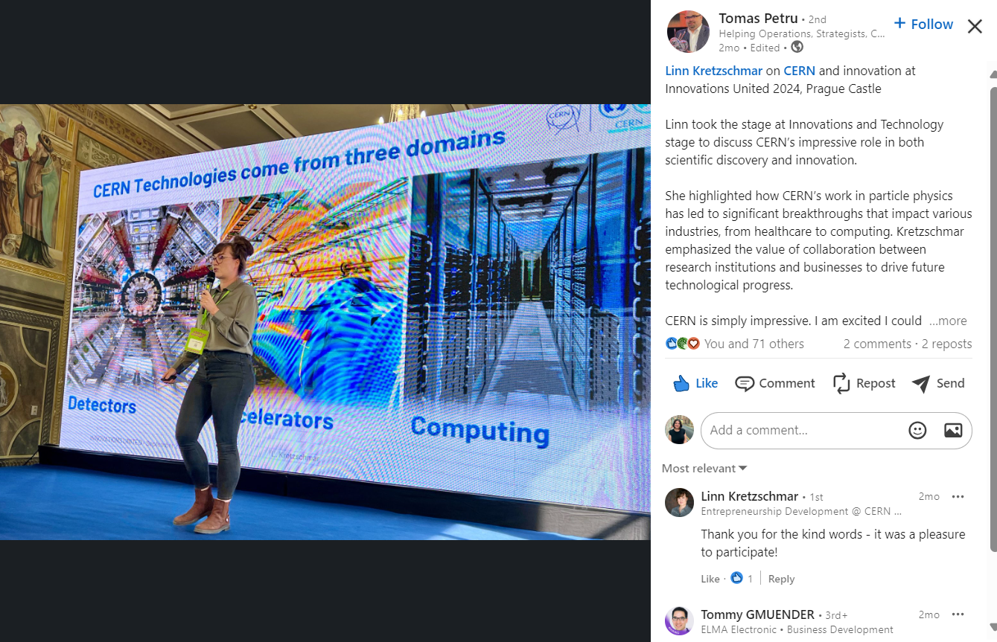
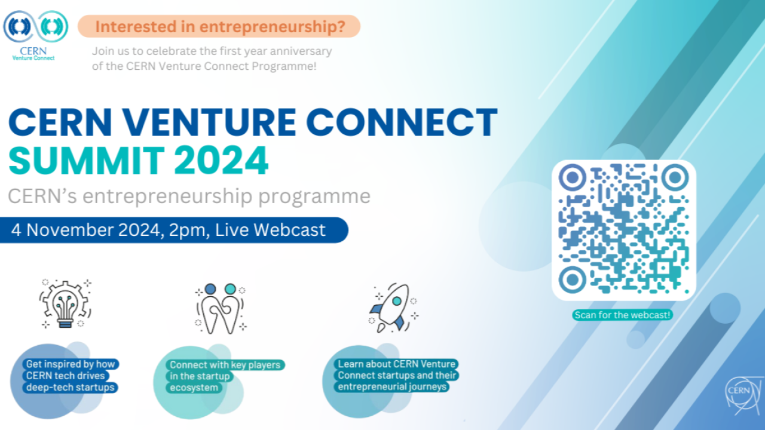
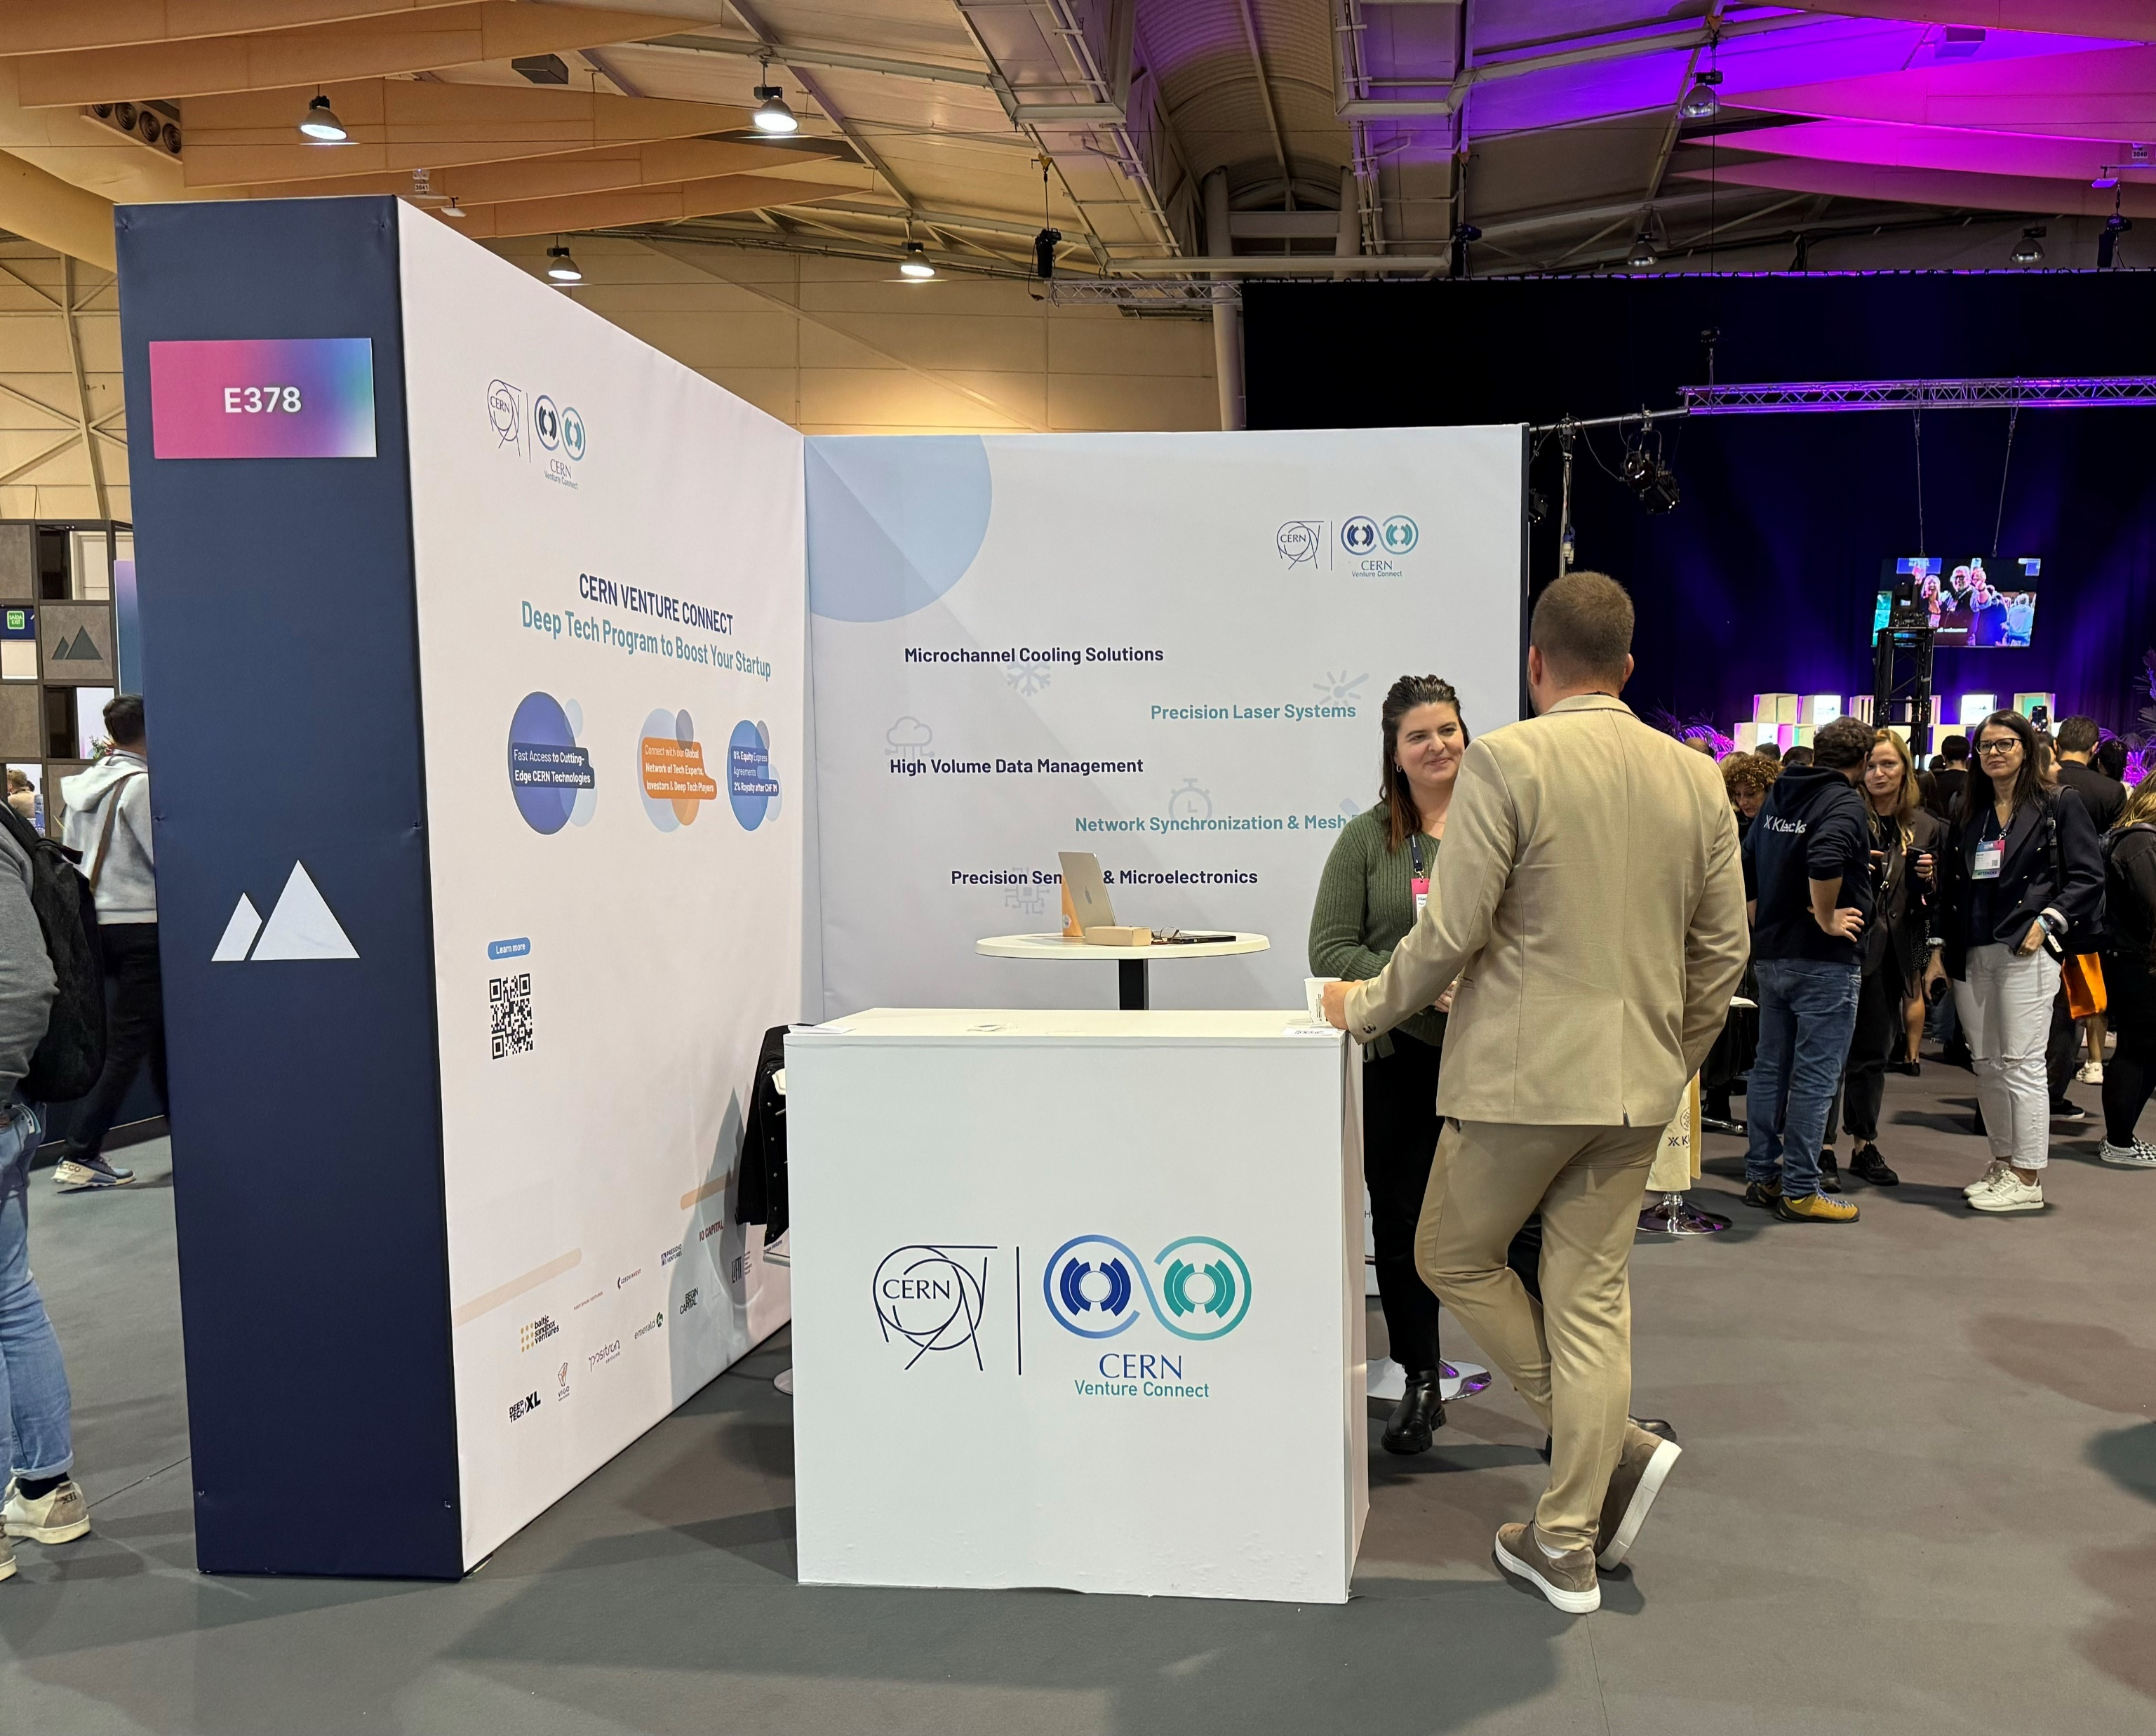
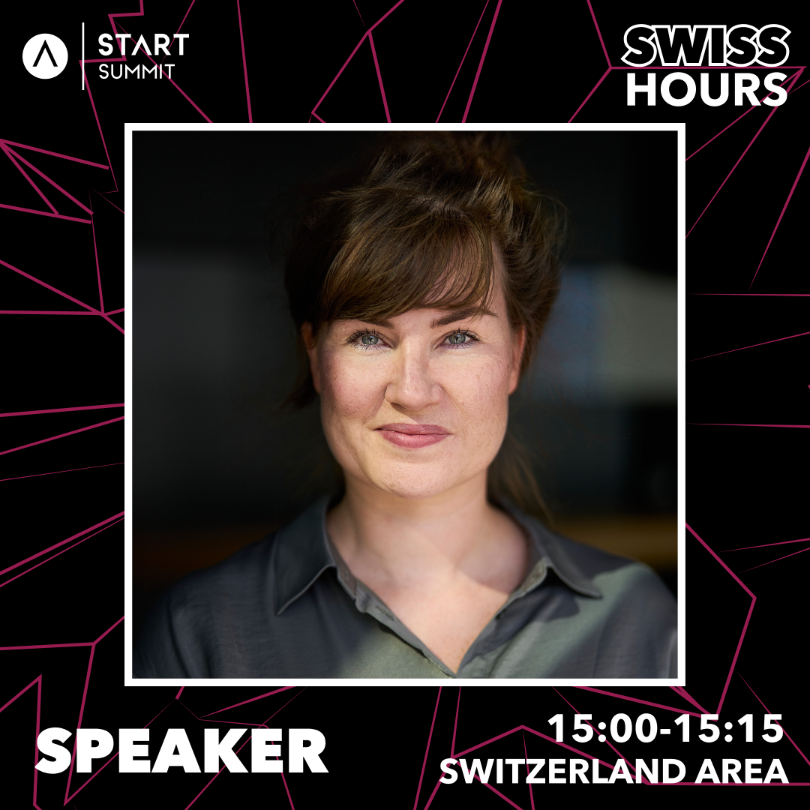
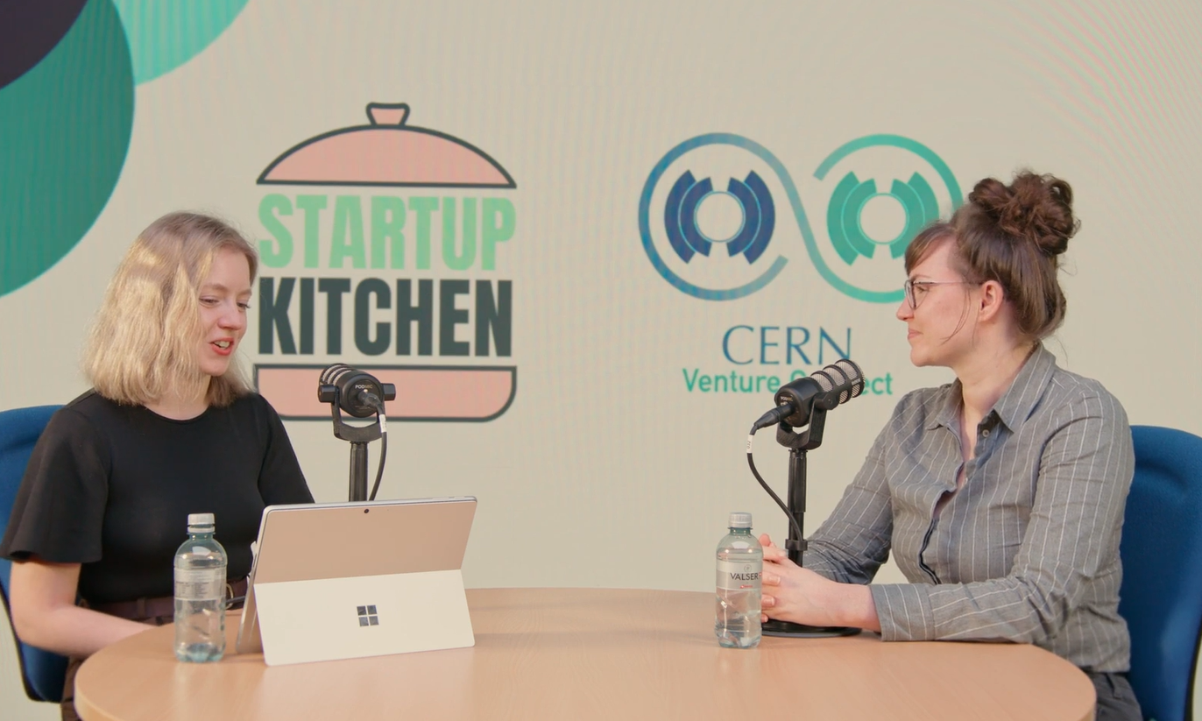
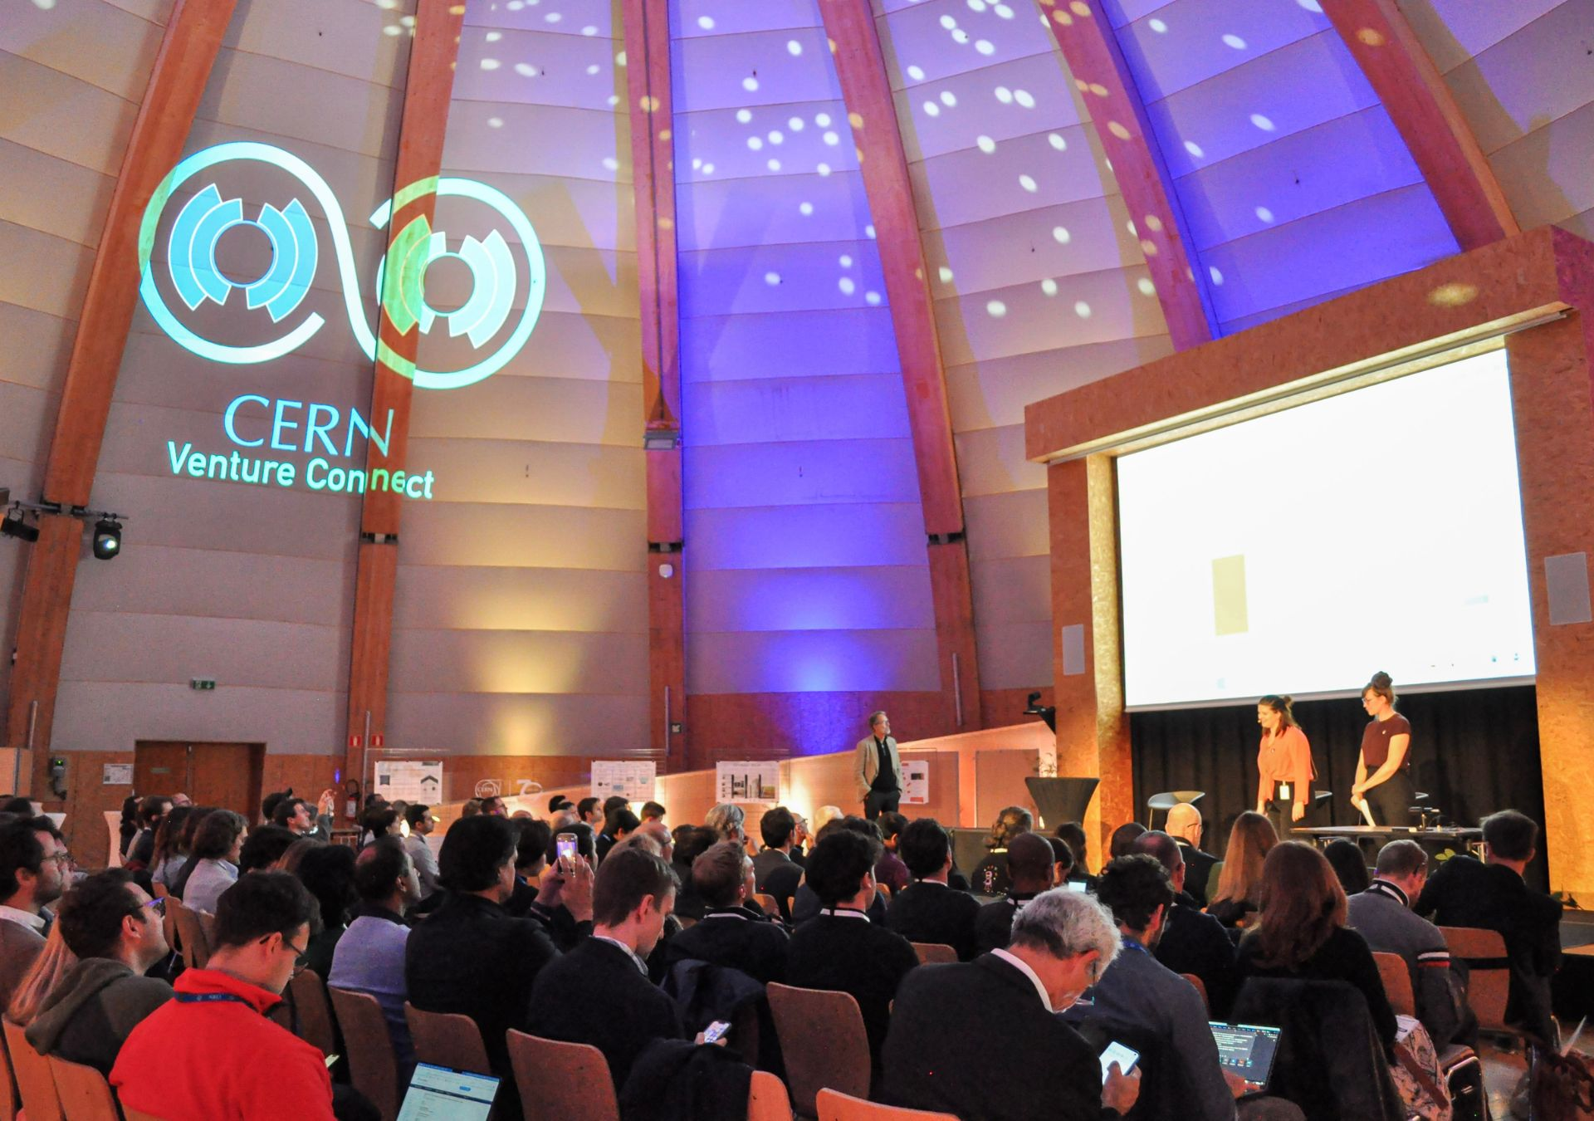
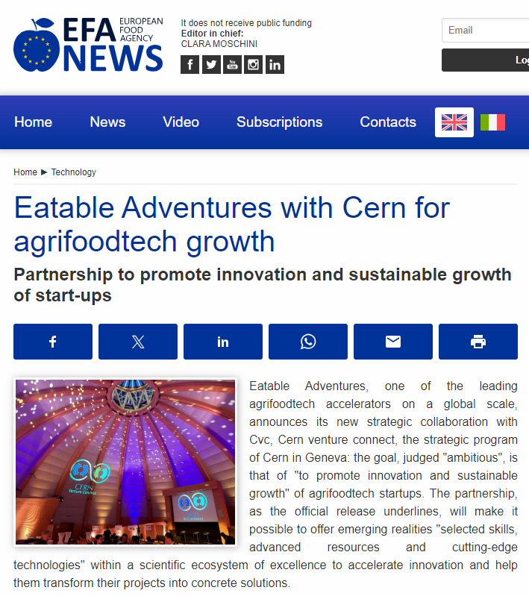
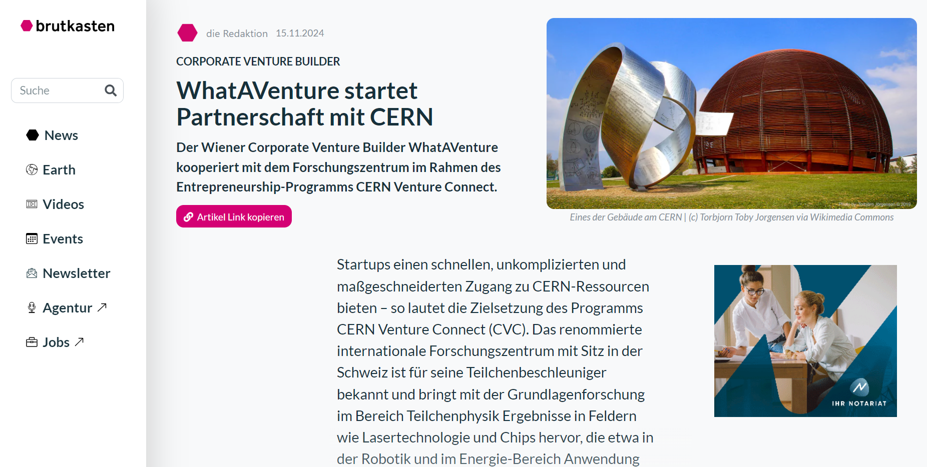
Milestones in the first 17 months.
CERN Venture Connect

Slide 16

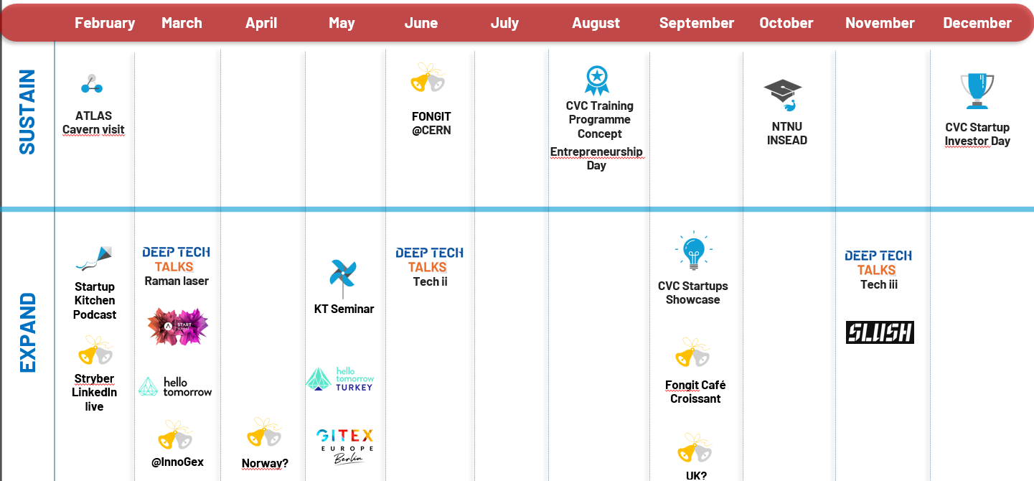
What to look out for in 2025.
Event Calendar 2025
Increased startup intake
Setup internal education programme
Engagement of current CVC network
Highlights
CERNtrepreneurship Event (May)
Annual CVC Gathering at CERN (Dec) (in collab. with SICTIC)
Funding rounds of CVC startups
Lots of co-branded events with our partners
CERN Venture Connect

Slide 17



Thank you!
Hanaé Taxis
CVC Communications & Partnerships
Linn Kretzschmar
CVC Programme Lead
Linn.Kretzschmar@cern.ch
Hanae.Taxis@cern.ch
Learn More.
Get In Touch.
CERN Venture Connect

