Slide 2
Polarization transport from linac to booster
Towards injection of polarized beams
Jorg Wenninger
BE-OP-LHC
Acknowledgements: P. Arutia (transfer line model)

Slide 3
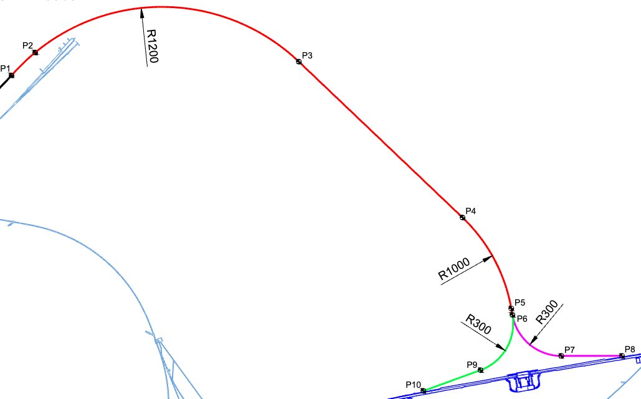
Transfer line linac - booster
Transport line of the 20 GeV beams from the end of the linac to the booster.
  E = 20 GeV, ν_{s} = aγ = 45.388
No optics is available for now, only the line geometry (bending) is defined.
  No proper particle tracking possible.
To begin the investigations for the injection of polarized beams (from a special damping ring), it is however possible to track the direction of the polarization vector through the line geometry.
P. Arutia from SY-ABT provided me Xsuite models of the line geometries.
Horizontal

Slide 4
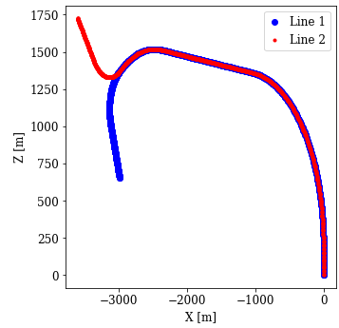
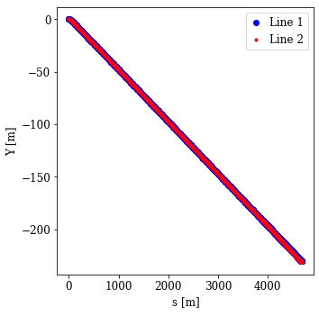
Transfer line survey
Transport 20 GeV beam from end of linac to the booster.
  E = 20 GeV, ν_{s} = aγ = 45.388
For convenience, the lines are called ‘Line 1’ and ‘Line 2’.
  Line 1 (blue) always bends horizontally in the same direction.
The major part of the ~4.5 km line is common for e+ and e-, two distinct branches in the second part.
  Line 2: the bending switches sign in the last section of the line.
  Line 1: ~180 deg total deflection, Line 2: little effective deflection.
  Consequently, the spin phase advances of the two lines are different.
The vertical bends are installed at the beginning and at the end of the lines – constant slope. Horizontal bending is in between.
  Height difference is 230 m.
MADX/Xsuite line geometry (“survey”)

Slide 5
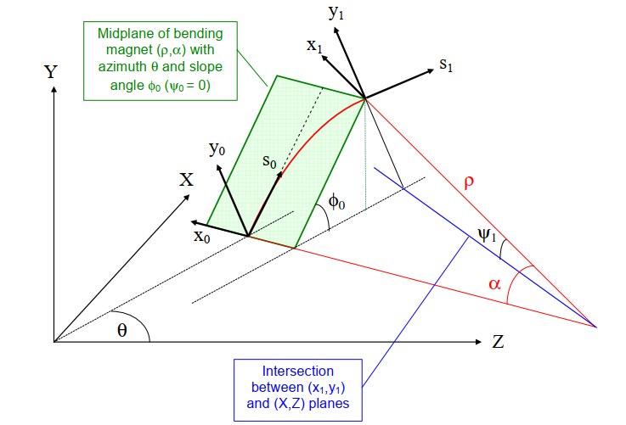
Coordinate system rotation
A horizontal dipole aligned with an inclination with respect to the reference frame introduces a “plane coupling” similar to a skew quadrupole.
Bending angle α, inclination φ → tilt ψ ≈ α φ
This effect is (can be) ignored for short lines, but it accumulates for km-long transfer lines that bend consistently in one direction.
This leads to a coordinate system “mismatch” in the X-Y plane. At the end of a long line, the transfer line coordinate system is rotated wrt receiving ring coordinate system – “coupling”.
from T. Risselada et al,
LHC project report 719 (2004)

Slide 6
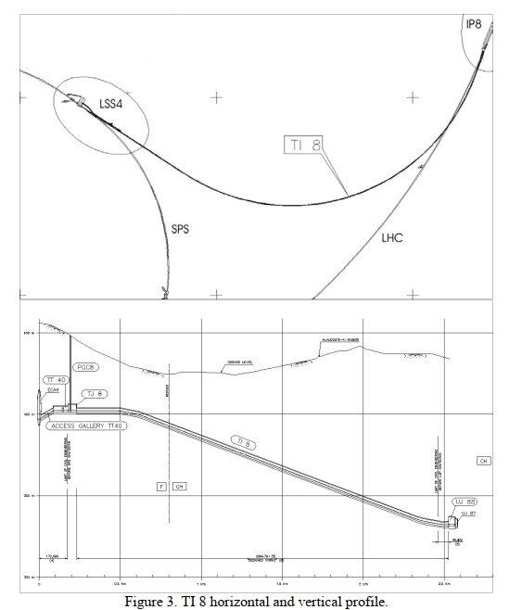
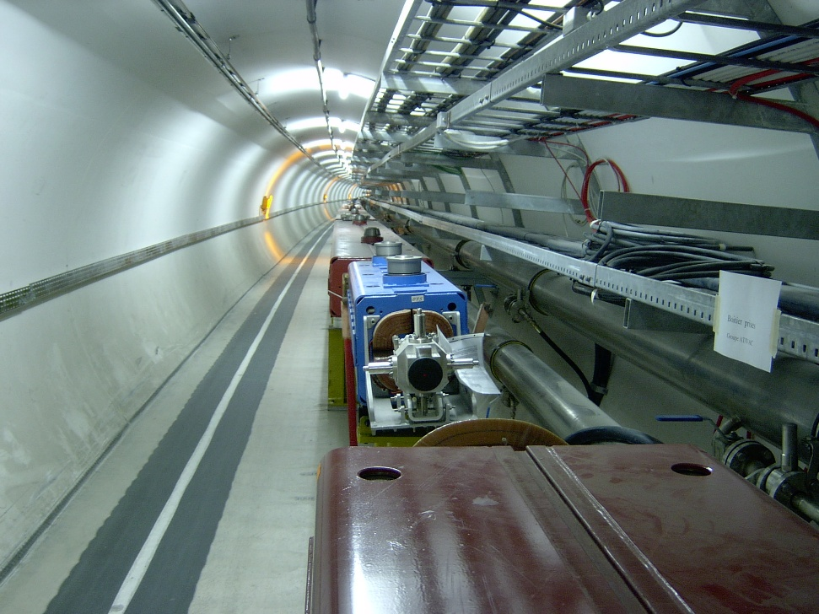
Coordinate system rotation – TI8
This effect is visible in the ~3 km long transfer lines from the SPS to the LHC, the ring 2 line (TI8) accumulates a tilt of ~4°.
The quadrupoles should be tilted to follow the local coordinate system to avoid “coupling” within the line.
The “coupling” is observed in kick-response measurements of a TL corrector: a H kick couples into the V plane in the LHC (and vice-versa).
This results in ~1-2% emittance growth in LHC (currently below the measurement accuracy).
For injection into LHC, this could be cured with skew quadrupoles installed before the injection point (not done)
Tilted quadrupole
near the end of TI8

Slide 7
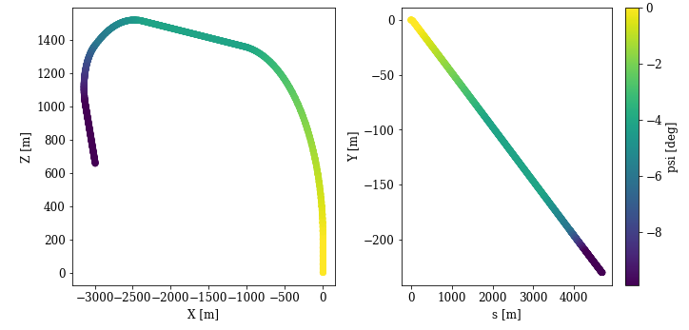
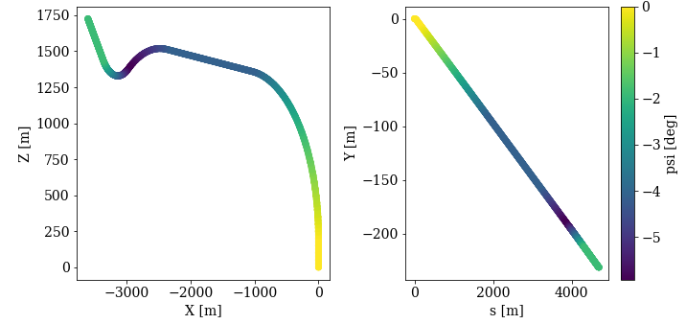
Coordinate system rotation
Line 1
The dipoles in the linac-booster lines are also inclined. The accumulated bending angles generate a plane tilt like the LHC case.
The tilt of the planes at the line ends is 9.9° for line 1, 1.9° for line 2.
See color coding on plots →
Line 2
DISCLAIMER:
The results presented in the following slide should correspond to the local reference frame at the end of the line.
The means that the vertical polarization direction differs from the booster vertical by the angles quoted above.
This needs further cross-checks !

Slide 8
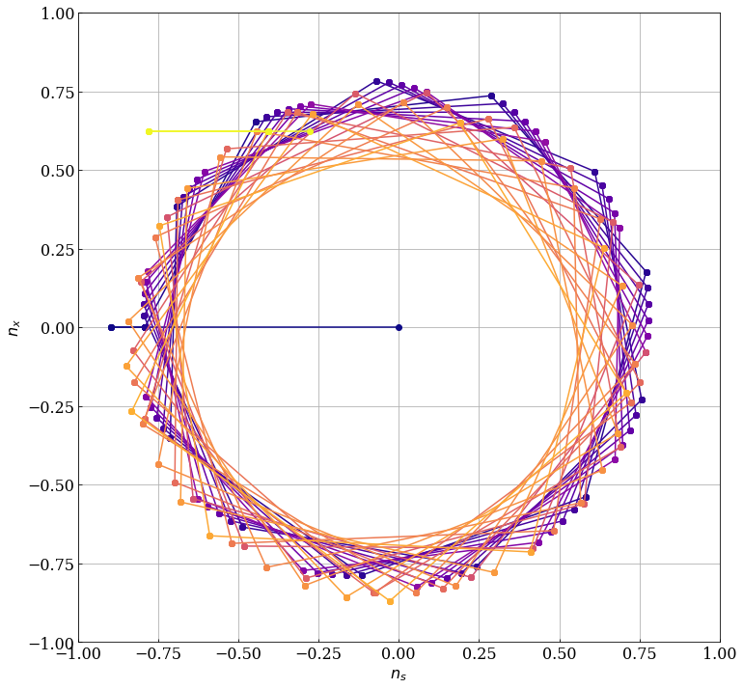
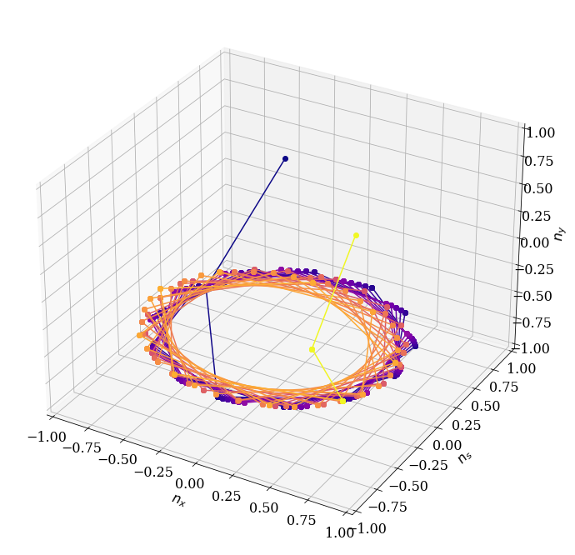
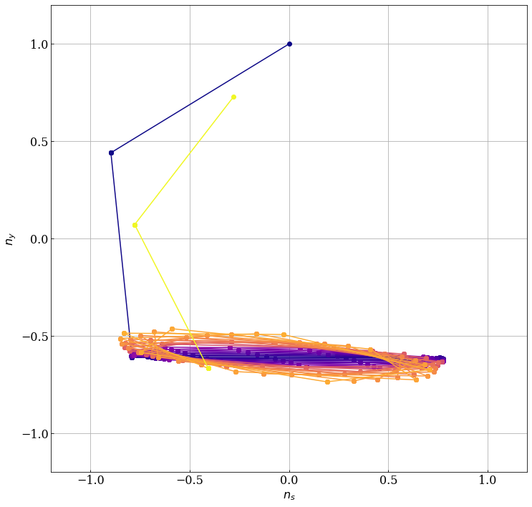
Polarization tracking for Line 1
Tracking of the polarization vector – assumed vertical at end of the linac – through line 1, aγ = 45.388 (20 GeV).
Projections
Spin phase advance due to horizonal bending Φ_{s} = 25.2 [2π].
Vertical bends at the end of line cannot completely restore P vector to vertical, spin precession not close enough to the integer.
X-S
start
end
start
end
Y-S

Slide 9
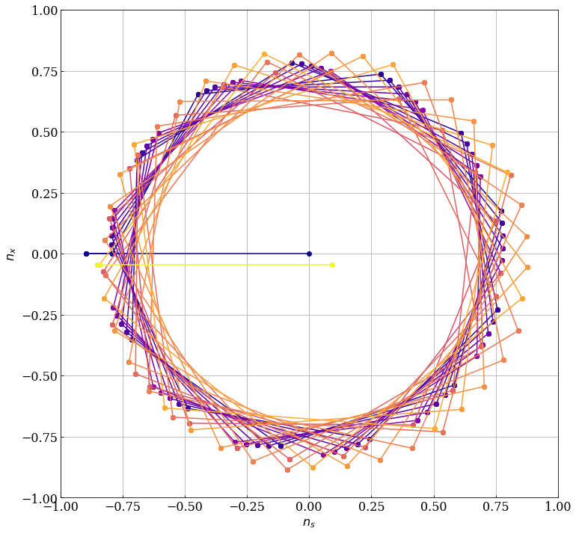
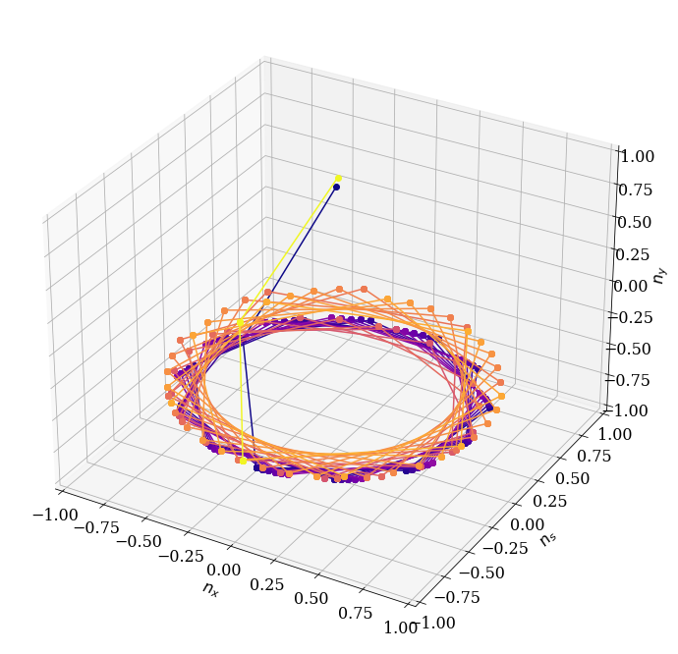
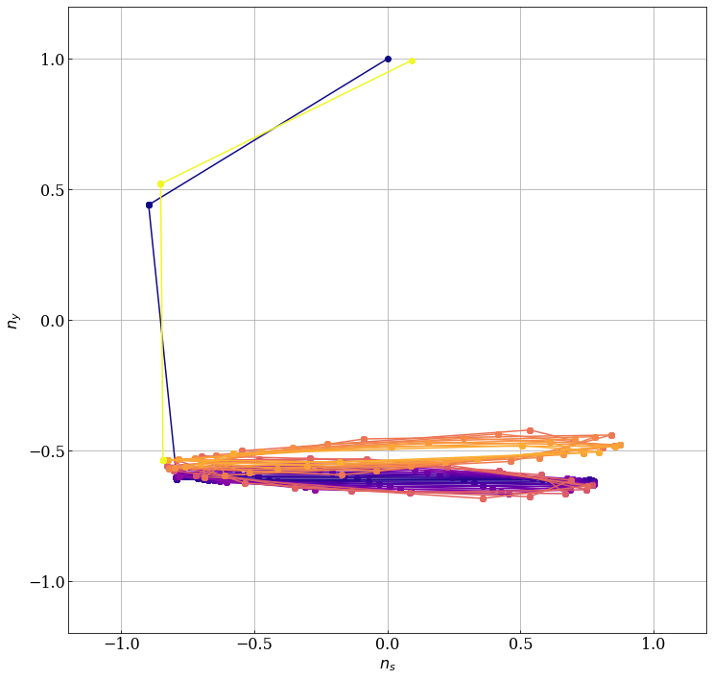
Polarization tracking for Line 2
Tracking of the polarization vector – assumed vertical at end of the linac – through line 1, aγ = 45.388 (20 GeV).
Projections
Spin phase advance due to hor. bending Φ_{s} = 5.002 [2π].
Vertical bends at the end of line restore P vector to vertical, because spin phase advance very close to the integer.
X-S
start
end
start
end
Y-S

Slide 10
Optimization
Before embarking into the installation of spin rotator devices, we can try to perform a simple optimization.
We can consider the energy at the end of the linac / injection into the booster as a free parameter and adjust energy/spin phase advance Φ_{s} to improve the situation for Line 1 !
  Line 1 : Φ_{s} = 25.2, Line 2 : Φ_{s} = 5.0.
If we reduce slightly the beam energy, the spin phase advances of both lines can be lowered to get a better overall optimum.

Slide 11
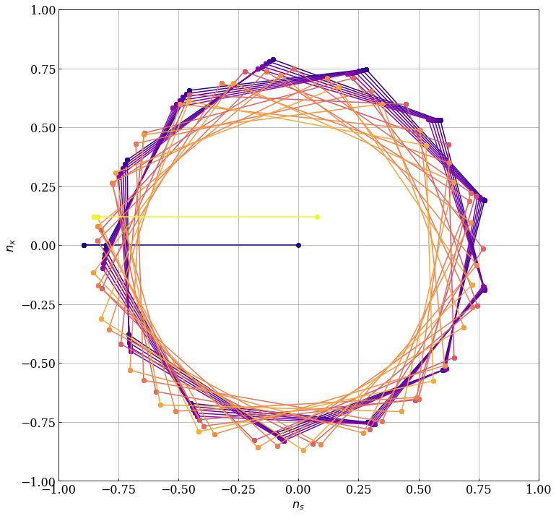

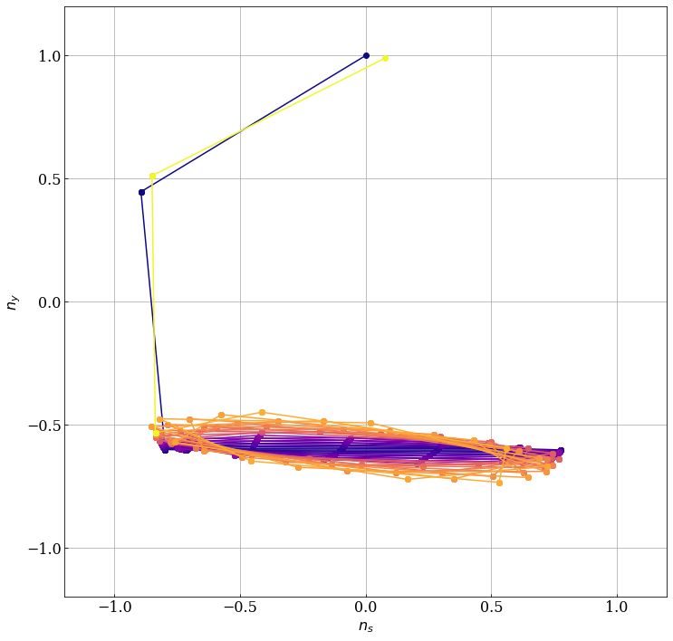
Polarization tracking for Line 1 optimized
Tracking of the polarization vector – assumed vertical at end of the linac – through line 1, aγ = 45.0994 (19.873 GeV).
Projections
Spin phase advance due to hor. bending Φ_{s} = 25.04 [2π].
Vertical bends at the end of line almost restore P vector to vertical with spin precession quite close to the integer.
X-S
start
end
start
end
Y-S

Slide 12
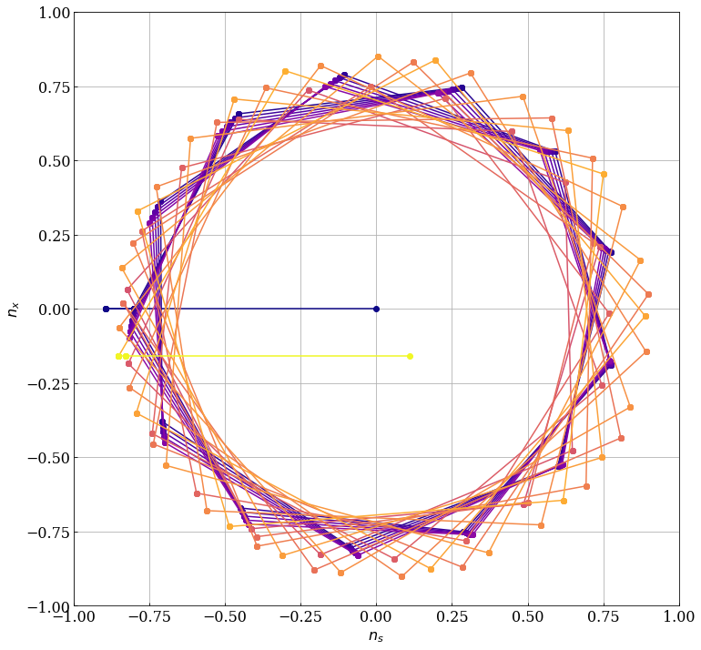
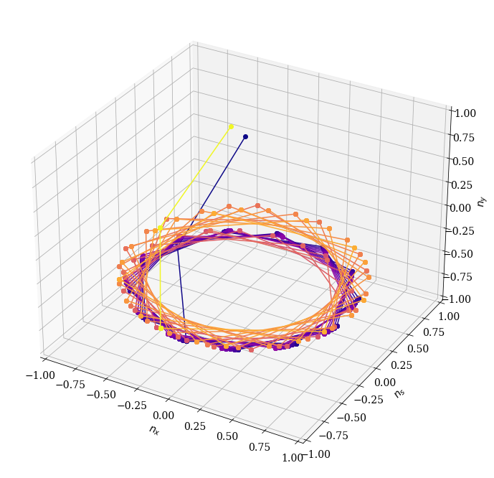
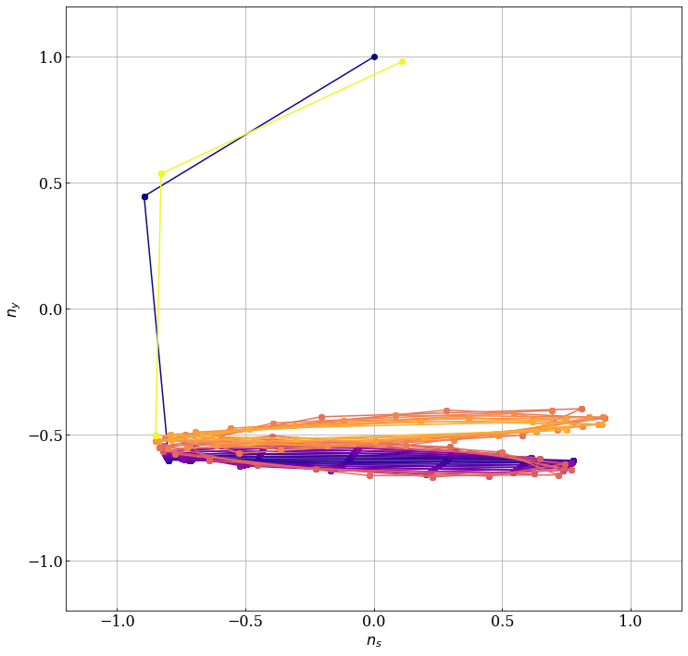
Polarization tracking for Line 2 optimized
Tracking of the polarization vector – assumed vertical at end of the linac – through line 1, aγ = 45.0994 (19.873 GeV).
Projections
Spin phase advance due to hor. bending Φ_{s} = 4.97 [2π].
Vertical bends at the end of line almost restore P vector to vertical, because spin phase advance remains close to the integer.
end
X-S
start
start
end
Y-S

Slide 13
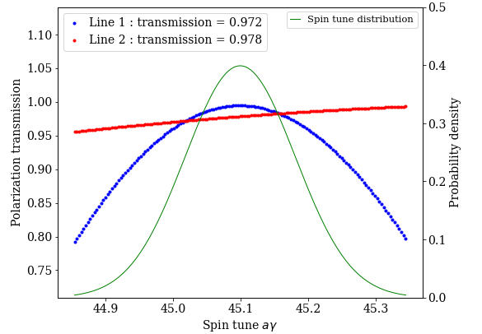
Energy spread and jitter
Current assumptions for energy spread and jitter at the end of the linac:
  RMS energy spread σ_{s} = 0.01%.
  Energy jitter δ_{s} = 0.03% → assuming this corresponds to 2σ (2xRMS).
  Effective total aγ spread = 0.082 (RMS).
With those assumptions, the transmission of the vertical polarization component is ~0.97 on average for both lines.
  Numerical convolution of transmission versus aγ and of aγ distribution.
The optimum energy corresponds to a spin tune at booster injection of 45.1: a bit too low…?
Vertical component of the polarization at the end of Line 1 and Line 2 (transmission) as a function of aγ and aγ distribution (E spread + jitter).

Slide 14
Impact of coordinate system rotation
Uncertainty on the coordinate system rotation implies that the direction of the vertical polarization component in the booster may differ by ~10° for line 1 (close to negligible for line 2) which would reduce the vertical polarization by a few %.

Slide 15
Discussion
Transport of the vertical polarization in the transfer line from linac to booster seems to be possible with good transmission without special devices (spin rotators).
As soon as a proper optics becomes available, the study should be refined by particle distribution tracking.
The coordinate system rotation should be double-checked for polarization transport.

