Slide 1
Study of vertical polarization variation and numerical simulations studies on monolithic active pixel sensor
Tamazirt juba
On behalf of IJCLab ILE group

Slide 2
Outline
1. Simulation Study on the Impact of Vertical Polarization on fit Parameters Extraction
2. Implementation of a Simulation on a monolithic pixel sensor with Dead Zones
Tamazirt juba
On behalf of IJCLab ILE group

Slide 3
Test on linearity over electron vertical polarization
Test of linearity in fit extraction of the scattered electron vertical polarization:
objective:
Verify the linearity of the extraction of the electron's vertical polarization in the fit.
Use a Toy Monte Carlo to explore multiple polarization configurations.
Explored configurations:
  Horizontal and longitudinal polarization: Px = 0, Pz = 0
  Vertical polarization: Py varying from -0.1 to 0.1 with the values: -0.1, -0.08, -0.06, -0.04, -0.02, 0, 0.02, 0.04, 0.06, 0.08, 0.1.
Initial detector configuration:
1600*80 pixels
10⁸ events
15 mm of beam-detector horizontal
distance
400mm*4mm detector size

Slide 4
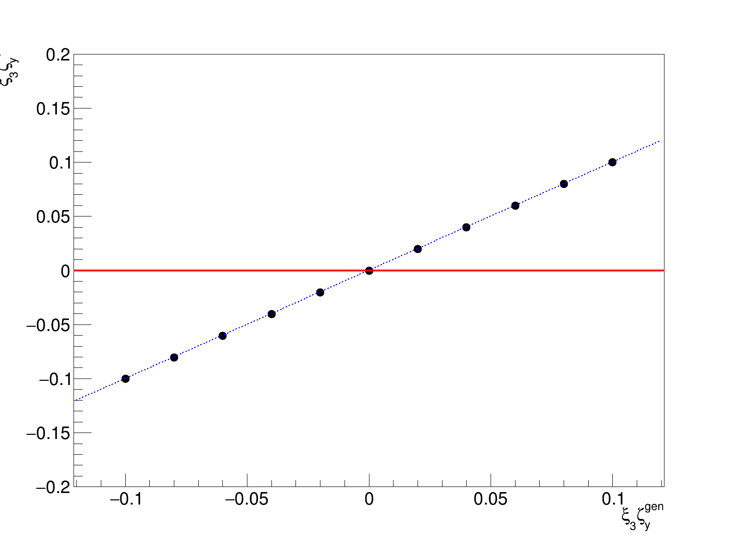
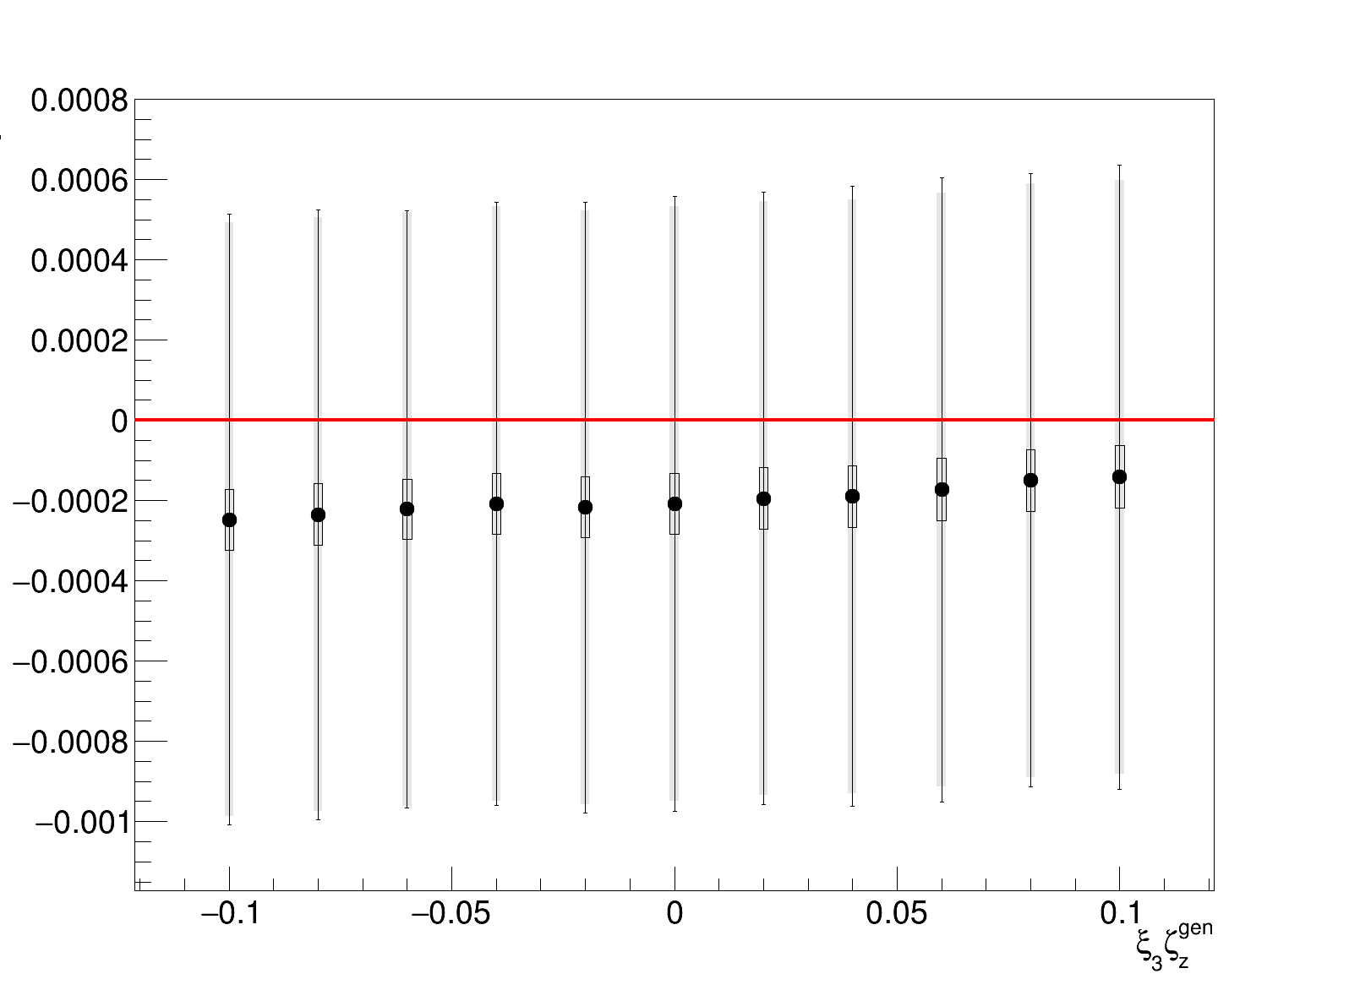
Test on linearity over electron vertical polarization
Results: scan over vertical polarization values
𝛏3𝝵y fit- 𝛏3𝝵y gen
Linearity on extracted vertical polarization with generated vertical polarization
small bias induced by e- vertical polarization shift
Presentation for FCCIS WP2.5 meeting

Slide 5
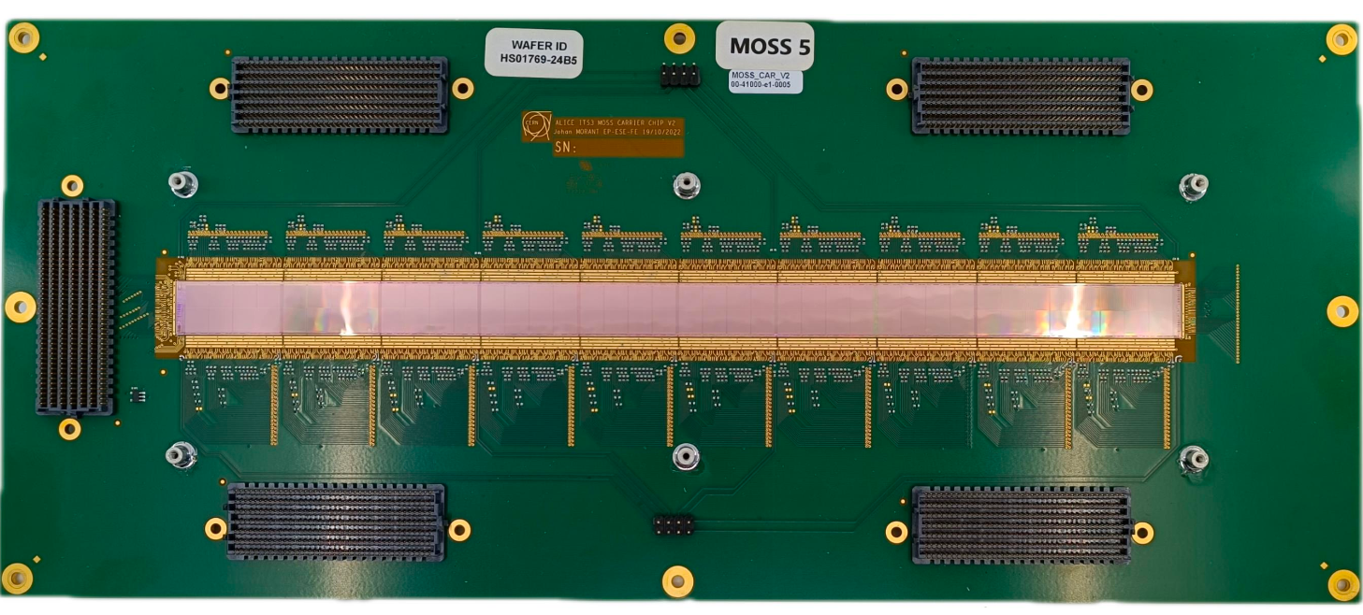
Simulations with a realistic geometry
Monte carlo simulation and Rebinning
y
x
pixellisation:
21020 nXpix
320 nYpix
too many pixels to perform a the fit !!!
18µm
18µm
pixel
18µm
18µm
Dead zones
Presentation for FCCIS WP2.5 meeting

Slide 6
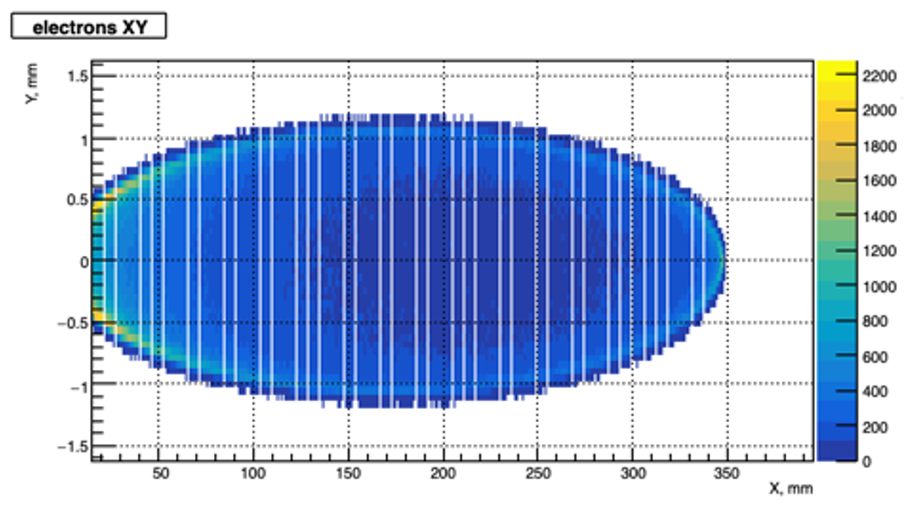
Simulations on Monolithic Active Pixel Sensor MAPS
Monte carlo simulation and Rebinning
Rebinning on x axis by 16
Rebinning on y axis by 3
warning! 5 rows of dead pixels instead of 2 for better visualisation
320 pixels (16)
320 pixels (16)
80 nYpix (3)
dead zone 34 pixels (2)
dead zone 34 pixels (2)
1320 nXpix with
60 dead zones
Presentation for FCCIS WP2.5 meeting

Slide 7
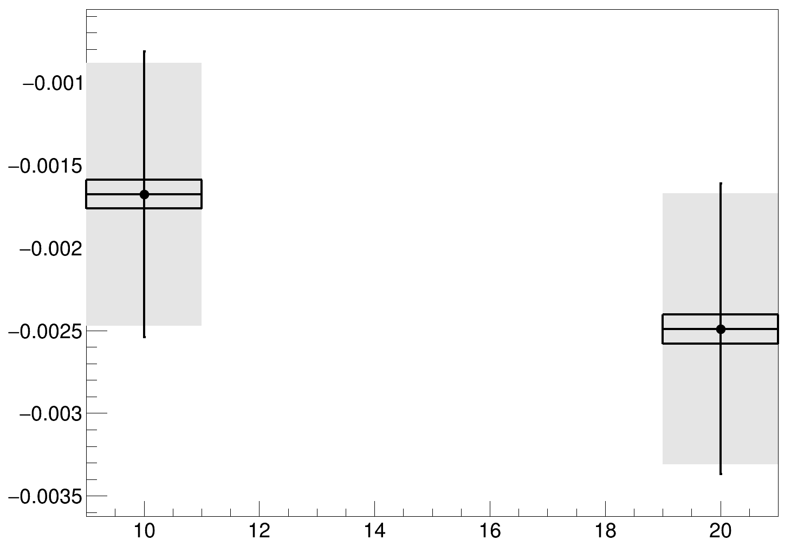
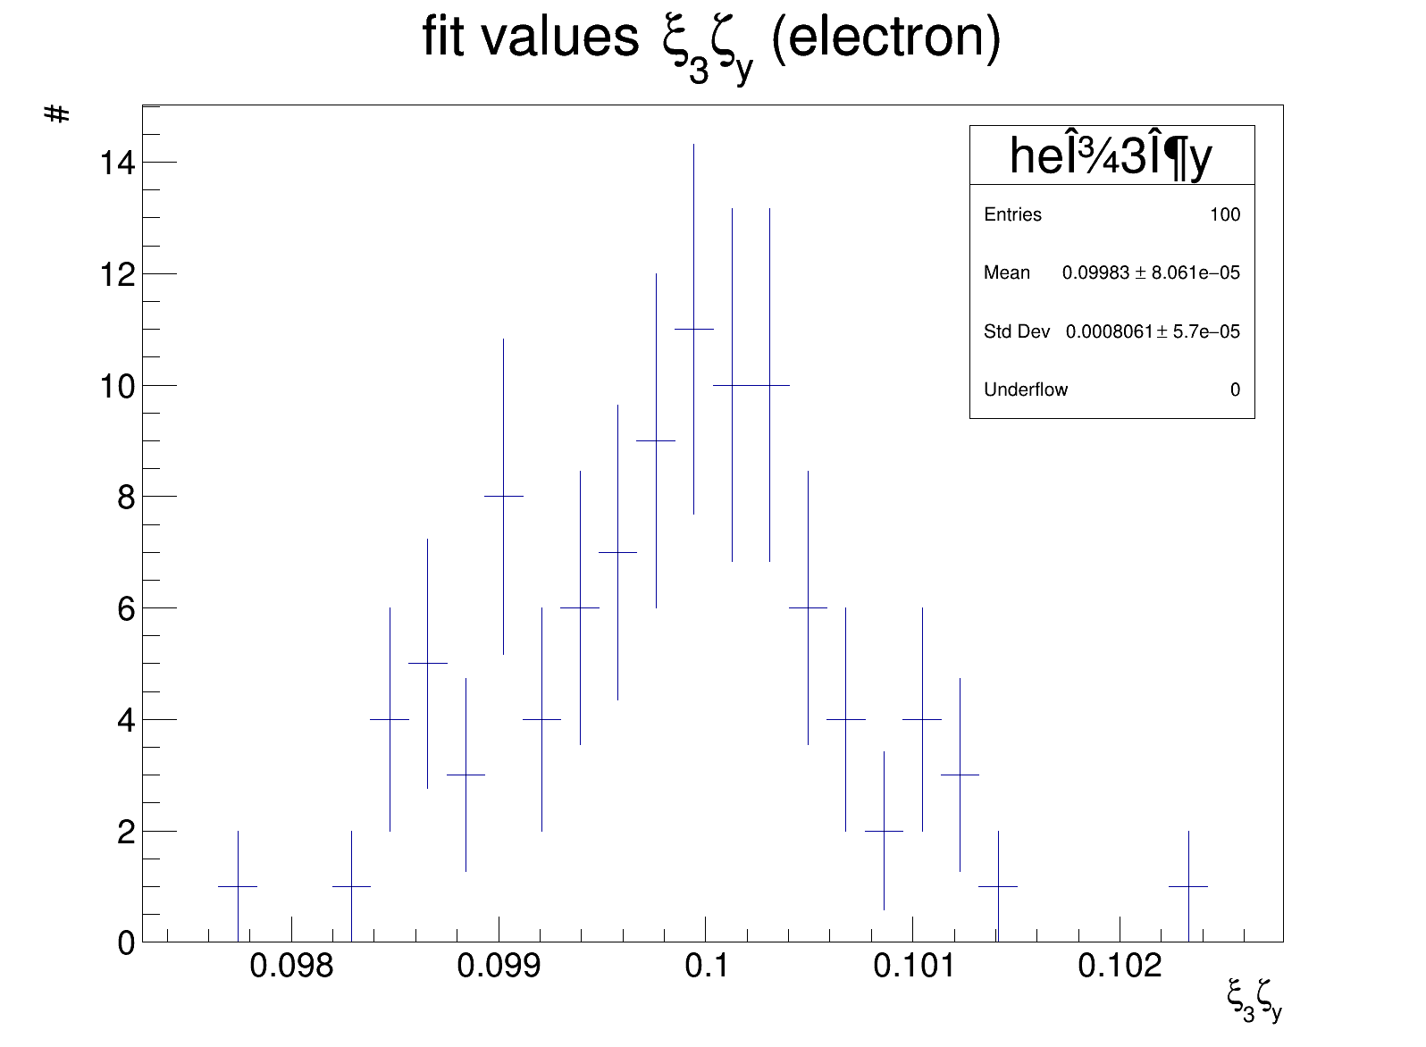
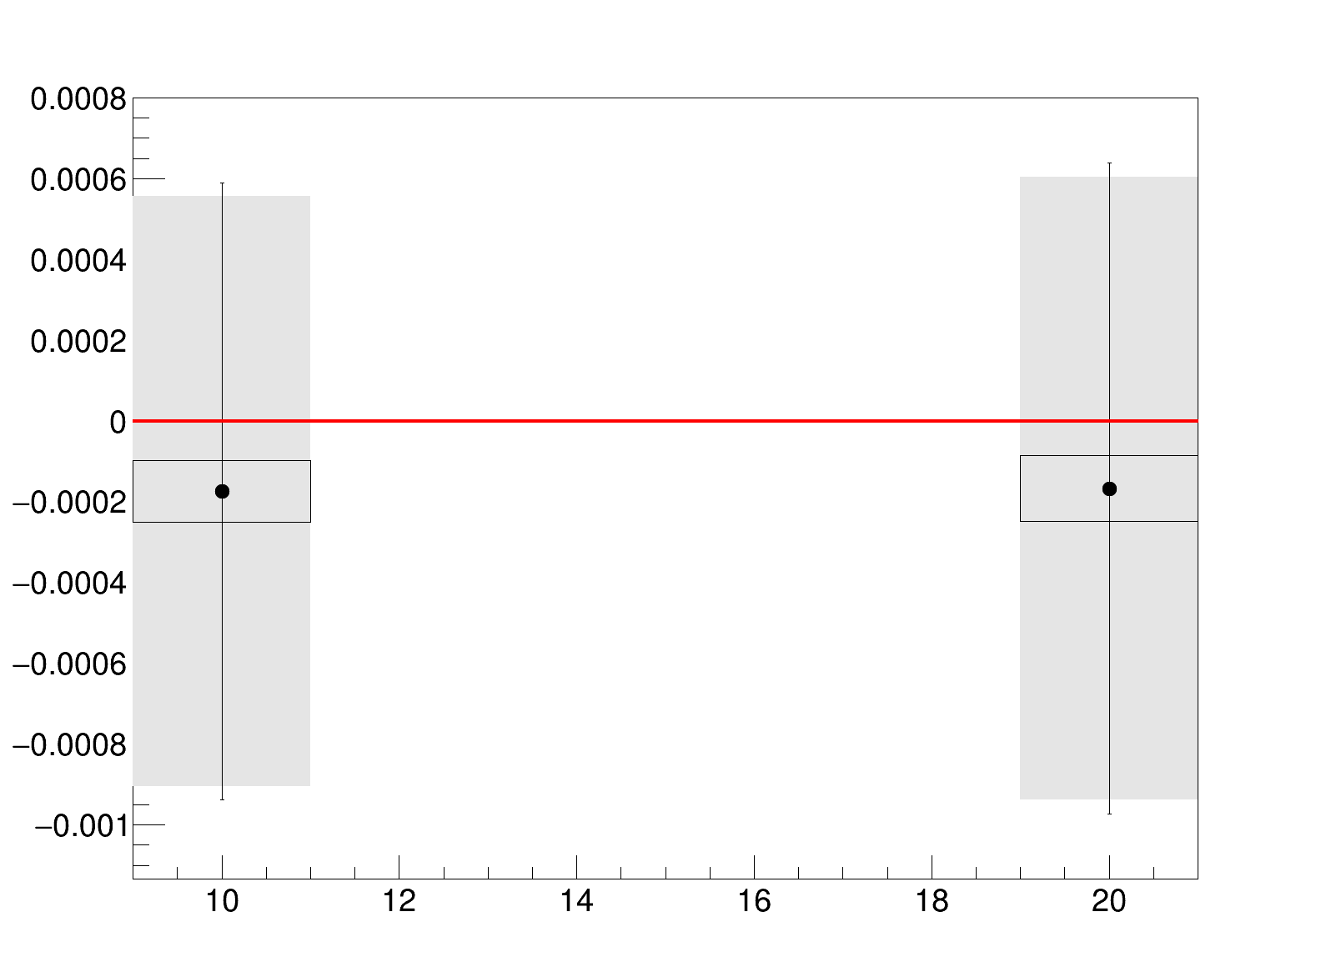
Simulations with a realistic geometry
Results: Comparing extracted fit parameters with and without dead zones simulation
Egen-Efit
Average of single
fit uncertainty
without dead
zones
with dead
zones
Standard deviation
𝛏3𝝵y fit- 𝛏3𝝵y gen
stat uncertainty
on average of
fit values
average of
fit value
with dead zones
without dead zones
with dead zones
Presentation for FCCIS WP2.5 meeting

Slide 8
Simulations with a realistic geometry
Results: Comparing extracted fit parameters with and without dead zones simulation
Egen-Efit
Vertical Polarization Extraction:
A small bias is observed in the extracted vertical polarization.
The uncertainty is slightly larger when dead zones are included.
Beam Energy Extraction:
A significant bias of order 10⁻⁴ is observed in the extracted beam energy.
The deviation is more pronounced between cases with and without dead zones.
Average of single
fit uncertainty
Standard deviation
without dead
zones
with dead
zones
stat uncertainty on
average of fit values
𝛏3𝝵y fit- 𝛏3𝝵y gen
average of
fit value
without dead zones
with dead zones
Presentation for FCCIS WP2.5 meeting

Slide 9
Conclusion - prospects
Conclusion
Vertical Polarization Bias:
  A small but consistent bias is observed in the extracted vertical polarization.
Energy Extraction Bias:
  The presence of blind pixels introduces a small additional bias in the reconstructed beam energy.
Prospects and ongoing steps:
Fit the asymmetries, ensuring the inclusion of the luminosity calculation in the analysis.
Study the systematic uncertainty related to the angular misalignment of the detector. We need to determine whether we can fit or scan for the detector angle.
Perform a simultaneous fit of electrons and photons to improve parameter extraction.

Slide 10
Thank you for your attention

Slide 11
Backup

Slide 12
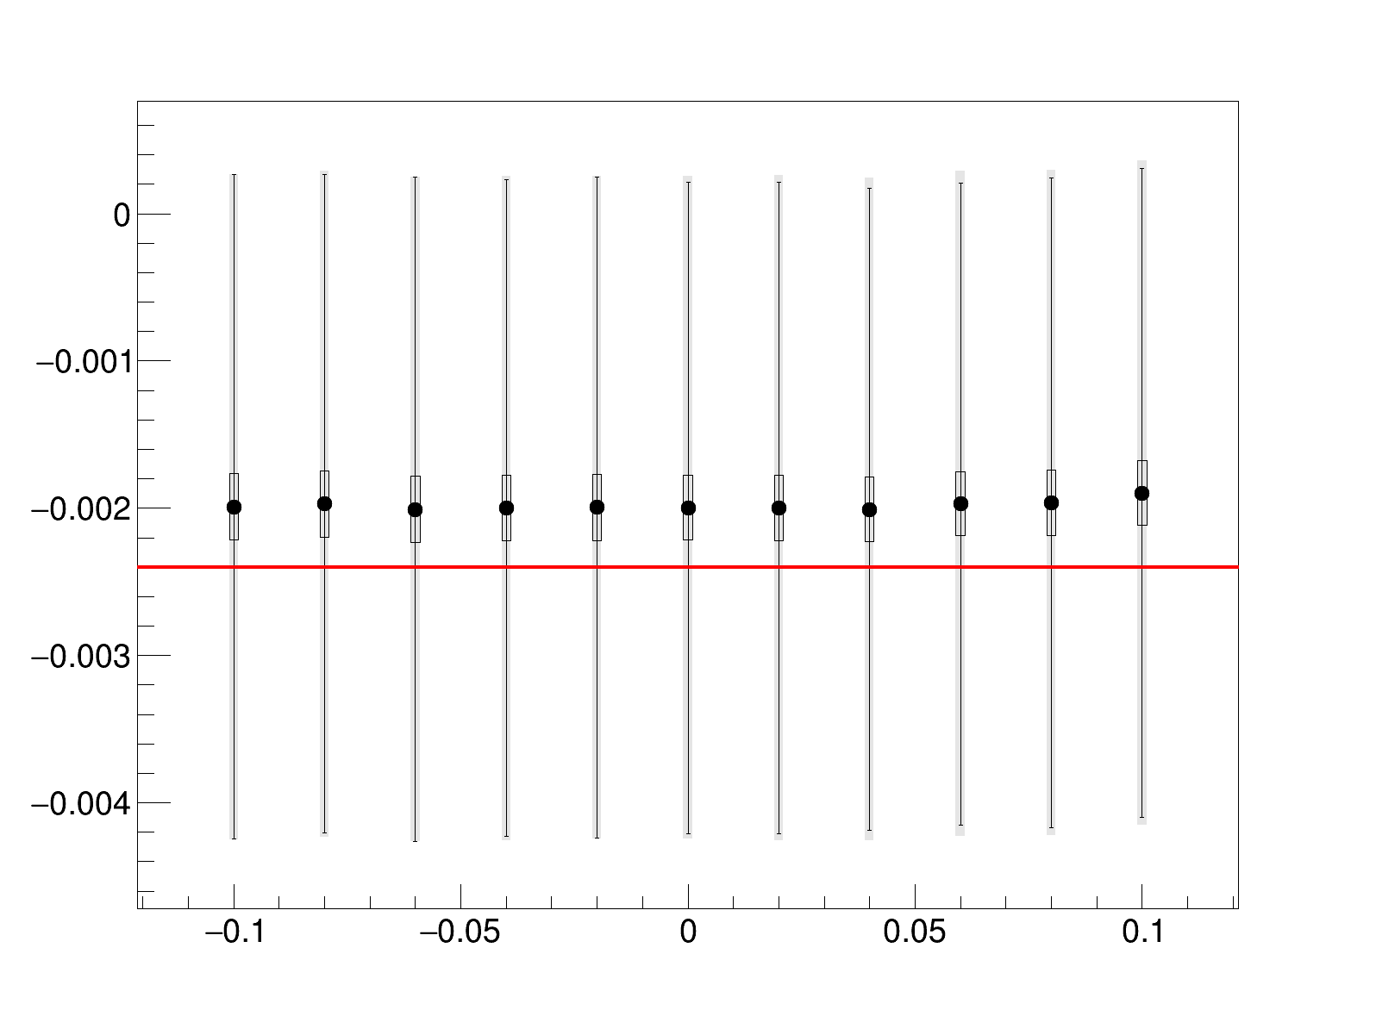
Extracted X1

Slide 13
Real detector pixel configuration
Study of dead zones effect on extracting fit parameters
Rebinning on x axis by 16
Rebinning on y axis by 3
Rebinning on x axis by 16
Rebinning on y axis by 3
320 pixels
320 pixels
320 pixels
320 pixels
80 nYpix
dead zone 34 pixels
dead zone 34 pixels
80 nYpix
1320 nXpix with
60 dead zones
1320 nXpix

