Slide 1
Modification of Interlocks for RQ4 Circuits at P1 and P5
Machine Protection Panel Meeting #257
Alain Antoine (TE-MPE-MI)
21 February 2025

Slide 2
Background
LMC Taskforce initiative
  The LMC mandated a taskforce to assess the impact of radiation on equipment lifetime in the LHC inner triplet regions and propose mitigation measures [CDS 2882512].
Identified Solution
  To reduce radiation exposure on the inner triplet main quadrupole magnets in IR1 (ATLAS) and IR5 (CMS), the taskforce proposed operating with reversed electrical polarities of the RQX circuits.

Slide 3
Implementation & Required Actions
Implementation & Consequences
  The reversed polarity were first implemented in IR1 (ATLAS) in 2024.
  This required switching off the RQ4 circuits in IR1 to align with the new optics configuration.
  However, this led to a significant increase in background radiation in the forward experiments at P1, negatively affecting physics production.
  A review concluded that the best approach is to reverse the RQX polarity in P5 while restoring the original configuration in P1 [497th LMC].
Required Actions
  Switching off the RQ4 circuits in IP5.
  Restoring the RQ4 circuits in IP1 to their original configuration.

Slide 4
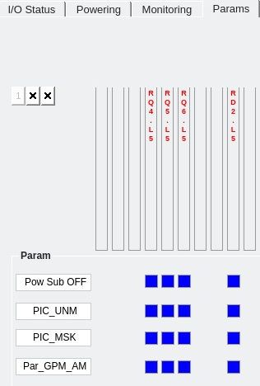
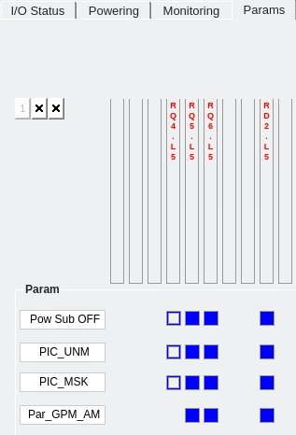
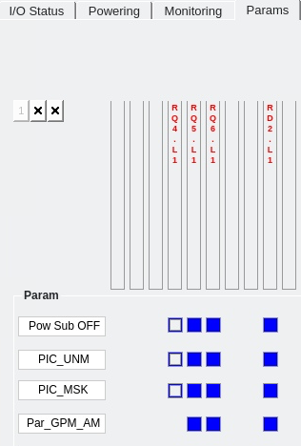
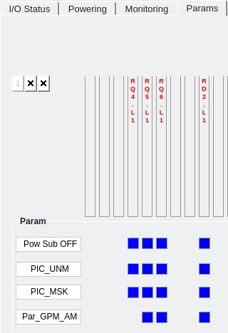
Technical Modifications
RQ4s
Point 5 (IP5)
  Removal of RQ4.L5 and RQ4.R5 circuits from interlock.
    Modification of CPLD firmware and PLC software.
    Disabling BIS and GPM inputs.
    Disable QPS_OK signals, bypass SIS logic, and deactivate HDS interlock in WinCC synoptic.
  Super-locking of circuits (locking out power converters and quench heaters).
Point 1 (IP1)
  Restoration of RQ4.L1 and RQ4.R1 circuits into interlock:
    Modification of CPLD firmware and PLC software.
    Reactivation of BIS and GPM functionalities.
    Reinstate QPS_OK signals, restore SIS logic, and re-enable HDS interlock in WinCC synoptic.
  Removing super-lock and unlocking power converters and quench heaters.
IP5
Removal
GPM
BIS
IP1
Rollback

Slide 5
Validation and Tests
Tests to be performed after modification:
  PIC2 - Interlock tests.
  PIC-BIC - Interlock connections between PIC and BIS.
Revalidation of affected circuits:
  Point 1: RD2.L1, RQ4.L1, RQ5.L1, RQ6.L1.
  Point 5: RD2.L5, RQ4.L5, RQ5.L5, RQ6.L5.

Slide 6
Conclusion and Next Steps
Before HWC 2025:
  Deployment of PLC and CPLD software modifications.
  Modification of high-level software: adjust QPS_OK signals, Software Interlock System (SIS) logic and HDS interlock in the WinCC synoptic application.
  Preparation of tests (AccTesting).
During HWC 2025:
  Verification of interlock operation (PIC2 tests).
  Super-locking of RQ4 circuits at P5 following the completion of powering tests for the LL5 and LR5 matching sections.
Rollback possibility: All modifications are fully reversible if necessary.

