Slide 1
Timepix3 Radiation Monitor installation at LHC IP2 DS
Daniel Prelipcean, Giuseppe Lerner
2025.02.12

Slide 2
Introduction
Objective: keep a previously deployed Timepix3 Radiation Monitor setup [1, 2, 3].
When:
  Deployed during 2024 Technical Stop 2 (TS2) - Oct 22nd (Tuesday)
  To be kept until 2025 EYETS
Where:
  LHC IP2 DS - Half-cell 12
  below the beamline
[1] Daniel Prelipcean, Arc Octant 2 - TimePix - TS2
in Reunion ICL Machines Complexe PS & LHC, 2024 Aug 21st, https://indico.cern.ch/event/1446324/#223-arc-octant-2-timepix-ts2
Reunion ICL Machine LHC, 2024 Oct 16th, https://indico.cern.ch/event/1467486/#211-timepix-arc-2-3
[2] Daniel Prelipcean, Towards a Timepix3 Radiation Monitor for the Accelerator Mixed Radiation Field: Characterisation with Protons and Alphas from 0.6 MeV to 5.6 MeV,
in Applied Sciences. 2024; 14(2):624. https://doi.org/10.3390/app14020624
[3] Benedikt Bergmann et al, Radiation field characterization with the MoEDAL Timepix network, https://www.petrmanek.cz/talks/2018_12_moedal_meeting.pdf

Slide 3
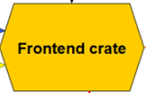
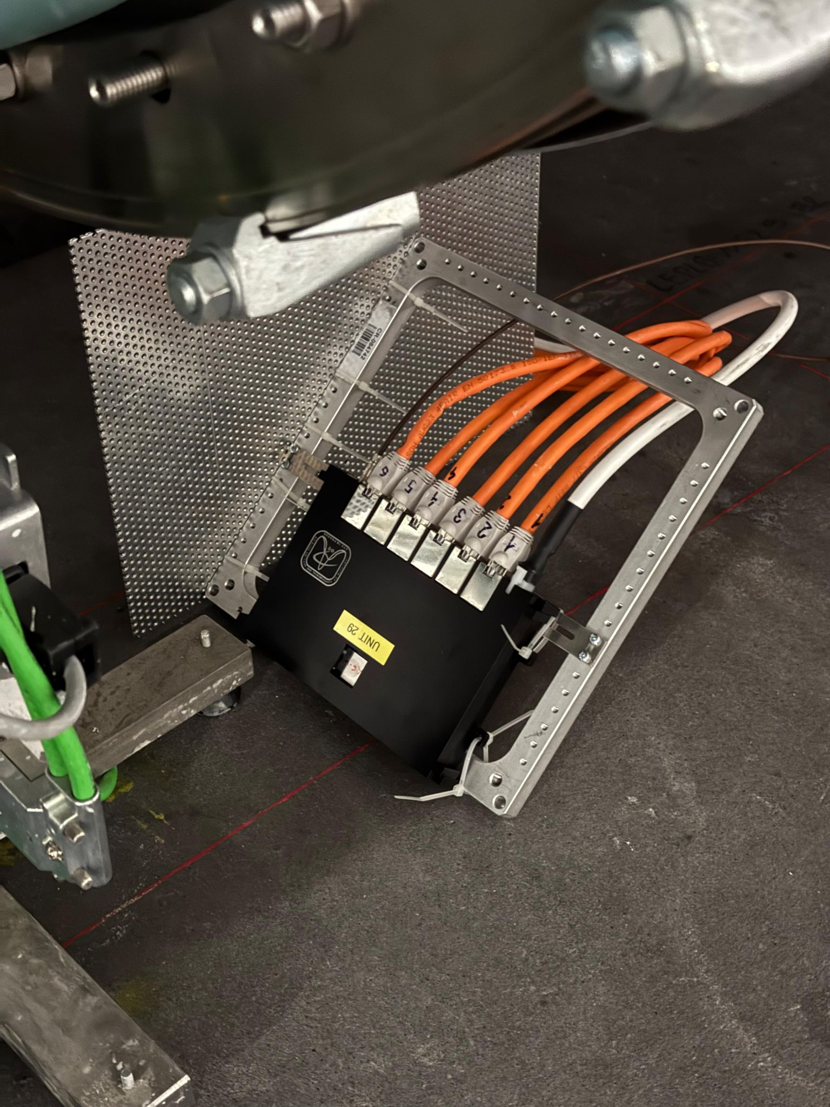
Timepix3 setup at IP2 - Configuration 4
Standard Electric Power Socket
~30 m
Radiation Tolerant
Power supply
OF: 30 m
LC to E2000
OF: 30 m
E2000
20 m, Ethernet
20 m, Ethernet
4 m, Ethernet
BYPM.12R2
BYPLM.12R2
422 (unit29)
440 (L6-W0067)
460
461
487
dIP2 [m]

Slide 4
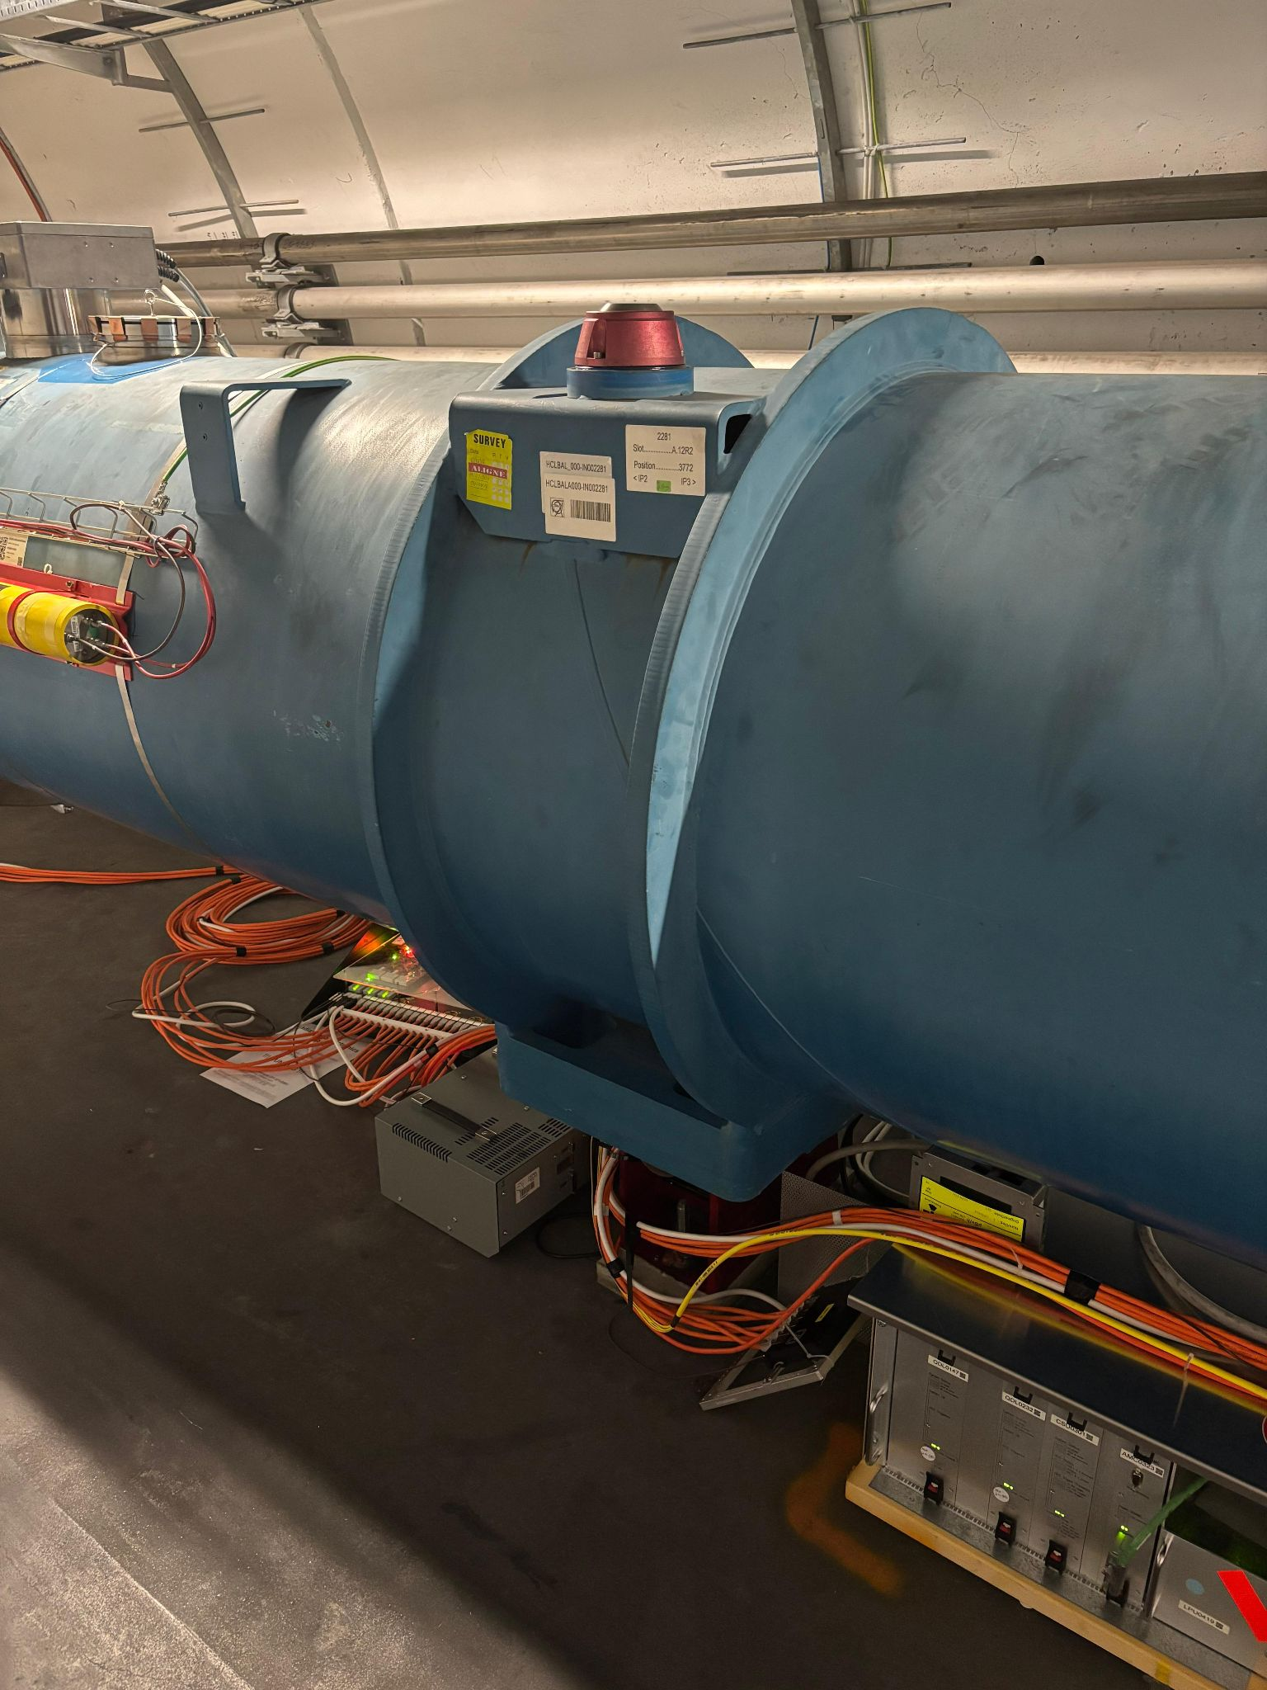
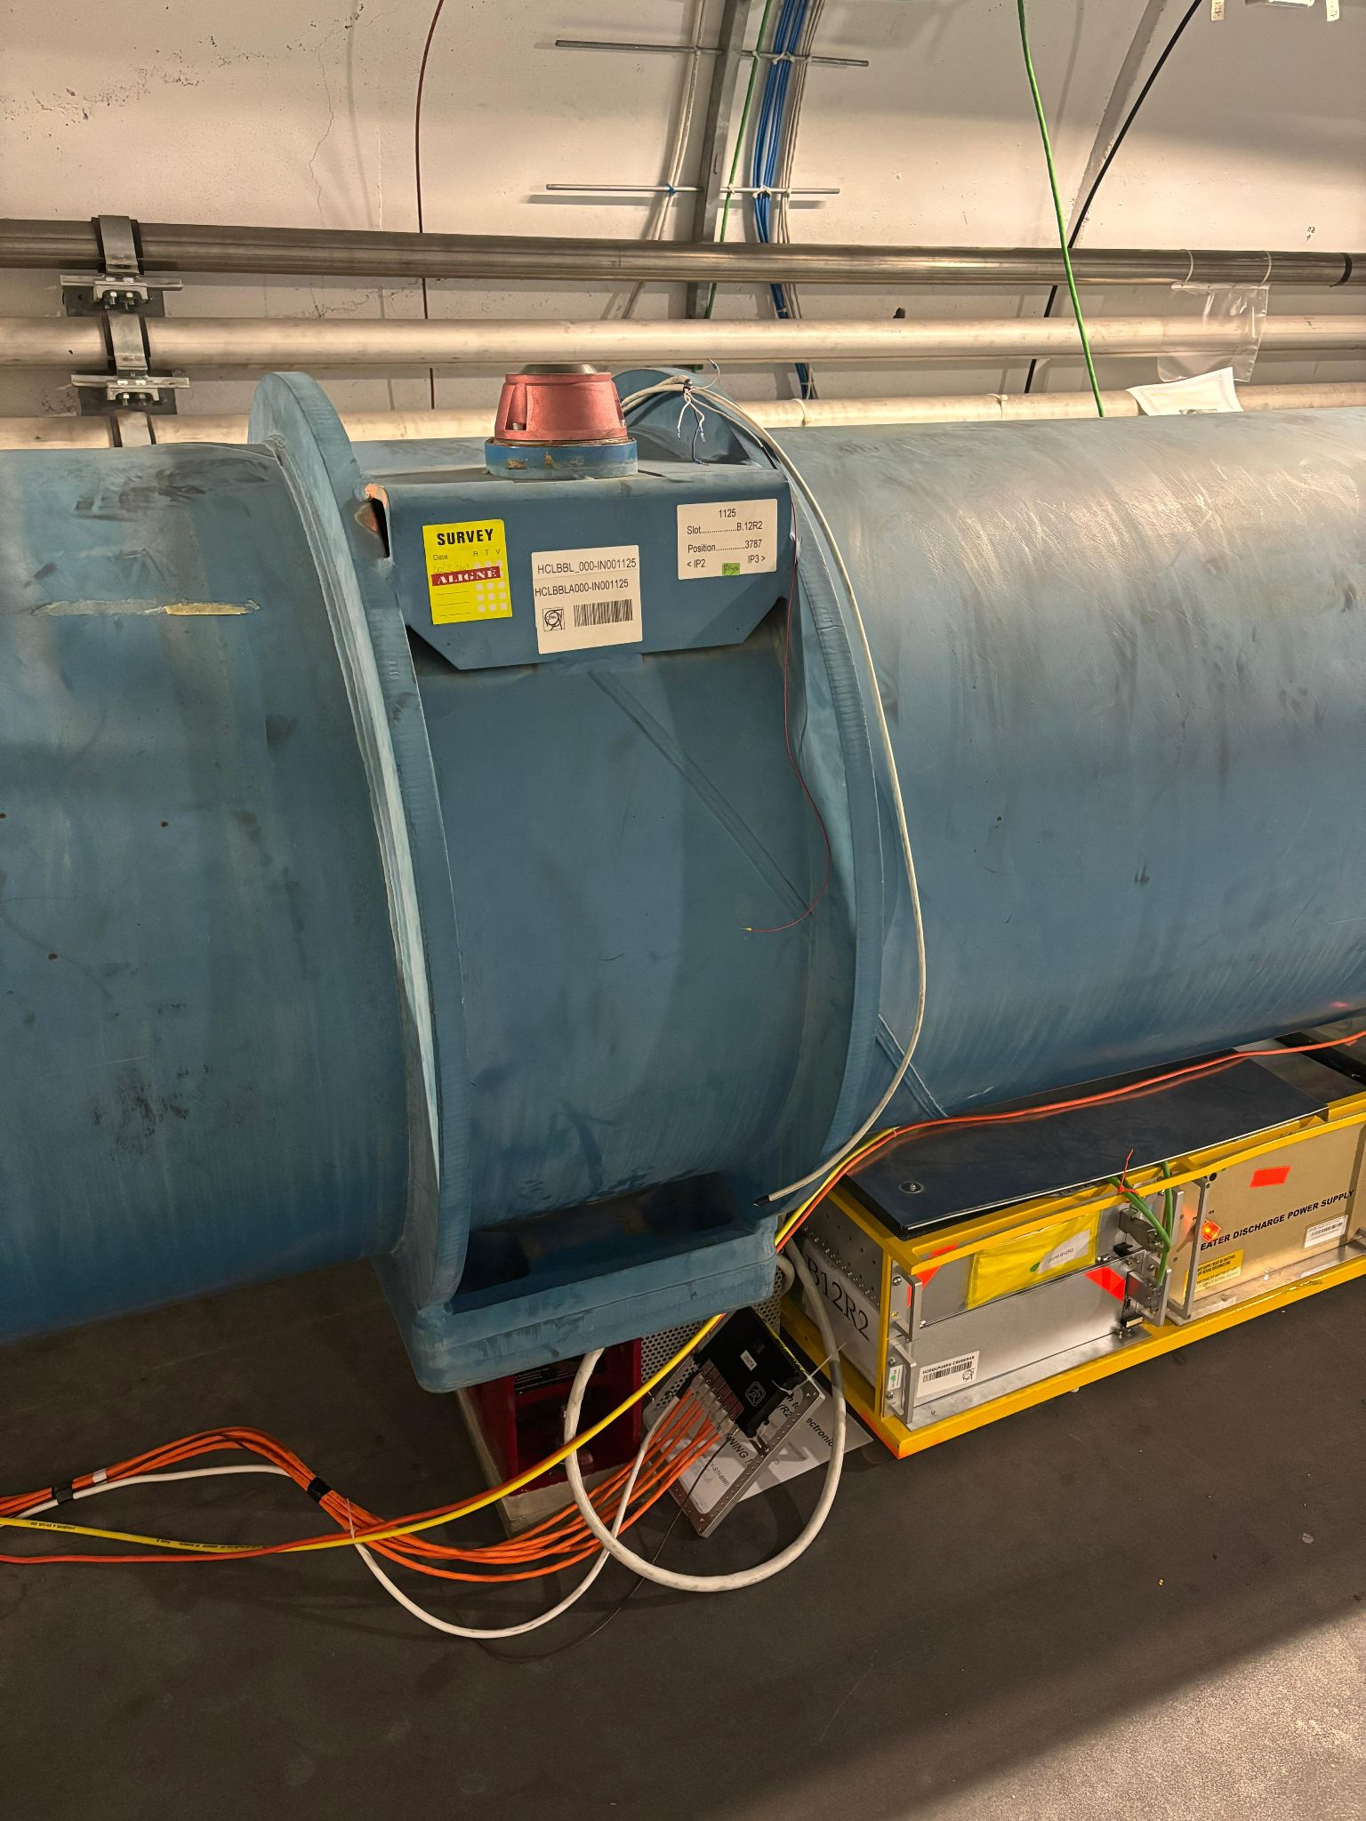
RadMon unit
Front-end crate
Power supply
Timepix3 detector
QPS rack
dIP2 [m]

Slide 5
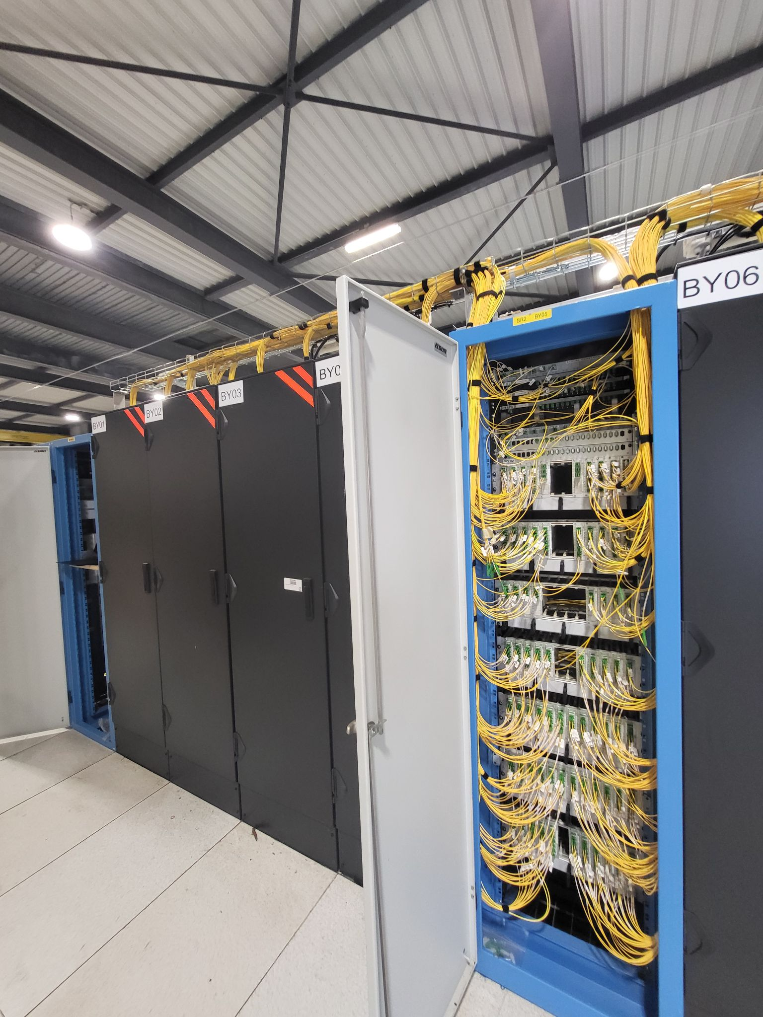
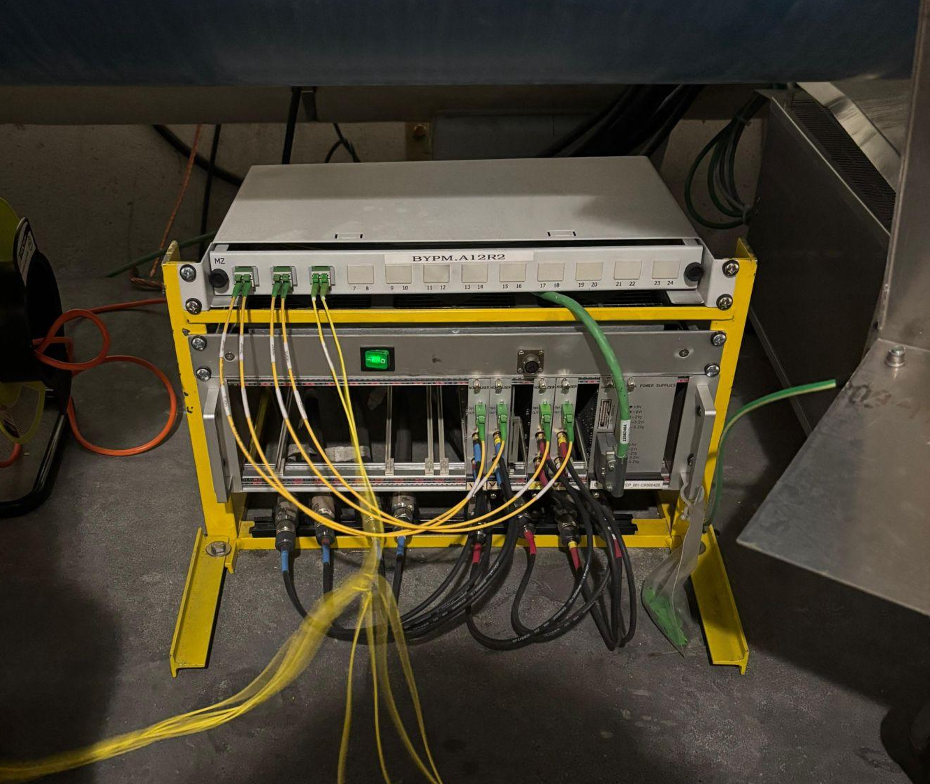
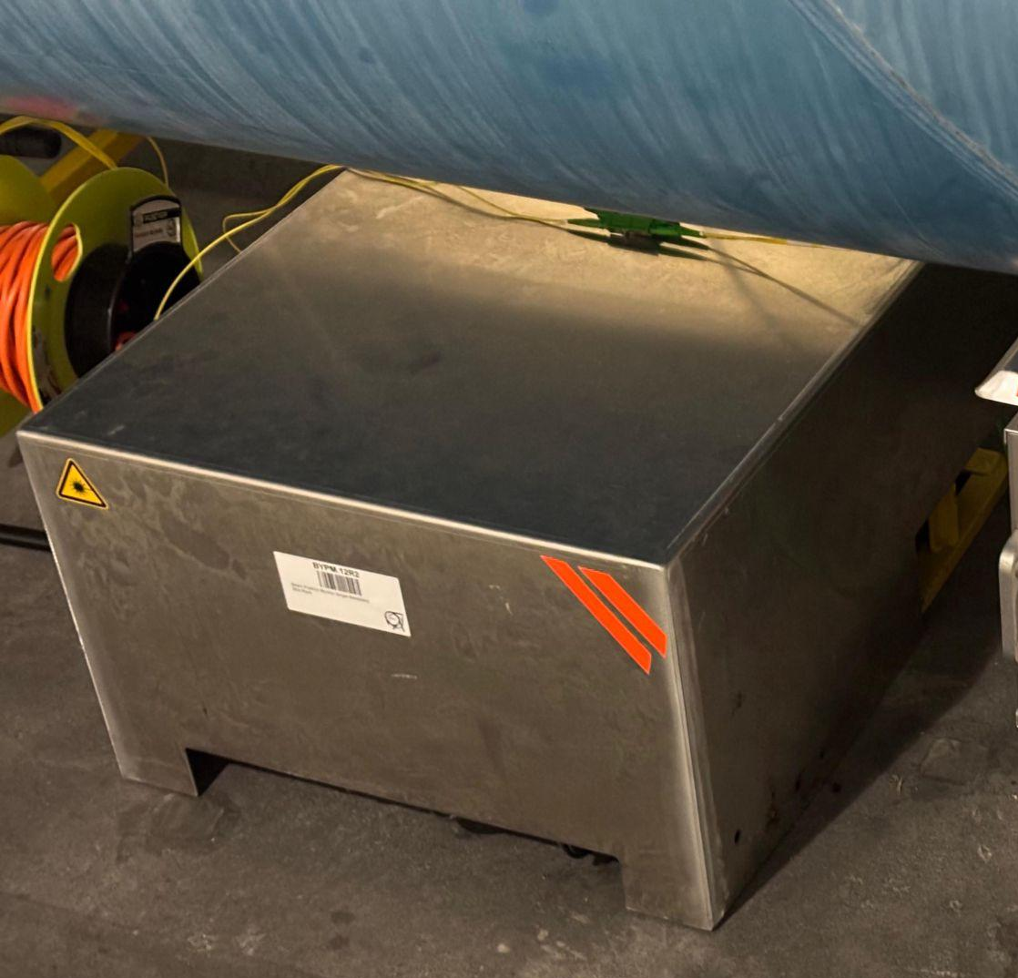
Timepix3 setup at IP2 - BI connections
The output of the BI racks are on the surface in SR2 building.
BYPM rack
(uncovered)
same BYPM rack
(covered)
Backend + control computer
BYPM.12R2 and BYPLM.12R2 outputs

Slide 7
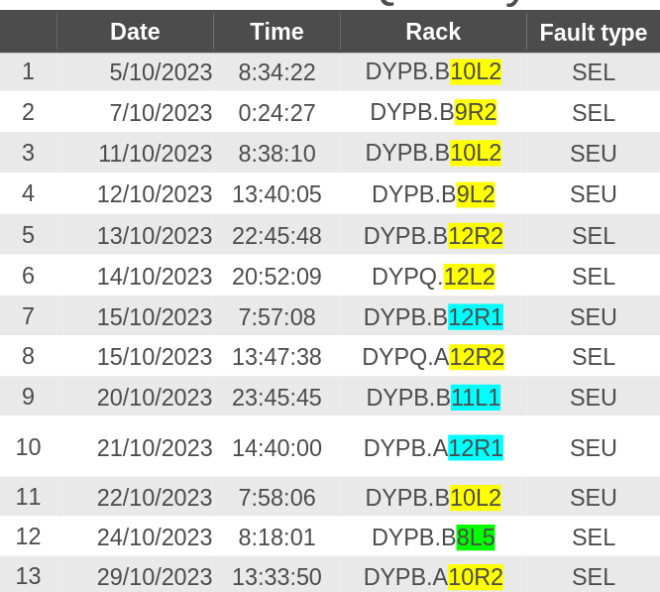
Introduction
Motivation: Ion operation in 2023 lead to 13 Quench Protection System (QPS) failures [1], out of which 9 events were in cells 9-11-12 Left/Right of IP2 (ALICE).
Objective:
  Monitor the radiation levels during ion operation at IP2, at the location of the QPS.
  Deploy a radiation monitor capable to characterise the radiation field: the Timepix3 Radiation Monitor [2].
When: Technical Stop 2 (TS2) - Oct 21st to 23rd:
before LHC ion operation.
[1] Daniel Paul Soderstrom, LHC Radiation level measurements during the 2023 Pb ion run and R2E dumps from QPS, in 57th MCWG meeting: https://indico.cern.ch/event/1350736/
[2] Daniel Prelipcean, Towards a Timepix3 Radiation Monitor for the Accelerator Mixed Radiation Field: Characterisation with Protons and Alphas from 0.6 MeV to 5.6 MeV, in Applied Sciences. 2024; 14(2):624. https://doi.org/10.3390/app14020624

Slide 8
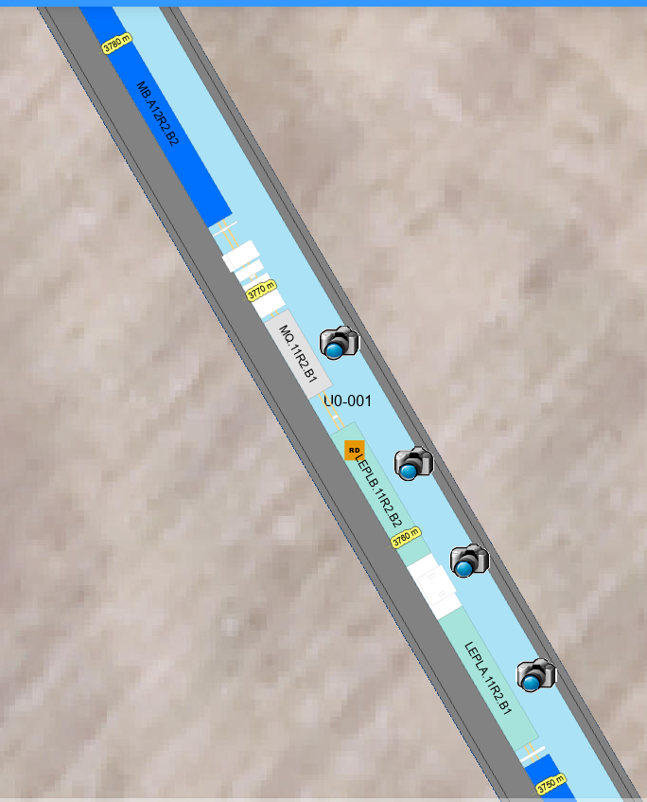
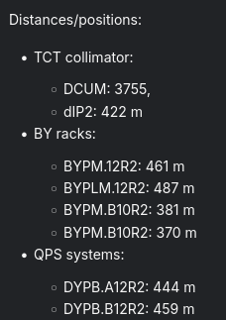
Timepix3 setup at IP2
- Configuration 4

Slide 9
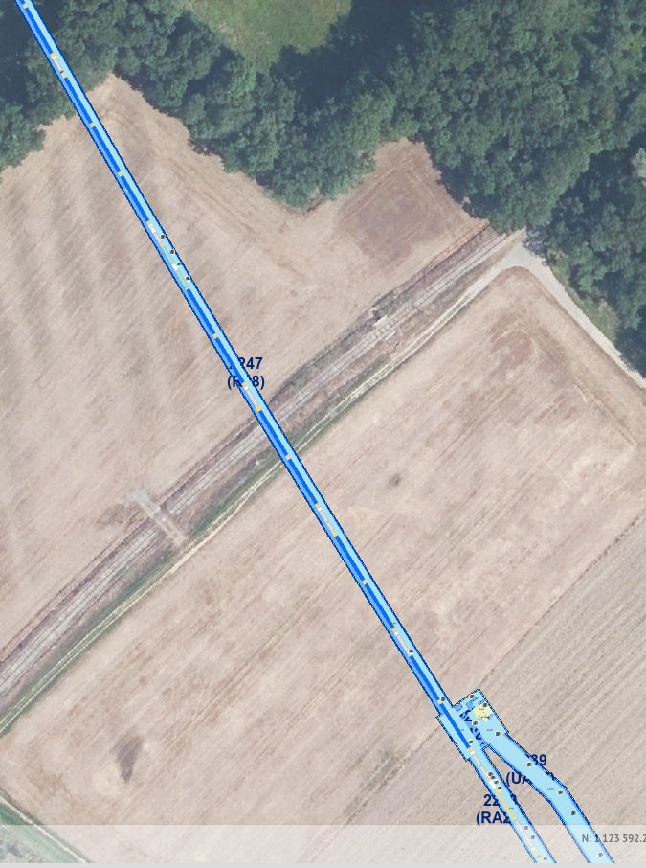
Radiation Monitor setup locations
1
Detector and front-end unit below beamline.
Back-end unit in shielded area (e.g. UA).
Connection between front- and back-end (about 160 m from 1 to 2):
  8 Optical Fibre (OF) connections for data transmission.
  1 BNC cable for powering the Front-End crate.
Currently, we are investigating solutions to avoid 3:
i. Connect the 8 OFs to an available BI crate in the tunnel.
ii. Use a radiation tolerant power supply to be deployed in the tunnel next to the front end (and using a standard wall plug connection).
3
2

Slide 10
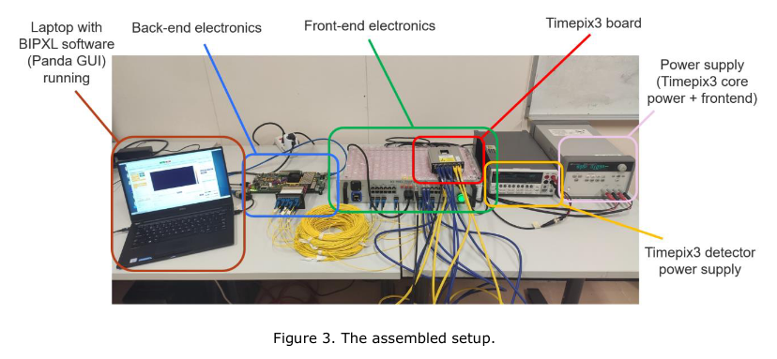
TimePix3 BLM
TimePix3 board/detector module to be
placed in the radiation field.
6 ethernet cables (data communication)
and 2 BNC cables (power supply) that can
be arbitrarily long.
Front-end electronics (radiation resistant) and 2 SMUs to be placed as far away as needed.
8 optical fibre connections of several meters between Front-end and Back-end.
Back-end not radiation resistant, to be placed as far away as needed.
Host PC/Laptop, to be placed in an area that could ideally be human accessible.

Slide 11
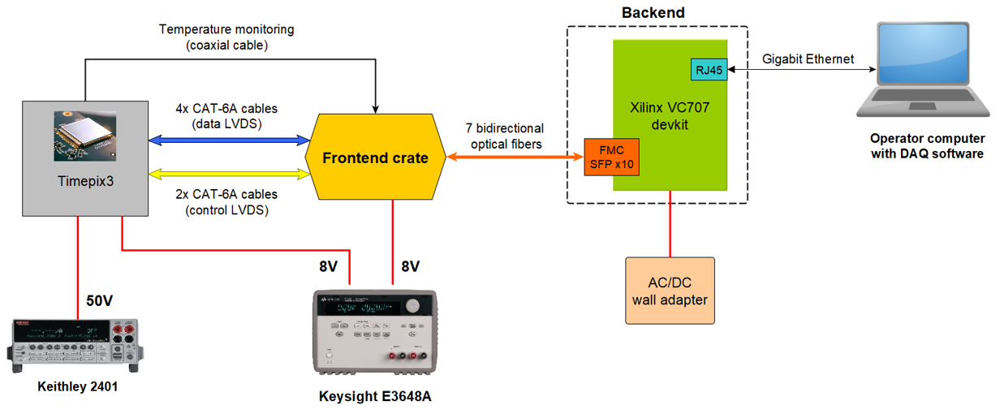
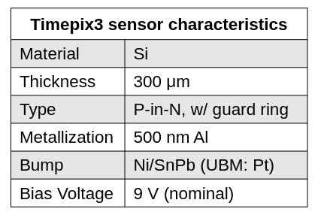
BGI Pixel setup: block diagram
Setup developed by CERN SY/BI group
02/03/2022
‹#›

Slide 12
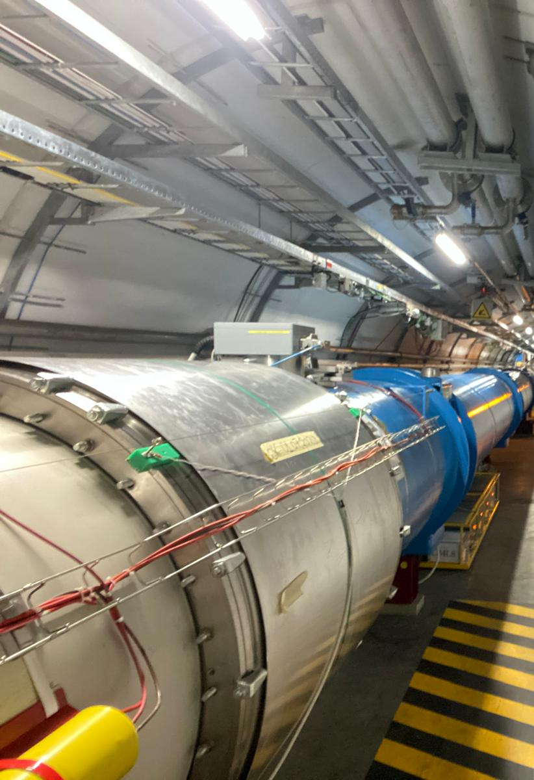
Desired location
Timepix3 module and Front-end crate to be placed below the beamline, on top or next to the QPS systems.
Ideally in 12R2 or 12L2, but half-cells 10 or 11 also doable.
Exact cell and side wrt. IP2 to be decided based on constraints.
Back-end crate and Host PC in a shielded area.

