Slide 1

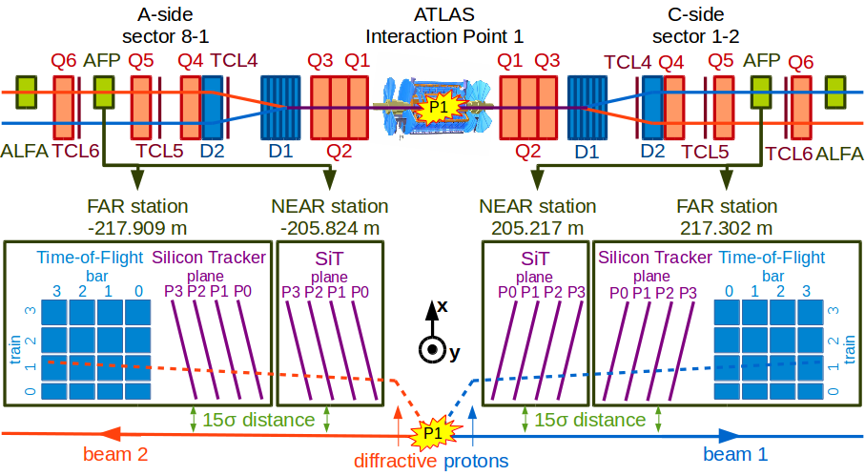
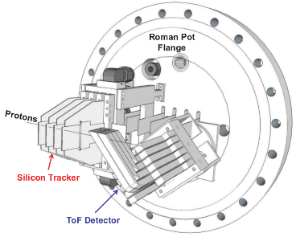
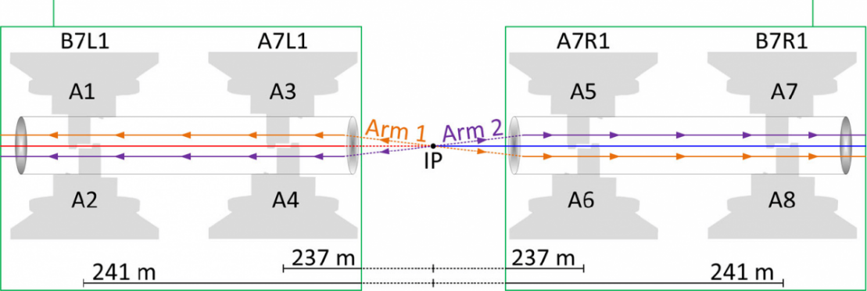
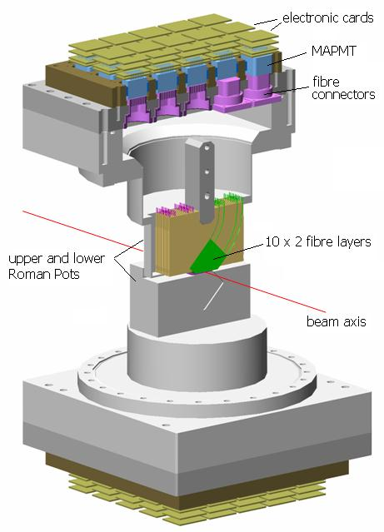
New AFP PP shielding wall
Reunion ICL Machines LHC & SPS
Maciej Trzebinski,
Marko Milovanovic
12.02.2025.

Slide 2
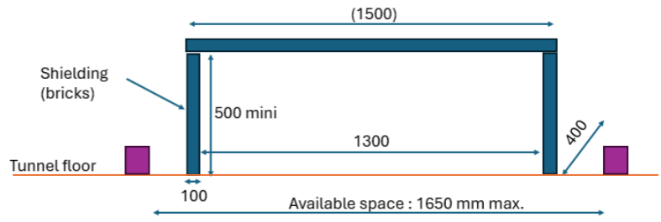
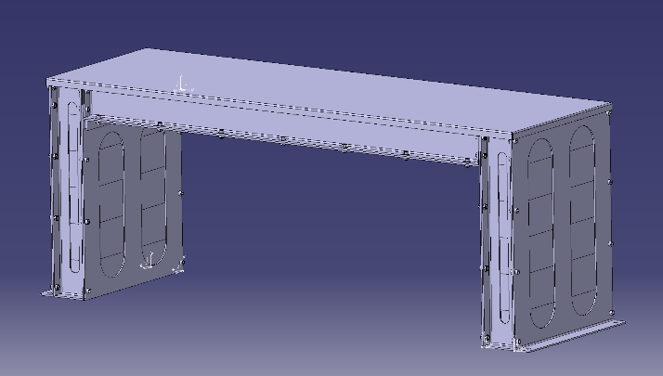
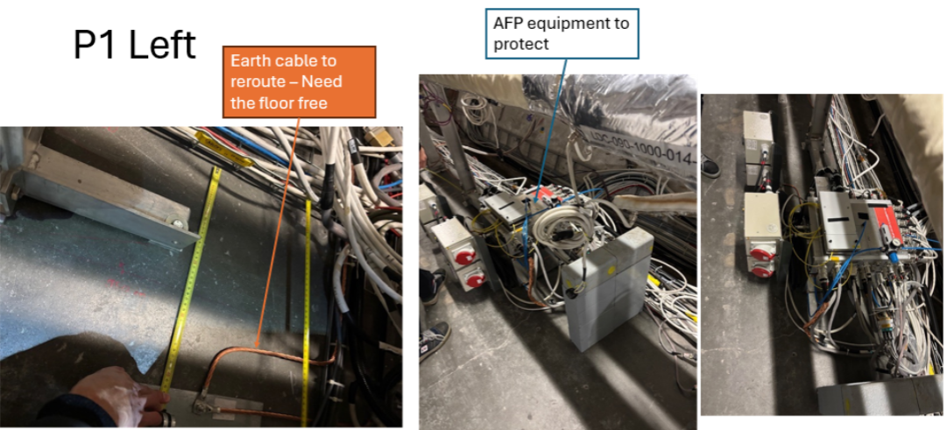
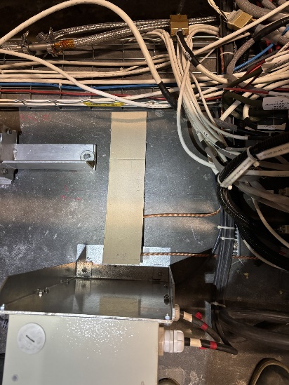
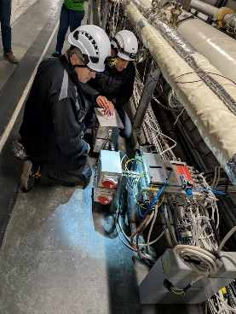
New AFP PP shielding update
Inspection visit(s) last week with JPC, ML et.al. to measure the available space for the new AFP PP shielding:
  Purpose: shield the PP equipment with min.100 mm (200 preferred) of steel
  Shielding material: steel bricks of 200 x 100 x 100 mm (provided by Cern)
  Task: make a light chassis (Al) to support the bricks on top and hold the bricks on each side. It should be transportable and installed by hand in the tunnel (to avoid using transport team services and make it faster)
  Mechanical calculation: done by MM; shielding dimensions provided.
  Constrain: need to re-route the grounding for the el.socket box in LSS1R (Sector 1-2), or move the whole box. EN-EL (Patrick VP) to check today if this can be quickly done by him (~2h) or it has to be outsourced.
  Next step (suggestion): initiate FLUKA simulations asap
Shielding should be completed/installed before 14.03!
Should be 200 mm!

Slide 3
Backup
Backup slides.

Slide 4
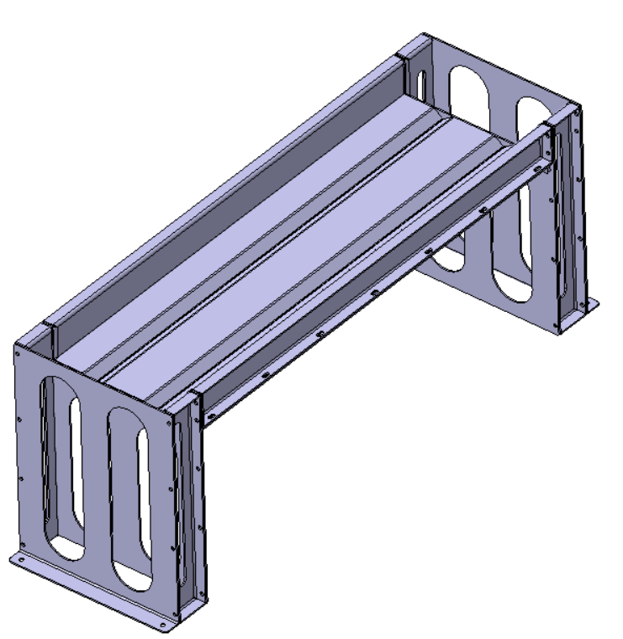
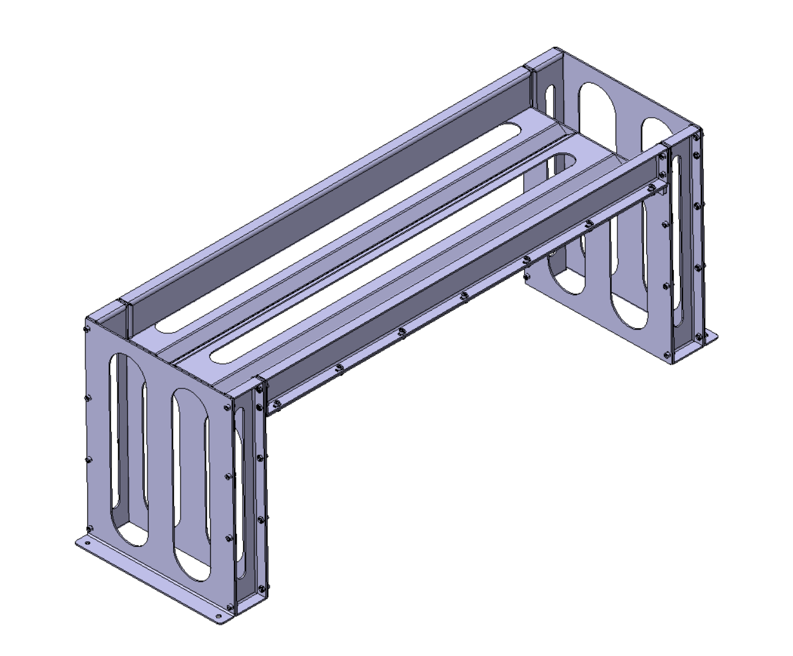
Modification of first 3D proposal
Initial proposal
Modified proposal
Modified plate for bricks

Slide 5
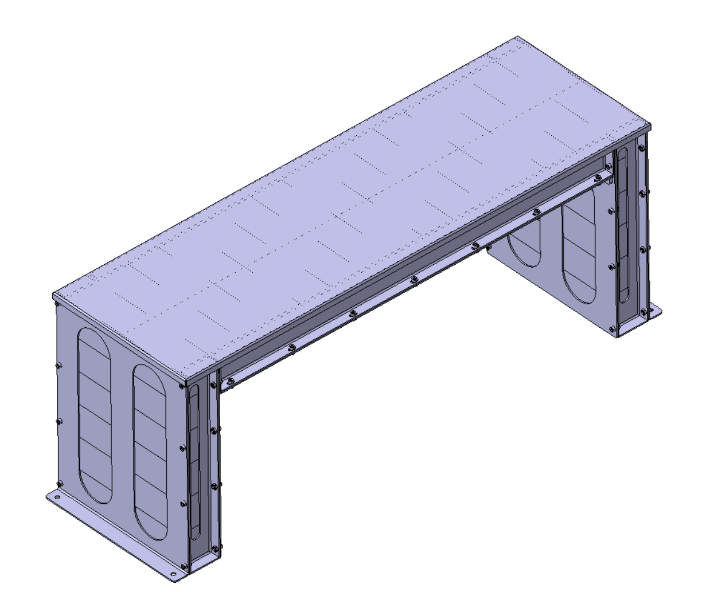
Modified proposal
Frame cover
Bricks 10x10x20 cm

Slide 6
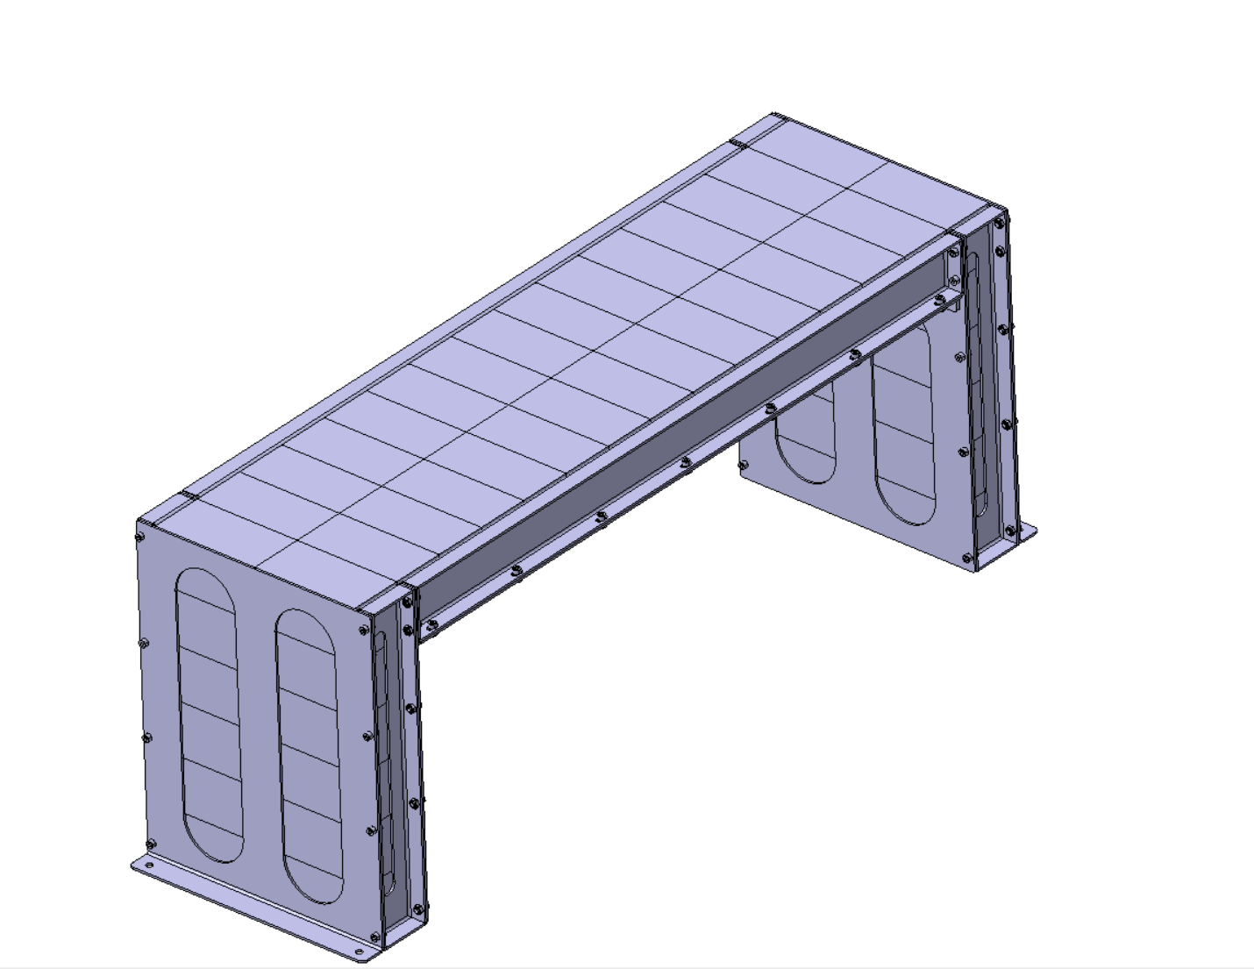
Shielding blocks
2 blocks
13 blocks
2 * 13 = 26 blocks
1 block = 16kg

Slide 7
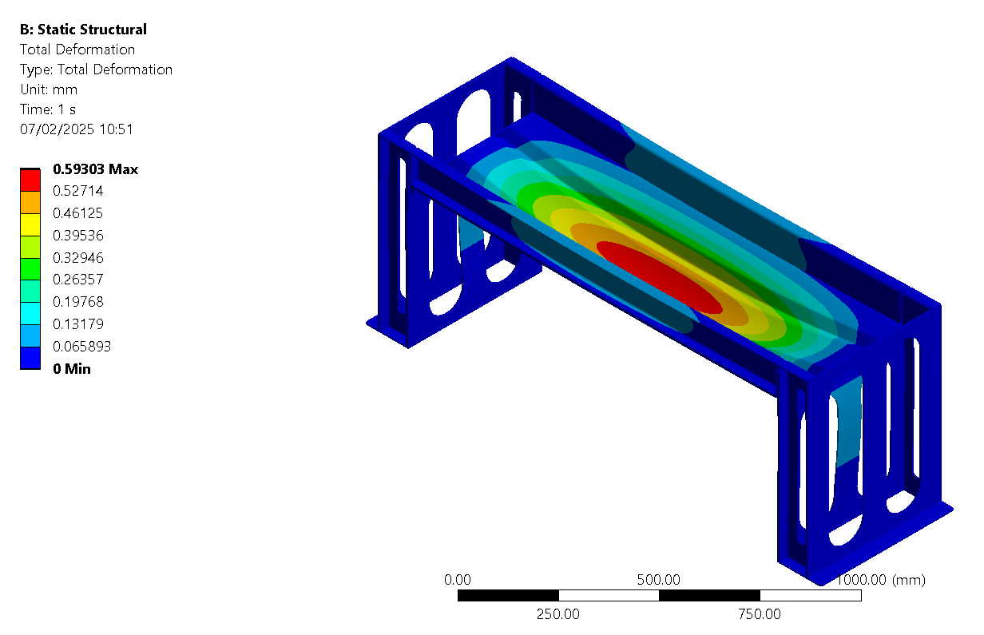
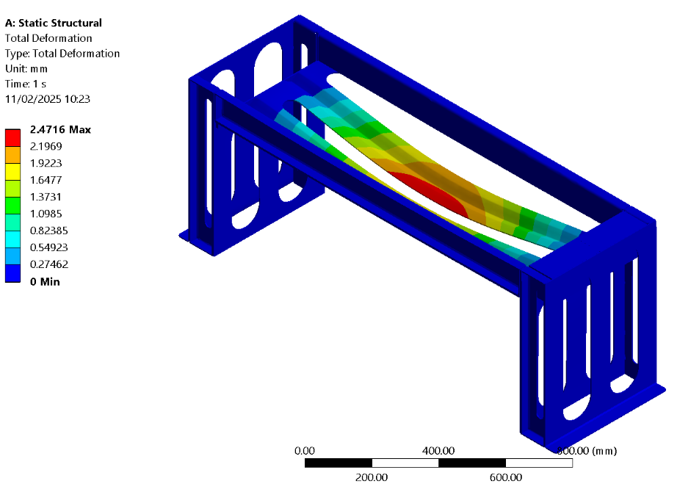
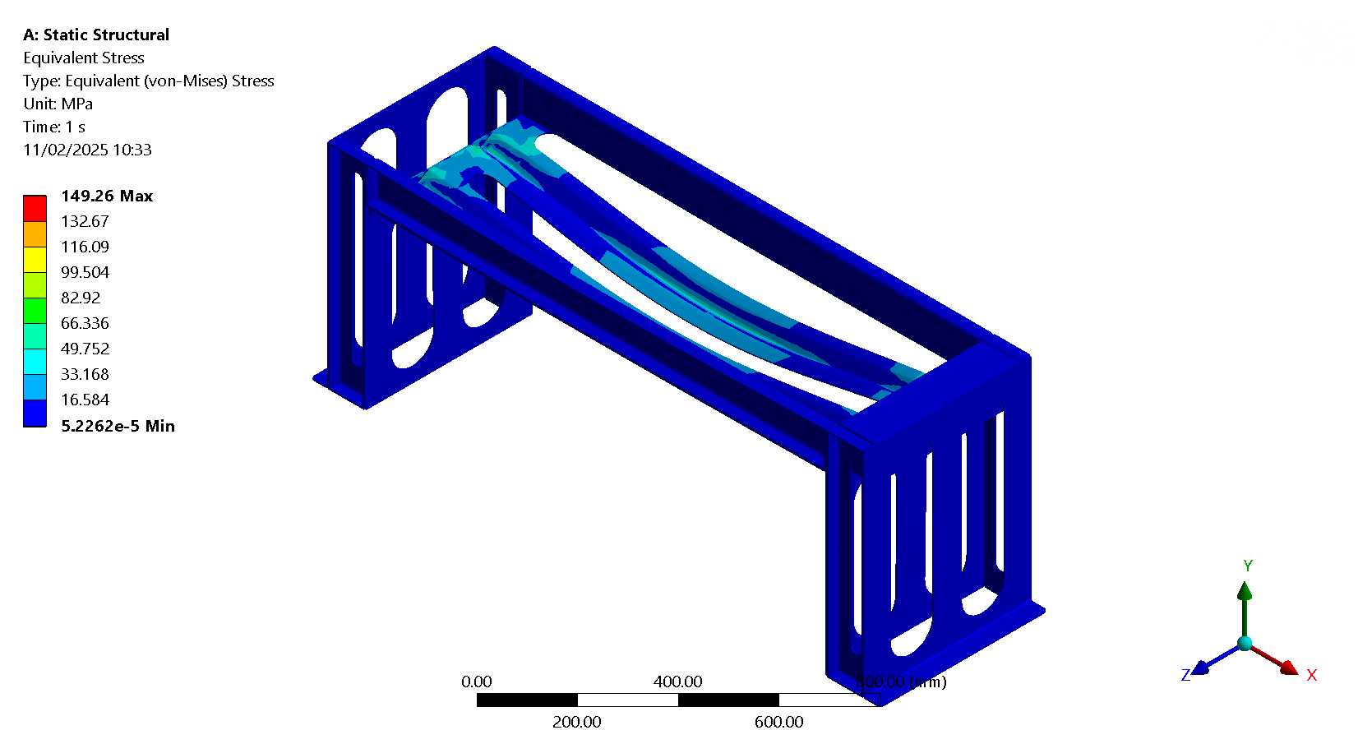
Total Deformation – load : 26 blocks * 16kg = 416kg
Initial proposal
Modified proposal
Material: S235 Structural steel

Slide 8
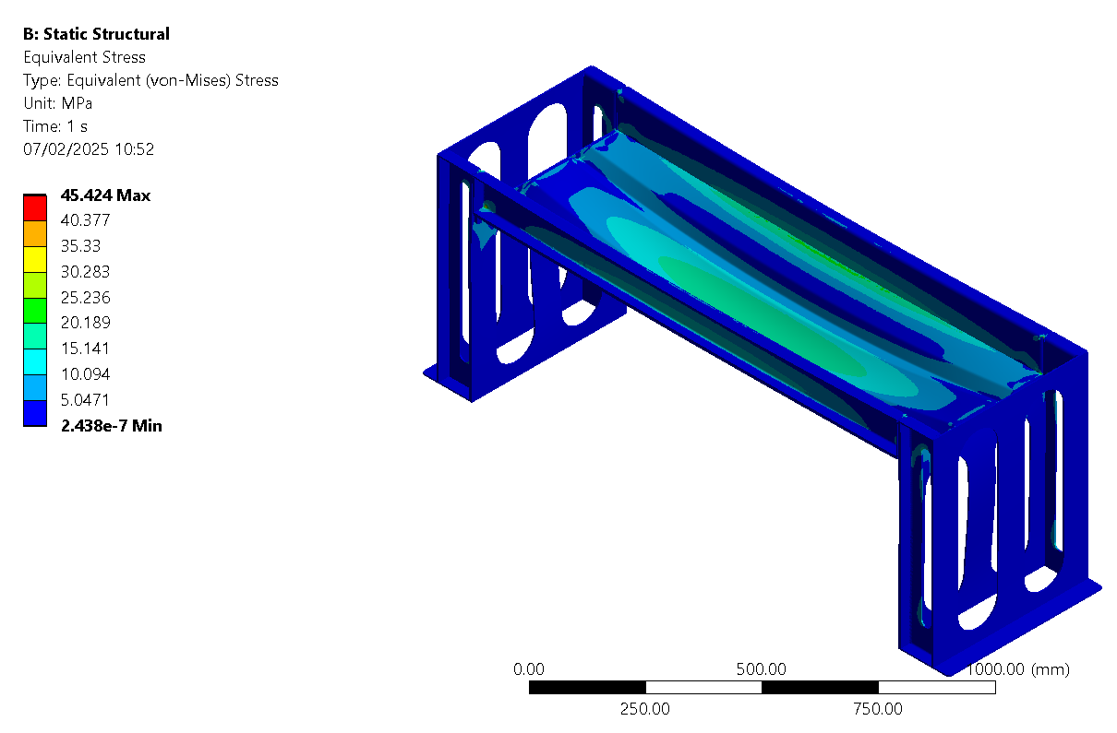
Equivalent Stress – load : 26 blocks * 16kg = 416kg
Initial proposal
Modified proposal
Material: S235 Structural steel

Slide 9


Total Deformation – load : 52 blocks * 16kg = 832kg
Initial proposal
Modified proposal
Material: S235 Structural steel

Slide 10
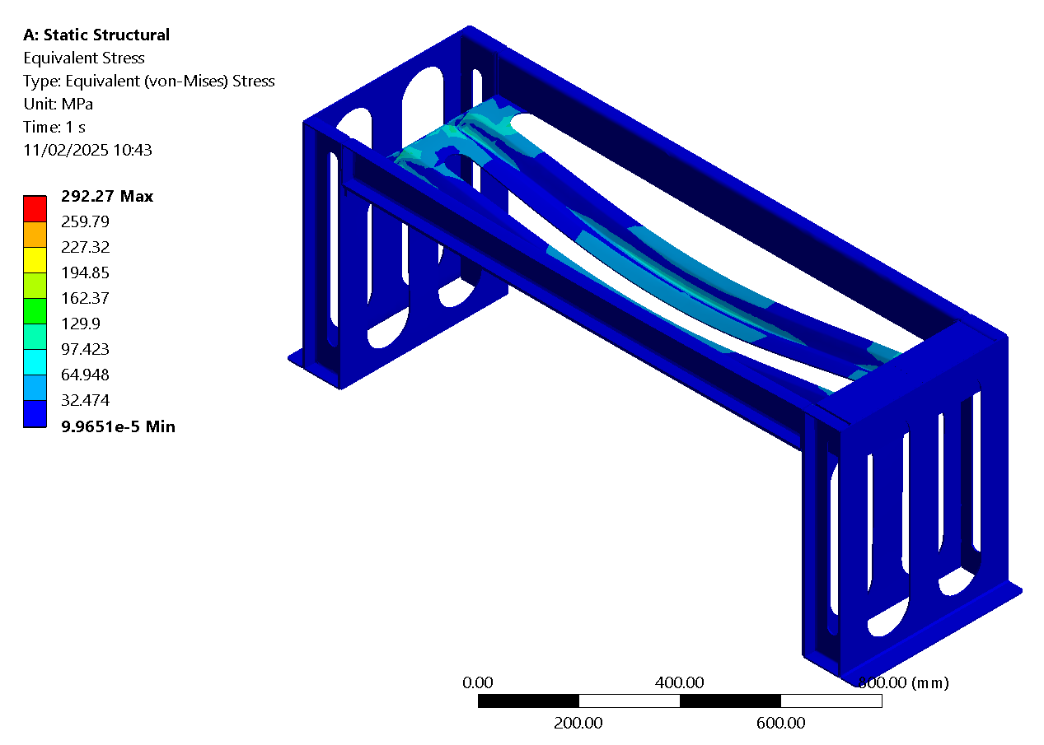

Equivalent Stress – load : 52 blocks * 16kg = 832kg
Initial proposal
Modified proposal
Material: S235 Structural steel

Slide 11

Results:
 | Initial proposal |  | Modified proposal
Weight | 416kg | 832kg | 416kg | 832kg
Max Equivalent Stress [MPa] | 149.26 | 292.27 | 45.424 | 86.32
Max Total Deformation [mm] | 2.4716 | 4.8515 | 0.59303 | 1.1467
Material: S235 Structural steel

