Slide 1
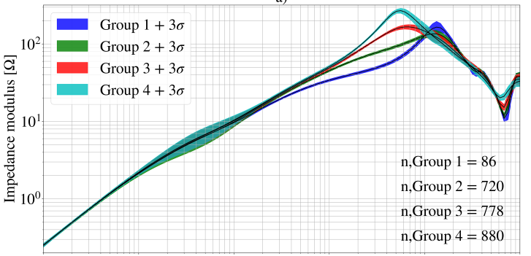
FTF at a.9K of 1232 MB magnets in the LHC
1
10
100
1000
10k
100k
Measurements by ELQA and M. Janitschke, TE-MPE-PE
A. Verweij, WP2 meeting, 13 Feb 2025

Slide 2
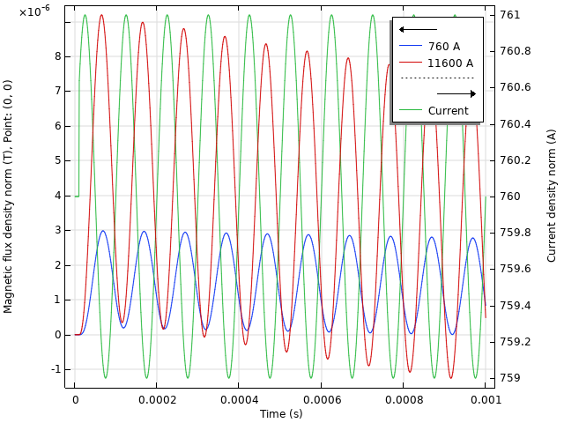
DC transfer function MB:
1A=7e-4 T
Simulations by M. Janitschke, TE-MPE-PE
A. Verweij, WP2 meeting, 13 Feb 2025

