Slide 1
Observations of high frequency noise in turn-by-turn spectra of LHC beams
BE-ABP, SY-EPC, EN-EL and many more..
234th WP2, 13/02/2025

Slide 2
Overview
Observations from the LHC:
  Power supply ripple in transverse beam spectrum
  Source of emittance growth with unknown origin both at injection and top energy
Tests with main dipole power supply active filters
Impact of transverse damper
Measurements of UPS noise & tests with beam
Impact on beam performance

Slide 3
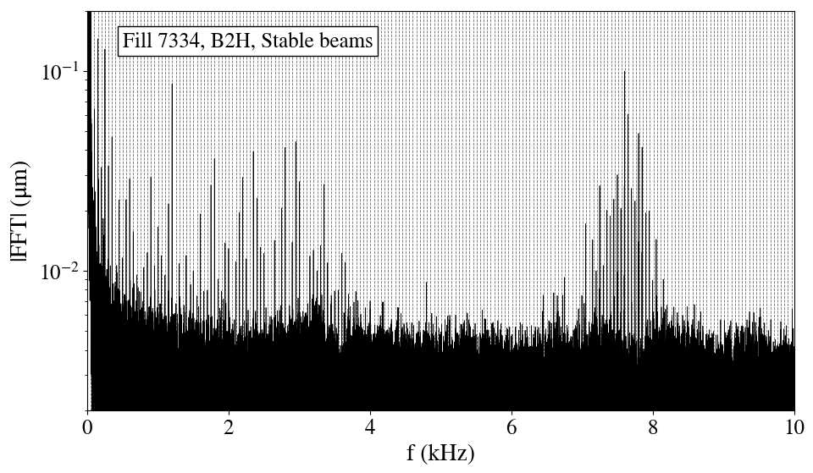
LHC observations: Power supply ripple
50Hz power supply ripple systematically observed in the transverse LHC spectrum in both beams and planes (mainly in H-plane).
Several studies confirm that it is a real beam excitation in the form of dipolar perturbations.
Very high frequencies also present (~8 kHz while ~11 kHz LHC revolution frequency)
50 Hz harmonics
50 Hz harmonics
Spectrum from bunch-by-bunch and turn-by turn position measurements
“Low frequency cluster”
“High frequency cluster”

Slide 4
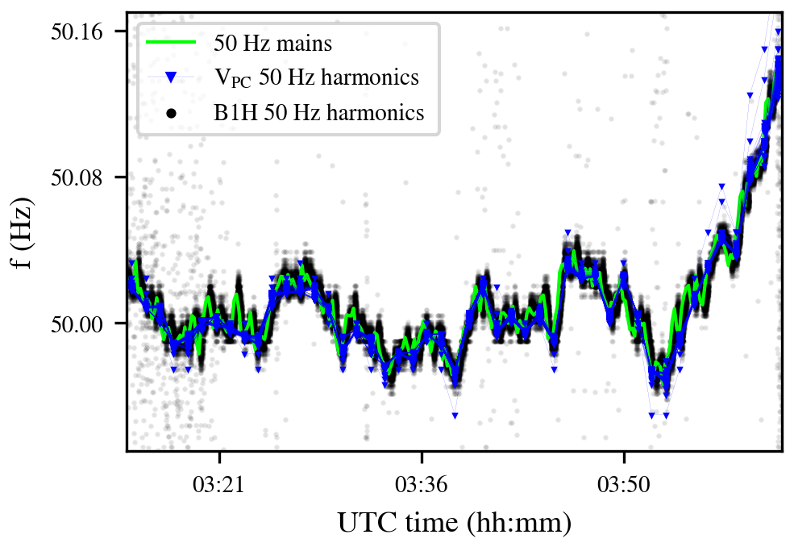
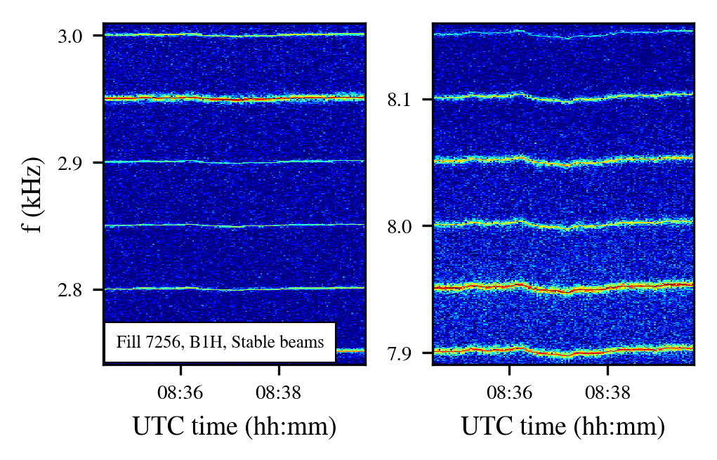
LHC observations: Power supply ripple
Low-frequency cluster & High-frequency cluster:
Multiple 50 Hz harmonics.
Similar frequency modulation from the mains, with f-modulation amplitude proportional to the order of harmonic.
“Low frequency cluster”
“High frequency cluster”
50 Hz in the beam, normalized
50 Hz mains

Slide 5
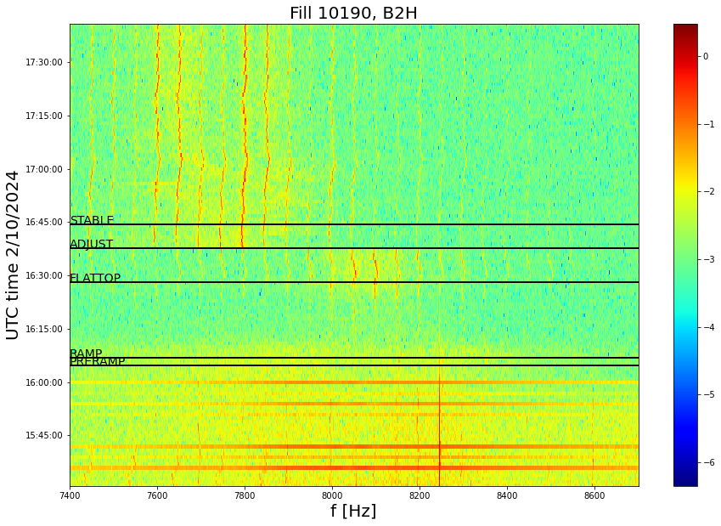
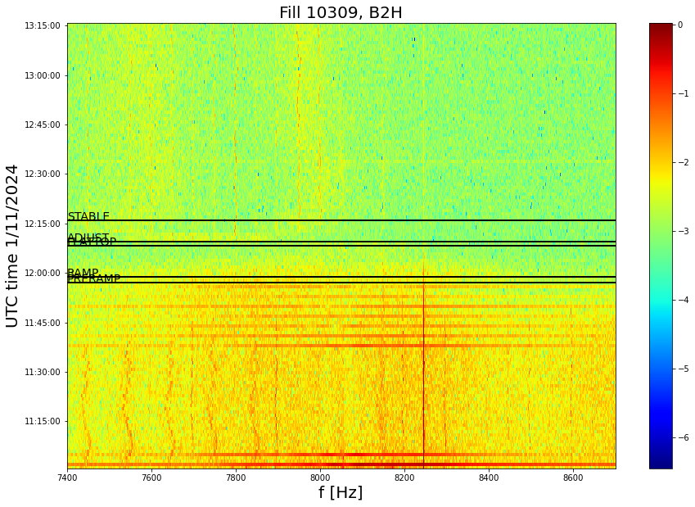
LHC observations: Power supply ripple
Origin of high-frequency 8 kHz cluster is not understood:
  Clear amplitude increase at the end of the ramp when reaching 6.8 TeV.
  Sensitivity to tune trims consistent with dipolar excitations.
  Significantly attenuated amplitude during p-p ref Run (2.68 TeV).
  Impact on performance is unclear, reproducible fill-by-fill.
Nominal fill
p-p ref

Slide 6
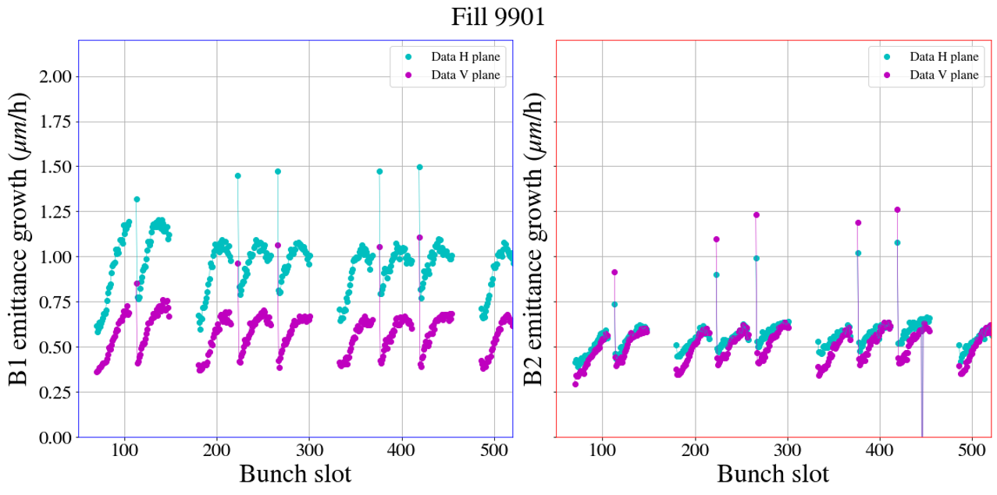
LHC observations: Emittance growth at injection
Emittance growth mechanism at injection not fully understood:

Slide 7
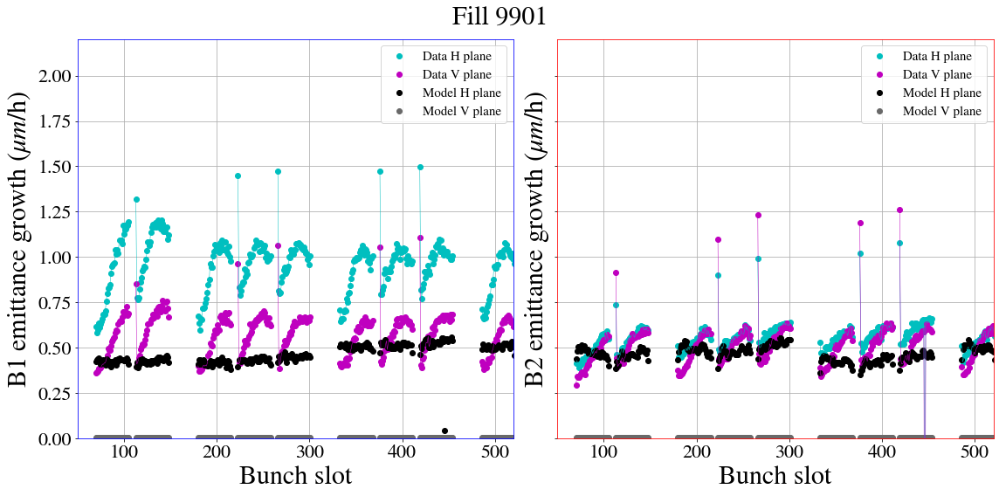
LHC observations: Emittance growth at injection
Emittance growth mechanism at injection not fully understood:

Slide 8
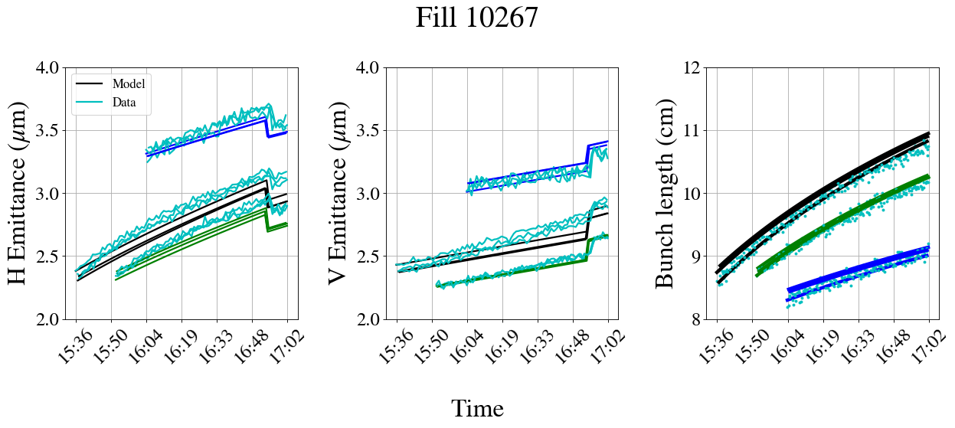
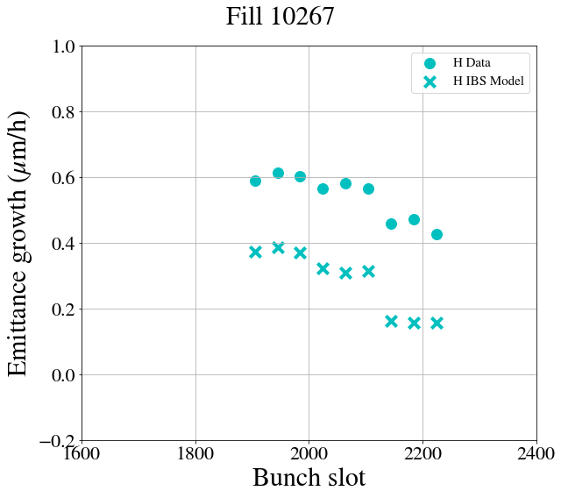
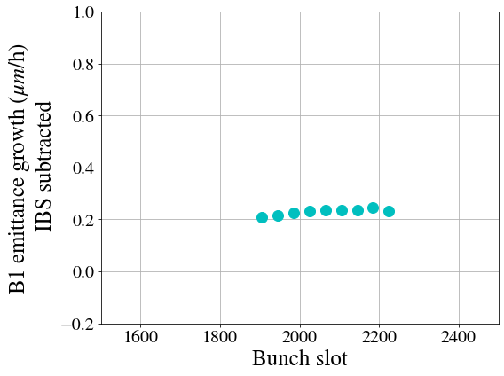
LHC observations: Emittance growth at injection
Emittance growth mechanism at injection not fully understood.
Max. brightness
-20% brightness
-60% brightness
Measurements
  Comparison of measured emittance growth & bunch length evolution against theoretical IBS model.
  Horizontal plane:
    Systematically larger in B1H: ~0.6 μm/h in addition to e-cloud:
      0.4 μm/h from IBS.
      0.2 μm/h of unknown origin:
        even with single bunches.
        brightness independent.
IBS + 0.2 μm/h
o Measured emittance growth for H & V
x IBS model emittance growth for H & V
Emittance growth in H with unknown origin after subtracting IBS contribution

Slide 9
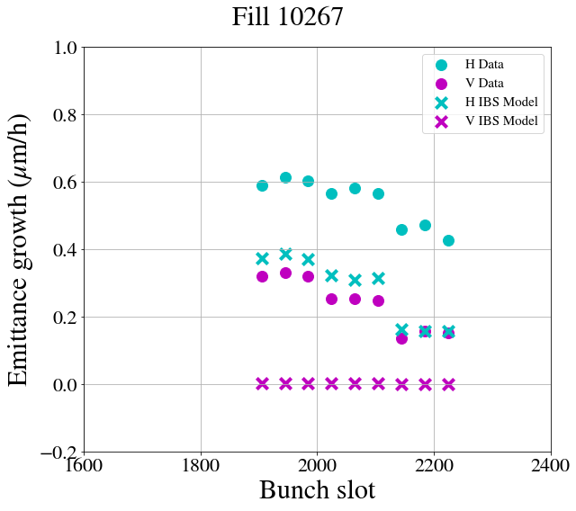
LHC observations: Emittance growth at injection
Emittance growth mechanism at injection not fully understood.
Max. brightness
-20% brightness
-60% brightness
Measurements
  Comparison of measured emittance growth & bunch length evolution against theoretical IBS model.
  Horizontal plane:
    Systematically larger in B1H: ~0.6 μm/h in addition to e-cloud:
      0.4 μm/h from IBS.
      0.2 μm/h of unknown origin:
        even with single bunches.
        brightness independent.
  Vertical plane:
    ~0.1-0.3 μm/h in addition to e-cloud (B1 & B2).
      Low vertical dispersion & good coupling control → small IBS contribution.
      Measurements suggest some brightness dependence → possibly underestimating IBS or emittance exchange with horizontal in the modeling.
      Linear increase of emittance over time.
IBS + 0.2 μm/h
o Measured emittance growth for H & V
x IBS model emittance growth for H & V
Emittance growth in H with unknown origin after subtracting IBS contribution

Slide 10
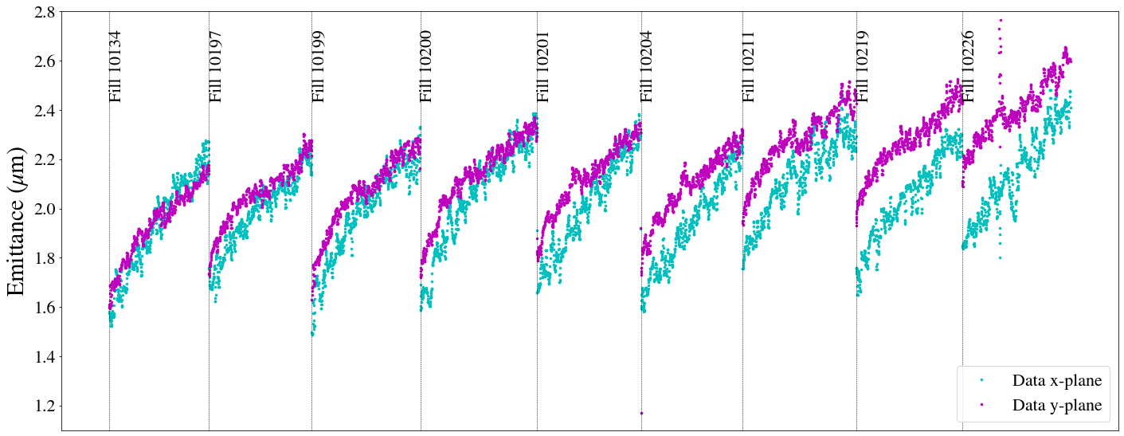
LHC observations: Emittance growth at collisions
Emittance growth of unknown origin also during collisions:
  Cannot be fully explained by IBS models.
  Vertical emittance expected to be shrinking due to SR.

Slide 11
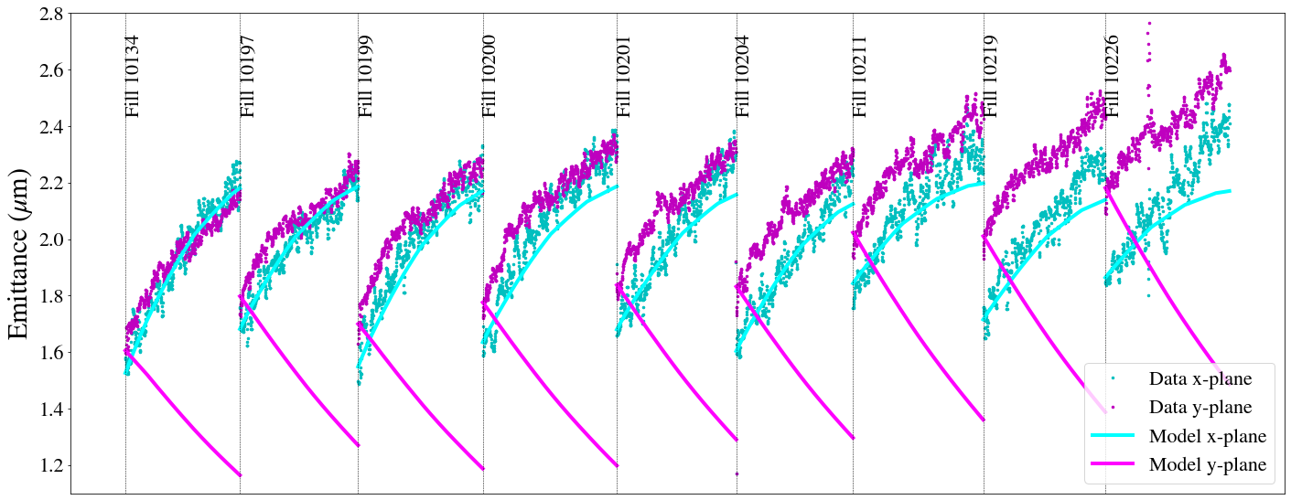
LHC observations: Emittance growth at collisions
Emittance growth of unknown origin also during collisions:
  Cannot be fully explained by IBS models.
  Vertical emittance expected to be shrinking due to SR.
Luminosity model with IBS & SR

Slide 12
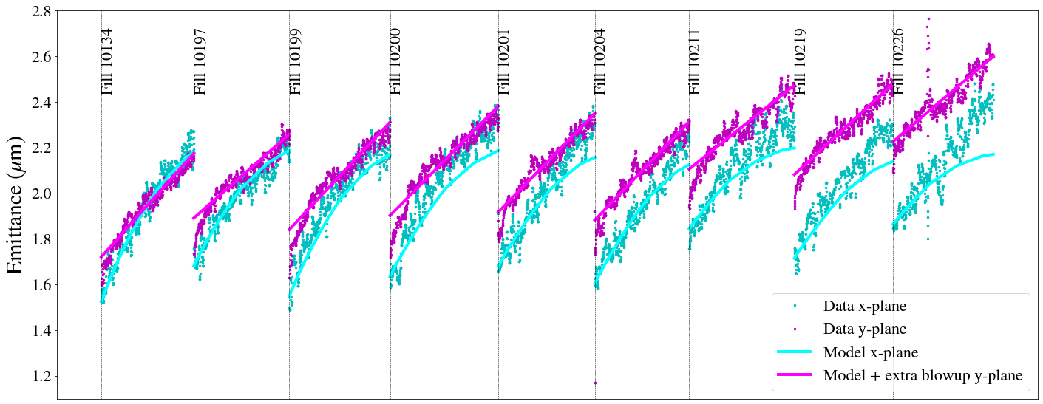
LHC observations: Emittance growth at collisions
Emittance growth of unknown origin also during collisions:
  Cannot be fully explained by IBS models.
  Vertical emittance expected to be shrinking due to SR.
Luminosity model with IBS & SR & extra emittance growth
Impact on integrated luminosity:
2-3% loss for fills that reached optimal fill length & τ=2.5 h

Slide 13
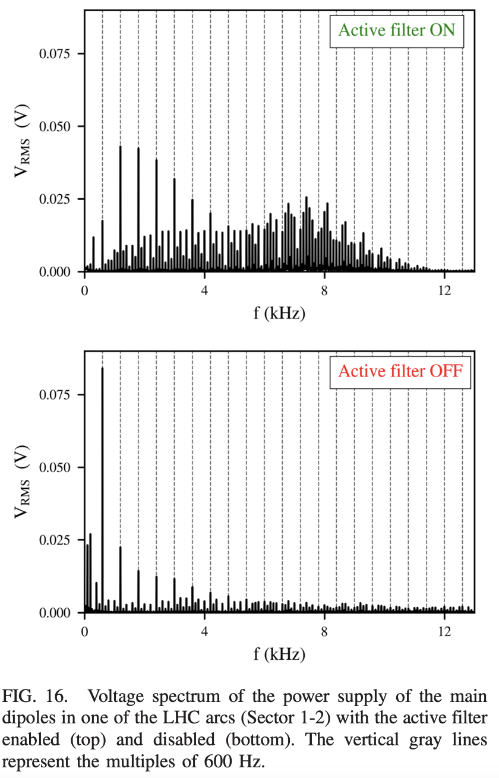
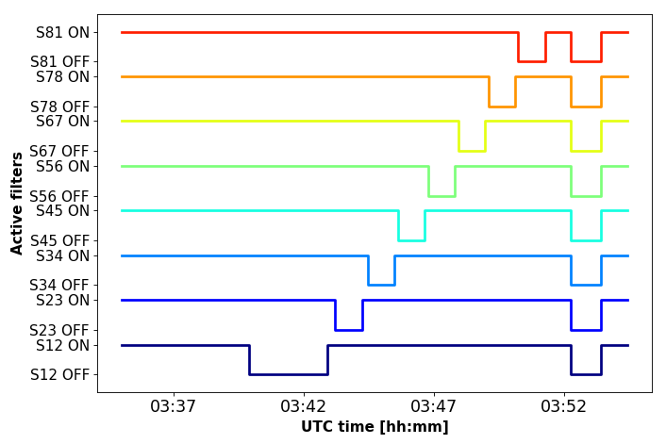
Tests with main dipole PC active filters
Simple modifications of main dipole power supplies combined with beam measurements: → Experiments with main dipole active filters:
  Responsible for attenuation of 50 Hz ripple.
  Enabling & disabling active filters sector by sectors and observing beam’s response.

Slide 14
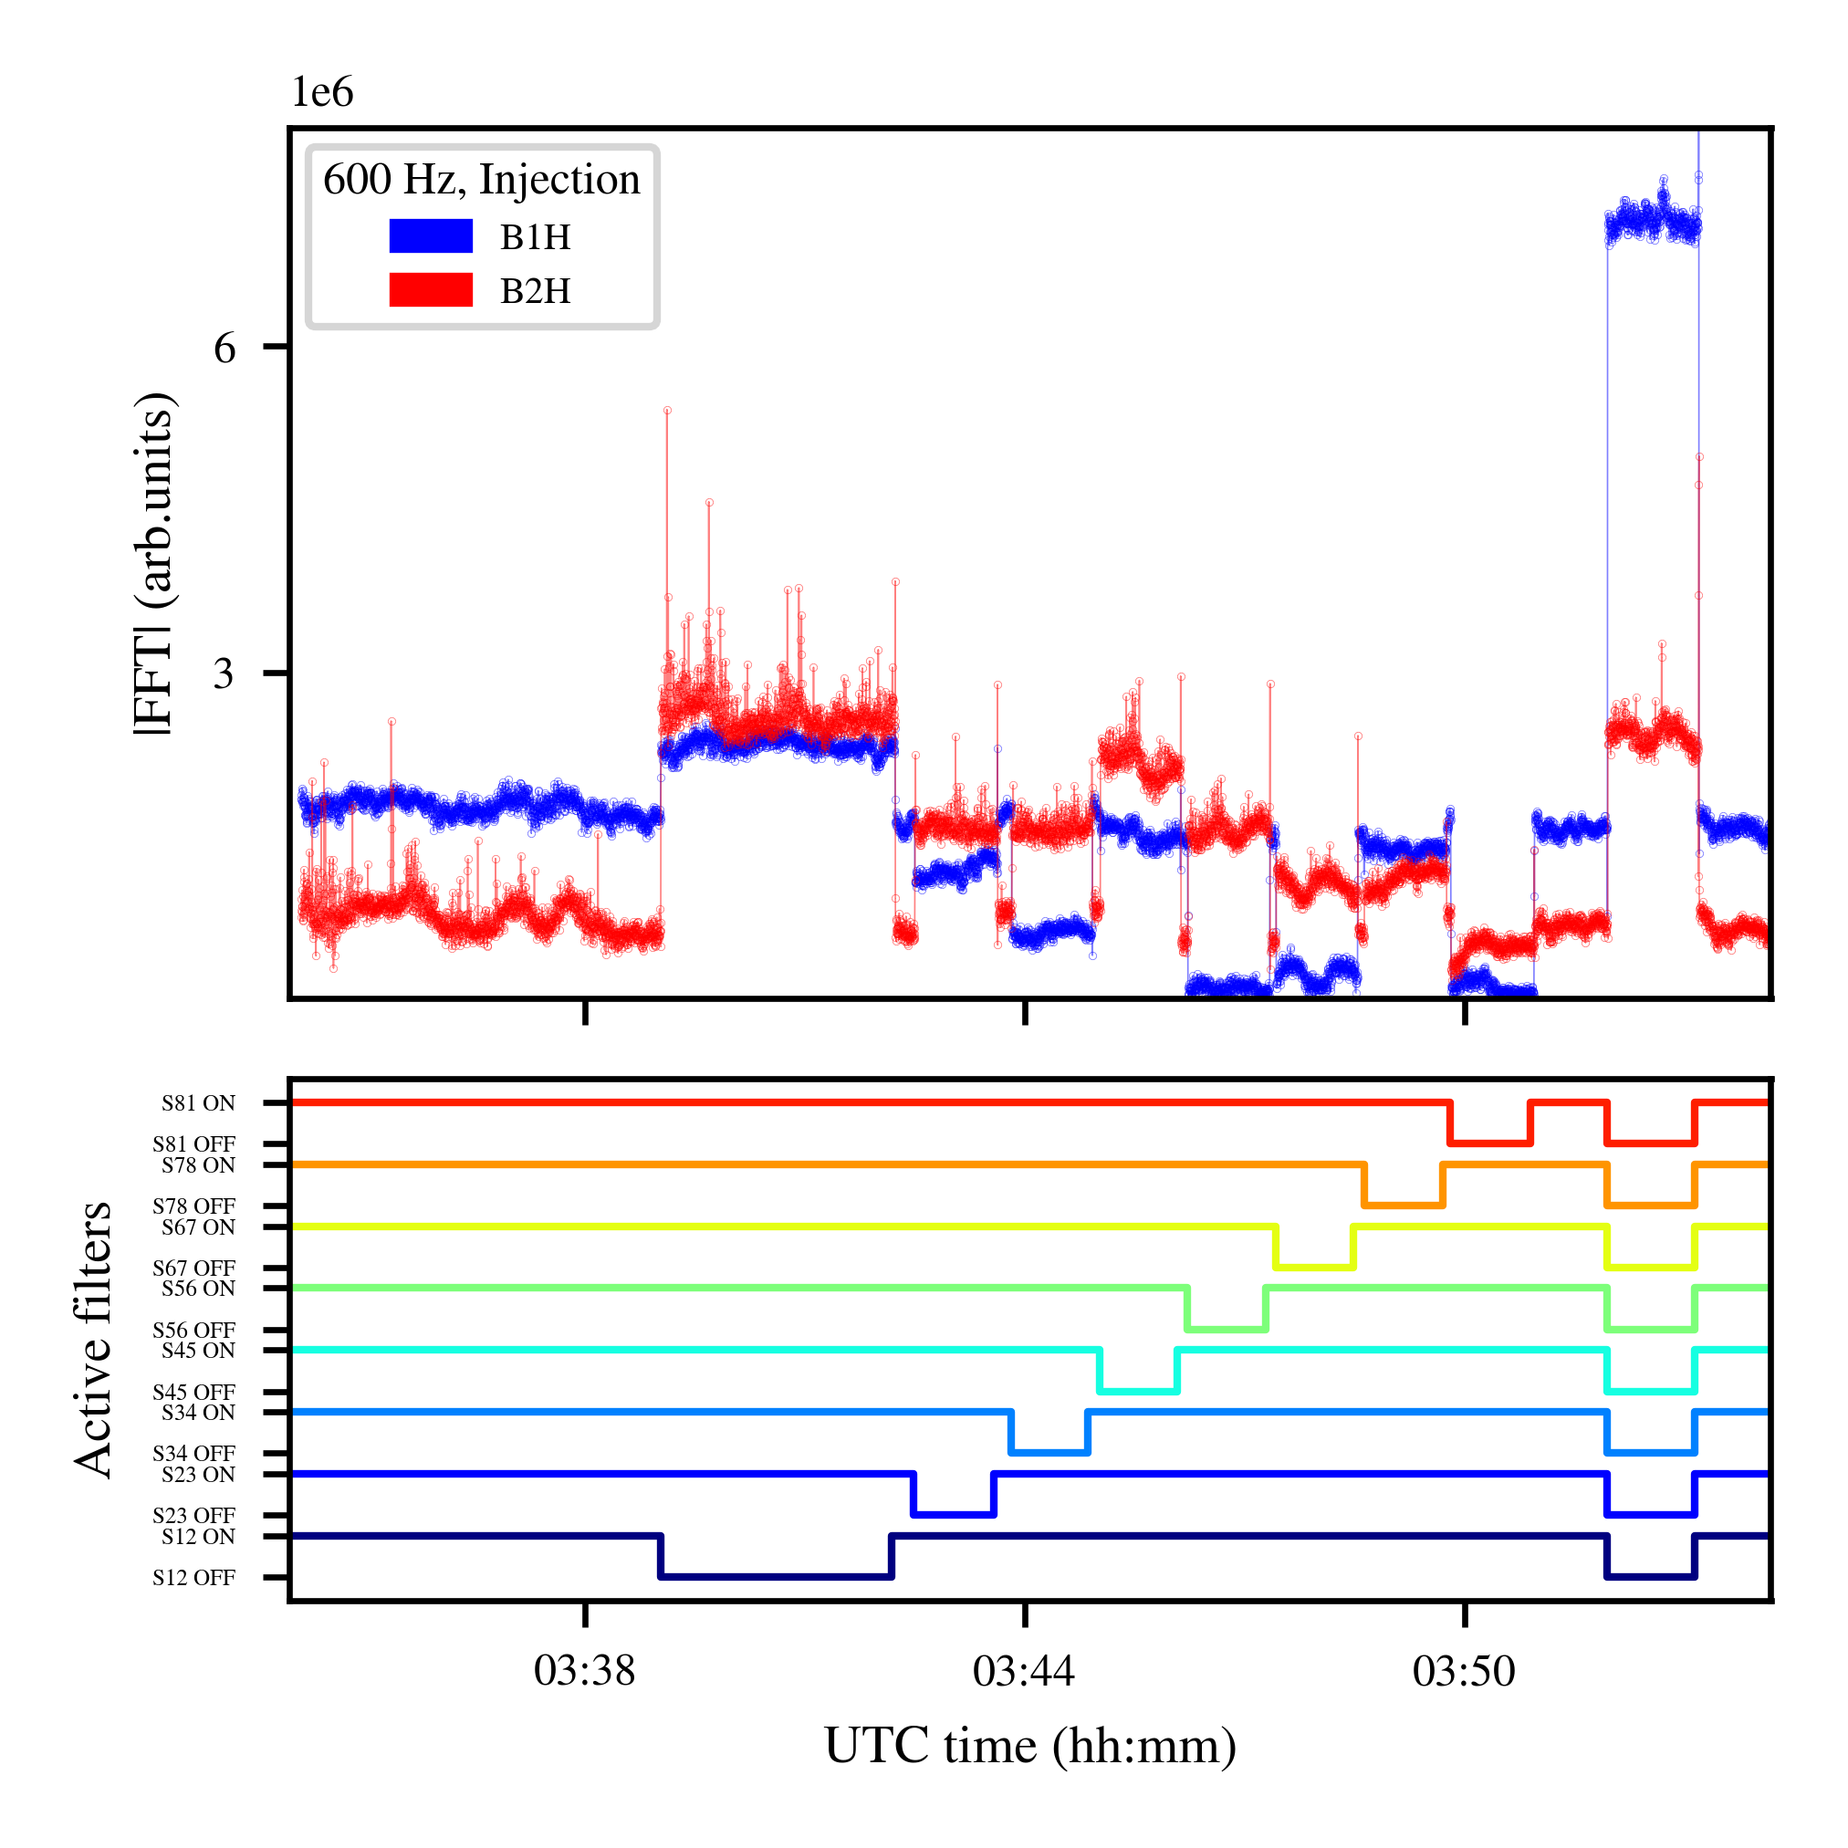
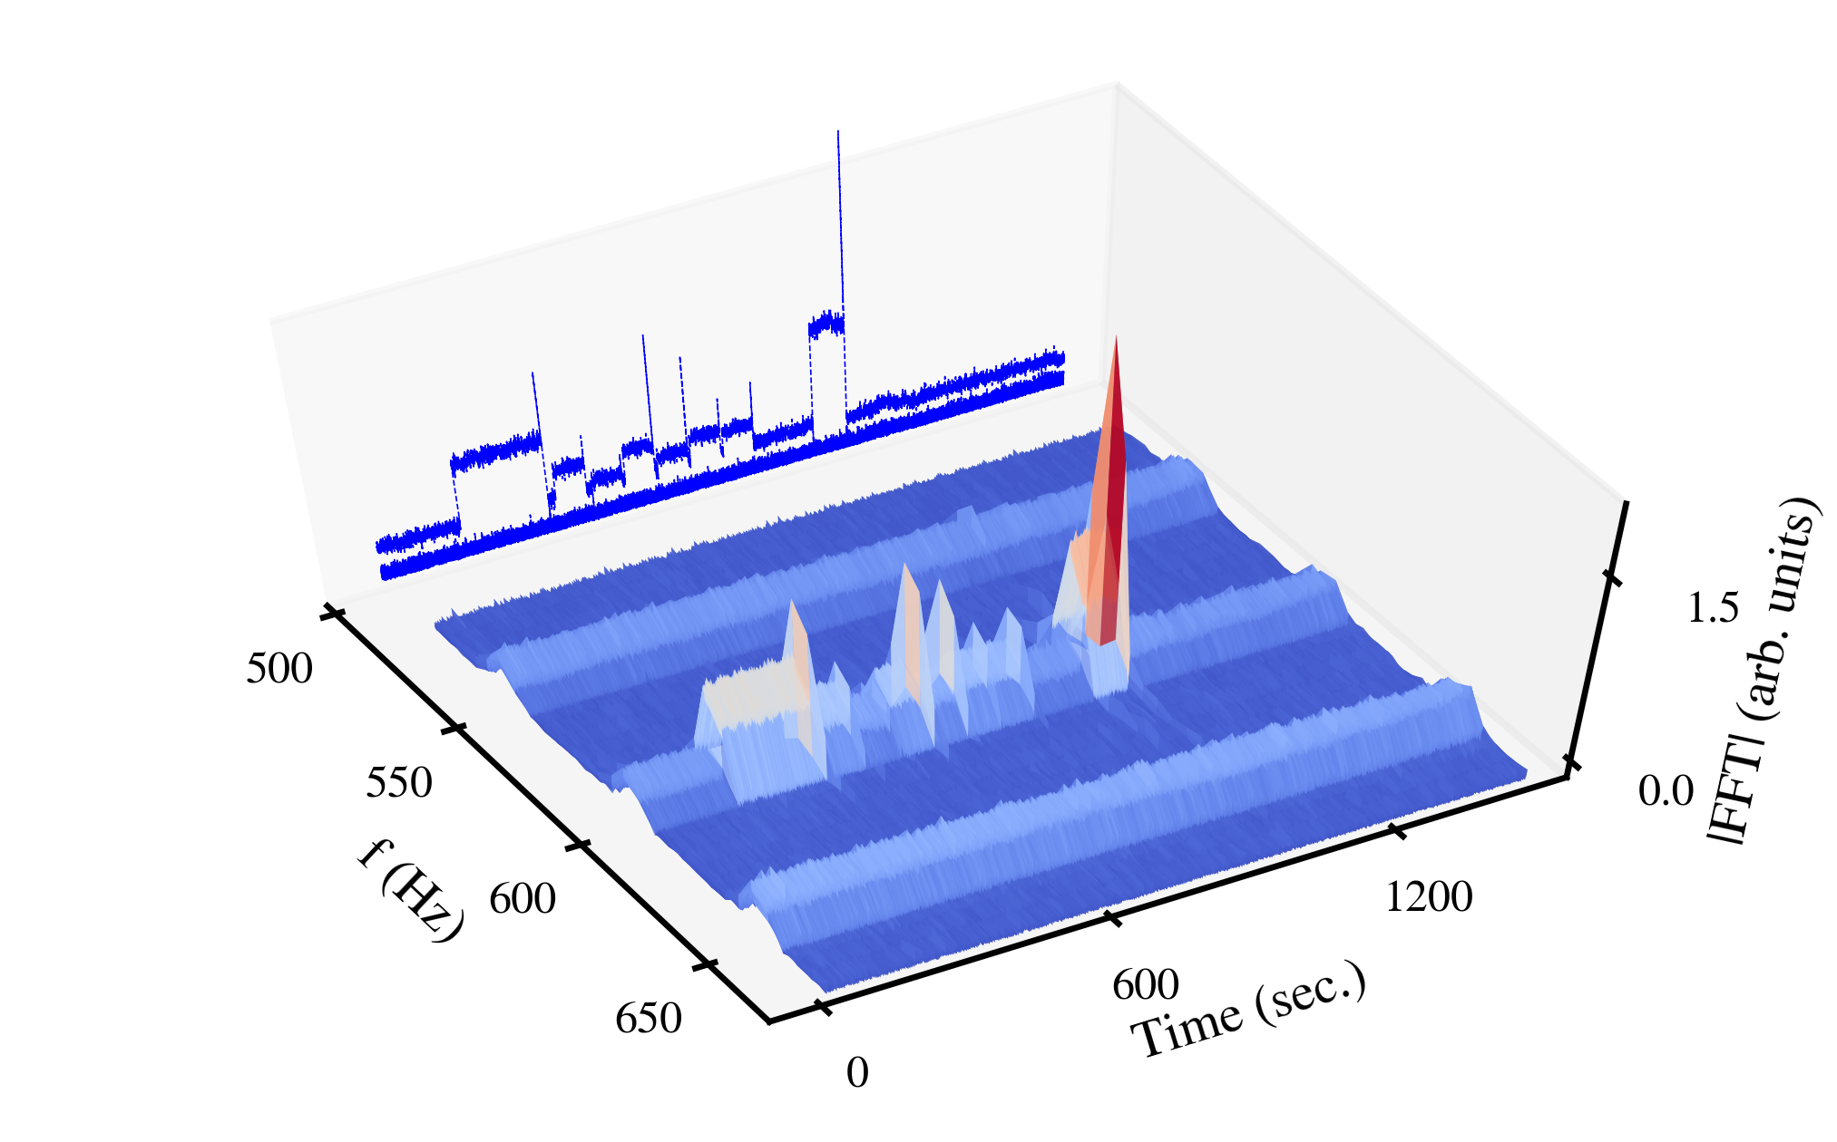
Tests with main dipole PC active filters
Beam spectrum
h=12
h=12
Clear impact on low-frequency cluster when enabling & disabling active filters.
All eight power supplies contribute to this effect → power supply ripple distributed in the whole ring.
For the same harmonics, different response between Beam 1 & Beam 2→ attributed to their different phase advances.
Status of active filter per sector

Slide 15
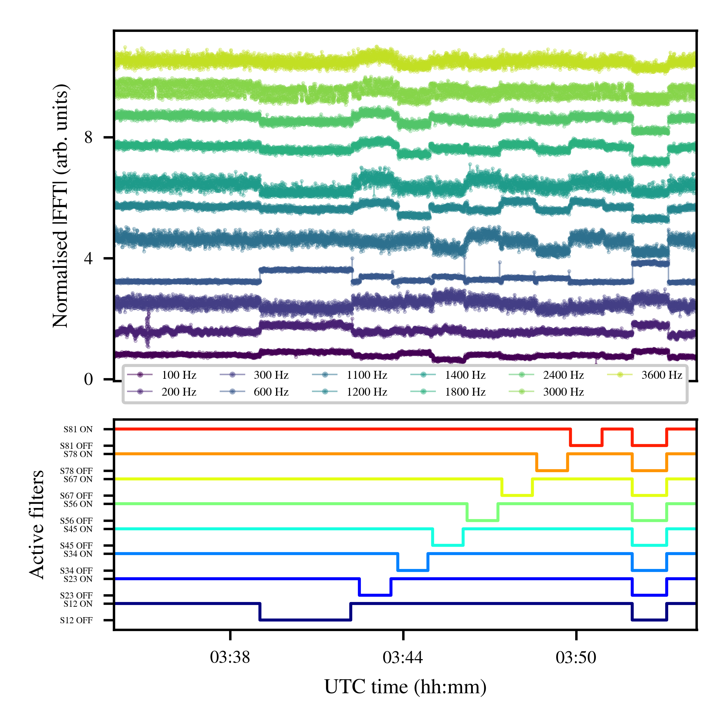
Tests with main dipole PC active filters
Amplitude evolution of beam harmonics up to 3.6 kHz (h=72)
Beam spectrum
h=12
Clear impact on low-frequency cluster when enabling & disabling active filters.
All eight power supplies contribute to this effect → power supply ripple distributed in the whole ring.
For the same harmonics, different response between Beam 1 & Beam 2→ attributed to their different phase advances.
Status of active filter per sector

Slide 16
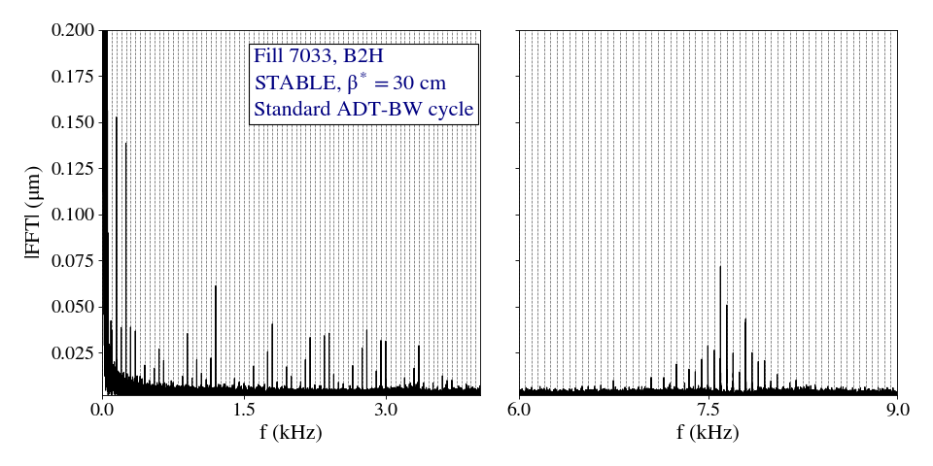
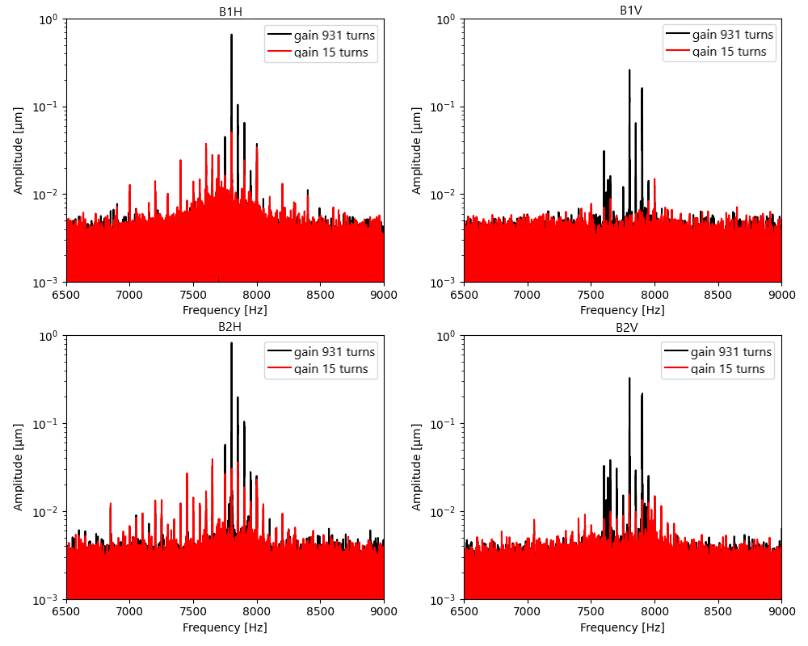
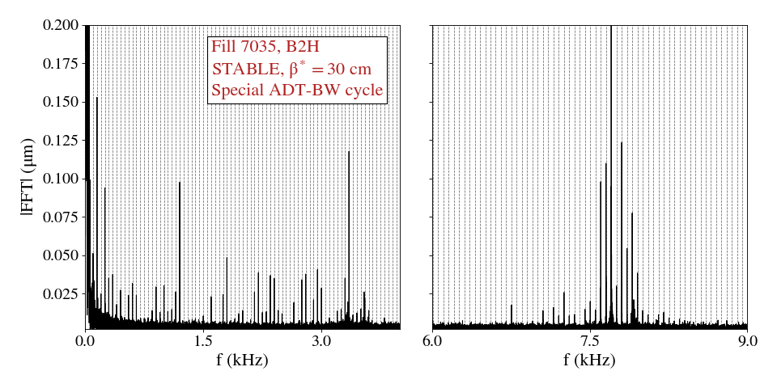
Impact of transverse damper
Run 2
Run 3
B2H
Standard setting
regular-BW cycle
Fill 7033, Stable beams
Special settings
Special cycle ADT extended-BW
Fill 7035 Stable beams
Increasing the transverse damper gain is beneficial: Clear reduction of harmonics’ amplitude

Slide 17
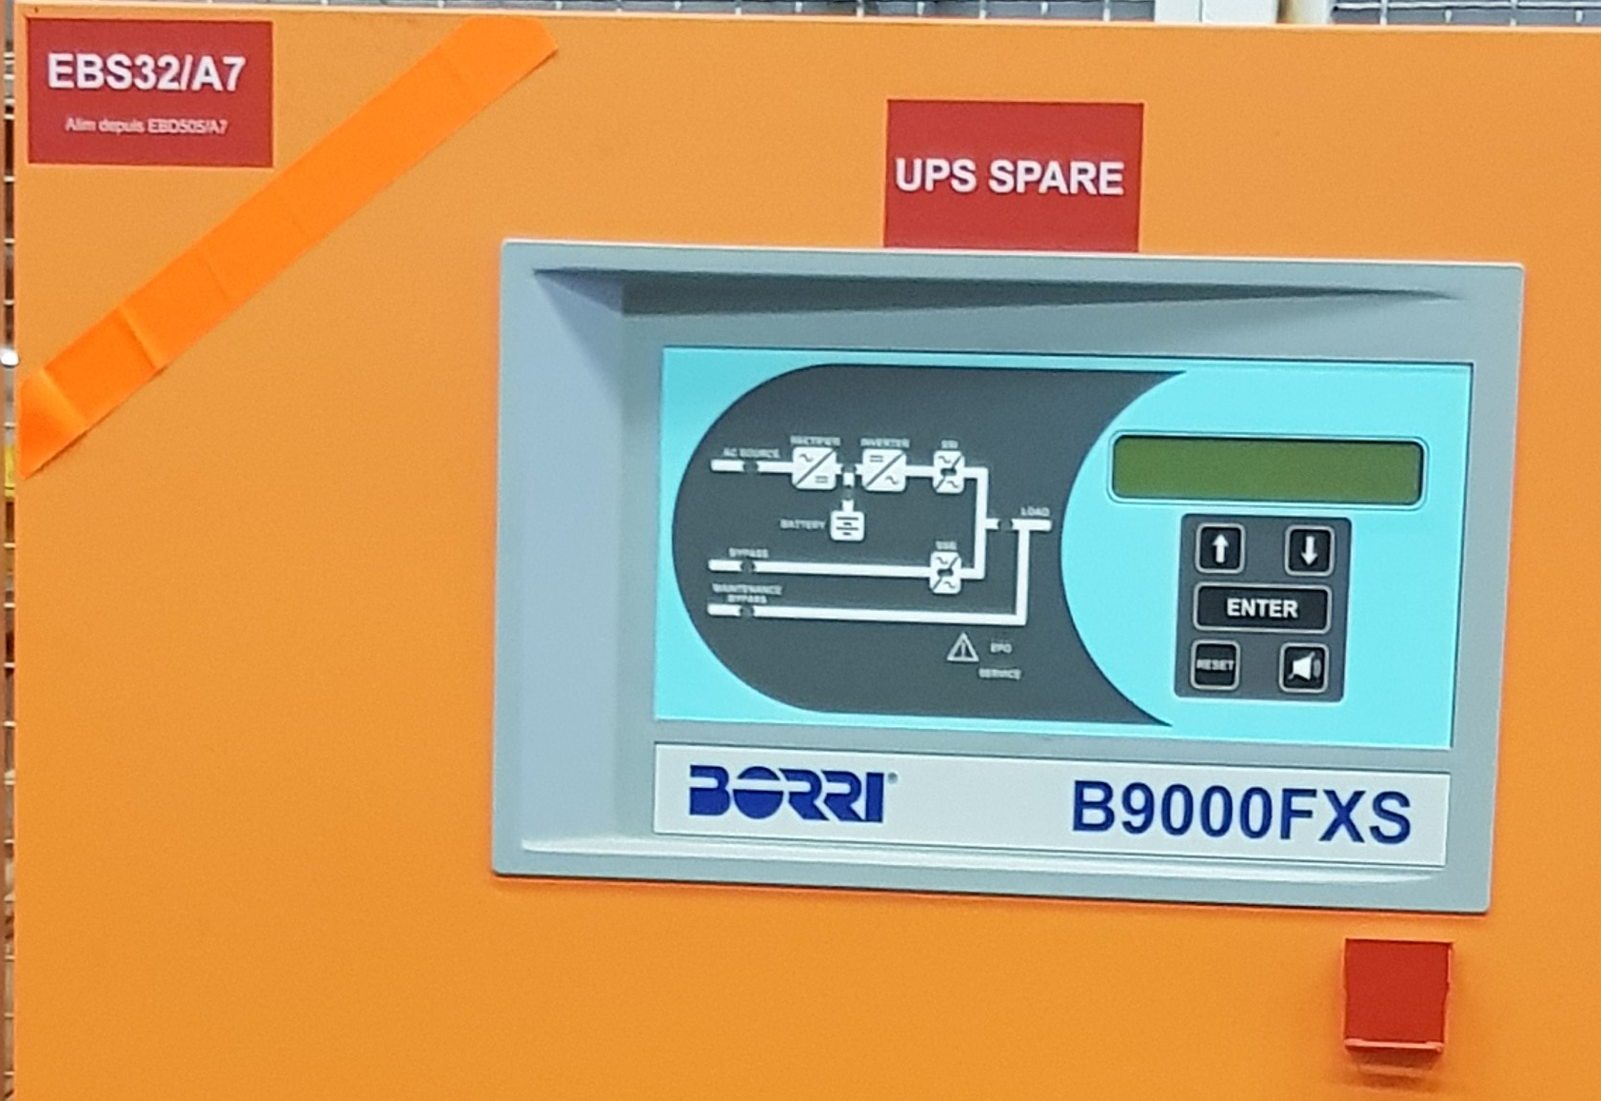
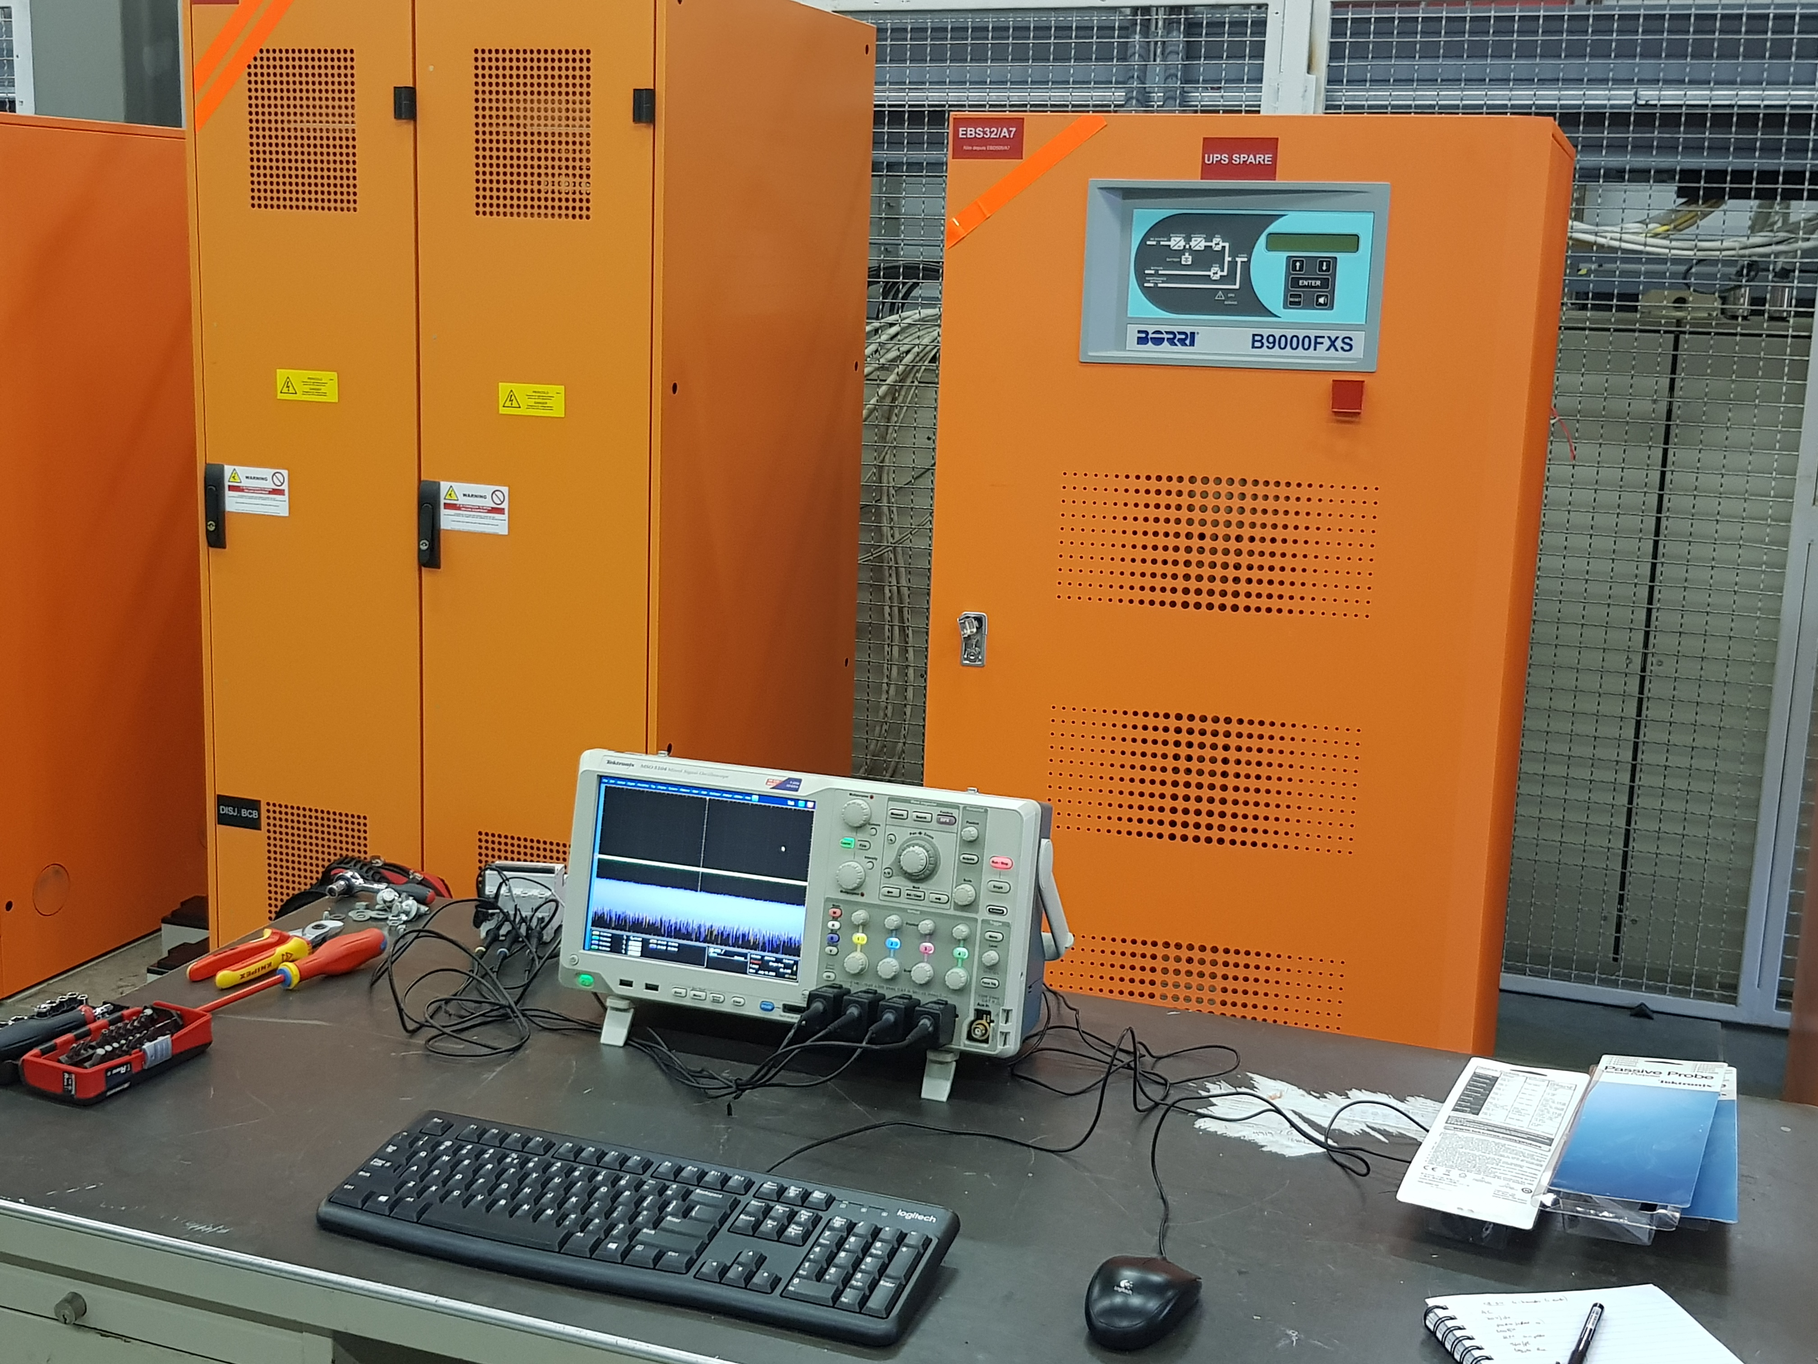
Measurements of UPS noise
Measurements of UPS output spectrum (same type as the ones in the LHC) to determine if possible candidate for high-f cluster:
  To determine if UPS noise spectrum contains 50 Hz harmonics around 8 kHz as observed on the LHC beam spectrum.
  To determine if spectral components are synchronized to the mains as observed on the LHC beam spectrum.
Changed mode of operation of a few UPSs during dedicated measurements in the LHC with beam.
B9000 100 kVA UPS BA7
UPS
Same type in the LHC

Slide 18
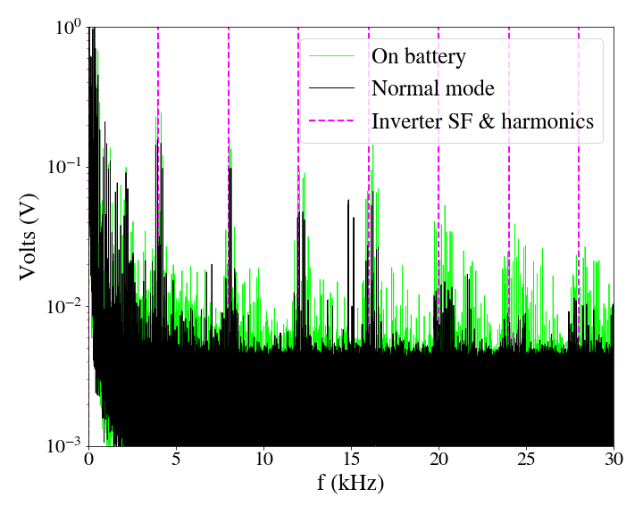
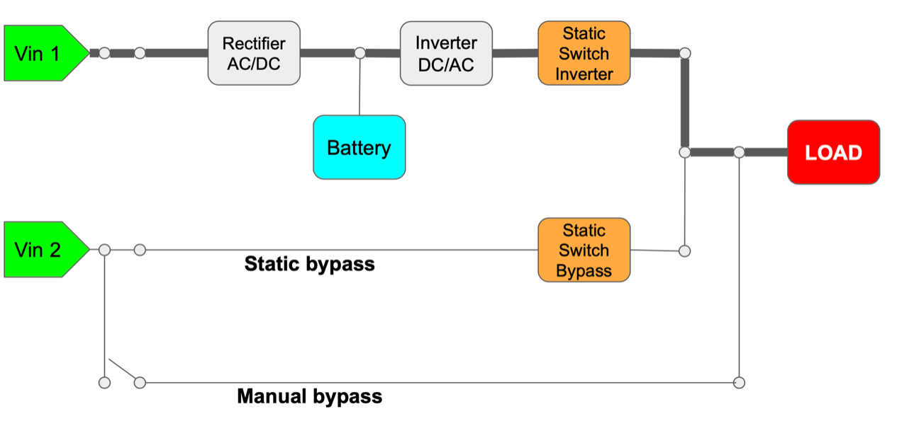
Measurements of UPS noise
Measurements of spare UPS in SM18 thanks to EN/EL: UPS output voltage spectrum very similar to transverse LHC beam spectrum in terms of ripple→ good candidate to study
Different modes of UPS operation:
Nominal
On battery
Static & manual bypass
UPS noise spectrum
UPS modes of operation
Link for UPS noise measurements in SM18

Slide 19
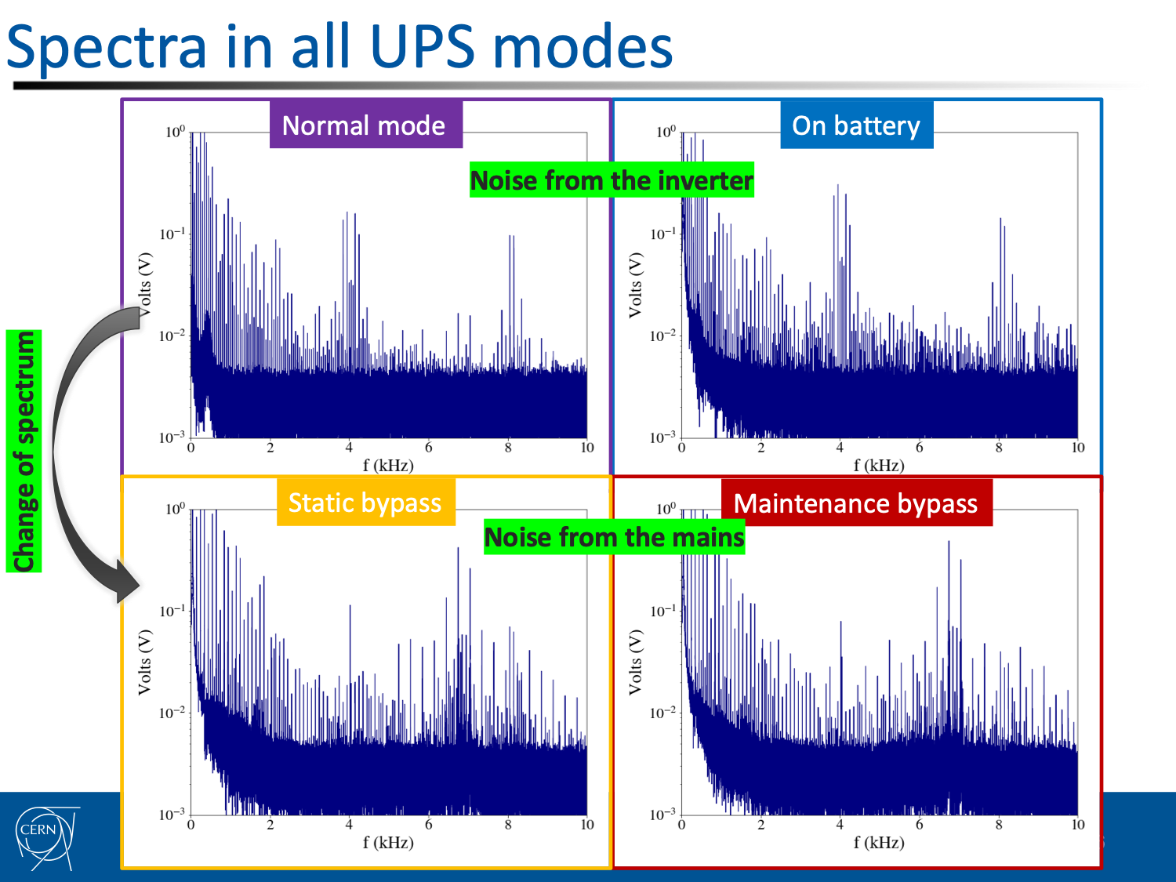
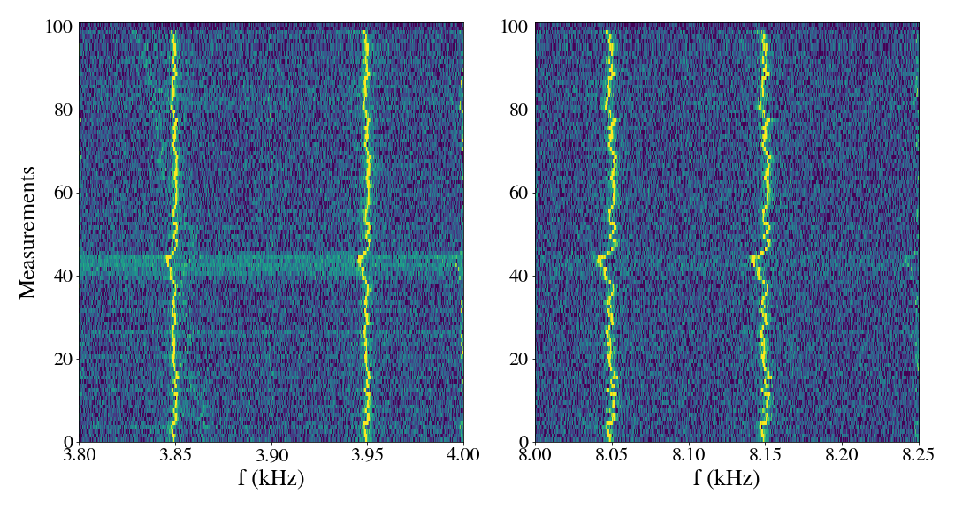
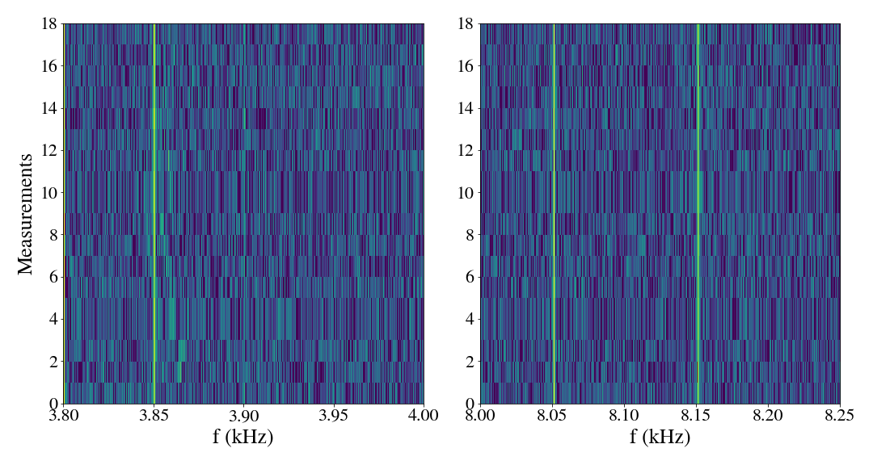
Measurements of UPS noise
Changing mode of UPS operation → different UPS output voltage spectrum → Can these changes be detected on the beam spectrum as well?
Bypass: Change of UPS spectrum (change of harmonics’ amplitude), not so easy to detect.
On battery: Clear change of UPS spectrum (loss of synchronization with mains), can be easily detected.
Nominal to battery mode

Slide 20
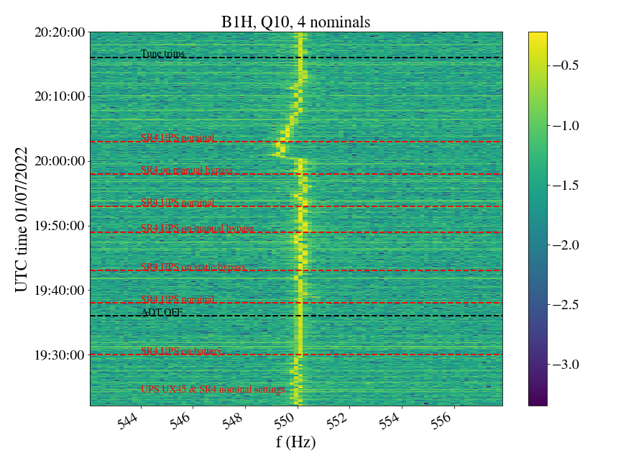
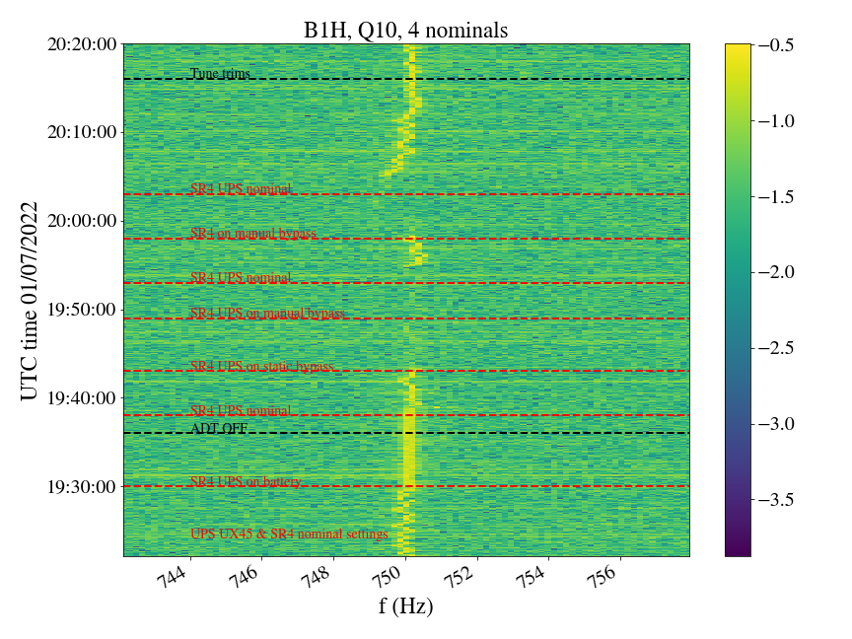
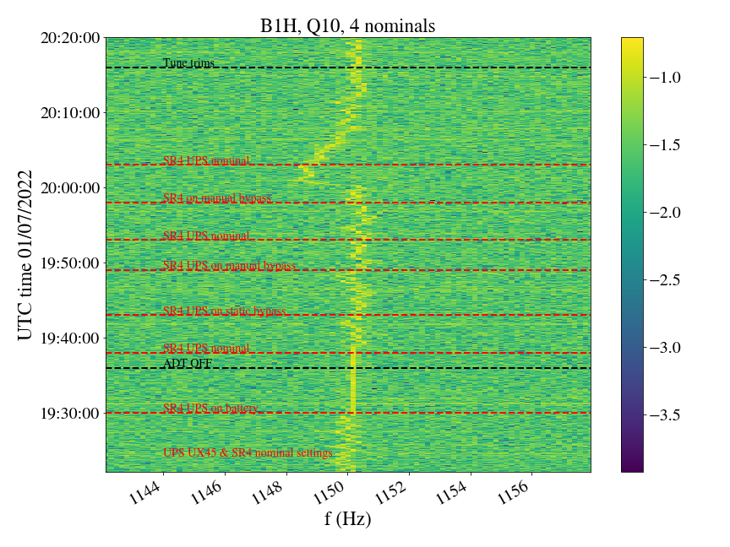
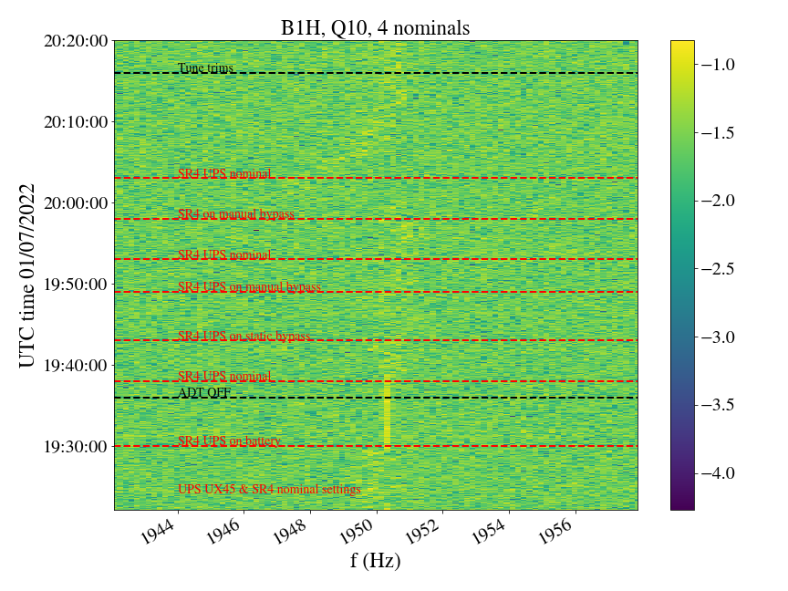
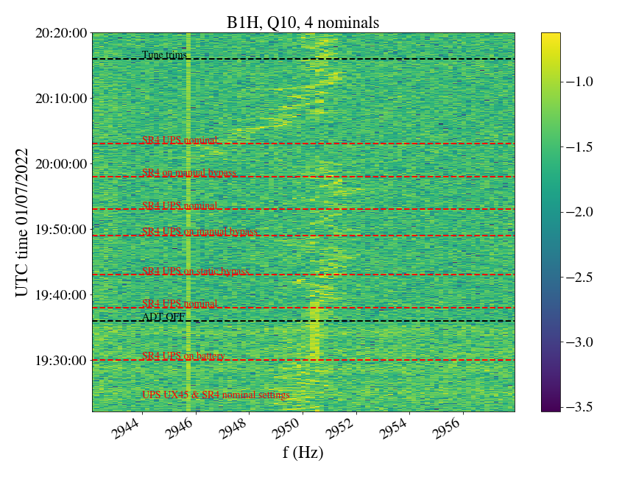
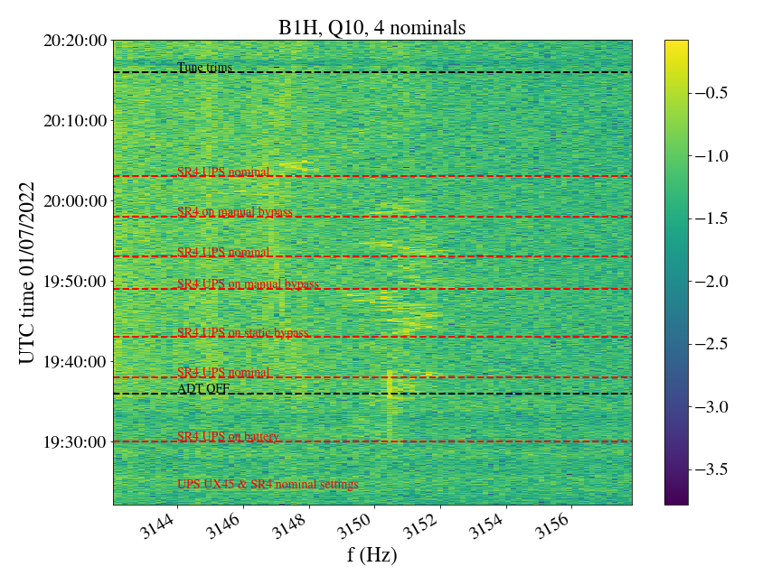
Beam spectrum during SR4 UPS modifications

Slide 21
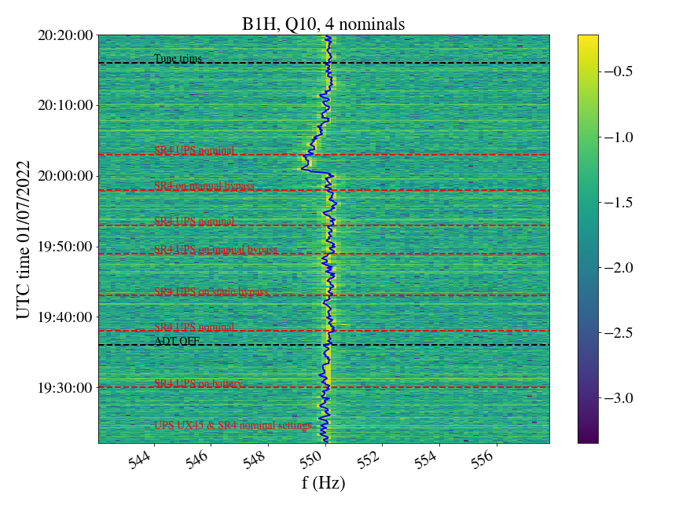
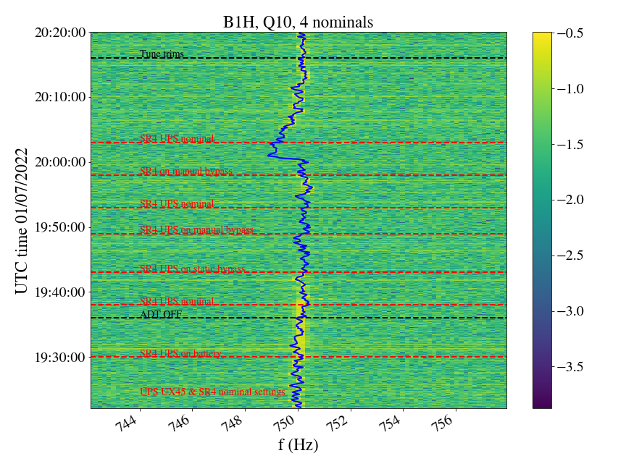
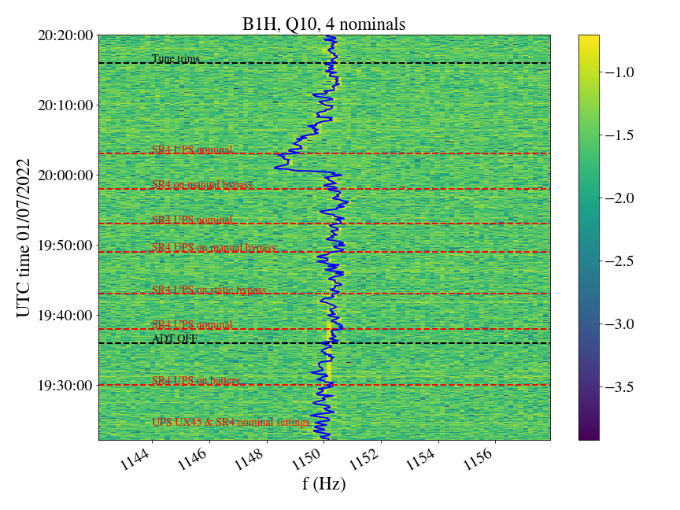
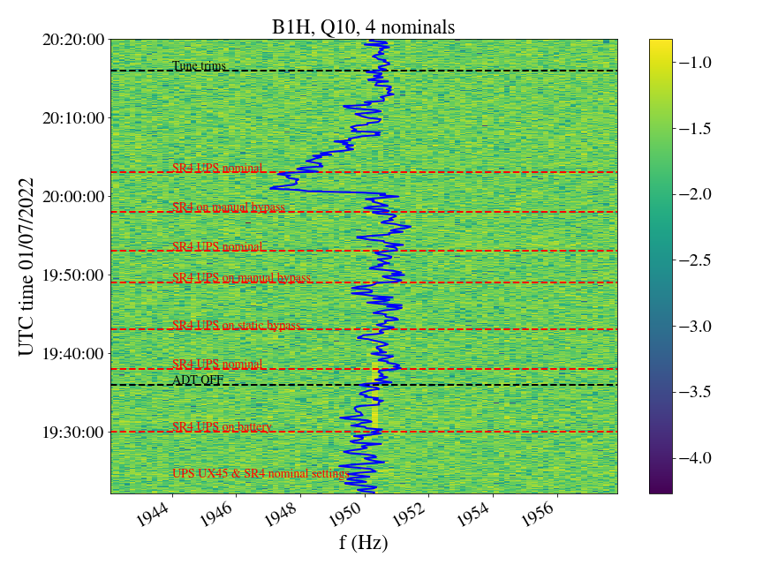
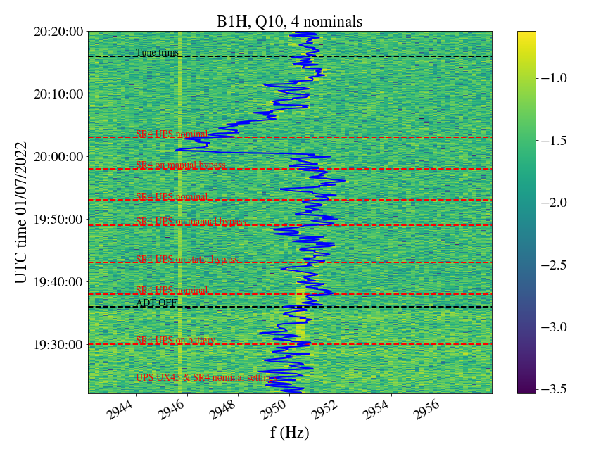
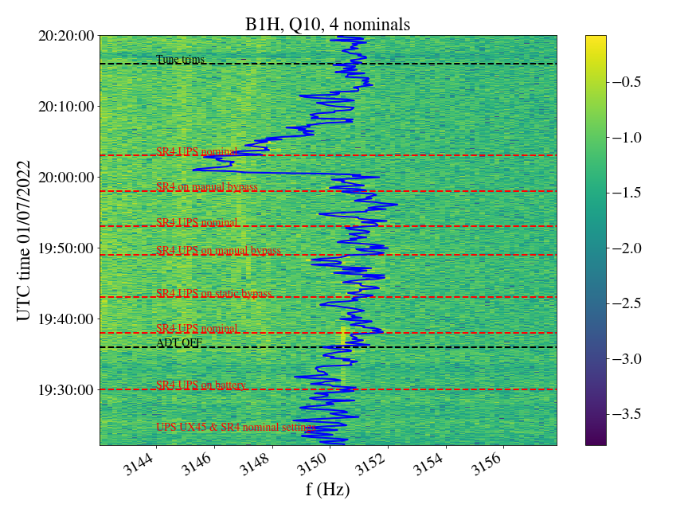
Beam spectrum during SR4 UPS modifications
Data from Réseau de Transport d'Électricité

Slide 22
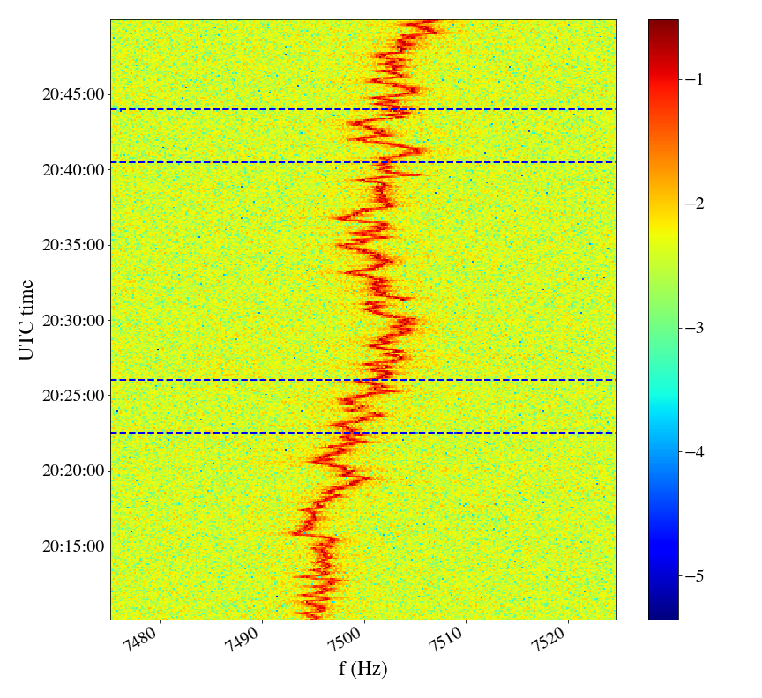
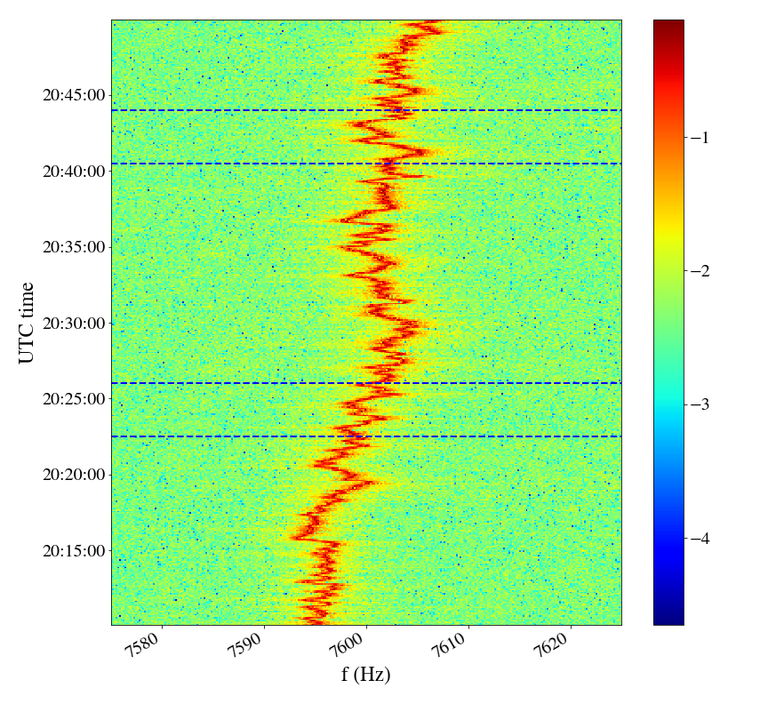
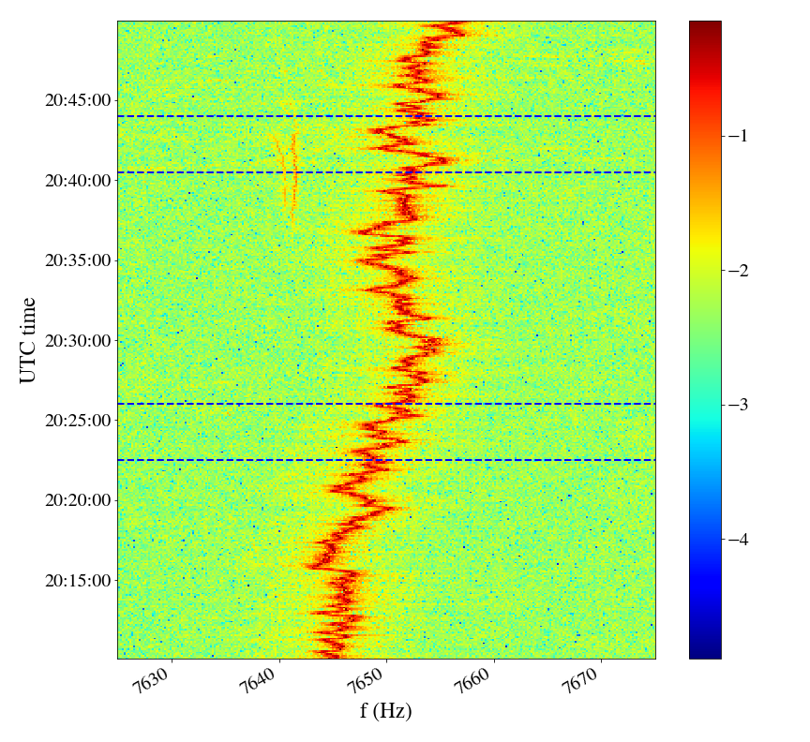
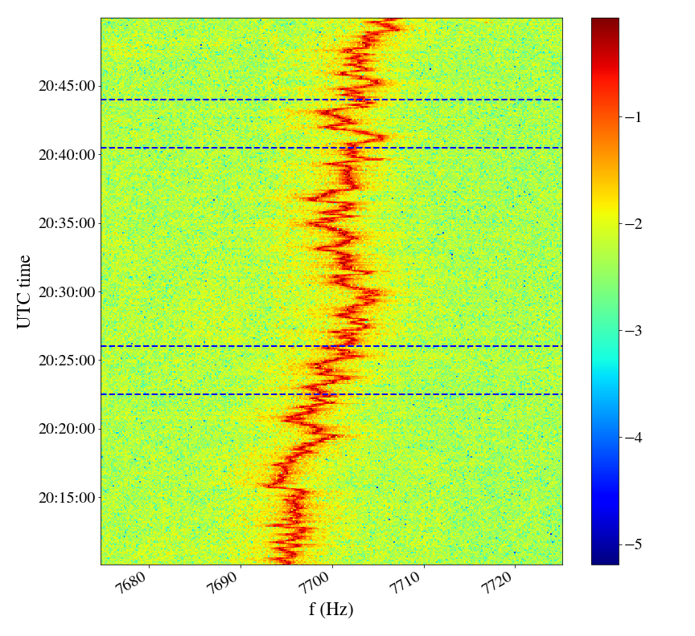
Beam spectrum during SR4 UPS modifications
No loss of synchronization during tests

Slide 23
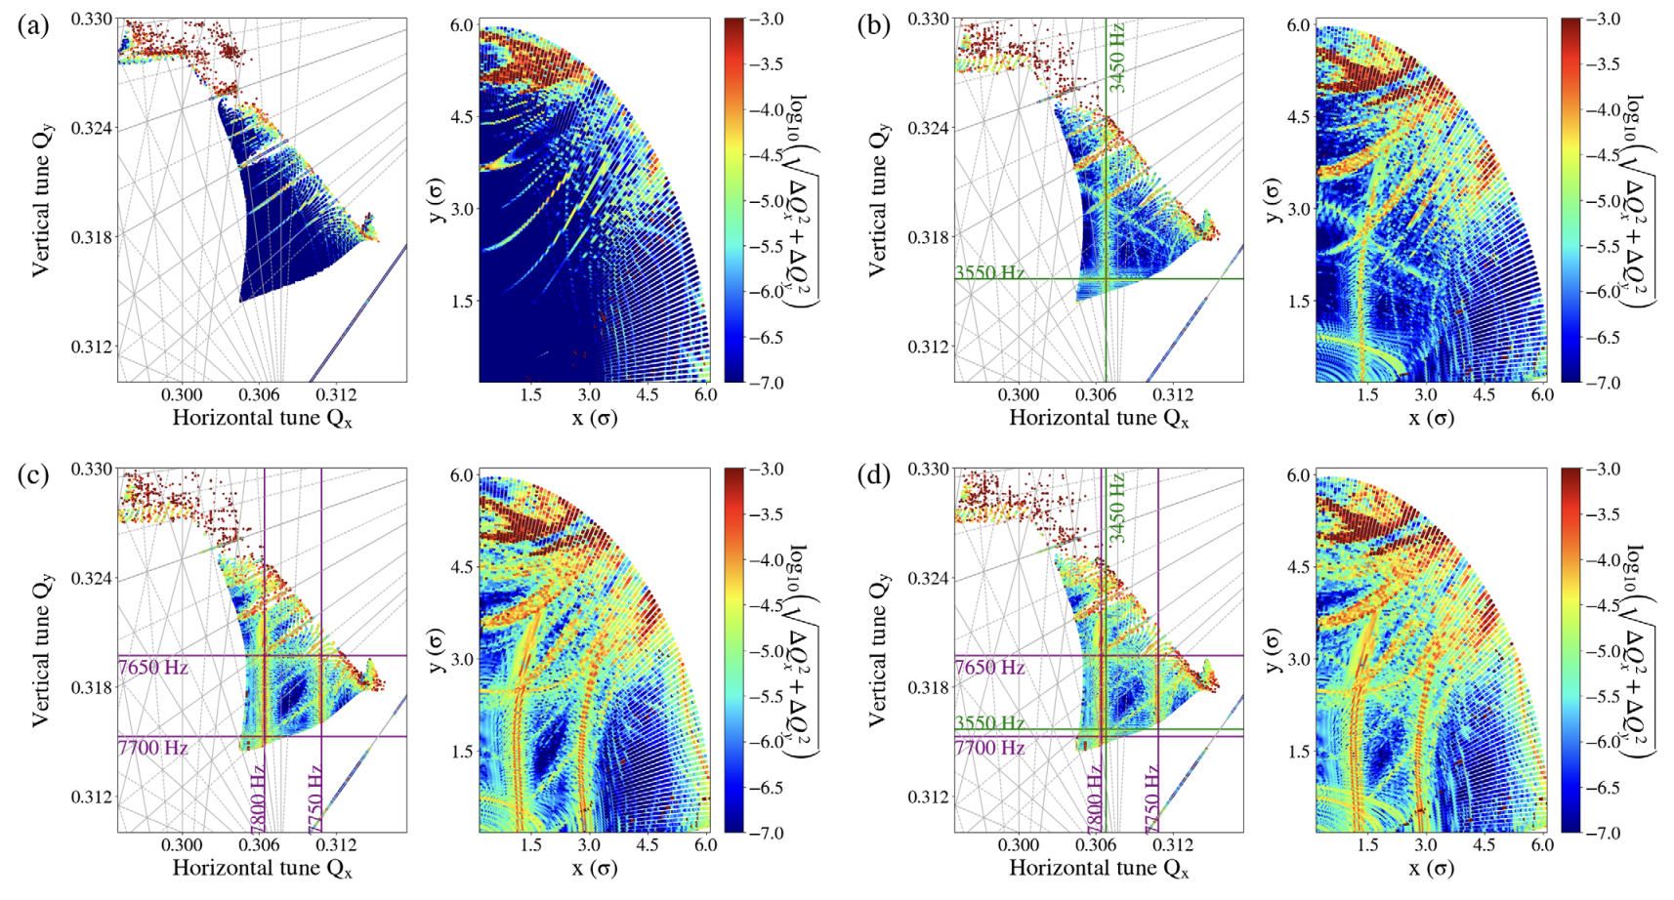
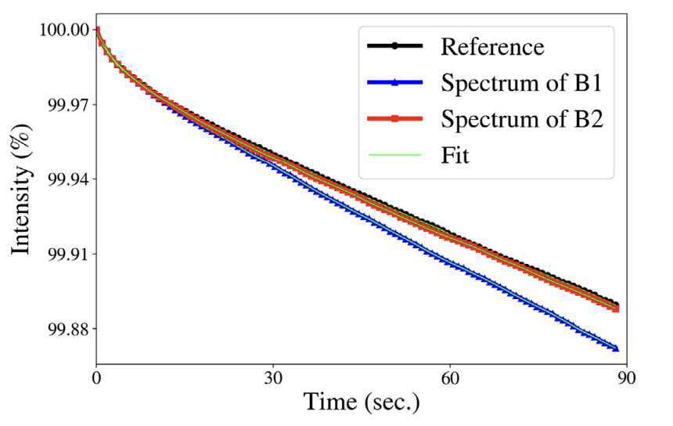
Impact on beam performance
Simulations reproducing the ripple spectrum observed in operation indicate that the high-f cluster has an impact on performance.

Slide 24
Conclusions
50 Hz dipolar power supply ripple systematically observed in transverse LHC beam spectrum up to high frequencies (~8 kHz).
Origin of harmonics up to 3.6 kHz are the power converters of the main dipoles. Active filters tests demonstrated that frequencies up to 3.6 kHz are passing from the power converter to the beam.
Source of high-frequency harmonics (~8 kHz) remains unknown. Their amplitude significantly increases at the end of the ramp and spectrum is reproducible fill-by-fill. Did not observe any “atypical” behavior that could pinpoint to the source. A lower amplitude was only observed during special runs (2.7 TeV instead of 6.8 TeV)
UPS noise signature matches beam observations: 50 Hz harmonics around 4 kHz & 8 kHz. Dedicated experiments switching some UPS in SR4 to “battery” mode affected only a few low-order harmonics (550, 750, 1150, 1950, 2050, 3150 Hz) only on B1, no impact (loss of synchronization to the mains) on high-f cluster. Testing all UPSs at top energy cannot be done without remote control for UPSs that require access. Switching to battery mode is the clearest signature to detect in the beam spectrum.
Increasing the transverse damper gain reduces amplitude of harmonics.
There is an unknown source of emittance growth at injection (brightness-independent) and during collisions, which cannot be explained by current models. It remains unclear whether this is related to power supply ripple.

Slide 25
Backup

Slide 26
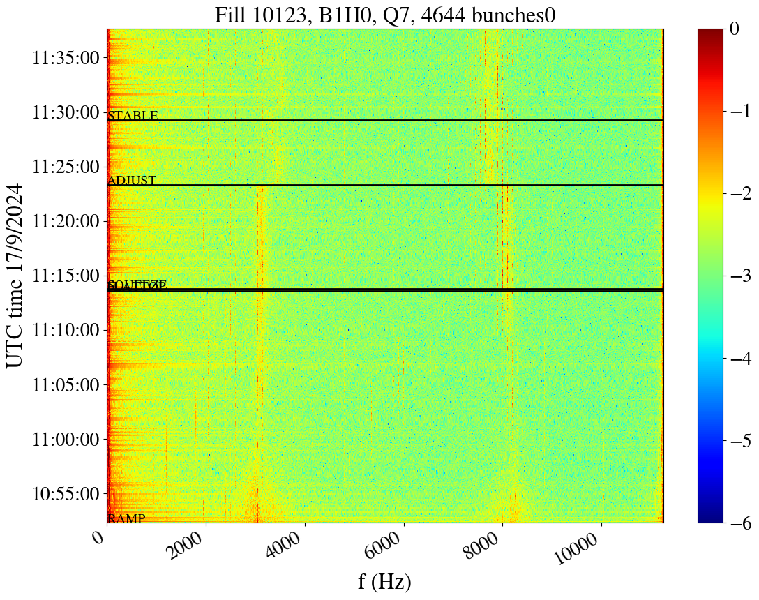
LHC observations: Power supply ripple

Slide 27
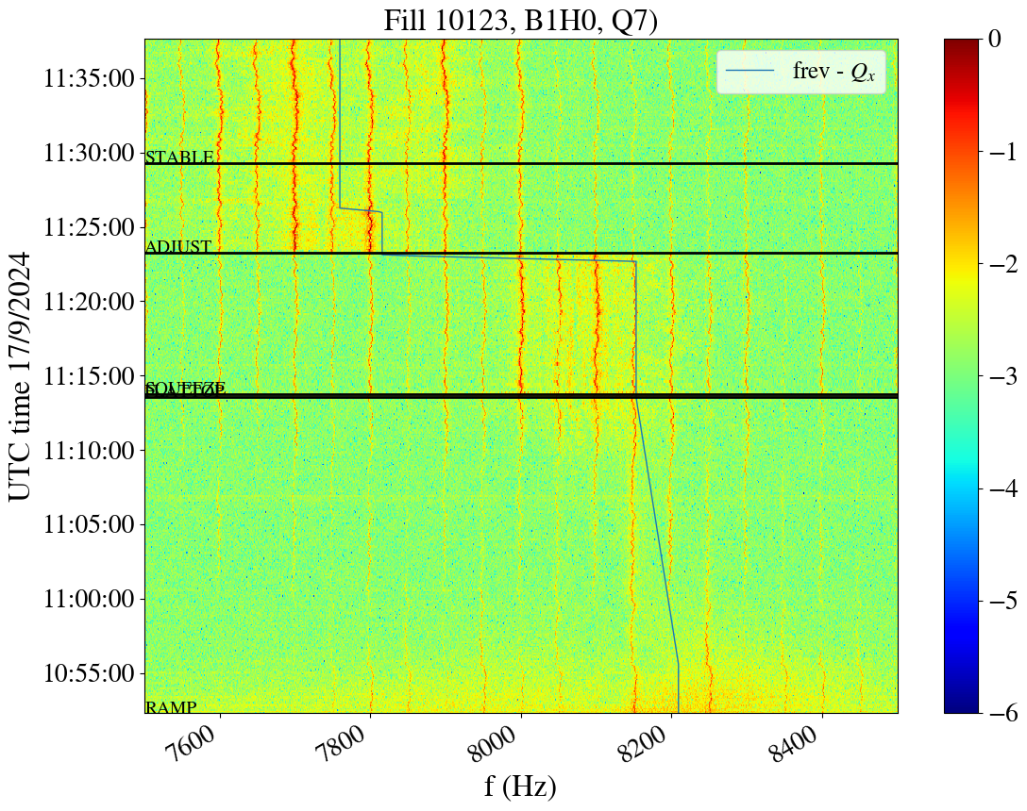
LHC observations: Power supply ripple

Slide 28
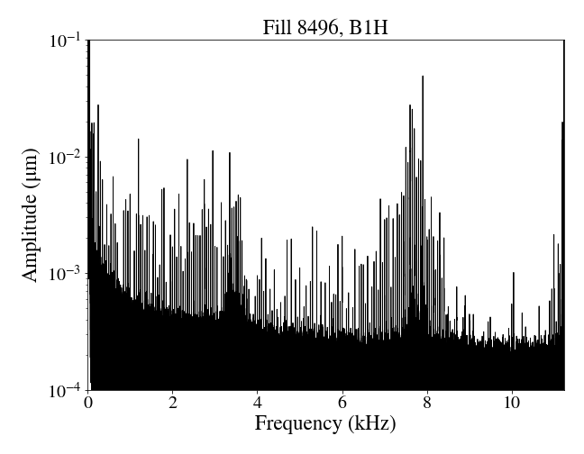



Observations in Run 3
B1H
B1V
Calibrated spectrum for fill 8496, 2390 bunches, Stable beams: similar to what was considered for Run 2.
B2H
B2V
Steps for calibration:
https://codimd.web.cern.ch/s/V1pL7RIBp

Slide 29


Introduction
Harmonics of mains power frequency (50 Hz):
  Observed in several unrelated instruments.
  Visible in all beam modes, fills, planes & both beams.
  Not present without beam (noise of instruments).
  Dipolar excitations, not sidebands around betatron tune.
  Similar observations of high-order harmonics in the form of dipolar excitations in other accelerators (Tevatron, RHIC).
  Several observations: real beam excitations, not an instrumentation artifact.
Beams dumped
Betatron tune

Slide 30

Comparison of Beam 1 & Beam 2 spectra
Stable Beams
B1
B2
~10⁻³ σ
Larger amplitudes of 50 Hz harmonics by factor of two in Beam 1 compared to Beam 2.
Main impact on the horizontal plane → consistent with dipolar field error.
Maximum amplitude of high-frequency cluster ~10⁻³ σ.

Slide 31

UPS modes
Normal mode: ACin1 → Rectifier→ Inverter→ Load
Synchronized to bypass (ACin2) through internal inverter PLL.
Switching frequency (info from Borri)
Inverter: 4 kHz
Rectifier: 7.5 kHz
ACin1
ACin2

Slide 32
UPS modes
Normal mode: ACin1 → Rectifier→ Inverter→ Load
Synchronized to bypass (ACin2) through internal inverter PLL.
On battery: Battery→ Inverter→ Load
In case of power failure.
In our measurements, no synchronization with ACin1 and ACin2.
ACin1
ACin2

Slide 33
UPS modes
Normal mode: ACin1 → Rectifier→ Inverter→ Load
Synchronized to bypass (ACin2) through internal inverter PLL.
On battery: Battery→ Inverter→ Load
In case of power failure.
In our measurements, no synchronization with ACin1 and ACin2.
Static bypass: ACin2 → Switch → Load
Switches automatically to maintain power continuity in case of inverter failure.
ACin1
ACin2

Slide 34
UPS modes
Normal mode: ACin1 → Rectifier→ Inverter→ Load
Synchronized to bypass (ACin2) through internal inverter PLL.
On battery: Battery→ Inverter→ Load
In case of power failure.
In our measurements, no synchronization with ACin1 and ACin2.
Static bypass: ACin2 → Switch → Load
Switches automatically to maintain power continuity in case of inverter failure.
Maintenance bypass: Acin2 → Load
Manual action required.
ACin1
ACin2
Notes:
c

Slide 35




Spectra in all UPS modes
Normal mode
On battery
Noise from the inverter
Change of spectrum
Static bypass
Maintenance bypass
Noise from the mains
Notes:
c

Slide 36
Spectrogram in normal mode
Normal mode
Notes:
c

Slide 37




Spectrogram in normal mode
Normal mode
Common jittering from the mains
Notes:
c

Slide 38


Spectrograms in all UPS modes
Normal mode
On battery
Without synchronization with ACin1 & 2
Static bypass
Maintenance bypass
Notes:
c

Slide 39




Spectrograms in all UPS modes
Normal mode
On battery
Static bypass
Maintenance bypass
Notes:
c

Slide 40



MD overview
Second MD:
  At top energy so that the 8 kHz cluster is clearly visible.
  With 3 trains of 48 bunches to have a symmetrical filling scheme.
  UPS in SR4 switched twice to battery mode and back to nominal operation
B1

Slide 41
MD overview
2 MDs (July & November)
First MD:
  at injection, with 6 pilots and then 4 nominals
  UPS modifications from EN/EL:
    First, EZS1/45X and EZS11/45X (in cascade) in UX45 (access needed) switched from “nominal” configuration to “manual bypass” and then back to “nominal”. Not possible to switch to “battery mode” without remote control.
      UPS connected to (H. Timko): ADT, racks for klystrons, LLRF crates for cavity control and longitudinal diagnostics in UX45.
    Then, EBS11/4R in SR4 (no access needed) switched from “nominal” configuration to “battery”, “static bypass”, “manual bypass” and back to “nominal”.
      UPS connected to (H. Timko): ADT, LHC beam control (RF frequency generation, beam phase loop, synchronisation etc.), longitudinal diagnostics in SR4 (APWL, beam spectra, longitudinal ObsBox)

