Slide 1
Updates on High Bandwidth Readout at SCIPP
Bruce Schumm / Simone Mazza
Santa Cruz Institute for Particle Physics
DRD3 WG6 SiC LGAD Meeting
February 21 2025

Slide 2
Two types of readout we’re considering
Optimized for fast timing
➔ Typically τ_{amp} ≈ τ_{rise}
➔ 0.5 – 1.5 GHz
➔ “SCIPP” board for Si LGADs; where to go from here?
➔ Not part of this talk (discussion afterwards?)
Optimized for feature extraction
➔ The faster the better
➔ Focus of this talk (updates from the past month)

Slide 3
High Bandwidth Inspiration: Compact Readout
Two institutions working independently on this: SCIPP and OAW
Similarities
Compact geometry
RF amplifier IC rather than discretes
Differences
OAW: Signal return path through amplifier
SCIPP: Signal return path local to sensor
Which is best? Let’s find out!
Collaboration
Working together has great advantages. SCIPP has already benefited significantly from the wisdom of this group (see below)

Slide 4
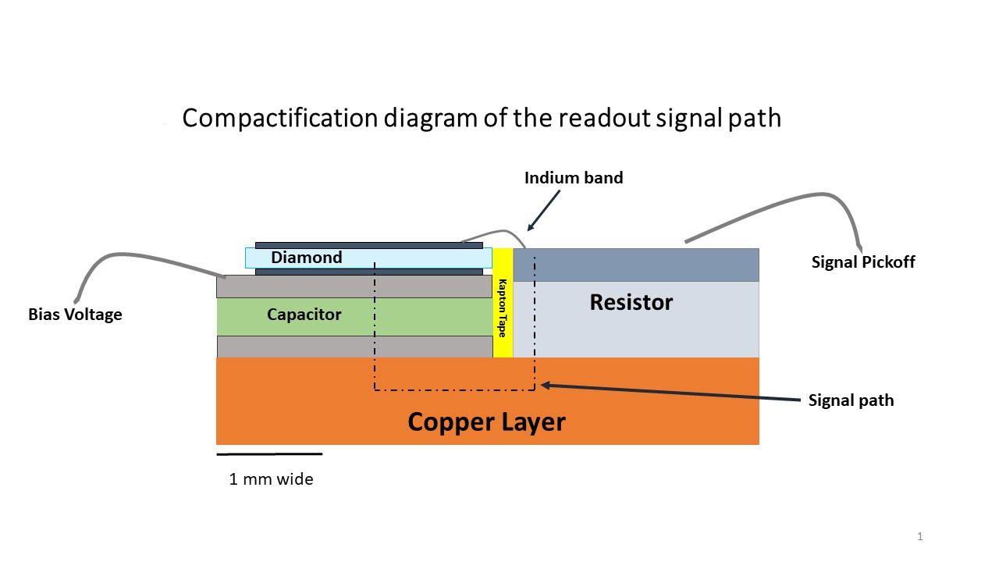
SCIPP Compact Signal Path Approach
Compact Signal Path
Make use of RF industry components to develop mm-scale signal path
Limit inductance, capacitance to push LC resonance above 10 GHz
Integrate with localized readout to eliminate signal transport degradation
To amplifier IC
Back-contact resistor
Single-layer capacitor

Slide 5
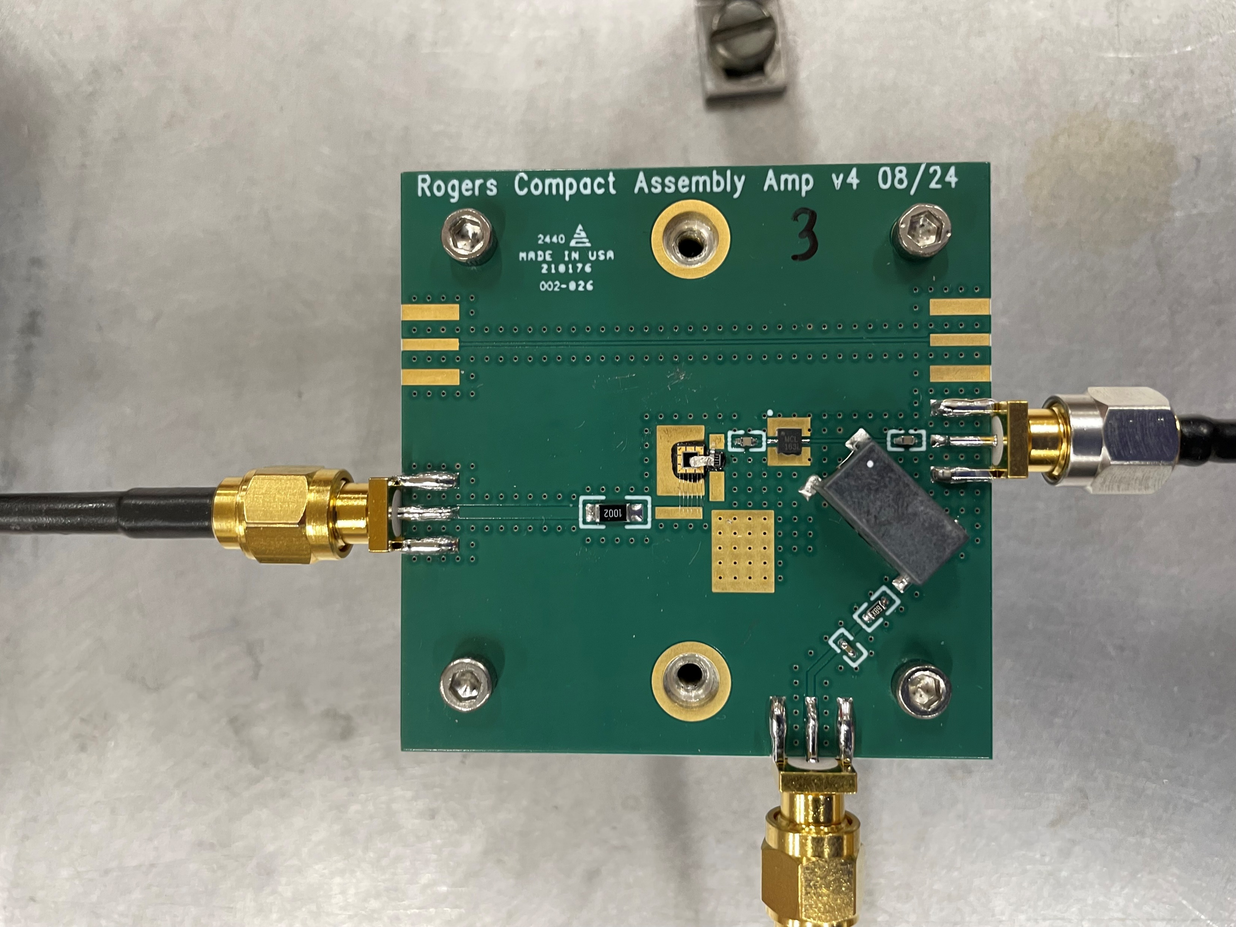
AC return through “back contact resistor, underneath solder mask to “single-layer capacitor” array
1.5x1.5 mm², 26 um thick diamond
Minicircuits EHA-163L+ RF amplifier
Diamond capacitance, per mm², 30 um thick: 1.7 pF (so this sensor is 4.4 pF)

Slide 6
From last month’s presentation:
At that point we had studied
Board with (slow) FR4 dielectric
Board with (fast) Rogers 4350b dielectric
And on these, we had excited (with an alpha source ~ 5 MeV)
Silicon PiN on FR4
33 um, 2x2 mm² diamond on FR4
26 um, 1.5x1.5 mm² diamond on Rogers 4350b

Slide 7
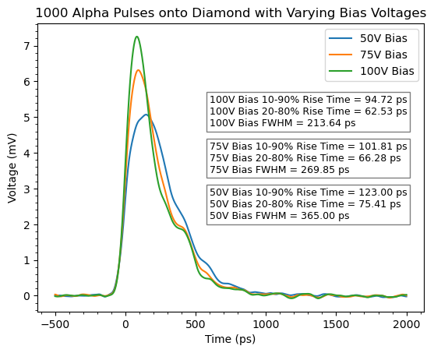
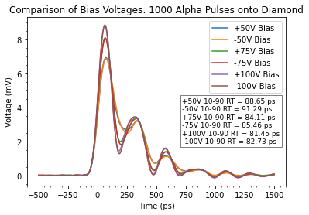
From last month’s presentation
33 um Diam
FR4
26 um Diam
Rogers
50 um Si
FR4
Rogers assembly fast, but develops ringing
Taking into account 13 GHz scope BW, τ_{rise} = 81 ps is ~ 4.8 GHz
Si PiN pulse features (~500 ps collection time) appear visible
Systematic difference for +/- voltage (Rogers assembly) suggests possible sensitivity to hole vs. electron drift in diamond
Studies underway in ANSYS HFSS to identify source of limitations

Slide 8
N.B.: For feature extraction, “Instrument response function (IRF)”, which is
just the FWHM, may be more appropriate figure of merit than rise time
82 ps rise time ➔ 4-5 GHz

Slide 9
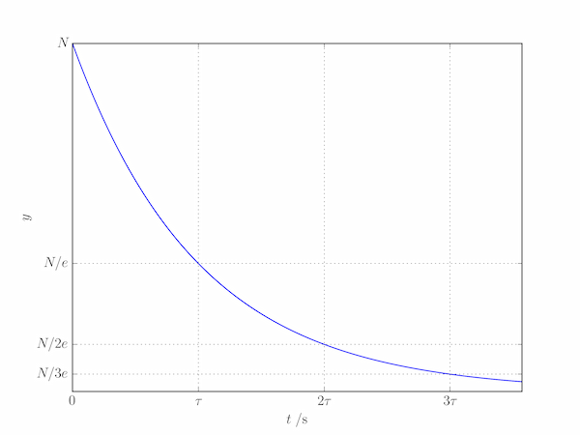
N.B.: For feature extraction, “Instrument response function (IRF)”, which is
just the FWHM, may be more appropriate figure of merit than rise time
82 ps rise time ➔ 4-5 GHz
200 ps FWHM ➔ 2-3 GHz
Exponential tail (and ringing) degrading IRF

Slide 10
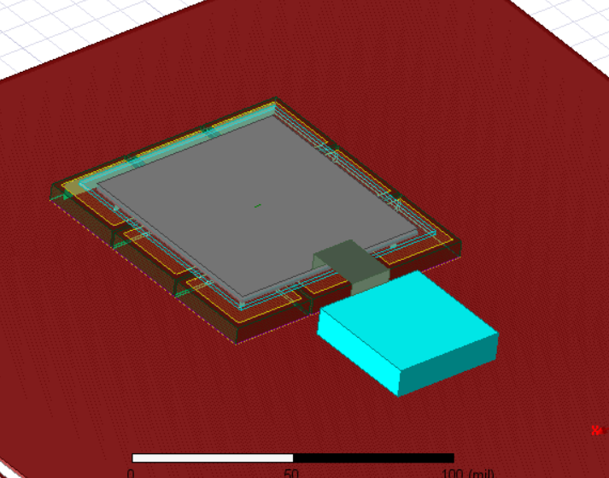
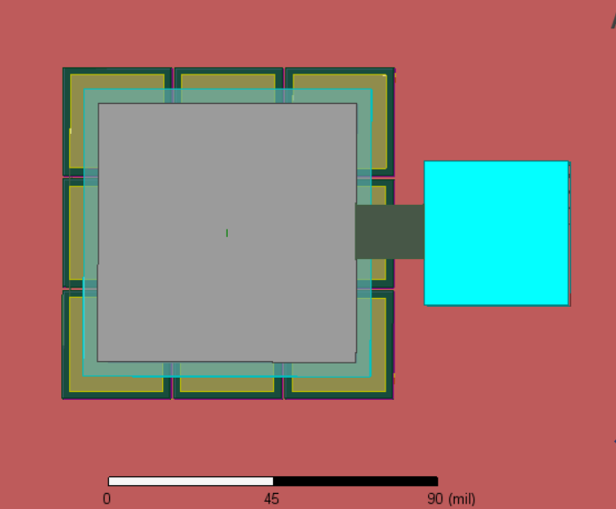
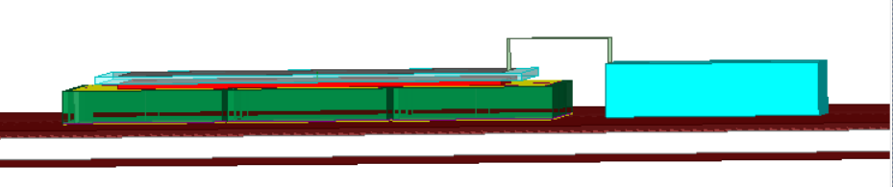
Ansys HFSS Simulations: Can we understand the response?

Slide 11
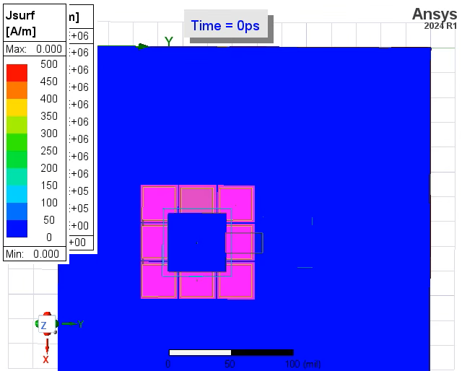
The sort of thing one can explore with HFSS…

Slide 12
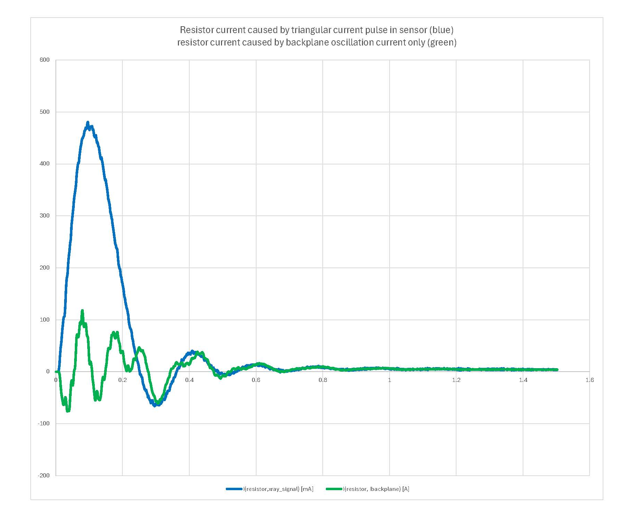
The sort of thing one can explore with HFSS…
Direct signal (sensor current)
a.u.
Induced from back-plane oscillation

Slide 13
Compact signal-path assembly
Were having trouble with leakage when biased (~mA)
This group suggested conducting tape
  Conductivity much better “through” than “along” the tape
  May suppress backplane oscillation?
HFSS simulation also suggested multiple bind wires about as good as conducting band
Good
Not as good

Slide 14
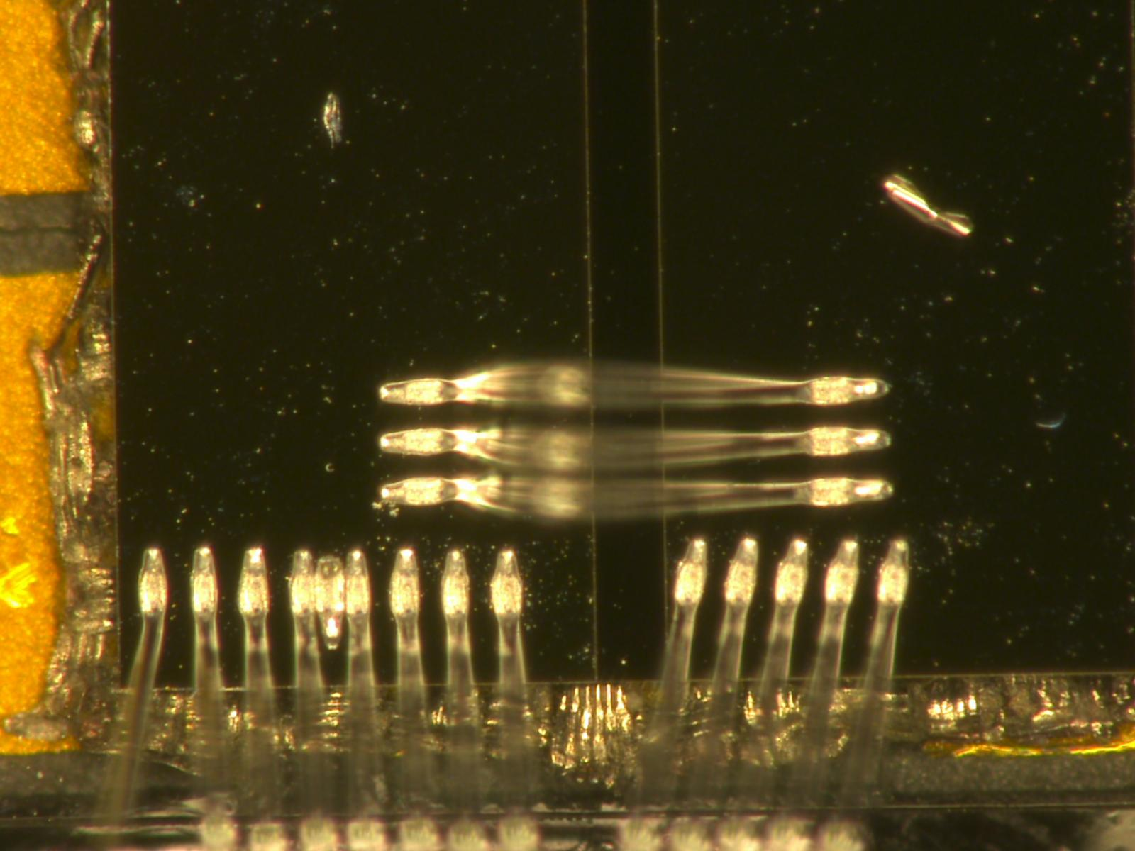
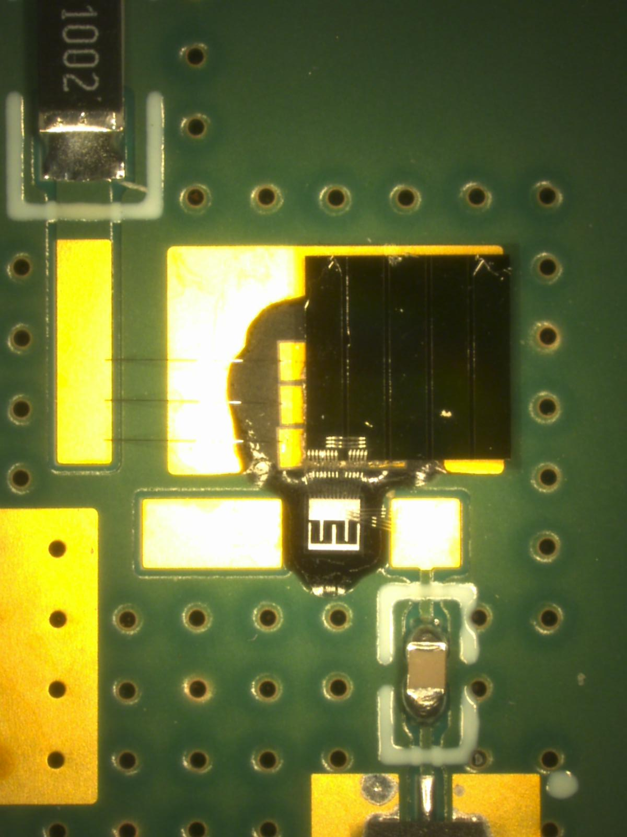
Decided to test new assembly method on defective strip sensor (isotope production project)
Illuminated with α’s just for fun
Low leakage current!
(Thank you…)

Slide 15
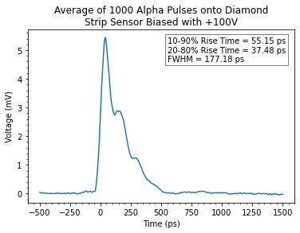
Response of assembly test structure
Estimated “true” FWHM ≈ 125 ps
➔ 4 Ghz
Encouraging result (could it be the tape?)
4 GHz (IRF) to 7 GHz (rise time)
Is this reproducible?

Slide 16
Thoughts on next steps for multi-GHz readout
Source improvement between pad and strip sensor assemblies?
IRF being limited by exponential-like tail – what is source of that?
  Detector capacitance? HFSS says maybe not…
  Continue to explore in lab and in simulation
Will work for a bit more to try to achieve reproducible system with <100ps IRF
Provide system for characterization studies
Discussing very thin (10 um) diamond sensor with small (100-um scale) pad (Los Alamos National Lab collaborator)
  50 ps collection time
  < 1 pF capacitance
Further develop UCSC “alpha station” (collimation, degradation) for independent characterization studies

Slide 17

BACKUP

Slide 18

Fast Timing Readout Scaling Laws (?)
Readout designed to optimize
$$σ_{t}=\frac{σ_{V}}{{dV}/{dt}}$$
Per um of bulk, SiC pair creation rate is roughly (3.2/7.8) / (2.3/3.6) = 64% of Si
But SiC is twice as fast
So dV/dt would be ~25% larger?
SCIPP board OK for SiC LGAD?
Gain = 1 signal would be difficult though
 | Si | SiC
e/h energy | 3.6 eV | 7.8 eV
density | 2.3 g/cm³ | 3.2 g/cm³
V_{drift} (saturated) | 100 um/ns | 200 um/ns

Slide 19
Feature Extraction Readout (multi GHz)
A fast readout system may be able to
Extract features in pulse
Be sensitive to v_{drift} and τ_{impact} as a function of local field
Best geared towards large depositions due to readout noise (alpha particle)
Under study at SCIPP
“Chain only as strong as weakest link” (charge collection, signal path, signal transport, readout…)

