Slide 1
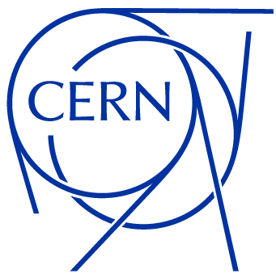
Status update
March 2025
Antonio Cristiano
EP-ESE-BE
BRATOL Meeting

Slide 2
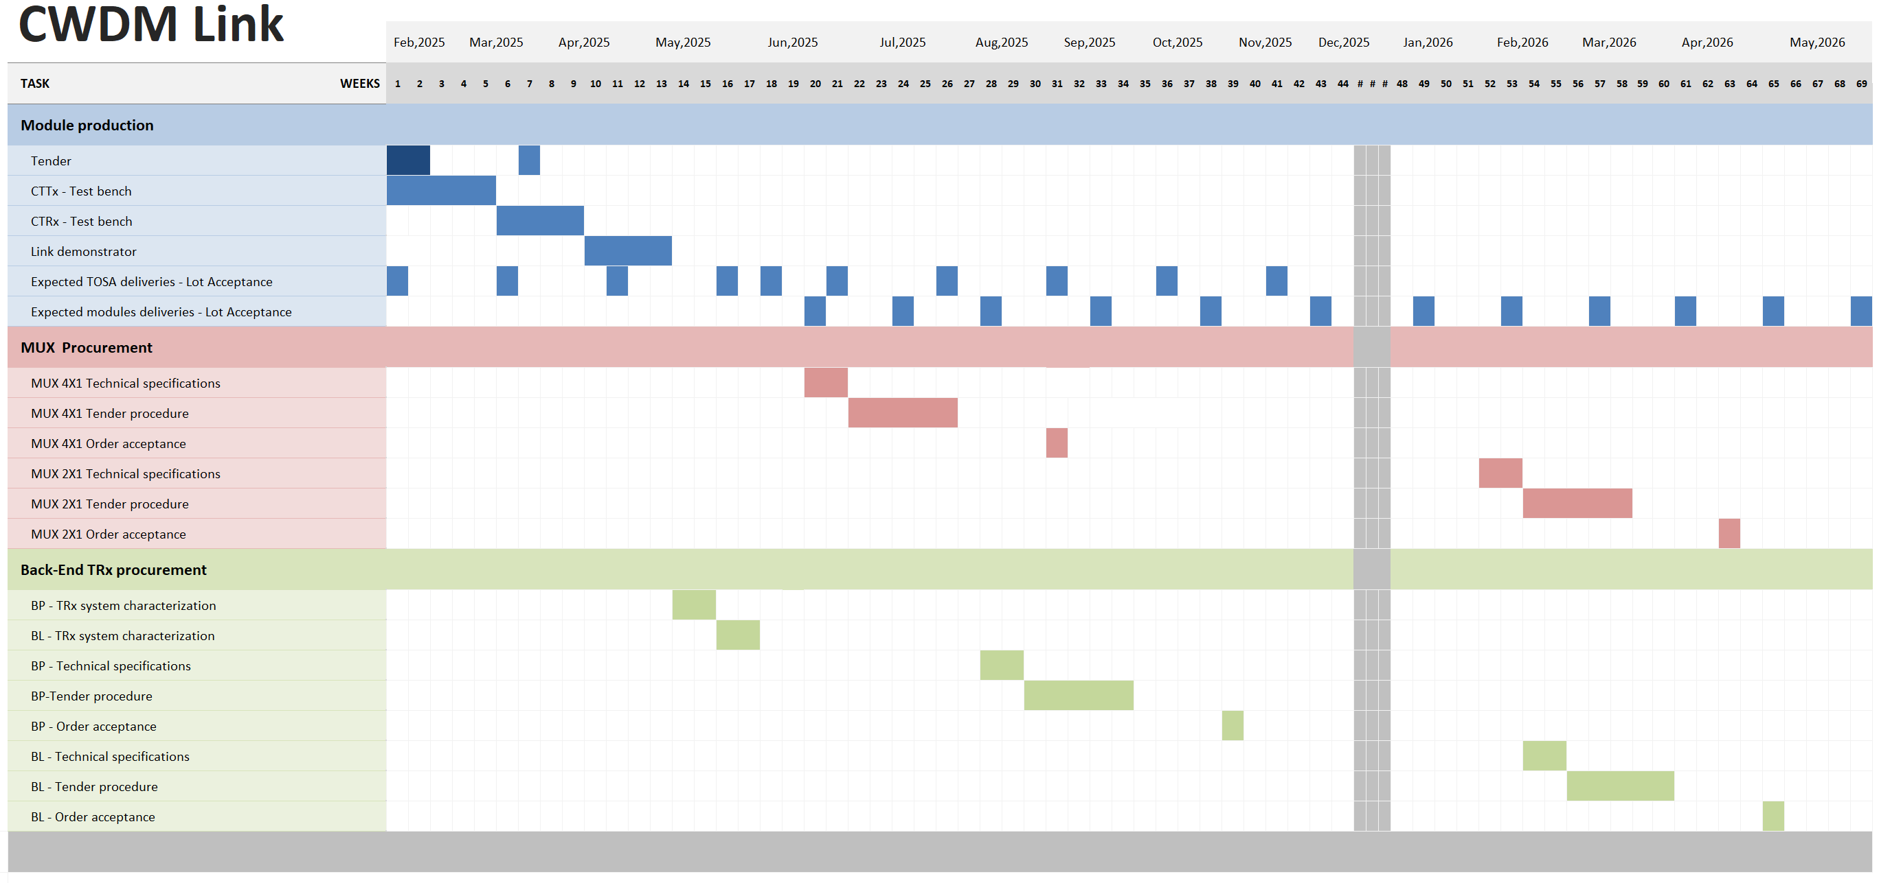
Timeline Feb ’25 – May ‘26
Timeline outcome
Production tender deadline :
20 March
Start of production – CTTx pre-series:
May (to be agreed with contractor)
MUX 4X1 :
Procurement closed before October 2025
Back-End TRx for BP :
Procurement closed before December 2025
BL design link:
Use of MUX 2X1 to be decided before December 2025.

Slide 3
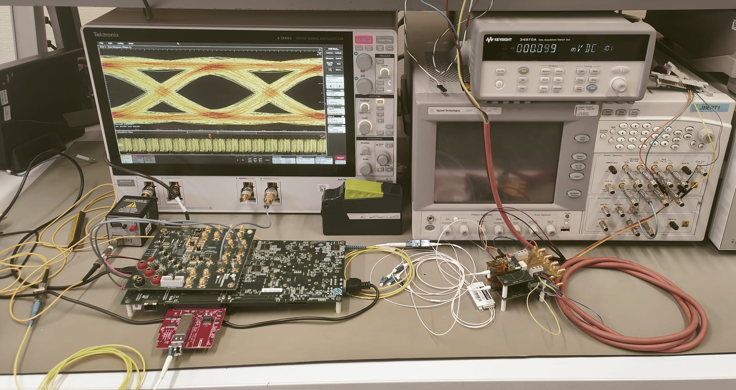
Production test bench
VRRx 1
Kintex KC705
DAQ
1x4 Mux
VRRx 2
CTTx
1x LC
Splitter 1:9
6 db Attenuator
Ref Photoreceiver
1544-B
FMC
CTRx
2x LC
RD-
DP4T Switch
RD+
RSSI
BER Tester
Out2
Out1
Ref Tx
VOA
SCOPE

Slide 4
Production test bench – CTTx tester
VRRx 1
CTTx Tester
Kintex KC705
DAQ
1x4 Mux
VRRx 2
Completed work:
FPGA Design:
  Pattern generator 10 Gb/s
  I2C Communication protocol
FMC Characterization
CTTx
1x LC
Splitter 1:9
6 db Attenuator
Ref Photoreceiver
1544-B
FMC
CTRx
2x LC
RD-
DP4T Switch
RD+
RSSI
BER Tester
Out2
Out1
Ref Tx
VOA
SCOPE

Slide 5
Production test bench – CTTx tester
VRRx 1
CTTx Tester
Kintex KC705
DAQ
1x4 Mux
VRRx 2
Completed work:
FPGA Design:
  Pattern generator 10 Gb/s
  I2C Communication protocol
FMC Characterization
CTTx
1x LC
Splitter 1:9
6 db Attenuator
Ref Photoreceiver
1544-B
FMC
CTRx
2x LC
RD-
DP4T Switch
RD+
RSSI
BER Tester
Out2
Out1
Ref Tx
VOA
SCOPE
The characterization of the FMC was carried on comparing eye diagram and dynamic characteristics of CTTx modulated through FMC and through JBERT.
The result is obtained:
Using an external low jitter clock synthesizer to overcome instability of FPGA clock generator
Selecting appropriate Pre-Emphasis settings of FPGA.
The photoreceiver used is the AC-Coupled version of the 1544-B. DC coupled version is being purchased.

Slide 6
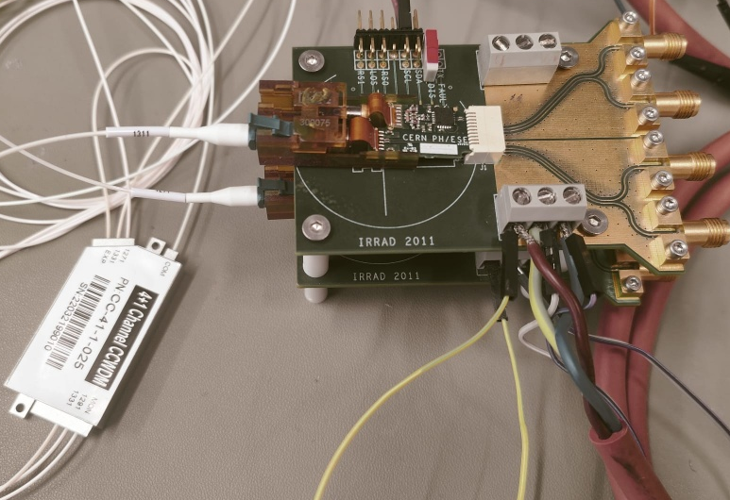
Production test bench – CTTx tester
VRRx 1
CTTx Tester
Kintex KC705
DAQ
1x4 Mux
VRRx 2
Completed work:
FPGA Design:
  Pattern generator 10 Gb/s
  I2C Communication protocol
FMC Characterization
Wavelength check system
CTTx
1x LC
Splitter 1:9
6 db Attenuator
Ref Photoreceiver
1544-B
FMC
CTRx
2x LC
RD-
DP4T Switch
RD+
RSSI
BER Tester
Out2
Out1
Ref Tx
VOA
SCOPE
The wavelength check is performed using two VRRx (VTRx in photo, VRRx are being assembled) connected to the four output channel of a 1x4 DEMUX. The RSSI of each channel is evaluated and compared to a threshold value.

Slide 7
Production test bench – CTTx tester
VRRx 1
CTTx Tester
Kintex KC705
DAQ
1x4 Mux
VRRx 2
Completed work:
FPGA Design:
  Pattern generator 10 Gb/s
  I2C Communication protocol
FMC Characterization
Wavelength check system
Measurement routine
CTTx
1x LC
Splitter 1:9
6 db Attenuator
Ref Photoreceiver
1544-B
FMC
CTRx
2x LC
RD-
DP4T Switch
RD+
RSSI
BER Tester
Out2
Out1
Ref Tx
VOA
SCOPE
Wavelength Check
OMA Measurement
Functional test
Connection check
LI Curve

Slide 8
Production test bench – CTTx tester
VRRx 1
CTTx Tester
Kintex KC705
DAQ
1x4 Mux
VRRx 2
Completed work:
FPGA Design:
  Pattern generator 10 Gb/s
  I2C Communication protocol
FMC Characterization
Wavelength check system
Measurement routine
To be done:
GUI Routine measurement
Production tests database on Database on Demand service
CTTx
1x LC
Splitter 1:9
6 db Attenuator
Ref Photoreceiver
1544-B
FMC
CTRx
2x LC
RD-
DP4T Switch
RD+
RSSI
BER Tester
Out2
Out1
Ref Tx
VOA
SCOPE
Wavelength Check
OMA Measurement
Functional test
Connection check
LI Curve

Slide 9
Production test bench – CTRx tester
VRRx 1
CTRx Tester
Kintex KC705
DAQ
1x4 Mux
VRRx 2
Completed work:
I2C and BERT design
Ongoing work:
SFP connector instantiation
BER test on FPGA
CTTx
1x LC
Splitter 1:9
6 db Attenuator
Ref Photoreceiver
1544-B
FMC
CTRx
2x LC
RD-
DP4T Switch
RD+
RSSI
BER Tester
Out2
Out1
Ref Tx
VOA
SCOPE

Slide 10
Gamma irradiation TOSA – February 2025
Dose: 10.4 kGy
Average increase : 1 nm
End-of-irradiation to measurement time: 1h
1st Gamma
Irradiation
Dose: 11 kGy
Average increase : 0.5 nm
End-of-irradiation to measurement time: 18h
2nd Gamma
Irradiation
A lower increase in case of the second irradiation could be due to TID anneal at room temperature between the end of irradiation and the characterization

Slide 11
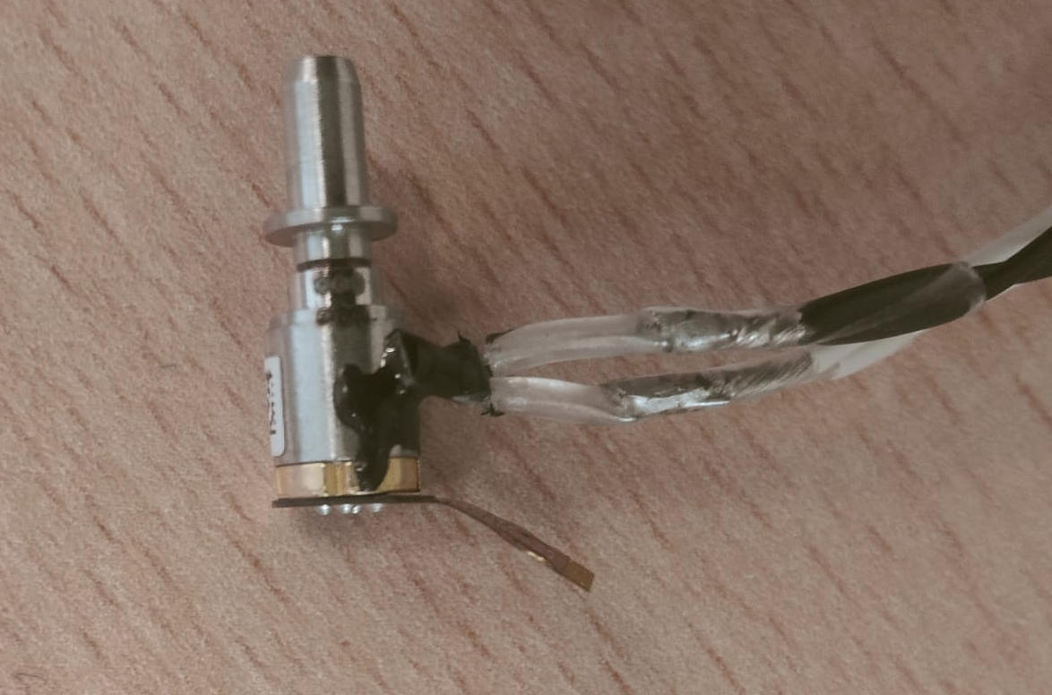
Gamma irradiation TOSA – February 2025
PT100
TOSA Bias OFF
60 s
36h
30 mins
Wavelength drop between PostRad and StartCycle, although the temperature increase, can be symptom of TID annealing.
The results lead into considering wavelength shift due to TID for MUX FWHM of specifications:

Slide 12
MUX – Channel bandwidth specifications
FWHM
Requirements on MUX FWHM
TOSA – WL variation
-5.5 nm < Δλ_{TOSA}(F,T) < + 5.7 nm
-6.5 nm < Δλ_{TOSA}(F,T) < + 6.5 nm
FWHM > 15 nm
ΔFWHM(T) < 2 nm
MUX – FWHM variation
ΔFWHM(T) < 2 nm
ΔFWHM(T) = 2 nm

Slide 13
Back-End components – CWDM 4x1 Price comparison
MUX 4X1
SFP+
QSFP
Vendor | Country of origin | Price [CHF] | Insertion losses [dB] | FWHM [nm] (measured)
Huber-Suhner | Germany | 225-240 | 1.8 | >16
AcalBFI | China | 67-58 | 1.2 | >16
HiFiber | China | 32-28 | 1.4 | >15
Vendor | Country of origin | Price [CHF] | Rx Sensitivity [dBm]
EdgeOptic | China | 8.5 | <-14
IntelliNetwork | China | 51 | <-13
CISCO | Taiwan | 31 | <-14.4
Vendor | Country of origin | Price [CHF] | Rx Sensitivity [dBm]
EdgeOptic | China | 65 | <-13.7
QSFPTEK | China | 68 | <-13.7
FlexOptix | Germany/ Taiwan | 195 | <-11.5
CTTx
1271
SFP+
Power Margin Rx Sens = -14 dBm IL Mux= 1.5 dB | MUX Total Price [CHF] 3000 pcs | SFP+ Total Price [CHF] 6000 pcs | Back-End total price [CHF]
>2 dB | ~174k | ~51k | ~225 k
BPM
Option 1
1291
SFP+
CTTx
1311
SFP+
1331
SFP+
CTTx
1271
Power Margin Rx Sens = -13.7 dBm IL Mux= 1.5 dB | MUX Total Price [CHF] 1500 pcs | QSFP Total Price [CHF] 1500 pcs | Back-End total price [CHF]
>3.2 dB | ~52.5k | ~97.5k | ~150 k
1291
QSFP
BPM
Option 2
1311
CTTx
1331
Price errata corrige in the following slide

Slide 14
Back-End components – CWDM 4x1 Price comparison
MUX 4X1
SFP+
QSFP
Vendor | Country of origin | Price [CHF] | Insertion losses [dB] | FWHM [nm] (measured)
Huber-Suhner | Germany | 225-240 | 1.8 | >16
AcalBFI | China | 67-58 | 1.2 | >16
HiFiber | China | 32-28 | 1.4 | >15
Vendor | Country of origin | Price [CHF] | Rx Sensitivity [dBm]
EdgeOptic | China | 8.5 | <-14
IntelliNetwork | China | 51 | <-13
CISCO | Taiwan | 31 | <-14.4
Vendor | Country of origin | Price [CHF] | Rx Sensitivity [dBm]
EdgeOptic | China | 65 | <-13.7
QSFPTEK | China | 68 | <-13.7
FlexOptix | Germany/ Taiwan | 195 | <-11.5
BPM Option 1
(2 MUX + 4 SFP+)
BPM Option 2
(1 MUX + 1 QSFP)
Power Margin Rx Sens = -14 dBm | MUX Vendor | MUX Total Price [CHF] 3000 pcs | SFP+ Total Price [CHF] 6000 pcs | Back-End total price [CHF]
2.6 dB | AcalBFI | ~174k | ~51k | ~225k
2.2 dB | HiFiber | ~84k | ~51k | ~135k
Power Margin Rx Sens = -13.7 dBm | MUX Vendor | MUX Total Price [CHF] 1500 pcs | QSFP Total Price [CHF] 1500 pcs | Back-End total price [CHF]
3.5 dB | AcalBFI | ~100.5k | ~97.5k | ~198k
3.3 dB | HiFiber | ~48k | ~97.5k | ~145 k
Option 2: Lower total price with AcalBFI MUX [Priority of low insertion losses over price]
Option 1: Lower but comparable total price with HiFiber MUX [Priority of price over losses]

Slide 15
Summary
CTTx/CTRx production
  Tender will close on 20th of March.
  Production will realistically start on May.
Production test setup
  Transmitter side completed.
  Receiver side ongoing.
  To be done: GUI and results database.
Gamma irradiation TOSA
  Validated previous measurements of TID effect on TOSAs.
  TID quickly anneals when TOSA is in operation.
Back-End components – CWDM 4x1
  The option MUX+QSFP is cheaper and guarantees higher power margin.
  Management of spares easier with 2 x MUX + SFP+

