Slide 1


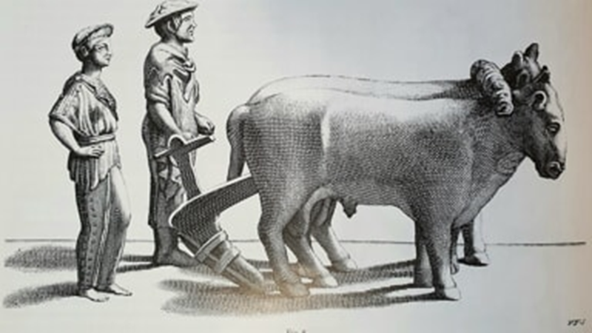
Quasi-free electron scattering on nuclei and atoms
SYMPOSIUM FOR UGO’s 90 YEARS
CERN Council Chamber, Friday 4 April 2025
Giovanni Stefani
Dipartimento di Scienze Università Roma Tre
CNR Istituto di Struttura della Materia
Notes:
A common thread between today speakers is that they have moved in furrows initially drawn by Ugo.
He has produced plenty of them and this is precisely what we will witness today.
Ugo is a groundbreaker with a clear view of the scientific path to be walked.
This was clear from the beginning of his career when he started the electron quasi-elastic scattering experiments on nuclei and clearly saw the possibility for application to a wider class of quantum systems.
In the early 1960s, the validity of the shell model was the subject of intensive research.
The model tries to solve one of the fundamental problems of quantum mechanics.
Namely, how to deal with the mutual interaction of N particles bound in an external potential.
That’s the problem he was addressing with these experiments

Slide 2
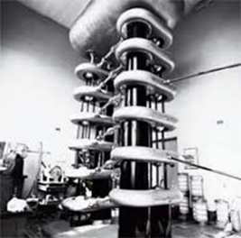
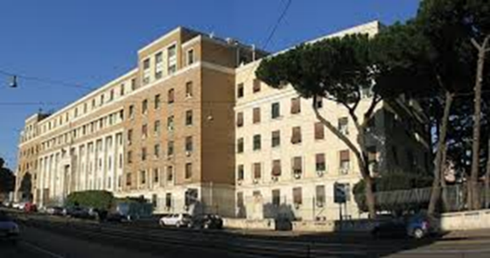
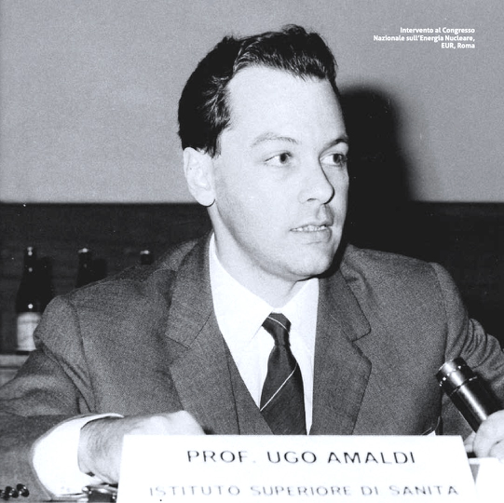
When I met Ugo 1969
SYMPOSIUM FOR UGO’s 90 YEARS CERN Council Chamber, Friday 4 April 2025
Notes:
I met Ugo in 1969 at Istituto Superiore di Sanità (ISS) were I went to ask for a thesis.
ISS is an imposing building just across the street from the Sapienza campus and I was immediately tempted by the atmosphere of a temple of science that floated at the Istituto.
I was sent to the 7th floor where, in the rarefied atmosphere NEXT of the place that housed the Cockroft-Walton accelerator by Fermi, I asked Ugo NEXT for a thesis in nuclear physics.
The answer was: I could suggest a subject, but a young person should embark on new paths such as the quasi-elastic scattering on atoms or aggregates of atoms.
There is much to learn in this new field.
He was convinced of that because his original electron quasi elastic collision on nuclei (e,e’p) and on atoms (e,2e) had reached already international fame.

Slide 3

unified view of electron-matter interaction
SYMPOSIUM FOR UGO’s 90 YEARS CERN Council Chamber, Friday 4 April 2025
Atoms
Nuclei
Courtesy
Of
Ugo
Amaldi
HERA Report 1980
Nucleons
Notes:
More than anything else, it was his unified view of electron-matter interaction to determine his certainty.
His broad view is well summarized in a figure of the ECFA Report produced by a committee he chaired in 1980.
The three graphs highlight an electron energy transfer mechanism (transferred energy on the x-axis and probability on the y) similar in atoms, nuclei and hadrons.
In particular, they share an energy transfer channel al large energy and momentum transfer, defined as quasi-free, that has been the guiding thread of Ugo’s activity in the decade 1962-1972.

Slide 4



Why quasi-free scatterinG?
Boron nucleus
5 protons+ 5 neutrons
Shell Model
¹⁰B
Binding energies and
Momentum Distributions
Unknown observables
Notes:
The key feature of the quasi-elastic channel is an impact localized in a radius shorter than the inter-particle distance.
It implies that one proton of the target nucleus takes all energy and momentum transferred by the incoming particle while the remainder is frozen in its previous configuration. NEXT
According to the Shell Model, in the ground state nucleons occupy the lowest energy levels with characteristic Binding Energy and Momentum Distribution. NEXT
Let’s take boron. NEXT Two different Binding Energy and Momentum Distributions should be measured for 1s and 1p.
If SM is not merely a mathematical model, BE and MD should be observable in a quasi-free scattering
Processes initiated by proton (p,2p) were largely applied in the early ‘60.

Slide 5


Quasi free
scattering
BE_{(n)}=E₀-E₁-E₂
q_{(n)} =P₀-P₁-P₂
E
E₁
E₀
AND
BE_{(n)}
q_{(n)}
E₂
Notes:
In a (p,2p) experiment, as in any quasi-elastic collision, the full kinematics is determined,
it implies to detect in coincidence the particle pair and to measure their kinetic energy and ejection angle.
Energy and momentum conservation allows to determine Binding energy and proper momentum of the proton.
In spite of the success of these experiments, the strength of the proton-proton nuclear interaction and the consequent multiple interactions with the target made their interpretation not straightforward.

Slide 6
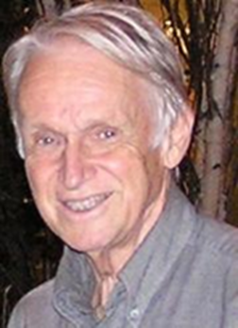
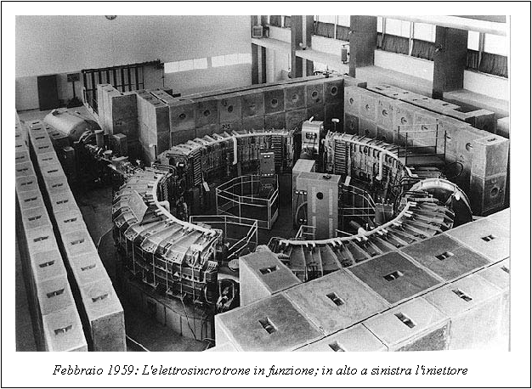

(e,e’p) insteAd of (p,2p) 1962
ELECTRON SYNCHROTRON
INFN LABORATORY @ FRASCATI - 1963
Thin internal target traversed by circulating electrons (FIRST TIME)
Torleif Erikson
Courtesy of
Ugo Amaldi
SYMPOSIUM FOR UGO’s 90 YEARS CERN Council Chamber, Friday 4 April 2025
Notes:
In 1962, Ugo accompanied the Swedish physicist Erikson to visit the Frascati electro synchrotron, and learned that two Brazilian (Jacob &Maris) physicists had proposed the (e, e'p), reaction, analogous to (p, 2p) but originated by an electron.
The weaker electron-proton electromagnetic interaction would have made interpretation more straightforward.
Ugo did not spend much time realising the (e,e’p) potentialities and successfully proposed to Ageno, then director of the Laboratorio di Fisica, to develop, in Rome and Frascati, such an experiment that had never been attempted before.
He established a research group with the members of Reparto di Fisica delle Alte Energie led by Cortellessa.
The winning ideaNEXT it was to exploit the longer duty cycle of the synchrotron and to insert the target in the inner circulating beam of electrons NEXT

Slide 7
FIRST (e,e’p) EXPERIMENT AT LNF: NUCLEAR SPECTRAL FUNCTION
E₀+A_{(N)}=E₁+E₂+A_{(N-1)}
BE_{(n)}=-E₀+E₁+E₂
SYMPOSIUM FOR UGO’s 90 YEARS CERN Council Chamber, Friday 4 April 2025
Notes:
In 1964 he published the first (e,e’p) experiment together with the ISS team.
The experiment measured the spectral function (missing energy or Binding Energy) of the C¹² and Al²⁷ nuclei. NEXT
In Al the occupied states are from 1s to 2d. NEXT
In the spectral function the nucleus shell structure was evident and, contrary to (p,2p) experiments, it was possible to single out, and assign a proper binding energy, to all levels from the outermost to the innermost 1s.
NEXT

Slide 8
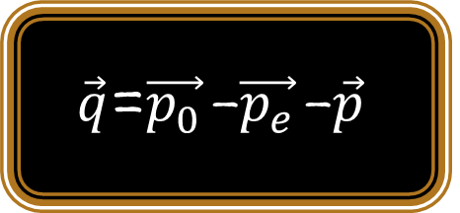
FIRST ANGLE RESOLVED (e,e’p) AT LNF: MOMENTUM SPECTROSCOPY
$−\vec{q}$=$\vec{p_{0}}$-$\vec{p_{e}}$-$\vec{p}$
Denis Haigh Wilkinson : “the most direct proof of the validity of the nuclear shell model”.
SYMPOSIUM FOR UGO’s 90 YEARS CERN Council Chamber, Friday 4 April 2025
Notes:
Two years later, is the original odometer designed by Ugo that made it possible to measure the angular distributions of the protons extracted from the ¹²C target for two values of the binding energy, the 1s and 1p shells.
The momentum distribution NEXT agreed with the Shell Model predictions, i.e with a maximum and a minimum at q=0 respectively.
Simultaneous, a theoretical work with Ciofi degli Atti discussed its capability to discriminate among different nucleon wave functions.
After these experiments NEXT validity of the Shell Model was fully established as a realistic description of the ground state of nuclei.
That is why Wilkinson valued these results NEXT as “the most direct proof of the validity of the nuclear shell model”.
The road was mapped out, the research team continued with a series of experiments from Be to As that consolidated the international status of the (e,e’p) research at the Frascati electro synchrotron.

Slide 9
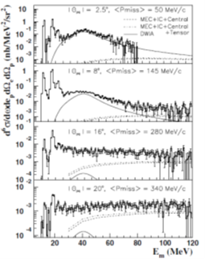
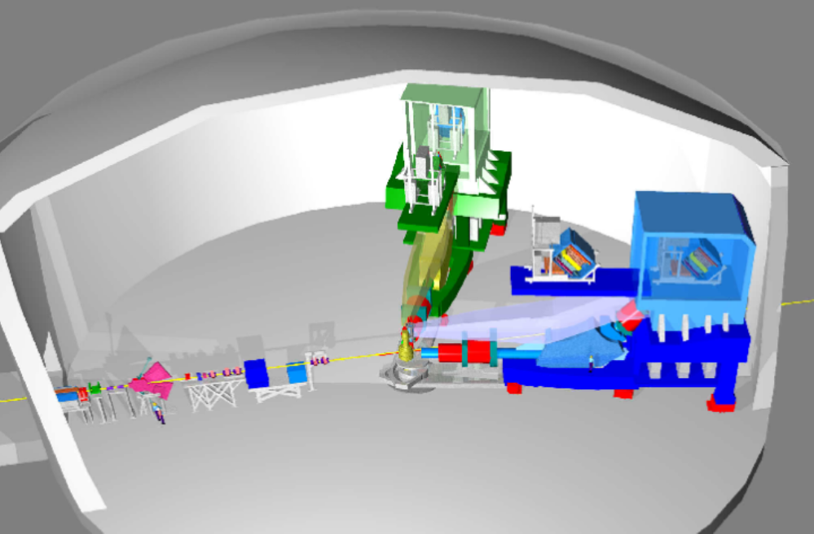

(e,e’p) 50 YEARS LATER
Many-body
Frascati I (1963) 500MeV
Tokyo (1970) 750 MeV
Frascati II (1972) 700MeV
SCLAY (1971-) 500MeV
Karkov (1972) 1.2 GeV
Desy (1973) 2.7 GeV
NIKHEF-K (1984) 500MeV
Jefferson Lab (1989) 2.2 GeV
Many-body
Many-body
Many-body
SYMPOSIUM FOR UGO’s 90 YEARS CERN Council Chamber, Friday 4 April 2025
Notes:
Over the following fifty years, (e,e’p) were started in a number of laboratories.
With increasing energy and momentum resolution generating a stream of new information on nuclear structure.
The latest implementation NEXT at the continuous beam accelerator of Jefferson lab has increased the energy and the momentum transfer NEXT to values that investigate the nucleus well beyond the independent particle limits thus extending (e,e’p) to the study of the Many Body features of the nucleus.

Slide 10
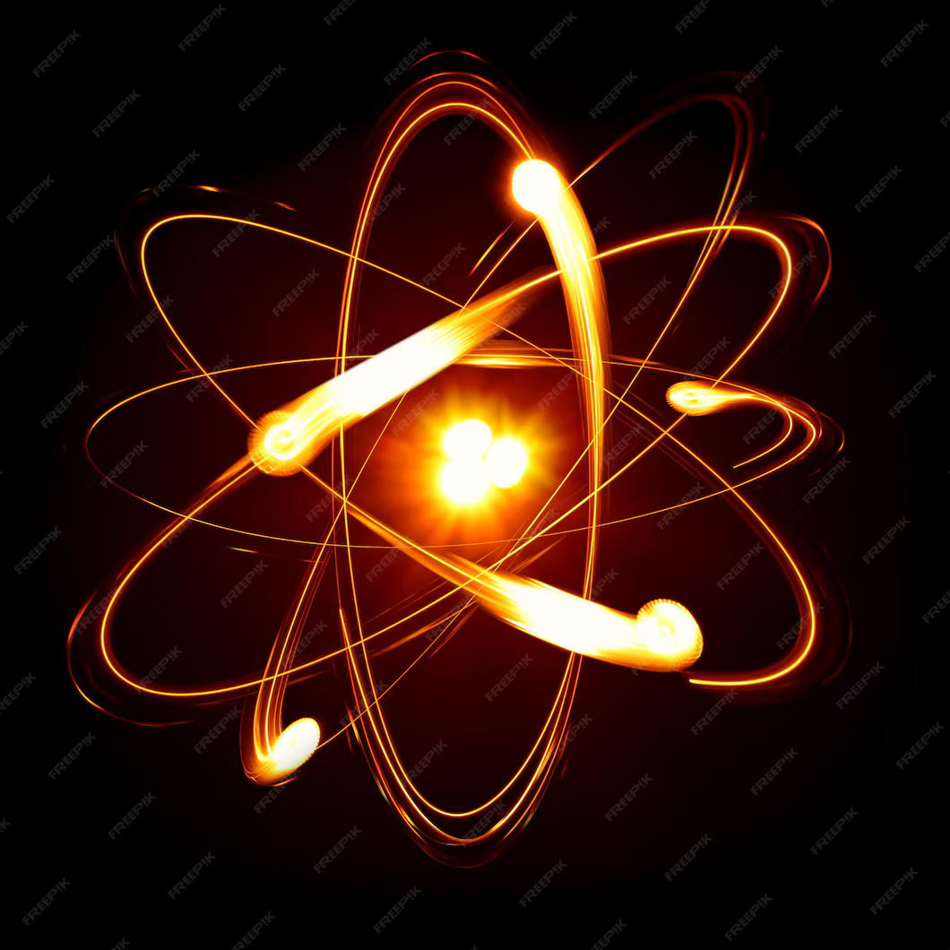
E₀
Quasi free scattering
On Atoms
BE_{(n)}=E₀-E₁-E₂
q_{(n)} =P₀-P₁-P₂
E₁
BE_{(n)}
q_{(n)}
₀
AND
E₂
(e,2e)
Notes:
Let me now return to the second half of 1960’s.
It was in a library that Ugo realized that an experiment similar to (e,e'p) had never been attempted before on atoms.
Even though, in those years, two theoretical papers had suggested that such an experiment would have been conceivable and feasible.
In these experiments, the incoming electron scatters quasi-free from a single bound electron leaving the residual atom frozen.
Energy and momentum conservation allow for determining Binding Energy and Momentum distribution.
At the same time as the theoretical predictions, Ugo succeeded in realizing one such experiment that, in analogy to the (e,e'p) were given NEXT the acronym (e,2e).

Slide 11
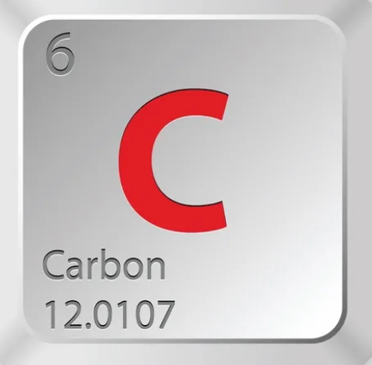
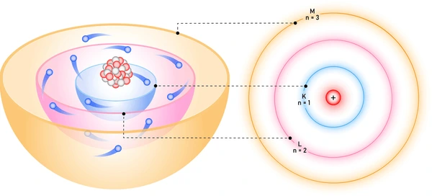
FIRST (e,2e) SPECTRAL FUNCTION ON ATOM
SYMPOSIUM FOR UGO’s 90 YEARS CERN Council Chamber, Friday 4 April 2025
K
L
BE=E₀-(E₁+E₂)
E₁
AND
E₀
E₂
0 200 400 BE(eV)
Notes:
The successful (e,2e) required a truly interdisciplinary effort.
The prototype spectrometer was assembled at Istituto di Fisica of La Sapienza exploiting the know-how on electron energy analysers and fast timing electron detection available in the astrophysics group.
NEXT
The experiment was performed on a few hundred Å thick Formvar film.
NEXT
In the figure, the coincidence rate vs. the binding energy shows, clearly separate in binding energy, contributions from the Carbon K and L shells. NEXT
This result is rightly recognized as the beginning of a new spectroscopy, the electron momentum spectroscopy.
Immediately followed a theoretical paper with Ciofi degli Atti that defined value and limitations of (e,2e).
The outer levels of the light atoms were recognized as the ideal field of application, but exactly those are the ones that matters the most for describing properties of condensed matter.

Slide 12
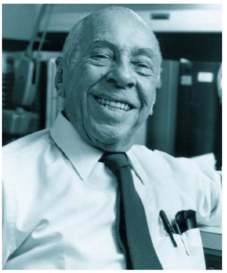
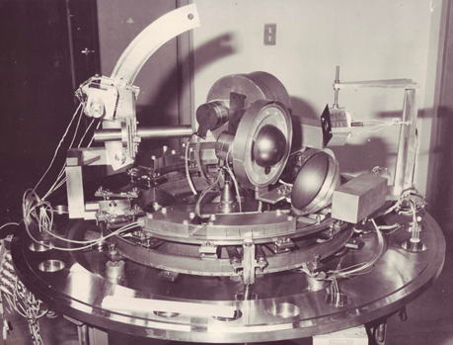
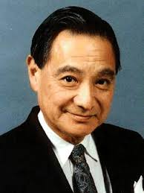
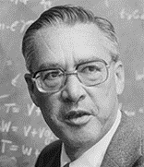
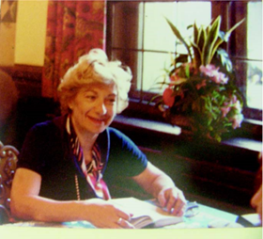
In ugo’s footsteps towards momentum spectroscopy
SYMPOSIUM FOR UGO’s 90 YEARS CERN Council Chamber, Friday 4 April 2025
Notes:
1968 Rossana Camilloni, NEXT joined Ugo in the (e,2e) project as a Laurea student. Meanwhile, the apparatus had been moved to ISS.
Months later, I started working for my thesis and Ugo told us that he was moving to CERN and had not plan having other graduates, but I had come and it was a sign of providence. Ugo has been hardly more prophetic than that. Not only that was the starting point of a scientific career for Rossana and I, but four years later we were married, and still we are today! Providence was very busy with us in that day!
ISS was a meeting point of atomic physicists and Ugo, as usual, was ready to absorb and share new opinions and ideas.
Hediscussed the (e,2e) with Ugo Fano, NEXT receiving a tepid reaction, Mitio Inokuti NEXT instead positively commented. The conflicting opinions rather than discouraging, convinced Ugo that it was worth pursuing the electron momentum spectroscopy.
In 69 McCarthy NEXT visited Ugo to discuss (e,2e) spectroscopy with him. They decided to keep closely in touch and shortly after a lively theoretical and experimental (e,2e) activity started at Flinders.
Ugo tried whatever he could, and usually is not a little, to gather a sizeable research group around the experiment.
He convinced Anna Giardini, NEXT his classmate and then on the way of transfer from CNR to LNF Frascati, to assume the responsibility of the group.
In 1971 the apparatus was moved to LNF and there began the activity of the (e,2e) group that was active for nearly two decades operating a second generation coincidence spectrometer. NEXT

Slide 13

First momentum spectroscopy on atoms
K
L
SYMPOSIUM FOR UGO’s 90 YEARS CERN Council Chamber, Friday 4 April 2025
Notes:
Ugo was a constant inspiration and support to the (e,2e) group and the upgraded (e,2e) prototype spectrometer was used to perform the first momentum-density measure on a carbon self-supported thin foil (100 and 250 Å).
The energy resolution was modest but sufficient to fully separate K (1s) NEXT from L(2s 2p) NEXT shell events. The momentum resolution adequate in order to discriminate between two different carbon 1s Hartree-Fock wave functions.
In this circumstance, one of the Ugo human traits that I most appreciate, generosity, was clearly manifested.
He did not want to sign the papers that were produced, not even the first paper. His main aim has always been to see carried out what he thought were good projects, regardless of his personal interest.

Slide 14
momentum spectroscopy: a vital and evolving legacy
1972 | Frascati National Laboratory CNEN (Italy)
1973 | Flinders University. Adelaide (South Australia)-.
1978 | British Columbia University. Vancouver (Canada)
1978 | University of Maryland. College Park (USA)
1981 | IMAI-CNR, Montelibretti (Italy)
1983 | Université Paris Sud. Orsay (France)
1983 | Virginia Polytechnic Institute (USA)
1989 | Tsing Hua University Peking (China)
1996 | City University Osaka (Japan)
1996 | University Science & Technology Hefei (China)
1997 | Tohoku University Sendai (Japan)
2002 | Tokio University of Agricolture and Technology Tokyo (Japan)
SYMPOSIUM FOR UGO’s 90 YEARS
CERN Council Chamber, Friday 4 April 2025
Notes:
Atomic physicists and chemist were impressed by these results and started undertaking similar experiments.
Since then (e,2e) experiments flourished throughout the world.
The latest (e,2e) paper published few days ago shows that the chemist’s dream of visualizing the molecular orbital has come through, in reciprocal space rather than in direct one. (April 1. 2025 (e,2e) Cyclopentane BE and MD of the molecular orbitals)

Slide 15
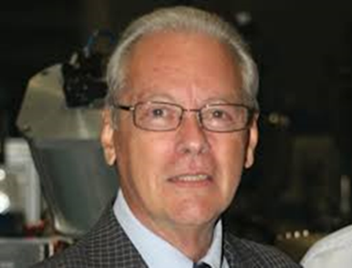
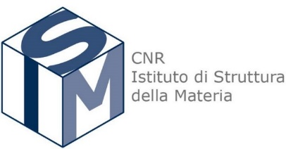
for the fertile fields of research you have ploughed
Thank you Ugo !
Notes:
Let me finish mentioning:
for the fertile fields of research you have ploughed

