Slide 1

Roman pots and the rise of the proton- proton cross section
Symposium to celebrate Ugo Amaldi’s 90th birthday
Tord Ekelöf
UppsalaUniversity

Slide 2
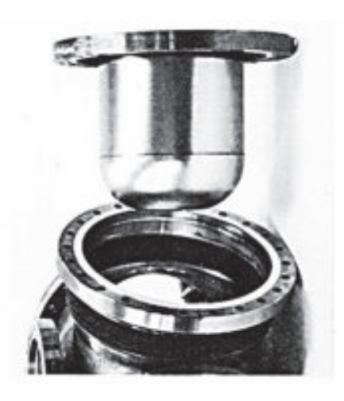

Roman Pots
Roman pot at Malton Museum
Roman Pot used at ISR

Slide 3
Total cross-sections 1970 and Asymptotia
Around 1970 the accelerator with the world’s highest
energy was the 70 GeV proton synchrotron in Serpukov
south of Moscow. The measurements of total cross-sections
in the plot were published in 1970. Each total cross-sections
seem to flatten out towards a constant value which gave
rise to the concept of Asymtotia that the cross-sections
would not change any more with energy when going to higher
and higher energies and that there would in consequence
be no interest in making experiments at higher energies.
Ugo Amaldi, who had started to work at CERN around that
time did not believe in the idea of Asymptotia. But where would
it be possible to measure total cross-sections at higher energies
than at Serpukov?

Slide 4
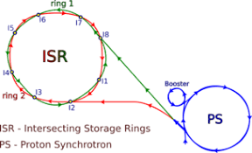
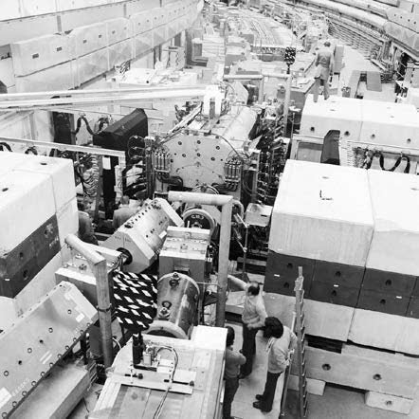
The Intersecting Storage Rings
At CERN the operation of the ISR (Intersecting Storage Rings), two intersecting proton synchrotron rings each with a circumference of 942 m, were to start in 1971. The CERN PS was to inject 26 GeV/c proton beams into the two rings that could accelerate up to 31.4 GeV/c implying a proton-proton centre-of mass energy of 63 GeV. This was a 5-fold increase with regard to the proton-proton collisions of the Serpukov fixed target measurement which could reach a center-of-mass energy of only 12GeV. Ugo realized at an early stage the opportunity to use ISR to challenge the idea of Asymptotia.

Slide 5
The CERN-Rome experiment at ISR
The basic idea of with the Roman pots was to measure the elastic differential cross-section at very small values of the four-momentum transfer squared t where the strong scattering amplitude becomes comparable in magnitude to the electric scattering amplitude, which is around at t=-0.002 (GeV/c)². This allows to determine at the same time the phase ρ of the strong elastic cross-section dσ/dt and, by extrapolation, its value at t=0. From these two quantities the total cross-section σ_{tot} can be evaluated using the optical theorem:

Slide 6
How to measure very close to the circulating ISR beams
With the aid of vacuum insertions, the Roman Pots, it would be possible to measure very small scattering angles
by approaching on either sides of the ISR collision region hodoscopes made of very thin scintillation counters
just millimeters from the circulating beams and measure elastically scattered protons in coincidence in the
two arms of ISR. The insertions got the name Roman Pots because they were designed by a French
engineer working in Rome.

Slide 7
With this method the CERN-Rome discovered in 1972 - 1973, together with the Pisa-Stony Brook group,the rise of the total pp cross-section
U. Amaldi et al. (CERN–Rome Collaboration), The energy dependence of the proton-proton
total cros-section for center-of-mass energies between 23 and 53 GeV, Phys. Lett. B44, 112–
118, (1973).
R. Amendolia et al. (Pisa–Stony Brook Collaboration), Measurements of the total protonproton
cross-section at the ISR, Phys. Lett. B44, 119–124, (1973).

Slide 8
The use of dispersion relations to extrapolate the total cross-section to higher energies

Slide 9
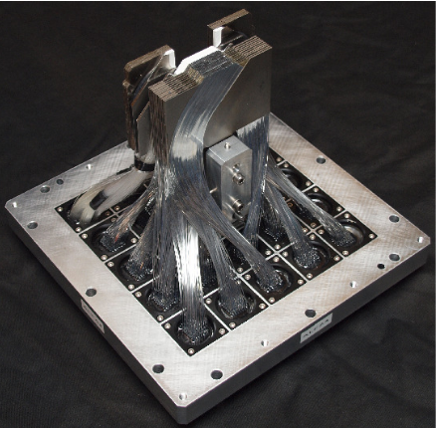
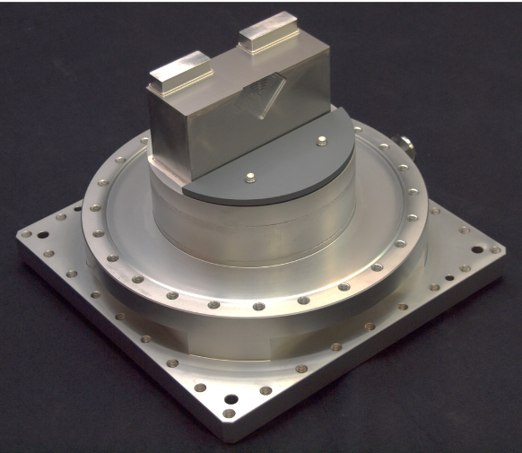
The method of measuring the total cross-section with Roman pots is currently used in the ATLAS experiment at the LHC

Slide 10
Results of the ATLAS measurements of σ_{tot}
ISR
ATLAS 2022

Slide 11
Pion-proton total cross-section can only be measure in fixed-target experiments
The WA9-NA8 SPS experiment
Scattered beam particle spectrometer
IKAR recoil spectrometer

Slide 12
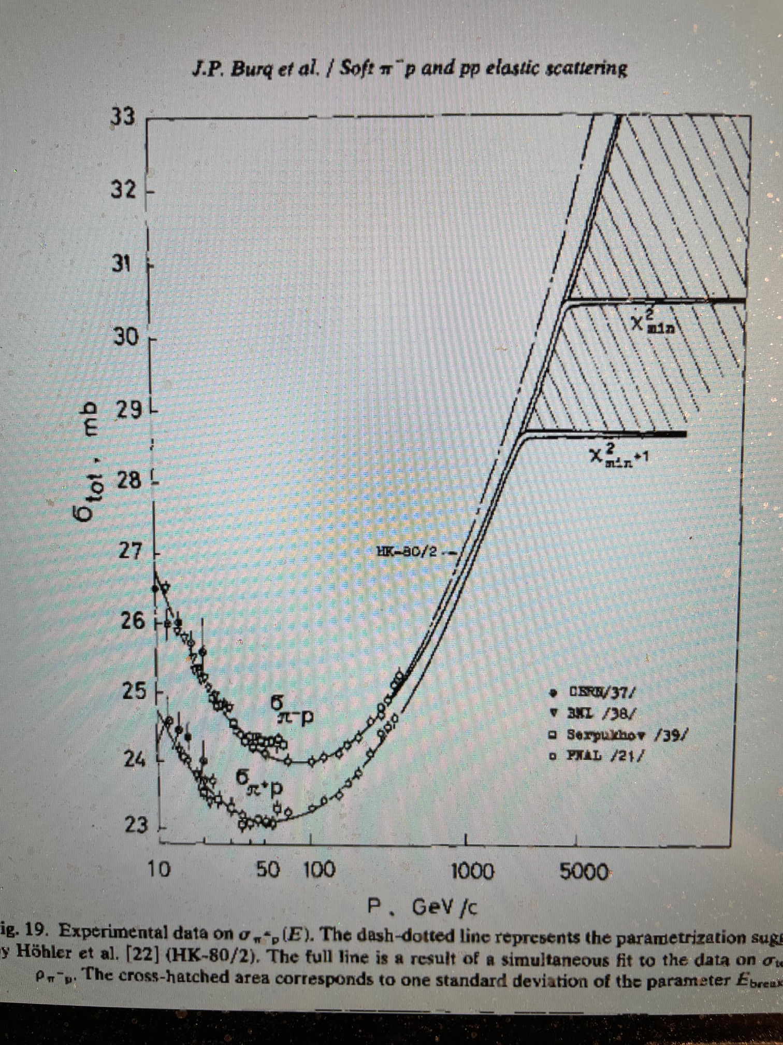
In most fixed-target measurements of the differential cross section for elastic scattering in the Coulomb interference region the forward scattered particle alone has been measured.
There are also experiments which have specialized in the measurement of the recoil only.
In an experiment I led together with we colleagues 1976-1983 at the CERN SPS we measure both the proton recoil, using a specially developed ionization chamber spectrometer, and the forward scattered beam particle, using a multiwire proportional chamber (MWPC)-magnet spectrometer.
One advantage of this method is the better resolution in four-momentum transfer squared t obtained with the recoil measurements in the Coulomb interference region (of the order of 10 ⁻⁴ (GeV/c) 2) as compared with the forward particle measurement (of the order of 5-10 × 10 ⁻⁴ (GeV/c)2).
Another advantage is the more efficient background rejection obtained from the simultaneous measurement of the recoil and the forward particles, as compared with experiments where measurements are made of only one of these particles.

Slide 13
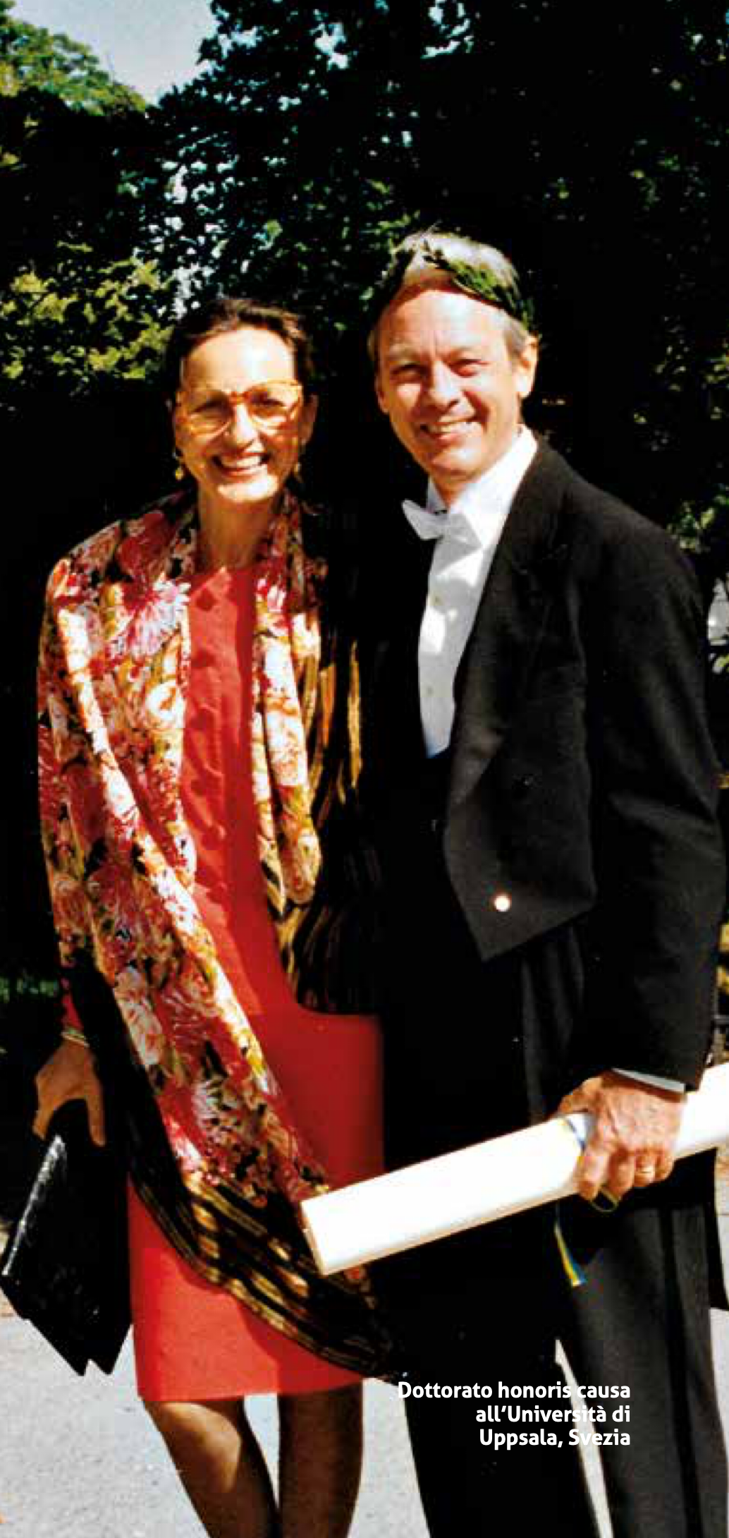
A personal note
The small angle pp elastic scattering measurements at ISR of the CERN-Rome collaboration came to be for me an incitement to study small angle πp elastic scattering, be it with a very different method. Ugo became for me an inspiring mentor in my study of this program. Even more so when, at the end of the 1970s, I came to take an interest in the development of what was to become the RICH particle identification detector, which Ugo invited me with colleagues to develop as detector component of the DELPHI LEP experiment of which Ugo was the spokesman. For all this I owe deep gratitude to my friend and colleague Ugo Amaldi.
The picture shows Ugo and Clelia at the occasion of Ugo’s promotion to honorary doctor at Uppsala University in 1993.

