Slide 1
DELPHI Collaboration and
The Physics Legacy of LEP
Symposium to celebrate Ugo
CERN, April 4, 2025
Alessandro De Angelis
Most of the material from Gerald Myatt and from Ugo

Slide 2

The game of the name
In the beginning it was COLLEPS
COLlaboration for LEP Studies
But this was judged unsuitable
So DELPHI was chosen
DEtector with Lepton Photon and Hadron Identification
(a proposal by Gerald Myatt)
and then a logo was needed
Logo by Angelo Rampazzo (Padua)
Apollo traveled to Delphi in the form of a dolphin (delfino in Italian)

Slide 3
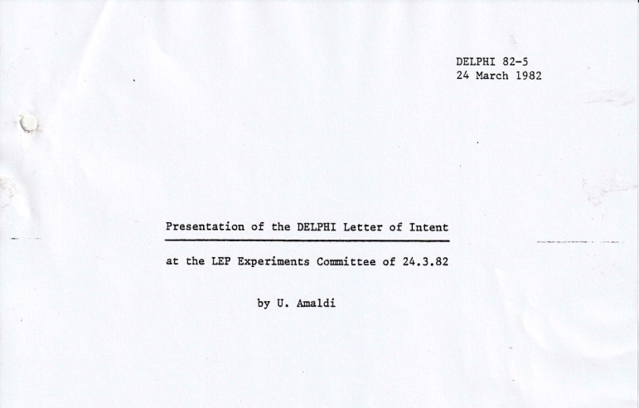
A complex experiment with a lot of information
One key question was whether to play safe, or to plan for a detector which looked forward to new horizons. Ugo had a major influence along the second direction, particularly on the particle identification which was DELPHI’s strongest points.
Tom Ypsilantis, Jacques Seguinot and then Tord Ekelof, RICH specialists, joined the collaboration. By 1992, the Barrel Rich was established.
Ugo insisted that there be sufficient space inside the Inner Detector to allow for 3 layers of Silicon strips. There is one and only one experimental line passing through three points (anonymous).
The b quarj had just been discovered, and there was little information on the b lifetime
TPC was chosen as main tracking device.
Ugo presented the DELPHI Letter of Intent to the LEPC in March 1982 and it was approved.

Slide 4
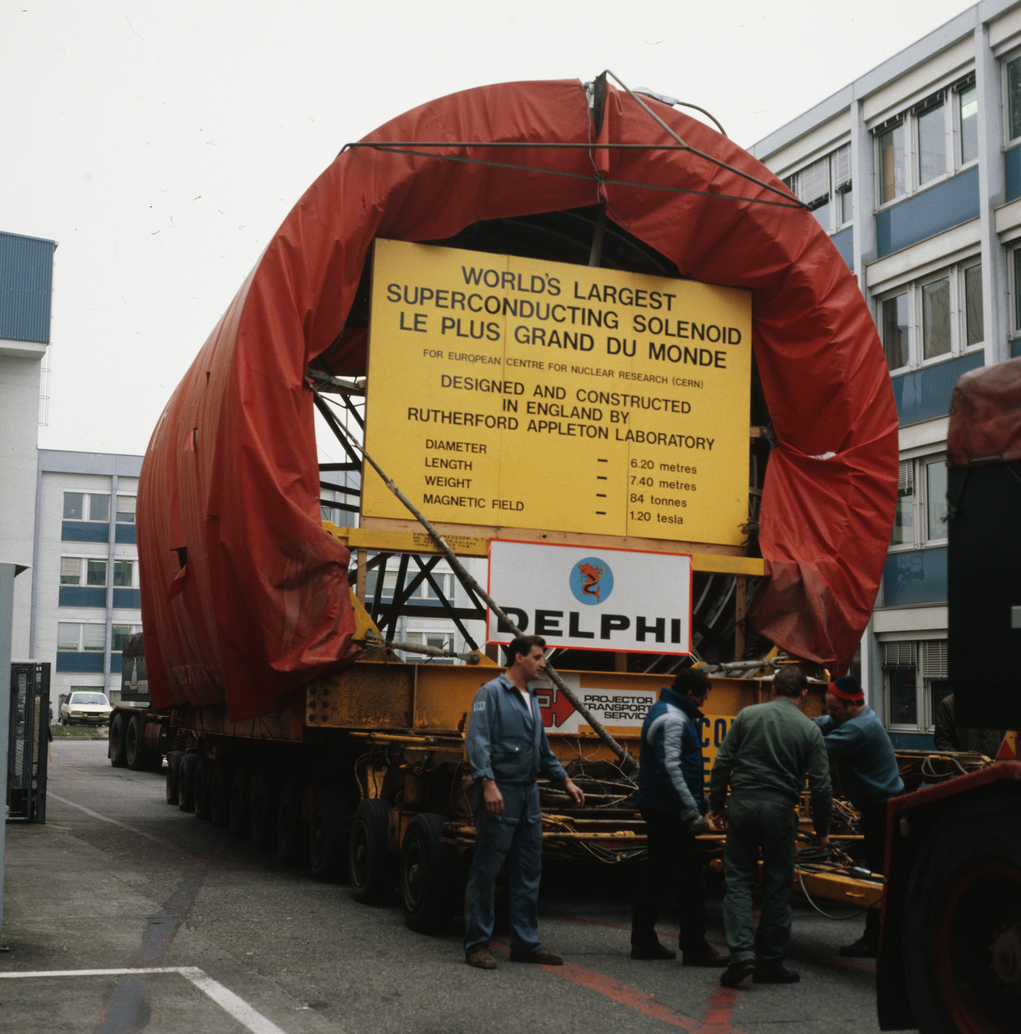
The largest superconducting coil (by RAL)
7.4 m long, 6.2 m in diameter, a 1.2 T field

Slide 5
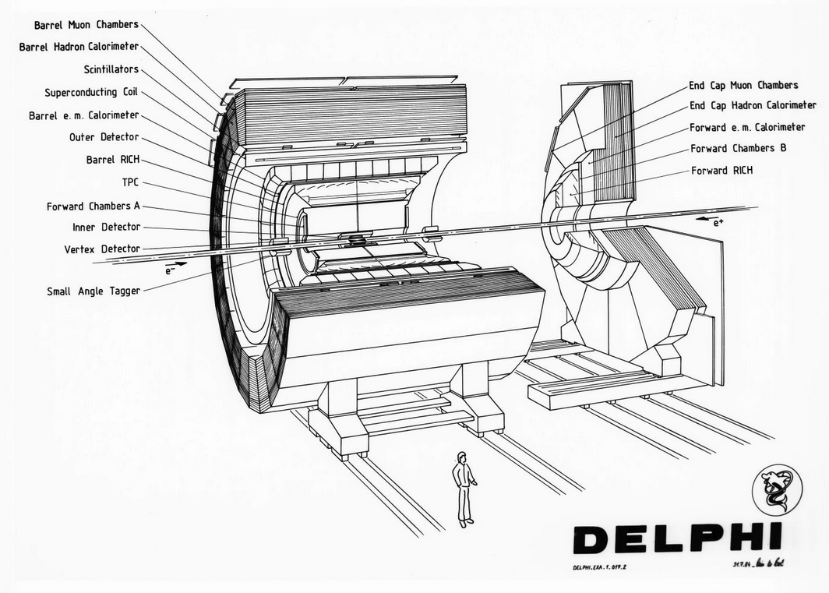

Slide 6
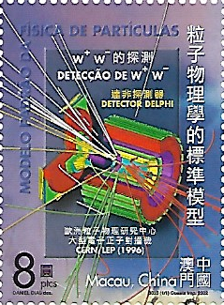
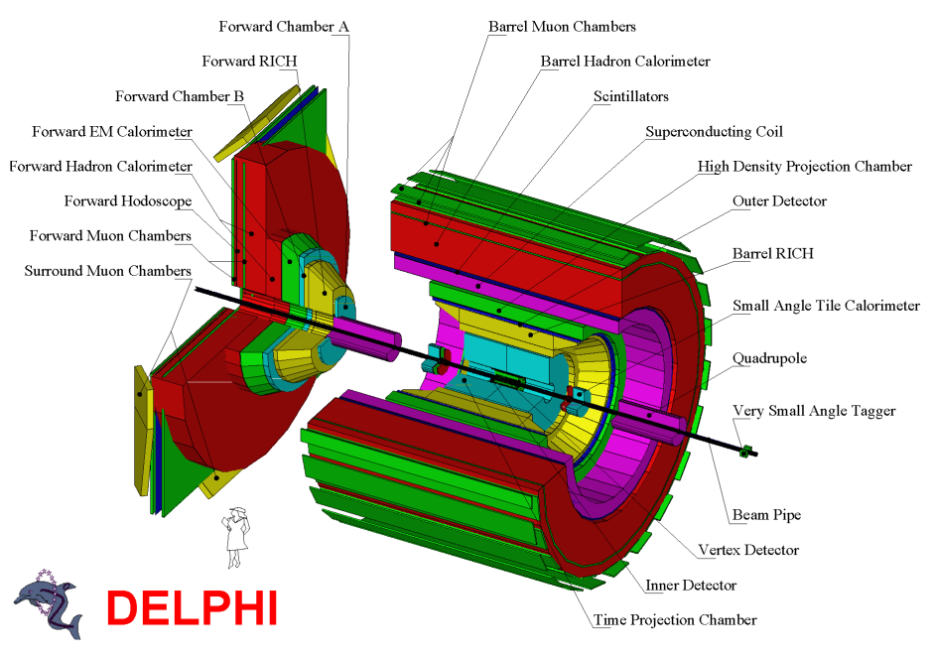
(drawing by Gabriele Cosmo,
Erik Vallazza, AdA, from the DB)

Slide 7
Installation times were very tense! Ugo was sleeping at the Novotel. In the control room, he was behind a yellow tape line that people were authorized to cross only if invited
  And un-understandable protocols like “roman one, roman two”
LEP operation began in July 1989. DELPHI was ready, more or less
First events were observed in August. On August 14, 3 out of 4 experiments had seen a Z. DELPHI, despite its wishful logo, none! This was traced to a misalignment of the beams in our crossing region, and within hours also DELPHI was observing its first Zs
Until the end of the year LEP operated at 5 energies at 1 GeV spacing on and around the Z peak and soon (early November) results on the mass and width of the Z boson were published as well a determination of the number of light neutrino species. The first DELPHI paper, sketched before the observations (Ugo’s protocol, again), contained the sentence “the trigger efficiency is believed to be (98 ± 2)% […]”
“Measurement of the Mass and Width of the Z Particle from Multi- Hadronic Final States Produced in e+e- Annihilations, Phys. Lett. B 231 (1989) 539.
  Ugo was calm again, and listening a lot

Slide 8
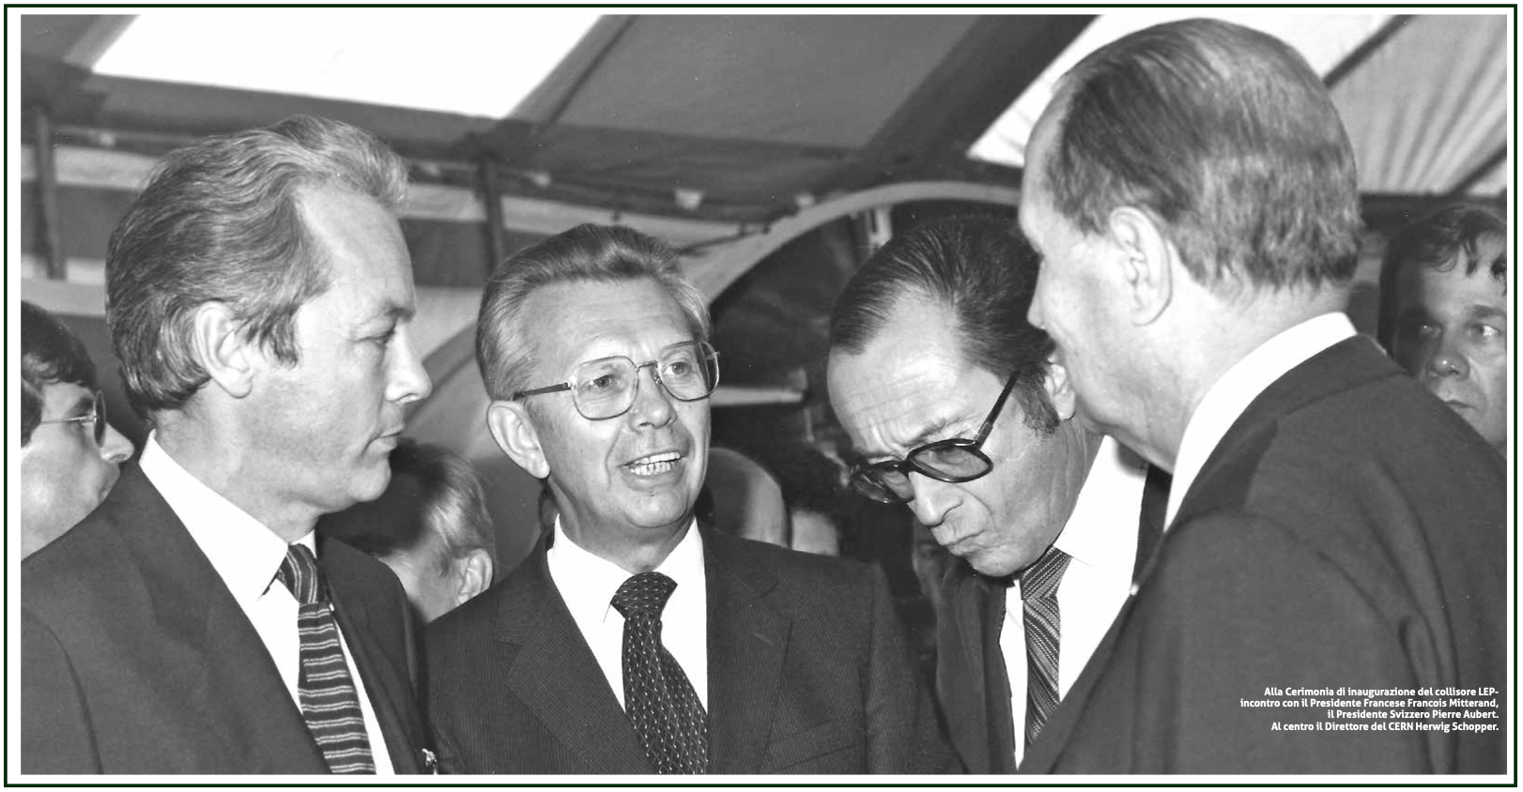
LEP Official Inauguration Nov 1989

Slide 9
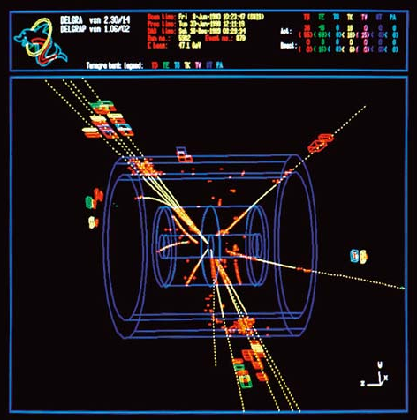
Necessity is the mother of invention
The fact that DELPHI was more complicated than other detectors (complex geometry, scattered information) imposed creativity (that Ugo encouraged a lot)
  Careful software studies
  Graphic interface
  Database
  Analysis tools
Merging inhomogeneous information for PID was a challenge. The first physics analysis paper in HEP based on Artificial Neural Networks has been by DELPHI
  Classification of the hadronic decays of the Z into b and c quark pairs using a neural network, Phys. Lett. B295 (1992) 383

Slide 10
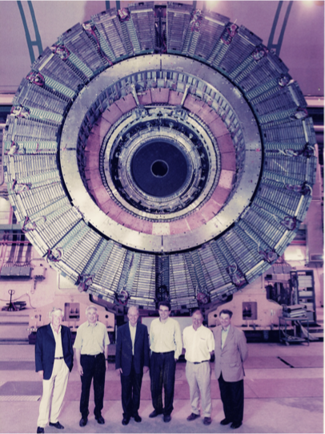
Changing the spokesperson
By 1993 Ugo had been Spokesman for 13 years and he felt it was time for a change. The Collaboration moved to a scheme of Spokesman who served for two years alongside of a Spokesman Elect who succeeded
The DELPHI Spokesmen were
Ugo Amaldi
Jean-Eudes Augustin
Daniel Treille
Wilbur Venus
Tiziano Camporesi
Jan Timmermans

Slide 11
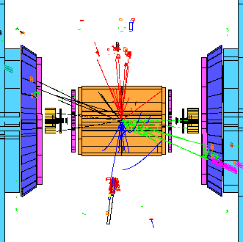
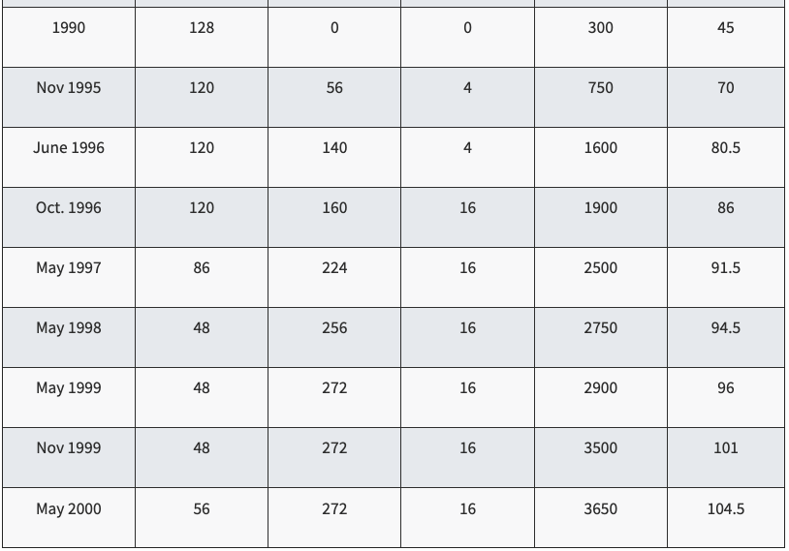
Energy increase, W studies and Higgs hunting
Date E_beam
On July 9, 1998, LEP achieves 161 GeV c.m. energy. DELPHI observes the first WW pair

Slide 12
The end (?)
By late 2000 LEP had reached a CM energy of 209 GeV and some were seeing signs of an accumulation of Higgs candidates at about 114 GeV, the top end of the accessible region
Researchers were split: some did not believe
The DG Luciano Maiani was required to make a decision. If he were to delay the end of LEP by one year, the people working on LHC could lose enthusiasm and CERN would have had to pay penalty of 100 million Swiss Francs to companies ready to dismantle LEP.
He did not risk, and LEP closed forever in November 2000.
A 125 HeV Higgs would have been detected with a very long LEP run, if the CM energy had reached 220 GeV

Slide 13
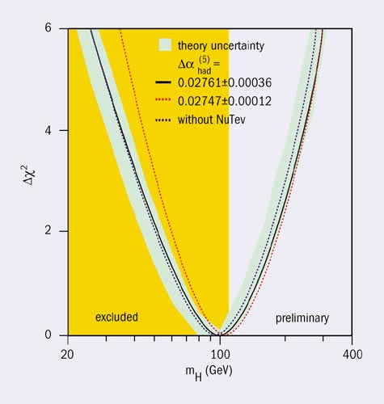
LEP Indirect measurement of m_H (2004)
M_H = 91+58-37 GeV
M_H >114.4 GeV (95% CL)
M_H < 202 GeV (95% CL)

Slide 14
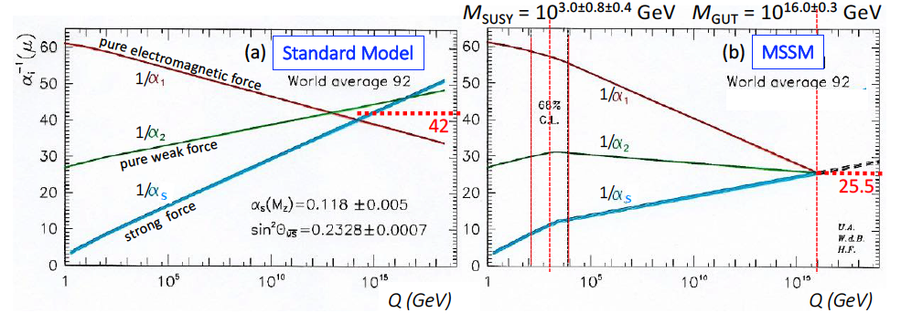
One of the most quoted “DELPHI” papers comes from an idea by Ugo
By extrapolating coupling constants of em, weak and strong interactions, Ugo showed that unification was not possible without extensions of the SM, and SUSY could play the game
The visual power of the three converging lines and the novelty of the fitted masses M_GUT and M_SUSY with their errors caused overwhelming reactions
A very impacting plot to show in a particle physics course

Slide 15
A few thoughts on DELPHI and scientific policy
DELPHI was the largest of the LEP collaborations
Need for a mechanism of giving visibility to younger physicists (e.g. DELPHI Speakers Bureau)
Promoted the formation of LEP Working Groups to combine the published results of the 4 Collaborations and take proper account of correlated systematic uncertainties
Also Jack Steinberger insisted that the combination was a job for the experimentalists from the four collaborations
DELPHI promoted allowing access to the data by people outside the Collaboration, but with strict rules. This was an immense amount of work, and only recently became a reality.

Slide 16
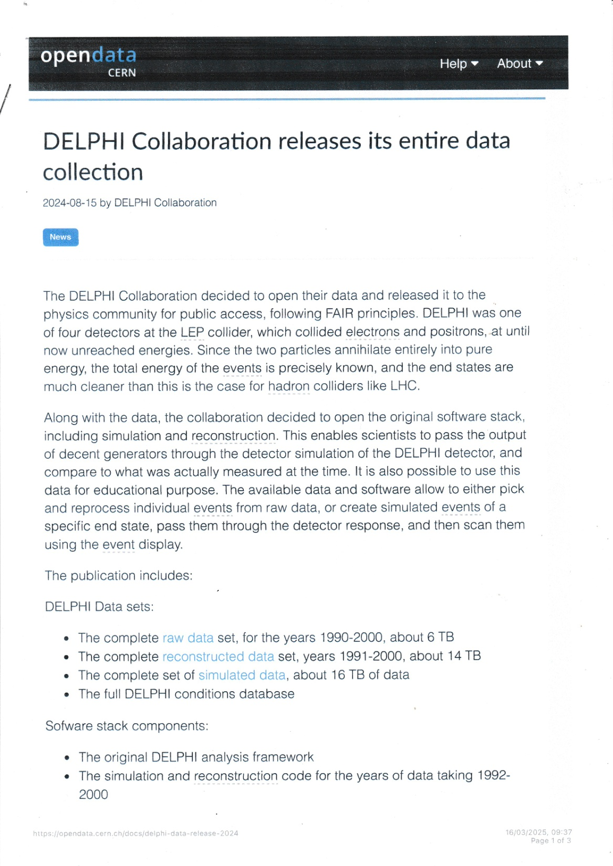

Slide 17
Congratulations Ugo on 90 years of achievements
And long live DELPHI!

Slide 18
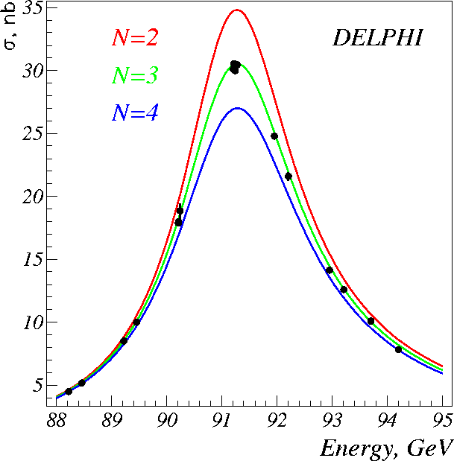

Slide 19
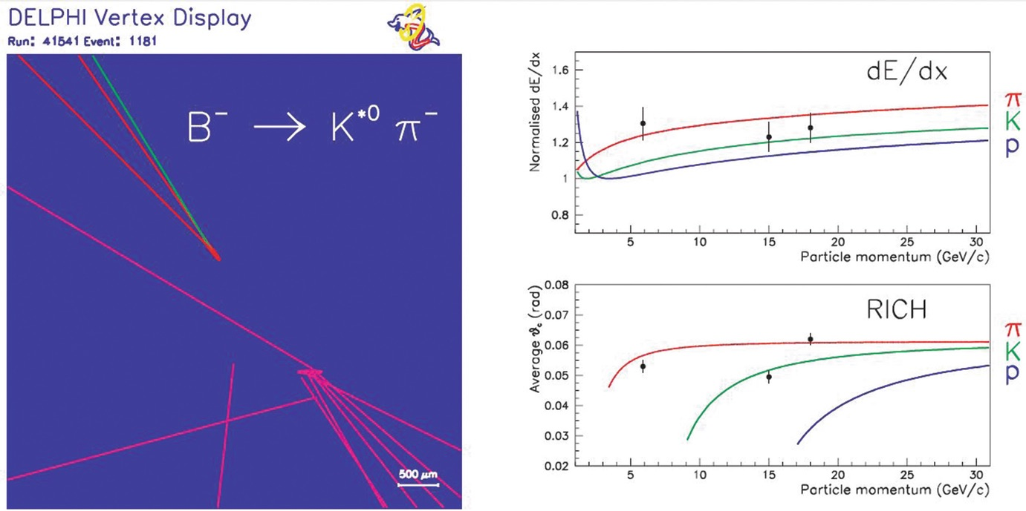
DELPHI: the most precise b (and c) tagging

