Slide 1
Collaboration between CERN and the TERA Foundation
Symposium to celebrate Ugo Amaldi’s 90th birthday
4th April 2025
Giovanni Anelli, Head of Knowledge Transfer Group, CERN

Slide 2
Many thanks
To all the people who, knowingly or not, have contributed to this presentation.
A lot of excellent material on the history of TERA (and, necessarily, its collaboration with CERN), can be found here:
30th Anniversary of the TERA Foundation Symposium
TERA Foundation Website
Having limited time in a dense program I had to make a selection, there would be so much to say about TERA and CERN…. Apologises in advance if your favourite project is not mentioned!

Slide 3
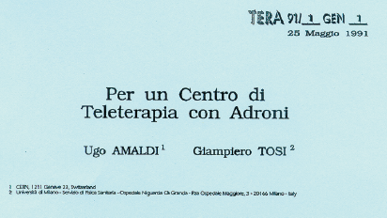
The seminal idea
Notes:
Since its founding in 1992 by Ugo Amaldi (CERN), Elio Borgonovi (Bocconi University), Giampiero Tosi (Niguarda Hospital) and Gaudenzio Vanolo (Secretary-General of the TERA foundation) – joined a few years later by Roberto Orecchia (Scientific Director of the European Institute of Oncology, Milan) – the foundation has been active in research and development in hadron therapy, a technique aimed at treating solid tumours with beams of hadrons, in particular protons and carbon ions. With strong links to CERN (most activities have been performed in collaboration with CERN physicists and engineers), the foundation has given rise to successful offspring, including the ion therapy centre CNAO in Pavia, which, to date, has treated more than 4000 patients.
On 15 September 1992, the TERA Foundation was established in Novara, Italy. Exactly 30 years later, a Symposium was held at CERN to review its contributions to hadron therapy.

Slide 4
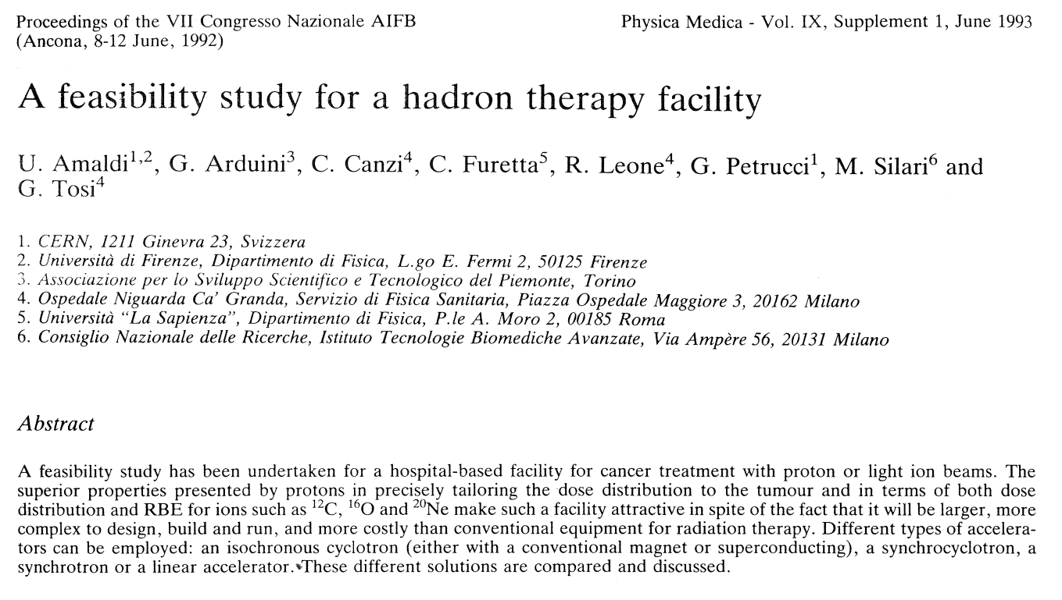
The “conservative” beginnings

Slide 5
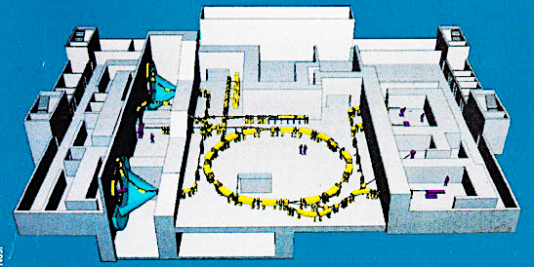
1994
COLLABORATION & DOCUMENTATION !
Notes:
TERA has followed 4 guidelines.
In the choice of the programmes:
CONSERVATION
INNOVATION
In the approach to realize them:
COLLABORATION
DOCUMENTATION

Slide 6
1996 – 1999 PIMMS
CERN – GSI – MedAUSTRON - Oncology2000 - TERA
Project Leader: Phil Bryant (CERN)
Project Advisory Committee Chairman: Giorgio Brianti (CERN)

Slide 7
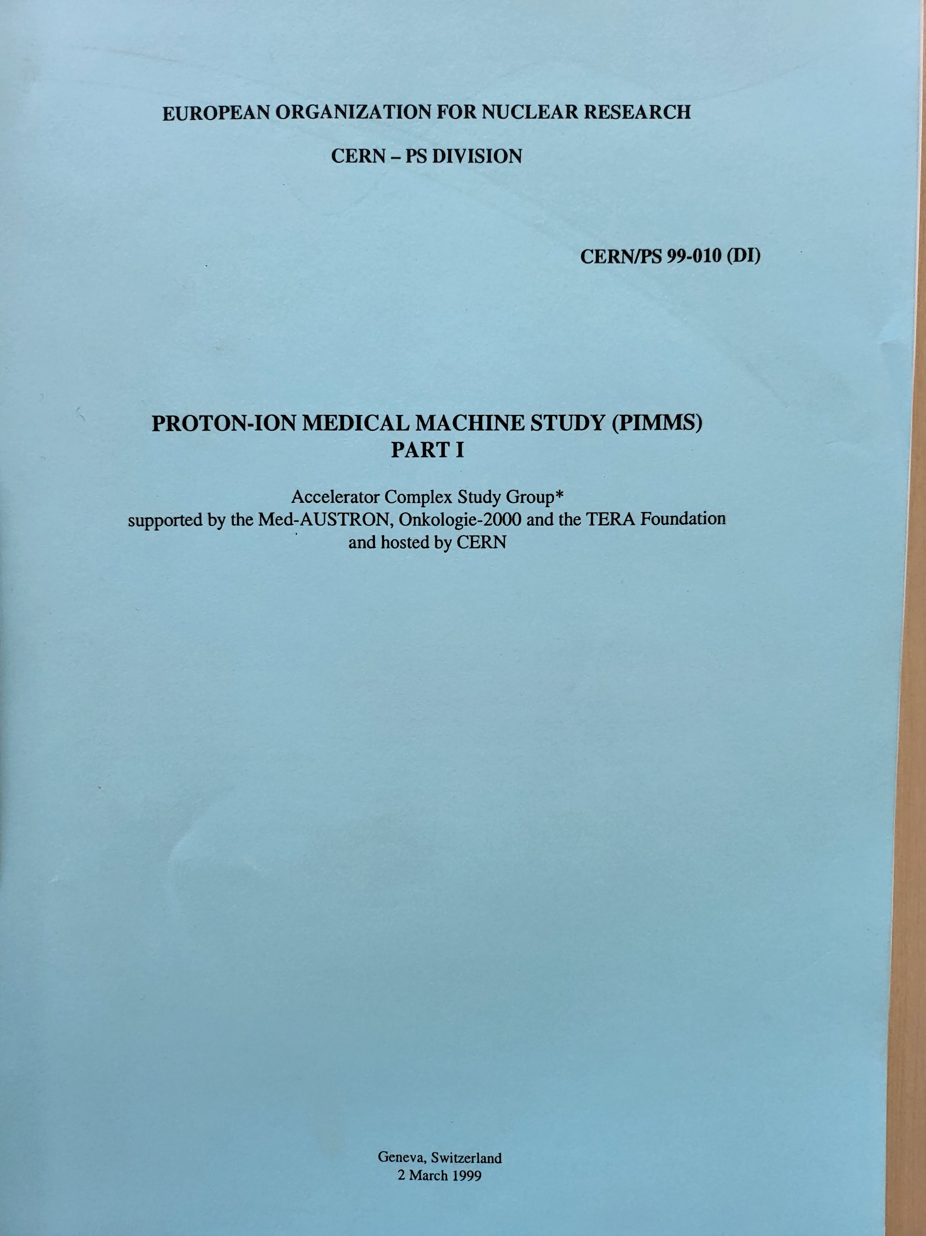
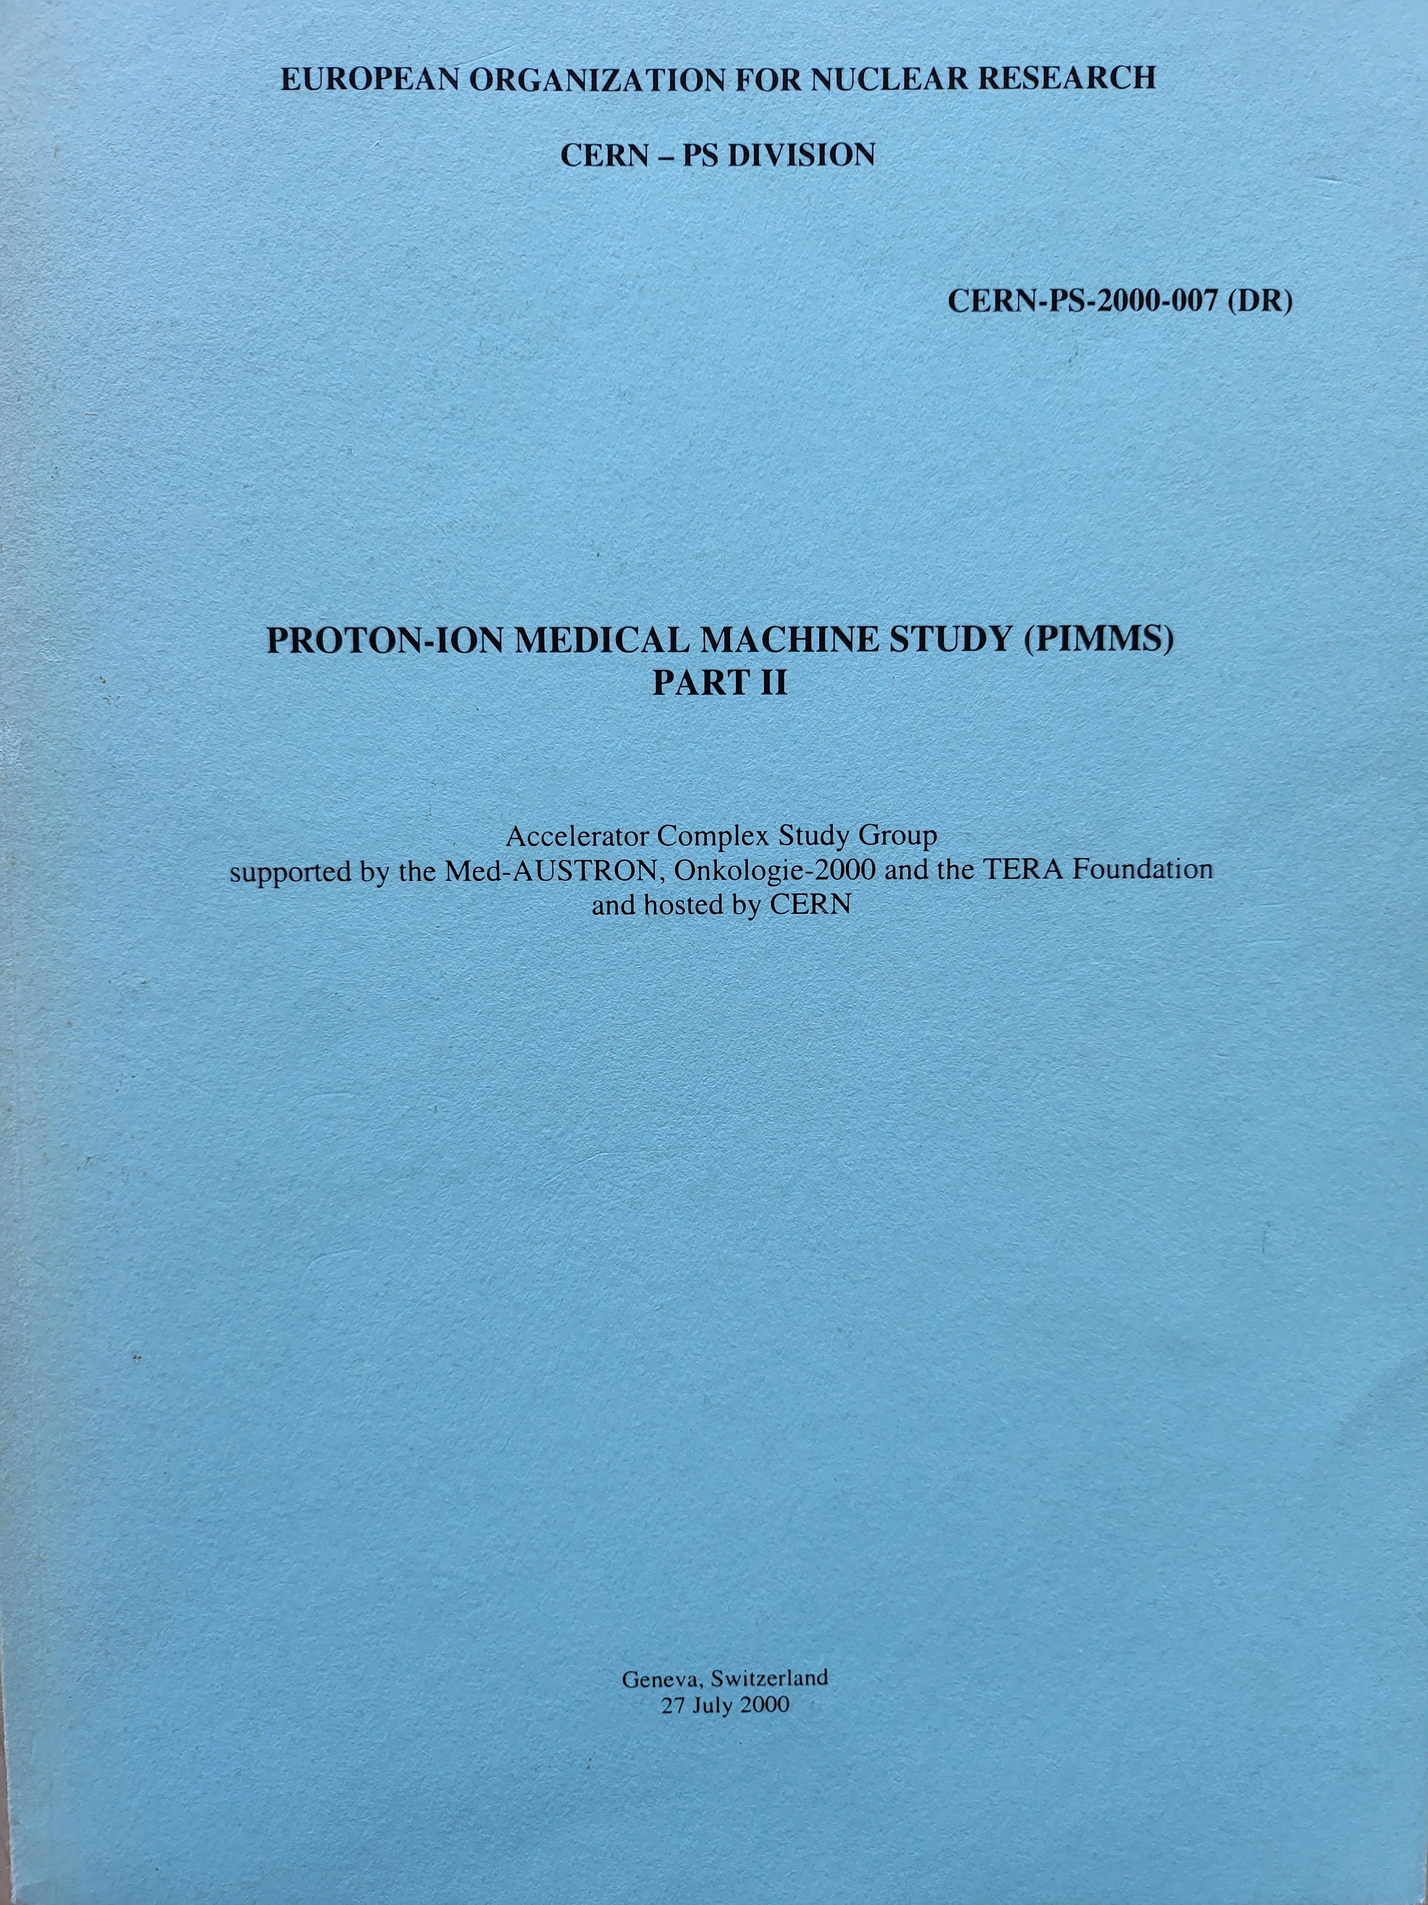
PIMMS → PIMMS / TERA → CNAO
Notes:
Transfer of more than 20 people

Slide 8
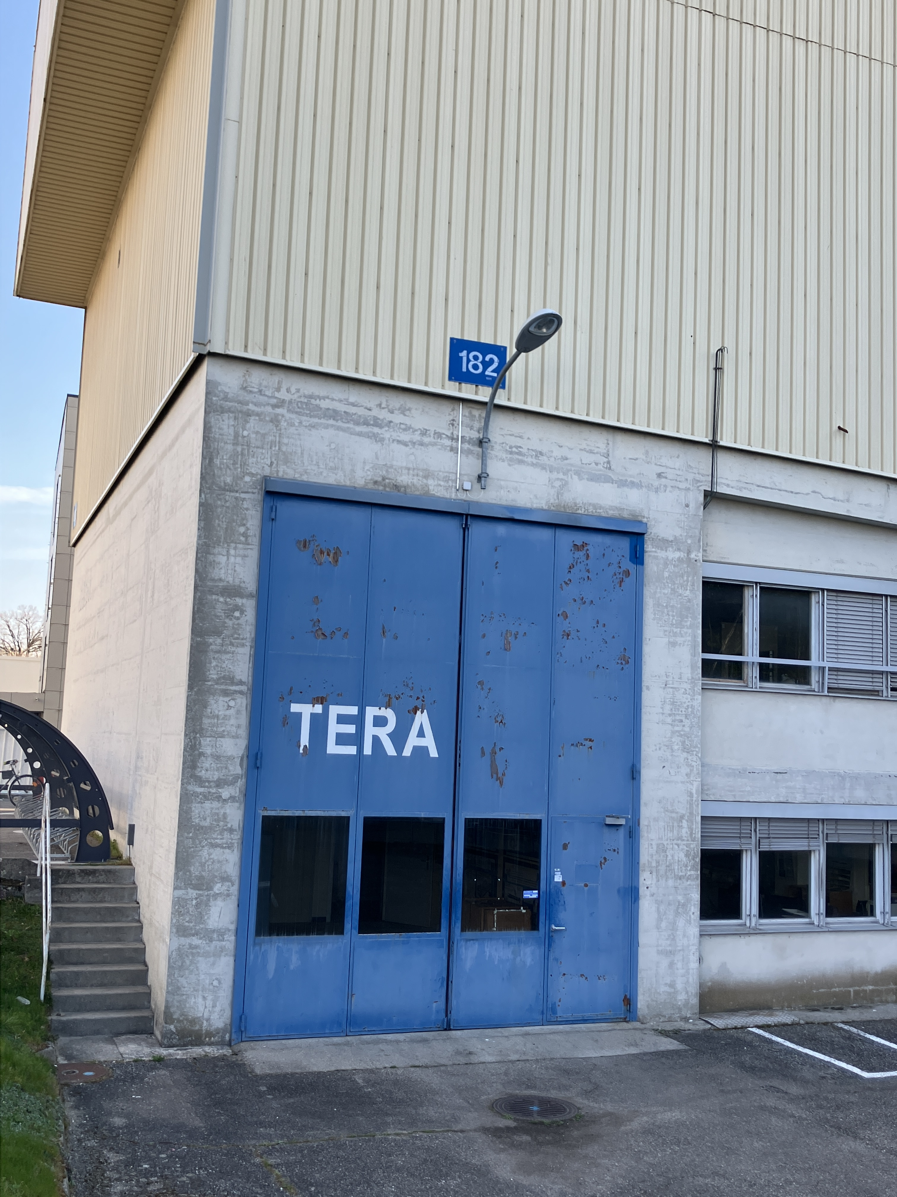
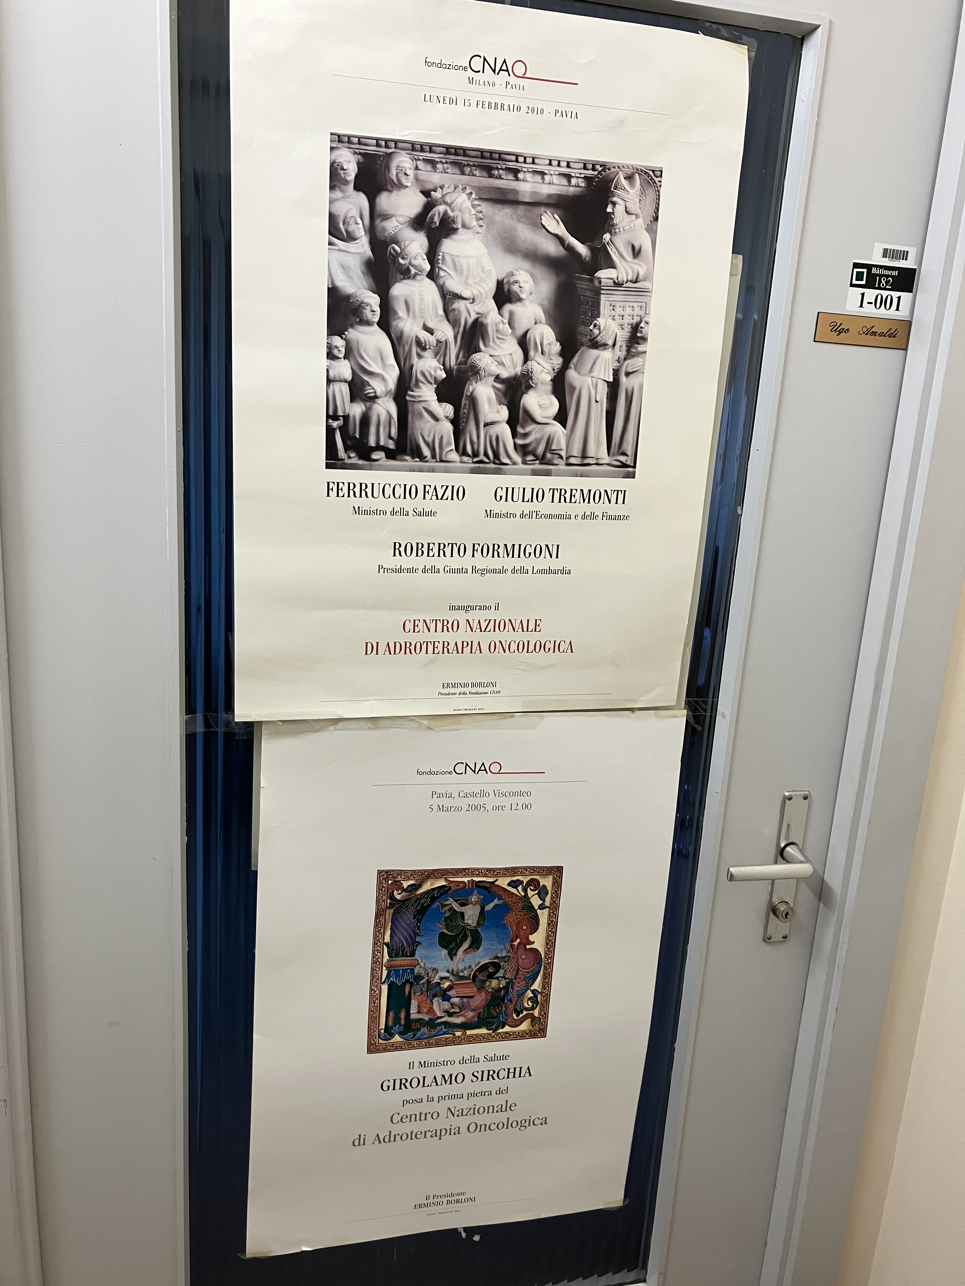
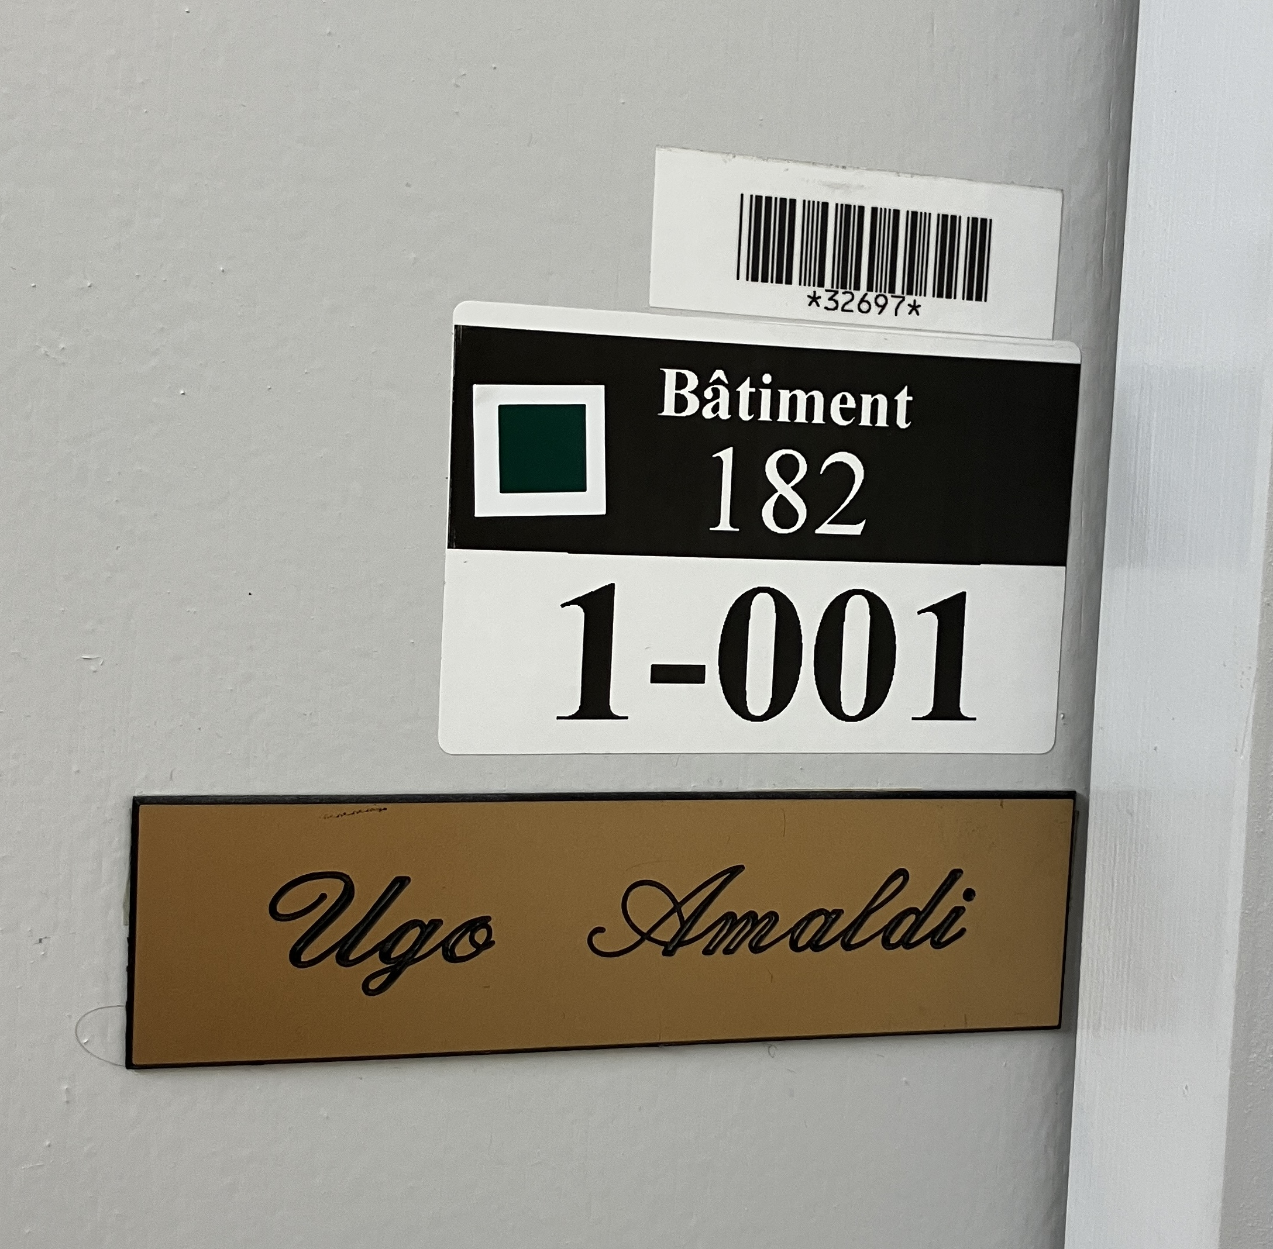
Notes:
2005: CNAO’s first stone
2010: CNAO’s inauguration

Slide 9
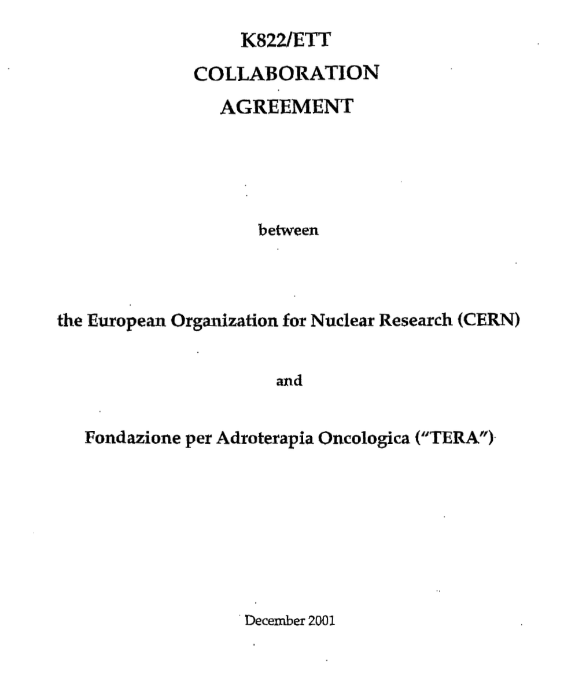
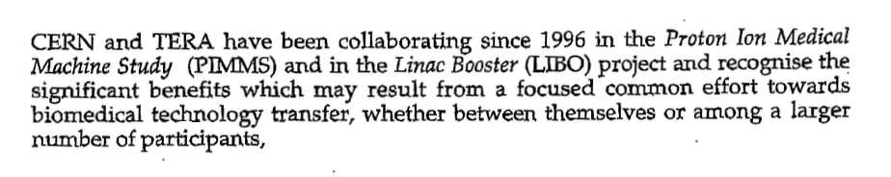
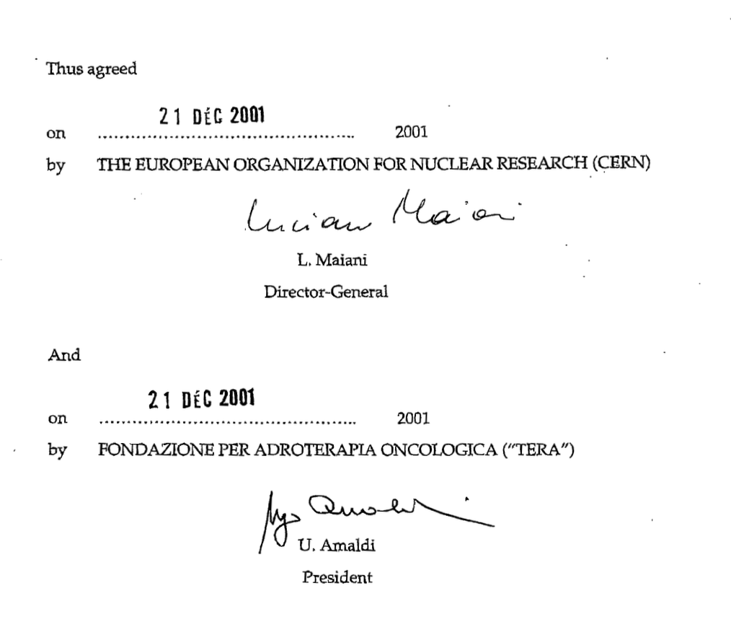

Slide 10
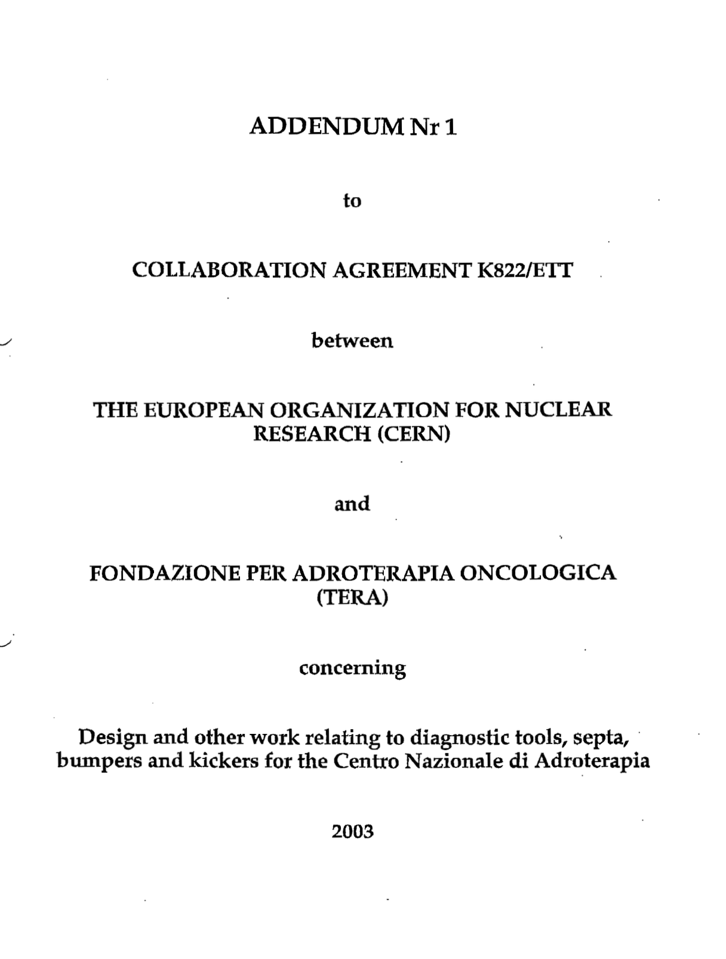
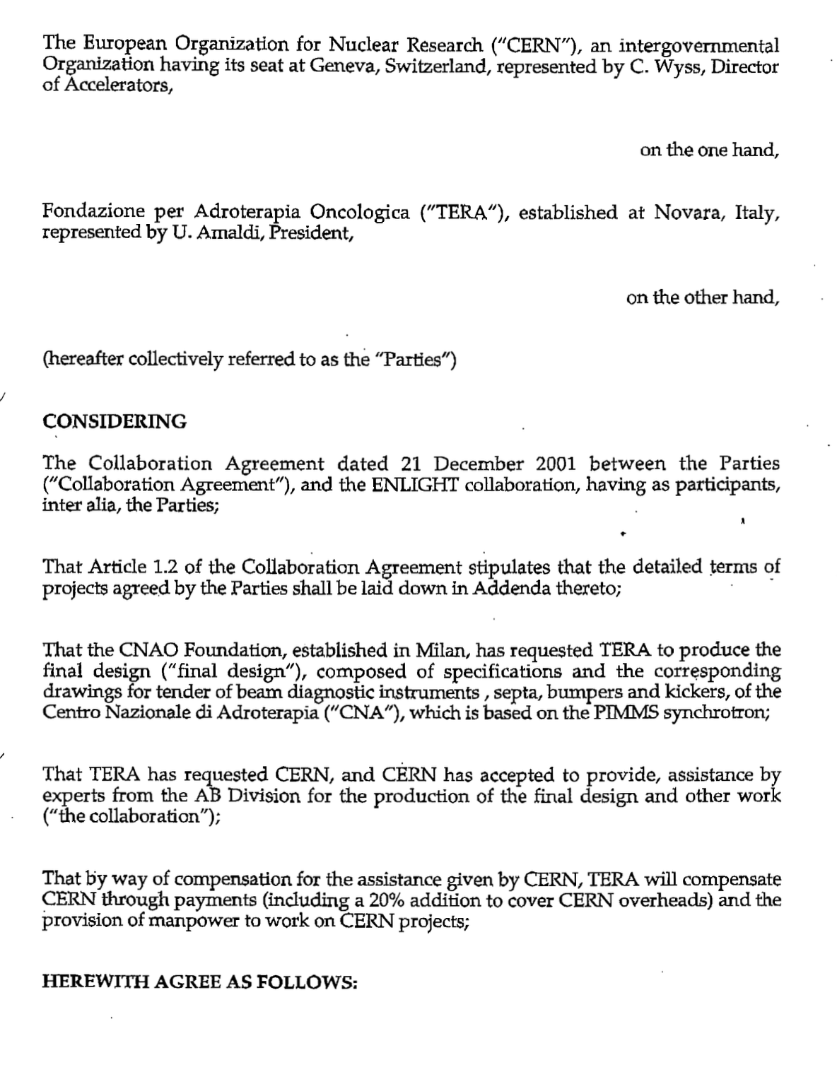

Slide 11
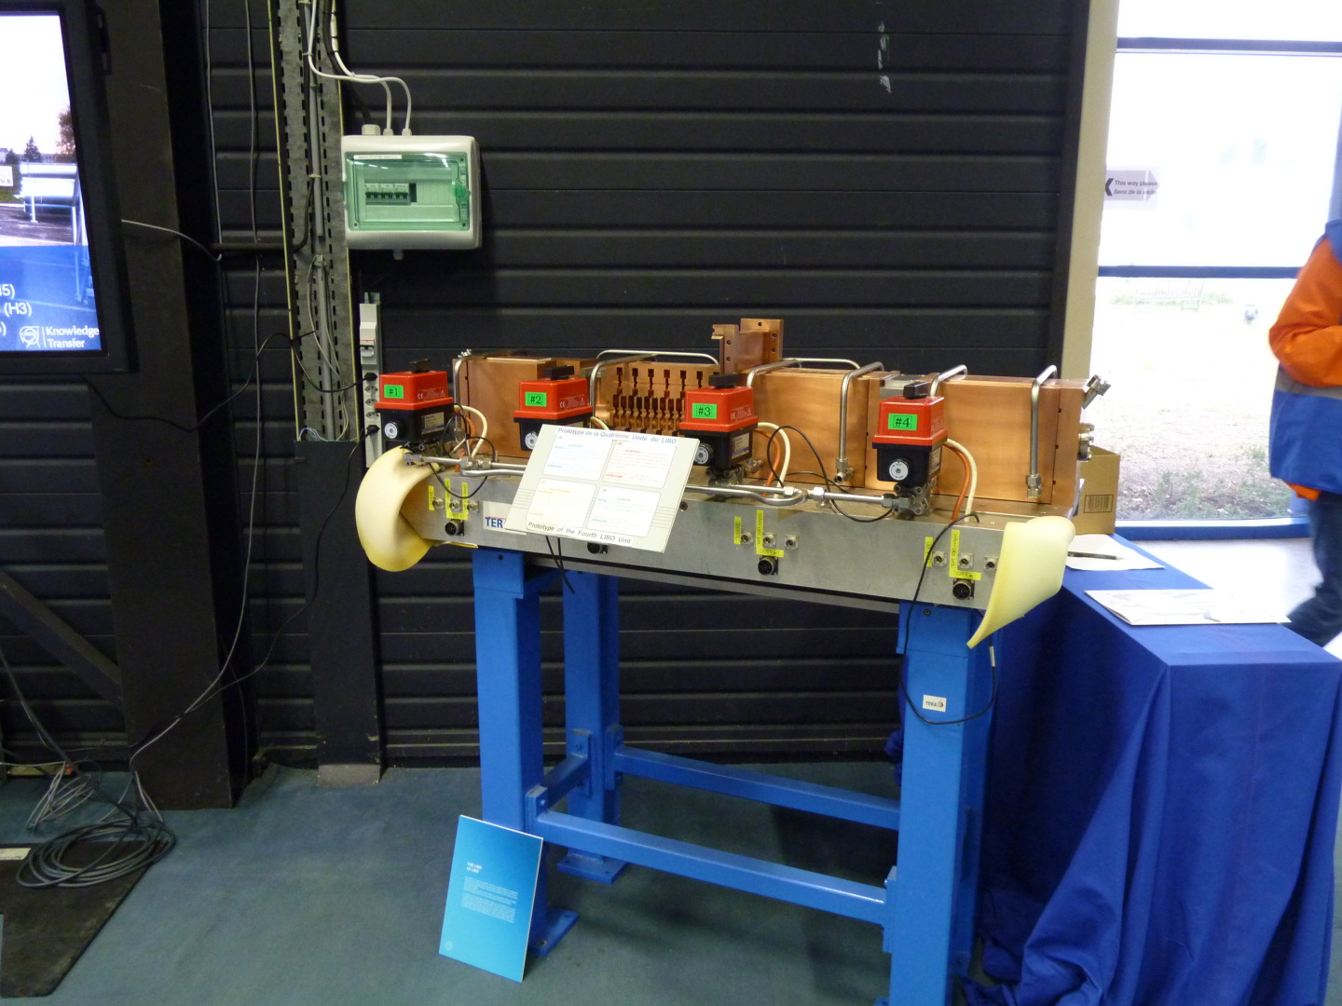
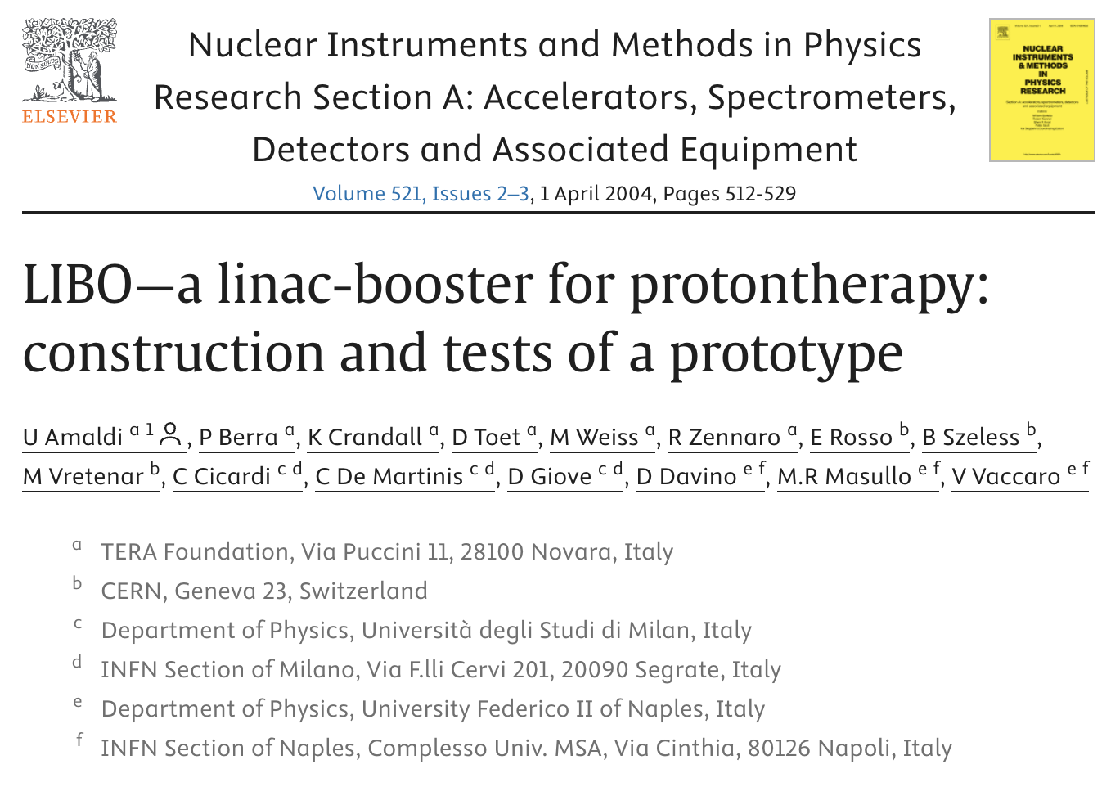
From “Conservative” to “Innovative”
CERN Open Days 2013

Slide 12
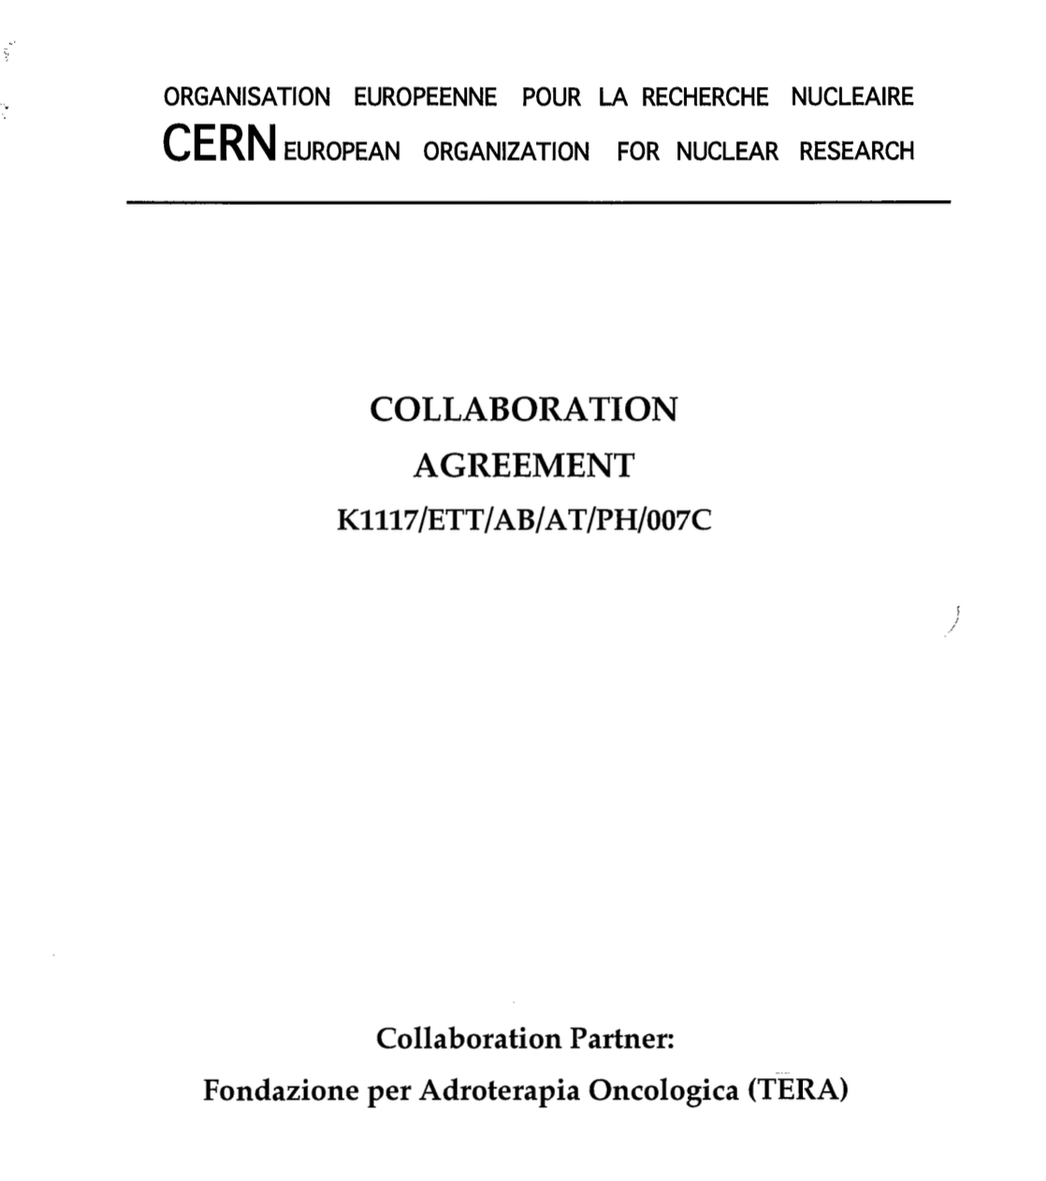
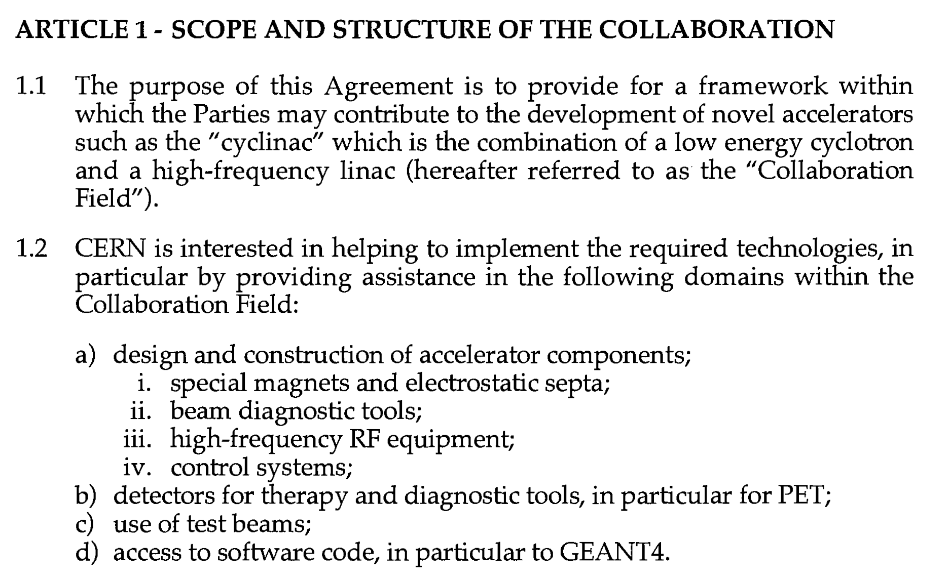
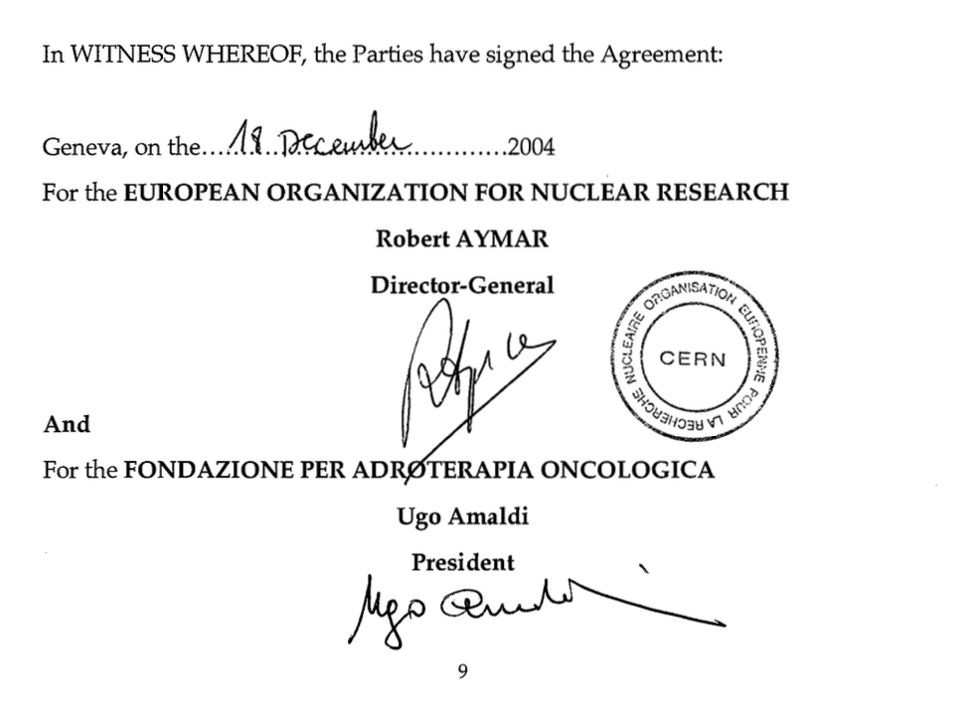
Notes:
Agreement still in force today

Slide 13
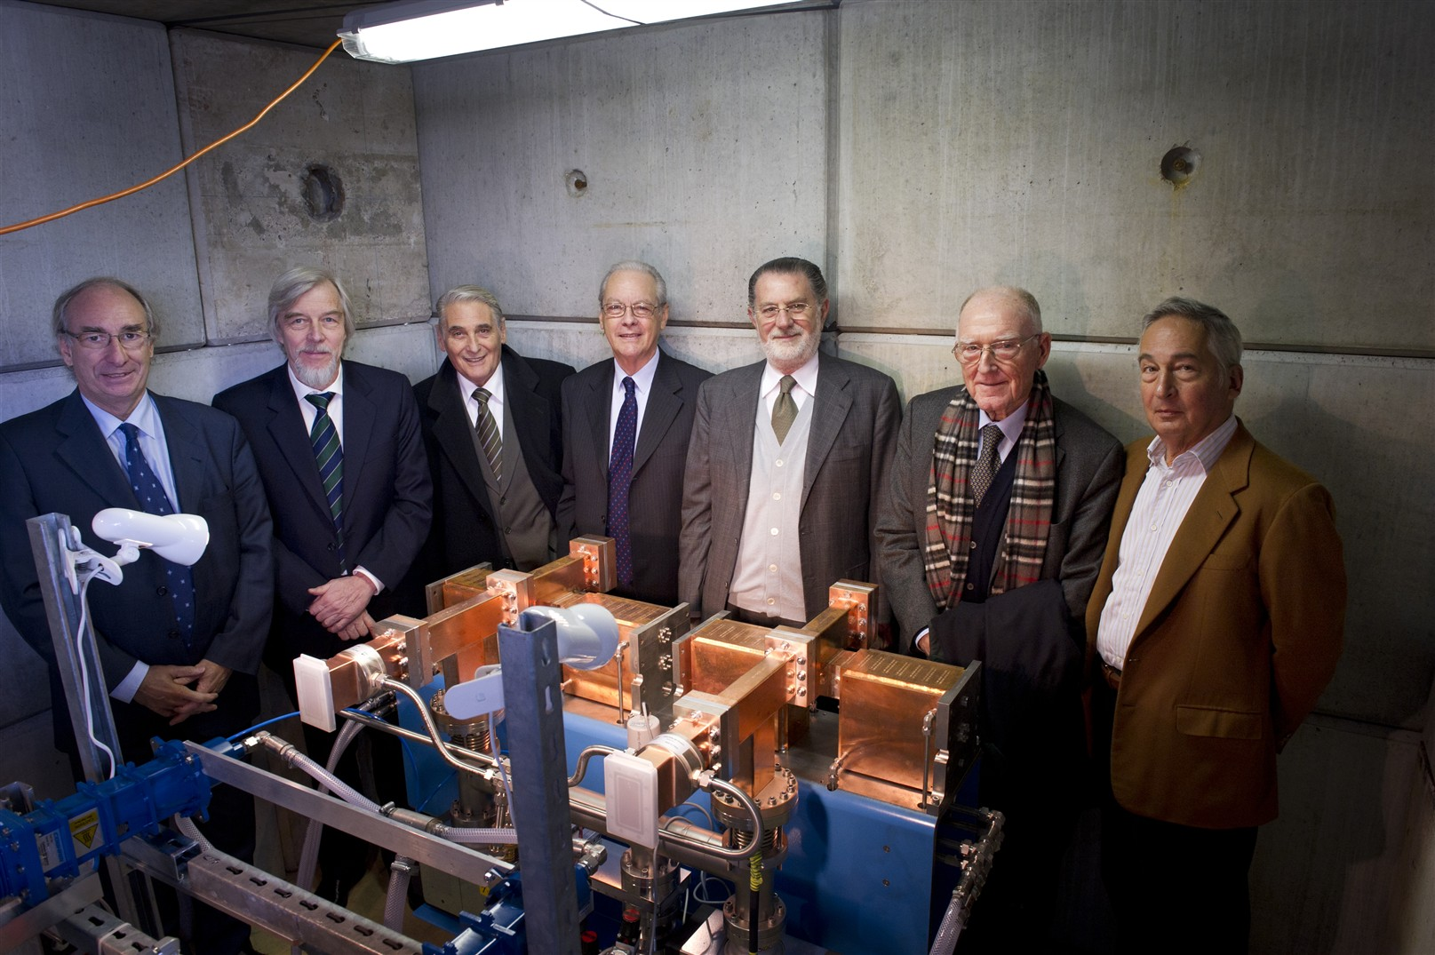
From LIBO to LIGHT: ADAM was created in 2007
First unit of LIGHT (2010)
Notes:
Linac for Image Guided Hadron Theraphy

Slide 14
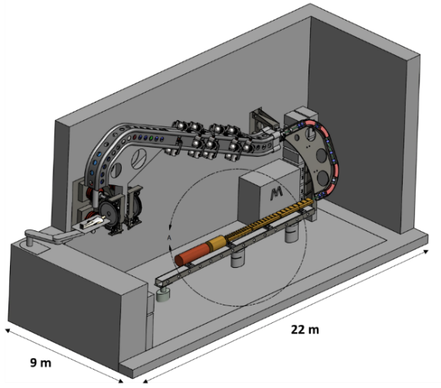
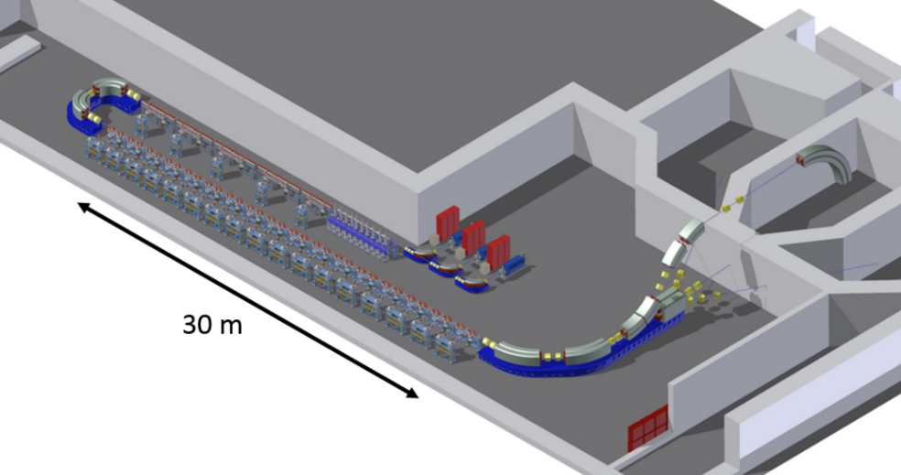
TULIP and CABOTO: 2008 - 2015
TULIP
Single-room proton therapy
CABOTO
Carbon ion therapy
Synergies with CLIC studies at CERN
Some funding from the KT fund
Notes:
Various versions

Slide 15
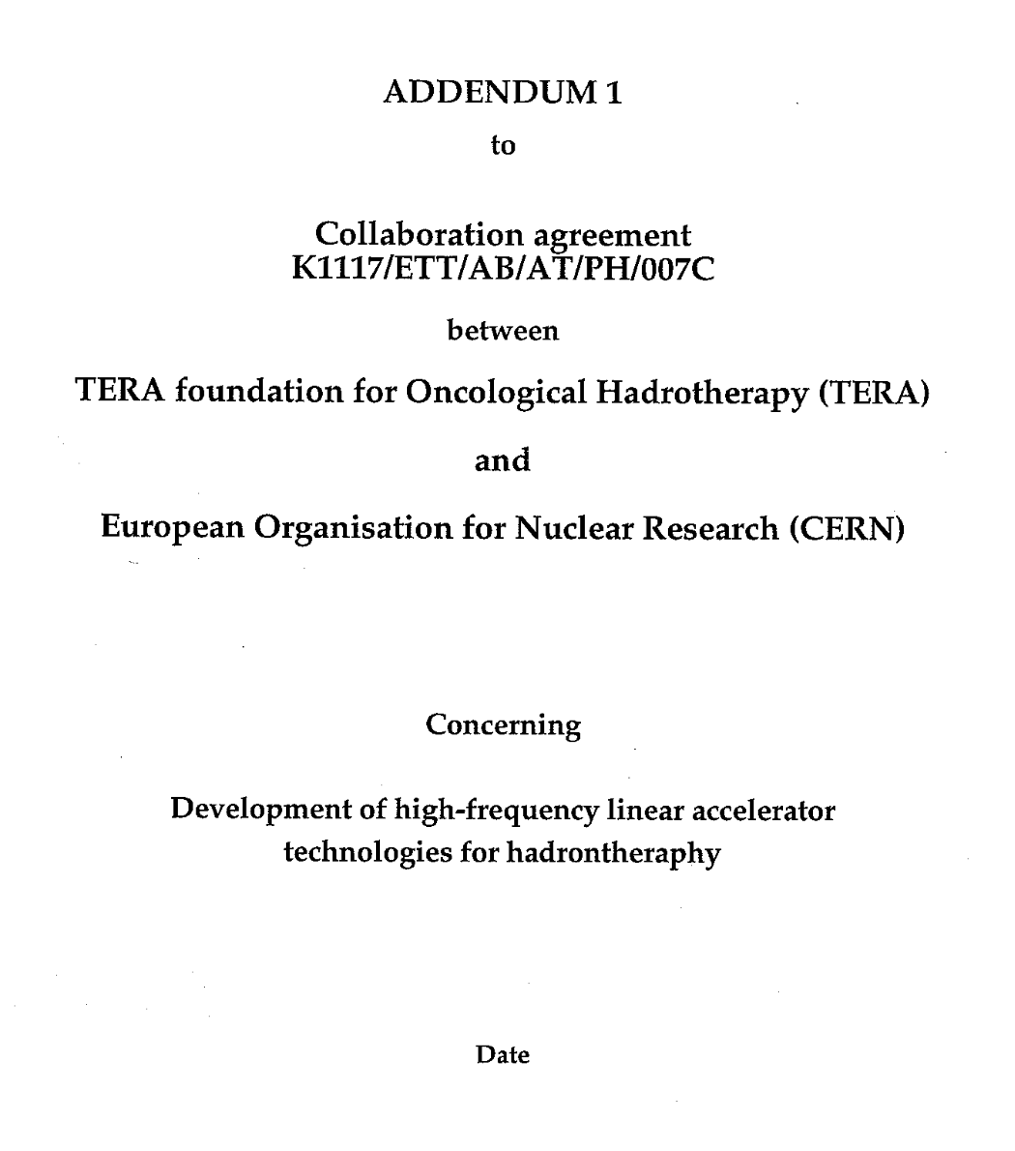
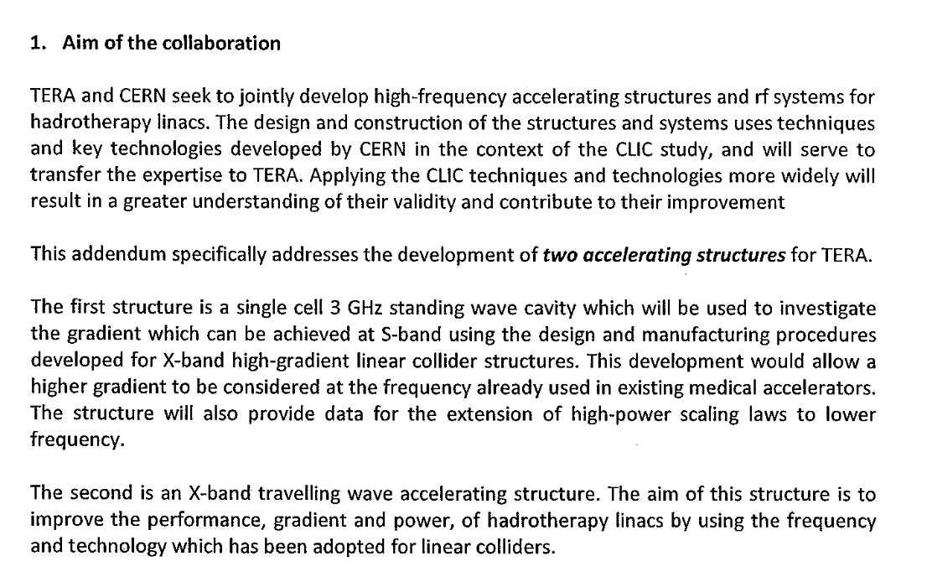
2010

Slide 16
South-East Europe International Institute for Sustainable Technologies (SEEIST)
Next Ion Medical Machine Study (NIMMS)

Slide 17
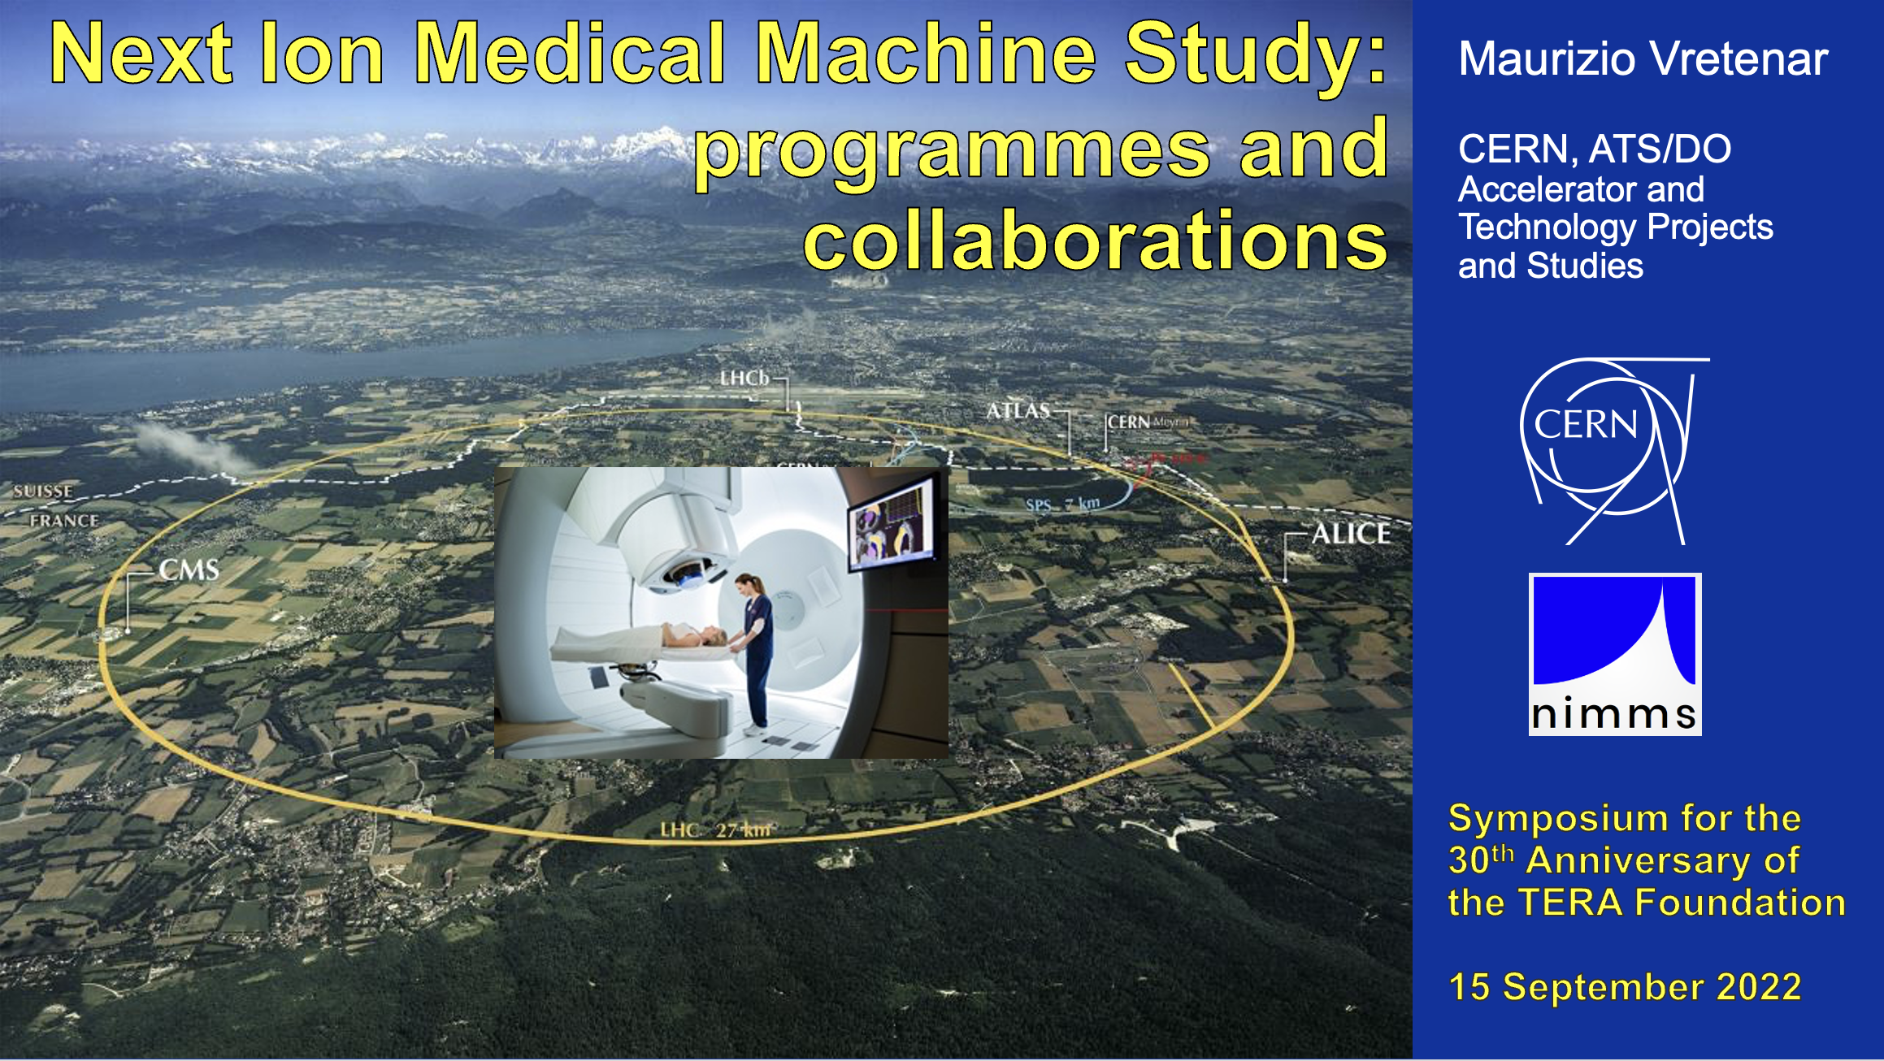

Slide 18
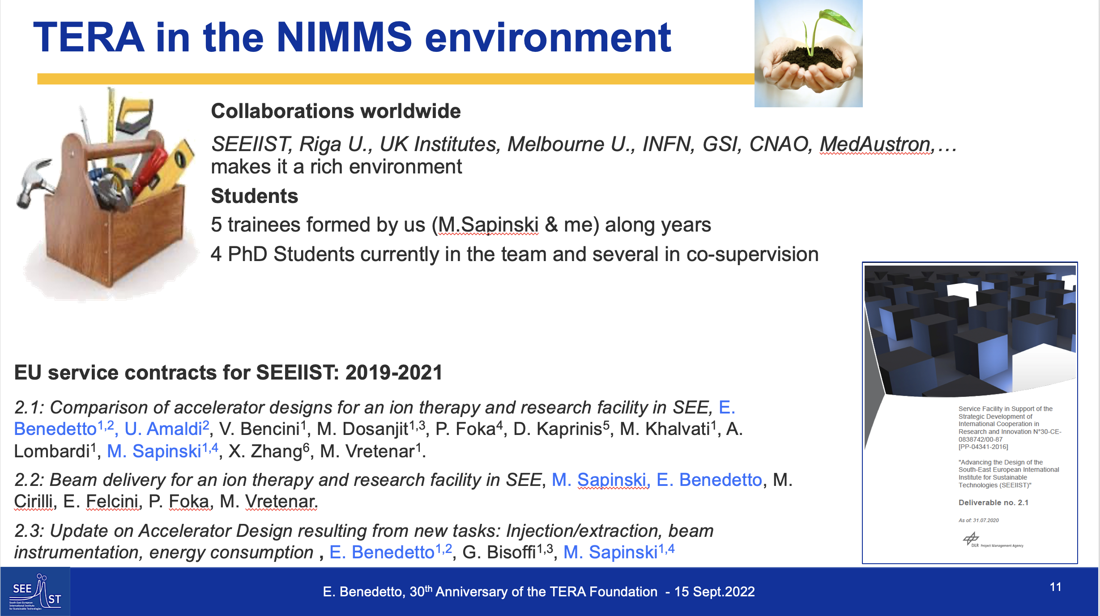

Slide 19
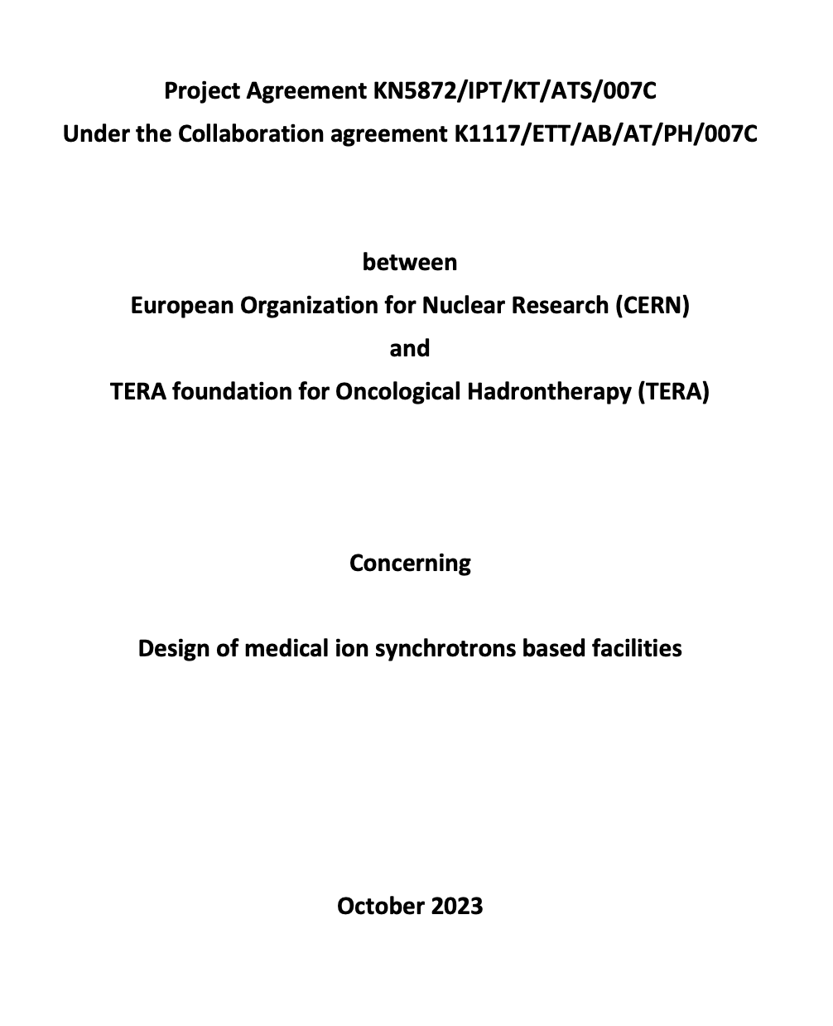
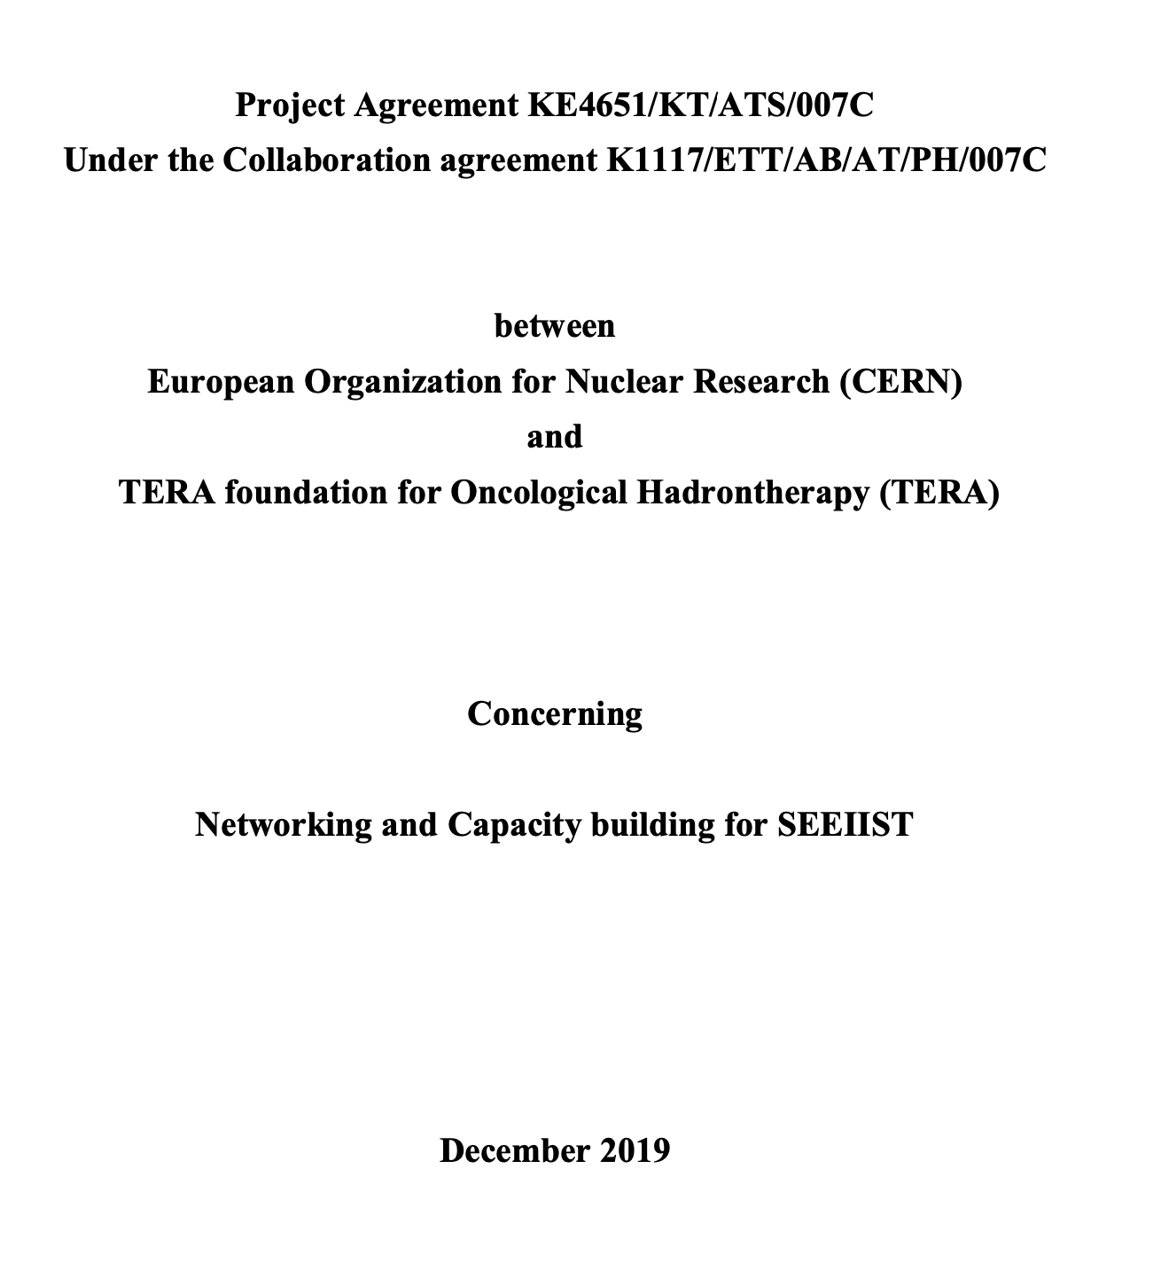
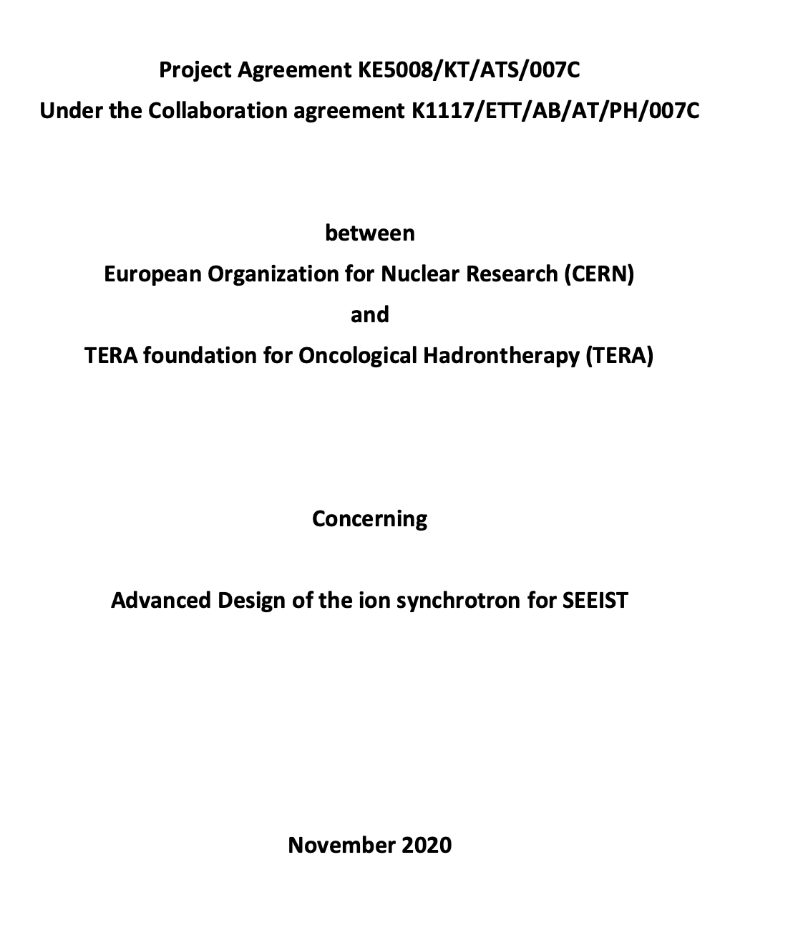
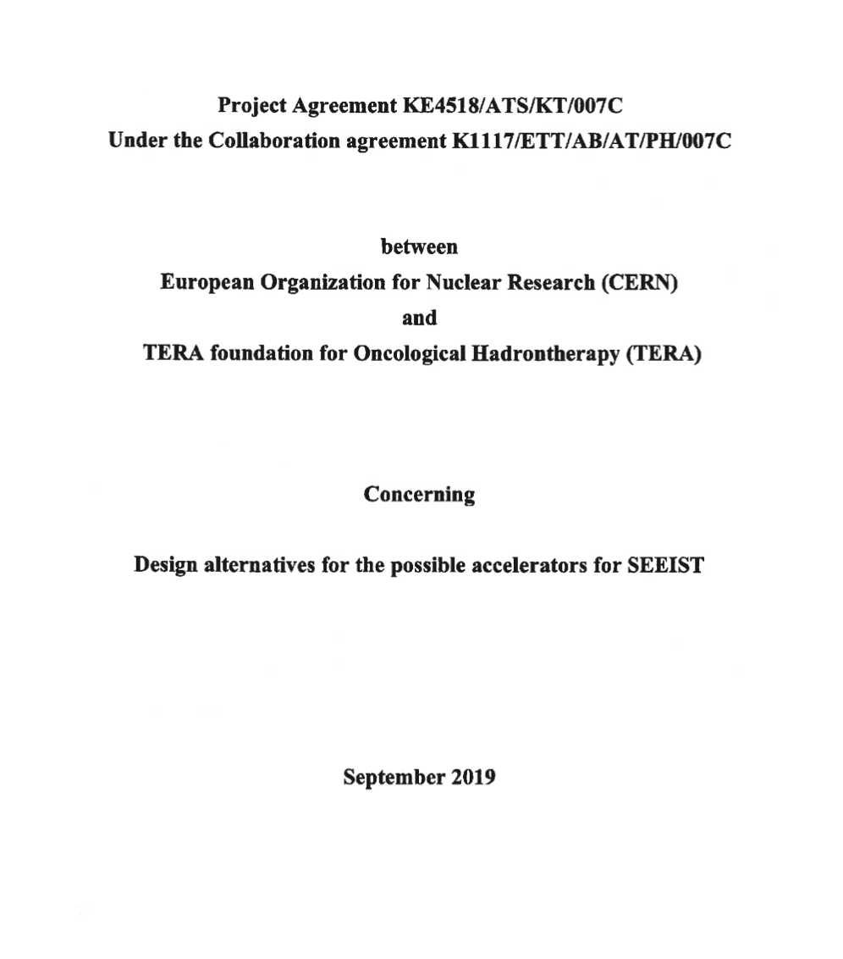
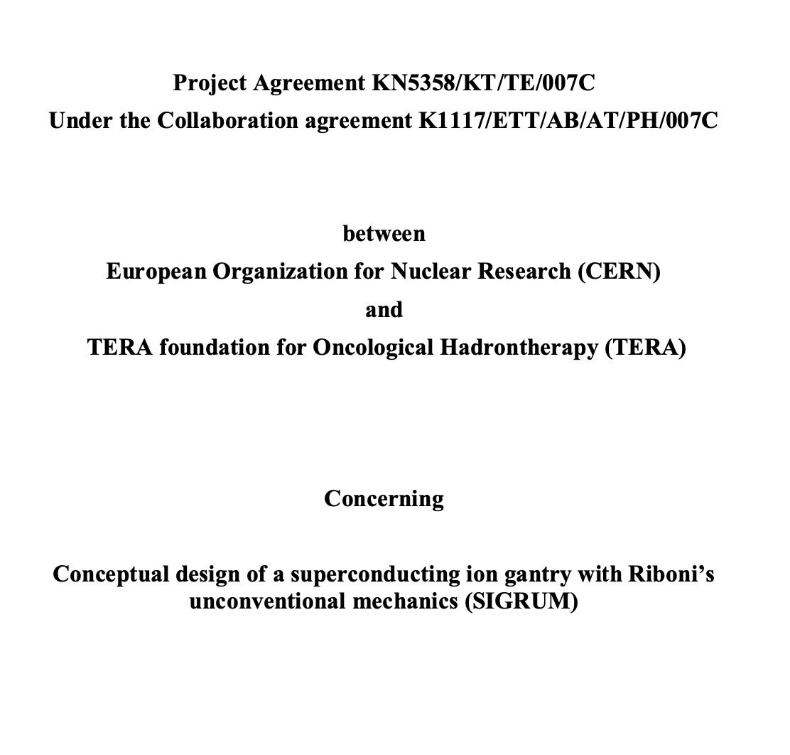
2022

Slide 20
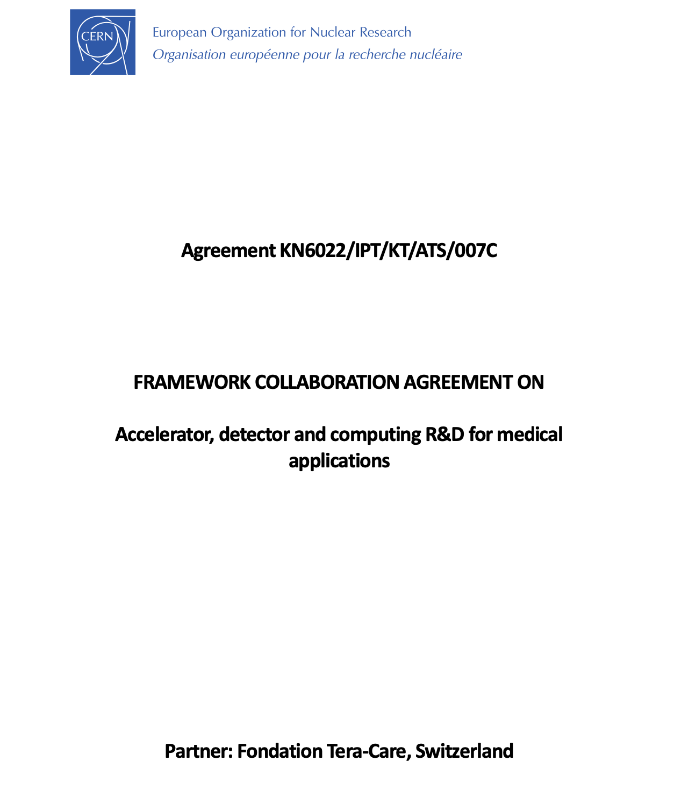
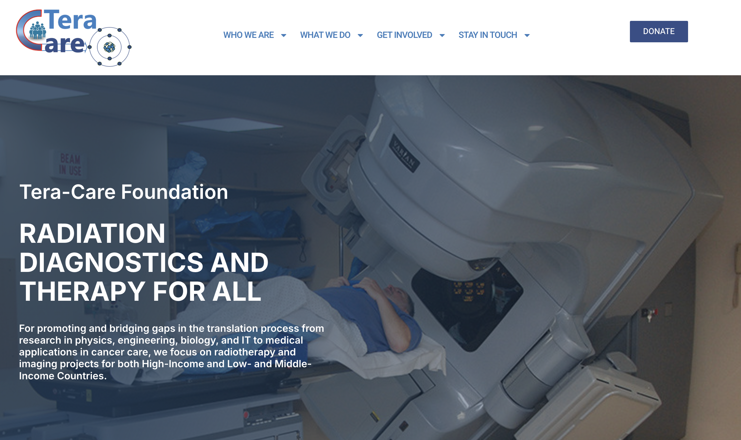
2024

Slide 21
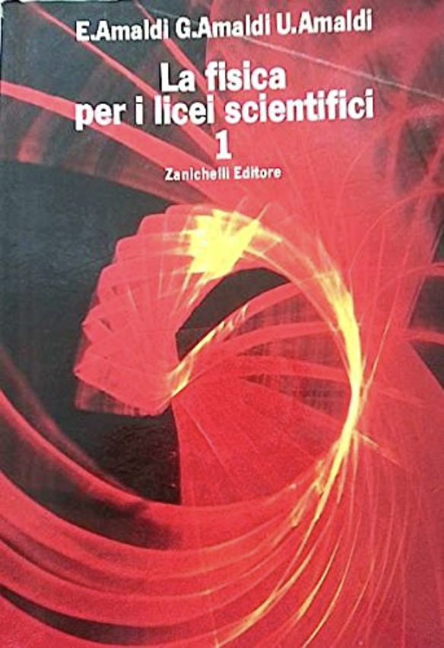
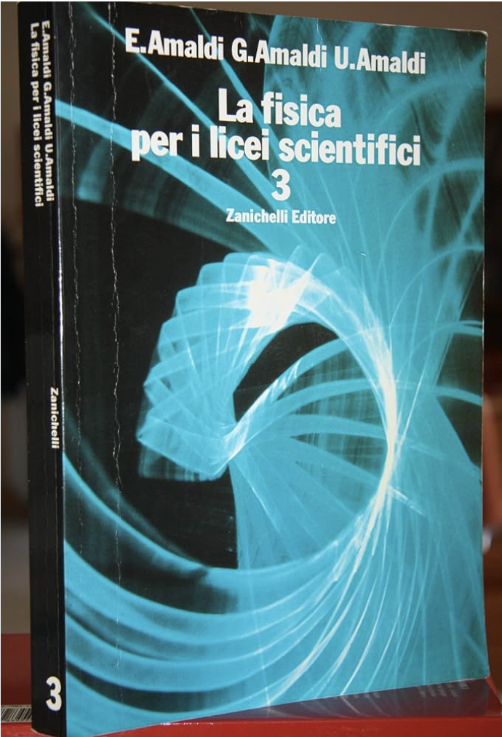
A few personal reflections to conclude
The ”fil rouge” of all these highlights is Ugo.
Thank you for having pushed CERN (multiple times) to be active in this field with vision, passion and persistence!
The importance of training people (and KT through people, from TERA to CNAO, CERN, SEEIST)
The Amaldi family for an Italian Scientific High-School student
Belated happy birthday Ugo!

