Slide 1
Latest State of Play at Participating Institutes
Setting the Scene:

Slide 2

ALBA
F.Becheri & E.Morales

Slide 3
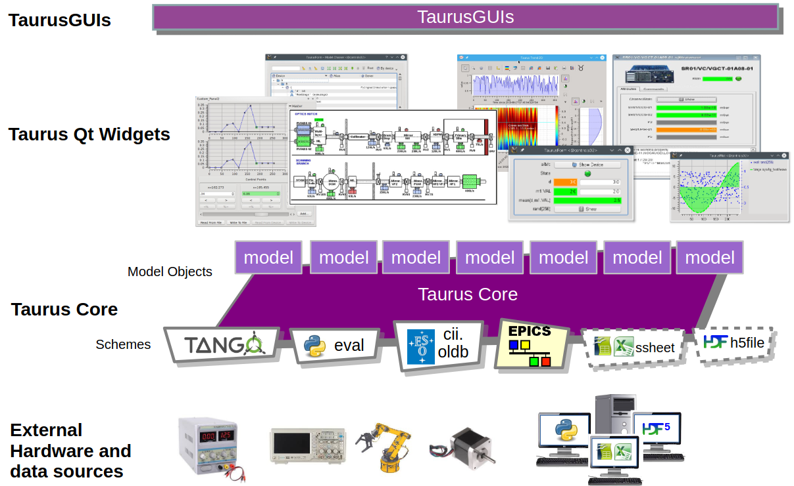
UI Technologies – Approaches & Challenges
We use and maintain Taurus, a python framework for control and data acquisition GUIs. Relies on Qt/PyQt5/PyQt6 and PyQtGraph libraries.
Other applications: MxCube, E-Giga, LaVue, pure Qt apps.
Proprietary software.
Challenges:
Keep up-to-date with Qt versions.
Plotting efficiency and general performance.
Centralize GUIs for support groups (Web?).
We use common approaches for GUIs devel. for Accelerator and Experiments.
F.Becheri & E.Morales

Slide 4
UI Components & Tools - Optimization
Taurus library provide Qt reusable widgets.
Documentation can be improved.
Updated widget catalog.
Autogenerated GUIs from tango properties or config files.
EPS GUI (CSV)
Vacca (TangoDB info)
LLRF GUI (YAML file)
Taurus provide solutions for codeless (non-programmers) or “low-code” that help the user to build and manipulate GUIs and their components.
F.Becheri & E.Morales

Slide 5

ANL
Keenan Lang (APS)

Slide 6
UI Technologies – Approaches & Challenges
Technologies in use
Beamlines: Transitioning from MEDM → caQtDM for control/monitoring.
Accelerator: Transitioning from MEDM → CSS-Phoebus.
Data acquisition: CLI (SPEC/Bluesky), custom PyQt-based GUIs.
Frameworks (on the beamline side): Gestalt for YAML-based, framework-agnostic screen generation (exportable to caQtDM, Phoebus, PyDM).
Challenges
Legacy systems coexist with new tools (a mix of MEDM + caQtDM in production).
Resistance to change
Accelerator vs beamline controls:
Historically not distinct — both relied on MEDM.
They are now diverging, with the accelerator side moving toward CSS-Phoebus, while beamlines are transitioning to caQtDM.
Keenan Lang
APS

Slide 7
UI Components & Tools - Optimization
Reusable components
synApps: Provides hundreds of reusable displays (motors, scans, detectors) used as baseline templates across beamlines (MEDM, caQtDM & Phoebus)
Gestalt: Introduces reusable YAML definitions (layouts, widgets) that can be shared and adapted.
Documentation: Being developed alongside Gestalt (GitHub repo, examples).
Automated UI generation
Yes — Gestalt is being developed specifically for this.
Purpose: to automatically generate UI screens from YAML templates that can be converted to caQtDM, Phoebus, or PyDM.
Benefit: reduces maintenance, ensures consistency, and allows facilities to standardize while still customizing.
Keenan Lang
APS

Slide 8
BNL

Slide 9

CERN – Accelerator Controls
Stephane Deghaye

Slide 10
UI Technologies – Approaches & Challenges
UI technologies
Web: Angular and Java with SpringBoot. Integrated in a home-made framework (ACW)
Mainly data manipulation (view/edit) and management at first. Moved to full-fledged Controls since a few years
Desktop: Python and Qt (PyQt 5 & 6) + home-made widgets and Controls integration libs
Simpler than web but more flexible than no-code/low-code platform. Maintenance cost to take into account
Obsolete but still alive: Java Swing (will stay for the next 15 years i.e. HL LHC lifetime).
What challenges are you facing?
Angular JS still present and web stability is a remaining concern, although it’s better than 8 years ago → Put in place a yearly update
Qt5 to Qt6 wasn’t straight-forward – PyQt vs PySide, OS compatibility, etc.
Pressure from users to keep investing in Java Swing – obsolescence is seen as stability
Accelerator Controls vs Beamline Controls
In the past, the high-level control system was completely different (professional operators vs visiting physicists)
Consolidation project ongoing (Java 8 & NetBeans) with the strategy to exclusively rely on customized Accelerator controls components.
Stephane
Deghaye

Slide 11
UI Components & Tools - Optimization
Do you have reusable UI components?
Web
In addition to Angular Material, ACW Components to homogenize tables, navigation, dialogues, etc.
Online documentation based on StoryBook. Although the maintenance is manual, gives user interactive options
https://acw-demo.web.cern.ch
Our low-code plateform (WRAP) provides several reusable components but within its scope only (so far)
Python
Rely on Qwidgets and PyQtGraph but added a few accelerator-specific widgets (more controls oriented than ACW)
Website to document the components and to cover typical use-cases with runnable examples
Do you, or do you plan to, utilize any form of automated UI Generation?
Yes, we want to leverage the accelerators’ descriptions (functional position) to generate synoptic views (see Procedurally-generated beamline controls and monitoring UI by Nodas later today)
First attempt to connect the Layout data with the controls data
Optimal solution for experimental areas where beamlines change on a weekly basis; may lack good UX for stable accelerators
Stephane
Deghaye

Slide 12

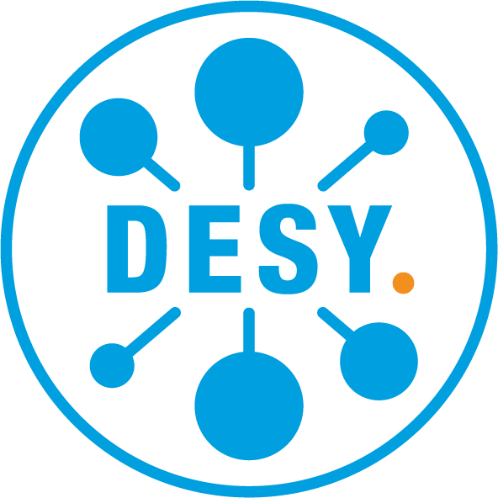

DESY
Zeynep Isil Isik Dursun

Slide 13
UI Technologies – Approaches & Challenges
In a nutshell, what UI technologies are you using (including any frameworks), for what? and Why?
DESY | PETRA III – 25 beamlines, ~60 measuring stations. Various UI solutions developed by beamline scientists, based on Python-coded graphical frameworks.
DESY | FLASH – 11 beamlines. More unified UIs compared to PETRA III.
What challenges are you facing? (can be technical and/or organizational)
UX perspective: Remembering the GUI, training time, many things to figure out - time consuming for both users and beamline scientists.
Automation, unified GUI design, online training before beamtime, well-designed digital user manual.
Do you have distinct or common approaches to UI solutions for both Accelerator Controls & Beamline Controls?
At PETRA III, most beamlines have individual UI solutions created and updated by various beamlines scientists, specifically designed for their needs. Accelerator controls are being developed separately by the MCS (Accelerator Control System) group.
FLASH – More unified; following a similar logic, using same UI modules when possible (camera control, motors, …).
Zeynep Isil ISIK DURSUN
Notes:
In a nutshell, what UI technologies are you using (including any frameworks), for what? and Why?
Deutsches Elektronen-Synchrotron DESY’s PETRA III (3rd generation synchrotron light source) has 25 beamlines, ranging from protein crystallography to catalysis research. DESY | FLASH (free electron laser facility) - 11 beamlines.
At these various beamlines at DESY, most of the beamlines have their own UI solution specifically designed for their needs. Many of these UI solutions are individual solutions developed by beamline scientists, based on Python-coded graphical frameworks.
What challenges are you facing? (can be technical and/or organizational)
I’ll give an answer from the UX perspective: Most common feedback was remembering the GUI, training time, many things to figure out - time consuming for both users and beamline scientists.
Solution: Automation, unified GUI design, online training before beamtime, well-designed digital user manual.
Do you have distinct or common approaches to UI solutions for both Accelerator Controls & Beamline Controls?
At DESY, each beamline has their own UI solution specifically designed for their needs. These are mostly designed by beamline scientists, throughout times according to the needs. Accelerator controls were developed separately by the MCS (Accelerator Control System) group at DESY.
I am not really sure about this answer. Though it is probably valid for PETRA III, but I would say at FLASH, the UIs are more unified. The Accelerator control modules following a similar logics and the same UIs for modules like camera control or motors are used at both accelerator and the beamlines.
MCS — it stands for Accelerator Control System (Beschleunigerkontrollsystem) at DESY.

Slide 14
UI Components & Tools - Optimization
Do you have reusable UI components?
ROCK-IT will use the Daiquiri GUI - modular, many reusable components.
Components section in the daiquiri documentation (File Browser, File Editor, Image Viewer, Scans, Synoptic, Parameteriser, etc.) are designed to be usable.
How do you document them and keep this updated?
Documentation maintained via Daiquiri docs site (“About”, “Installation”, “Configuration”, “Concepts”, “Resources”, “Components”) – includes up-to-date reference of available and updated components, layouts, usage guidelines, and examples.
Do you, or do you plan to, utilize any form of automated UI Generation?
Present: UI not automatically generated from schema definitions. Modules use well-defined UI components from the shared library.
Looking ahead: plans to integrate with the Bluesky QueueServer to enable automatic UI generation
Allowing Daiquiri to dynamically build forms & interfaces for plans exposed by the QueueServer.
Reduced manual frontend work, ensured reflection of the current experimental workflow on the UI, more flexible experiment setup and responsive to changes.
Acknowledgement: Udai Singh (DESY) | udai.singh@desy.de
Zeynep Isil ISIK DURSUN
Notes:
• Do you have reusable UI components? Yes. ROCK-IT will use the Daiquiri GUI. Daiquiri’s frontend is built in a modular manner, with many reusable UI components. The Components section in the Daiquiri documentation (File Browser, File Editor, Image Viewer, Scans, Synoptic, Parameteriser, etc.) are designed to be reusable across different modules of the system. (ui.gitlab-pages.esrf.fr) These shared components allow consistent UI behavior and appearance, and reduce duplication.
• How do you document them and keep this updated? Documentation is maintained via the Daiquiri docs site (“About”, “Installation”, “Configuration”, “Concepts”, “Resources”, “Components”) which includes an up-to-date reference of available components, layouts, usage guidelines, and examples. (ui.gitlab-pages.esrf.fr) Changes to UI components are accompanied by documentation updates, so developers and users always have a synchronized view.
• Do you, or do you plan to, utilize any form of automated UI Generation? At present, the UI is not automatically generated from schema definitions. Instead, modules explicitly use well-defined UI components from the shared library, such as the Scans view, Hardware views, and Image Viewer.
Looking ahead, there are concrete plans to integrate with the Bluesky QueueServer to enable automatic UI generation for experiment control. This would allow Daiquiri to dynamically build forms and interfaces for available plans exposed by the QueueServer, reducing manual frontend work and ensuring the UI reflects the current experimental workflow. This approach would make experiment setup more flexible and responsive to changes in the beamline environment.

Slide 15

DIAMOND
Mark Heron

Slide 16
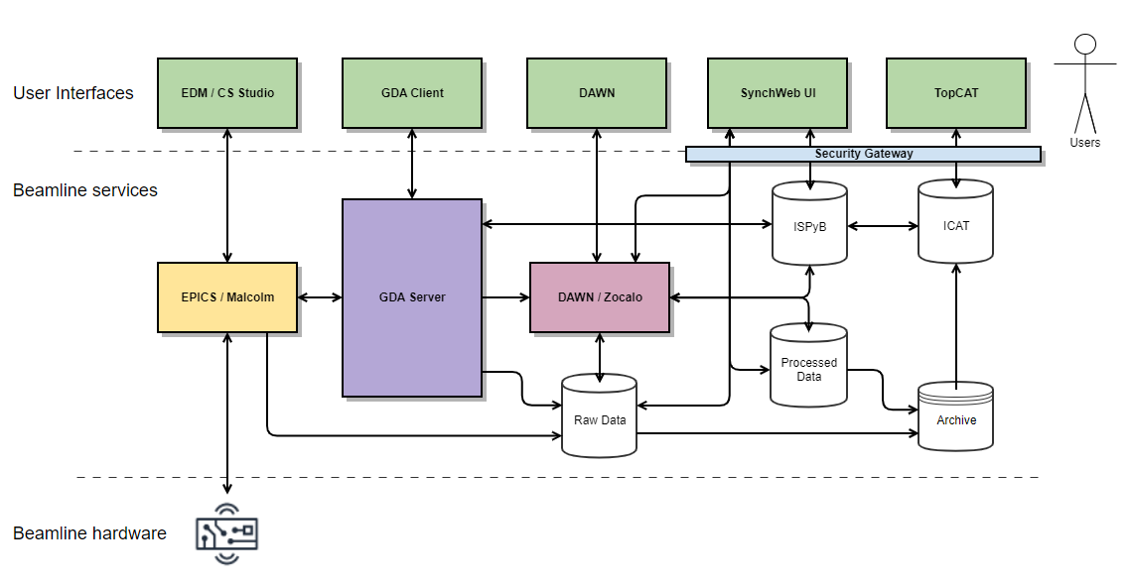
Where we are
Controls Acc and BLs : EDM, CSS
Panda UI: React and WebUI : React
Data Acquisition: Java RCP
Data Analysis: mixed
LIMS: ISPYB SynchWeb Backbone/Marionette & Vue
UAS: GWT
Data archive: ???
Problem: separate systems, separate interfaces, no standardization
Controls, Acq, Analysis remote access is through NX NoMachine
Made excellent use of ISPyB for remote access and unattended access mainly to MX beamlines and EMs
Mark
Heron

Slide 17
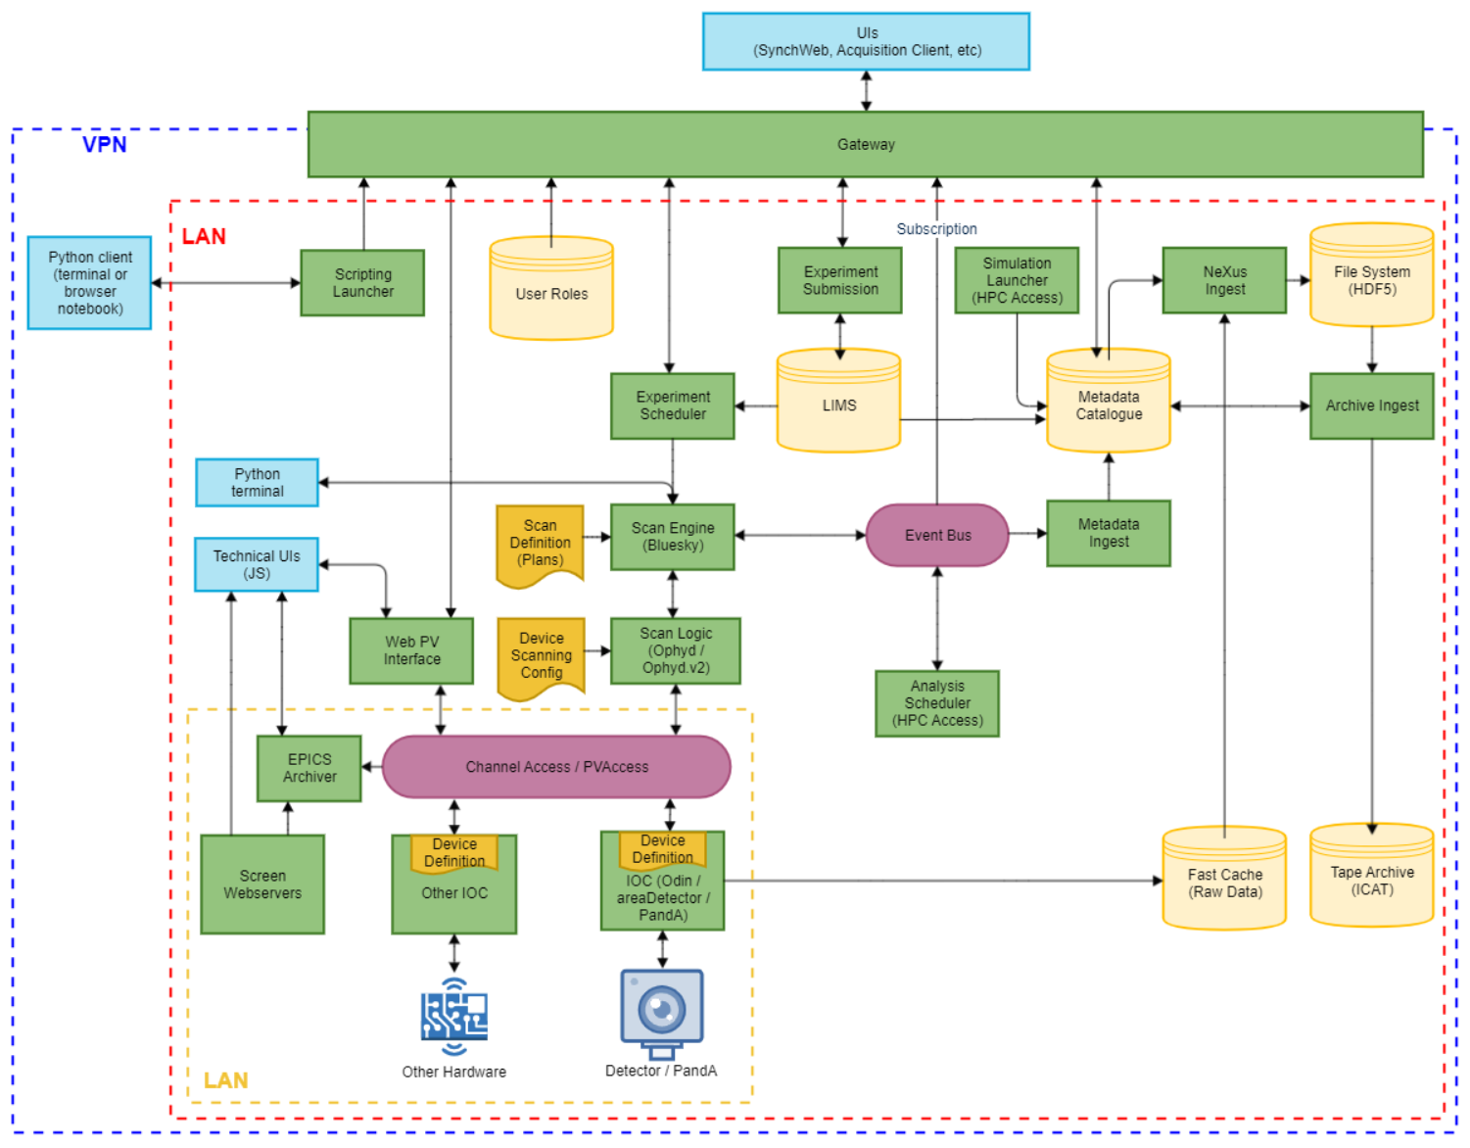
Goal
Integrated user experience from beamtime submission through experiment orchestration, data processing and data access.
All through a common UI, accessible locally or remotely, in a secure way, with consistent behaviour.
Mark
Heron

Slide 18
UI Technologies – Approaches & Challenges
In a nutshell, what UI technologies are you using adopting (including any frameworks), for what? and Why?
For most systems React with Material UI components and Material Table to facilitate dataTables
PATo is currently using Chakra Ui
Controls Phoebus BOB files, which Phoebus, and our Web application Daedalus application can render.
See React as performant, robust, and market leading
What challenges are you facing? (can be technical and/or organizational)
There is no defined Design system @Diamond
Standardisation of behaviour of different through one Web interface
How we interact with GraphQL from web UIs
Unsure yet of approach to plotting
UI/UX design tried with Figma, though as a team we are not too confident with this at the moment
Accessibility has had some thoughts, but still questions around how accessible our UIs are.
Authentication and Authorisation
Scale and mix of in-house development resource – mainly backend developers
Number of touch points to add new information to a UI
Risk to changes to licensing
Do you have distinct or common approaches to UI solutions for both Accelerator Controls & Beamline Controls?
Both use Phoebus BOB files, but Accelerator are likely to use Phoebus to render, while beamlines will use the Daedalus web applciation
Goal is a common UI for facility users across UAS, Controls, Data Acquisition, Data Processing, Data Download, LIMS
Mark
Heron

Slide 19
UI Components & Tools - Optimization
Do you have reusable UI components?
Sci React UI components
cs-web-lib is a reusable component library that has good support for Phoebus .bob file widgets, and a full compatibility matrix is available on the GitHub page
How do you document them and keep this updated?
Usual code maintenance
Do you, or do you plan to, utilize any form of automated UI Generation? If so, for what?
Use JSON Forms for automatic UI generation. For example we are using this for sample creation views.
Beamline Controls use FastCS ( In house builder) to generate .bob files
Automated conversion from .opi to .bob is usually possible
Mark
Heron

Slide 20
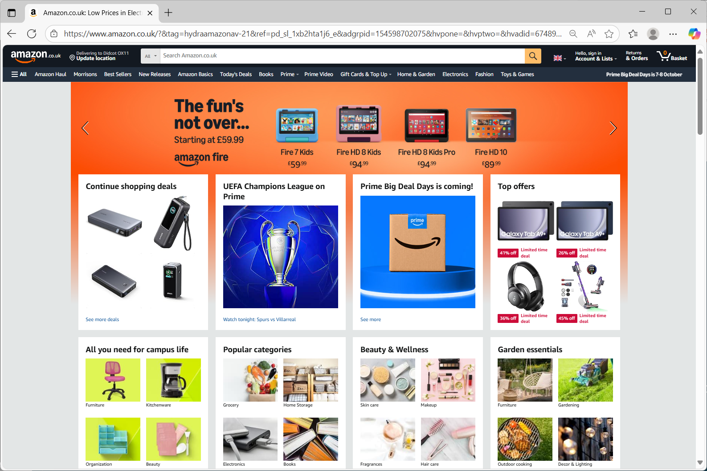
Mark
Heron

Slide 21
Sci React UI
https://github.com/DiamondLightSource/sci-react-ui
Library for CS web UI prototype cs-web-lib
https://github.com/DiamondLightSource/cs-web-lib
Mark
Heron

Slide 22

Elettra
Lucio Zambon

Slide 23
UI Technologies – Approaches & Challenges
UI technologies: QT, with Taurus (python) and Cumbia (C++), JavaScript, SVG, ThreeJS, Websockets, Node.js, NiceGUI, Flask, FastAPI, Bottle, Streamlit, Plotly Dash. We have different points of view about easiness of development, maintenance and quality of final results in terms of efficiency, responsiveness etc. We tested a configuration in Firefox that allows native applications to be launched directly from a web page.
Our challenges are: some old OS versions, hard to find a general purpose web framework, use of AI as a development techniques, for example development of microservices customized for specific applications.
We have distinct approaches to UI solutions for both Accelerator Controls & Beamline Controls
Lucio Zambon

Slide 24
UI Components & Tools - Optimization
Reusable UI components: Taurus & Cumbia components, SVG files used as standalone elements placed in an HTML synoptic or as <symbol> called by <use> tag in an SVG map/synoptic with transformations (rotation & translation); 3D components written in JavaScript using ThreeJS primitives (extended at low level in a specific case); GLB files derived from mechanical department designs and from photogrammetry. To capture user attention on another browser tab, we implemented a blinking LED effect displayed in the favicon area.
Automated UI Generation: DonkiGUI & DonkiWEB (few lines of python or JavaScript), JSON lattice file for interactive web maps. Internal gitlab for versioning and custom PHP scripts to check components misalignment.
Lucio Zambon

Slide 25
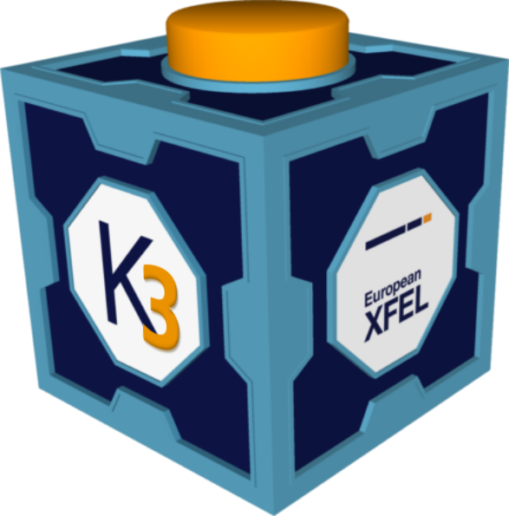
European XFEL
Cammille Carinan

Slide 26
UI Technologies – Approaches & Challenges
Tech Stack
Desktop (main):
PyQt (framework)
Traits (typed observables)
Pyqtgraph (plotting)
Web (development):
React (framework)
Zustand/Redux (state management)
Material UI (components)
Plotly (plotting)
Challenges
Transitioning to and developing a web framework
Interchangeability of components (e.g., widgets) across desktop/web & external tools (e.g., Inkscape)
Similar look and feel (fonts, layouts, functionality)
Strict performance requirements and diverse UI elements
Consistency (across accelerator and beamline)
Accelerator runs on a different control system (DOOCS)
Bridges (both directions) provide UI in each control system using the relevant standard
Cammille Carinan

Slide 27
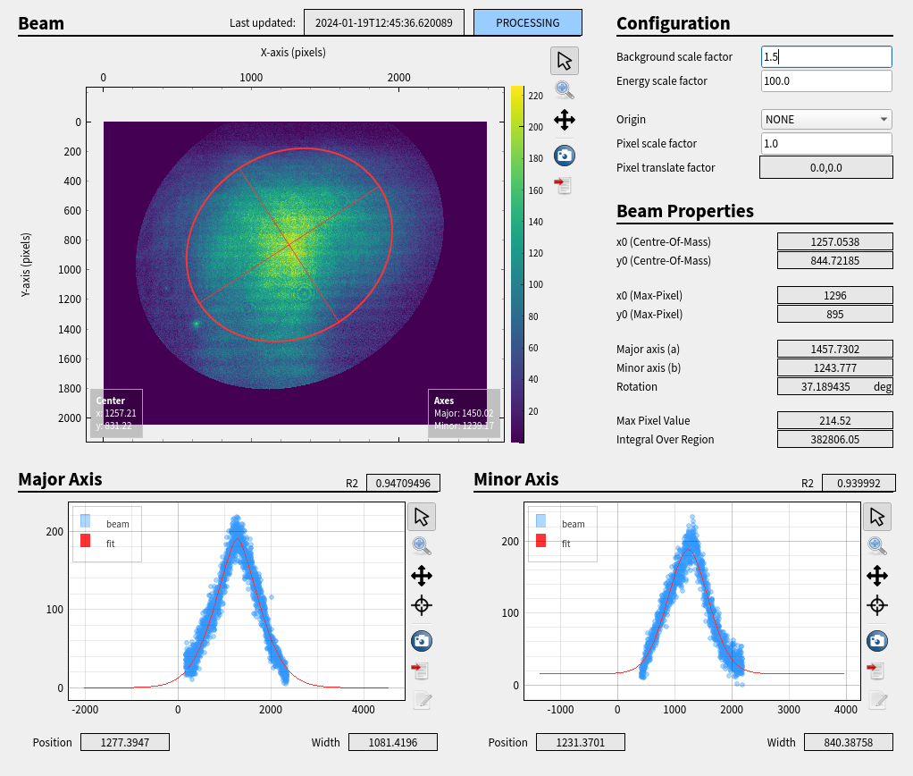
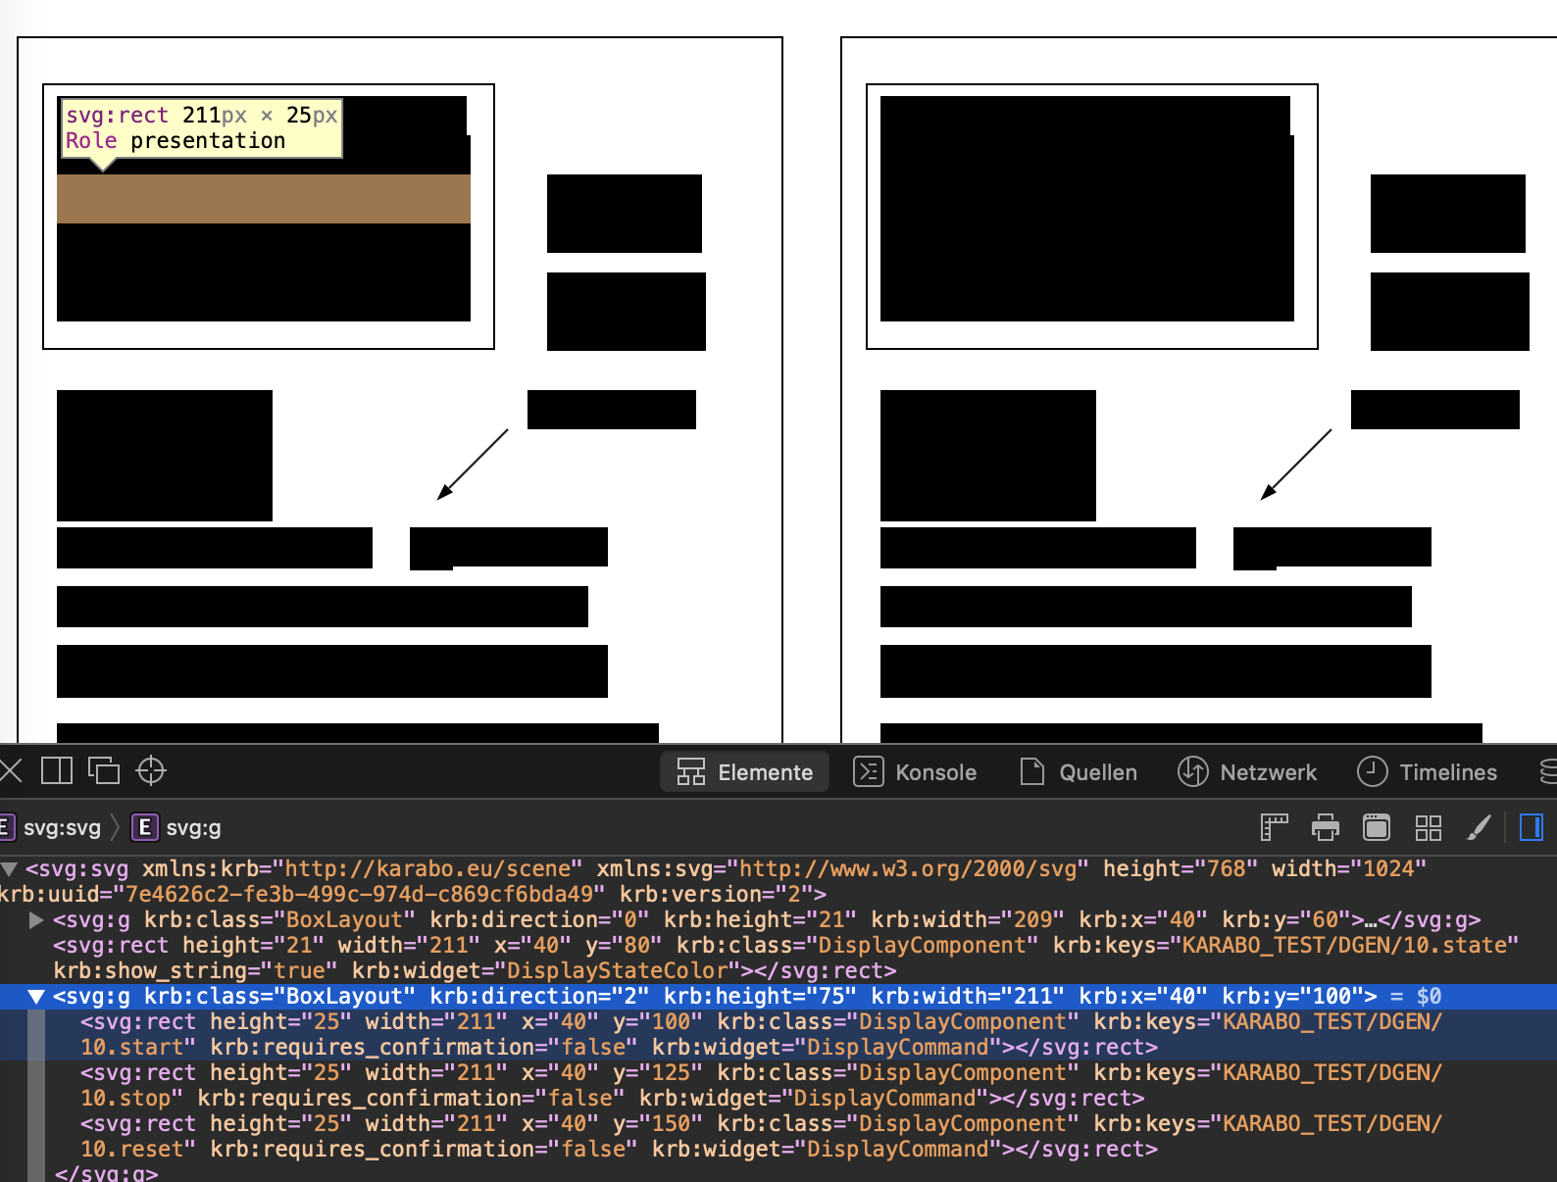
UI Components & Tools - Optimization
Reusable UI Components
Yes; both desktop and web use reusable base widgets (components)
External description (XML) in a database is UI-independent
Web components targeted to be split into their own package
Automated UI Generation
Yes; exists in the desktop application from device definitions
Interlock views
Synoptic views
Combined control elements
Cammille Carinan

Slide 28

FNAL
Beau Harrison

Slide 29
UI Technologies – Approaches & Challenges
In a nutshell, what UI technologies are you using (including any frameworks), for what? and Why?
We use Flutter deployed to the web, with a GraphQL API gateway.
What challenges are you facing? (can be technical and/or organizational)
AuthN/AuthZ
API stability
Microservices architecture education
Do you have distinct or common approaches to UI solutions for both Accelerator Controls & Beamline Controls?
Our exising system is unified and we don’t have plans to change that
Beau Harrison

Slide 30
UI Components & Tools - Optimization
Do you have reusable UI components?
how do you document them and keep this updated?
We have a core library of reusable functions and GUI elements. Our main challenge is making developers aware of the existing functionality.
We are fans of Storybook but have not yet implemented a formal system for documentation.
Do you, or do you plan to, utilize any form of automated UI Generation?
If so, for what?
We're exploring tools for automated UI generation, similar to what DLS does with Phoebus to generate engineering displays.
Beau Harrison

Slide 31


GSI
Jutta Fitzek

Slide 32
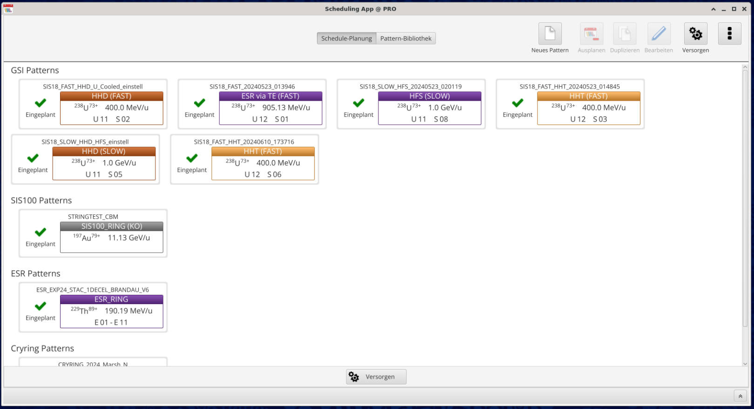
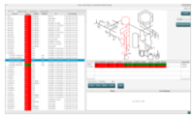
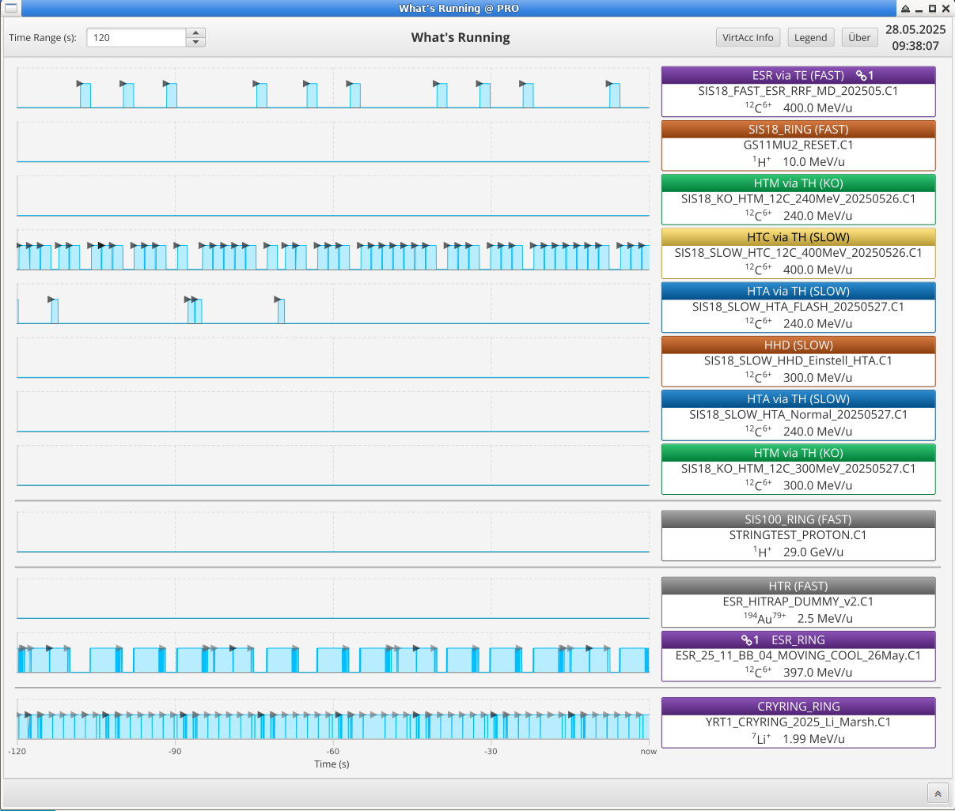
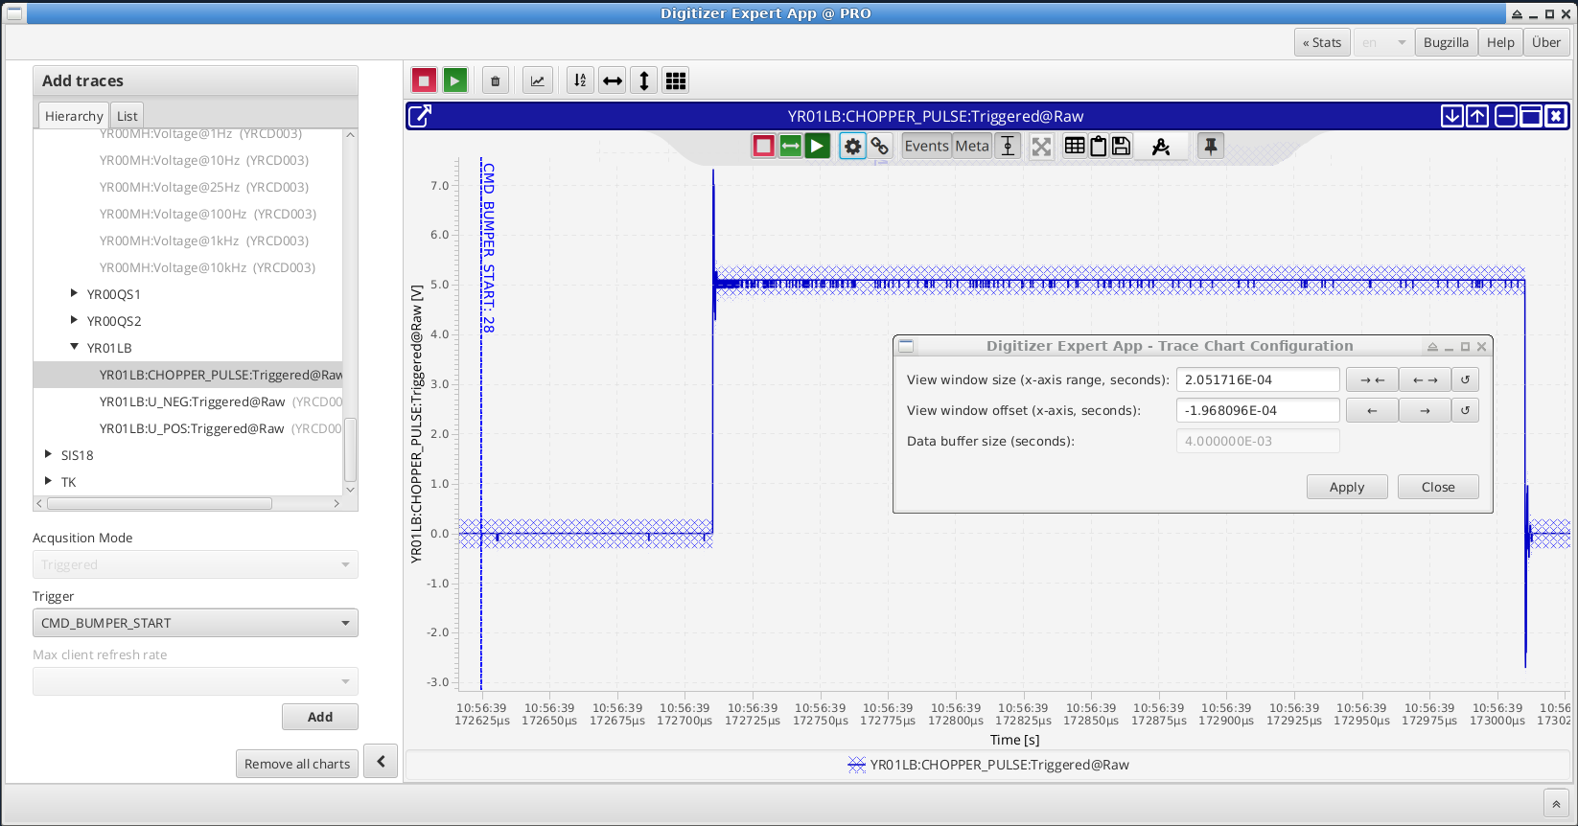
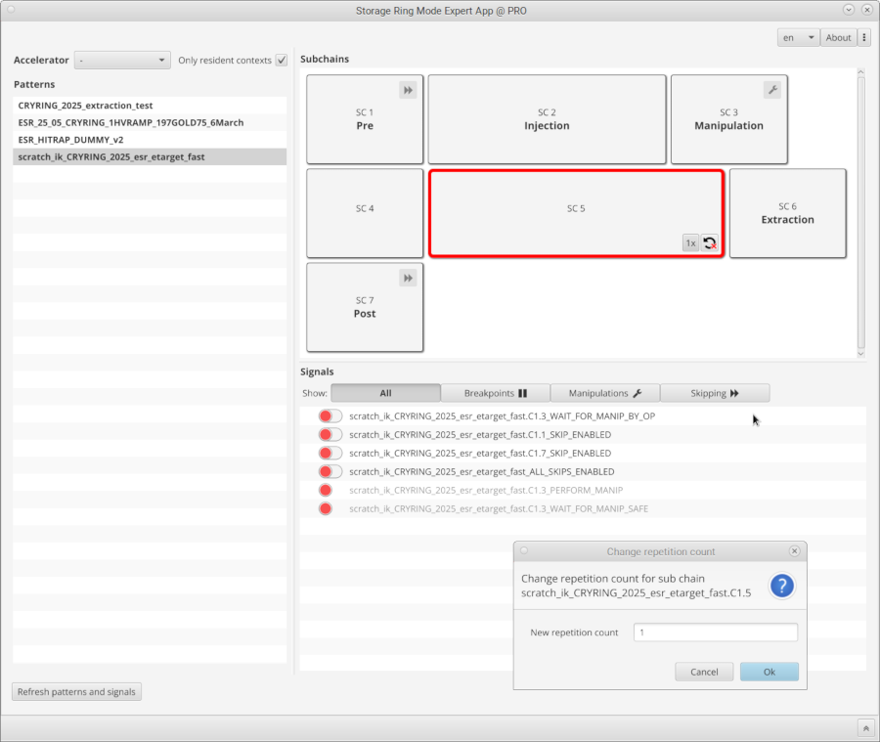
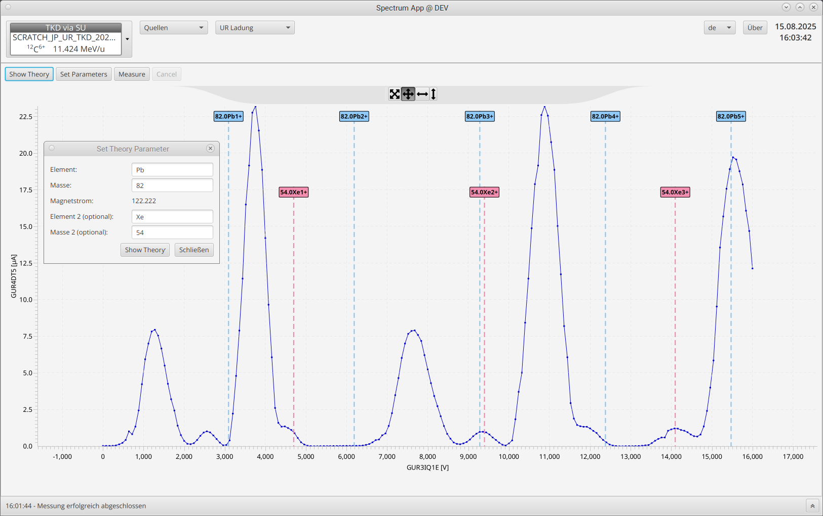
UI Technologies – Approaches & Challenges
In a nutshell, what UI technologies are you using?
Java 17, JavaFX 19, (few Swing legacy apps), ControlsFX (e.g. ToggleSwitch), RichTextFX, Flowless (only renders what you see), accsoft-gui-fx (CERN), ChartFx (FAIR), TestFX
Separation into more light-weight UI and an application service for the logic
Jutta Fitzek

Slide 33
UI Technologies – Approaches & Challenges
In a nutshell, what UI technologies are you using - why?
Why?
coming from Swing with JavaFX we are more productive, good features also for graphical functionalities, stylesheets, more structured
writing solid and robust applications seems easier in Java than in other technologies
Why not..
Why not Web? very high pace ecosystem
Why not C++/Qt? manpower consists of Java developers as also services are written in Java
Why not python? python sometimes used for internal tools or prototypes
=> we prefer solid applications over fast prototypes and don’t have the need for super-high performance (although we do have some special apps in each of those technologies)
Jutta Fitzek

Slide 34
UI Technologies – Approaches & Challenges
What challenges are you facing?
Organizational challenges:
hard to find new developers with JavaFX knowledge, training on the job necessary
Technical challenges:
ecosystem is not that big, not for everything a library exists
JavaFX still has some bugs that cost time for workarounds, effort for reporting bugs and getting it fixed
some libraries used still have performance issues, tackled by careful programming
Do you have distinct or common approaches to UI solutions for both Accelerator Controls & Beamline Controls?
same Control System and same applications are used for both
Jutta Fitzek

Slide 35
UI Components & Tools - Optimization
Do you have reusable UI components? How do you document them and keep this updated?
Common Widgets like the frame, the beam (“context”) selector, …
Documentation in the Web, updated by the developers
Browsable platform with lists of all projects, specific project for common UI widgets
Quick usage guide / readme in Git as .md file
Detailed documentation in JavaDoc
Not so many GUI developers outside the Accelerator Controls Department (just a handful), it’s therefore easy to inform them about changes in regular meetings
Do you, or do you plan to, utilize any form of automated UI Generation?
Not planned so far
Jutta Fitzek

Slide 36
LBNL
Seij De Leon

Slide 37
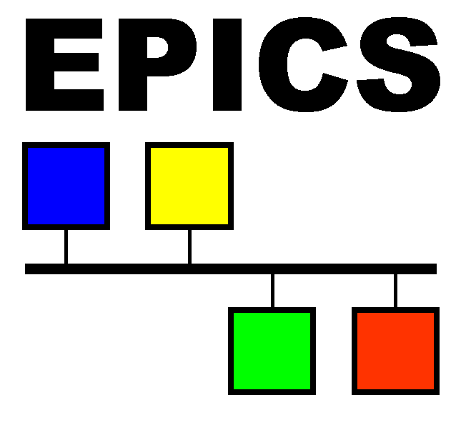
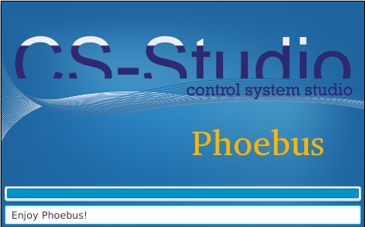




UI Technologies – Approaches & Challenges
UI Technologies
Accelerator: EPICS + CS Studio/MEDM
Beamline:
Labview is used at most beamlines.
Great async support and codebase
Highly experienced devs
Web UI for Bluesky/EPICS will be used at all new beamline endstations
In development. Intended to provide excellent user experience
Challenges
Labview: No devops integrations (version control, pipelines), upgrades require new OS
Bluesky: Limited expertise in Bluesky controls and large time investment for new UI
Approach
Accelerator and Beamline groups are functionally separate
Different software stacks and workflow processes
Seij De Leon

Slide 38
UI Components & Tools - Optimization
Do you have reusable UI components?
Labview
Common code gets updated every 6 months and rolled out at all beamlines
Beamline specific code gets updated per request
Currently making component library with React for Bluesky beamlines
Documentation through storybook
Updates rolled out through versioned package managers
Automated UI Generation?
Agentic AI in testing for creating React applications for Beamline data analysis
Beamline controls team wants to explore generating control panels
Seij De Leon

Slide 39

LNLS
Lucas Vecina

Slide 40
UI Technologies – Approaches & Challenges
In a nutshell, what UI technologies are you using (including any frameworks), for what? and Why?
Mostly Python GUIs based on PyQt5, PyDM and pyqtgraph
Jupyter Notebook is also common on beamlines
New WEB developments under study and development: Next.js with shadcn/ui and tRPC
What challenges are you facing? (can be technical and/or organizational)
Standardization (templates, packages, deploy)
Generic/Reusable widgets and components
Usability metrics
Do you have distinct or common approaches to UI solutions for both Accelerator Controls & Beamline Controls?
Both Accelerators and Beamlines use mostly desktop solutions (PyQt, PyDM)
Accelerators and Beamlines share an in-house web archiver viewer
Accelerator also uses some web monitoring solutions with epics2web backend
Lucas Vecina

Slide 41
UI Components & Tools - Optimization
Do you have reusable UI components?
At Mogno beamline: mgnwidgets with reusable PyQt5 widgets
At laboratory level: suitscase for PyQt5 widgets and GUIs; sophys-gui and sophys-web for Bluesky integration
how do you document them and keep this updated?
Package upload on Gitlab Registry and documentation using Gitlab Pages or Wikis
CI/CD at some levels – could be more explored
Do you, or do you plan to, utilize any form of automated UI Generation?
Designer for no/low-code
Some local/exploratory solutions to create PyQt5 Forms from configuration files
Lucas Vecina

Slide 42

MAX IV
Yimeng Li & Carla Takahashi

Slide 43
UI Technologies – Approaches & Challenges
In a nutshell, what UI technologies are you using, for what? and Why?
Web:
React(component-based architecture, easy to maintain and develop, virtual DOM)
Angular for SciCat(collaboration)
Desktop: PyQt5 (taurus integrated, ready-to-go widgets, cross platforms, integrated with Python as it is the main develop language in our lab)
What challenges are you facing?
Hard to maintain many different complicated Qt GUIs created by users
Keep update with the dependencies sometimes requires big code refactoring
Old apps cannot be easily extended to incorporate new user needs
Most of our implementations are not compatible with mobile view now
Do you have distinct or common approaches to UI solutions for both Accelerator Controls & Beamline Controls?
The web user interfaces for monitoring/control and archive viewer are the same for both acc and beamlines.
The synoptic SVG viewer itself is common, but an extra layer of development is necessary case by case.
PyQt5 Taurus widgets tend to be common, but extra development needs to be done case by case.
Yimeng Li & Carla Takahashi

Slide 44
UI Components & Tools - Optimization
Do you have reusable UI components?
how do you document them and keep this updated?
We have a library of MAX IV widgets that are shared between taurus applications.
The library of SVG synoptics is also a reusable UI components.
Taranta widgets are also shared by all users to create their own UI.
We use Git and Ansible for managing all libraries and use Git for documentation.
Do you, or do you plan to, utilize any form of automated UI Generation?
If so, for what?
For the Rings synoptics a configuration XML file is used to automatically generate the SVG file used by the viewer.
Yimeng Li & Carla Takahashi

Slide 45

ORNL
Hao Hao

Slide 46
UI Technologies – Approaches & Challenges
In a nutshell, what UI technologies are you using, for what? and Why?
CSS-phoebus for majority of control, mature software
TDM for some subsystems, new tool
What challenges are you facing?
remote access: need a remote desktop to use the program
program efficiency: CPU and memory usage
Do you have distinct or common approaches to UI solutions for both Accelerator Controls & Beamline Controls?
common approach
Hao Hao

Slide 47
UI Components & Tools - Optimization
Do you have reusable UI components?
how do you document them and keep this updated?
Do you, or do you plan to, utilize any form of automated UI Generation?
Yes, for generating simple PV list in display manager for IOC testing.
Hao Hao

Slide 48
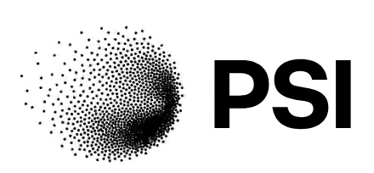
PSI
Guifré Cuní & Jan Wyzula

Slide 49
UI Technologies – Approaches & Challenges
In a nutshell, what UI technologies are you using, for what? and Why?
We use the C++ & Qt to provide panels for the operators of the accelerators and the scientists and users of the beamlines and end stations.
There is one Control Room for the 4 accelerators, and is better to have a unified interface and look&feel.
Many expert groups, operators and scientist build their own panels.
For archiving interfaces and some particular UI needs, special web frameworks have been chosen by individuals in one-person developments that we have great difficulty to maintain and also lack necessary insights into the chosen technologies and solutions (a Zoo of Web Components, Lit+MVC pattern, React, ???)
What challenges are you facing?
Keep compatibility with OS as Qt releases
caQtDM inherited from Operations, development knowledge only in one person: very limited support for new features.
We cannot afford someone with UX expertise to ensure proper design. Especially for web, where technologies are fast changing (e.g. web data-ui experience)
Guifré Cuní

Slide 50


UI Technologies – Approaches & Challenges
In a nutshell, what UI technologies are you using, for what? and Why?
Qt/PySide6 + PyQtGraph + Redis
High performance, scalability
What challenges are you facing?
Testing qt, SEGFAULTs
Jan Wyzula

Slide 51
UI Technologies – Approaches & Challenges
Do you have distinct or common approaches to UI solutions for both Accelerator Controls & Beamline Controls?
For hardware integration, both the Accelerator and Beamlines have caQtDM panels. In addition, Beamlines have BEC interfaces for the experiment control.
Guifré Cuní & Jan Wyzula

Slide 52
UI Components & Tools - Optimization
Do you have reusable UI components?
Yes, but at the graphics level, not Controls Objects.
how do you document them and keep this updated?
We keep https://caqtdm.github.io/ updated
Do you, or do you plan to, utilize any form of automated UI Generation?
Not for now
Guifré Cuní

Slide 53
UI Components & Tools - Optimization
Do you have reusable UI components?
How do you document them and keep this updated?
Yes, whole framework is based on widgets
Documentation per widget, developer guidelines
ANSIBLE auto deployment per beamline
Do you, or do you plan to, utilize any form of automated UI Generation?
Used for scan orchestration widgets, setting widget properties, event driven updates
QtDesigner Plugins + RPC Interface
Jan Wyzula

Slide 54

SOLARIS
Magdalena Szczepanik & Michal Piekarski

Slide 55
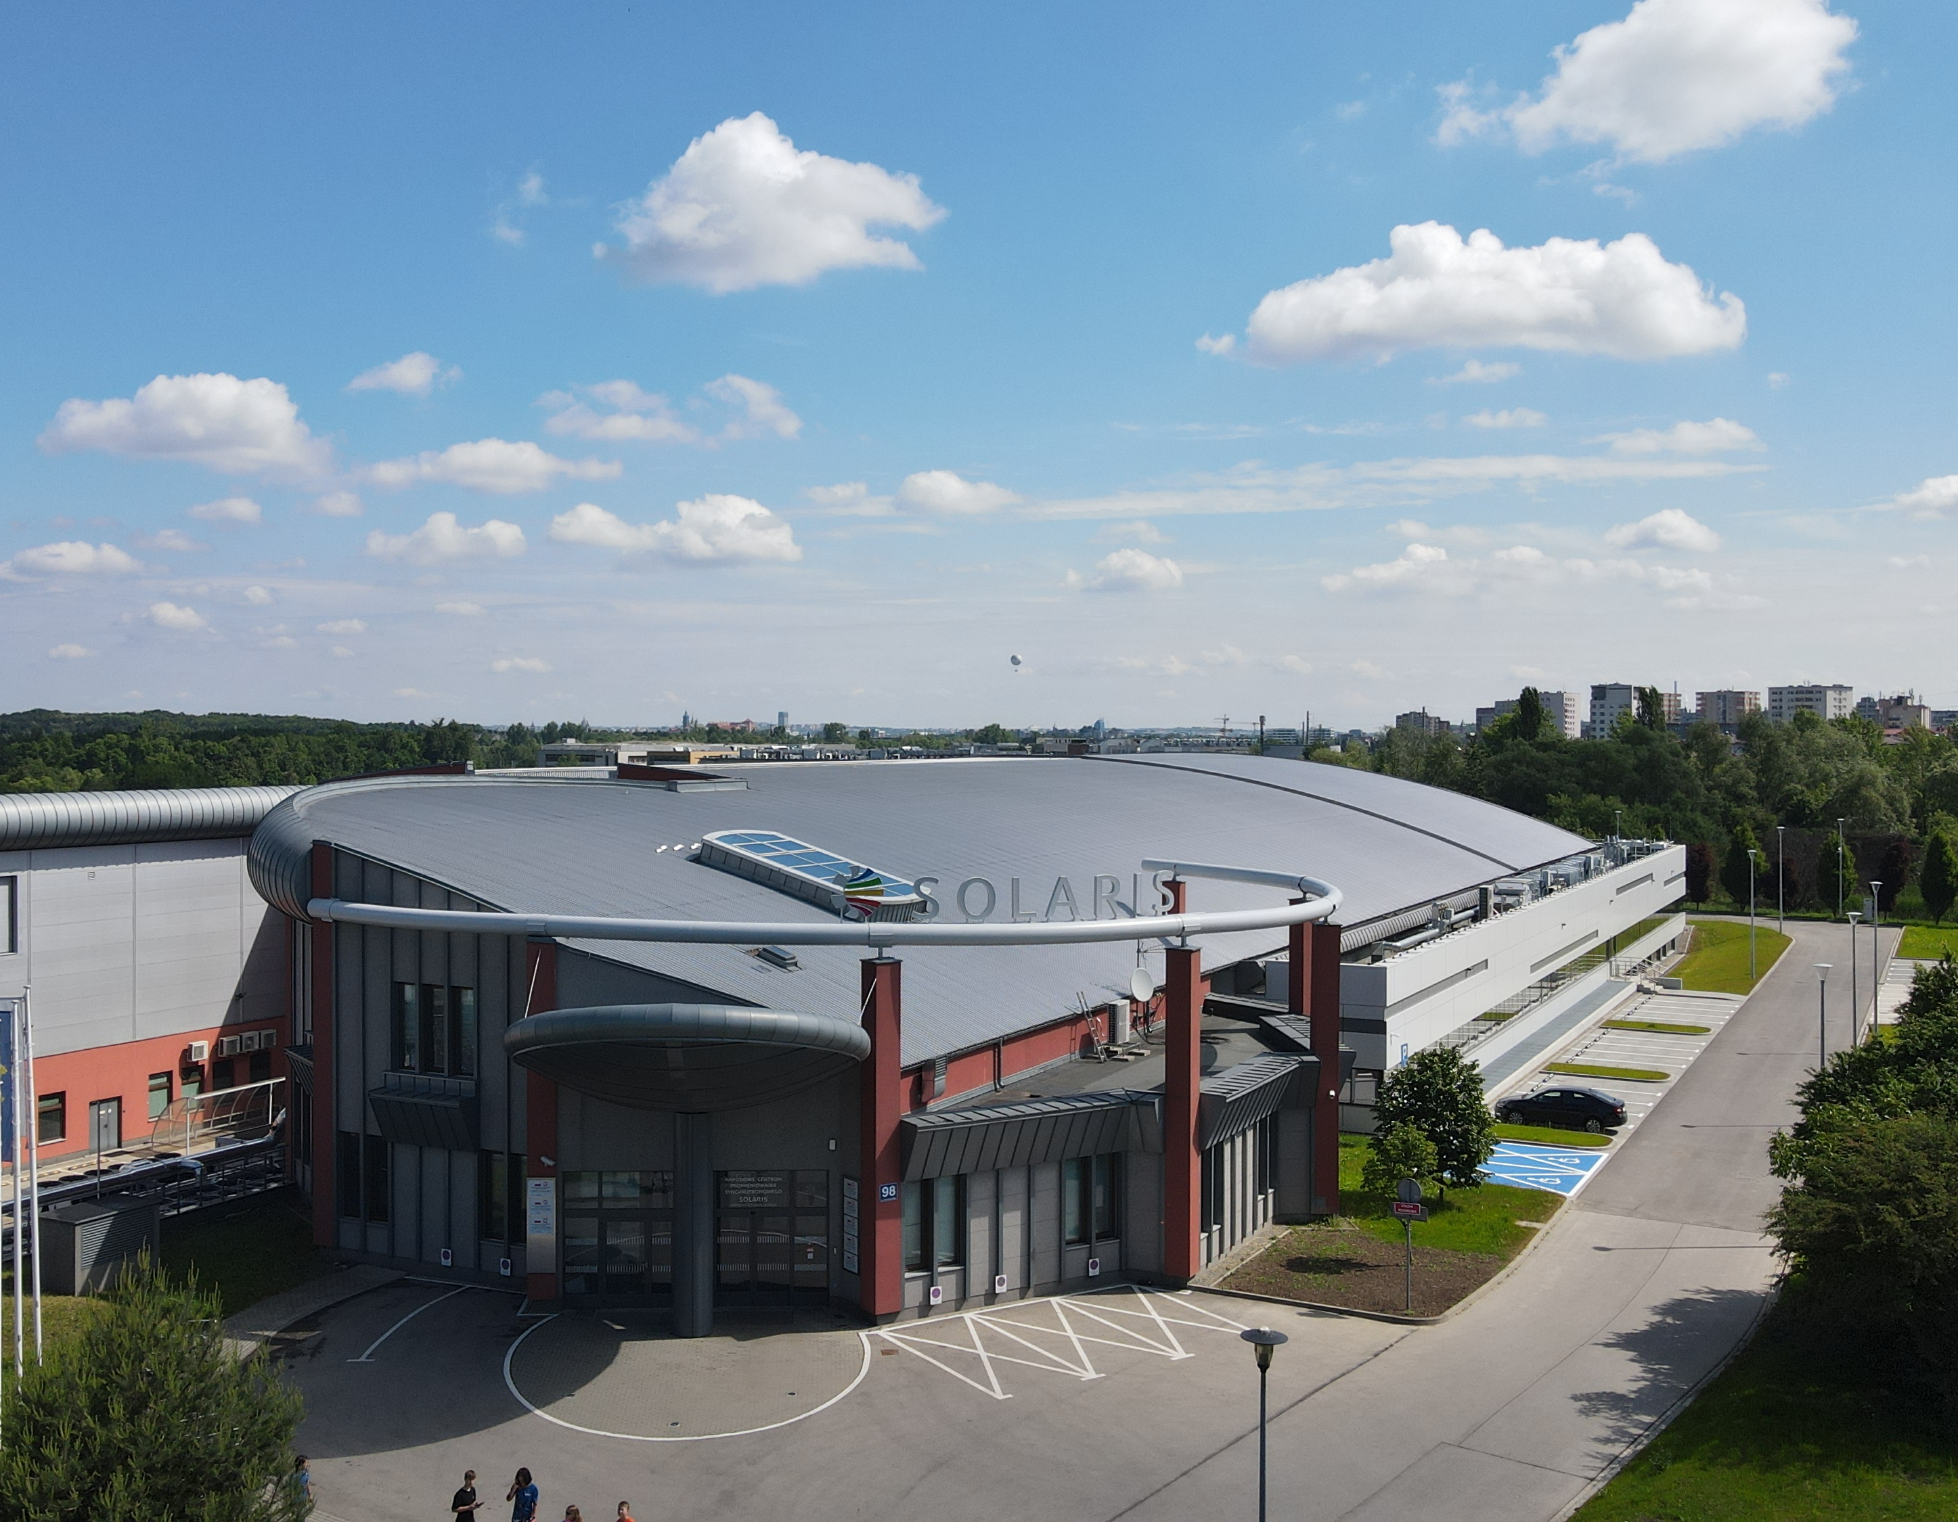
SOLARIS synchrotron
Third generation light source.
Constructed 2010 - 2015 in Krakow, Poland.
Since October 2018 Solaris has been in the user operation mode
Now seven beamlines in operation, three in construction
Magdalena Szczepanik Michal Piekarski

Slide 56
UI Technologies – Approaches & Challenges
In a nutshell, what UI technologies are you using (including any frameworks), for what? and Why?
Tango Controls as a main control system
For Qt-based GUIs we use mainly Taurus framework
More and more WEB GUIs using Taranta Suite (React client to interface with Tango)
Custom vue.js apps
Magdalena Szczepanik Michal Piekarski

Slide 57
UI Technologies – Approaches & Challenges
What challenges are you facing? (can be technical and/or organizational)
Some Users are not willing to contribute to GUI creation (eg. simple gui for beamlines)
A lot of effort for the Controls Team to make many trivial changes
Keeping pace with the development of technology and tools
An increasing number of beamlines with limited Controls resources – adopting a more generic GUI approach
Legacy GUI code and user habits – problematic changes
Magdalena Szczepanik Michal Piekarski

Slide 58
UI Technologies – Approaches & Challenges
Do you have distinct or common approaches to UI solutions for both Accelerator Controls & Beamline Controls?
The technologies are the same, but the Accelerator Controls contains more of legacy code (GUIs)
We are after big upgrade (both operating system and control system environment)
We plan to introduce more and more web technologies
Magdalena Szczepanik Michal Piekarski

Slide 59
UI Components & Tools - Optimization
Do you have reusable UI components?
how do you document them and keep this updated?
Some custom widgets (not many)
Generic GUIs may be also an example (common parts)
Magdalena Szczepanik Michal Piekarski

Slide 60
UI Components & Tools - Optimization
Do you, or do you plan to, utilize any form of automated UI Generation?
If so, for what?
For now: not a huge thing – GUI creation from config (yaml, json…)
For future: Creation from technical datasheet (eg. beamline synoptics)?
Magdalena Szczepanik Michal Piekarski

Slide 61


STFC - ISIS
Tom Willemsen
Tom Willemsen

Slide 62
UI Technologies – Approaches & Challenges
Beamline/experiment controls (accelerator are a separate team)
Main UI: Java, Eclipse RCP - looking to replace this
Monolithic UI, single user interface for "everything". Desktop only.
Embedded CS-Studio for OPIs (screens for specific hardware), plotting, alarms
But CS-Studio eclipse is obsolescent
PyDEV python scripting console, custom matplotlib backend
Various facility-specific views/functionality (migration to Phoebus is not obvious)
Web dashboard (read-only): React/NextJS, pvws, Grafana
Exposes a read-only overview - not full functionality. Mobile-optimized.
Performance challenges with many/fast updates in React

Slide 63
UI Components & Tools - Optimization
Do you have reusable UI components?
CS-Studio OPIs for hardware UI
With a standard template / 'format checker' script to enforce consistency, colours, style, etc
Monolithic UI
Does promote internal consistency / component re-use
But is much harder to move when favoured UI frameworks change (every N years)
Automated UI Generation
Self-describing devices (e.g. SECOP) - maybe in future?
But unclear how user-friendly those screens can be made, compared to a hand-crafted screen
Many of our UIs/OPIs already respond dynamically to beamline configuration
To display parameters which are relevant for the current beamline setup

Slide 64
SKAO

Slide 65
SLAC
Zachary Lentz & Yekta Yazar

Slide 66

LCLS Photon-side:
UI Technologies – Approaches & Challenges
In a nutshell, what UI technologies are you using (including any frameworks), for what? and Why?
PyDM / PyQt for all new systems (since ~2019): easy to use and extend, functional
Still a lot of legacy EDM screens
What challenges are you facing? (can be technical and/or organizational)
Limited budget, prioritization for designing user interfaces
Efficiently transitioning screens to modern frameworks
Do you have distinct or common approaches to UI solutions for both Accelerator Controls & Beamline Controls?
Similar use of PyDM, but likely different philosophies
Not coordinated except in development of PyDM
Zachary Lentz

Slide 67
UI Technologies – Approaches & Challenges
In a nutshell, what UI technologies are you using (including any frameworks), for what? and Why?
PyDM / PyQt (since ~2019) – used in control room displays and tools as well as physics applications. Lots of proficient python developers on staff
lots of legacy EDM screens – used in control room displays . This summer built an EDM to PyDM converter to try to finally clear out the EDM screens, but have a monumental task ahead (10k+ screens to convert)
React/JavaScript – Recently built a new electronic logbook with React for the frontend. React was selected since we had some developers on staff with React experience and it met the needs of the project
What challenges are you facing? (can be technical and/or organizational)
Accelerator control room computer infrastructure. GUI applications struggling with boot up time/performance
Do you have distinct or common approaches to UI solutions for both Accelerator Controls & Beamline Controls?
We both use PyDM/PyQT and have worked together on the development of PyDM.
Yekta Yazar

Slide 68
LCLS Photon-side:
UI Components & Tools - Optimization
Do you have reusable UI components?
how do you document them and keep this updated?
We have custom pydm widgets in a python module
We have github repositories with shared screens, reusable embedded screens
Do you, or do you plan to, utilize any form of automated UI Generation?
If so, for what?
We automatically generate expert-level screens for devices
We automatically generate home screens for instruments to assemble known devices into one group
The quality of automated screens is limited, we’re considering scaling this back
Zachary Lentz

Slide 69
UI Components & Tools - Optimization
Do you have reusable UI components?
how do you document them and keep this updated?
Planning on putting together a GitHub repo of common components, like stylesheets, and modular code for our PyDM/PyQt applications
Do you, or do you plan to, utilize any form of automated UI Generation?
If so, for what?
I believe some PyDM Screens are generated. We are more focused on building PyDM itself and bespoke software tools and applications
Yekta Yazar

Slide 70

Spring 8
Akio Kiyomichi

Slide 71
UI Technologies – Approaches & Challenges
In a nutshell, what UI technologies are you using, for what? and Why?
SPring-8 have been using Fuji data system’s X-Mate. Now migrating to Qt6 for more programing flexibility. We stick with compiled code for the stability.
What challenges are you facing?
Keep track of users’ code. Keep users away from implementing third-party application indiscriminately.
Do you have distinct or common approaches to UI solutions for both Accelerator Controls & Beamline Controls?
There are different divisions (and people) for accelerator and beamline controls. The control framework are different. So, nothing is common.
Akio Kiyomichi

Slide 72
UI Components & Tools - Optimization
Do you have reusable UI components?
how do you document them and keep this updated?
The base components close to the MADOCA4.0 control framework are made into libraries. About the users’ GUI, it seems they copy each others. But it isn’t real reusable UI components, I guess.
Do you, or do you plan to, utilize any form of automated UI Generation?
If so, for what?
We don’t have anything yet. Is it possible to utilize generative AI, nowadays?
Akio Kiyomichi

