Slide 1


SlicOps: Modern Responsive Web UI
Robert Nagler and Paul Moeller
ICALEPS Controls GUI Strategies
This material is based upon work supported by the U.S. Department of Energy.

Slide 2
SlicOps: Accelerator Ops
Notes:
http://localhost:8000/screen

Slide 3
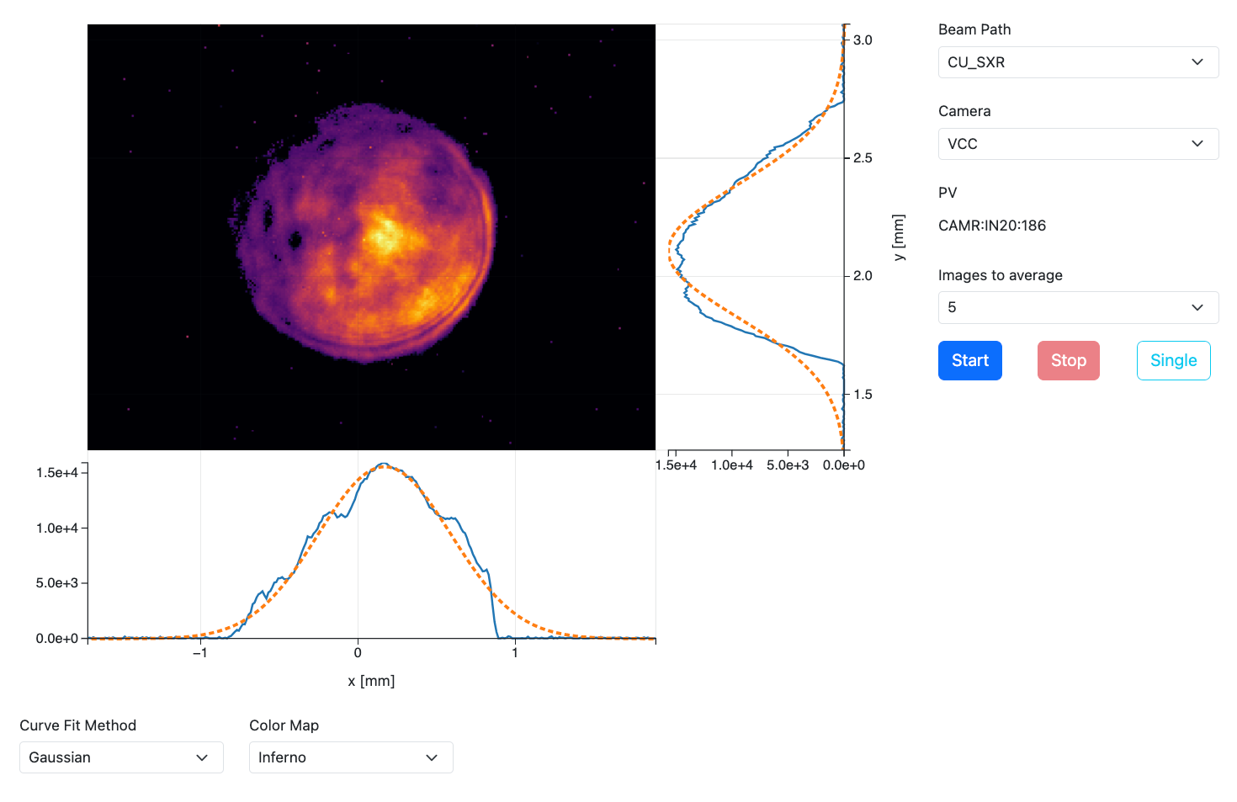
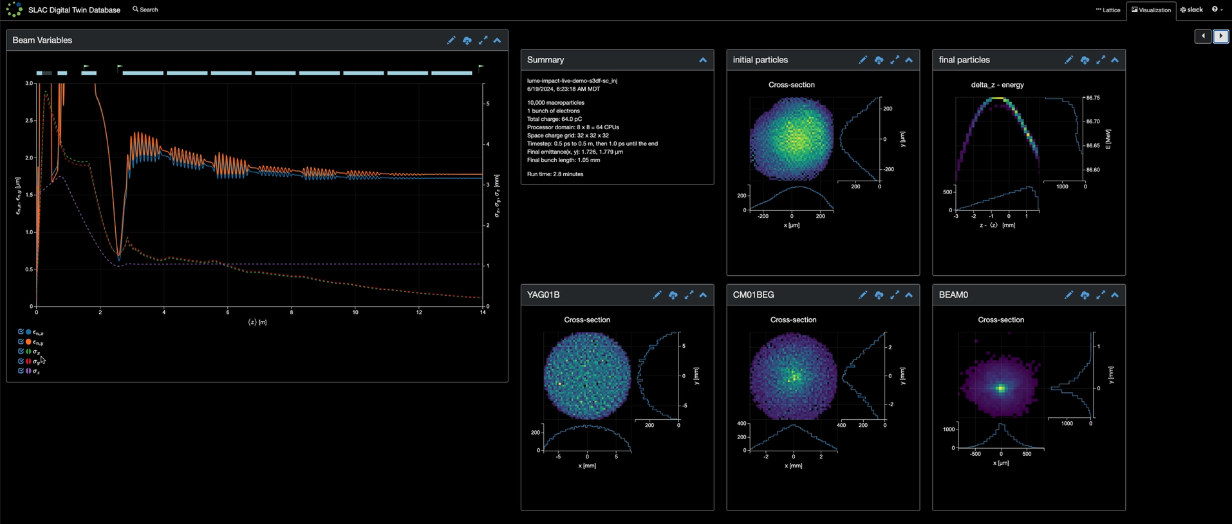
SLAC LCLS-I VCC Screen
Fully asynchronous client and server
Flexible middle layer for use by ML, UI, scripts, etc.
YAML-specified UI objects and layout
Python UI logic and event handling
Minimal interfaces to reduce coupling and improve compatibility

Slide 4
Declarative UI
ui_layout:
- cols:
- css: col-sm-3
rows:
- beam_path
- camera
- pv
- cell_group:
- start_button
- stop_button
- single_button
- css: col-sm-9 col-xxl-7
rows:
- plot
- cols:
- css: col-sm-3
rows:
- curve_fit_method
- css: col-sm-3
rows:
- color_map
fields:
camera:
prototype: Enum
constraints:
choices: []
curve_fit_method:
prototype: Enum
constraints:
choices:
Gaussian: gaussian
"Super Gaussian": super_gaussian
value: gaussian
plot:
prototype: Dict
ui:
widget: heatmap_with_lineouts
writable: false
start_button:
prototype: Button
ui:
css_kind: primary
label: Start

Slide 5
Tech Evolution
Decade of Change:
AngularJS to Angular|React to Vue
HTTP+JSON to Websockets+JSON to WebSockets+MessagePack
No Auth to GitHub OAuth to Email, LDAP, and BasicAuth
Flask/UWSGI to Tornado
WebSockets allow UI to subscriptions so fully asynchronous
MessagePack is much faster, especially for large data objects
Vue.js simplified the code, and allowed us to jettison legacy in the UI
Threads (Flask) to coroutines (Tornado) to hybrid coroutines and threads

Slide 6
Thank you
github.com/slaclab/slicops
Questions?

