Slide 1
LHC linear wire scanner CONS Project meeting mechanics update
10th Feb 2025
Harry Sullivan
Notes:
Harry

Slide 2
Overview
Instrument design:
Chamber changes (MME)
Solid block machining
Welded bottom cap
Locations
Electrical contact
Electrical feedthrough location
Coating feedback
Ruler
Changes to optical feedthroughs with MME
Review complete
Awaiting patterns
Drawing
Changes to RF contacts
Test rig:
In house parts
Material arrived
Machining to commence end of next week
External parts
Card water jet complete
Bearings to arrive now
Next testing
Ruler spec to be sent to Selba
Test rig to be machined for Nabil’s rig
Electrical contact prototype to be machined

Slide 3
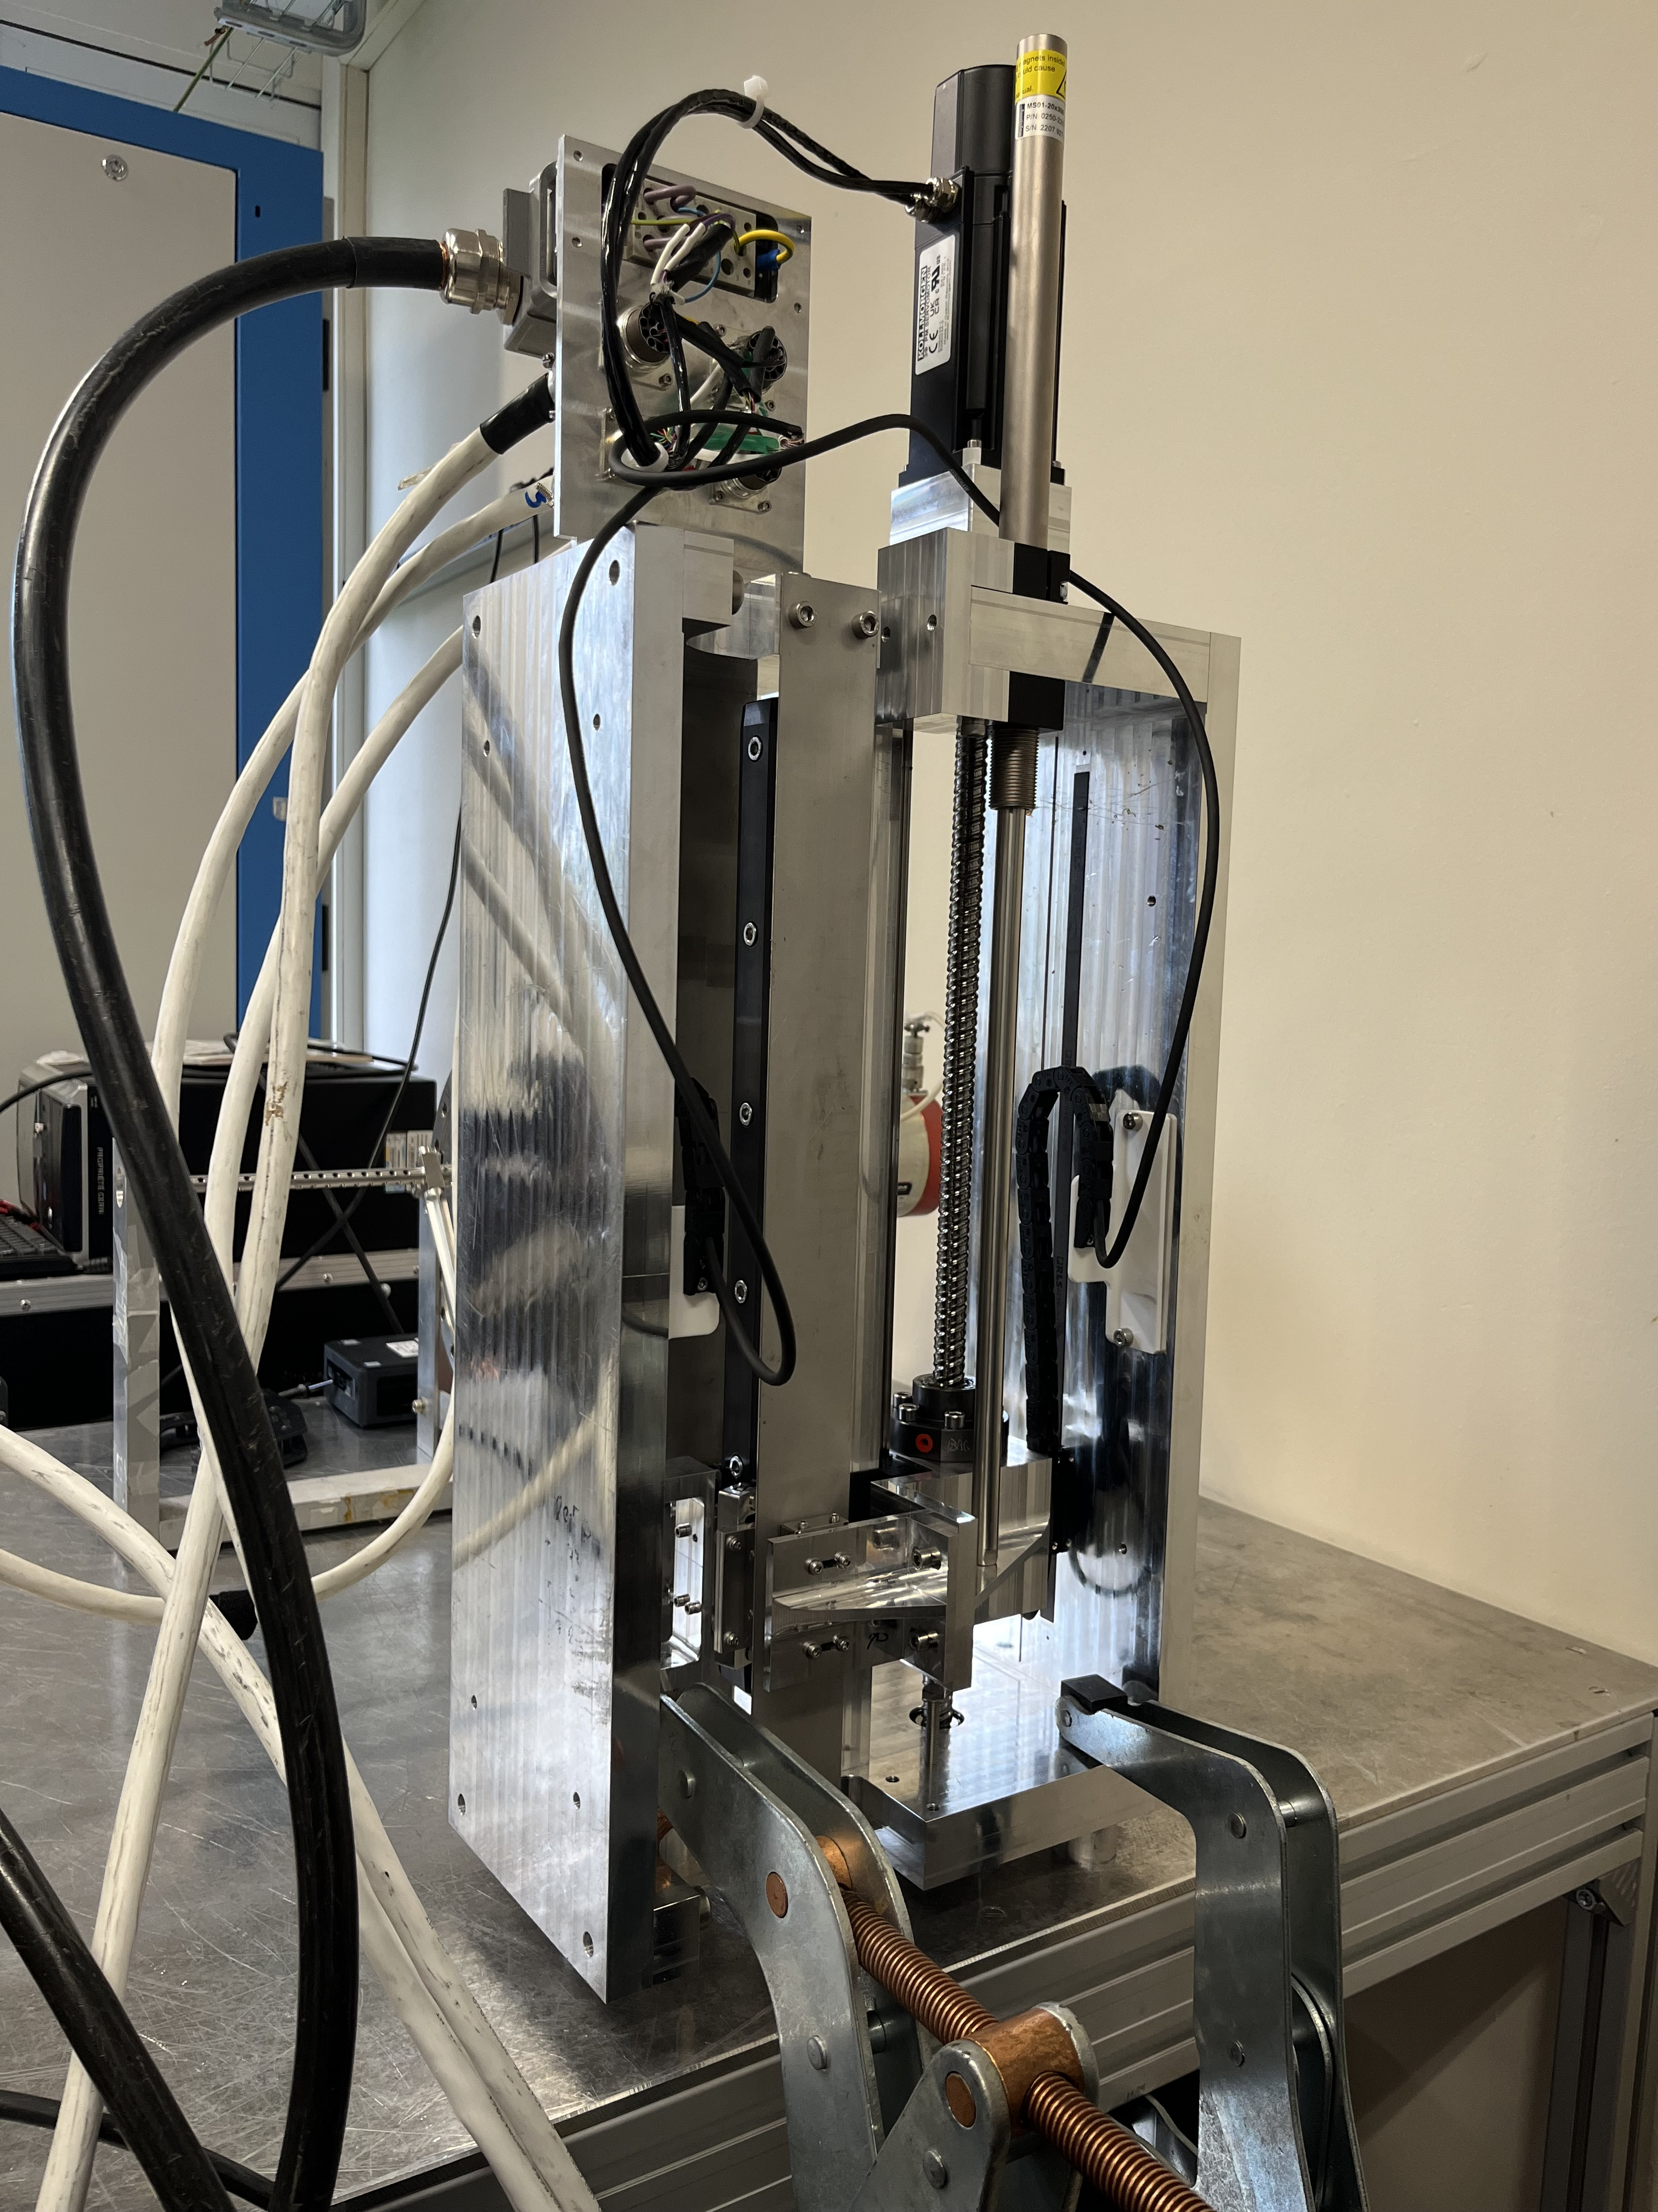
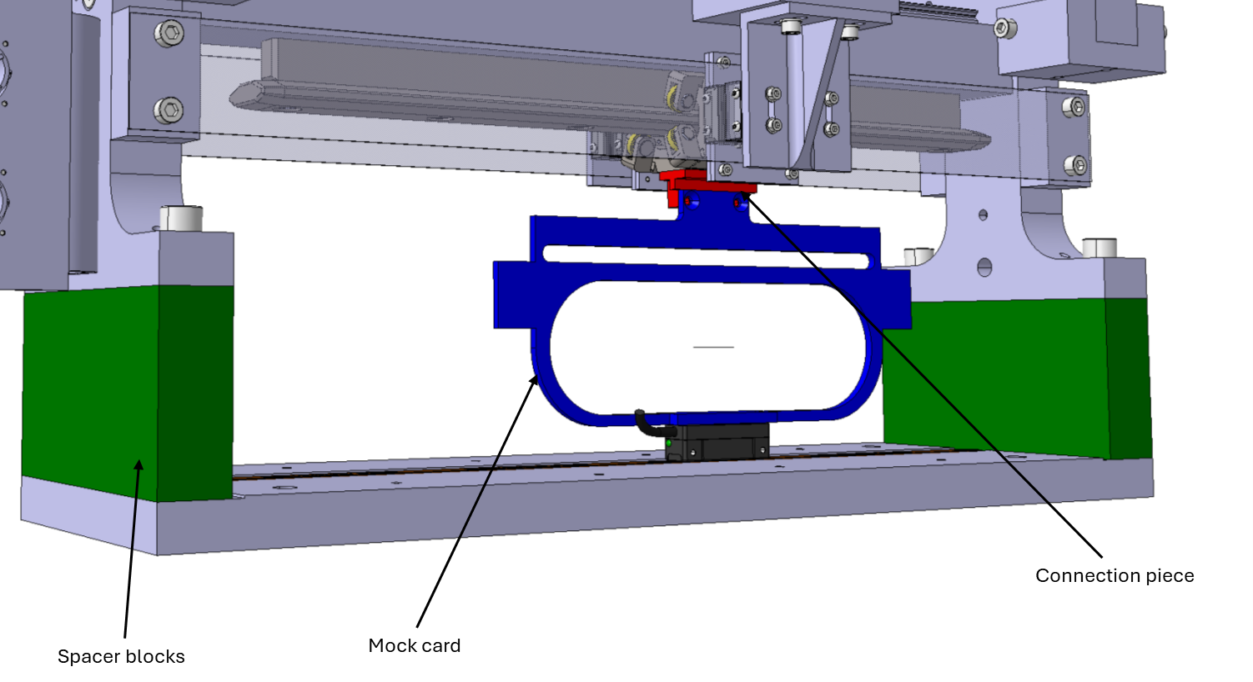
Test rig update
Updates:
Stainless steel 1mm panels installed
Initial results show negligible effect on motion
Next steps:
Integrate new components to test realistic loading case
Integrate new bearings and tensioning method
Internal parts:
Material delivered
Machining to start end of this week
External parts:
Card water jet cutting complete
Bearings delivered to CERN
Future testing
Design prepared for integrating glass ruler into Nabil’s test rig
Design required for integrating glass ruler into this test rig
Design required for integrating sliding electrical contact into this test rig

Slide 4
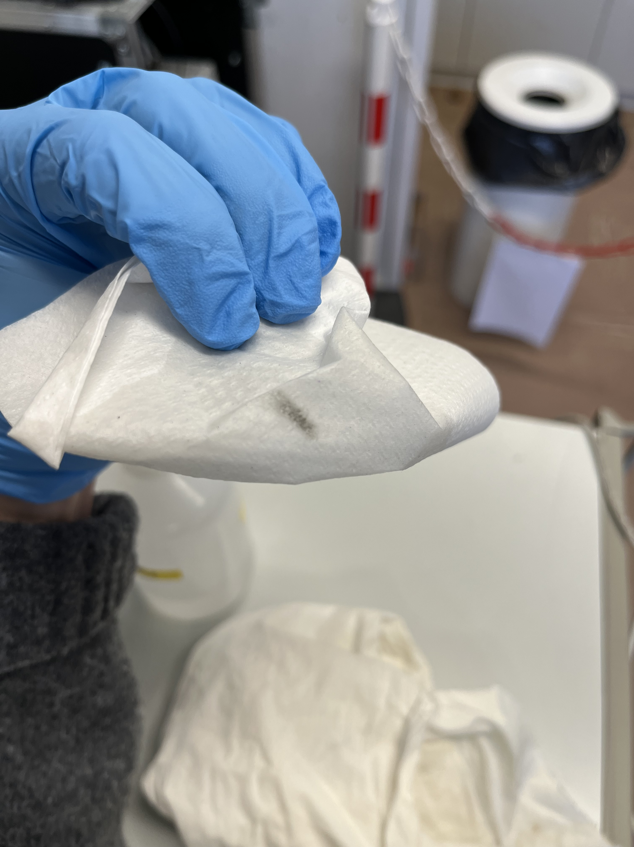
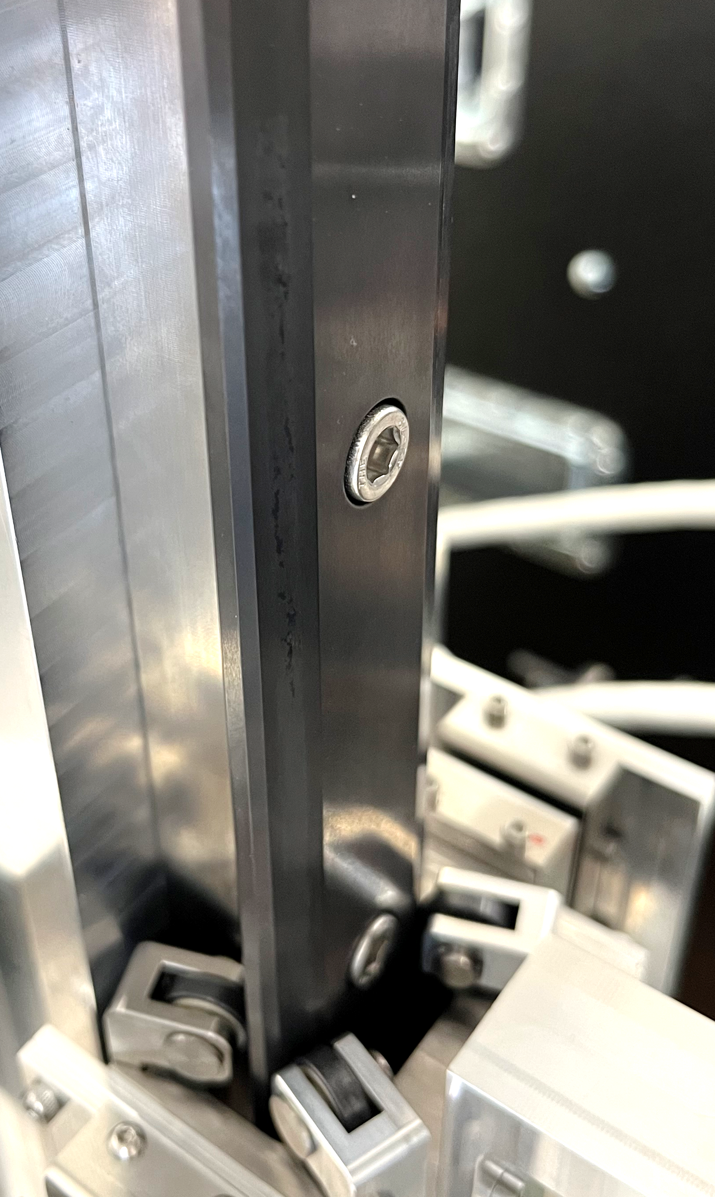
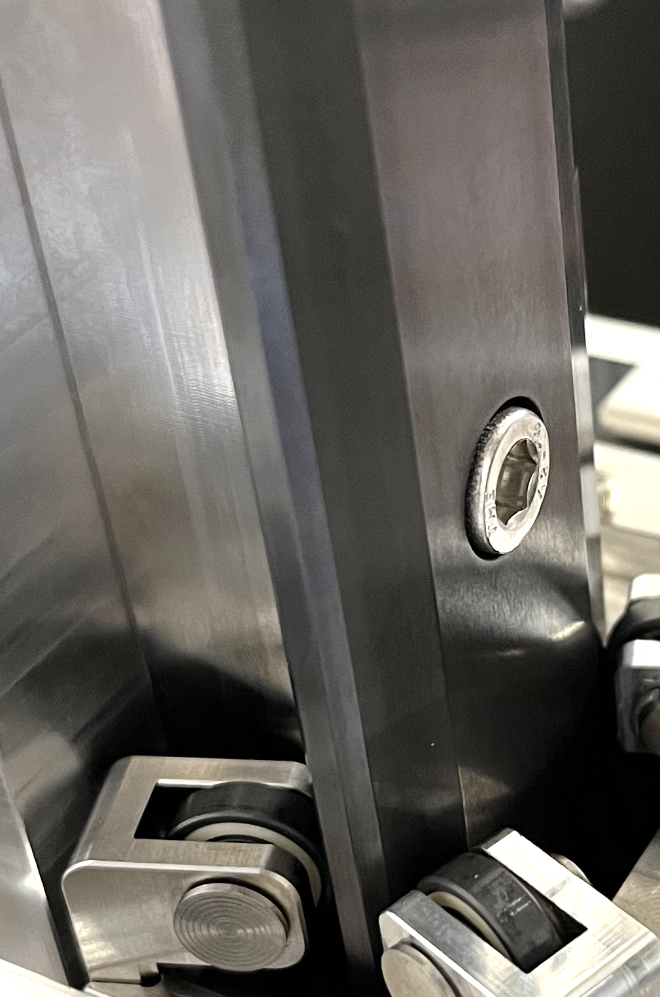
Test rig observations
40k cycles report:
Residue/dust seen all four sides of the rail
Most deposited on window side rail
Could not be felt and was not removed with finger
Wipes off clean with alcohol and tissue and rail appears – after which rail appears undamaged
With visible track marks in the right light, as seen after a few thousand cycles
Bearings were all marked with the same dust/residue
Carriage still feels rigidly held in place
Conclusions
Dust is in very small quantities, and appears to stick to rail – so should not provide a UFO risk
Particulates do not appear to affect the performance of the carriage
Carriage connection is unbalanced, due to the difference in deposition – to be rectified with next iteration
Deposition estimated to be less when new bearings integrated

Slide 5
Instrument design updates
Detailed design started with MME
Meetings with workshop held to identify optimum machining processes
Material for chambers on order
Design progress advanced, estimated chamber to be finished next week

Slide 6
Instrument design updates
Ruler
Ruler assembly concept complete
Ready to order test samples from Selba, once required patterns identified
Modifications to optical laser port assembly implemented

Slide 7
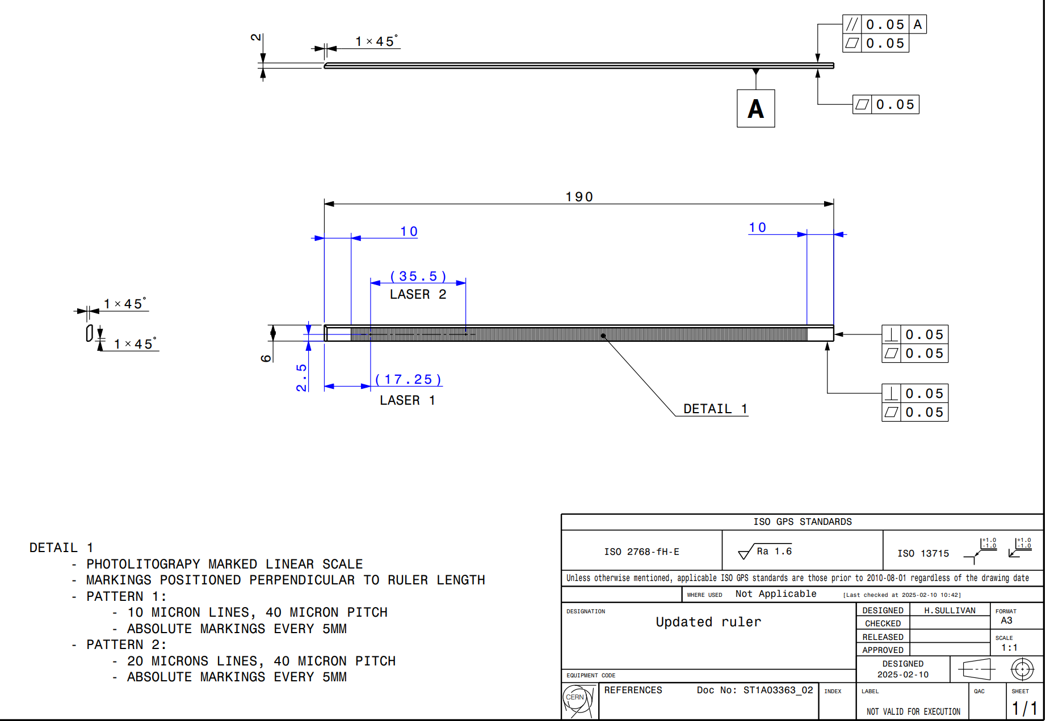

Slide 8
Instrument design updates
Instrument chamber
To be machined from solid billet, due quantity required
CF feedthrough/ porthole features added
Rail alignment feature added

Slide 9
Instrument design updates
Electrical contact
Fixed wires to connect sliding contact to feedthrough
Same connector used as seen on rotary scanner
Sliding contact
Copper deposition on ceramic, with rhodium plating
Silver plating on copper beryllium spring contacts
Should have lifetime far exceeding requirement for scanner, and provide very low friction

Slide 10
RF contacts

Slide 11
Instrument design updates
Vacuum chamber
Welded assembly
Main body to be machined from solid, (EDM wire cut)

Slide 12
Other updates
Meeting to be organised with vacuum to review outstanding design questions
12 x Magnets cleaned and ready for vacuum testing
Final model to be simulated with Impedance when complete (planned for next week)
Impedance working group next week

