Slide 1
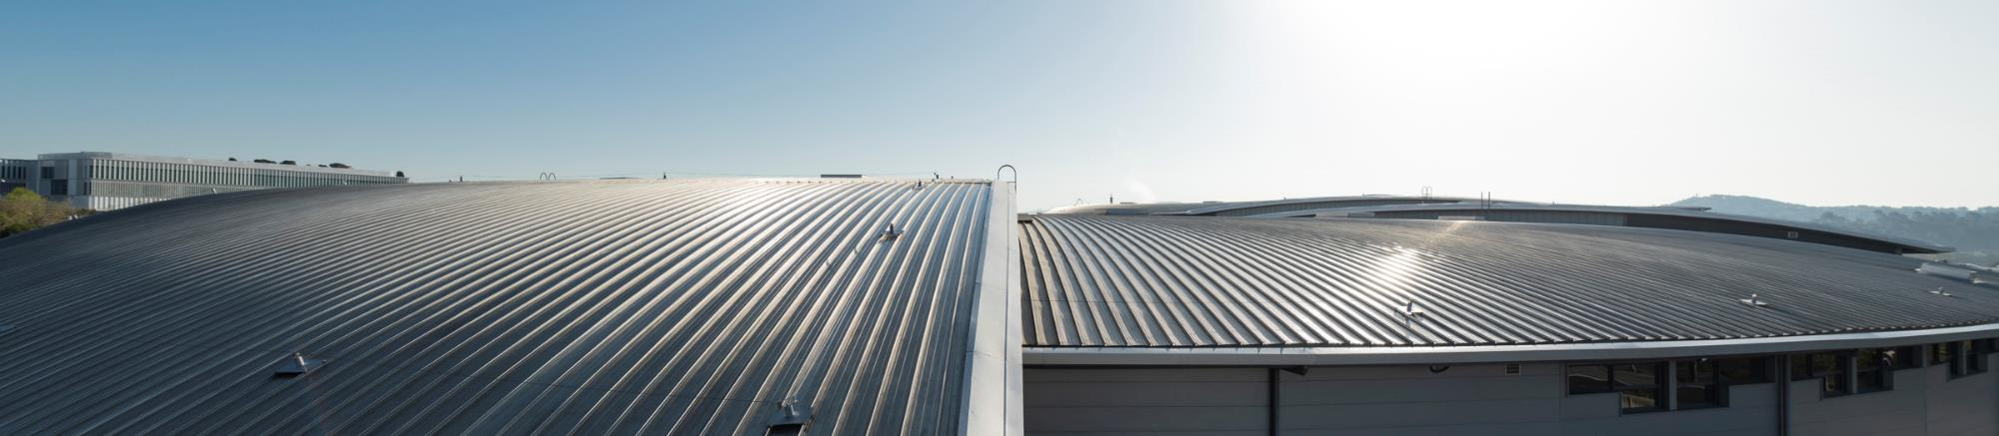
PLC based Control System Alberto Rubio on behalf of Controls Section

Slide 2
Summary of contents
ALBA
ALBA II
PLC Based Introduction
Personnel Safety System (PSS)
Personnel Protection System (PPS)
Equipment Protection System (EPS)
PLC Automation

Slide 3
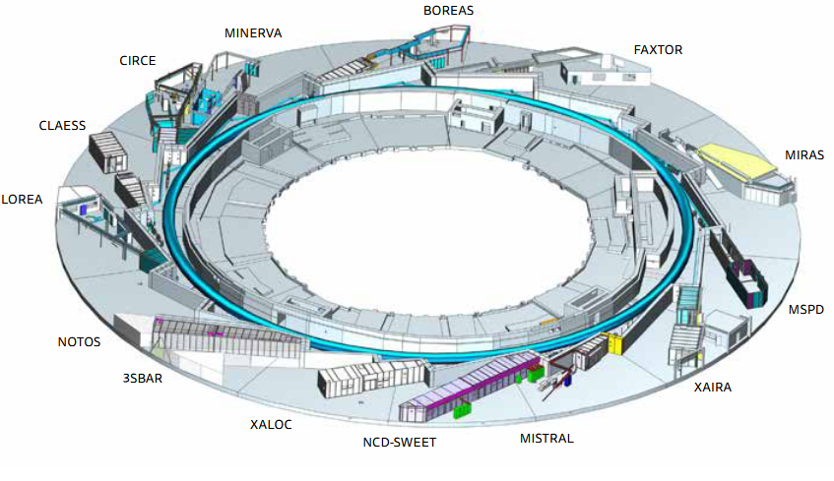
ALBA
3rd generation Synchrotron Light
Complex of electron accelerators to produce synchrotron light
3 GeV (LINAC + BOOSTER + STORAGE RING)
13 operational beamlines comprising soft and hard X-rays
Devoted mainly to biosciences, condensed matter (magnetic and electronic properties, nanoscience) and materials science
The 14th ALBA beamline, 3Sbar awarded with Next Generation EU funds, is the first beamline fully optimized for ALBA II
More than 6.000 hours of beam time per year
Available for the academic and the industrial sector
Serving more than 2.000 researchers every year.
Managed by the Consortium for the Construction, Equipping and Exploitation of the Synchrotron Light Source (CELLS), it is funded in equal parts by the Spanish and the Catalonian Administration, in particular by the Ministry of Science and Innovation and the Secretary of Universities and Research

Slide 4
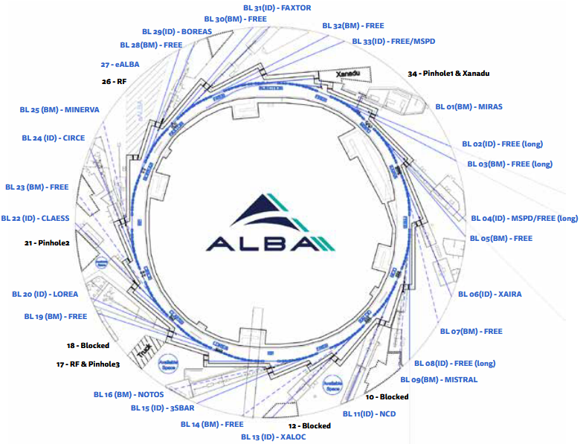
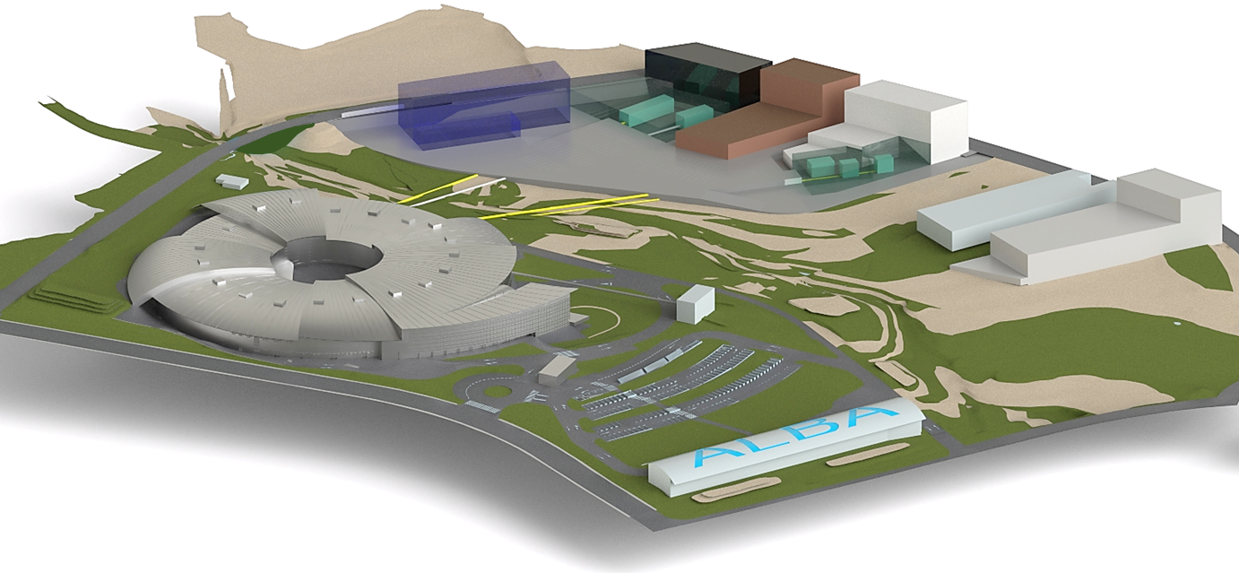
ALBA II
Transforming ALBA in a 4th generation light source.
ALBA II will bring a substantial increase in:
Brilliance
Resolution
Coherence
Data analysis
ALBA II will provide a wide range of new analytical tools, innovative methodologies and improved data management and analysis.
It is a very cost-efficient project as it maintains the existing infrastructure, the injection system and the beamlines.
New Beamlines
CORUS (Cryo nano-scanning X-ray Fluorescence and Spectroscopy beamline)
CODI (Coherent Diffraction Imaging beamline)
CALIMA (BioSAXS beamline)
MSPD-2 (Materials Science and Powder Diffraction),
REACH OneHealth
CODI
CORUS
InnoFAB

Slide 5
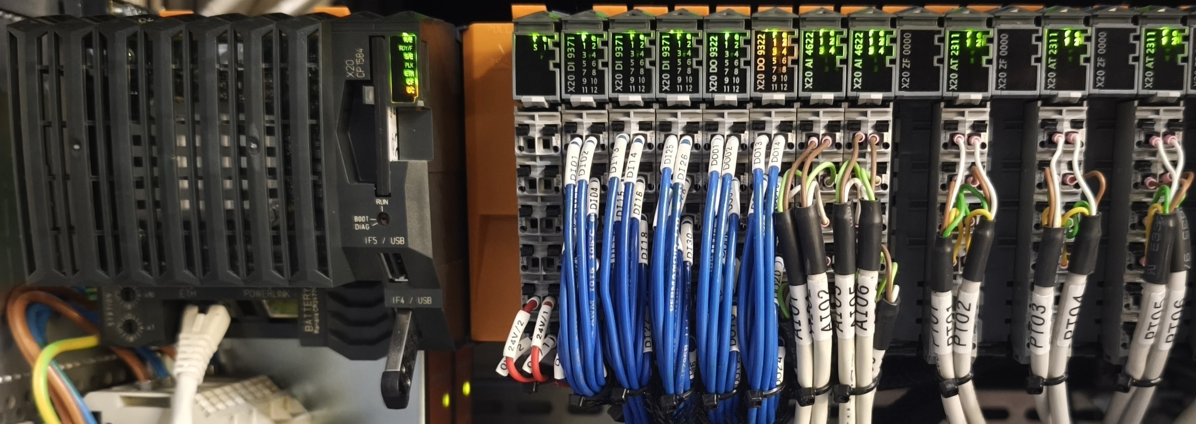
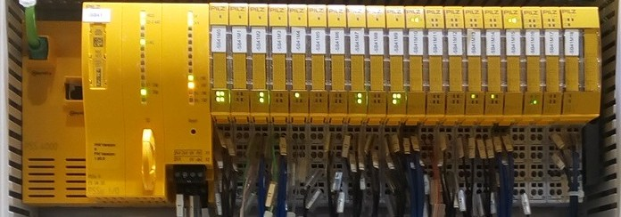
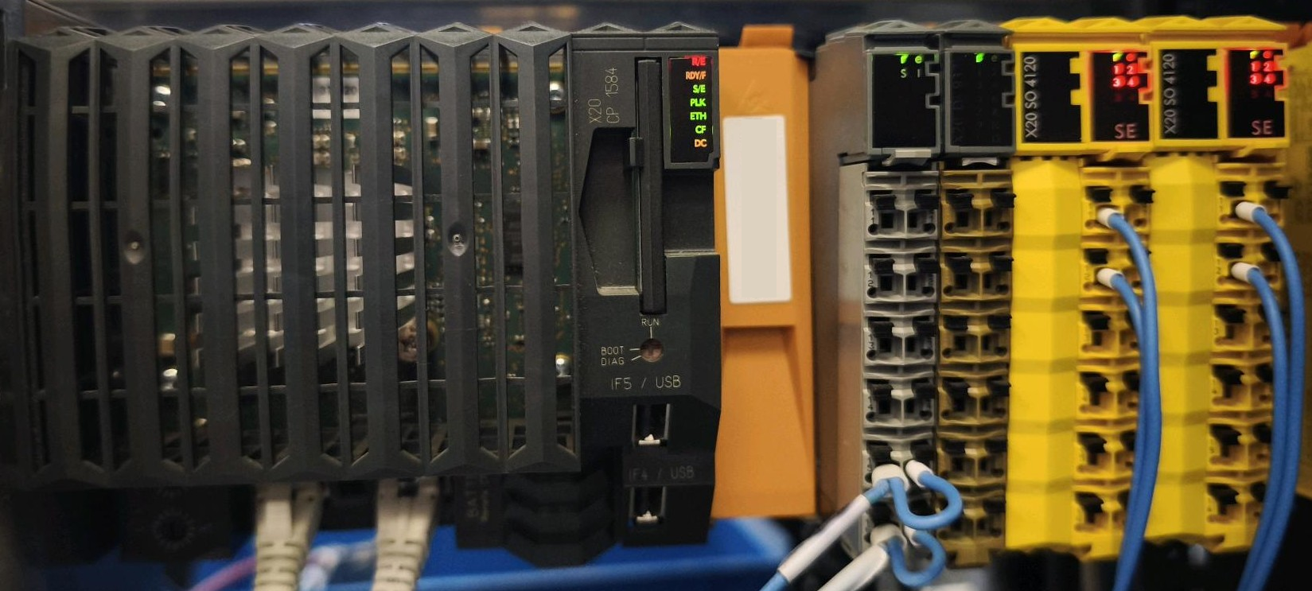
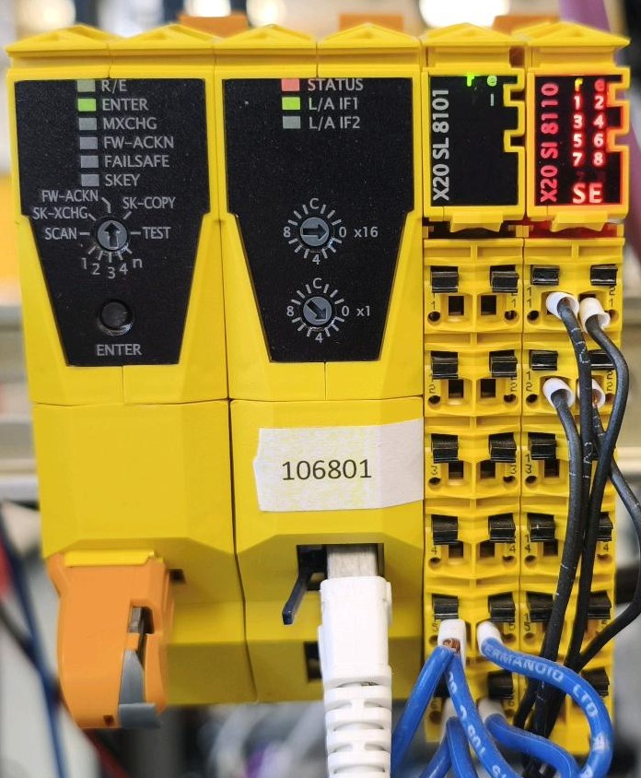
PLC Based Introduction
PLCs are used in whole facility for many different applications.
Controls PLC:
EPS (Equipment Protection System)
PSS (Personnel Safety System - radiological risk)
PPS (Personal Protection System - conventional risk)
PLC Automation
PSS is completely independent and its implementation have been outsourced using PILZ Safety PLC.
EPS, PPS and PLC Automation are Assembled in-house using B&R PLCs.
EPS is part of the MPS (Machine protection System) and share hardware and infrastructure with PPS and PLC Automation.
EPS PLC
PSS PLC
PPS PLC
Ethernet Powerlink

Slide 6
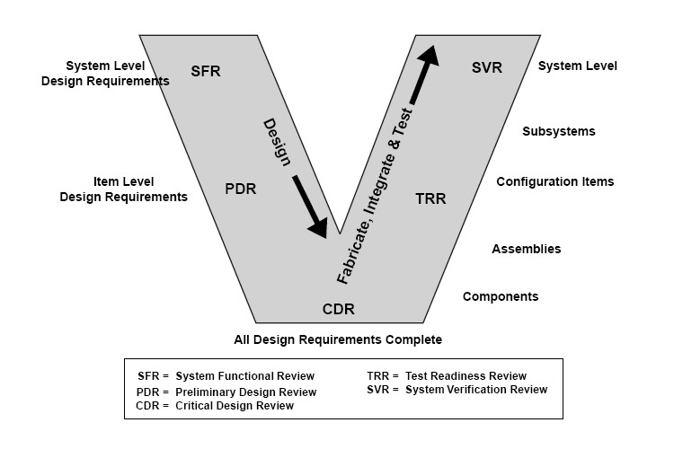
PLC Based Introduction
Are any of the methodologies applied rigorously?
PLC Development and implementation phases
Specification
Design is verifiable and that the risks have been identified, characterized, and mitigated where appropriate.
Design
Ensure that the "build-to" baseline contains detailed hardware and software specifications that can meet functional and performance requirements
Commissioning
Ensures that the test article (hardware/software), test facility, support personnel, and test procedures are ready for testing
Verification
Establish that the system is ready to transition into an operational mode
Main challenges
Heterogenous background: needs common language
Standardization is difficult (ccdb)
Automatic code generation, in-house tools are needed (Autogeneration tool)
Logic definition change management. Version control is difficult (expert user logic coding)
Sistematic test is difficult
Verification must have clear procedure and involve many experts

Slide 7



PLC Based Introduction
Does anyone have a large installation in progress?
PLCs are used in whole facility for many different applications.
Concept
Use, Operation and Maintenance
Development
Production
Renewal

Slide 8
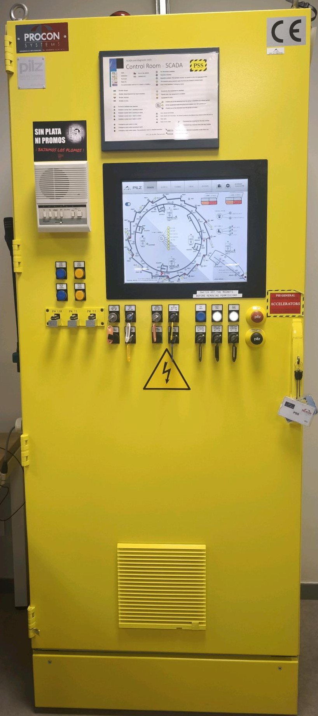
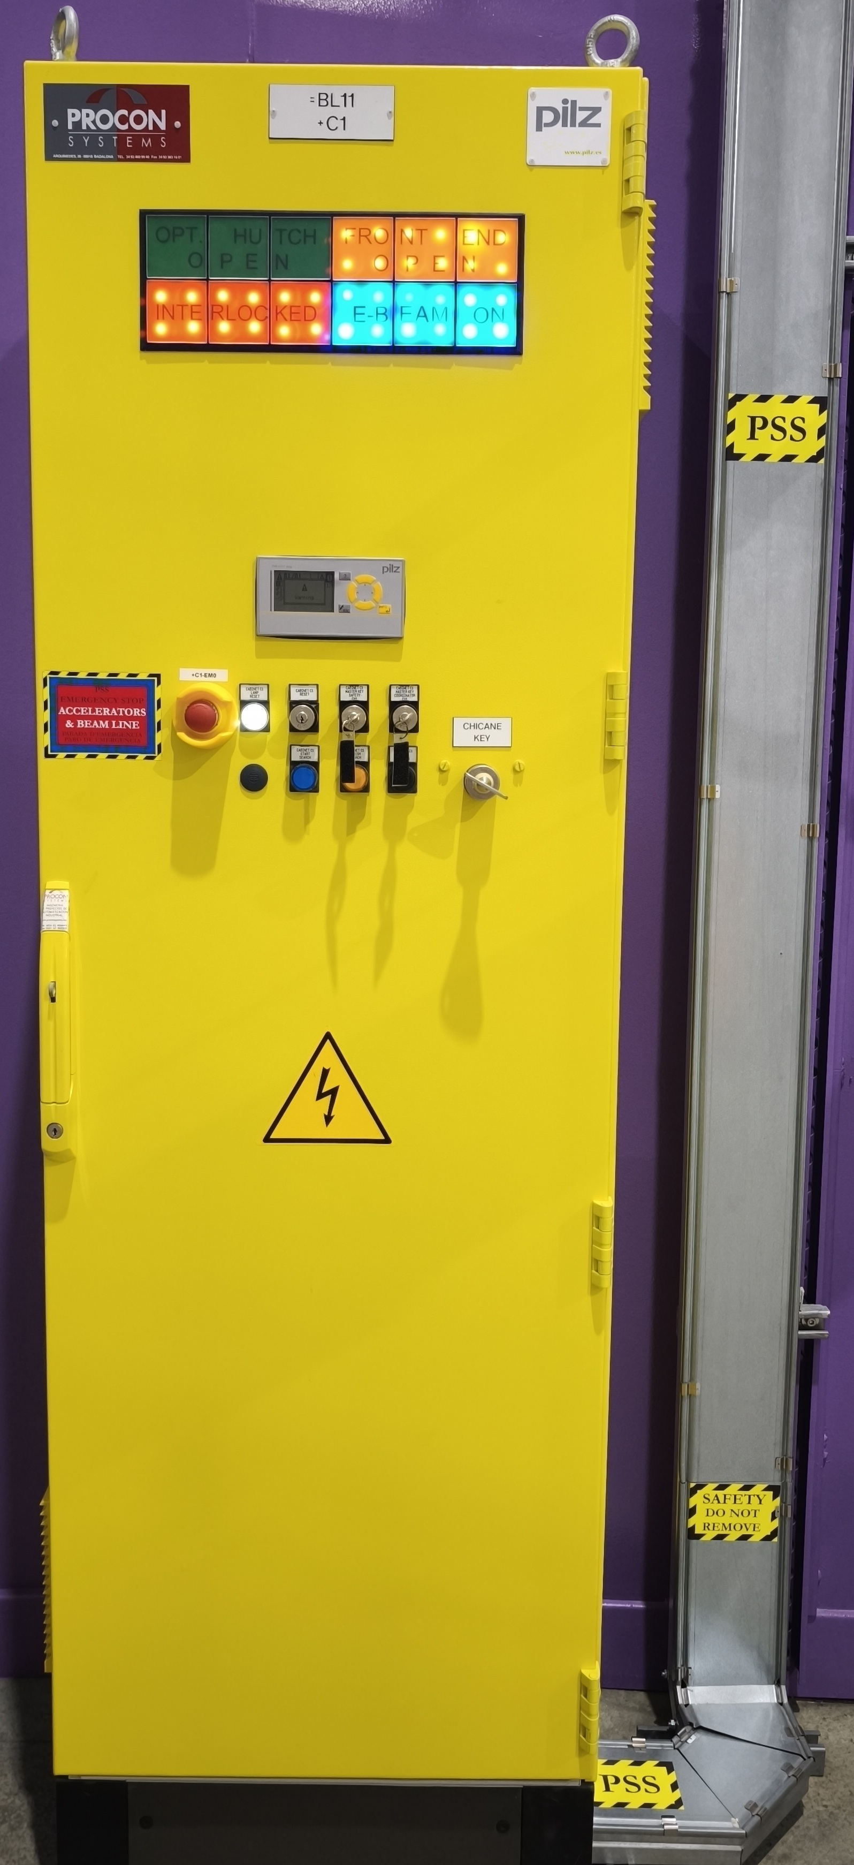
PSS
Personnel Safety System
PLC based System that prevents people at Alba to get a radiation dose higher than the limits given by the law
Periodic evaluation of a number of machine status, check their state and in case of malfunction drive it (either a subsystem or the whole machine) to a safe state.
The PSS implements a set of Procedures that, among others:
Helps the Operator and Control Room to be sure that the shielded zones are clear of personnel during the operation (Tunnel, Linac and Beamlines hutches).
Disables machine operation permits in case of radiation levels are out of limit.
Disables machine operation permits in case of intrusion or emergency button pressed.
It is provided with failure detection mechanisms.
The Procedures can be:
Operation Procedures like Search, Restricted or Top-up
Emergency Procedures like Radiation Monitors Alarm/pre-alarm, Emergency Mushroom or Intrusion

Slide 9
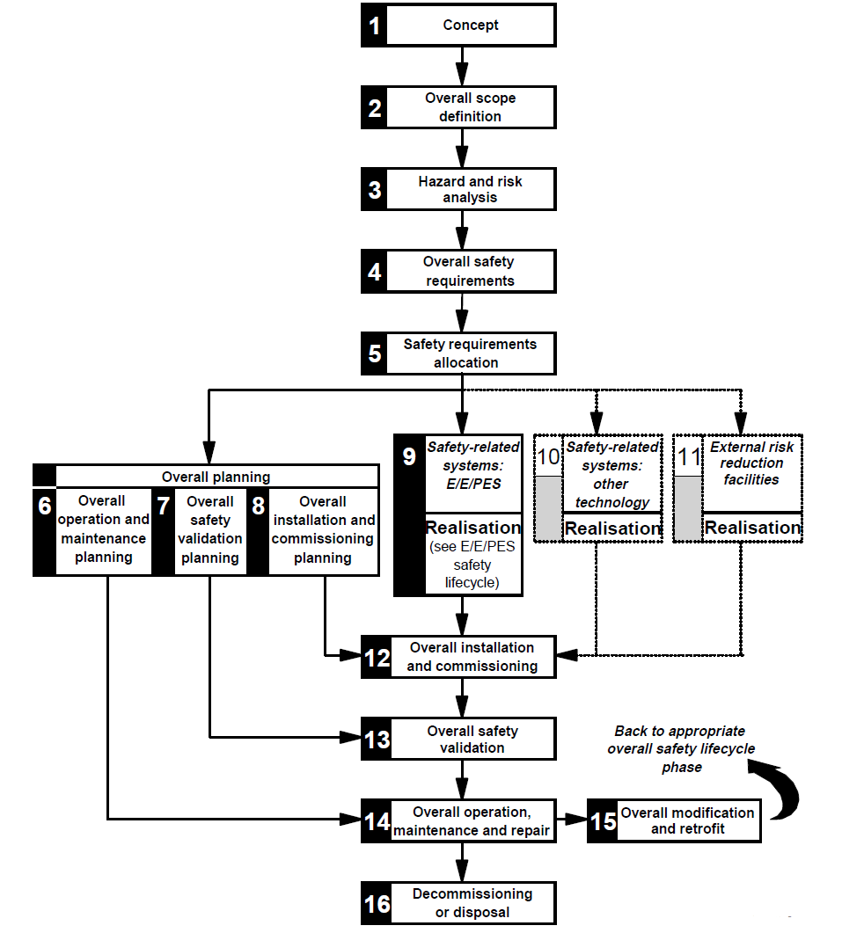
PSS
IEC 61508
IEC 61508-1: 1998:
Overall safety lifecycle
Personnel Protection System:
Key design criterias
Redundancy
the existence of more than one means for performing a required function or for representing information
Diversity
different means of performing a required function
Failure Detection mechanisms
The system is able to identify failures and react upon.
The affectation depends on the equipment failing: from single permit revoked to full system halt
Essential steps to be performed prior to the Safety Functions definition and SIL level calculation
E/E/PES: Electrical, Electronic and Programmable Electronic Systems

Slide 10
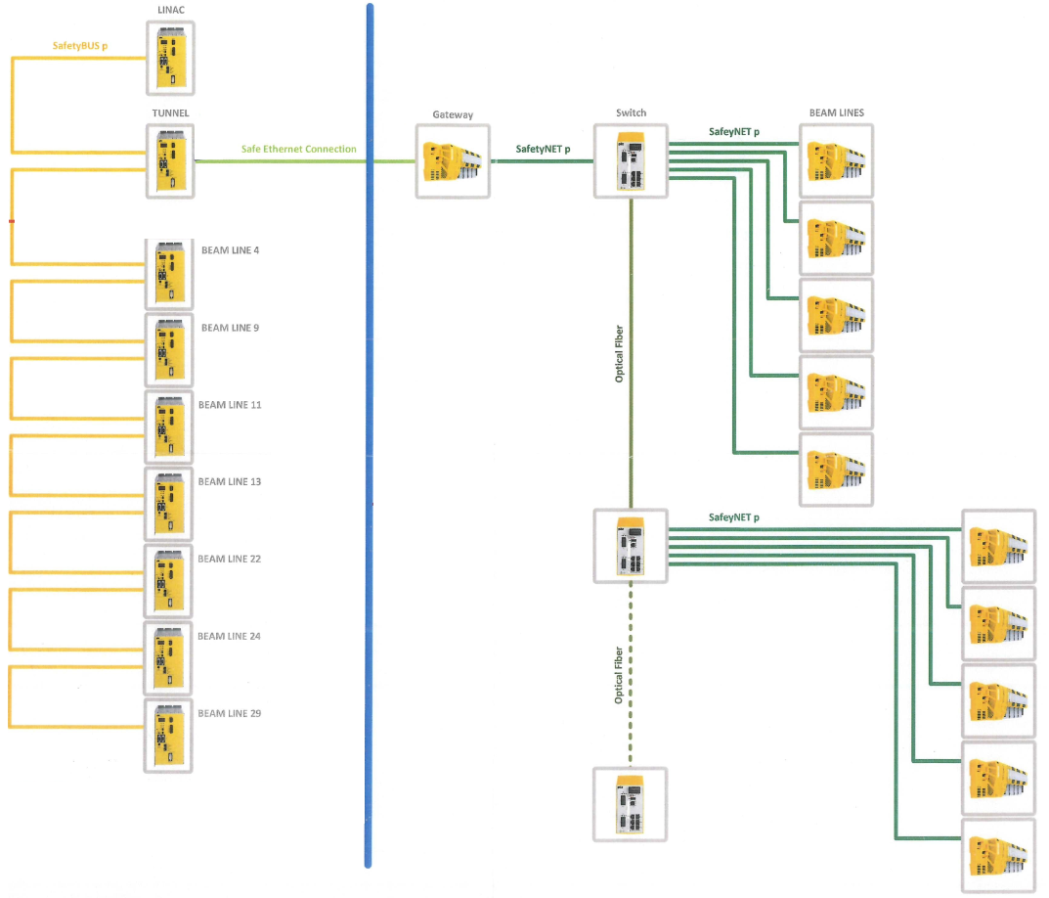
PSS
Architecture
Coexistance of two different hardware from the same vendor
Gateway
Communications problems
hardwired
Robust but rigid
Dealing obsolescense
Hardware not available
Limited number of outsourced companies capable to do job
SafetyBus
SafetyNet
Hardwired
What is your experience with obsolescence?
How to manage the coexistence of different equipment that don't easily communicate with each other?
PSS 3000 CPUs and SafetyBus
PSS 4000 CPUs and SafetyNet

Slide 11
EPS
Functionalities by subsystem:
The PLCs are organized in subsystems. The interaction between the PLCs is governed by the Powerlink.
There are six different EPS subsystems: Vacuum (VC), Magnets and Power Converters (PC), Insertion Devices (ID),Radiofrequency (RF), Front Ends (FE) and Beam lines (BL).
RF
Magnets-PC
Vacuum
IDs
Front Ends
Beamlines
7 CPUs
2 CPUs
16 CPUs
10 CPUs
15 CPUs
13 CPUs
Flow
Pressure
Temperature
RF detectors
RF Plant States
Limit switches
Water leak det.
Flow
Temperature
Flow
Pressure
Temperature
Valves
Flow
Temperature
Limit switches
Tilt
Flow
Pressure
Temperature
Shutters
Flow
Pressure
Temperature
Limit switches
Main Interlocks:
Stop SR RF
Main Interlocks:
Stop PC
Main Interlocks:
Close valves
Kill beam
Main Interlocks:
Stop Motors
Stop PC
Main Interlocks:
Close valves
Close Shutters
Main Interlocks:
Close Shutters
Stop Motors
Vacuum Interlocks
Ethernet Powerlink:
Interactions between subsystems

Slide 12
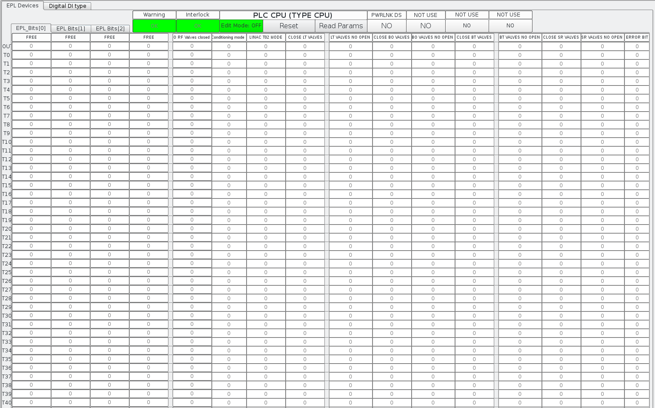

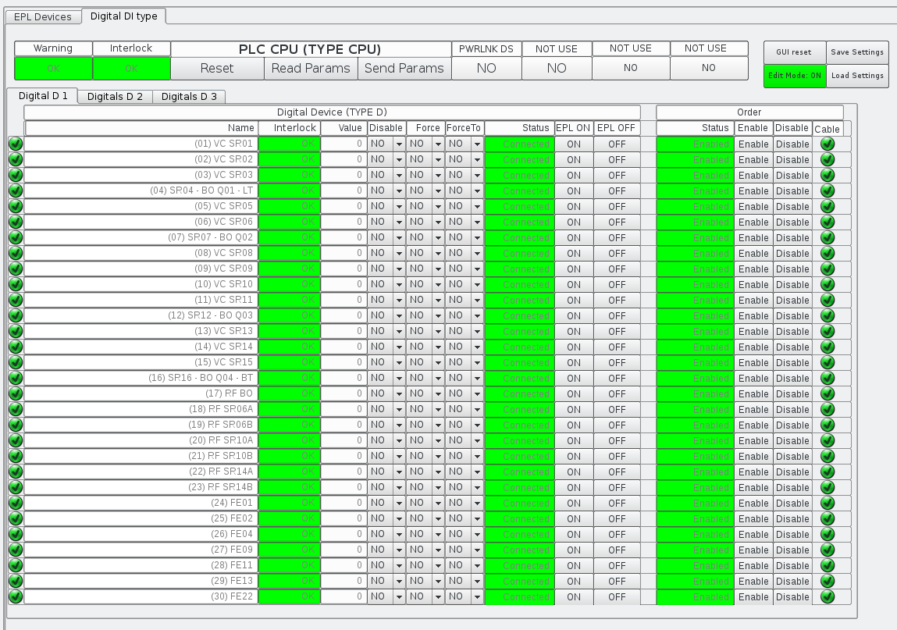
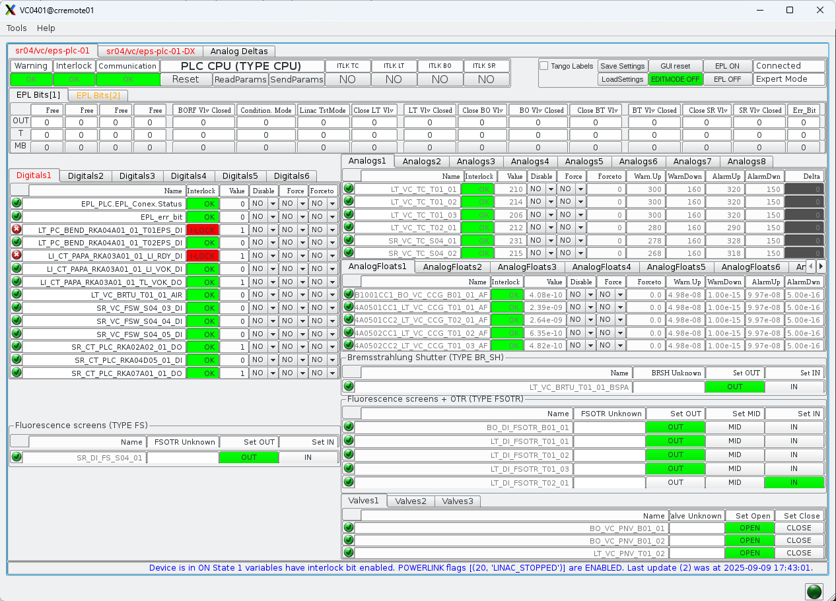
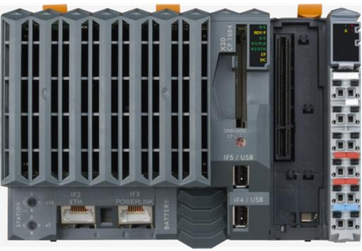
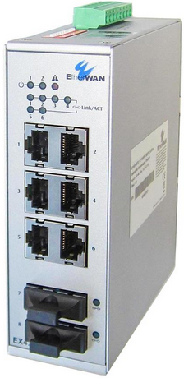
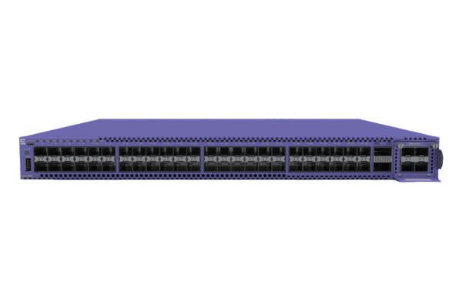
EPS
ctepsmaster
AlbaPLC DS
Powerlink Architecture:
Ethernet Powerlink:
Deterministic: all nodes addressed each cycle
Requires one EPL network master
Uses standard network infrastructure (VLAN)
Modbus DS
ctepsmaster
cteps
Ethernet Powerlink cycle time: 4 ms
Cycle 1: 12 ms Main SW tasks
AlbaPLC DS
Ethernet
Modbus TCP
Modbus DS
t=t_{o}
t=12
t=24
Powerlink Master
PLCs Hardware (Powerlink):
OT Switch
OT Switch
OT Switch
Sector16
Sector 1
Ethernet Powerlink
Fiber Optics (Powerlink)
FO Switch

Slide 13
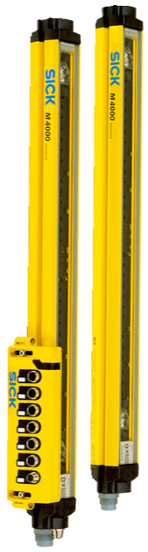
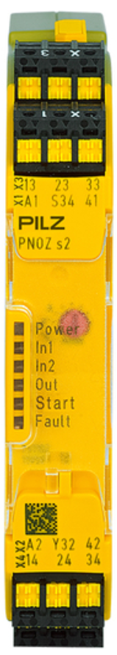
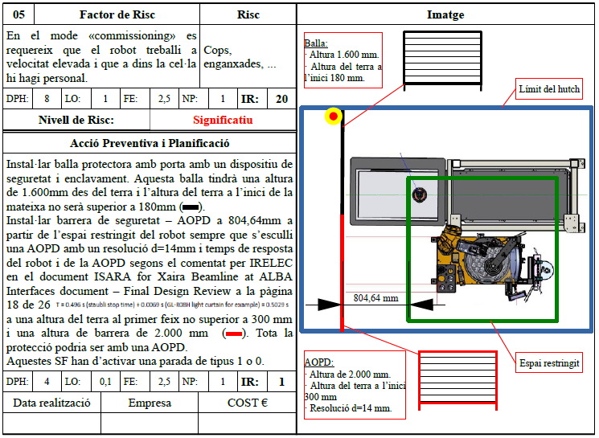
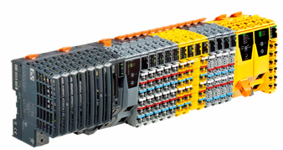
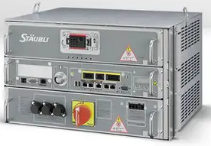
PPS
Any experience coexisting automation, equipment protection and personal protection?
Personal Protection System:
PPS is in charge of ensuring personal protection
PLC based System that prevents people from conventional risk
Laboratories require solutions for personal safety related to the operation of end stations.
The most common solutions requested are to reduce risk of collision/entrapment, Laser hazards, Chemical hazards, and Electrical hazards.
To implement these systems, it is possible to provide a specific solution (relay, emergency stop connected directly to the equipment).
But in some cases it will be part of the programming of a safety PLC,
At ALBA it is considered to use the EPS infrastructure and must include a safety CPU.
Examples already implemented at ALBA:
XAIRA robot
XALOC Robot
New protection requests
Gas management
Laser
HVPS
Gonio movement
XAIRA Double cabinet protection
Irelec PLC

Slide 14
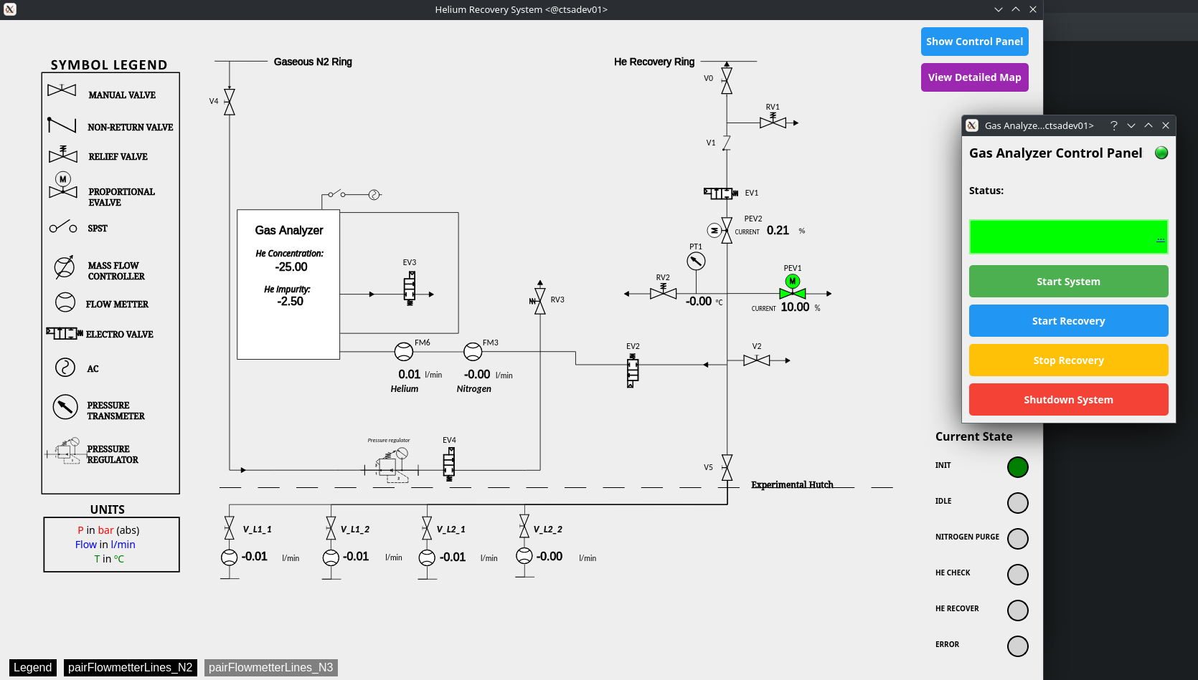
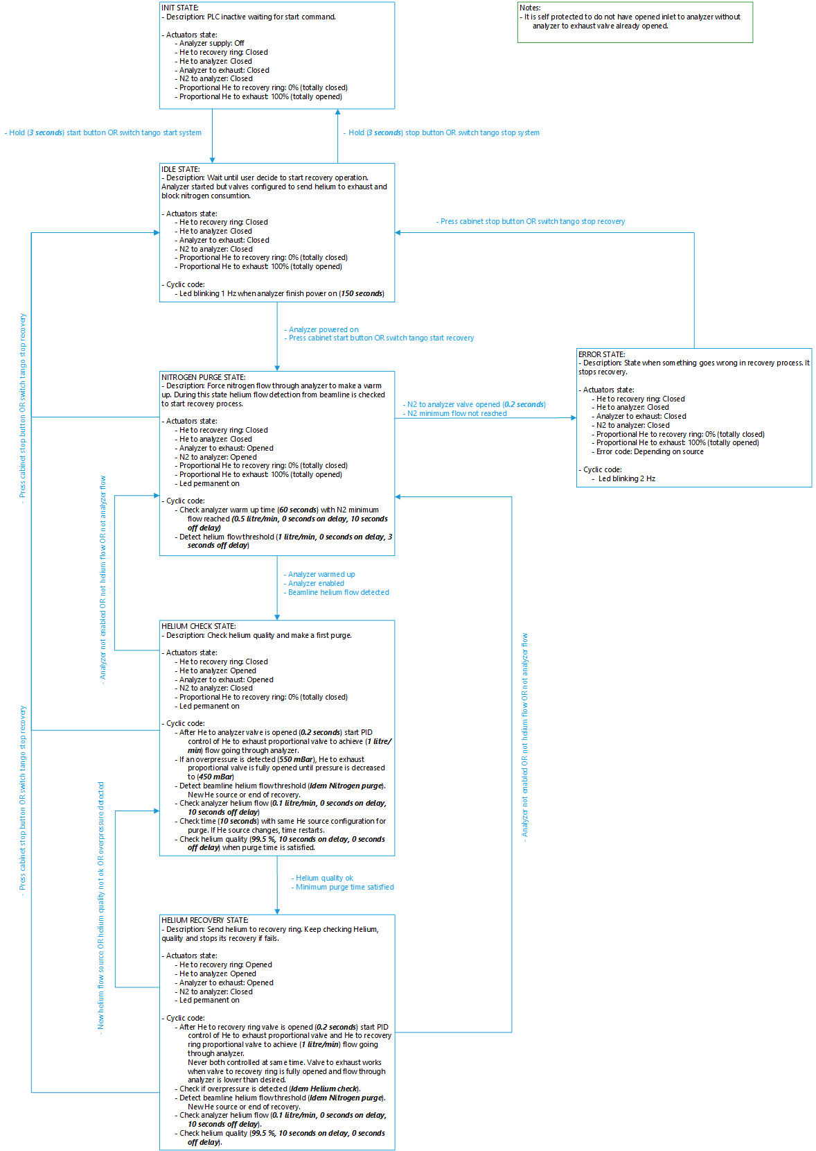
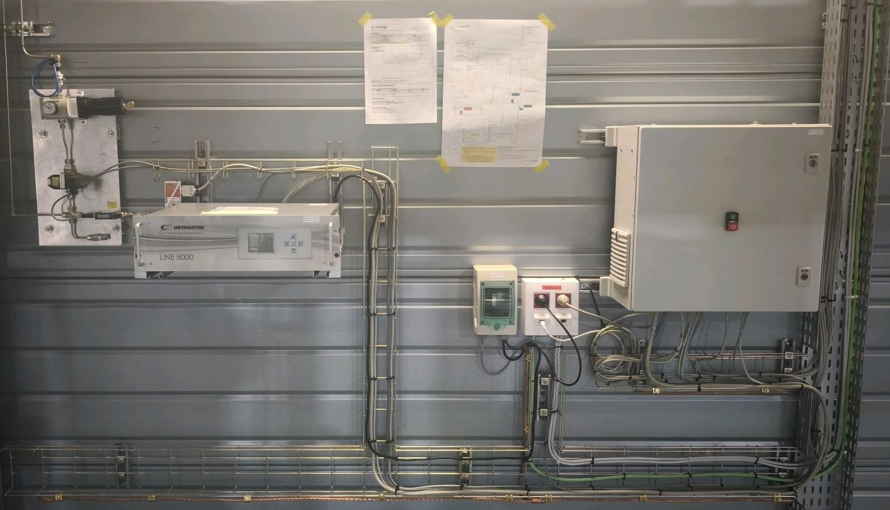
PLC Automation
Control machines PLC based:
End Station PLC include EPS & PPS and also automation solutions
Grafcet. Status machine
Hierarchy architecture
PPS
EPS
Automation
Examples already implemented at ALBA:
Gas mixture control for ionization cells
Helium recovery system
Hierarchy between PPS, EPS and Automation ?
Share hardware (CPUs, sensors y actuators)
Software discrimination (Diagnostics)

Slide 15
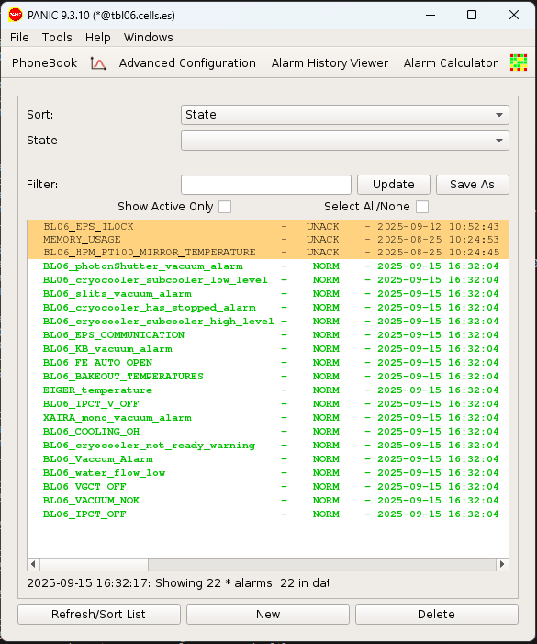
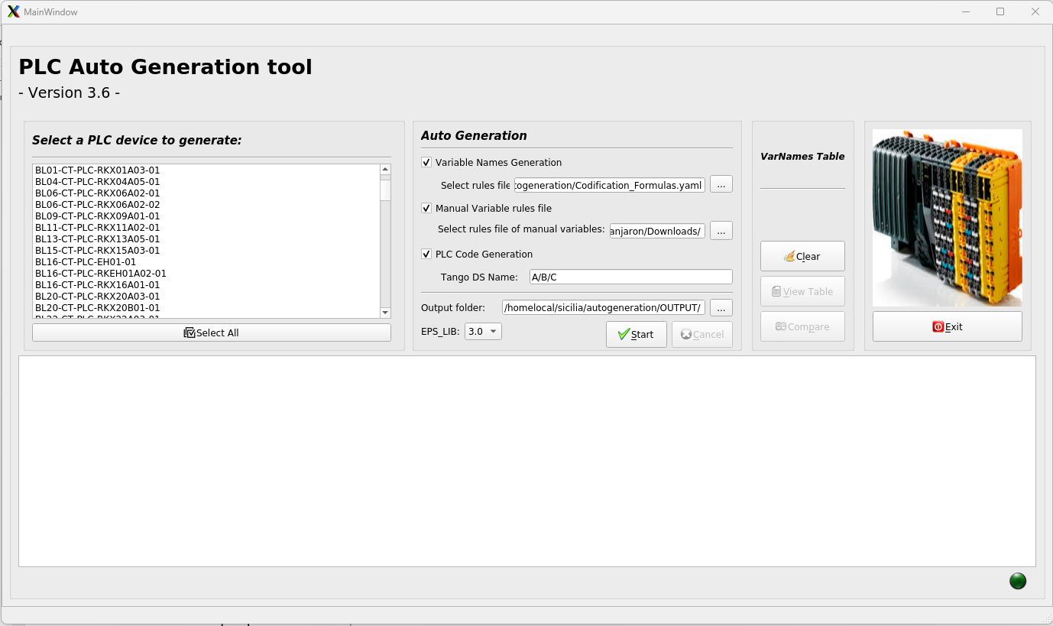
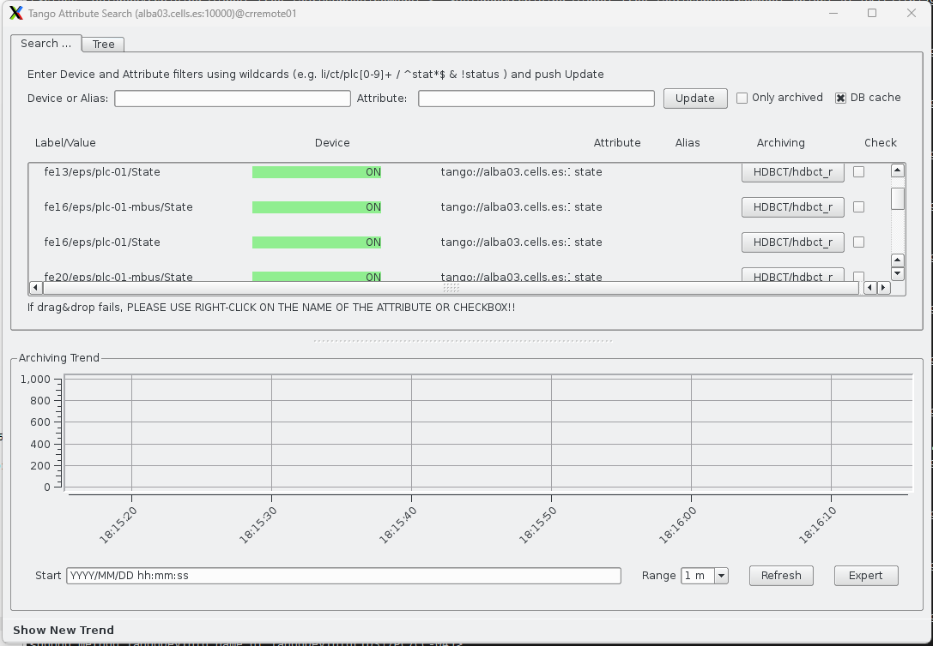

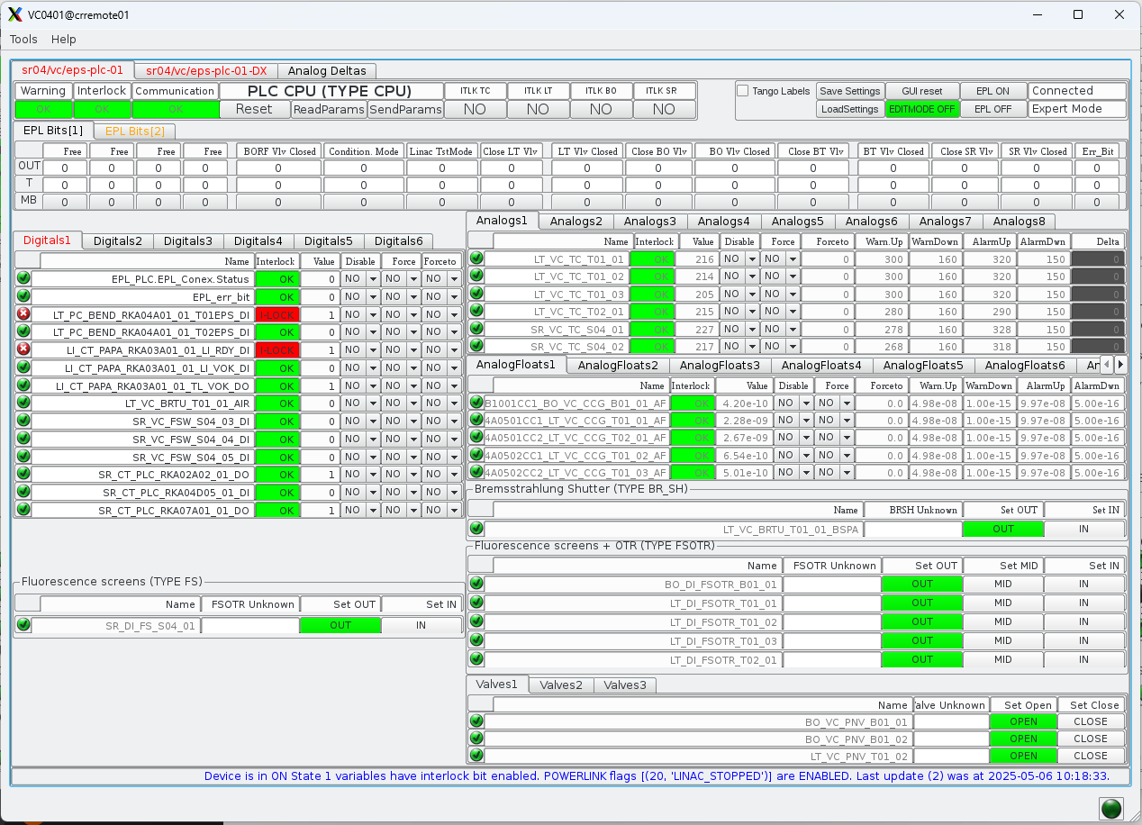

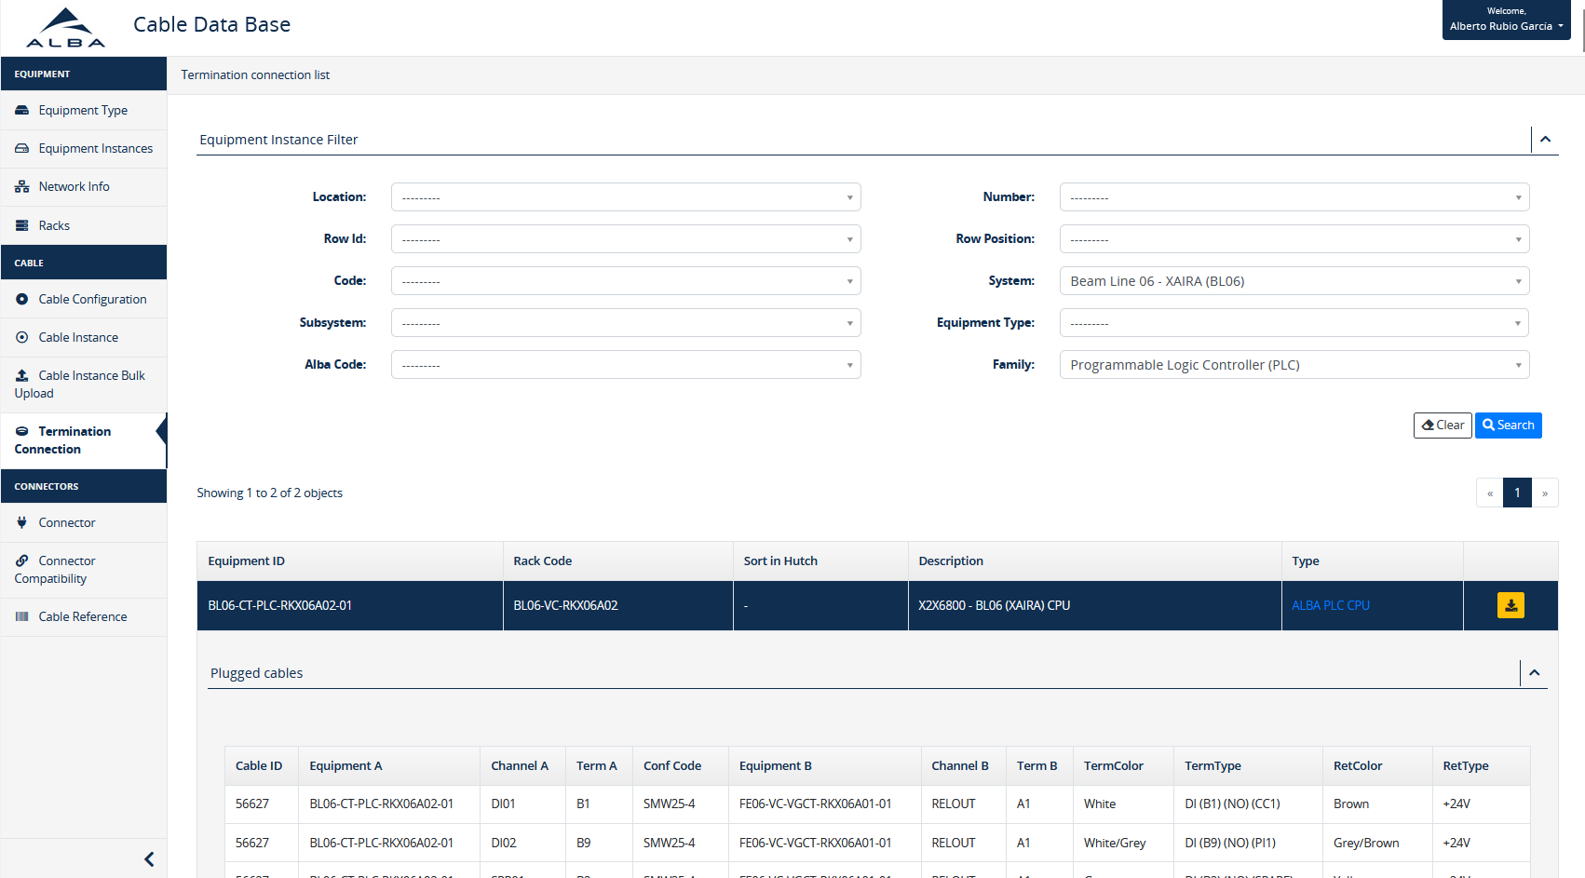
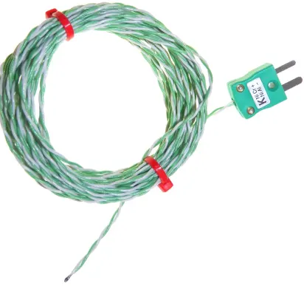
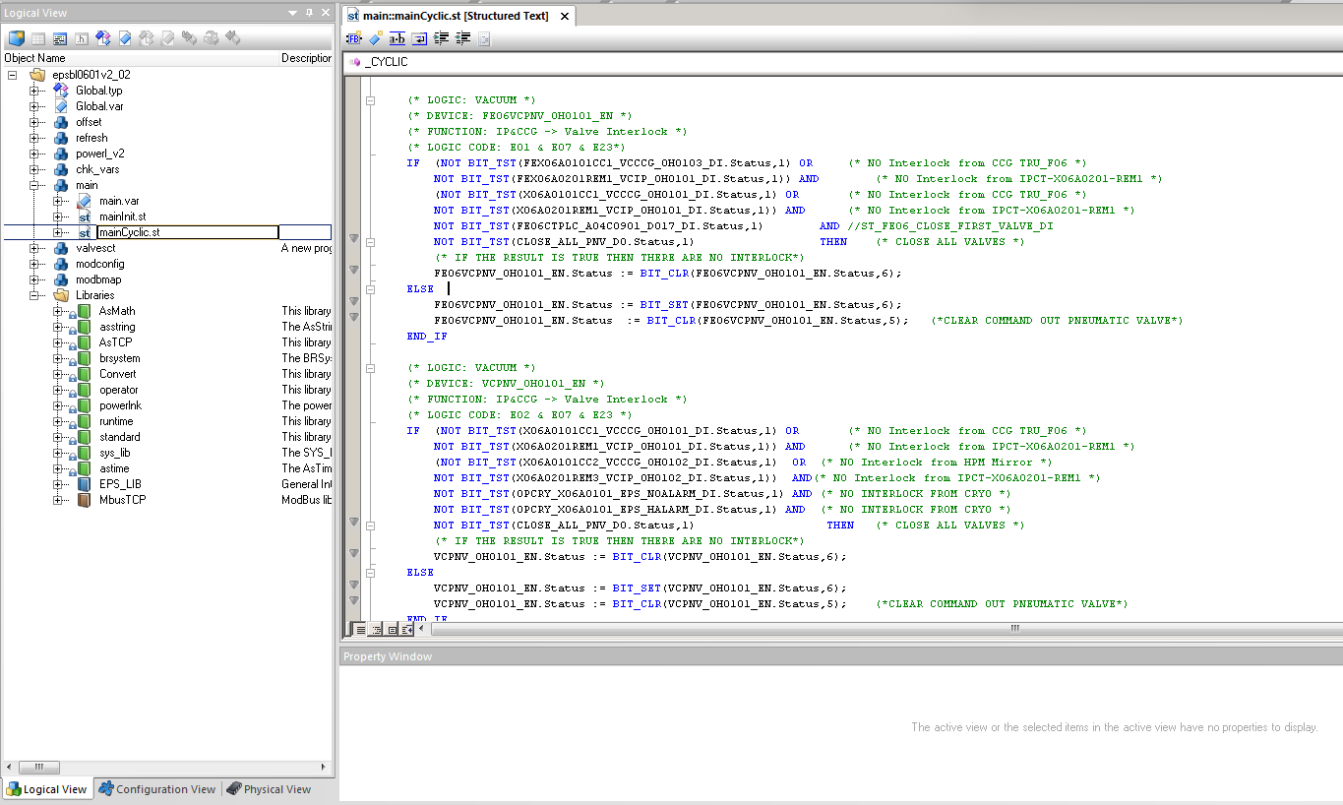
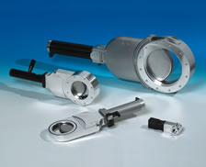
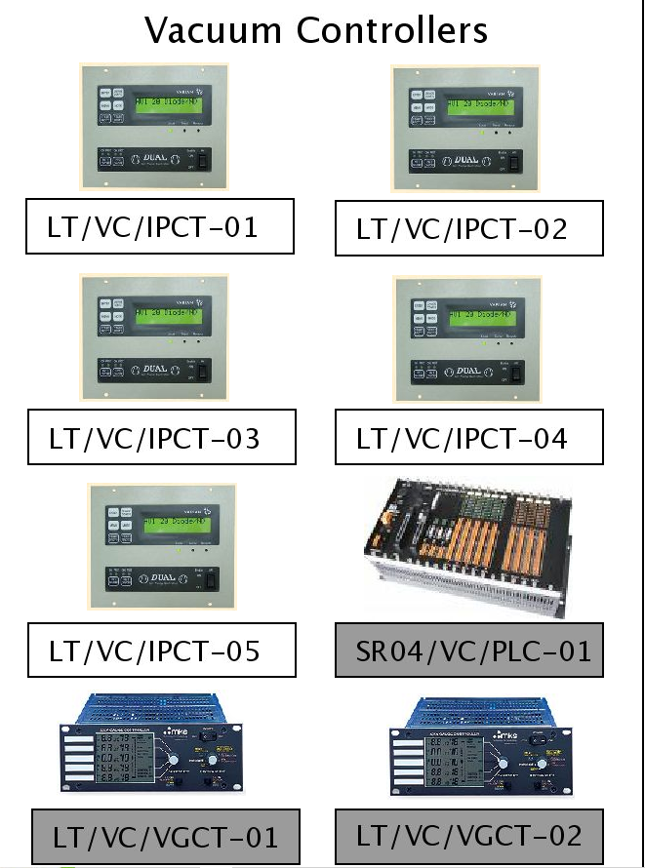
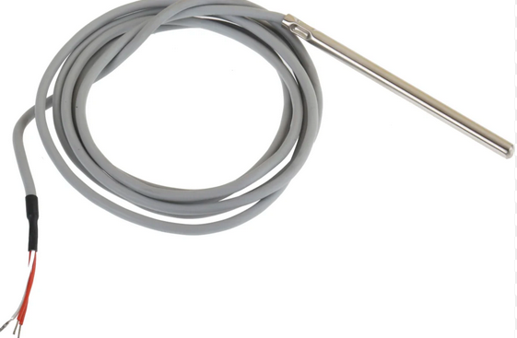
Workflow
panic
cteps_autogeneration
ctarchiving
cteps
USERS REQUIREMENT
Text files
What they want
What they have
What they need
text files
PLC documentation: I/F with devices, I/O channels assignation, etc.
PLC code generation:
PLC variables declaration (naming convention)
PLC Modbus mapping and variables allocation.
PLC standard services: disable and force variables, alarm/warning thresholds checking, etc.
AlbaPLC DS
Modbus DS
Ethernet
Modbus TCP
X2X Link
APJ
Control devices
Ethernet
Powerlink
APJ file
PLC Common INIT file: - Coms. Libraries (Modbus, EPL)
Data structures (EPS_LIB)
Common variables
Main SW task (Protection logic)
Field devices
Programmer Inputs
Service Area
Tunnel/Bunker/Hutch
Automation Studio
Commissioning

Slide 16
Open discussion
Experiences, problems and opportunities
Are any of the methodologies applied rigorously?
Does anyone have a large installation in progress?
What is your experience with obsolescence? How to manage the coexistence of different equipment that don't easily communicate with each other?
Any experience coexisting automation equipment protection and personal protection?
Hierarchy between PPS, EPS and Automation ?
Share hardware (CPUs, sensors y actuators)
Software discrimination (Diagnostics)

Slide 17








ALBA Controls and PLC Automation
Controls (PLC tools development at ALBA)
PLC Automation Team is part of Controls Section in Computing division
Zbigniew Reszela
Controls Section Head
zreszela@cells.es
Sergi Rubio
Controls, SW developer
srubio@cells.es
Emilio José Morales
Controls, SW developer
emorales@cells.es
Jose Ramos
Controls, SW developer
jramos@cells.es
Jorge Villanueva
Controls, PLC SW & HW
jvillanueva@cells.es
Nil Serra
Controls, PLC SW & HW
nserra@cells.es
Xavier Mercadal
Controls, PLC SW & HW
xmercadal@cells.es
Alberto Rubio
Controls, PLC SW & HW
arubio@cells.es

Slide 18
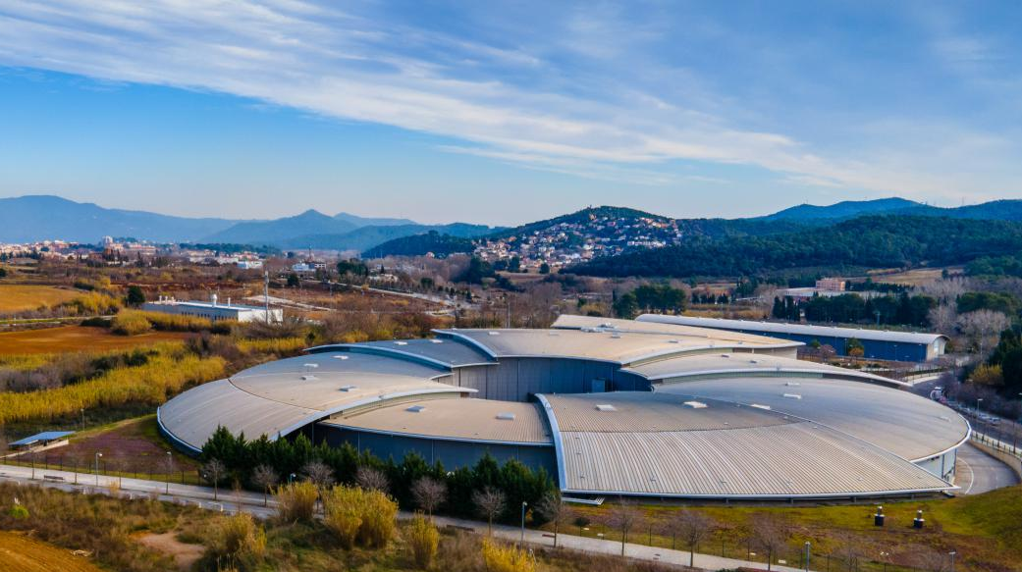
Thanks for your attention!!
Questions?

