Slide 1
PLC usage at JCNS
20.9.25 I Harald Kleines, JCNS, Forschungszentrum Jülich

Slide 2
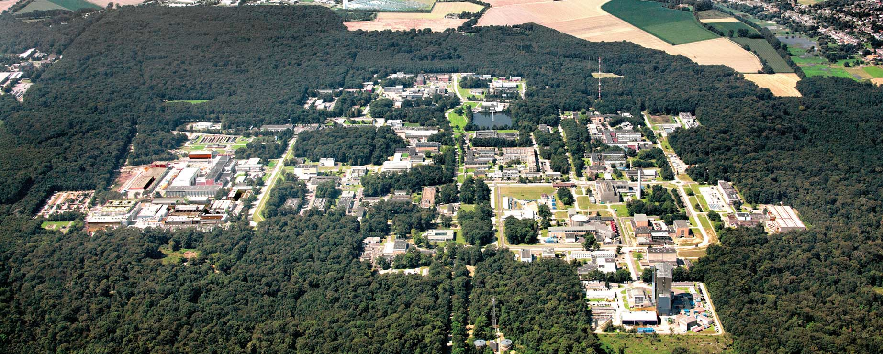
Forschungzentrum Jülich and JCNS
Forschungszentrum Jülich
  Interdisciplinary research center
  Strategic research priorities
    information, energy, bio-economics
  Ca. 7500 employees
Jülich Centre for Neutron Science (JCNS)
  Neutron instrument development and operation, science with neutrons
  Main outstation: research reactor FRM II in Garching (14 neutron instruments)
  Neutron instruments also at ILL, SNS, NIST (Gaithersburg), and ESS (4 instruments)
  ESS: evaluation projects (robotics, linear motors, rotary motors), basic ECAD design and prototype manufacturing of standard motion cabinets, cooperation with ESS and ISIS for a common PLC motion software framework
  In Jülich: X-ray instruments,…..
  Ca. 200 employees

Slide 3
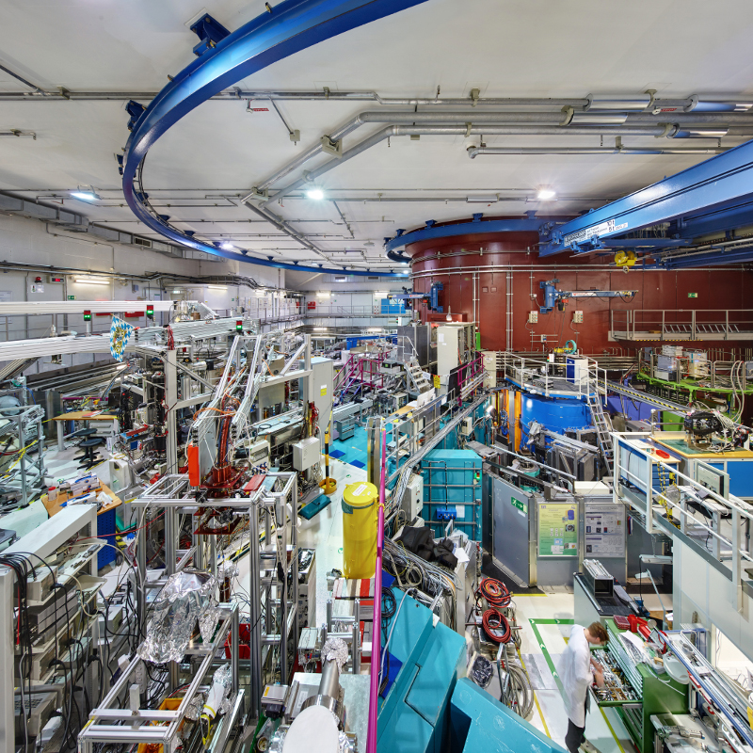
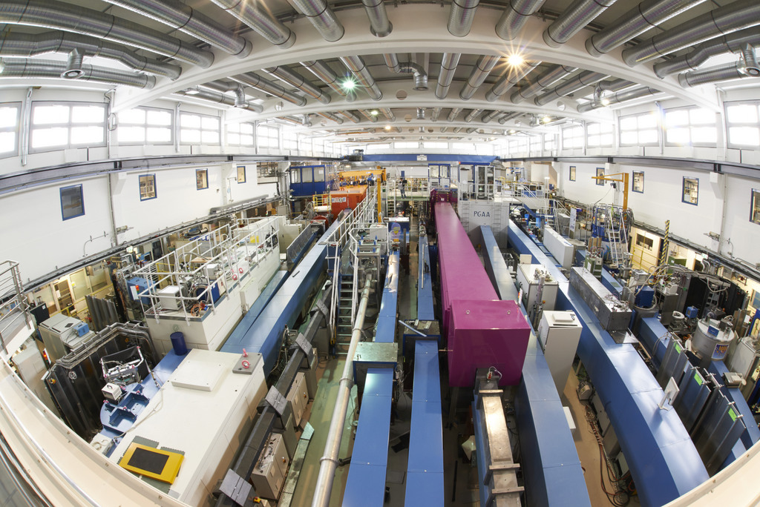
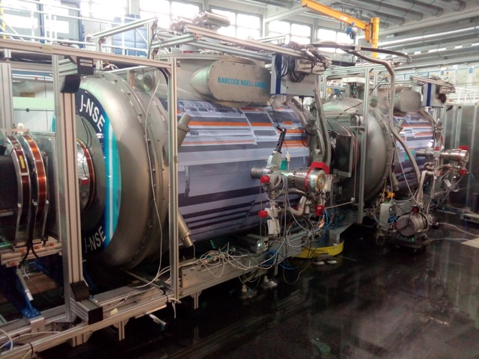
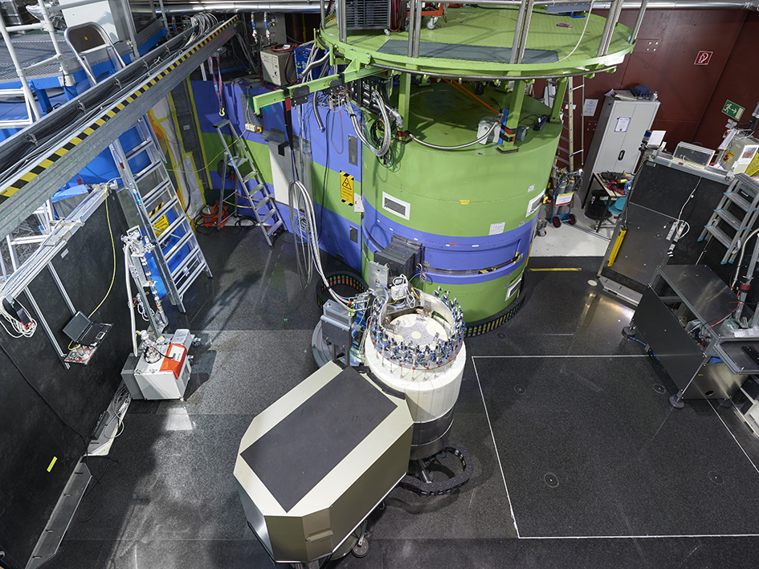
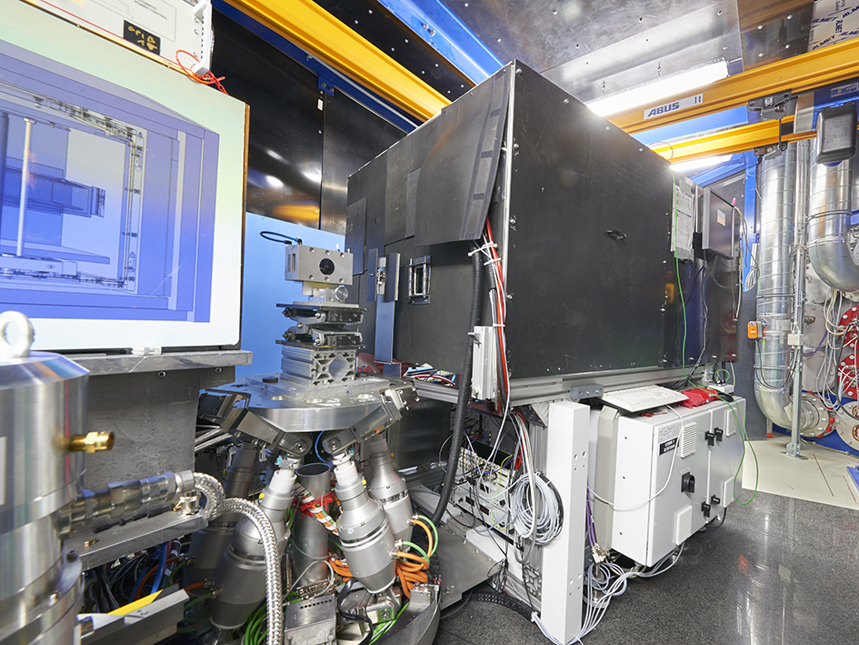
Control in Neutron Instruments
FRM II experimental hall
Control tasks:
  Motion (avg. 25 axes / instrument)
  Personal Safety
  Vacuum
  Cooling
  Pressed air actuators
  Sample Environment (Electric and magnetic fields,…..)
  ……
FRM II neutron guide hall
Spin Echo Instrument J-NSE
Triple Axis Inst. PANDA
Diffractometer MARIA

Slide 4
PLCs in JCNS Instruments
Number of PLCs per Instrument:
  Original approach: two or three PLCs per neutron instrument (for each subsystem, e.g. motion, vacuum, personal safety,…) communicating via PROFIBUS or PROFINET
  Now common approach: one PLC per neutron instrument
    Major simplification of communication and maintenance
Almost exclusively Siemens S7-300 and S7-1500 (+ ET200S, ET200SP, ET200pro, ET200eco, Sinamics,….)
  Siemens is the dominant market leader
  Traditionally used at Forschungszentrum Jülich, good experiences with HW and SW quality
  Fulfils all requirements (Personal safety, motion,…..)
  Exception: ESS forces us to use Beckhoff for motion

Slide 5
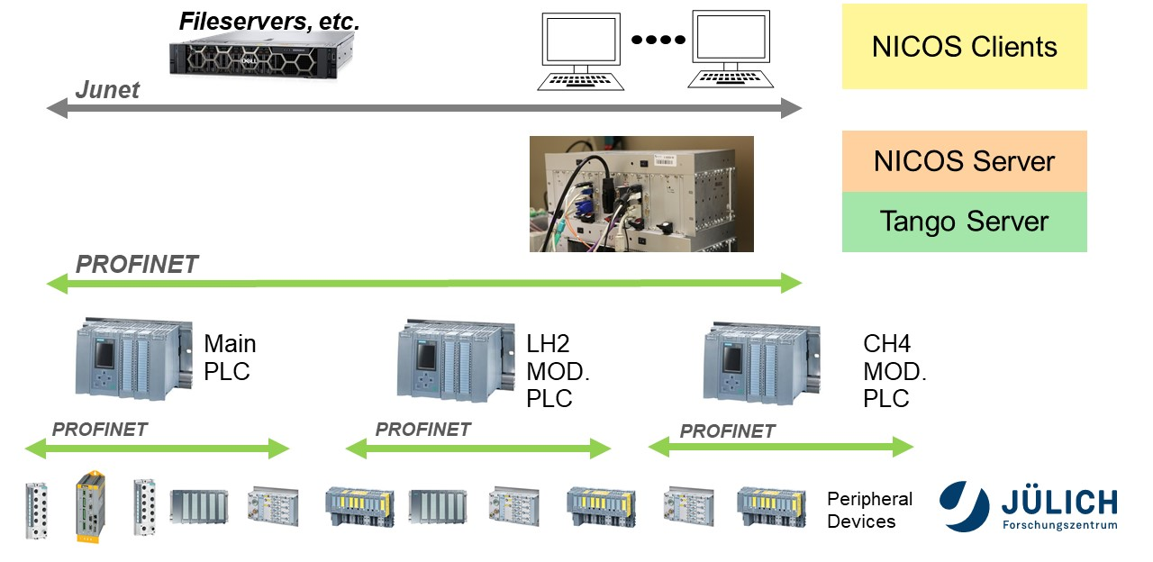
Control System Architecture
Proprietary application protocol for motion and variable access on top of PROFINET
  Implemented by Tango Servers and PLC SW modules

Slide 6
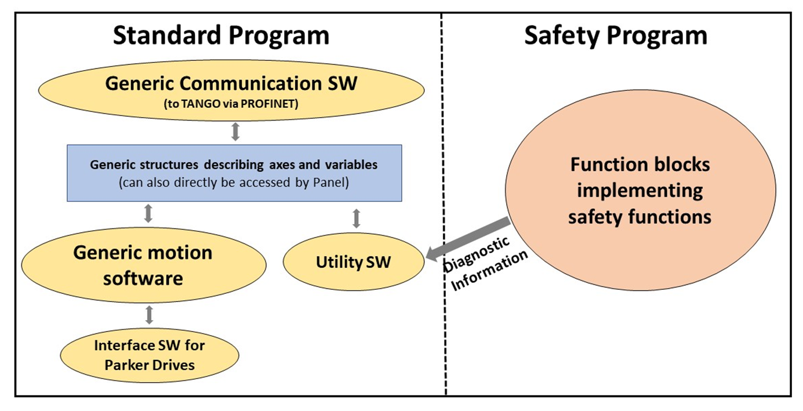
PLC Software
Languages:
  Mainly ST (some historical modules in STL)
  Safety Program: Exclusively FBD
Versioning: Gitlab (only for generic SW modules)
  TIA Portal version control interface does not support hardware configuration
Generic array of structures representing axes
  Control, status, configuration
  NICOS/Tango dynamically read the axes configuration
In TIA portal: Standard access to axes via PROFIdrive
  Use of technology objects for motion
  Use of standard PLCopen motion control function blocks
  Enhanced functionalities (Camming, electronic gearing,…) “for free”
  Interface SW modules required for motion hardware that does not support PROFIdrive

Slide 7
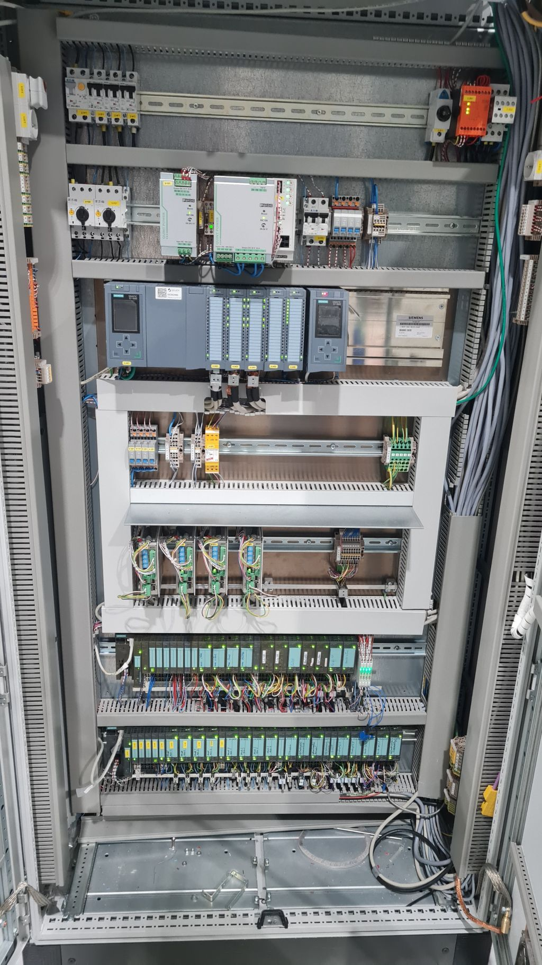
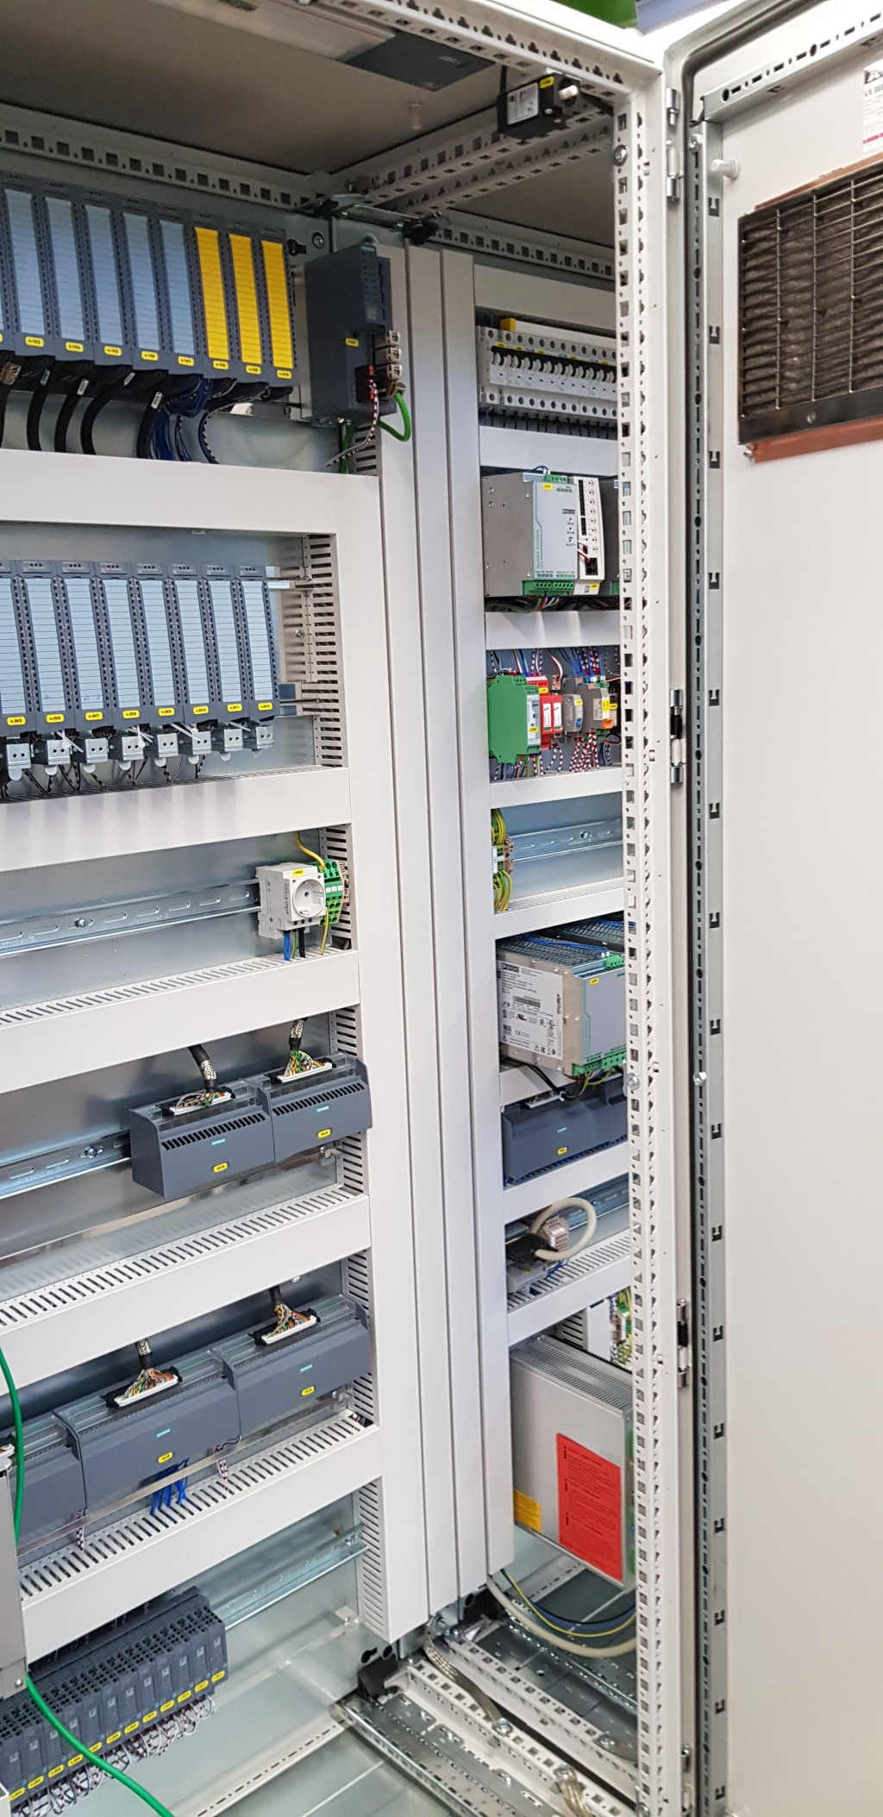
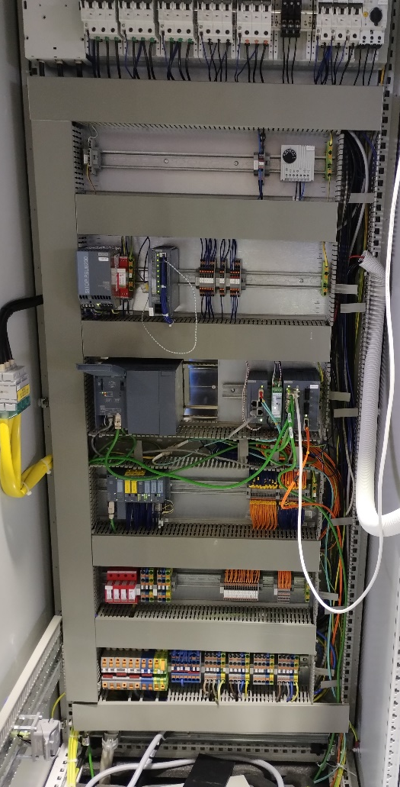
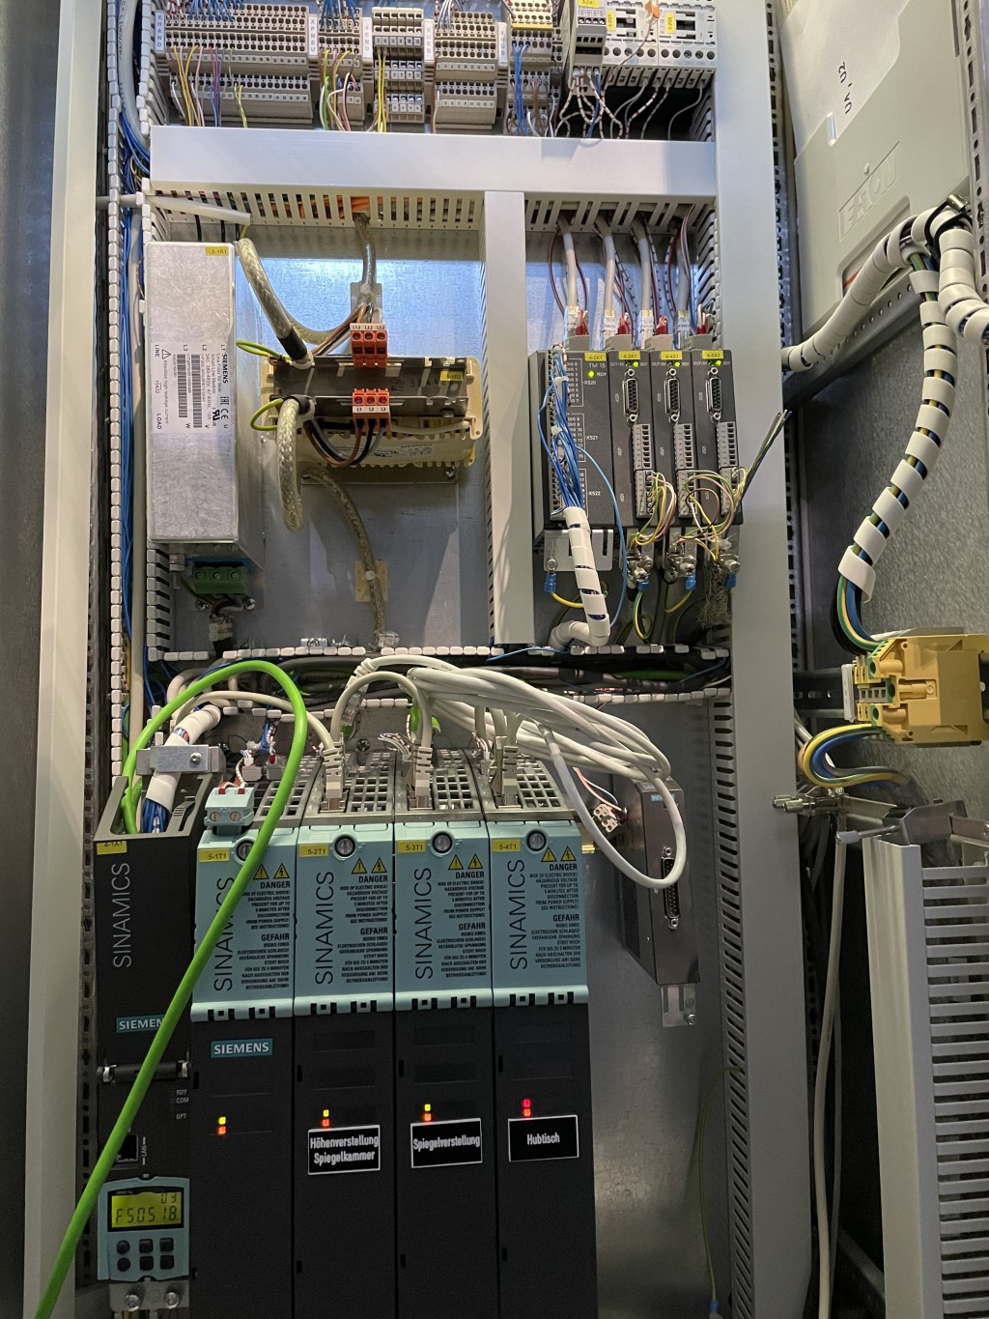
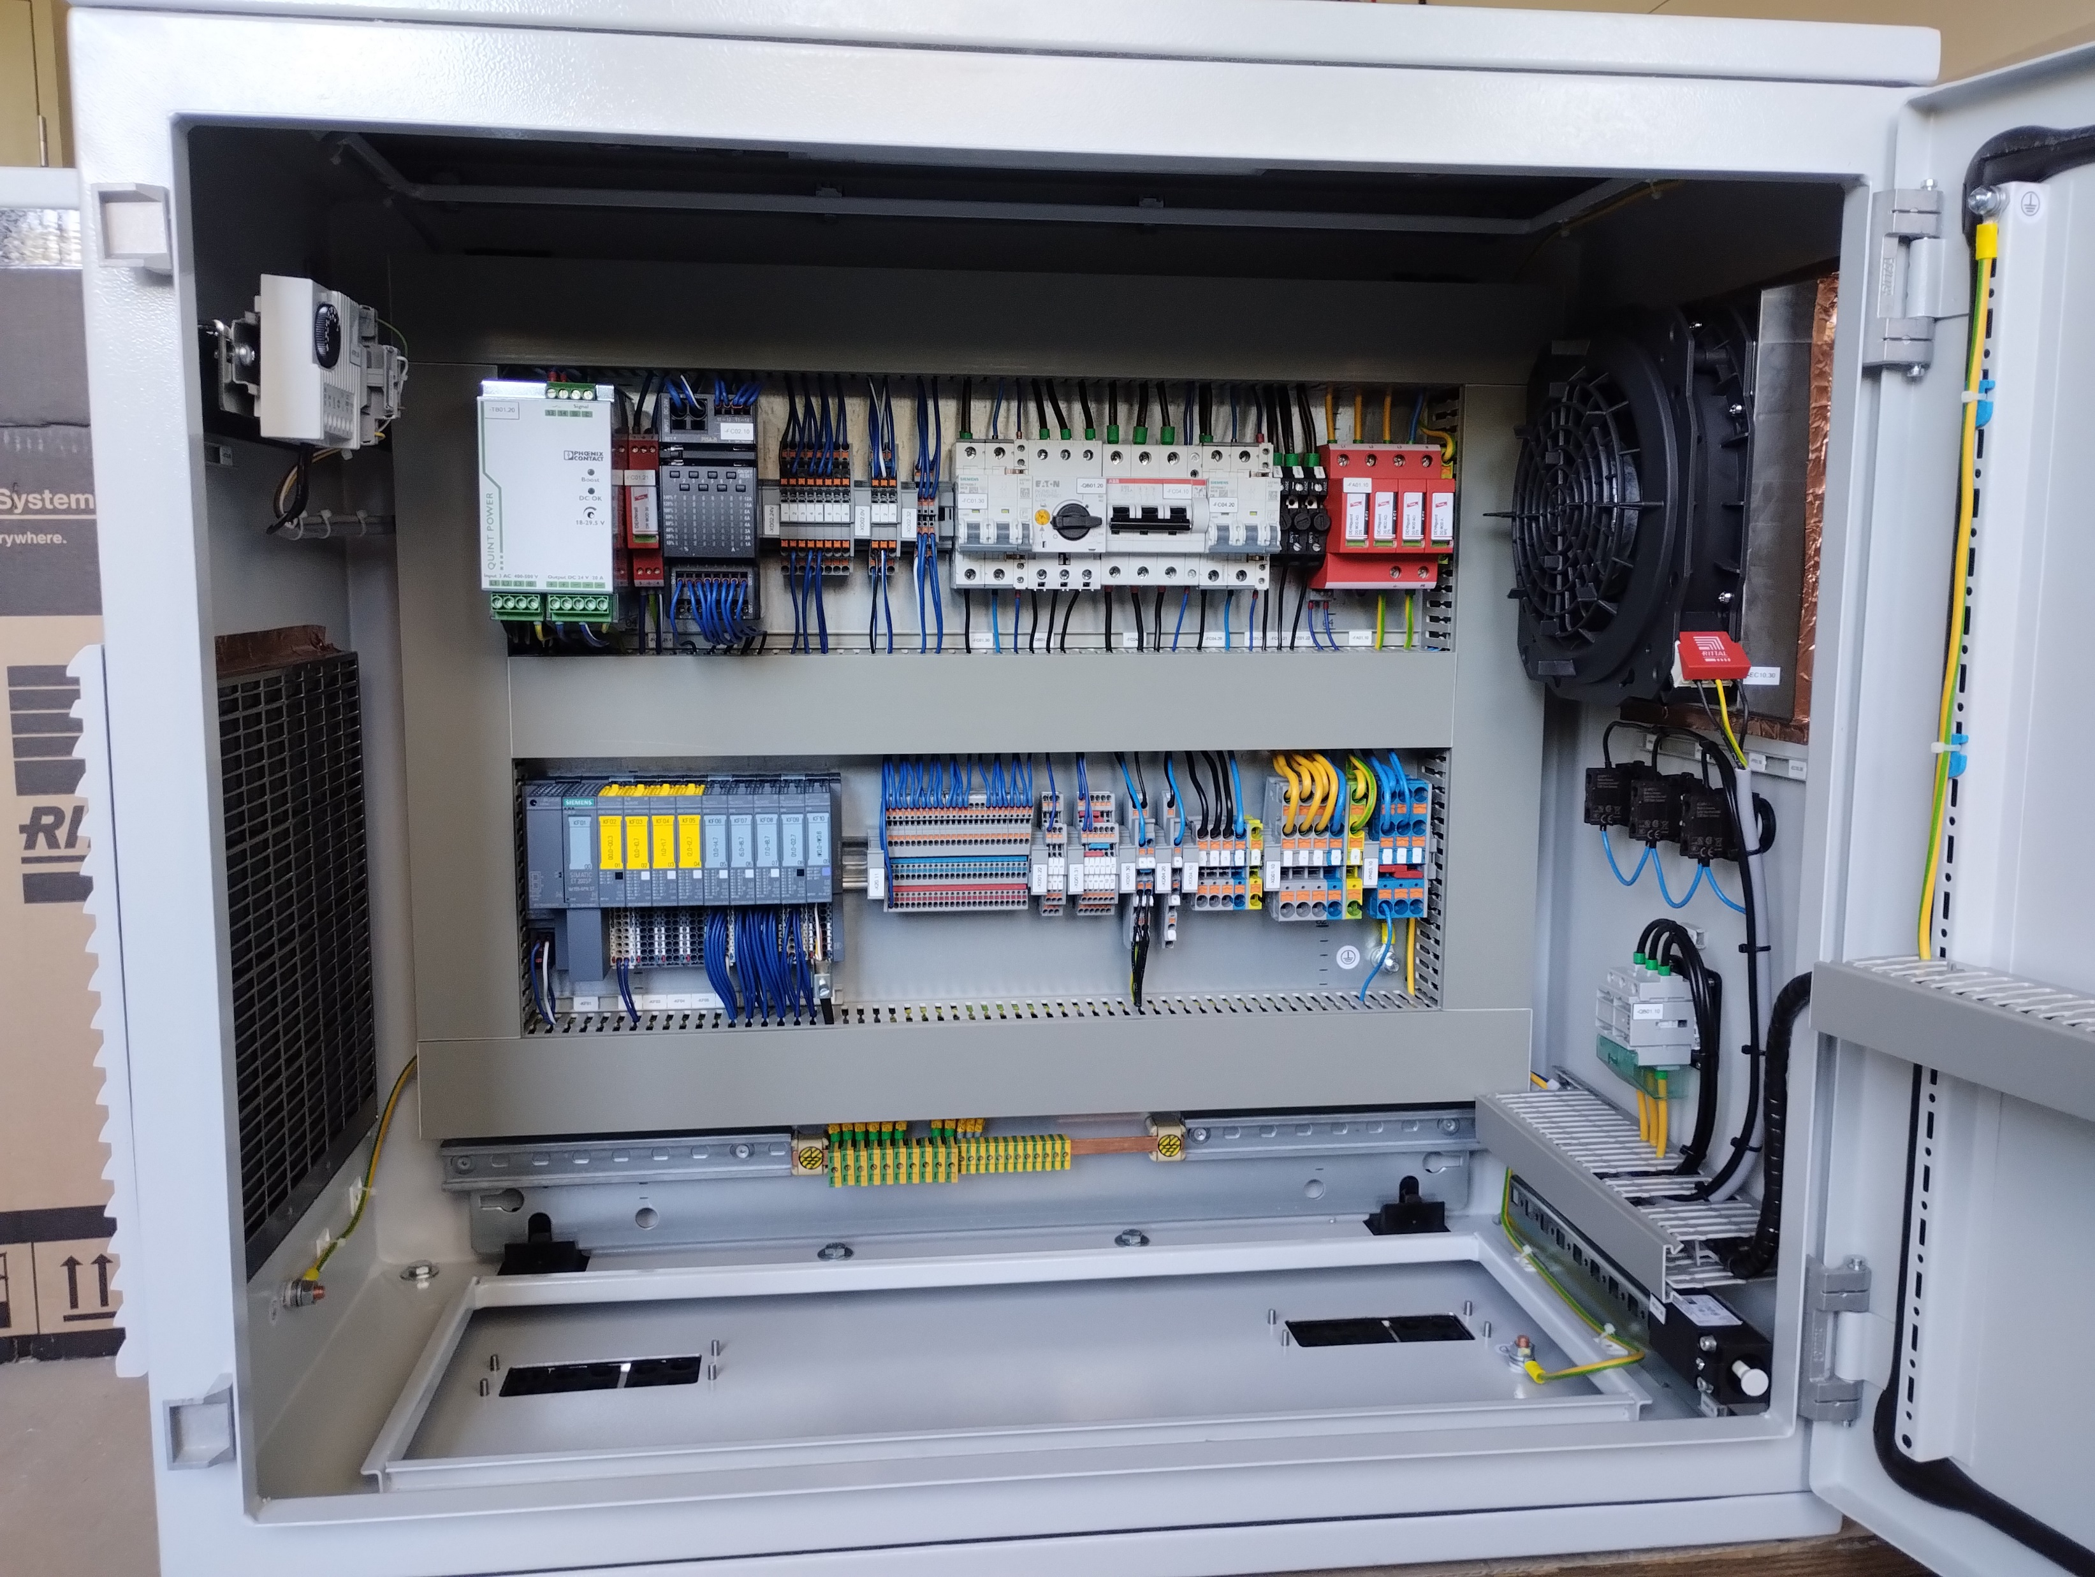
PLC Hardware
ECAD design with EPLAN, normally in-house
Manufacturing of racks normally in-house
Ongoing transition form S7-300 to S7-1500
  Pretty straight forward
  Major part of the SW consists of generic modules
  Peripheral Modules: mainly ET200S
    Modules not supported by TIA-Portal can be reused via GSD or GSDML files
    Exception: safety modules

Slide 8
Future Challenges
Project HBS-I on the BMFTR shortlist for German national large research infrastructures
HBS-I (High Brilliance Source Phase I) is a High Current Accelerator Based Neutron Source (HiCANS)
  20 MeV pulsed proton Linac with 100 mA peak current
  Target Station
  5 Neutron instruments + radioisotope production for medical applications
  Completely new requirements for PLC usage

