Slide 1
ALS/ALS-U PLC-based Control Systems
PCBS Workshop, ICALEPCS 2025
Najm Us Saqib, Control Systems Engineer @ ALS-U
September 20th, 2025

Slide 2
Outline
Facility Introduction
ALS
IRMs
Storage Ring Magnet Interlock System
Beamline Equipment Protection System
ALS-U
Vacuum Equipment Protection System
Slow Machine Protection System
RF Equipment Protection System
Personnel Protection System

Slide 3
Facility Introduction

Slide 4
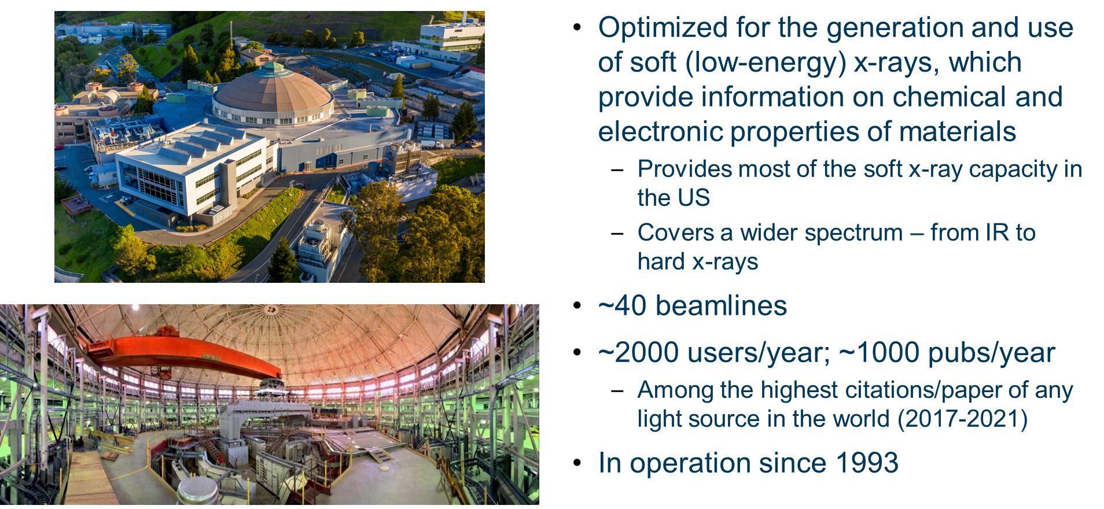
Advanced Light Source (ALS)

Slide 5
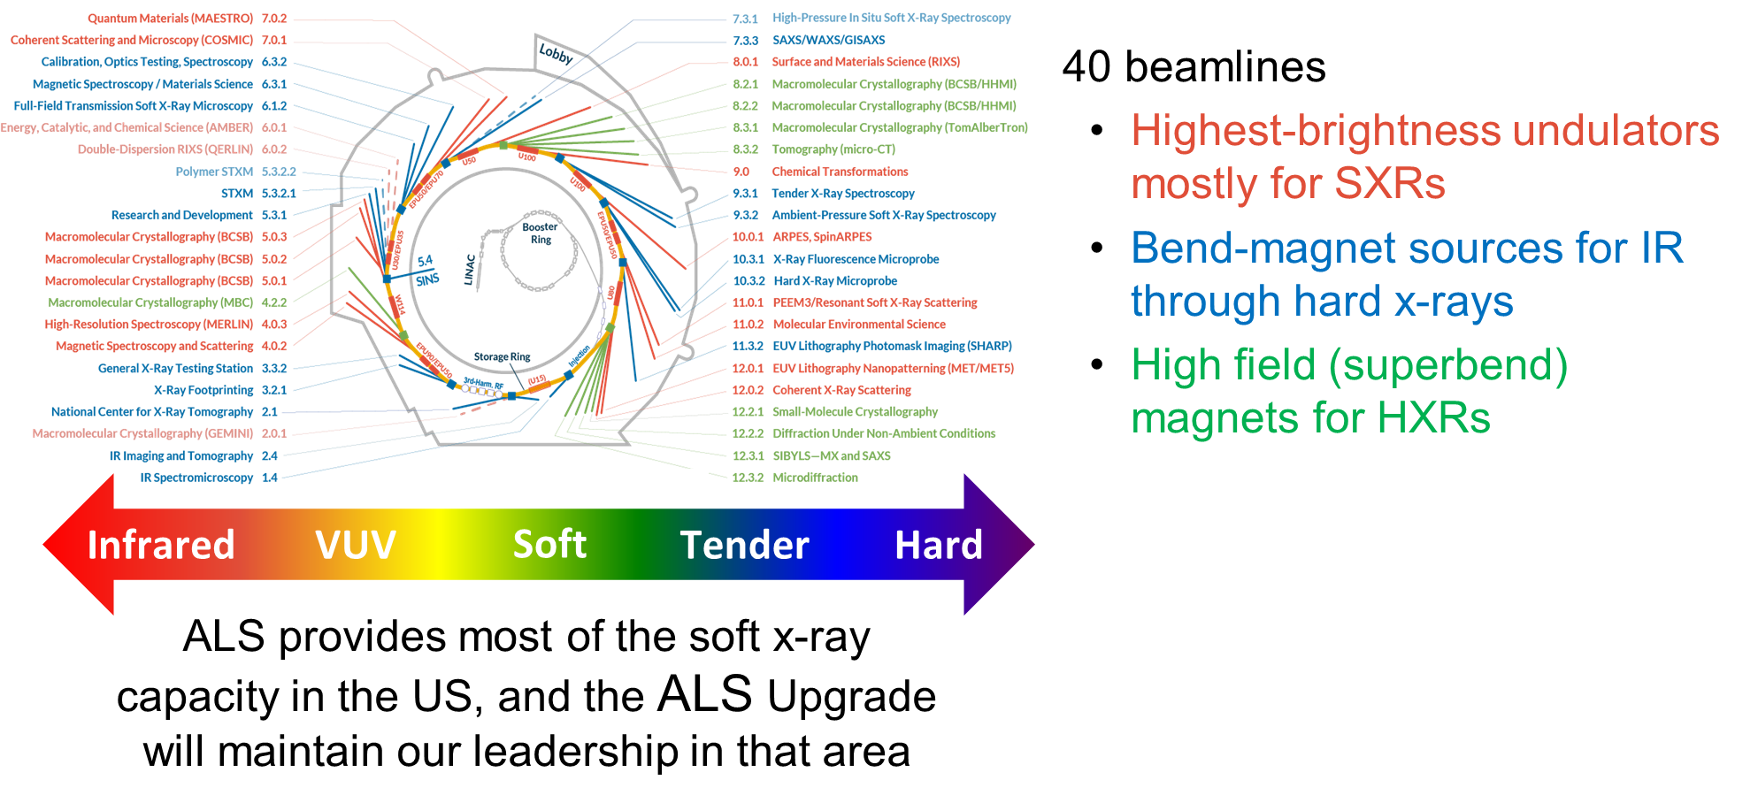
ALS offers tools from IR to harder x-rays

Slide 6
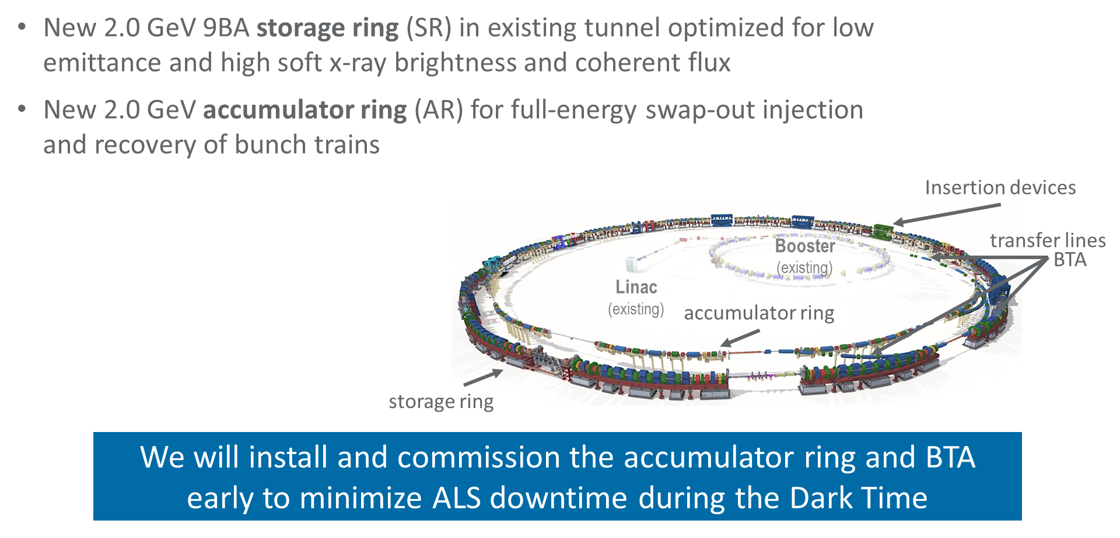
ALS-U

Slide 7
Existing Systems at ALS
IRM

Slide 8
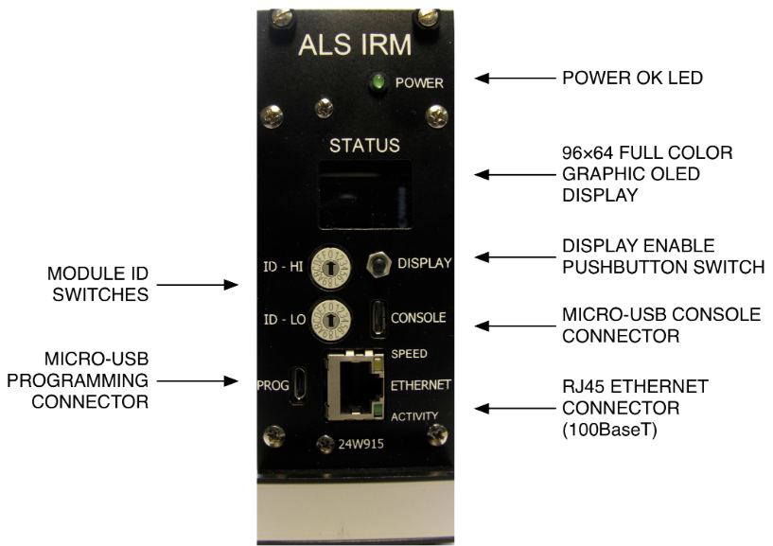
ILC Replacement Module (IRM)
ALS PLC-like system
ILC → Intelligent Local Controller
Chassis-based FPGA system
Ai, Ao, bi, bo
EPICS interface

Slide 9
Existing Systems at ALS:
Storage Ring Magnet Interlock System

Slide 10
Sextupole Magnet Interlock System
Storage ring magnet interlocks
1 PLC chassis/sector
12 sectors in total
Allen Bradley series 1769
Will be decommissioned as part of ALS-U

Slide 11
Existing Systems at ALS
ALS Beamline Equipment Protection System

Slide 12
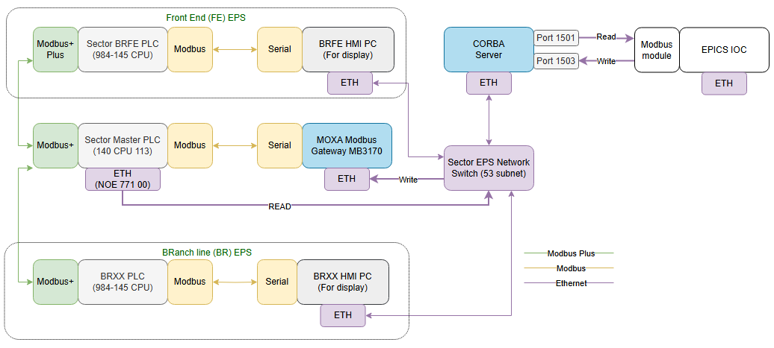
Beamline Equipment Protection System
Subsystems
Front End
Branch lines
End stations
Current architecture
Modicon PLCs
End of life
Phoebus OPIs

Slide 13
Beamline Equipment Protection System Upgrade
Modicon to Allen Bradley
Ongoing upgrade in phases
Standardized on ALS-U Slow MPS hardware (explained later)

Slide 14
ALS-U Vacuum Equipment Protection System

Slide 15
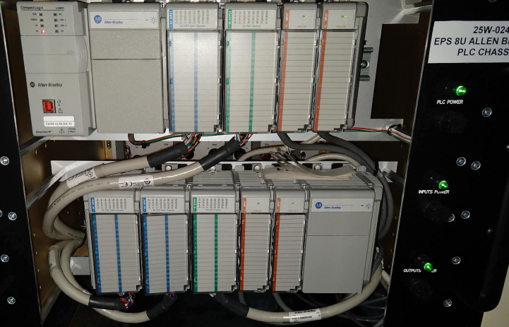
ALS-U Vacuum Equipment Protection System
First PLC-based system designed/implemented as part of ALS-U
1769 series
Chassis based system
Accumulator Ring: 1 PLC chassis/ 3 sectors
Storage Ring: 1 PLC chassis/sector

Slide 16
ALS-U Slow Machine Protection System

Slide 17
Slow Machine Protection System
Five different variants of PLC Chassis
MPS A
Main PLC Chassis
Magnet/LCW interlocks
Interfacing with Vacuum and neighbor Slow MPS PLCs
MPS B
Remote I/O
Accumulator Ring Power supplies controllers (Solo)
MPS C
Remote I/O
Accumulator Ring Power supplies controllers (String)
MPS D
Remote I/O
Injection/Extraction interlocks
Beam Diagnostics interlocks
MPS E
Remote I/O
Storage Ring power supplies controllers
Hardware - 5069 series
CPU: 5069-L320ER
Analog Input: 5069-IF8
Analog Output: 5069-OF8
Digital Input: 5069-IB16
Digital Output: 5069-OB16

Slide 18
Slow MPS
MPS Component Name | Chassis Model | AR/BTA | SR/STA/ATS
AR/SR Main PLC | A | 13 | 14
AR Solo/BTA PSC RIO | B | 13 | 0
AR String PSC RIO | C | 1 | 0
FB, Inj/Ext, Cold Finger, Beam Scraper, In-Vac ID RIO | D | 5 | 15
SR PSC RIO | E | 0 | 14
Model
AR/BTA
SR/ATS/STA

Slide 19
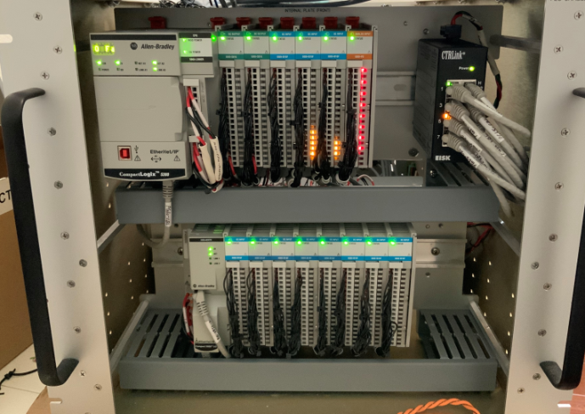
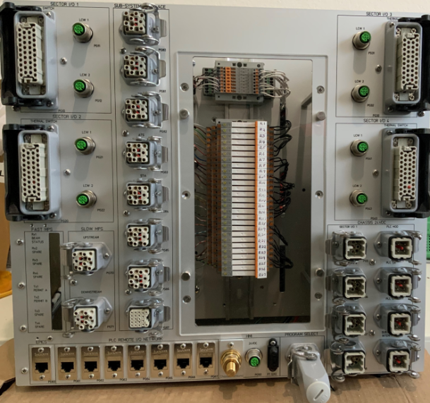
ALS-U Slow MPS
MPS A - Front
MPS A - Rear

Slide 20
ALS-U RF Equipment Protection System

Slide 21
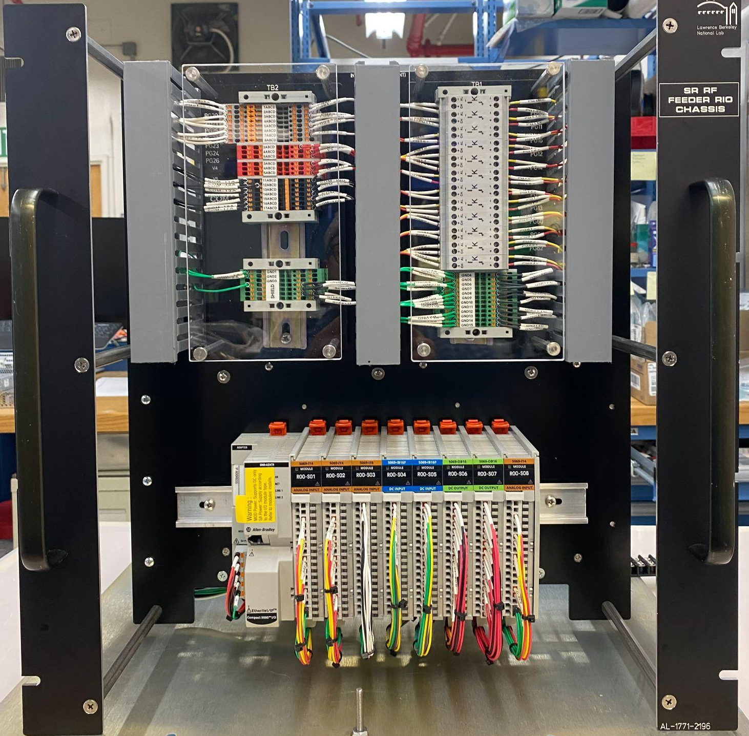
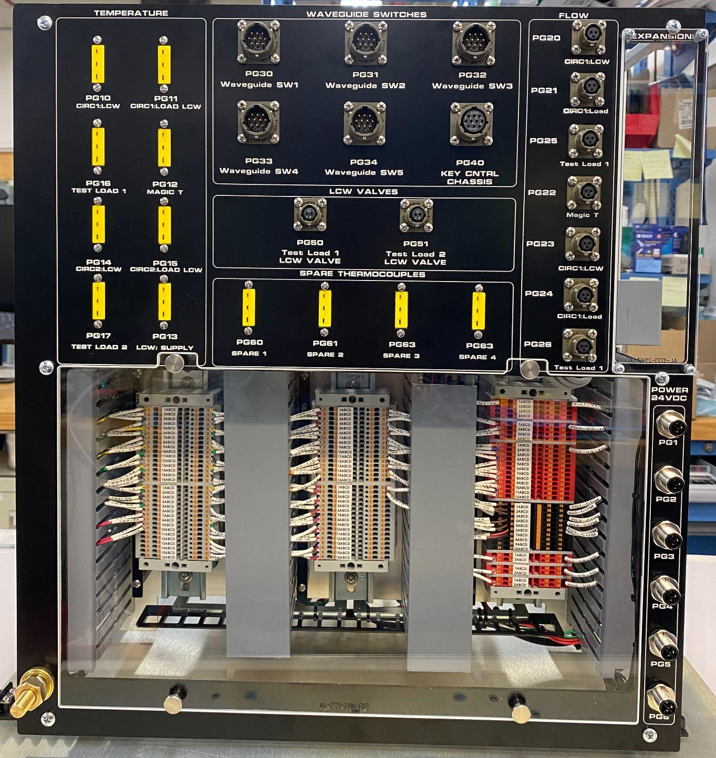
RF Equipment Protection System
AR
1 Main PLC chassis
1 RIO in tunnel
Design similar to Slow MPS chassis
SR - RF system remains unchanged for ALS-U
Horner end-of-life controllers
Upgrade to Allen Bradley in progress
4 phases
1 phase/year
4 Main PLC Chassis
8 RIO chassis
Accessible terminal blocks included
SR RF Cavity Water Control PCL chassis

Slide 22
ALS-U Personnel Protection System

Slide 23
Personnel Protection System
ALS: Relay-based system
ALS-U: Siemens safety PLCs
Combination of Main PLC chassis and Remote I/Os

Slide 24
ALS-U Development Practices

Slide 25
ALS-U Development Practices
PLC code
Ladder logic/Structured text
Use of UDTs
Base
High-level
EPICS
Base UDTs → Database template files
Substitution file from spreadsheet
Phoebus for operator displays
Version Control
GitLab + Compare tool
Small team
Less overhead
Inexpensive

Slide 26
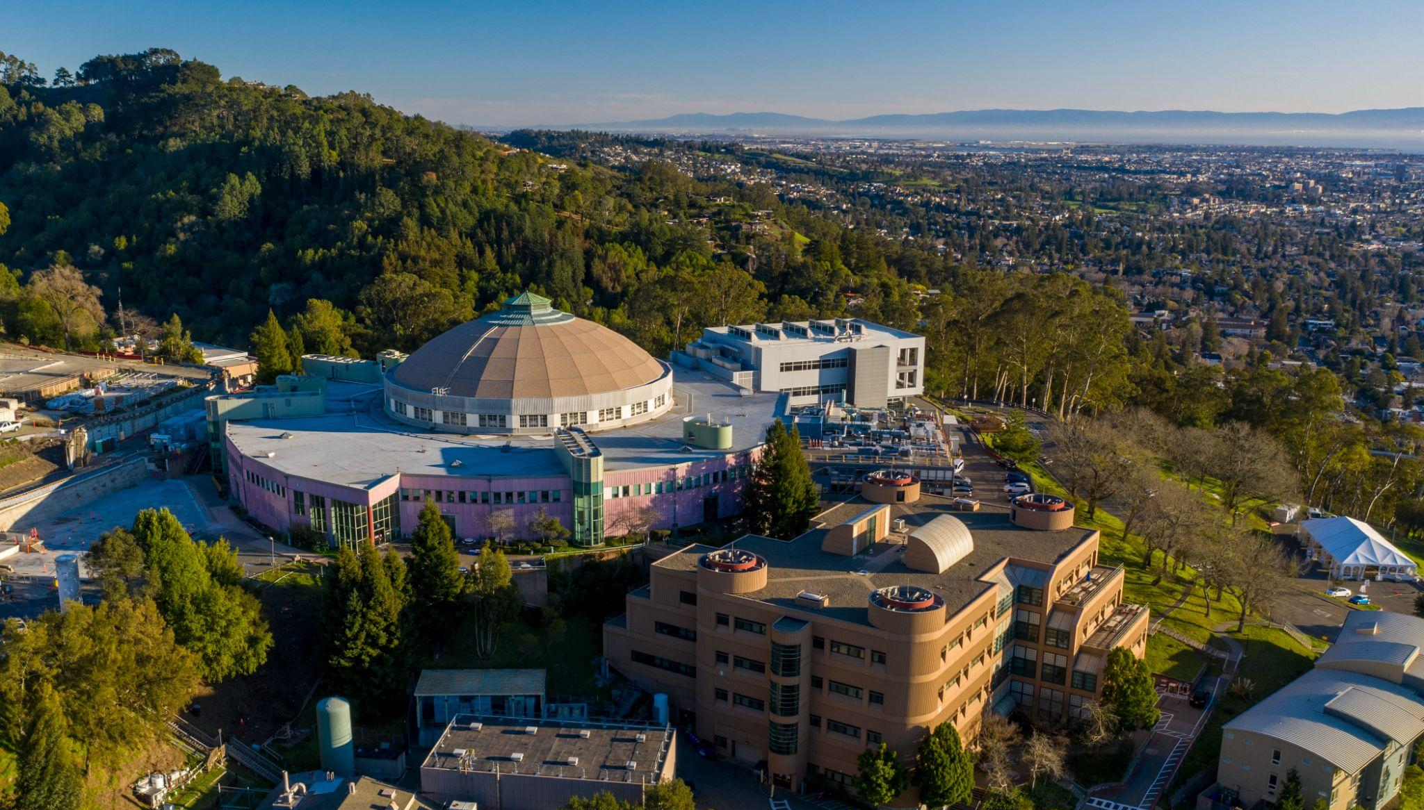
Thank you!

