Slide 1
LCLS-II Cryogenic Software
ICALEPCS 2025 - PLC Workshop
Andrew Wilson / Staff Engineer / andreww@slac.stanford.edu / Electronics Engineering Division
September 20, 2025

Slide 2
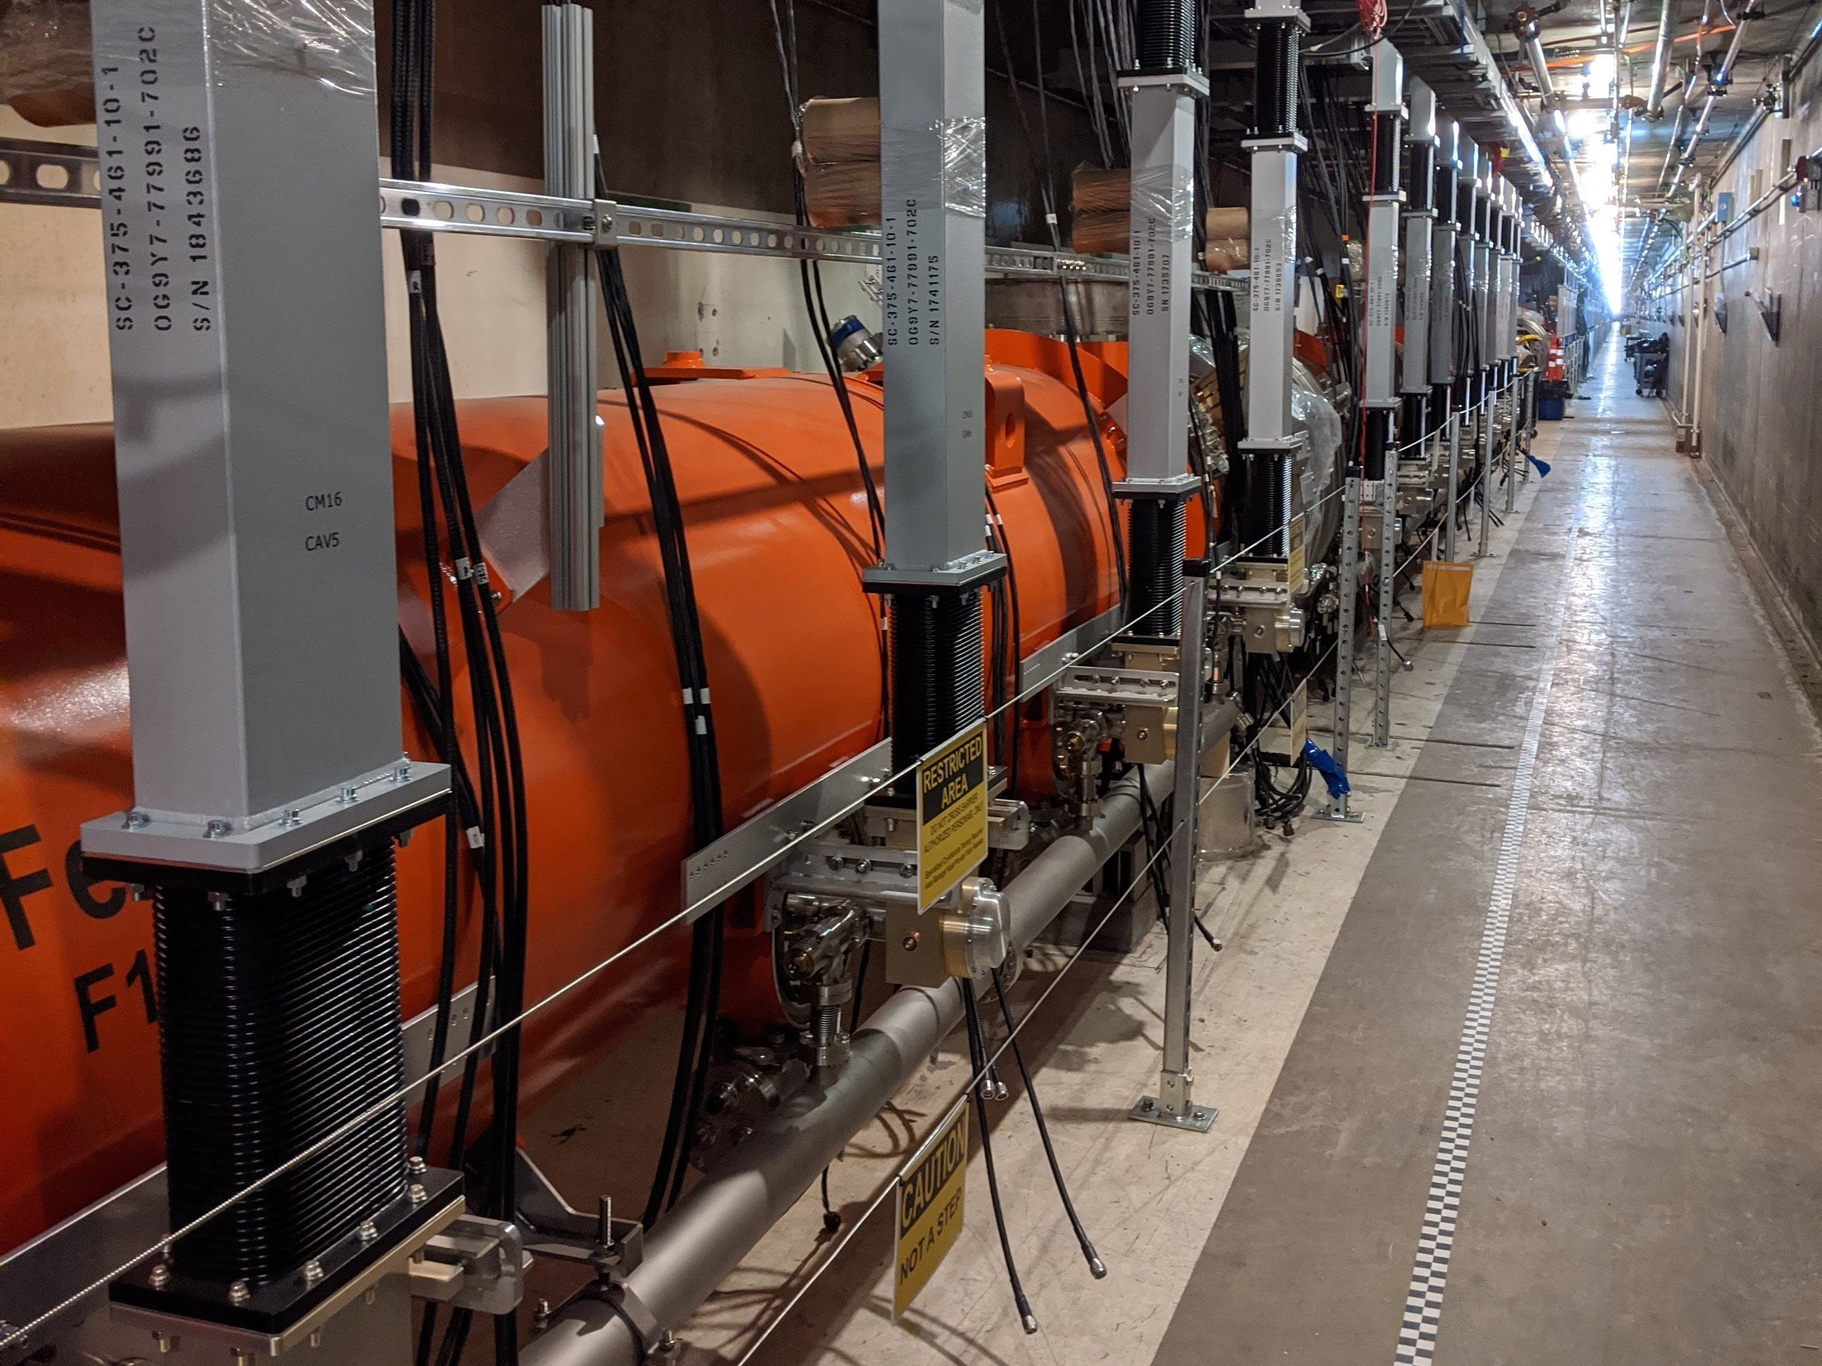
Overview
LCLS-II control architecture
How did this happen?
How will we fix this?

Slide 3
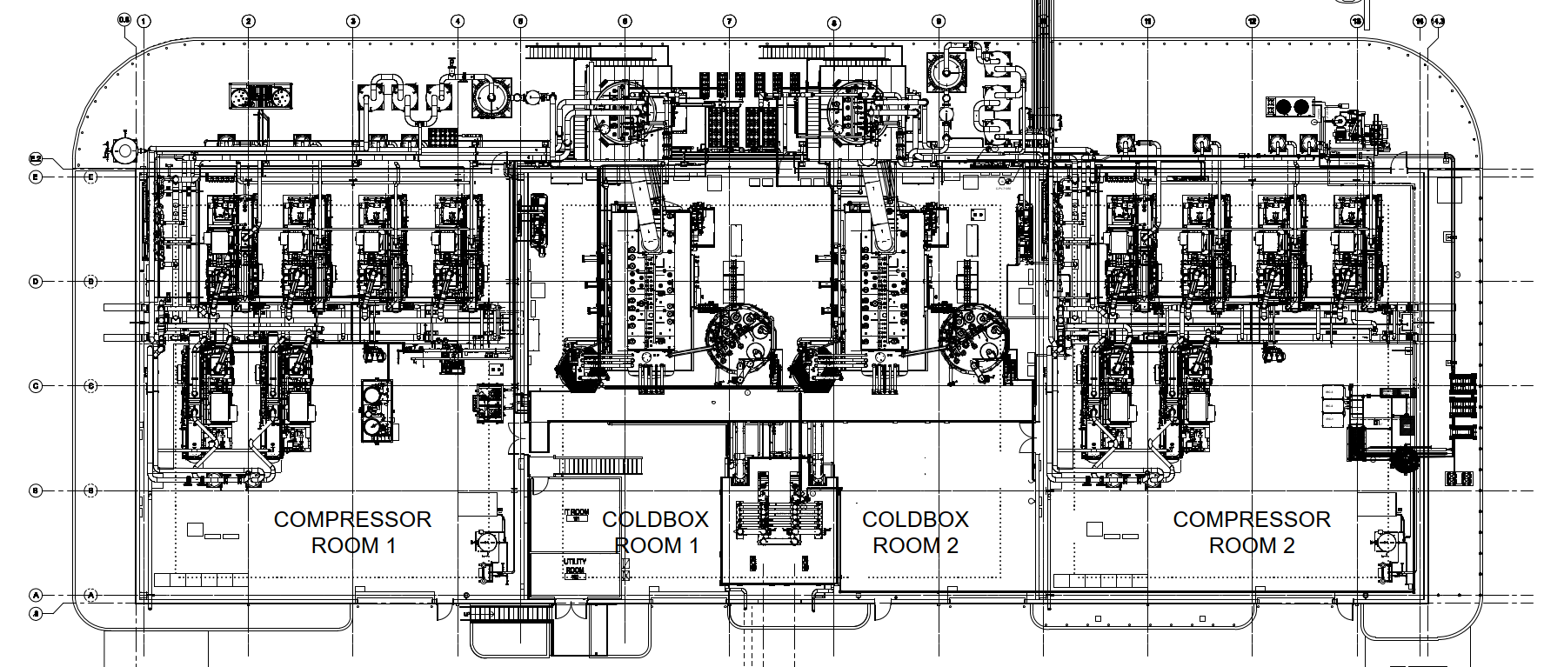
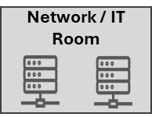
LCLS-II Cryogenic System
Scope
60 Cryomodules
2 Cryoplants
22 PLCs
>Tens thousand devices
Software
PLC control
EPICS HMI
IB3
DB1
DB2
DB3
EC1
01
FC1
FC2
02
03
HL01
HL02
FC3
FC4
04
05
06
07
08
09
10
11
12
13
14
15
FC5
FC6
16
17
18
19
20
21
22
23
24
25
VB
26
27
28
29
30
31
33
34
35
EC
2
FC7
36
37
38
39
40
41
42
43
44
45
46
47
48
VB
49
50
51
52
53
54
55
56
57
58
59
EC4
L0
L1
L2
L3
L4

Slide 4
LCLS-II Cryogenic Control Architecture
IO Responsibilities
CP1 2KCB
CP2 2KCB
UTILITY
DB1 PLC
DB2 PLC .
DB3 PLC

Slide 5
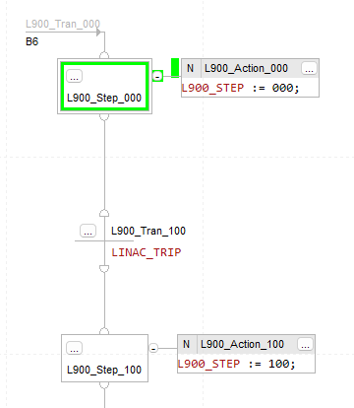
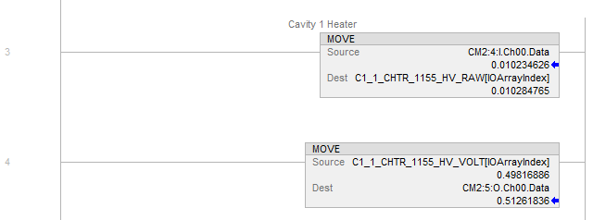
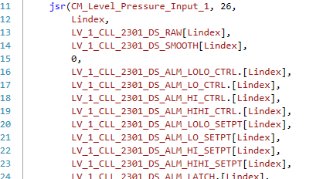
LCLS-II Cryogenic PLC Code Structure
Main Task Loop
IO Buffering
IO Cards mapped to tags used internally and monitored by EPICS
Profibus data parsed and mapped to internal tags
Produced/Consumed tags mapped to internal tags
Calculations
Calculated signals
Temperature Delta
Rate of change
Averages
Flows
Mapped to internal PLC tags
Device Processing
One routine per device type
Evaluates information relevant to the device
Filters
Interlocks
Alarms
Control Loops
Sequences
Specific processes defined in functional analysis
Multiple unique steps
Not repetitive

Slide 6
LCLS-II Cryogenic Control Architecture
Control Responsibilities
CP1 2KCB
CP2 2KCB
DB1 PLC
DB2 PLC .
DB3 PLC

Slide 7
LCLS-II Cryogenic Control Architecture
Issues
CDS and Cryoplant PLCs use different objects
Cryoplant PLCs use standard objects and program execution style
CDS PLC developed separately and uses its own objects and style
Makes it difficult for others to understand the system well enough to support it
Large amounts of integration work at the end of the LCLS-II project
PLC code developed independently as integrated controls was not scoped
Current architecture a result of this last minute un-scoped integration work, instead of thoughtful planning
Centralized control required large amounts of produced/consumed tags – Over 7,000 per PLC
Highlights
All Code is based on clear documentation
Functional Analysis matches code in naming, structure, and flow
Naming conventions defined and followed
Hardware architecture matches the system well
PLCs connect to logical hardware
Interface points between PLCs are clear

Slide 8
How Did This Happen?
Development
Cryoplant was developed at JLAB
Functional Analysis
Controls Hardware
Controls Software
Distribution System Controls developed at SLAC
PLC and EPICS code developed by controls department
Only basic requirements from cryogenic system provided
SLAC Cryogenic Department Organized
This division to own the cryogenic system
Includes controls engineers
Inherited only project development documentation which did not cover operational procedures, maintenance, or other things not funded by the project
Developed thorough documentation and standards
Future system owner not involved in development!
Integration not scoped because interfaces were defined!

Slide 9
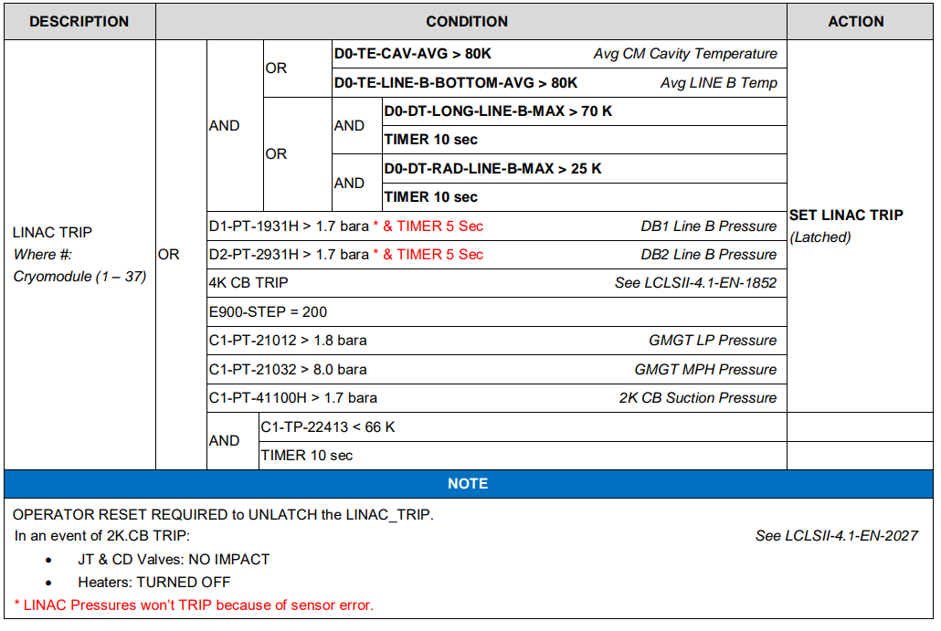
How Did This Happen?
Integration
Cryoplant developed thorough documentation and rewrote cryoplant software to match
Allowed them to have clear, maintainable documentation
Included many requirements that are needed to be able to operate the system practically
Global controls
Automated sequences
Project did not fund integration but handed off to operation
Schedule was already stretched without this work
We ended up rewriting the distribution code in the last 2 months of the project to match cryoplant functional analysis

Slide 10
How Will We Fix This?
What is an ideal system?
Well documented
Consistent
Modifiable
Support new operating configurations
How to make it?
Build based on cryogenic group’s documentation
System owner defined
Consistent vocabulary
Clear flow from requirements to descriptions to code to procedures
Define coding standard
Consistent objects
Consistent processing
Consistent naming
Local control
Local PLC responsible for all functions of connected devices
Share dozens of needed signals, not all
One source of truth
Manageable amount of interfaces allows multiple configurations
One team

Slide 11
LCLS-II Cryogenic Control Architecture
IO responsibilities local control responsibilities
CP1 2KCB
CP2 2KCB
UTILITY
DB1 PLC
DB2 PLC .
DB3 PLC

