Slide 1
PLC code generation at ELI
Karel Majer
ELI ERIC
Date:
20.09.2025

Slide 2
Motivation
Personnel safety system designed as a set of state machines
Description in Excel spreadsheet (documentation = implementation)
Deployed on Pilz PLC, communication through EPICS Modbus IOC

Slide 3
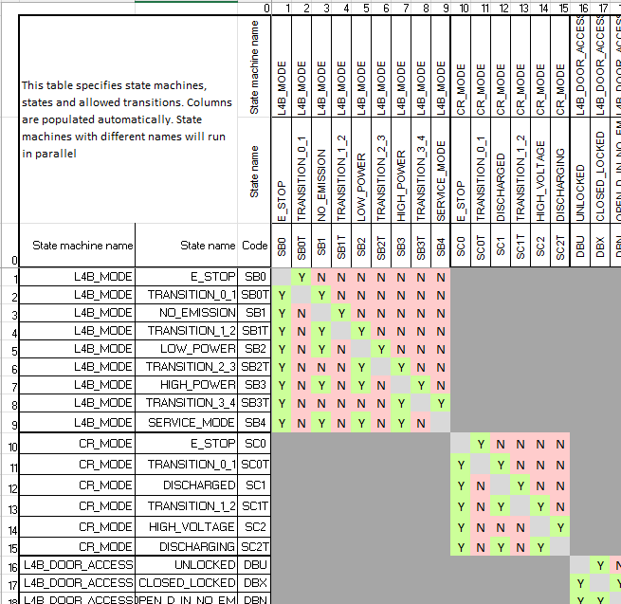
Table description
States table

Slide 4
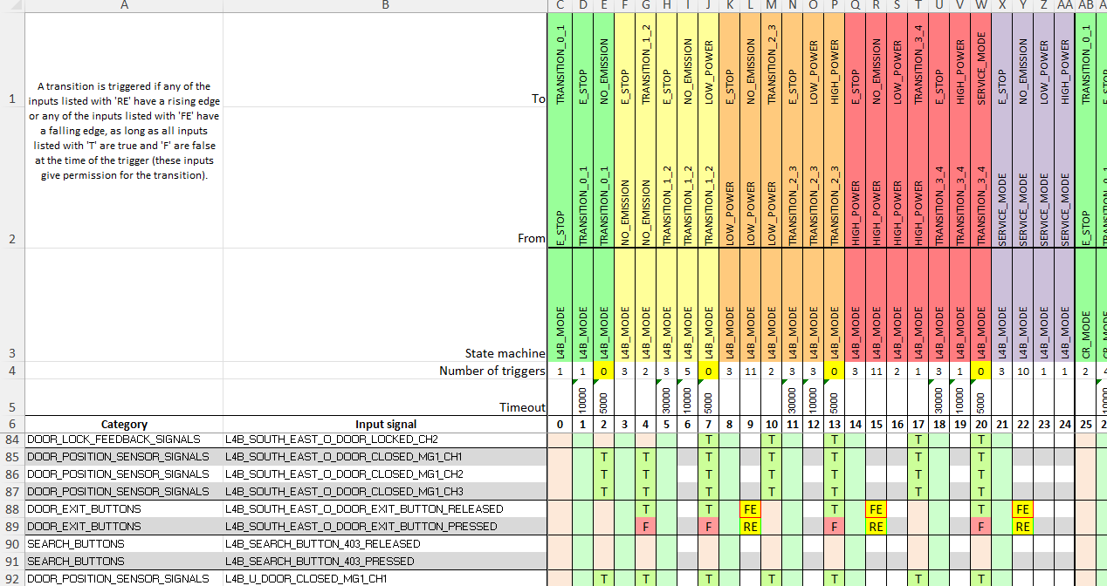
Table description
Transitions table

Slide 5

Table description
Simple logic:
All hardware inputs + states form state machine inputs
Any input marked as trigger may trigger a transition
Triggered transition succeeds if all inputs marked as conditions have expected value
Interlocks define set of input conditions for each state. If any input does not have expected value, interlock variable is set to False
Output values are defined by active states, can be forced high, forced low or have interlock value

Slide 6

Table description
Used for machine safety, vacuum controls, pneumatic devices…
Large, mostly empty spreadsheets, hard to navigate
Copy-paste solution for new systems (nice), but prone to hard-to-find errors when pasted into wrong cell (not so nice)
State machine is not always the best description
Limits available logic functions
Lack of diagnostics in generated code

Slide 7
Requirements for generator upgrade
Combine strengths of tables with missing features
Definition of additional variables to be used as transition triggers or conditions (extension of simple AND logic on conditions)
Stateless control of outputs where Boolean logic is more appropriate
Stateless interlock conditions (valve powered => valve open, instead of state-based input checks)
Reusable templates for common patterns
Generated ST code
Publish diagnostic variables (machine transitions, cause of blocked transitions and interlock trips) in low-level form – must work over Modbus
Process only active states – shorter cycle time
Generate ready-to-build project
All relevant settings must be included in description file
Generate startup script and .db files for EPICS IOC alongside the project

Slide 8




New code generator

Slide 9
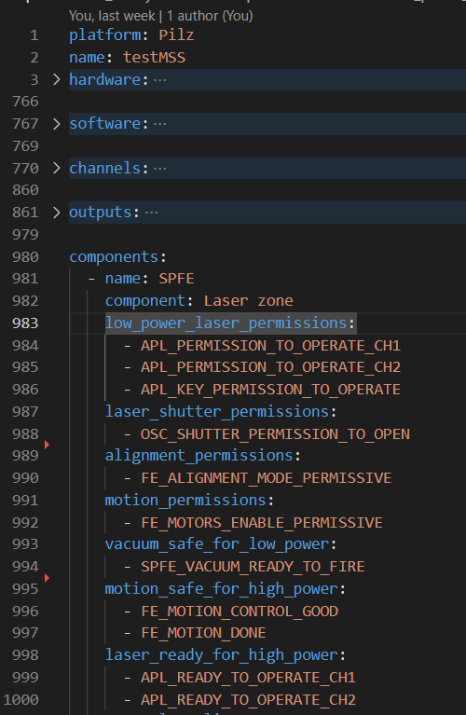
New code generator
YAML description file
Hardware description
IO configuration
System components
Physical devices (vacuum gauge)
Parts of system represented by a state machine (vacuum chamber, laser zone)

Slide 10
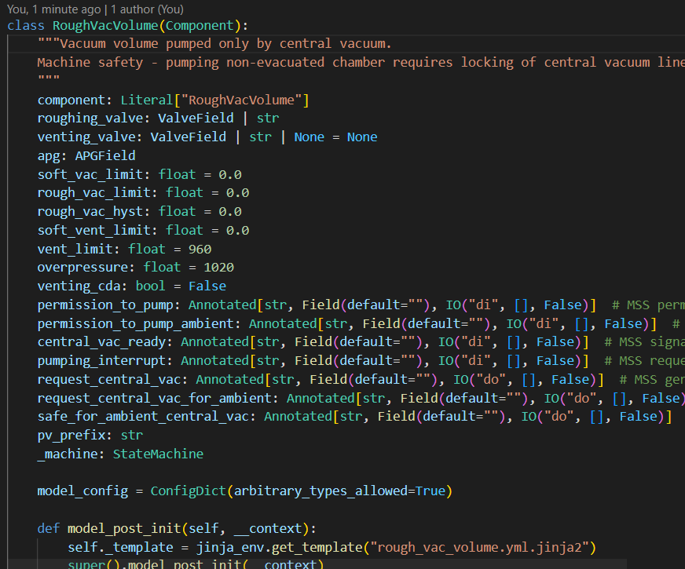
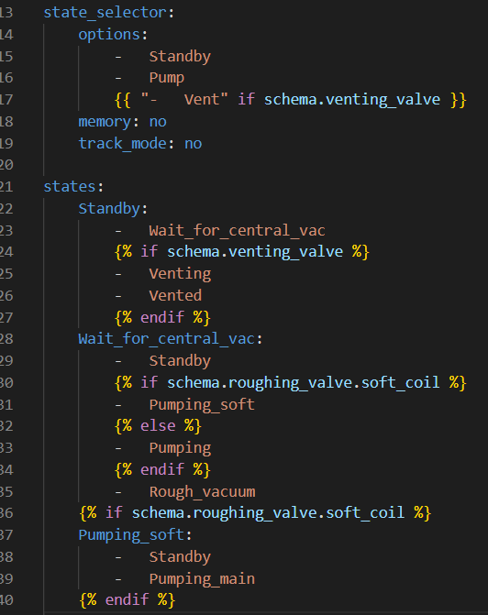
New code generator
Component library
Pydantic – data validation
Base Component class
Links to IO configuration
Creation of state machine
Jinja template file
Template for state machine
Component may output different state machines based on its parameters

Slide 11
New code generator
YAML source
Hardware description
System components with parameters
Jinja
State machines constructed
Python processing
IO configuration
Full state machine description - indices of triggers, conditions
More abstract system description created
Code generation
Jinja templates for ST code, Python for project creation
Pilz – XMLRPC API server
B&R – not officially supported, but everything is XML
Beckhoff (in development) – C# API, we will use client/server architecture

Slide 12
Thank you for your attention
Karel Majer
karel.majer@eli-beams.eu

