Slide 1

5th PLC Based Control Systems workshop PLC trends
20-September-2025 ICALEPCS 2025, Chicago, USA
https://indico.cern.ch/event/1514024/

Slide 2
PLC based systems trending topics
Edge Computing & PLC Integration
PLC-Cloud / IIoT Connectivity
Model-Based Engineering & Digital Twins for PLC Systems
Next-Gen PLC Architectures: SoftPLCs, Virtualization, AI-Augmented Control
PLC cybersecurity
Others

Slide 3
Edge Computing & PLC Integration
PLCs are increasingly being paired with “edge” computation, either built into PLC hardware (“edge-PLCs”) or via partner edge gateways. The goal is to push data processing, analytics, ML inference, or decision-making closer to the physical process to reduce latency, improve robustness, reduce bandwidth & cloud dependency, and support real-time control and/or diagnostics.
Examples
Vibration sensors on magnetic bearings. An “edge-PLC” runs a machine learning model that flags anomalous vibration patterns and shuts down or slows machinery before damage occurs.
Energy usage monitoring in a plant: PLCs measure power, edge modules compute load profiles and automatically adjust usage to prevent high costs during peak hours
References
Possible Applications of Edge Computing in the Manufacturing Industry - Systematic Literature Review
Convergence of IoT and PLC in Industrial Automation: A Systematic Review of Emerging Trends, Technical Challenges, and Prospects
Robust automation with PLC/PAC and edge controllers

Slide 4
PLC-Cloud / IIoT Connectivity
Connectivity from PLCs (or via gateways) to cloud platforms, enabling data-aggregation, remote monitoring, big data analytics, predictive maintenance, digital twins, dashboards…
Applications
A plant installs sensors on its PLC controlled pumps and sends real-time pump telemetry (vibration, temperature, pressure) to the cloud for trend analysis and sets up alerts. Over time, predictive models reduce pump failures.
Aggregating data across multiple plants for benchmarking performance (e.g. energy usage, uptime), via cloud dashboards.
References
OPCConnect article — Important use cases of OPC UA PubSub (practical examples and OT-IT bridging)

Slide 5
Model-Based Engineering & Digital Twins for PLC Systems
Model-based engineering supports designing PLC control logic with simulation in the loop, verifying behaviour, testing without risk, reducing commissioning time, and enabling updates based on real operational data.
Digital twins are virtual replicas of physical systems, which can be used for simulation, virtual commissioning, optimization, predictive maintenance, operator training, what-if scenarios...
Applications
Using surrogate models within digital twins to approximate more complex dynamics cheaply for real-time inference or optimization.
Energy optimization digital twin
Virtual commissioning
Operator training environments
References
Automatic PLC Control Logic Generation Method Based on SysML System Design Model
Methodology and Tools to Integrate Industry 4.0 CPS into Process Design and Management: ISA-88 Use Case

Slide 6
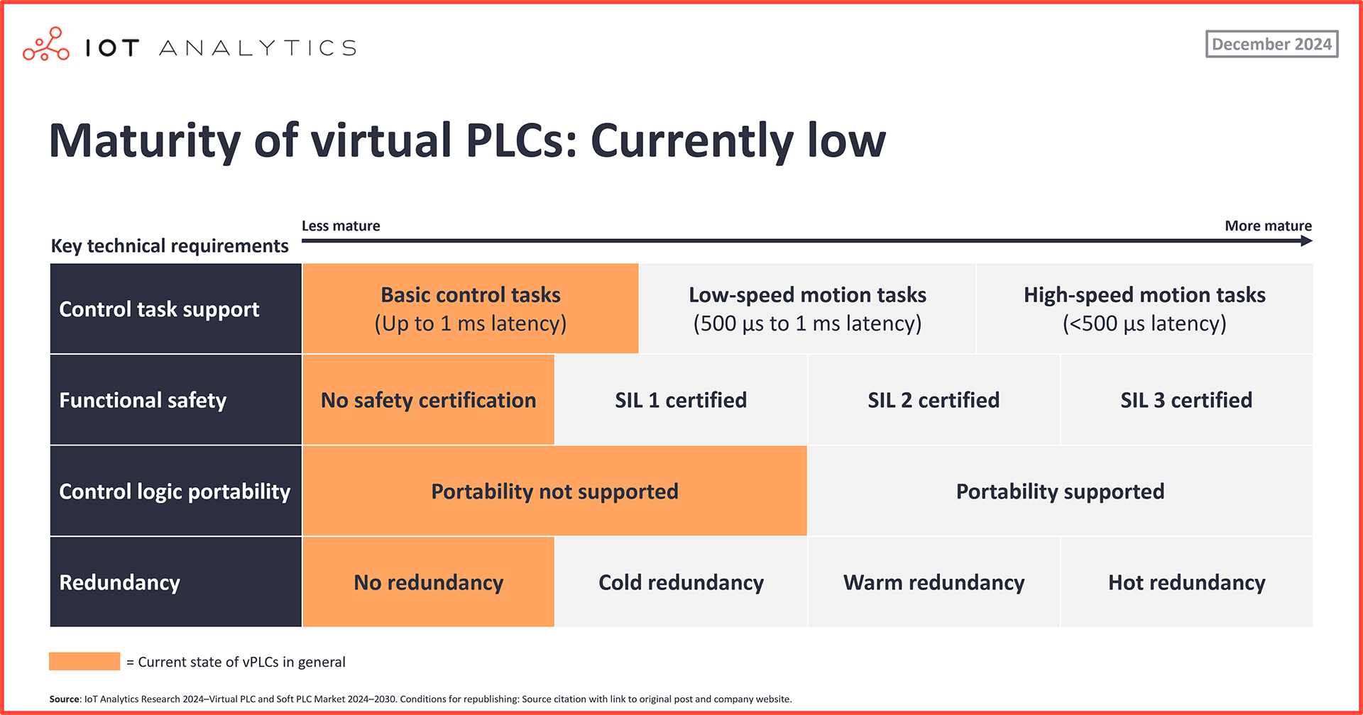
Next-Gen PLC Architectures: SoftPLCs, Virtualization, AI-Augmented Control
Moving from rigid hardware-only PLCs to “softPLCs” or virtualized PLC logic running on industrial PCs
Also blending AI/ML components with PLC control loops (where allowed by safety/timing constraints).
Research explores how to maintain deterministic behaviour, safety, real-time guarantees in such hybrid or virtual architectures. Also issues of certification, timing, reliability, maintainability.
Applications
Virtualization: replicating PLC logic in VM for testing / staging, then deploying to hardware; or having redundant softPLCs for fallback.
Using containerization to deploy PLC logic or control logic updates centrally, especially in distributed installations (multiple small machines), so updates / patches can be rolled out more consistently with no impact on the plant
References
Virtual PLCs: can they become the industry norm?
How Real (Time) Are Virtual PLCs?
Revolutionizing PLC Systems with AI

Slide 7
PLC cybersecurity
As PLCs become more connected (Ethernet, wireless, remote-access, cloud, IIoT), their attack surface increases. Weaknesses include firmware vulnerabilities, insecure network protocols, lack of authentication or encryption, insider threats…
References
PLC Logic-Based Cybersecurity Risks Identification for ICS — ARES conference (2023)

Slide 8
Others
Formal Verification & Model Checking of PLC Code (PLCVerif: https://cern.ch/plcverif)
PLC + AI for Adaptive Control / Reinforcement Learning
Low-Code / No-Code PLC Programming Tools
Communications:
Time-Sensitive Networking (TSN) for Real-Time PLC Communication
Wireless

Slide 9
Questions
What is your ideal PLC evolution?

Slide 10
PLC market
PLC global market global: $12-$15 billions in 2025
Projected growth rate of ~ 4-6%
Top5 PLC manufactures (market share)
SIEMENS (30-33%)
Rockwell Automation (20-22%)
Schneider Electric (8-10%)
Mitsubishi Electric (10%-12%)
OMROM (5-6%)
* Combined sources: ARC, PLCOpen, Global Market insights…

Slide 11
PLC selection criteria
Reliability and Durability
Prioritizing reliability and durability is essential when selecting a PLC brand. Industrial environments demand that PLCs withstand extreme conditions while maintaining operational integrity, ensuring minimal downtime and prolonged service life.
Scalability and Flexibility
The ideal PLC should support growth and adapt to new technologies or processes, allowing businesses to expand or modify their operations without the need for a complete system overhaul.
Support and Global Service Network
A robust support and global service network guarantees that technical assistance and spare parts are readily available, minimizing operational disruptions. This global presence is particularly vital for multinational operations, providing assurance regardless of the facility’s location.
Compatibility with Industry Standards
Ensuring compatibility with industry standards simplifies integration with existing and future systems. A PLC that adheres to widely accepted protocols and interfaces eases connectivity with other equipment
Initial and Long-term Costs
Assessing initial and long-term costs is critical for a cost-effective investment. This assessment should consider not only the purchase price but also installation, maintenance, and potential upgrades. Opting for a PLC that offers a lower total cost of ownership over its lifecycle represents a financially sound decision.

