Slide 1

Presenting Science:
How to prepare a scientific presentation with impact!
Professor Dr. Çiğdem İşsever (she/her)
“Tchidem Isch-sever”
Humboldt-Universität zu Berlin
DESY and University of Oxford
26.03.2025
LHC Soft Skills Workshop
Notes:
This is an experiment with the audience.

Slide 2
Acknowledgements
Prof. Dr. Ken Peach
Prof. Dr. Todd Huffman
I have taken their slides and mine and have updated and adjusted them over the years.
Intellectual property of all of us.

Slide 3
Introduction
Learning about giving good presentations
Visual impact
  How not to have any impact at all
  How to have plenty of impact; just in the wrong way.
  How to have effective visual impact
Encourage you to develop your presentation style
Show you things you should NEVER do
Never say NEVER…

Slide 4
Some “Rules”
“There are no strict Rules.”
There seem to be only guidelines.
I mostly agree but there is one VERY important rule!

Slide 5
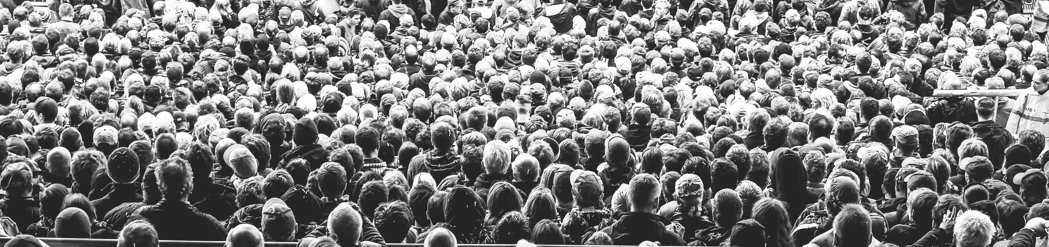
Some “Rules”
“There are no Rules.”
There seem to be only guidelines.
I mostly agree but there is one VERY important rule!
Know your audience!!!

Slide 6
The Structure of the Talk
Title | Who are you
 | Where are you from
 | Date (make sure to update it!)
 | Occasion or Location
Outline | Tell the audience what will come
Body | Not more than three key messages
 | Have a story line
 | If long, break it up into sub section
 | If long, break up the flow with anecdotes or a joke or something of note.
Summary/Conclusions | Summarize key points and results
Outlook
Backup Slides | Important and strategic tool

Slide 7
Title of your presentation
A Measurement of X
In Search of X
Much Ado About X
X
X: A Personal Journey of Discovery

Slide 8
Who am I?
Çiğdem
Çiğdem İşsever
CA İşsever
Professor Dr. Çiğdem İşsever
Doctor CA İşsever
Doctor CA İşsever
C.Phys., Ph.D., M.Sc., B.S.E.E., M.A.

Slide 9
Adventures in the Quantum Kitchen
E. Picure
The Escoffier Institute for Quantum Gastronomy
delivered to the
International Conference on Quantum Gastronomy
Bakewell, UK
1st April 2019
“If music be the food of love, play on. Give me excess of it;”
Twelfth Night, William Shakespeare

Slide 10
Presenting Science:
How to prepare a scientific presentation with impact!
Professor Dr. Çiğdem İşsever (she/her)
“Tchidem Isch-sever”
Humboldt-Universität zu Berlin
DESY and University of Oxford
30.10.2024
P8f Student Seminar Series
„Vom Größten zum Kleinsten:
Das dunkle Universum & die Teilchenphysik “

Slide 11
Outline of talk
Introduction
  Overview and status
Recent Progress
  Experimental setup
  Data taking
  Analysis
  Results
Summary and Conclusions
From Presenting Science, Oxford University Press 2010, © Çiĝdem İşsever and Ken Peach

Slide 12
Adventures in the Quantum Kitchen
E. Picure
The Escoffier Institute for Quantum Gastronomy
Introduction
  Overview and status
Recent Progress
  Experimental setup
  Data taking
  Analysis
  Results
Summary and Conclusions
International Conference on Quantum Gastronomy
Bakewell, UK
1st April 2009
From Presenting Science, Oxford University Press 2010, © Çiĝdem İşsever and Ken Peach

Slide 13
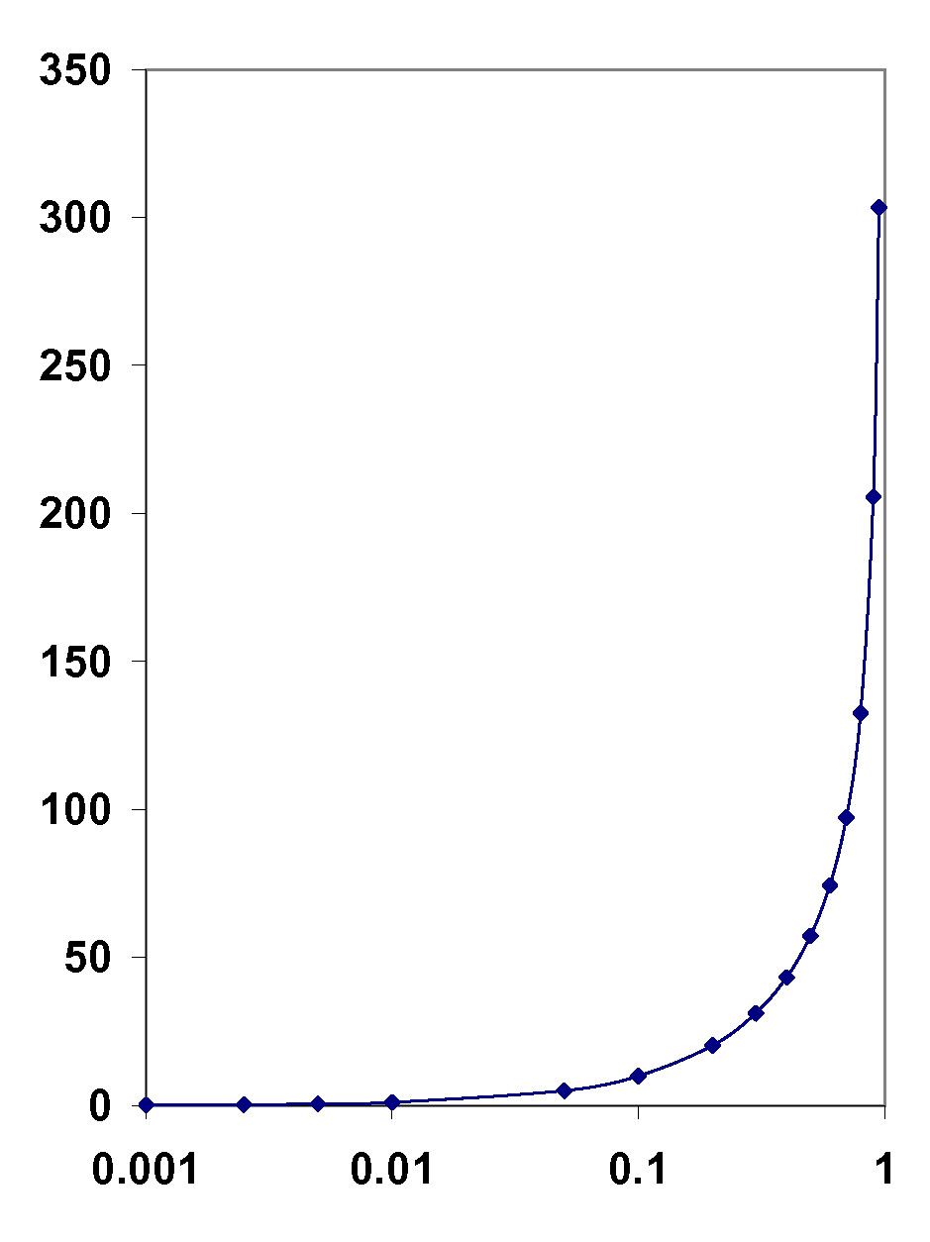
Content of a slide
Deviation from
Newtonian Mechanics
%
Newtonian Mechanics
  Adequate for v<<c
Special Relativity
  Essential for v~c
For v>0.01c
  Deviation > 5 × 10⁻⁵ %
  Relativity important
Deviation
0.00005%
0.01c = 3 × 10⁶ m/s
v/c
Everything on the slide has to have a purpose

Slide 14
Purpose of slides
Some Extreme views on a Slide’s purpose:
a) To Help the Speaker
b) To Help the Audience
Both are valid, but lead to rather different styles of slide.
A mix of the two can exist.
My Opinion: Audience is King!

Slide 15

Summary and Outlook
Summary
  Status quo ante
  Innovation
  Result
  Impact
Outlook
  What needs to be done
  What I will do
Thank you
From Presenting Science, Oxford University Press 2010, © Çiĝdem İşsever and Ken Peach

Slide 16
Fonts
Several Choices, and they can be important.
  Style: Serif or Sans Serif
  Appearance: normal, bold, italic, underlined or combined
  Size: small (8pt), medium (12pt), Large (16pt), Huge (20pt), Vast (24pt)
  Colour: foreground (text) and background
Hint: Get hold of a data projector, go To Back of room.
Other issues – do you want to try odd fonts?
Gigi, Castellar, Segoe Script, Btradley Hand ITC …
Note: If you use any fancy fonts, you must embed them
  For PowerPoint, use OPTIONS/SAVE/EMBED TRUETYPE FONTS.

Slide 17
Have a nice day
(Times New Roman 14pt normal)
Have a nice day
(Arial 14pt normal)
Have a nice day
(Times New Roman 20pt normal)
Have a nice day
(Arial 20pt normal)
Have a nice day
(Times New Roman 20pt normal)
Have a nice day
(Arial 20pt normal)
Have a nice day
(Times New Roman 14pt normal)
Have a nice day
(Arial 14pt normal)
Have a nice day
(Times New Roman 36pt normal)
Have a nice day
(Arial 36pt normal)
Have a nice day
(Times New Roman 14pt italic)
Have a nice day
(Arial 14pt italic)
Have a nice day
(Times New Roman 20pt bold)
Have a nice day
(Arial 20pt bold)
Have a nice day
(Times New Roman 20pt bold)
Have a nice day
(Arial 20pt bold)

Slide 18
Have a nice day
(Bradley Hand ITC 20pt bold)
Have a nice day
(Gigi 14pt normal)
Have a nice day
(Bradley Hand ITC 20pt normal)
Have a nice day
(Gigi 20pt normal)
Have a nice day
(Gigi 36pt normal)
Have a nice day
(Gigi 20pt normal)
Have a nice day
(Bradley Hand ITC 14pt normal)
Have a nice day
(Bradley Hand ITC 20pt normal)
Have a nice day
(Bradley Hand ITC 20pt normal)
Have a nice day
(Bradley Hand ITC 36pt normal)
Have a nice day
(Gigi 20pt bold)
Have a nice day
(Bradley Hand ITC 20pt italic)
Have a nice day
(Gigi 20pt bold)
Have a nice day
(Gigi 20pt normal)
Have a nice day
(Bradley Hand ITC 20pt bold)
Have a nice day
(Gigi 20pt italic)

Slide 19
Slide Background
Is my background helping audience to understand message?

Slide 20
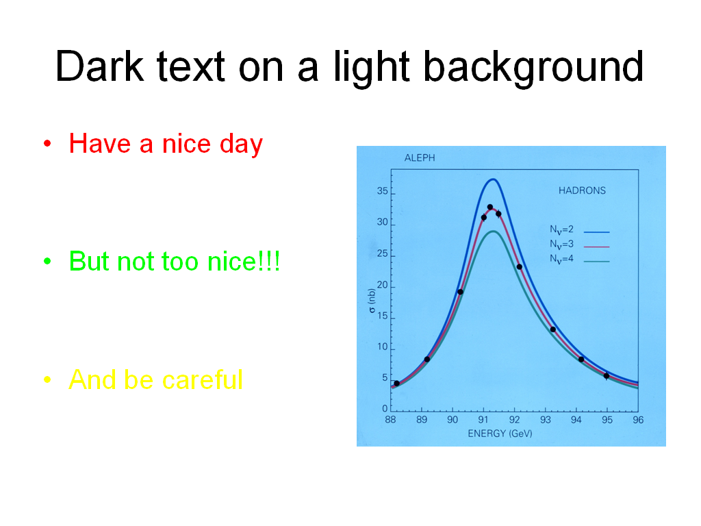
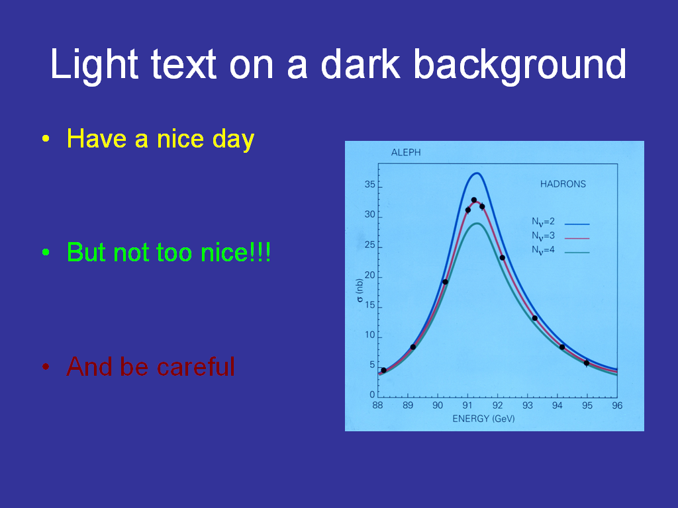
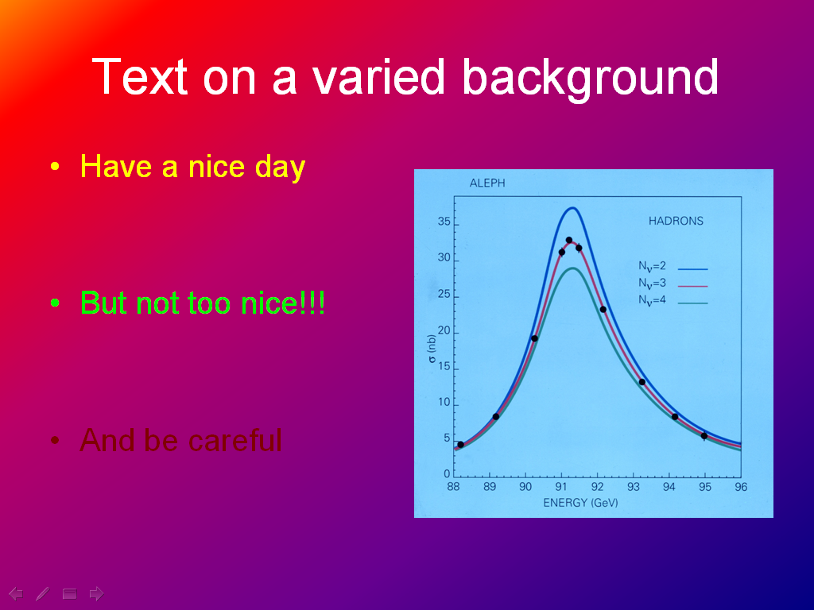
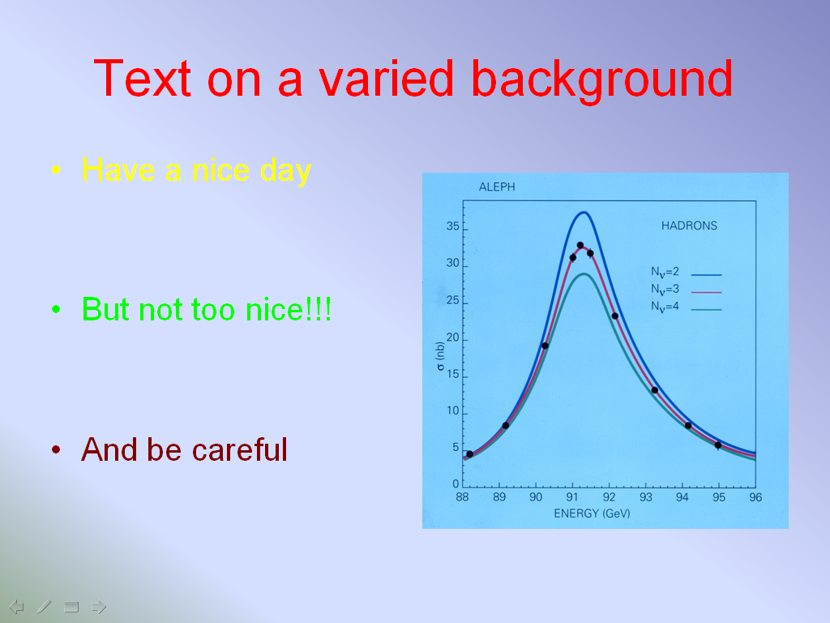

Slide 21
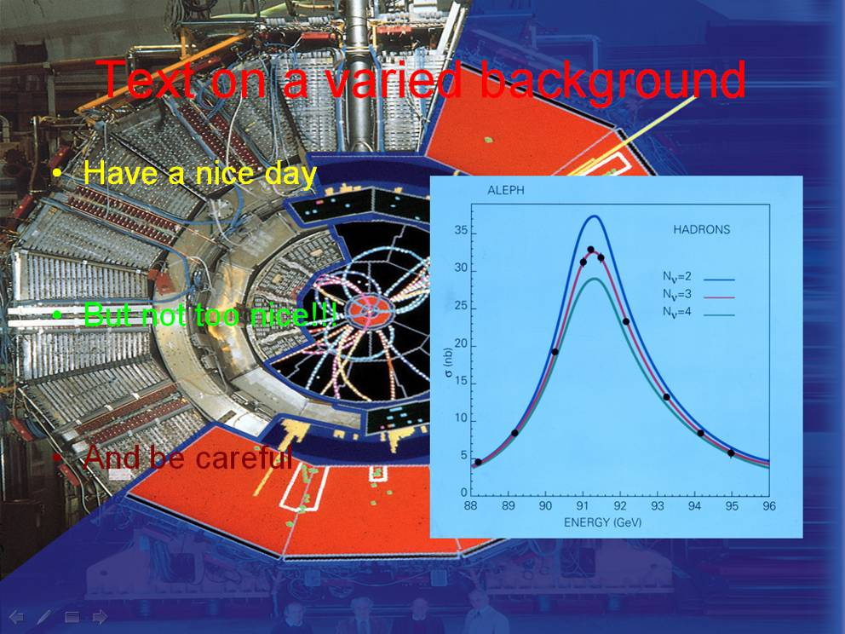
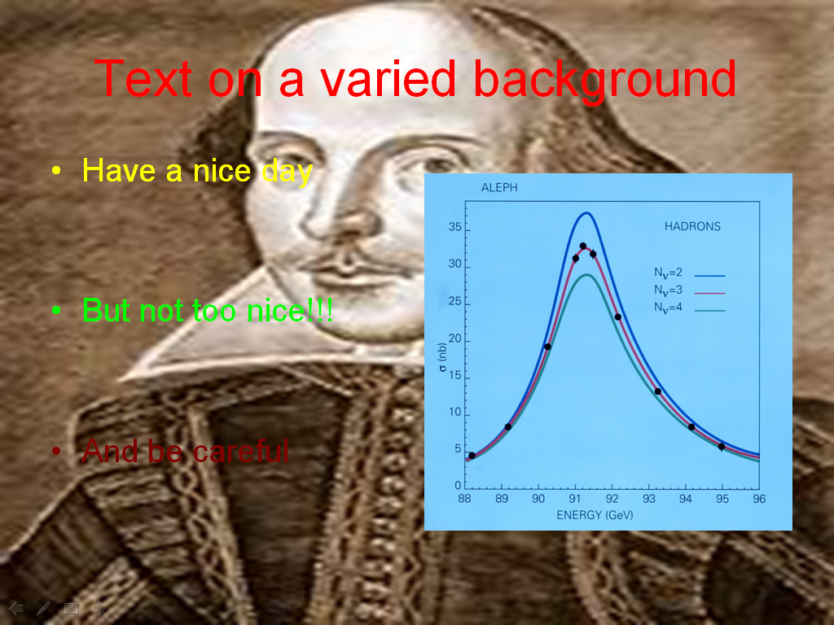
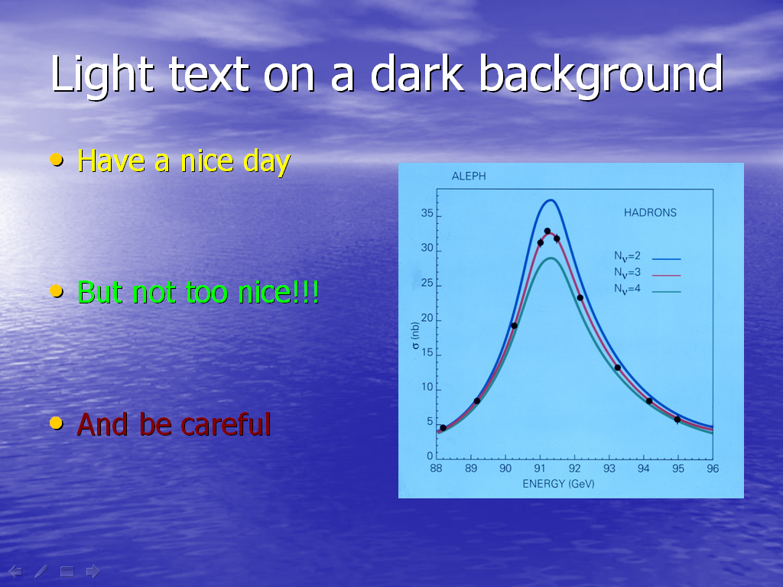
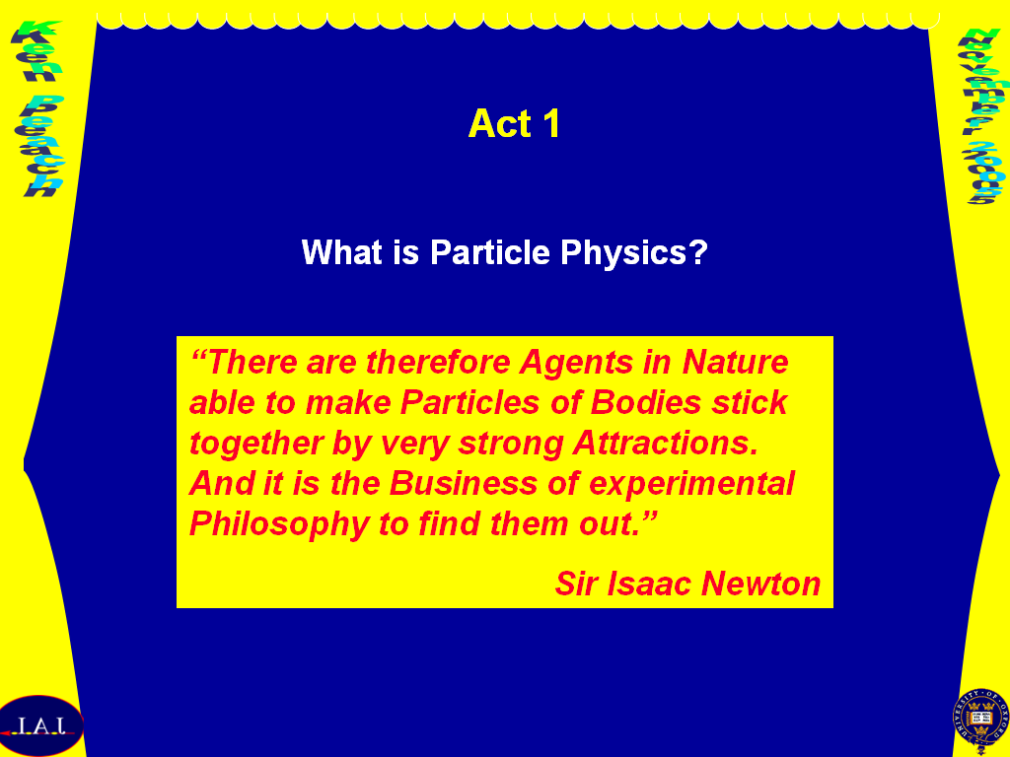

Slide 22
Making a point: Full Text
Without the Higgs mechanism, all of the particles in the Standard Model (quarks, leptons, gauge bosons) are massless. What the Higgs mechanism does, respecting the underlying symmetry of the Standard Model while spontaneously breaking that symmetry, is to give all of the particles and the weak gauge bosons mass, as well as protecting the masslessness of the photon. A physical consequence of the Higgs mechanism is that there is one massive scalar field that cannot be absorbed in the masses of the other particles, and this is the Higgs boson.

Slide 23
Making a point: Bulleted Text
Unbroken SM
  Quarks, leptons massless
  All gauge bosons massless
Higgs mechanism
  Respects the underlying gauge symmetry
  While spontaneously breaks symmetry
    Quarks, leptons → mass
    W,Z → mass
    photon remains massless
Consequence
  Physical scalar field → Higgs field
  → Higgs Boson

Slide 24
Making a point: Full Text
Without the Higgs mechanism, all of the particles in the Standard Model (quarks, leptons, gauge bosons) are massless. What the Higgs mechanism does, respecting the underlying symmetry of the Standard Model while spontaneously breaking that symmetry, is to give all of the particles and the weak gauge bosons mass, as well as protecting the masslessness of the photon. A physical consequence of the Higgs mechanism is that there is one massive scalar field that cannot be absorbed in the masses of the other particles, and this is the Higgs boson.

Slide 25
Making a point: Bulleted Text
Unbroken SM
  Quarks, leptons massless
  All gauge bosons massless
Higgs mechanism
  Respects the underlying gauge symmetry
  While spontaneously breaks symmetry
    Quarks, leptons → mass
    W,Z → mass
    photon remains massless
Consequence
  Physical scalar field → Higgs field
  → Higgs Boson

Slide 26
Making a point: Bulleted Text
Unbroken SM
  Quarks, leptons massless
  All gauge bosons massless
Higgs mechanism
  Respects the underlying gauge symmetry
  While spontaneously breaks symmetry
    Quarks, leptons → mass
    W,Z → mass
    photon remains massless
Consequence
  Physical scalar field → Higgs field
  → Higgs Boson

Slide 27

The history of the neutrino
Dear Radioactive Ladies and Gentlemen, 4th of December 1930
As the bearer of these lines, to whom I graciously ask you to listen, will explain to you in more
detail, how because of the "wrong" statistics of the N and Li⁶ nuclei and the continuous beta
spectrum, I have hit upon a desperate remedy to save the "exchange theorem" of statistics and
the law of conservation of energy. Namely, the possibility that there could exist in the nuclei
electrically neutral particles, that I wish to call neutrons, which have spin 1/2 and obey the
exclusion principle and which further differ from light quanta in that they do not travel with the
velocity of light. The mass of the neutrons should be of the same order of magnitude as the
electron mass and in any event not larger than 0.01 proton masses. The continuous beta
spectrum would then become understandable by the assumption that in beta decay a neutron is
emitted in addition to the electron such that the sum of the energies of the neutron and the
electron is constant...
I agree that my remedy could seem incredible because one should have seen those neutrons
very earlier if they really exist. But only the one who dares can win and the difficult situation,
due to the continuous structure of the beta spectrum, is lighted by a remark of my honoured
predecessor, Mr Debye, who told me recently in Bruxelles: "Oh, it's well better not to think to
this at all, like new taxes". From now on, every solution to the issue must be discussed. Thus,
dear radioactive people, look and judge. Unfortunately, I cannot appear in Tubingen personally
since I am indispensable here in Zurich because of a ball on the night of 6/7 December. With my
best regards to you, and also to Mr Back.
Your humble servant
W. Pauli
Dear Radioactive Ladies and Gentlemen, 4th of December 1930
As the bearer of these lines, to whom I graciously ask you to listen, will explain to you in more
detail, how because of the "wrong" statistics of the N and Li⁶ nuclei and the continuous beta
spectrum, I have hit upon a desperate remedy to save the "exchange theorem" of statistics and
the law of conservation of energy. Namely, the possibility that there could exist in the nuclei
electrically neutral particles, that I wish to call neutrons, which have spin 1/2 and obey the
exclusion principle and which further differ from light quanta in that they do not travel with the
velocity of light. The mass of the neutrons should be of the same order of magnitude as the
electron mass and in any event not larger than 0.01 proton masses. The continuous beta
spectrum would then become understandable by the assumption that in beta decay a neutron is
emitted in addition to the electron such that the sum of the energies of the neutron and the
electron is constant...
I agree that my remedy could seem incredible because one should have seen those neutrons
very earlier if they really exist. But only the one who dares can win and the difficult situation,
due to the continuous structure of the beta spectrum, is lighted by a remark of my honoured
predecessor, Mr Debye, who told me recently in Bruxelles: "Oh, it's well better not to think to
this at all, like new taxes". From now on, every solution to the issue must be discussed. Thus,
dear radioactive people, look and judge. Unfortunately, I cannot appear in Tubingen personally
since I am indispensable here in Zurich because of a ball on the night of 6/7 December. With my
best regards to you, and also to Mr Back.
Your humble servant
W. Pauli
β energy spectrum

Slide 28
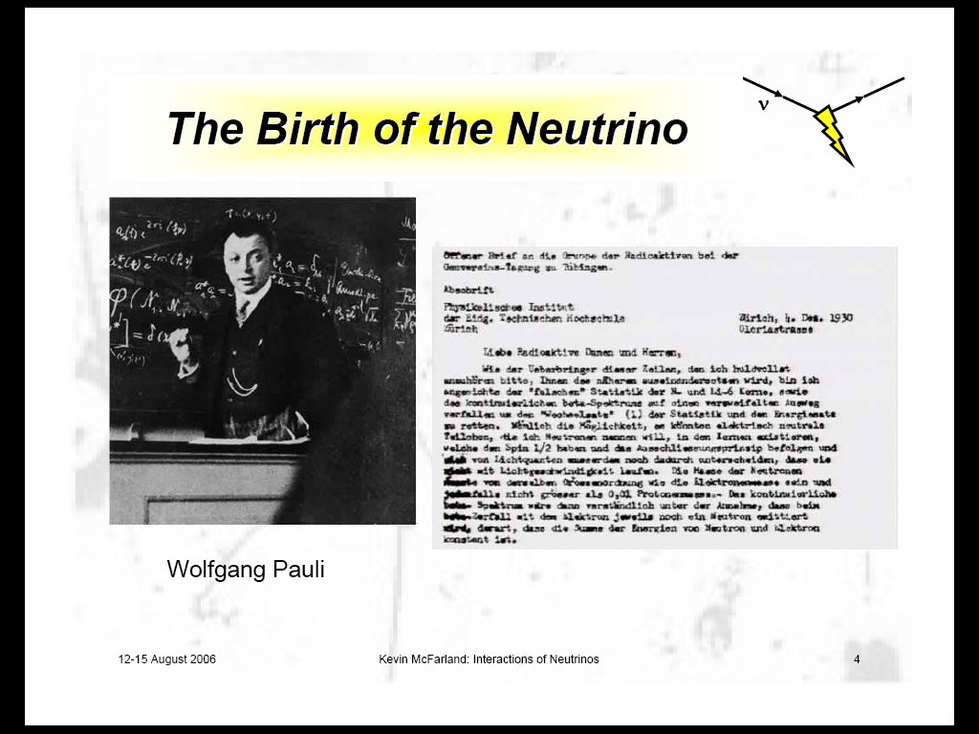

Slide 29
Animation
There are several different types of animation.
Remember that using animation may slow you down –
it becomes a “play” and not a discourse.
If you like it, and you think it helps the audience, do it,
but don’t overdo it.
Embedded clips (Quicktime, Realtime, video)
  can be very illuminating
  It may not work – unless you can use your own laptop.
Test it ahead of time, ON THE CONFERENCE MACHINE!

Slide 30
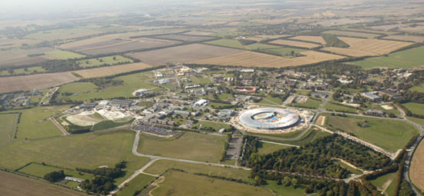
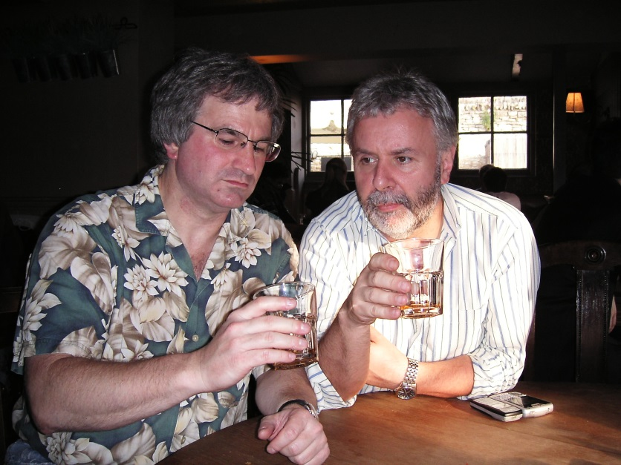
A lot of Animation
Here is a line of text
  And another
    And another
And Here is some more
  And more
    And more

Slide 31
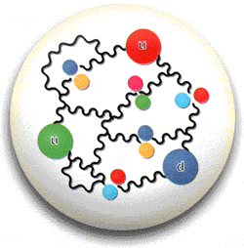

Proton - Proton Kollisionen bei 14 TeV*
7 TeV 7 TeV
1 TeV ~ kinetic energie (KE) of a mosquito
Not much … BUT
Energy densities at the LHC are extremely high!
*Lead-lead collisions at 1150 TeV
Notes:
Here’s a picture (courtesy of Tom LeCompte) to illustrate this point. The kinetic energy of battleship guns is 300 Megajoules, or just less than half that of the full LHC beam. Now we understand why the machine folks want to be a bit cautious… http://blogs.discovermagazine.com/cosmicvariance/2006/06/20/the-lhc-dashboard/

Slide 32
Mathematical Formulae
Mathematical formulae present several problems.
  Very long, complicated formulae need a lot of explanation if they are to be understood by the audience.
You can still get away with it ONLY if you really think about it!

Slide 33
Formulae
Simple formulae in PowerPoint
  y = m x + c
  y = m x + c
  y = m x + c
Or in Microsoft Equation
….
33

Slide 34
Complicated Formulae
a = 7.6 10⁻⁵ ρ E
Where ρ is the electron density (g/cm³) ;
E is the neutrino energy (GeV)
c_{ij}=cosθ_{ij}, s_{ij}=sinθ_{ij}
(Richter: hep-ph/0008222)

Slide 35
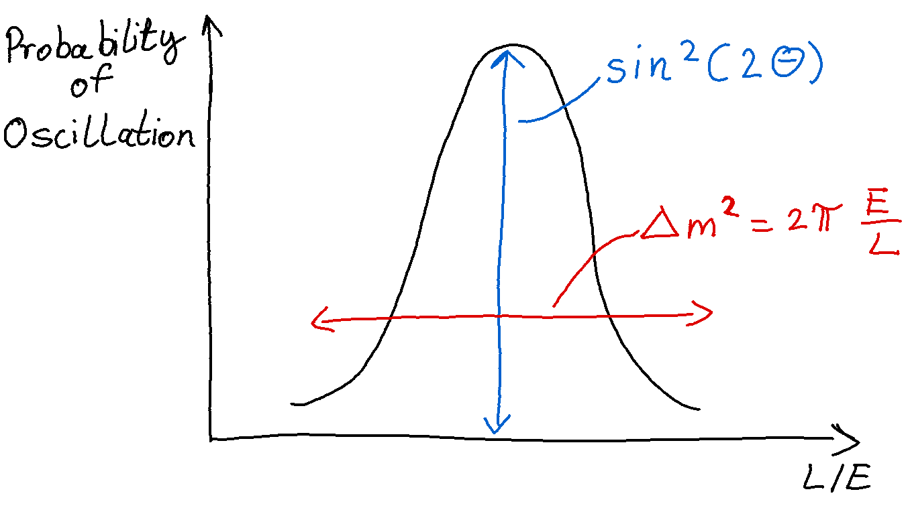
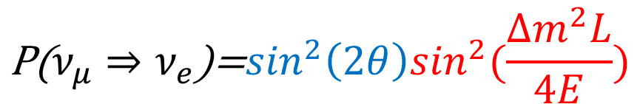

Neutrino Oscillation Formula – 2 flavour
$$\text{P}\text{(}ν_{μ}⇒ν_{e}\text{)=}\sin^{2}\left(2θ\right)\sin^{2}(\frac{∆m^{2}L}{4E})$$
Where E is the neutrino energy (GeV)
L is the distance
θ is the mixing angle and
$∆$m is the mass difference

Slide 36
Neutrino Oscillation Formula – 3 Flavour
3-flavour expression
Matter
Effects
Interference
CP-Violation
a = 7.6 10⁻⁵ ρ E
Where ρ is the electron density (g/cm³) ;
E is the neutrino energy (GeV)
c_{ij}=cosθ_{ij}, s_{ij}=sinθ_{ij}
(Richter: hep-ph/0008222)

Slide 37
Pictures
Pictures can enliven an otherwise pedestrian presentation
The eye/brain is a fantastic “pattern recognition” machine
However, for each picture shown, indicate:
  what is shown and
  why you have shown it.

Slide 38
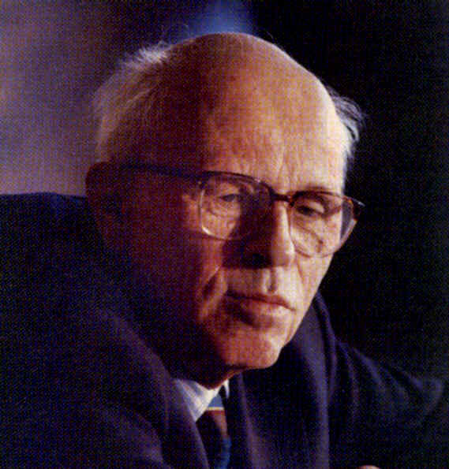
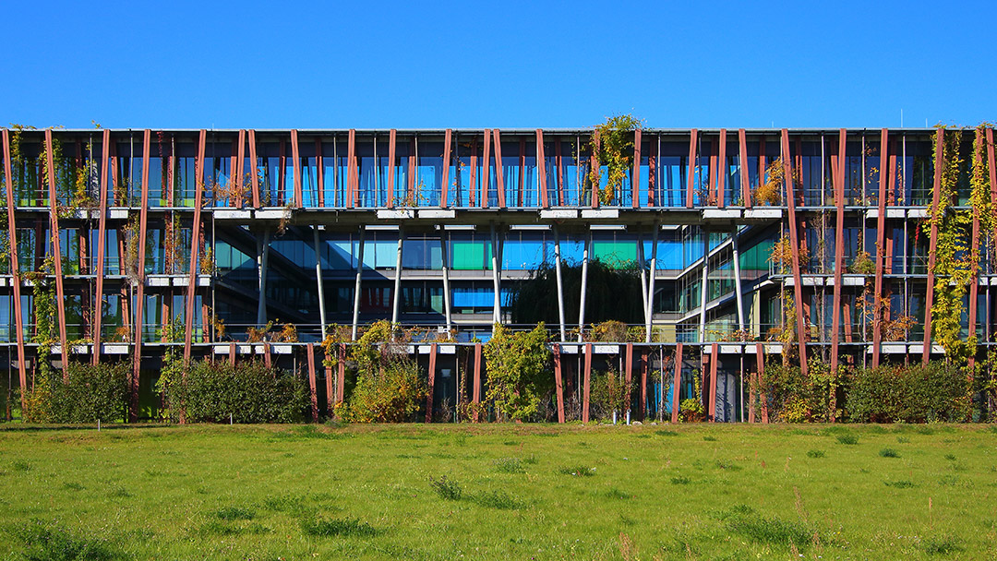
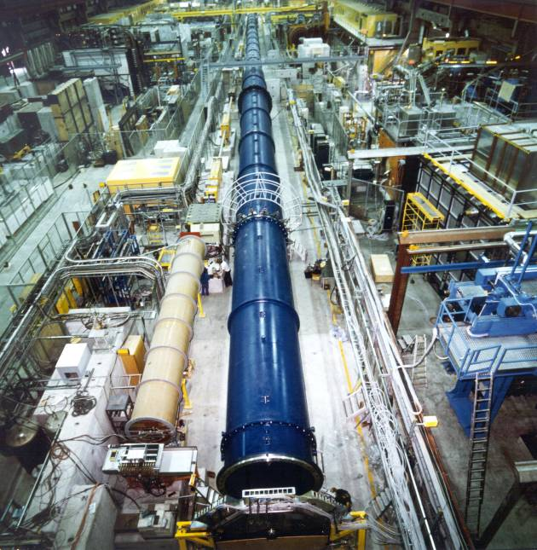
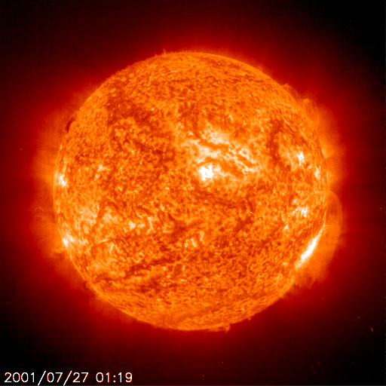

Pictures
Sakharov
Lise-Meitner Gebäude, Institut für Physik, HU-Berlin
ATLAS Detector at CERN
The Sun by the SoHo satellite
The 160m long NA31 decay tube and helium tank

Slide 39
Plots
Plots: very heart of a physics presentation
Given their importance - surprising how often plots fail
Usually, because the following obscure the meaning …
  The plot is too small
  There is no title
  axes are unlabelled, or the labels are unreadable
  scales are unreadable or missing, as are the units
  There are a lot of extra irrelevant “lines”
  The plot was originally in colour but is now in B&W

Slide 40
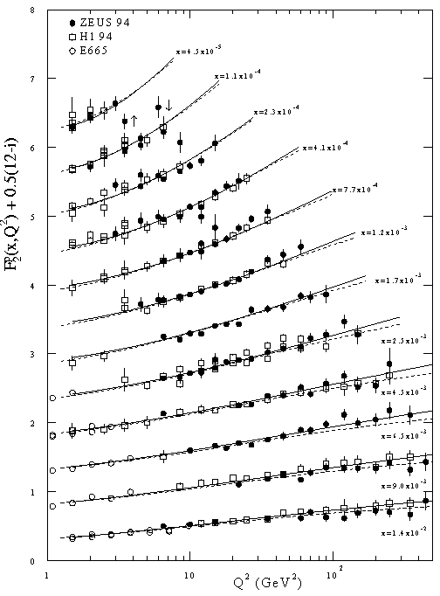
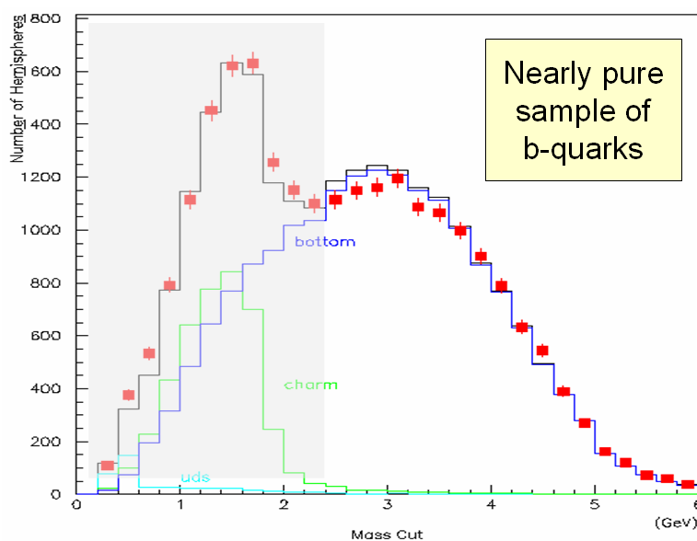
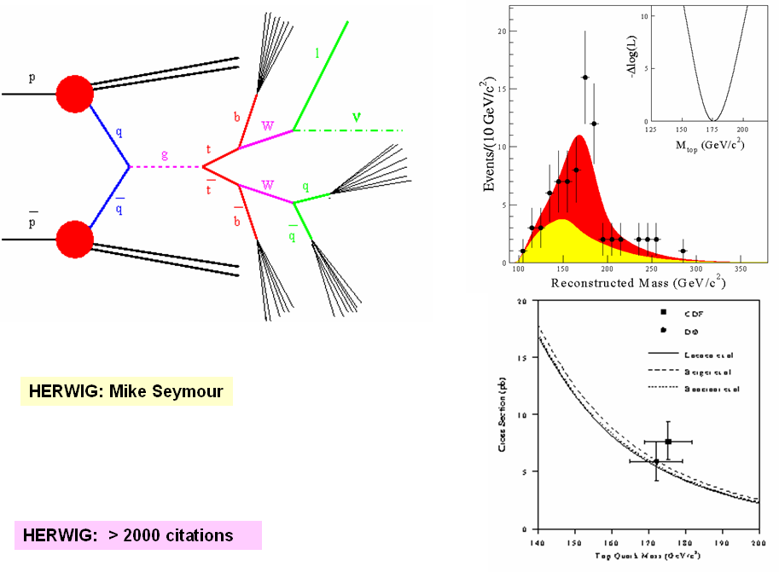
Plots

Slide 41
Plots

Slide 42
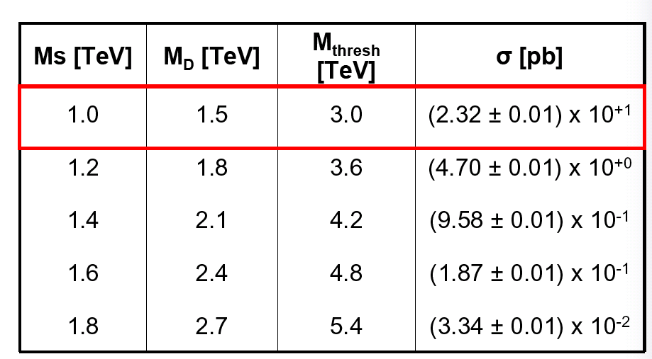
Sample Table
From Presenting Science, Oxford University Press 2010, © Çiĝdem İşsever and Ken Peach

Slide 43
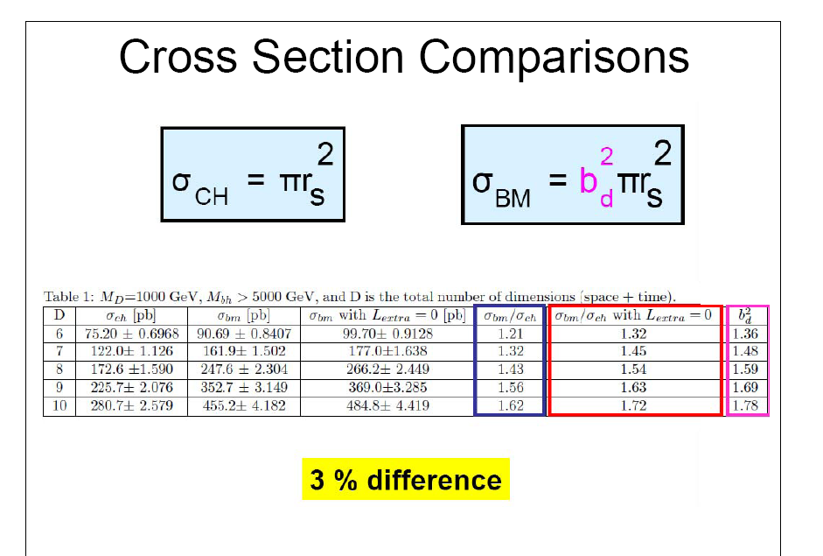
From Presenting Science, Oxford University Press 2010, © Çiĝdem İşsever and Ken Peach

Slide 44
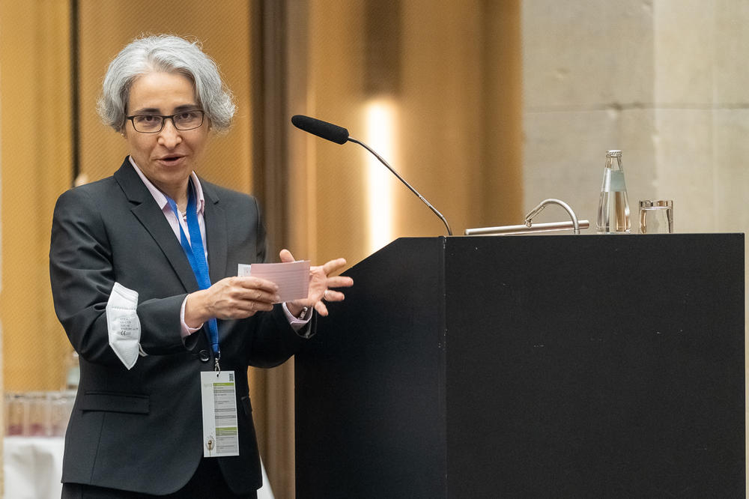
Some comments to presenting
https://www.berlin-university-alliance.de/en/impressions/220803-oxber-event/index.html

Slide 45

…DRESS
Too Dressed up or too dressed down will be noticed.
Do you want to be noticed for
  your Pink Socks and Orange striped trousers or
  a brilliant talk which the audience understood?
https://it.vecteezy.com/arte-vettoriale/5273208-uomini-d-affari-personaggio-cartone-animato-testa-set-collezione-uomini-d-affari-e-imprenditrici-in-stile-ufficio-su-sfondo-bianco-illustrazione-vettoriale-piatta

Slide 46
…DRESS
But in general : Dress slightly better than your audience will dress.
Dress should be functional (where to put microphone?)
Dress should make you feel comfortable and confident
https://it.vecteezy.com/arte-vettoriale/5273208-uomini-d-affari-personaggio-cartone-animato-testa-set-collezione-uomini-d-affari-e-imprenditrici-in-stile-ufficio-su-sfondo-bianco-illustrazione-vettoriale-piatta

Slide 47
…Body language
https://www.ted.com/talks/amy_cuddy_your_body_language_may_shape_who_you_are?language=de

Slide 48
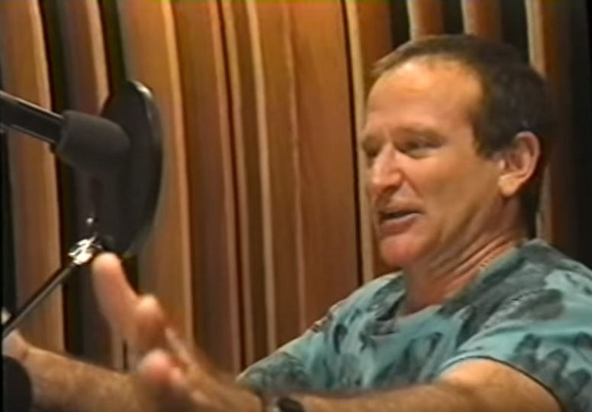
…Voice and speaking speed
Not too fast.
Take a breath and use pauses.
Speak up
https://www.pinterest.com/pin/robin-williams-in-the-recording-studio-in-aladdin-and-the-king-of-thieves--325385141809739273/

Slide 49
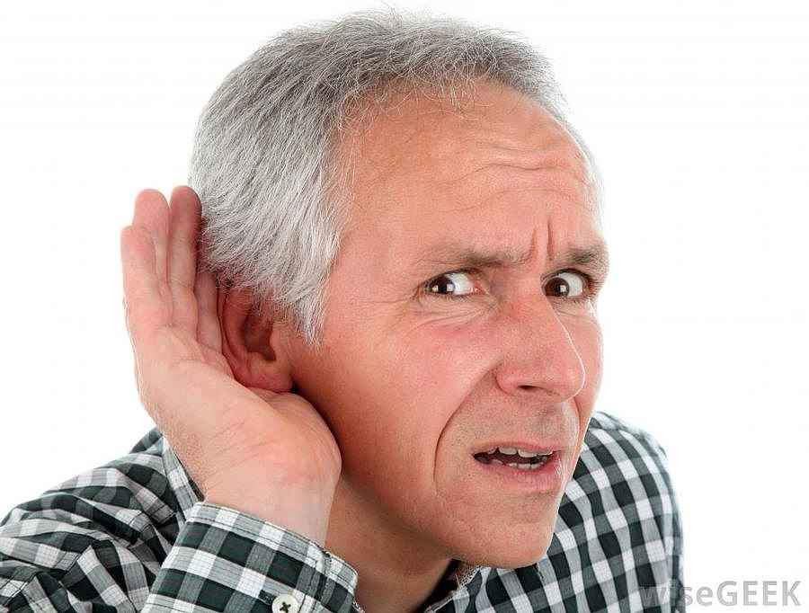
…Voice, microphone, etc…
Remember, if people cannot hear you
  → they will not understand the presentation
  if a microphone is provided, USE IT and TEST IT
  careful with noisy jewellery or shoes
https://www.seniorlifestyle.org/express/senior_moments/i-cant-hear-you

Slide 50

https://www.istockphoto.com

Slide 51

Rules
There are no absolute rules in presentation!
Rules CAN be broken
– But keep in mind whether they SHOULD be!
https://www.linkedin.com/pulse/why-people-break-rules-daud-o-shittu

Slide 52

Your Audience
Have a care for your audience
There is no excuse for a sloppy, ill-prepared presentation.
  Speak to the audience, not the slides
  Do not read from notes!
  Be careful with jokes.
Treat a presentation as a theatrical performance
rehearse it.
https://hawksem.com/blog/in-market-audiences-google-ads/

Slide 53

Use of laser pointers
practice where you want to point,
and keep still,
use it to POINT.
https://www.baamboozle.com/game/659165

Slide 54
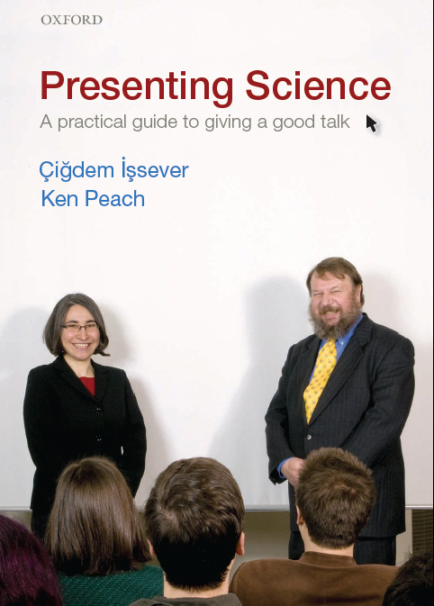
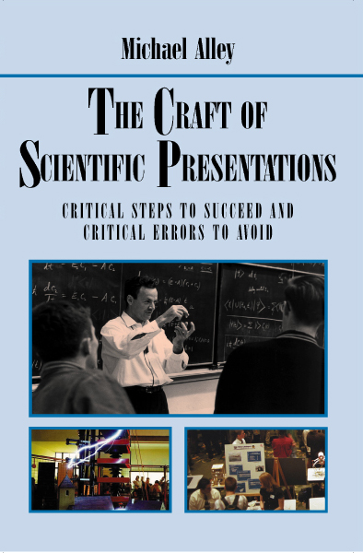
Feynman
– one of the great communicators

Slide 55
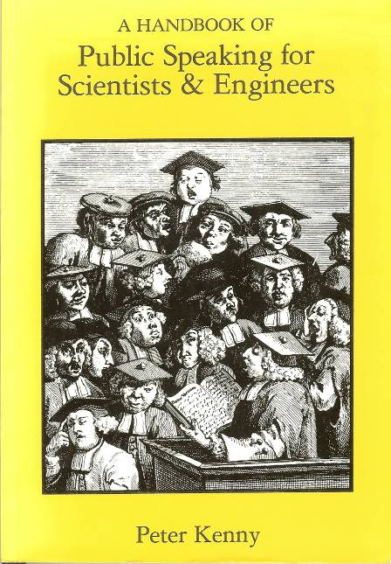



Some more books
“This author has hit the proverbial nail on the head, sending much needed advice to speakers in the scientific community … With such a wealth of information in such a little book, it deserves a niche in the briefcase of all scientists and engineers interested in improving their public speaking skills.” J. Chem. Inf. Comput. Sci. (from Chemical Abstracts Service)”
From our point of view, the book is too prescriptive in some cases just wrong (it advises writing out the full text of your presentation in words before you do anything else).
“A horrendous book by my former professor...., Upon reading and studying this guide, I wholly expected that it would provide me with knowledge and confidence in presentations. I was unfortunate enough to encounter Dr. Walters as a professor AFTER reading this title, and am appalled at his lecturing skills. One would think that he would take a few hints/pointers from his own text and apply them to his lecturing. “
(Review on Amazon)
Each chapter starts with a “story” illustrating something that went wrong with a presentation, and then trying to extract the lessons from it.
Probably closest to our approach … basically sound
This is a new book from professional communicators (5 easy steps to the perfect presentation) and claims to be the result of many years of experience running courses. A bit too “slick” for our taste – in general, physicists are a bit wary of a presentation that is too slick.

Slide 56
Summary
Structure of Presentation
Slide Structure and Purpose
Building blocks of a slide
  Fonts
  Backgrounds
  Text and Bullets
  Animations
  Mathematical Formulae
  Pictures and Plots
  Tables
Presenting and the presenter
  Pointer
  Voice
  Dress Code
Literature
Notes:
Foto: http://throwastoneandmakearipple.blogspot.com/2011/04/try-it-and-see-what-happens.html

