Slide 1

AD/ELENA FACILITY
ADTC Meeting 13th March 2025
2024-2025 YETS follow-up

Slide 2
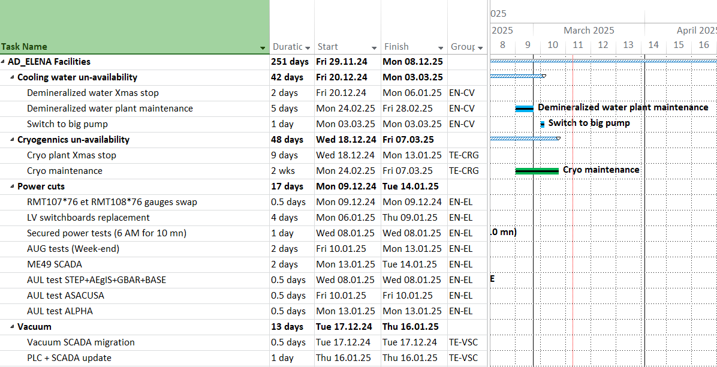
Anticipated Services Disruptions
Crane 190/191 maintenance on 28th March, (191 AM. 190 PM) !
Planning available at
https://oss-coordination.web.cern.ch/gantt/latest?facilities=AD/ELENA&scale=week&worktypeproject=

Slide 3
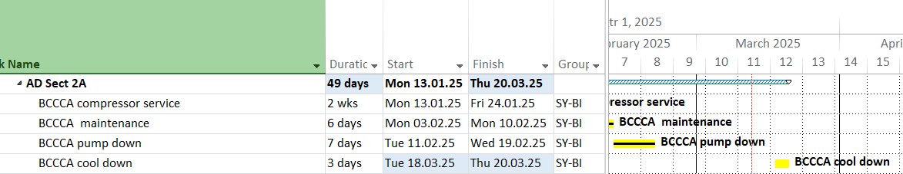
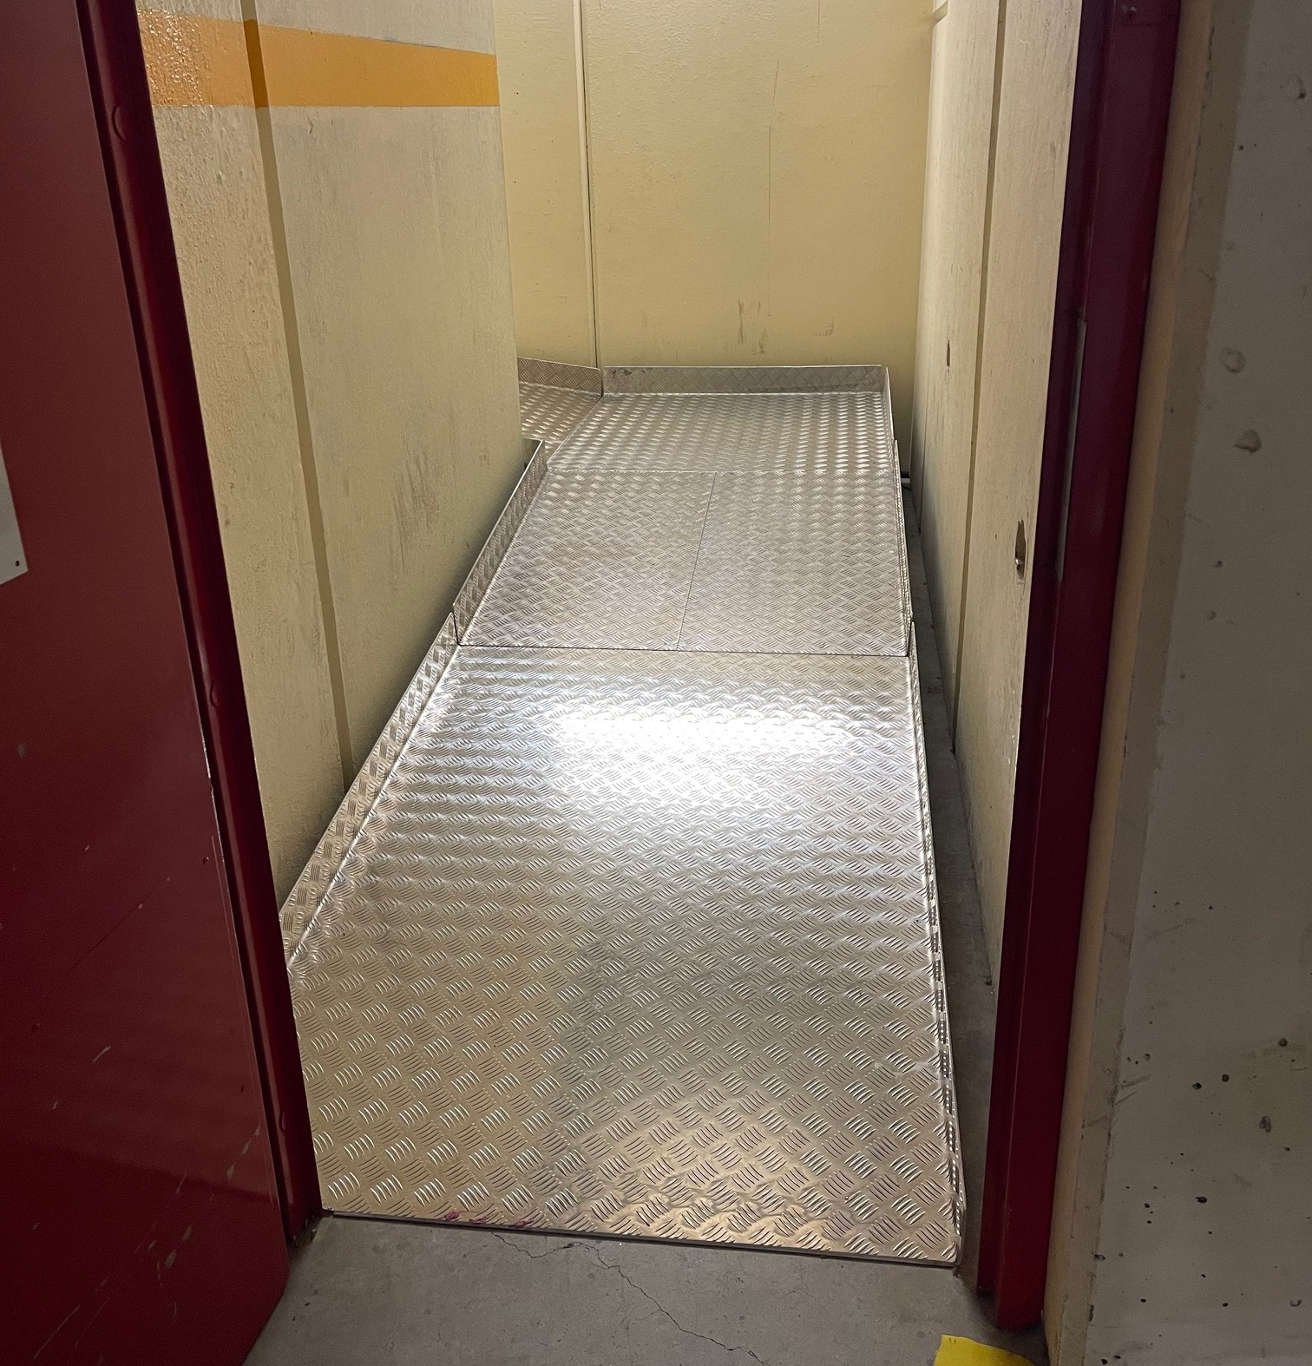
AD ring sector 2A
New ramp for
BCCCA dewar !

Slide 4
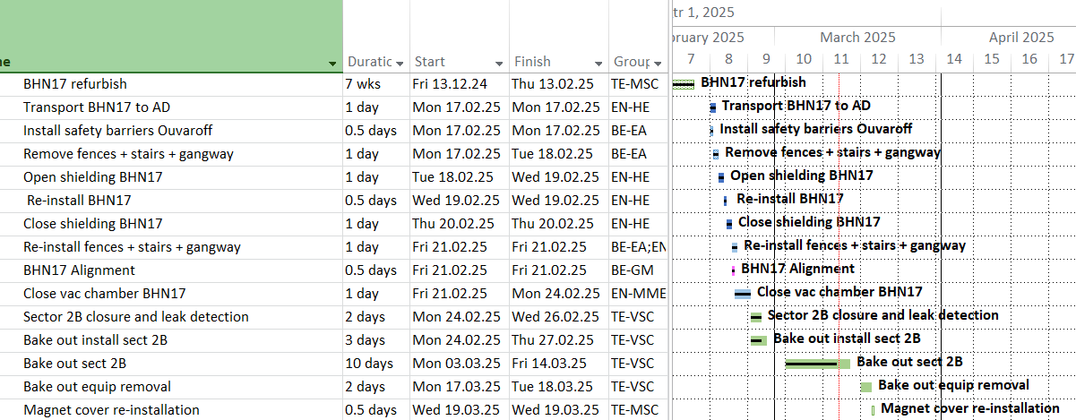
AD ring sector 2B – BHN17

Slide 5
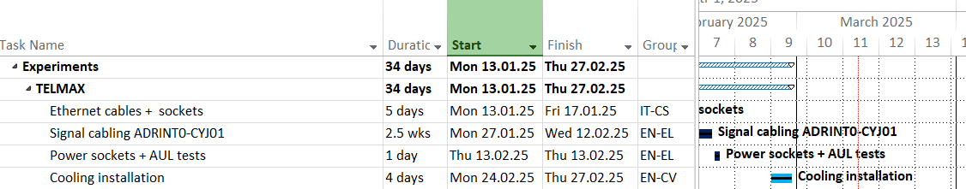
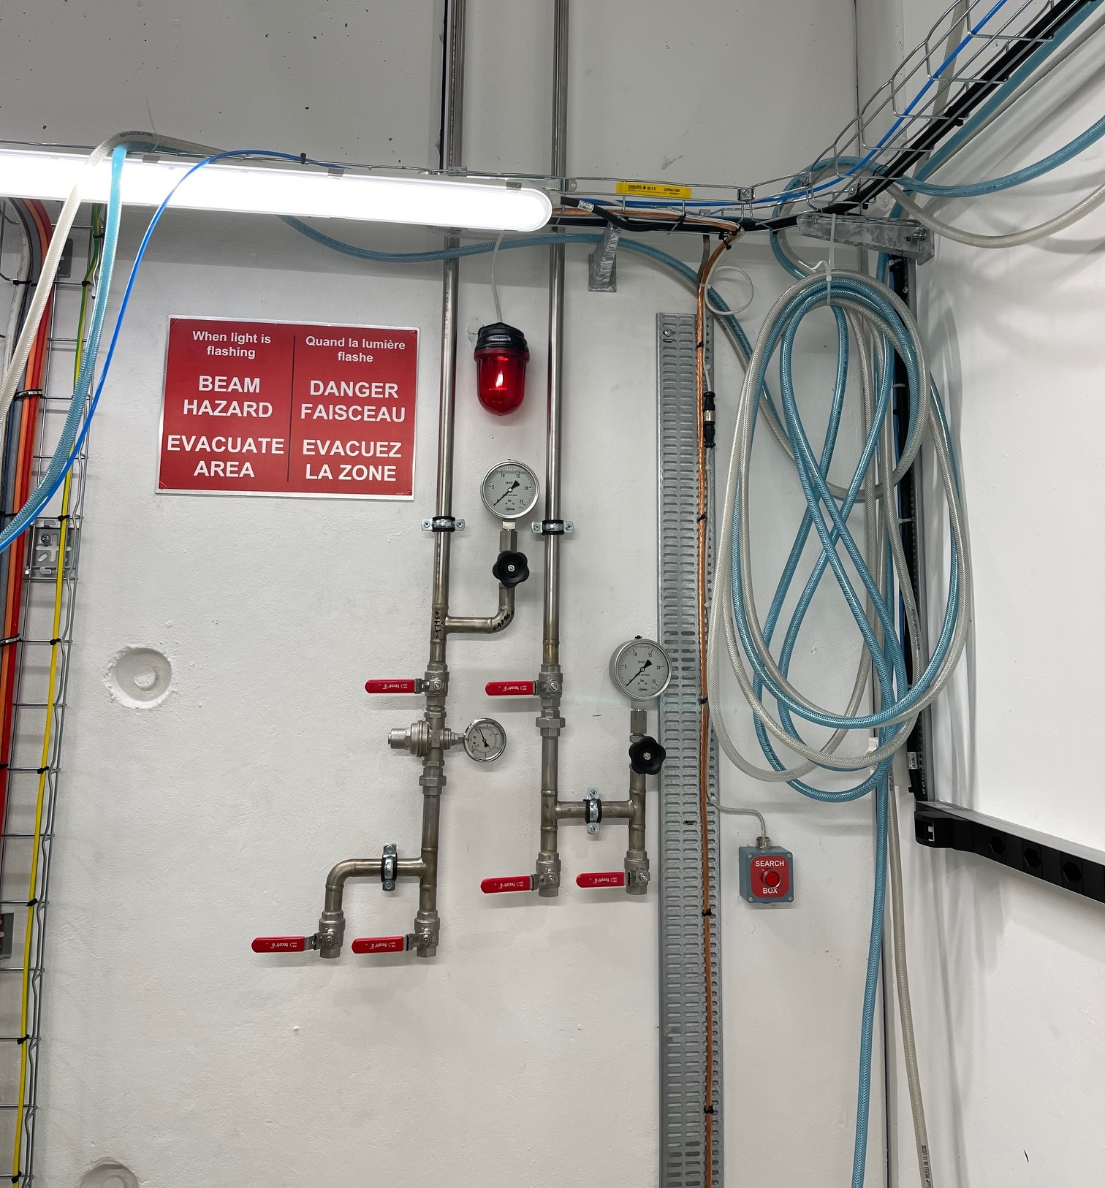
ELENA + TELMAX works

Slide 6
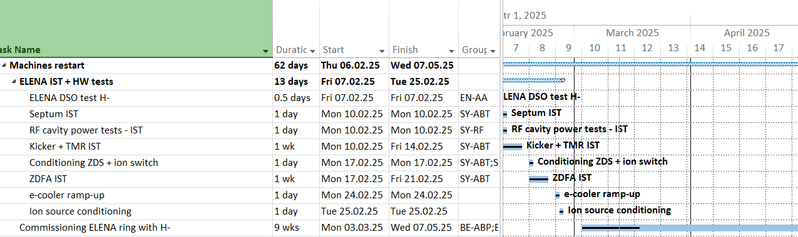
ELENA restart

Slide 7
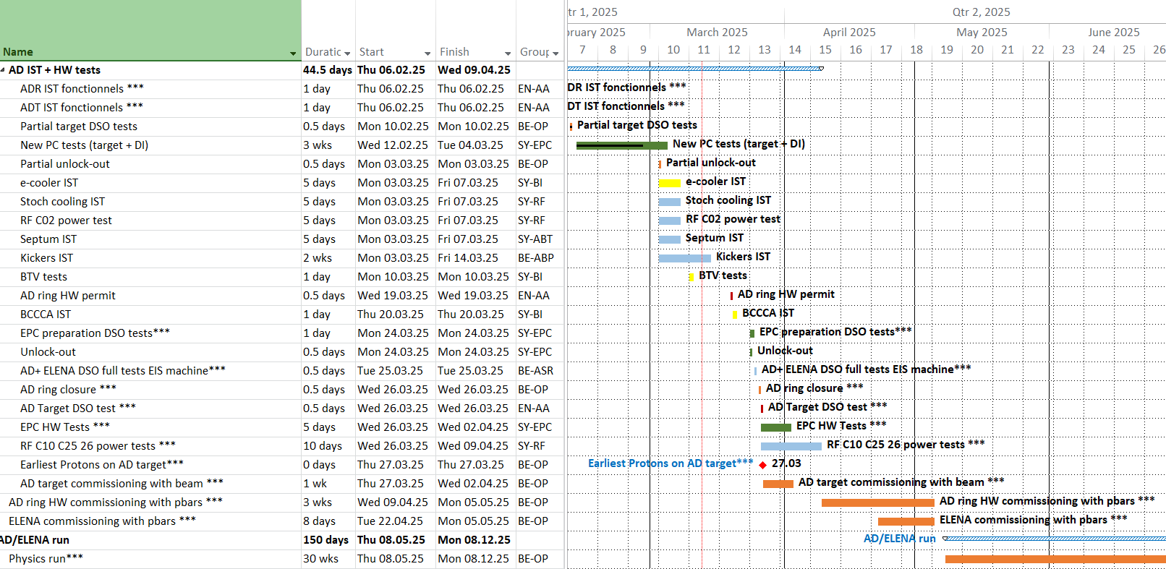
AD restart

