Slide 1
AD-Target YETS 2024-25
Sven De Man SY-STI
13/03/2025

Slide 2
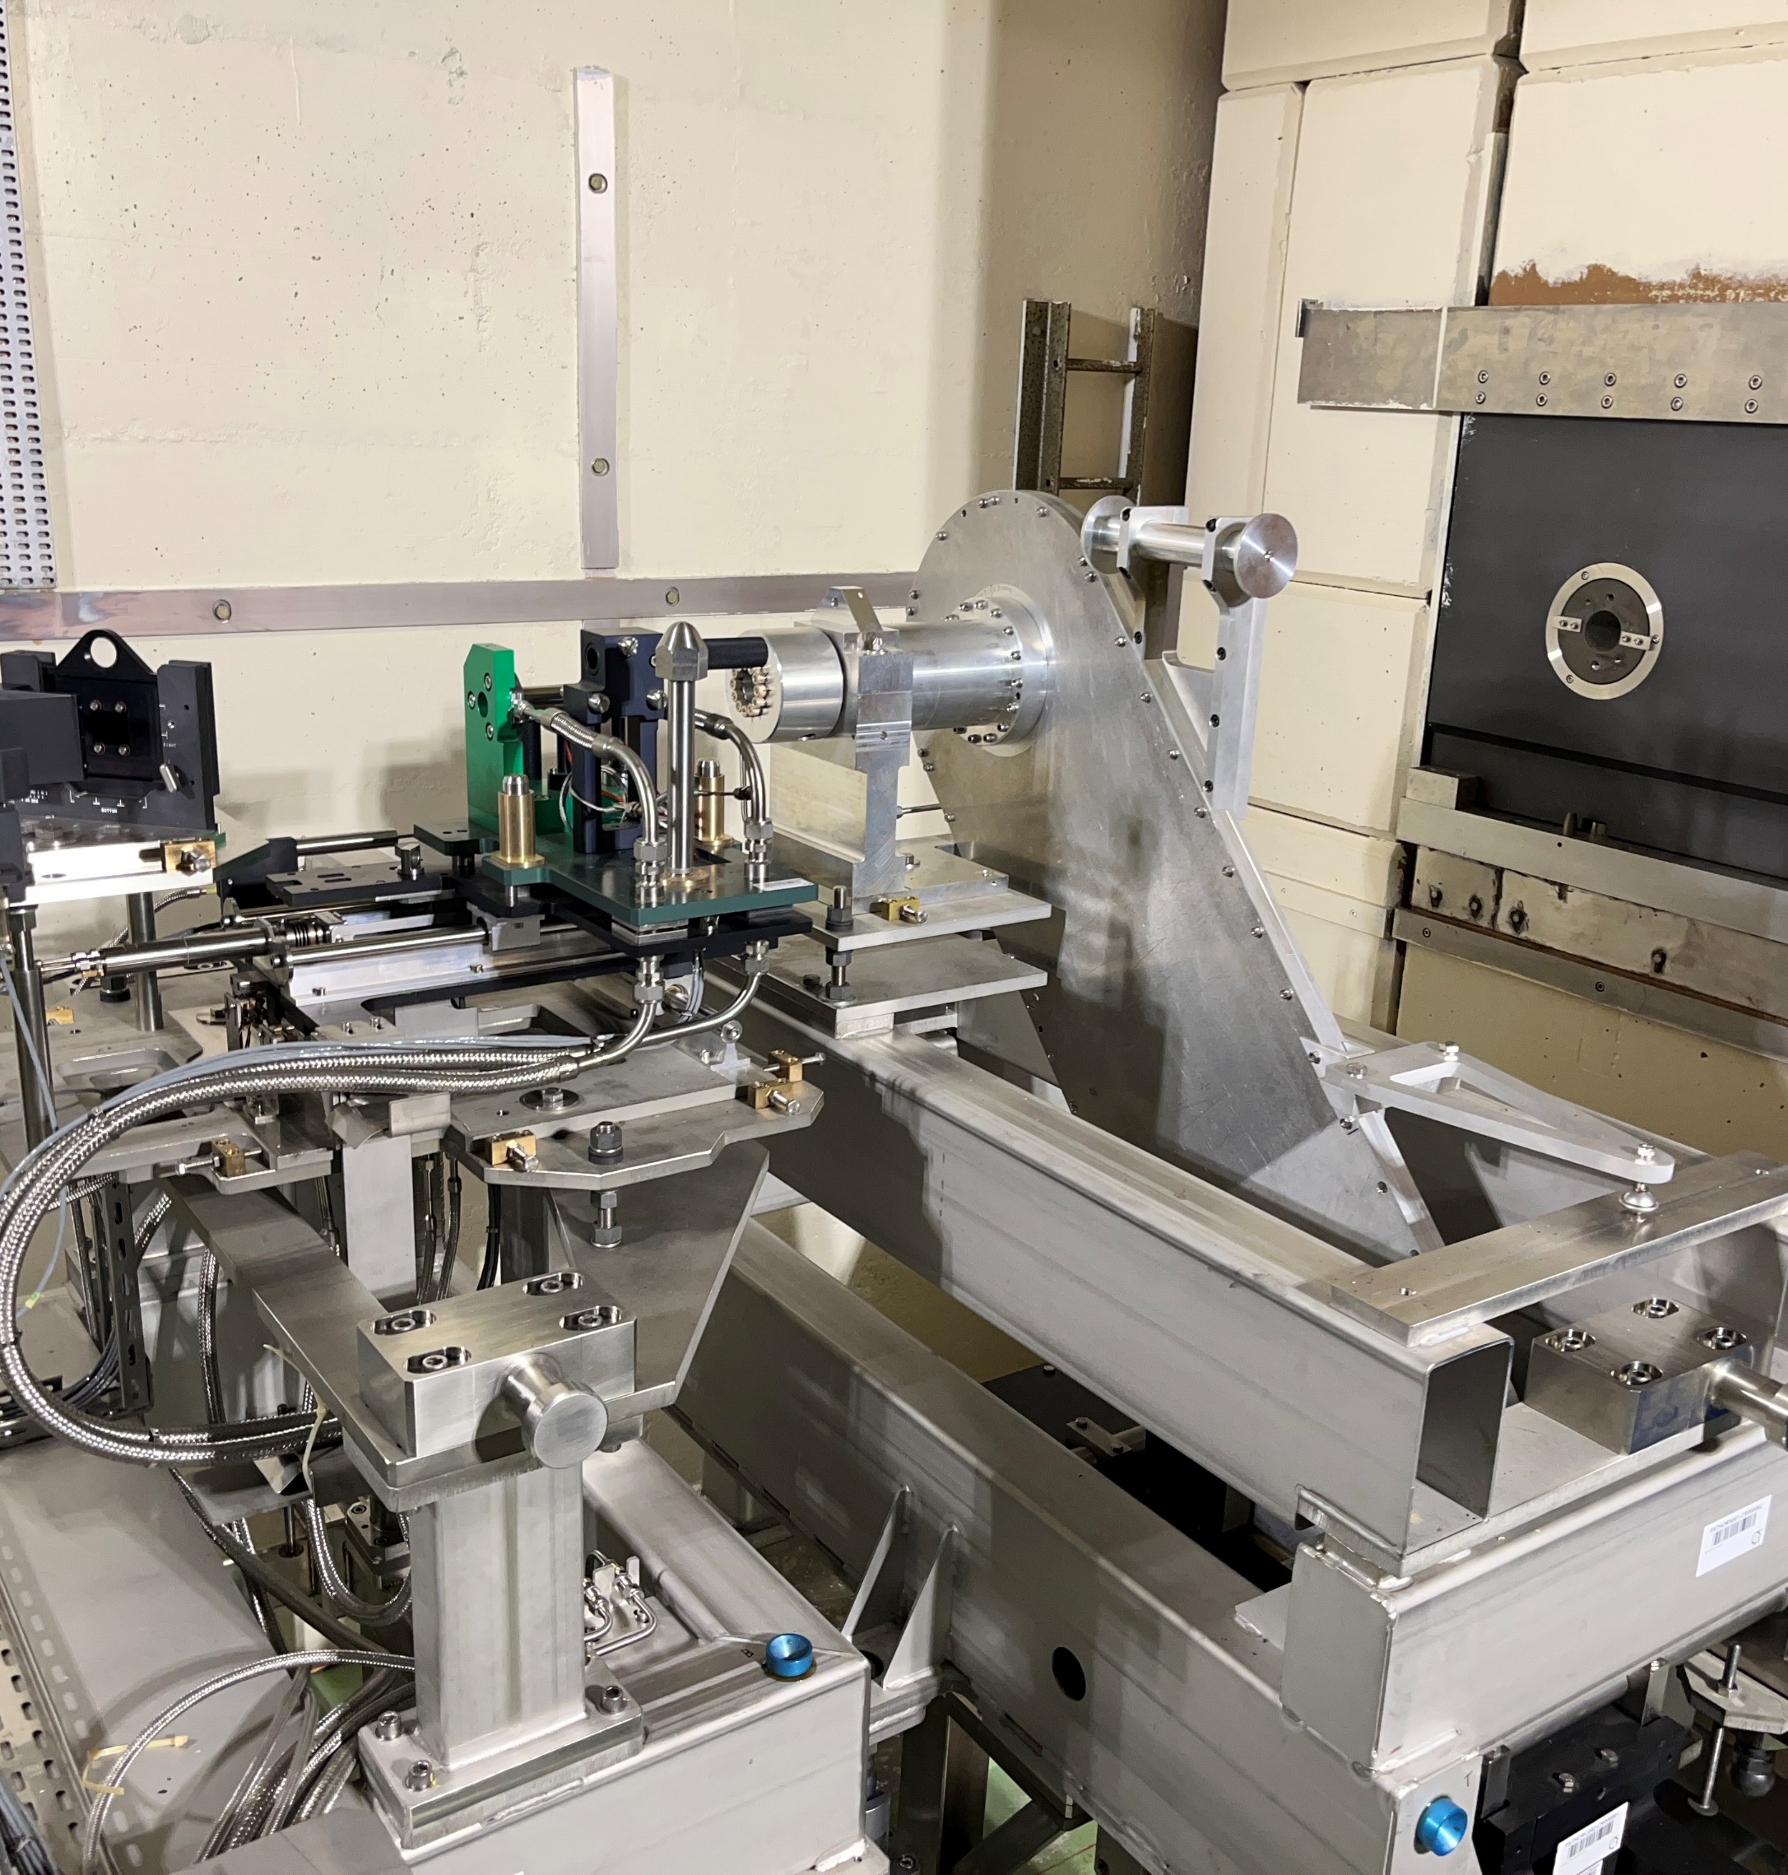
13 March 2025 - End of interventions
Maintenance operations finished
Target replaced
Target movement: bellow ratchet drive replaced by a pneumatic vane motor
No change to the control system
Remote control foreseen later today
Magnets ‘MALT’ will be removed this Friday

Slide 3
https://edms.cern.ch/file/3263486/1/YETS24-25_Exchange_AD_Target_and_motorisartion.mp4

