Slide 1
AD Low voltage substation renewal Power cut impacts for ME76(366)
ADTC - LONJON Mickael – EN/EL/EPM
2024-19-12
EDMS : 3126596

Slide 2
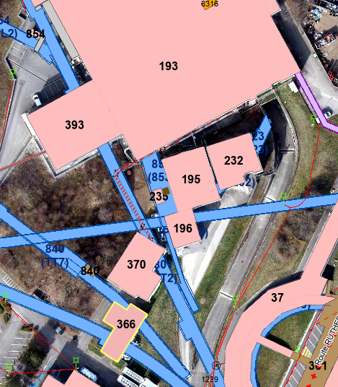
Situation :

Slide 3
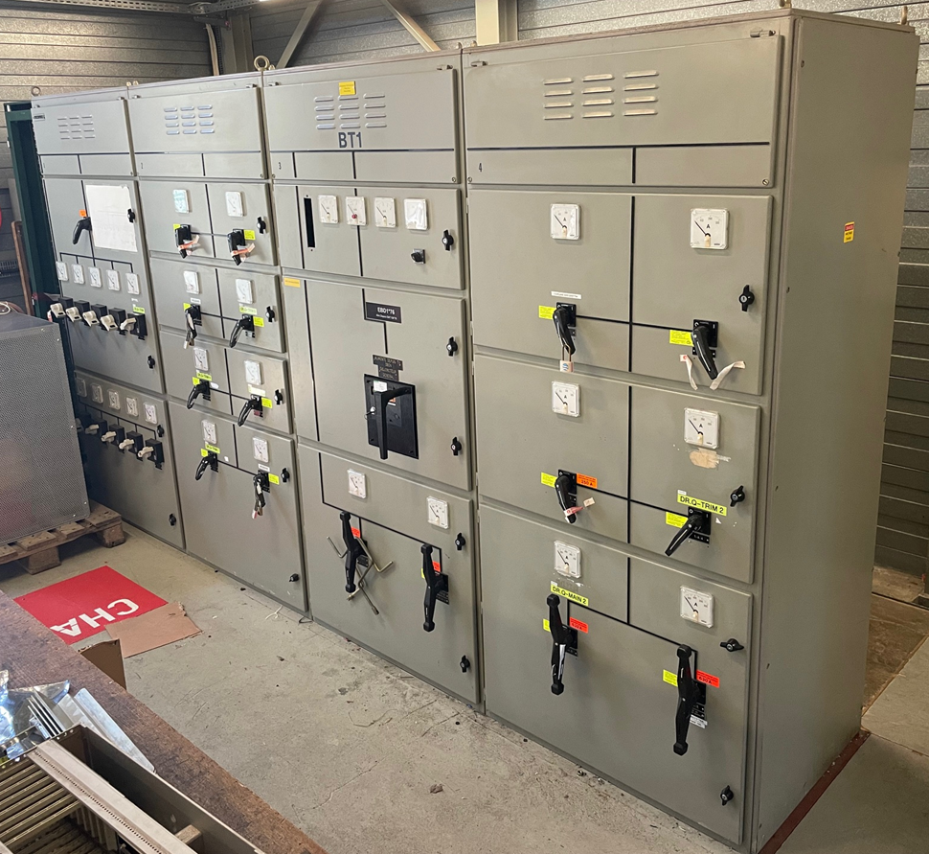
Renewal of EBD1*76 :
List of loads :
Position | Description | Location
EBD1.1*76 | INTER. JEU DE BARRES | 366
EBD1.1.10*76 | Alim. UACV3-00074 Ventil. Bat. 366 | 366
EBD1.1.5*76 | BZH TRIM (DR.BHZ-TRIM) | 366
EBD1.1.7*76 | Alim. EBD11*76B SG Bat. 370 | 366
EBD1.1.8*76 | Alim. ERD11*76 Bat. 366 | 366
EBD1.1.9*76 | Alim. EBD12*76 SG Bat. 366 | 366
EBD1.2.4*76 | DR.QUAD-TRIM5 | 366
EBD1.2.5*76 | QTRIM4 DR.QUAD-TRIM4 | 366
EBD1.2.6*76 | QTRIM3 DR.QUAD-TRIM3 | 366
EBD1.2.7*76 | QTRIM1 DR.QUAD-TRIM1 | 366
EBD1.3*76 | ARRIVEE TRANSFO EMT103*76 | 366
EBD1.3.1*76 | Alim. ERD1*76B Bat. 370 | 366
EBD1.3.2*76 | Alim. ERD2*76B Bat. 370 | 366
EBD1.4.1*76 | REALIM. ERD1*76A | 366
EBD1.4.3*76 | Alim. ERD13*76 Bat. 366 | 366
EBD1.4.4*76 | QTRIM2 DR.QUAD-TRIM2 | 366
EBD1.4.5*76 | QMAIN2 DR.QUAD-MAIN2 | 366
EBD1.4.6*76 | Alim. EBD11*76A SG Bat. 195 | 366

Slide 4
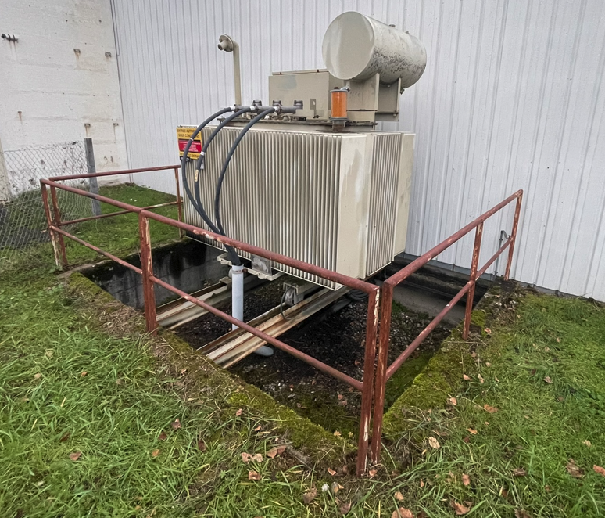
Renewal of EMT106*76 :
Out of age
Power can drasticly be reduced

Slide 5
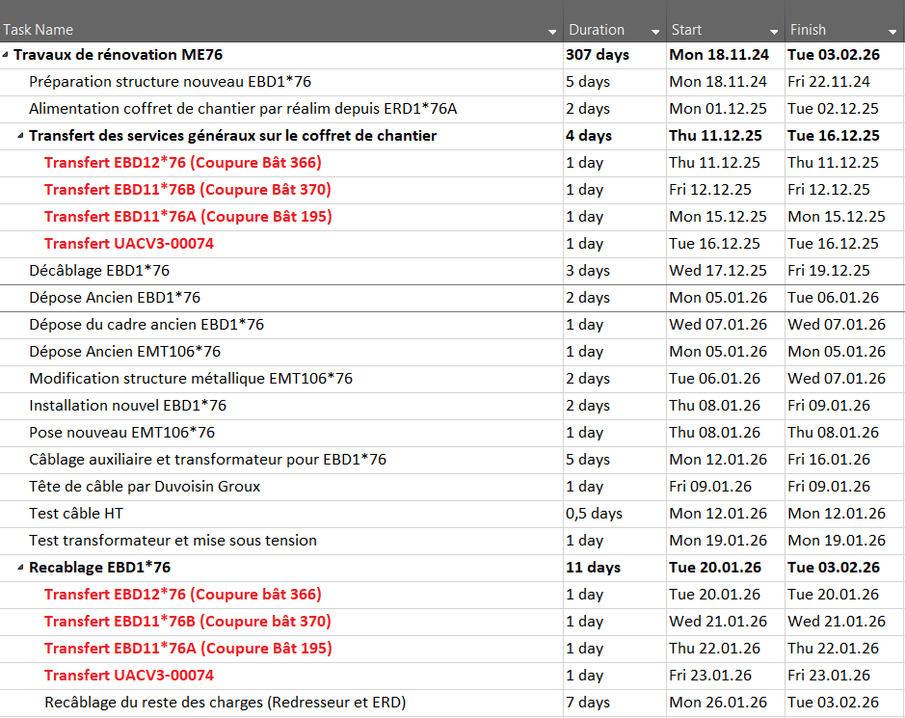
Transfer of general service on temporary switchboard :
Lights, socket outlets and ventilations affected during transfer
All other loads (Converters and ERD switchboards) will be cut until 20/01/26

