Slide 1

AD/ELENA FACILITY
ADTC Meeting
2025-2026 YETS
30 Oct 2025

Slide 2
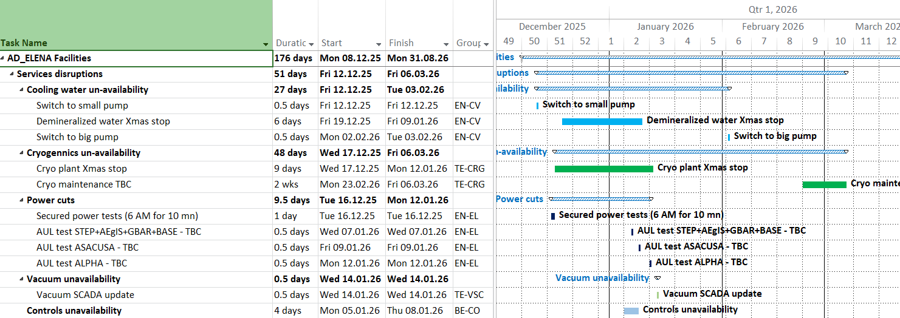
YETS 25-26 Services disruptions
TBC
TBC
YETS dates: 8th December – 27th Feb

Slide 3
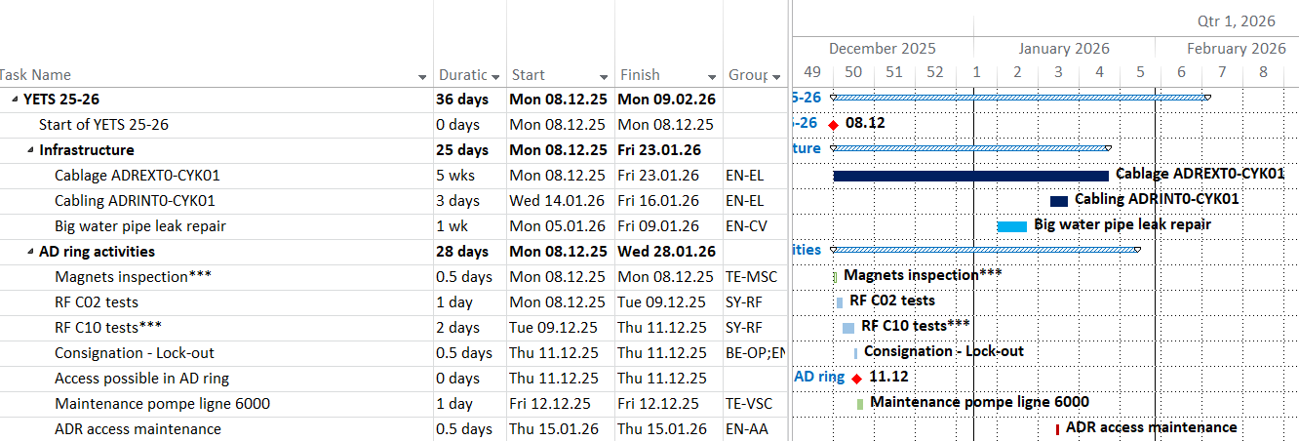
YETS 25-26 - General
New

Slide 4
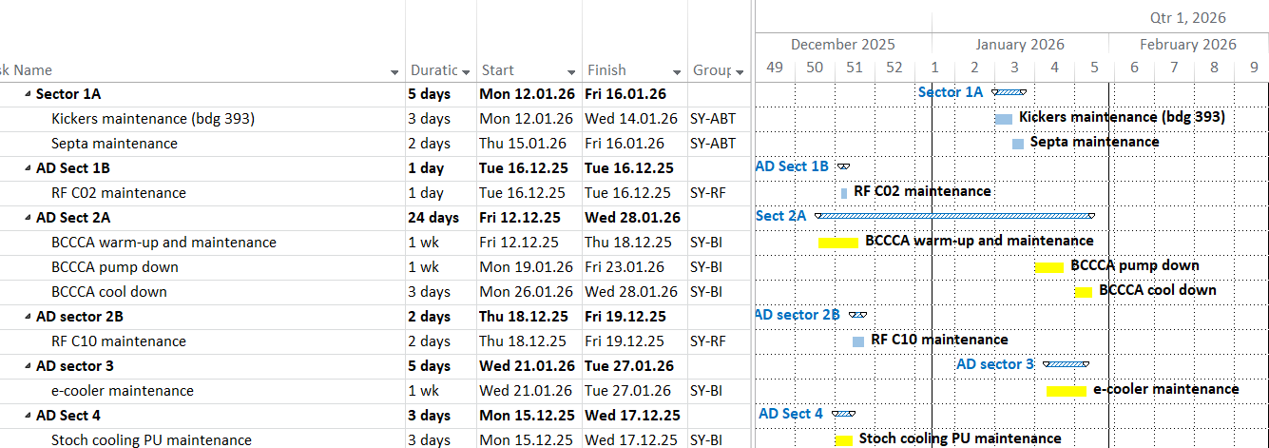
YETS 25-26 – AD ring sectors

Slide 5

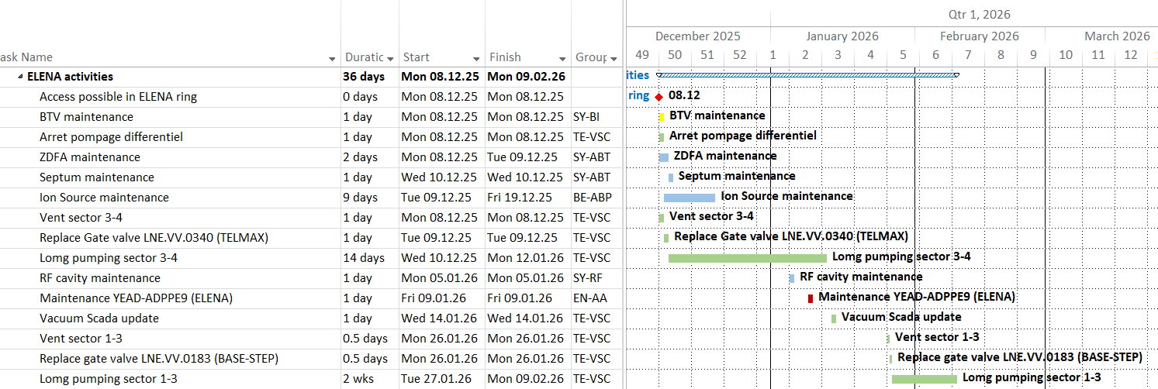
YETS 25-26 - ELENA
New

Slide 6
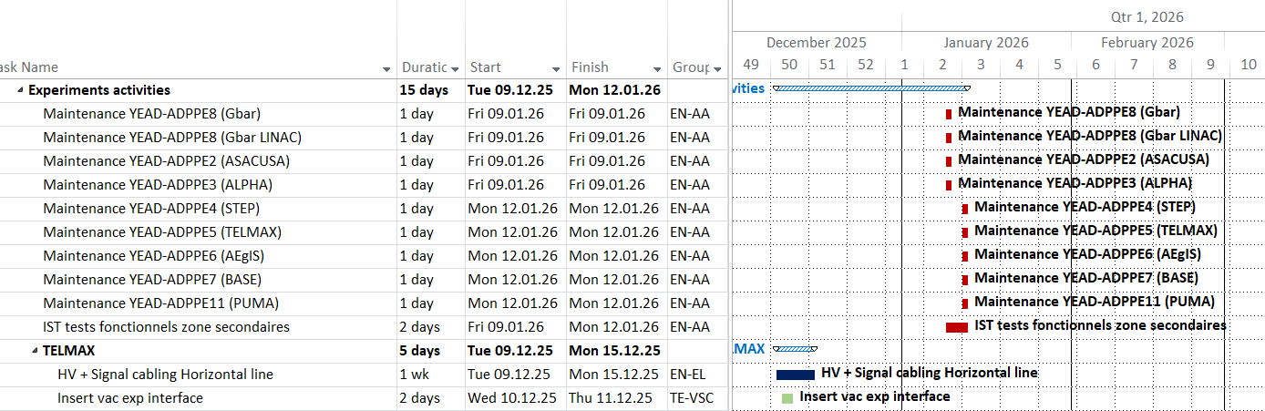
YETS 25-26 – Exp Areas
TBC

Slide 7
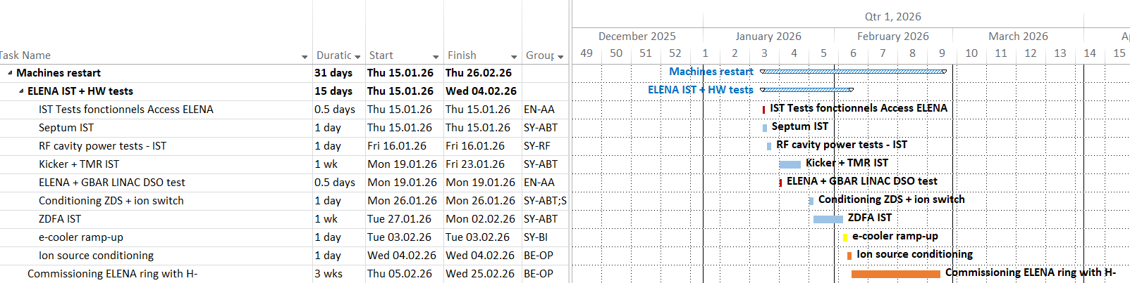
ELENA restart

Slide 8
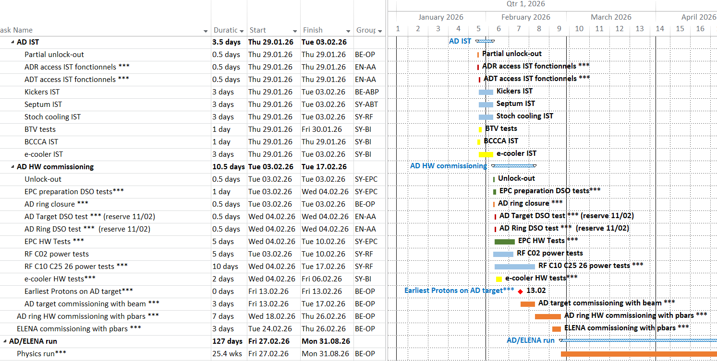
AD restart

Slide 9
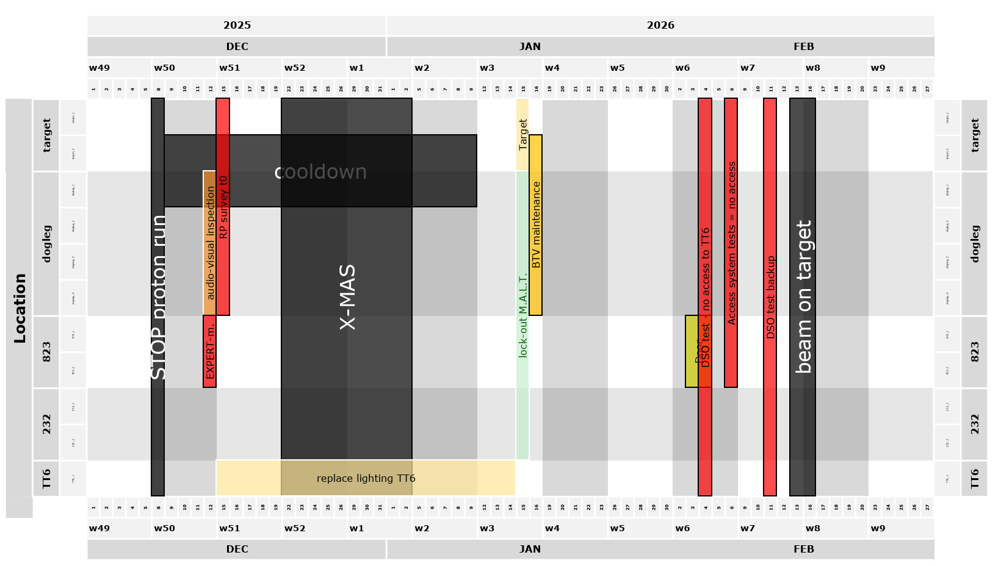
Target activities
TBC

