Slide 1
BDF dilution system failure
Aleksandr Gorn, Francesco Maria Velotti, Matthew Alexander Fraser (SY-ABT-BTP)
Laurie Nevay, Fabian Metzger (BE-EA-LE)
13.02.2025

Slide 2
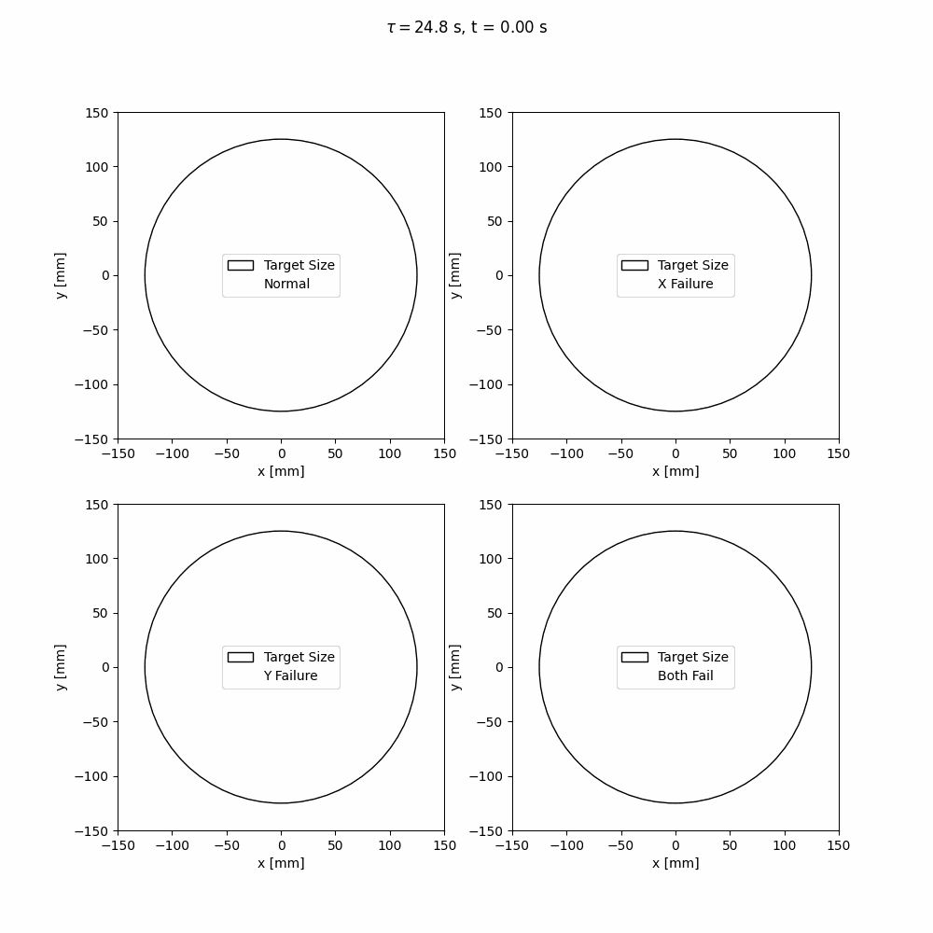
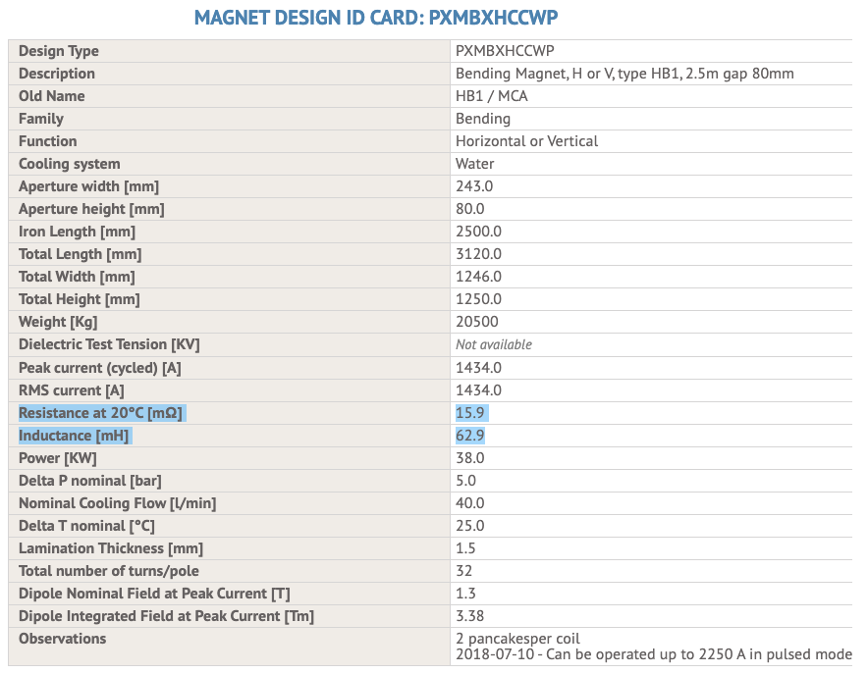
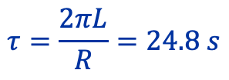
DS failure
$$τ=\frac{2πL}{R}=24.8 s$$

Slide 3
Thanks for your attention!

Slide 4
DS failure
$$τ=\frac{2πL}{R}=24.8 s$$

Slide 5
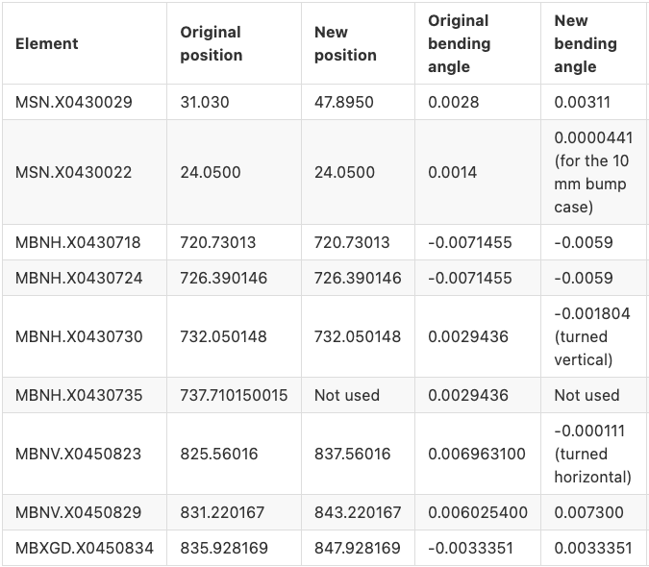
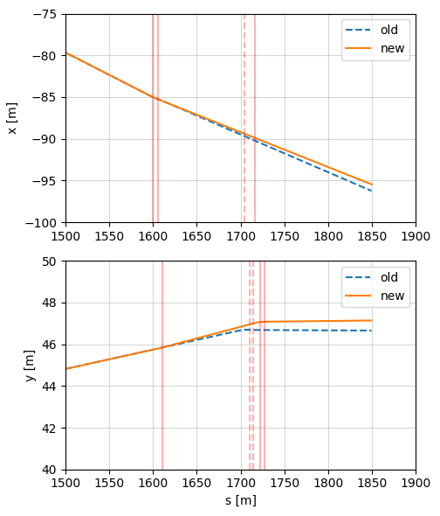
Offsets at the target
0.8 m shift
towards Jura
0.5 m vertical shift

Slide 6
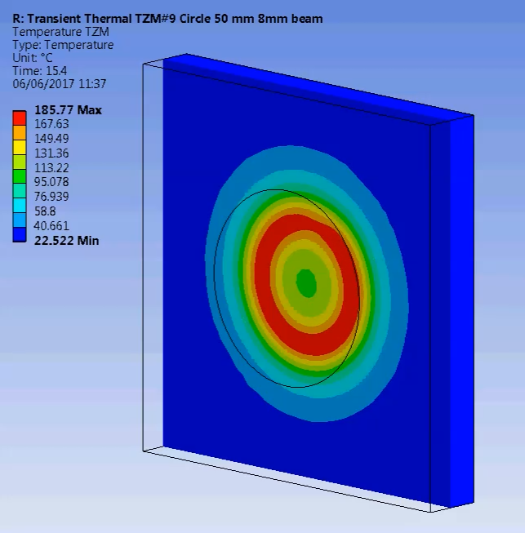
Final focus and dilution system: requirements
SPS Beam Dump Facility - Comprehensive Design Study: CERN-2020-002
Round beam with 𝛔 = 8 / 16 mm on target
50 mm sweep radius @ 4 Hz
About 120 m drift
Possible solution – 4 magnets (2 per plane)

Slide 7
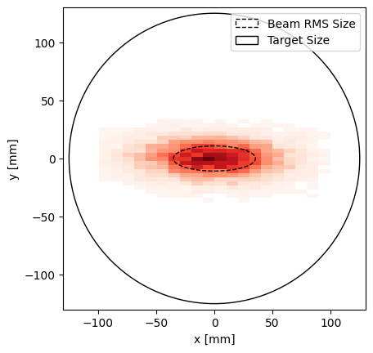
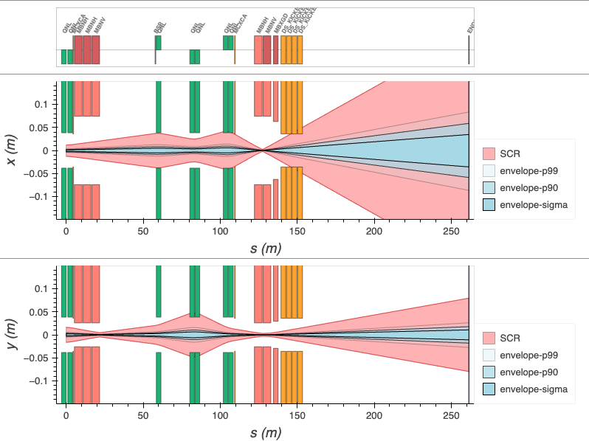
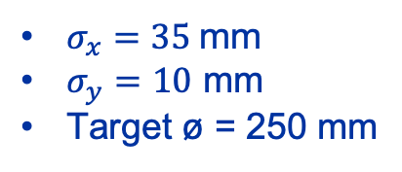
Final focus rematching
kq18
kq19
kq20
kq21
$σ_{x}=35$ mm
$σ_{y}=10$ mm
Target ø = 250 mm
Knob | Quadrupoles
kq18 | QNL.X0430710 QNL.X0430714
kq19 | QNL.X0450770
kq20 | QNL.X0450792 QNL.X0450795
kq21 | QNL.X0450814 QNL.X0450817

Slide 8
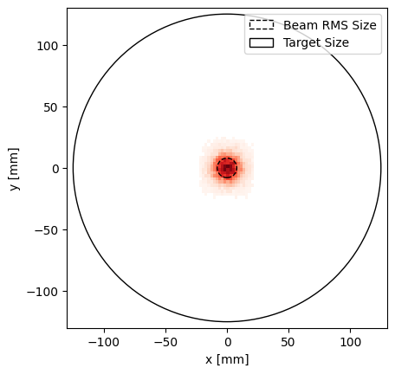
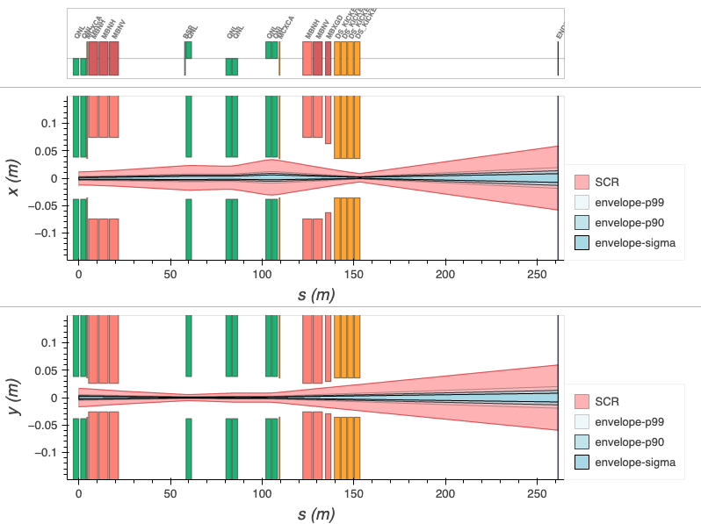
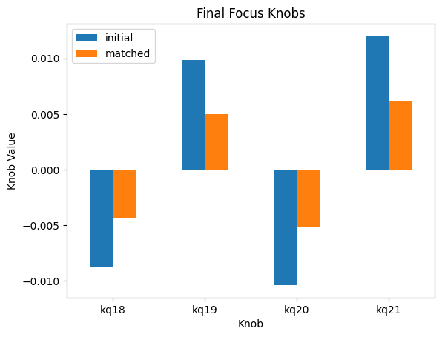
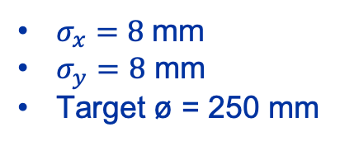
Final focus rematching
kq18
kq19
kq20
kq21
$σ_{x}=8$ mm
$σ_{y}=8$ mm
Target ø = 250 mm
Knob | Quadrupoles
kq18 | QNL.X0430710 QNL.X0430714
kq19 | QNL.X0450770
kq20 | QNL.X0450792 QNL.X0450795
kq21 | QNL.X0450814 QNL.X0450817

Slide 9
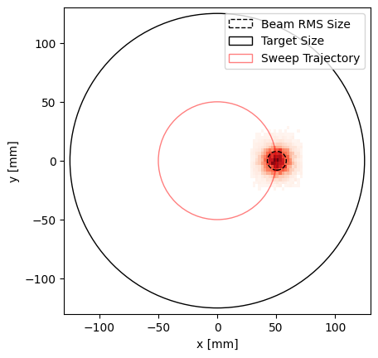
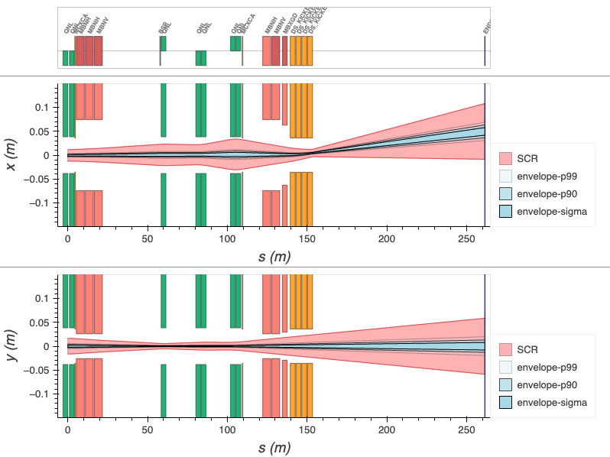
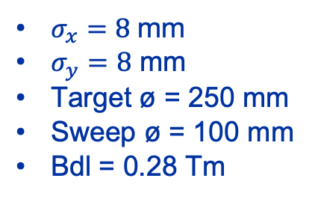
Introducing the sweep
kq18
kq19
kq20
kq21
$σ_{x}=8$ mm
$σ_{y}=8$ mm
Target ø = 250 mm
Sweep ø = 100 mm
Bdl = 0.28 Tm
Knob | Quadrupoles
kq18 | QNL.X0430710 QNL.X0430714
kq19 | QNL.X0450770
kq20 | QNL.X0450792 QNL.X0450795
kq21 | QNL.X0450814 QNL.X0450817

Slide 10
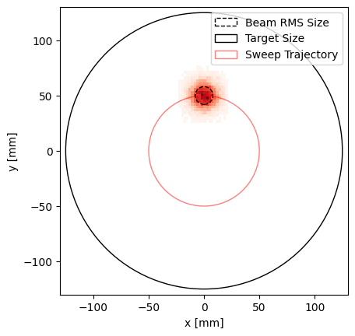
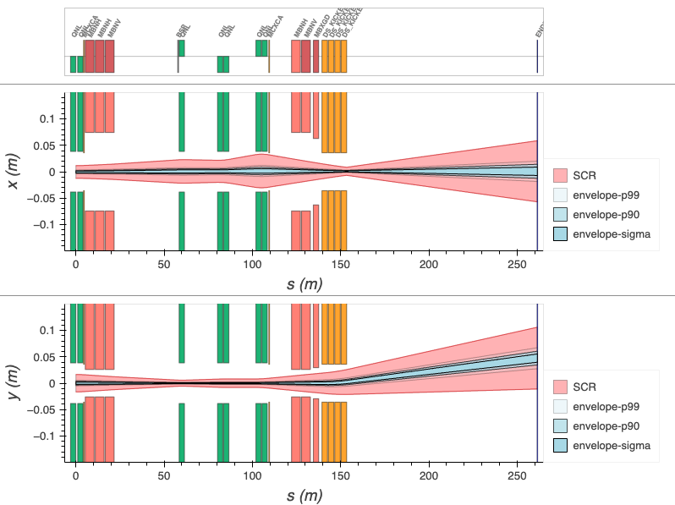
Introducing the sweep
kq18
kq19
kq20
kq21
$σ_{x}=8$ mm
$σ_{y}=8$ mm
Target ø = 250 mm
Sweep ø = 100 mm
Bdl = 0.28 Tm
Knob | Quadrupoles
kq18 | QNL.X0430710 QNL.X0430714
kq19 | QNL.X0450770
kq20 | QNL.X0450792 QNL.X0450795
kq21 | QNL.X0450814 QNL.X0450817

Slide 11
Summary
We can match the beam size at the target with the existing quads.
MCA magnets aperture and integrated strength is sufficient for the dilution system.
One more iteration is required to find an optimum settings for the final focus.

Slide 12
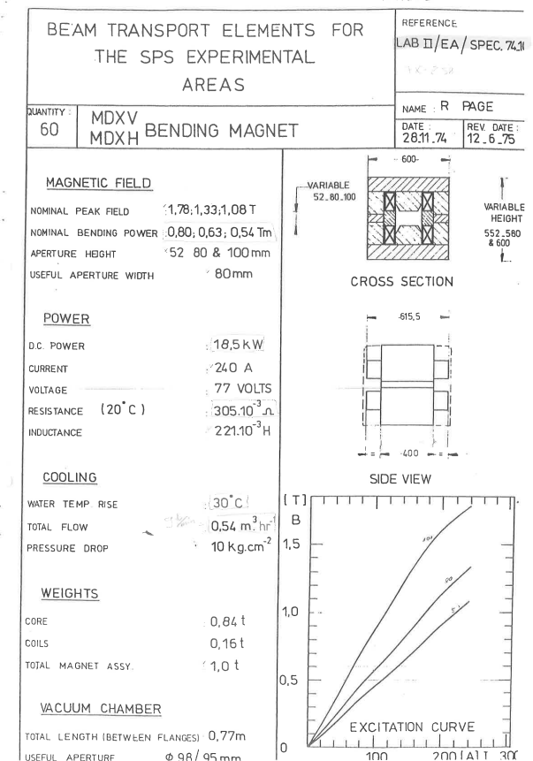
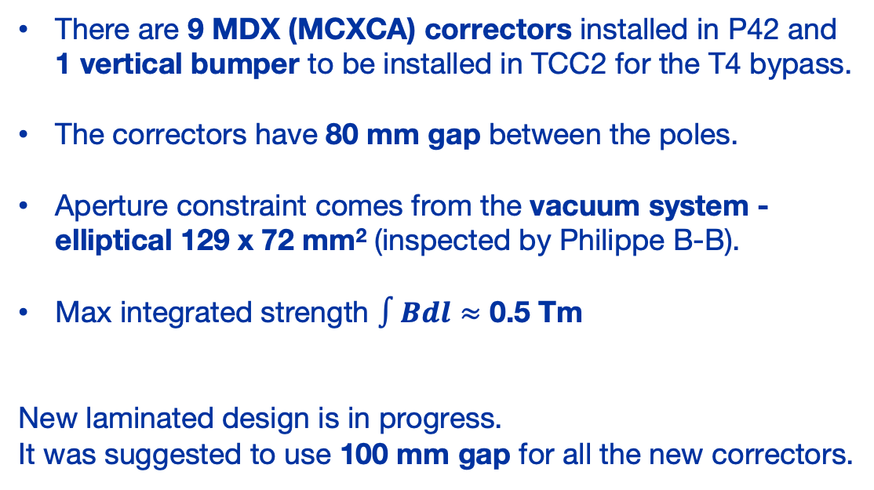
MDX specifications
There are 9 MDX (MCXCA) correctors installed in P42 and 1 vertical bumper to be installed in TCC2 for the T4 bypass.
The correctors have 80 mm gap between the poles.
Aperture constraint comes from the vacuum system -elliptical 129 x 72 mm² (inspected by Philippe B-B).
Max integrated strength $∫Bdl≈$ 0.5 Tm
New laminated design is in progress.
It was suggested to use 100 mm gap for all the new correctors.

