Slide 1



Nb3Sn and NbTiN progress towards Cavity coating
14th IFAST WP9 Quarterly Meeting

Slide 2

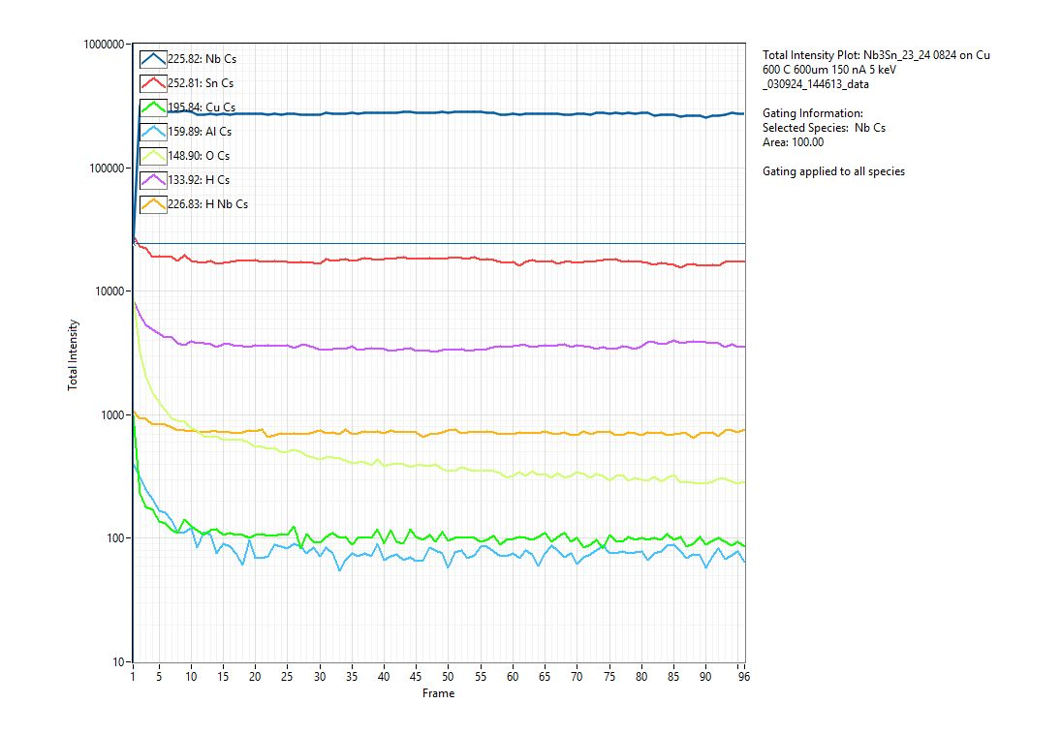
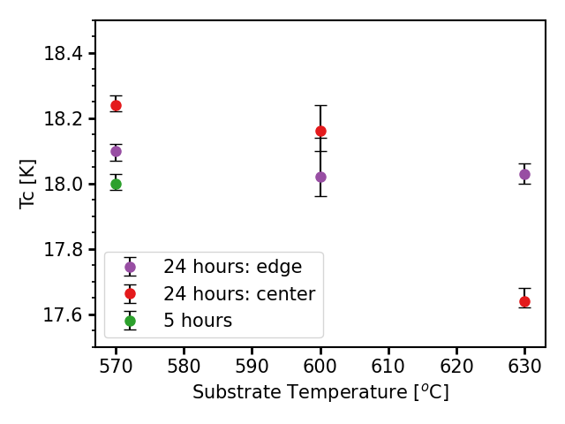
Nb3Sn Deposition Temperature Optimisation
Nb
Cu
Nb3Sn with bulk like properties is synthesised at 570 C and 50 W
The film is very uniform in stoichiometry through out the depth with the lowest level of oxygen and Cu
Very sharp interface and good adhesion
Four point probe on sapphire

Slide 3
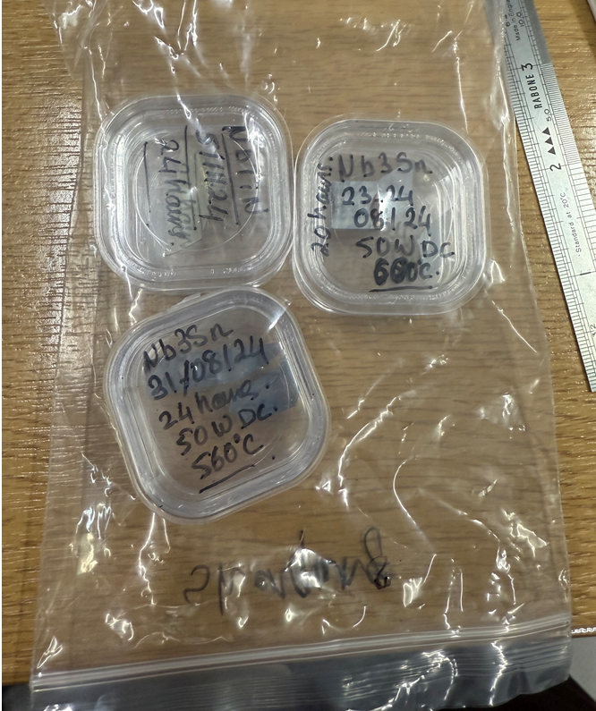
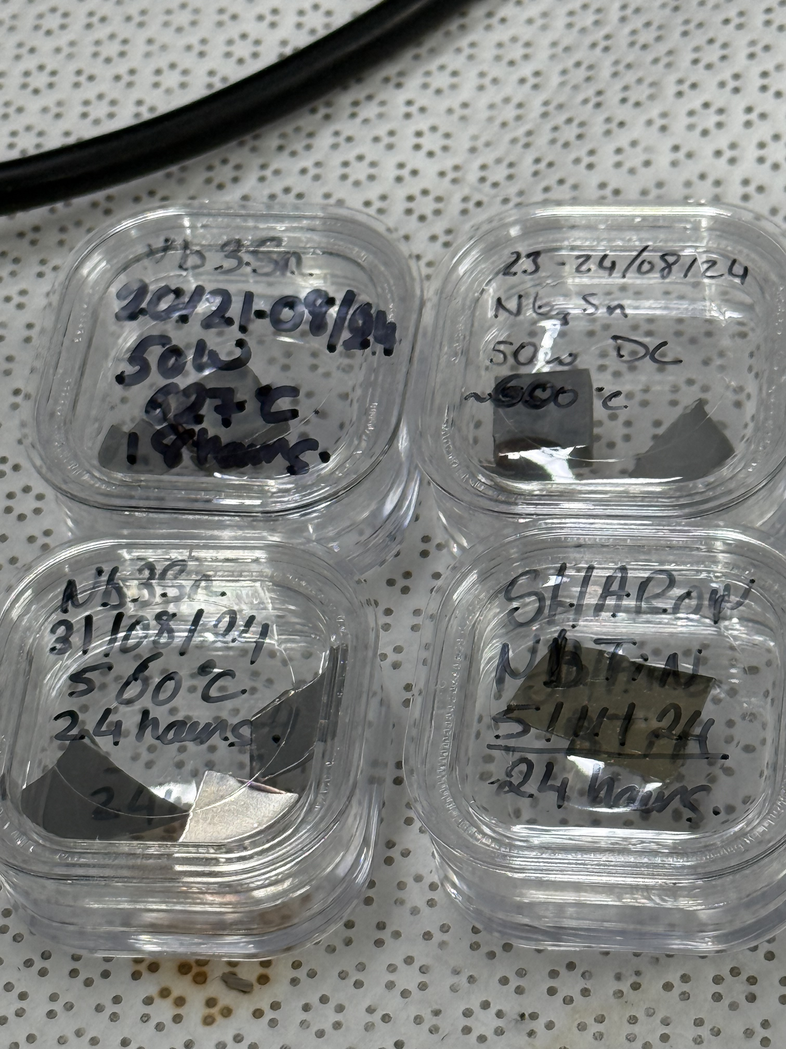
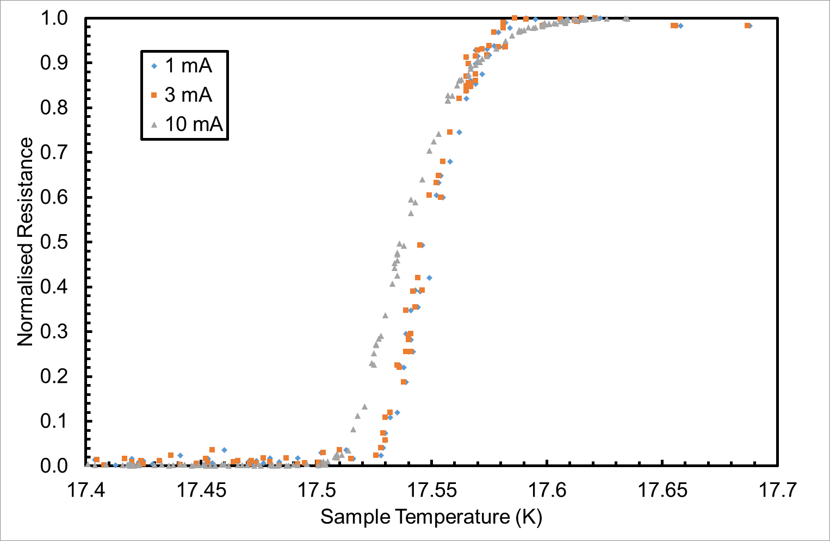
Follow up of the samples
Three of the samples with the highest Tc were sent for point contact tunnelling (PDC) for both TC, bandgap measurement and XRD.
For each set both sapphire and copper witness sample was sent.
Also a NbTiN deposited on sapphire in Sharon for 24 hours and RRR tested here which gave 17.was also sent.
Nb3Sn and NbTiN also sent to HZBDR for positron annihilation for point defect measurement.

Slide 4
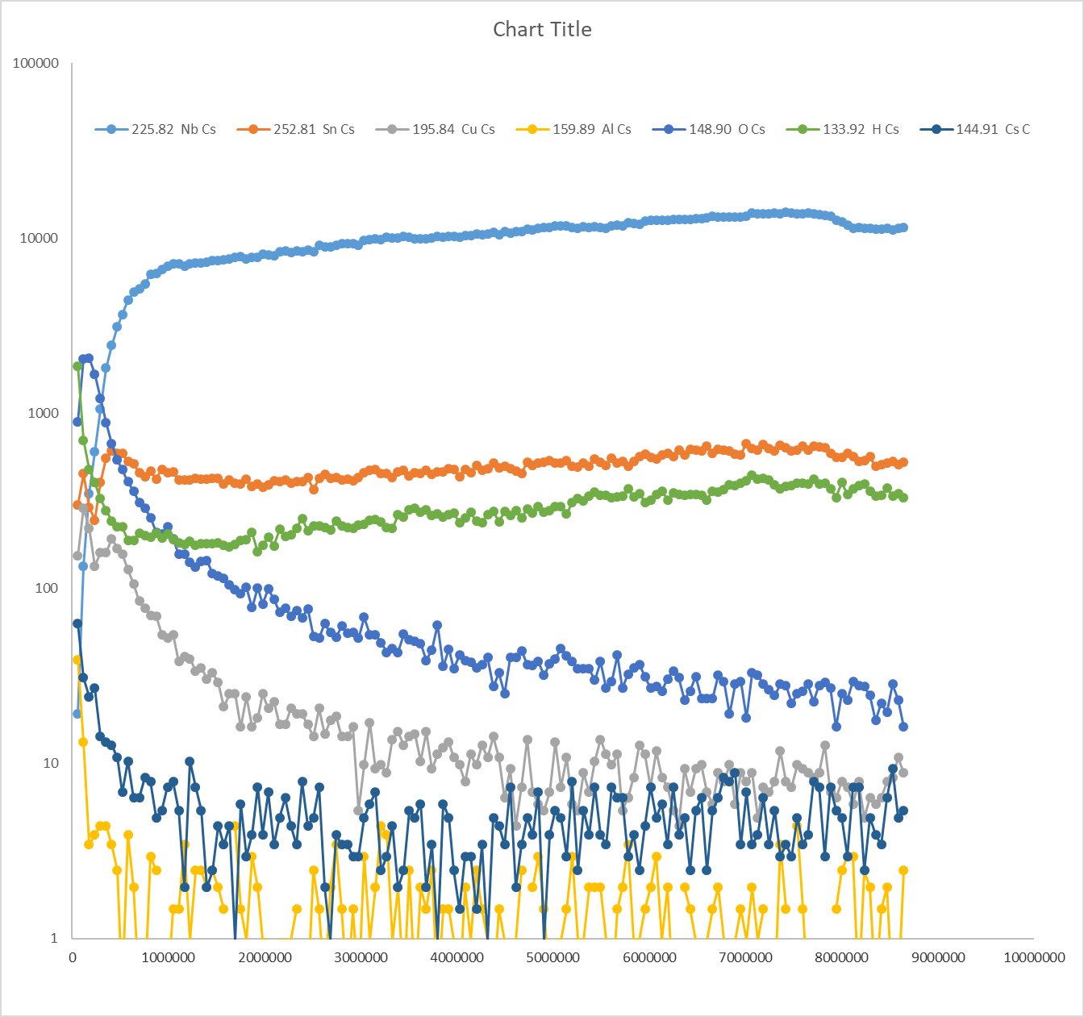
Nb3Sn dep on INFN Cu after NEG Cartridge
Sn
SnO
Nb
Cu
Cu2p3
Cu2p1
Nb2O5
Sn3d3
Sn3d5
NbO2
Nb3d3
Nb3d5

Slide 5
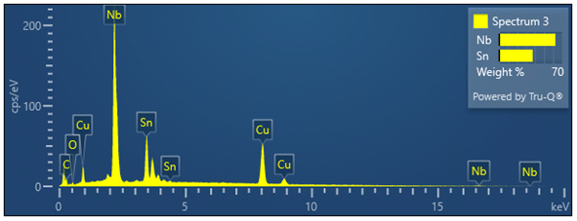
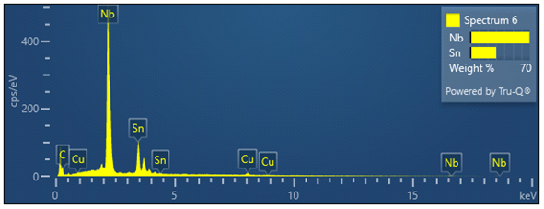
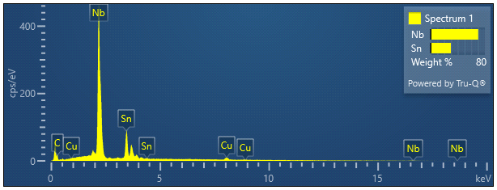
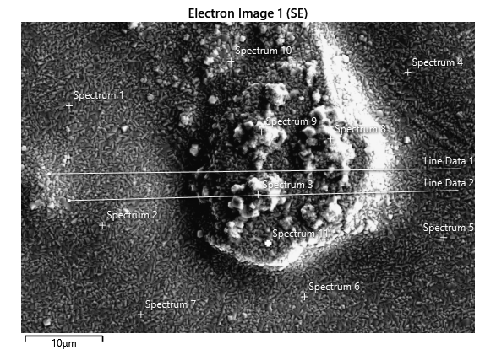
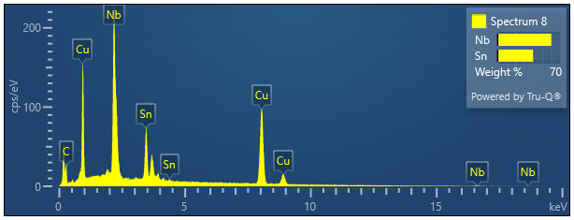
Nb3Sn dep on INFN Cu after NEG Cartridge

Slide 6
Nb3Sn
25/01/25
Critical Temperature [T_{c}] measured by the Magnetic Field Penetration Facility [MFPF].
Sample deposited by INFN and tested at Daresbury Laboratory.
Point of full Flux Penetration [B_{fp}] measured by the Magnetic Field Penetration Facility [MFPF].
15 K
14.4 K

Slide 7
6 GHz cavity

Slide 8
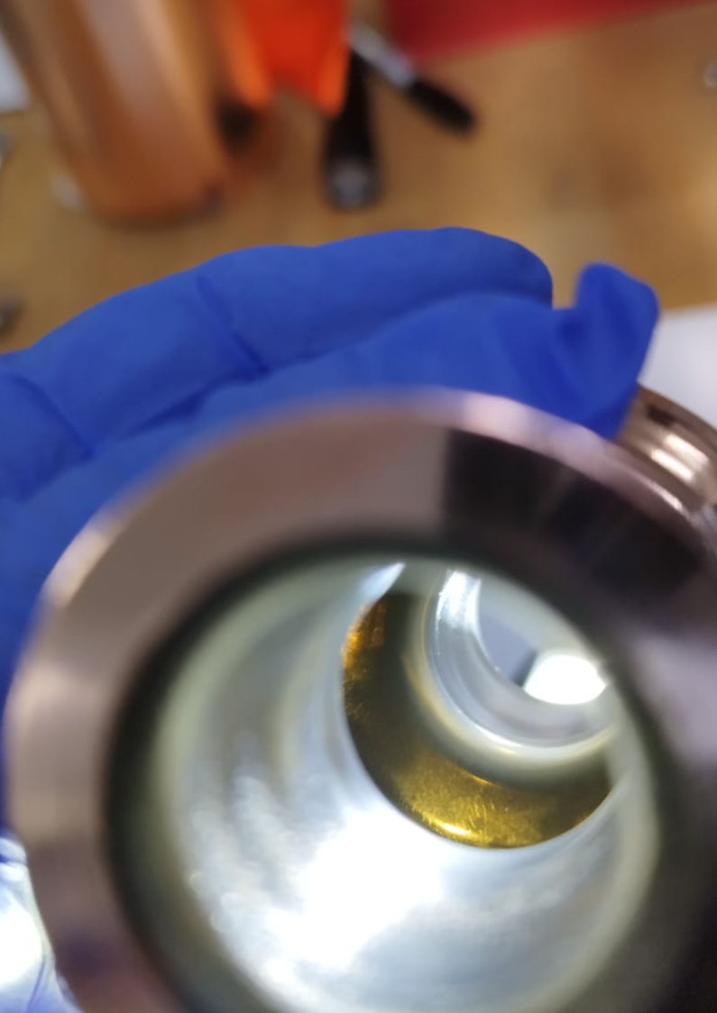
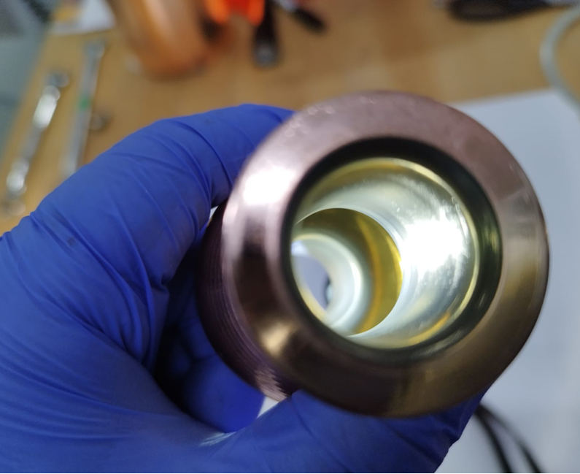
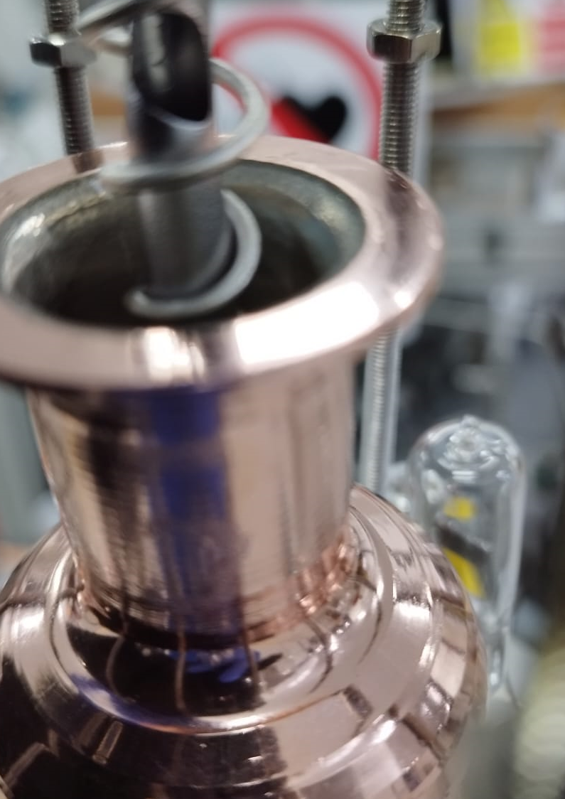
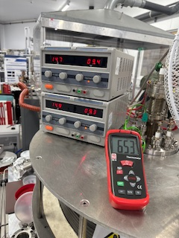
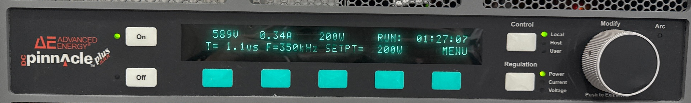
6 GHz cavity deposited NbTiN
Cavity to be shipped to INFN
Ideally tested at low power at Daresbury and then sent to INFN.
Waiting for new cavity to be shipped from INFN

Slide 9
NbTiN (Twisted)(Rod)
17/01/25. Darcy.
Two samples tested:
    Multi-probe: T_{c} measured on Sapphire [ø= < 10mm].
    MFPF: B_{fp} & T_{c} measured on Cu [ø = 50 mm].
17.5 K
Critical Temperature [T_{c}] measured by the Multi-probe.
Point of full Flux Penetration [B_{fp}] measured by the Magnetic Field Penetration Facility [MFPF].
Critical Temperature [T_{c}] measured by the Magnetic Field Penetration Facility [MFPF].

Slide 10
Future work
Planar samples:
  Nb3Sn on copper disk for RF surface resistance
    Nb3Sn on Thick Nb underlayer
    Nb3Sn with 3 different layer thickness 6h, 12h and 24 hours
    V3Si on copper(Lower Priority)
  Nb3Sn on Sapphire disk
    With copper under layer
    With copper under layer and Nb
QPR
  Waiting for the QPR to arrive from HZB
6 GHz Cavity
  Close cavity with NbTiN deposition in Darcy (to be measured at INFN)
  Open cavity with Nb3Sn deposition in Sharon new chamber (to be measured at Surf lab)
1.3 GHz cavity for Nb3Sn deposition
  Open cavity
  Close Nb cavity (3 cavities)
  Close diamond turned Cu cavity from CERN
  Close hydroformed Cu cavity coated with Nb at CERN ready for deposition of Nb3Sn.

