Slide 1
Arnold Pompoš PhD
March 10, 2025
CERN, Geneva, Switzerland
UTSW Radiation Oncology
From HEP to AI Driven Cancer Care
Arnold Pompos PhD

Slide 2
Arnold Pompoš PhD
March 10, 2025
CERN, Geneva, Switzerland
PHYSICIST
UTSW Radiation Oncology
From HEP to AI Driven Cancer Care
Arnold Pompos PhD

Slide 3
Arnold Pompoš PhD
March 10, 2025
CERN, Geneva, Switzerland
PHYSICIST
UTSW Radiation Oncology
HUMAN
From HEP to AI Driven Cancer Care
Arnold Pompos PhD

Slide 4
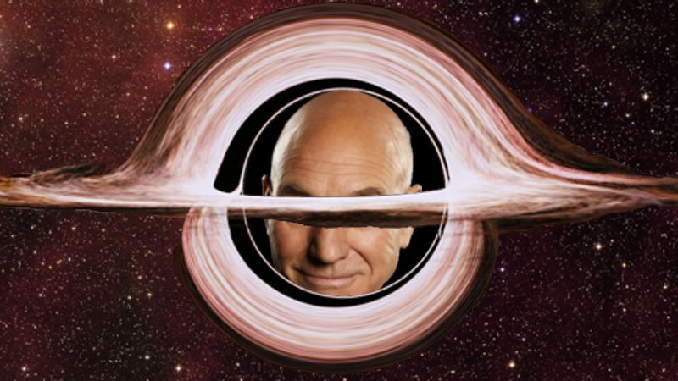
Jacob Bekenstein , John Archibald Wheeler- black holes have no hair (conjecture)
Image from https://hardscienceainthard.com/tag/black-holes/

Slide 5
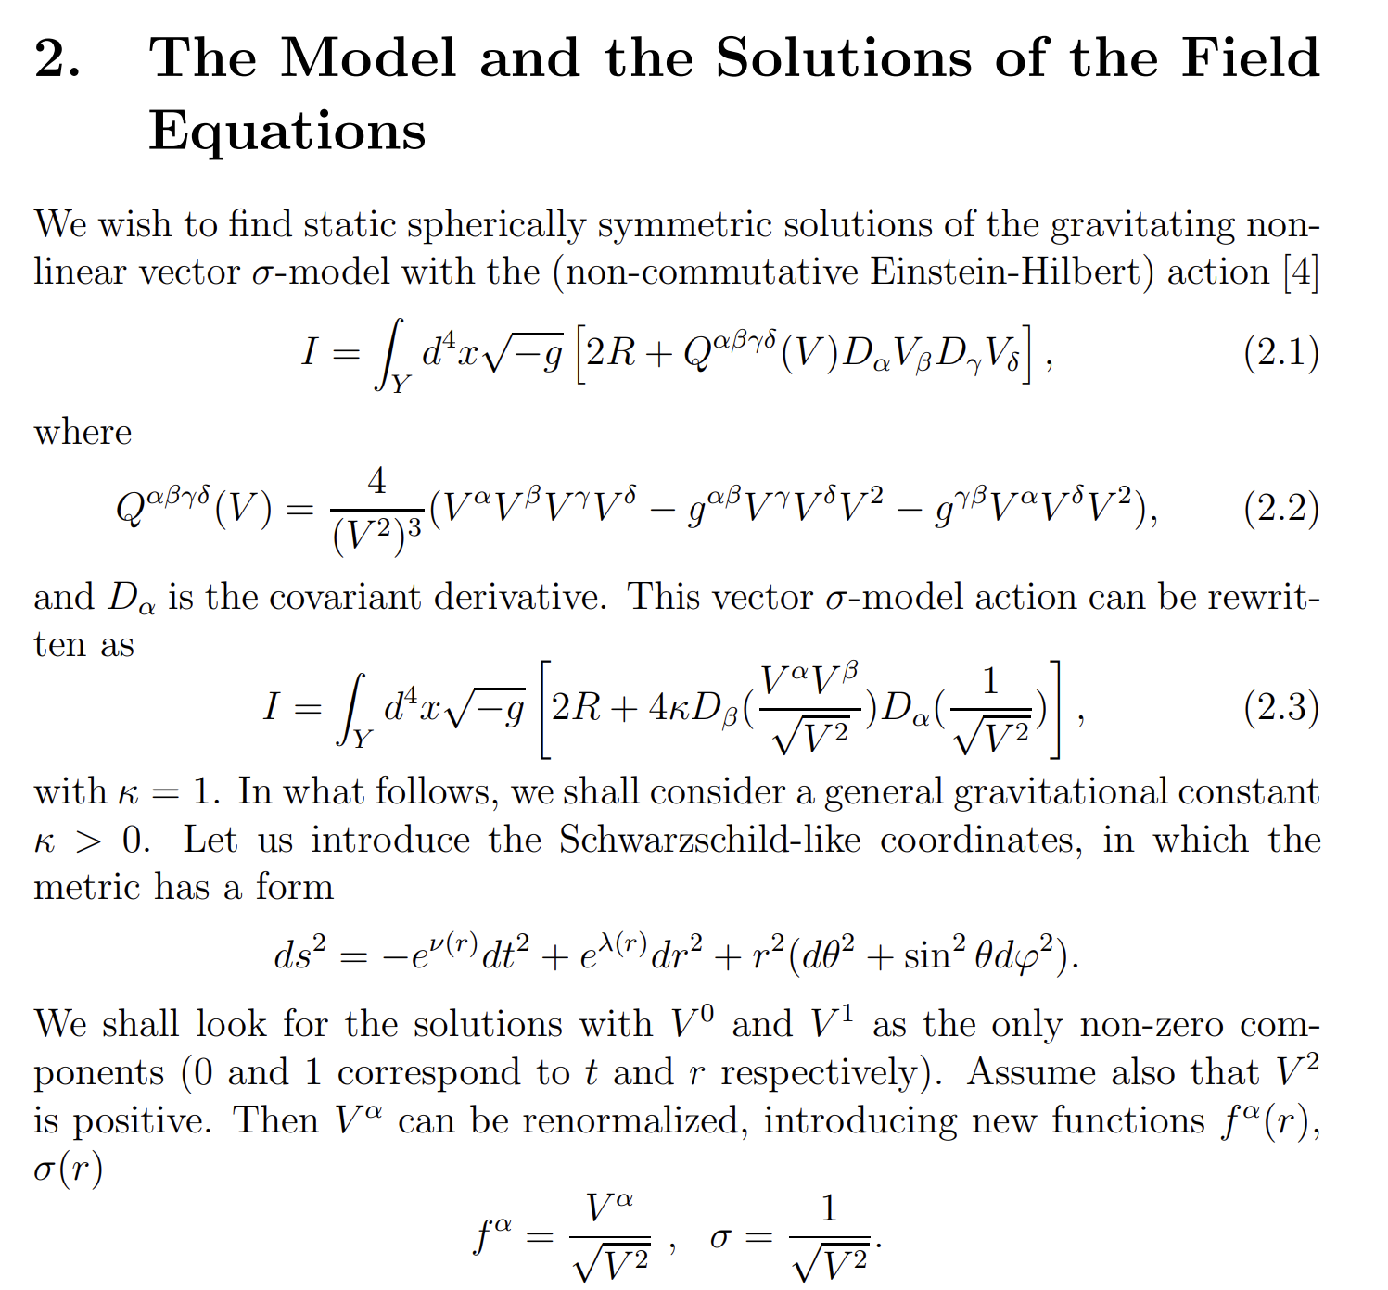
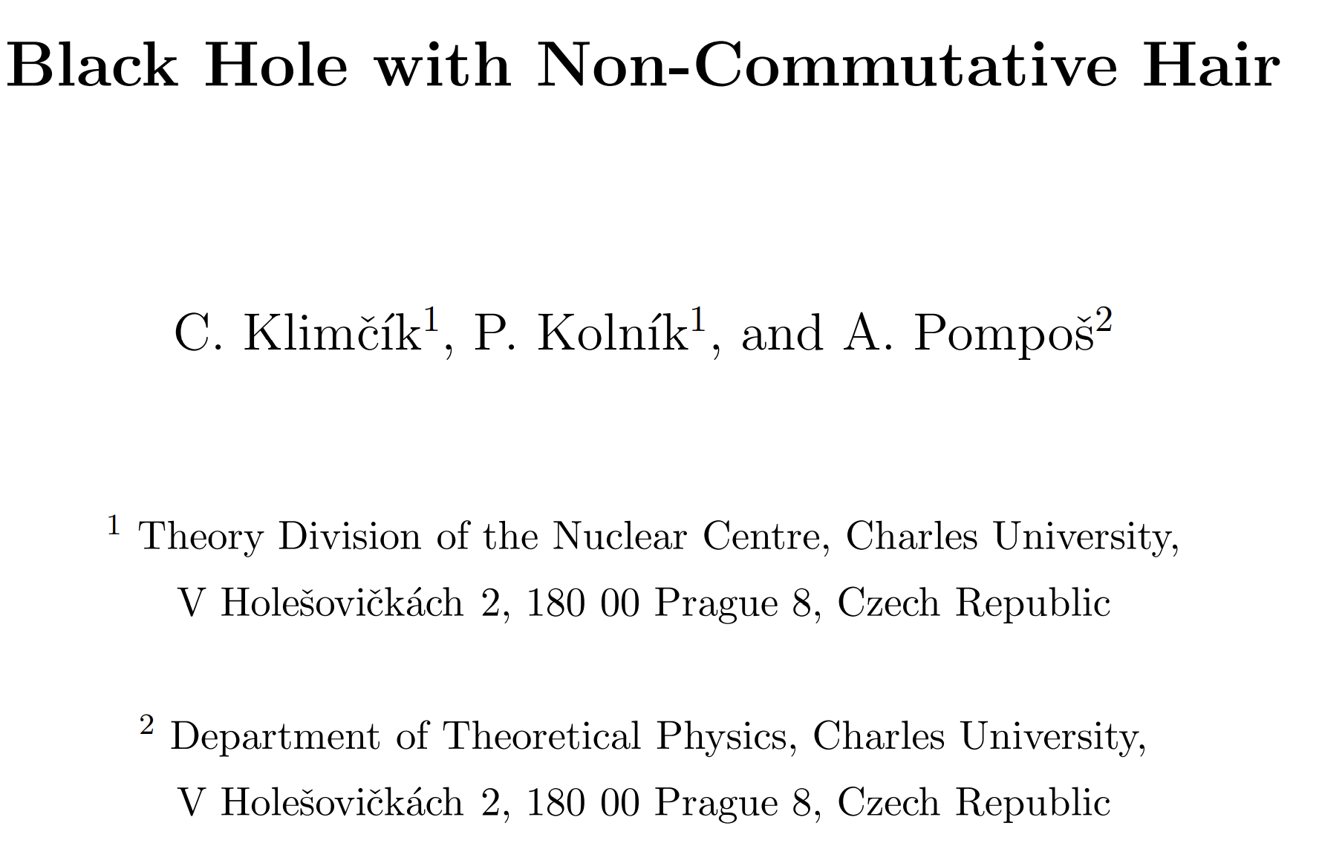
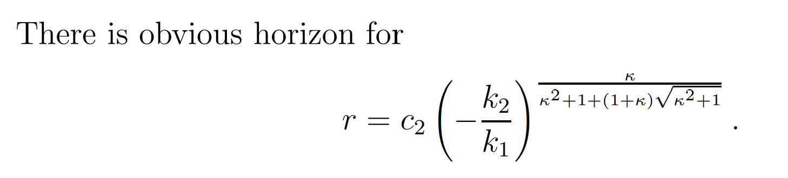
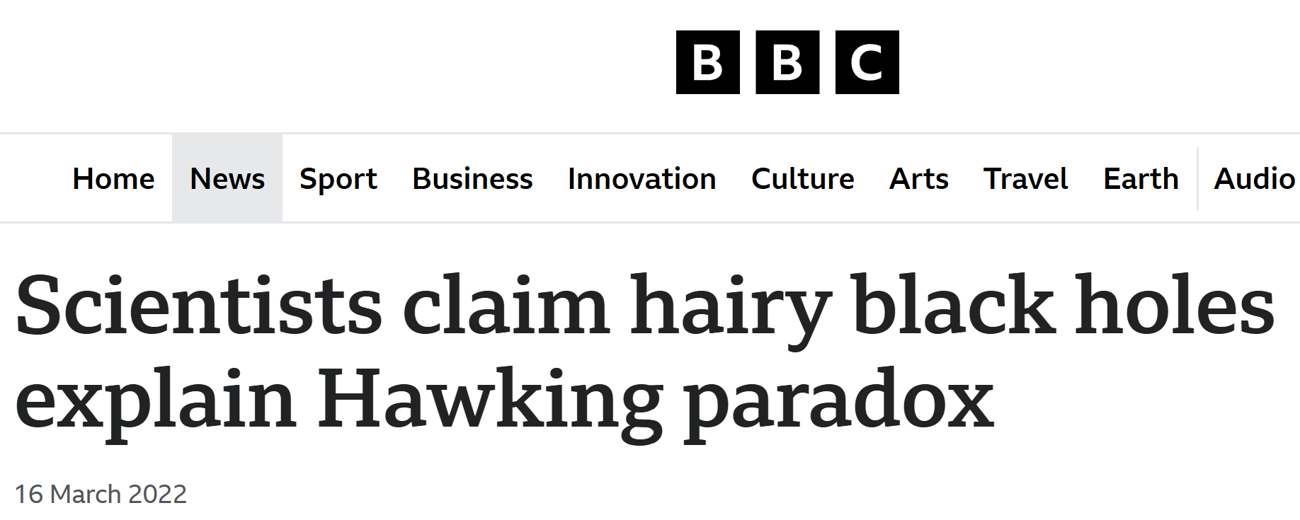

Slide 6
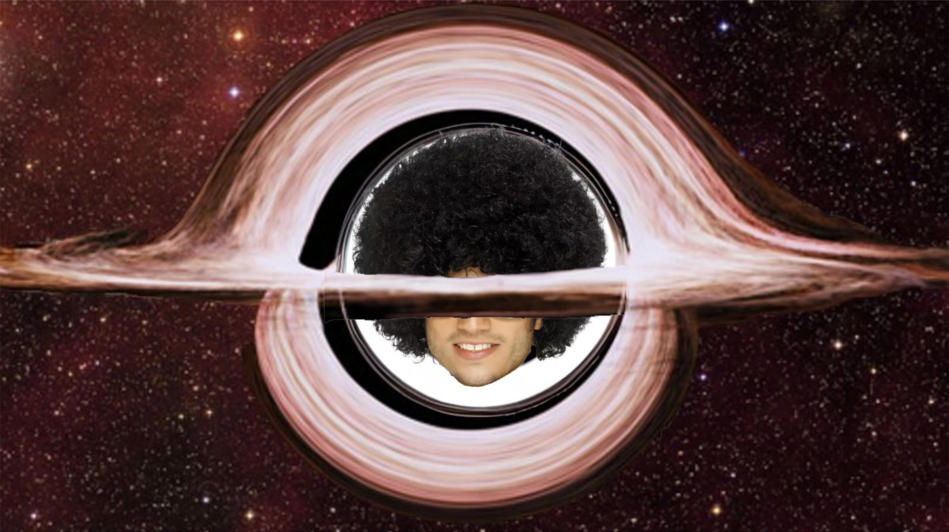
AI (Arnold Intelligence) representation of a hairy black hole
OK, maybe hairy, whast’s next?
Image from https://www.karneval-universe.de/en/p/funky-afro-wig-black.html

Slide 7
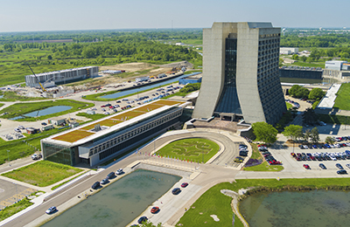

Slide 8
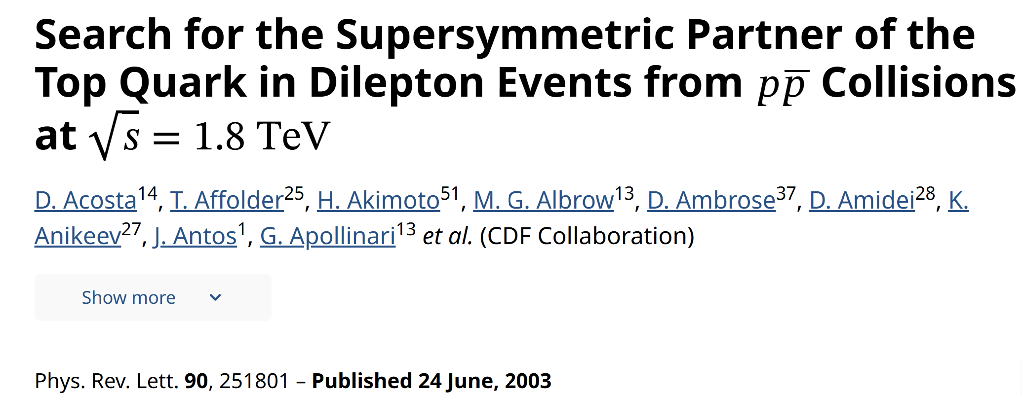
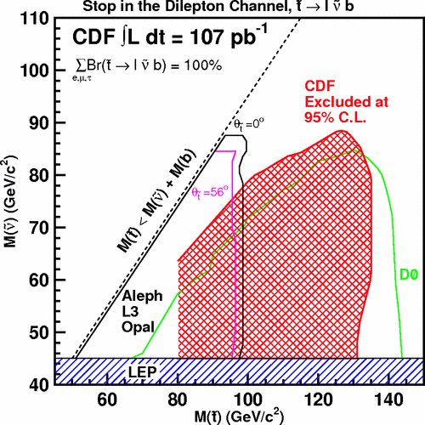
OK, No STOP, whast’s next?

Slide 9
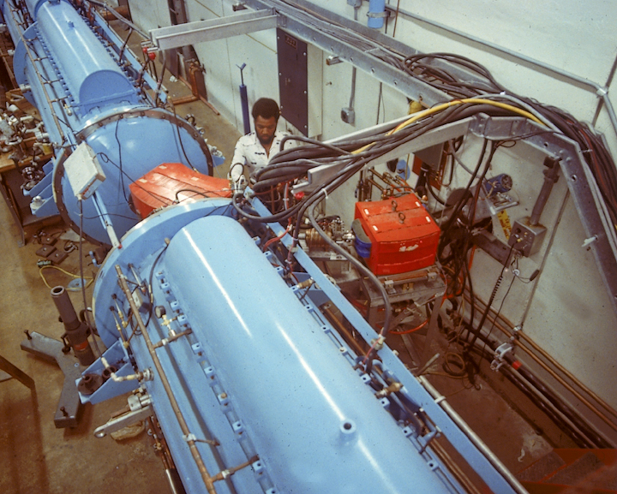
Proton linear accelerator for Neutron therapy

Slide 10
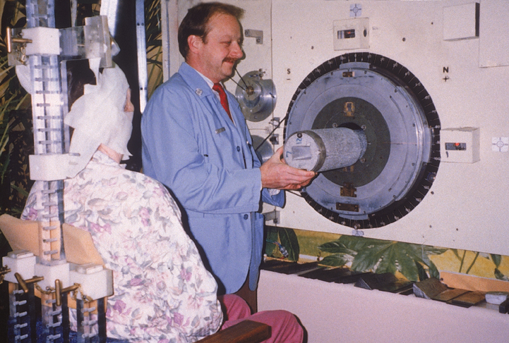

Slide 11
SOLD! Started as HEP Theorist, continued as HEP experimentalist and ended up as Medical Physicist ☺
Arnold Pompoš PhD

Slide 12
Brief Intro to Radiation Oncology
the where, what, why, how and by whom.
Arnold Pompoš PhD

Slide 13

WHERE is UTSW?
CERN

Slide 14
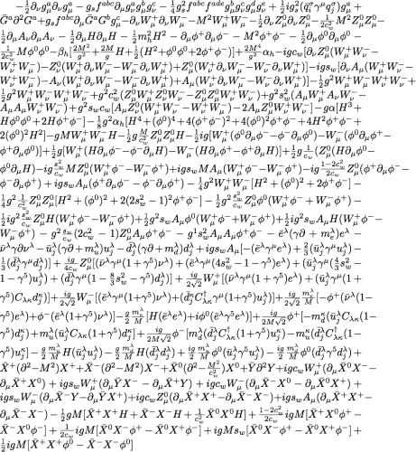
WHAT?
Arnold Says THIS!!!

Slide 15
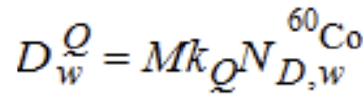
WHAT?
Medical Physicist are saying THAT!!!

Slide 16
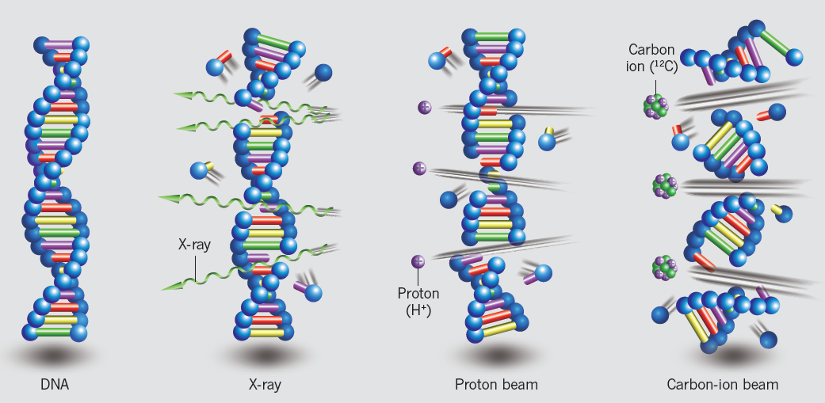
WHY?
Conventional
Heavy Ion

Slide 17
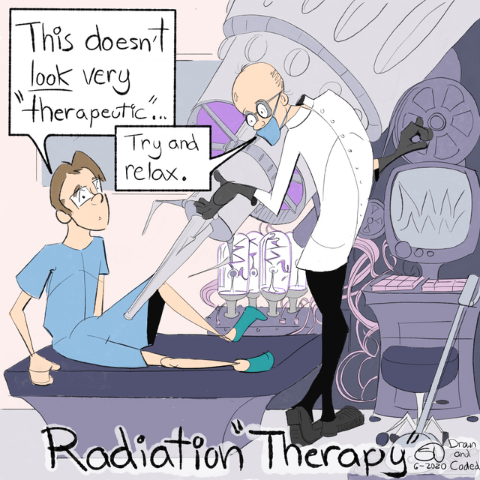
Are you sure
you are not going to miss?
HOW?
AP modified from this source:
Arnold Pompoš PhD

Slide 18

BY WHOM?

Slide 19
More specifically, let’s start with the basics first.

Slide 20
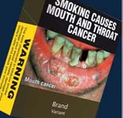
What is a cancer cell?
Answer: a cell that forgot how to die
Any dividing tissue/cell can become cancerous
Estimated 10¹² cells in human body
Even if malignant transformation probability is tiny, tiny*huge can be significant
Why some willingly increases tiny to small or large?
  Inhale chemicals, put carcinogens in food, etc
There are more than 200 cancer types
US population 300 million
  Estimated 1.5 million new cancer cases/year
  Estimated 0.5 million cancer death / year

Slide 21
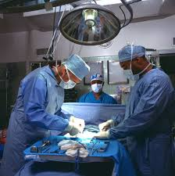
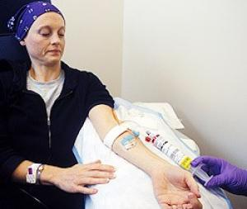

How to remind cancer cells how to die?
Cut blood & food supply (surgery)
Inject poison to body (chemotherapy)
  and hope one kills more cancer cells than healthy ones
Deposit energy to cells via ionizing radiation (radiation oncology)
  and break their DNA

Slide 22
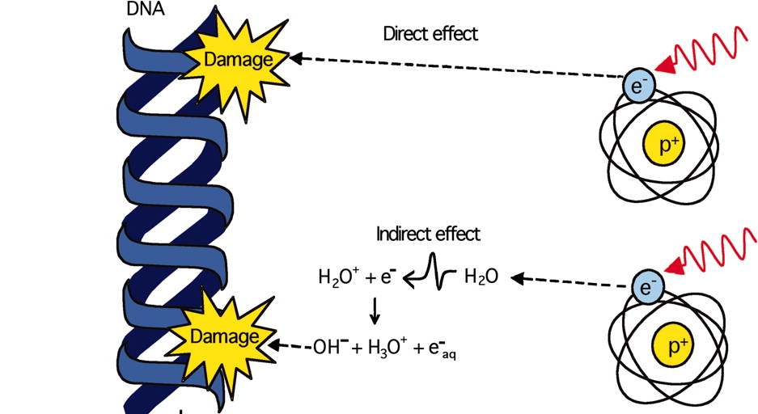
How ionizing radiation breaks DNA?
Estimated 60% of body is water
Ionizing radiation creates free radicals e.g OH and H
Free radicals are highly reactive
If they are close to DNA, they will steal a hydrogen and break DNA strand
.
.

Slide 23
Warning!
Yes, ionizing radiation can mutate DNA
  and therefore suggest healthy cells how NOT to die
Yes, cells (healthy or cancerous) do have damage repair mechanisms
Yes, TUMOR cells are LESS efficient in repair than HEALTHY ones

Slide 24
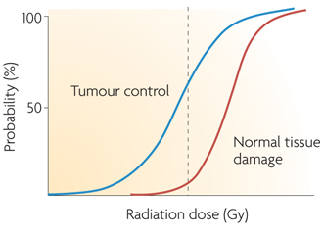
Radiation Oncology Philosophy
is based on the following observations

Slide 25
Physics

Slide 26
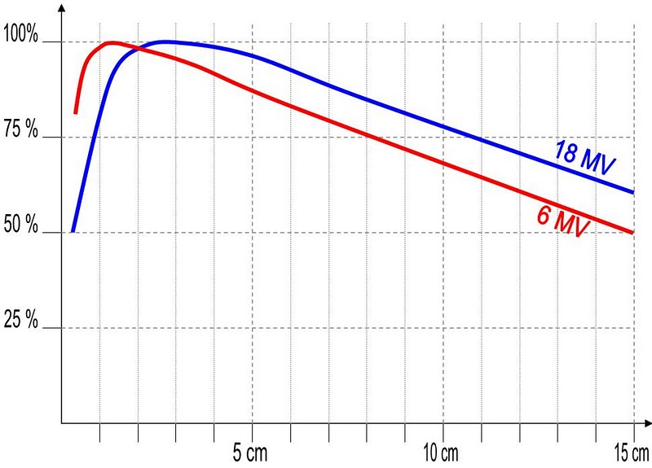
Irradiation with Photons – External Beam
Relative (to Maximum Dose) Depth Dose Curves for 6MV and 18MV Photon Beams

Slide 27
Overall Workflow

Slide 28
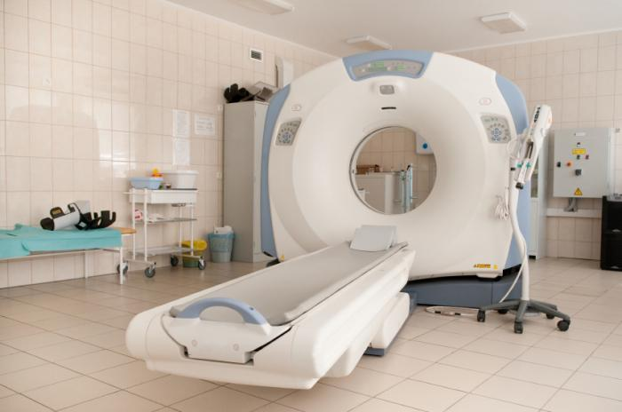

Slide 29
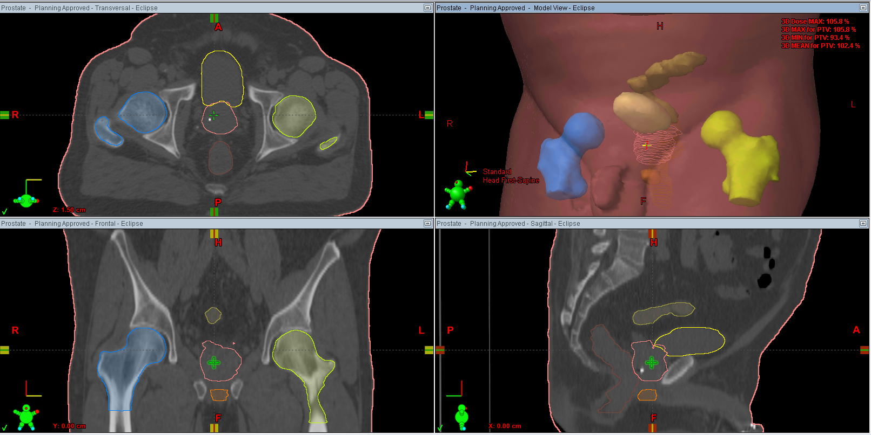

Slide 30
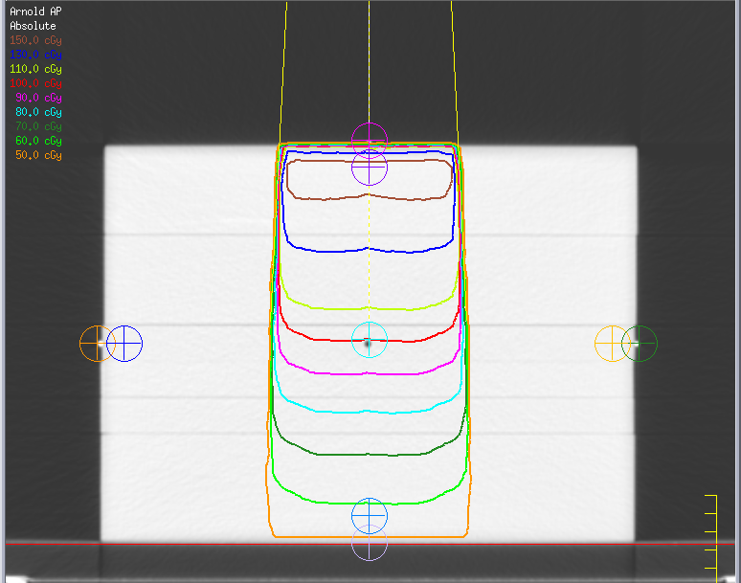
Therapy with Photons - I
Prescribed 1Gy to 11cm deep T
One Anterior 6MV photon beam
Note the dose at various points
A=1.5Gy
R=0.03Gy
L=0.03Gy
T=1Gy
P=0.6Gy

Slide 31
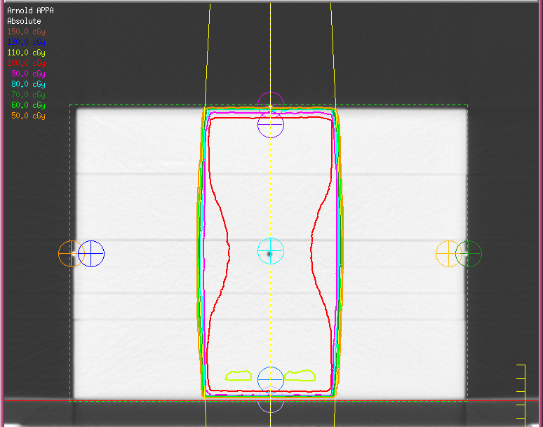
Therapy with Photons - II
Prescribed 1Gy to 11cm deep T
One Anterior 6MV photon beam
One Posterior 6MV phot. beam
Note the dose at various points
A=1.07Gy
R=0.03Gy
L=0.03Gy
T=1Gy
P=1.07Gy

Slide 32
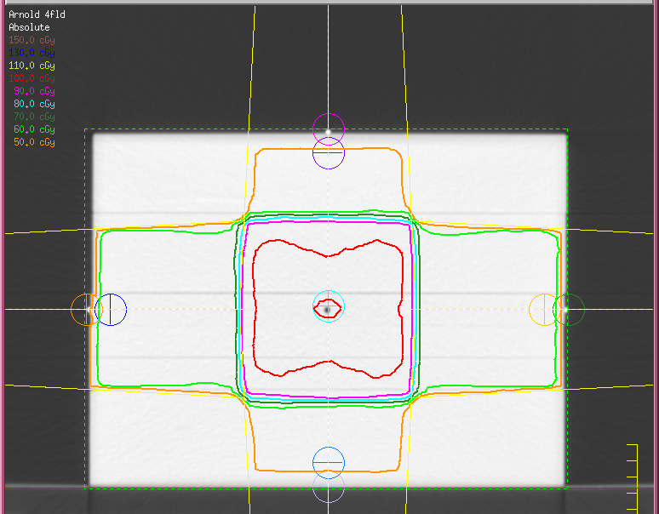
Therapy with Photons - III
Prescribed 1Gy to 11cm deep T
One Anterior 6MV photon beam
One Posterior 6MV phot. beam
One Right 6MV photon beam
One Left 6MV photon beam
Note the dose at various points
A=0.5Gy
R=0.67Gy
L=0.67Gy
T=1Gy
P=0.5Gy

Slide 33
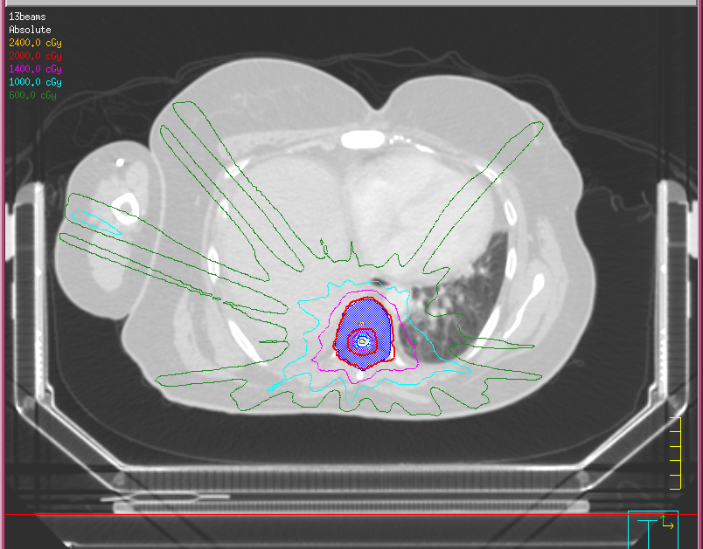
Therapy with Photons - IV
Prescribed 20Gy to Blue Area
13 Beams from Various directions and various energies
Note the great coverage of blue
Note the spine getting only a small fraction of the prescribed dose

Slide 34
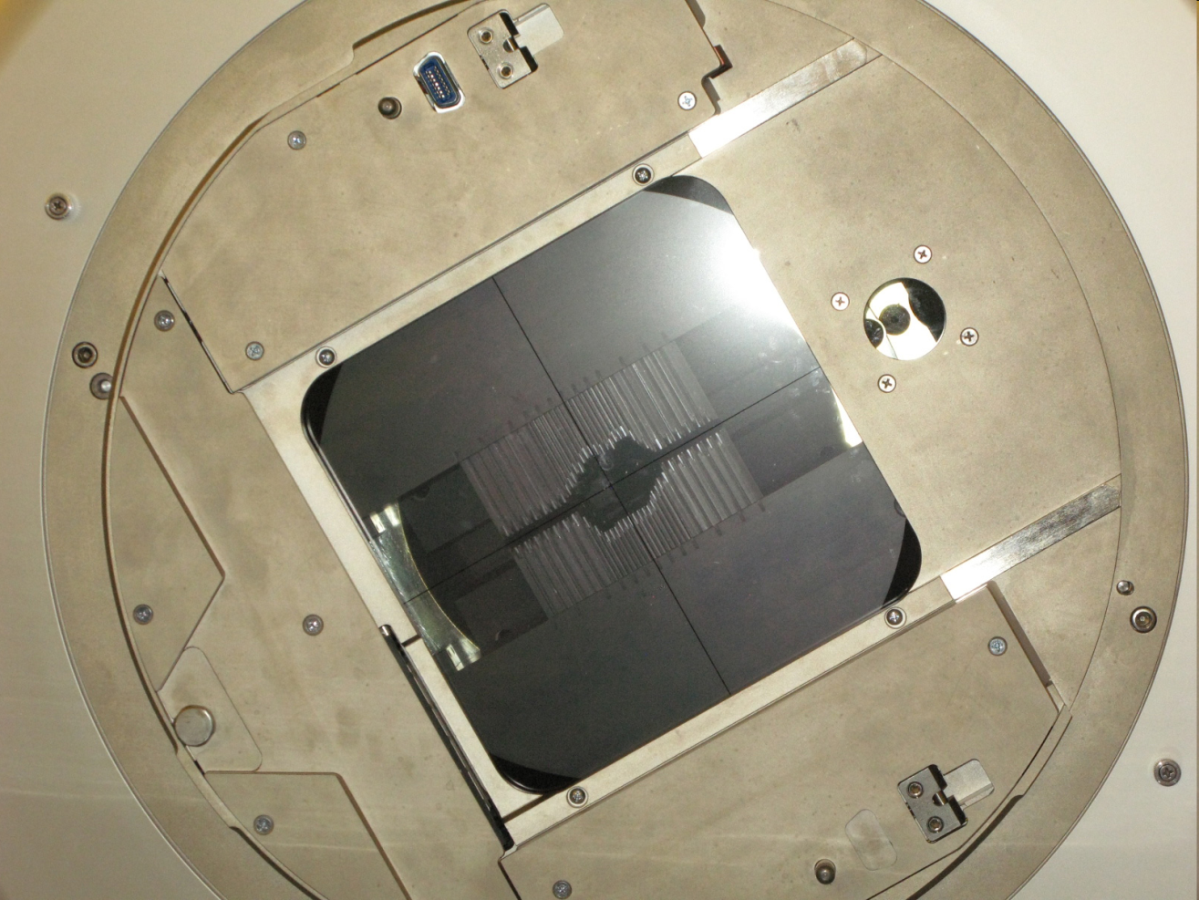
Therapy with Photons - VI
How to improve dose distributions?
IRRADIATE
BLOCK

Slide 35
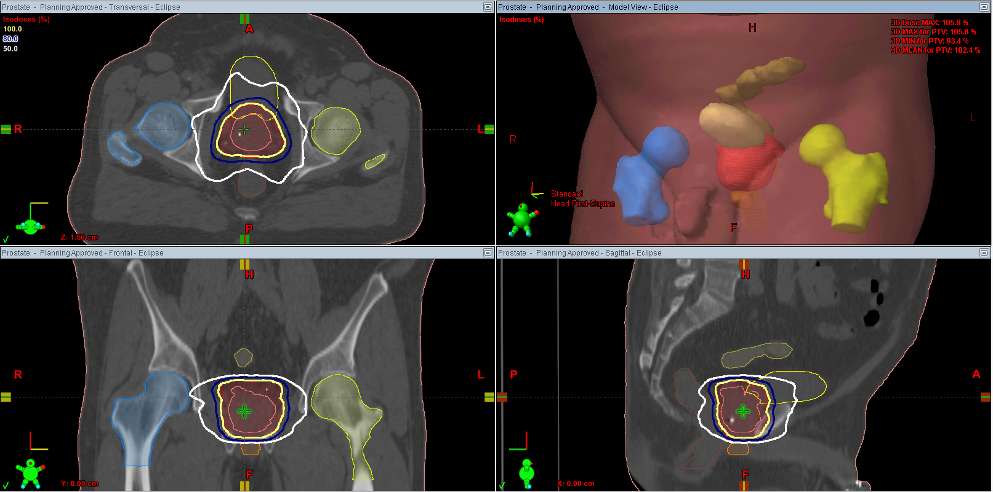

Slide 36
CERN AND HEP HEELLLPPP!!!
Radiation machines!

Slide 37
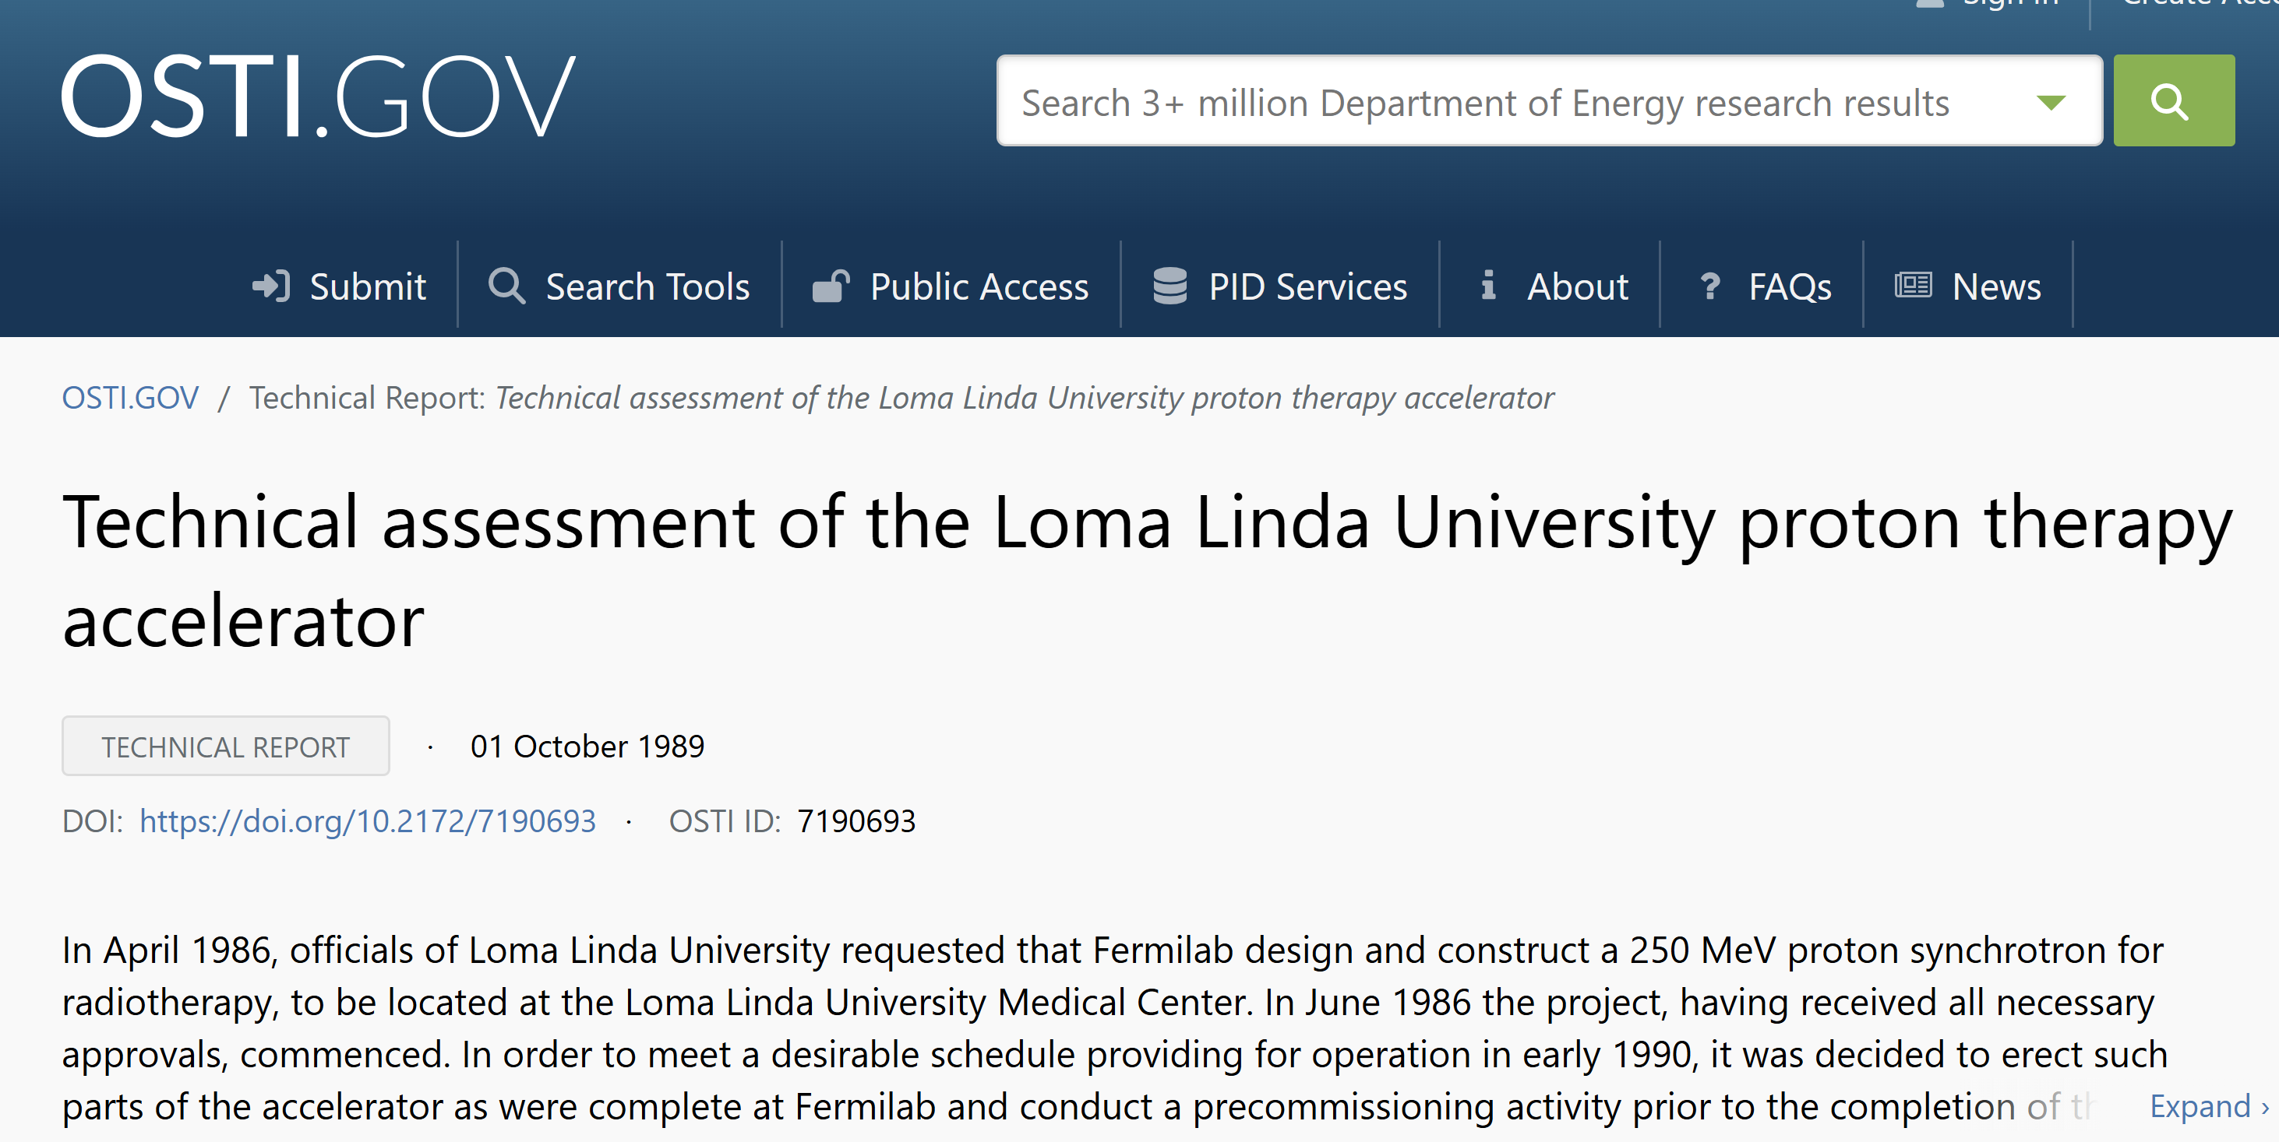
Fermilab Gave First Clinical Proton (Loma Linda)

Slide 38
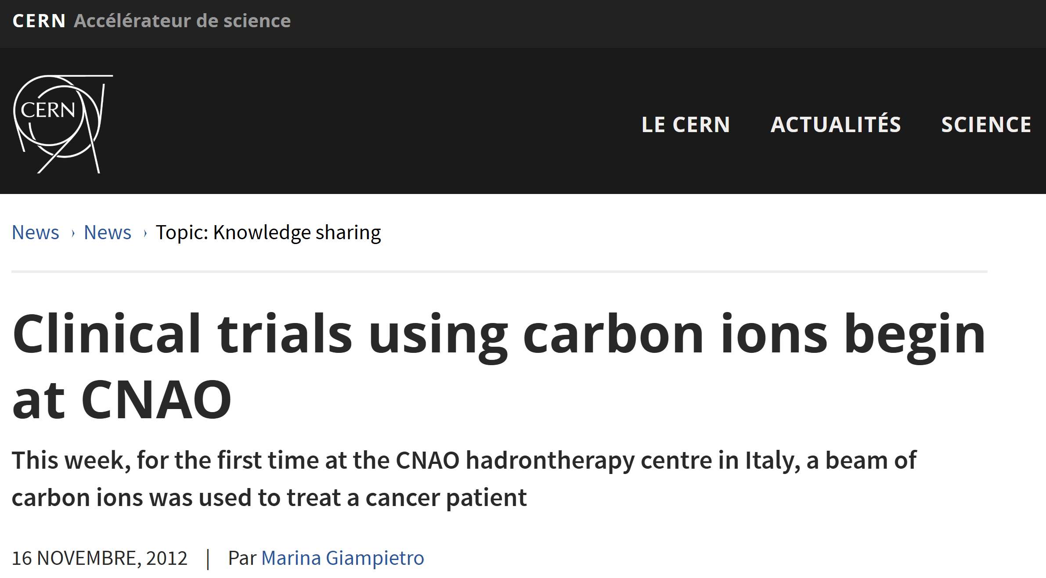
CERN gave “First” Clinical Carbon Ion (CNAO)
PIMMS
The accelerator complex which provides beams for CNAO is based on the Proton Ion Medical Machine Study (PIMMS), a design study that took place at CERN from 1995 to 2000 and involved researchers from CERN, TERA Foundation and MedAustron.

Slide 39

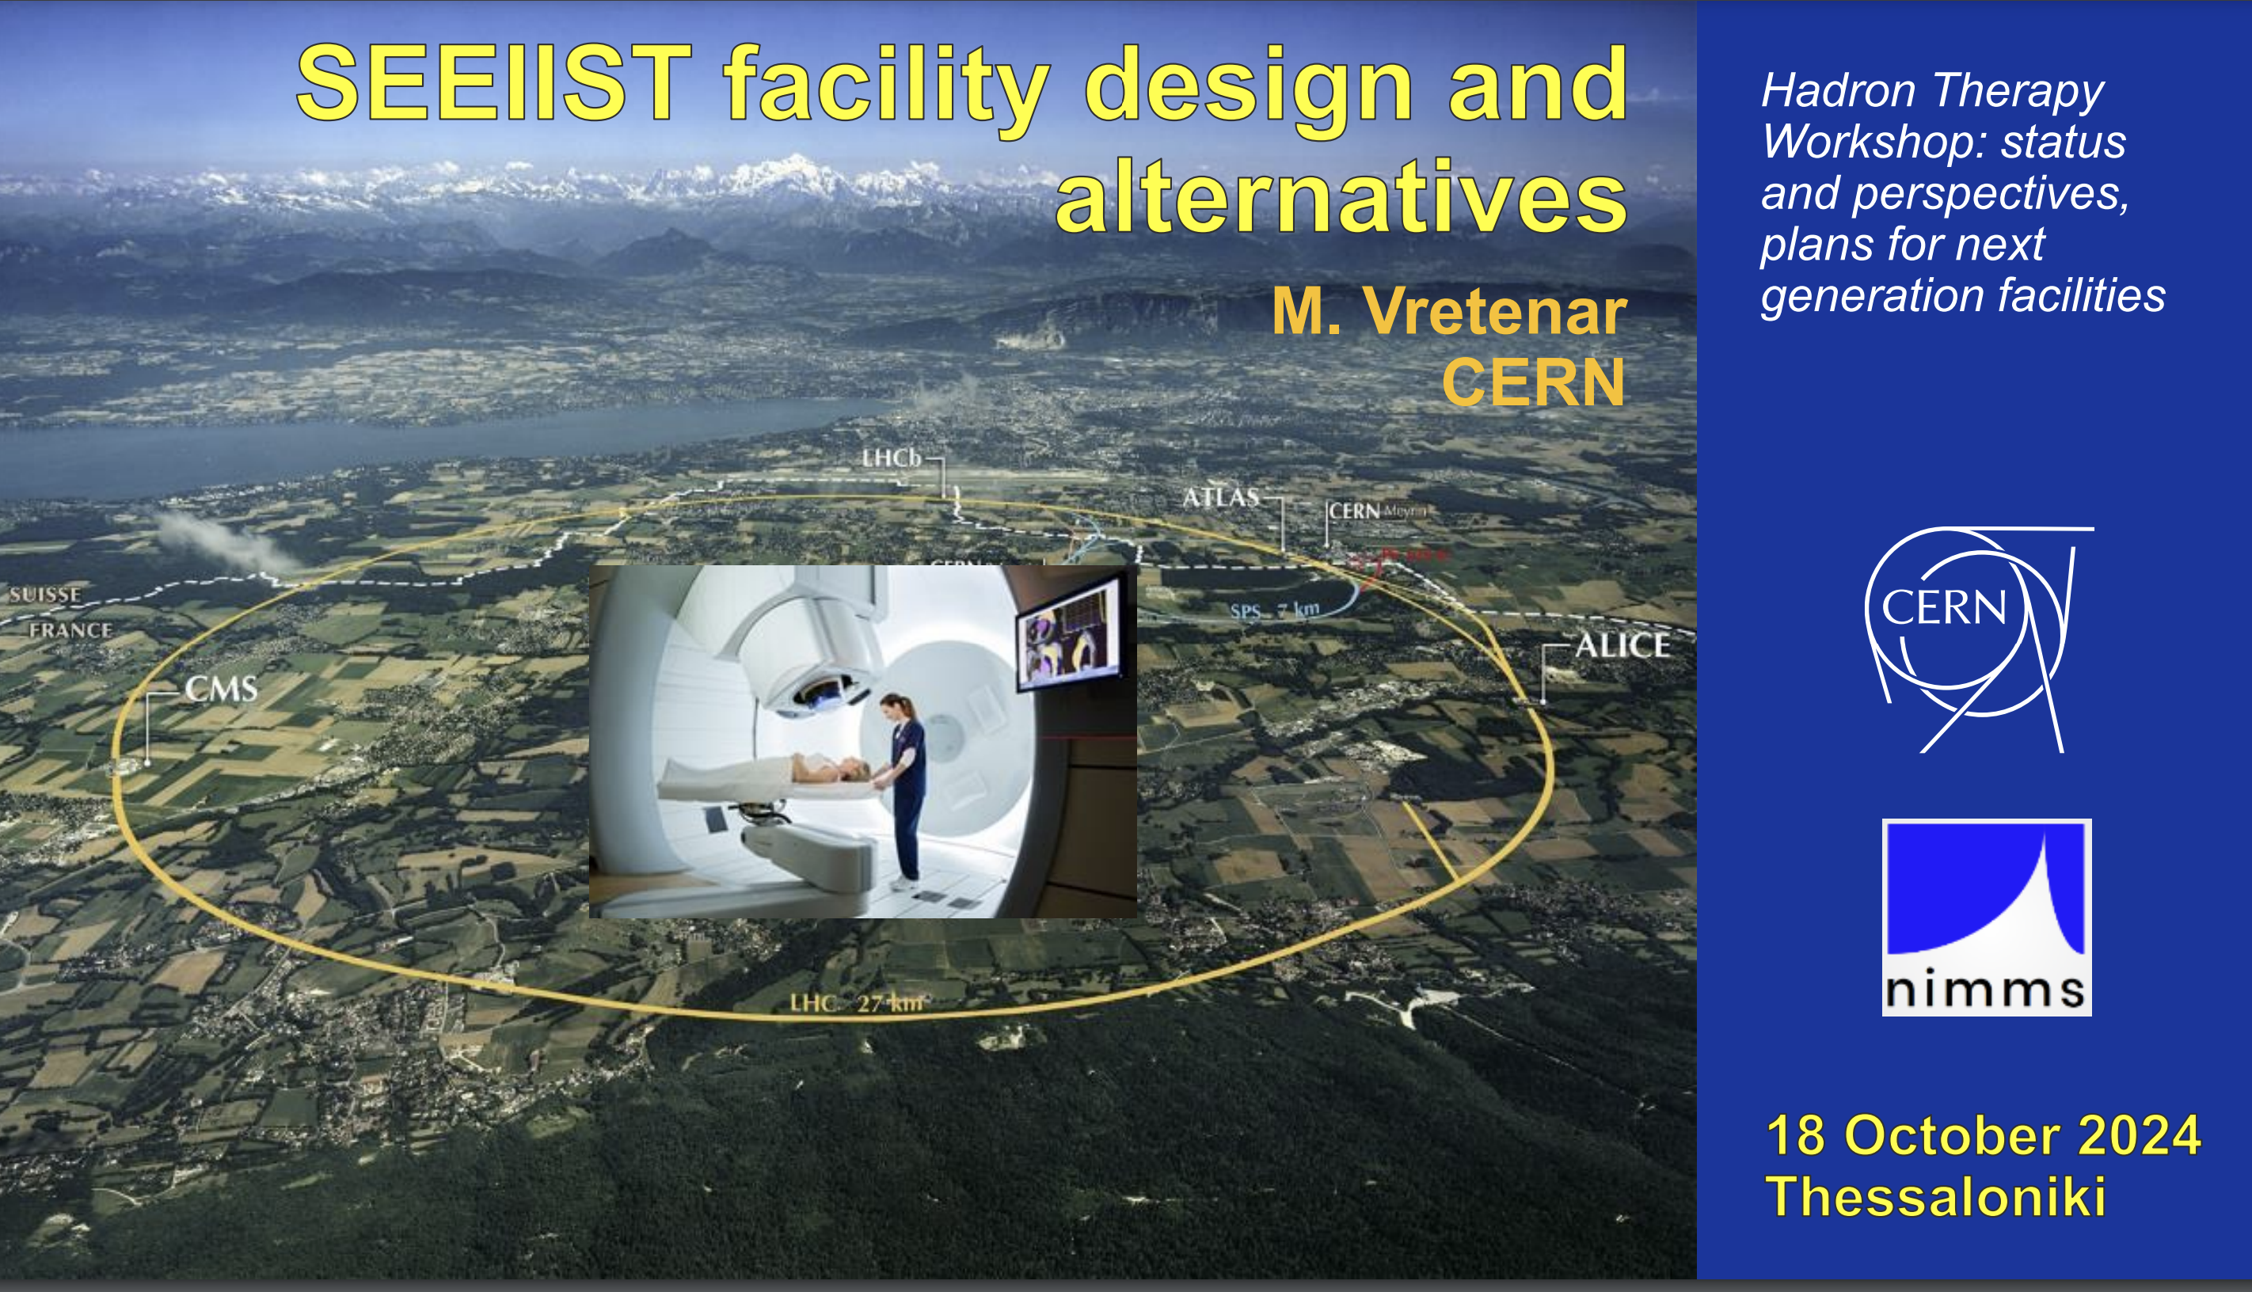
Is CERN giving the next Hadron Therapy system?
NIMMS

Slide 40
COMPACTIFICATION EFFORT LIKE CERN’s IS VITAL!
3 UTSW buildings 55mil, 75mill, 150mil!!!
Arnold Pompoš PhD

Slide 41
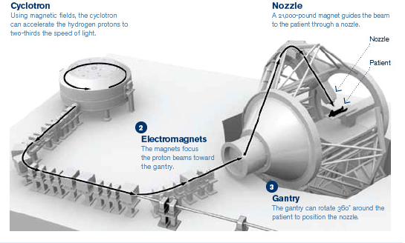
How to Produce Therapeutic Proton Beams

Slide 42
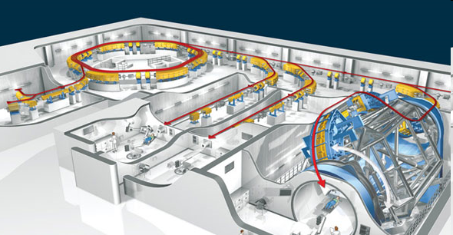
How to Produce Therapeutic Carbon Beams

Slide 43
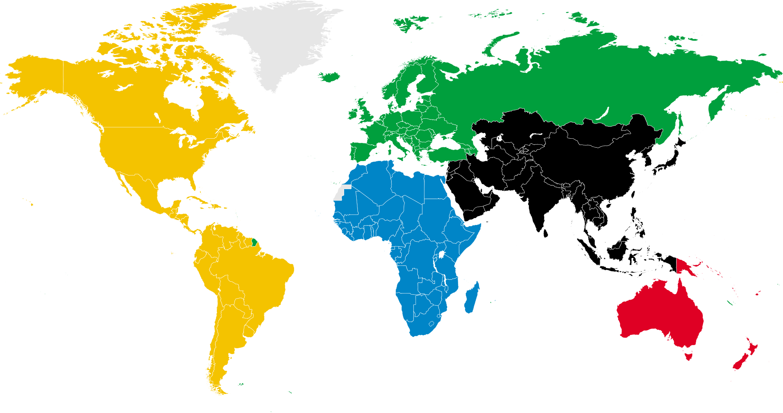
World Wide Heavy Ion Therapy Centers
Forgotten
USA Berkeley Nat. Lab, last patient treated1993
Operational (8)
China Fudan Univ CC, Shanghai
China IMP-CAS, Lanzhou
Germany HIT, Heidelberg
Italy CNAO, Pavia
Japan HIMAC, Chiba
Japan HIBMC,Hyogo
Japan GHMC, Gunma
Japan SAGA-HIMAT, Tosu
Under Construction(6)
China HITFiL, Lanzhou
China Another Center, Lanzhou
Germany MIT, Marburg
Austria MedAustron, Wiener Neustadt
Japan i-ROCK, Kanagawa
South Korea KHIMA, Busan
Advanced Planning(4)
France ETOILE, Lyon
Japan Okinawa
Japan Yamagata
Japan Osaka
Total : 18
AP 6-22-2014

Slide 44
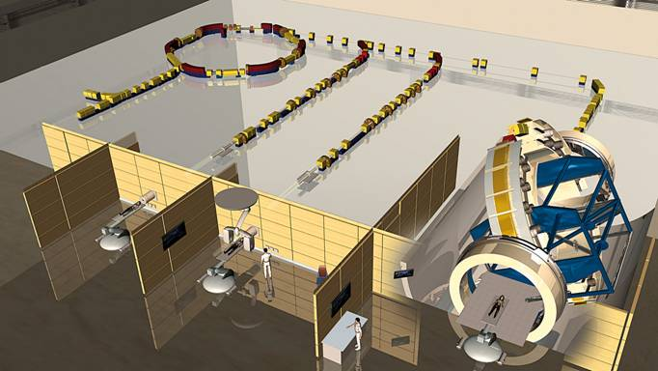
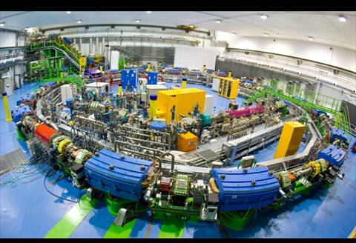
How Does a Heavy Ion Facility Look Like?
44

Slide 45
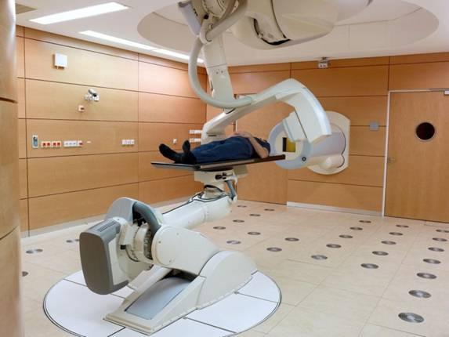
How Does a Heavy Ion Facility Look Like?
45

Slide 46
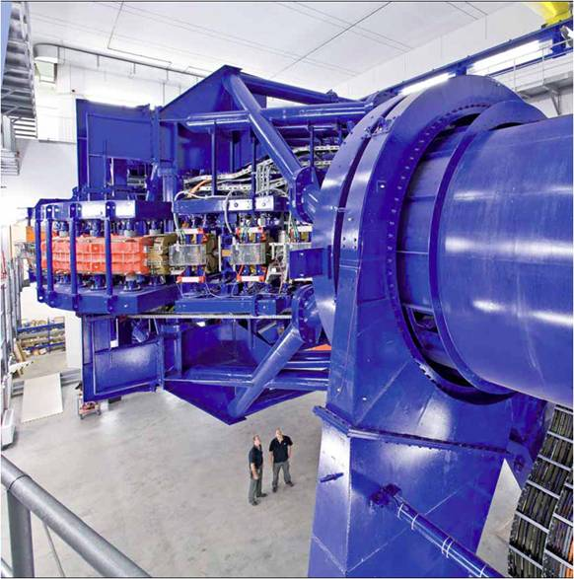
How Does a Heavy Ion Facility Look Like?
46

Slide 47
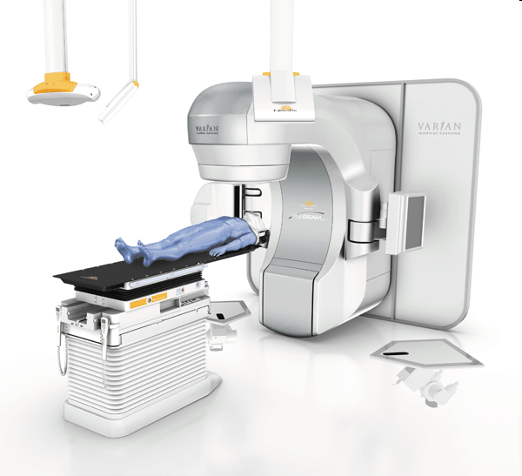
Put Patient in Treatment position

Slide 48
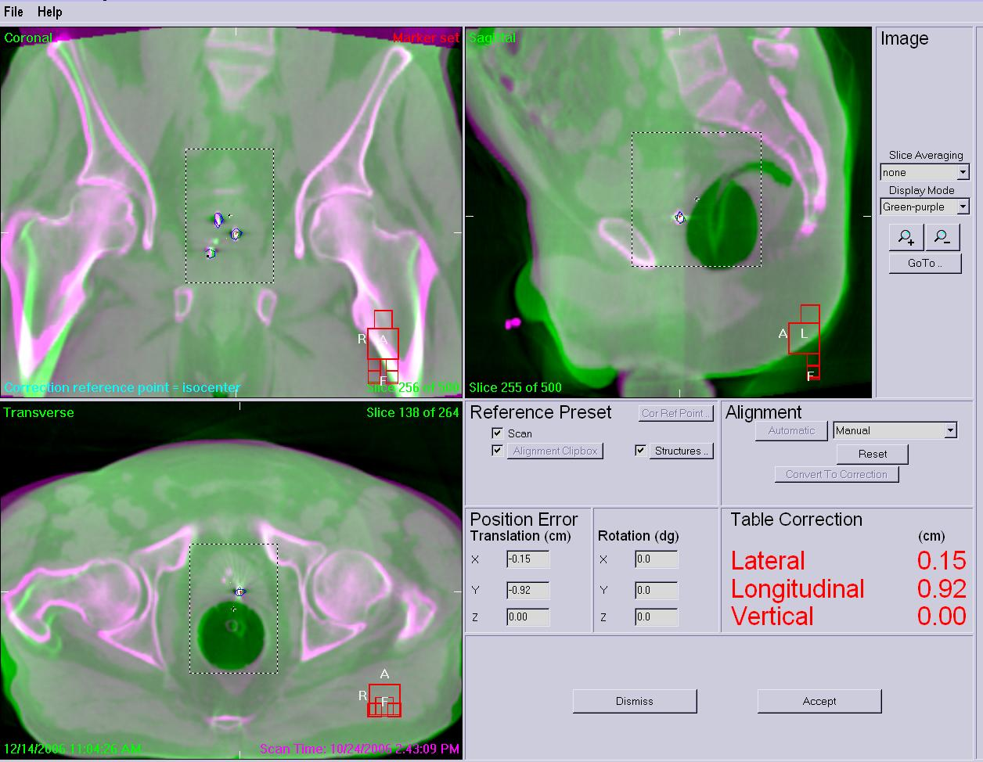
CBCT Localization

Slide 49
Irradiate

Slide 50
This Takes typically 1-2 weeks
At UTSW, 5day pre-planning timeline
  2 days contouring
  2days planning
  1 day Quality Assurance
BUT patients ask questions, especially in Texas!
Arnold Pompoš PhD

Slide 51

A Friendly Texan Patient quizzes Radiation Oncologist during On Treatment Visit
Ordinary Rad Onc MD in Texas
Ordinary Texas
Cancer Patient
Arnold Pompoš PhD

Slide 52
A Friendly Texan Patient quizzes Radiation Oncologist during On Treatment Visit
Patient asks:
    What?? Doc, you are treating me with a plan you generated weeks ago?
    Is my bowel still far from tumor?
  Geometric (location) changes of OAR from Fraction to Fraction
Patient asks:
    Doc, is my tumor getting smaller?
  Geometric(size) changes of tumor during therapy course
Patient asks:
    Doc, did you hit all targets today?
  Geometric(location) changes of targets Frac. to Frac.
Patient asks:
    Doc, did you kill my tumor or is it still alive?
  Functional tumor changes during therapy course
Patient asks:
    Doc, I started to have diarrhea, did you injure my bowel?
  Functional OAR changes during therapy course
Patient asks: .
    Is my tumor really hit when you shoot the beam?
  Visualization of target during beam on
Ordinary Rad Onc MD in Texas
Ordinary Texas
Cancer Patient
Especially these as Dr. Timmerman mentioned
Arnold Pompoš PhD

Slide 53
AND NO! THE DISCUSSION IS NOT OVER YET!
Because the moment MD starts to inform patient about statistical outcomes of clinical trial XXXX relevant to patient disease, patient will scream:
Arnold Pompoš PhD

Slide 54
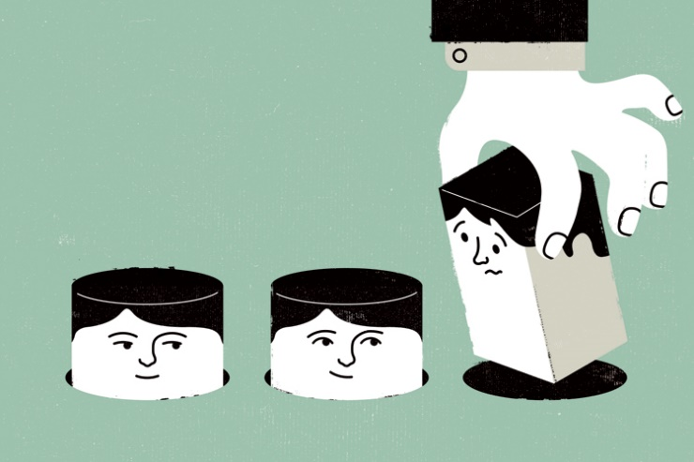
A Friendly Texan Patient quiz continues!
WHAT DO YOU MEAN BY:
“If there were 1000 of you, 800 I will cure but 200 I will not”
DUDE! I AM ONLY 1
  There is no 1000 of me!!!
  Are you curing ME or not?
Ordinary Rad Onc MD in Texas
Ordinary Texas
Cancer Patient
Why are you doing One Size Fits All Practice on me?
Arnold Pompoš PhD

Slide 55
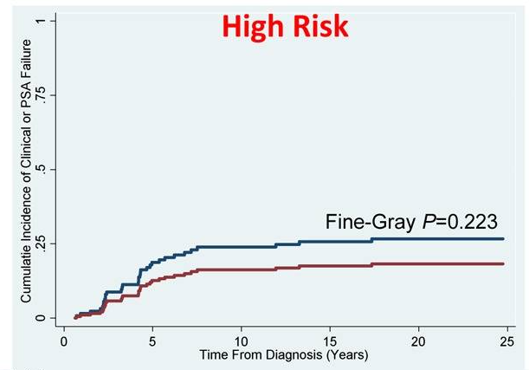

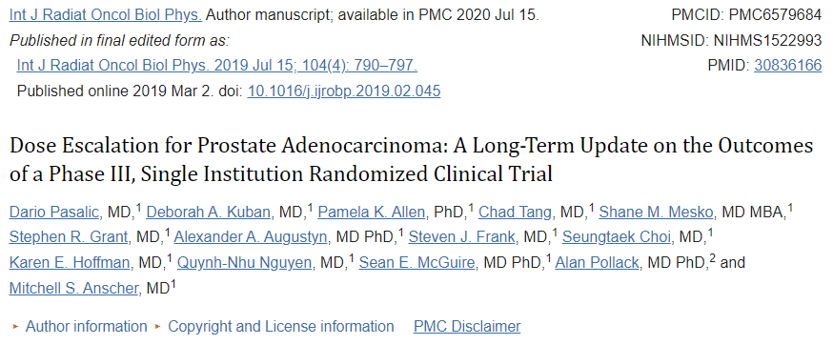
One Size fits all is suboptimal – not a good answer to patients

Slide 56
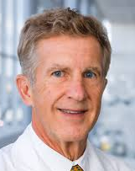
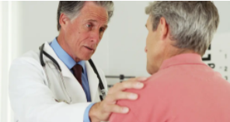
Radiation Oncologist Responds to Patient : Relax
My goal is to:
  Increase your survival chances
  Increase local control of your tumor
  Decrease your toxicities
  Improve your quality of life
  Minimize the uncertainty in your outcome prediction
BY ENDING THE COURSE OF RADIATION THERAPY
BY PRACTICING ULTRAPERSONALIZATION OF YOUR CANCER CARE, PULSAR
™Dr. Robert Timmerman
Arnold Pompoš PhD

Slide 57
FIRST, THE BIG PICTURE:
WHAT IS “ENDING THE COURSE”?
Arnold Pompoš PhD

Slide 58
Simple Algorithm of Ultrapersonalization
….
Identify a set of FEATURES that might have prognostic relevance
  Examples of features: assays, tests, biomarkers (EX: PSA, CircTumCells/DNA, Size, SUV …)
Set target values to be achieved by therapy
  Say if SUV less than 0.1, STOP therapy
Identify Therapeutic Variables that influence the values of FEATURES
  Set value for the therapeutic Variables (EX: Dose, Delta T between pulses, …)
Give a potent Radiation Pulse
WAIT WAIT WAIT – GIVE BIOLOGY CHANCE TO REACT!
Assess response to Pulse (evaluate the values of features)
  Have you reached the target value of FEATURES
    If YES, STOP THERAPY.
    If NO, set new value for the therapeutic variables and give NEXT Pulse
    CONTINUE THE LOOP
Easy to say, challenging to do
Arnold Pompoš PhD

Slide 59
WHAT TO DO?
Arnold Pompoš PhD

Slide 60
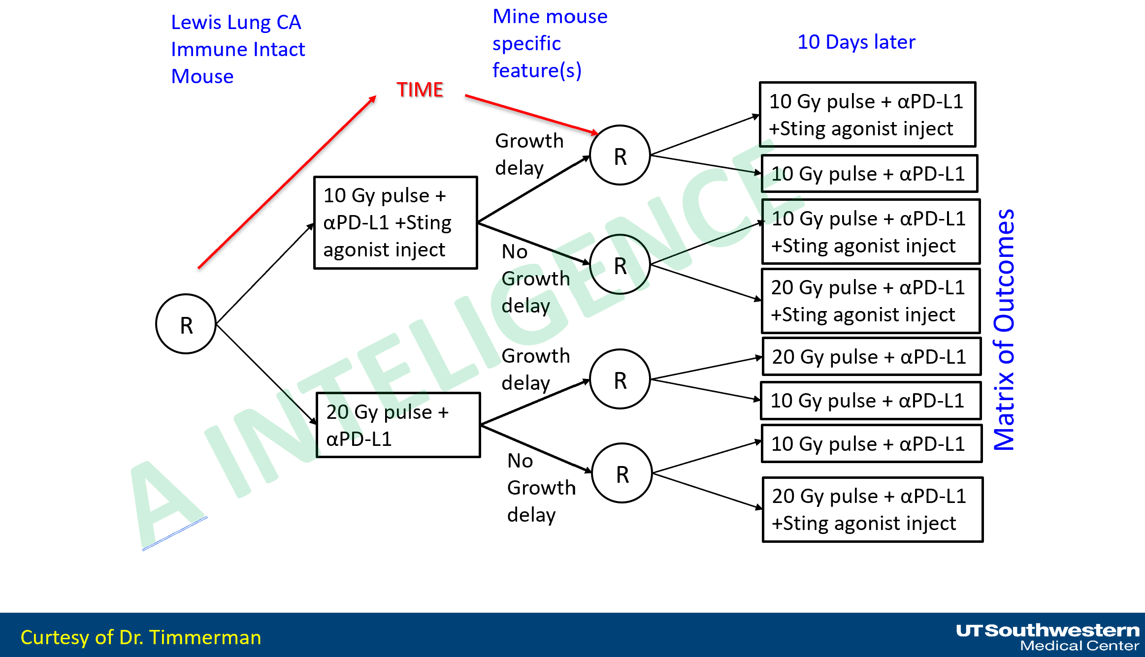
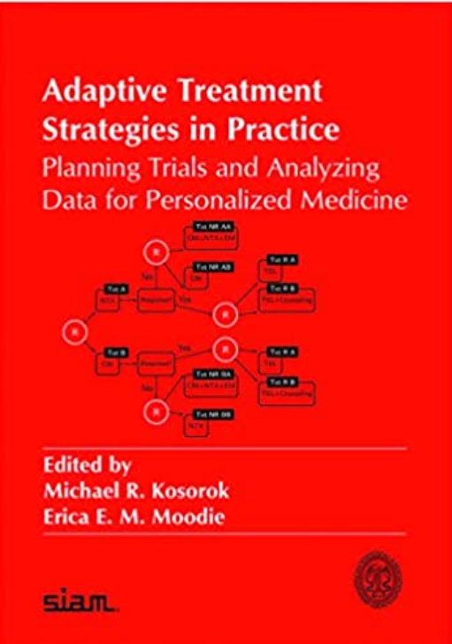
FIRST, COLLECT ENOUGH RELEVANT DATA IN A NOVEL WAY – SMART TRIALS!
CERN AND HEP HEELLLPPP!!!
STATISTICAL ANALYSIS!!!
Arnold Pompoš PhD

Slide 61
Smart trials
Dynamic treatment statistical designs
Recurring randomizations allow deeper understanding of treatment effects
“Delta” changes for a single patient can trigger a new randomization
Create a matrix of outcomes
Curtesy of Dr. Timmerman

Slide 62
SECOND, DECYPHER THE DATA!
Arnold Pompoš PhD

Slide 63
YES, YOU GUESSED IT RIGHT
USE AI Assistant
Arnold Pompoš PhD

Slide 64
THIS SHOULD TAKE CARE OF DATA ISSUE
Clinical Systems
DATA PROCESSING
A INTELIGENCE
Tx OUTCOMES
Model Training
Analytics
Model training
Model acceptance test
Model commissioning
Model adaptation
Data Pipeline
Retrieving
Normalization
Harmonization
Standardization
Ontology mapping
De-identification
LLM processing
Data Warehouse
Data storage
Data maintenance
Data access control
EHR
Clinical Notes, Lab Data, etc
PACS
Images
TPS
DICOM RT Data
Model Validation
Prospective validation
Bias detection etc
OIS
Tx Delivery Data
Path/Genomic Data
Model Deployment
Inferences
Performance monitoring
Regular model QA
Wearable Sensor Data
© Steve Jiang, Ph.D., MAIA Lab, 2023

Slide 65
THIS SHOULD TAKE CARE OF DATA ISSUE
Clinical Systems
DATA PROCESSING
A INTELIGENCE
Tx OUTCOMES
Model Training
Analytics
Model training
Model acceptance test
Model commissioning
Model adaptation
Data Pipeline
Retrieving
Normalization
Harmonization
Standardization
Ontology mapping
De-identification
LLM processing
Data Warehouse
Data storage
Data maintenance
Data access control
EHR
Clinical Notes, Lab Data, etc
CERN AND HEP HEELLLPPP!!!
HOW TO DEAL WITH LARGE DATA!!!!
PACS
Images
TPS
DICOM RT Data
Model Validation
Prospective validation
Bias detection etc
OIS
Tx Delivery Data
Path/Genomic Data
Model Deployment
Inferences
Performance monitoring
Regular model QA
Wearable Sensor Data
© Steve Jiang, Ph.D., MAIA Lab, 2023

Slide 66
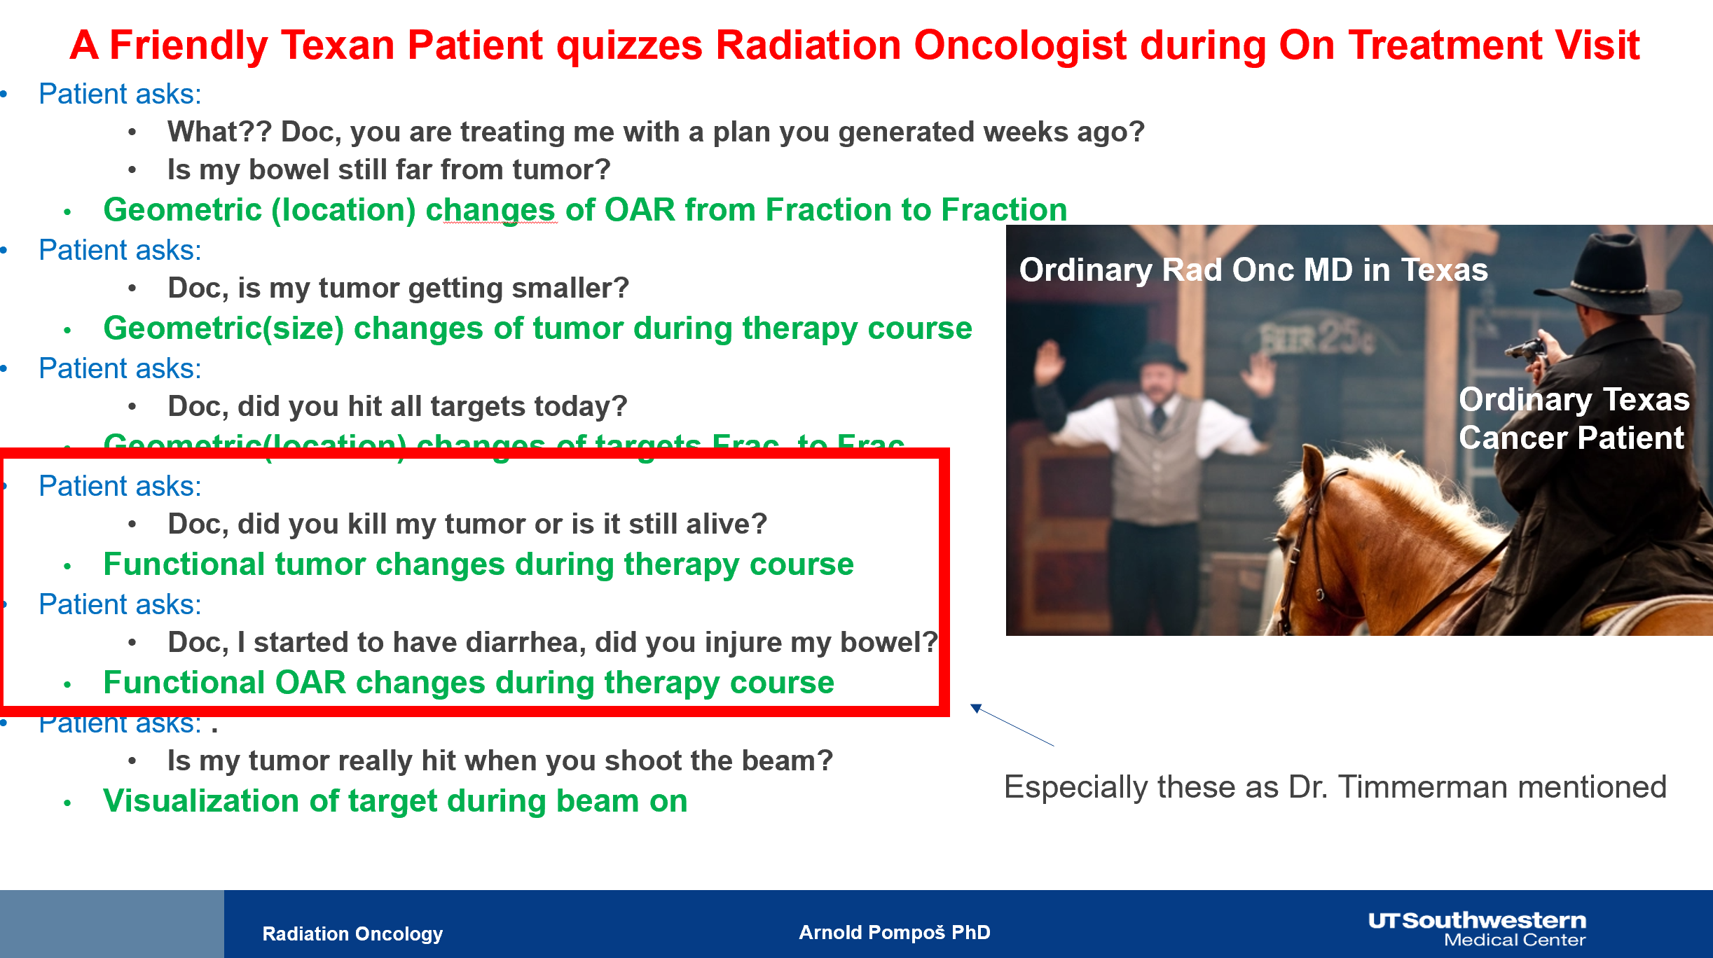
THIRD: Adapt your treatment strategy to changes!
Arnold Pompoš PhD

Slide 67

Welcome to the new chapter of radiation oncology –
Adaptive Radiation Therapy
Ultimately, Dr. Adapt enables
  Ultrapersonalization
Dr. Adapt
Arnold Pompoš PhD

Slide 68
CHALLENGES TO RESOLVE
CHANGES BETWEEN PULSES (interPULSE)
B) CHANGES WITHIN PULSE DELIVERY
(intraPULSE)
Arnold Pompoš PhD

Slide 69
SOLUTION TO CHANGES FROM
PULSE TO PULSE
Online Adaptive Radiation Therapy (oART) workflow
Arnold Pompoš PhD

Slide 70
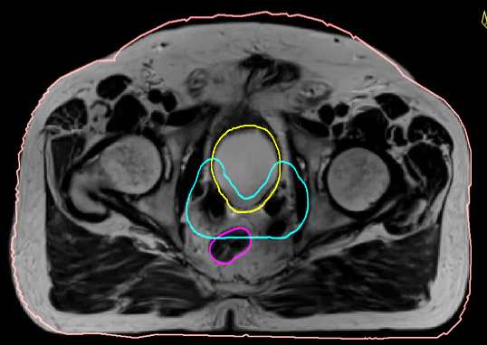





Online adaptation workflow MR-Linac
QA
Independent dose calculation
Delineations
Daily MRI
Pseudo CT
Motion Monitoring
OK
Image regis-tration
Pre-treatment CT
Adapted plan
Arnold Pompoš PhD

Slide 71
Imaging for ART
CBCT
Arnold Pompoš PhD

Slide 72


CBCT based ART
UTSW’s CBCT based ART

Slide 73
Imaging for ART
Fan beam CT
Arnold Pompoš PhD

Slide 74


Imaging for ART: fan beam CT challenges
Fan beam CT linac (non isocentric)
UTSW’s fan beam CT linac (non isocentric)
Arnold Pompoš PhD

Slide 75
Imaging for ART
MRI
Arnold Pompoš PhD

Slide 76

Imaging for ART: MRI based ART
UTSW MR Linac - reality

Slide 77
Imaging for ART
PET based online adaptive therapy
Arnold Pompoš PhD

Slide 78


Imaging for ART: PET based adaptation
PET Linac
Arnold Pompoš PhD

Slide 79


Imaging for ART: Functional Imaging based adaptation, i.e. PET signal
PET LINAC, FDG, before any
Radiation therapy
PET LINAC, FDG, after 48/60Gy in 4/5Fx SBRT
Radiation therapy
Arnold Pompoš PhD

Slide 80
SOLUTION TO CHANGES DURING
PULSE DELIVERY
Imaging DURING DELIVERY
Arnold Pompoš PhD

Slide 81

X ray based solutions
Synchrony from Accuray for Cyberknife
Triggered imaging – fiducial based Varian and Elekta
Arnold Pompoš PhD

Slide 82

Imaging for ART: MRI based ART
Note the passing gas effect on the location of target
Beam was stopped, then started again
Arnold Pompoš PhD

Slide 83
Imaging for ART: PET based tracking
PET signal used as a fiducial for tracking
PET Linac
PET provides 250ms update and linac fires every 500ms
Arnold Pompoš PhD

Slide 84
Challenges of oART
Imaging – need fast, treatment planning quality online imaging
Contouring – need fast, treatment planning quality online contouring
EXTRA CHALLENGE: NEED MD time to on line review target & OARs & decide if to adapt
Optimization – need fast, optimizers
Dose Calculation – need fast, dose calculation system
EXTRA CHALLENGE: NEED MD to on line review dose distribution
Quality Assurance – need independent online QA system of patient plan
Imaging again – need fast pre-treatment confirmation of patient status
Intra-fraction imaging– need fast intra fraction “continuous” imaging
Dose accumulation – need fast pre-treatment confirmation of patient status

Slide 85
Challenges of oART
Imaging – need fast, treatment planning quality online imaging
NEED THIS
Contouring – need fast, treatment planning quality online contouring
EXTRA CHALLENGE: NEED MD time to on line review target & OARs & decide if to adapt
Optimization – need fast, optimizers
FAST
Dose Calculation – need fast, dose calculation system
EXTRA CHALLENGE: NEED MD to on line review dose distribution
Quality Assurance – need independent online QA system of patient plan
Imaging again – need fast pre-treatment confirmation of patient status
Intra-fraction imaging– need fast intra fraction “continuous” imaging
Dose accumulation – need fast pre-treatment confirmation of patient status

Slide 86
FAST IS OK, BUT
Where is the MD?
He needs to approve current plan I just generated NOW
Patient is on treatment table. No delays are acceptable
Arnold Pompoš PhD

Slide 87
A not so friendly discussion regarding getting MD to console to approve plan
Physicist looking for MD
Medical Doctor
Explainig that he was in transit to machine to approve plan

Slide 88
So we quickly discovered the Heisenberg's principle of uncertainty of US medical doctors!
Δx.Δt ≥ constant

Slide 89

Fundamental law of MD in clinic Δx.Δt ≥ const
When we attempted to localize MD to a precise location (Δx small) we ended up with huge time uncertainty (Δt huge)
When we attempted to localize MD to a precise time (Δt small) we ended up with huge location uncertainty (Δx huge)
Cannot fight fundamental laws! We had to adapt to it!

Slide 90
Our software allows Δx to be ∞ hence Δt can be 0!!!
Fundamental law of MD in clinic Δx.Δt ≥ const

Slide 91


Our software allows Δx to be ∞ hence Δt can be 0!!!
Fundamental law of MD in clinic Δx.Δt ≥ const
YES, you guessed it right!
We are sending approval web link to MDs cell phones

Slide 92


Conclusion:
We satisfy Heisenberg’s principle of uncertainty of MD Δx.Δt ≥ constant
Weekly adaptive patients are being treating on Unity
Unity Physicist in Texas
Medical Doctor
Treating on Unity in Texas

Slide 93
IS ALL THIS REALISTIC?
Arnold Pompoš PhD

Slide 94



Our stand:
YES it is realistic and we live in the right moment in time
BF
BB
Arnold Pompoš PhD

Slide 95

Our stand:
YES it is realistic and we live in the right moment in time
NOW
AI
BF
BB
Arnold Pompoš PhD

Slide 96


Lately: ~100% is online adaptive on Unity !
ATS takes about 45min (start imaging to end of delivery
Lately: ~100% is online adaptive on ETHOS!
ART takes about 30 – 50 min
ABOUT 25% of ALL OUR PATIENTS ARE ONLINE ADAPTIVE PATIENTS!
Arnold Pompos PhD

Slide 97
AI Driven Radiation Oncology
Arnold Pompoš PhD

Slide 98
PROMISE trial
Arnold Pompoš PhD

Slide 99

UTSW PROMISE:
A Happy Kid,
Happy Parents
Pediatric Radiation Solution
Example of a Big Title
Example of smaller subtitle
Kiran Kumar MD, Tu Dan, Malgorzata Kozak
Steve Jiang, Xuejun Gu
David Chiu PhD, David Parsons
Liyuan Chen, Xinran Zhong, Chenyang Shen, Justin Visak, Chris Kabat, Yesenia Gonzales, Yulong Yan, Eric Chamber
Kiran Kumar MD PhD

Slide 100
Background: Pediatric Anesthesia
Radiation therapy (RT) requires precise immobilization in order to accurately deliver a conformal dose to the target(s) while avoiding nearby organs at risk.
In children, RT frequently requires daily anesthesia use during the entire course of treatment, often up to 4-6 weeks total. While the data varies, ~40-50% of children, and the majority of those under the age of 7, require daily general anesthesia¹.
Anesthesia can have significant short- and long-term detrimental effects on patient health, including increased risk of hypoxia, allergic reactions, hyperthermia, vascular access device complications (20-25%), and neurocognitive impairment.
Furthermore, daily anesthesia provides significant logistical and financial burden, with the average 6-week course of daily anesthesia for RT being approximately $50,000 in payer charges.
1: McMullen et al Radiat Oncol 2015 (https://doi.org/10.1186/s13014-015-0363-2)
Kiran Kumar MD PhD
Notes:
1. Page 3 – Background – Pediatric Anesthesia – “In children, RT frequently requires daily anesthesia use during the entire course of treatment, often up to 4-6 weeks total. While the data varies, ~40-50% of all children, and the majority of those under the age of 7, require daily general anesthesia.” Are these %’s UTSW numbers or National? What is the source?
- Source is large single institution publication (~400 kids), not UTSW data (coming in couple slides)

Slide 101

OUR SOLUTION – WE HYPNOTIZE THE KIDS!!
Arnold Pompoš PhD

Slide 102

David Chiu PhD

Slide 103


Background: PROMISE
PROMISE (Pediatric Radiation Oncology with Movie Induced Sedation Effect) is an interactive incentive-based movie system that integrates with a video surveillance gating module (VisionRT) as an alternative sedation solution for pediatric patients undergoing RT.
While audiovisual distraction techniques have previously been described, PROMISE is the first system that allows for real time monitoring of patient motion and automatic shutting off of the beam and video if the patient moves outside of defined parameters. This not only provides a built-in safety mechanism, but also allows for real time behavior training that incentives patients to not move.
At UTSW/Children’s, we designed a phase II clinical trial implementing PROMISE for all children ages 3-11 undergoing daily RT, with the goal of reducing the number of pediatric patients requiring general anesthesia.
Kiran Kumar MD PhD
Notes:
2. Page 4 – Background: PROMISE – “ This not only provides a built-in safety mechanism, but also allows for real time behavior training that incentives patients to not move.” What does real time behavior training look like?
- Real time behavioral training is negative feedback for operant conditioning (video shuts off if patient moves outside of predetermined parameters) and positive feedback when patient returns to original position and lays still (video turns back on and stays on)

Slide 104
PROMISE: Preliminary Data- Results
PROMISE was successfully implemented in 21 children, the majority (76%) who were 7 years or younger and most likely would have otherwise required daily anesthesia.
Patient movement during RT with PROMISE was minimal, with in-treatment variation of ~1.2 mm (0.8 mm standard deviation) from the reference baseline.
On per patient comparison, PROMISE resulted in a 30% absolute benefit in those 3-7 years old, with 70% previously requiring anesthesia to only 40% after the implementation of PROMISE.
Patients requiring general anesthesia
Age | Prior to PROMISE (2018-2019) | After PROMISE (2020)
0-3 | 100% (6/6) | 100% (5/5)
3-7 | 70% (14/20) | 40% (8/20)
8-11 | 14% (4/28) | 8% (1/13)
Fractions requiring general anesthesia
Age | After PROMISE (2020)
0-3 | 100% (76/76)
3-7 | 29% (90/315)
8-11 | <1% (1/221)
Chapman J, Kumar KA; Presented at ASTRO 2021
Kiran Kumar MD PhD
Notes:
2. Page 4 – Background: PROMISE – “ This not only provides a built-in safety mechanism, but also allows for real time behavior training that incentives patients to not move.” What does real time behavior training look like?
- Real time behavioral training is negative feedback for operant conditioning (video shuts off if patient moves outside of predetermined parameters) and positive feedback when patient returns to original position and lays still (video turns back on and stays on)

Slide 105

PROMISE 1.0
Components
AlignRT
Linac
In-room
cameras
Server
Client
(Therapist)
Client
(Patient)
David Chiu PhD

Slide 106

PROMISE 1.0
HUMAN
Components
AlignRT
HUMAN
Linac
HUMAN
In-room
cameras
Server
Client
(Therapist)
Client
(Patient)
David Chiu PhD

Slide 107
PROMISE 1.0
A INTELIGENCE
PREDICTS KIDS MOTION
Components
AlignRT
Linac
In-room
cameras
Server
Client
(Therapist)
Client
(Patient)
David Chiu PhD

Slide 108
INVOLVED NODES trial
Arnold Pompoš PhD

Slide 109



Predict Lymph Node Malignancy
AI-based model predicts the malignancy status of otherwise benign-appearing lymph nodes
Eliminating elective neck irradiation and strictly treating involved and suspicious lymph nodes
INRT-AIR: Prospective Phase II Study
  First prospective study of involved nodal radiotherapy in H&N cancer
  8/2019- 9/2020 enrolled 67 patents
  Minimum follow-up ~ 3 years for surviving patients, without any solitary elective nodal failure, and patient-reported outcomes superior to any H&N prospective study of radiotherapy
A INTELIGENCE
Jing Wang, Ph.D.
David Sher, M.D.
Chen,…, Wang, PMB, 64(7)075011, 2019
Sher et al, Clin Cancer Res 2023 (accepted)
© Steve Jiang, Ph.D., MAIA Lab, 2023

Slide 110

Normal tissue dose sparing with INRT-AIR
Jing Wangt PhD

Slide 111
Clinical trial matching
Arnold Pompoš PhD

Slide 112


AI-Assisted Clinical Trial Screening
A INTELIGENCE
Michael Dohopolski MD PhD
Notes:
Aim 1: Optimize Prompting Strategies to Improve LLM Performance in Clinical Trial Screening
Objective: Evaluate and refine prompting approaches, including Structured Output (SO), Chain of Thought (CoT), and Self-Discover (SD), to improve LLM-based screening accuracy for clinical trial eligibility. Rationale: Although LLMs have demonstrated promising results in clinical trial screening, different prompting strategies yield varied accuracy. Optimizing these prompts could enhance the efficiency and reliability of LLMs in patient screening. Work Completed: Initial experiments have demonstrated that prompting strategies such as Structured Output + Expert Guidance (EG) and Chain of Thought with LLM Guidance (LLM-G) significantly impact LLM accuracy and efficiency. Proposed Work: Further refine and evaluate these prompting strategies on larger, more diverse cohorts, identifying the optimal prompting configuration to ensure high accuracy across various clinical trial criteria.
Aim 2: Develop a Hybrid Screening Approach Combining Proportional Eligibility and Manual Review for Enhanced Patient Identification
Objective: Design and validate a hybrid screening method where LLMs flag patients based on the proportion of eligibility criteria met, followed by manual review to confirm trial enrollment suitability. Rationale: The strict eligibility approach showed limitations in identifying patients who met all criteria, but the proportional eligibility approach showed promise in balancing accuracy and efficiency. This hybrid approach could reduce manual screening workload while maintaining high precision. Work Completed: Proportional eligibility screening using GPT-4 has been tested, demonstrating improved AUC and Youden Index compared to strict eligibility criteria. Proposed Work: Implement and evaluate the hybrid approach in clinical settings, measuring efficiency gains and the ability to increase patient accrual rates for clinical trials.
Aim 3: Explore the Scalability and Cost-Efficiency of LLMs for Automated Screening in Multiple Unique Clinical Trials
Objective: Investigate the scalability of GPT-4-based patient screening across larger clinical trial datasets, focusing on minimizing processing time and costs while maintaining accuracy. Rationale: GPT-4 outperformed GPT-3.5 in screening accuracy, but at higher costs and longer processing times, which could limit its use in larger trials. Finding ways to optimize the trade-off between cost, time, and accuracy is critical for wider clinical adoption. Proposed Work: Develop and test cost-efficient strategies for deploying GPT-4 in large-scale clinical trials, including batching patient data and optimizing model deployment settings, to evaluate its feasibility in reducing overall trial costs and time to patient accrual.

Slide 113
AI Assistant
Arnold Pompoš PhD

Slide 114
WE CANNOT DO THIS ALONE!
Clinical Systems
DATA PROCESSING
A INTELIGENCE
Tx OUTCOMES
Model Training
Analytics
Model training
Model acceptance test
Model commissioning
Model adaptation
Data Pipeline
Retrieving
Normalization
Harmonization
Standardization
Ontology mapping
De-identification
LLM processing
Data Warehouse
Data storage
Data maintenance
Data access control
EHR
Clinical Notes, Lab Data, etc
PACS
Images
TPS
DICOM RT Data
Model Validation
Prospective validation
Bias detection etc
OIS
Tx Delivery Data
Path/Genomic Data
Model Deployment
Inferences
Performance monitoring
Regular model QA
Wearable Sensor Data
© Steve Jiang, Ph.D., MAIA Lab, 2023

Slide 115
AI has a role for all of us in clinic
DATA
  AI is vital in making sense of big data and is GOOOOOOOODDDDD at it!
MD
  AI is becoming MDs assistant
    AI suggests treatment directives
    Performs routine MD tasks where MD will review and fix but not DO
  AI takes away from MDs shoulder stupid things
    LETS have MD focus on what MD is a master of e.g. SEEING PATIENTS!
PATIENT
  AI drives clinical trials
  AI is becoming Patient assistant
ADMINISTRATION
  AI Increases efficiency
PHYSICISTS
  AI assists with quality assurance
  AI automates clinical planning
Arnold Pompoš PhD

Slide 116
Conclusion
CERN and Rad Oncology has a lot in common
  You beg for funding to push the knowledge of human kind – 99% of folks respond – who cares
  We beg payers to pay for treatment that push the knowledge of human kind – 99% of them says – who cares
Ultrapersonalization of Care is unstoppable.
We have challenges to resolve
Collaborations between basic research institutions and radiation oncologies is desired
  Radiation Machines are still bulky and expensive
  Imaging Devices are still bulky and expensive
Trials are expensive
  Registry protocols might be the way to go
  Smart trials are attractive.
    Need novel statistical approaches
AI has a vitral role
Arnold Pompoš PhD

Slide 117
Acknowledgment
Dr. Robert Timmerman
Dr. David Sher
Dr. Steve Jiang
VP Kajal Desai
Dr. Jing Wang
Dr. Weiguo Lu
Dr. MuHan Lin
Dr. Andrew Godley
Dr. Bin Cai
Dr. Chris Kabat
Dr. Yang Park
Dr. David Tsuicheng Chiu
Deepkumar Mistry
Arnold Pompoš PhD

Slide 118
BACKUP SLIDES
Arnold Pompoš PhD

Slide 119


SPORT- Sim and Pre-Planning Omitted Rad Tx
Arnold Pompoš PhD

Slide 120

Preliminary Results
SPORT plan vs. Individually optimized plan
Slide curtesy of MuHan Lin and T L Zhuang

