Slide 1

NN-based MPC for energy efficient HVAC systems for CERN accelerators
Nikolina Bunijevac EN/CV/CL
Notes:
The Cooling & Ventilation group (CV) is responsible for the design, installation, commissioning, operation and maintenance of the cooling systems, pumping stations, air conditioning plants and fluid distribution systems for the whole of CERN’s accelerator complex, its experimental areas and some of the special cooling systems of the LHC experiments’ sub-detectors as well as for strategic technical installations such as the Computer Centre.

Slide 2
NN-based MPC for energy efficient HVAC systems for CERN accelerators

Slide 3
NN-based MPC for energy efficient HVAC systems for CERN accelerators
heating, ventilation, air conditioning

Slide 4
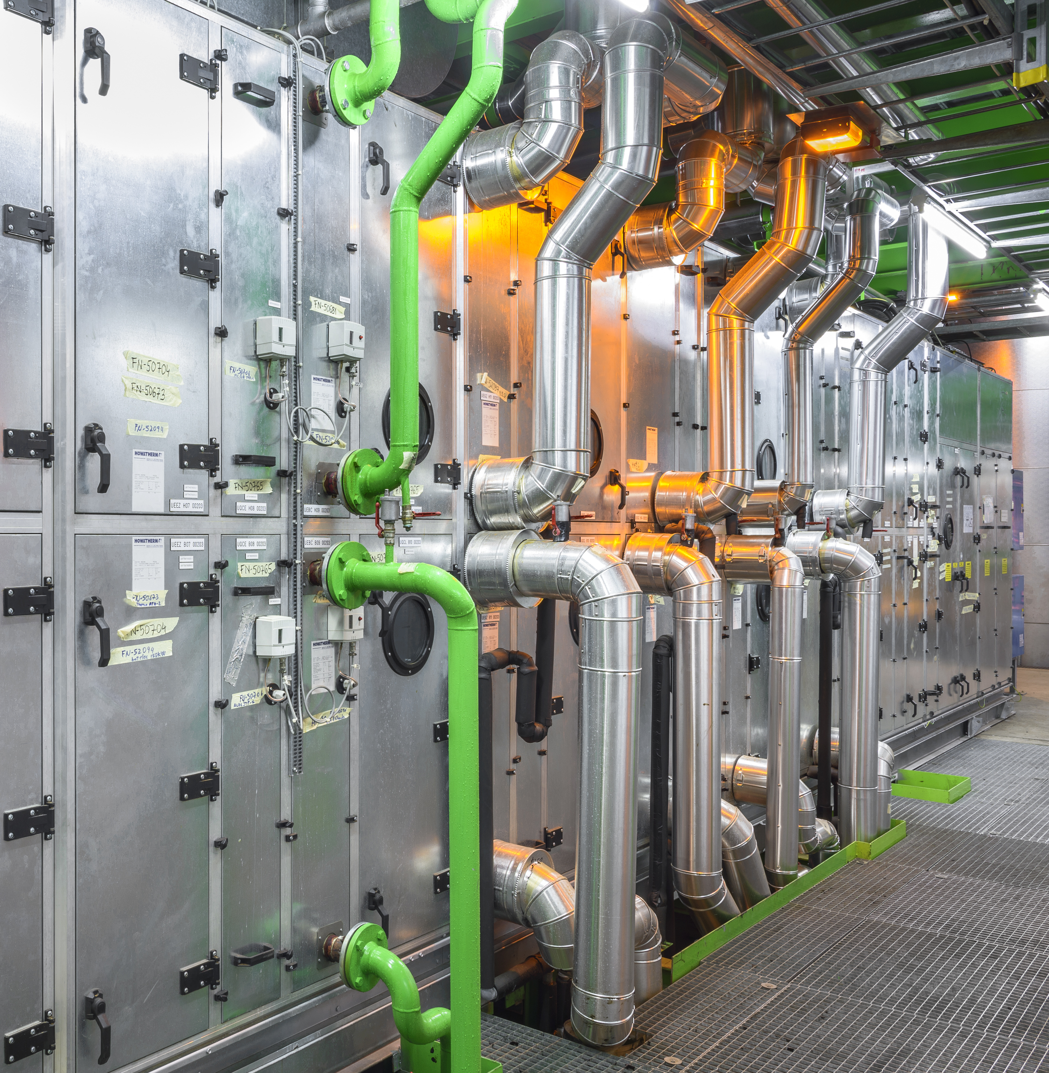
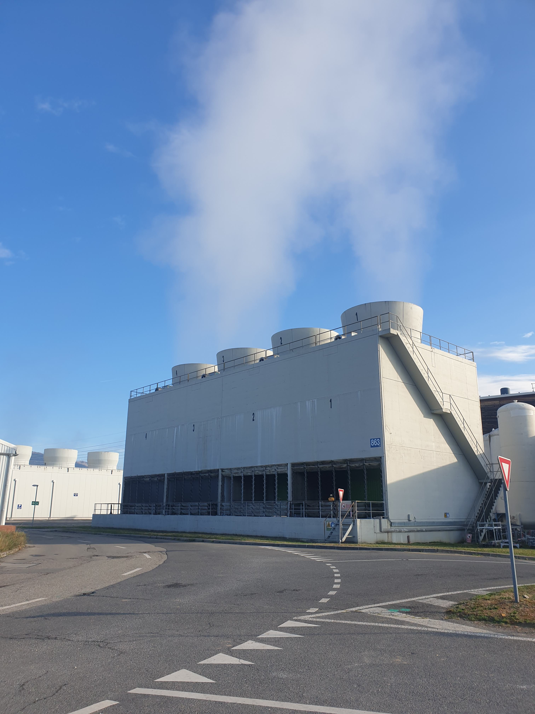
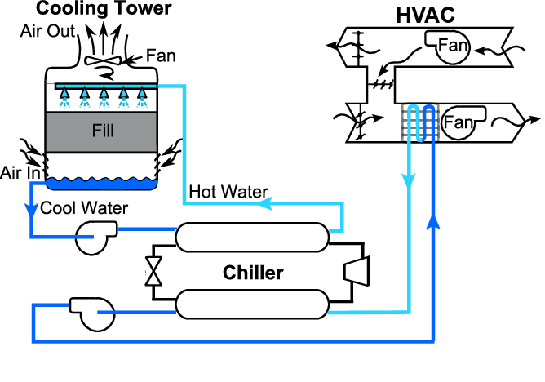
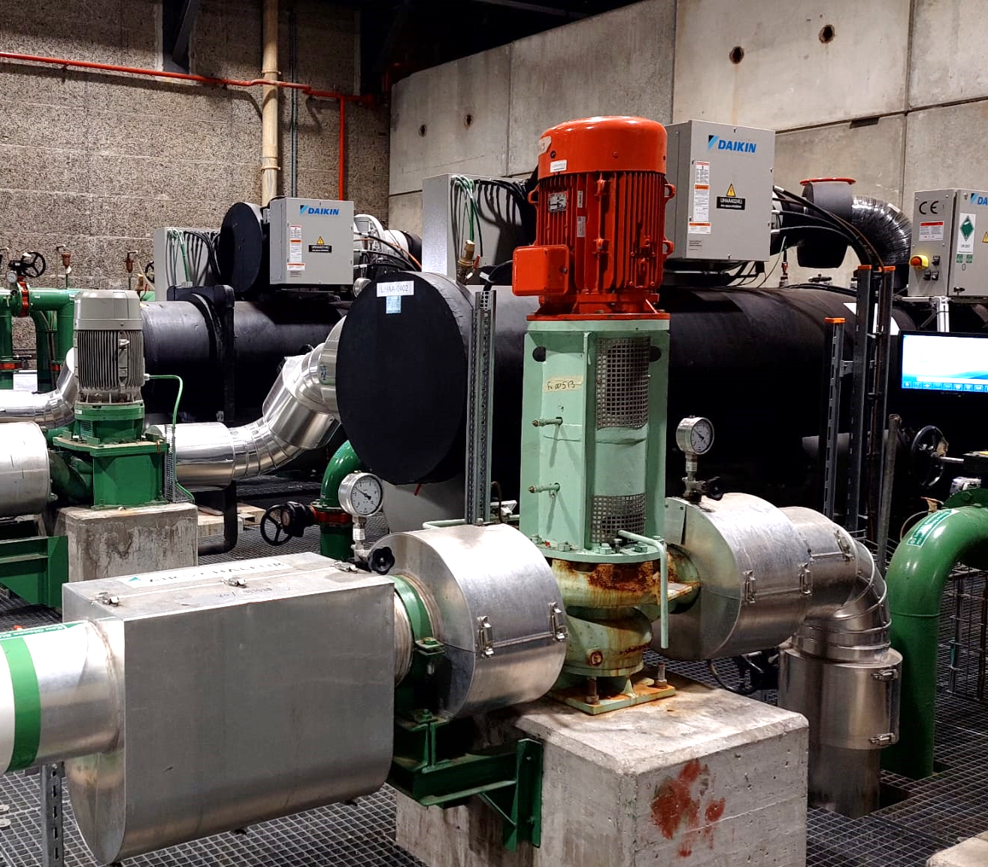

Slide 5
NN-based MPC for energy efficient HVAC systems for CERN accelerators

Slide 6
Research motivation
  Following global sustainability concerns, “pursuing actions and technologies aiming at energy savings and reuse” is listed as one of the main objectives for 2021-2025 at the European Organization for Nuclear Research (CERN). This objective extends to the Cooling and Ventilation group.

Slide 7
NN-based MPC for energy efficient HVAC systems for CERN accelerators

Slide 8
Controls optimization

Slide 9
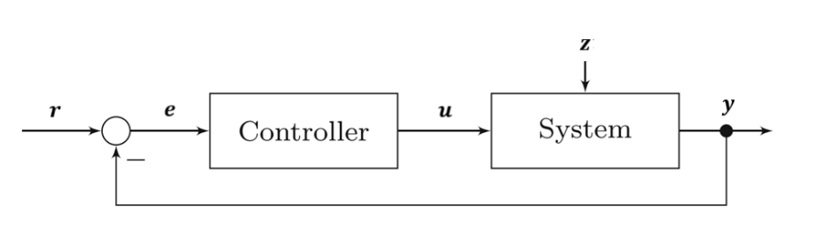
Controls optimization
Classical feedback Controller
Notes:
pid

Slide 10
Controls optimization
Classical feedback Controller
PID
Notes:
pid

Slide 11
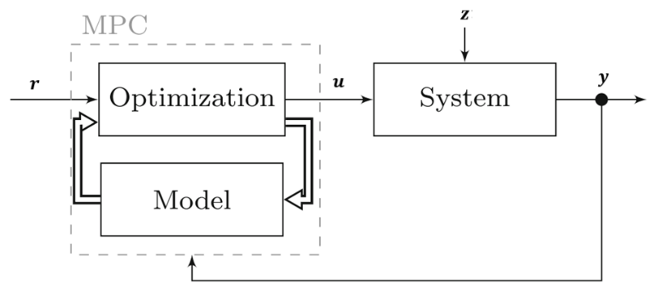
Controls optimization
Classical feedback Controller
Model Predictive Controller
PID
external information
- prediction horizon

Slide 12
Modelling

Slide 13
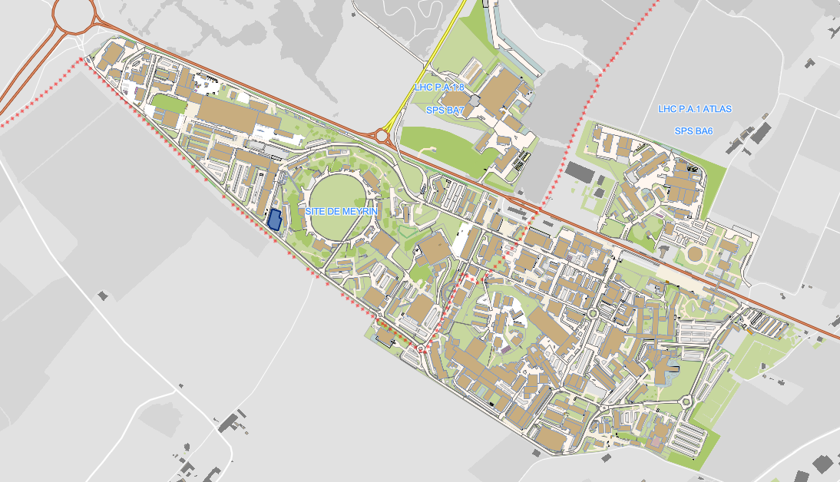
System: Air Handling Unit (HVAC311)

Slide 14
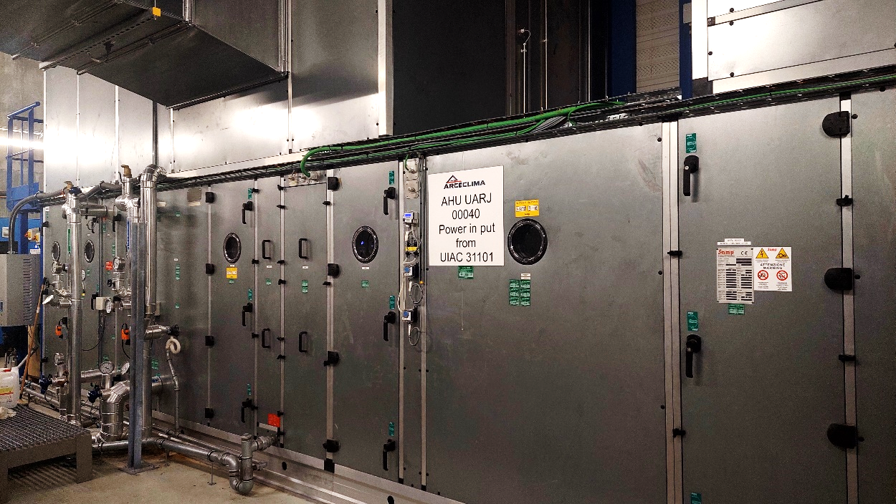
System: Air Handling Unit (HVAC311)

Slide 15
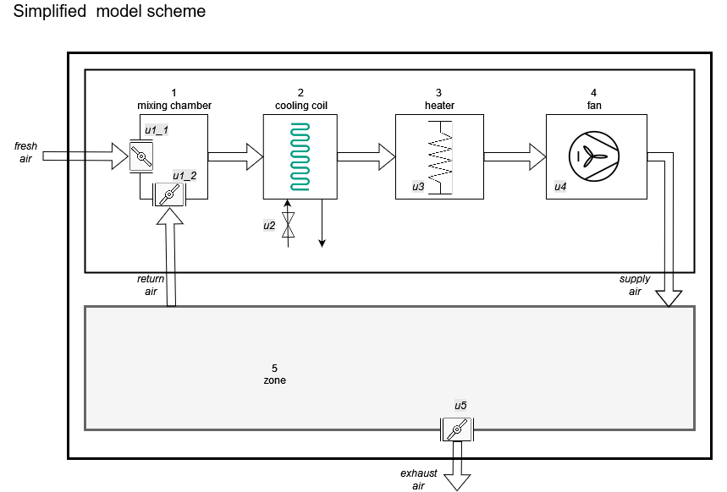
System: Air Handling Unit (HVAC311)
Controlled variables

Slide 16
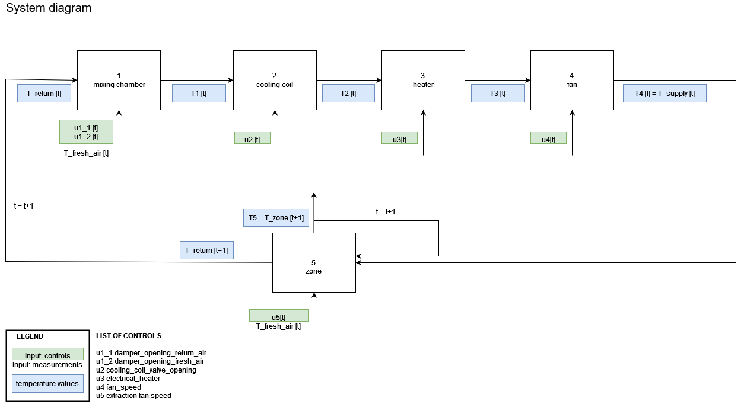
Physics-informed approach

Slide 17
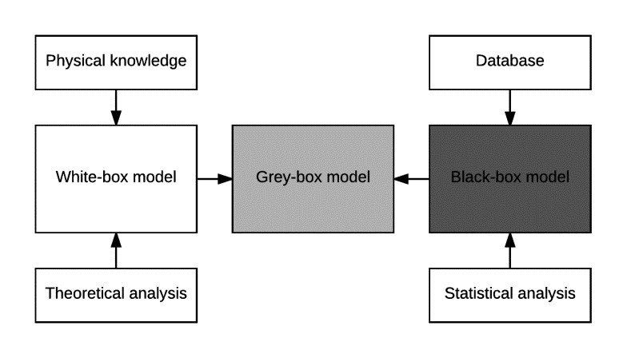
Modelling: methodology
Notes:
Advantages of data-driven model
Reduced Development Time and Cost
Flexibility
Efficiency (reduced computational load)
Disadvantages
Lack of Insight into Internal Processes
Dependency on Quality of Data
Limited Accuracy in Novel Situations

Slide 18
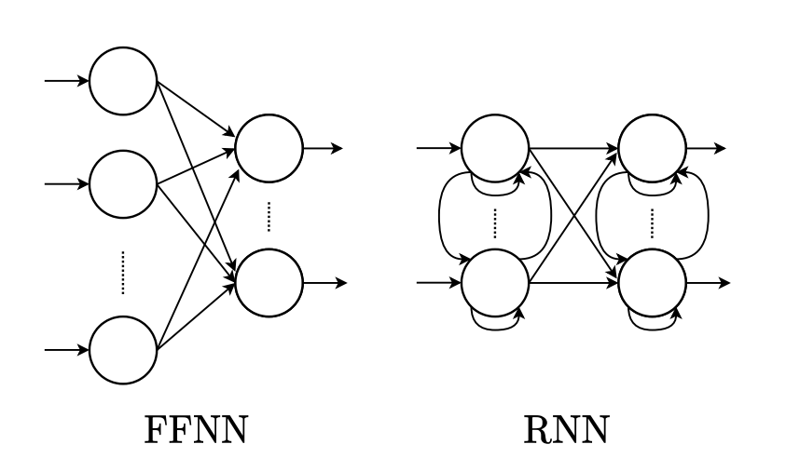
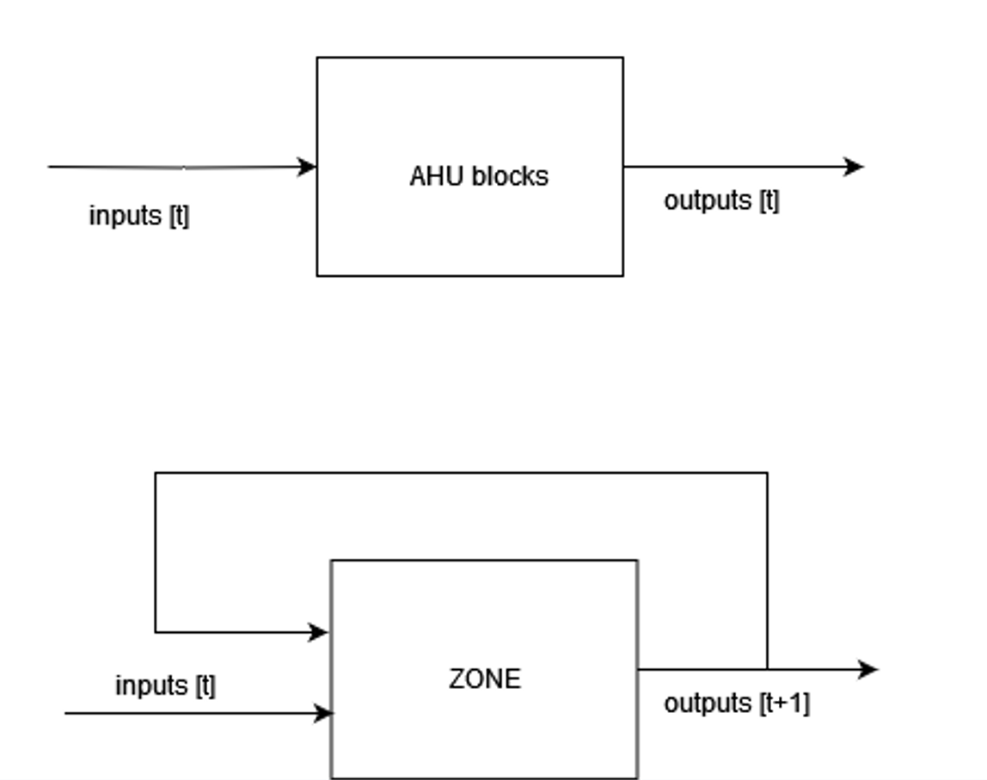
Modelling: methodology – black-box
AHU blocks: steady-state
Zone: autoregressive and dynamic

Slide 19
Modelling: methodology – black-box
AHU blocks: steady-state

Slide 20
Modelling: methodology – black-box
AHU blocks: steady-state
Zone: dynamic

Slide 21
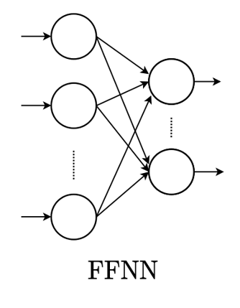
AHU
Steady state models
Zone
Dynamic model

Slide 22
AHU
Steady state models
Zone
Dynamic model

Slide 23
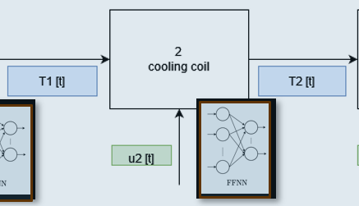
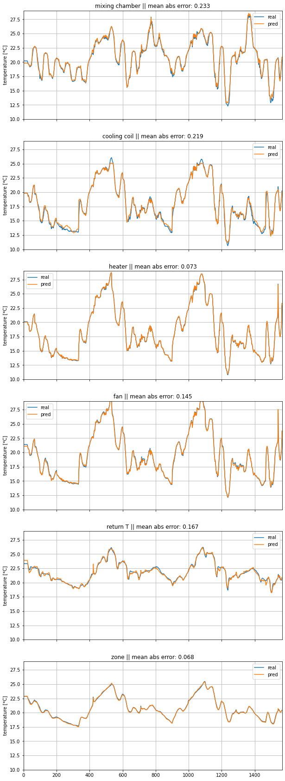
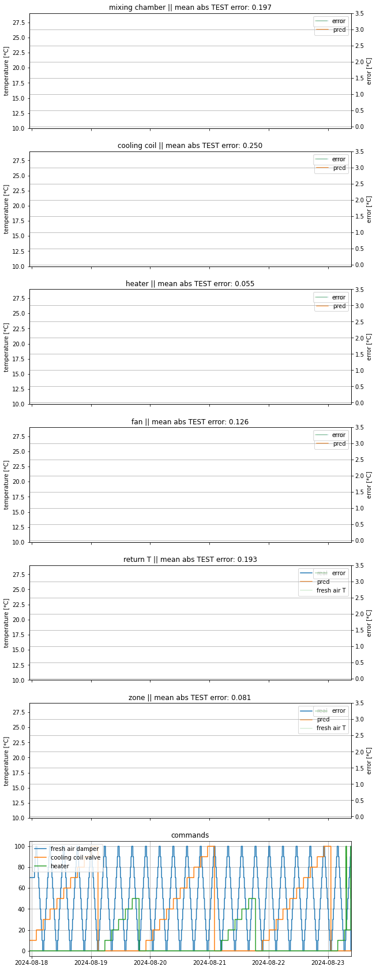
Example: cooling coil

Slide 24
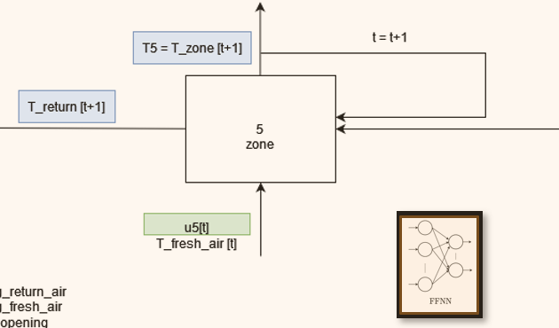
Example: cooling coil & zone

Slide 25
Optimization

Slide 26
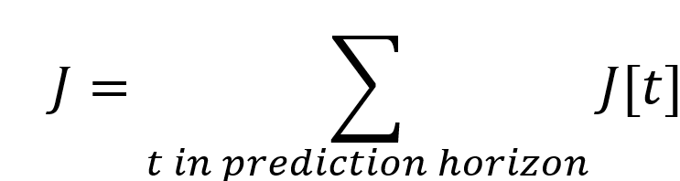
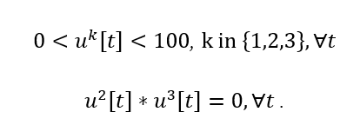
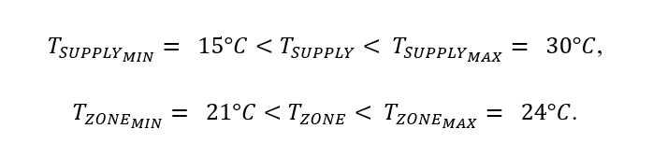

Optimization
optimization function: estimation of electricity consumption for the prediction horizon + penalty
optimization variables:
- constraints:
  control constraints
  variable constraints
genetic algorithm
$u^{1}$ (fresh air damper opening),
$u^{2}$ (cooling coil valve),
$u^{3}$ (heater command)
embedded in variable coding
penalty when violated
optimization technique based on evolutionary principles to find solutions to complex problems
binary
Notes:
Time for execution: 5minutes

Slide 27
Optimization
optimization function: estimation of electricity consumption for the prediction horizon + penalty
optimization variables:
- constraints:
  control constraints
  variable constraints
genetic algorithm
$u^{1}$ (fresh air damper opening),
$u^{2}$ (cooling coil valve),
$u^{3}$ (heater command)
embedded in variable coding
penalty when violated
optimization technique based on evolutionary principles to find solutions to complex problems
binary
Notes:
Time for execution: 5minutes

Slide 28
Optimization
optimization function: estimation of electricity consumption for the prediction horizon + penalty
optimization variables:
- constraints:
  control constraints
  variable constraints
genetic algorithm
$u^{1}$ (fresh air damper opening),
$u^{2}$ (cooling coil valve),
$u^{3}$ (heater command)
embedded in variable coding
penalty when violated
optimization technique based on evolutionary principles to find solutions to complex problems
binary
Notes:
Time for execution: 5minutes

Slide 29
Optimization
optimization function: estimation of electricity consumption for the prediction horizon + penalty
optimization variables:
- constraints:
  control constraints
  variable constraints
genetic algorithm
$u^{1}$ (fresh air damper opening),
$u^{2}$ (cooling coil valve),
$u^{3}$ (heater command)
embedded in variable coding
penalty when violated
optimization technique based on evolutionary principles to find solutions to complex problems
binary
Notes:
Time for execution: 5minutes

Slide 30

Optimization
optimization function: estimation of electricity consumption for the prediction horizon + penalty
optimization variables:
- constraints:
  control constraints
  variable constraints
genetic algorithm
$u^{1}$ (fresh air damper opening),
$u^{2}$ (cooling coil valve),
$u^{3}$ (heater command)
embedded in variable coding
penalty when violated
optimization technique based on evolutionary principles to find solutions to complex problems
binary
Notes:
Time for execution: 5minutes

Slide 31
Optimization
optimization function: estimation of electricity consumption for the prediction horizon + penalty
optimization variables:
- constraints:
  control constraints
  variable constraints
genetic algorithm
$u^{1}$ (fresh air damper opening),
$u^{2}$ (cooling coil valve),
$u^{3}$ (heater command)
embedded in variable coding
penalty when violated
optimization technique based on evolutionary principles to find solutions to complex problems
binary
Notes:
Time for execution: 5minutes

Slide 32
Optimization
optimization function: estimation of electricity consumption for the prediction horizon + penalty
optimization variables:
- constraints:
  control constraints
  variable constraints
genetic algorithm
$u^{1}$ (fresh air damper opening),
$u^{2}$ (cooling coil valve),
$u^{3}$ (heater command)
embedded in variable coding
penalty when violated
optimization technique based on evolutionary principles to find solutions to complex problems
binary
Notes:
Time for execution: 5minutes

Slide 33
Optimization
optimization function: estimation of electricity consumption for the prediction horizon + penalty
optimization variables:
- constraints:
  control constraints
  variable constraints
genetic algorithm
$u^{1}$ (fresh air damper opening),
$u^{2}$ (cooling coil valve),
$u^{3}$ (heater command)
embedded in variable coding
penalty when violated
optimization technique based on evolutionary principles to find solutions to complex problems
binary
Notes:
Time for execution: 5minutes

Slide 34
Optimization
optimization function: estimation of electricity consumption for the prediction horizon + penalty
optimization variables:
- constraints:
  control constraints
  variable constraints
genetic algorithm
$u^{1}$ (fresh air damper opening),
$u^{2}$ (cooling coil valve),
$u^{3}$ (heater command)
embedded in variable coding
penalty when violated
optimization technique based on evolutionary principles to find solutions to complex problems
binary
Notes:
Time for execution: 5minutes
Tricks : start with actuators off – even less than 2s solution found
Also limit actuators controls change within function to create individuals
Penalize sudden changes in supply T (expect this to reflect In zone as well)
Start where stopped: for actuators

Slide 35
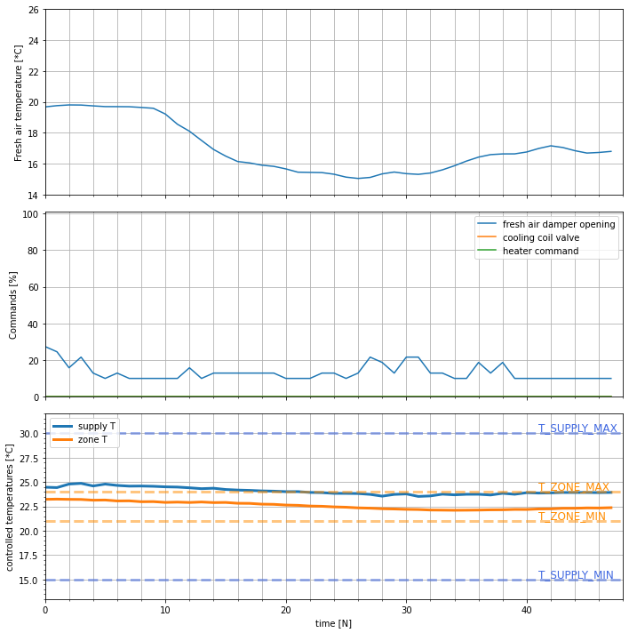
Example:
MPC solution
4h
4h

Slide 36
Example:
MPC solution
4h

Slide 37
Example:
MPC solution
4h

Slide 38
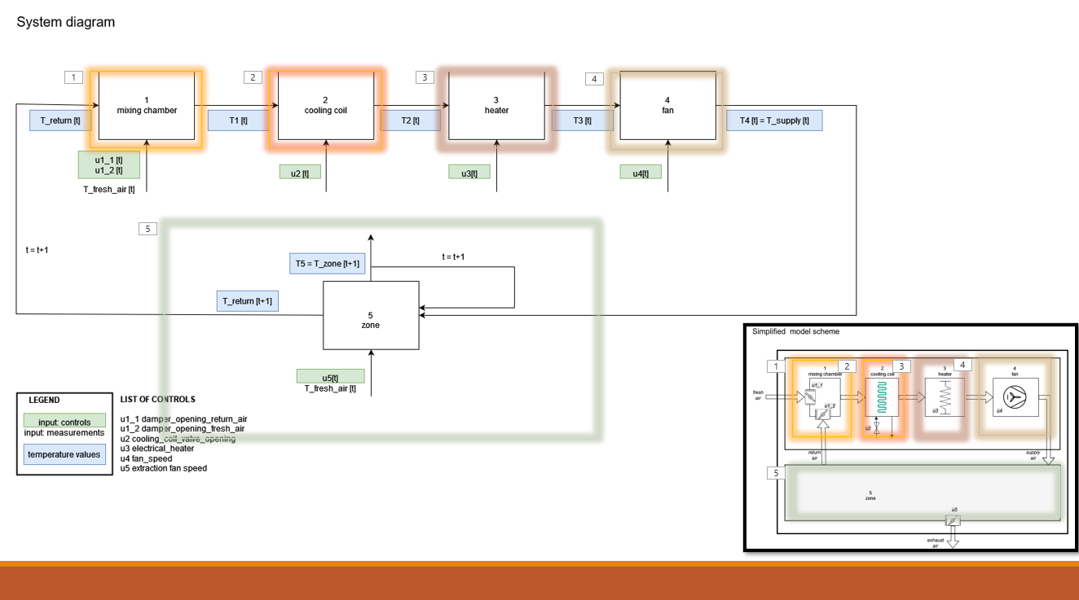
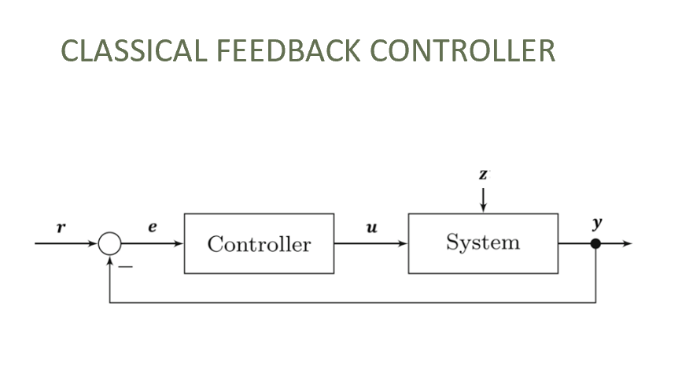
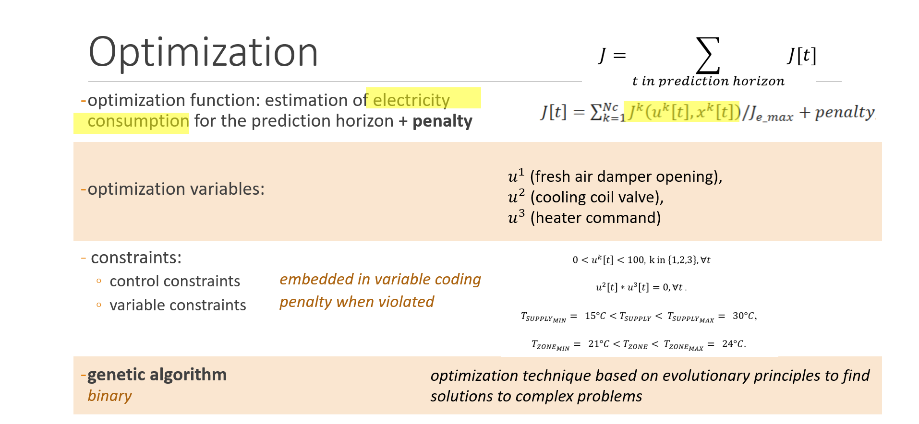
Next step
  thorough comparison between classical controls and MPC
  test zone on larger dataset
  If needed, MPC optimization upgrade for faster convergence

Slide 39
Discussion

Slide 40
Extra slides

Slide 41
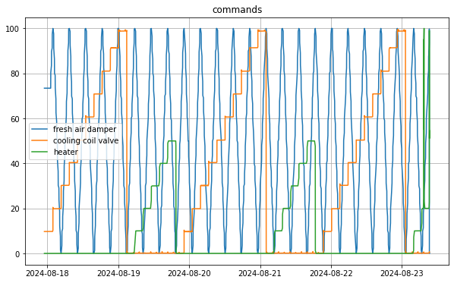
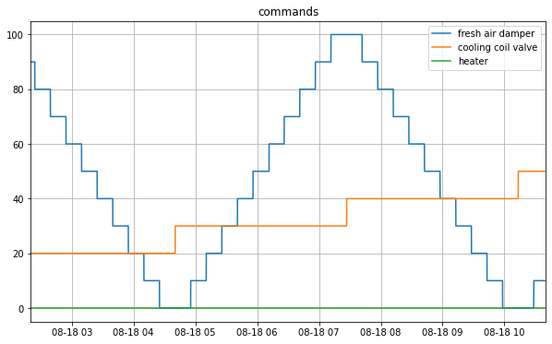
MPC for HVAC
Modelling upgrade: dataset

Slide 42
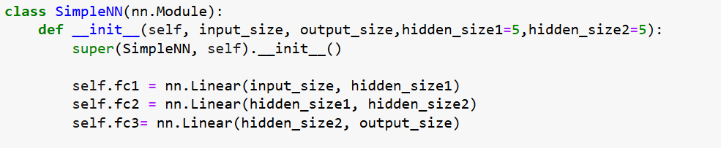
Modelling: methodology – black-box
 | AHU (4 NNs) | ZONE (1 NN)
Number of parameters | ~50 (61, 51, 51, 46) | 182
Size of dataset (6:1 training:test) | 2290 | 1565
Individual precision Mean abs error [*C] | ~0.25 (0.39, 0.33, 0.09, 0.17) | 0.17 (0.25, 0.09)

Slide 43
Modelling: methodology - update
AHU - fast
Zone - slow
Prediction in next point in time
Steady state

Slide 44
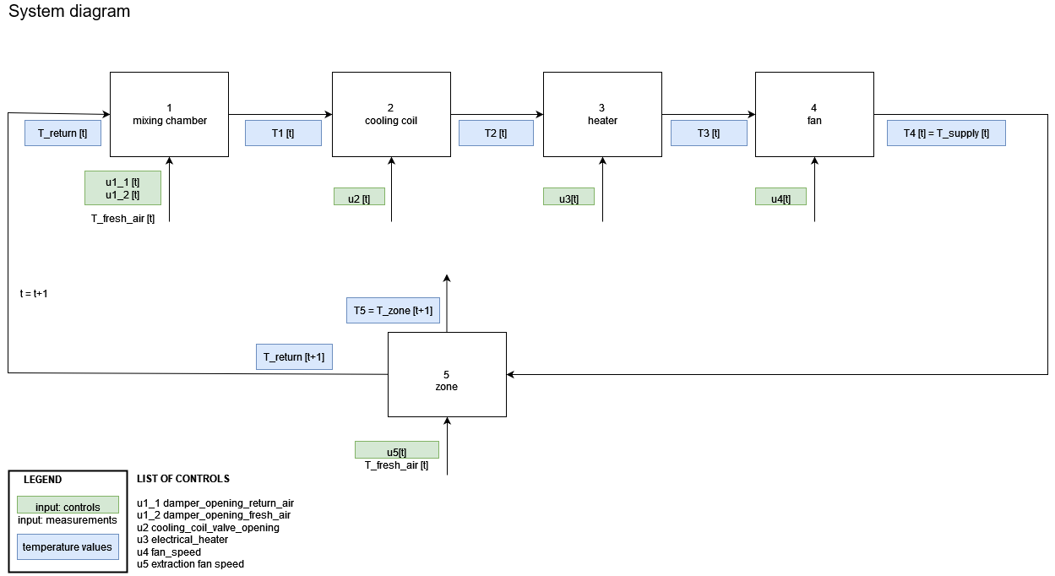
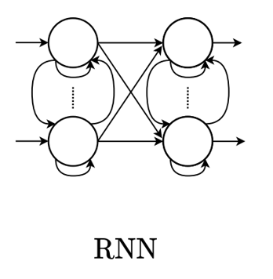
AHU
Steady state
Zone
Prediction in next point in time

Slide 45
AHU
Steady state
Zone
Prediction in next point in time
Problems with RNN initialization

Slide 46
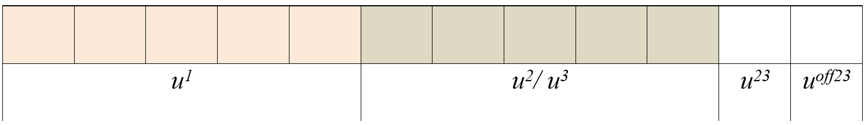
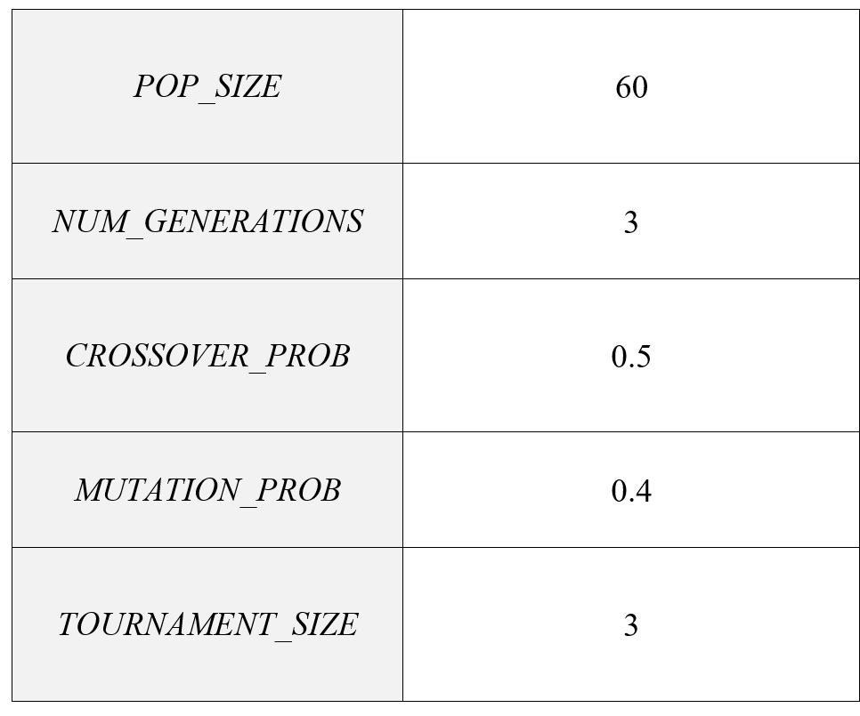
MPC for HVAC:
Genetic algorithm: implementation
- prediction horizon: 2h (Ts = 15min → 8 points)
- optimization variable binary representation for 1 pt in time:
  bits in total: 8*12 = 96 bits/optimization
- parameters:

Slide 47
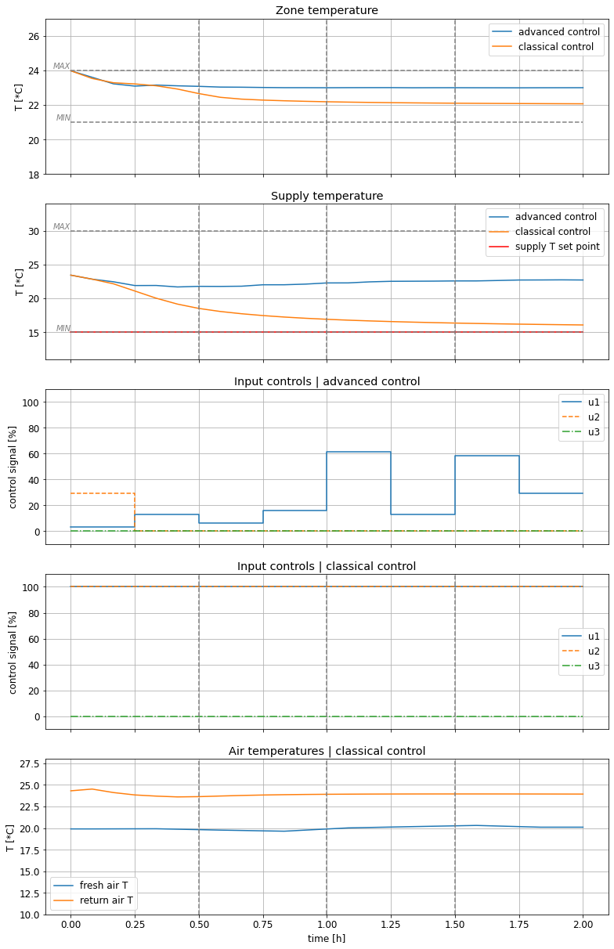
- temperatures within limits
- advance controls: damper management
- PID: more active components

Slide 48
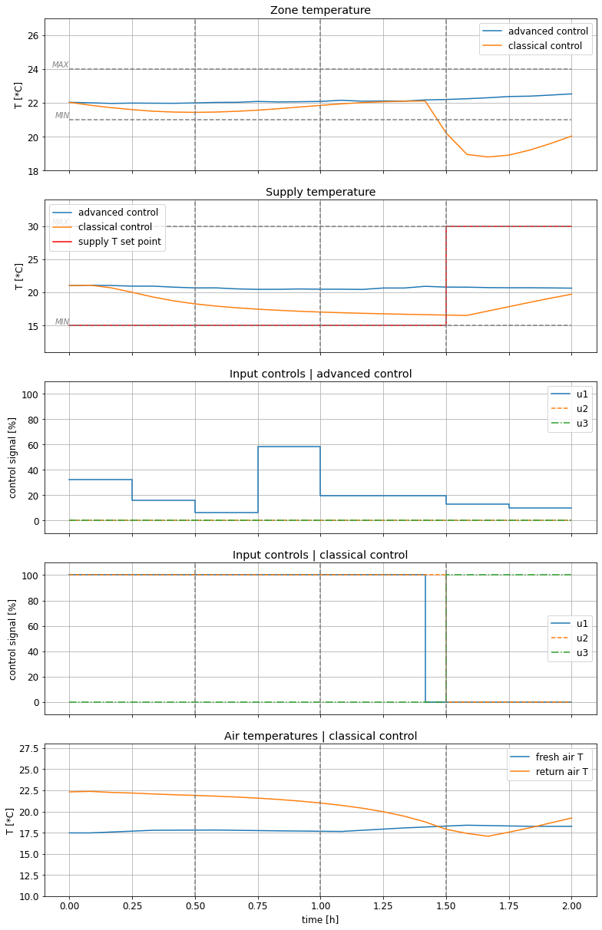
MPC for HVAC
Results
- constraints violated
- unusual system response
- unusual PID response

Slide 49
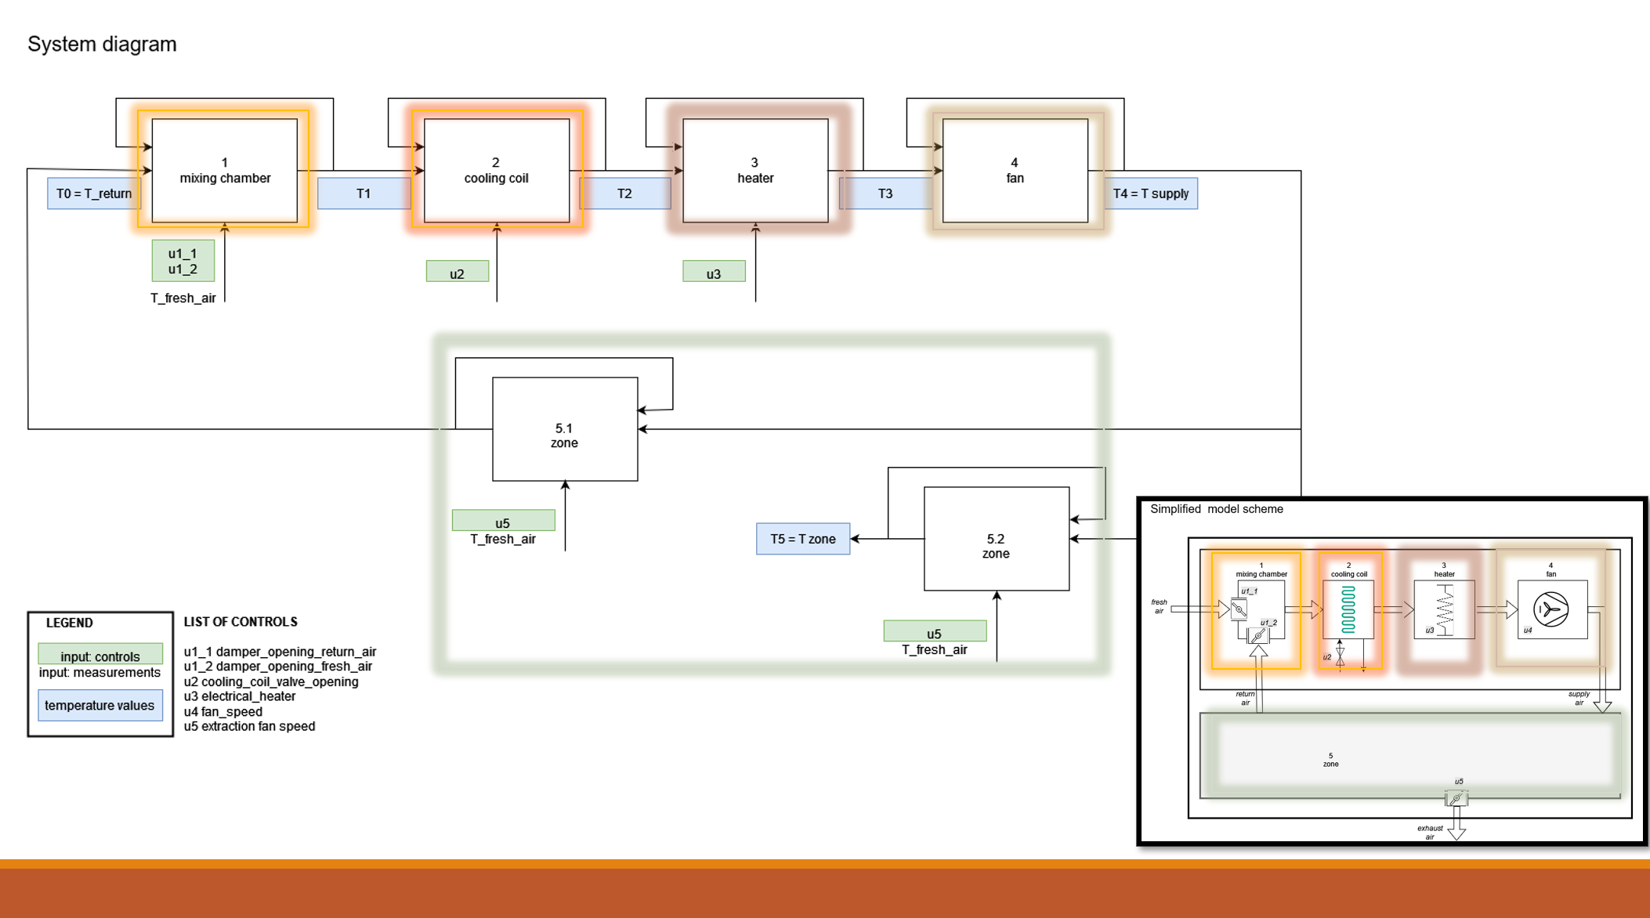
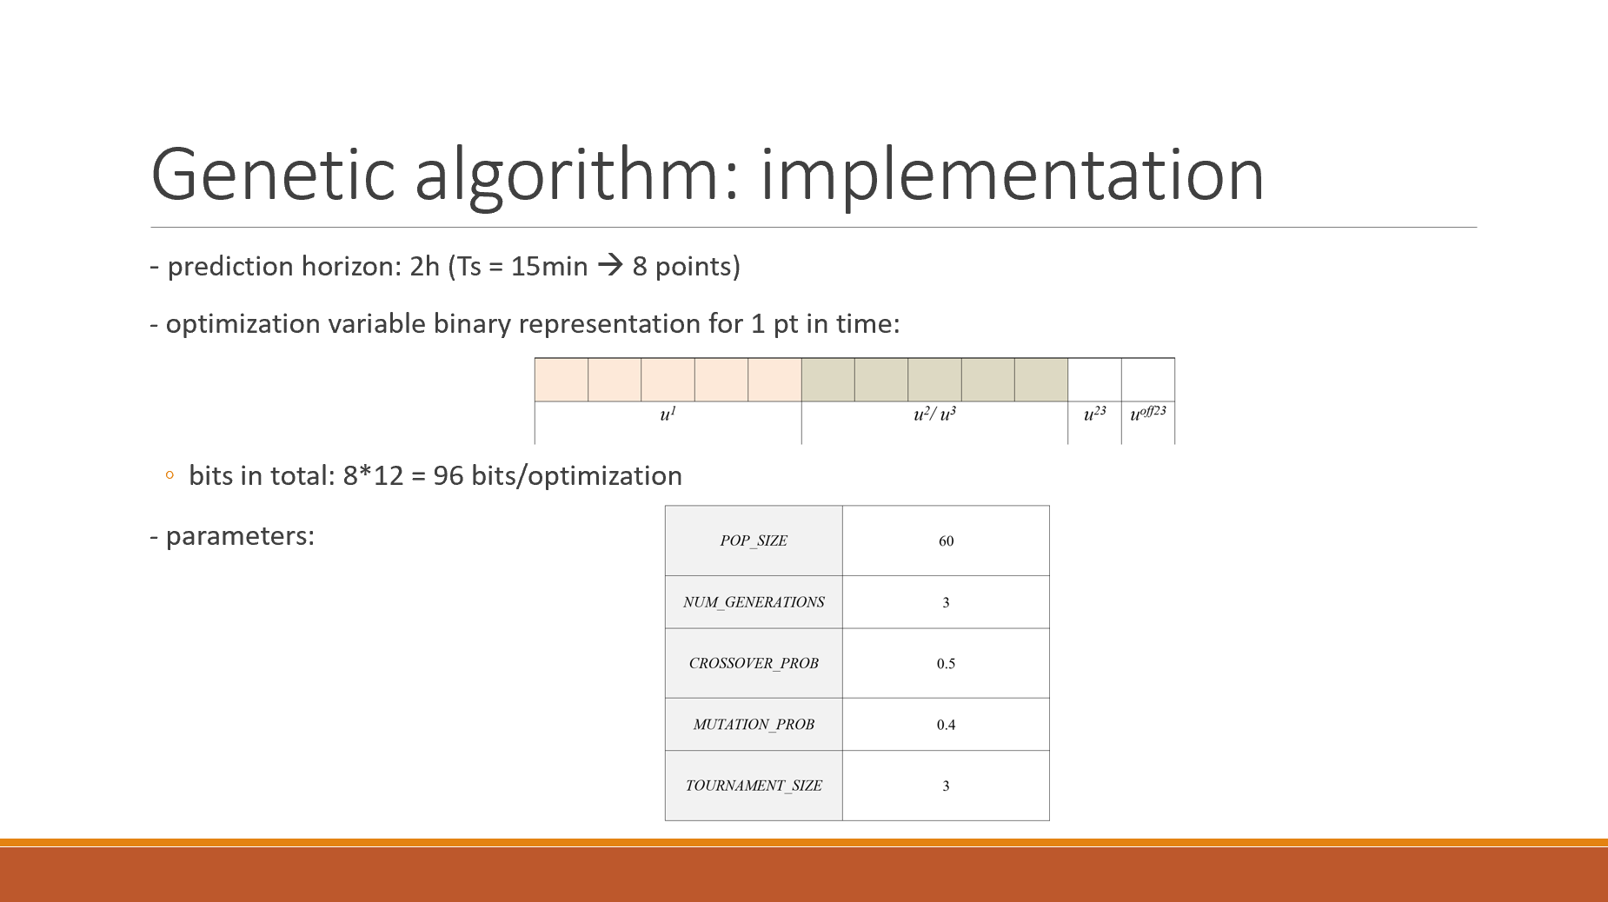
Conclusion
- promising results, but too optimistic (savings 77% comparing to 20% in literature)
- improvements:
  improving model:
    dataset, architecture, training
  improving optimization algorithm:
    faster execution → faster test comparison
  tunning PID for fair comparison

Slide 50
Optimization
optimization function: estimation of electricity consumption for the prediction horizon + penalty
optimization variables:
- constraints:
  control constraints
  variable constraints
genetic algorithm
$u^{1}$ (fresh air damper opening),
$u^{2}$ (cooling coil valve),
$u^{3}$ (heater command)
embedded in variable coding
penalty when violated
optimization technique based on evolutionary principles to find solutions to complex problems
binary
Notes:
Time for execution: 5minutes

