Slide 1

NN-based MPC for energy efficient HVAC systems for CERN accelerators
Nikolina Bunijevac EN/CV/CL

Slide 2
NN-based MPC for energy efficient HVAC systems for CERN accelerators

Slide 3
NN-based MPC for energy efficient HVAC systems for CERN accelerators
heating, ventilation, air conditioning

Slide 4
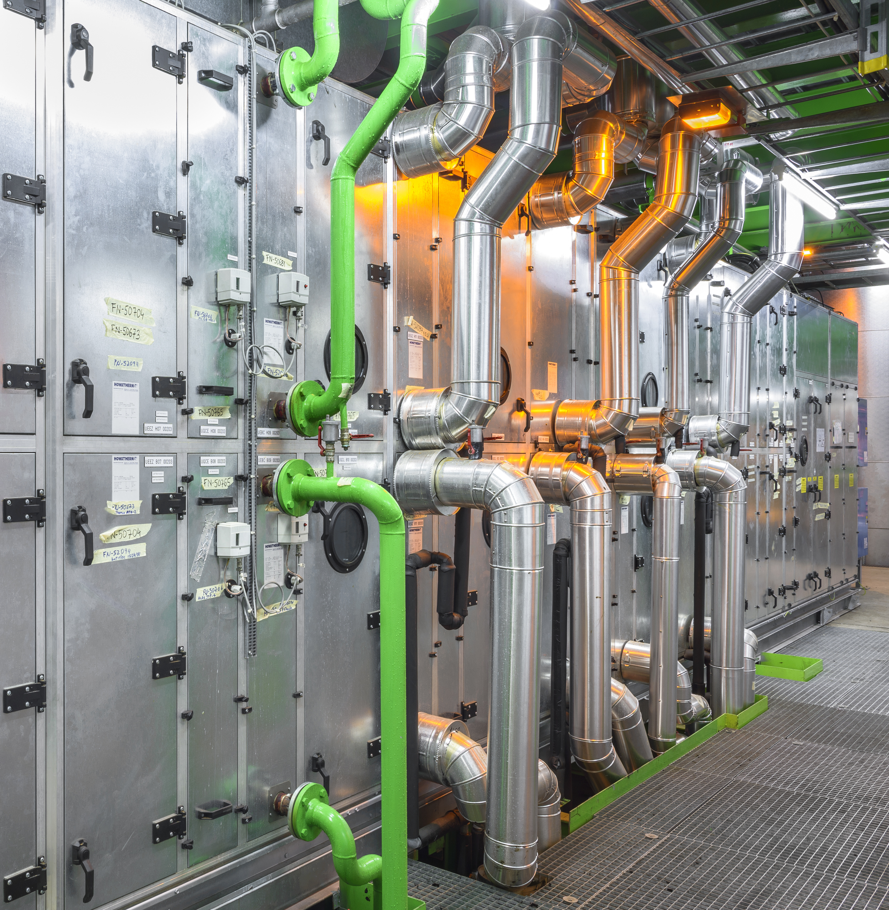
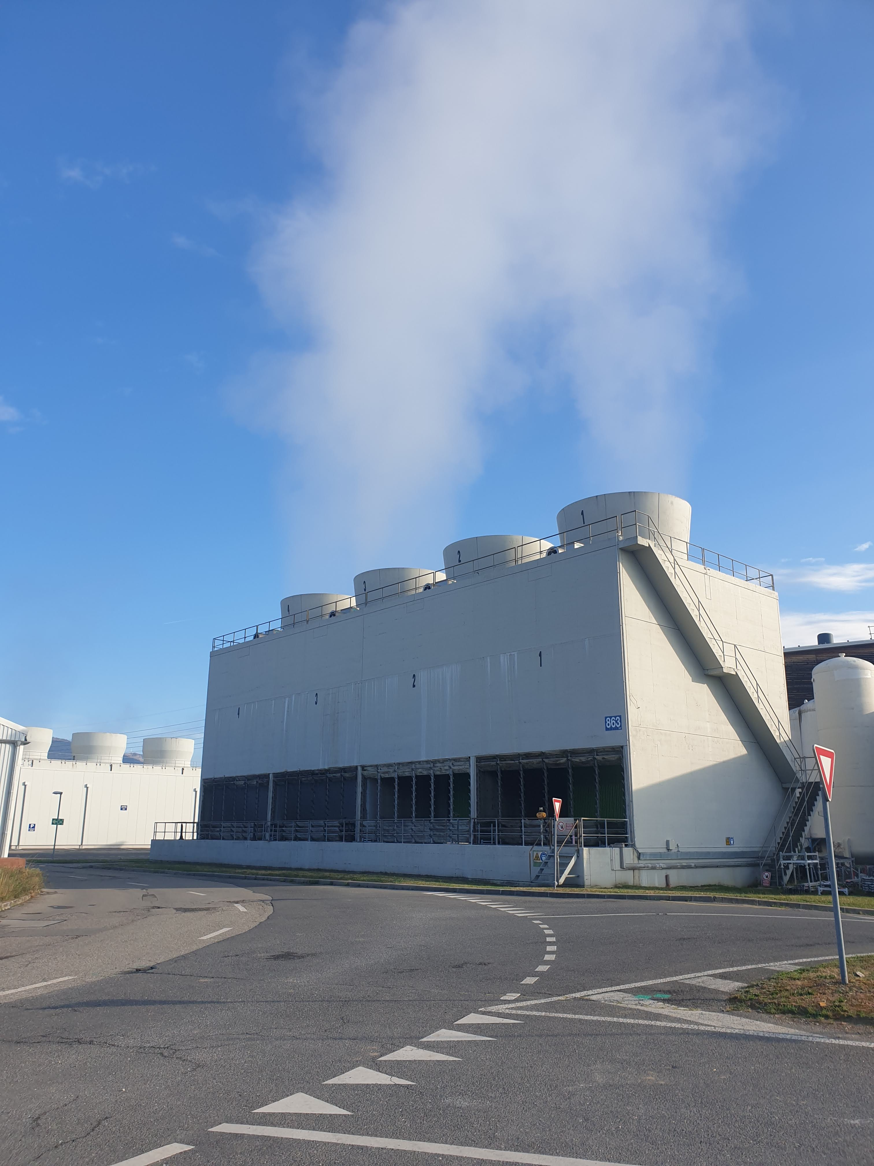
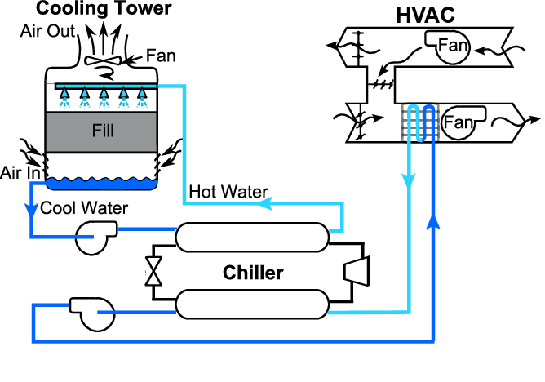
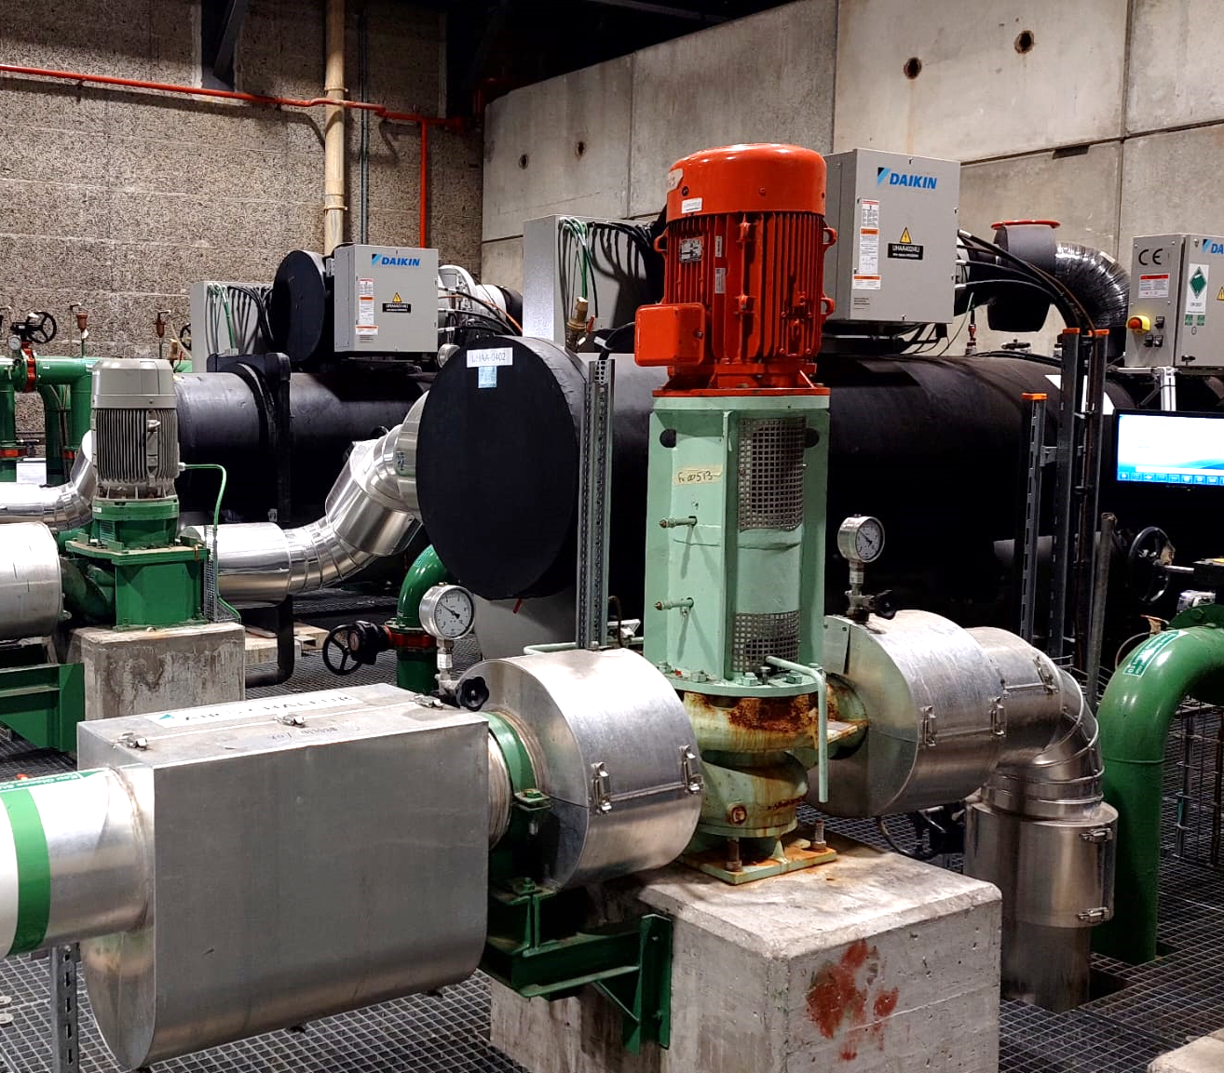

Slide 5
NN-based MPC for energy efficient HVAC systems for CERN accelerators

Slide 6
Research motivation
  Following global sustainability concerns, “pursuing actions and technologies aiming at energy savings and reuse” is listed as one of the main objectives for 2021-2025 at the European Organization for Nuclear Research (CERN). This objective extends to the Cooling and Ventilation group.

Slide 7
NN-based MPC for energy efficient HVAC systems for CERN accelerators

Slide 8
Controls optimization

Slide 9
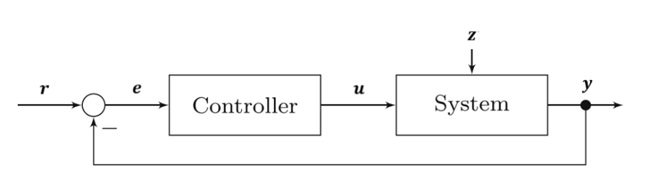
Controls optimization
Classical feedback Controller

Slide 10
Controls optimization
Classical feedback Controller
PID

Slide 11
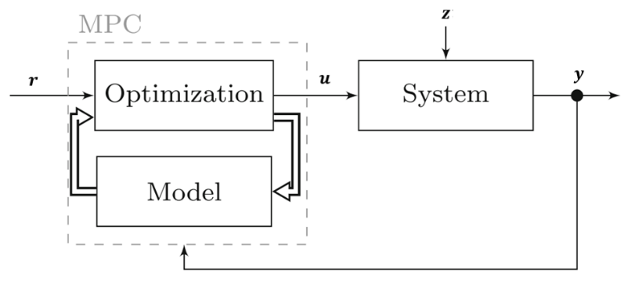
Controls optimization
Classical feedback Controller
Model Predictive Controller
PID
external information
- prediction horizon

Slide 12
Modelling

Slide 13
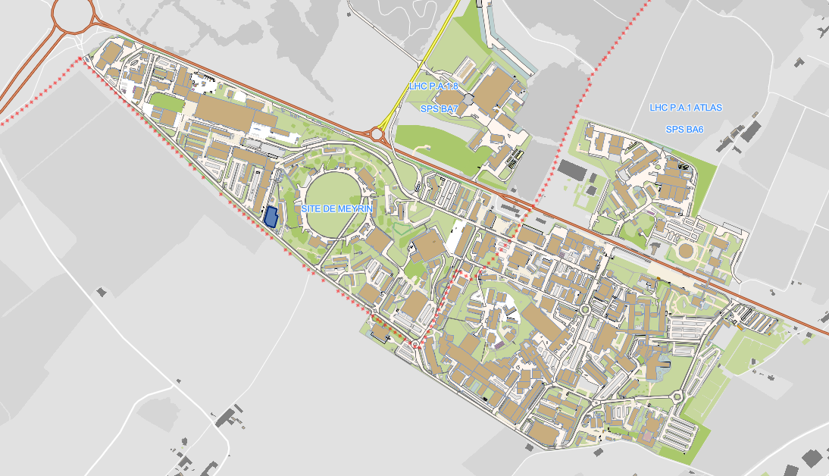
System: Air Handling Unit (HVAC311)

Slide 14
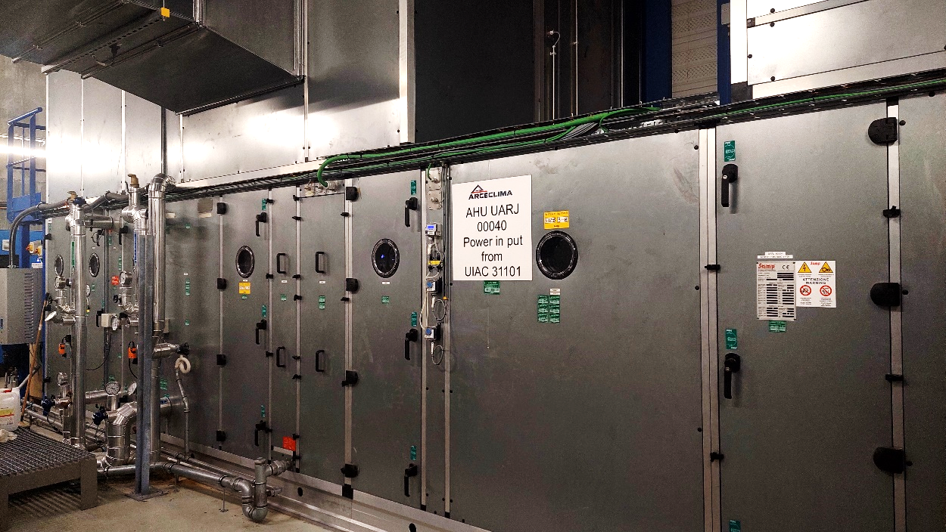
System: Air Handling Unit (HVAC311)

Slide 15
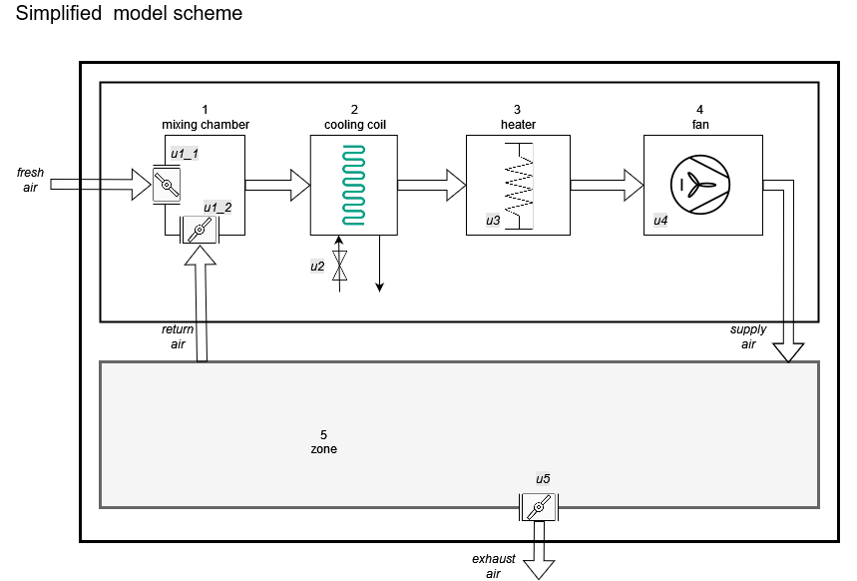
System: Air Handling Unit (HVAC311)
Controlled variables

Slide 16
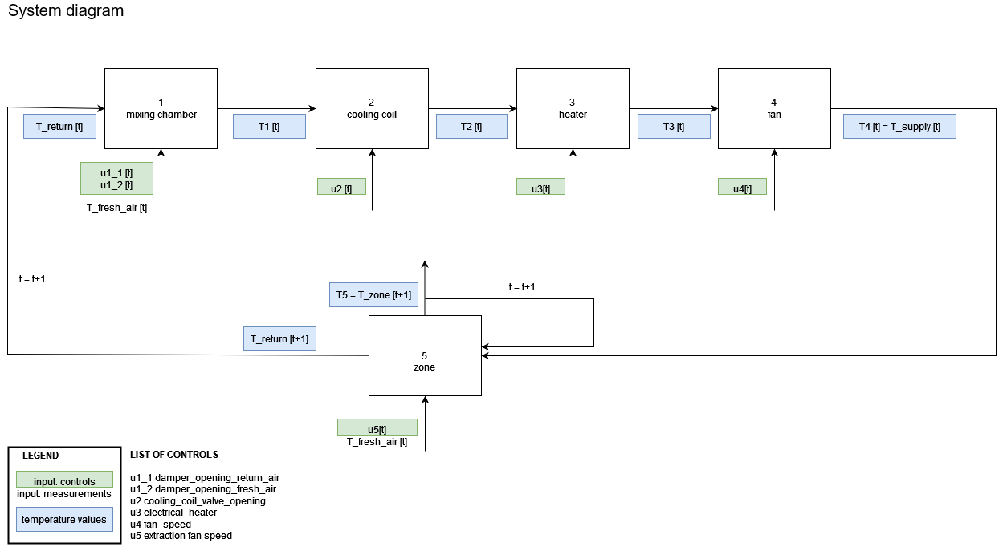
Physics-informed approach

Slide 17
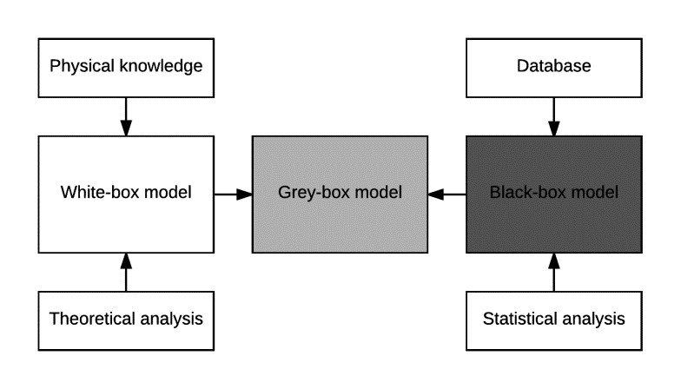
Modelling: methodology

Slide 18
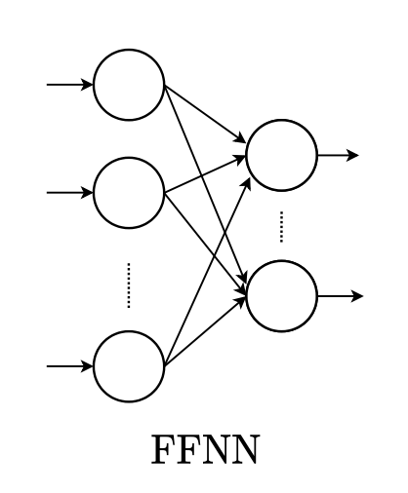
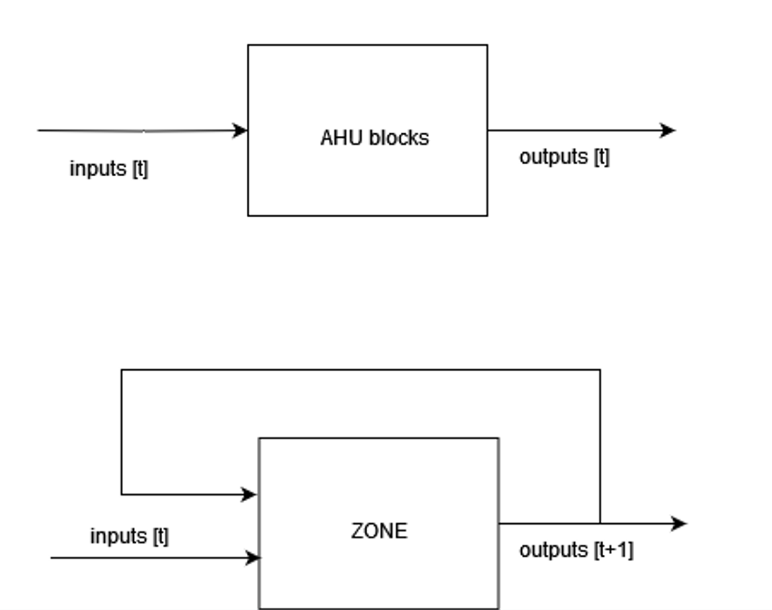
Modelling: methodology – black-box
AHU blocks: steady-state
Zone: autoregressive and dynamic

Slide 19
Modelling: methodology – black-box
AHU blocks: steady-state

Slide 20
Modelling: methodology – black-box
AHU blocks: steady-state
Zone: dynamic

Slide 21
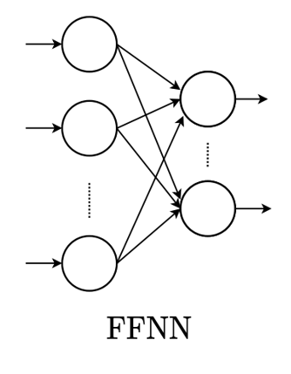
AHU
Steady state models
Zone
Dynamic model

Slide 22
AHU
Steady state models
Zone
Dynamic model

Slide 23
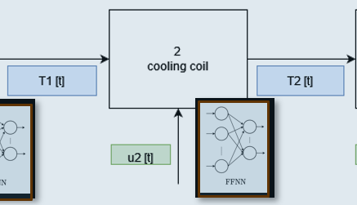
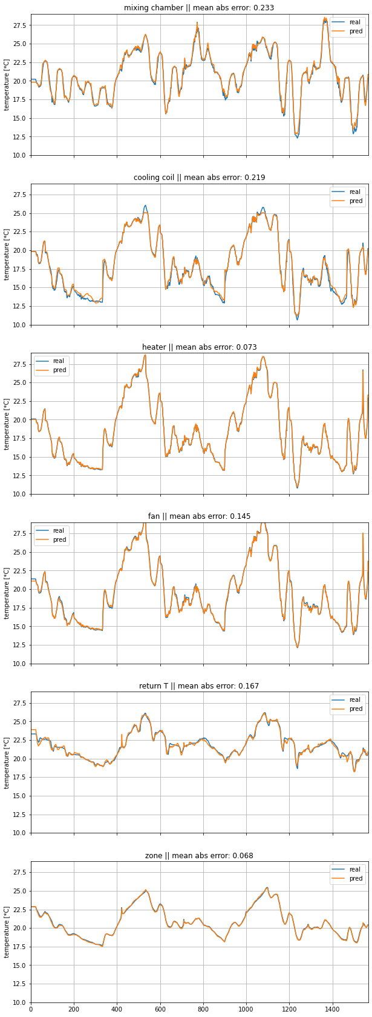
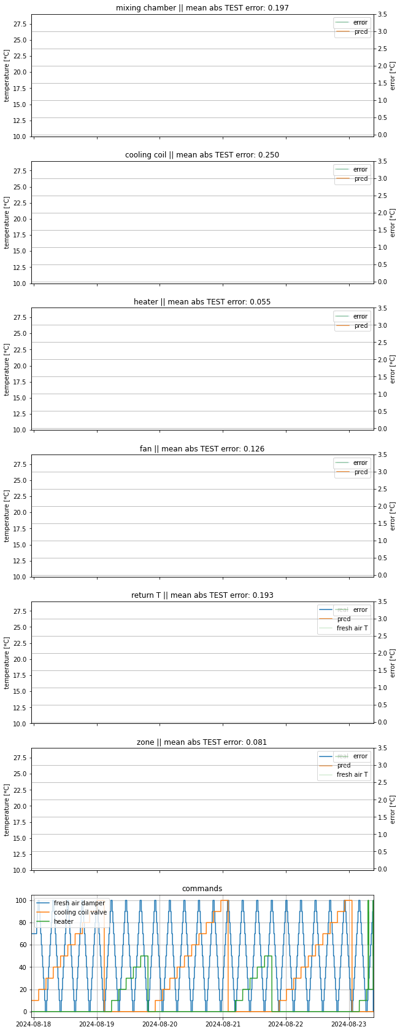
Example: cooling coil

Slide 24
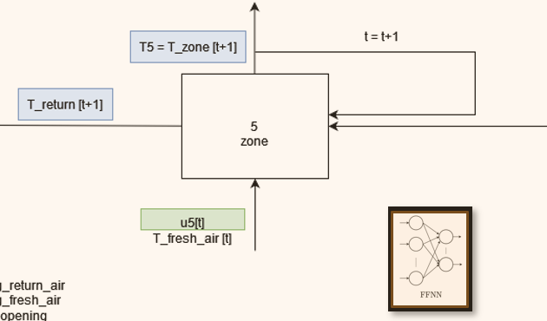
Example: cooling coil & zone

Slide 25
Optimization

Slide 26
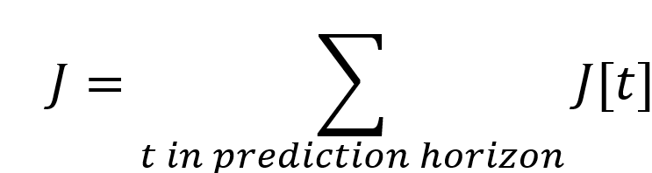
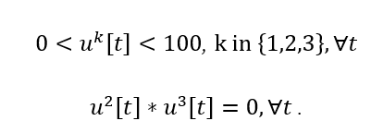
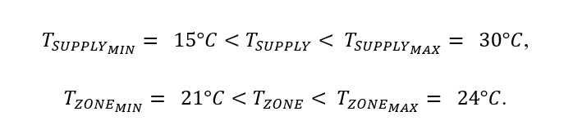

Optimization
optimization function: estimation of electricity consumption for the prediction horizon + penalty
optimization variables:
- constraints:
  control constraints
  variable constraints
genetic algorithm
$u^{1}$ (fresh air damper opening),
$u^{2}$ (cooling coil valve),
$u^{3}$ (heater command)
embedded in variable coding
penalty when violated
optimization technique based on evolutionary principles to find solutions to complex problems
binary

Slide 27
Optimization
optimization function: estimation of electricity consumption for the prediction horizon + penalty
optimization variables:
- constraints:
  control constraints
  variable constraints
genetic algorithm
$u^{1}$ (fresh air damper opening),
$u^{2}$ (cooling coil valve),
$u^{3}$ (heater command)
embedded in variable coding
penalty when violated
optimization technique based on evolutionary principles to find solutions to complex problems
binary

Slide 28
Optimization
optimization function: estimation of electricity consumption for the prediction horizon + penalty
optimization variables:
- constraints:
  control constraints
  variable constraints
genetic algorithm
$u^{1}$ (fresh air damper opening),
$u^{2}$ (cooling coil valve),
$u^{3}$ (heater command)
embedded in variable coding
penalty when violated
optimization technique based on evolutionary principles to find solutions to complex problems
binary

Slide 29
Optimization
optimization function: estimation of electricity consumption for the prediction horizon + penalty
optimization variables:
- constraints:
  control constraints
  variable constraints
genetic algorithm
$u^{1}$ (fresh air damper opening),
$u^{2}$ (cooling coil valve),
$u^{3}$ (heater command)
embedded in variable coding
penalty when violated
optimization technique based on evolutionary principles to find solutions to complex problems
binary

Slide 30

Optimization
optimization function: estimation of electricity consumption for the prediction horizon + penalty
optimization variables:
- constraints:
  control constraints
  variable constraints
genetic algorithm
$u^{1}$ (fresh air damper opening),
$u^{2}$ (cooling coil valve),
$u^{3}$ (heater command)
embedded in variable coding
penalty when violated
optimization technique based on evolutionary principles to find solutions to complex problems
binary

Slide 31
Optimization
optimization function: estimation of electricity consumption for the prediction horizon + penalty
optimization variables:
- constraints:
  control constraints
  variable constraints
genetic algorithm
$u^{1}$ (fresh air damper opening),
$u^{2}$ (cooling coil valve),
$u^{3}$ (heater command)
embedded in variable coding
penalty when violated
optimization technique based on evolutionary principles to find solutions to complex problems
binary

Slide 32
Optimization
optimization function: estimation of electricity consumption for the prediction horizon + penalty
optimization variables:
- constraints:
  control constraints
  variable constraints
genetic algorithm
$u^{1}$ (fresh air damper opening),
$u^{2}$ (cooling coil valve),
$u^{3}$ (heater command)
embedded in variable coding
penalty when violated
optimization technique based on evolutionary principles to find solutions to complex problems
binary

Slide 33
Optimization
optimization function: estimation of electricity consumption for the prediction horizon + penalty
optimization variables:
- constraints:
  control constraints
  variable constraints
genetic algorithm
$u^{1}$ (fresh air damper opening),
$u^{2}$ (cooling coil valve),
$u^{3}$ (heater command)
embedded in variable coding
penalty when violated
optimization technique based on evolutionary principles to find solutions to complex problems
binary

Slide 34
Optimization
optimization function: estimation of electricity consumption for the prediction horizon + penalty
optimization variables:
- constraints:
  control constraints
  variable constraints
genetic algorithm
$u^{1}$ (fresh air damper opening),
$u^{2}$ (cooling coil valve),
$u^{3}$ (heater command)
embedded in variable coding
penalty when violated
optimization technique based on evolutionary principles to find solutions to complex problems
binary

Slide 35
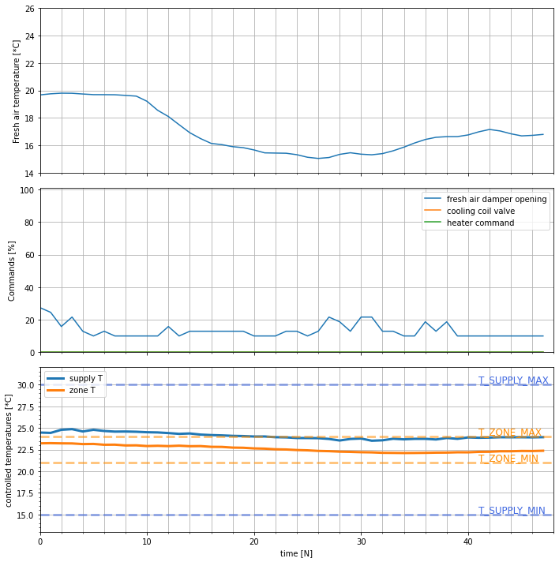
Example:
MPC solution
4h
4h

Slide 36
Example:
MPC solution
4h

Slide 37
Example:
MPC solution
4h

Slide 38
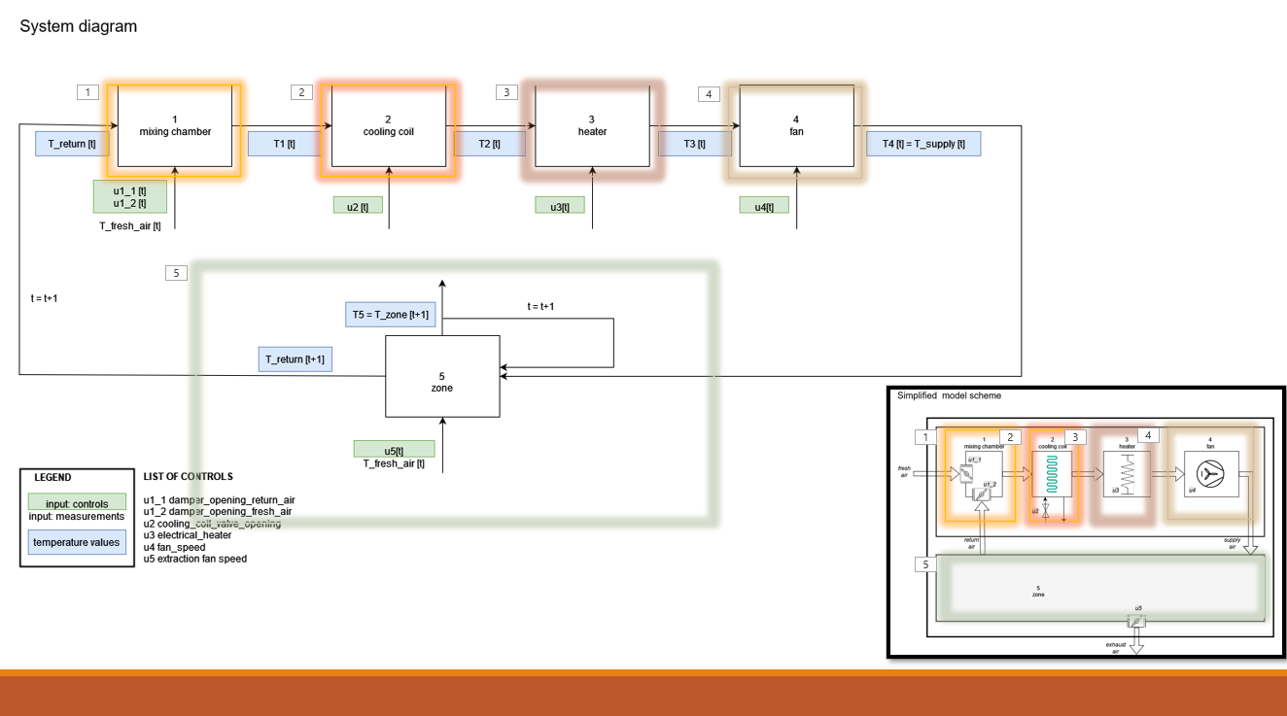
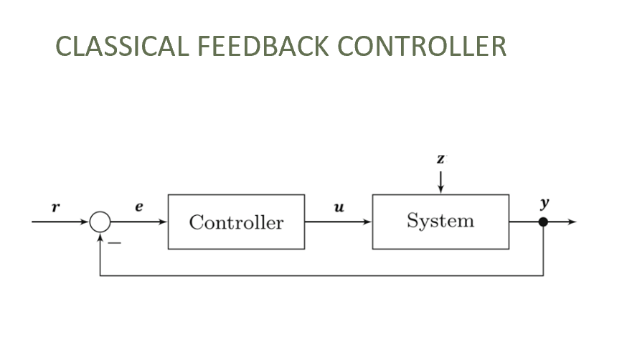
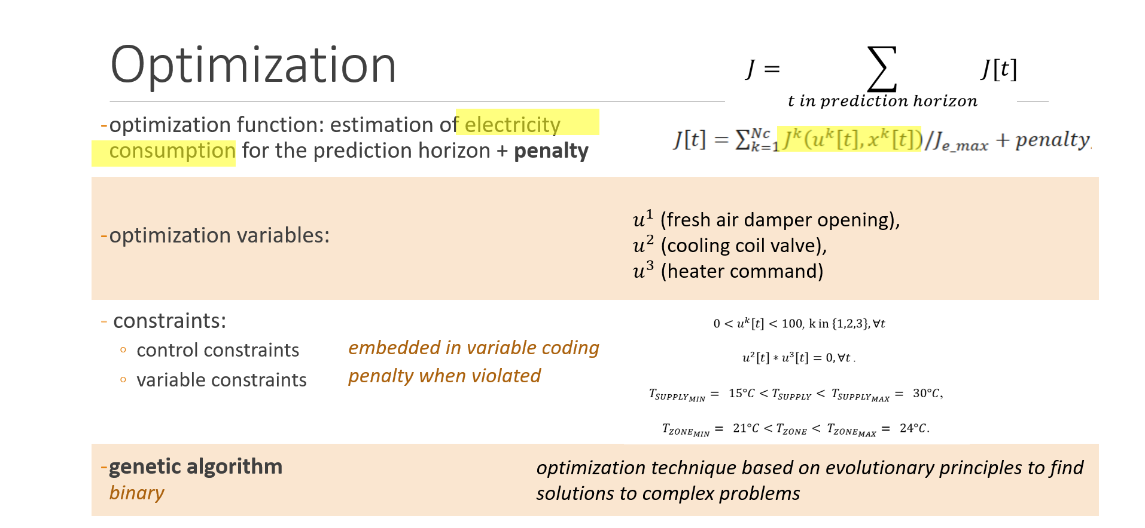
Next step
  thorough comparison between classical controls and MPC
  test zone on larger dataset
  If needed, MPC optimization upgrade for faster convergence

Slide 39
Discussion

