Slide 1
Retour d’experience and DIMR next steps
Beniamino Di Girolamo
TE Department

Slide 2
Outline
Recap of the technical visits
What we understood in terms of sequence
FOCUS: DIMR and Work Dose Plans
  What we have
  What we need

Slide 3
Technical visits
IT.R1
  Impact 244357 09-Jan-2025
  Extended visit and several discussions
  Around 205 µSv collective dose
IT.L5
  Impact 245649 22-Jan-2025
  Looking for difference Point 1 vs. Point 5
  Around 150 µSv collective dose

Slide 4
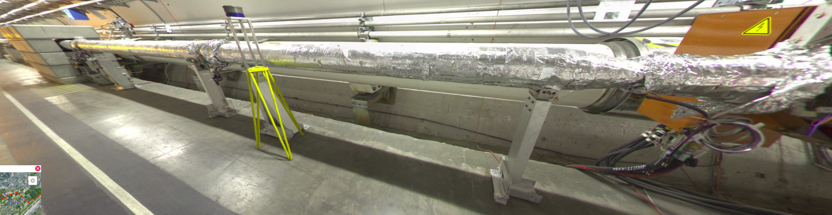
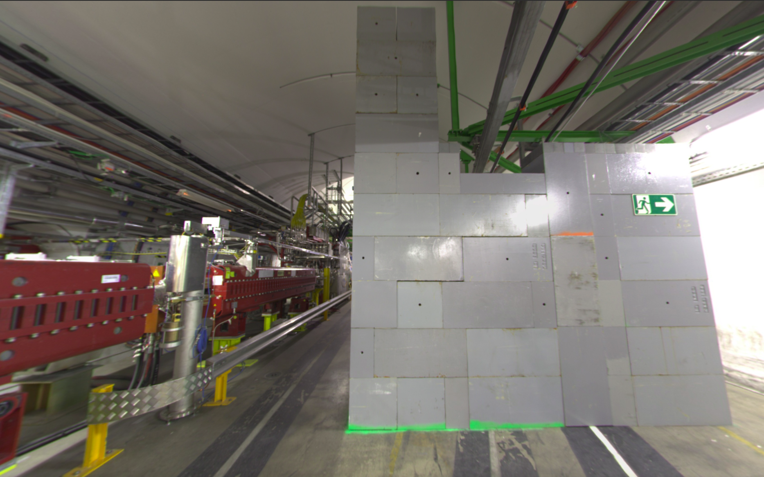
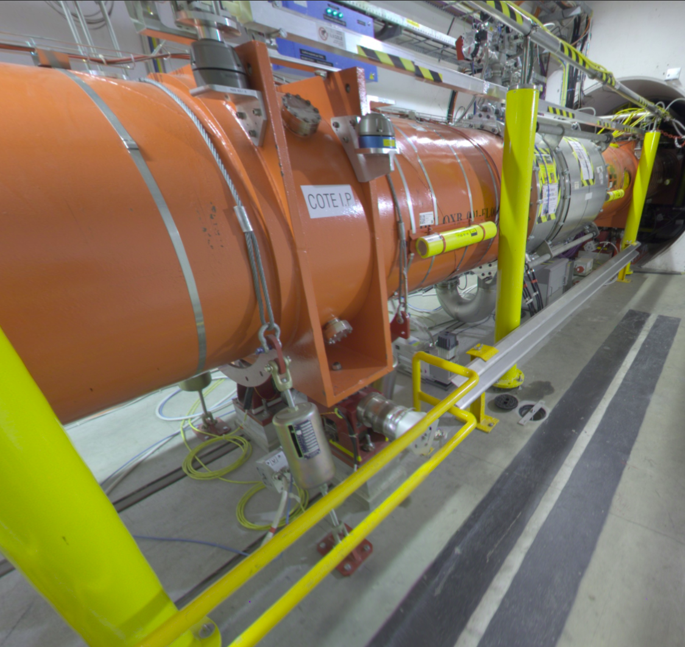
Points to be retained (please add) – part I
Sequence from beginning to end for IT dismounting
  Elctrical lockout
  TE-VSC at early stage: dismounting of beam vacuum warm part
  EN/HE Remove shielding walls were needed to widen the passage
  EN/ACE dismounting rails and motors protections
  Vacuum venting, atm pressure in cryomagnet and beam vacuum
  BE-GM nuts on jacks and dismount radial motors
  SY-BI (in parallel?) dismount BLMs
  BE-GM remove alignment systems (HLS fluid, wire, rails, yellow pillars)
  TE-VSC insulation vacuum
  Cryo lockout (to be assessed with EROS)
  EN-ACE removing bumpers (postpone hotter ones)
  EN-ACE removing ties on the bumpers (only point 5)

Slide 5
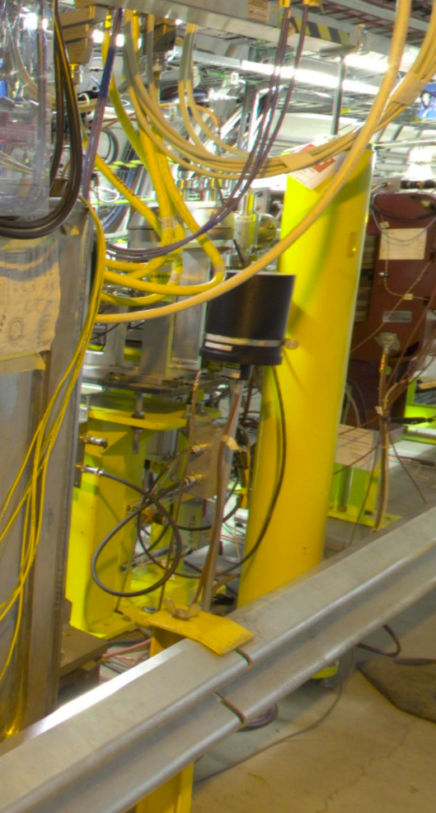
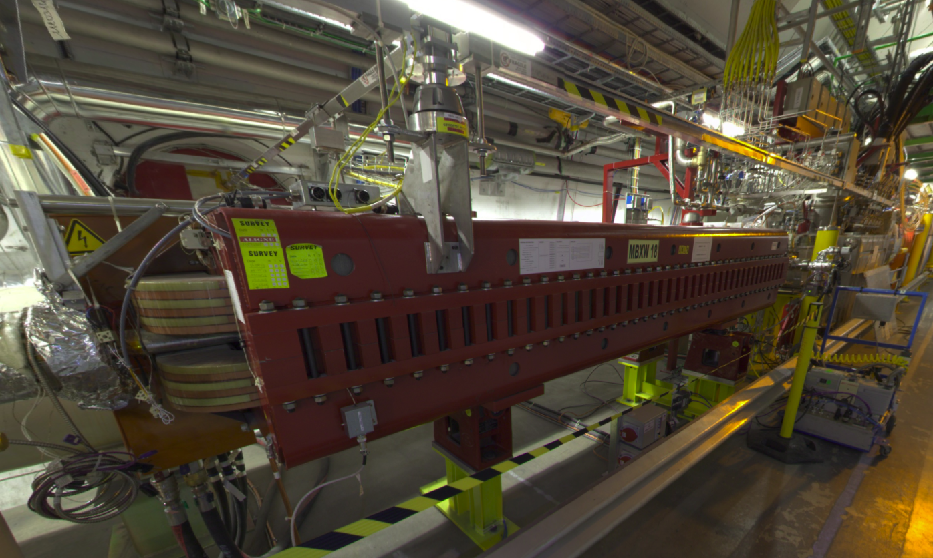
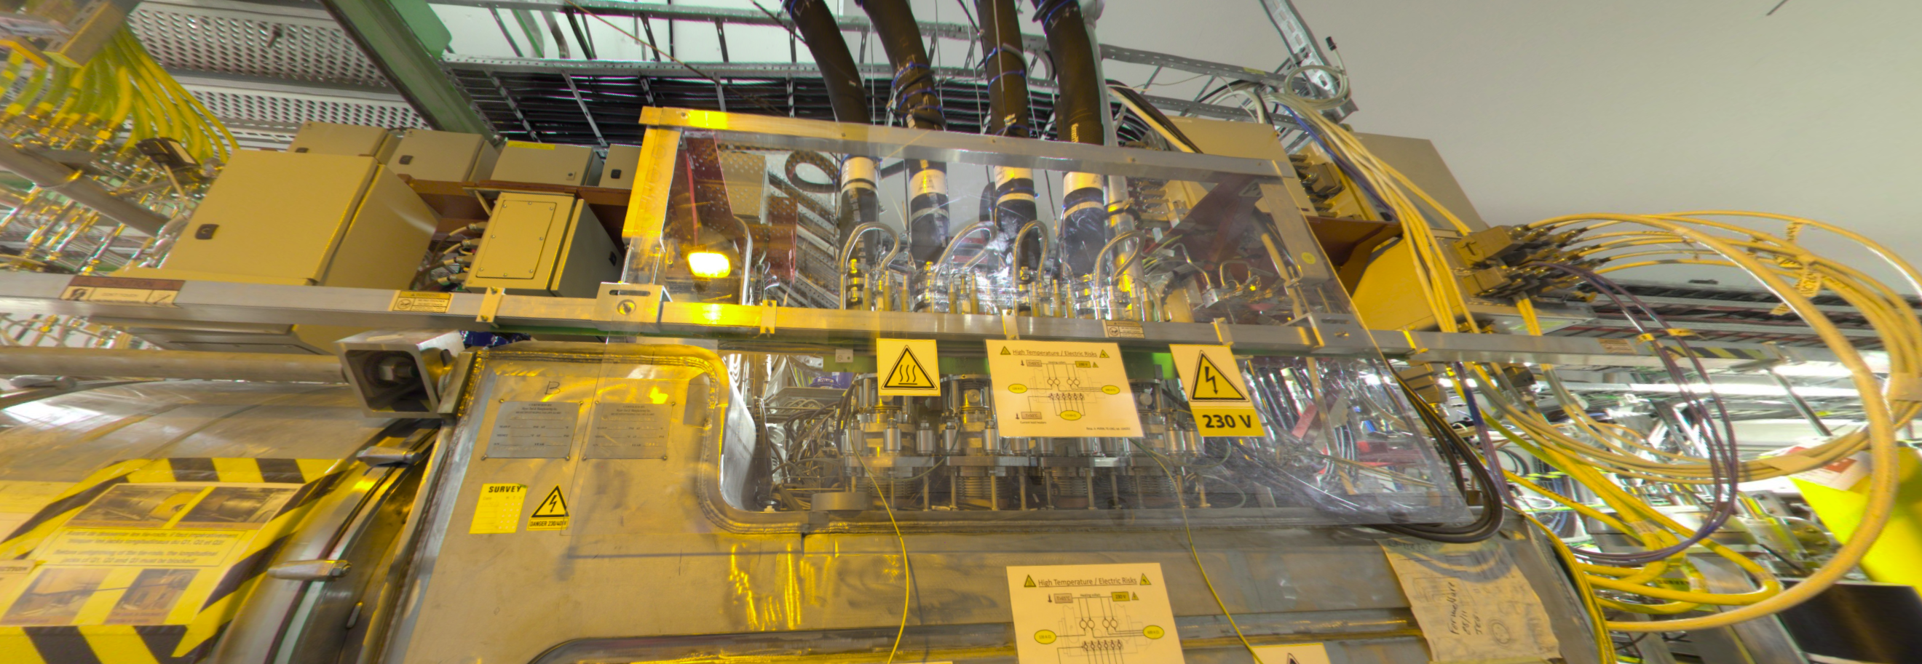
Points to be retained (please add) – part II
Sequence from beginning to end for IT dismounting (cont.)
  TE-VSC and SY-BI remove valves and BPM and supports
  TE-MSC to remove D1 magnets (priority to first on IP side to free up space for DFBX access): this can go in parallel
  TE-MPE disconnect (TE-CRG disconnect instrumentation) and remove complete upper part of red frame with electrical boxes (different access on the back of DFBX between P1 and P5)
  EN/CV emptying, EN/EL removing water-cooled cables
  TE-CRG work on DFBX
  TE-MSC Interconnect work (in parallel or shortly after): several operations (tie rods, W-bellows etc)
  TE-VSC, SY-BI and EN/AA remove Q1 connections and elemets IP side (VAX, TAS, BPM, BLM)
  All electrical boxes under magnet gone
  EN-ACE removing bumpers (if not done before)
  TE-MSC removing ties (if not done before)
  EN-HE remove D1 (at least first one), DFBX, Q3, Q2, Q1

Slide 6
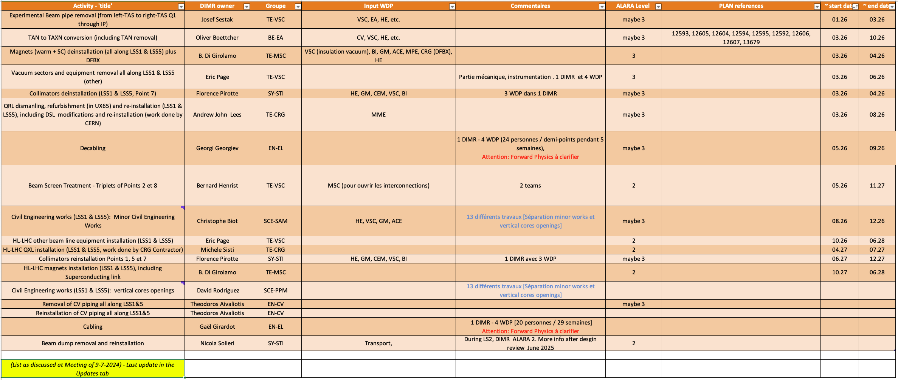
Main focus of today: WDPs and DIMR

Slide 7
What we have
TE-MSC Warm magnets
  Point 1: WDP 3877/1
  Point 5: WDP 3938/1 https://impact-ng.cern.ch/wdp/3938/1
TE-MSC Cold magnets interconnects
  Q1-Q2, Q2-Q3, Q3-DFBX
TE-VSC
  LSS5R
    https://impact-ng.cern.ch/wdp/3278/1
    https://impact-ng.cern.ch/wdp/3272/1
    The de-installation document: https://edms.cern.ch/document/3171092/1.0
  LSS1 and LSS5L
    WDPs to be cloned

Slide 8
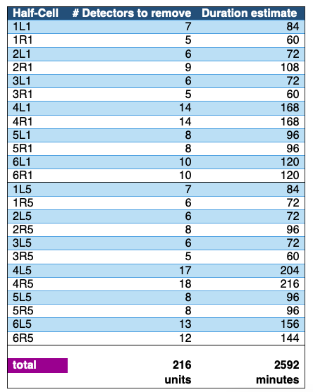

What we have (cont.)
SY-BI
  BLM
    Timing estimation per BLM
    Total timing estimation
    Need to input in WDP with doses
    Possible to reduce time after technical visit?
    Divide IMPACTs for different regions in the machine
    2 teams of 3 each

Slide 9
We miss
EN/ACE
BE-GM
TE-MPE
EN/HE: given indication to follow EDMS 1409757, to be optimised
TE-CRG
DEADLINE: 31 March 2025

Slide 10
WDPs
https://impact-ng.cern.ch/wdp/

