Slide 1
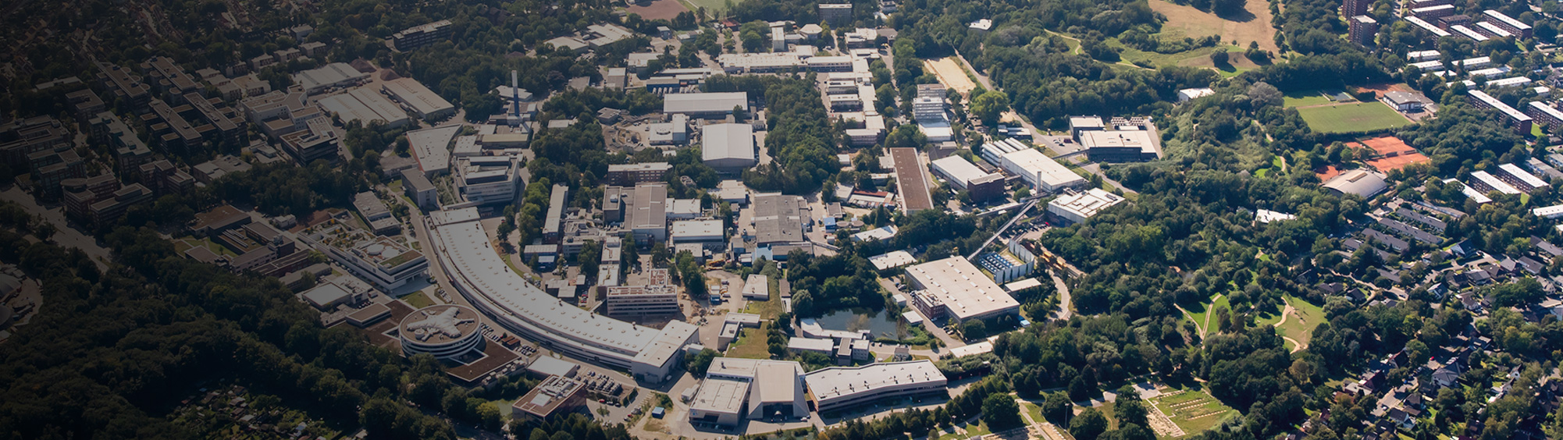
Vacuum and Cryogenic Technologies in large Axion Detectors
Axion search at DESY
Jörn Schaffran
IUVSTA Workshop 109 : APPEC Tech Forum Vacuum & Cryogenics, Maastricht, 24-26 Nov. 2025

Slide 2
Overview
Agenda
01 Physics
Introduction
Motivation
Overview of the three experiments
02 ALPS II
Detailed setup (technical concept)
The magnet
Other vacuum and cryo-technical requirements
03 BabyIAXO
Technical requirement
The magnet
Bore tube requirements (experimental components) and FAT
04 MADMAX
Experimental setup
The magnet
The prototype cryostat
Other subcomponents
Summary
Summary and outlook

Slide 3
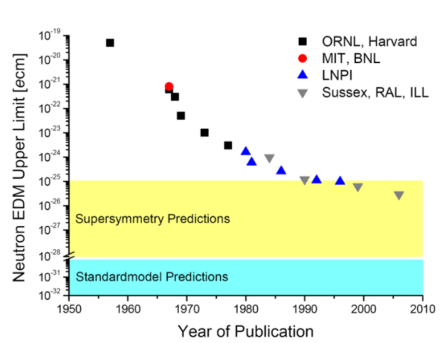
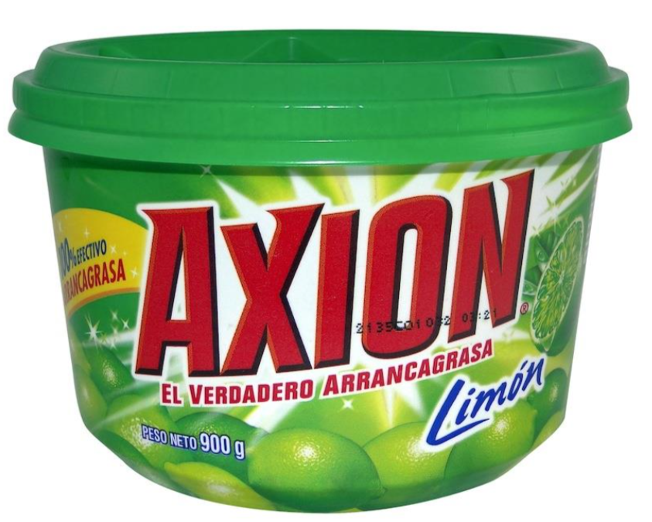
Introduction – Axion search
Axion Motivation
QCD CP violation
Axion originally proposed to solve Charge Parity violation problem in Quantum Chromo Dynamics (strong interaction)
QCD CP violating term
Expect electric dipole moment to the neutron, CP violation phase θ ≠ 0,
Experiment |d_{n}| < 3.0 10⁻¹³ e fm => θ < 10⁻⁹
New symmetry: θ=0 (Peccei-Quinn 1977), axion (Wilczek)
Dark matter
Standard Model only 15% of matter content in universe. Best motivated candidates those which occur in SM extensions solving also other problems
Hierarchy problem: MSSM neutralino
Strong CP problem: QCD axion
Apart from dark matter, other hints from astrophysics which might be explained by axions
Excessive energy losses of stars in various stages of their evolution
Excessive transparency of the universe for TeV gamma ray might be explained by photon - axion conversion
Could solve the CP violation and explain dark matter.

Slide 4
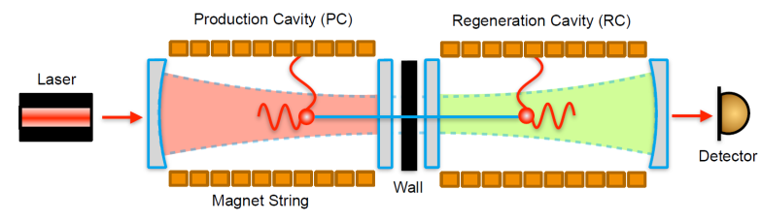

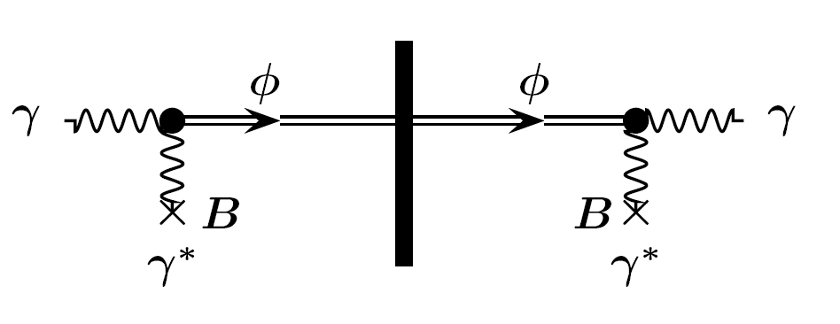
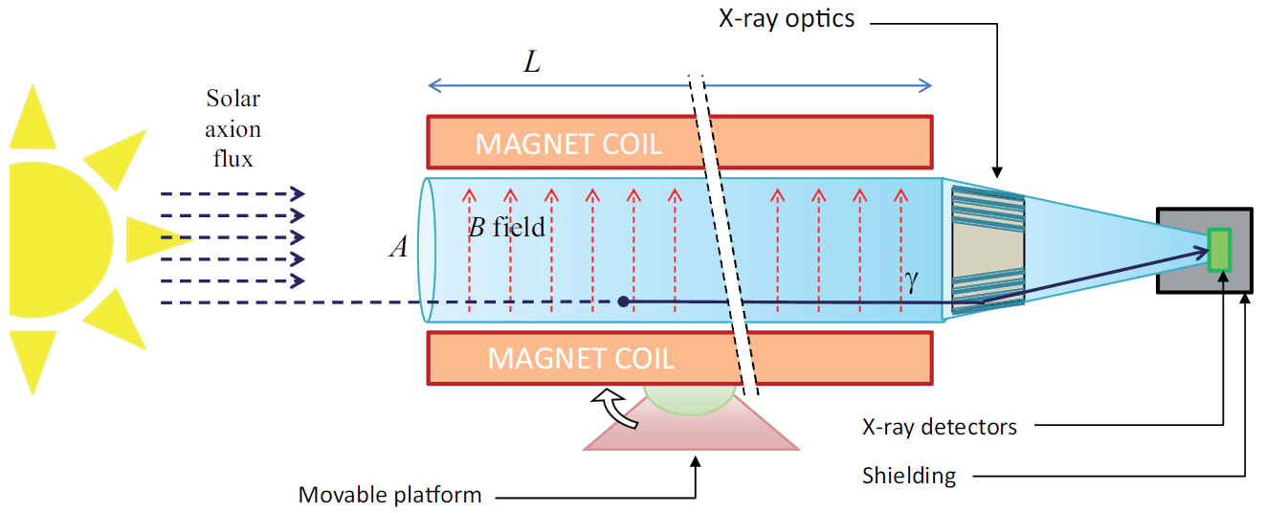

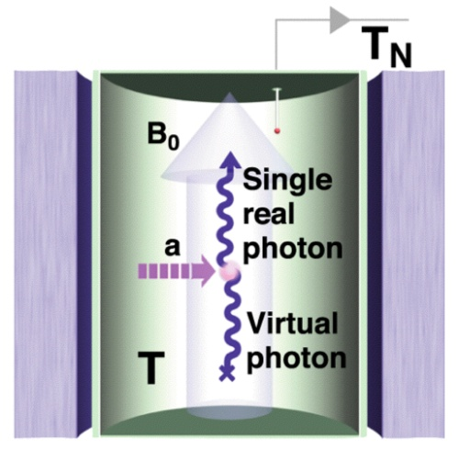

How to search - Experimental Axion Search Methods
Light-shining-through-a-wall (LSW)
Production and detection of axions in laboratory
Helioscopes
Axion production in sun, detection in laboratory
Haloscopes
Axion dark matter production in early universe, detection in lab (microwaves)
Primakoff effect
conversion
a
a
a
a
a
Very complementary axion production and detection Different techniques and systematics

Slide 5
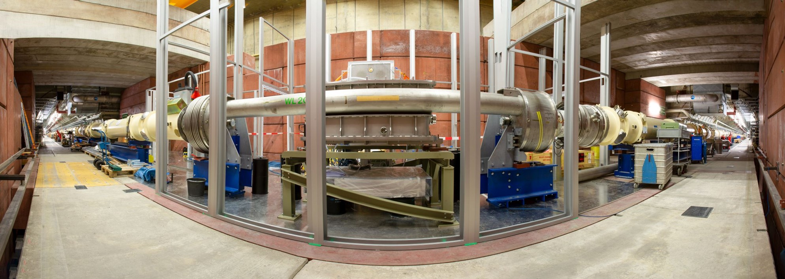
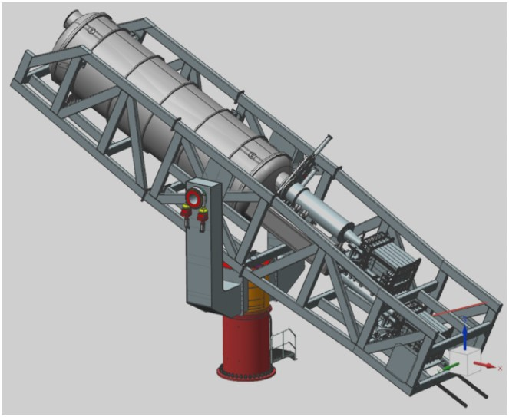
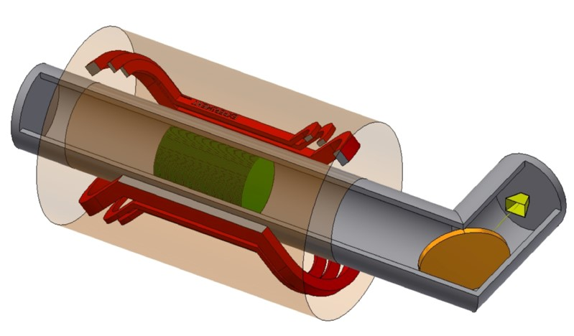
How to search - Experimental Axion Search Methods
Light-shining-through-a-wall (LSW)
Production and detection of axions in laboratory
Helioscopes
Axion production in sun, detection in laboratory
Haloscopes
Axion dark matter production in early universe, detection in lab (microwaves)
Primakoff effect
conversion
a
a
a
a
a
Very complementary axion production and detection Different techniques and systematics

Slide 6
How to search - Experimental Axion Search Methods
Light-shining-through-a-wall (LSW)
Production and detection of axions in laboratory
Helioscopes
Axion production in sun, detection in laboratory
Haloscopes
Axion dark matter production in early universe, detection in lab (microwaves)
Primakoff effect
conversion
a
a
All of these experiments require cryogenic and vacuum techniques.
IAXO
a
a
a
Very complementary axion production and detection Different techniques and systematics

Slide 7
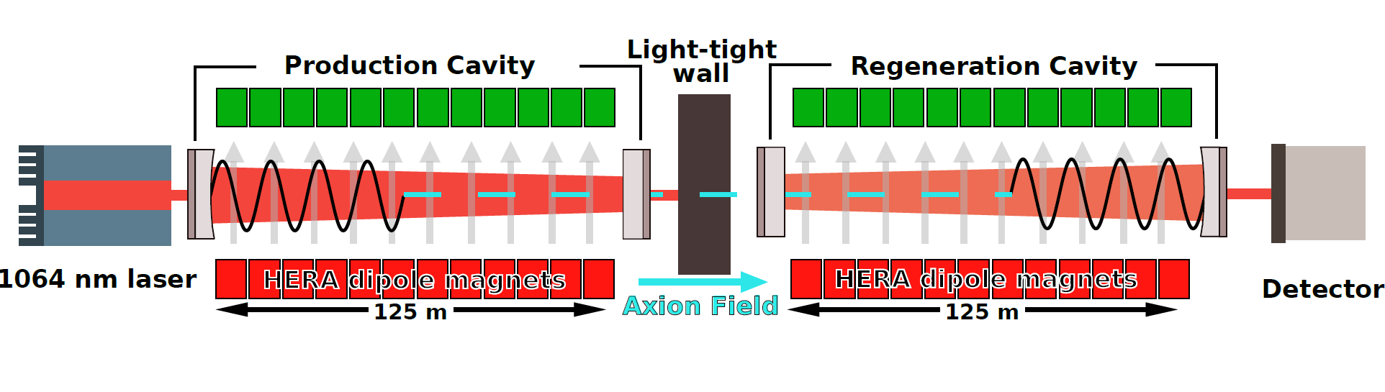
ALPS II - Any Light Particle Search II
Light-through-a-wall
Probing axion-photon couplings model independently.
5 cm
Axion generation
250 m
Axion reconversion
Light injection
Axion pass the wall
Light detection

Slide 8
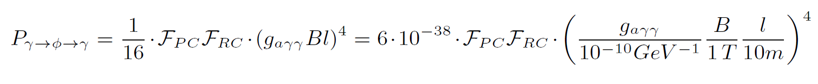
Any Light Particle Search II
Light-through-a-wall
Demands given by the FoM:
Probing axion-photon couplings model independently.
Long section of dipole magnets
Strong magnetic field
5 cm
Axion generation
250 m
Axion reconversion
Light injection
Axion pass the wall
Light detection
Particle free vacuum space for optics (powerfull laser light)

Slide 9
Any Light Particle Search II
Light-through-a-wall
Techniques:
24 old HERA dipole magnets operated at 4.2 K and a field of 5.3 T.
250 m long vacuum tube @4.2 K and with >5 cm diameter.
Nearly particle free environment close to the optic components.
Commissioning successful and first science run done, next will follow 2026.
Next steps:
Upgrade with TES (next slide).
Vacuum Magnetic Birefringence (VMB).
GW detection.

Slide 10
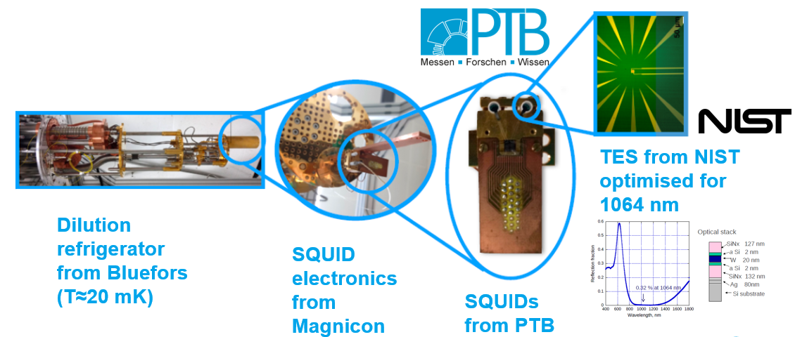
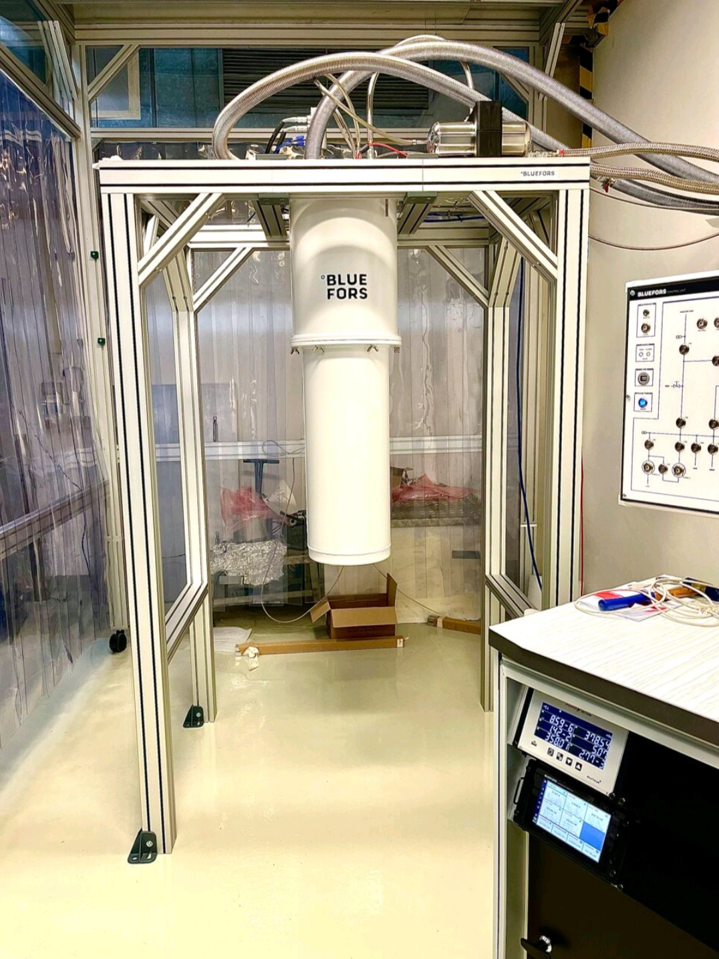

ALPS II -Transition Edge Sensor (detection)
Looking for 5·10⁻²⁴ W @ 1064 nm
“Characterization of 1064 nm photon signals and background events of a tungsten TES detector for the ALPS experiment”, J. Dreyling-Eschweiler et al., Journal of Modern Optics, 62:14, 1132-1140
Dilution Refrigerators from Bluefors with superconducting transition edge sensor (TES) for photon counting:
Base temperature about 20 mK.
Cooling power at 100 mK about 300 µW.
One of the cryostats placed in a gray (semi-clean) room ➔ clean room lab planned.
Different temperature stages.

Slide 11
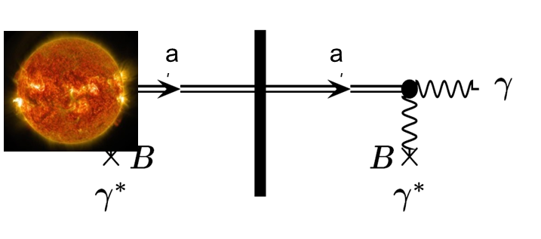
Baby(IAXO) - physics
Why do we search an Axion?
Motivation
Detecting Axions coming from the sun.
How to detect an Axion?
Axionen are produced in the core of the sun by interaction of photons with the electromagnetic field. Detection by Helioscope.
Helioscope: a magnet pointing to the sun in order to maximize the Axion flux.
Axions coming from the sun, converted in a photon (Primakoff-Effect) and measured.

Slide 12
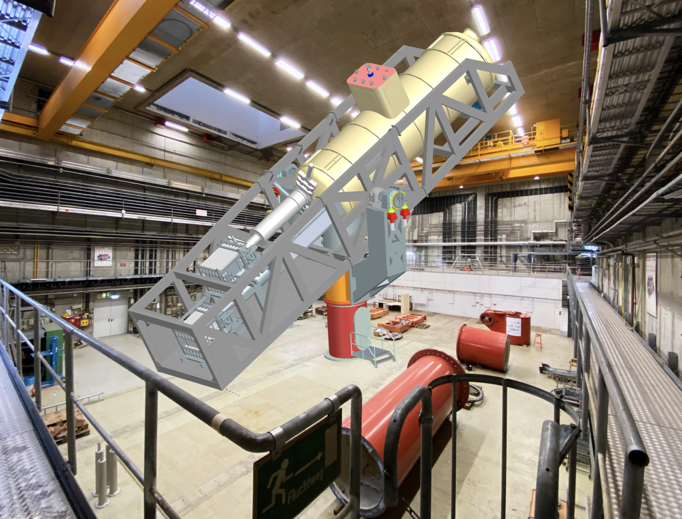
BabyIAXO - concept
What do we need?
Optics & Detectors
Magnet
Realization
A 10 m long superconducting dipole magnet (2.2 T) follows the sun with its 2 bore tubes (0.7 m diameter each, vacuum) to trap, convert and detect Axions.
Field and bore tube dimensions (length and diameter).
Experimental setup
Support und Drive System

Slide 13
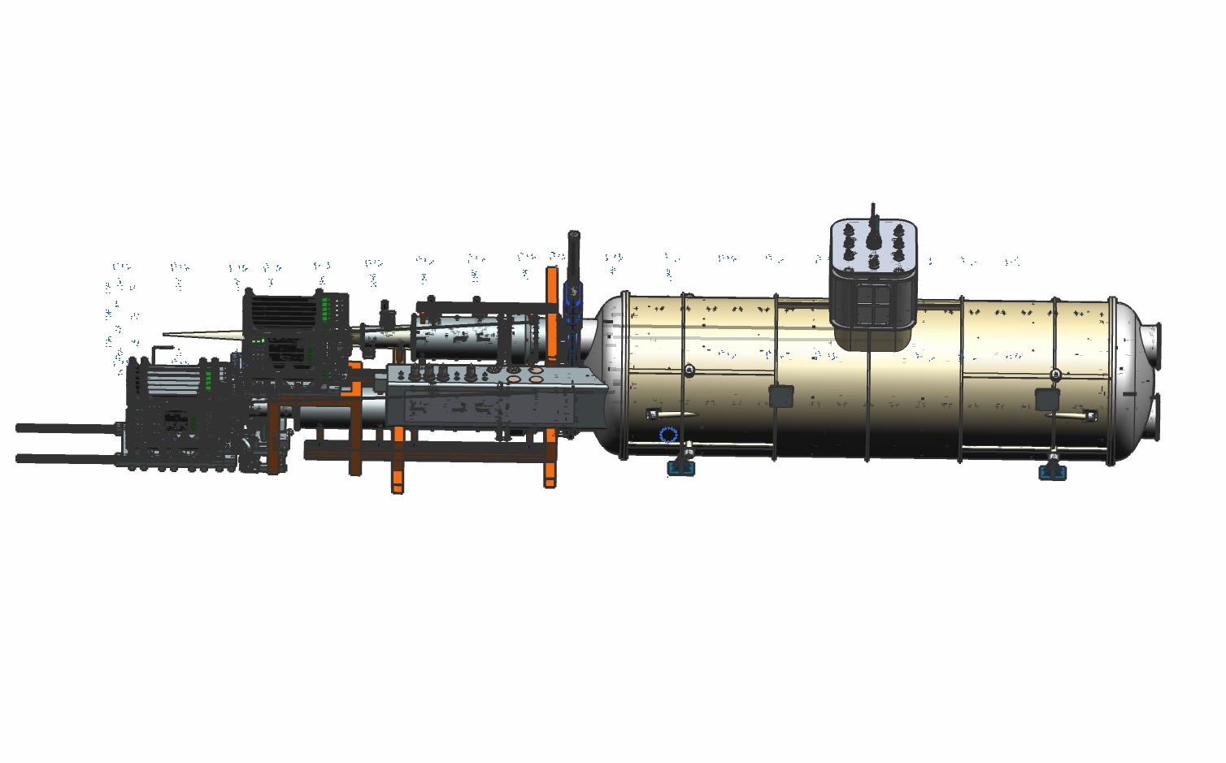
BabyIAXO - concept
Magnet
What do we need?
Realization
A 10 m long superconducting dipole magnet (2.2 T) follows the sun with its 2 bore tubes (0.7 m diameter each, vacuum) to trap, convert and detect Axions.
Field and bore tube dimensions (length and diameter).
A lot of conceptional engineering is already outsourced (Elytt, Spain).
Next step: tender for TDR and manufacturing.
Detektoren
Optik
Experimental setup

Slide 14
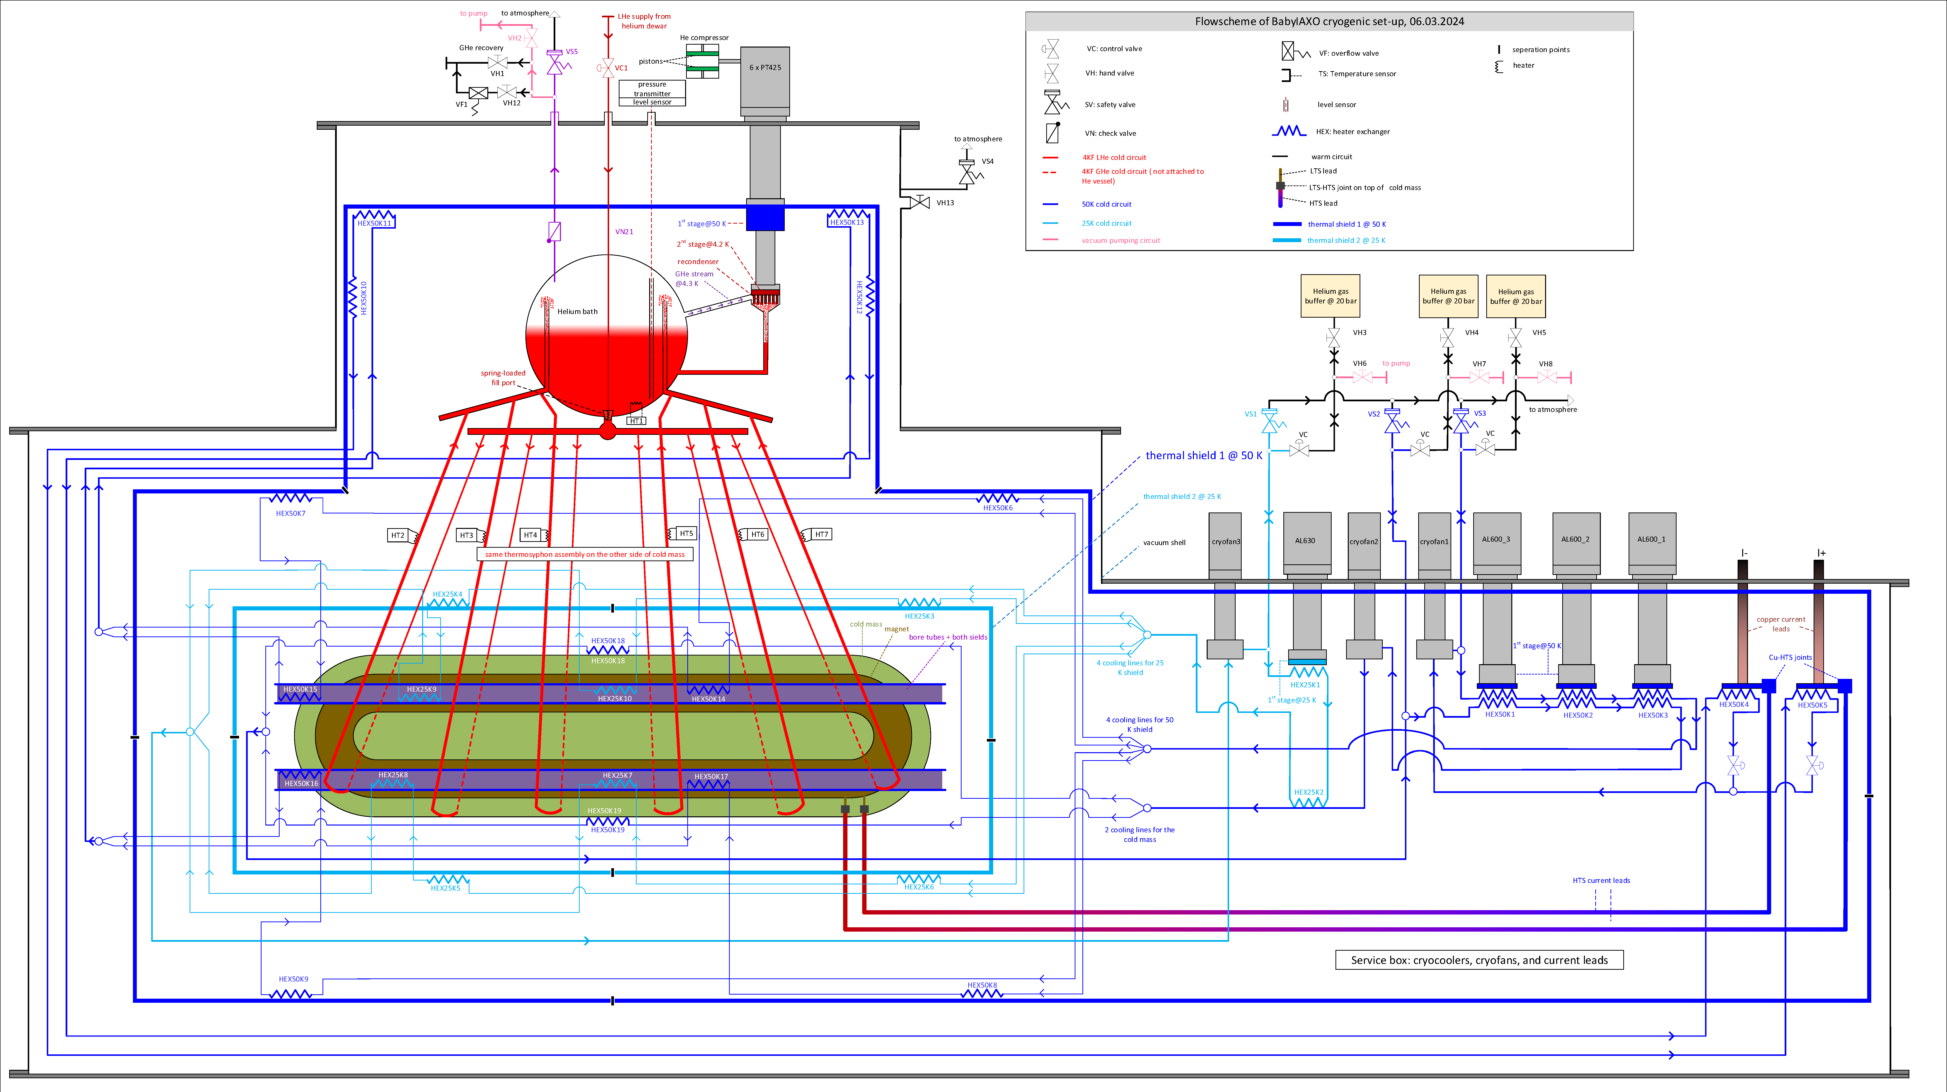
BabyIAXO
Cryogenics…
Concept:
Cooling of cold mass by thermos siphon (recondensing by 6-8 cryo cooler; currently planed with PT425-RM).
Cold mass is surrounded by two thermal shields operating at T=25 K (1x AL630 cooler) und T=50 K (3x AL600) and Cryofans (supplier not defined yet).
Additional cooling of leads (HTS) at 50 K (same 3 Als).
Separate cooling loop for cool down process.

Slide 15
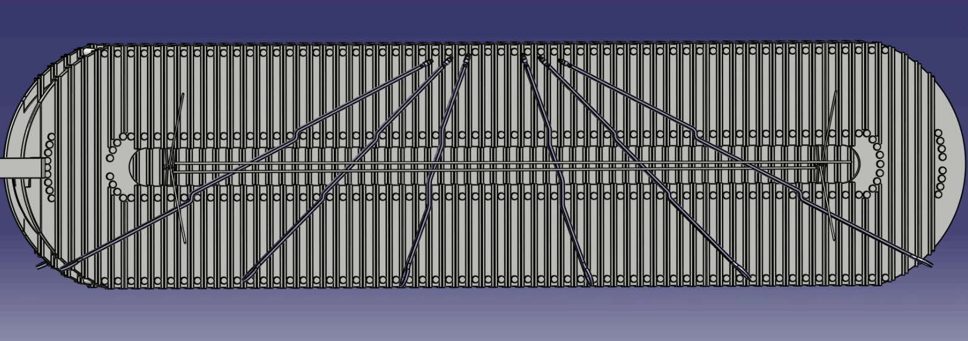
BabyIAXO
Cryogenics…
Concept:
Cooling of cold mass by thermo siphon (recondensing by 6-8 cryo cooler; currently planed with PT425-RM).
Cold mass is surrounded by two thermal shields operating at T=25 K (1x AL630 cooler) und T=50 K (3x AL600) and Cryofans (supplier not defined yet).
Additional cooling of leads (HTS) at 50 K (same 3 Als).
Separate cooling loop for cool down process.
Magnet design is a cooperation between CERN, DESY and industry (Elytt).
Conductor design and manufacturing investigated by CERN.
Cryogenic design by DESY / CERN.
Vacuum: UZar / DESY and Cadinox.
Magnet cross section
Al stabilized conductor
Siphon cooling

Slide 16
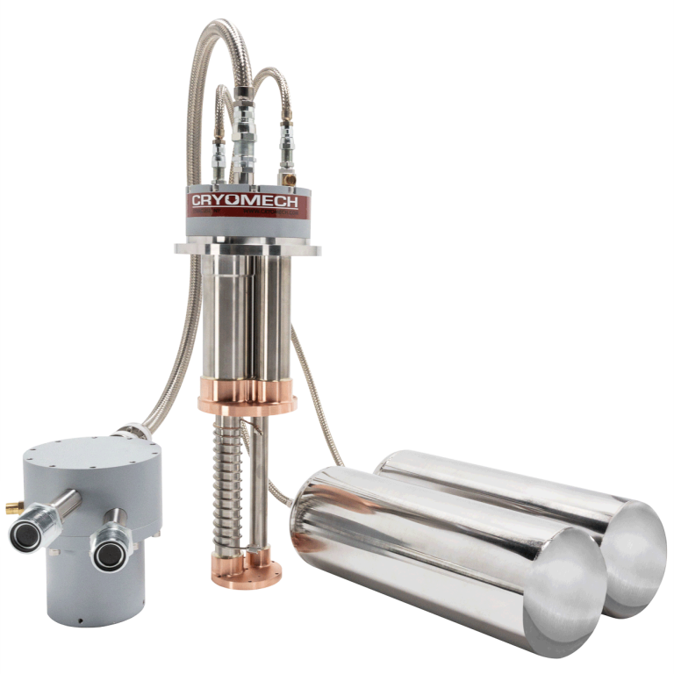
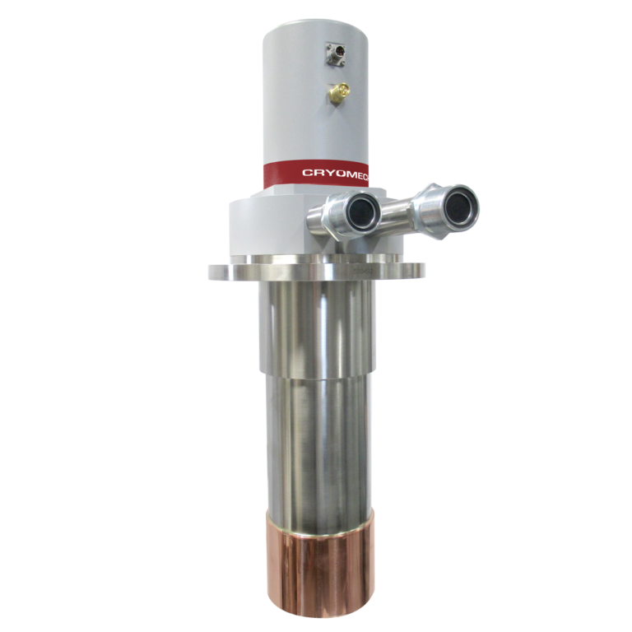
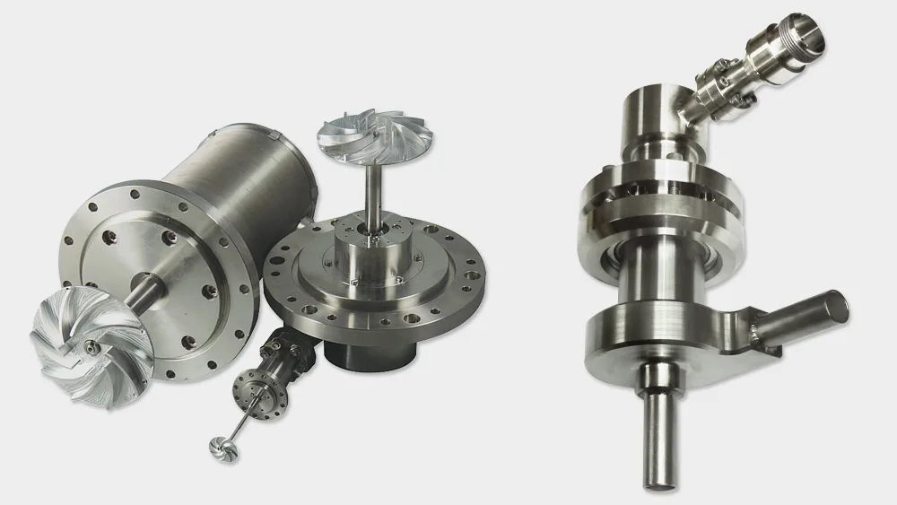
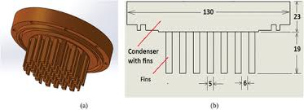
BabyIAXO
Cryogenics… accessories
Concept:
Cooling of cold mass by thermo siphon (recondensing by 6-8 cryo cooler; currently planed with PT425-RM).
Cold mass is surrounded by two thermal shields operating at T=25 K (1x AL630 cooler) und T=50 K (3x AL600) and Cryofans (supplier not defined yet).
Additional cooling of leads (HTS) at 50 K (same 3 Als).
Separate cooling loop for cool down process.
AL630
Heat exchanger
PT425-RM
Recondenser
Cryofans

Slide 17
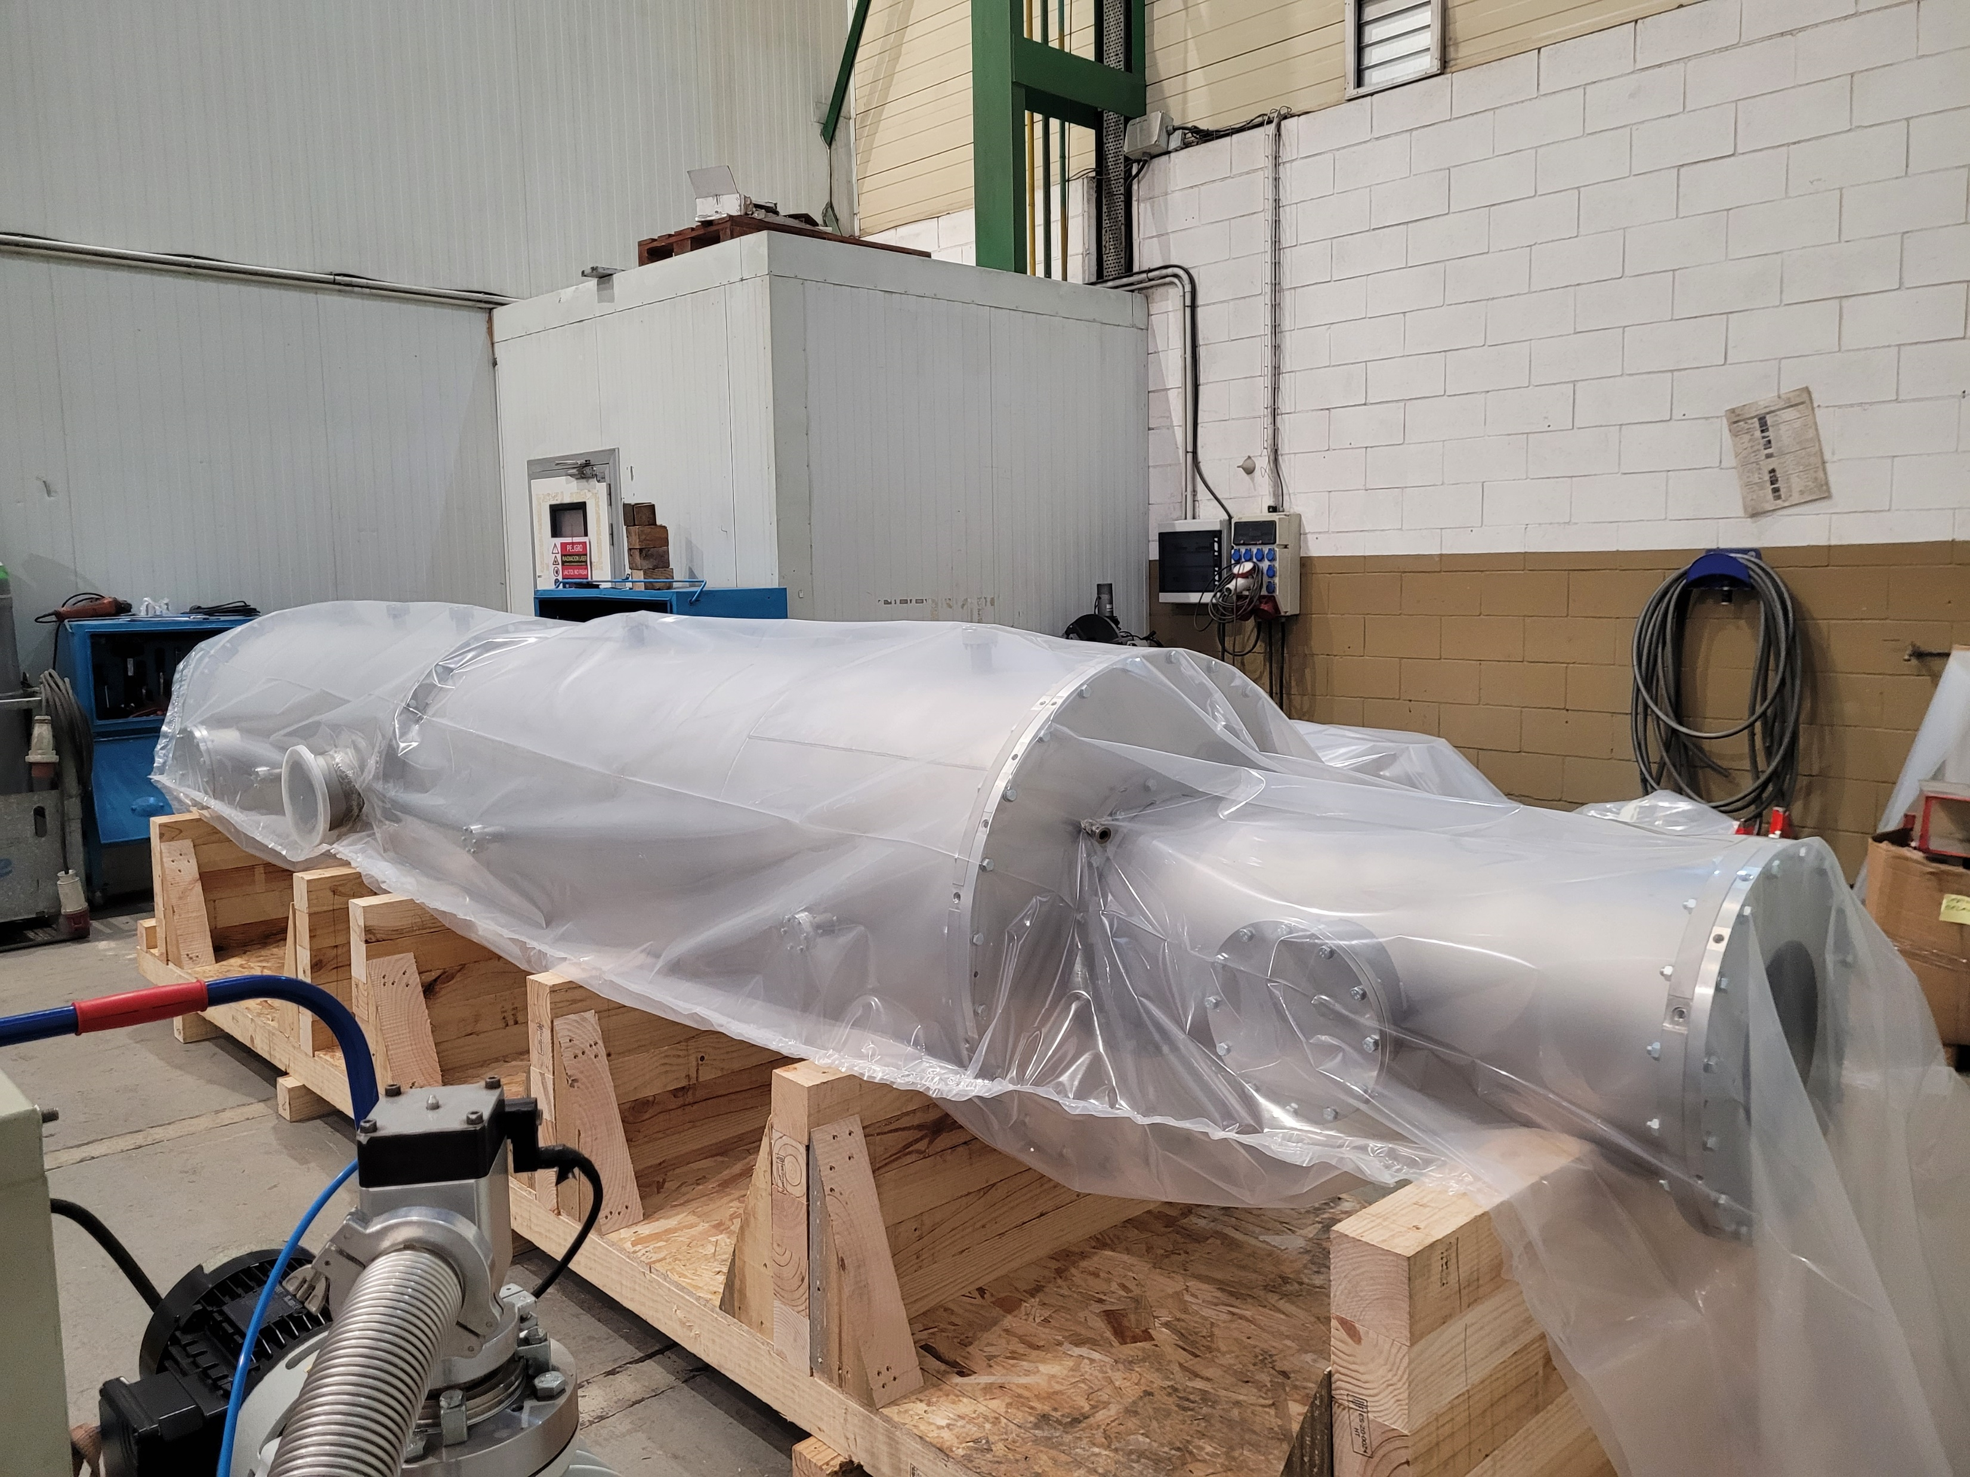
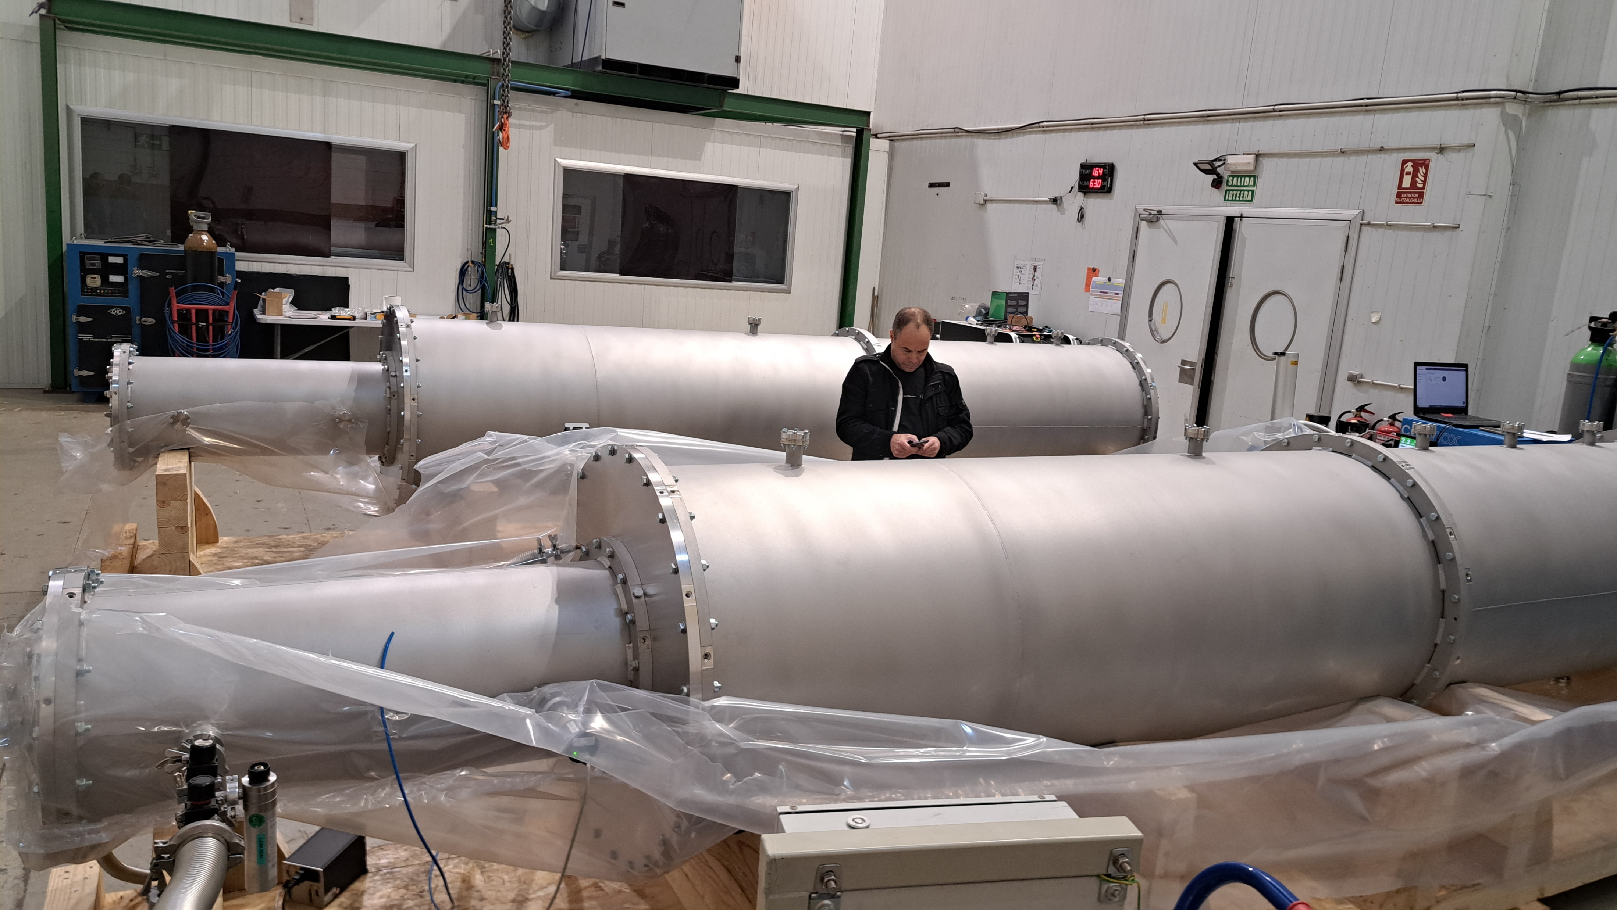
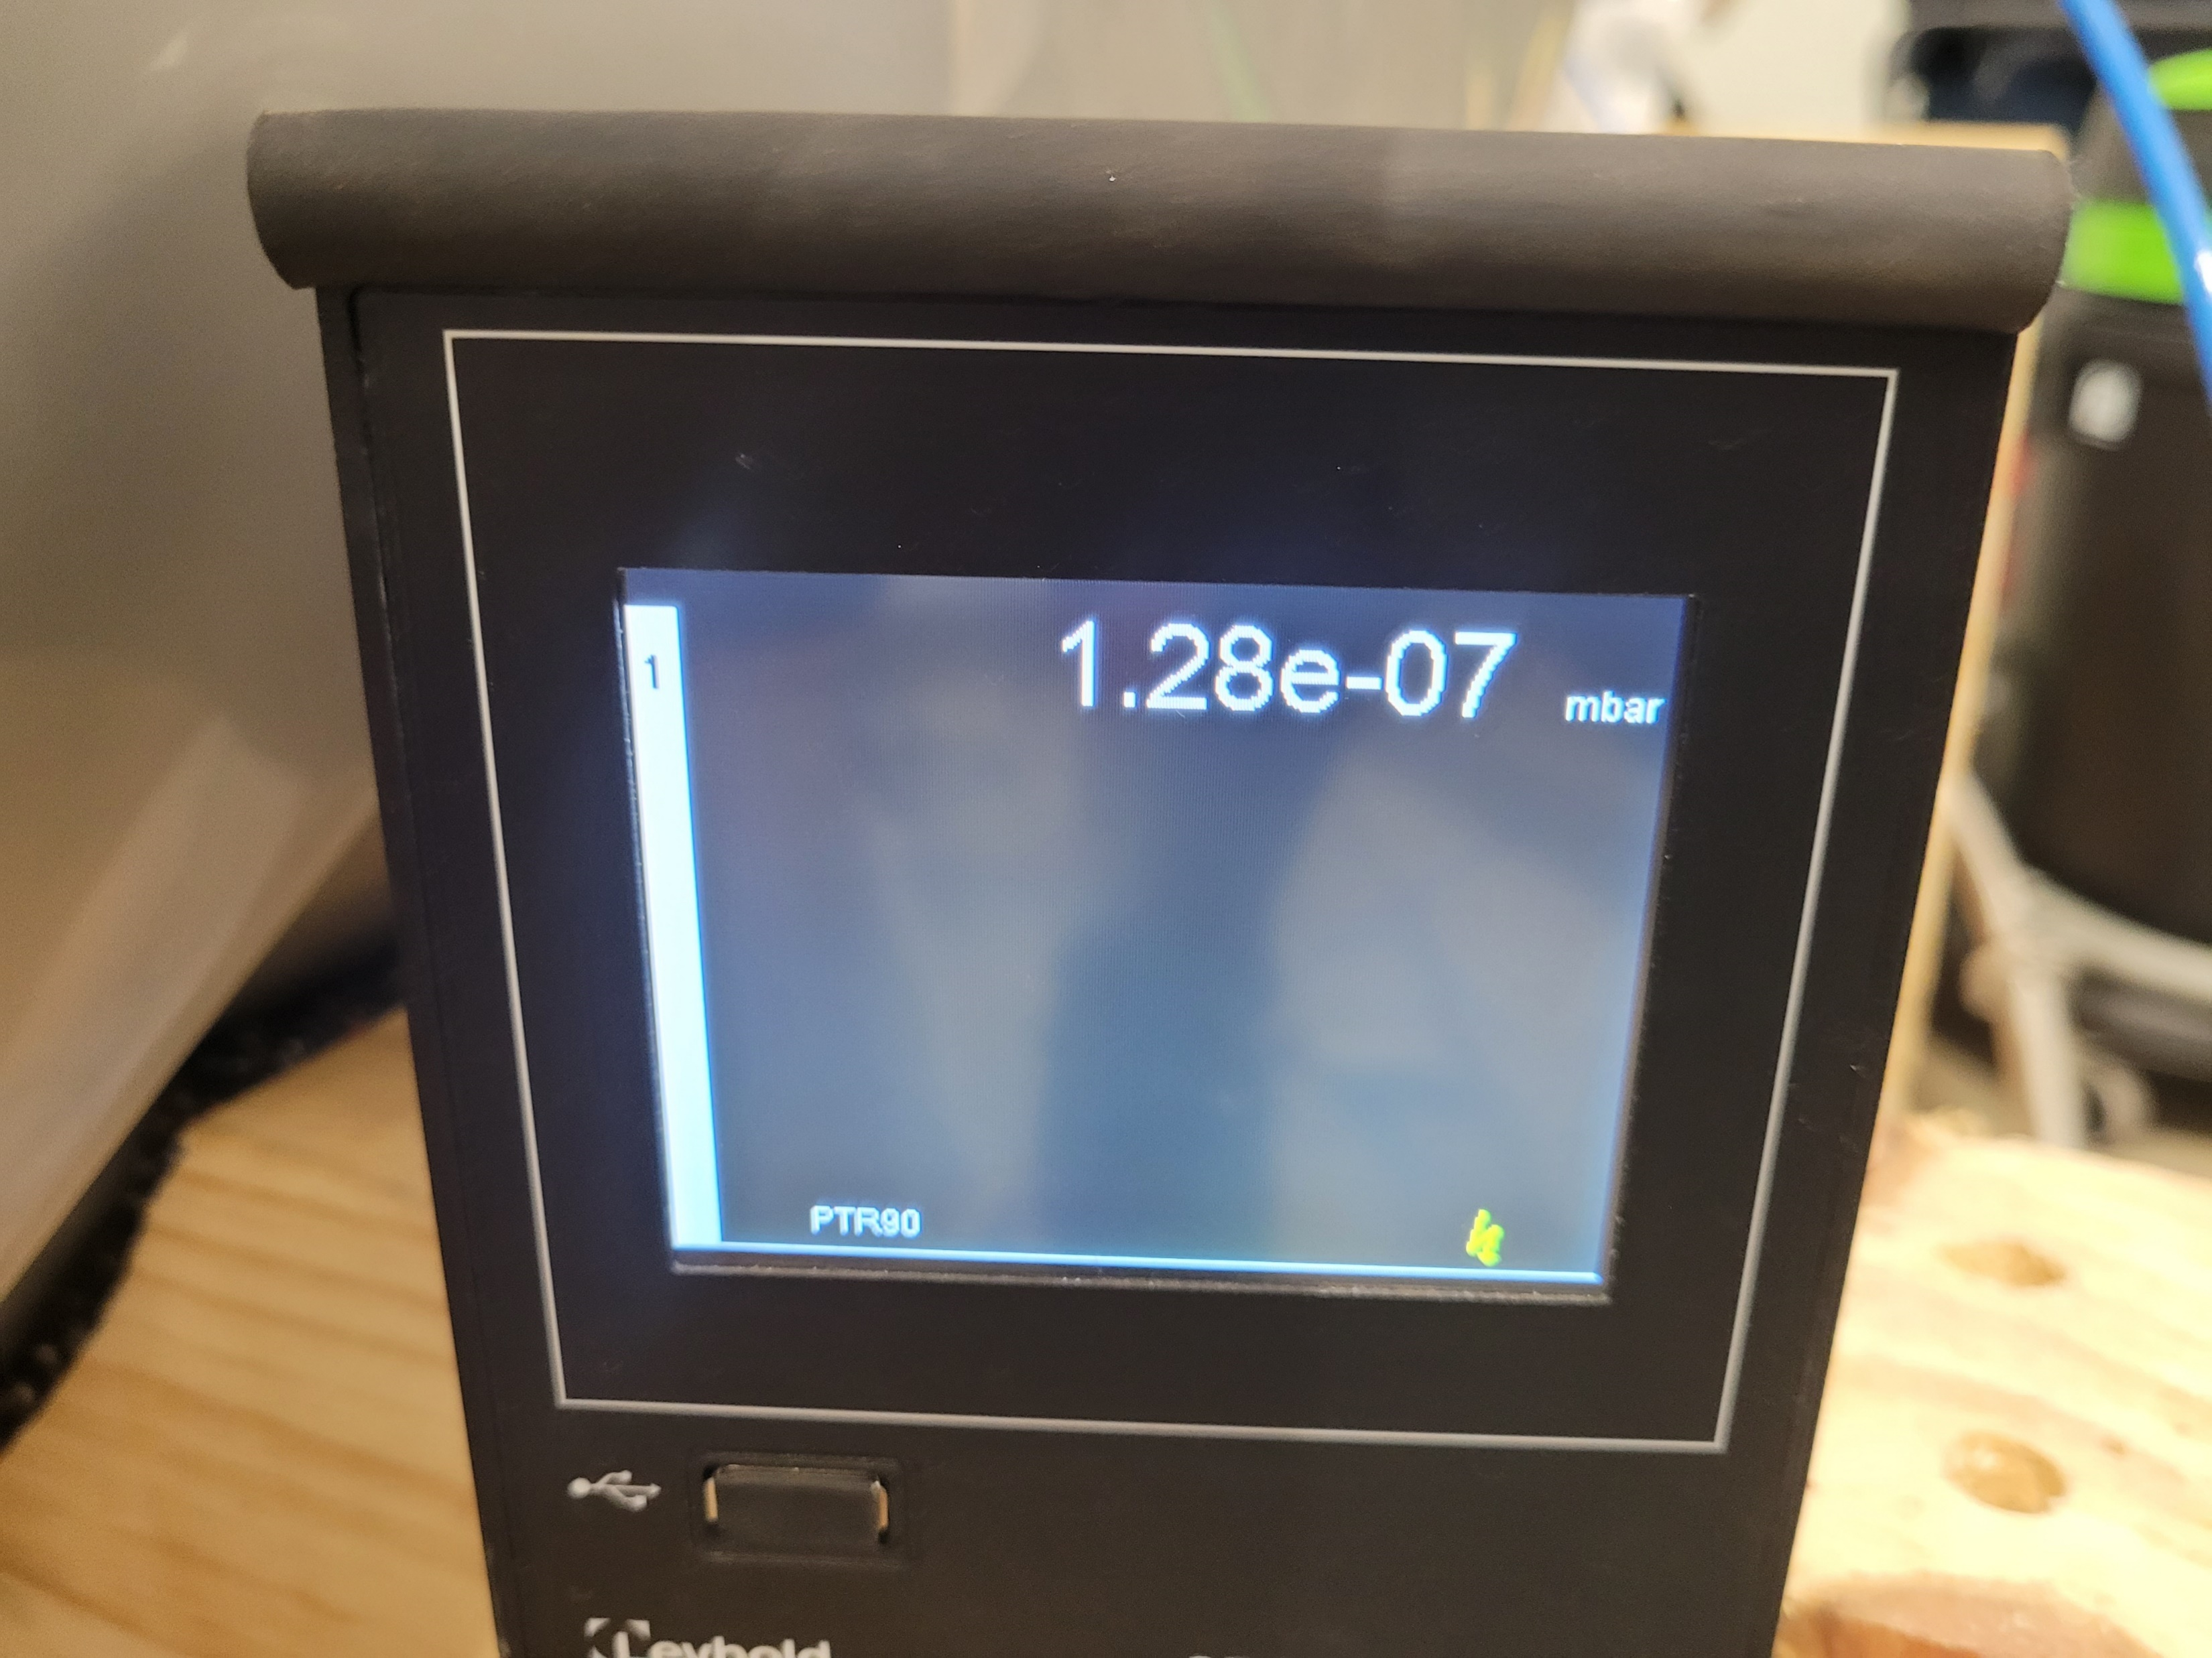

BabyIAXO
Vacuum… UHV and partial pressure operation compatible
Beamtube vacuum design finalized and some main parts already ordered:
2x cryo pump (DN200, S_{N2} = 1200 l/s) => ordered
4x turbomolecular pump (DN200, S_{N2} =1250 l/s) => ordered
9x DN200 gate valves => ordered
9x SCROLL pump (KF25 or KF40, S_{N2} =12-15 m³/h) => ordered
Accessories like gauges, 2x DN800 gate valves, flow control, etc. => open
Tubes, etc. => partly open

Slide 18
BabyIAXO
Vacuum… UHV and partial pressure operation compatible
Beamtube vacuum design finalized and some main parts already ordered:
2x cryo pump (DN200, S_{N2} = 1200 l/s) => ordered
4x turbomolecular pump (DN200, S_{N2} =1250 l/s) => ordered
9x DN200 gate valves => ordered
9x SCROLL pump (KF25 or KF40, S_{N2} =12-15 m³/h) => ordered
Accessories like gauges, 2x DN800 gate valves, flow control, etc. => open
Tubes, etc. => partly open
Demands on isolating vacuum not finalized yet:
Big surface (MLI)
Big volume (3.3 m x 11 m)
Partly magnetic fringe field
Horizontal and vertical movement
Cryostat(s)
Specification not finalized.

Slide 19

Magnetized Disc and Mirror Axion Experiment
Haloscope - Searches for Dark Matter Axions around us
Large aperture strong dipole magnet to host the “booster” (dielectric disks).
Magnet figure of merit: B² x A
strong dipole field
Large disc diameter
Main goal:
9 T dipole magnet with 1.35 m warm bore.
Next step:
4-5 T dipole with 0.6 m warm bore diameter
~9T dipole magnet: Total length 6m, mass 200t
Horn antenna
(+receiver)
Reflecting mirror
80 adjustable
Dielectric disc
dia. ~ 1.25m
Focussing mirror
Site: HERA Hall North next to ALPS II at DESY

Slide 20
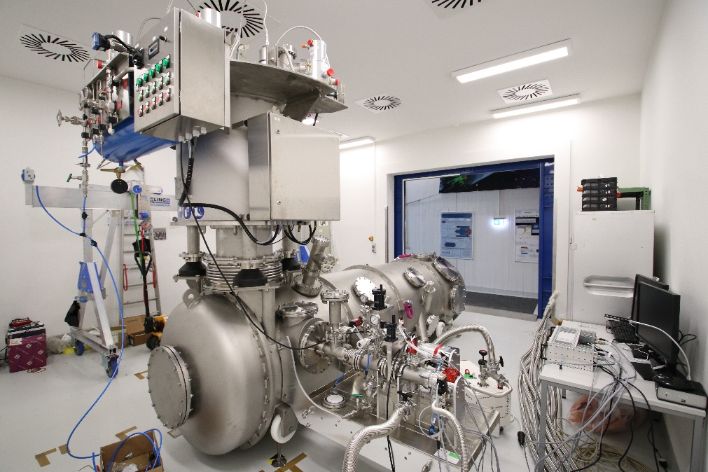


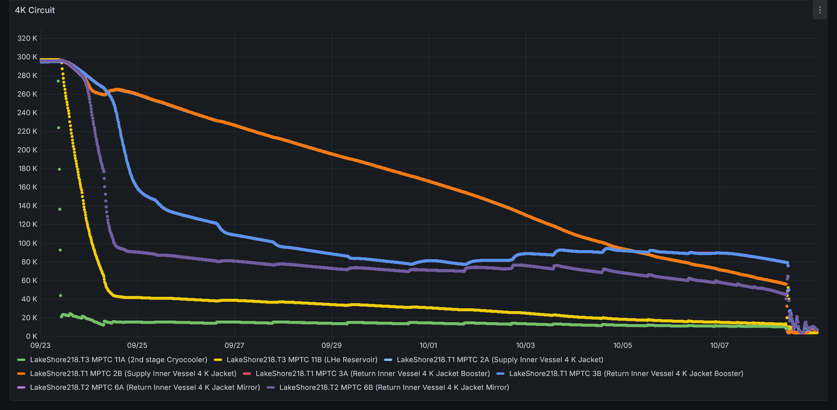

Magnetized Disc and Mirror Axion Experiment
Cryostat to reduce system temperature (noise)
Cooling concept:
Cold wall at 4.2 K is needed.
Intermediate solution of double walled cylinder and thermos siphon.
Phase separator with 5 cryo-cooler (SHI-RP-182B2S; 1.5 W/36 W)) and re-condensers.
Thermal shield at 50 K with cryofan (Absolut System).
Operation in vacuum and gHe partial pressure (1E-2 mbar)
Goal: operation in a CERN dipole with 1.6 T field.
Status:
Successful (warm) FAT April 2025.
Currently commissioning on DESY campus (SHELL, UHH laboratory).
Cool down successful, next step: check final close cycle operation.

Slide 21
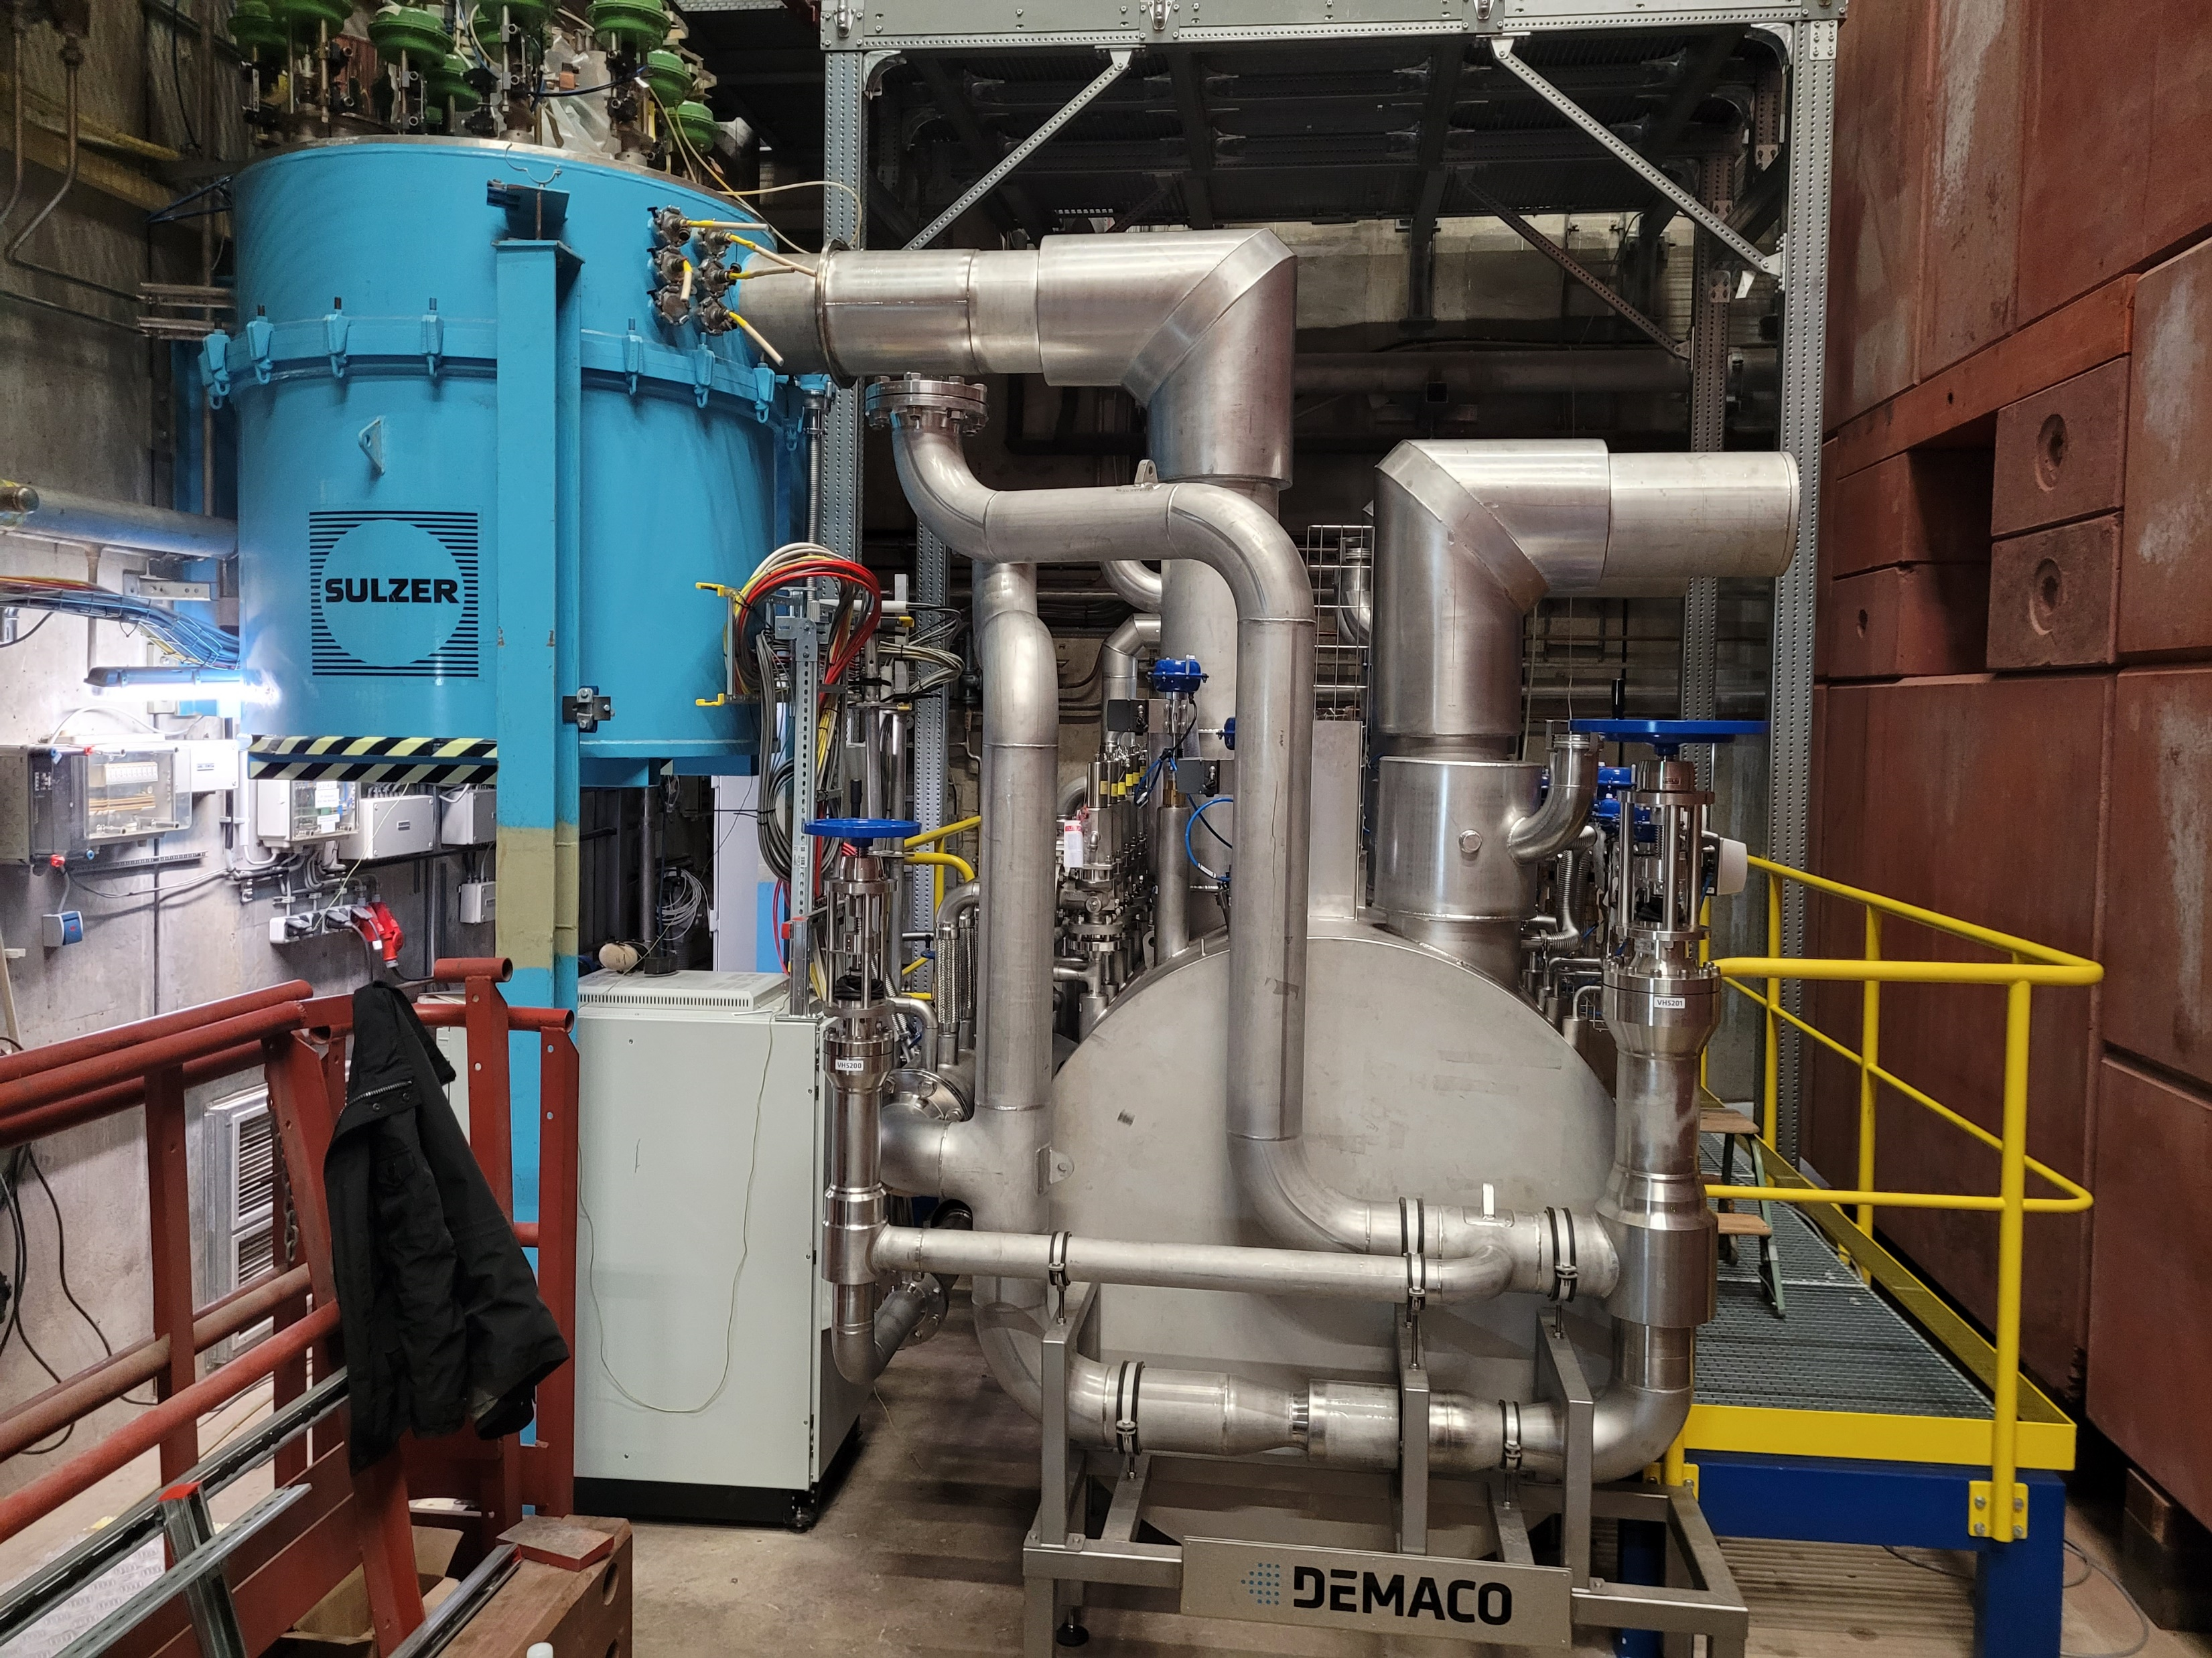
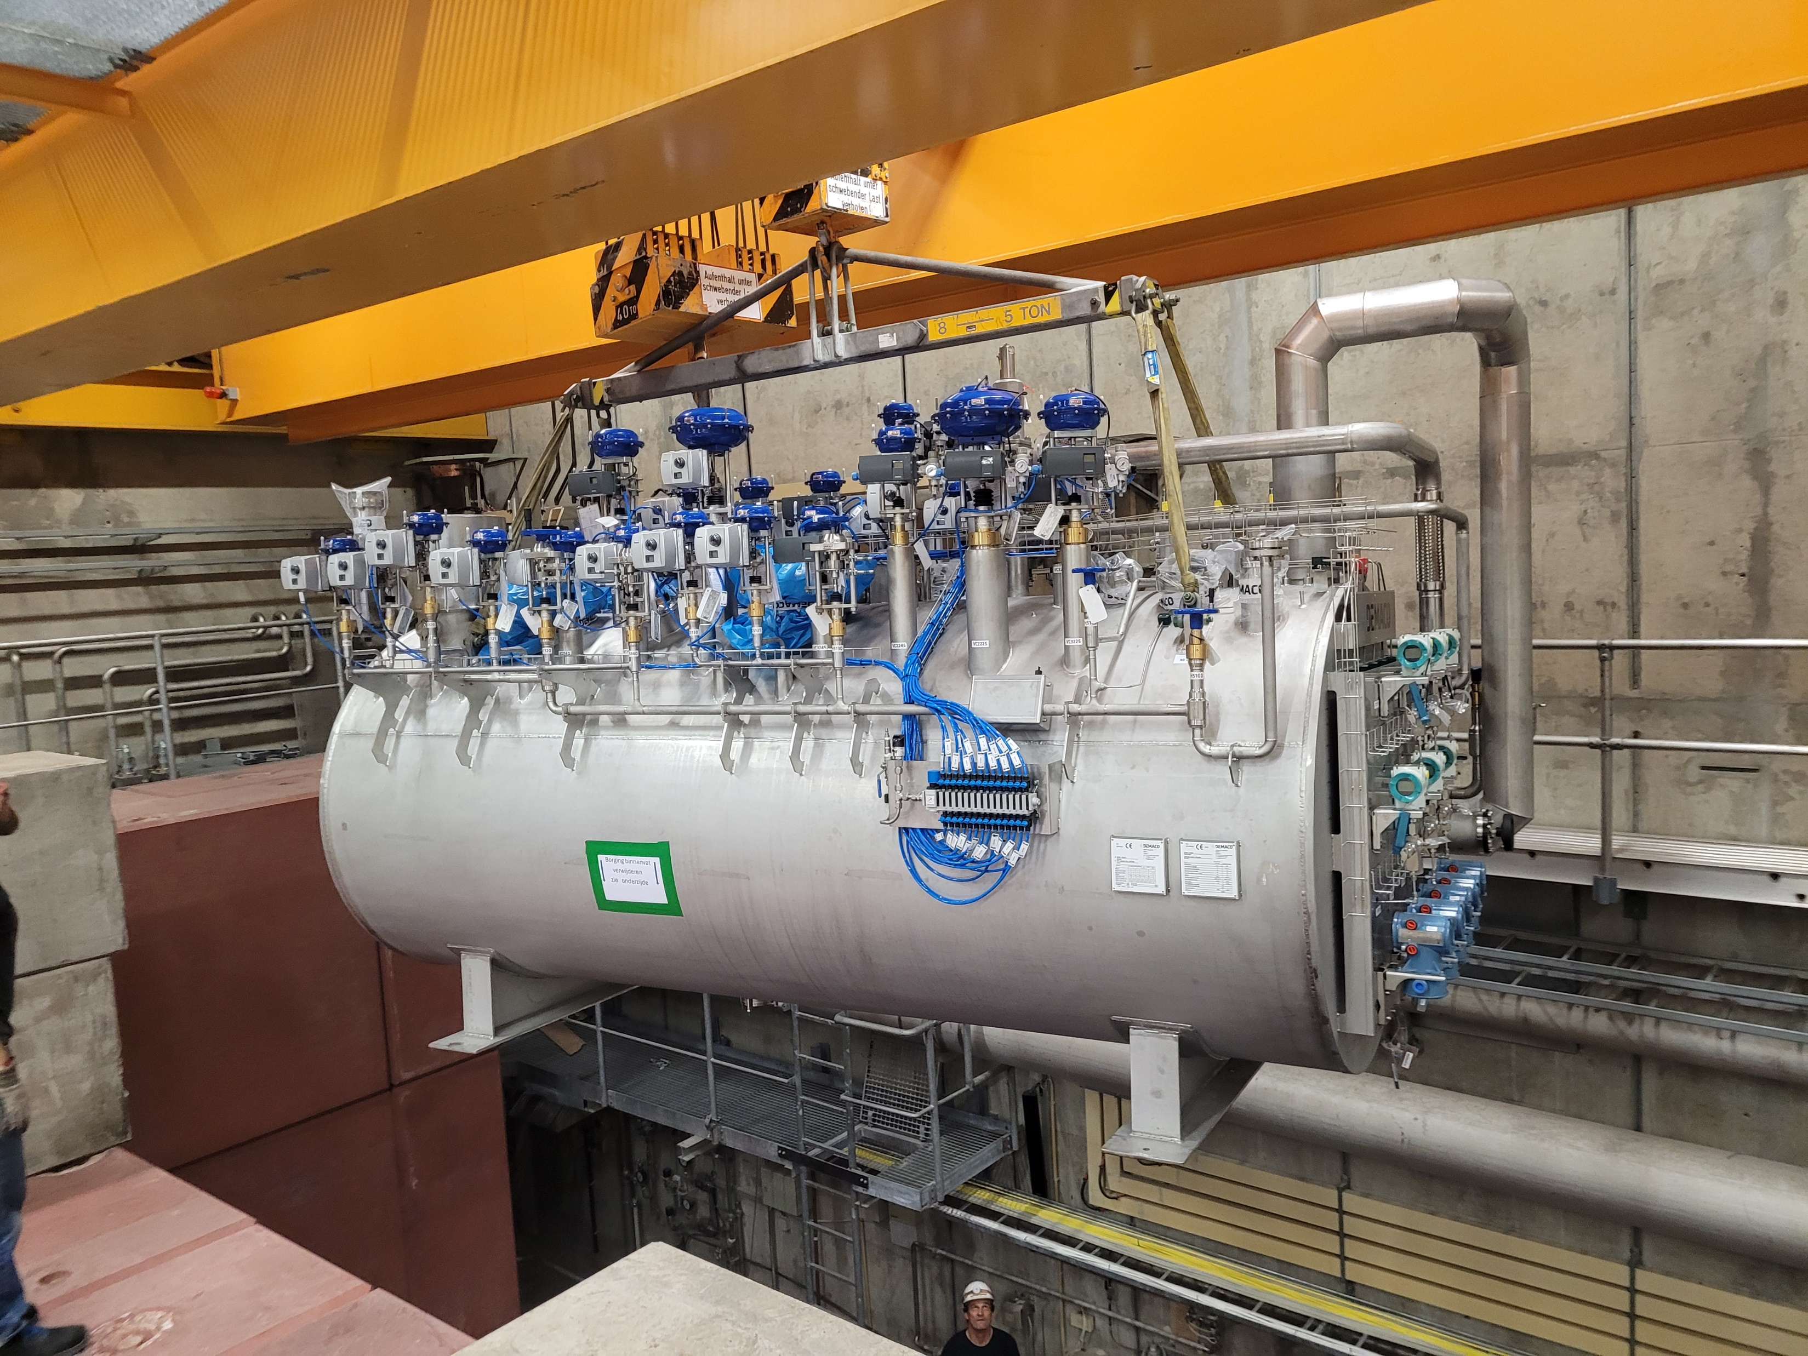
Magnetized Disc and Mirror Axion Experiment
Experimental preparation (DESY: HERA North hall)
New sub-cooler distribution box 2024 (ACPS):
Distributes helium at 4.2 K and 3-4 bar for 3 independent experiments.
Successful FAT at DEMACO in May 24.
Installation at DESY in mid of 2024.
Warm SAT in July 24 .
Status: wait for final connection on warm gas management.

Slide 22
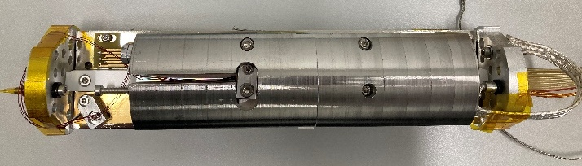
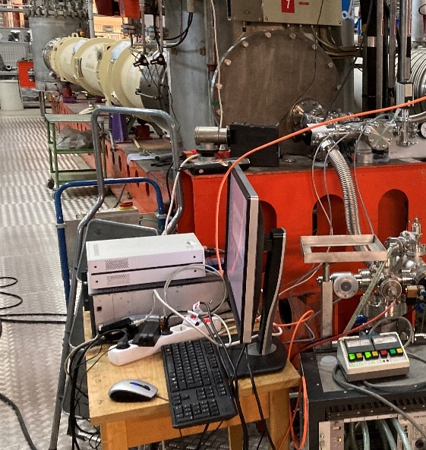


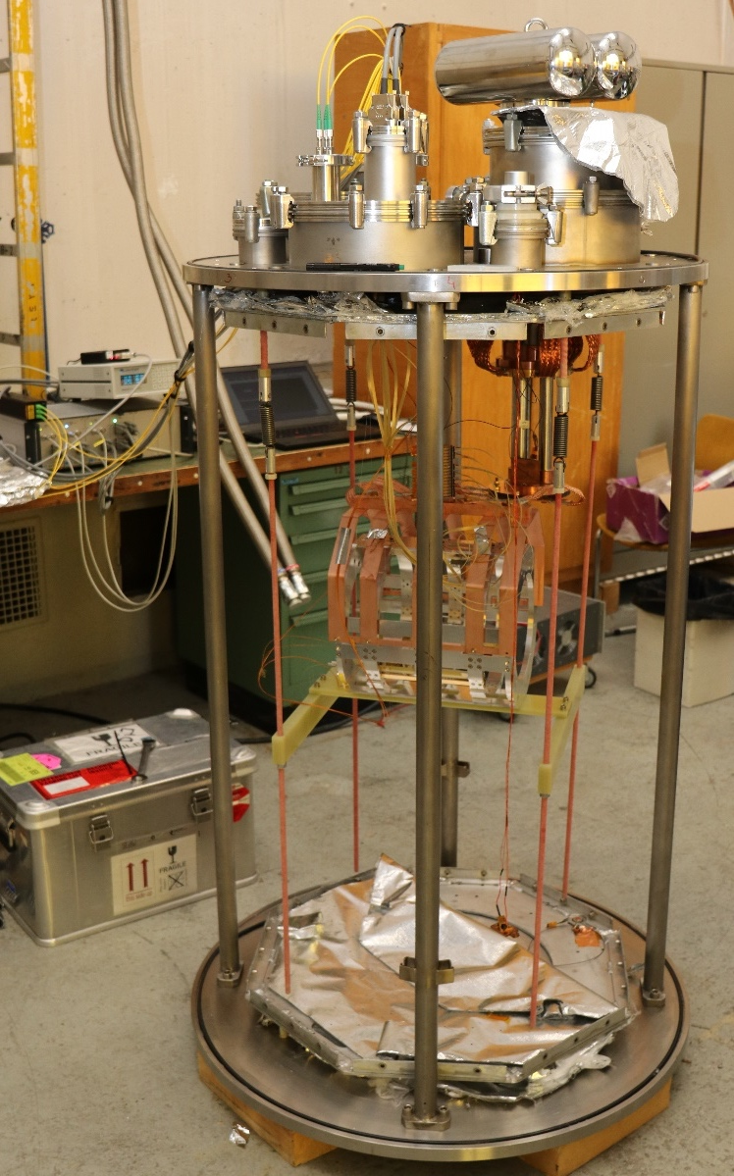
Magnetized Disc and Mirror Axion Experiment
Moving disks: motors
Setup single motor test
ALPS-II magnet test stand
Mechanical demonstrator with (warm and cold test):
One 200 mm sapphire disk in titanium ring + mirror.
Three JPE piezo motors on self-built carriages.
Piezo controller system for driving a disk with three motors.
Cryo interferometer for displacement measurement.
Add. test at CERN Cryolab
Successful piezo motor tests in cryogenics & inside ALPS II magnet → Motor works in 5.3 T field and at 5 K
Motor velocity with/without B Field
E. Garutti et al 2023 JINST 18 P08011 (arxiv:2305.12808)
Networking to find a suitable motor working in cryogenic and magnetic environment was done here (APPEC Technology Forum 2018)

Slide 23
Summary
Moving disks: motors
A lot of cryogenic and vacuum applications are needed.
3 strong collaborations also in exchange with other collaborations from Axion community.
Already strong input from industry during the design phase.
New and unique technical developments with industry partners.
How to improve: setting up a cryolab at DESY to test new applications and make cooling concepts more economic.
Additional funding is needed or maybe collaboration with industry?

Slide 24
Bedankt!
Vielen Dank!
Thank you!
Jörn Schaffran
ALPS
Joern.schaffran@desy.de

