Slide 1
Introduction and News
Manuela Boscolo and Fabrizio Palla
FCC-ee MDI meeting #65
CERN
31 March 2025

Slide 2
Feasibility Study Report and other documents for the ESPPU
To appear on https://indico.cern.ch/event/1439855/
Feasibility Study Report
Vol. 1 PED: (262 pages)
Vol. 2 Integrated Project (Accelerator, technical infrastructures and safety) (660 pages)
Vol. 3 Implementation (~340 pages)
Separate ‘10-pages’ documents to be submitted to the ESPPU
  PED side: One general, four specific (Higgs-EW-top, QCD, BSM, Flavour, FCC-hh), one on EoI on R&D and Detector Concepts (this one already submitted)
  Accelerators: one for FCC-ee and one for FCC-hh

Slide 3
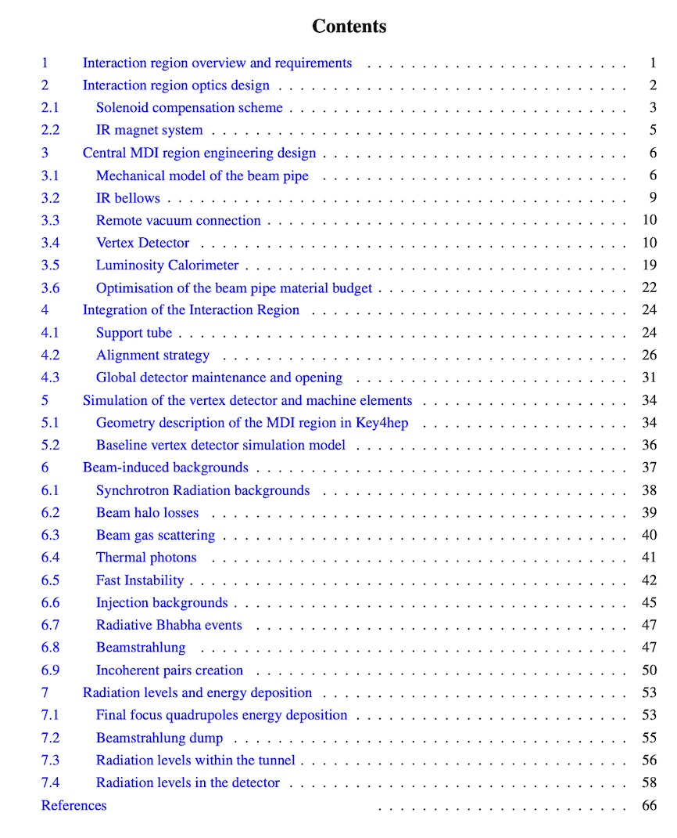
MDI note is now public
https://doi.org/10.17181/w4kws-rne05
66 pages

Slide 4
Workshops, Weeks and Symposia
Third annual US Higgs Factory FCC Workshop
  FNAL+Argonne April 14-17 https://indico.fnal.gov/event/67484/
FCC-ee Workshop: Tracking Detector and Software
  BNL, May 7-9, https://indico.cern.ch/event/1516157/
FCC Week 2025
  Vienna, May 19-23 https://indico.cern.ch/event/1408515/
European CEPC Workshop 2025
  Barcelona, June 16-19 https://indico.ifae.es/event/2054
Open Symposium of the European Strategy for Particle Physics
  Venice, June 23-27 https://agenda.infn.it/event/44943/

