Slide 1



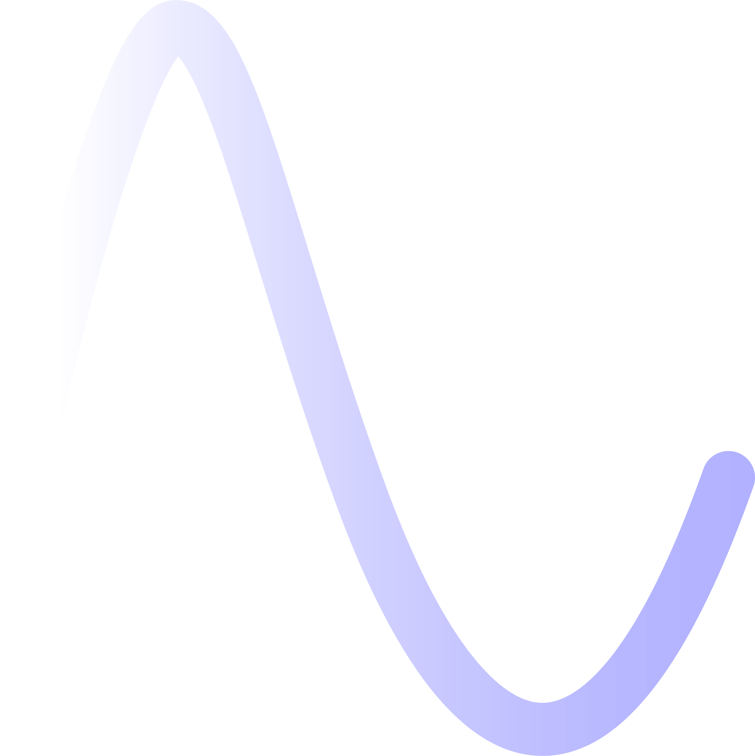

Xsuite-based simulations of Touschek effect in DAFNE
G. Broggi^{1,2,3} M. Boscolo³, R. Bruce²
¹ Sapienza University of Rome, Italy ² CERN, Meyrin, Switzerland ³ INFN-LNF, Frascati, Italy
97th BE-ABP-NDC section meeting, 26/03/2025
Many thanks for discussion and input to:
De Santis, F. Galletti, G. Iadarola, V. Lollo, C. Milardi, A. Natochii, S. Redaelli, F. Van der Veken, M. Zobov

Slide 2
Motivation
Ongoing effort to benchmark FCC-ee collimation simulation tool (Xsuite-BDSIM coupling) with measured data from operating e+e- colliders
Operating e+e- colliders being considered:
  SuperKEKB
  DAFNE
Measured data are either:
  Measured beam lifetimes
  Measured beam-induced backgrounds
SuperKEKB and DAFNE operate at lower beam energies compared to FCC-ee (45.6 GeV - 182.5 GeV)
  SuperKEKB: 4 GeV (LER), 7 GeV (HER)
  DAFNE: 0.51 GeV
  At such beam energies, Touschek effect affects both beam lifetime and beam induced background
Need to be able to simulate this effect
26/03/2025
G. Broggi | Xsuite-based simulations of Touschek effect in DAFNE

Slide 3
Outline
Introduction
  Touschek scattering
  Theory snapshot
Monte Carlo simulation of Touschek scattering
  Method
  MC simulation vs. Piwinski formula
  Xsuite-based Touschek scattering simulations
First application: DAFNE p-ring
Outlook and next steps
26/03/2025
G. Broggi | Xsuite-based simulations of Touschek effect in DAFNE

Slide 4
Outline
Introduction
  Touschek scattering
  Theory snapshot
Monte Carlo simulation of Touschek scattering
  Method
  MC simulation vs. Piwinski formula
  Xsuite-based Touschek scattering simulations
First application: DAFNE p-ring
Outlook and next steps
26/03/2025
G. Broggi | Xsuite-based simulations of Touschek effect in DAFNE

Slide 5
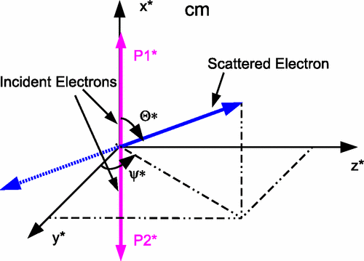
Touschek scattering
Touschek scattering: Coulomb collision between relativistic electrons (or positrons) within a particle beam
  Causes sudden energy change in scattered particles
Touschek scattering is a relativistic effect
  Momentum transfer from transverse to longitudinal plane
  In lab. frame, transfer is amplified by Lorentz factor γ
Touschek scattering causes beam losses if:
  Energy deviation exceeds RF acceptance
  Off-energy orbit/oscillation exceeds the dynamic/physical aperture
Touschek scattering may lead to:
  Beam lifetime reduction
  Beam backgrounds
26/03/2025
G. Broggi | Xsuite-based simulations of Touschek effect in DAFNE

Slide 6




Touschek scattering: theory snapshot
In center-of-mass (c.m.) system:
  Scattering probability into solid angle dΩ⁎ given by Møller differential cross section:
re: classical electron radius
Θ*: scattering angle
γ*: Lorentz gamma factor​
β*: Lorentz beta factor
NOTE: starred quantities are in the c.m. system
Total Touschek scattering rate R - obtained by integrating:
  Møller cross section over all possible scattering angles
  Phase space distribution of all particles in the bunch
v: particle velocity after scattering
σ: total Møller cross section
ρ: phase-space density
26/03/2025
G. Broggi | Xsuite-based simulations of Touschek effect in DAFNE

Slide 7
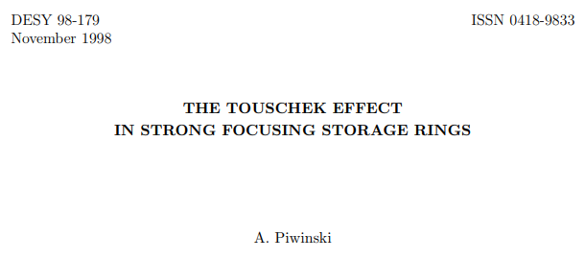
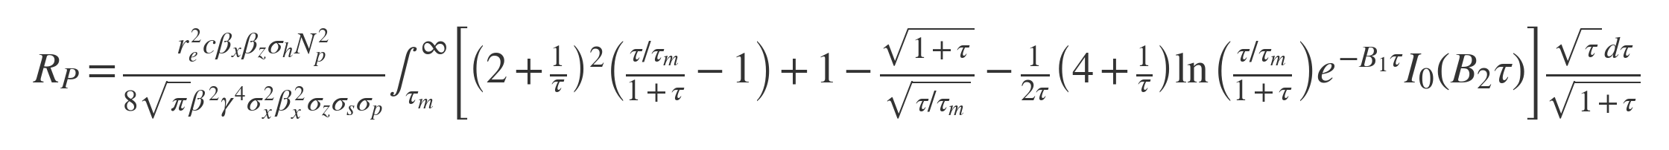
Touschek scattering: theory snapshot
Total Touschek scattering rate R:
Piwinski made a detailed evaluation of the above equation for R for a Gaussian-distributed bunch:
Piwinski Touschek scattering rate
26/03/2025
G. Broggi | Xsuite-based simulations of Touschek effect in DAFNE

Slide 8
Outline
Introduction
  Touschek scattering
  Theory snapshot
Monte Carlo simulation of Touschek scattering
  Method
  MC simulation vs. Piwinski formula
  Xsuite-based Touschek scattering simulations
First application: DAFNE p-ring
Outlook and next steps
26/03/2025
G. Broggi | Xsuite-based simulations of Touschek effect in DAFNE

Slide 9
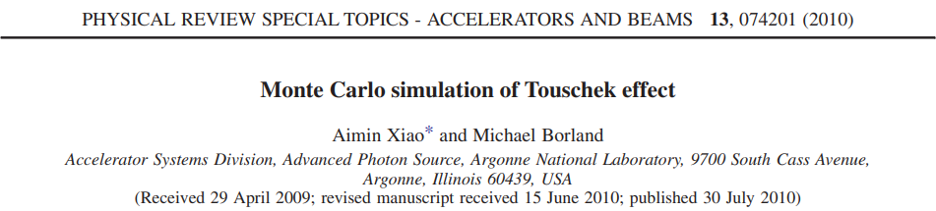


Touschek scattering: Monte Carlo simulation
The integral in Piwinski formula can be computed via Monte Carlo integration with N uniformly distributed random points in the n-dimensional volume V (if N is large enough):
The average scattering rate for particles that results in momentum deviation δ greater than a min. value δm is given by:
Monte Carlo Touschek scattering rate
v*': particle velocity
γ: Lorentz gamma factor
dσ*'/dΩ*': Møller DCS
ρ: phase-space density
N: number of simulated scattering events
M: total number of scattered particles with δ>δm
NOTE: starred quantities are in the c.m. system
NOTE: primed quantities mean "after scattering"
NOTE: when δm = δa, with δa being the local momentum acceptance, the above equation gives the Touschek beam loss rate
26/03/2025
G. Broggi | Xsuite-based simulations of Touschek effect in DAFNE

Slide 10



Touschek scattering: Monte Carlo simulation
To use Monte Carlo integration, one needs to generate a series of random scattering events
  Each event involves a pair of scattering particles
A gaussian-distributed bunch is considered
  Nine uniformly distributed random numbers are generated in the normalized phase-space range
Let us call these 9 random numbers n0, n1, …, n8. These are assigned as:
rx, ry, rz: user-defined parameters (default is 3) ex, ey, ez: geometric emittances
X1 = n0
X1' = n1
Y1 = n2
Y1' = n3
z1 = n4
δ1 = n5
Since the two particles are colliding the spatial coordinates x, y, zeta for particle 2 are identical to those of particle 1:
X2' = n6
Y2' = n7
δ2 = n8
particle 1
particle 2
x2 = x1, y2 = y1, z2 = z1
X, X', Y, Y': transverse normalized coordinates z, δ: longitudinal coordinates
26/03/2025
G. Broggi | Xsuite-based simulations of Touschek effect in DAFNE

Slide 11




Touschek scattering: Monte Carlo simulation
Particle 1: converting from normalized to real phase space coordinates and including dispersive effects:
Particle 2:
Complete set of coordinates (x, y, z, x1', y1', δ1, x2', y2', δ2) for both particles before scattering defined
Phase-space density (Gaussian-distributed bunch):
  Computed for each scattering particle
26/03/2025
G. Broggi | Xsuite-based simulations of Touschek effect in DAFNE

Slide 12

Touschek scattering: Monte Carlo simulation
Random uniform sampling for Θ* ∈ (0, π/2] and Ψ* ∈ [0, 2π]
  Møller DCS is computed
Phase space volume computed as:
Scattering is applied
  Transform particle momenta from lab frame to c.m. frame
  Rotate momenta according to Θ* and Ψ* (in the c.m. frame)
  Transform back to the lab frame
All ingredients to compute the Touschek scattering rate (via Monte Carlo integration) available:
26/03/2025
G. Broggi | Xsuite-based simulations of Touschek effect in DAFNE

Slide 13
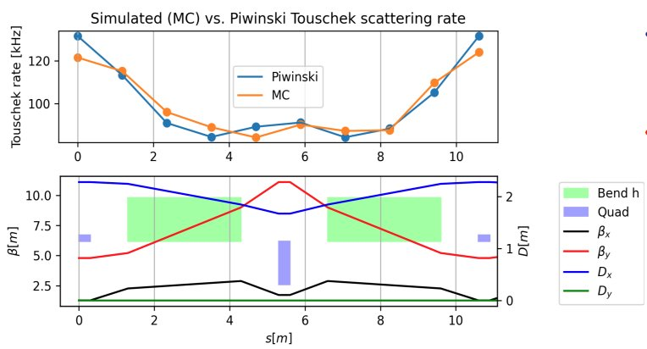
Monte Carlo simulation vs. Piwinski formula
Excellent agreement between simulated (MC) and Piwinski Touschek scattering rate for a Gaussian-distributed beam
Level of agreement depends on number of simulated scattering events
  For the comparison presented here, 1E+7 scattering events are simulated at each scattering center
  Such value is currently being considered as a standard for these simulations
26/03/2025
G. Broggi | Xsuite-based simulations of Touschek effect in DAFNE

Slide 14




Xsuite-based Touschek scattering simulations
Scattering rate simulation validated vs. Piwinski formula
Using Xsuite particle tracking it is possible to simulate Touschek scattering beam losses
  To each simulated scattered particle is assigned a total scattering rate Ri
  The integral of RP is taken over each section upstream of each Touschek scattering center, starting from the previous scattering center: this way, the simulated scattered particles accurately represent the scattering rate from the entire upstream section
The beam-loss rate and location can be calculated by tracking the Touschek-scattered particles and recording all lost particles
The total loss rate Rtot will be the sum of Ri for all the particles lost at any location:
  The Touschek lifetime can be computed as:
26/03/2025
G. Broggi | Xsuite-based simulations of Touschek effect in DAFNE

Slide 15
Xsuite-based Touschek scattering simulations
Starting from an Xtrack line, the following procedure is used:
1
2
3
An arbitrary number of Touschek scattering centers (Xtrack markers called TMarker) is inserted in the line
If not pre-computed, local momentum aperture is estimated by tracking test particles and recording the max. stable δ
Piwinski formula to assign to each TMarker the integrated scattering rate from the upstream section
6
4
5
Generate pre-scattering particle coordinates at TMarkers, compute phase-space density and phase-space volume
Compute Monte Carlo scattering rate RMC and assign total scattering rate Ri to each particle
SCATTER
7
8
9
TRACK*
Record lost particles
Compute Touschek loss rate and Touschek lifetime
*To speed-up simulations, only highest-weight particles that contribute to the 99% of the scattering rate are tracked
26/03/2025
G. Broggi | Xsuite-based simulations of Touschek effect in DAFNE

Slide 16
Outline
Introduction
  Touschek scattering
  Theory snapshot
Monte Carlo simulation of Touschek scattering
  Method
  MC simulation vs. Piwinski formula
  Xsuite-based Touschek scattering simulations
First application: DAFNE p-ring
Outlook and next steps
26/03/2025
G. Broggi | Xsuite-based simulations of Touschek effect in DAFNE

Slide 17
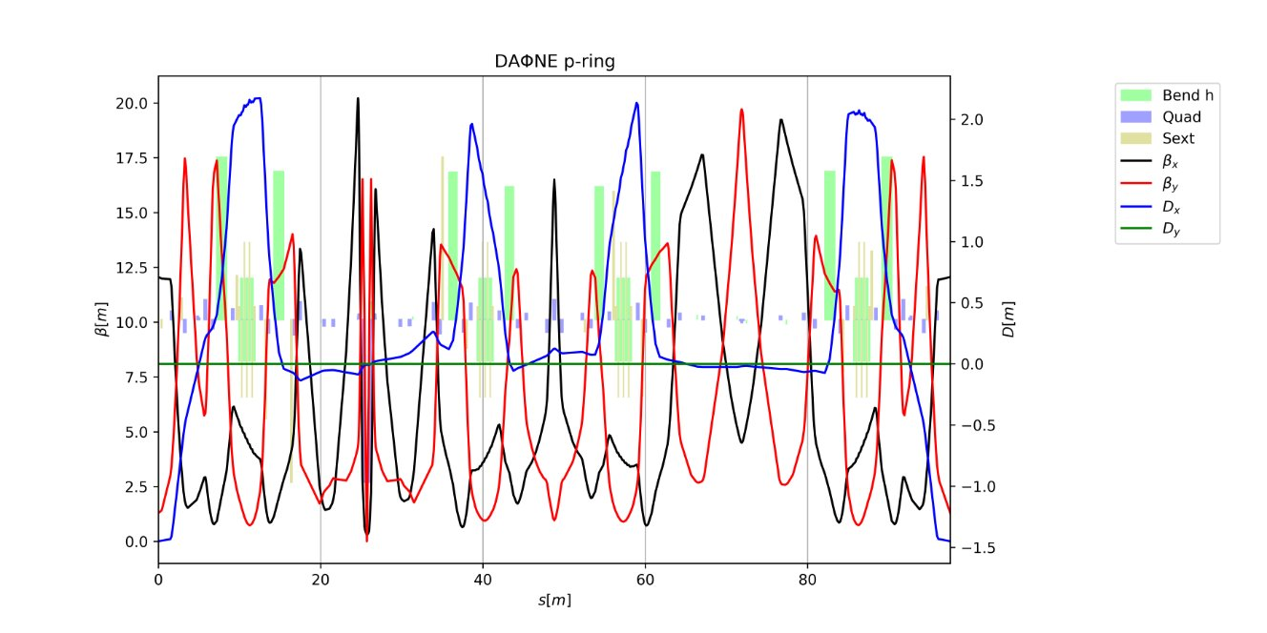
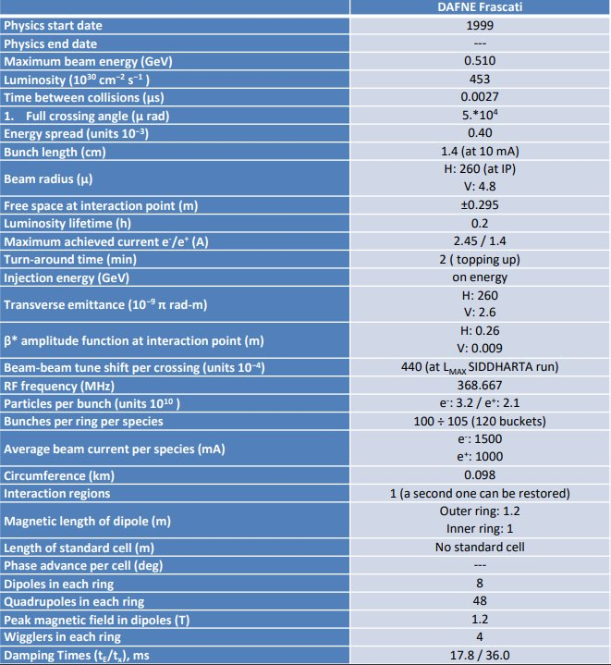
First application: DAFNE p-ring
DAFNE is a 98 m circumference e+e- collider located in Frascati (Italy)
Started operation in 1999, served different experiments KLOE, KLOE-2, DEAR, FINUDA, SIDDHARTHA
Lately operating for the SIDDHARTHA-2 experiment – goal is to measure properties of kaonic deuterium
26/03/2025
G. Broggi | Xsuite-based simulations of Touschek effect in DAFNE

Slide 18
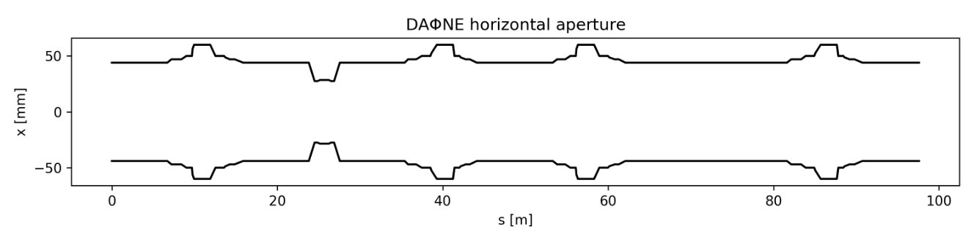
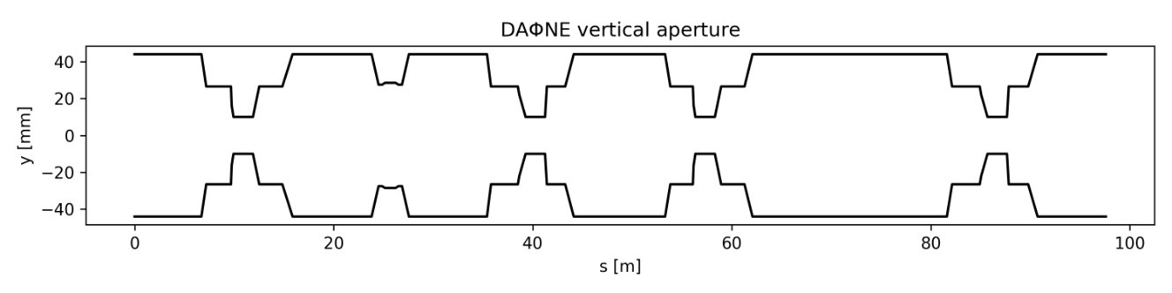
DAFNE: aperture model
26/03/2025
G. Broggi | Xsuite-based simulations of Touschek effect in DAFNE

Slide 19
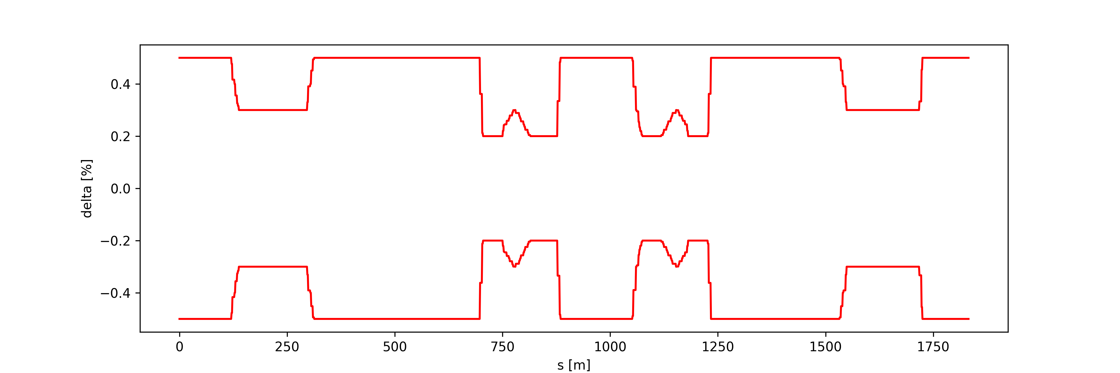
DAFNE: local momentum aperture
Tracked for 1000 turns from 98 distinct s-locations (1m spacing), with particles starting on the on-momentum closed orbit with different momentum offsets
  Recorded the maximum stable momentum offset
Local momentum aperture serves as input for Touschek scattering simulation
  Required for computing Piwinski and Monte Carlo Touschek scattering rates
A 0.85 safety factor is applied to the local momentum aperture values to ensure all potentially lost Touschek-scattered particles are tracked—untracked losses would otherwise not contribute to the total Touschek loss rate (lifetime).
26/03/2025
G. Broggi | Xsuite-based simulations of Touschek effect in DAFNE

Slide 20
DAFNE: Touschek simulation parameters
DAFNE p-ring SIDDHARTHA-2 lattice (Jun 2024)​
Local momentum aperture profile from tracking
Scrapers not included (i.e., fully retracted)​
98 Touschek scattering centers simulated (~1 m spacing)​
Total of ~6E+6 Touschek scattered particles tracked for 1000 turns​
  Thick lattice​
  NO radiation​
  Design parameters
Particles lost on the mechanical aperture recorded​
  Total scattering rate Ri of each lost Touschek-scattered particle accumulated in 20 cm bins​
  First Xsuite-based DAFNE Touschek scattering loss map, showing the Touschek loss rate distribution along the DAFNE p-ring
26/03/2025
G. Broggi | Xsuite-based simulations of Touschek effect in DAFNE

Slide 21
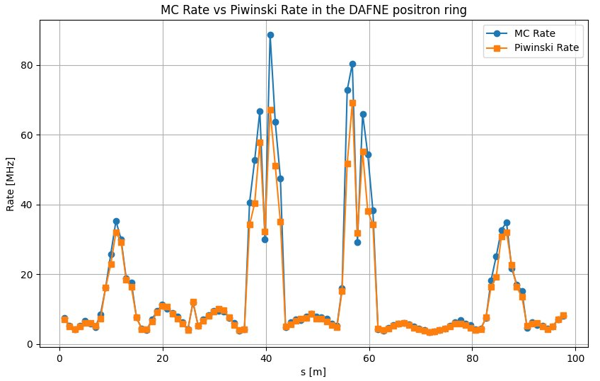
DAFNE: simulated vs. Piwinski scattering rate
Excellent agreement overall
May need to increase statistics for better agreement at s ≈ 40 m and s ≈ 60 m
  At such locations, the minimum momentum aperture was recorded
26/03/2025
G. Broggi | Xsuite-based simulations of Touschek effect in DAFNE

Slide 22
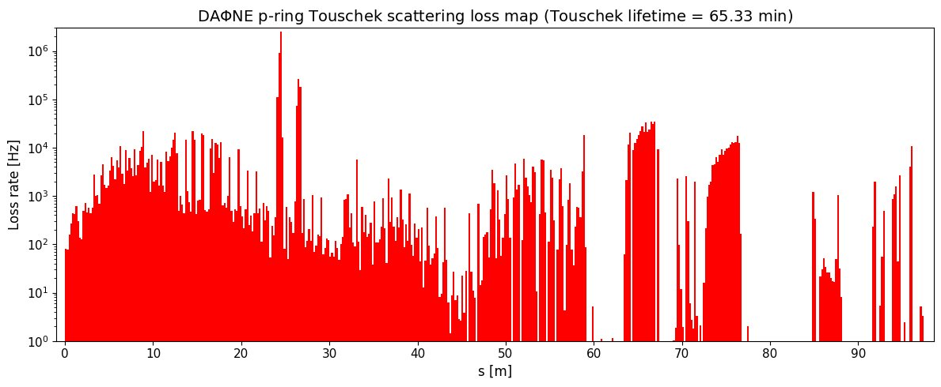
DAFNE: Touschek scattering loss map
A ~1-hour Touschek lifetime with fully retracted scrapers is in line with expectations
Tracking beyond 1000 turns may be needed for a more accurate Touschek lifetime estimate, as some particles were still being lost in the final simulated turns
26/03/2025
G. Broggi | Xsuite-based simulations of Touschek effect in DAFNE

Slide 23
Outline
Introduction
  Touschek scattering
  Theory snapshot
Monte Carlo simulation of Touschek scattering
  Method
  MC simulation vs. Piwinski formula
  Xsuite-based Touschek scattering simulations
First application: DAFNE p-ring
Outlook and next steps
26/03/2025
G. Broggi | Xsuite-based simulations of Touschek effect in DAFNE

Slide 24
Outlook
A Touschek scattering routine to simulate Touschek scattering has been developed
  Based on the work by A. Xiao and M. Borland (ELEGANT implementation)
  Validated vs. the well-established Piwinski formula
The Touschek scattering routine has been tested for the first time on the DAFNE p-ring
  Touschek lifetime from simulation is in line with expectations
Next steps
Perform Touschek scattering simulations on other machines: SuperKEKB, FCC-ee
Xsuite-BDSIM benchmark with measured data at DAFNE ?
  Lifetime
  Background rates at DAFNE luminometer
26/03/2025
G. Broggi | Xsuite-based simulations of Touschek effect in DAFNE

Slide 25
Thank you!
26/03/2025
G. Broggi | Xsuite-based simulations of Touschek effect in DAFNE

