Slide 1
Status of injection background studies
31/03/2025 FCC-ee MDI meeting #65
Giulia Nigrelli
G. Nigrelli^{1,2,3}, M. Boscolo², G. Broggi^{1,2,3}, R. Bruce¹, S. Redaelli¹, K. Skoufaris¹
¹ CERN, Geneva, Switzerland,
² INFN-LNF, Frascati, Italy,
³ Sapienza Università di Roma, Roma, Italy

Slide 2
Outline
31/03/2025 FCC-ee MDI meeting #65
Giulia Nigrelli
Introduction
On-axis & Off-energy scheme
Simulation framework
Case Studies:
  Injected beam
  Circulating Core
  Circulating Halo
Conclusions & future steps

Slide 3
Top-up Injection for FCC-ee
31/03/2025 FCC-ee MDI meeting #65
Giulia Nigrelli
Beam lifetime during collisions well below 1h → top-up injection scheme required.
Depending on the operation mode, interval between injections of positron and electron beams ranges from 40 s to 10 s, and the number of bunches per injection varies between 1120 and 56.
Z-mode most critical for injection → Injection occurs every 3 s, 1120 bunches are injected each with 10% intensity of a bunch → in total 1 % of full beam intensity.
Off-axis & On-energy injection scheme not feasible for SR levels at the SR mask collimator.
On-axis & Off-energy current baseline scheme.
Hybrid mode is considered as an option, and as baseline for W-mode.

Slide 4
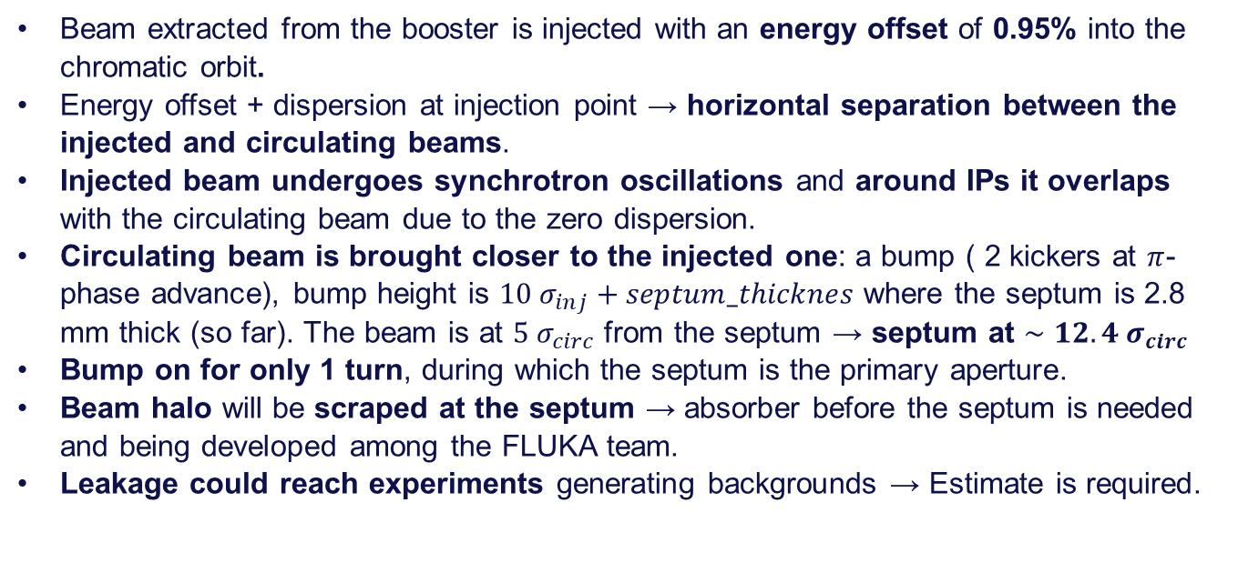
On-axis & Off-Energy injection scheme
31/03/2025 FCC-ee MDI meeting #65
Giulia Nigrelli
Beam extracted from the booster is injected with an energy offset of 0.95% into the chromatic orbit.
Energy offset + dispersion at injection point → horizontal separation between the injected and circulating beams.
Injected beam undergoes synchrotron oscillations and around IPs it overlaps with the circulating beam due to the zero dispersion.
Circulating beam is brought closer to the injected one: a bump ( 2 kickers at $π$-phase advance), bump height is $10 σ_{inj}+septum_thicknes$ where the septum is 2.8 mm thick (so far). The beam is at $5 σ_{circ}$ from the septum → septum at $∼12.4 σ_{circ}$
Bump on for only 1 turn, during which the septum is the primary aperture.
Beam halo will be scraped at the septum → absorber before the septum is needed and being developed among the FLUKA team.
Leakage could reach experiments generating backgrounds → Estimate is required.

Slide 5
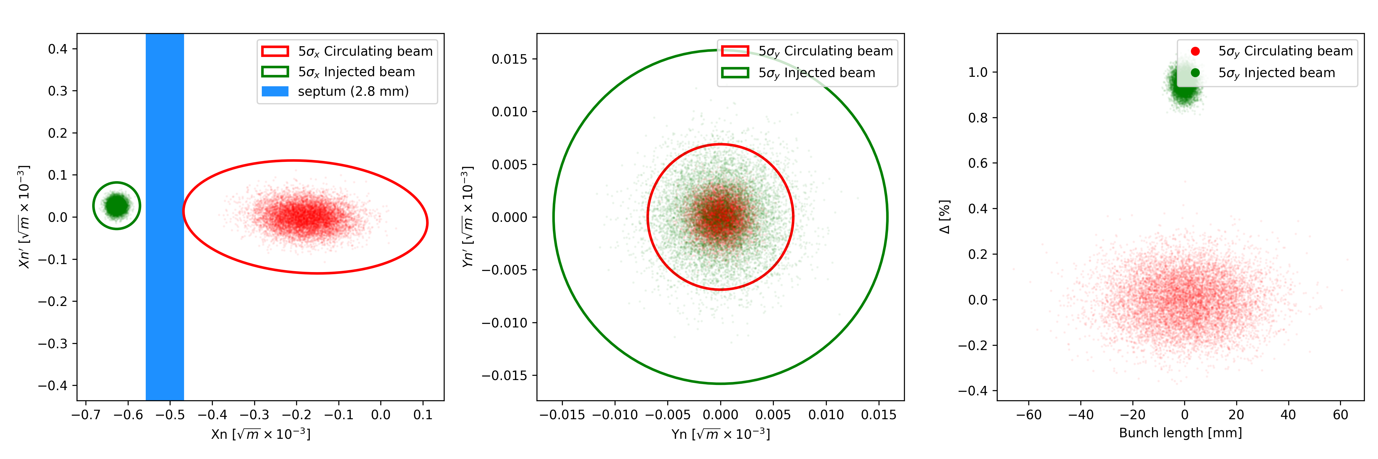
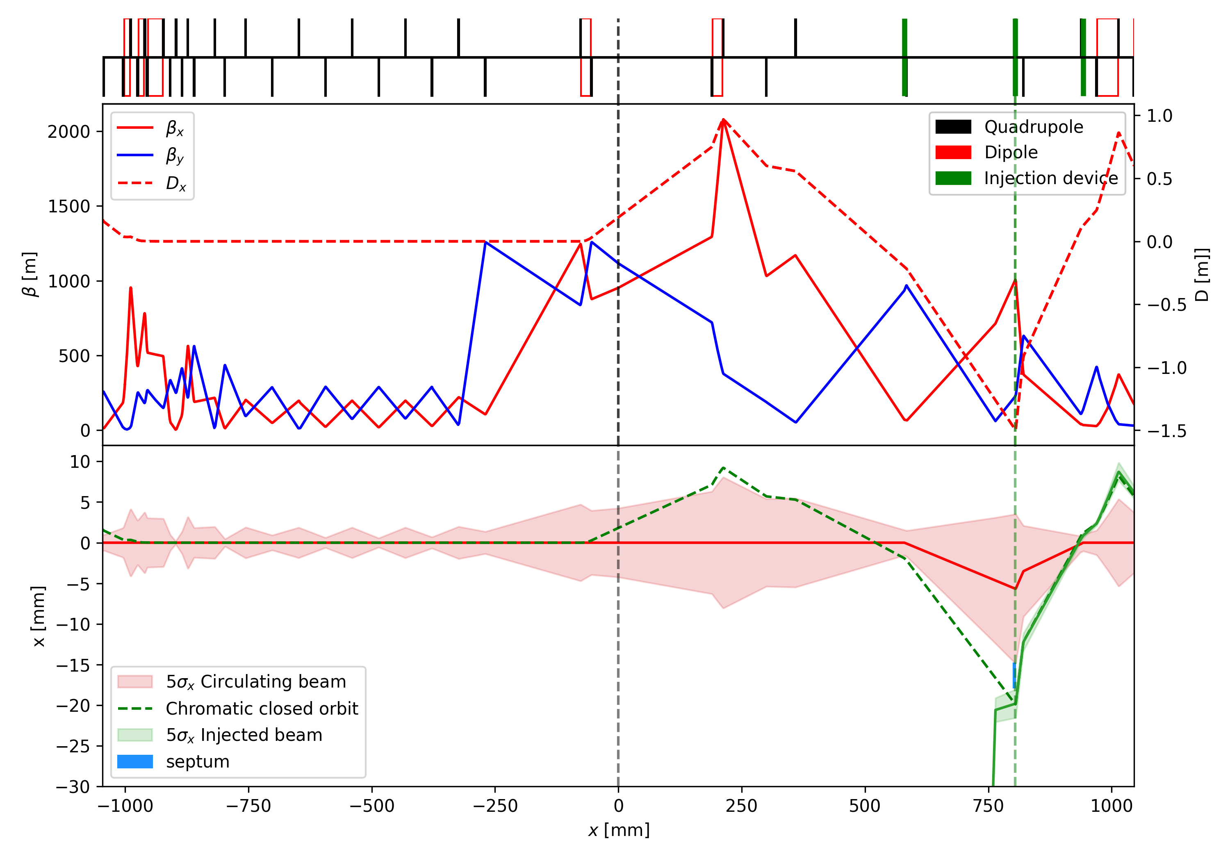
On-axis & Off-Energy injection scheme
31/03/2025 FCC-ee MDI meeting #65
Giulia Nigrelli

Slide 6
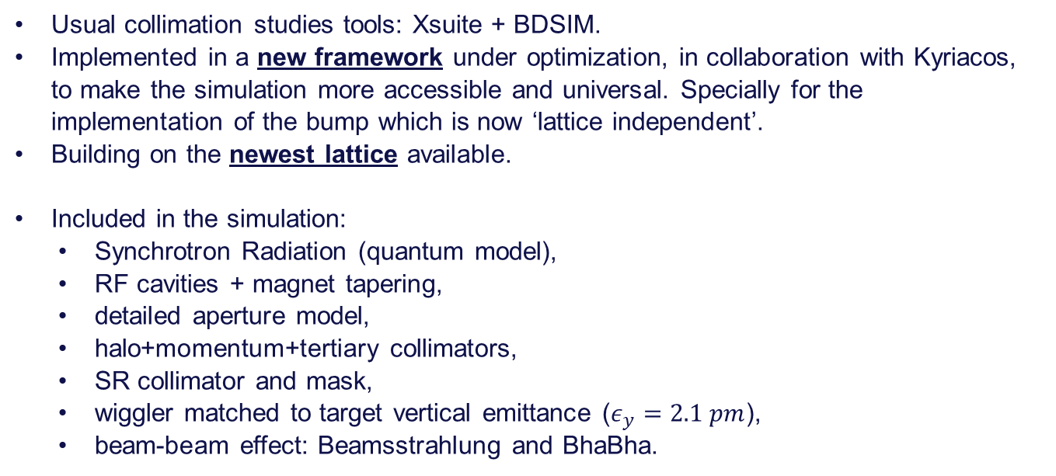
Simulation framework
31/03/2025 FCC-ee MDI meeting #65
Giulia Nigrelli
Usual collimation studies tools: Xsuite + BDSIM.
Implemented in a new framework under optimization, in collaboration with Kyriacos, to make the simulation more accessible and universal. Specially for the implementation of the bump which is now ‘lattice independent’.
Building on the newest lattice available.
Included in the simulation:
  Synchrotron Radiation (quantum model),
  RF cavities + magnet tapering,
  detailed aperture model,
  halo+momentum+tertiary collimators,
  SR collimator and mask,
  wiggler matched to target vertical emittance ($ε_{y}=2.1 pm$),
  beam-beam effect: Beamsstrahlung and BhaBha.

Slide 7
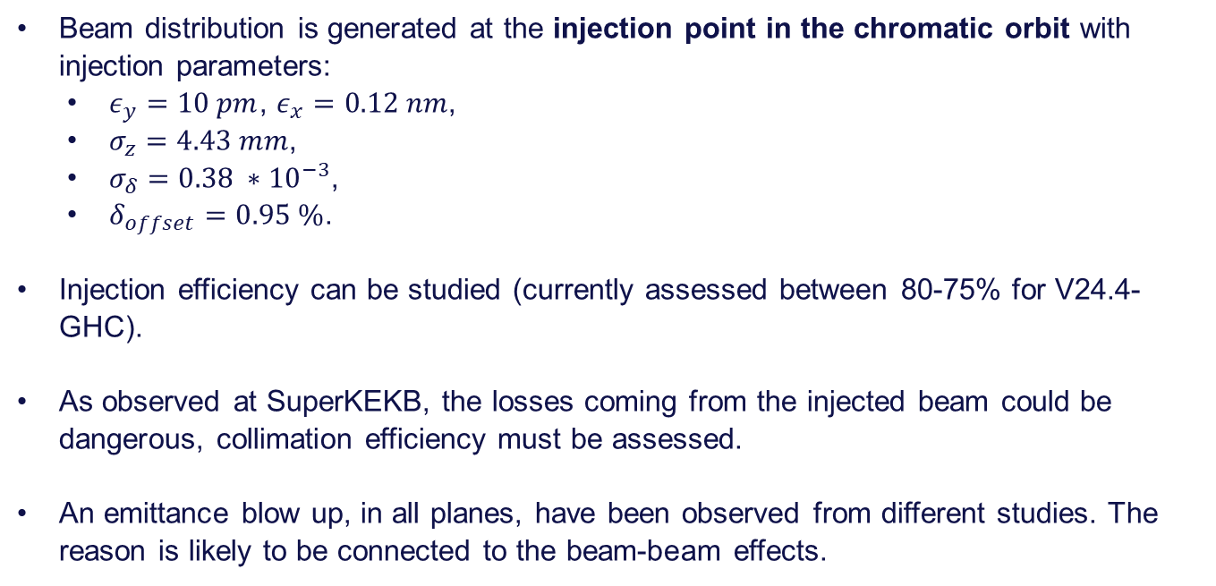
Case studies: Injected beam
31/03/2025 FCC-ee MDI meeting #65
Giulia Nigrelli
Beam distribution is generated at the injection point in the chromatic orbit with injection parameters:
  $ε_{y}=10 pm$, $ε_{x}=0.12 nm$,
  $σ_{z}=4.43 mm$,
  $σ_{δ}=0.38 ∗{10}^{−3}$,
  $δ_{offset}=0.95 \%$.
Injection efficiency can be studied (currently assessed between 80-75% for V24.4-GHC).
As observed at SuperKEKB, the losses coming from the injected beam could be dangerous, collimation efficiency must be assessed.
An emittance blow up, in all planes, have been observed from different studies. The reason is likely to be connected to the beam-beam effects.

Slide 8
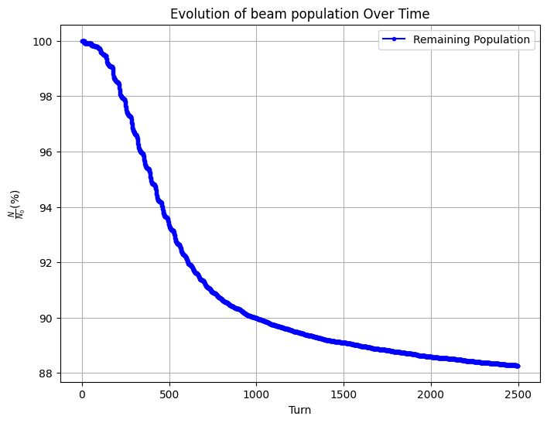
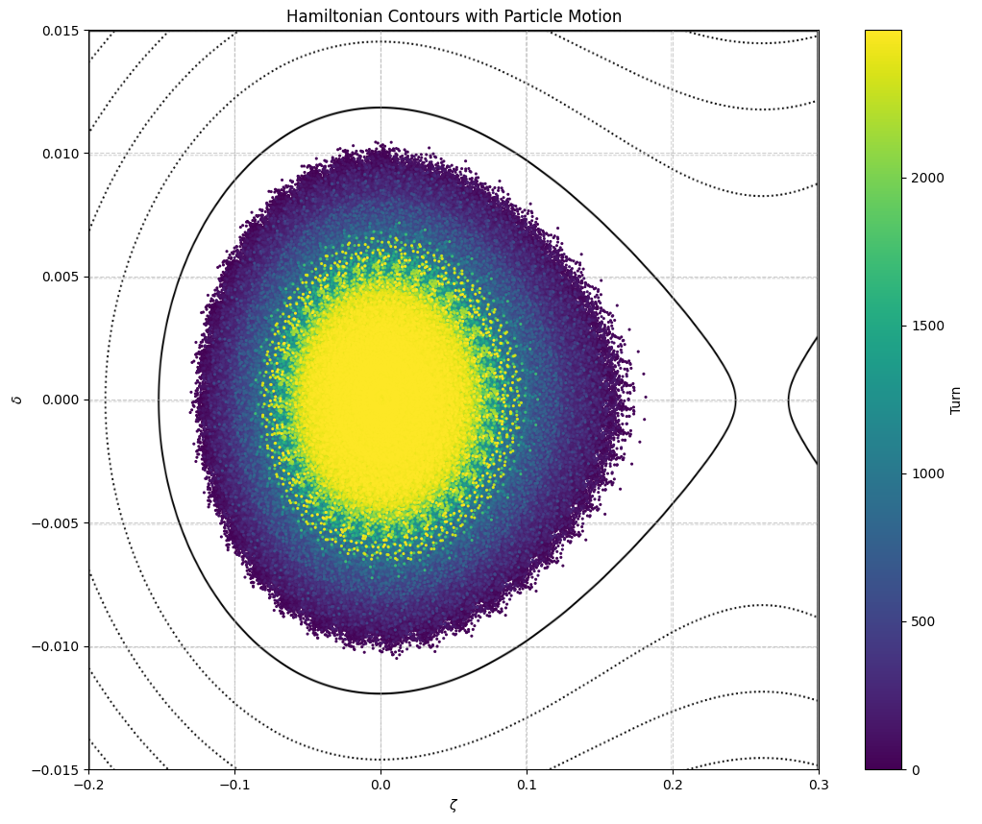
Case studies: Injected beam
31/03/2025 FCC-ee MDI meeting #65
Giulia Nigrelli
With the latest version of the lattice the injection efficiency is $∼87\%$.
The injected beam dump in the longitudinal plane and reach the center already after 2.5 k turn only 2 dumping time, and there are almost 8 between two consecutive injection.

Slide 9
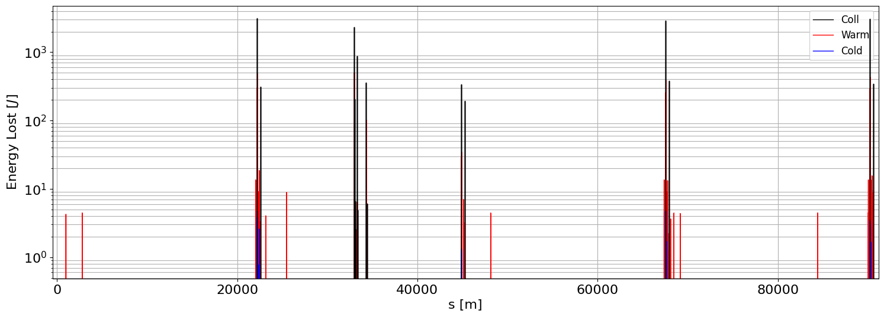
Case studies: Injected beam
31/03/2025 FCC-ee MDI meeting #65
Giulia Nigrelli
As expected the losses are distributed along the whole ring, and the tertiary collimaor at the IPs get as much losses as the collimation insertion.
Background estimate is required.
INJ
IP
COLL
IP
IP
IP

Slide 10
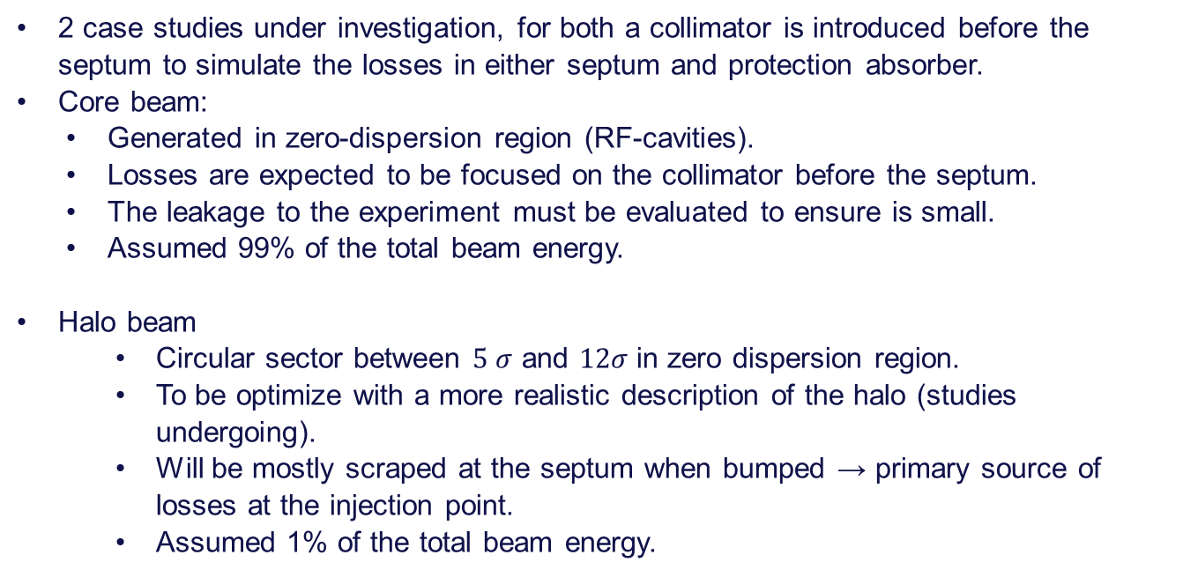
Case studies: Circulating beam
31/03/2025 FCC-ee MDI meeting #65
Giulia Nigrelli
2 case studies under investigation, for both a collimator is introduced before the septum to simulate the losses in either septum and protection absorber.
Core beam:
  Generated in zero-dispersion region (RF-cavities).
  Losses are expected to be focused on the collimator before the septum.
  The leakage to the experiment must be evaluated to ensure is small.
  Assumed 99% of the total beam energy.
Halo beam
    Circular sector between $5 σ$ and $12σ$in zero dispersion region.
    To be optimize with a more realistic description of the halo (studies undergoing).
    Will be mostly scraped at the septum when bumped → primary source of losses at the injection point.
    Assumed 1% of the total beam energy.

Slide 11
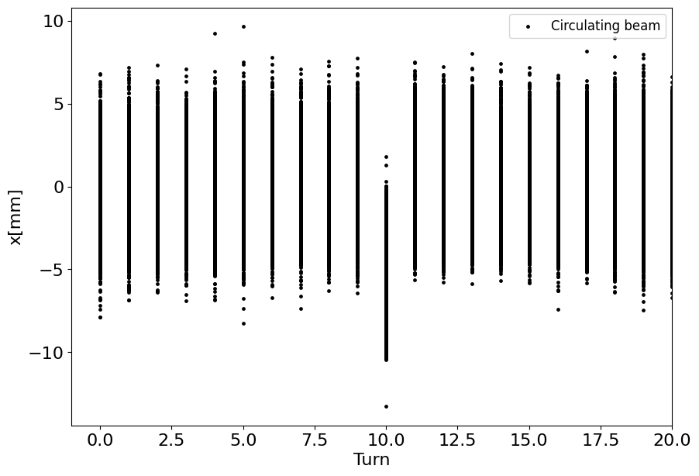
Case studies: Circulating beam
31/03/2025 FCC-ee MDI meeting #65
Giulia Nigrelli
In both cases, the beam is bumped towards the injected one only for 1 turn, in this simulation has been chosen the beam is bumped at turn 10.

Slide 12
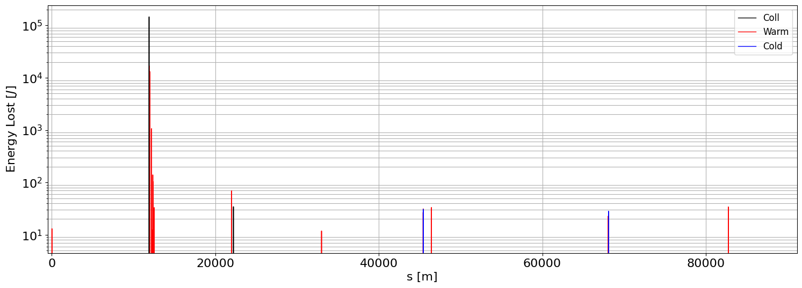
Case studies: Circulating core beam
31/03/2025 FCC-ee MDI meeting #65
Giulia Nigrelli
As expected, some particles are lost around the septa and there is no significant leakage to the experiment.
INJ
IP
COLL
IP
IP
IP

Slide 13
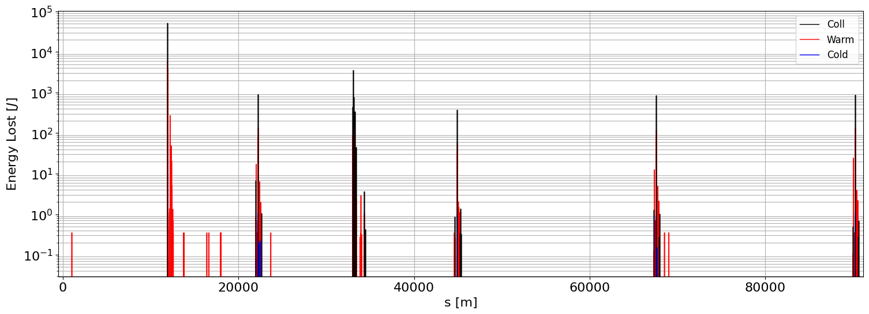
Case studies: Circulating halo beam
31/03/2025 FCC-ee MDI meeting #65
Giulia Nigrelli
On the other hand, almost 50% of the halo is lost at the injection point and the leakage to the experiment is significant and need further investigation.
INJ
IP
COLL
IP
IP
IP

Slide 14
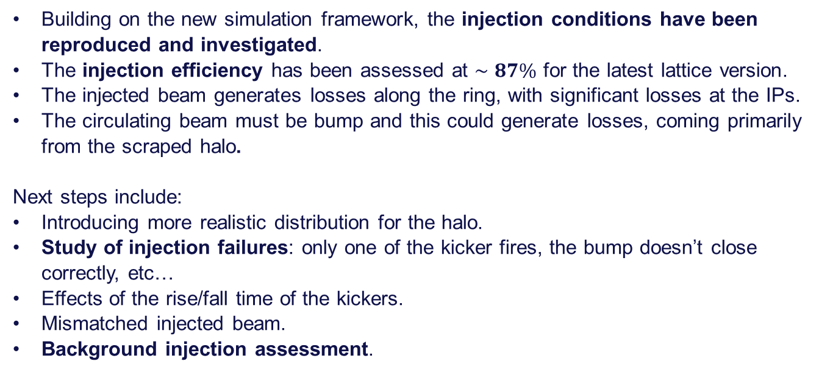
Conclusion and Future Steps
31/03/2025 FCC-ee MDI meeting #65
Giulia Nigrelli
Building on the new simulation framework, the injection conditions have been reproduced and investigated.
The injection efficiency has been assessed at $∼87\%$ for the latest lattice version.
The injected beam generates losses along the ring, with significant losses at the IPs.
The circulating beam must be bump and this could generate losses, coming primarily from the scraped halo.
Next steps include:
Introducing more realistic distribution for the halo.
Study of injection failures: only one of the kicker fires, the bump doesn’t close correctly, etc…
Effects of the rise/fall time of the kickers.
Mismatched injected beam.
Background injection assessment.

Slide 15
Thank you for your attention.
31/03/2025 FCC-ee MDI meeting #65
Giulia Nigrelli

Slide 16
Backup

Slide 17
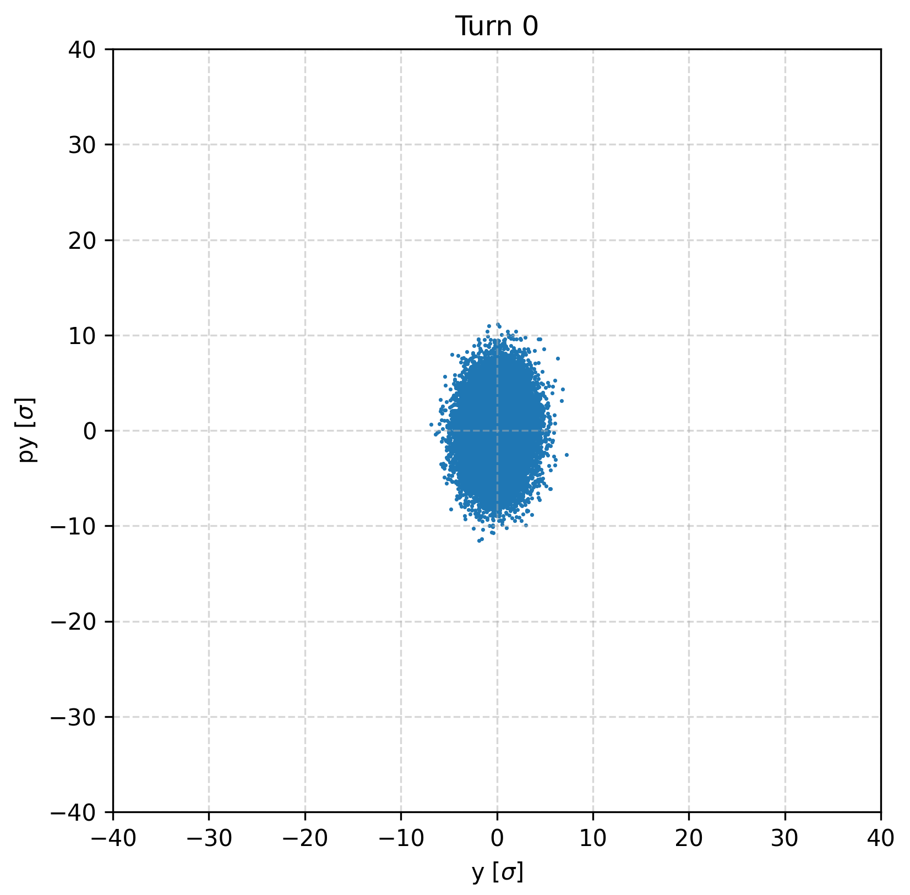
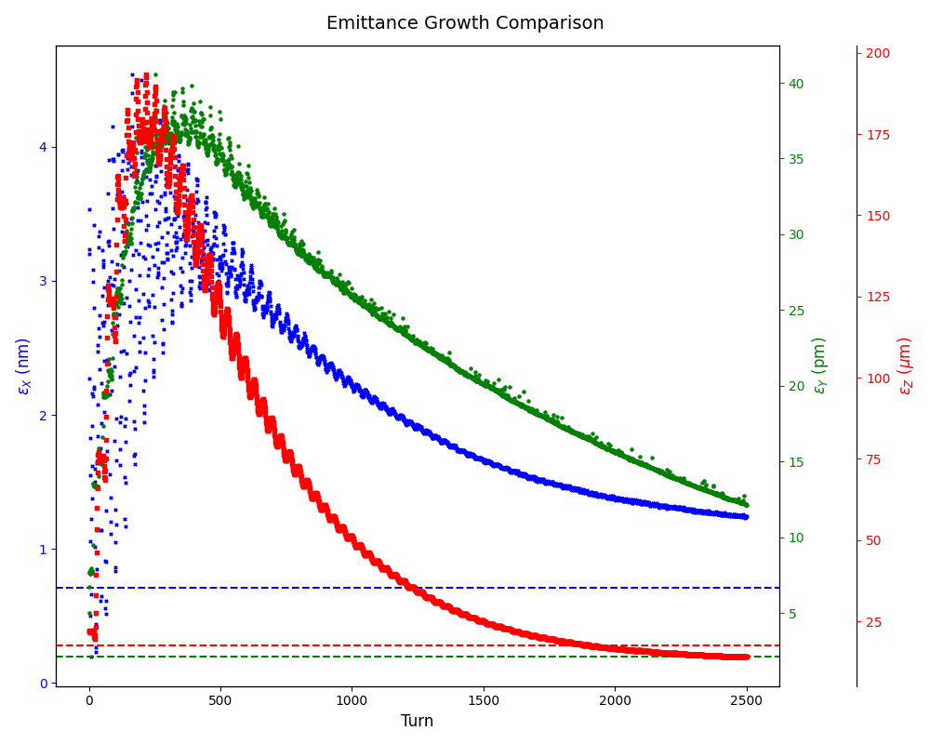
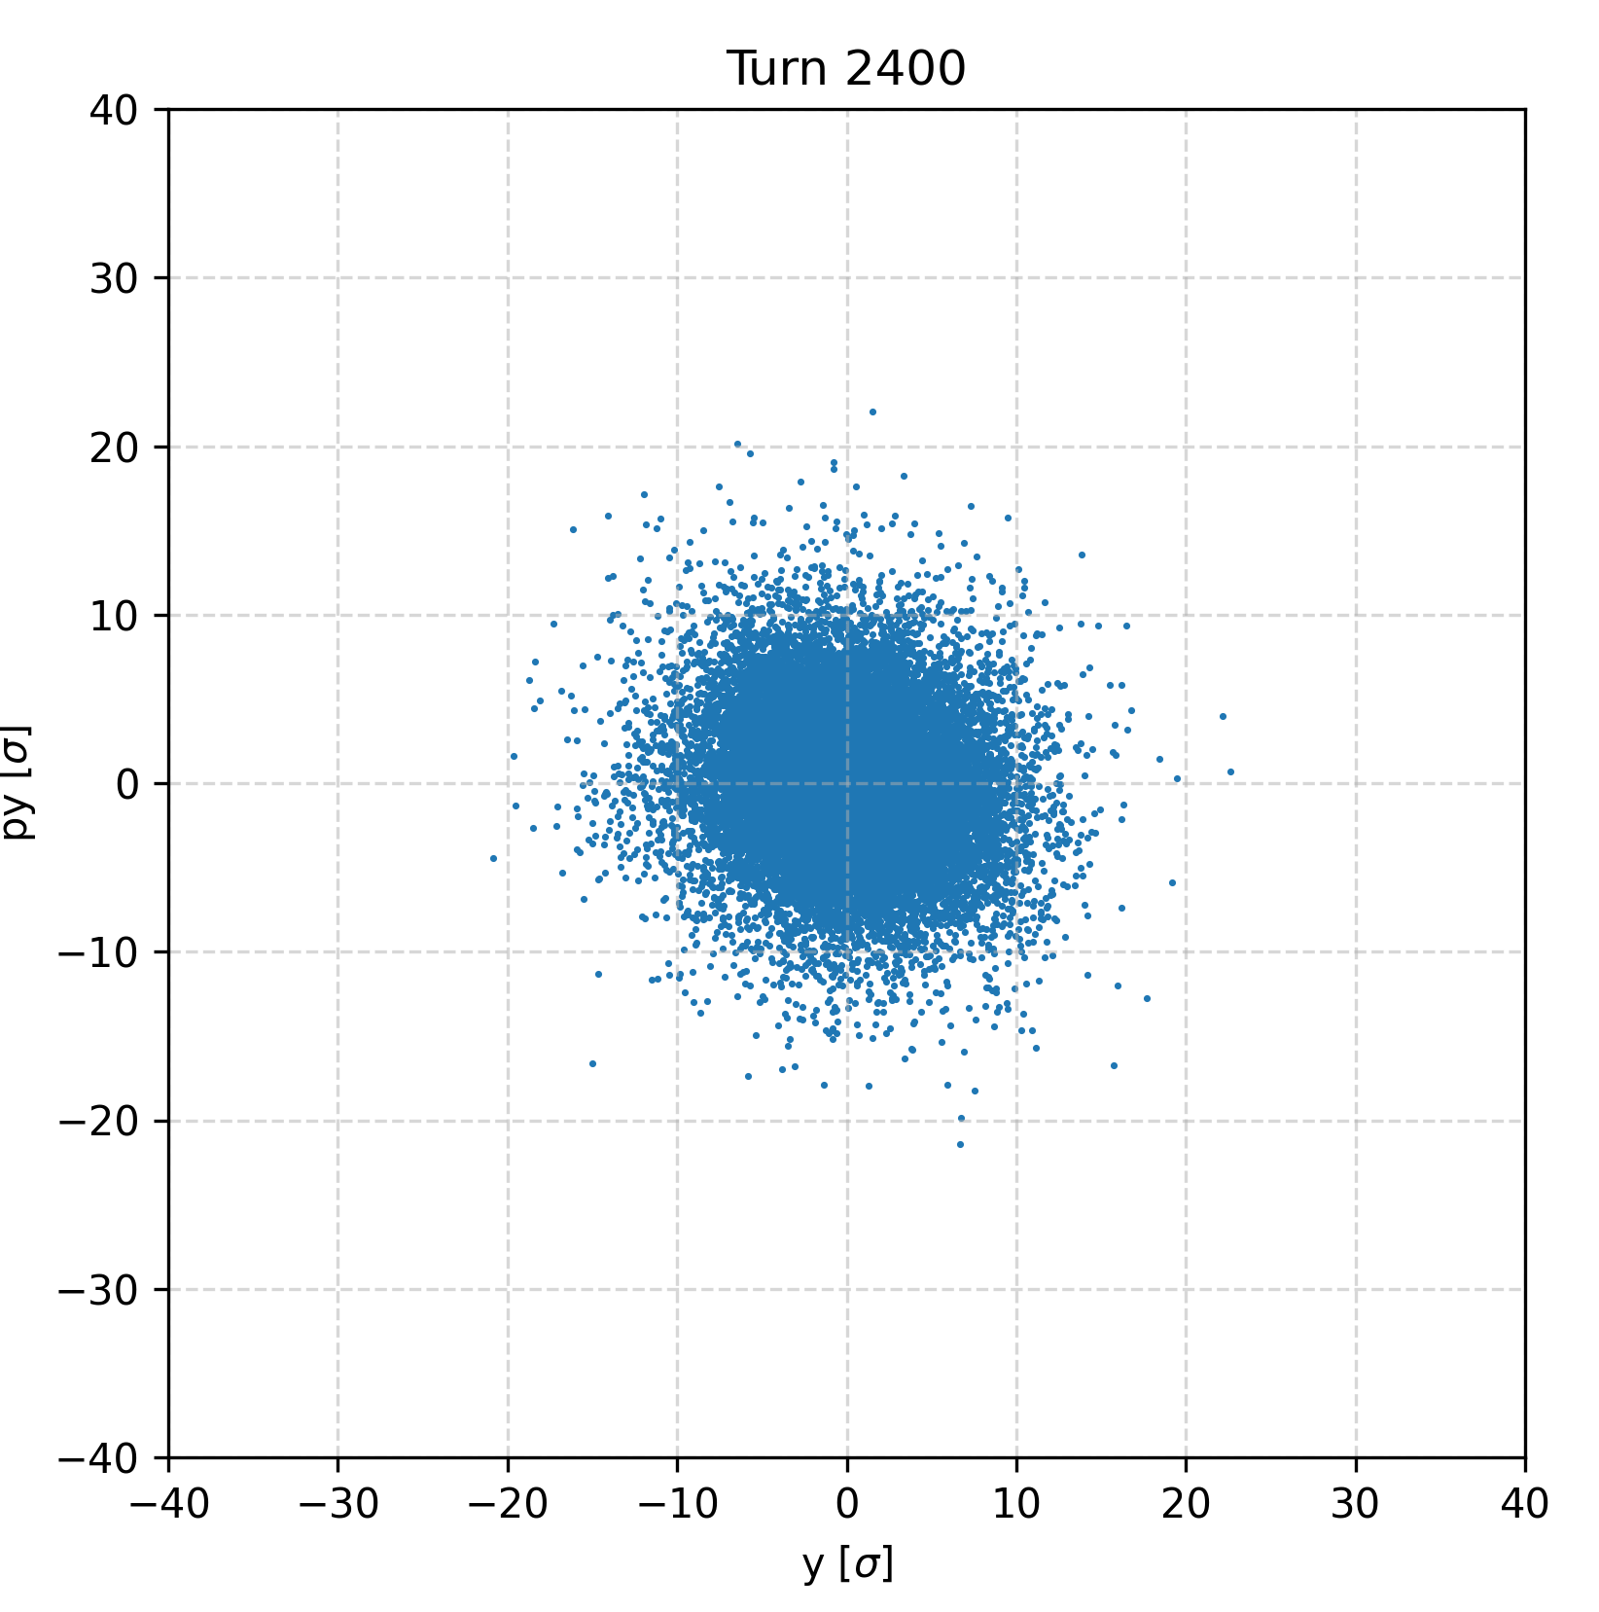
Emittance blow up

Slide 18
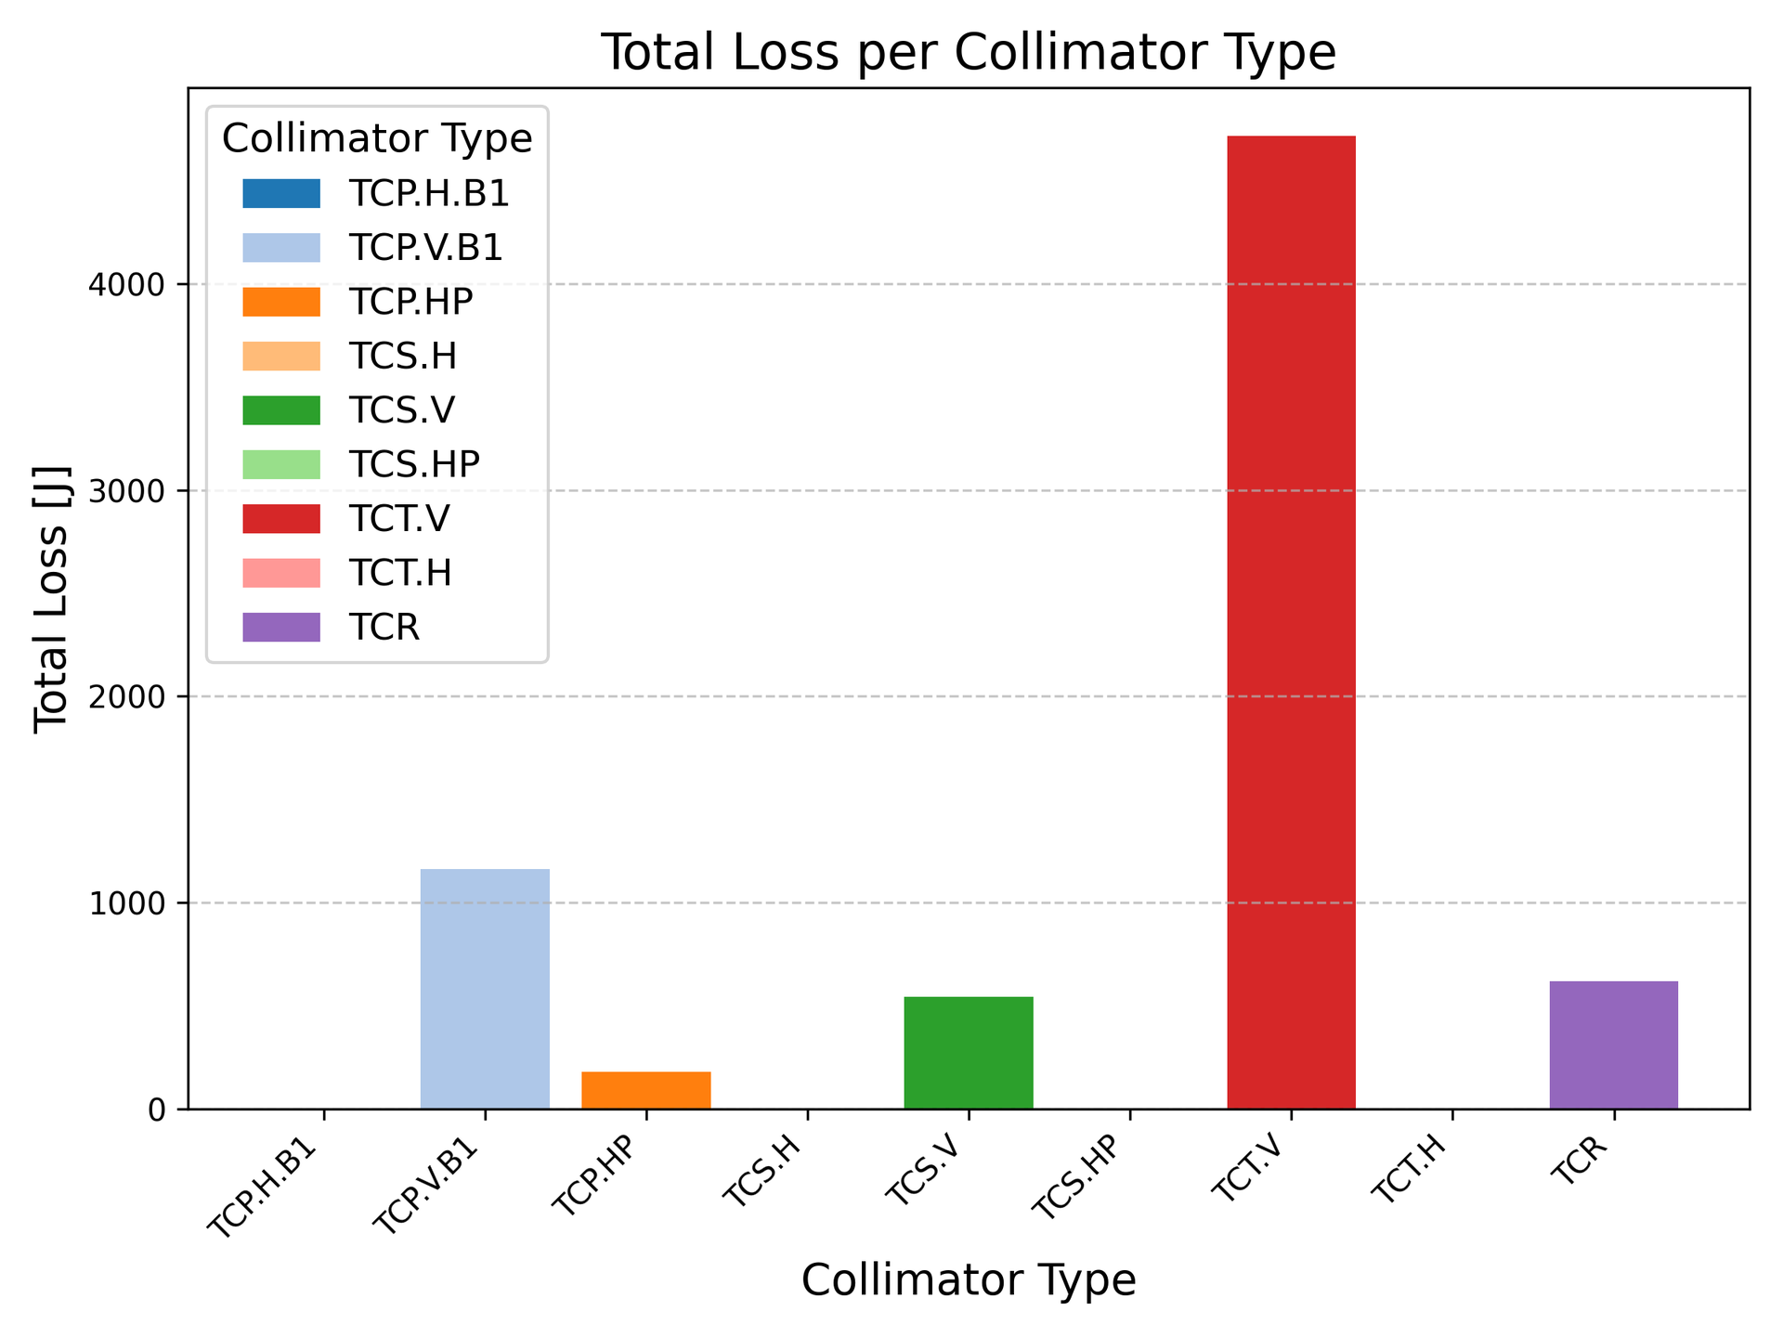
Case studies: Injected beam
NB: Losses in the TCT should be divided by the number of tcts (4), same for TCR(6)

Slide 19
Colors
Backgrounds
Background Blue
Background Purple
Background Yellow
Background Grey
Use for Layout
Radiant Blue
Flash
Energy
Green
Red
Deep
Blue

Slide 20
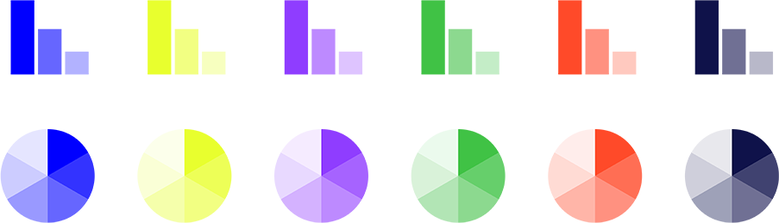
Graphical Elements
Badges
This information is a badge because it is important!
This information is a badge because it is important!
Separation lines 1.5 pt
Arrows
Use blue badges on light backgrounds
Infographics
This information is a badge because it is important!
This information is a badge because it is important!
Use light badges on dark backgrounds

