Slide 2
Cryostat Joining Techniques and
Leak Testing
T. Koettig on behalf of the Cryolab team

Slide 3
Content
Mechanical joints
Solder joints and welded connections
Outgassing vs. leaks
Leak detection
Electrical breakdown

Slide 4
Mechanical connections

Slide 5
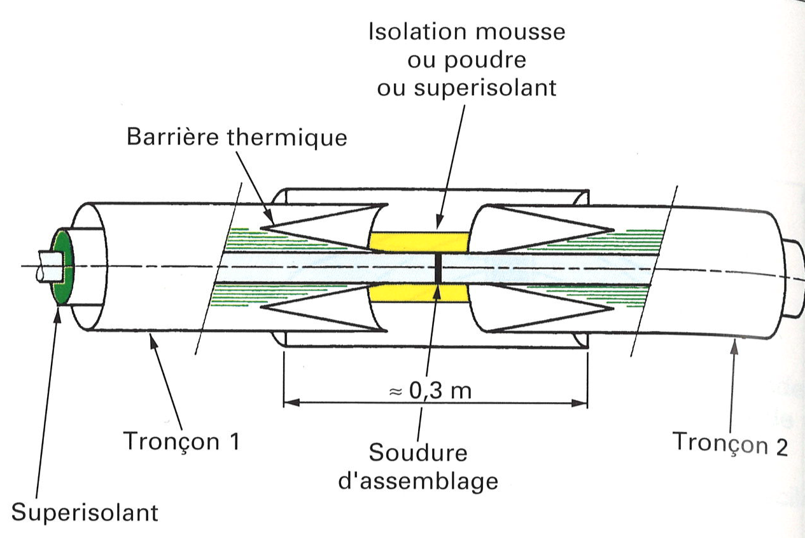
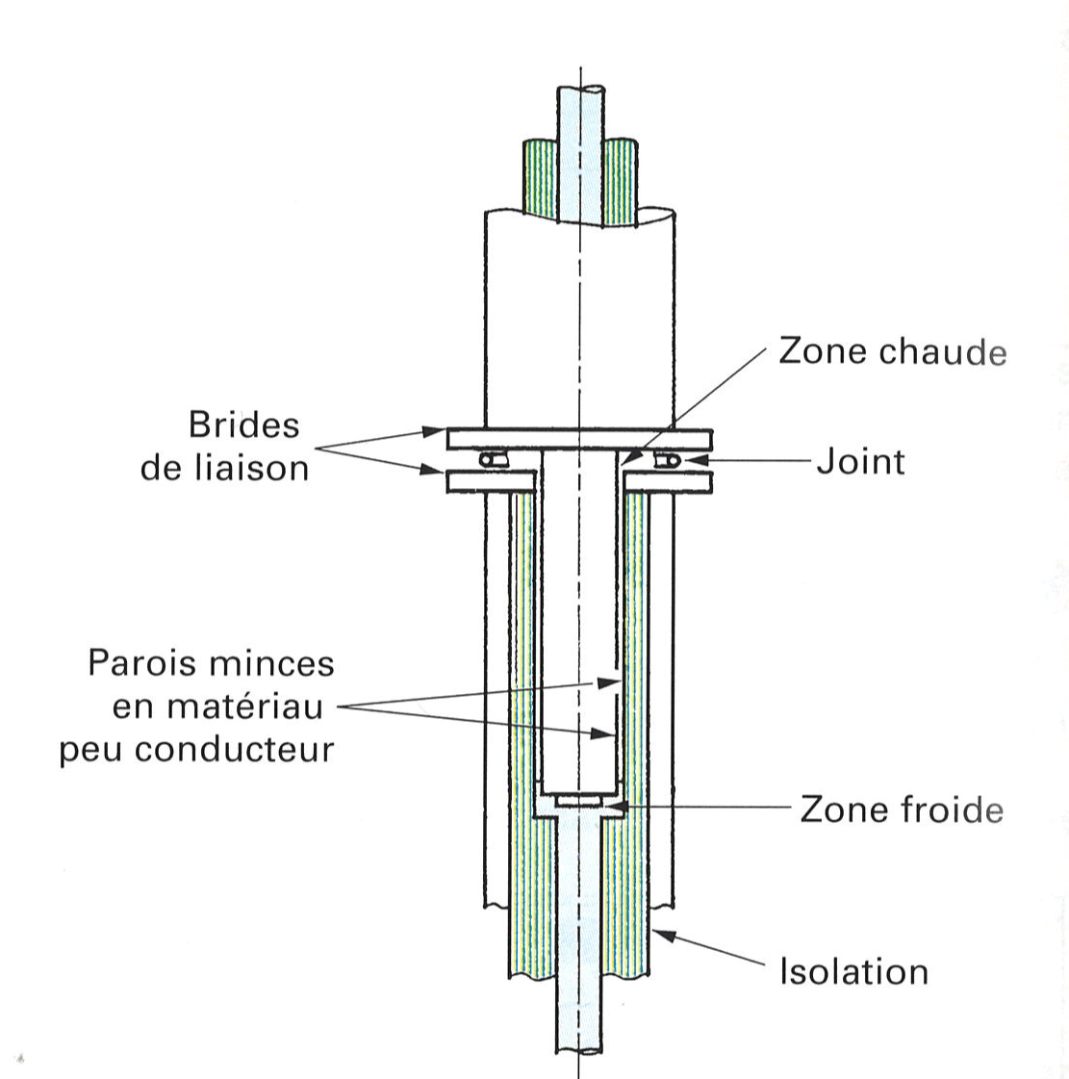
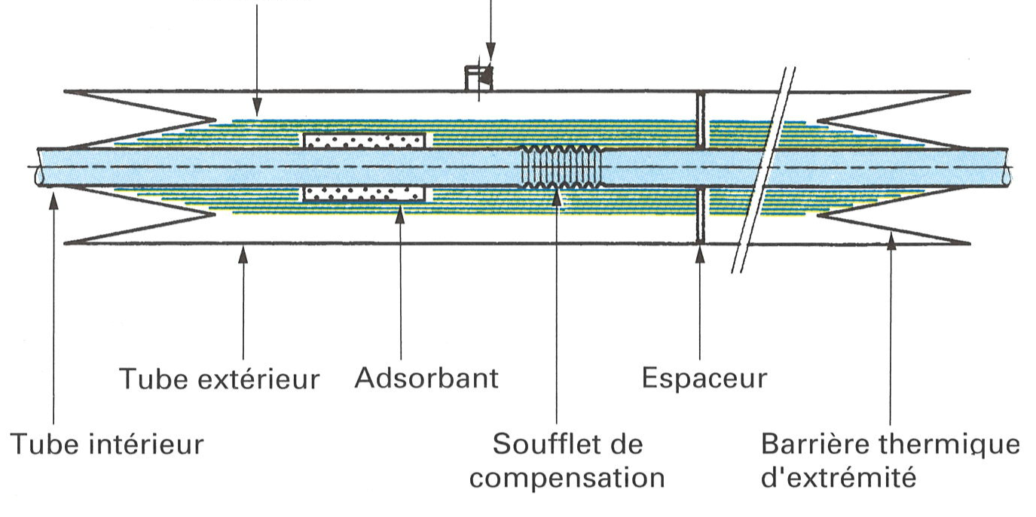
Transfer line examples
Rigid transfer line connection
Bayonet Johnston connection
Insulation by foam, powder or MLI
Thermal barrier
Warm zone
Connection flanges
Joint, O-ring or gasket (Al, Cu, In)
Line 1
Assembly weld
Line 2
MLI
Annular gap of 50 to 100 micron possible cold Teflon seal to reduce convection
MLI
Pumping port
Cold zone
MLI
Ext. tube
Adsorbent
Support, spacer
Internal tube
Bellow
Thermal barrier
Adapted from: Cryogenie, Institute International du Froid

Slide 6
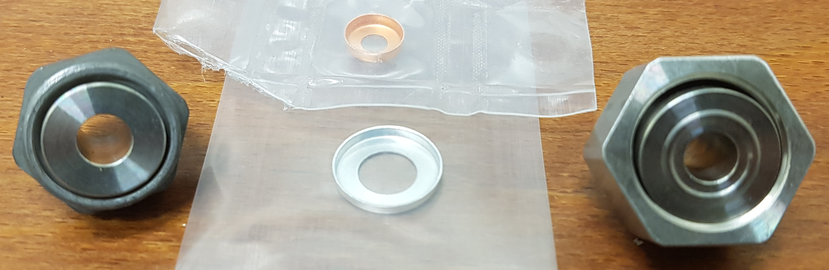
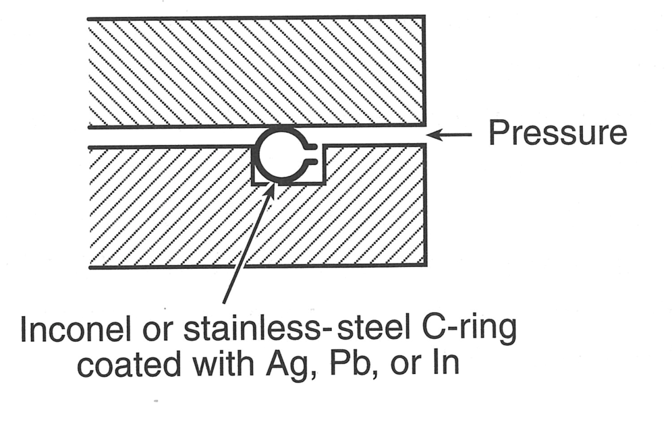
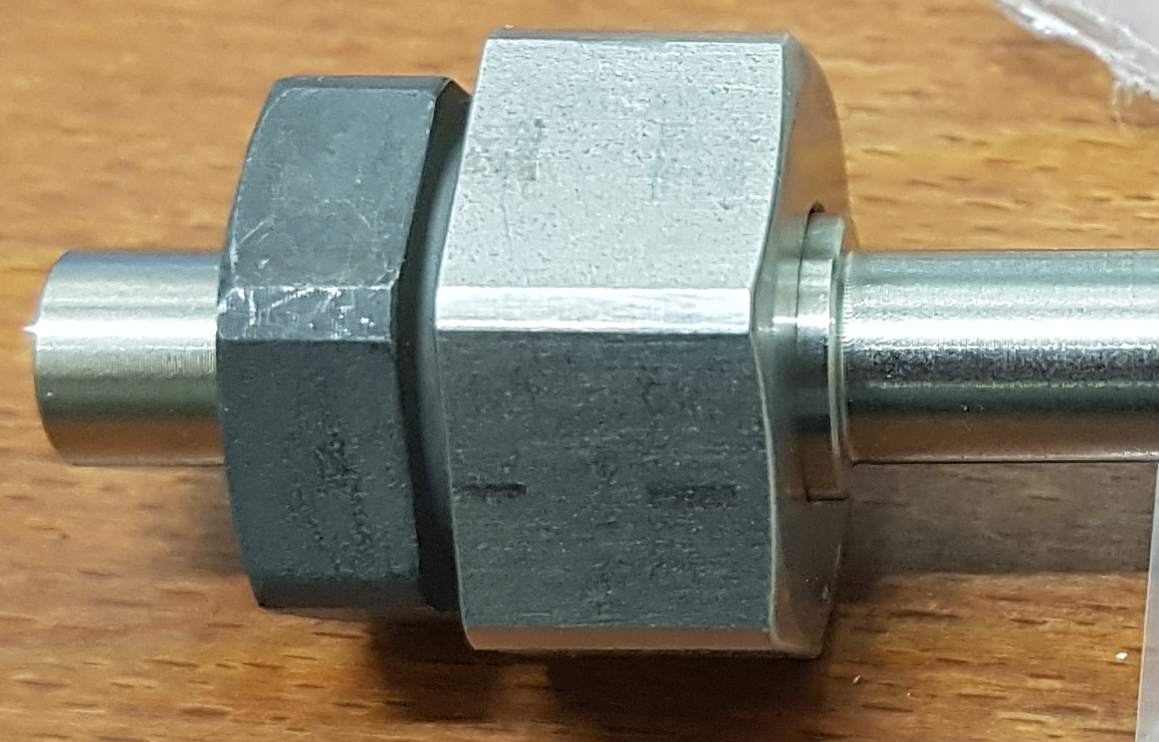
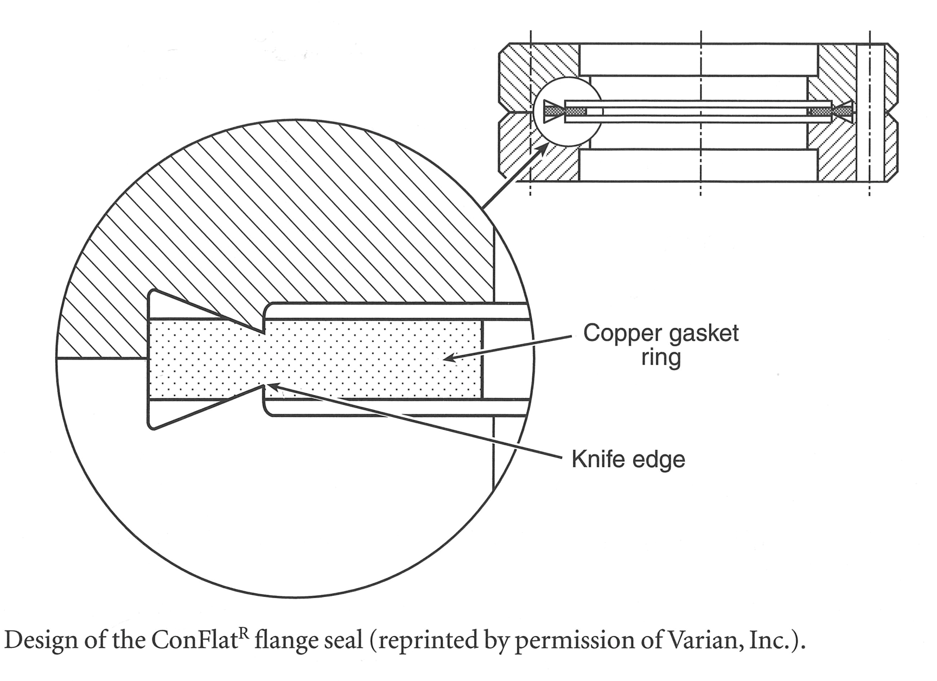
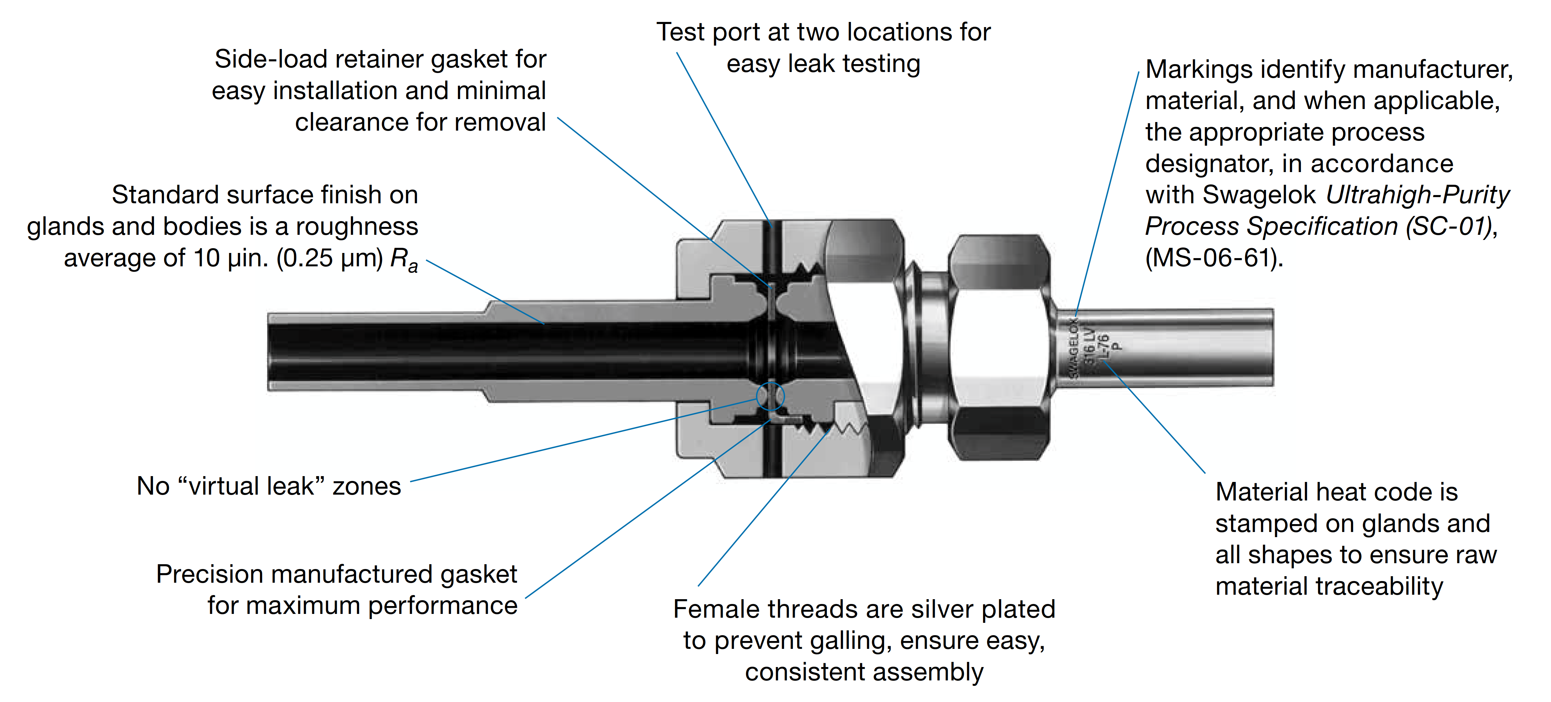
Low-temperature sealing techniques- demountable joints
Joint techniques Helicoflex and CF
Leak tight pipe connections
Kenol connector, metal flat seal, 1 side with convex shaped surface
From: Ekin, Experimental Techniques for Low Temperature Measurements
www.swagelok.com: VCR, with wide variety of connectors, valves etc.

Slide 7
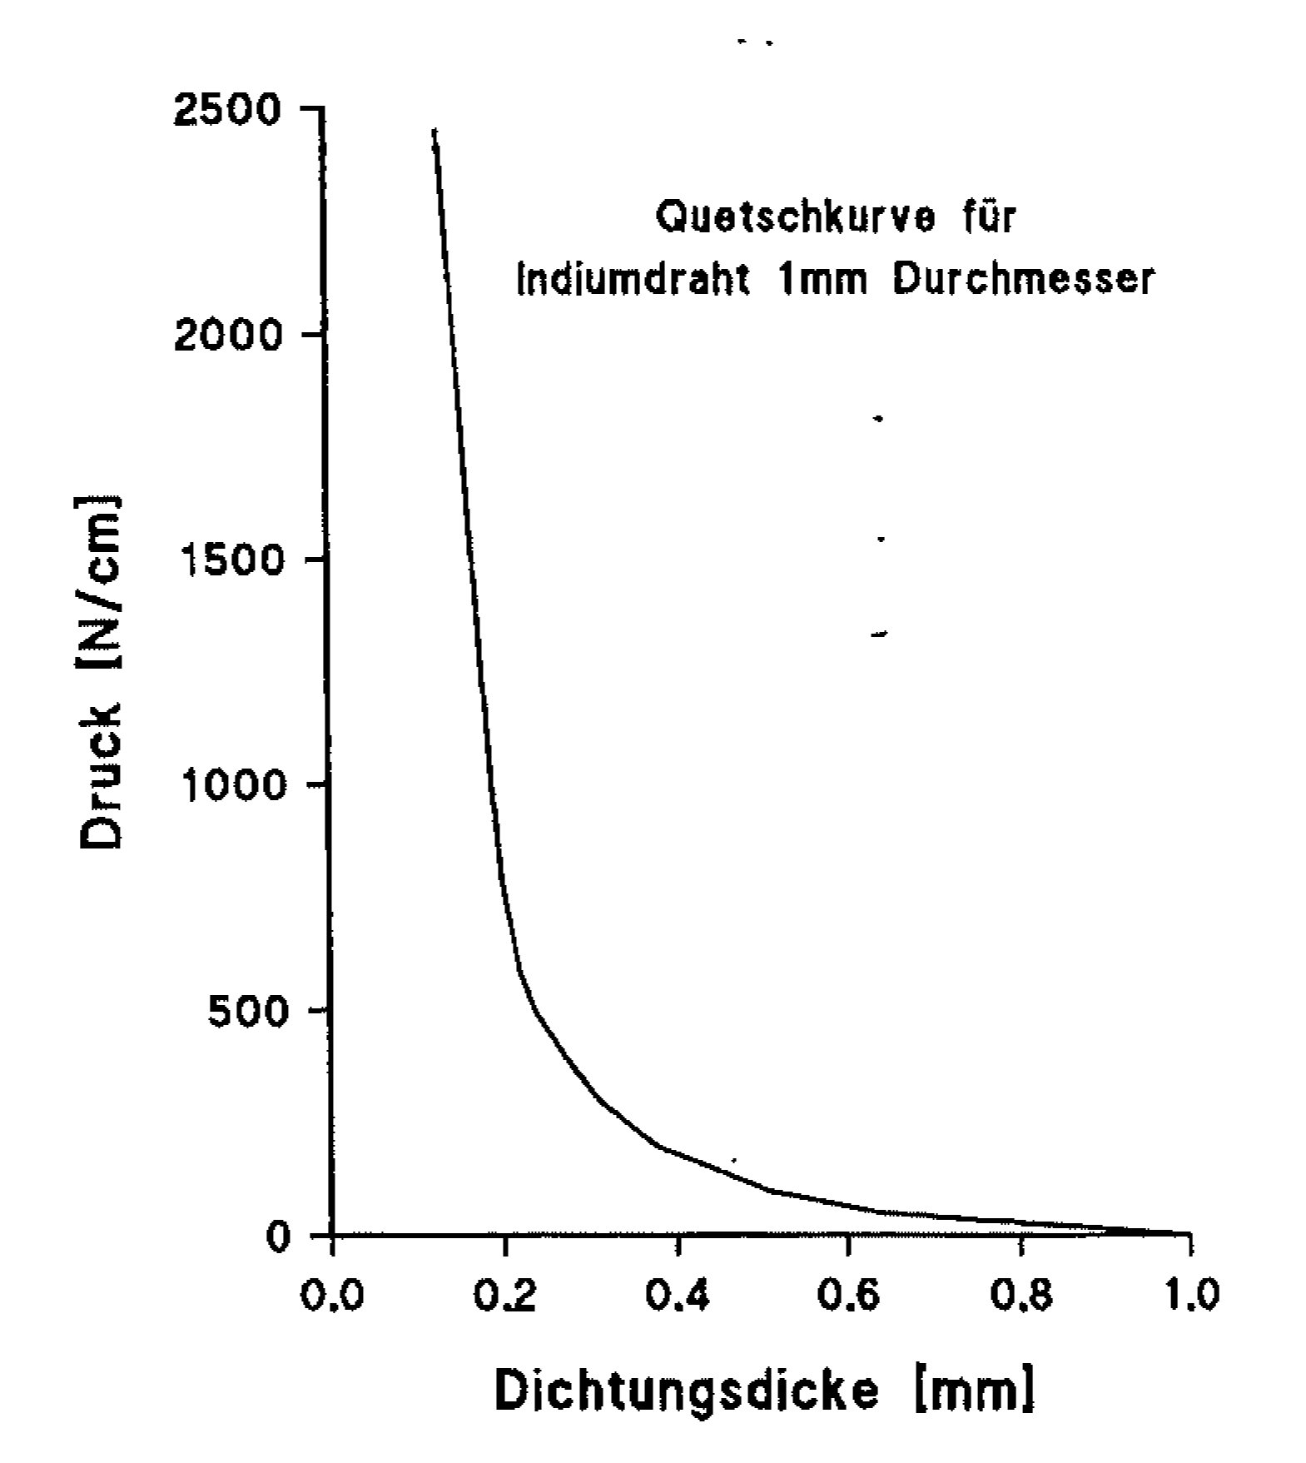
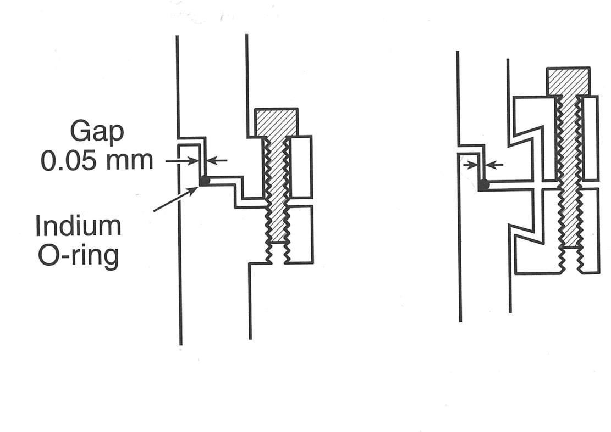
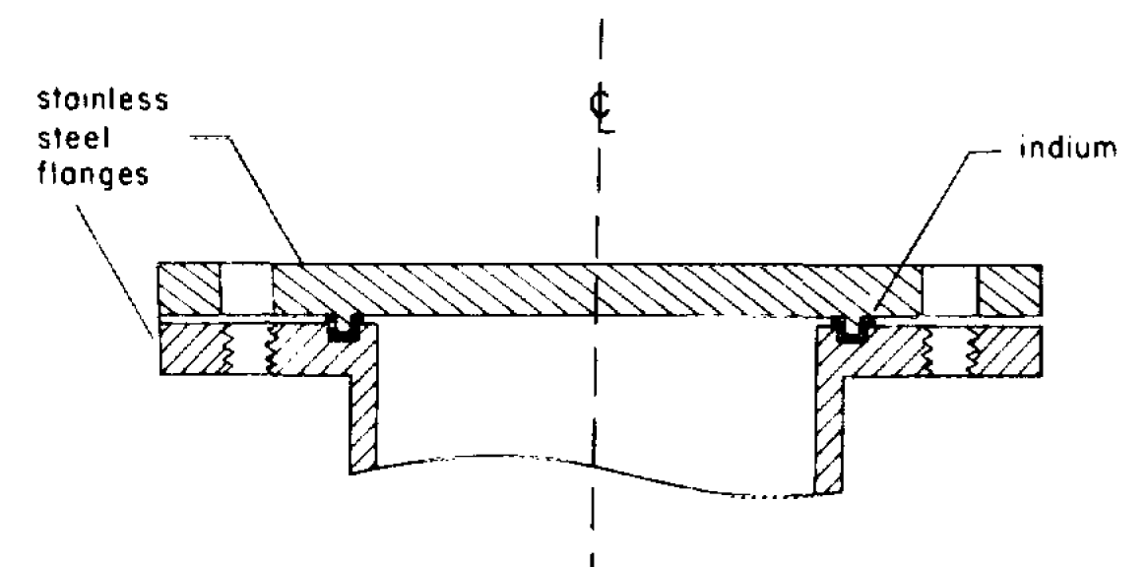
Low-temperature sealing techniques- demountable joints
Joint techniques Indium
Compression curve for a 1 mm Indium wire
Force/length (N/cm)
Remaining thickness in mm
From: Lim, Indium seals for low temperature and moderate pressure applications, Rev. Sc. Instr. 1986
From: Katheder, VDI course Cryostats

Slide 8
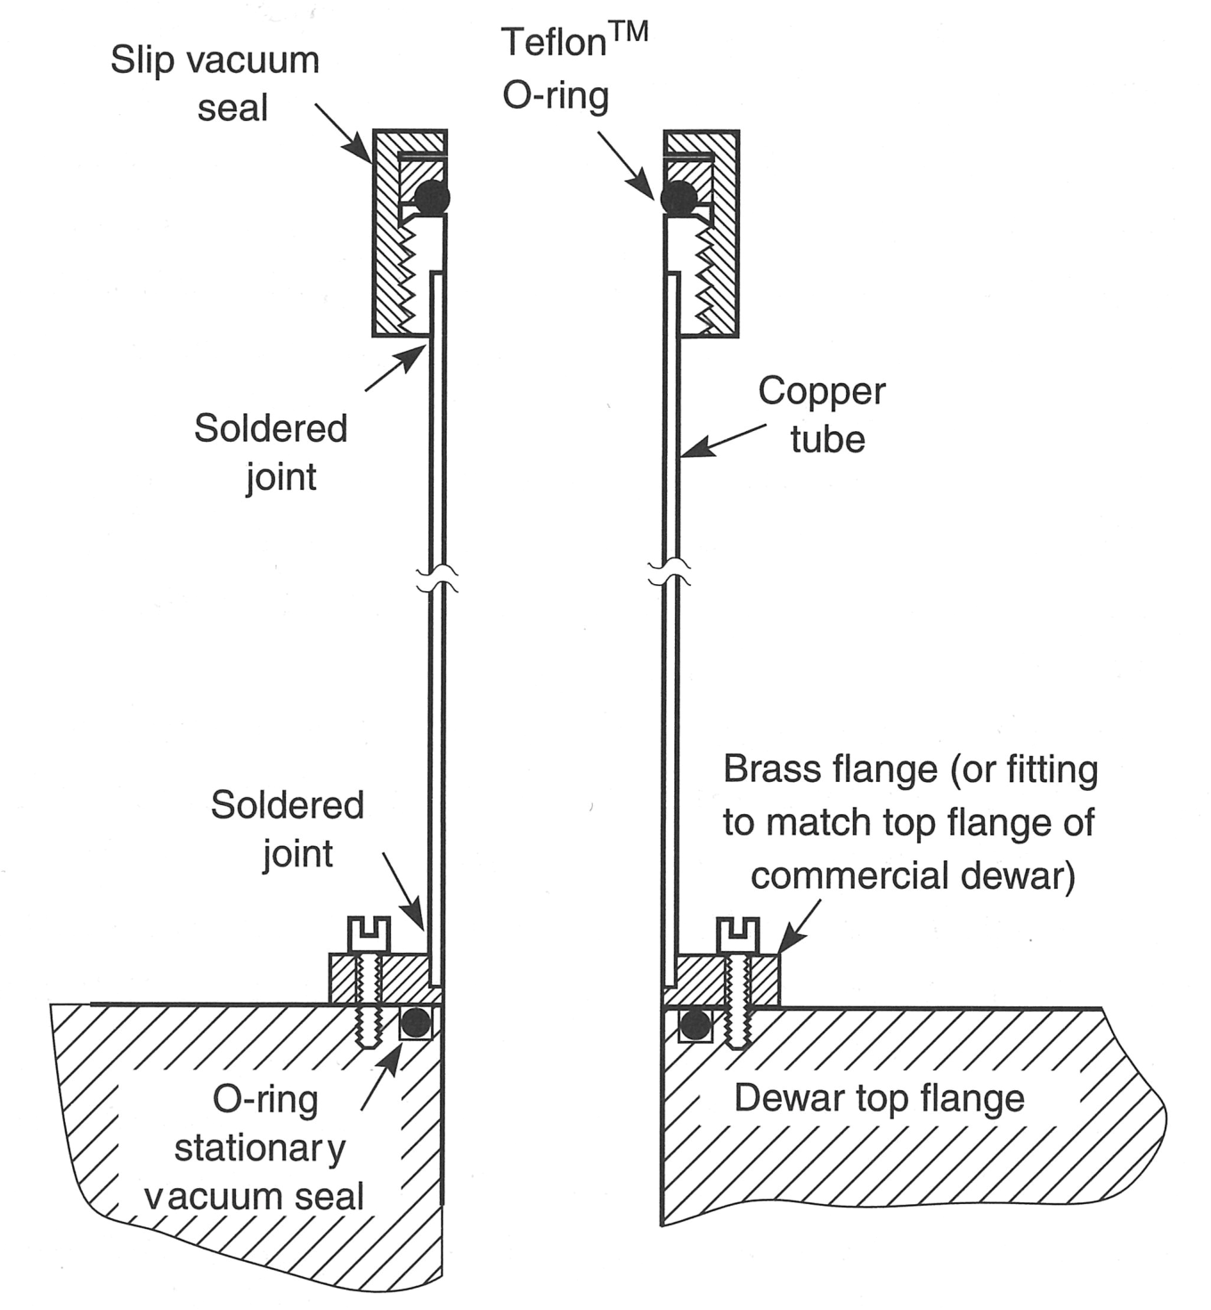
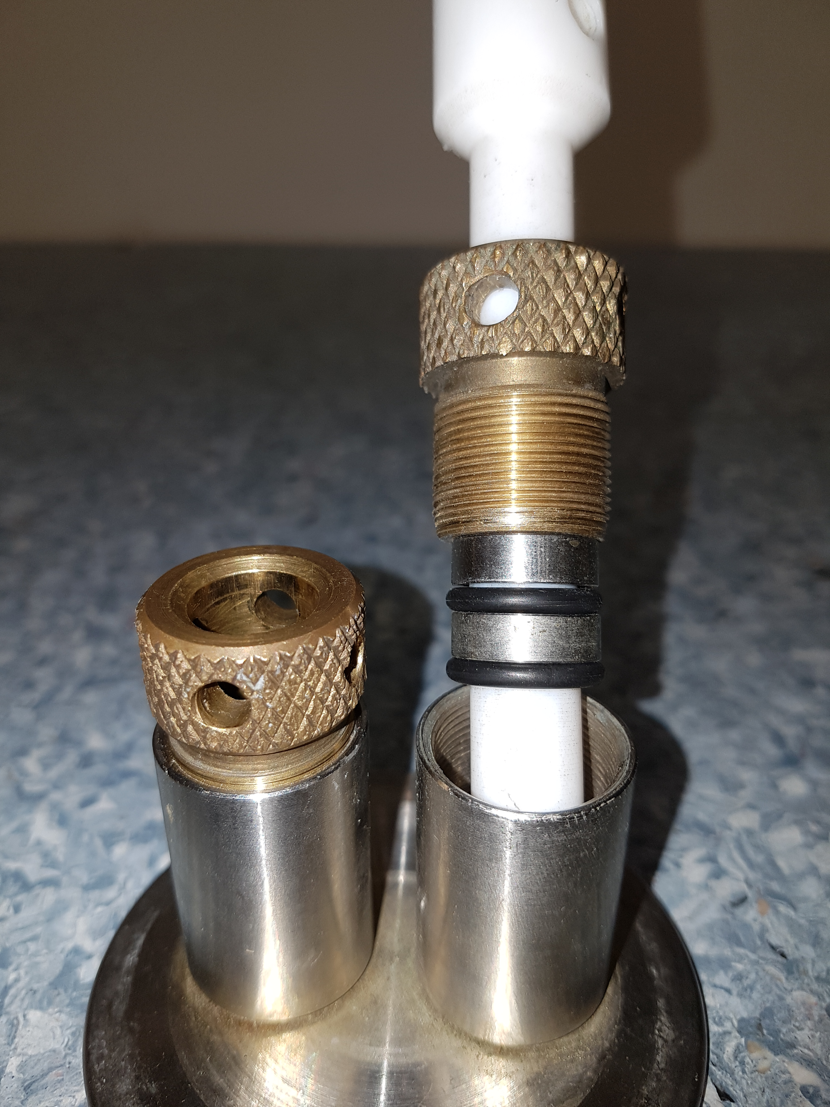
Tube feedthrough and pressed mechanical contact
Tube feedthrough
Preferred solution double O-ring ?
Stainless steel tube
Stainless steel flange matching the main flange
Welded joint
Adapted from:
Ekin, Experimental Techniques for Low Temperature Measurements

Slide 9
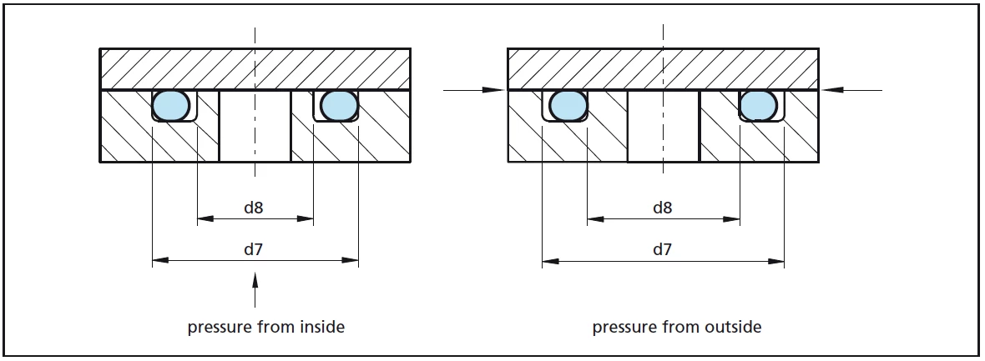
O-ring groove, and positioning
https://www.rubbershop.ca/pages/o-ring-groove-design
Inner overpressure: chose the O-ring approx. 1 to 2% larger than the outer groove diameter d7.
External overpressure: chose the O-ring approx. 1 to 3% smaller than the inner groove diameter d8.
Dimensioning of the O-ring groove for 15-20 % compression and allow deformation in groove width of +30 % (e.g. 5 mm O-ring depth 4.2 mm, width 6.7 mm)

Slide 10
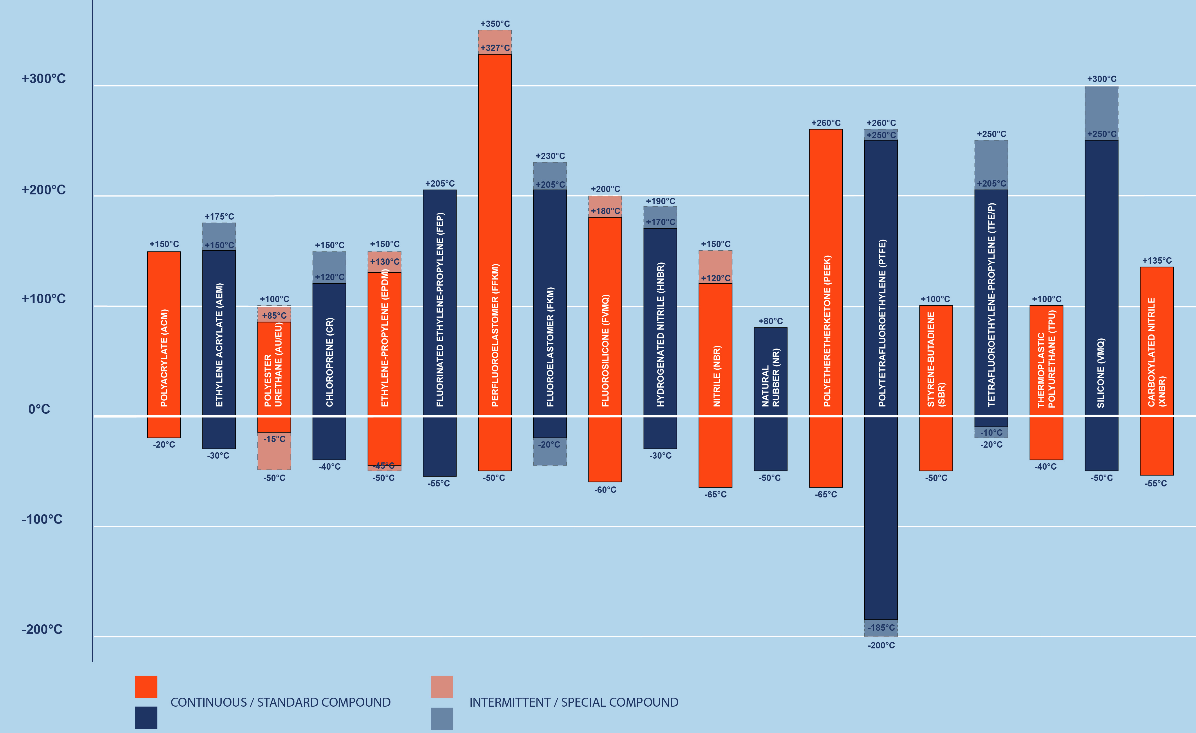
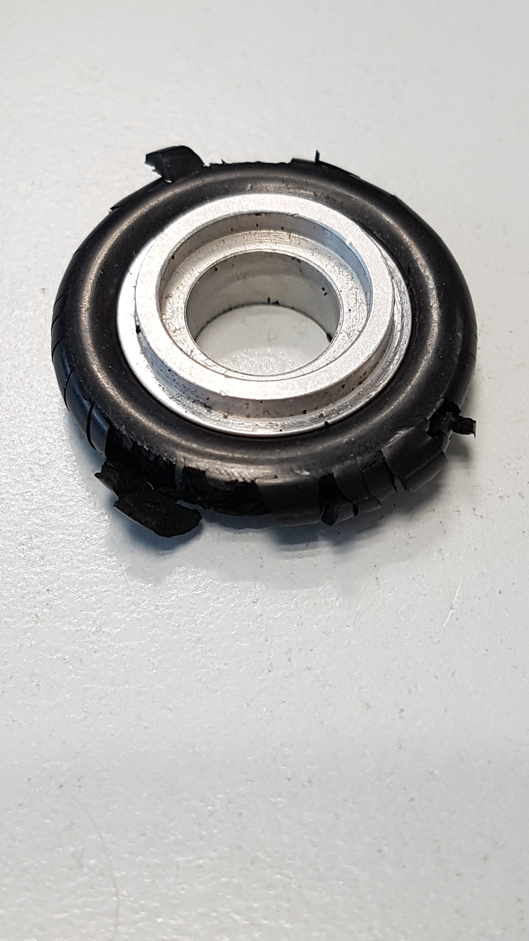
O-ring materials vs. temperature
PEEK
PTFE
EPDM
HNBR
NBR
Rubber
Silicone
From: https://www.barnwell.co.uk/what-is-an-o-ring/
Damaged KF 16 O-ring, reason? oil, chemicals…

Slide 11
Joining techniques

Slide 12
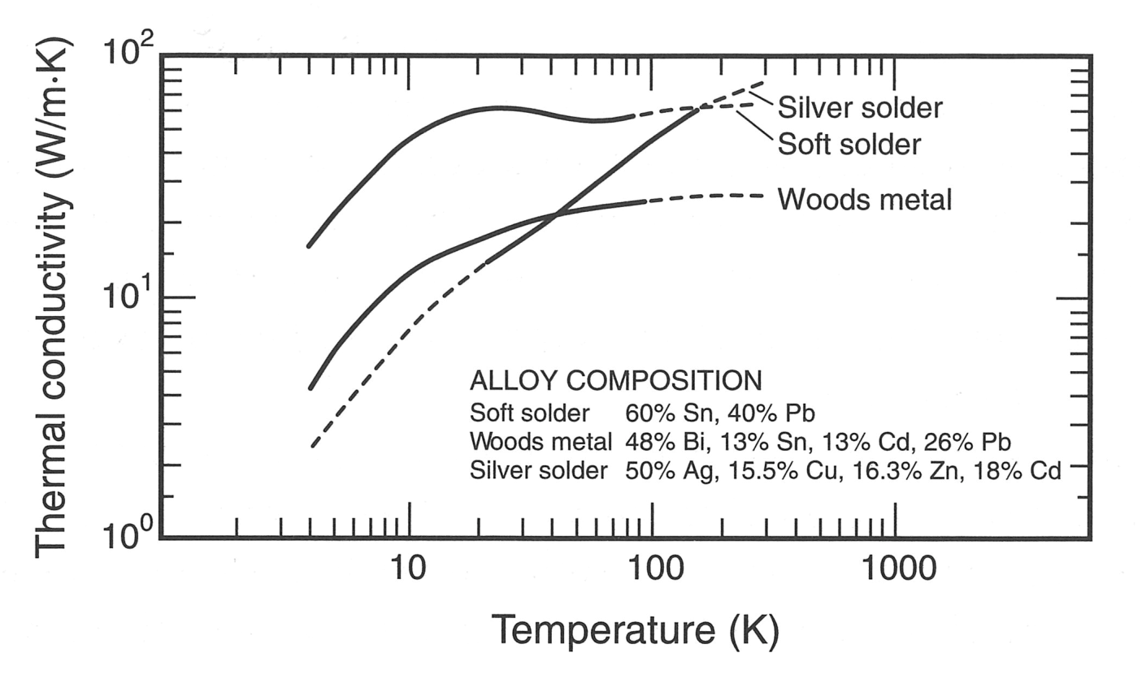
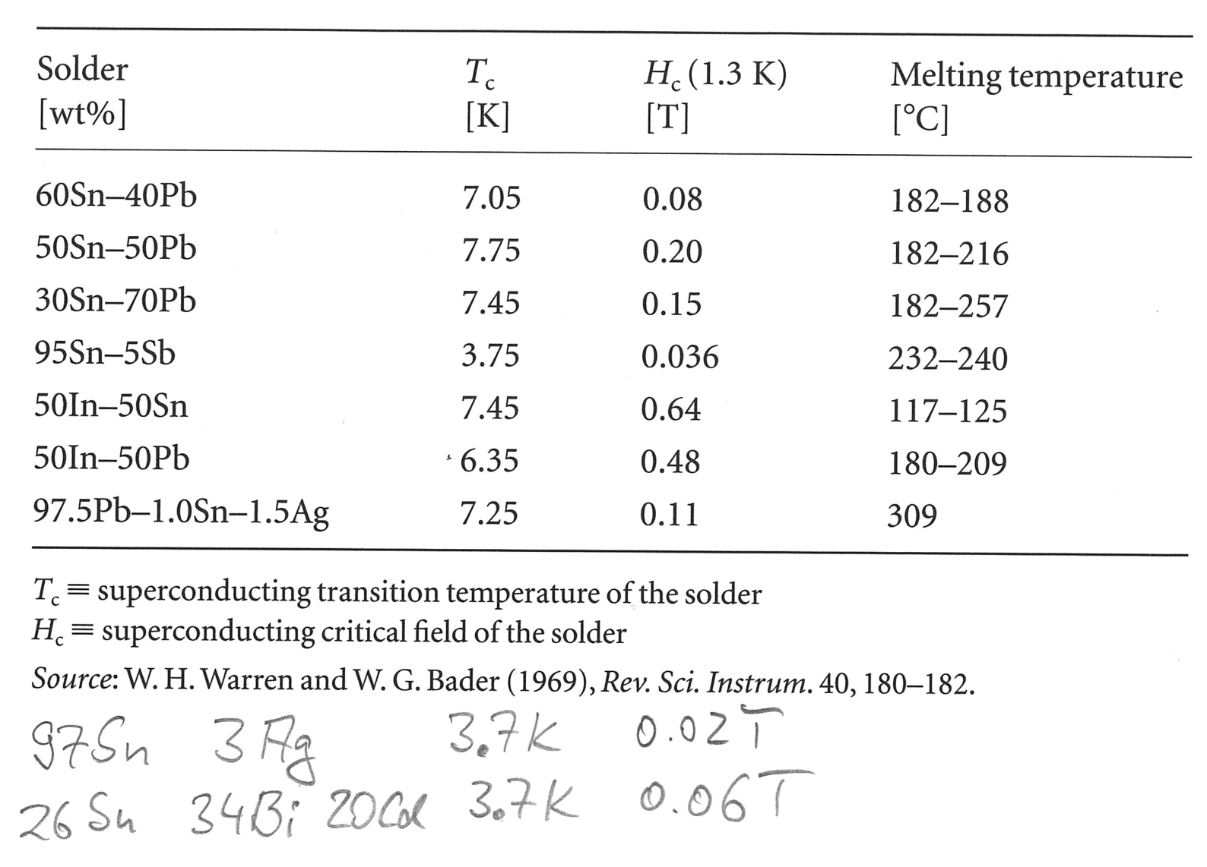
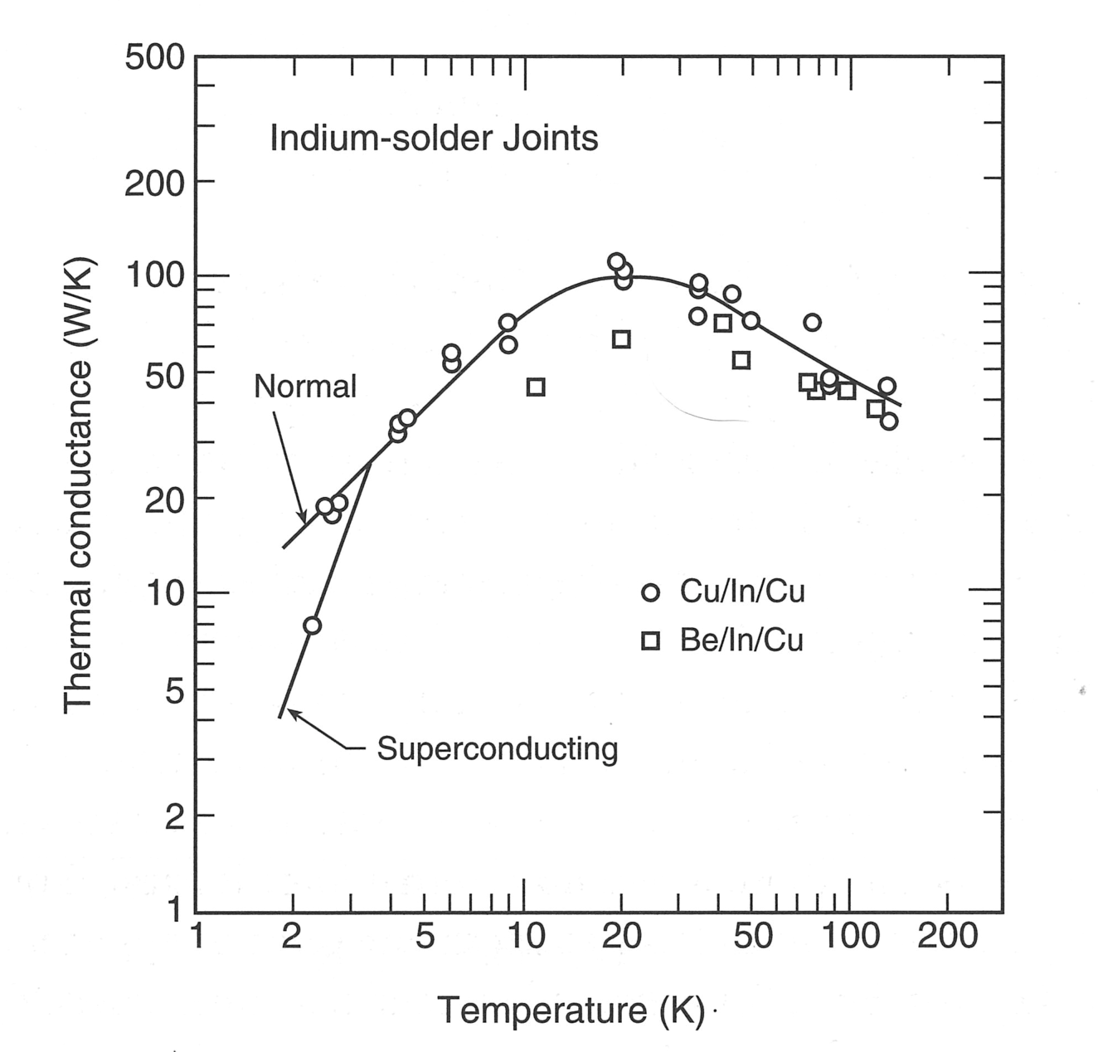
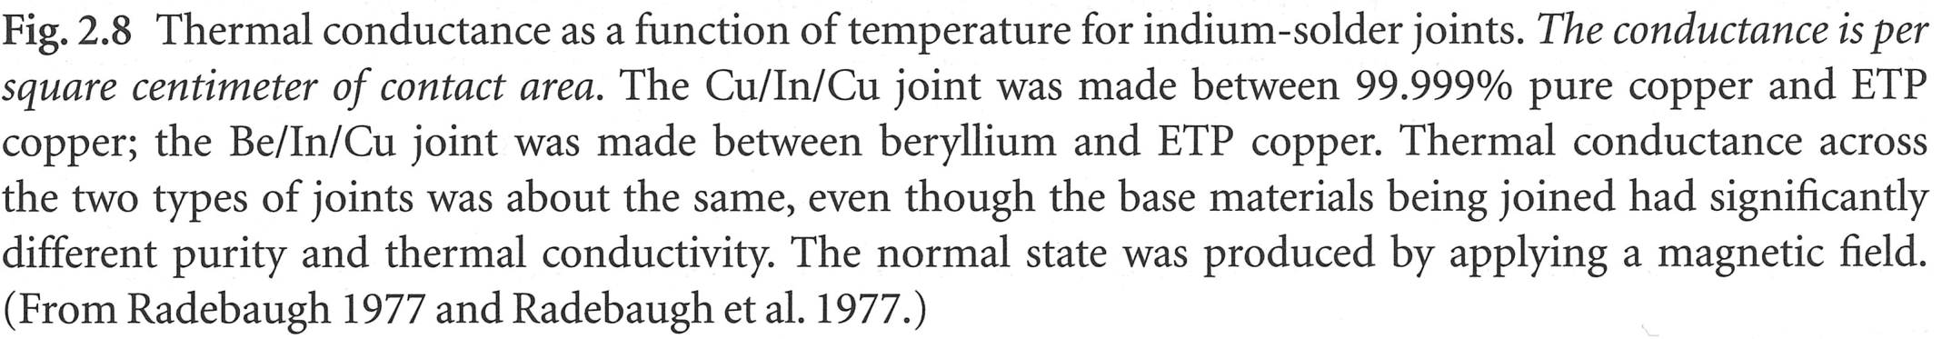
Material choice – solder joints
Soft solder is better in thermal contact below 100 K
Attention with SC transition =>
From: Ekin, Experimental Techniques for Low Temperature Measurements

Slide 13
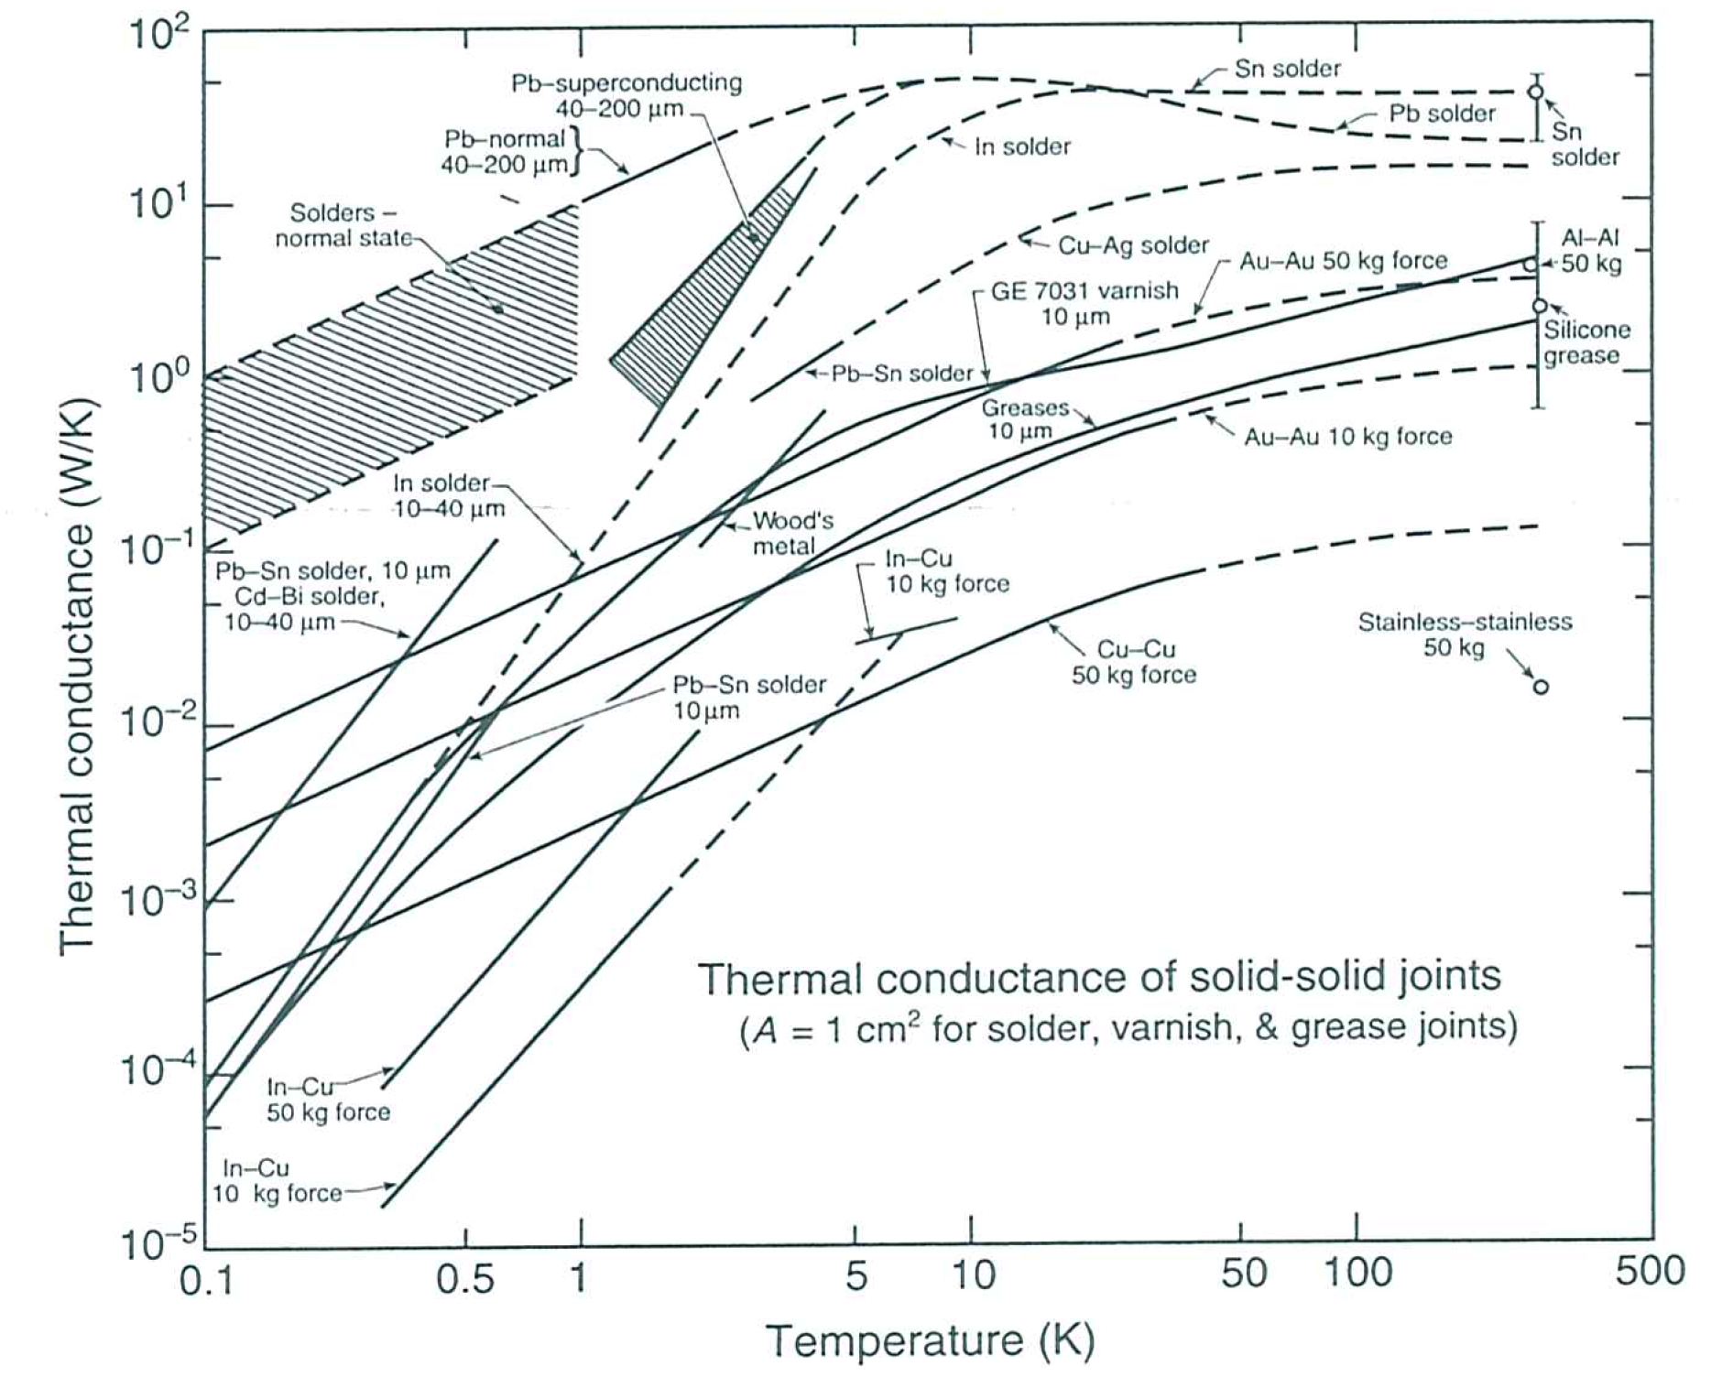
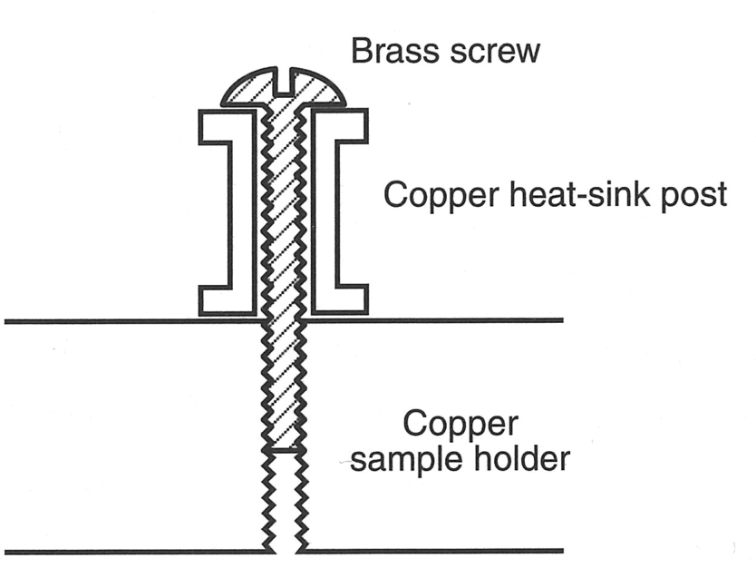
Material choice – joints and thermal contact
Thermal conductance vs. T
data of solder, varnish and grease is per 1 cm²
Pressed joints are area independent and only vary with force!
Attention to thermal dilatation for pressed contacts!
From: Ekin, Experimental Techniques for Low Temperature Measurements

Slide 14
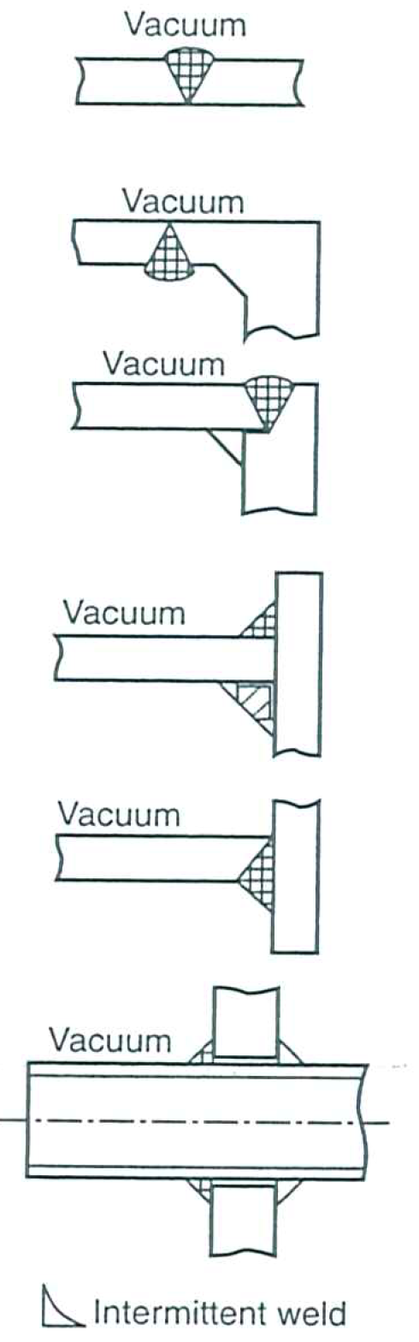
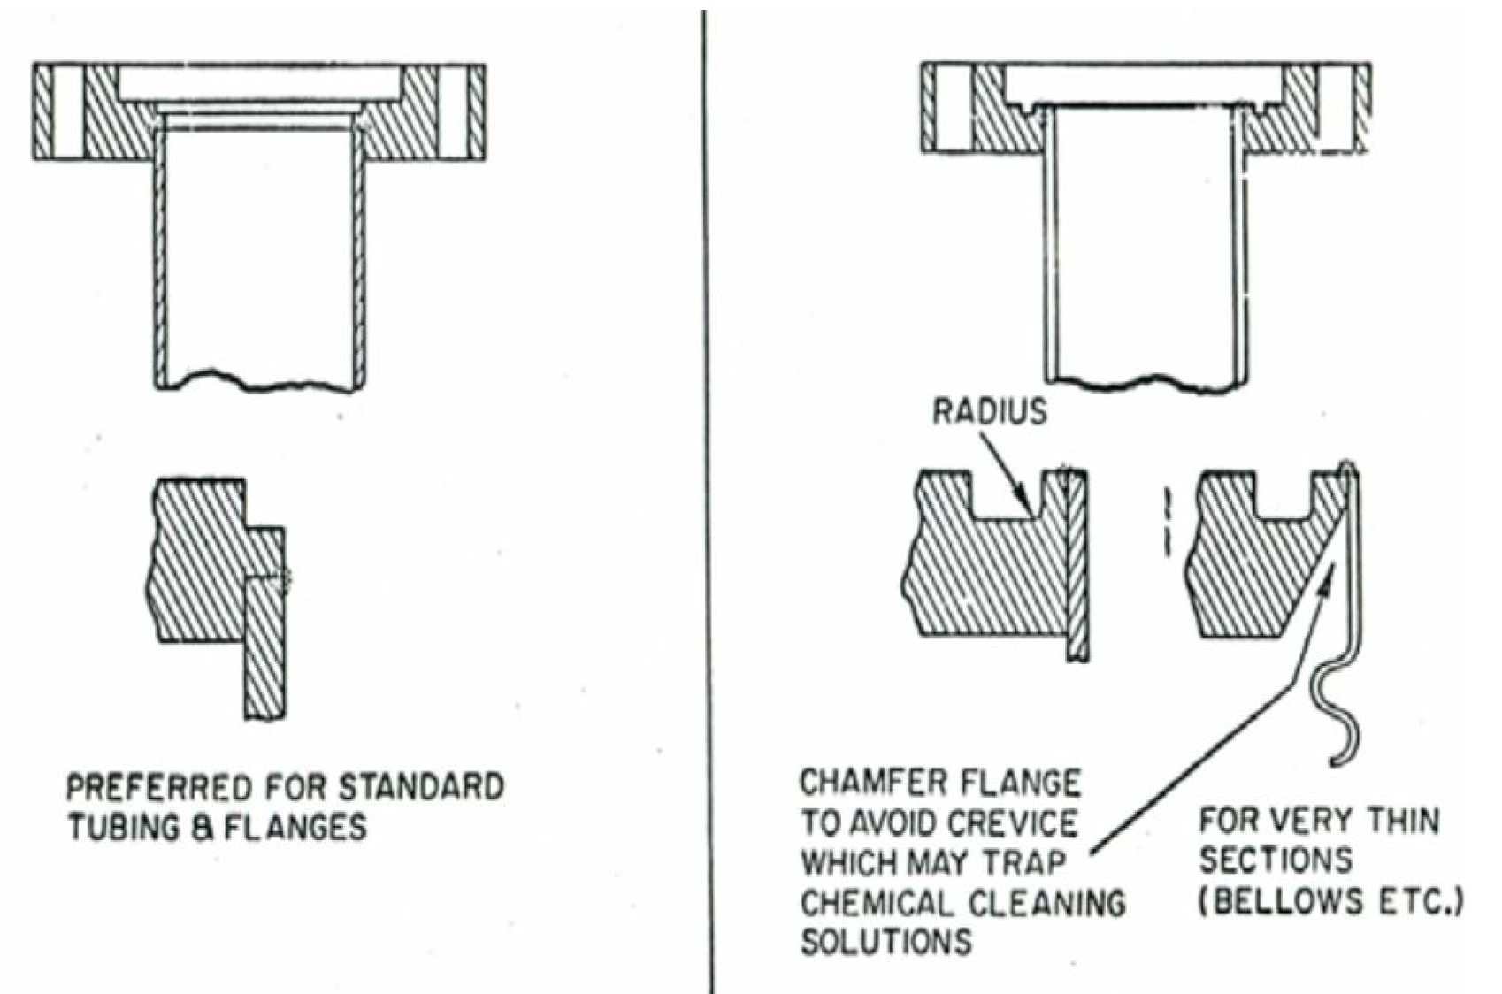

Welded connections – things to consider
Fin for similar thermal mass
From: Parma, Cryostat design, CAS 2013
From: Ekin, Experimental Techniques for Low Temperature Measurements

Slide 15
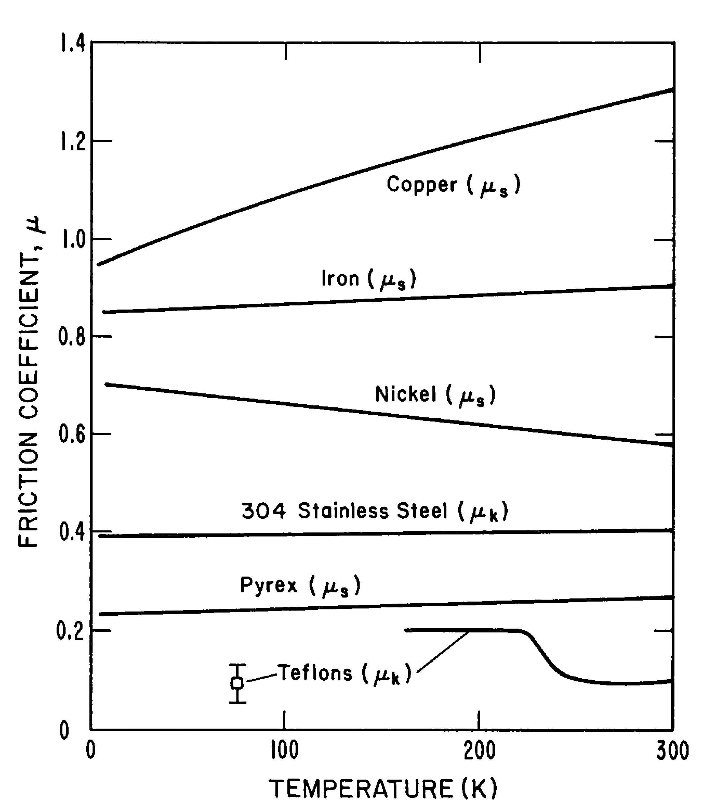
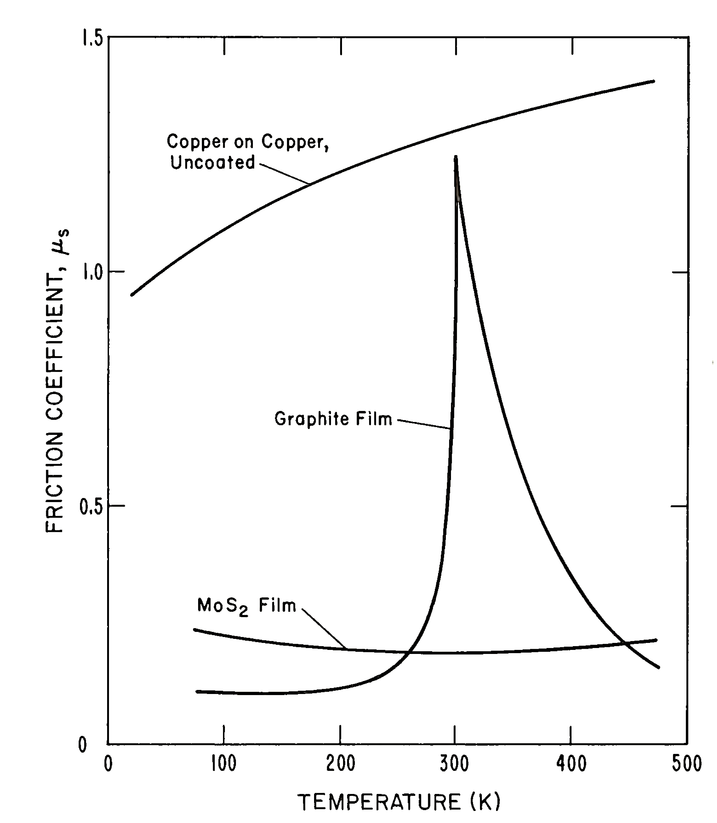
Moving vs. fixing things
From: Tobler, Materials for Cryogenic Wind Tunnel Testing
Temperature dependence of self-friction coefficients for selected materials
Effect of lubricating films on the friction of copper.
Stainless steel and copper => silver coating for UHV applications, screws, gaskets

Slide 16
Outgassing and leak rate

Slide 17
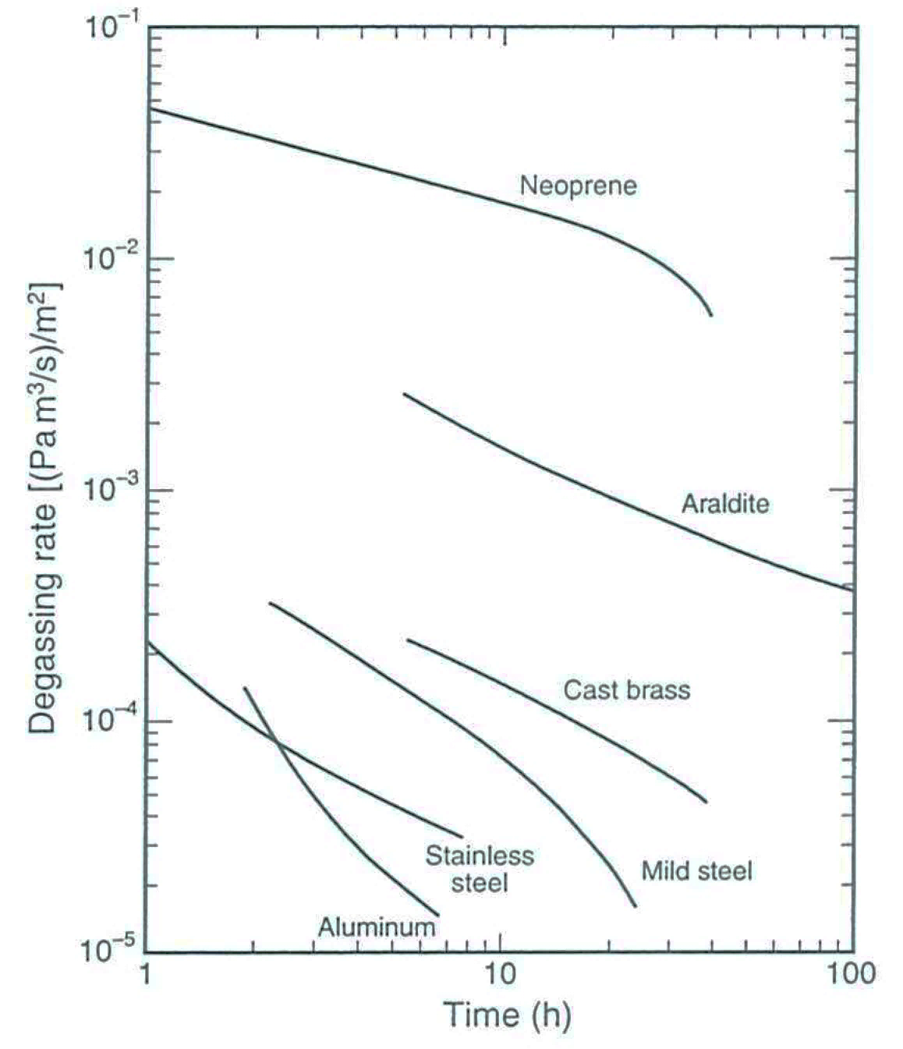
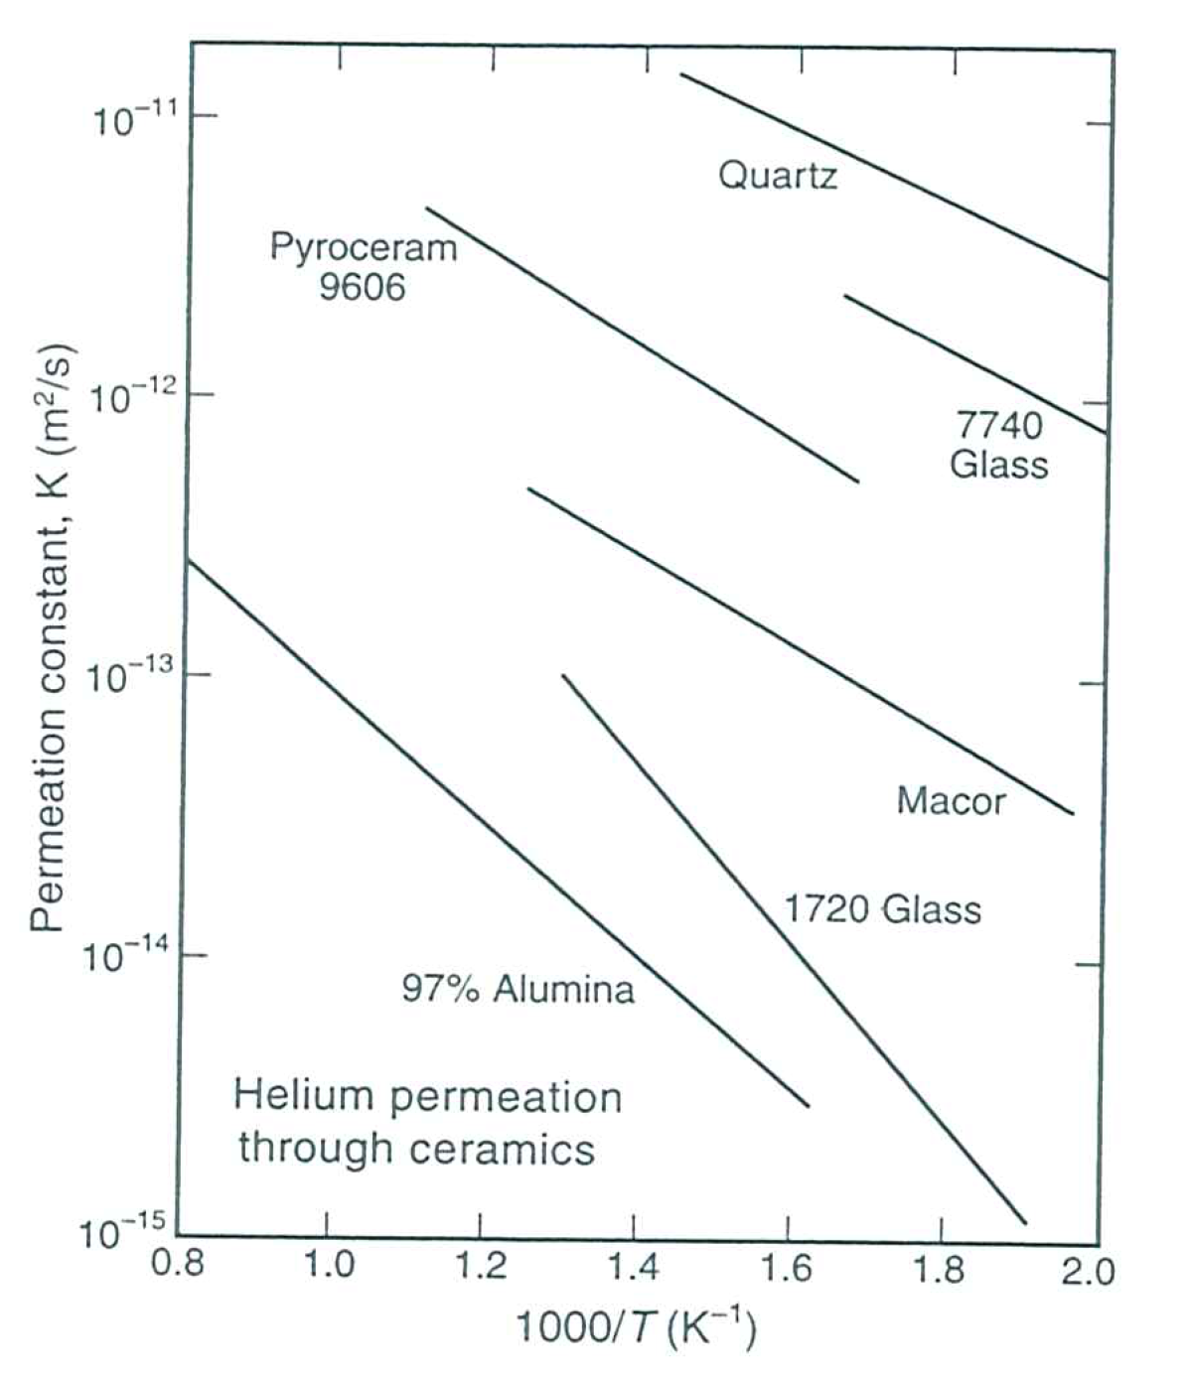
Vacuum degradation – leaks, outgassing, diffusion
From: Ekin, Experimental Techniques for Low Temperature Measurements

Slide 18
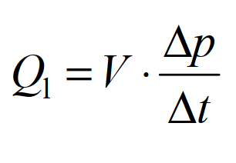
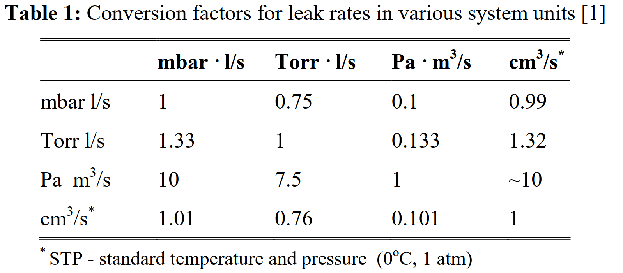
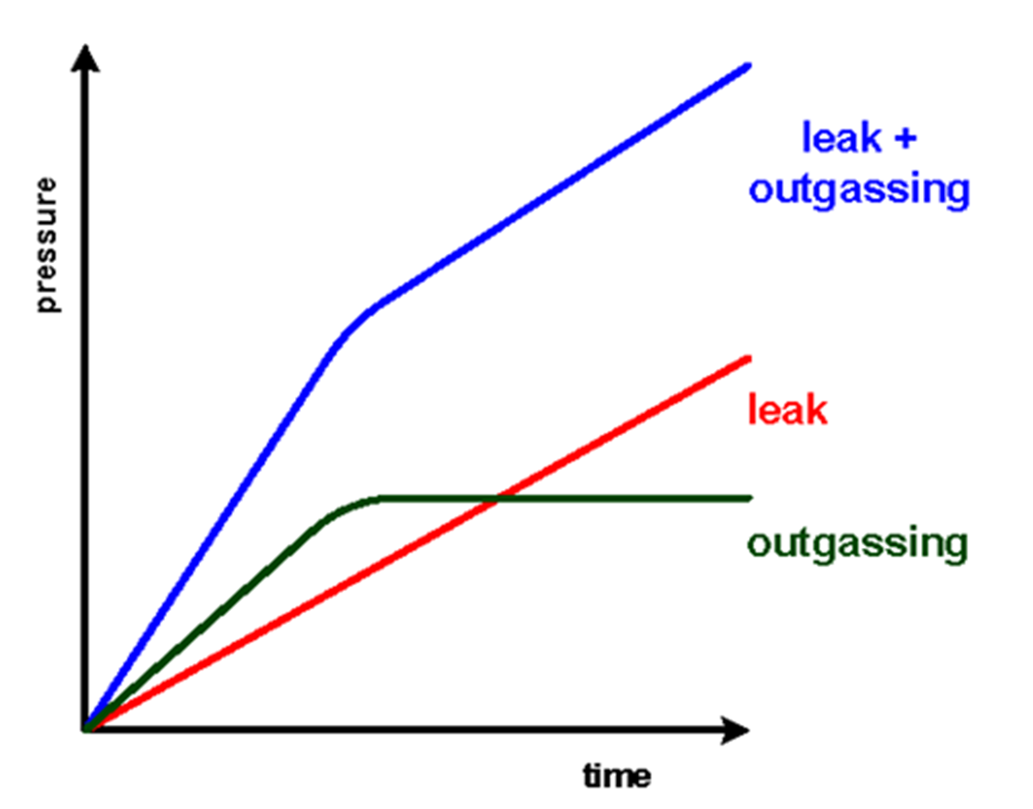

Vacuum degradation – leaks, outgassing, diffusion
V = 1L
From: Zapfe, Leak Detection, DESY
$$\frac{Δp}{Δt}=1\frac{mbar}{s}⇒Ql=1 mbar l/s$$

Slide 19
Vacuum degradation – leaks, outgassing, diffusion
Example from BCCCA vacuum vessel

Slide 20
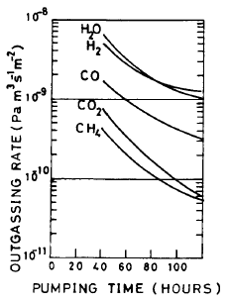
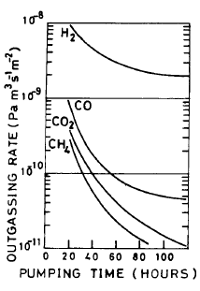
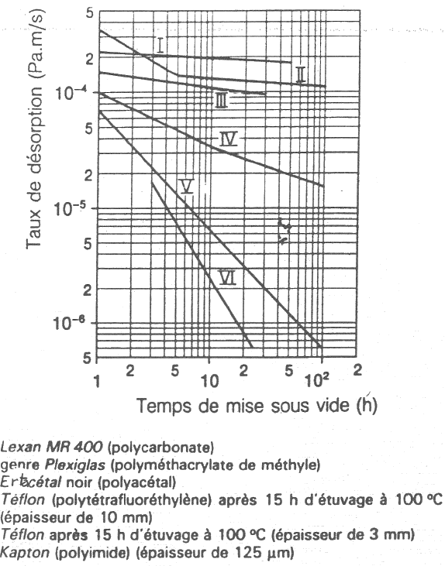
Vacuum degradation – outgassing
Metallic surfaces q ~ q₀/t
Plastic surfaces q ~ q₀/√t
x 5 000
Unbaked Al
Baked Al
A.G. Mathewson et al.
J.Vac.Sci. 7(1), Jan/Fev 1989, 77-82
A.G. Mathewson et al.
J.Vac.Sci. 7(1), Jan/Fev 1989, 77-82
Stainless steel after 10 h of pumping (Torr.ℓ/s/cm²)
 | H₂ | CH₄ | H₂O | CO | CO₂
Unbaked | 7x10⁻¹² | 5x10⁻¹³ | 3x10⁻¹⁰ | 5x10⁻¹² | 5x10⁻¹³
Baked | 5x10⁻¹³ | 5x10⁻¹⁵ | 1x10⁻¹⁴ | 1x10⁻¹⁴ | 1x10⁻¹⁴
V. Baglin, CAS basic course, vacuum systems, 2021

Slide 21
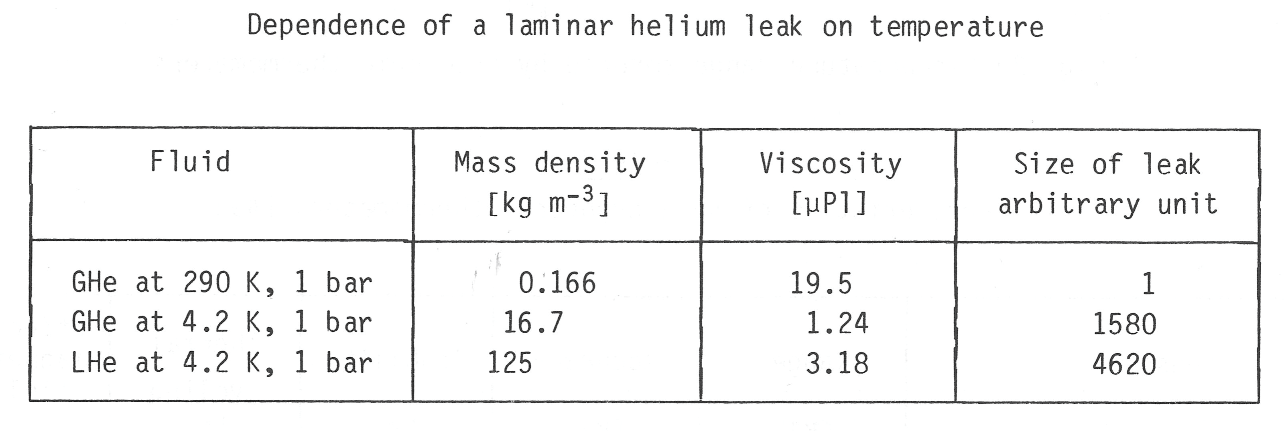
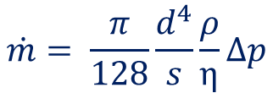

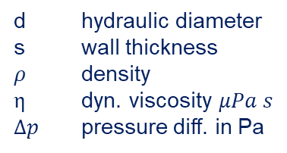
Vacuum degradation – leak rate
Poiseulle’s law describing the mass flow $\dot{m}$:
d hydraulic diameter
s wall thickness
$ρ$ density
$\text{η}$ dyn. viscosity $μPa s$
$Δp$ pressure diff. in Pa
$$\dot{m}= \frac{π}{128}\frac{d^{4}}{s}\frac{ρ}{\text{η}}Δp$$
He II => Superleak?
Lebrun, CAS course proceedings, 1989

Slide 22
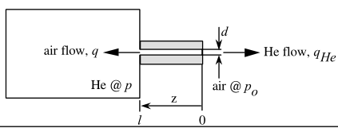
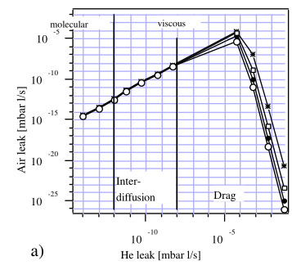
Vacuum degradation – back diffusion
Above 5×10⁻⁹ mbar l/s:
helium flux is dominated by drift,
out-streaming gas effectively hinders the back-streaming of impurities,
maximal air flux appearing for helium leaks of the order of 10⁻⁴ mbar l/s.
From: Dauvergne, Backstreaming of Impurity Gas through a Leak in a pressurized Vessel, LHC Project Report 229

Slide 23
Leak detection

Slide 24
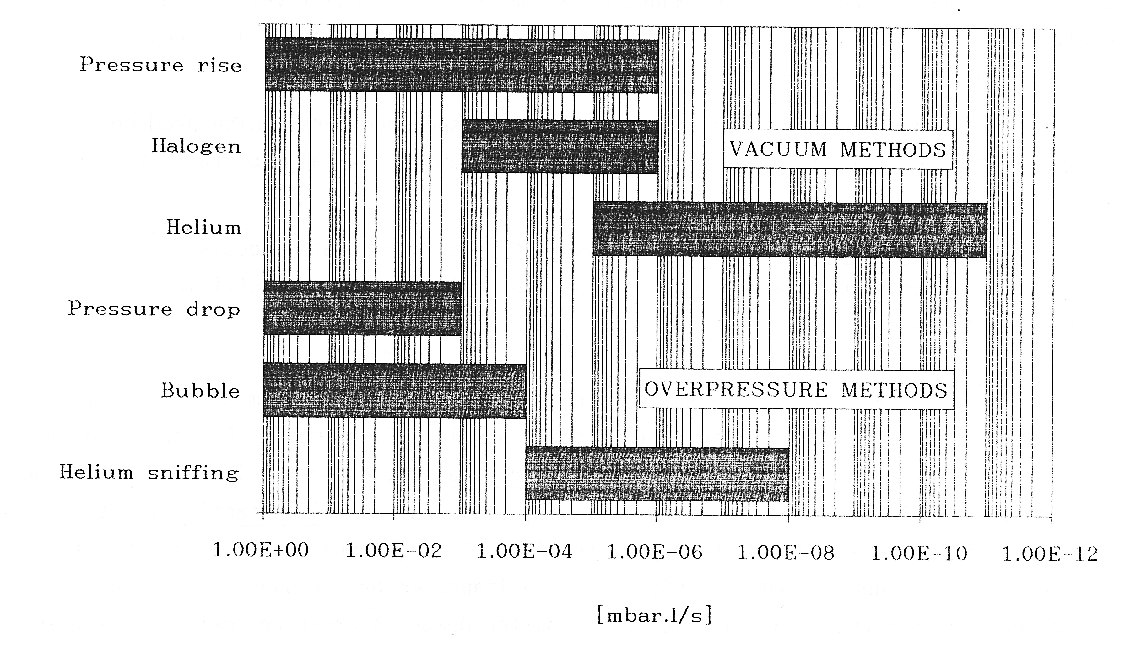
Leak rate detection option
Lebrun, CAS course proceedings, 1989

Slide 25
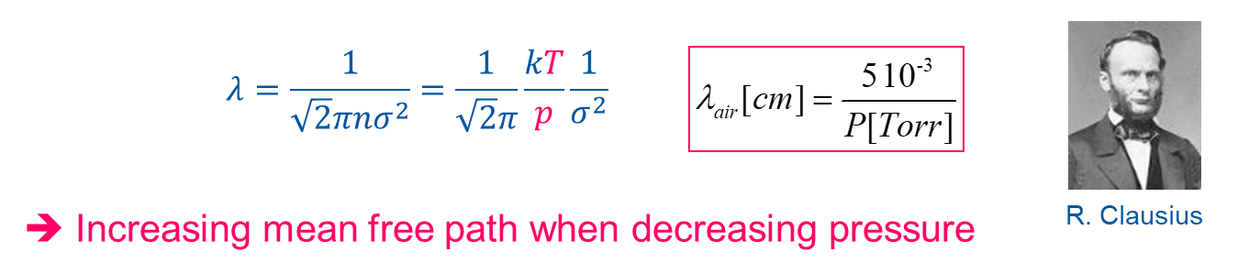
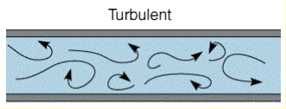
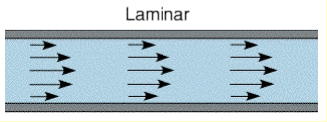
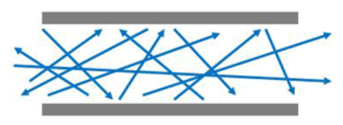
Mean free path of molecules
p~10⁻³ mbar
λ~10 cm
The turbulent flow is established around the atmospheric pressure
In the low vacuum (10³ - 1 mbar), the flow is viscous and laminar.
In the high vacuum (10⁻³ - 10⁻⁷ mbar) and ultra-high vacuum (10⁻⁷-10⁻¹² mbar), the flow is molecular. The mean free path is much larger than the vacuum chamber size. Molecules interact only with the vacuum chamber walls.
Molecular
V. Baglin, CAS basic course, vacuum systems, 2021

Slide 26
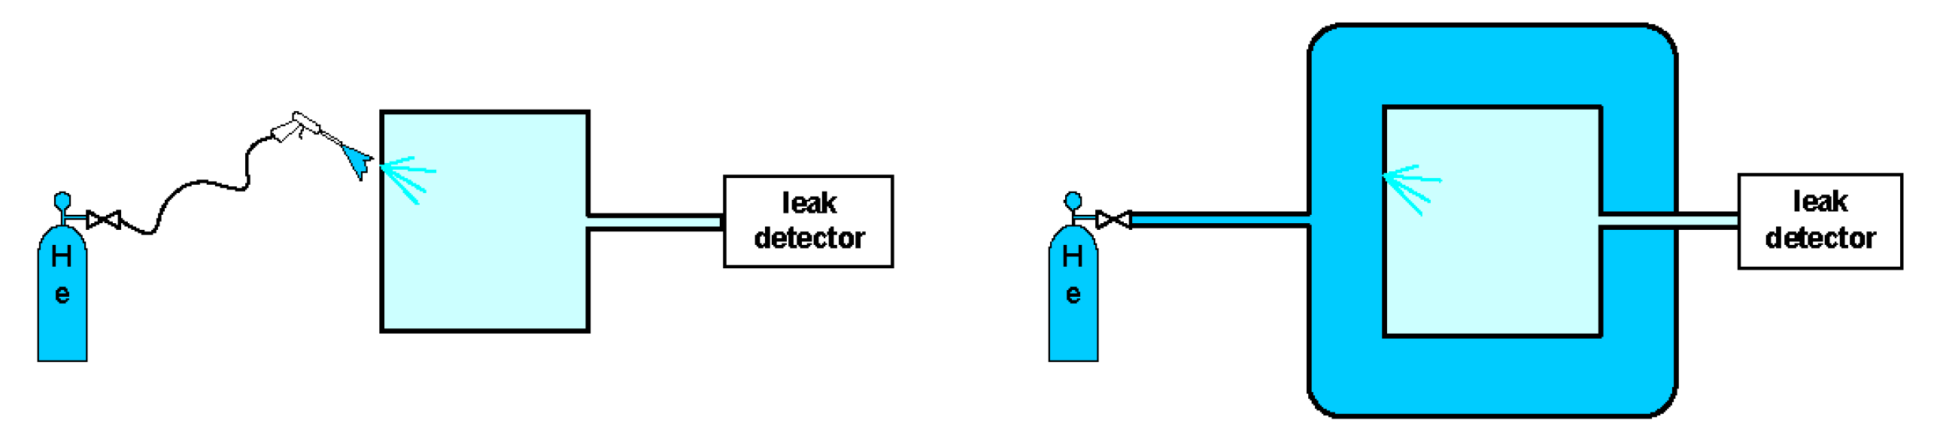
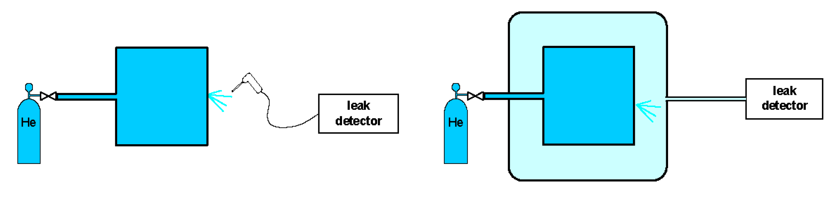
Vacuum degradation – leaks, outgassing, diffusion
Sensitivity
From: Zapfe, Leak Detection, DESY
Localized test
Integral test

Slide 27
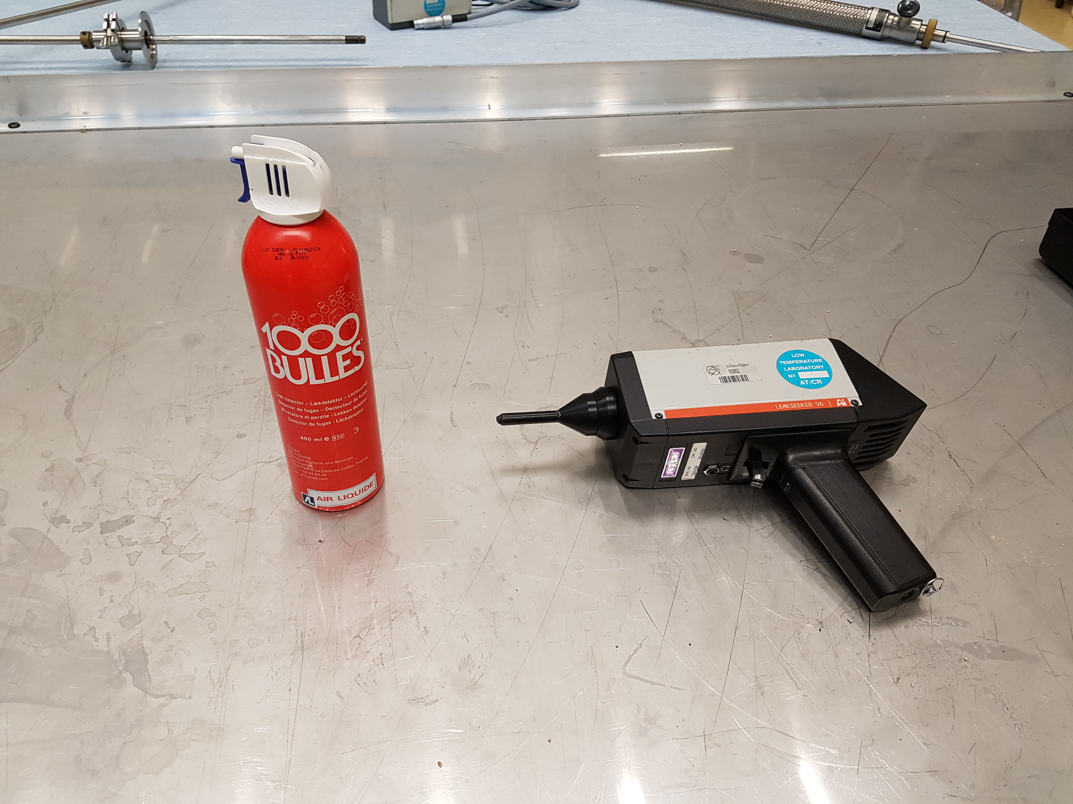
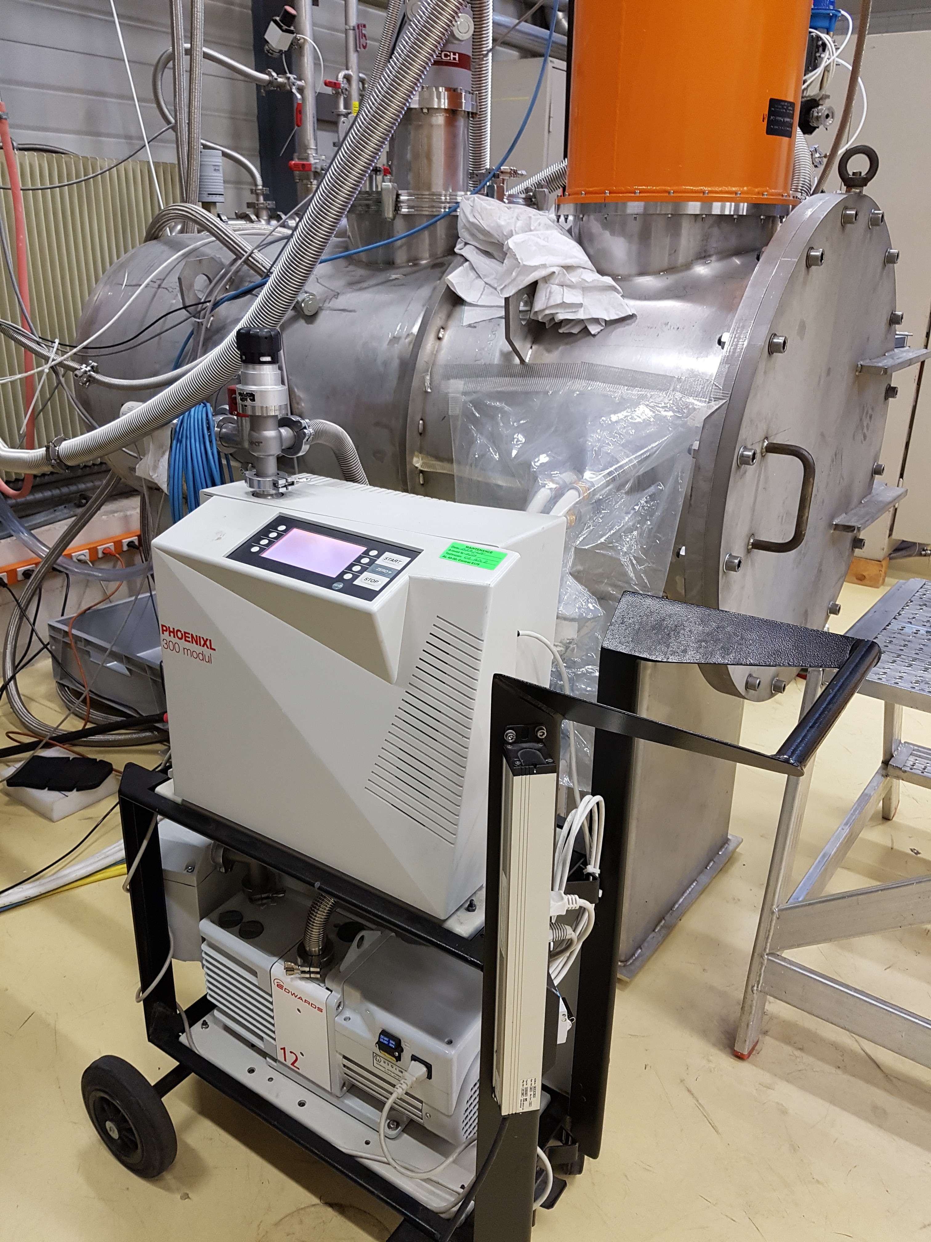
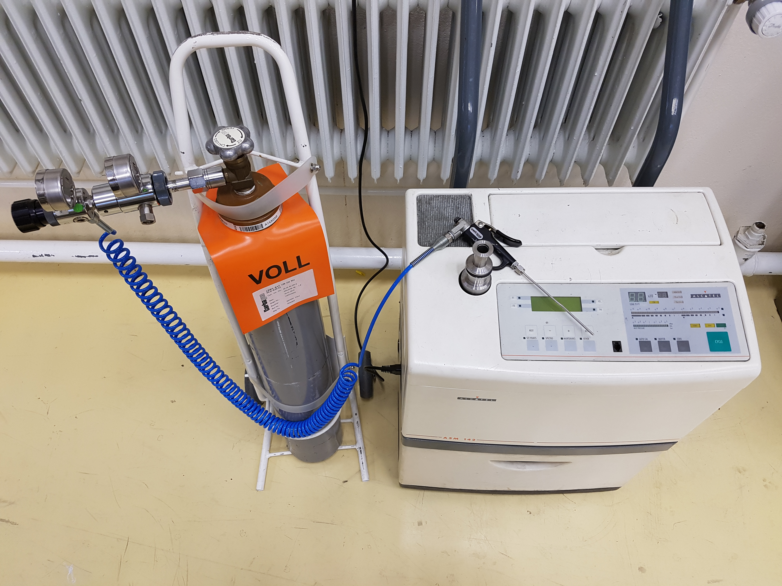

Leak detector steps/models
Le pistolet:
measures He, CO₂
Leak detector with its roughing pump connected to the cryostat pumping system, integral test.
Soap spray for large leaks, system in overpressure to atmosphere
He gas bottle with PRV to 50 mbarg and He sprayer, $\dot{V}$< 2 bubbles per sec!

Slide 28
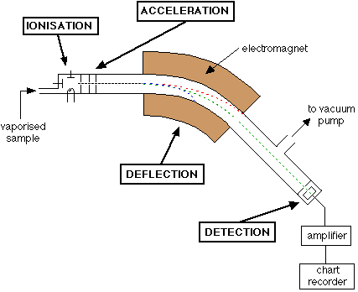






Mass spectrometer principle
Step 2: Acceleration to same speed
$m\vec{a}=\vec{F}=q\vec{E}$
e/m selection
gas stream
Step 3: Deflection in perpendicular magnetic field, Lorentz force
$$m\vec{a}=\vec{F}=q \left(\vec{v}×\vec{B}\right)$$
Step 1: Ionization to +1 by e- stream
Step 4: Detection, neutralization by e- current
⁴He => ⁴He⁺
m/q=4
gas stream
Adapted from: https://chem.libretexts.org/Bookshelves/Analytical_Chemistry/Supplemental_Modules_(Analytical_Chemistry)/ instrumental analysis/mass spectrometry/

Slide 29


Vacuum degradation – leaks, outgassing, diffusion
Sniffing mode => He inside the process vessel:
Keep the direction of He in air in mind
=> Start sniffing from the bottom!
Detection time is ~ 3-5 sec.
Separate parts from each other (plastic bag etc.)
Alcohol can temporarily close small leaks
Mustique can help as well
Careful with O-rings etc. 10⁻⁷ mbar l/s
From: G. Gisteau, INTRODUCTION TO HELIUM REFRIGERATION FOR SUPERCONDUCTING DEVICES

Slide 30

Vacuum degradation – leaks, outgassing, diffusion
Vacuum mode test procedure:
Pump vacuum system for one night
Connect and start leak detector, pump connection line!
Close V1 valve towards the roughing pump
Open slowly V2 valve to leak detector
Spray small amount of He from gas bottle p~50 mbar
Start from the top! (He gas rises)
Wait and check signal for 30 sec.
Repeat spray of He gas and check
Repair big leaks and start fresh! Small leaks can be temporarily closed by alcohol (Mustique, chewing gum)
Small leaks <10⁻⁸ mbar l/s need to be confirmed 3 times in a row to be valued => DR rule! esp. for ³He circuit
Progress to next location in downward direction
From: Zapfe, Leak Detection, DESY
V2
V1

Slide 31
Vacuum degradation – leaks, outgassing, diffusion
Test procedure remarks:
Rubber O-ring seals and epoxy feedthroughs giving a signal of 10⁻⁷ to 10⁻⁸ mbar l/s after some time of He exposure
Close first V2 valve before stopping leak detection mode (possible venting of air)!
Open V1 valve to roughing pump
From: Zapfe, Leak Detection, DESY
V2
V1
Good practice, values of leak tightness for:
insul. vacuum => 10⁻⁷ mbar l/s
4.2 K He => 10⁻⁸ mbar l/s
He II cooling => 10⁻⁹ mbar l/s
³He systems => 10⁻¹⁰ mbar l/s

Slide 32



High density feedthroughs for future detector calorimeters of LAr
Experimental setup with samples and list of tests:
DAQ
LN₂
GHe
LN₂
Pumping system and leak detector
Cryostat flange
High density feedthrough flange:
G10 supports
Tests:
-Pressure and leak test at
room temperature
-Pressure and leak test at
low temperature
Cryostat
LN₂ circulation
Strip cable
(32 signals)
Cylinder
Thermal shield
3D-printed epoxy or fiberglass structure
Sample

Slide 33

Electrical breakdown fct. (p, distance and T)
Room temperature
d
p_{gas}
- +
Source Wikipedia

Slide 34


Electrical breakdown fct.(p, distance and T)
d
Transitions to liquid density
p_{gas}
- +
Source Wikipedia

Slide 35

Magnet helium conditions during Quench and HV testing
Further reading: E. Sili, Temperature Dependence of Electrical Breakdown Mechanism on the Left of the Paschen Minimum

Slide 36
Summary
How to join different parts
Metal and polymer dismountable joints
Outgassing of materials
Leak detection methods
Example for FCC calorimeter cryostat
Electrical breakdown

