Slide 1

Magnet installation and
Interconnections Plan
LMF, 12/02/2025

Slide 2
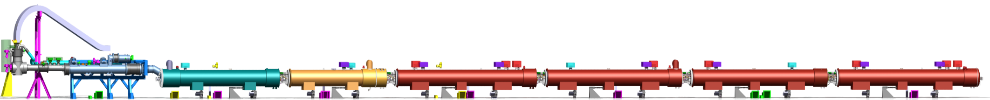



IT String : interconnection naming
Cell4
Cell3
Cell2
Cell1
DFX
DFXI
DCM
LDQD
D1
LBXFC
CP
LCXFC
Q3
LQXFF
Q2b
LQXFJ
Q2a
LQXFG
Q1
LQXFE
QDDIX.4SF
QDBIX.4SF
QBCIF.3SF
QCQIF.3SF
QQQIF.B2SF
QQQIF.A2SF
QQQIF.1SF
QQSJF.4SF
QQSJF.3SF
QQSJF.2SF
7 interconnections
3 Jumpers
e-MIP structure in progress (~ WISH during LS1 / LS2)

Slide 3
Present configuration
DFX
DFXI
DCM
LDQD
D1
LBXFC
CP
LCXFC
Q3
LQXFF
Q2b
LQXFJ
Q2a
LQXFG
Q1
LQXFE
Installation planned end of february
Installation planned ~ 2 months
Jumper interfaces to be fixed by TE/CRG (feb)
Installation of Q3 : 28/02/25.

Slide 4
Before starting
DFX
DFXI
DCM
LDQD
D1
LBXFC
CP
LCXFC
Q3
LQXFF
Q2b
LQXFJ
Q2a
LQXFG
Q1
LQXFE
After magnet installation
  Check jumper connection TE/CRG & TE/MSC
  Remove transport equipment (if still any)
  Installation of the anchors
    Anchors to ground ( with concrete !) : EN/ACE
    Anchors to cryo-magnets : TE/MSC
  ElQa test of the magnet
  Magnet alignment
General inspection before starting
  Phase 3 complete TE/MSC
    Check that electrical test was done before
    Cable identification done
    Line N leaders
    Sleeves (Line M2N, L)
    W bellow + O rings properly protected (and with spares)
    18kA cable in Q2a
    Endoscopy + lyra inspection
    Jumper gimbal in place
    Endoscopie ligne N1-N2 des cryo-aimants
Fake PIM in CP-Q3 and Q2b-Q2a
First week of March
Formation securite ?

Slide 5
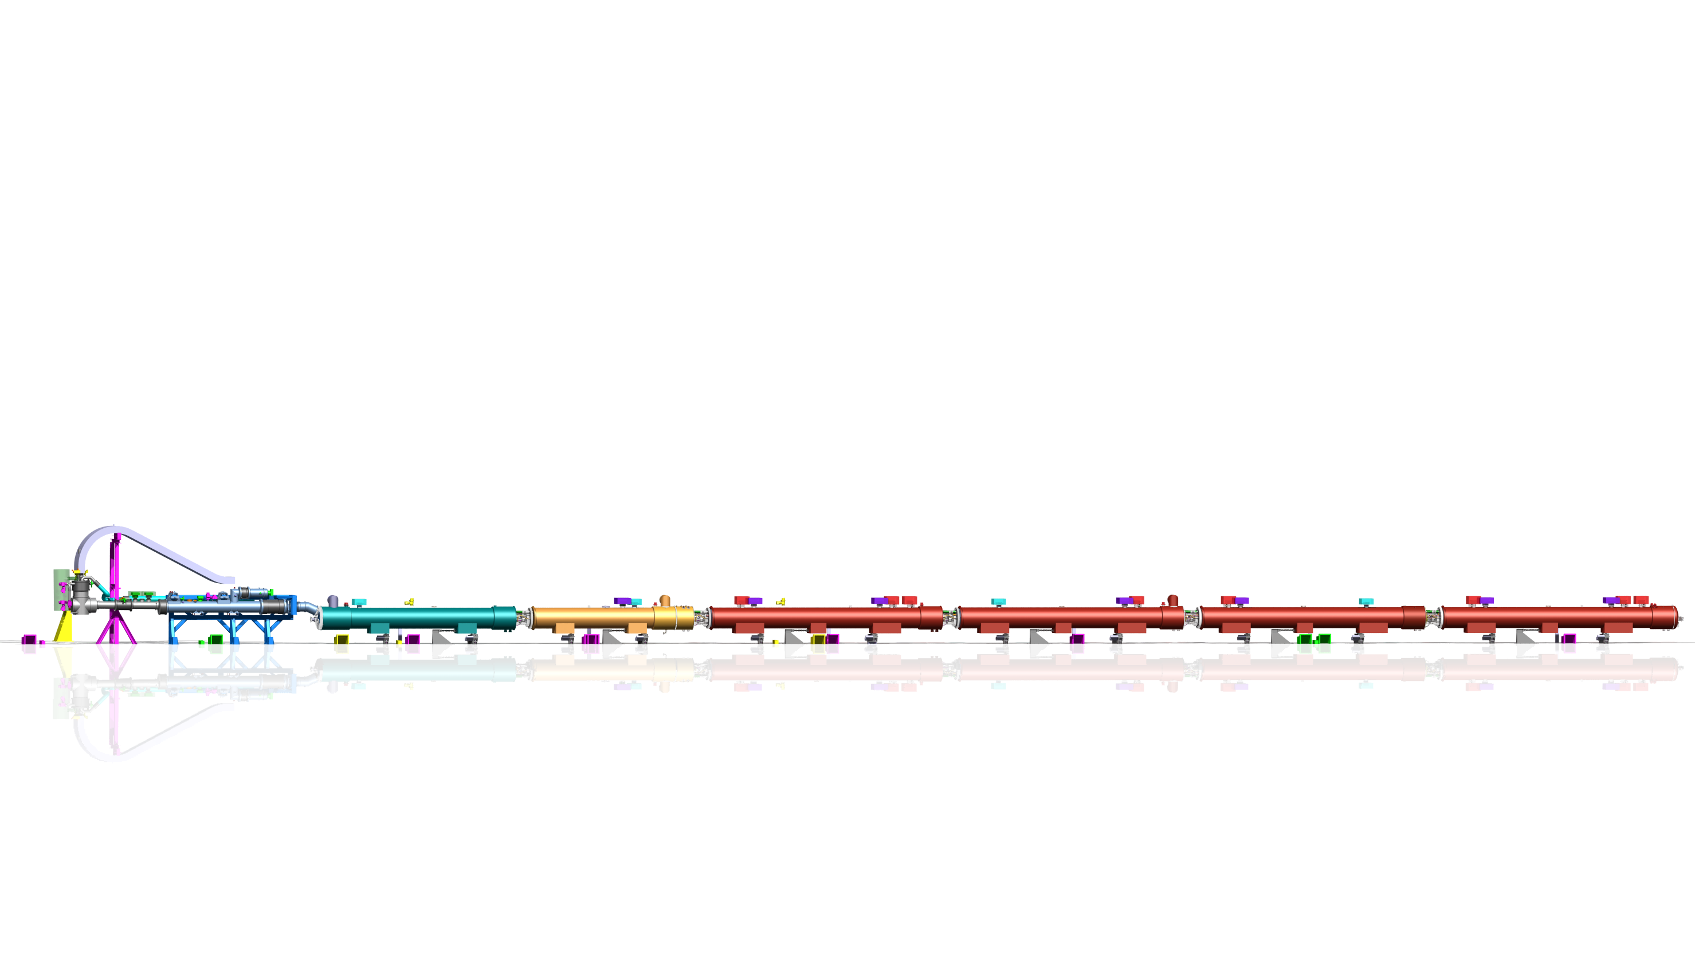
N lines insertion
DFX
DCM
D1
CP
Q3
Q2b
Q2a
Q1
Insertion of N2 line (pulled from Q1) → ElQa test
Insertion of N1 line (pulled from Q2a if possible) → ElQa test
Installation of D1 swan neck vacuum vessel
Installation of DCM Frame
Installation of D1 module
Welding of D1 module
→ ElQa test of N1 and N2 ( no magnet connection)
In parallel : stabilisation of lines N in D1-Q2a
QC : end of cables

Slide 6
First blank assembly & splice soldering
DFX
DFXI
DCM
LDQD
D1
LBXFC
CP
LCXFC
Q3
LQXFF
Q2b
LQXFJ
Q2a
LQXFG
Q1
LQXFE
Installation of the DCM
Alignment of the DCM
Splices blank assembly from CP to Q2a
  QC of blank assembly
→ ElQa test from QDBIX on QCQIF, QQQIF.B, QQQIF.A
Splices soldering 18kA
  QC : visual inspection
  QC : splice resistance
Splices soldering 2kA
  QC : visual inspection
  QC : splice resistance
Splices insulation 18kA and 2kA
  QC
→ ElQa test from QDBIX on QCQIF, QQQIF.B, QQQIF.A

Slide 7
First blank assembly & splice soldering
DFX
DFXI
DCM
LDQD
D1
LBXFC
CP
LCXFC
Q3
LQXFF
Q2b
LQXFJ
Q2a
LQXFG
Q1
LQXFE
Installation of insulation box
  QC
→ ElQa test
Eccobon injection (?)
  QC
→ ElQa test

Slide 8
Second blank assembly & splice soldering
DFX
DFXI
DCM
LDQD
D1
LBXFC
CP
LCXFC
Q3
LQXFF
Q2b
LQXFJ
Q2a
LQXFG
Q1
LQXFE
Splices blank assembly of QDDIX and QDBIX
  QC of blank assembly
→ ElQa test from DFHX
Splices soldering +Vtaps
  QC visual inspection
  QC splice resistance
  Vtaps connection
  → ElQa continuity
Splices insulation
→ ElQa test from DFHX + Vtaps checks
…..
Sleeves welding
  Visual inspection EN/MME
Jumpers welding
  Visual inspection EN/MME

Slide 9
Third blank assembly & splice soldering
DFX
DFXI
DCM
LDQD
D1
LBXFC
CP
LCXFC
Q3
LQXFF
Q2b
LQXFJ
Q2a
LQXFG
Q1
LQXFE
WIB (WP6a)
Sleeves +E lines welding
Visual inspection EN/MME
Splices blank assembly of Q1
  QC of blank assembly
→ ElQa test from DFHX
Splices soldering 18kA
  QC : visual inspection
  QC : splice resistance
Splices soldering 2kA
  QC : visual inspection
  QC : splice resistance
Splices insulation 18kA and 2kA
  QC
→ ElQa test from DFHX
Sleeves welding
  Visual inspection EN/MME

Slide 10
Leak test
DFX
DFXI
DCM
LDQD
D1
LBXFC
CP
LCXFC
Q3
LQXFF
Q2b
LQXFJ
Q2a
LQXFG
Q1
LQXFE
Ready for leak test : first estimation beg of May (if start 2nd week of March)
If all OK : inspection before W closing
MLI + thermal shields
W closure
Ready for global test and pressure test

Slide 11
