Slide 1
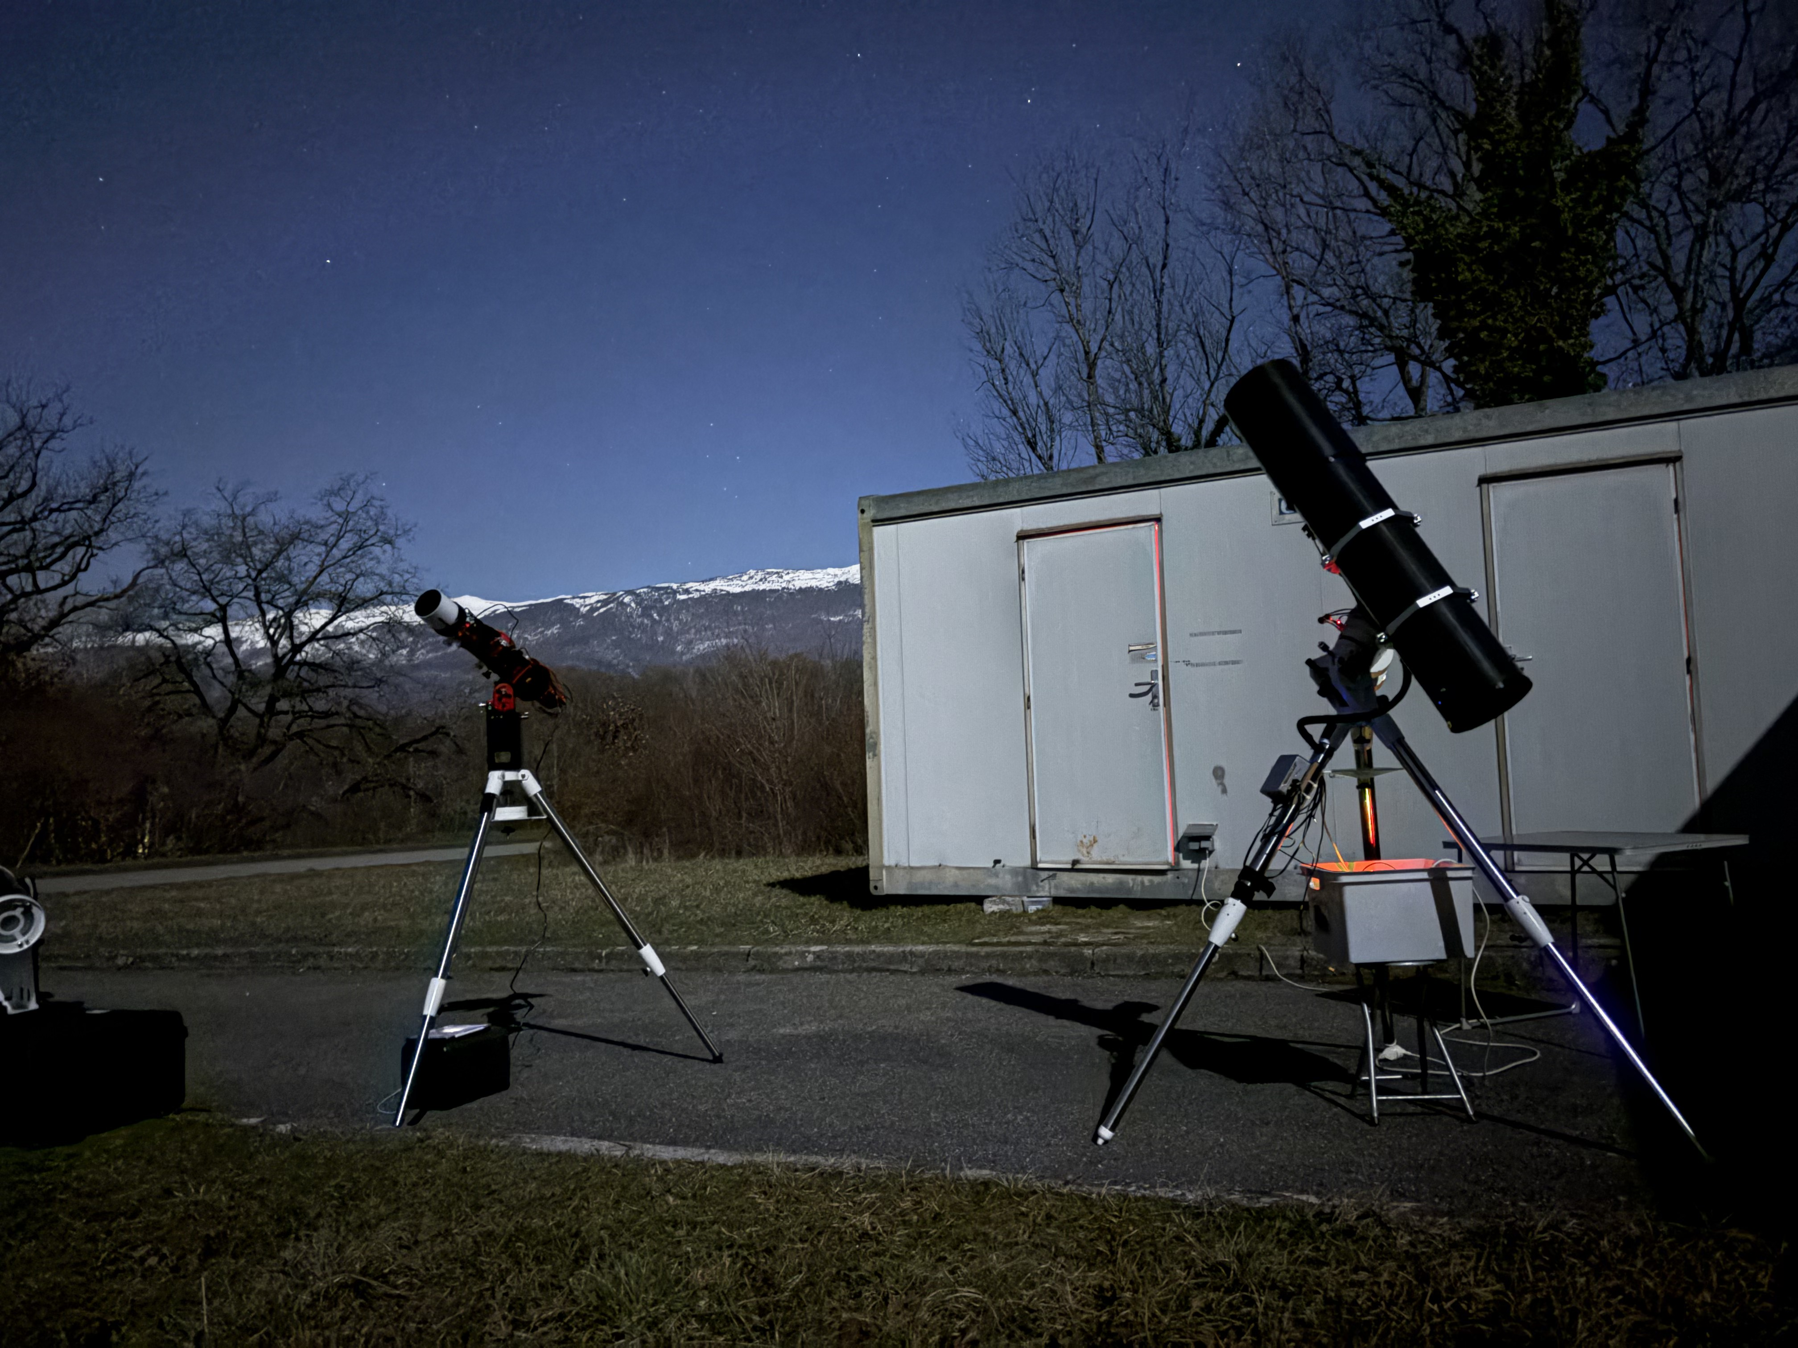
Annual meeting of the
CERN Astronomy Club.
Jan Buytaert.
25 february 2025

Slide 2
Agenda
Overview of club activities in 2024. (Jan)
Presentation of the club account (Francoise)
Election of the members of the committee.
Outlook for 2025 & proposals, discussion.
Drink / dinner in Restaurant 1

Slide 3
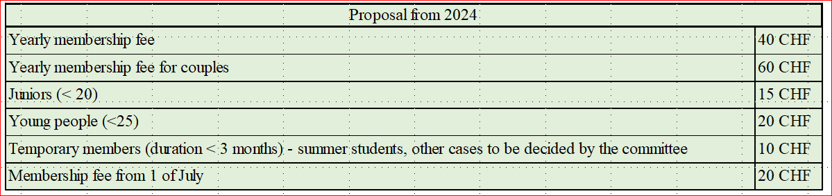
Members
Increased to 33 members (17 last year)
  22 internal, 11 external
  50% reduction from 1st September instead of 1 July ? Vote
  Couple (and family ? ): 60 CHF. Vote
  Membership to be paid soon after this meeting.

Slide 4
Communication
Website :
  Drupal will be stopped at CERN. Replaced by Wordpress.
  Still accessible … for how long ?
  : https://astro.web.cern.ch/
Email through 2 groups:
  Member group.
  Interested group. (occasional invitation).
Whatsapp group: only members.
  Quite active and effective.
Publish astro pictures in club flickr account : https://www.flickr.com/groups/cern-astro-club/

Slide 5
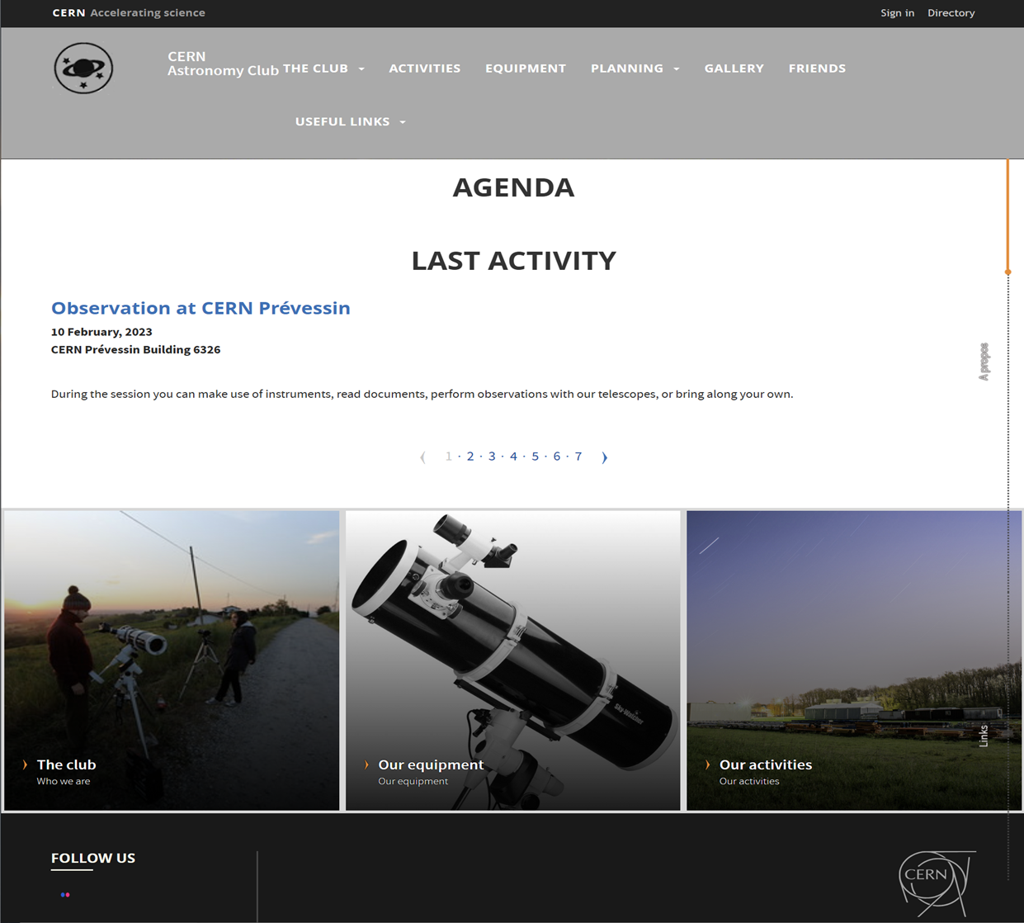

Slide 6
Overview of club activities 2024.
Observations at club barrack (Prevessin site) :
  We had several sessions, mostly on Fridays or weekends. Announced by email/whatsapp
  Good average attendance (3 to 5).
  Mostly around half/full moon (to leave the few precious clear nights around new moon for members to do their astrophotography.
  Aim :
    introduction of interested people to astronomy, and possibly ‘recruit’ new members.
    Explain how to setup and operate telescopes, in particular dobsons and equatorial mounts.
    Show astrophotography techniques (guiding, polar alignment).
Also observed once at “La Barillette”.
  1 hour drive , up the Jura 1500 m
  To avoid stratus clouds in pays de gex.
  Reasonable light pollution. Quite good for visual observation.
  Car pooling.
Several Observation at col de la faucille comet Tsuchinshan-Atlas

Slide 7
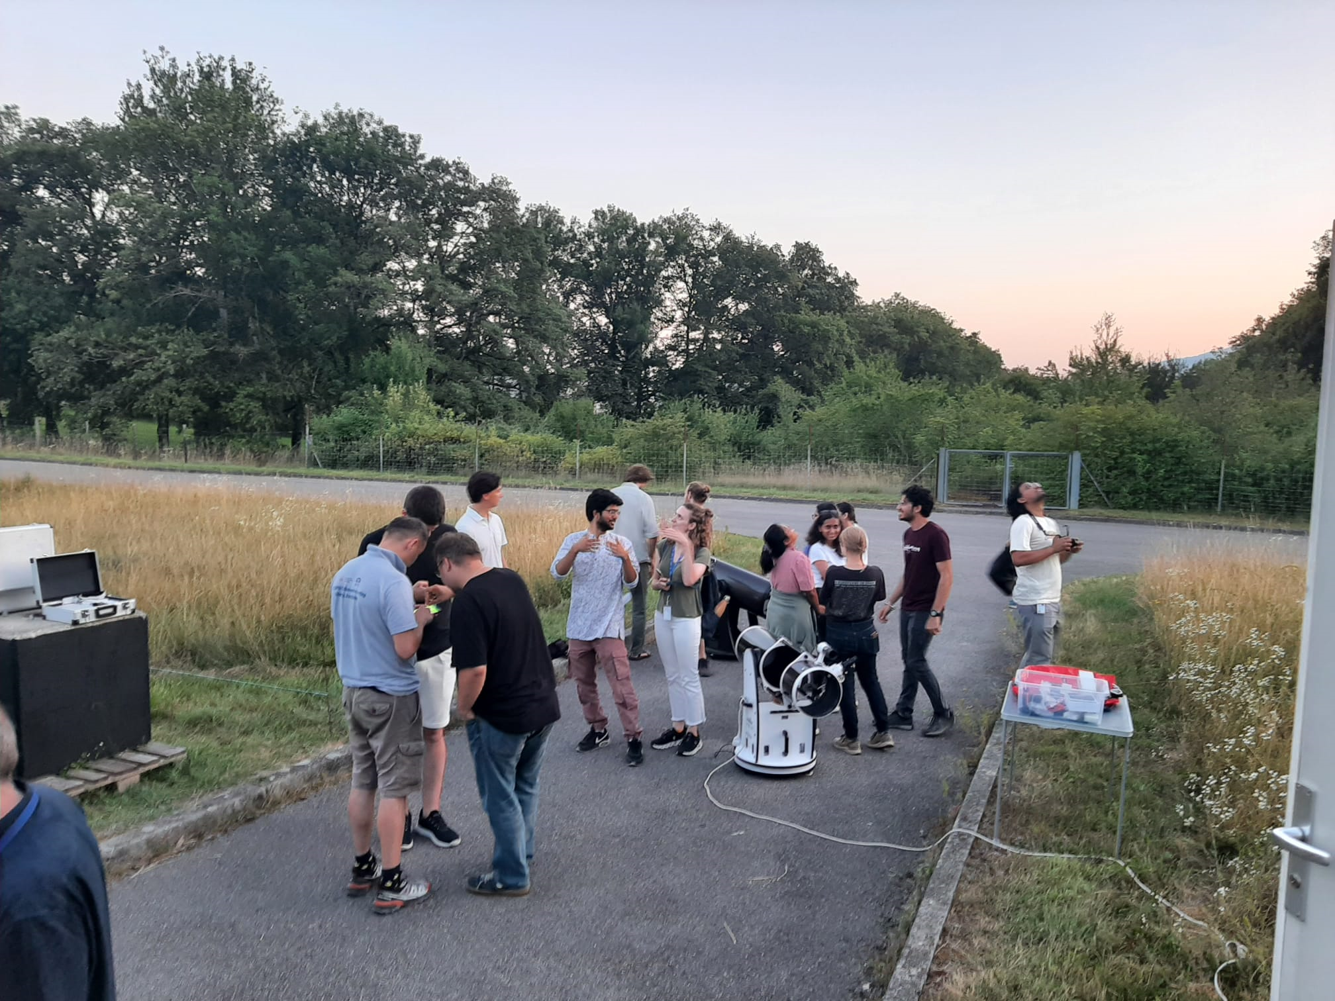
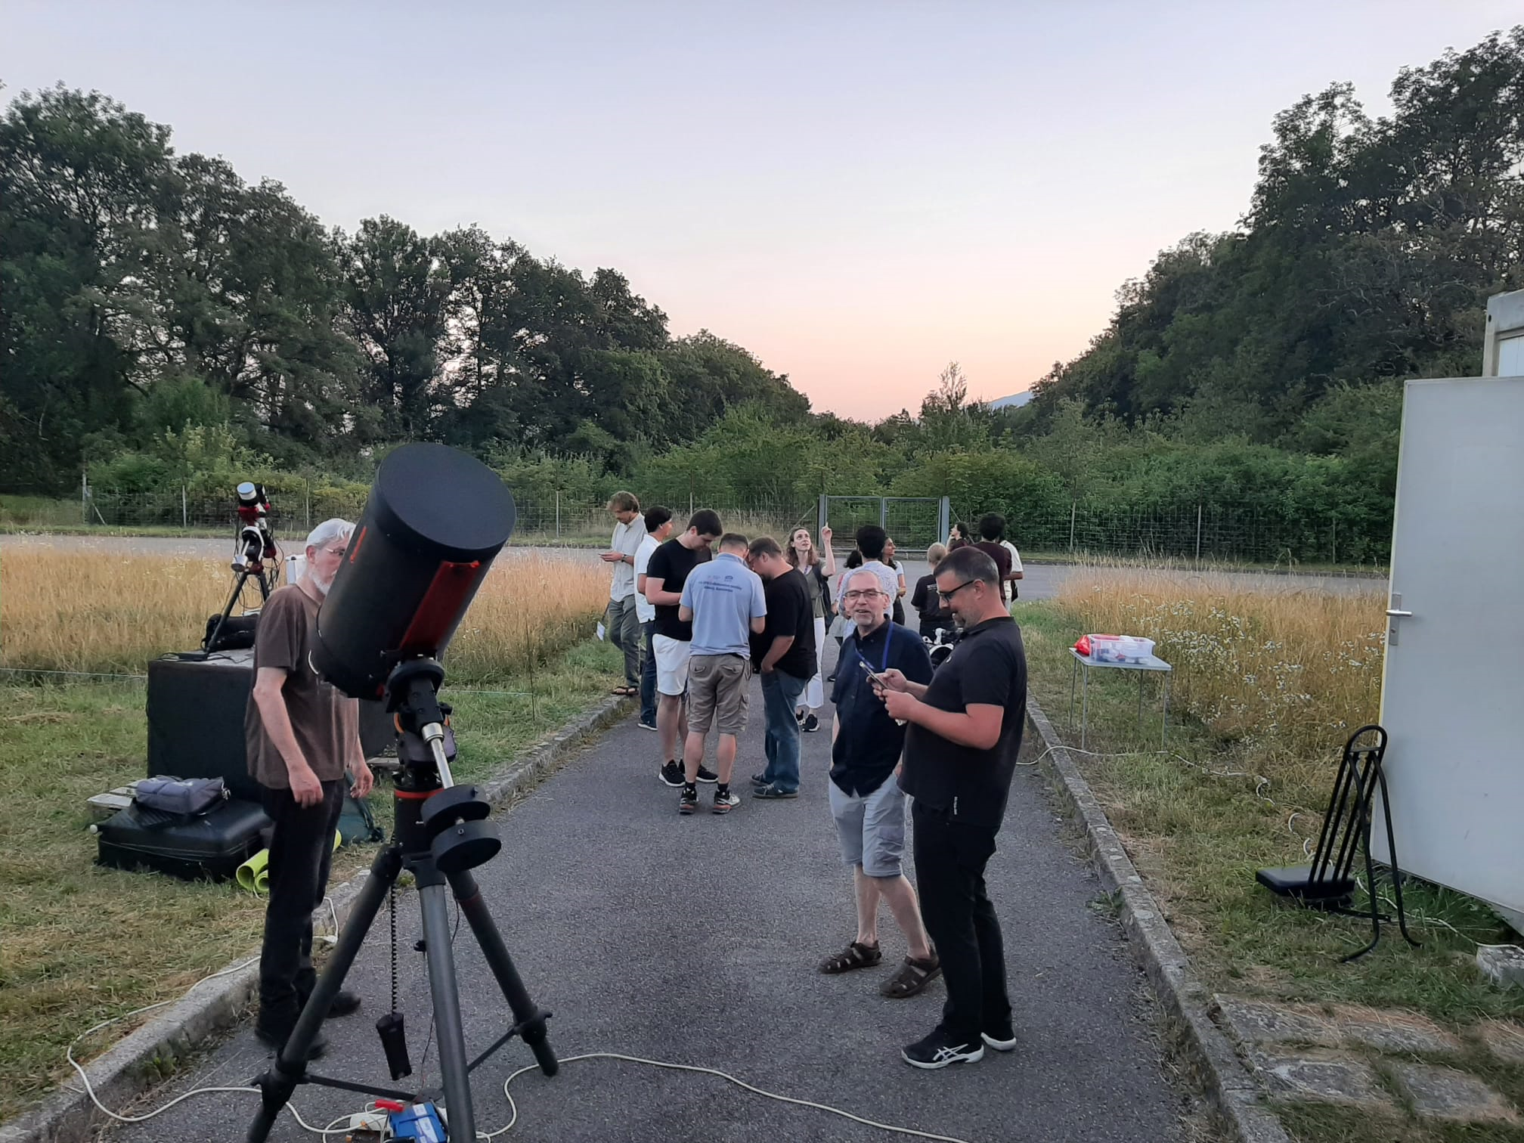
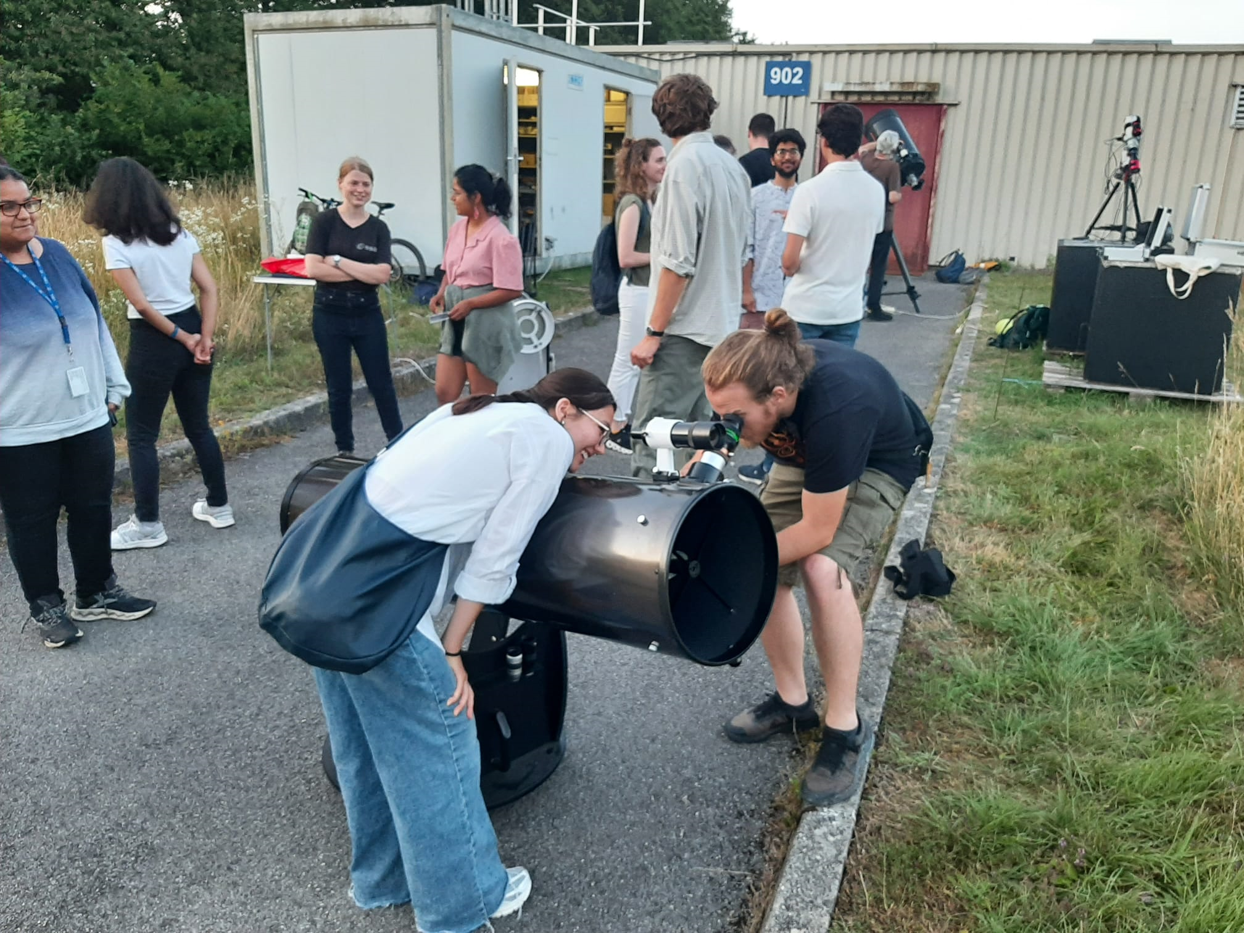
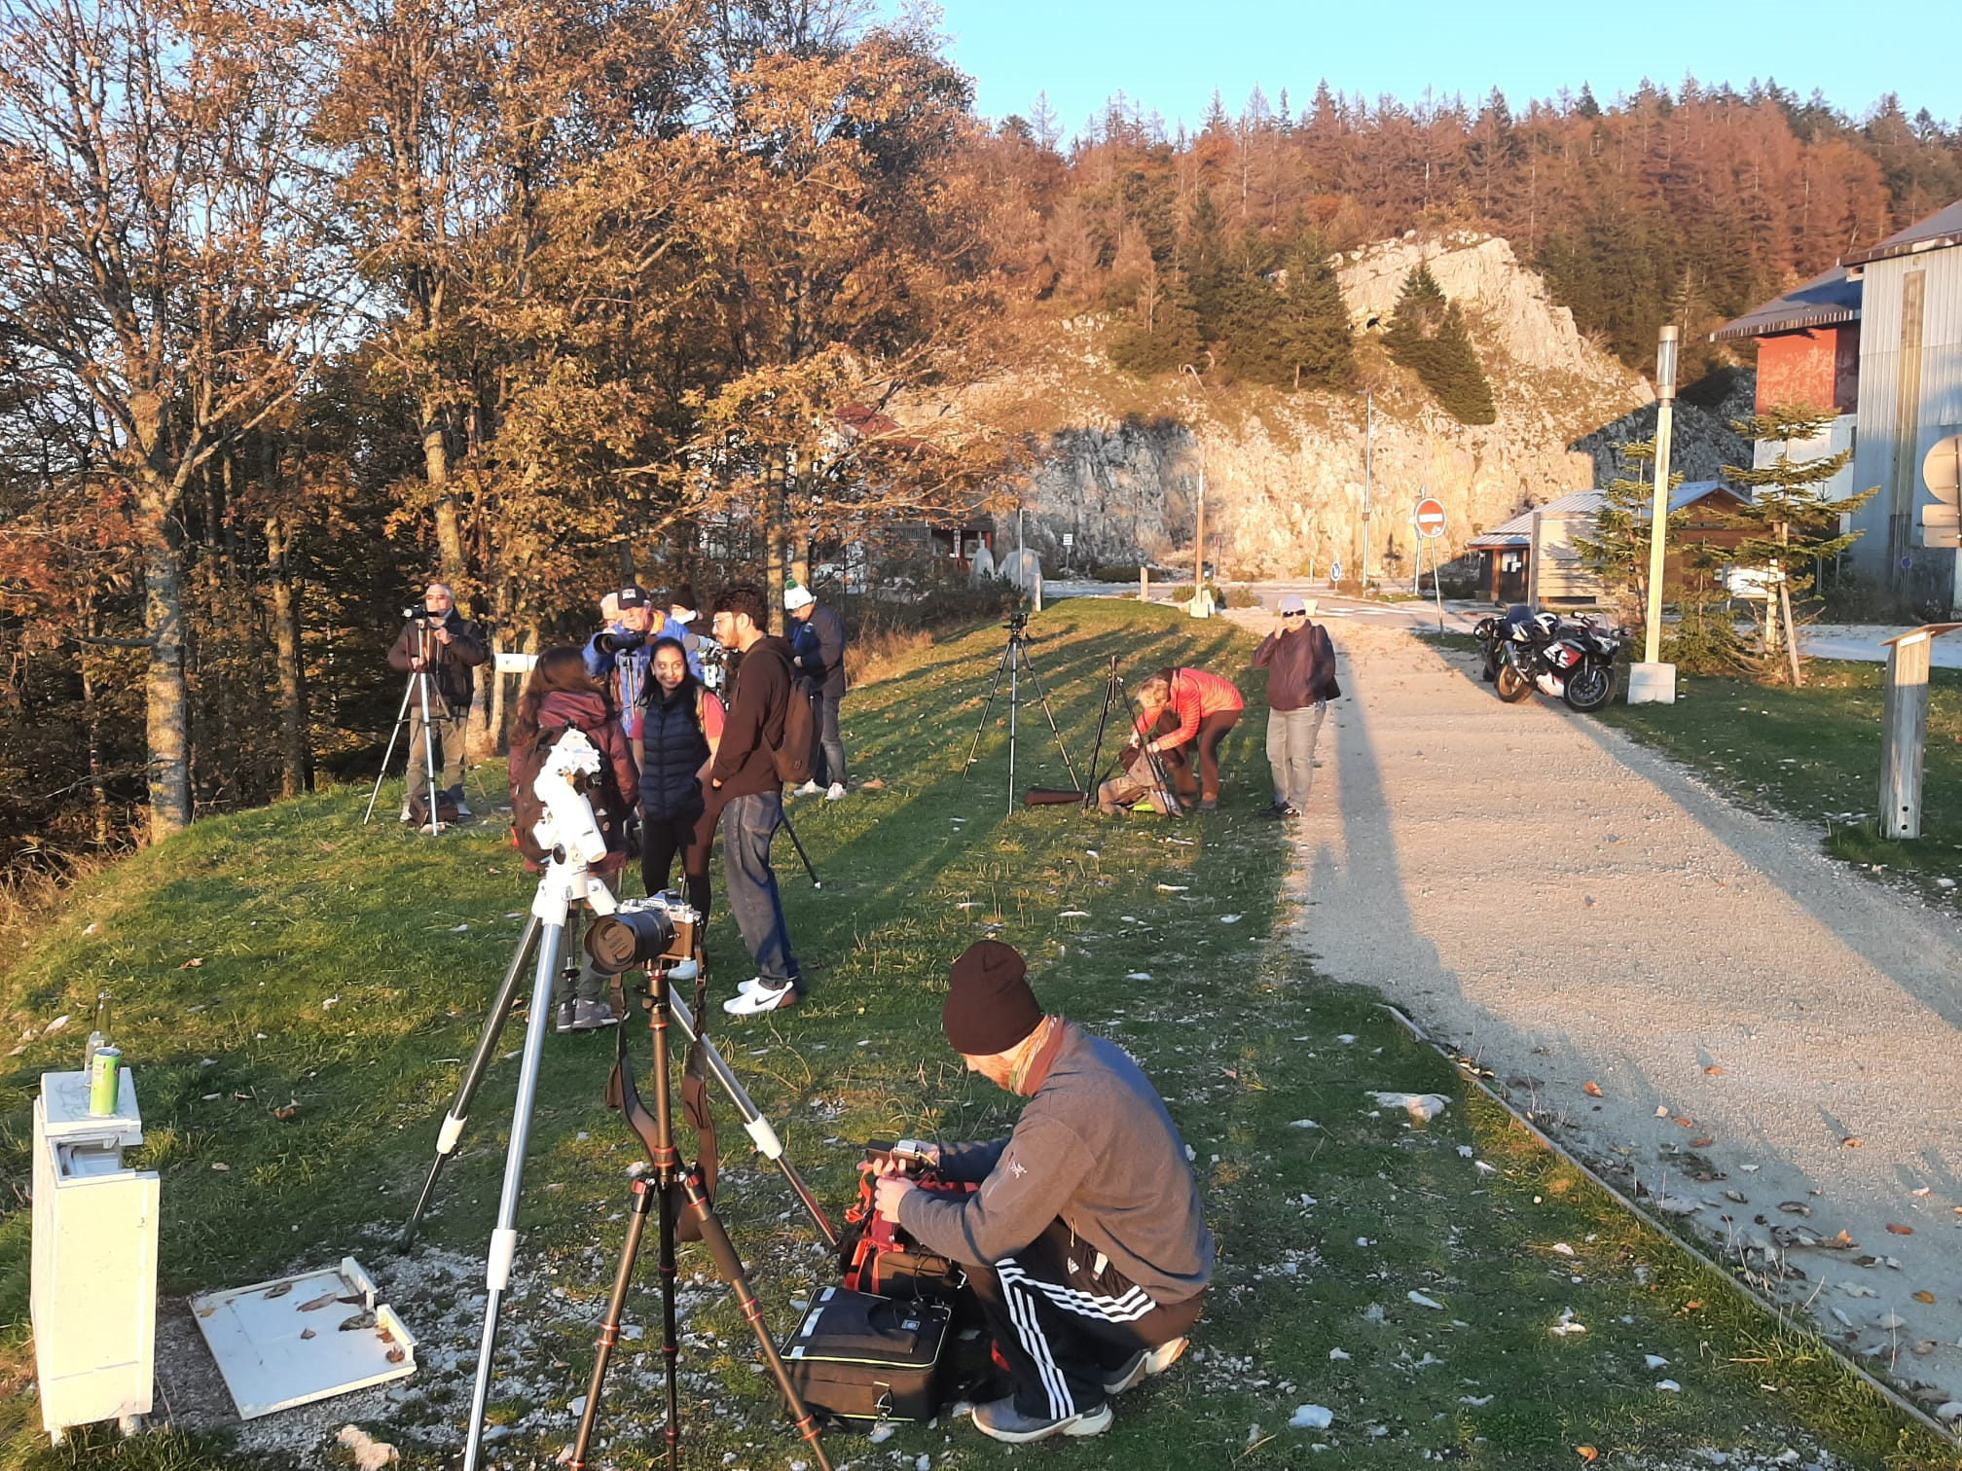

Slide 8
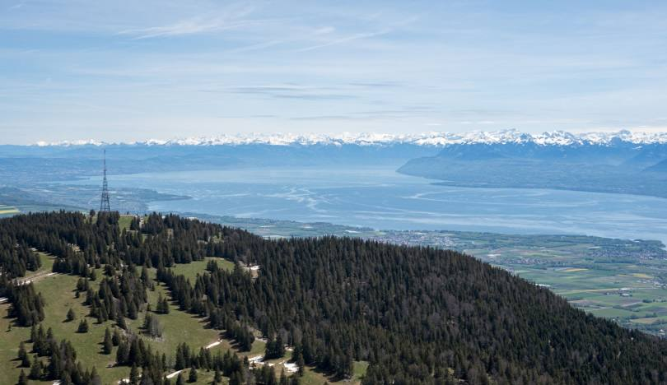
Also observed once at “La Barillette”.
  1 hour drive , up the Jura 1500 m
  To avoid stratus clouds in pays de gex.
  Reasonable light pollution. Quite good for visual observation.
  Car pooling.
La barillette

Slide 9
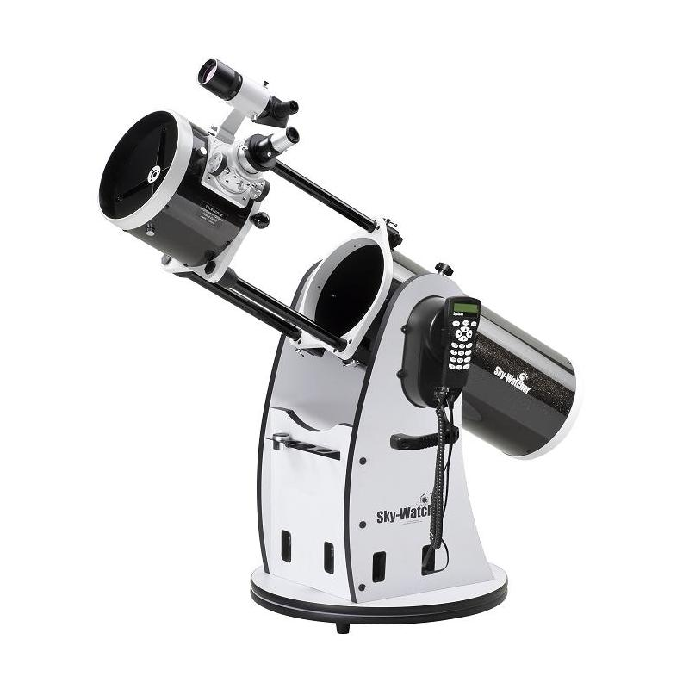
Workhorse: 8’’ Cesltron Dobson.
Skywatcher flex-tube 200.
Motorised:
  go-to and tracking capability.
Light weight and « telescopic ».
  Can easily be transported/installed by 1 person.
Built-in wifi and remote control through synscan and skysafari.
  Operated through tablet Samsung A7lite. Fully configured and « ready to go ».
  Wrote an operation guide with instructions.
We organise training sessions for new members to use it independently.
  Members should use it autonomously once acquainted with it.

Slide 10
Public events.
La nuit est belle.
  No event in 2024.
  New event scheduled on 11th April 2025. https://www.lanuitestbelle.org/#
  Was contacted by CERN public events office, but I will be absent in this period and informed that we will skip this year…
Fort l’Ecluse
  We joined with ORION club on 10th August.
  Clear night !
  >500 participants
  Installed the club goto Dobson.

Slide 11
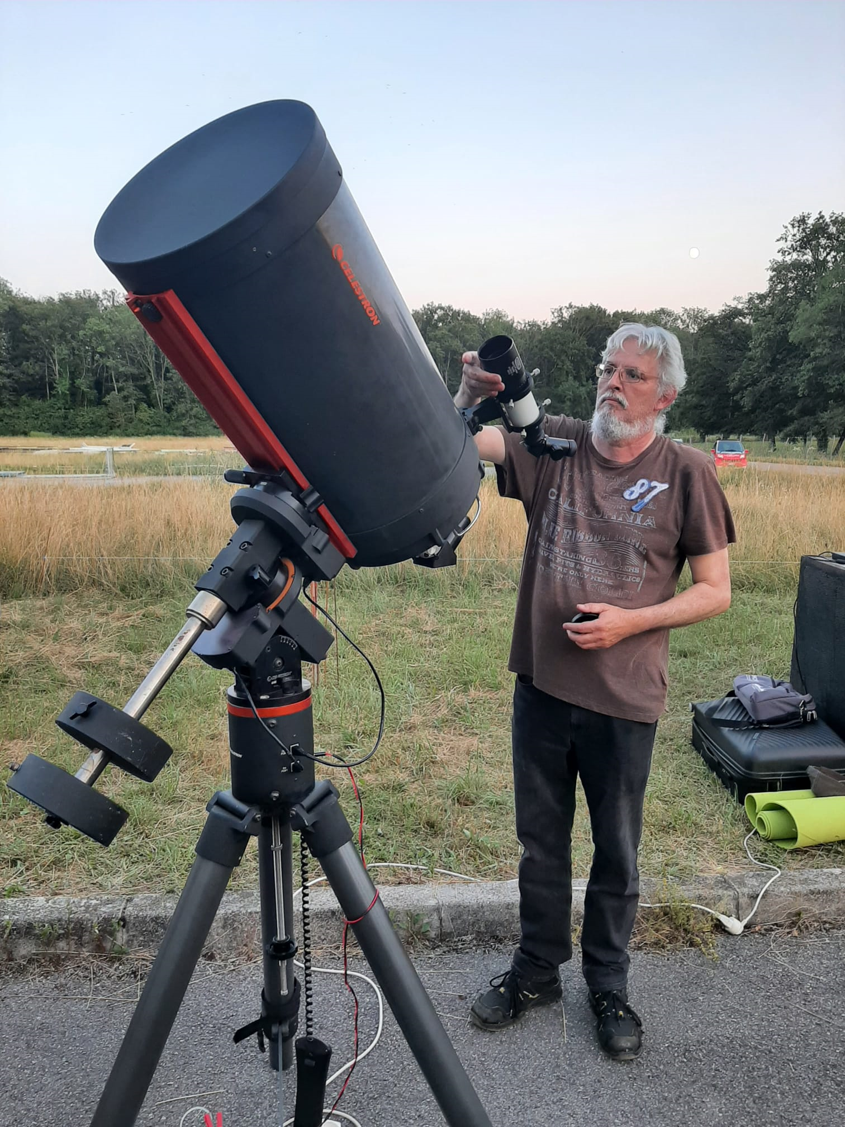
New equipment 2024.
We received a very nice 14 inch Celestron Schmidt-Cassegrain telescope from a previous member Wolfgang Fritsch !
Quite heavy. Needs a permanent mount.
Ideal for planets.
Need some small repair.
Buy a specialised planetary camera
Can be fully computerised

Slide 12
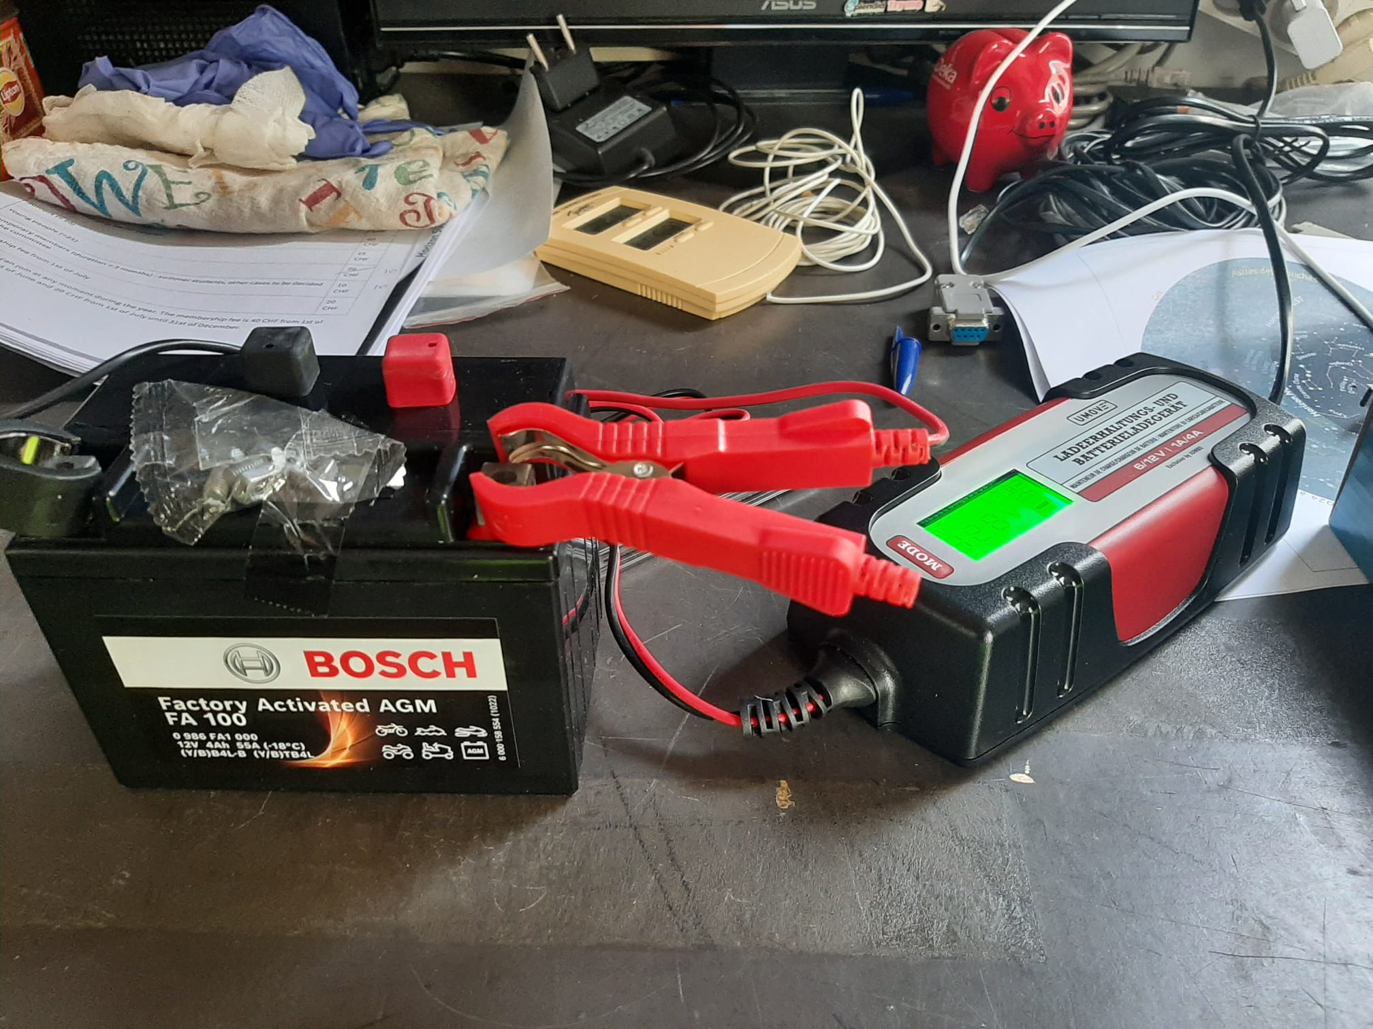
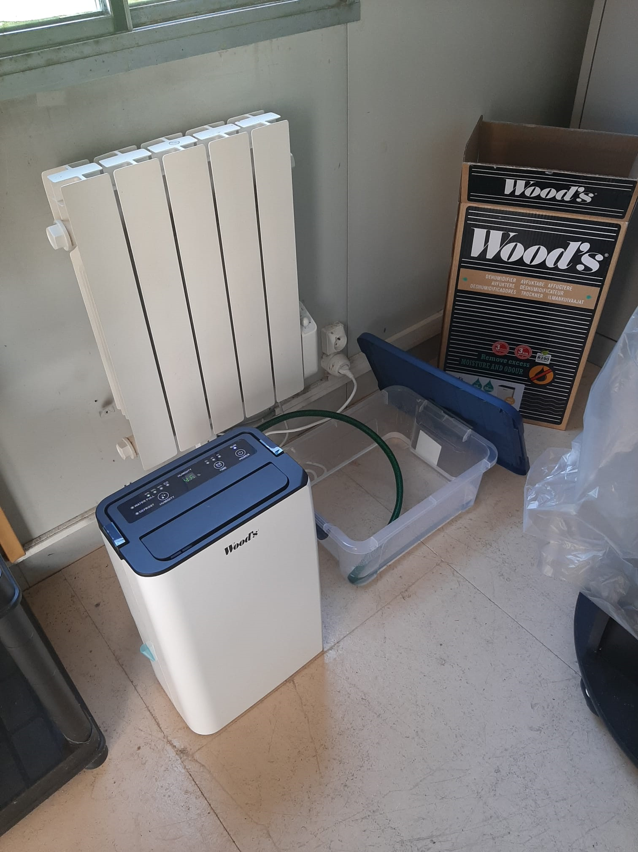
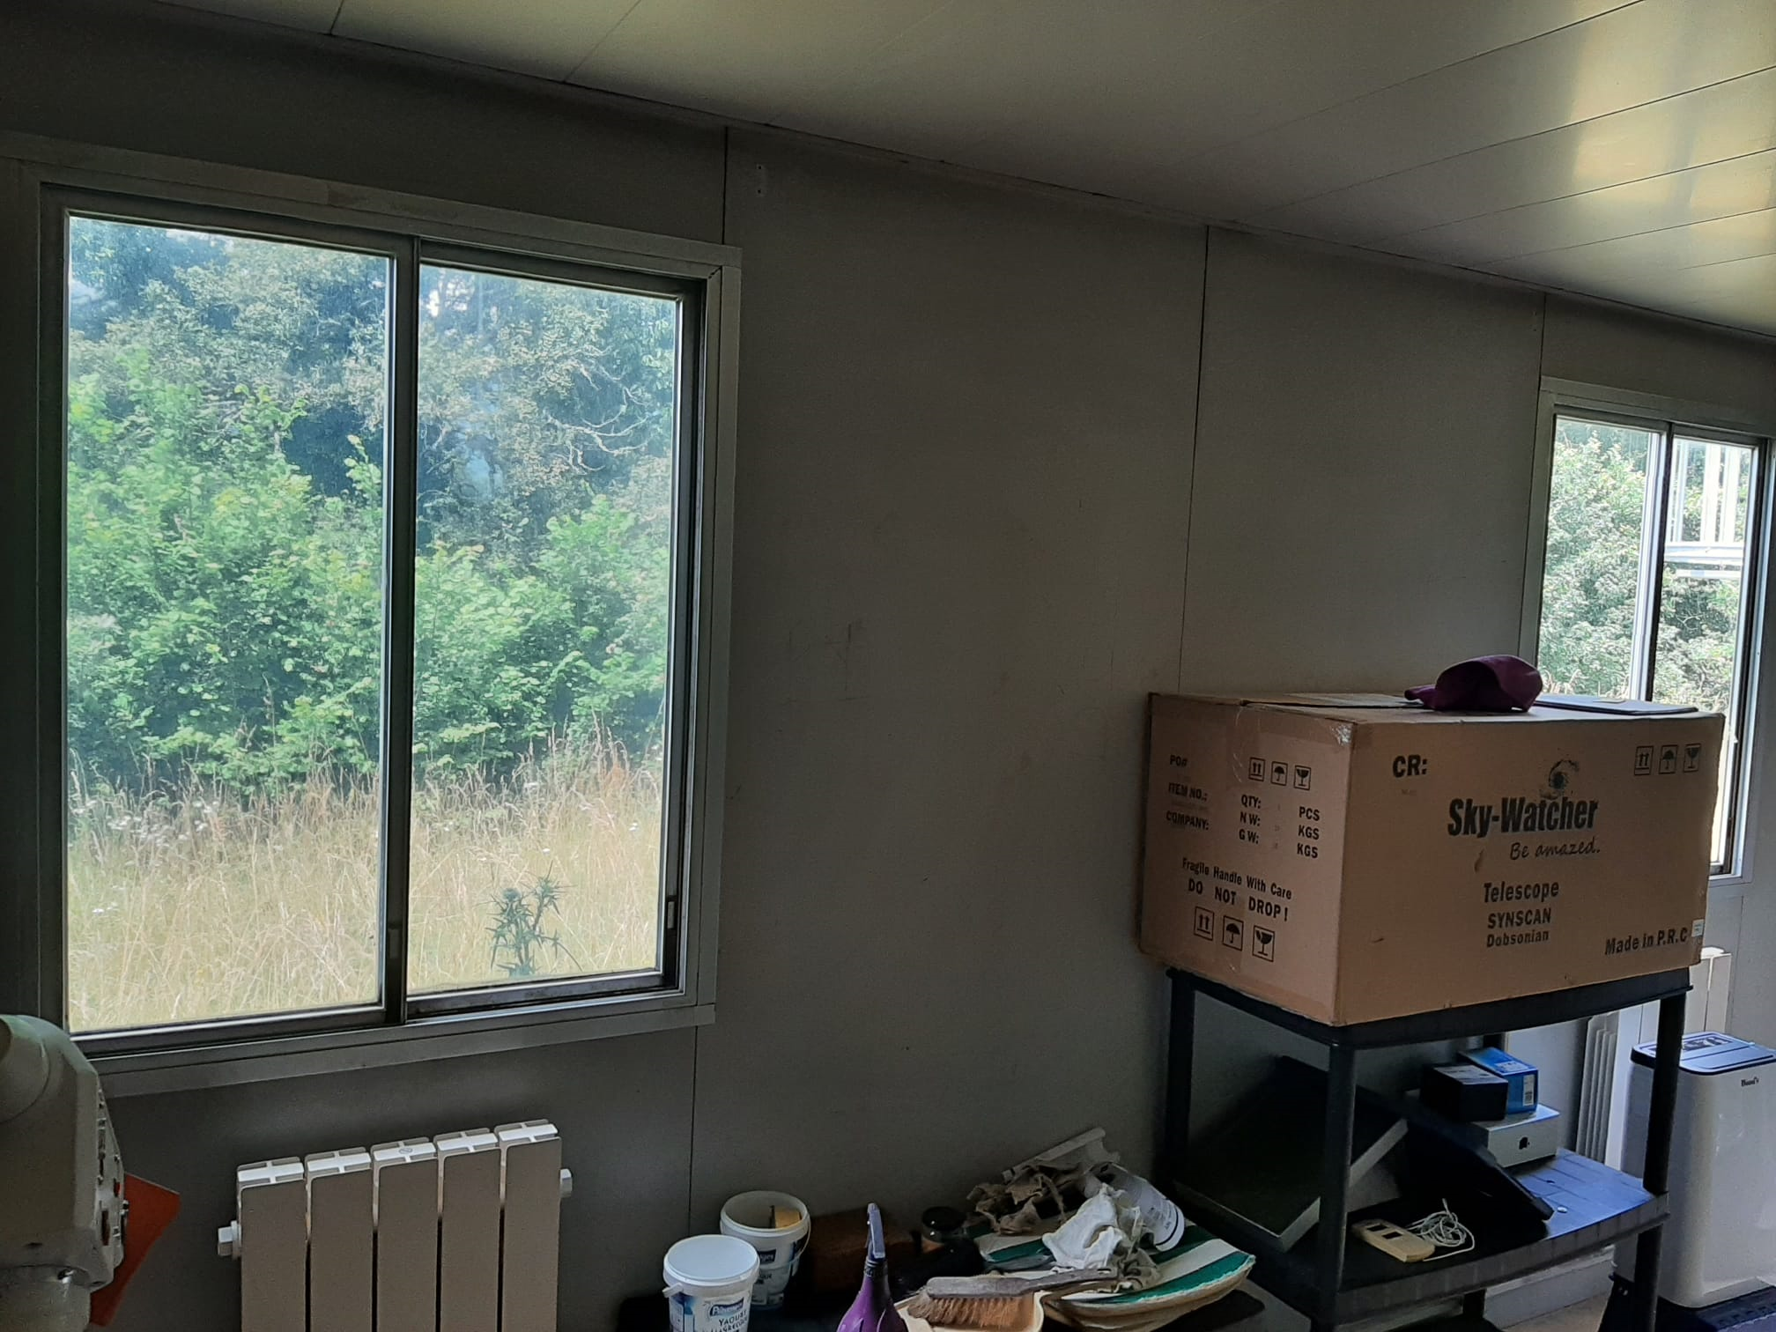
New equipment 2025
Dehumidifer
Small 12V battery for dobson
and charger
Window shields

Slide 13
Club account.
Treasurer presentation can be found on indico.
  Healthy financial situation !
  Net positive saldo in 2024 of 1761 CHF.
  Increased club reserve to 6395 CHF.
  We can spend some amount on a project.
  Keep membership fees as in 2024.

Slide 14
Election of members of commitee.
President : Jan Buytaert.
Treasurer : Francoise Fabre
Secretary : Philomena.
Members : candidates ?
VOTE

Slide 15
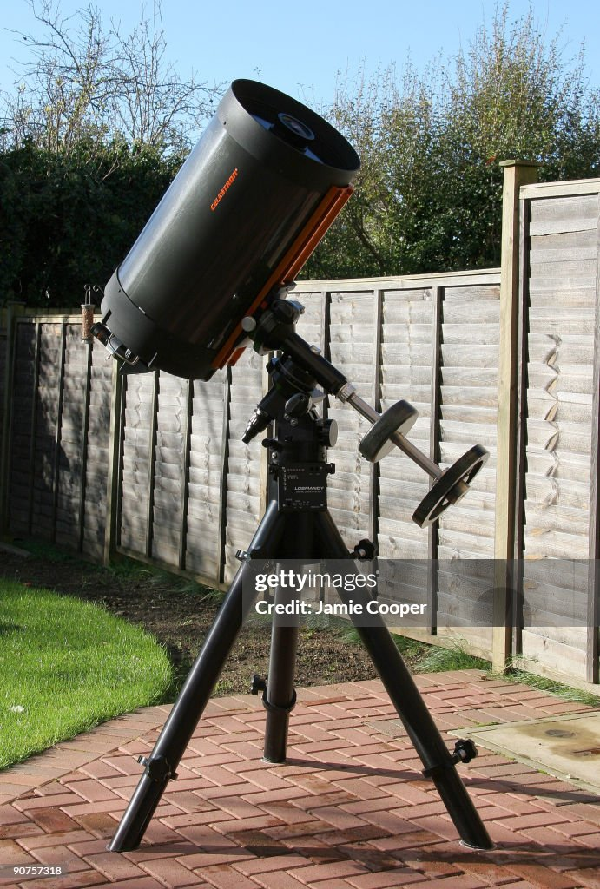
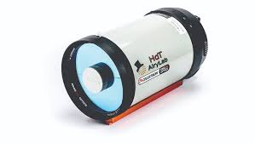
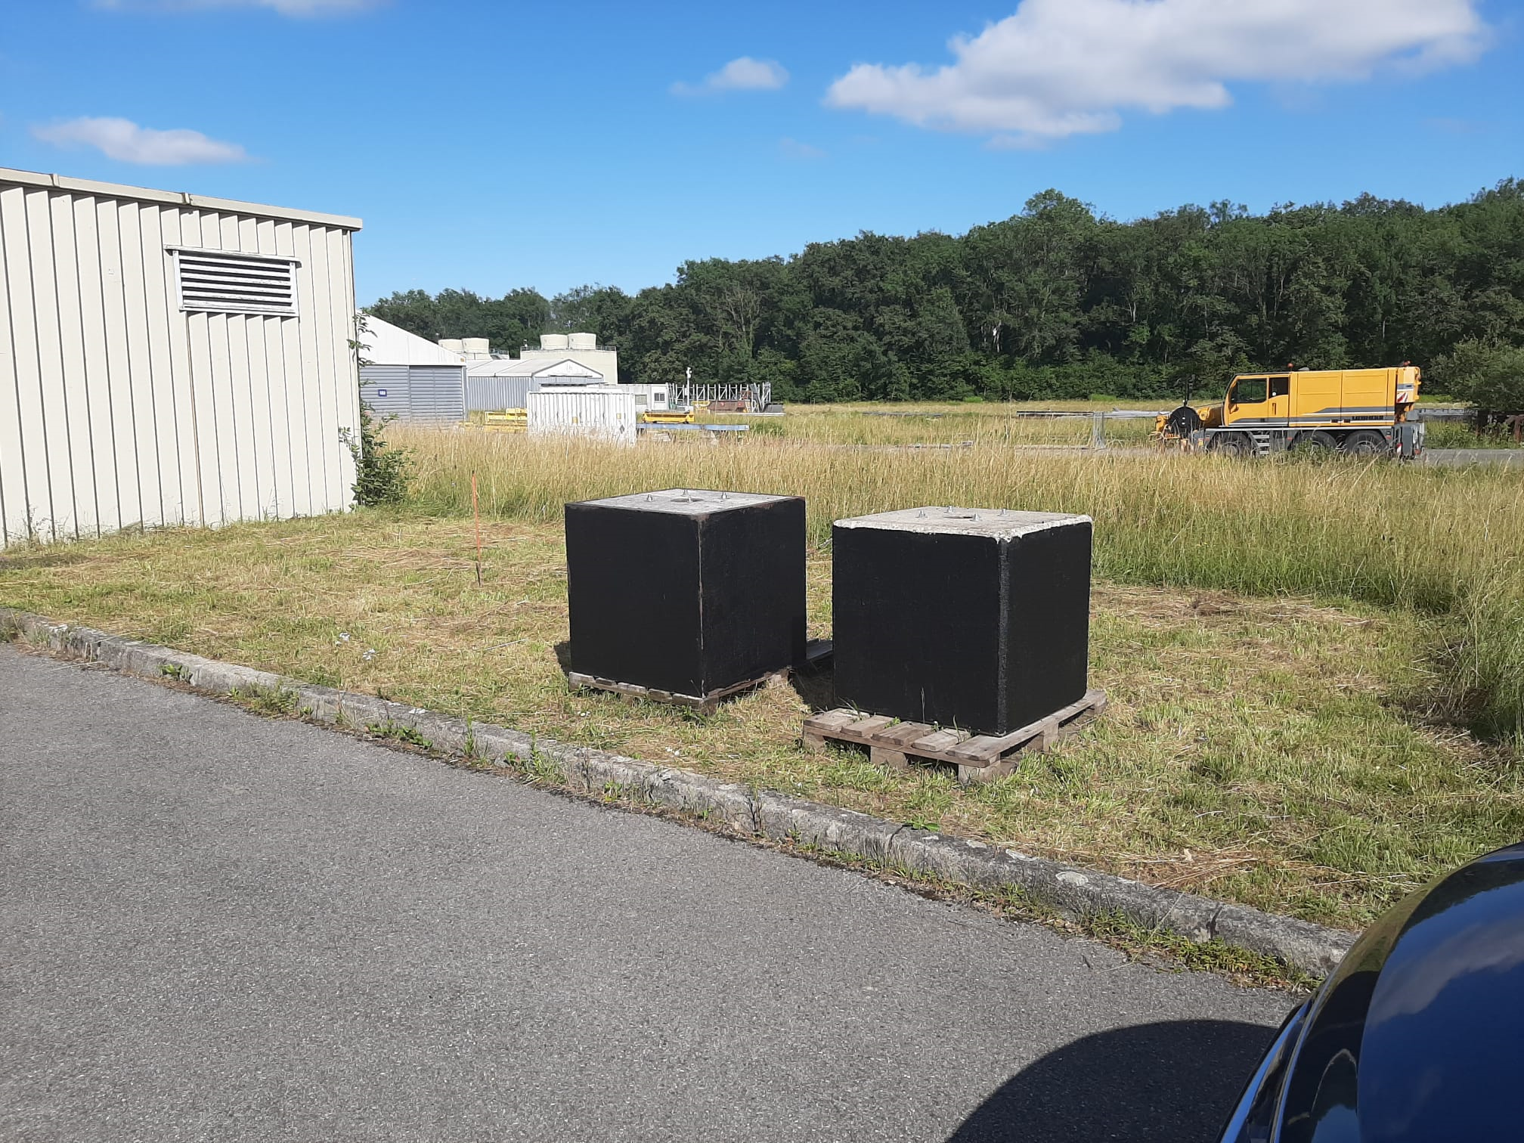
Outlook for 2025.
Build a movable shelter to house 2 telescopes:
  Sun observation : HalphaSCT from Airlabs.
  Celestron 14’’ CGX
Will call for volunteers. May April.

Slide 16
Outlook for 2025.
Plan monthly observation at club barrack during half/full moon.
Occasional outing to a darker site in the Jura. La barillette
Planetary astrophotography on prevessin site. Jupiter is very favourable now.
Solar observations. During weekend.
Zoom presentations/discussions.
  Astroberry, personal observatory, 3D printed mount, NINA, SIRIL, Pix insight.

Slide 17
Last but not least ….

Slide 18
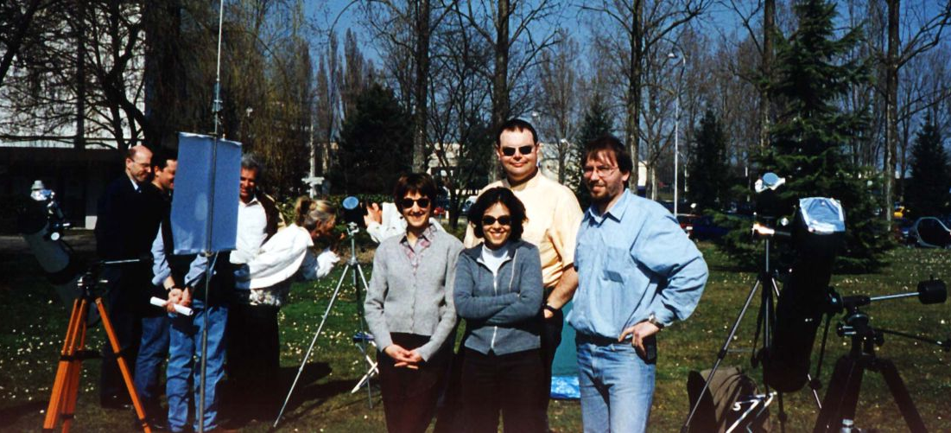
Thank you, Matthias !!!
Matthias is a founding member and has been treasurer since the beginning !
Unfortunately he will most likely move back to Germany this year …?
I propose to nominate Matthias as honorary member !

Slide 19
Proposals/suggestions for discussion

Slide 20
Take away from survey:
Prevessin observation once/month.
Occasional trips to nearby dark sites (Jura) for visual.
Sun observations.
Talks : by members on subjects.
  Astroberry, personal observatory, 3D printed mount, NINA, SIRIL, Pix insight.
Lessons on equipment:
  New dobson, others.
Once a get together in Prevessin.
  Weekend afternoon: Sun observation, snack, personal telescopes.

Slide 21
Useful information.
Our barrack on prevessin site: 6326
Our website : https://astro.web.cern.ch/
Our flickr account : https://www.flickr.com/groups/cern-astro-club/

