Slide 1

EVERSE Network of Research Software Quality
Graeme A Stewart (CERN) and Marco Bartolini (SKAO)
2025-02-18, EVERSE Network Launch

Slide 2
Research Software Quality
Software is a critical part of our scientific process
  From simulation and digital twins, to data acquisition and analysis of results - software is vital to transform data into knowledge!
  The size of the software required to support recent experiments is growing
    Our organisations are often not best setup to recognise this increasing need for software
Consequently, software quality really matters to us
  Software has to be a good fit for its purpose
  We strive to make our software FAIR
    Findable; Accessible; Interoperable; Reusable

Slide 3
Why a Network…?
There are many organisations that are concerned with aspects of software quality
  RSE organisations, EOSC OA7, European Science Clusters, RDA, ReSA, etc.
As a “problem/opportunity” we are still evolving and discovering best practices for managing software over its lifetime
  From legacy codes written decades ago to our latest newborn project ideas
  From million-line code bases relied on by many communities, to the scripts used to produce a final publication plot
The scientific world can be slow to embrace best practices from industry
  Which often need recontextualised to be effective in the scientific domain
There is a body of practice emerging and we believe that there is a lot to learn from each other

Slide 4
The Network and EVERSE
EVERSE has the role to enhance software quality and to promote software to a first-class citizen in the research field
We specifically conceived the network activity as something that EVERSE would foster to help shape software quality practices – specifically in Europe, but within the worldwide research context
  Provide a connection between your community and EVERSE activities
    E.g., the EVERSE Research Software Quality Kit, RSQkit
  Help to shape software quality policy and practice based on your needs
  Learn from the wider software industry and translate this practice to academic research software
  Host events that showcase good practice, introduce tools, understand communities, provide training

Slide 5
Network Activities - Webinars
We would like to host online presentations as part of the network
There are many interesting topics around software quality, e.g.,
  What did we learn from our EVERSE best practice survey?
  How different communities address software quality matters in their workflows and pipelines?
  In what way will upcoming technologies affect our software?
    From hardware aspects, such as accelerators, to new languages, like Julia
  Presentation and discussion on the latest content in, e.g., the EVERSE RSQkit and software quality pipelines

Slide 6
Network Activities - Tools Discovery and Training
One of the continuing areas of evolution in software is in tools
  From Makefiles to Cmake, from CVS to git and social coding, …
An EVERSE area of activity is in discovering new tools that help software quality
We want to present these new tools as part of the network events, to help bring them to a wider audience and discuss how to use them most effectively (which is not always clear!)
This forms part of a wider goal to promote tools and practice
  Not only online, but at in-person events where we can have training sessions and network meetups and join-ups!

Slide 7
Network Goals – Policies and Task Forces
Based on what we learn in the network, can we influence the policies around software quality?
We have a brilliant opportunity to connect scientific needs to evolving policy decisions by providing input and comments
  With the goal to have policy backed up by practical measures that allow us to meet them
However, policy doesn’t just drop from the sky
  To help inform policy choices we could setup task forces that examine particular areas of software quality and provide informed inputs
We hope for a strong interaction with the new EOSC-A Opportunity Area, OA7: Research Software
Notes:
E.g., impact of AI and LLMs on SQ

Slide 8
Network Vision - Community of Practice
Software is about code, but it’s also about people!
We want the network to be a community of those who care about software quality
  For their own projects and in the wider context of research
So, we envisage the network as an evolving community of practice
  People who “share a concern or a passion for something they do and learn how to do it better as they interact regularly”
We think this is something worth striving for and there is much to be gained from it!
We welcome everyone to join us, whatever their location or scientific affiliation

Slide 9
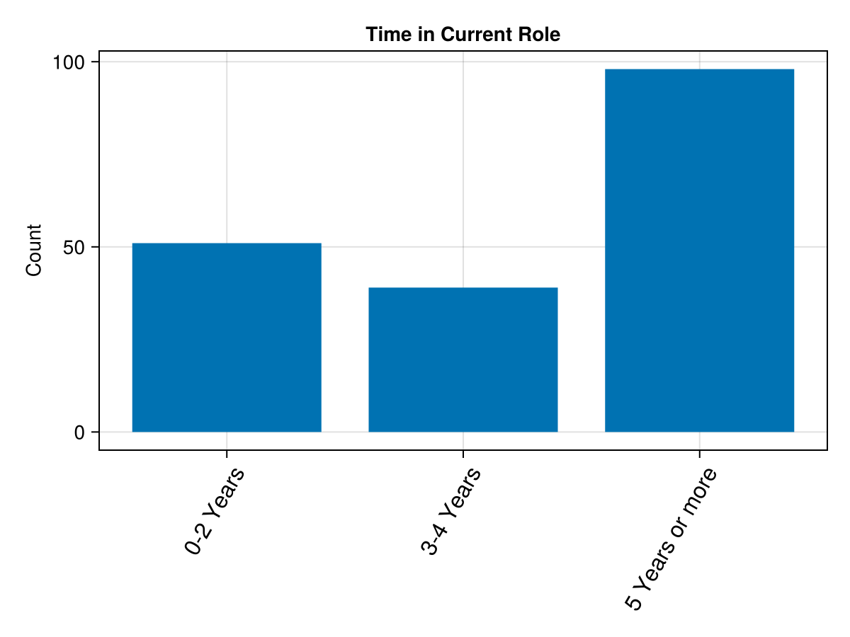
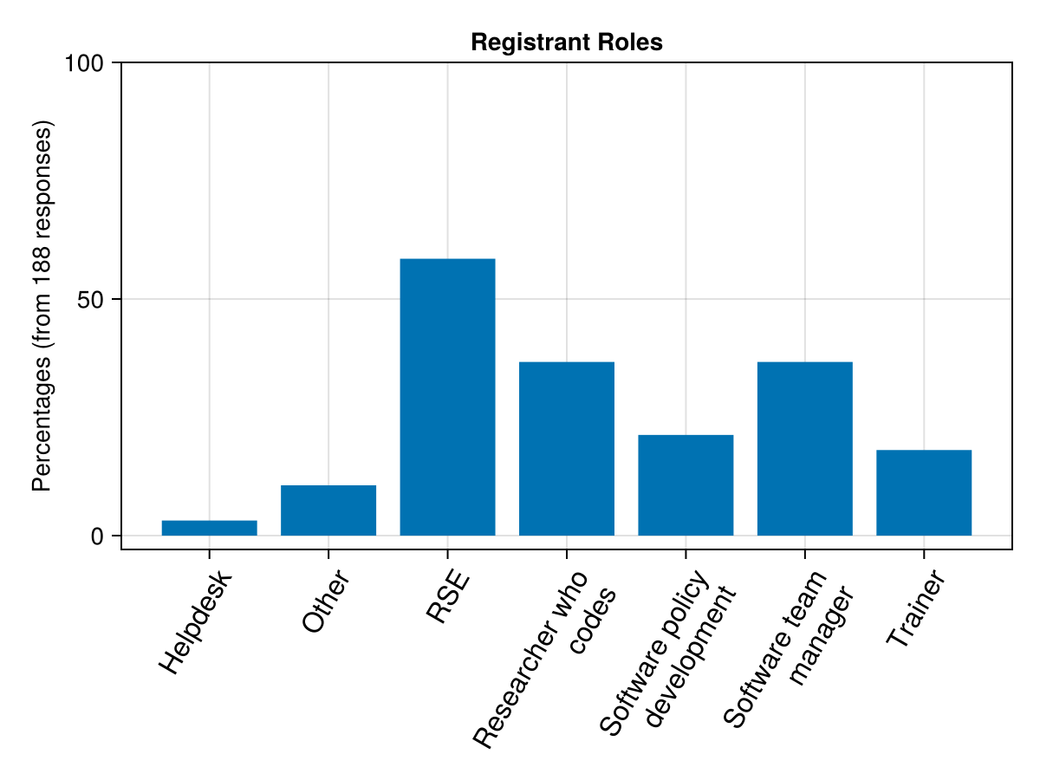
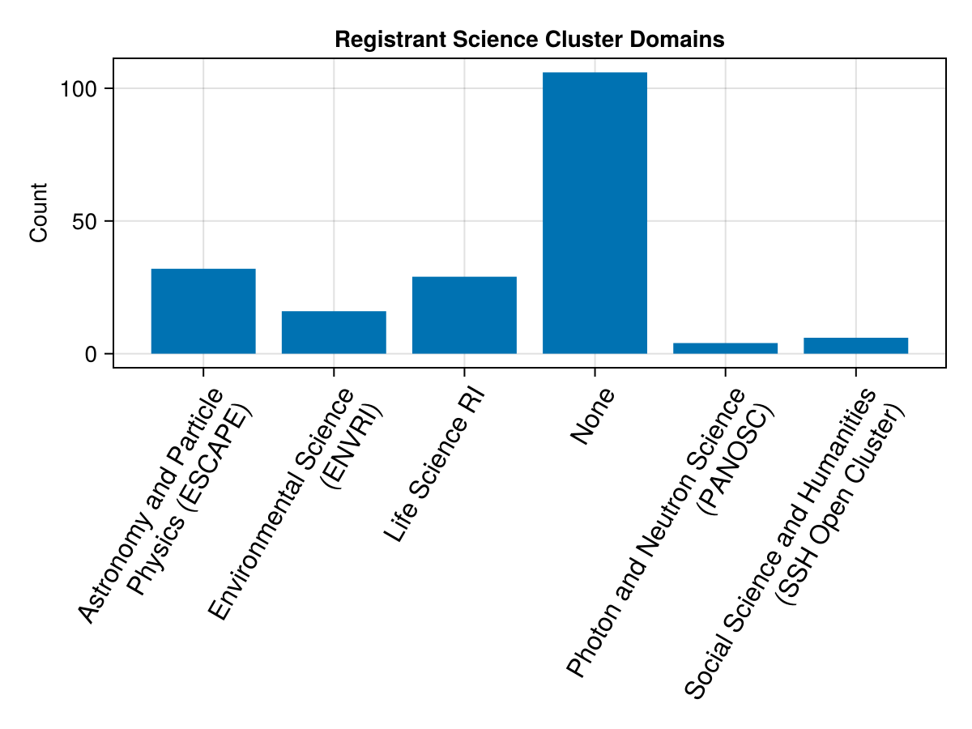
Who are we today?

Slide 10
Today - Learning about your needs!
We outlined here some of our ideas about the Network
It is certainly the case that we haven’t thought of everything
So, we would now like to hear from your side
  What are your hopes for the network?
  Where do you see it having the greatest impact?
  What are the areas where your community needs the most support?
To help do that we have an interactive and fun session on Slido, followed by an open Q&A

