Slide 1
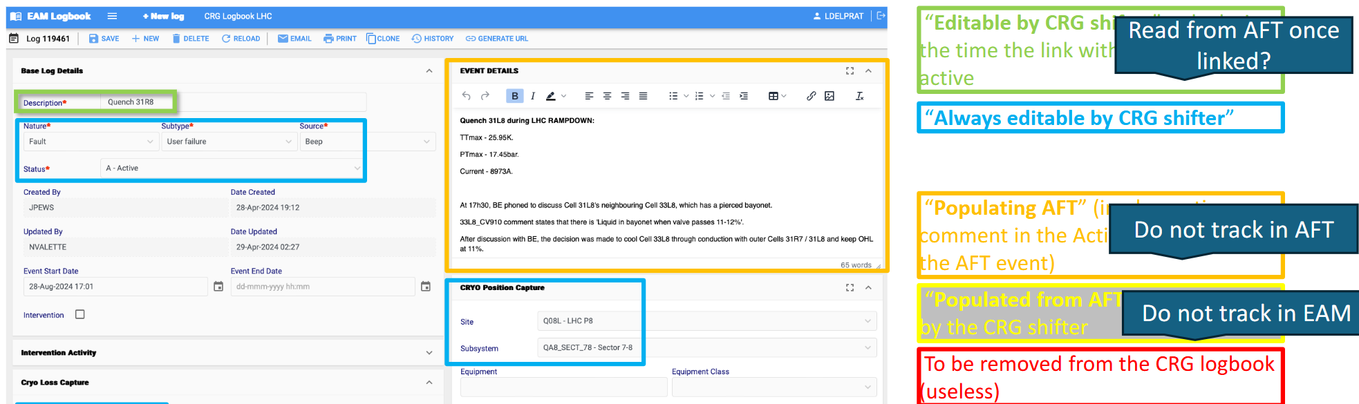
Re-cap on EAM & AFT Integration
Started out ~1 year ago
Discussed integration requirements with CRG, CV, EL, TIOC, AFT, EAM & RAWG
Motivations:
  Less workload – avoiding double bookkeeping & reviewing
  Added value from combining information of both databases
    Beam impact in AFT, equipment code from EAM,…
  Opportunity to homogenize data recording and build common tools for data analysis/KPI definition
First proposal from CRG:

Slide 2
Vision
Accelerators &
Equipment
AFT tool
AFT event
AFT owns operations impact data
EAM owns equipment fault data
1:N link - 1 EAM log links N AFT events
  useful for infrastructures
Linking primarily from EAM logbook to AFT events.
Link is key - basis for:
  Combining data
  Populating AFT/EAM
  Auto-review
High degree of automation
Beam
Log
AFT event
AFT event
Link, populate & review
1:N
EAM:AFT
Optional: log & link
Equipment/TIOC Accelerator Operations
EAM tool
Log
Equipment
Logbook event
Work order
Physical/Operations Database
Notes:
What about CRG & CV
If it is not your fault – don’t link to AFT but link to the EAM log that brought you down

Slide 3
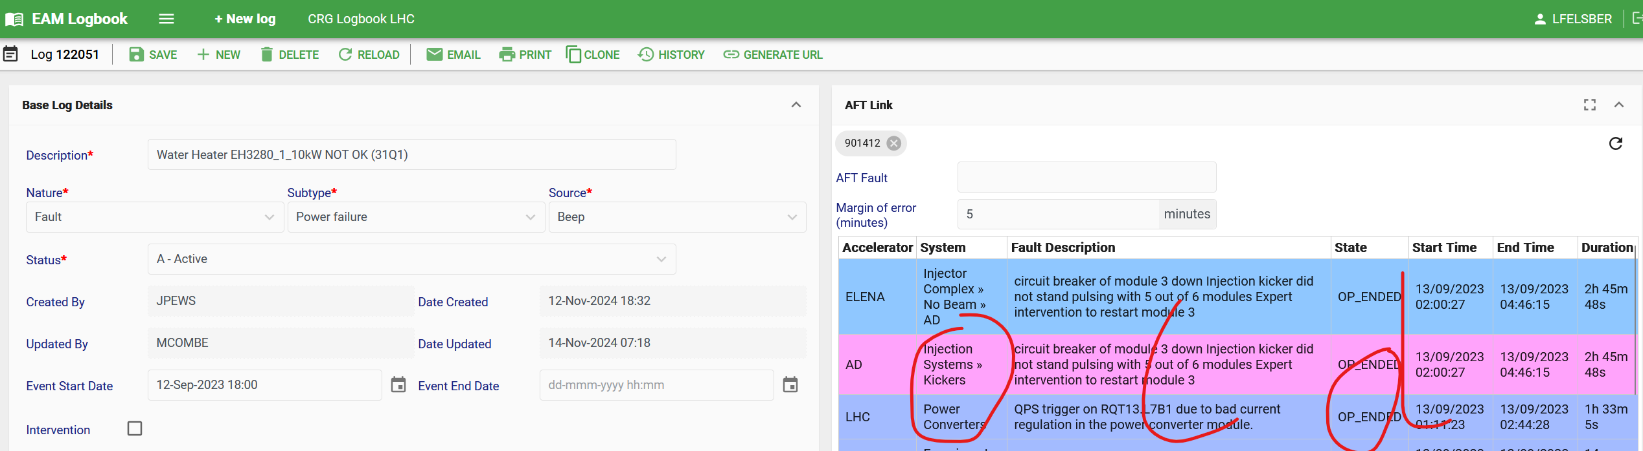
What is available for 2025? Linking Plug-In
Allows efficient linking from EAM to AFT:
Systems pre-filtered for each logbook & by time
Time filter can be fine-tuned
Search results ordered by start time
Generates link on both EAM & AFT & prevents double linking
Can be deployed to production version of logbooks already!

Slide 4
DEMO & Workflow
https://testeamlogbook.cern.ch/LBQLHC/log2/122051
AFT – Fault details (1107322)
Fault gets recorded in AFT
AFT system sends Email notification to experts
Equipment experts follow up fault
Expert documents fault in EAM
If you are root cause, link to EAM
RAWG review & reassignment
Reclassifications trigger new AFT notifications
Existing EAM link gets deleted
Mark linked AFT fault as reviewed
or request change
99% of cases are done here
1% of cases are reclassified

Slide 5
What could be the next steps?
Auto-Review
Auto-Populate
Consider an EAM ‘claimed’ AFT fault to toggle automatically reviewed
Would save manual step
Idea remains to separate information between EAM (equipment) & AFT (beam) instead of duplicating
Nevertheless, certain fields useful in both EAM & AFT. E.g.
  EAM description as comment into AFT - done
  Functional position/equipment code
  Sub-systems
  System specific properties (implemented by group) – e.g. CRG timestamps, EN-EL glitch dip/swell & duration
Auto-Log
AFT to publish pre-filled logbook events to EAM
  1:N relationship problematic for infrastructures across machines
Would save manual step

Slide 6
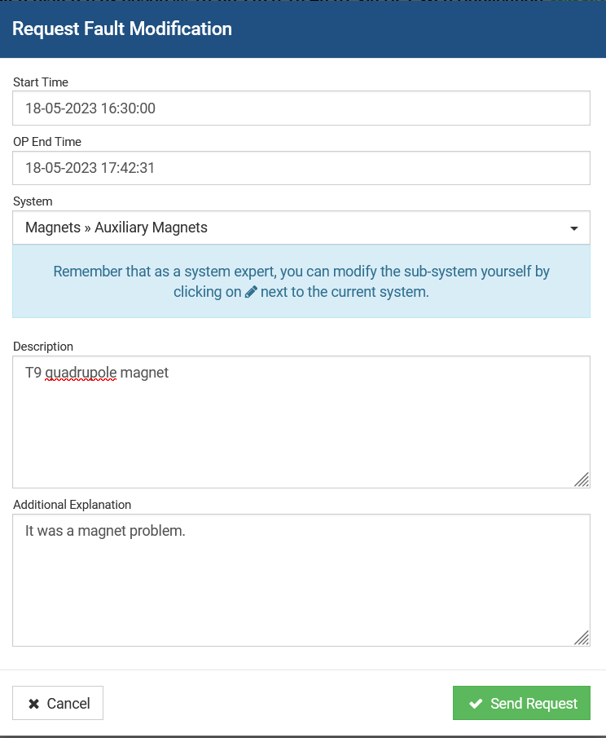
Why not implemented yet?
Clarification of data modification rights and rules
AFT APIs need to grant different rights to different EAM logbooks
  Avoids EAM integration of system X modifying AFT log of system Y
AFT API extensions to access review state and change requests
How to handle links under reassignment of fault from system X to system Y?
  Not considering all edge cases can have big impact when tool is operational
Resource allocation
AFT tool essentially feature frozen
Currently, no development resources allocated

Slide 7
Next steps
RAWG, EAM & AFT team to
  Narrow down next integration steps (roles & rules)
  Look for resources
EAM logbook users have linking plug-in available for 2025 operation
  Please share your experience and feedback – eam.support@cern.ch
  Review of added value mid-2025

Slide 9
Auto-document & review
Auto-Review
Auto-Document
With link made, experts would still need to go to AFT and toggle review state
We could consider an EAM ‘claimed’ AFT fault to toggle automatically reviewed
  Would need to be set from EAM side, cause logic on AFT level could not distinguish between properly linked fault and ‘someone’ just adding EAM link for info
Idea remains to separate information between EAM & AFT instead of duplicating
Nevertheless, certain fields worth in both EAM & AFT. E.g.
  EAM description as comment into AFT
  Functional position/equipment code
  System (if breakdowns equal between AFT & EAM)
  System specific properties (if group implements this) – e.g. CRG timestamps, EN-EL glitch dip/swell & duration
Have to watch out for access rights! Current linking plug-in has full write access to database (CV could claim CRG fault etc.)

Slide 10
Workflows with and without plug-in
(experts’ point of view)
Currently
With EAM/AFT integration
OP records fault
AFT system sends Email notification to experts
Experts follow up fault
Documents in EAM
Reviews & Documents (/links EAM) in AFT
RAWG review & reassignment
Reclassifications trigger new notifications
Existing EAM link gets deleted - tbc
OP records fault
AFT system sends Email notification to experts – still relevant?
Experts follow up fault
Documents in EAM
Use plug-in to link to AFT
RAWG review & reassignment
Reclassifications trigger new notifications
Existing EAM link gets deleted – notification?
Auto-document & review?
AFT creating EAM log if desired (already linked)
Notes:
Data consistency, less redundant information,
How to update faults that are reassigned from one eam to another eam logbook

Slide 11
Plug-in to link to AFT
Feedback received
What could we propose?
Lionel (CRG)
  It does not take into account the Site/Subsystem/equipment : for instance, in the LHC logbook, we may have the following Accelerators: LHC, ELENA, PS, AD, EA, etc.
  For the LHC Cryogenic logbook, we have all systems: Injector Complex, Radio Frequency, etc.
  It looks like the margin of error takes into account the start date and the end date as well.
  The same AFT id can be recorded multiple time whenever the logbook is saved.
Jesper (TIOC)
  Limit the list of AFT events to those within the same time frame. Perhaps with the possibility to manually expand the list - done
  Group the list by machine, then order by start time ?
  Remove from the list the ones you have already attached
  Perhaps add more description when the AFT is attached. You see only the ID now, perhaps it could be useful to see also the description from the AFT inside EAM? - next slide
System filter for each logbook
  Egroup based
    Long-term: integration with IT egroups - grabber
  Mapping (how to maintain? Put reference on start page of eam logbook & send yearly reminder)
Ordering search results - done
Avoid double linking - easy
Fine-tuning of duration - unclear

Slide 12
Next steps
Aim to finish features of linking-plug-in as discussed and make equipment groups aware so they can use it for 2025 operation
Features as discussed are
  Only show relevant AFT systems in each EAM logbook (mapping attached – note that it is sufficient to filter by top level system)
  Avoid double linking
  Add failure description to linked AFT faults
  add EAM description as comment to AFT fault
Make equipment groups aware
  I will invite for meeting in about a month from now
  I will update the proposal & workflow taking into account your comments
  We may iterate upon that before the meeting with the equipment groups
The linking plug in functionality will remain limited for now (resources) as
  Auto-document/complete AFT fault information requires handling of access rights of EAM plug-in
  Auto-review action requires extension of AFT API on top of that
  Writing AFT logs to EAM requires updating of current work order creation & discussion on how to handle AFT fault updates etc.

