Slide 1
Prototyping at CERN
27.03.25
Dina Zimmermann

Slide 2
What is IdeaSquare?
Notes:
Educational programmes –
IdeaSquare co-designs and runs more than 22 project-based student courses in collaboration with international universities from Europe, Australia and the US.
Tackling challenges – SDGs and exploring how to use the technologies developed in ATTRACT in new ways.
R&D&I projects –
Our phycisists Umut are working with scintillators detecting neutrinos. Superkamoikande.
We have the Italians on the second floor here working on discovering muons for ATLAS. The ATLAS experiment employs a trigger system consisting of a first-level hardware trigger (L1). The L1 muon trigger system uses resistive-plate chambers (RPCs) to generate the muon-induced trigger signals in the central (barrel) region of the ATLAS detector. Pattern recognition for particle identification. Developing a chip. RPC.
Europaen projects –
ATTRACT: is a funding instrument for early-stage R&D&I projects. Initiative to bring together Europe’s fundamental research and industrial communities to create the next generation of detection and imaging technologies.
Crowd4SDG
Prototype workshop –
I will show you.
Events –
CMS Patatrack Hackaton, Arduino, FPGA workshops.
Innovation knowledge –
CIJ

Slide 3
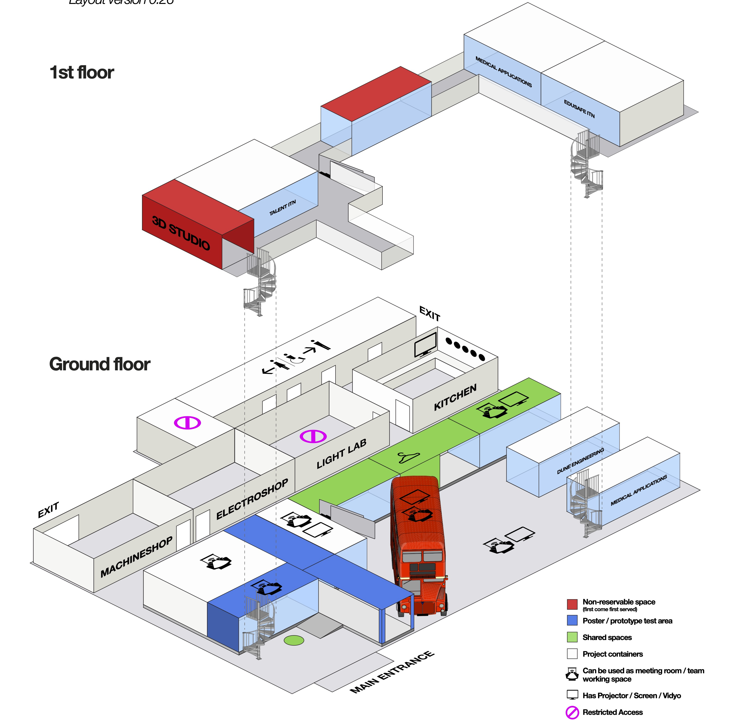


Slide 4
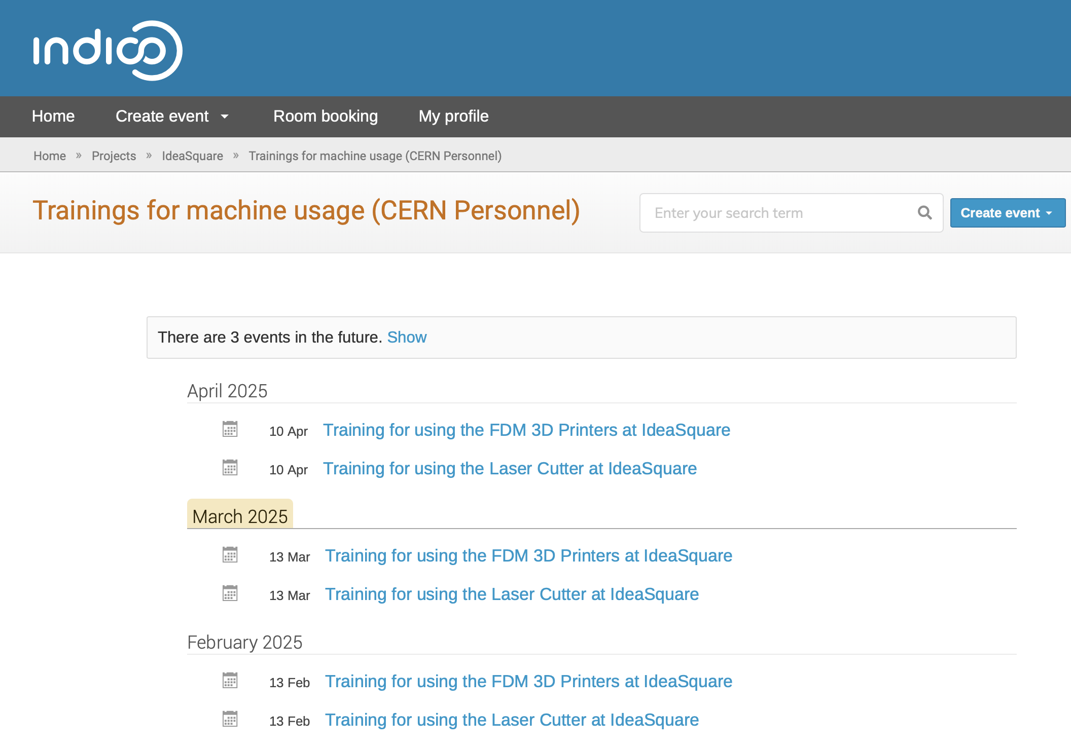

Slide 5
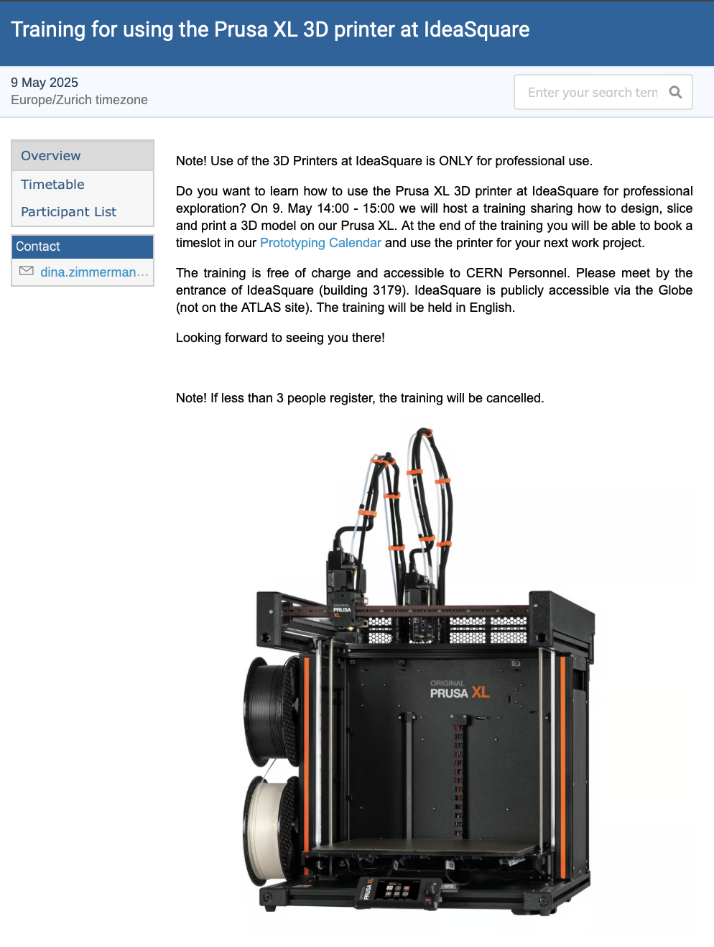

Slide 6
Let’s listen to the prototyping presentations!

