Slide 1
Isotope mass separation at CERN: from fundamental physics to clinical translation at CERN-MEDICIS
Dr. Thierry STORA – CERN
Medicis.cern
LPHE seminar – EPFL – Mar 2025

Slide 2
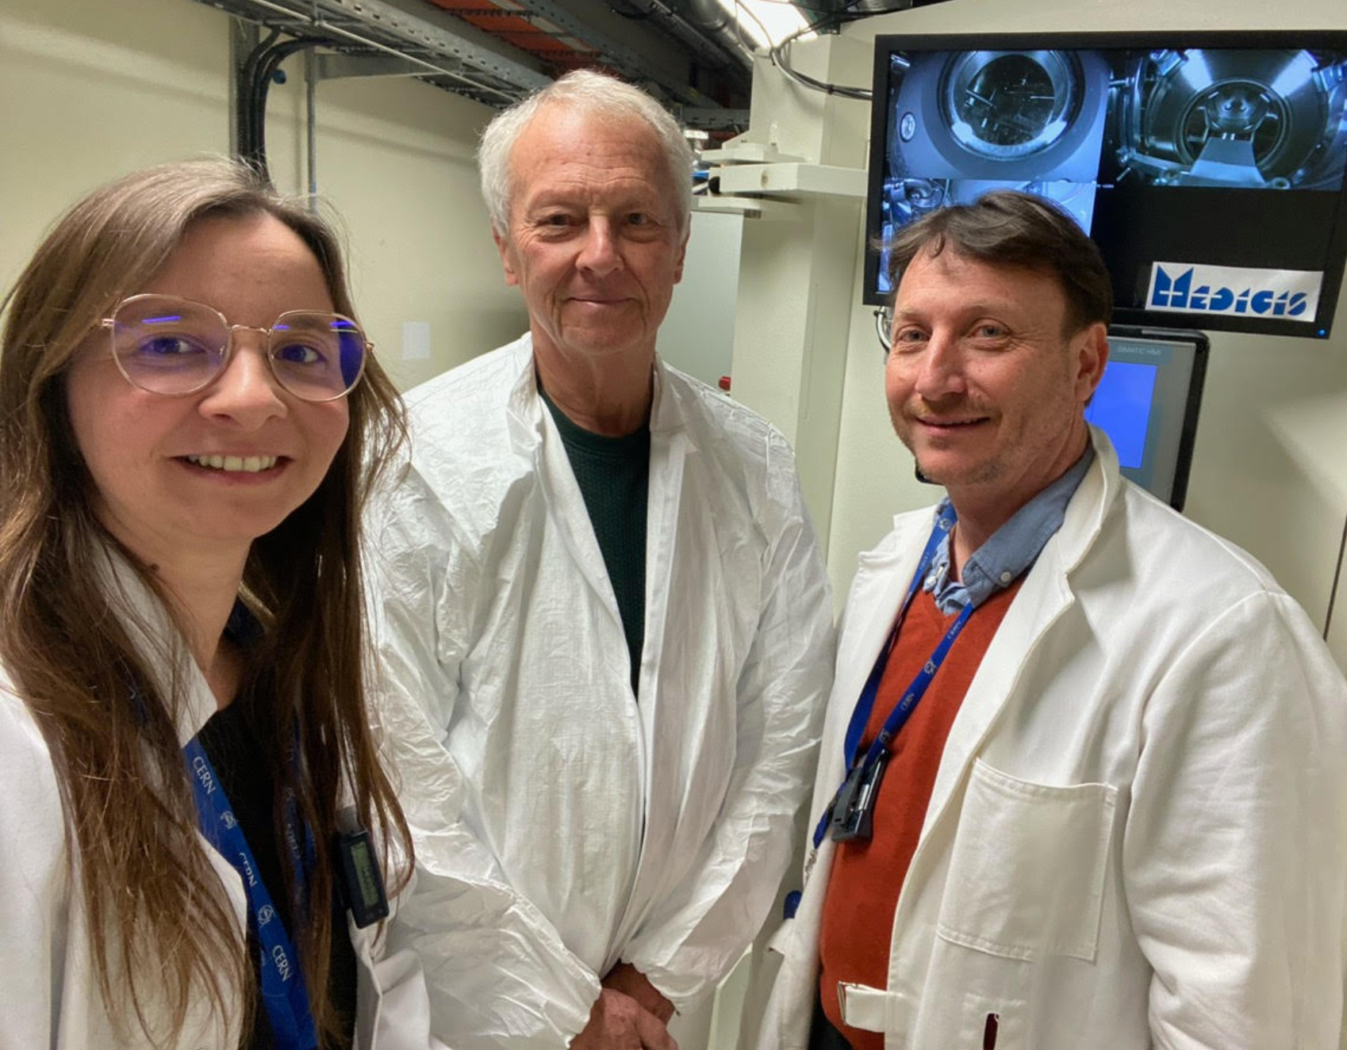
Medical “applications” at CERN : from a 1st PET-CT at Geneva Hospital/CERN to (the history of) isotope mass separation
Visit of Dave Townsend at CERN
A couple of months ago

Slide 3
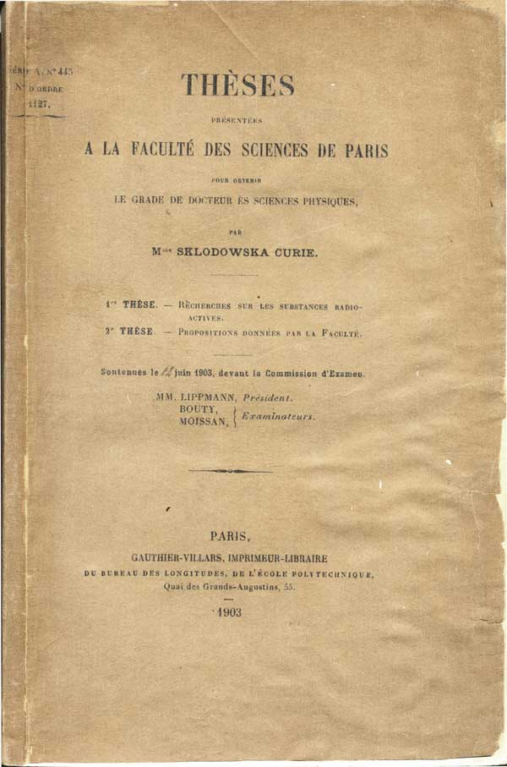
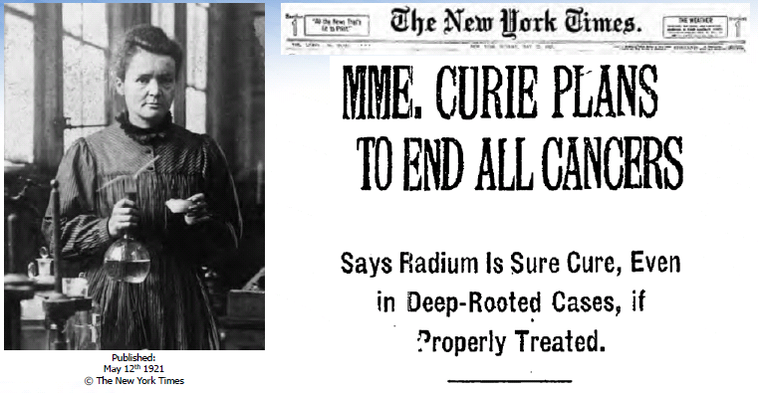
The early days of… radionuclides for medical treatments
Marie Sklodowska-Curie
1867-1934
Courtesy prof O. Ratib

Slide 4
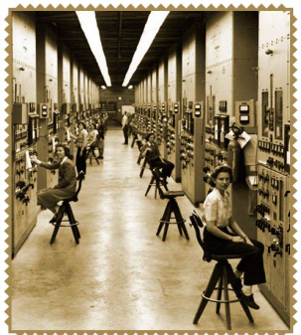
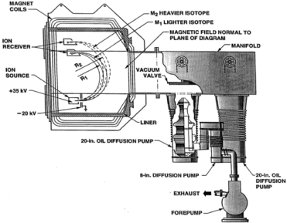
(“Stable”) Isotope mass separation added value
Non carrier added radioisotope fraction (high specific activity)
Efficiencies to be developed
Can this process be applied in large scale ?
A first terrifying use: 235 uranium enrichment of “Little Boy”
And later a much more positive application :
isotope enrichment for medical isotope production
The Calutron (E. Lawrence)

Slide 5
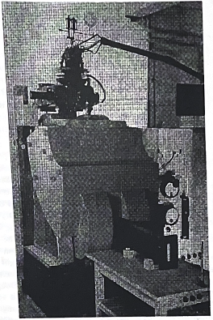
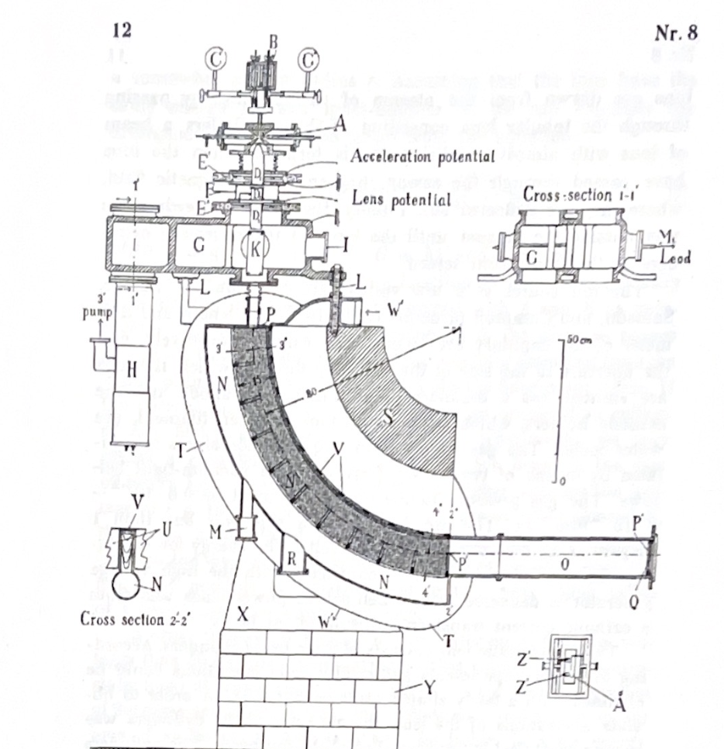
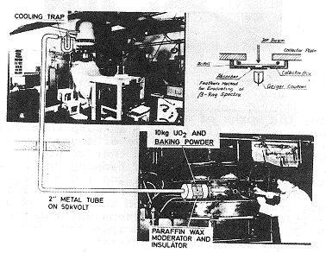
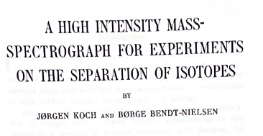

ISOLDE “0”
O.Kofoed-Hansen
K.O. Nielsen
Dan. Mat.Fys.Medd. 26, no. 7 (1951)‏
10 MeV deuterons
d-to-n converter (Be)‏
n moderator (wax)‏
UO₂ (10 kg)
Baking powder
a 4.5t isotope mass
separator
⁸⁹Kr (CO₂, H₂O, NH₃)‏
Hosted in the institute of… theoretical physics
headed by prof. Niels Bohr
CERN 76-13, 3rd conf. nuclei far from stability

Slide 6
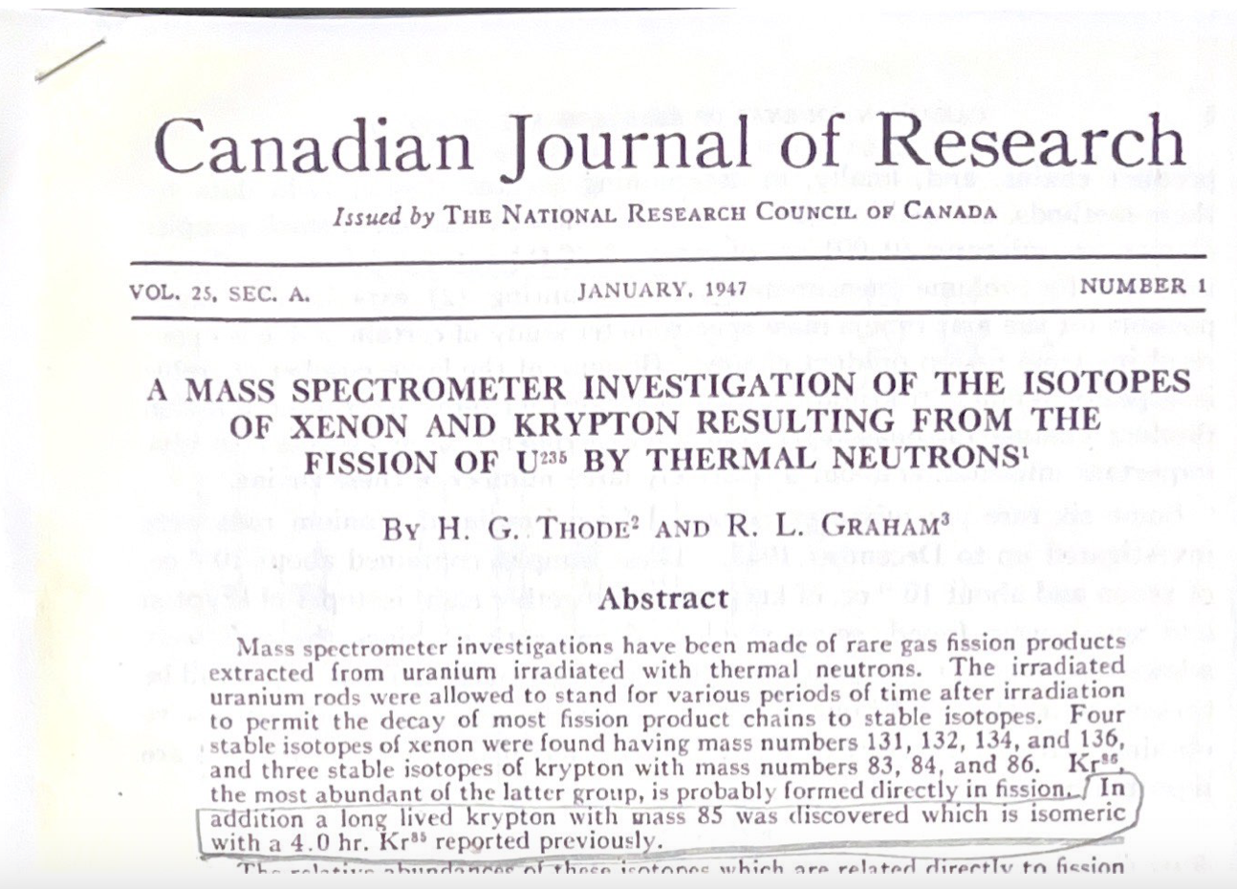
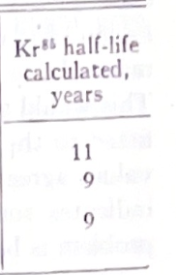
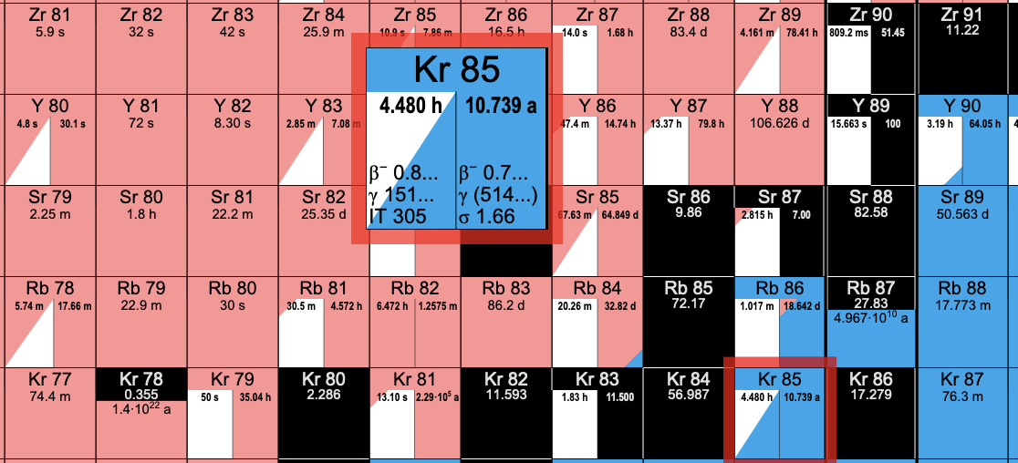
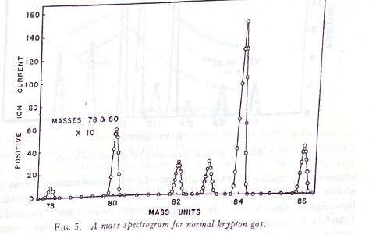
And the birth of (radio!)isotope mass separation
1st (long-lived) artificial radionuclide
separated
T_{1/2} = 9.7 (+/- 1.15 !) yr !

Slide 7
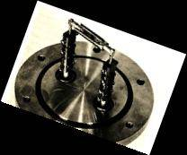
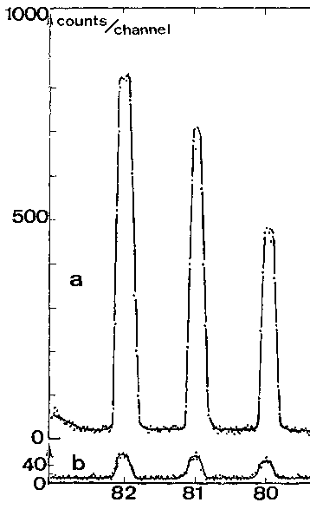
And later at CERN,
1st Targets used at CERN-PS for alkali metals (p 10-24 GeV)‏
Target preparation:
5cm long, 6mm diameter.
36x 70μm C, 1-10μm (1-8mg/cm²) U compound, 100μm gap: tot 0.3g/cm² U
Operated at ca 1500°C
Fission
(10.5GeV p on ThCx)‏
Rb release
Phys Rev Lett, 1968
After
Proton
pulse
R. Klapish et al.
(UCx at CERN-PS&IPNO/CSNSM, 1967)‏
Na from Ir/C target
After 8 sec.

Slide 8
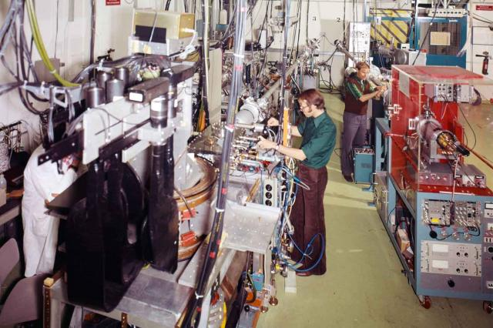
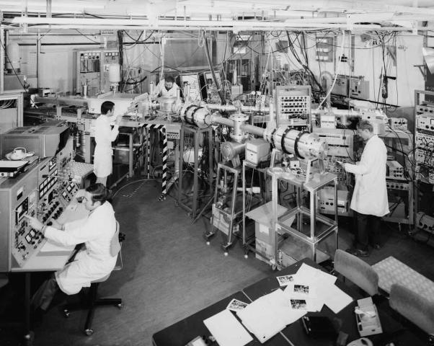
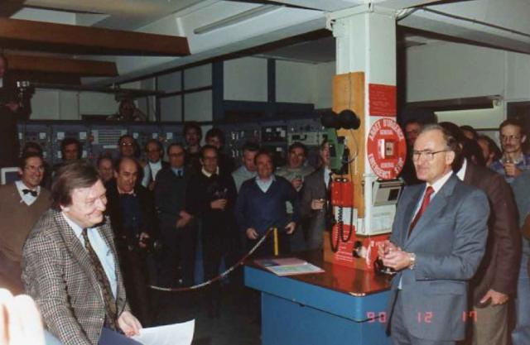
ISOLDE : celebrating 60 years at CERN (CERN celebrating 70 years) in 2024
June 1983: ISOLDE III approved –
high resolution separator (2x) HRS magnet
Delta M/M ~ 5000
1964: CERN approves ISOLDE
CERN Convention: 1953
1967: First beam at ISOLDE
Dec 1990: The Synchrocyclotron beam ends
New ISOLDE facility → Online in 1992@PSB
8

Slide 9
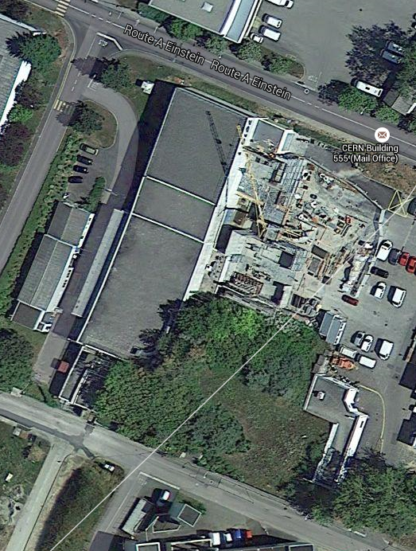
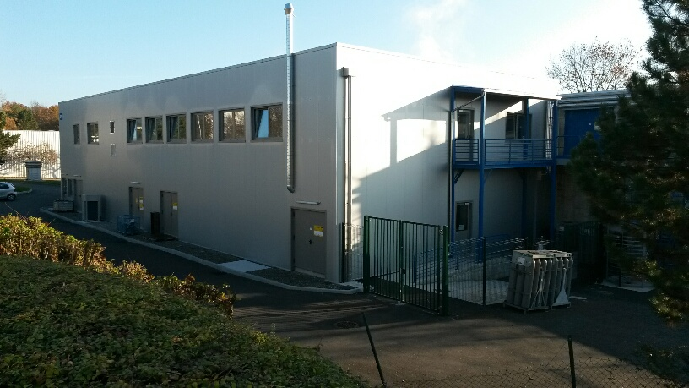

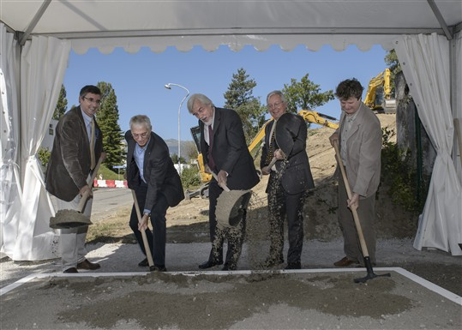
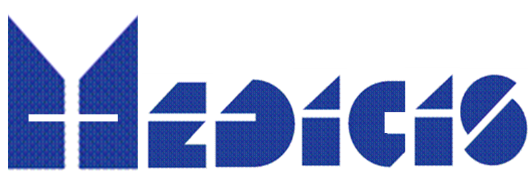
ISOLDE complex and MEDICIS at the PSBooster
2014
2007
1999
2014
User and Operations facility building
2012
Year 1992
2013
Nanolab
in 2020
PSBooster
1→1.4GeV
2GeV for
LHC (2021)
2004
Proton beam upgrades
2GeV
2026-27
2020
2014
Groundbreaking
9

Slide 10
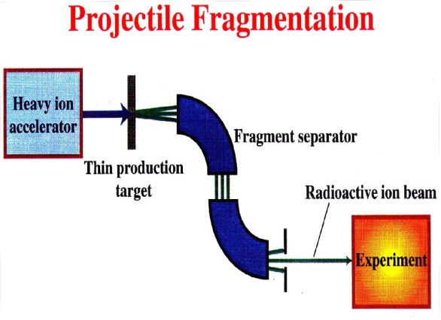
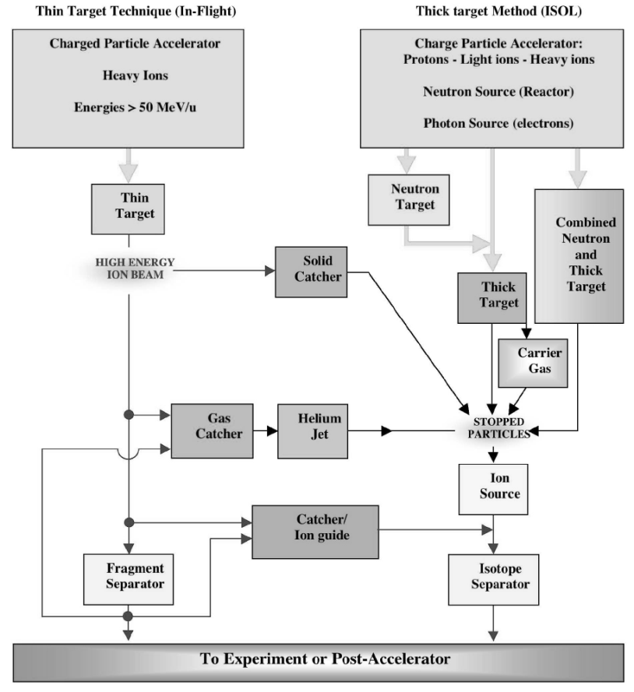

The main ingredients :An accelerator for isotope production + mass purification

Slide 11
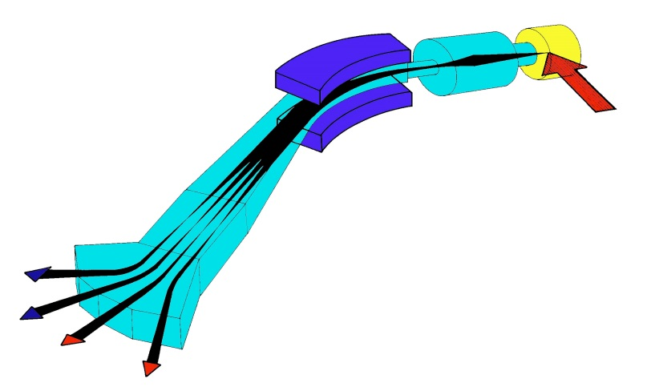
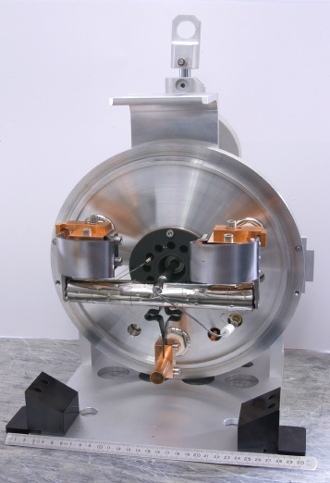
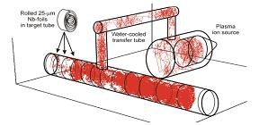

Radioisotope Beam Production at ISOLDE
I[pps] ~ Φ[pps] σ[barn] N[g/cm2] ε [%]
20cm
10-100m
Target and Ion Source
Analyzing
Magnet
Intensity
Purity (quality)
Reliability
Proton 1.4 GeV
Isotope Separation
OnLine (ISOL)
Diffusion
Physical Chemistry
ΔH_{ads} = 145 ± 15 kJ/mol
Eur. Phys. Lett. 98, 32001 (2012)
Highlighted in Europhysics news

Slide 12
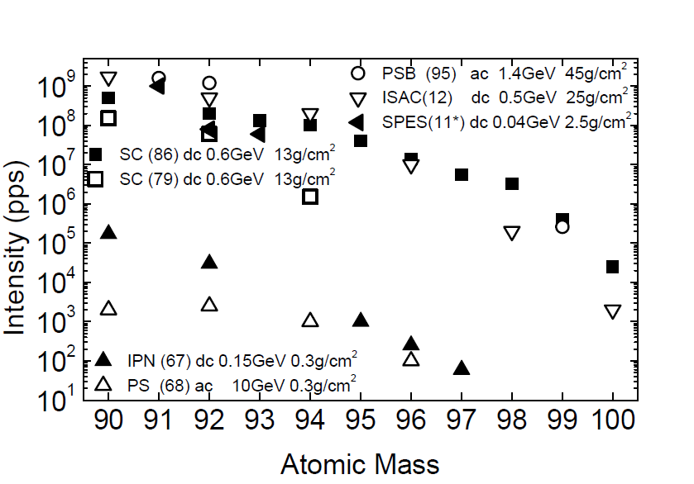
Rb intensities over time across facilities
HIE-ISOLDE 6μA-2GeV
(ARIEL, SPIRAL 1 upgrade,
SPIRAL 2, RISP,
ISOL@Myrrha, …)
Rb
Figure of merit of a given radioactive ion beam facility:
Diversity of available beams.
Beam intensity (secondary ions/ primary beam μC).
Beam quality, for instance purity, time structure and emittance.
Facility down-time.
Stability of beam intensity over time.
T. Stora, Recent developments of target and ion sources to produce ISOL beams, NIM B317, 402 (2013)

Slide 13
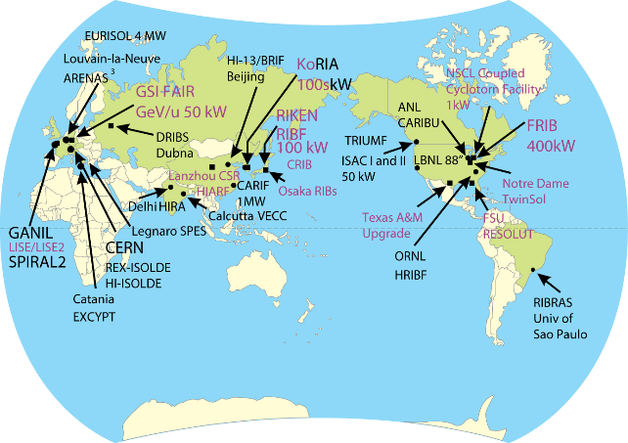
World map of radioisotope ion beam facilities*
In-flight
Fragmentation
Facilities (in red)
Isotope Separation
OnLine Facilities
ISOL (in black)
ISOL@Myrrha
( ) RISP/Raon
RAON has started in 2023
SPES started in 2024
ISOL@Myrrha project->2028
has started construction
Workshop at SNS in 2024
( )
E
SPES
*As shown during FPRIB, Saha inst., Kolkata, India
(Apr 2012)

Slide 14
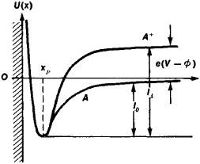
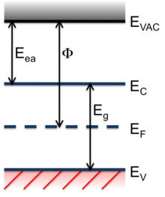
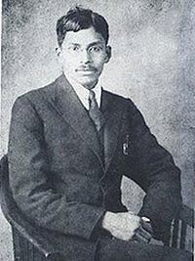

Surface Ion Sources
0
e-
+
Hot tube
Material work function Φ
Isotope 1st Ion. Pot. : Wi
Saha-Langmuir Equation
For Alkalis,
g₀=2 (2S1/2, degeneracy 2), g+=1
Some additional correction factors such as applied electrical potential or
surface coverage
Meghnad Saha, 1920

Slide 15
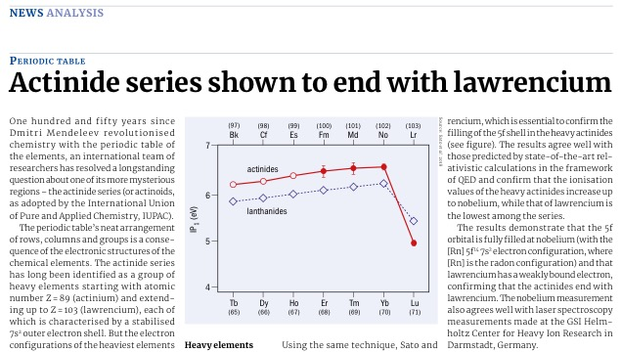
Clever use of Surface Ion Sources
2015
New publication in 2018
Ideas to measure Ionization potential
On element Z=104

Slide 16
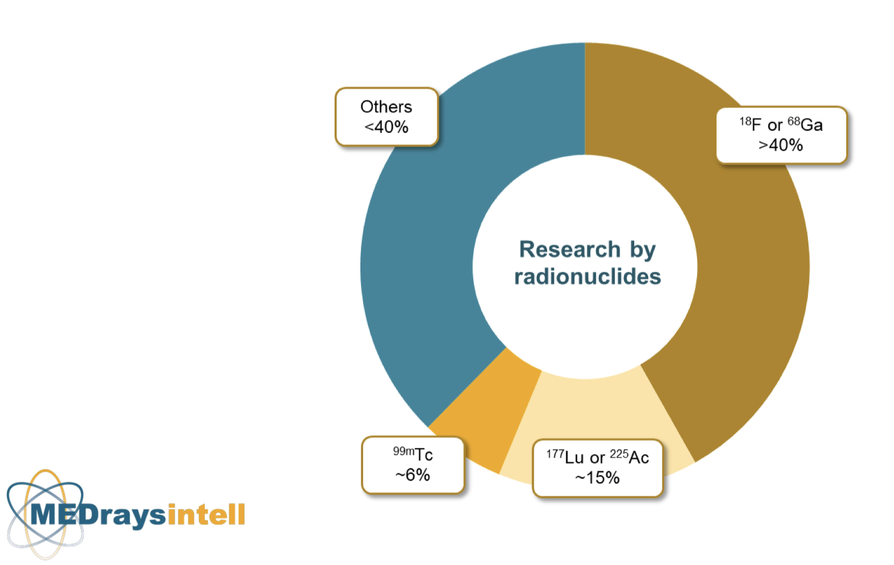
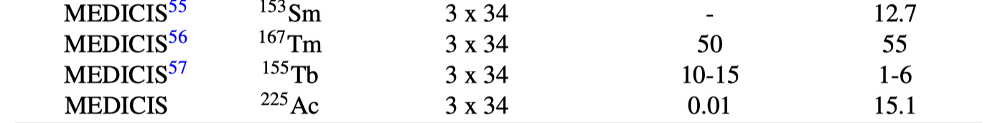
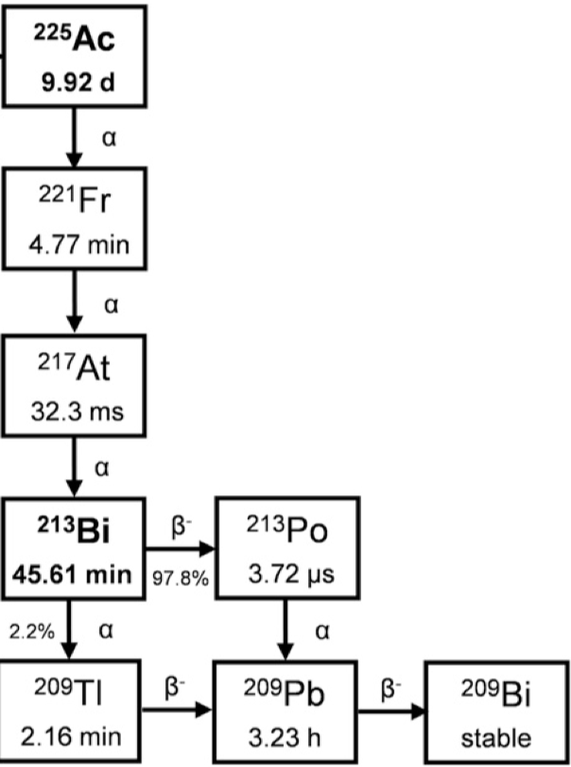
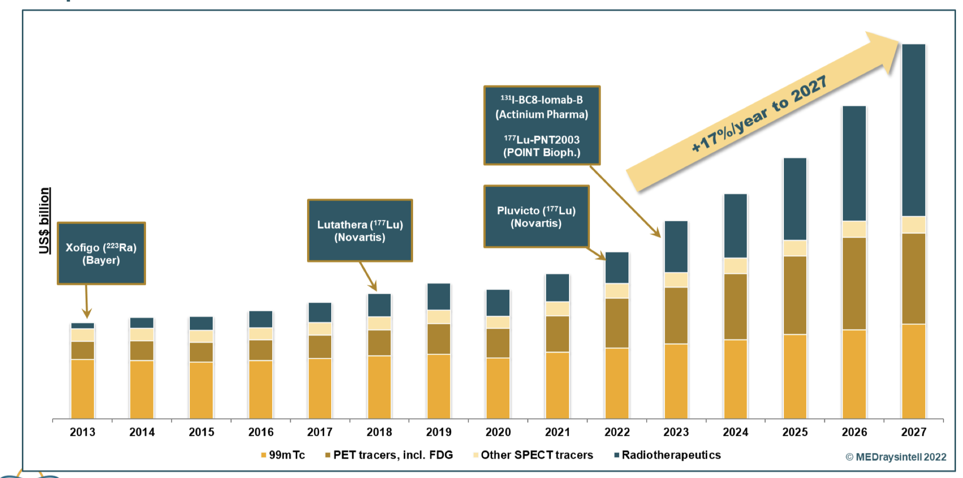
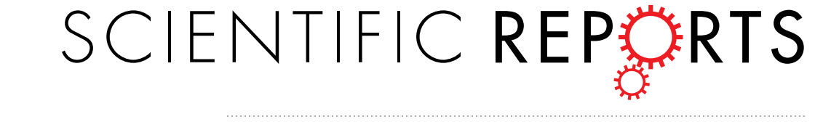
Fom one-atom-at-a-time experiments to larger production needs
Ionisation efficiencies
%
%
²²⁵Ra 50-70%

Slide 17
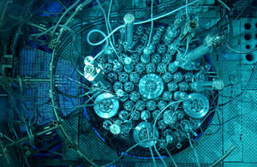
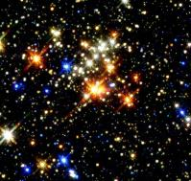
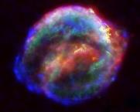
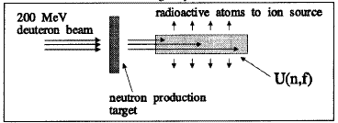
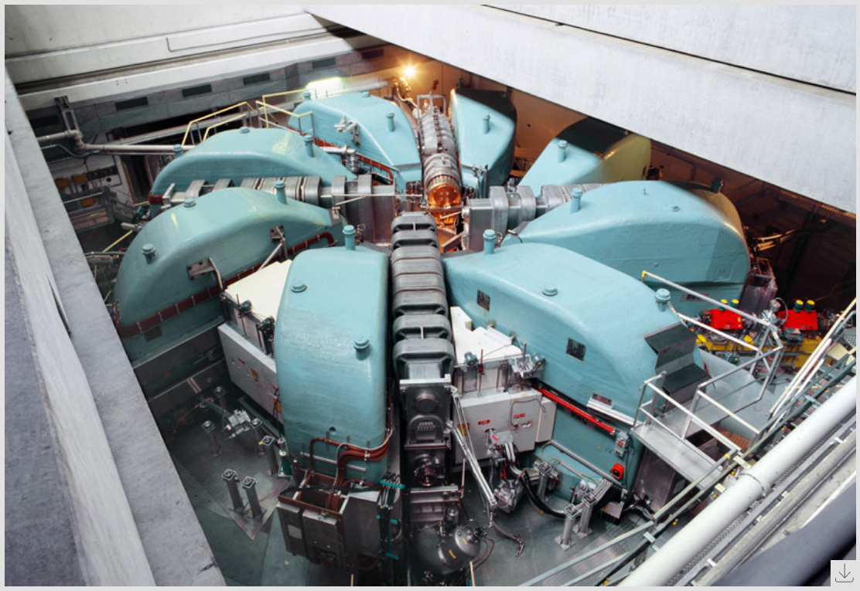
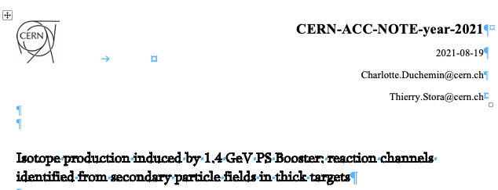
Which facility ( accelerator, particle, other) for which isotope ??
Aka how to translate isotope production to machine parameters ?
Research reactor
P-> d,α, t
Accelerator
J. Nolen, Report to Users of ATLAS,
ANL, USA, 1995

Slide 18
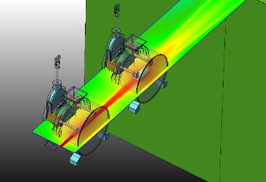
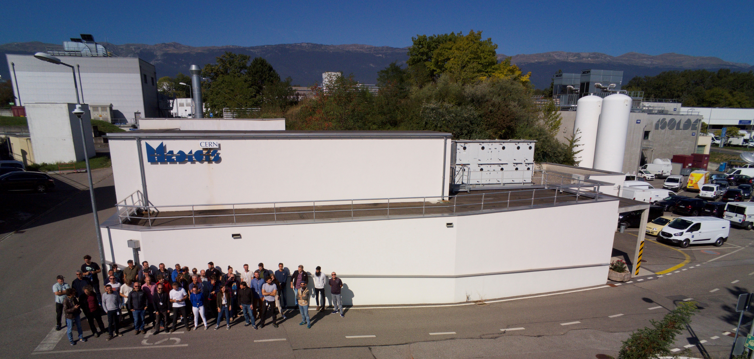

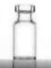
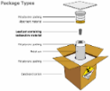

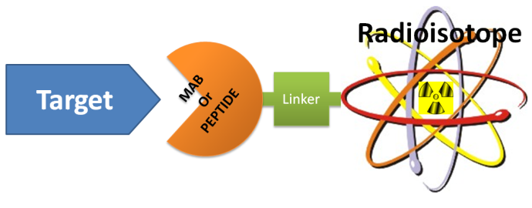
Mass separation as applied in MEDICIS in a snapshot
“Free” proton beam
(otherwise lost in the dump)
Some MEDICIS isotopes :
High activity Sm-153, Ba/Cs-128, Tm/Er-165
MEDICIS
1.4 GeV protons
ISOLDE
120MBq Auger ¹⁶⁵Tm >99%
Produced/delivered in 24hr
A dedicated
medical isotope
Mass separation facility
in Europe.
From CERN- MEDICIS to the lab/Hospital

Slide 19
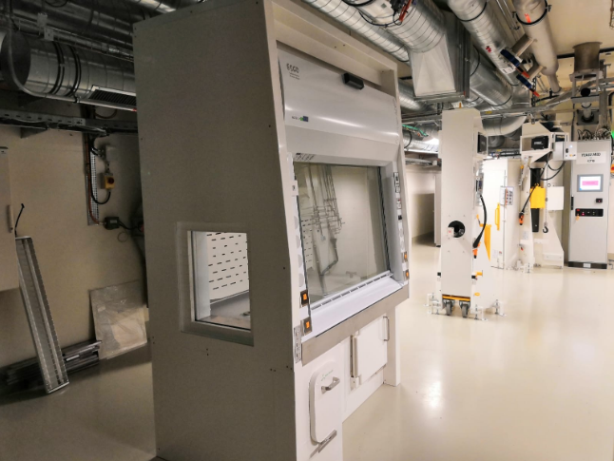







From CERN- MEDICIS to the lab/Hospital
120MBq Auger ¹⁶⁵Tm >99%
Produced/delivered in 24hr
Isotope separation for experiment MED011
from external 168/169Er source
From CERN- MEDICIS to the lab/Hospital
(Countries: BE, CH, FR, PK, PT, LV, UK)

Slide 20




From ISOLDE in fundamental physics to MEDICIS
²²⁴Radium is pear shaped.
Highlighted by Physics World as one of the 10 breakthroughs in 2013
Radium radionuclides in the spotlight
Ra-225/Ac-225 & Ra-224
provided up to 700 MBq
High demand from MEDICIS
and PRISMAP end-users
223, 224, 225, 226
Pb-212
Ac-225

Slide 21



How to progress in the field (The MEDICIS approach) ?
MEDICIS Board
CERN Council vote 27 March

Slide 22






There is two important elements:
Radiopharmaceuticals can have imaging and treatment properties
The same biological vector can be used, and targeting tissues for diagnostics and therapy
PET 152-Terbium radionuclide in antibody-based targeted moleculer therapy
Diagnostics
THERAPY
A
B
Matched therapeutic Tb
C. Müller et al.,
Journal of nuclear medicine 53.12 (2012): 1951.

Slide 23



Historical medical studies of radiolanthanides collected at ISOLDE
ISOLDE, MEDICIS,
Arronax+MEDICIS
G. Beyer et al,
Hyperﬁne Interactions 129 (2000) 529–553
Total body scan of a rabit
with Tm-167-citrate
G. Beyer et al,
https://doi.org/10.1016/
0020-708X(78)90105-9.
Sm-142 EDTMP
&(p,n)
CERN-MEDICIS
ILL+MEDICIS
Most of the radiolanthanides produced with
the isotope mass separation technique
were investigated for preclinical
and imaging proof-of-concept studies
High Molar Activity Sm-153 : SCK CEN + MEDICIS
Tm-167 : PSI + MEDICIS

Slide 24






How to construct a magic bullet – FAPI-46
Multi tumor targeting molecule
Tumor specific, high uptake (SUV >10)
Large extra-cellular domain
Ligand-induced internalization
Post-Proline-Cleaving-Protease Inhibitor
Rapid kinetics of low-molecular-weight ligand
Universal DOTA-Chelator
⁶⁸Ga-FAPI-04 PET/CT 1 h p.i.
Courtesy MD Dr Kratochwill, Heidelberg hospital
Image of the year SNMMI / JNM 2019

Slide 25


FAPI-46 – Optimization of PharmacoKinetics
Courtesy MD Dr Kratochwill, Heidelberg hospital

Slide 26


FAPI-46 – Optimization of PharmacoKinetics --> 16 h
Courtesy MD Dr Kratochwill, Heidelberg hospital

Slide 27


FAPI-46 – radionuclide match for PharmacoKinetics --> 16 h
Courtesy MD Dr Kratochwill, Heidelberg hospital

Slide 28


A magic bullet would have perfect tumor vs. normal-organ dosimetry
Serial imaging and blood sampling
Segmentation of organs and tumors.
TAC fitting. Integration of number of decays
in target volume.
Segmentation of target mass per CT
OLINDA calculates organ und tumor (Sphere model) absorbed dose [Gy]
Dose-limiting organs:
Red-marrow: 1-3 Gy
Kidneys: 23-30 Gy
Tumor: > 80 Gy needed
Courtesy MD Dr Kratochwill, Heidelberg hospital

Slide 29

¹⁵³Sm-FAPI-46 – the issue of “specific activity”
TUMOR SECIFIC UPTAKE: TARGET NUMBERS
RECEPTOR NUMBER
typical example:
10 g tumor ≙ 10¹⁰ cells
10⁵ receptors per cell
patient: 10¹⁵ binding sites
TRACER NUMBER
86 mg Doxorubicin ≙ 10²⁰ molecules
3.5 mg Vinchristin ≙ 10¹⁸ molecules
270 mg Kadcyla ≙ 3 x 10¹⁷ molecules
6 GBq ¹⁷⁷Lu ≙ 5 ×10¹⁵ atoms
20 MBq ²²⁵Ac ≙ 10¹⁴ atoms
Courtesy MD Dr Kratochwill, Heidelberg hospital

Slide 30




¹⁵³Sm-FAPI-46 – the issue of “specific activity”
Limitations of reactor produced ¹⁵³Sm:
Eu-152 and Eu-154 impurities
(half-life > 8 y)
Sm-152 : Sm-153 is 120 : 1
Courtesy MD Dr Kratochwill, Heidelberg hospital

Slide 31



The PRISMAP Consortium

Slide 32



From one-atom-at-a-time experiments to large production needs
Scaling-up – and down(!) - stories
Tomorrow
Today
Raman Z-fold laser using diamond
Ionisation efficiencies
Physics and Chemistry
Objective:
Wavelength extension
%
%
²²⁵Ra 52 (70) %
=> First-ever use online for Radium ionization in MEDICIS in September
C. Bernerd et al., to be published

Slide 33




From low to high specific activity radiopharmaceuticals for theranostics
¹⁵³Sm-EDTMP
(low specific activity)
¹⁵³Sm-DOTATATE
²²³RaCl₂
¹⁷⁷Lu-DOTATATE
Matched with Ba/Cs-128
Matched with Pb-203

Slide 34



Thank you ! Questions ?
Some information and references:
medicis.cern
prismap.eu (join the PRISMAP user forum)
This project has received funding from the European Union’s Horizon 2020 research and innovation programme under grant agreement No 101008571 (PRISMAP).

Slide 36
Example of schedule when CERN Accelerator complex is in Long Shutdown

