Slide 2
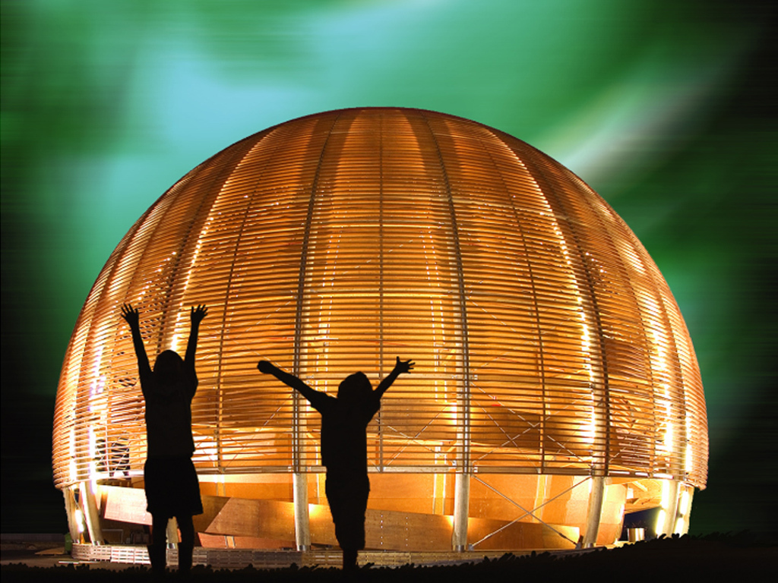
Welcome @ CERN
© CERN Photo
Notes:
1
WELCOME

Slide 3
Welcome Bienvenue
Muriel Colson
HR Department
People eXperience & Engagement
Jenni Suutala
HR Department
People eXperience & Engagement
Notes:
1
2

Slide 4
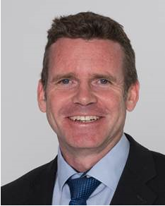
Bienvenue
Welcome
James PURVIS
Chef du département des ressources humaines
Head, Human Resources Department
Link to video on Indico
Notes:
1
**************
But first let me welcome James Purvis, our Head of HR department.
Lisette Van Den BOOGAARD, our HR Deputy Department Head, who will welcome you this morning.
James/Lisette the floor is yours.
Thank you James.

Slide 5
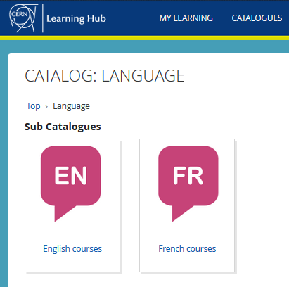


Logistics - language
Tandem
→ link
Find a partner
to practice speaking
each other’s language
Different levels, different formulas
classroom on site
virtual classroom (online)
blended (mix)
self-study with online platform
→ Learning Hub
Notes:
1
*************
At CERN we have 2 official languages, English and French.
Aujourd’hui, nous utiliserons principalement l’anglais, mais n’hesitez pas d’intervenir en francais si vous le souhaitez !
Est ce que certains d’entres vous maitrisent bien ces 2 langues ?
No problem if not, to learn English or French, there are classroom courses organised on the site, which are also open for spouses. You find the details on the CERN learning hub – link here.
And you can also create the opportunities yourself by exchanging with your colleagues / peers and maybe you meet someone here who could help you out with learning the other language.
We also propose a tandem website. The aim of the website is to facilitate finding a partner (not to bike together but) to meet and learn by practicing on a voluntary basis each other’s language, not limited to English and French !

Slide 6

Logistics - slides
Available at any time
direct link : https://indico.cern.ch/category/10150/
Notes:
2
*************
The slides are available on Indico, which is an event management software tool created at CERN.
All documentation we are mentioning today + the sessions for Tuesday, 7th, are put on the INDICO page.
The details of your programme are on CERN’s event organization platform: Indico.

Slide 7
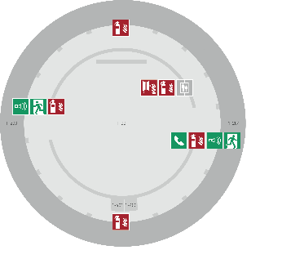
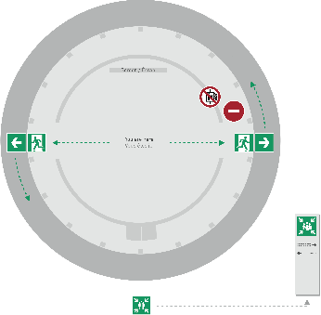
Emergency Procedure d’Urgence
When the alarm sounds
Lorsque le signal d’évacuation retentit
Evacuate immediately
Évacuez immédiatement
Don’t use the lift
N’utilisez pas l’ascenseur
Follow the signs
Suivez le balisage
Go to assembly point
Rendez-vous au point de rassemblement
74444
Escape routes
Voies d’évacuation
Fire hose
Lance d’incendie
Extinguisher
Extincteur
Assembly point
Point de rassemblement
Notes:
2
**************
Welcome on board !
When you take a flight, you always get the emergency demonstration
When the alarm goes off (sound), everybody leaves immediately the room, using one of the 2 exits – never the lift.
We come together in front of the green panel “Assembly Point”.
Safety is important at CERN – there is a whole unit in charge of Health, Safety and Environment, which is directly attached to the DG.

Slide 8
Programme of the morning
08.50 Quiz – Part 1: CERN as organization
09.15 Group photo, coffee break and networking
09.55 Quiz – Part 2: Daily life at CERN
10.25 Meet colleagues from your department
Transfer to department
11.00 Welcome in your department
Notes:
1
************
So as in mentioned we will be spending about 2hours together.
We will start with a first quiz part to know more about CERN as an organisation.
After this we will take a group photo Souvenir of this first day, have a coffee break and do some networking.
We will then have a 2nd part of Quiz looking at the Daily life at CERN and then it will be time to close thi session and you will join the colleagues in your departments.

Slide 9
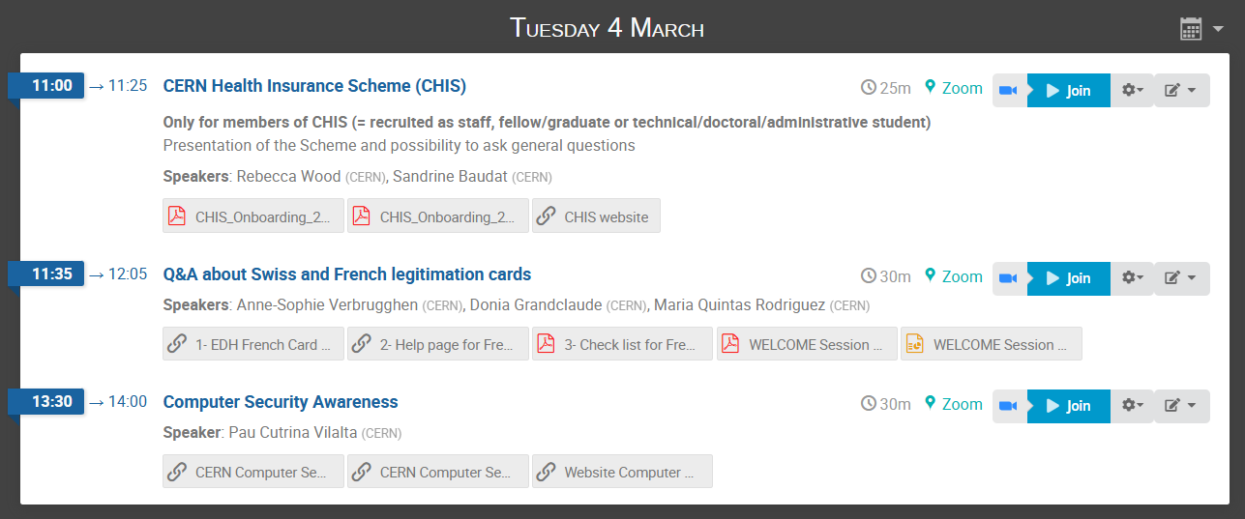


Also: Tuesday 4 March
Notes:
1
************

Slide 10

Ready to learn
more about CERN
via a quiz ?
Notes:
2
**********

Slide 11
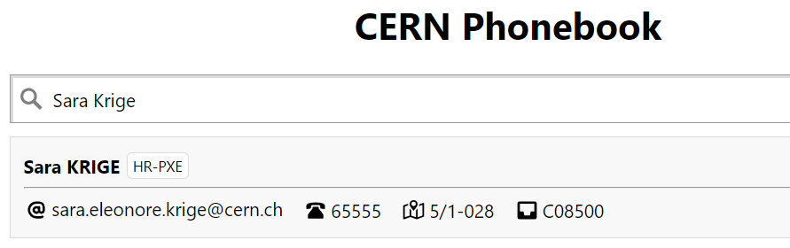


Building 5,
1st floor
office 028
R = ground floor (rez de chaussee)
S = basement (sous-sol)
<<<<<<<<<<<<<<<<<<<
Notes:
1
*************
So if you need to find the office of someone you can use the CERNphonebook:
Type my name you will find my office 5/1-28. I have my office in building 5, on the 1st floor, and the office number is 28.

Slide 12
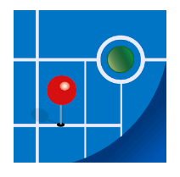
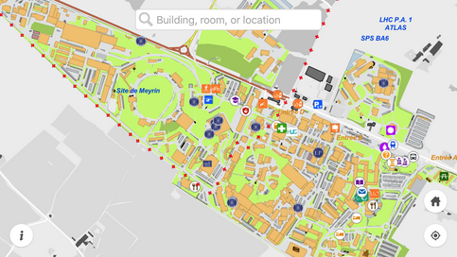
MapCERN
Notes:
1
************************
So if you are looking for my office how will you work it out – CERN campus is quite huge as you will surely discover.
Luckily there is a CERN Map application which you can install on your phone and this will help you navigate.
You can do a quick search, it covers all places at CERN and works offline.

Slide 13
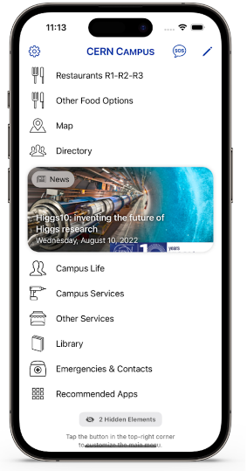
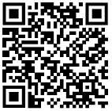
New
CERN Campus app
centralizes all your most important campus services in one place
Notes:
1
To go even further a CERN campus app is also avaialble and it covers of course the map, but also other very useful info such as restaurants, the phonebook, upcoming events, campus services you can find onsite etc.
I installed recently and its super handy.

Slide 14
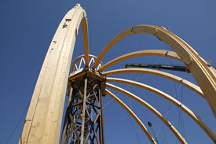
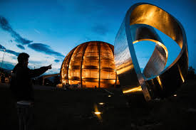
© CERN Photo
https://visit.cern/globe
© CERN Photo
Notes:
2
************************
The Globe is building with a history similar to the Eiffel tower.
Built for a national exhibition in Switzerland in 2002, which lasted 6 months, it was located near the lake of Neuchatel and called at that time the Palais de l’equilibre.
This name is however no longer used.
At the end of the exhibition, it was dismantled and the Swiss Governement offered to re-build it on the CERN site.
The building technique is quite unique : they start with top crown, which is on a temporary platform. Once all the beams are put in circle, the platform is dismantled : the crown holds everything together.
The shape of the building represents the planet Earth (outer layer to protect the building against Sun and other elements, just like the atmosphere does).
The Globe has become a landmark in the Geneva area.
If you want to know more about it, here is a link :
https://visit.cern/globe/history-globe

Slide 15

CERN as an international organization
Quiz – part 1
Notes:
2
************************
Ready to start with the real quiz ?
We first have a few questions about CERN as an international organisation.

Slide 16






CERN MoP
~16 950
Contractors
> 4 500
Employed MPE
~ 3 560
Associated MPA
~ 13 400
Staff
~ 2 660
Fellows/ Graduates
~ 900
Users
~ 11 900
Associates
~ 950
Students
~ 540
Notes:
1
************
If you answered 2 660, then you probably only took into account the staff members.
But on top of the staff, we also have around 900 fellows/grads.
The staff members and fellows/grads together are the employed members of the personnel or MPE.
CERN is their employer.
But besides these more than 3500 people, there are also many more who have a contract with CERN, although it is not an employment contract :
First of all, we have more than 11 000 users, who are working in scientific collaborations
And also almost 950 associates
And more than 500 students
All together approximately 13 400 people who have a contract of association with CERN.
Both MPE and MPA are considered MoP, and you are a member of that big family of almost 17 000 people.
How many people on the CERN site on an average day ?
Not all users are present at CERN every day. Note also that there is also personnel from contractors which can be working on the CERN site : there are more than 4 500 such people with an active registration, and some of them come here every day while others come only for the duration of a specific intervention.
In May 2022 we had an average of 6500 people on site every day (including 1500 contractors)

Slide 17
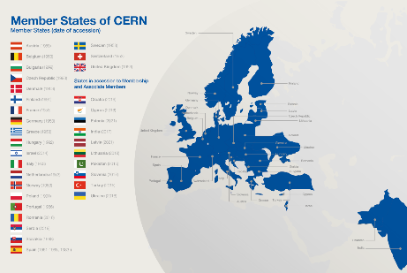
Revenues 2022
Member State contributions 84 %
Associate Member State contributions 2 %
Special contributions 3.7%
(to HL-LHC, specific experiments, from EU)
Other 10 %
(e.g. knowledge transfer, donations, …)
Principle =
proportional to Gross National Income
→ equal effort for every country
Notes:
2
************************
Sources :
- https://cds.cern.ch/record/2799098?ln=en (budget 2022)
- https://cds.cern.ch/record/2790156 (map member states)
The CERN member states are indeed providing 84 % of CERN’s budget. (click)
There are today 24 Member states – originally when CERN was founded, there were only 12 countries. (click)
In order to have a fair sharing of the cost, the contributions are calculated as a certain percentage of the National Income.
And were does the remaining 16% comes from ?
Well, CERN also has associated member states, who pay a reduced contribution compared to the members states. This amounts to 2% of the budget.
The remaining 14% of the budget come a variety of sources : special contributions from certain countries or institutes, participation of the European Commission, income from knowledge transfer activities, donations to CERN, …)

Slide 18
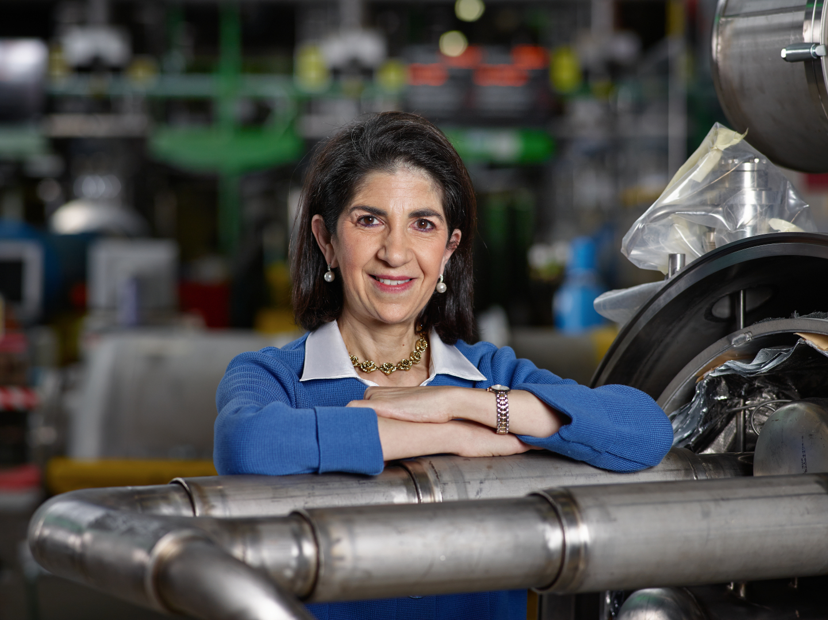
Link to biography
© CERN Photo, 2015
Notes:
1
************************
https://press.cern/biographies/fabiola-gianotti-born-1960-Italian
Fabiola Gianotti is indeed CERN’s 1st female Director General, since 1st January 2016.
From 2009 to 2013, she was spokesperson for the ATLAS experiment, and presented the results on the search for the Higgs boson in a seminar at CERN on 4 July 2012. This discovery led to the Nobel prize for Higgs and Englert.
Gianotti has been awarded several prizes, but not the Nobel prize.
In 2013, she was included among the “Top 100 most influential women” by Forbes magazine, and today she continues to figure in their top 100 of Power Women.
https://www.forbes.com/profile/fabiola-gianotti/?list=power-women

Slide 19
Health, Safety & Environment
Director General
Internal Audit
Legal Service
Pension Fund
Accelerators & Technology
Beams
Technology
Finance & Human Resources
International Relations
Research & Computing
Engineering
Finance & Administrative Processes
Industry, Procurement & Knowledge Transfer
Human Resources
Site & Civil Engineering
Experimental Physics
Theory
Information Technology
AcceleratorSystems
Diplomatic & Stakeholder Relations
Education, Communication & Outreach
Science Gateway Operations
Sector
Department
Group
Notes:
1
So if look now at the structure of CERN, it’s organigramme.
You have Fabiola as DG as just seen and then we have 4 sectors (Acceleretors & Tech, Finance & HR, IR, Research and computing) divided themselves in departments, groups and sections.
We also have some units which are directly attached to the DG and the Pension Fund.

Slide 20
HSE
PF
DG
Benoit Delille
Doug Heron
Fabiola Gianotti
ATS
BE
TE
FHR
IR
RCS
EN
FAP
IPT
HR
SCE
EP
TH
IT
SY
Sector
Mike Lamont
Raphael Bello
Charlotte Warakaulle
Joachim Mnich
Rhodri Jones
Florian Sonneman
Manfred Krammer
Department
J. Miguel Jiménez
Christopher Hartley
Gian Giudice
Katy Foraz
James Purvis
Enrica Porcari
Brennan Goddard
Mar Capeans
Notes:
1
At CERN we love acronyms, you will see there are loads of them.
So the organigram now looks like this with the Acronyms.
ATS – FHR – IR – RCS and the names of the correspoding departments under.

Slide 21
Sector
Director
Department
Department Head
DAO
DPO
DSO
DTO
…
Group
Group
Group
Group Leader
Section
Section
Section
Section Leader
Notes:
1
************
The size of a Department can be from less than 100 people to several hundreds of people.
A Department has usually several groups.
And groups can in turn be composed of several sections.
Here you also see some of the acronyms used: DAO; DPO, DSO, DTO
Departmental admin officer
Departmental planning officer
Departmental safety officer
Departmental training officer

Slide 22
Working at CERN when Nobel prize
1992 : Georges Charpak
1988 : Carlo Rubbia & Simon van der Meer
1984 : Jack Steinberger (with Lederman and Schwartz)
Working at CERN after Nobel prize
1952 : Felix Bloch
1976 : Sam Ting
Nobel prize thanks to discoveries at CERN
2013 : Peter Higgs & Francois Englert
Notes:
2
************************
https://public-archive.web.cern.ch/public-archive/en/About/Nobels-en.html
https://www.nobelprize.org/nobel_prizes/facts/
3 prizes for people who were working at CERN when they received the Nobel prize
1992 : Georges Charpak
1988 : Carlo Rubbia & Simon van der Meer
1984 : Jack Steinberger (with Lederman and Schwartz)
+ 2 Nobel prize winners who worked at CERN
1952 : Felix Bloch, became CERN DG in 1954
1976 : Sam Ting, still works here at CERN on AMS (alpha magnetic spectrometer which is installed on ISS, the International Space Station)
+ 2 Nobel prize winners thanks to discoveries at CERN
2013 : Peter Higgs and François Englert

Slide 23
Welcome to HR-PXE colleagues
Opportunity to ask questions during coffee break
Collective induction session by type of contract
  Graduates (Origin, Quest, …)
  Tech & Admin students in the 2nd week
  Doctoral students
Individually contacted by HRA : Staff
Notes:
1
**************
We have nearly closed this first part, but before that let me welcome my colleagues from the HR PXE team – they will be staying during the coffee break so don’t hesitate to ask questions to them during this time. If you don’t get a chance to meet them, no worries there will be collective induction sessions proposed to you depending on your type of contract and if you are joining us a staff member you will be individually contacted by your HR Adviser.

Slide 24


Slide 25
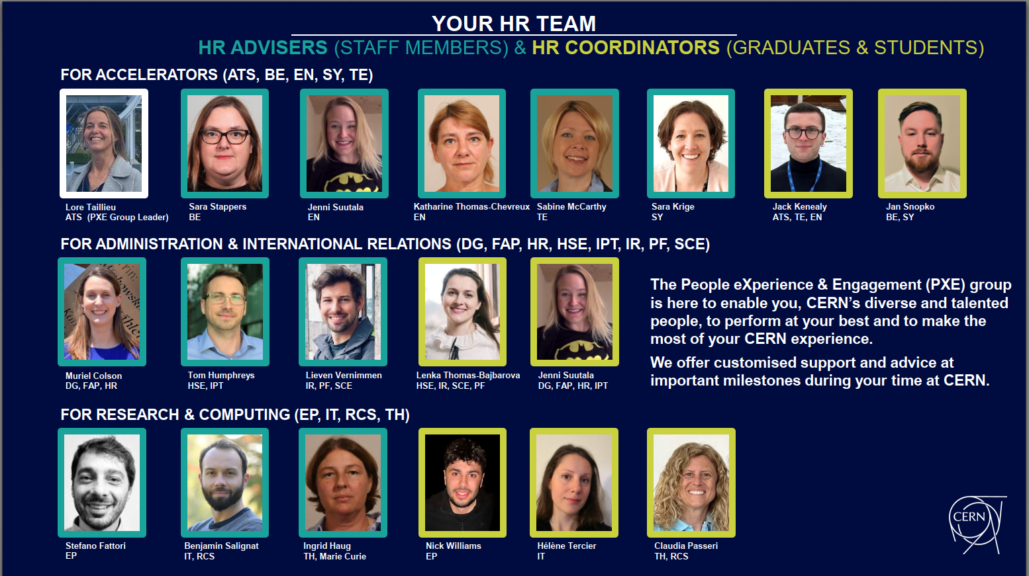

Slide 26
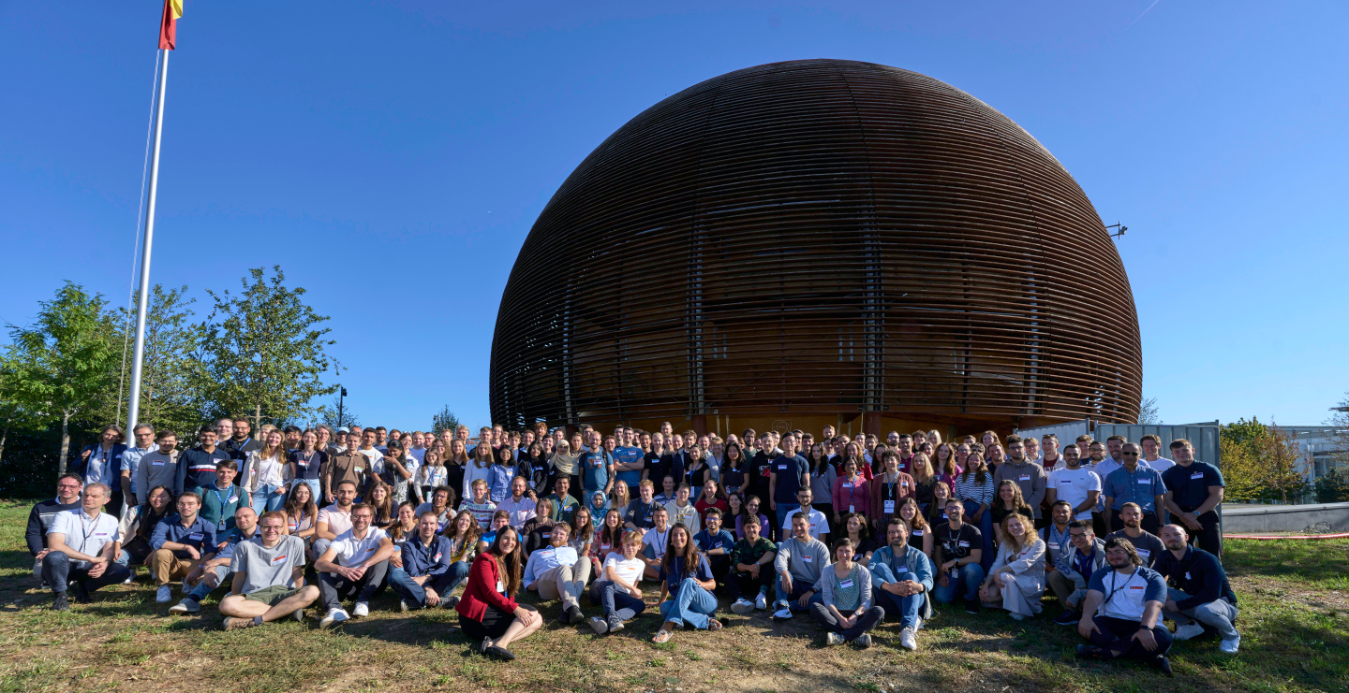
Time for a group photo !
© CERN Photo
Notes:
2
***************

Slide 27
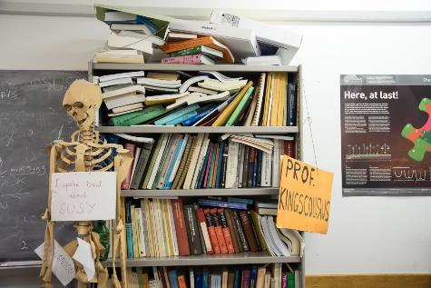
Daily life at CERN
Quiz part 2
Notes:
2
************************
We have some questions for you, which will be helpful for your daily life at CERN.

Slide 28
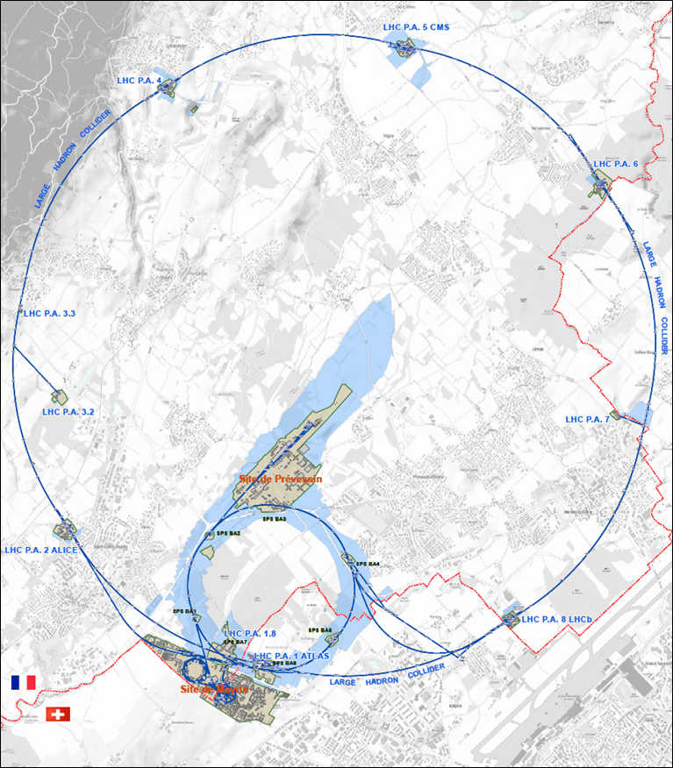




625 ha
515 ha
fenced : 220
110 ha
… 700+ buildings
accounting for
500.000 m²
5 900 parking spots
101 ha
green
spaces
30 km roads
Notes:
2
************************
Source : https://indico.cern.ch/event/669690/contributions/2740056/attachments/1553507/2441980/Mobility_IoT.pptx
CERN is indeed composed of 2 major sites : Meyrin in Switzerland and Prevessin in France. But there are many more smaller CERN sites, especially in France.
CERN has all in all 625 hectares of land, of which 1/3 is fenced. The majority is on the French territory.
There are more than 700 buildings, for a variety of purposes and built in different periods in a variety of styles. Office space as well as parking space are sometimes difficult to find !
There are also 30 km of roads, and normal traffic rules applies. And there is control and sanctions : if you park your car on the footpath, the sidewalk, your car might be towed away.
There also green spaces, especially on the Prevessin site. Some people have the luck to see through their window deers coming out of the wood or a flock of sheep grazing in the prairie next to their office.

Slide 29
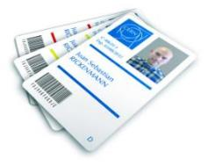
CERN access card
CERN access card
CERN Community Support Centre
buidling 33- Meyrin site,
7.00 am to 6.30 pm, Monday to Friday
vehicle registration
biometrics registration
https://sce-dep.web.cern.ch/security/access
Notes:
1
****************************
Your access card will be available for collection at the CERN Community Support Centre (buidling 33- Meyrin site), in front of CERN tramway stop 18.
The service will be open from 7am. Due to the large number of people coming to CERN that day, please be aware that queues may be expected. You will be able to collect your access card after the Welcome session.

Slide 30




Gates | Days
Meyrin A | Mon-Fri | 24/24 |  | 7-20
Porte Jura Bldg 33 |  | 24/24
Meyrin B (Main entrance) |  | 24/24
Meyrin C | Mon-Fri | 24/24 |  | 7-20
Meyrin D (goods only) | Mon-Fri |  |  |  | 08-12 13-16
Meyrin E (Only Authorised Personnel and contractors. Rules of Use) | Mon-Fri | In : 7-9.30 Out : 16.30-20
Intersites tunnel (restrictions) | Mon-Fri |  |  | 7-18
Prevessin Main entrance |  | 24/24 |  |  | 08-12 13-16
Prevessin Route du Maroc |  | 24/24
Prevessin Moulin des Ponts |  | 24/24
Notes:
1
************************
So how and where you get into CERN.
There are 7 gates at the Meyrin site, and 3 gates at the Prevessin site.
The Main gates in Meyrin and Prevessin are open 24 hours a day, for pedestrians, bikes and motorized vehicles.
You see here the details of when the gates are open, and if accessible by foot, bikes, cars of trucks. As you see there is a specific good entry and there intersite tunnel which requires special authorisation to use.

Slide 31

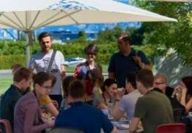
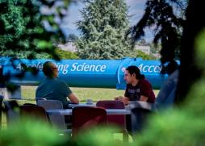
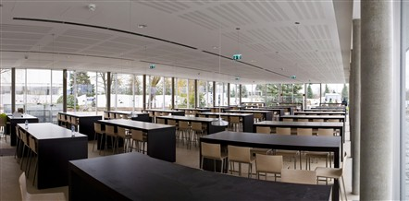
Restaurants
2 in Meyrin (resto 1 & 2)
1 in Prevessin (resto 3)
Cafeteria (snacks)
Building 13, 30, 40, 54, …
Click for more info
© CERN Photo
Notes:
2
************************
There are 3 restaurants on the site. There are always several menus, including a vegetarian.
You can find menus and opening hours in the CERN directory.
There are also microwave ovens, when you heat the food you bring along yourself.
There are also some cafeterias, which often have a reduced offer, and shorter opening hours.
From 15 June to 15 September : discount for students for a meal. Need a badge, can be obtained from your secretariat.
(see announcement https://home.cern/news/announcement/cern/restaurants-offer-student-discount-over-summer

Slide 32
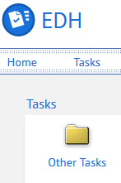
CERN Car
Requires
CERN driving authorization :
Valid driving licence
OK Department Head
Private vehicle
Not requiring registration
  Bike, “trottinette”
Requiring registration
  Must be registered in member state or EU country
  “Tourist” cars only
  Not allowed :
  Scooter, moto, lorry, bus, …
Notes:
1
********************
How do you do this:
- via an EDH request you can ask for the CERN driving authorization.
With regards to the use of private vehicles for journeys on official duty (this includes duty travel, but also travel during working hours and travel to and from the Org Sites), you can find all details in one of our admin circulars (AC20).
In short are permitted for journeys on official duty:
a) private cars provided that they are registered in one of the Organization’s Member States or in a Member State of the European Union, and
b) private non-motorised or electric motor vehicles that do not require vehicle registration.
7. Consequently, all other categories of private vehicle, including motorbikes, scooters, mopeds and private utility motor vehicles are not permitted for journeys on official duty.
WHY – For insurance questions.

Slide 33
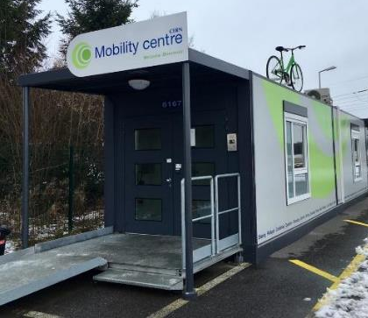
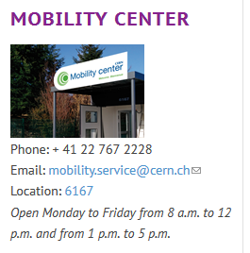
CERN Mobility Centre
Located next to Entrance A
Services offered
Bike rental
Car rental
Car sharing
Bike sharing
Shuttles
….
https://sce-dep.web.cern.ch/campus-life/mobility
Notes:
2

Slide 34


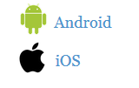
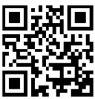
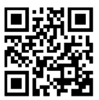
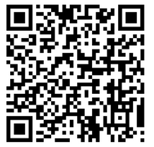
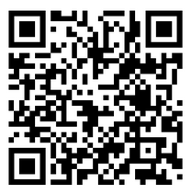
Mobility apps
Car sharing
glide.io
login with CERN SSO
Bike sharing
www.mobility-parc.net/
login with CERN SSO
Notes:
2
********************
For professional use, not for personal use
Car sharing
Max. 4 hours
Driving authorization is required + complete the Safety at CERN online course
If stay on the CERN site – no mission order required, outside CERN site : mission required
Pick-up and return to the same station
Bike Sharing
CERN site and to Prevessin allowed
Normal and e-bikes
50 ebikes all year round + 50 more during Summer
Pick-up and drop off in the another station allowed
Note : you should first complete the online course Road Traffic – Bike riding (and Safety at CERN)
(and wait for one night that the information is propagated and that you can logon to the app)
Link e-learning = https://lms.cern.ch/ekp/servlet/ekp?PX=N&TEACHREVIEW=N&CID=EKP000040487&TX=FORMAT1&LANGUAGE_TAG=en&DECORATEPAGE=N

Slide 35
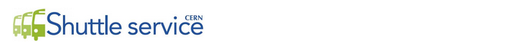
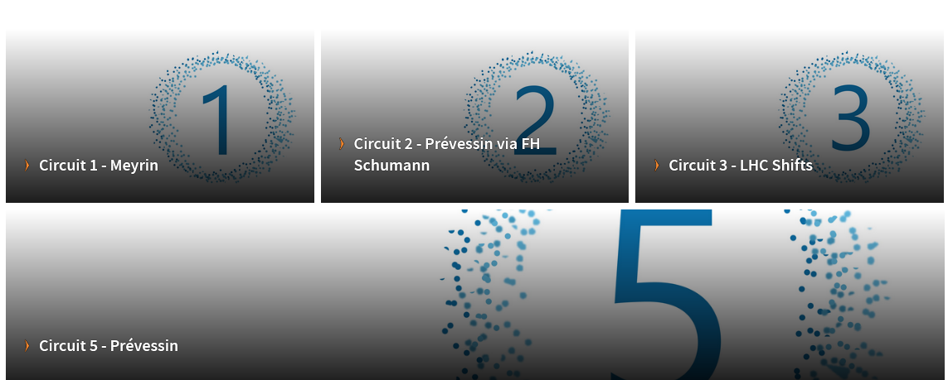
https://sce-dep.web.cern.ch/cern-shuttle-service
Notes:
2
********************
Line 4 is suspended.

Slide 36
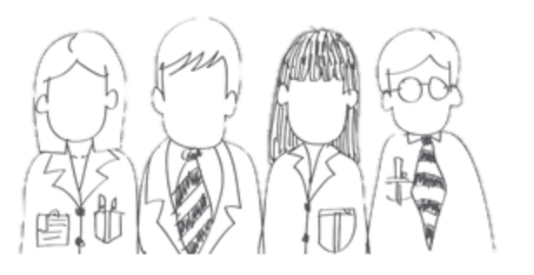

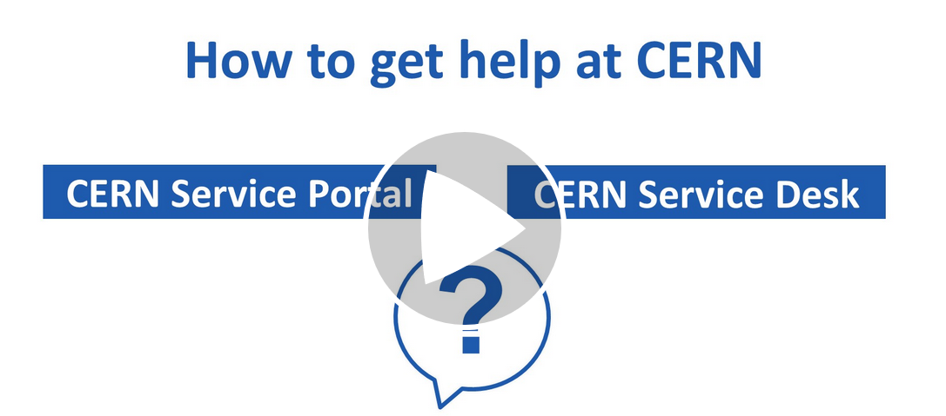




CERN Service Desk
Phone: +41 22 76 77777
Email: service-desk@cern.ch
Monday to Friday
from 7.30 to 18:30
( Geneva time )
CERN Service Portal
Services
Service overview in a glance
Online forms
Report an incident, submit a request
Knowledge articles
Find your answer!
Feedback
Your feedback matters!
https://cern.ch/service-portal
Notes:
1
***************
The CERN service desk will help you with any request, and especially if you do not know which service to contact. They will make sure that your question gets to the right person, and that you get a reply.
Your request will generate a ticket and you will be informed by mail.
You can contact them by phone or by sending an e-mail.
The CERN service portal, accessible from the directory or from the link below, allows you to search for a service, find out what they offer and make an online request. There are also Knowledge Base articles where you find answers to the most frequent questions.

Slide 37
Accident on site – different cases
In all cases
Inform supervisor
In case of
Injury
Environmental hazard
Disruption traffic
3rd party involved
CERN Fire & Rescue 74444
(+ 41 22 767 44 44)
+
Internal accident report (EDH)
+
European Union Car Accident form
Notes:
1
************************
The correct answer in all cases is to call your supervisor 4) and in some cases (3, the CERN Fire and rescue service, through the number 74444.
Why always your supervisor ?
Internal accident report :
- needs to be signed by your supervisor, so for that reason they must be informed immediately.
- also used to report near-misses -> can be used to avoid further accidents
In certain cases, the CERN Fire and rescue need to be called.
We recommend to add the full number in your mobile phone
+41 22 767 44 44, so you can also call them if you are not connected to the CERN telephone network.
And through the CERN campus app you also have the emergency contact details available at hand.
https://admin-eguide.web.cern.ch/node/352
2.2.1 Accident on the CERN site
In the event of injury, disruption to the flow of traffic or involvement of a third party:
The CERN Fire Brigade will go to the scene of the accident, take the appropriate measures required by the circumstances and draw up a call-out report.
The local Gendarmerie/Police will intervene only if so requested by CERN (Relations with the Host States Service or CERN Fire Brigade).
The driver(s) of the vehicle(s) (or, if not possible, the Fire Brigade) must complete a European car accident form (a blue form known as the "Constat européen d'accident automobile"), which must be signed by the parties involved. A copy of page 1 of the form must be sent to the Legal Service and to the CERN's Insurance Manager. If the injured party is a member of the personnel or a family member who is a member of the CERN Health Insurance Scheme, the procedure set out in paragraph 3 must also be followed.
In all other cases, and if the vehicle suffers material damage:
The member of the personnel must draw up a report to which he must attach, where possible, a statement by a witness (the European car accident form may be used). This report (or a copy of the European car accident form) must be sent to the CERN's Insurance Manager together with a statement by the Head of Department or his designated representative, certifying that the journey was made on official duty, or a copy of the official travel form if applicable.

Slide 38
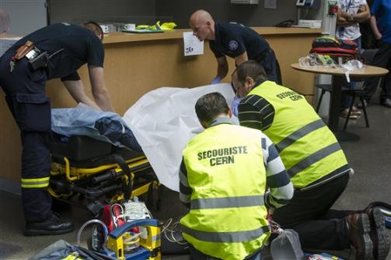
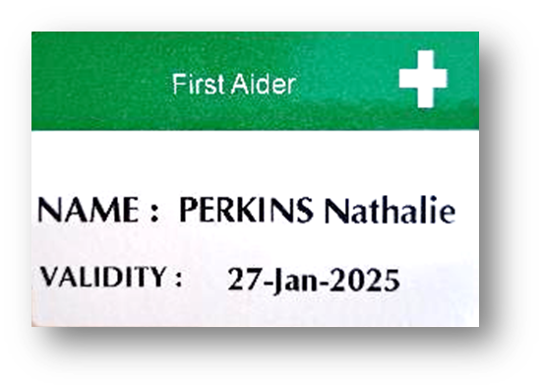
CERN Fire and Rescue Service
assisted by local First Aiders
Find out who
are closest to
your office / usual work places
© CERN Photo
Notes:
1
************************
The CERN’s Fire and Rescue Service who will come in cases needed after an accident is located on Site and is a team of more than 50 qualified fire-fighters and paramedics. They are available 24h/day, all year long.
They are assisted by more than 150 First Aiders, who are trained volunteers.
************************
You can find the qualified first aiders in your building by spotting the green stickers on their door,

Slide 39
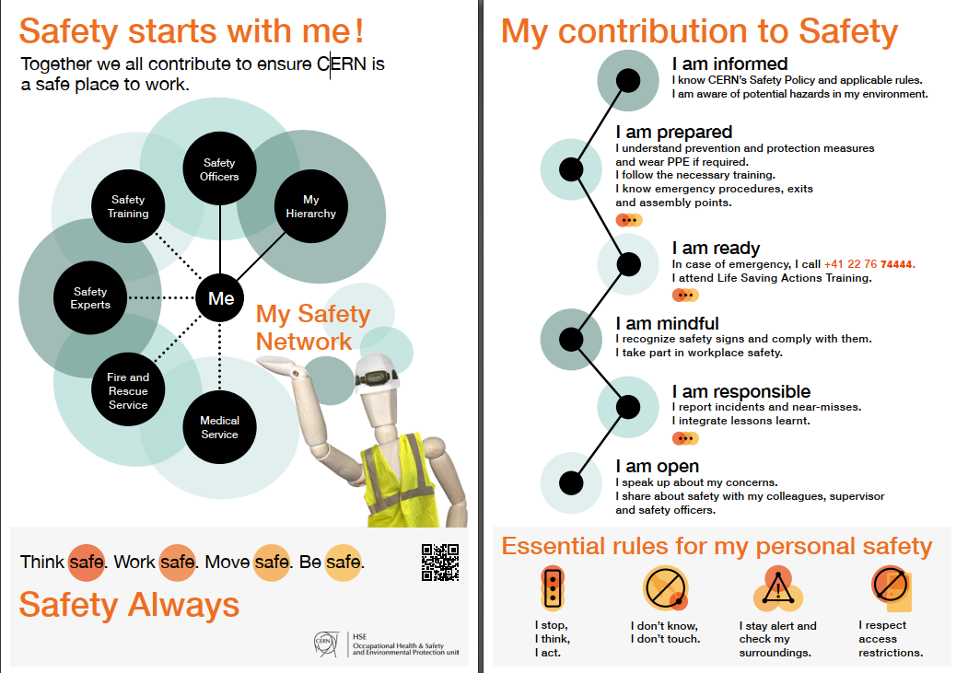
Click on the picture to download the flyer
Notes:
2
Training available for all All personnel working at CERN : First Aid - Life-Saving Actions (Covid-19)
https://lms.cern.ch/ekp/servlet/FORMAT1?CID=EKP000043535&LANGUAGE_TAG=en

Slide 40


Defends all personnel
on a collective and on an individual basis
Become member : Website
Network of people who work(ed) at CERN
Become member : Website
Notes:
1
************************
The Staff association defends your rights, they organize regularly public meetings to inform you. The also have a website, and you can become a member by paying a fee.
CERN Alumni is an initiative launched in 2017.
It brings together people who have worked at CERN and those who work today at CERN. As such, you can be a member as from today. Membership is free.

Slide 41
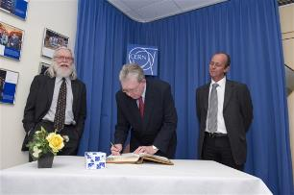
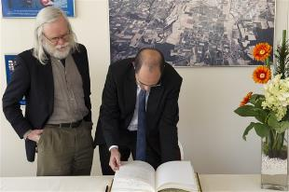
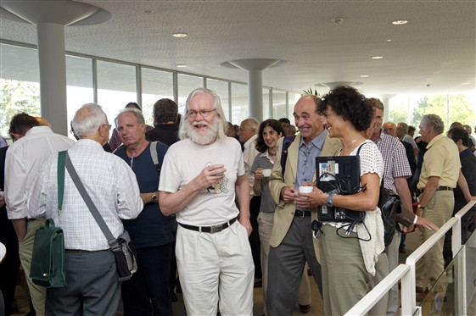
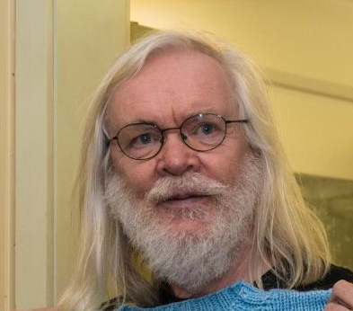
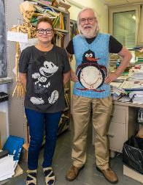
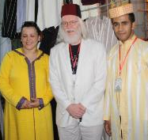
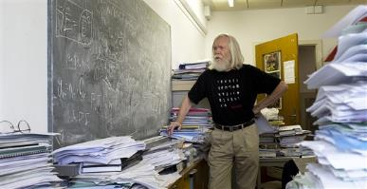
© CERN Photo
Notes:
2
************************
This is John Ellis, a British theoretical physicist.
Employed by CERN, he has been department head of the Theory department, and an advocate for geographical enlargement of CERN.
You can see him
At an official ceremony to sign an agreement, dressed business formal, in a suit and tie
In his office, amongst his papers, casual with pants and a black T-shirt
At another official ceremony, smart casual or business casual, with a shirt and jacket, but no tie
At a Physics School in Morocco, in local traditional clothes, including the fez
Again in his office, with a Finnish teacher who knitted him a pullover with his famous penguin diagram
In 2011, at the coffee break of the colloquium in honor for his 65th birthday
Conclusion:
CERN is very casual
CERN is very tolerant
Recommendations :
Dress according to the situation
Nothing offending other people – T-shirts with text/images

Slide 42
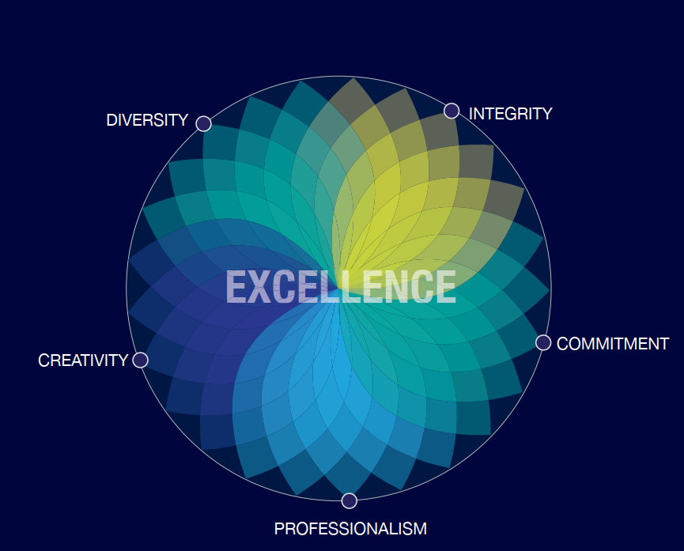
Code of Conduct
Link to Code of Conduct
Notes:
1
*****************
The Code of conduct was introduced in 2010 and it is a guide to help us, as CERN contributors, understanding how we should behave, how we should treat others and how we should expect to be treated.
It is structured around the Organization's five core values. We should all familiarise ourselves with this code and try to integrate it into our daily lives at CERN.
You will find a copy of this document at the tables when departing.
Ethics:
On the CERN Human Resources webpage, you can also find the Ethics framework where: policies, official documents, guidelines, training courses, etc. are classified.
We recommend that you consult this page to understand what can and cannot be done, as CERN is no ordinary employer and some specific obligations may surprise you.
For example, did you know that as a member of staff, if you wish to engage in political, commercial or professional activities outside CERN, you must obtain authorisation from the Director General?
To do this, you will need to complete an external activity request.

Slide 43

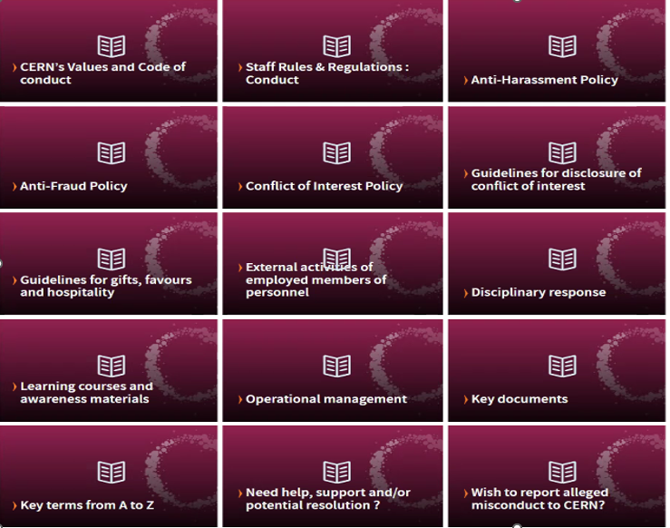
https://hr.web.cern.ch/ethics
Notes:
1
*****************
On the CERN Human Resources webpage, you can also find the Ethics framework page providing you info on: policies, official documents, guidelines, training courses, etc.
We recommend that you consult this page to understand what can and cannot be done, as CERN is no ordinary employer, and some specific obligations may surprise you.

Slide 44



CERN tools
Phone (audio only) : CERNphone
  Mobile client (iOS and Android)
  Desktop client (Windows, macOS, Linux)
Videocalls and videoconferencing cern.zoom
Messaging – individual and public/private ”channels”
integration with Zoom
dedicated channel New @ CERN
Notes:
2
****************
A call is usually more efficient than an email,
So we encourage you to reach out to colleagues, programme cordinators or supervisor, and we give you different options to do so:
If you go for a voice call, we are using CERNPhone
You can access the CERN phone book to find any employee working at cern, and dial her or his number.
For video conference, we use now Zoom on a CERN specific instance cern.zoom (with SSO)
For messaging, you can use Mattermost. You can invite someone for a instant Zoom call from

Slide 45
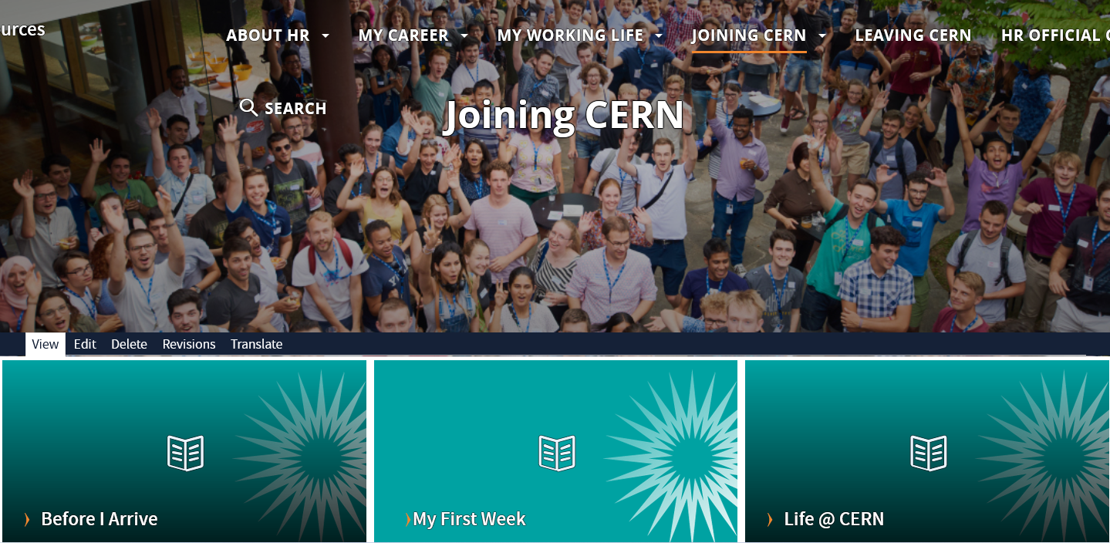
Newcomers website
https://hr.web.cern.ch/joining-cern
Notes:
1
************************
We have come to the end of our quiz – I hope you enjoyed it!
Some final slides:
On the HR website, you will find the Welcome to CERN pages.
You have already looked at the pages “Before I arrive”, but there is more information for you to discover now under “My first week” and later on under “life@CERN”

Slide 46



Many questions, answers are …
  Your departmental secretariat
  Your supervisor, your colleagues
  Specific question for personal situation?
  → Make appointment with the expert services
  Pension Fund, Health Insurance, Installation Service, Housing Service, Social Service, …
  HR Website > Welcome > my first week
Notes:
1
************************
CERN is a big and complex organisation, with more than 60 years of history. Enough to have certain traditions, a certain way to do things, a certain culture.
You will certainly have many questions …
But where to find the answers ?
The departmental secretariat is an important info to help you out navigate on all admin questions and it is close to you. You will meet them later today.
Your supervisor and colleagues will also be able to answer some of your questions
On the HR website, there is also the Welcome site with a dedicated section “My first week”
If you have specific questions related to your personal situation, there are expert services at your disposal. You’ll find their contact details on the Welcome pages.
We encourage you to make an appointment with them, why not do it later today ?

Slide 47

Public meetings
Click for past and future events (agenda, slides, recordings)
Directorate
Highlights of Council Week and other recent news.
HR
Focus on one topic (eg. flexibility)
Staff Association
Latest information on priorities and current issues
Notes:
2
**************

Slide 48

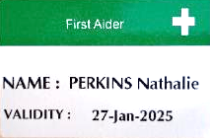
Important info to remember
Download CERN Campus app on your phone
Enter full number Fire and rescue service in your phone
Find out who are closest first-aiders
+ 41 22 76 74444
Notes:
2
************************

Slide 49
Onboarding continues with …
Welcome session in your department
Meet the experts (online – Zoom)
  CERN Health Insurance (CHIS) 4 March, 11.00 – 11.25
  Legitimation cards 4 March, 11.35 – 12.05
  Computer security 4 March, 13.30 – 14.00
More short sessions with experts (online – Zoom)
  Pension Fund* 19 May, 13.30 – 14.00
  Library and Open Science* 8 April, 13.30 – 14.00
Connecting the dots* 15 April, 13.15 – 18.00
Spouse welcome session* 18 Mar, 16.00 – 18.00
Collective induction session or Individual contact by HRA
Visit* of CERN installations – register via Indico
Part of
Welcome session
see Indico
* You will be invited
* You need to register
Notes:
2
Guided tour in English to Synchro-Cyclotron (SC) + ATLAS Visitor Center
next guided tour Tuesday 18 Feb 2025, 16:30 → 18:00 registration via Indico.

Slide 50
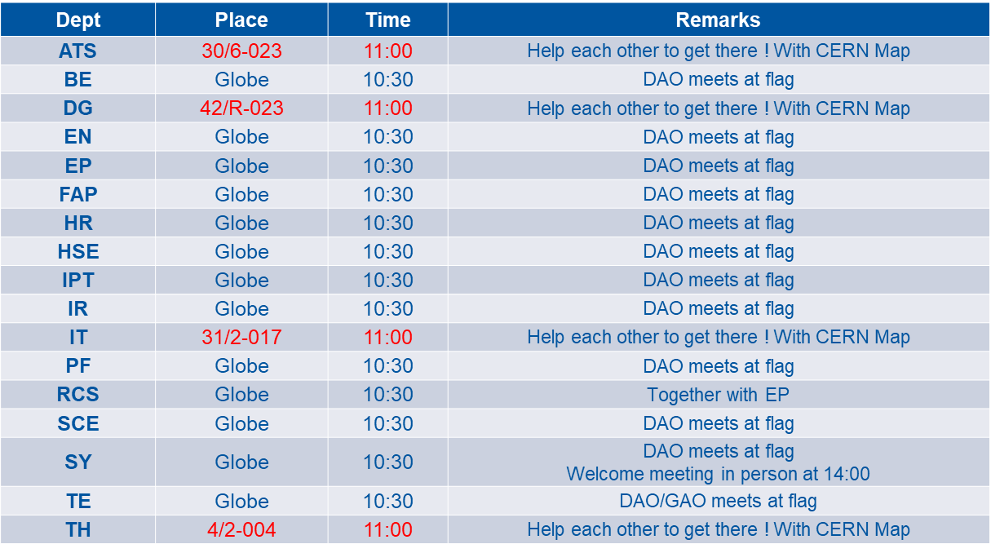
Meeting points
Notes:
2
We wish you all the best in this new adventure! Enjoy every day of it!

Slide 51

Notes:
All the best !

