Slide 1
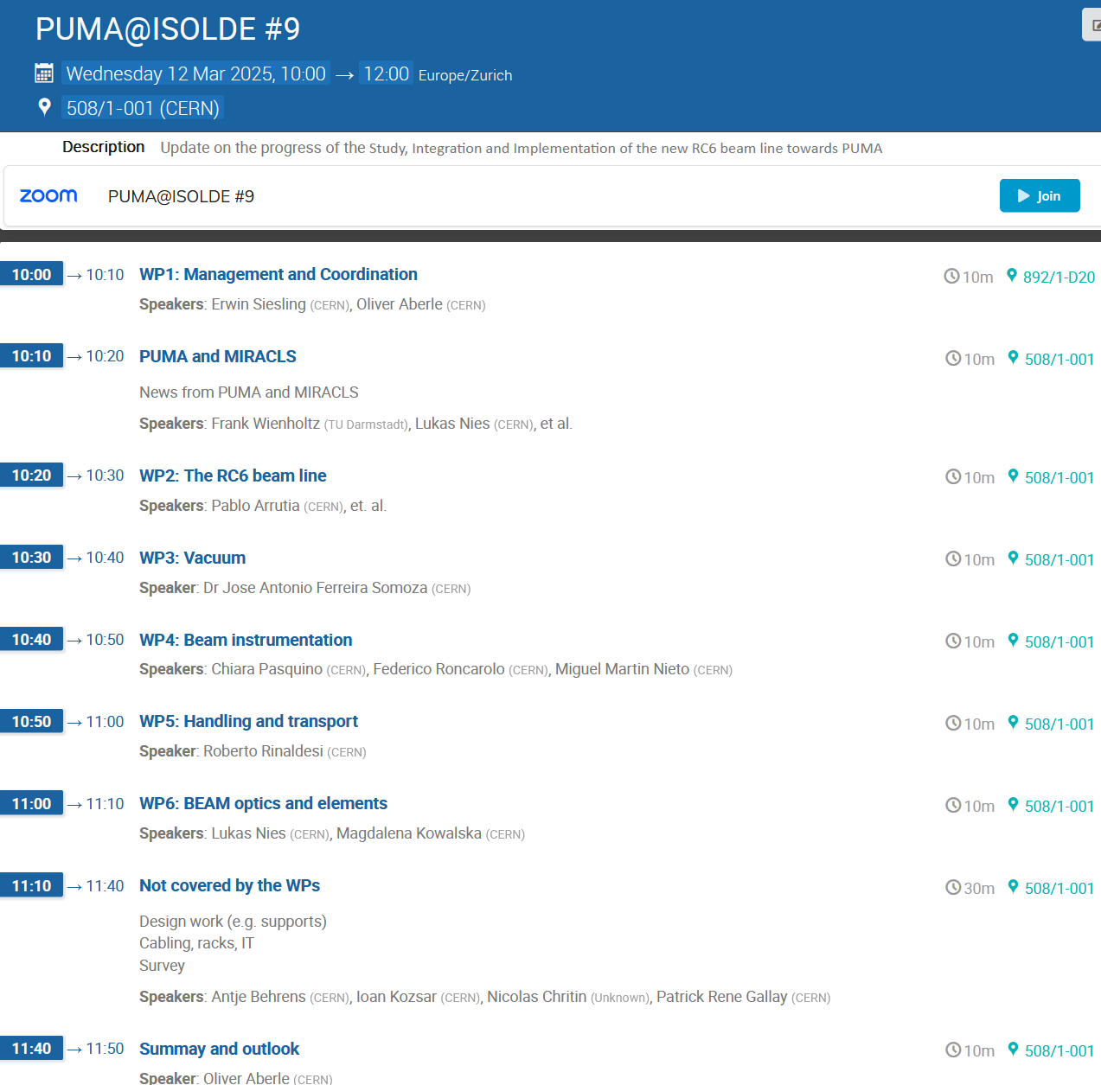
Today's agenda
Updating form September's meeting, thanks to everyone for your effort and shortness
More dedicated meetings - ongoing
Goal of today's meeting:
Update everyone on the progress of the project
Layout
Start installation
Project timeline

Slide 2
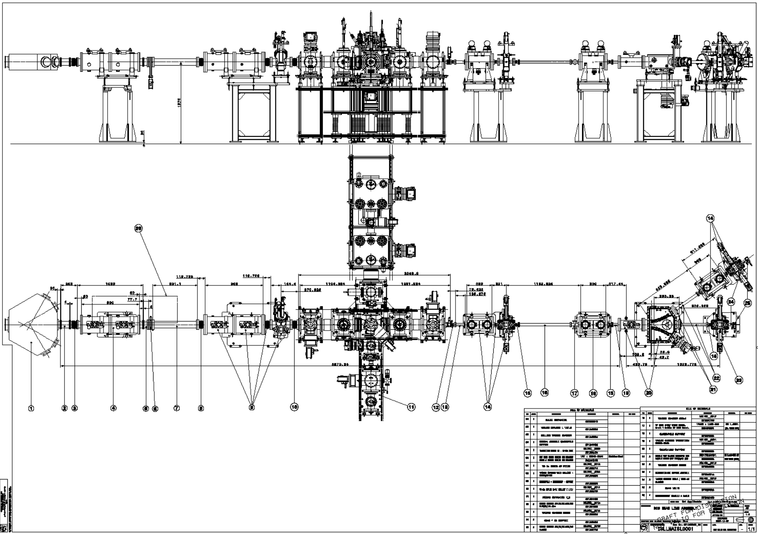
Layout
ISLLMAISL0001 – ST1828365

Slide 3
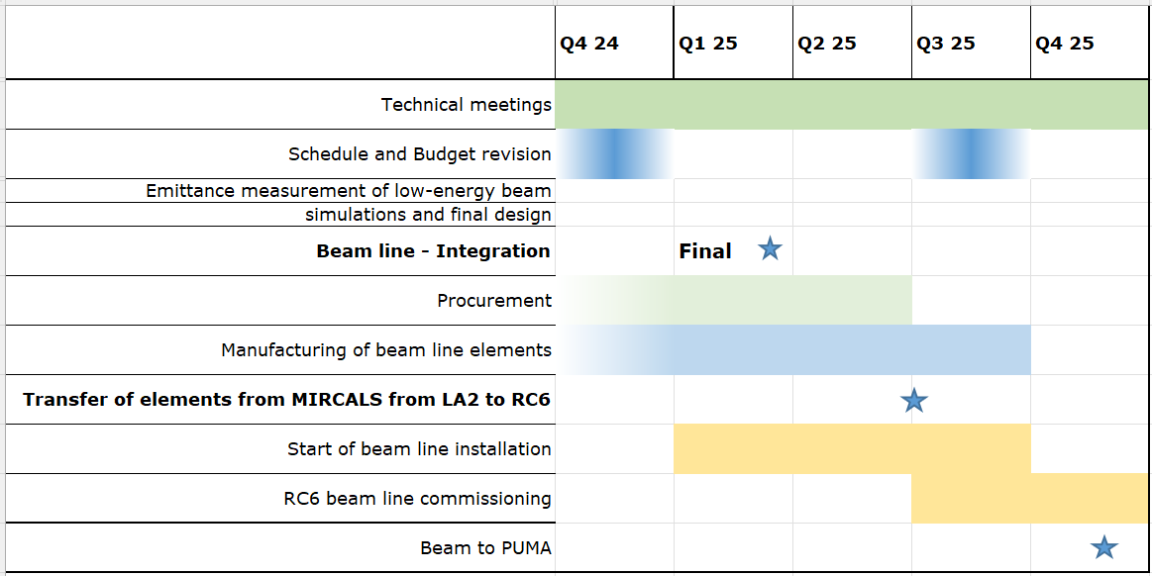
Schedule

