Slide 1
PUMA
STATUS Update
Mark Kirschbaum
PUMA / Institut für Kernphysik TU Darmstadt
11.03.2025
1

Slide 2
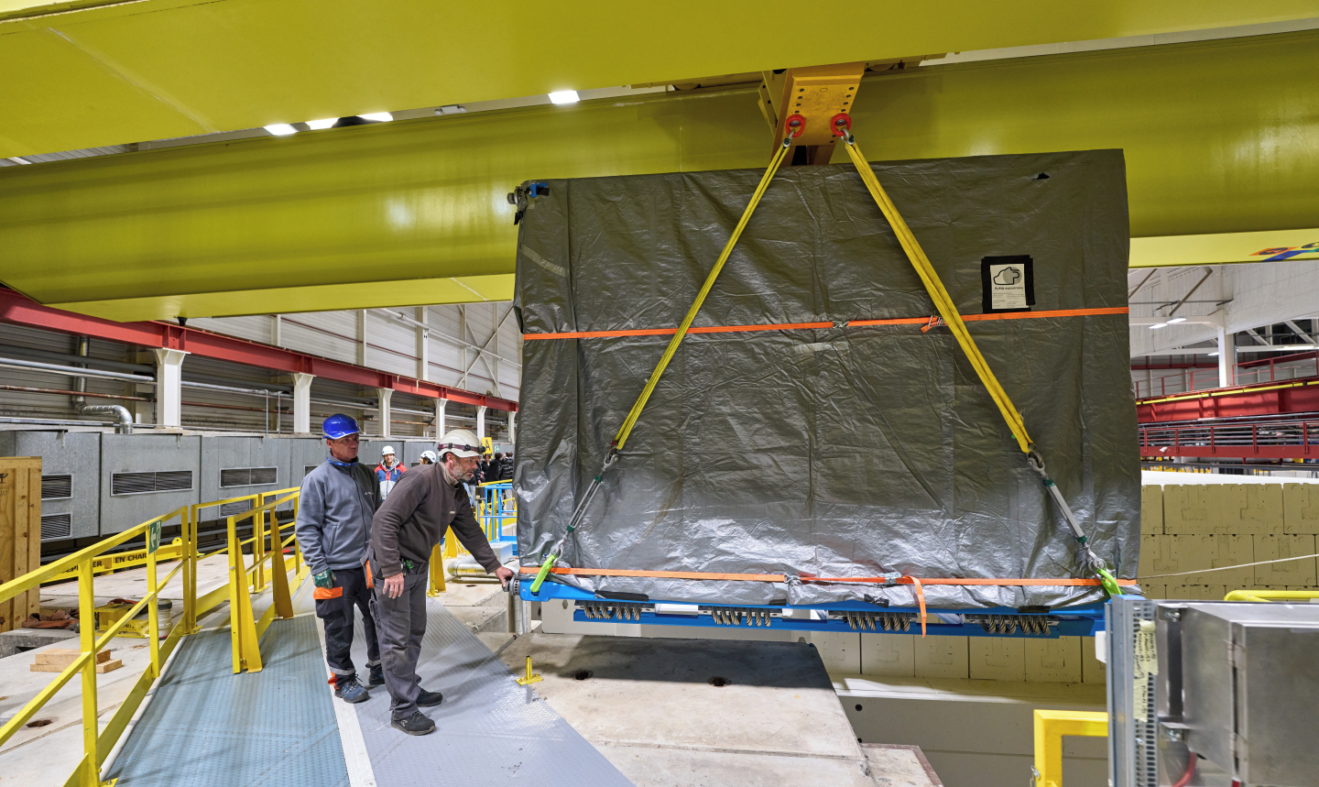
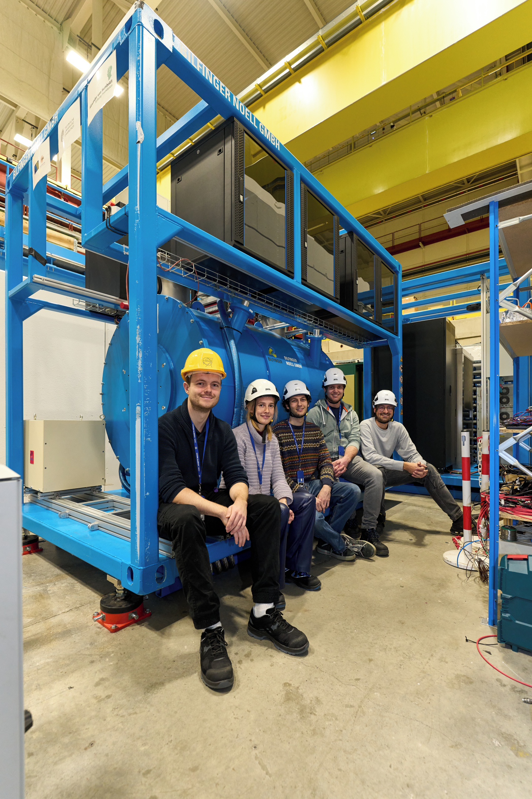
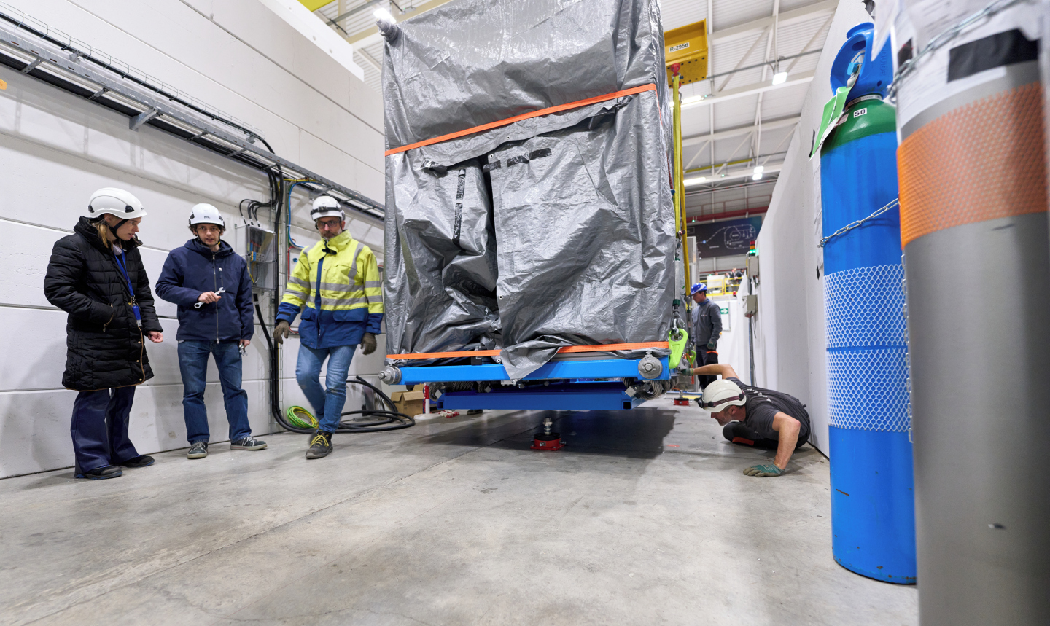
Arrival of the magnet frame
11.03.2025
2

Slide 3
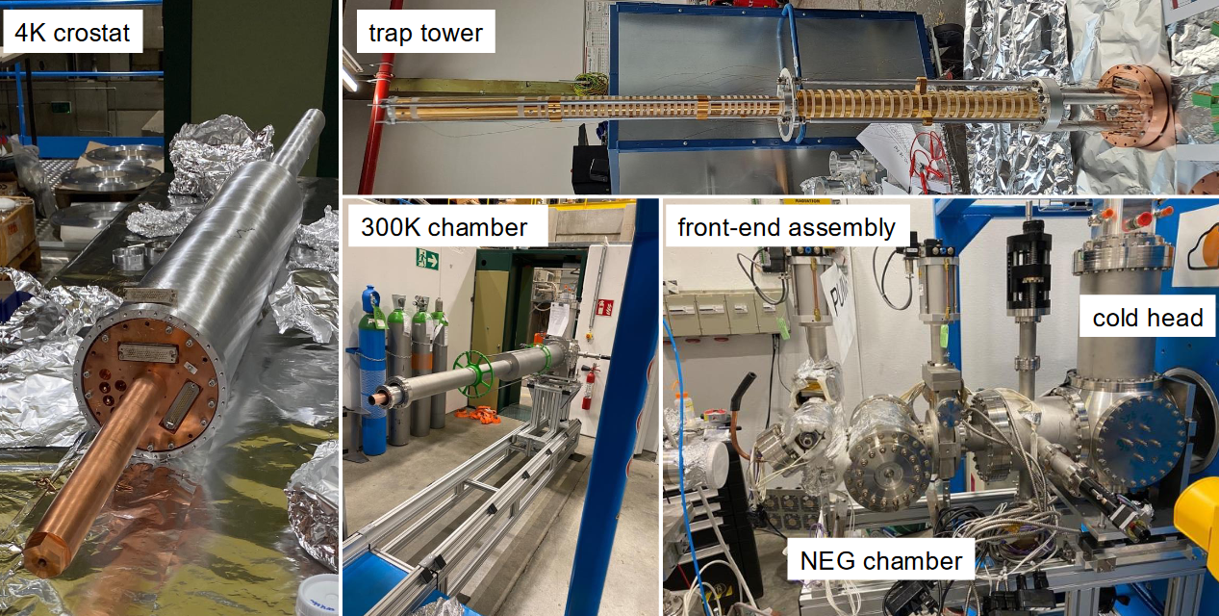
Trap Assembly
TPC dummy
11.03.2025
3

Slide 4
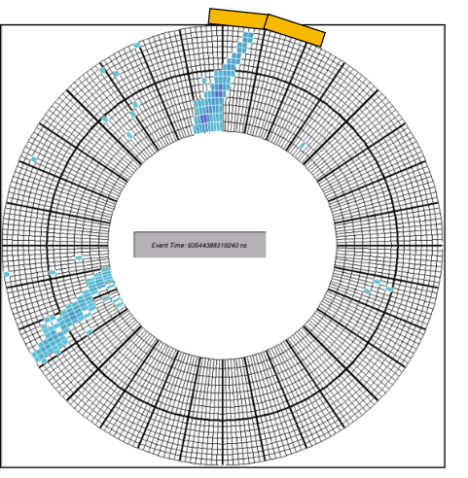
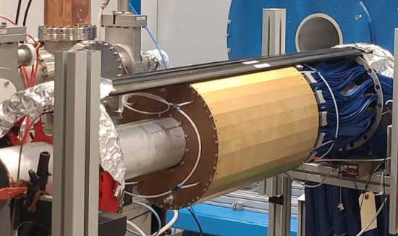
PION Tracker / tPC
To verify functionality of TPC:
  Measurements with comics and sources
  TPC externally triggered by two bars of the trigger barrel
Trigger Barrel Bars
11.03.2025
4

Slide 5
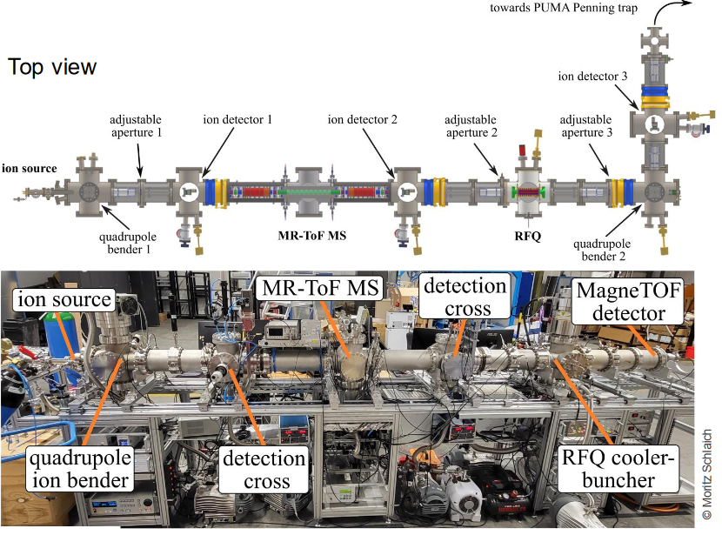
Next steps
TPC Installation (~April 25)
Installation of offline ion source (~ May 25)
Settlement of a local PUMA team:
  1 permanent position (to be opened)
  1 post doc. (will join in summer)
  2 PhD students (since Jan 25)
11.03.2025
5

