Slide 1
PUMA-RC6 Beam Manipulation
Beamline optics and elements
2025-03-12
Lukas Nies (EP-SME-IS)

Slide 2
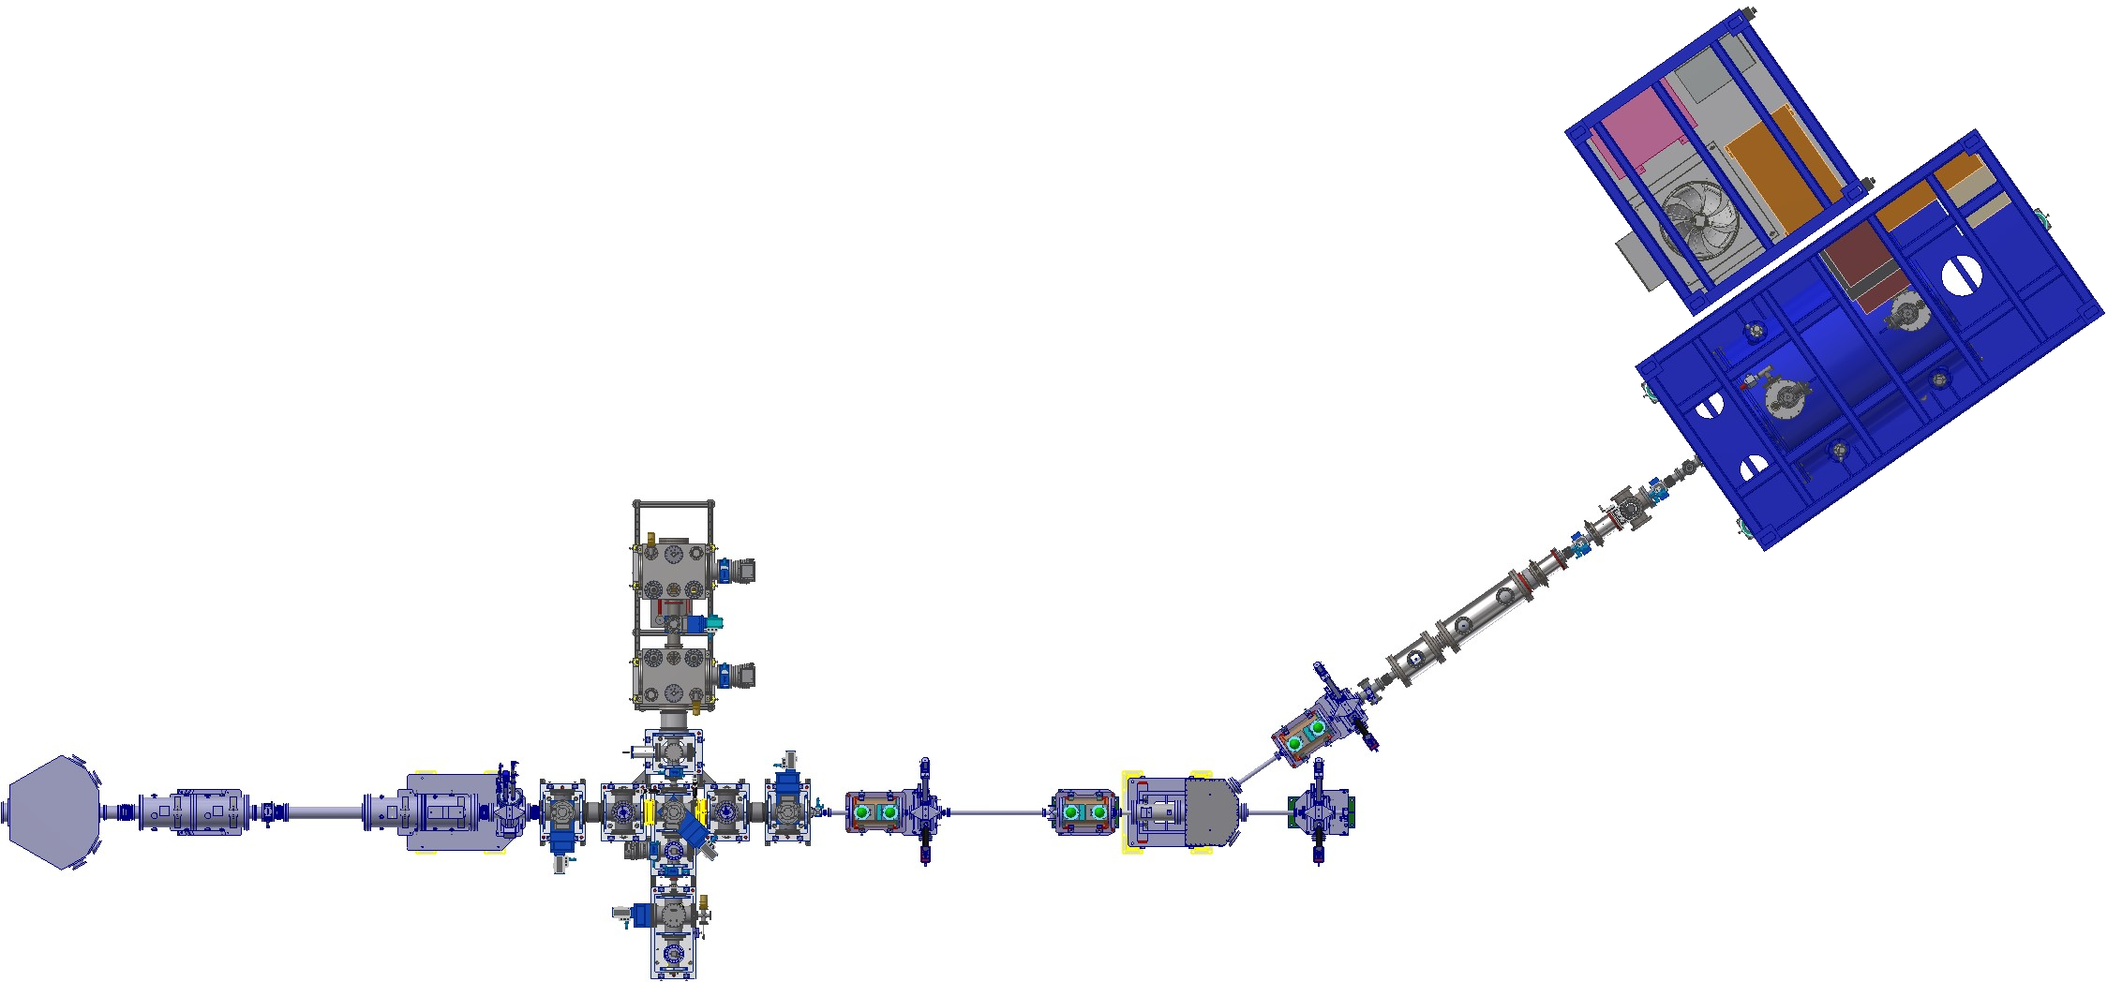
TRANSFER BEAMLINE
Deceleration and accumulation of RIBs in RFQ cooler buncher Paul trap
Isobar separation for beam purification in MR-ToF MS
Reacceleration to 30 keV for beam transport
Deceleration with pulsed drift tube and injection into PUMA
PUMA annex frame
10⁻¹¹ mbar
10⁻⁶ mbar
10⁻⁸ mbar
10⁻⁹ mbar
PUMA main frame
Isobar separator (MR-ToF MS)
Diagnostics
Diagnostics
ISOLDE quadrupole doublets
To IDS
Pulsed drift tube
Diagnostics
ELENA quadrupole doublets
Handover point to PUMA
Temporary setups
at RC8
30 keV RIBs from ISOLDE
Quadrupole bender
Paul trap
Kicker
Bender
2 m
Diagnostics
Ion Source
Lukas Nies
ISOLDE
Collaboration
WORKSHOP 2024

Slide 3
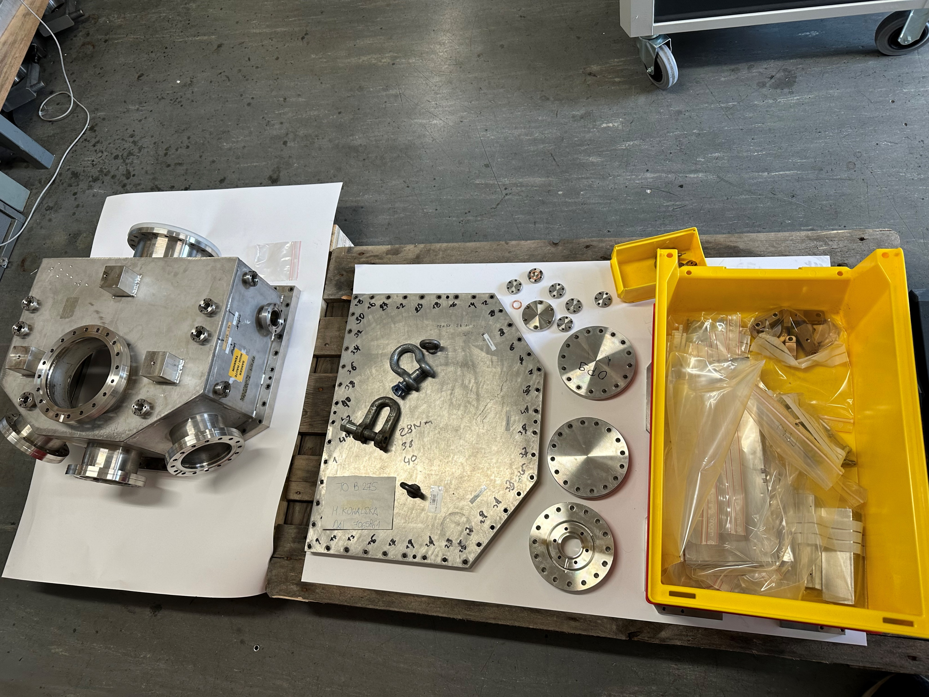
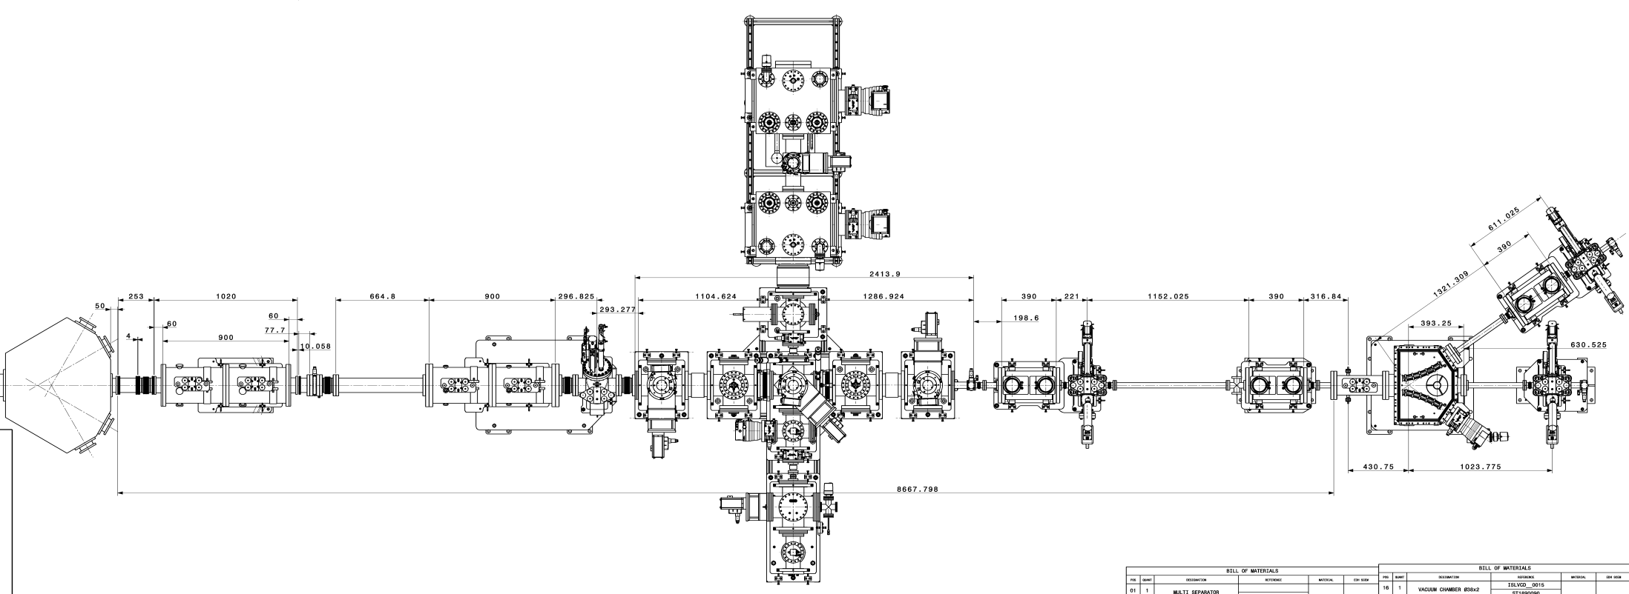
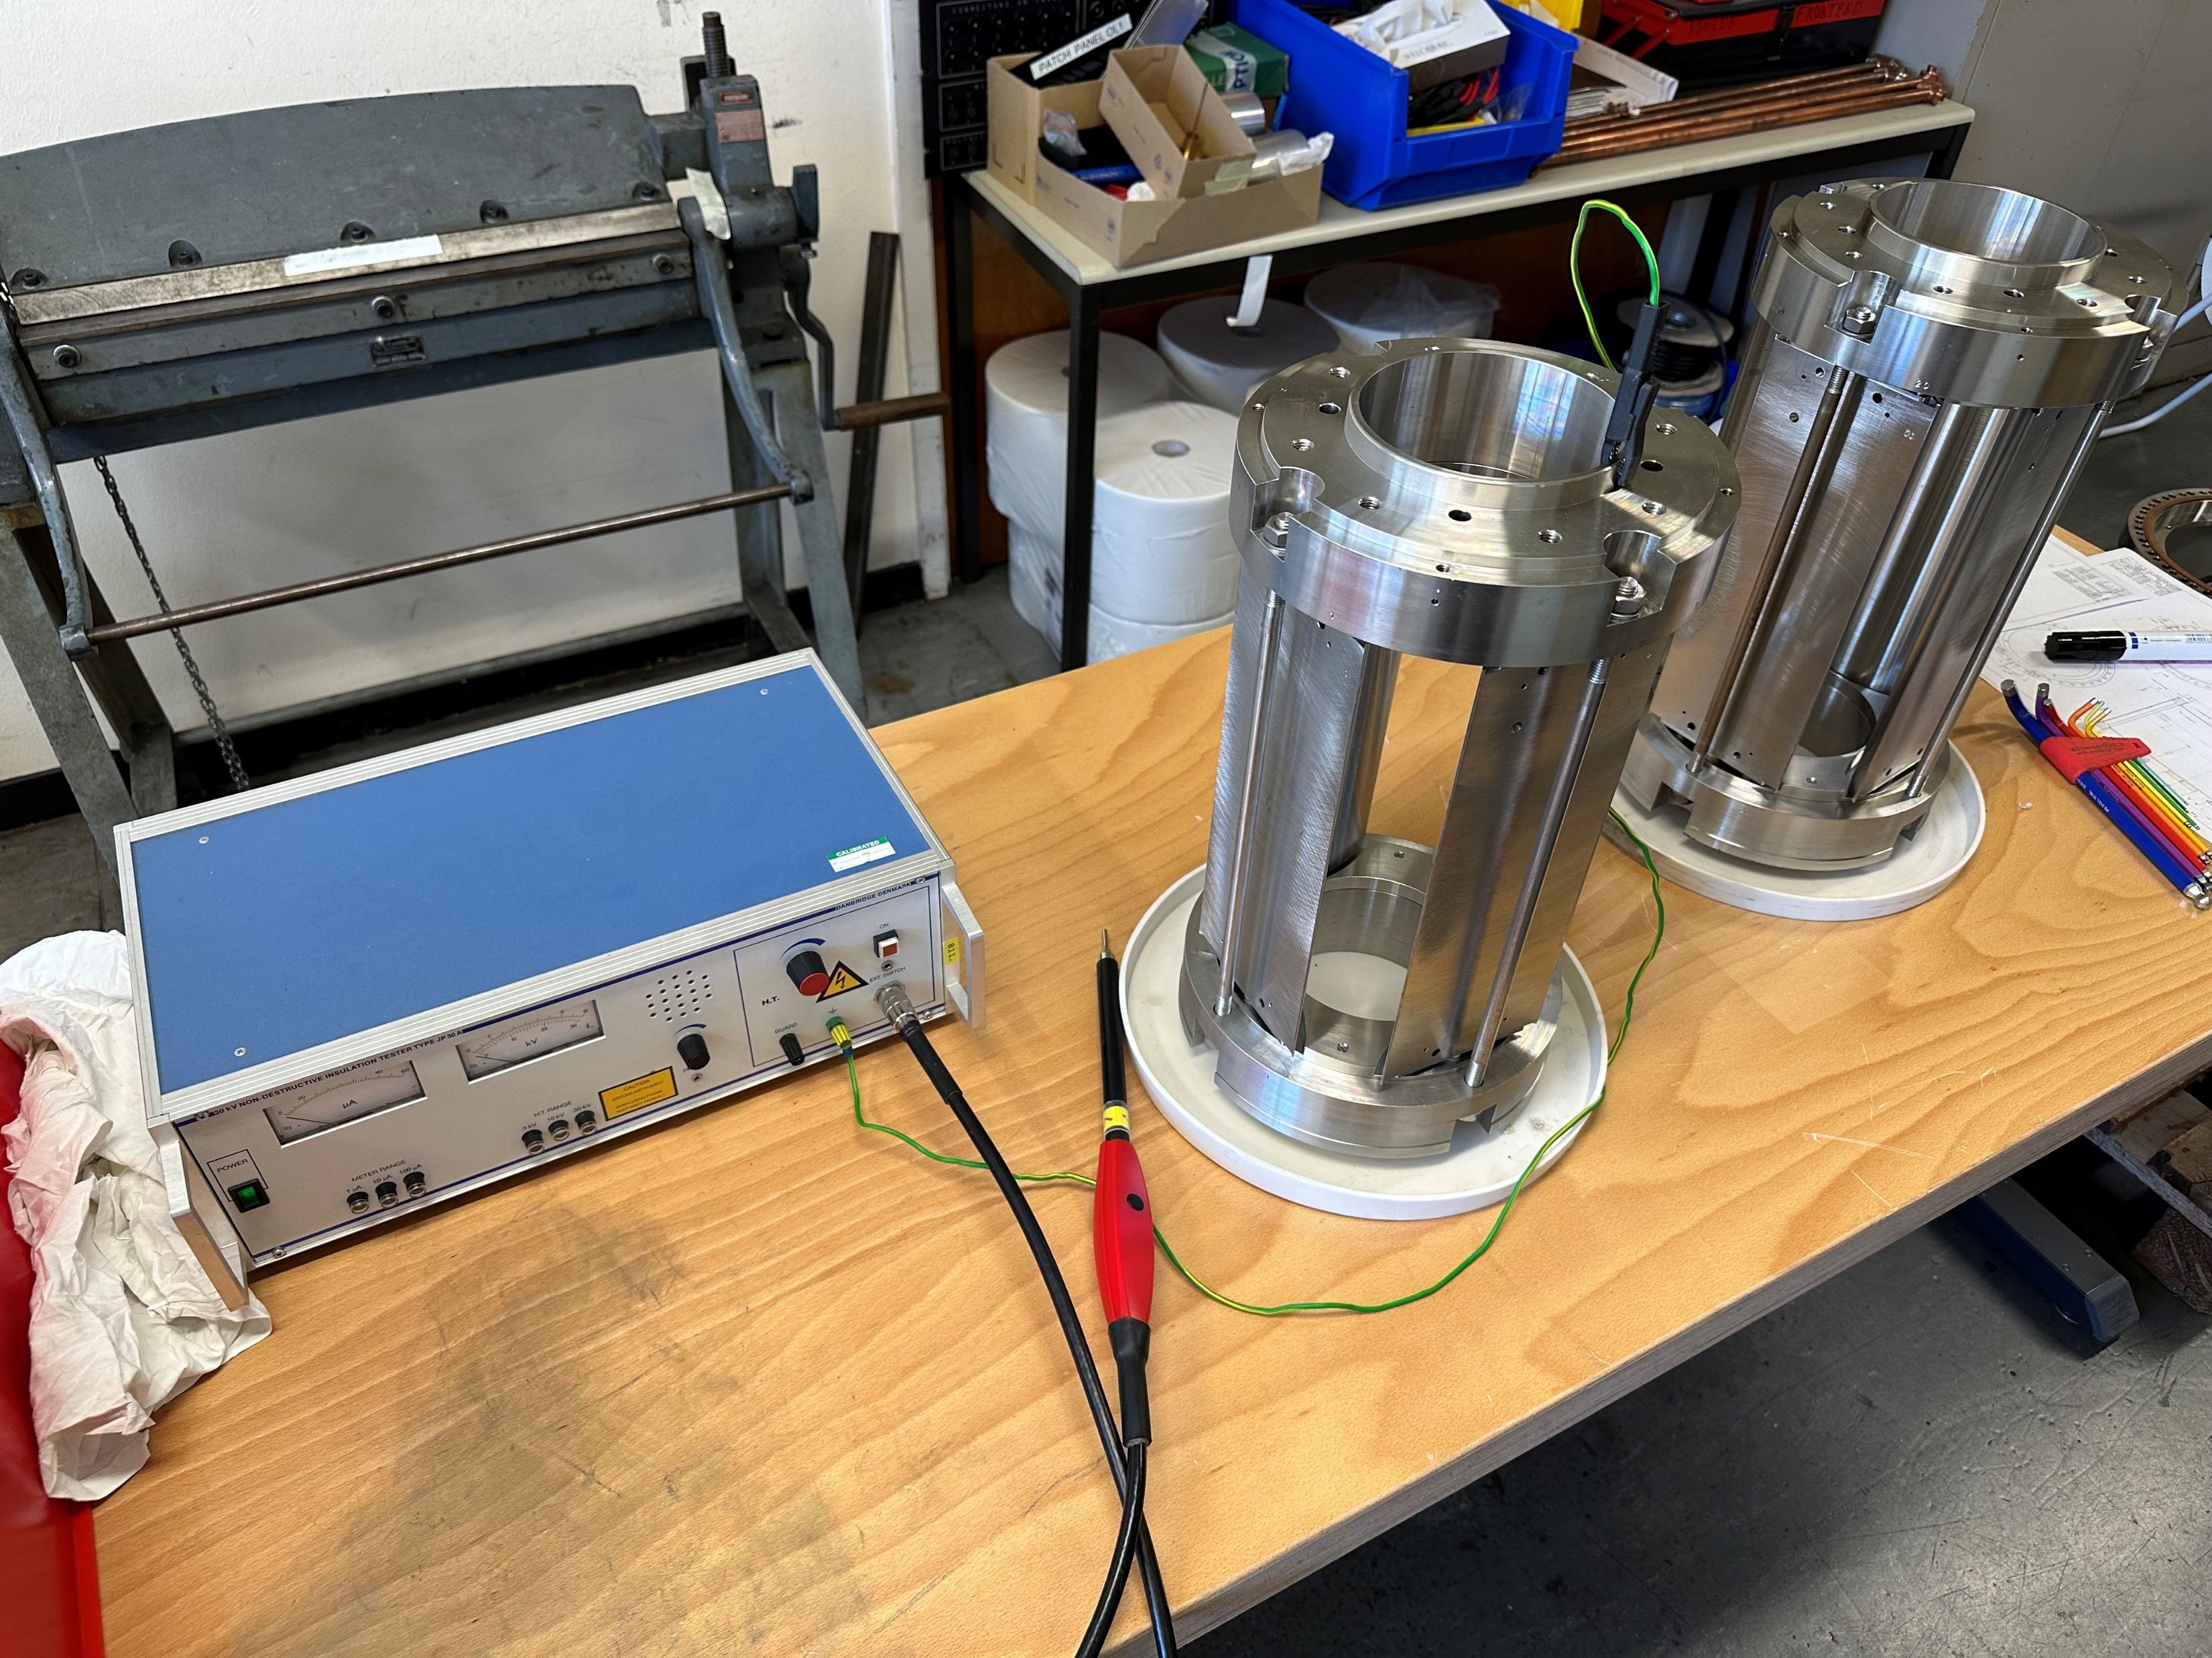
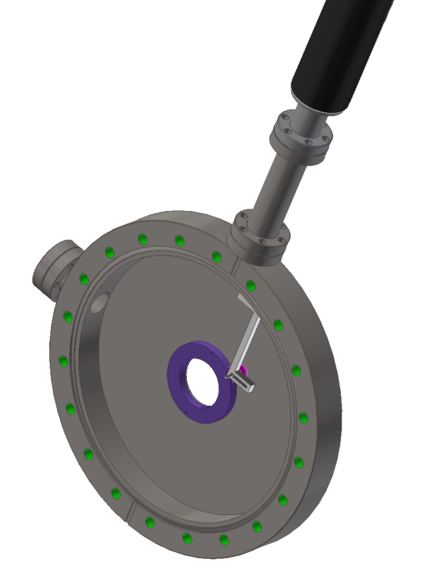
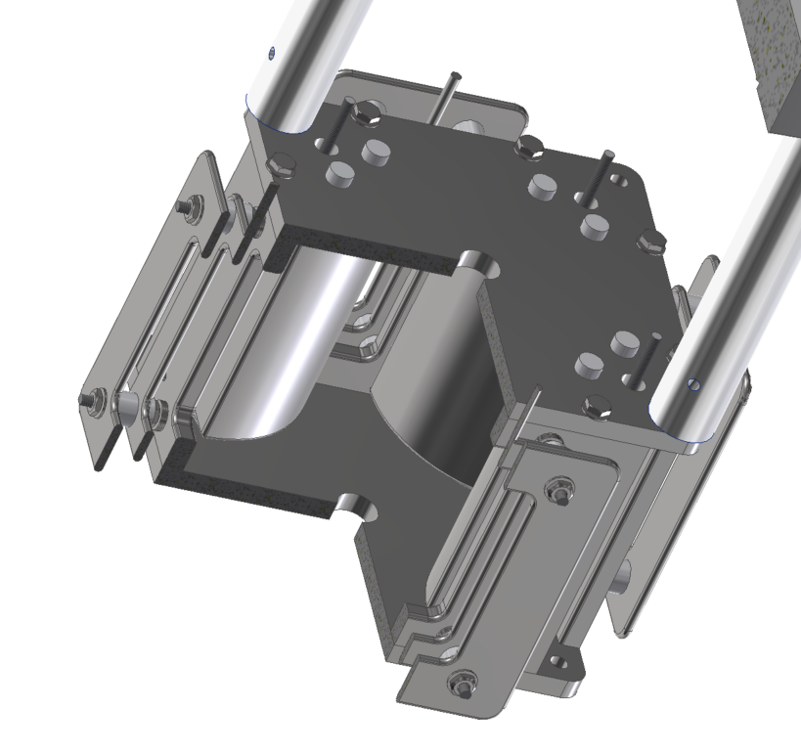
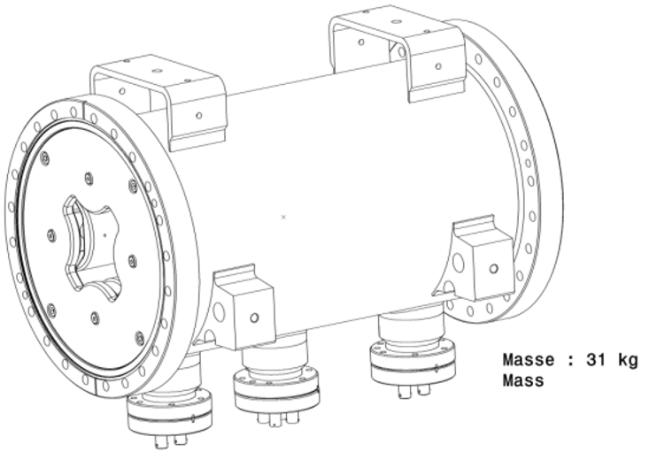
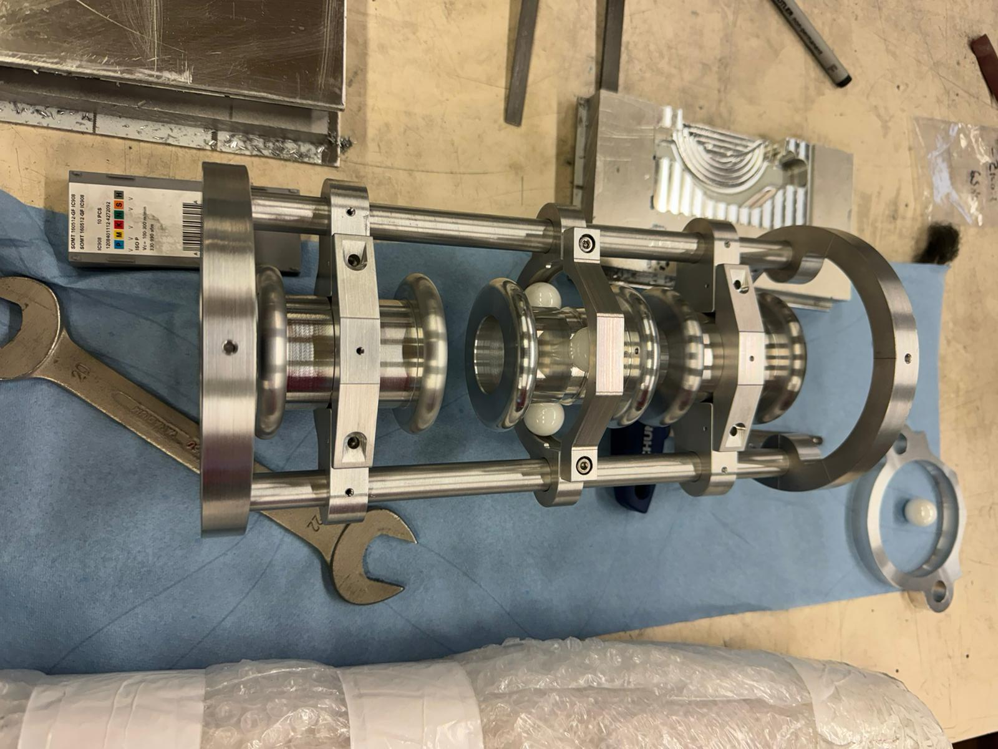
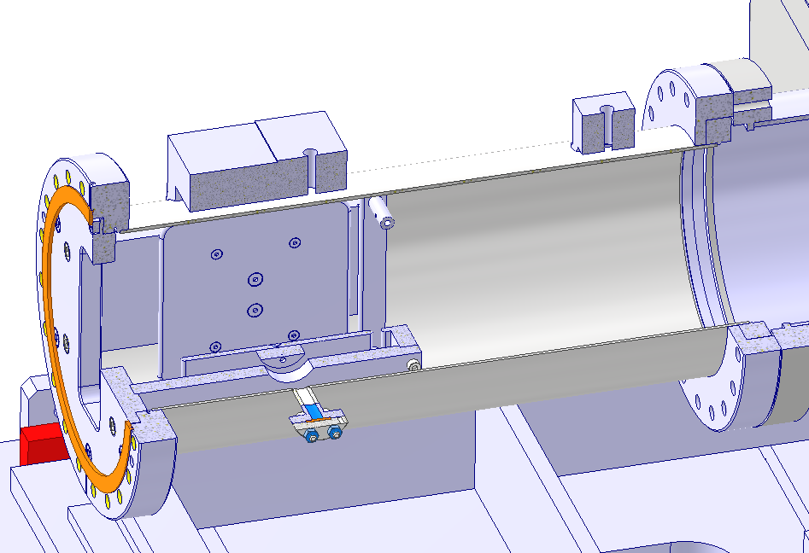
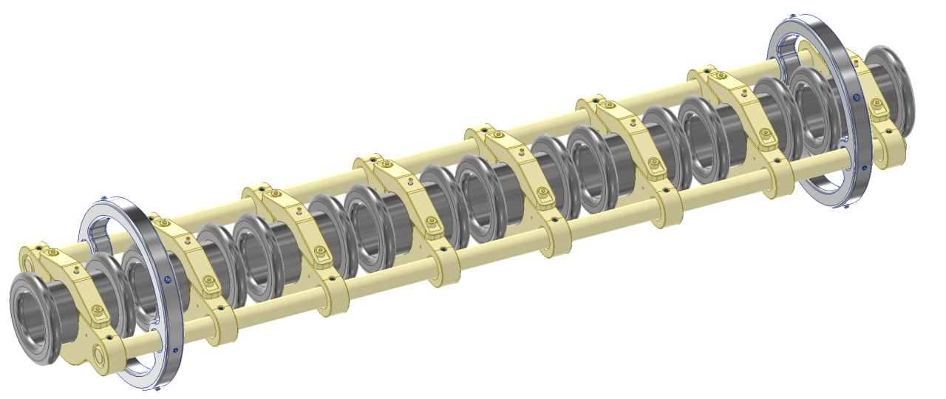
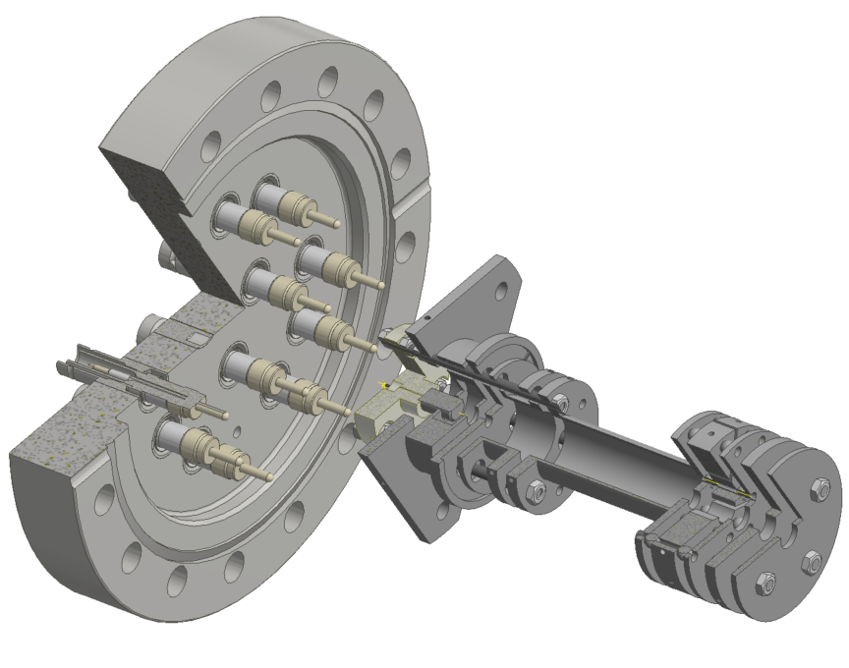
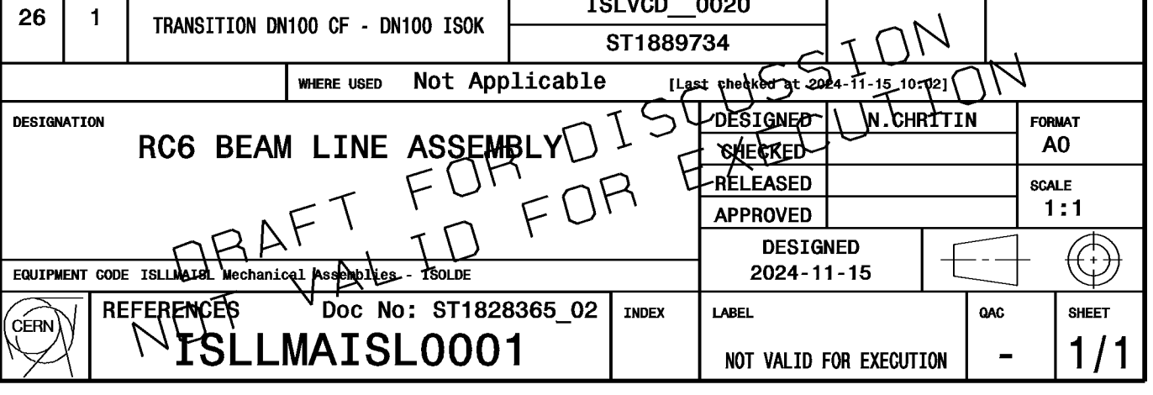
FINAL LAYOUT– ISLLMAISL0001
15/12/2023
15/12/2023
ST1828365_02

Slide 4
STATE OF HARDWARE
 | CAD Design | Prototyping | Production drawings | Production | Delivered | UHV cleaned | Tested | Installed | Aligned | Commissioned |  | Modifications needed
ISOLDE Quadrupole 1 (standard)
ISOLDE Quadrupole 2 (UHV)
Decelerator / Accelerator
Quadrupole bender
Iris
Einzel lenses (MIRACLS)
Ion Source
ELENA Quadrupoles
Kicker
Bender
MR-ToF MS (MIRACLS) |  |  |  |  |  |  |  |  |  |  |  | X
Paul Trap (MIRACLS) |  |  |  |  |  |  |  |  |  |  |  | X
15/12/2023
15/12/2023

Slide 5
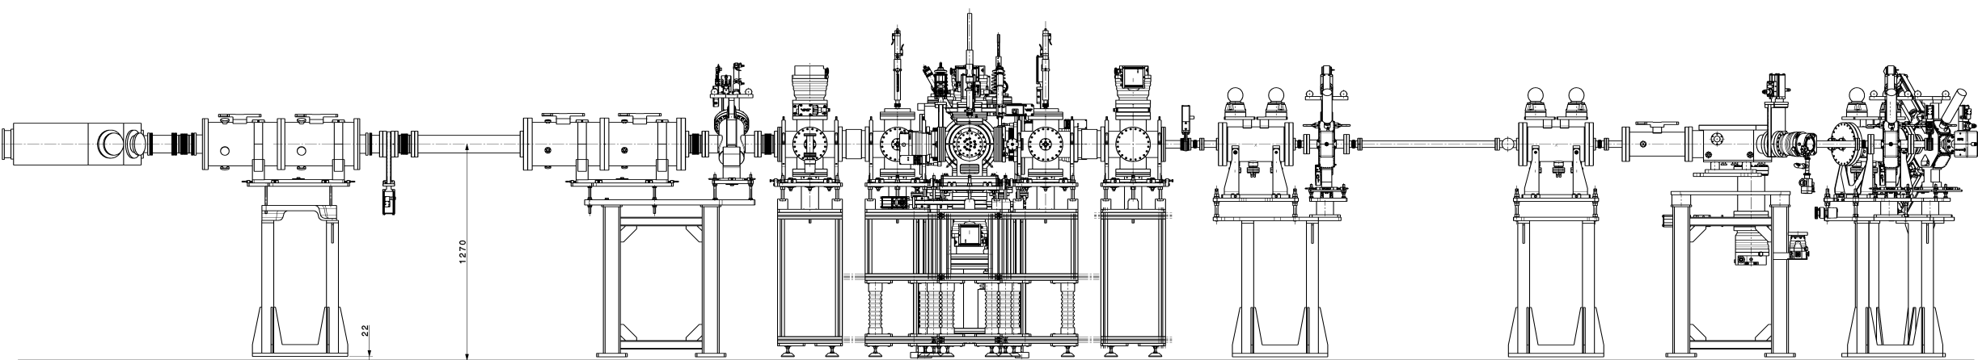
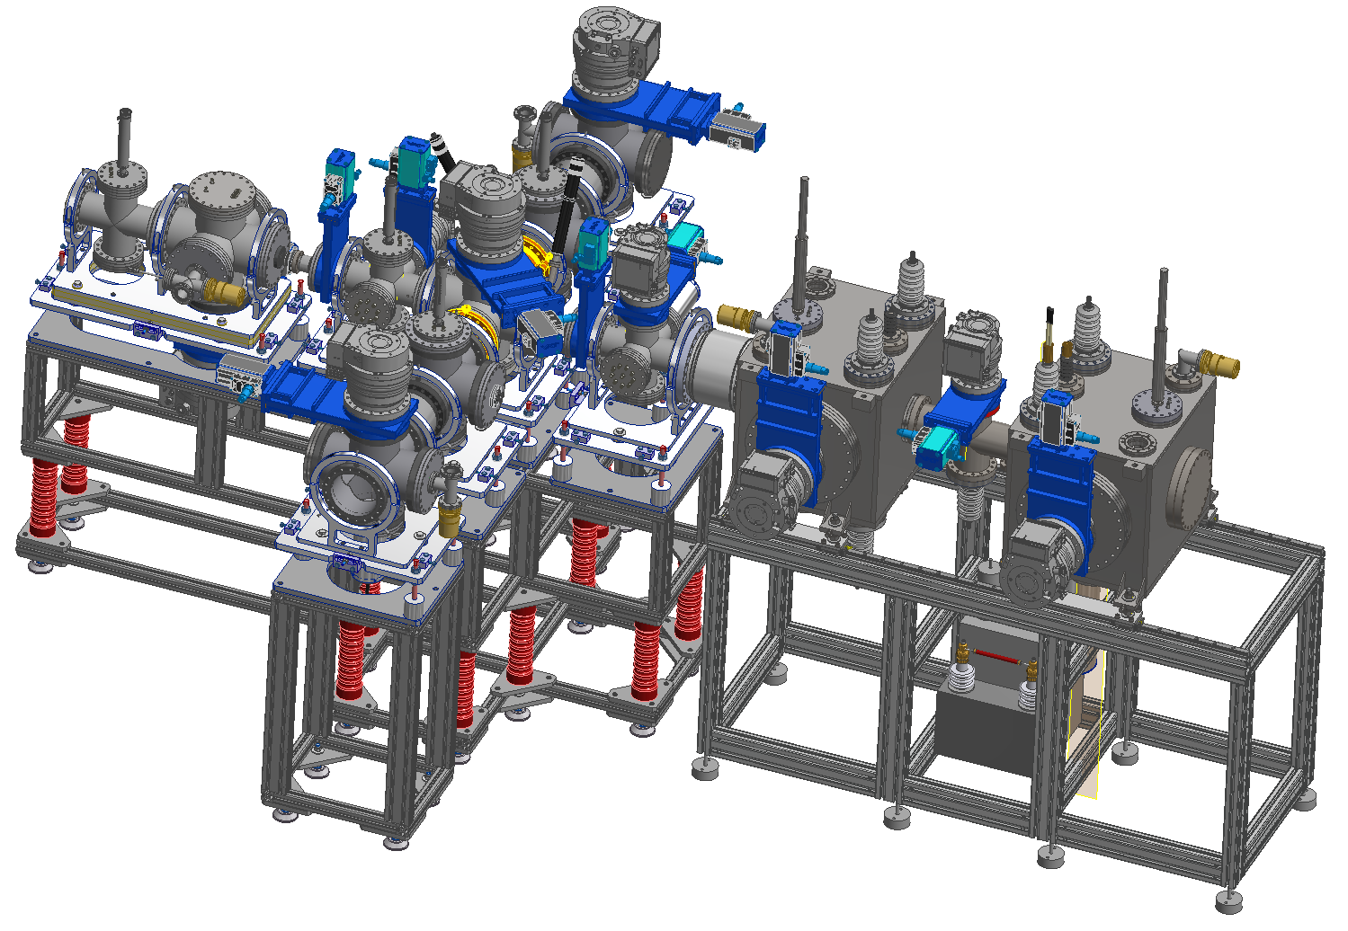
SUPPORTS
available
available
available
Production drawings
available
Production drawings
delivered
15/12/2023
LAYOUT VERSION – 15.11.24

Slide 6
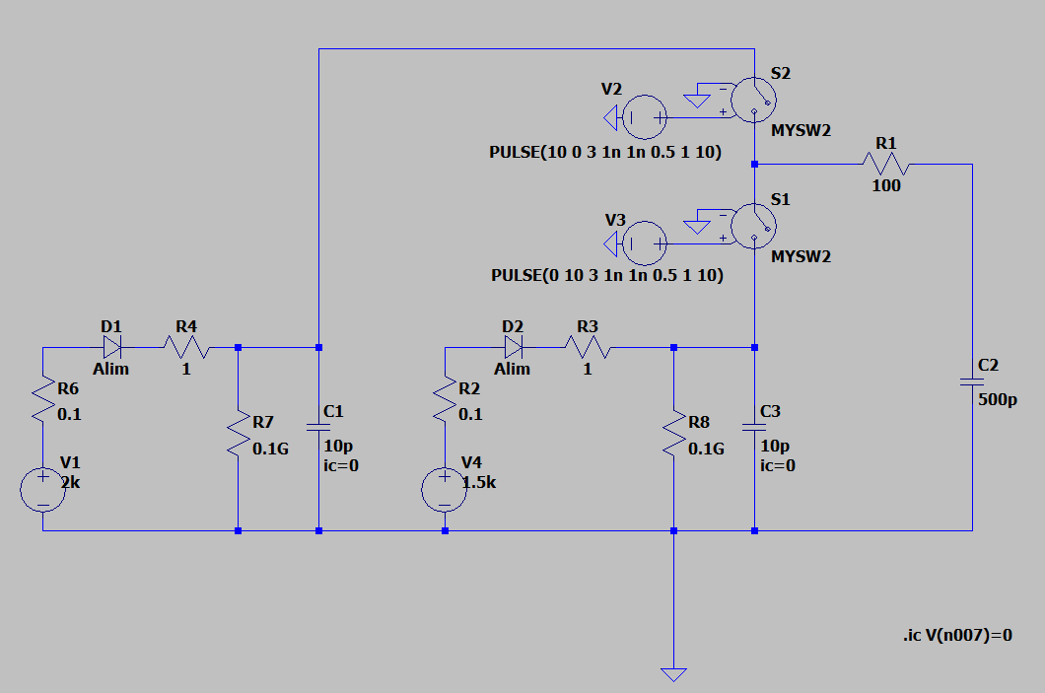
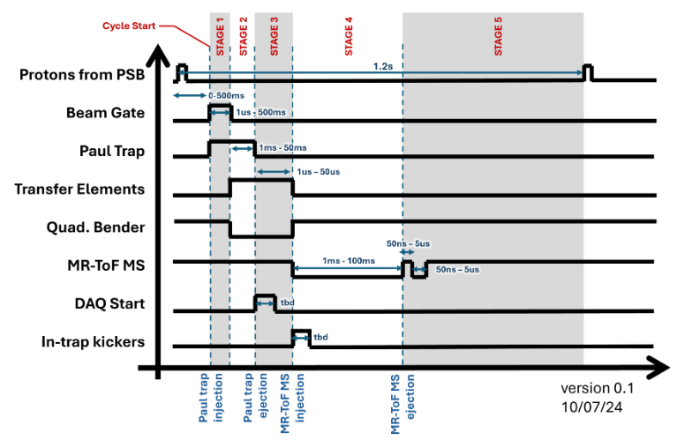
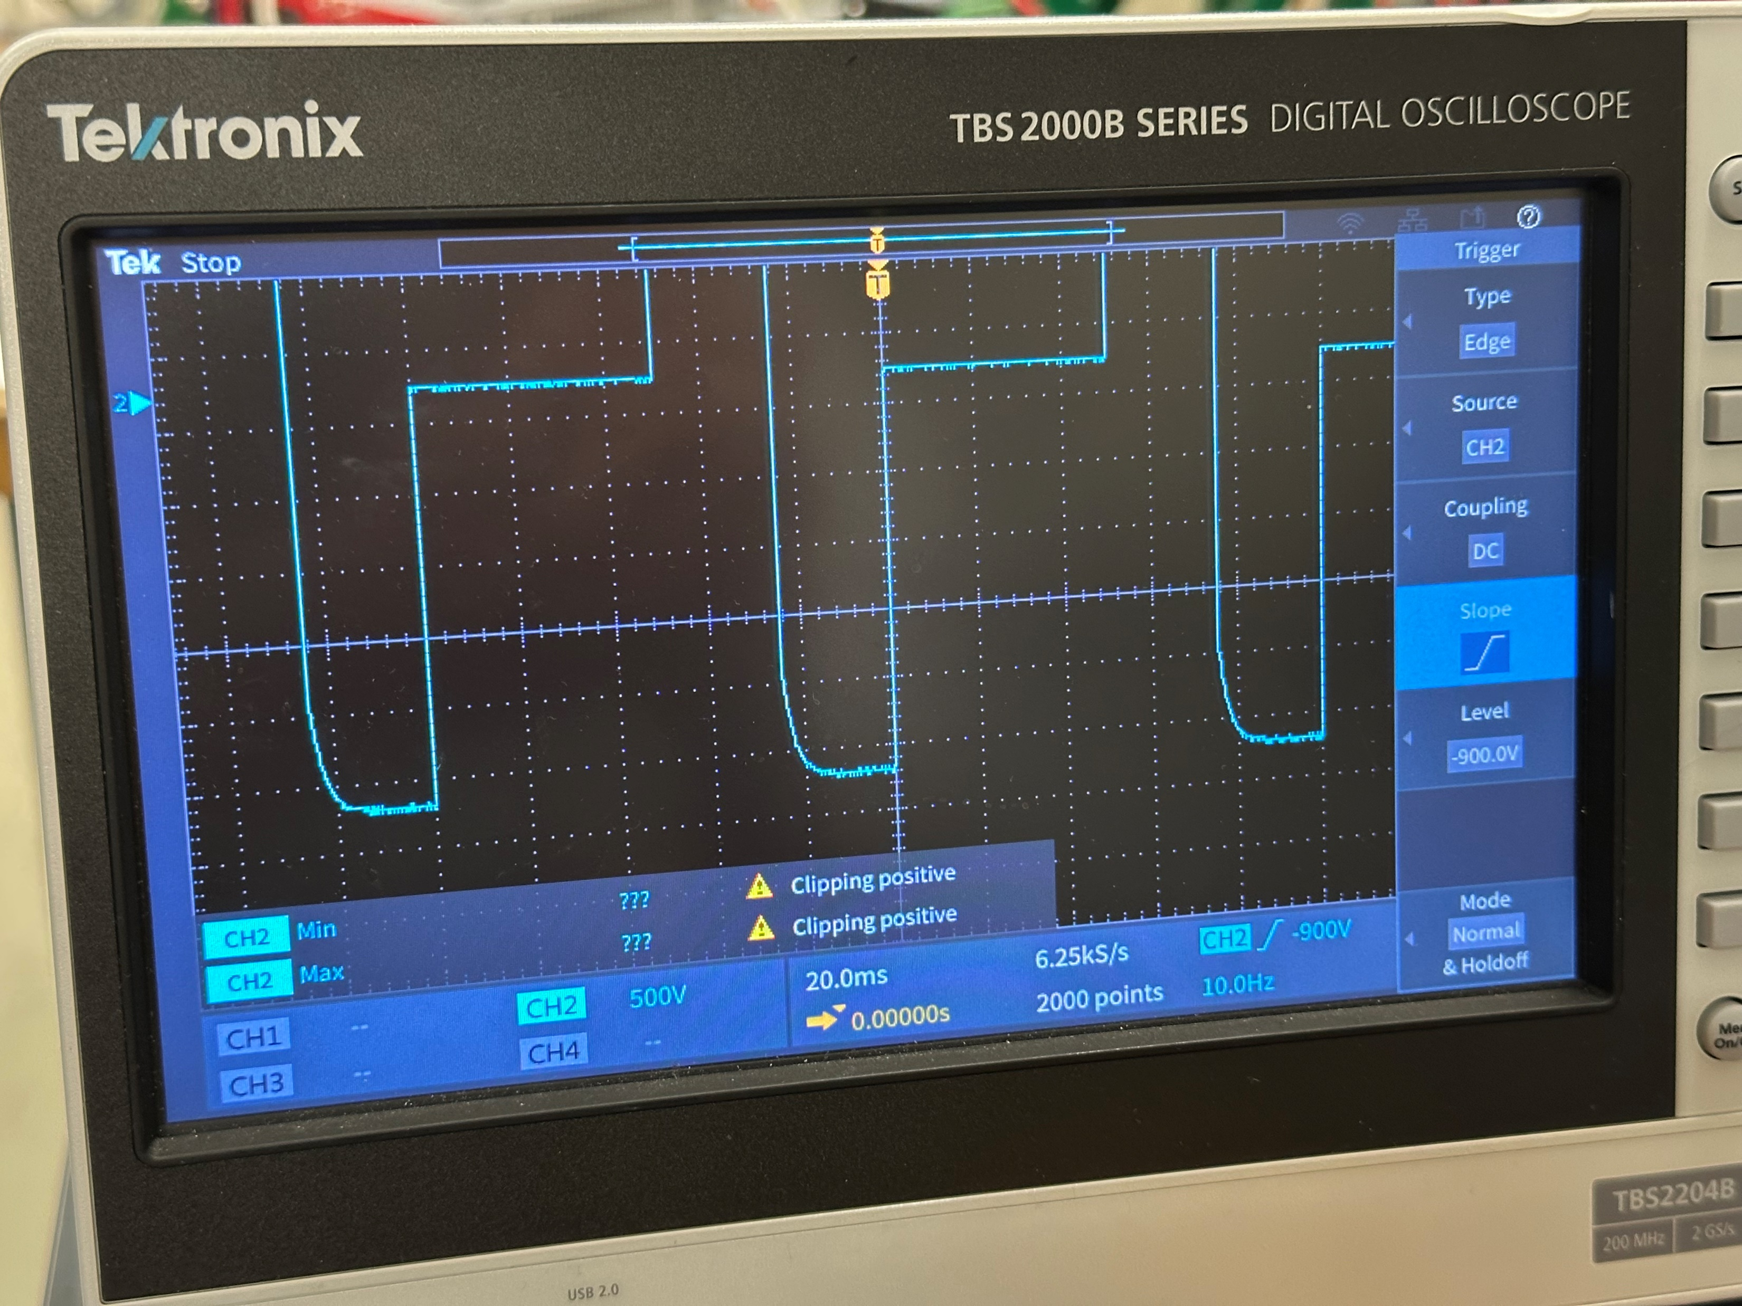
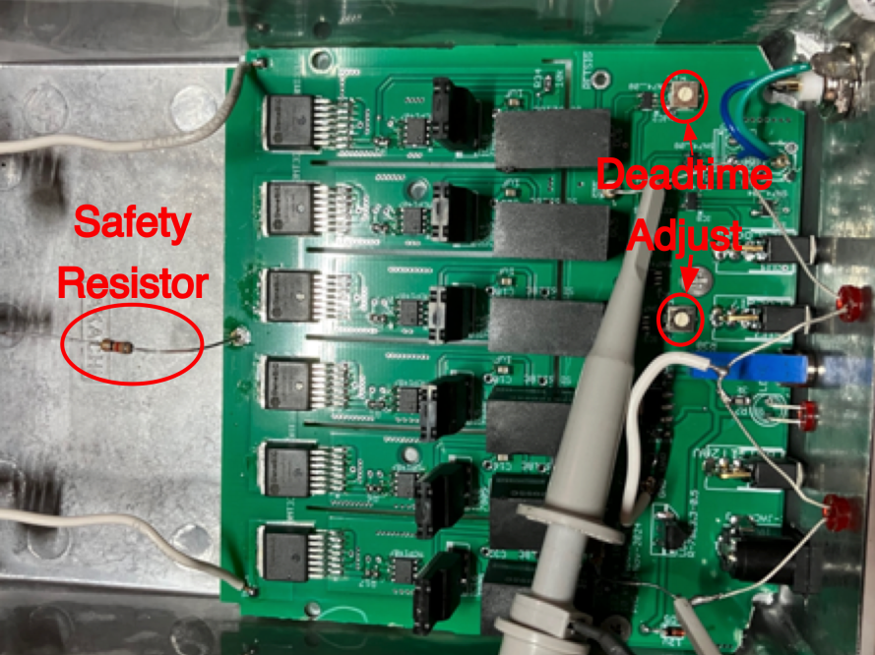
BEAM SWITCHING
2- and 3-state switch prototypes from external company tested
Need minor adjustments to fulfill specifications
15/12/2023

Slide 7
PROCUREMENT FOR MASS SEPARATOR SECTION

Slide 8
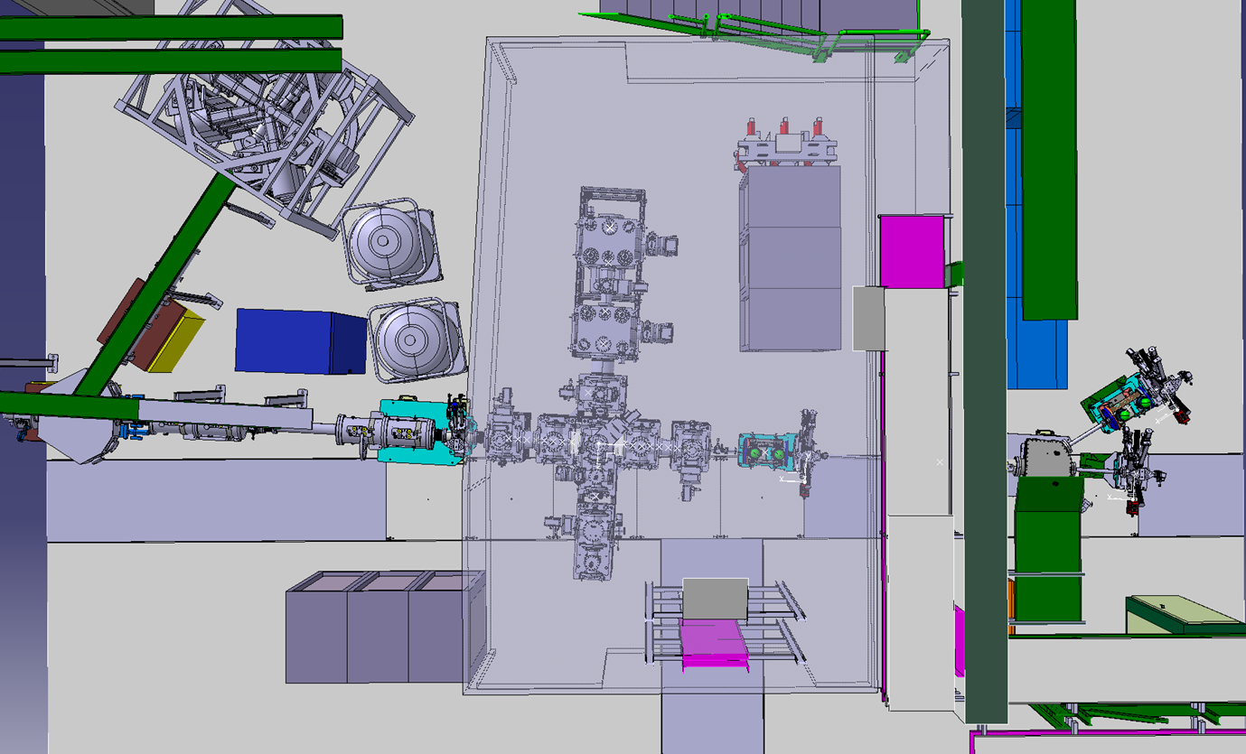







INFRASTRUCTURE
HV Racks HVPF1
HV Sub-Rack HVPF1
GND Racks
15/12/2023
15/12/2023
LAYOUT VERSION – 15.11.24

Slide 9
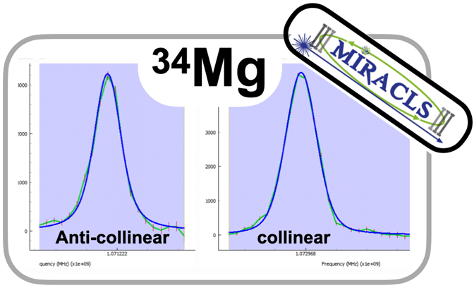
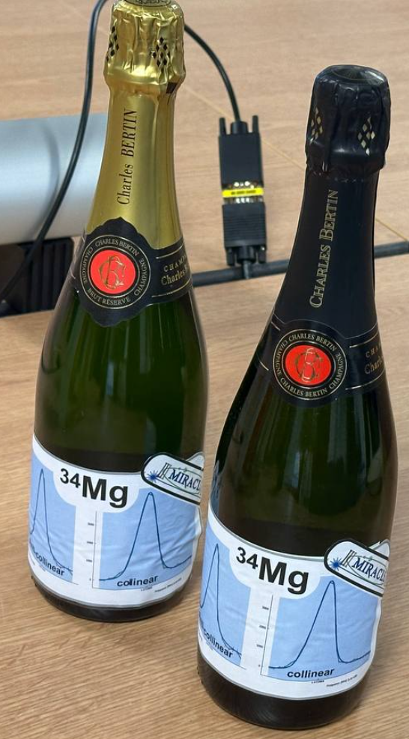
30 10.5 keV MR-ToF LASER SPECTROSCOPY
Laser spectroscopy on 24Mg – 34Mg successfull !!!
Future second experiment:
Year | 2024 |  | 2025
Month | 11 | 12 | 1 | 2 | 3 | 4 | 5 | 6 | 7
Experiment I: Magnesium
Writing Cd experimental proposal for 78th INTC Meeting
78th INTC Proposal Defense
Offline ion source change Mg -> Cd
Installation HV Capacitor
In-depth MR-ToF MS tuning for longer trapping times
Change TISA 1 from dye to Ti:Sa
Set up Wavetrain 1 and 2
Tune MR-ToF MS with stable Cd beams
First offline Cd CLS and crosschecks
COLLAPS early 2025 experiment
Change TISA 2 to Cd, set up Wavetrain 3 and 4
Experiment II: Cadmium
MIRACLS ready to be moved to RC6
16.11.2024
15/12/2023

Slide 10
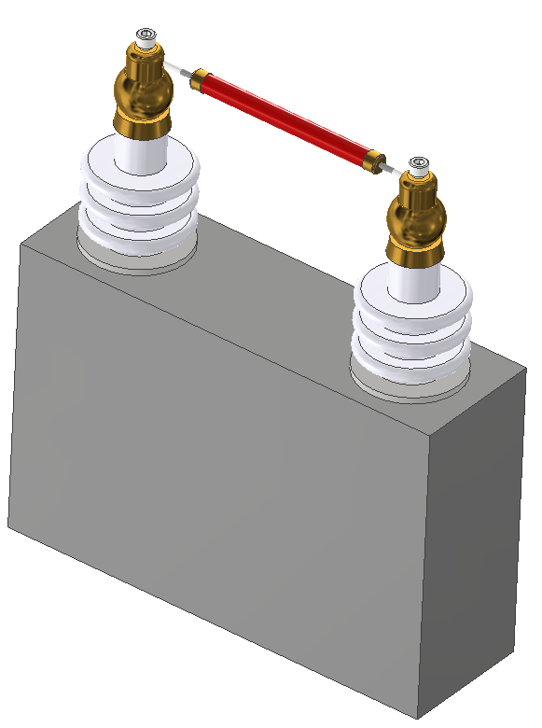
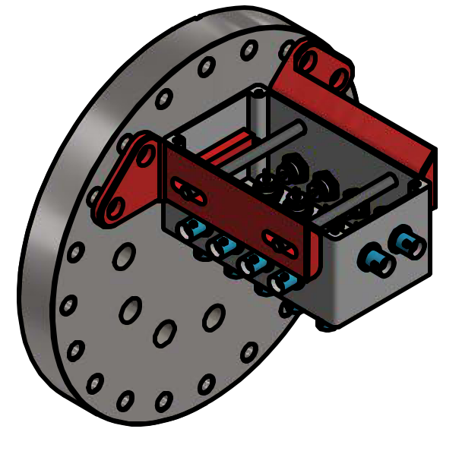
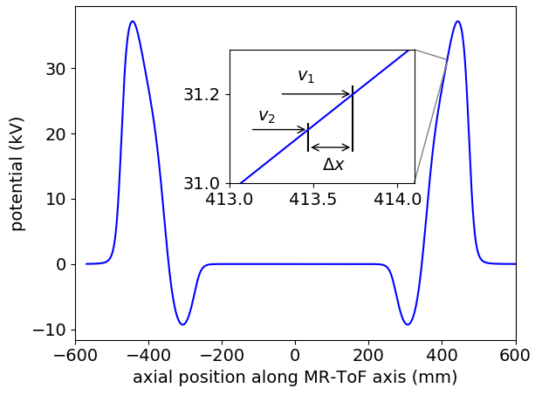
MODIFICATIONS NEEDED
Paul Trap
Change DC coupling of electrical feedthrough flange
Change cabling inside chamber
Replace RF electrodes
MR-ToF MS
Replace drift tube with shorter version
(currently 690mm, simulations yield
best results for 420mm for mass separation)
Update vacuum design
Install HV buffer capacitor
15/12/2023

Slide 11
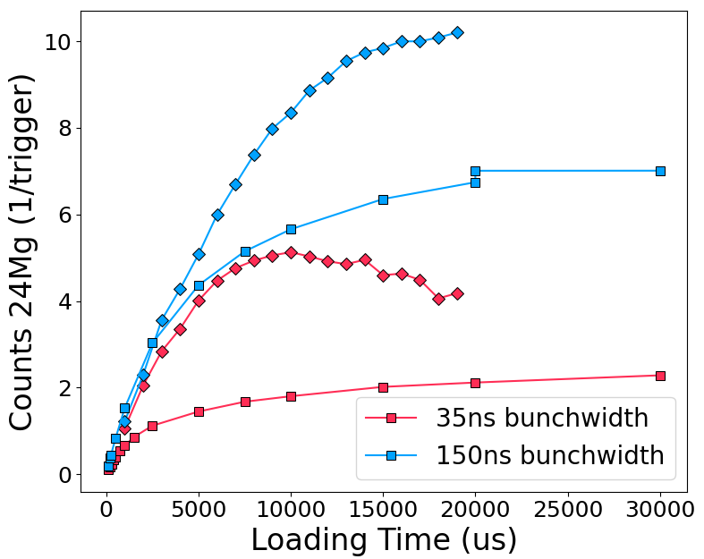
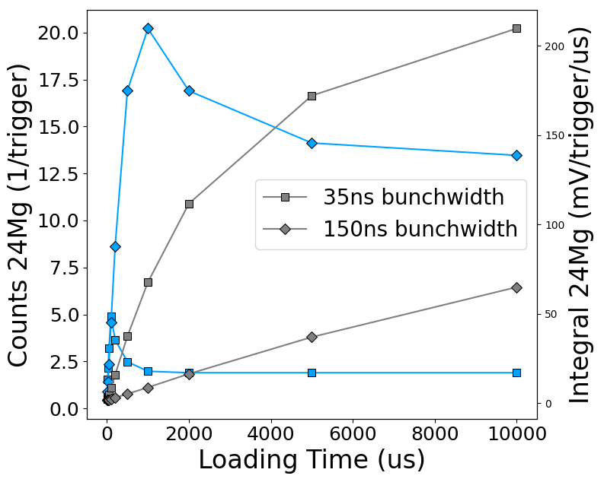
MODIFICATIONS NEEDED
Paul Trap
Change DC coupling of electrical feedthrough flange
Change cabling inside chamber
Replace RF electrodes
MR-ToF MS
Replace drift tube with shorter version
(currently 690mm, simulations yield
best results for 420mm for mass separation)
Update vacuum design
Install HV buffer capacitor
Update detector readout
15/12/2023

